Slide 1
High Speed Networks
Unit 5
Robert Iakobashvili,
Courtesy Akiva Sadovski from Broadcom
Fall 2019

Slide 2

Ethernet

Slide 3
Ethernet promise
Ethernet architectural goals are a product of market, experience, and history — and are not always obvious, they must be stated and restated.
INTEROPERABILITY
Multicast capabilities; unicast simply reflects one of the cases where the number of ways to reach a destination can be reduced (locally) to a single choice.
Globally unique MAC address.

Slide 4
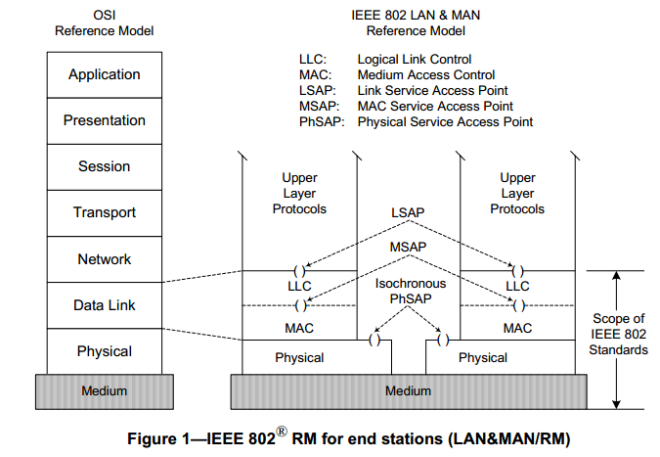
IEEE802 Reference model vs. OSI

Slide 5
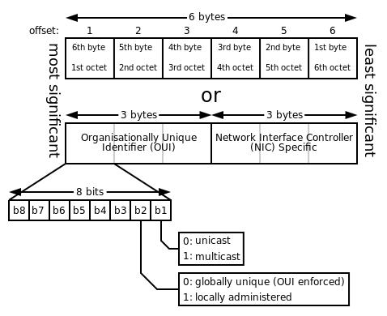
MAC Address
From Wikipedia: The original IEEE 802 MAC address comes from the original Xerox Ethernet addressing scheme.^{[2]} This 48-bit address space contains potentially 2⁴⁸ or 281,474,976,710,656 possible MAC addresses.
(16 million addresses per organization)

Slide 6
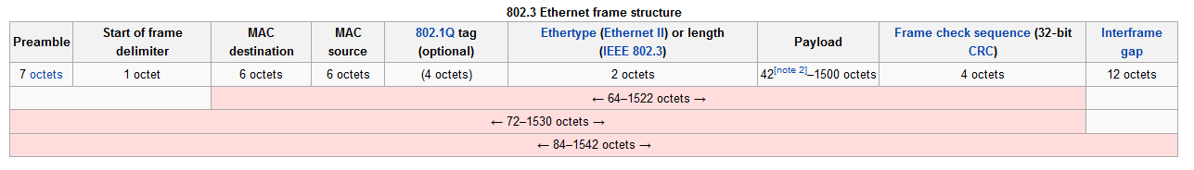
Ethernet Header
Source: http://en.wikipedia.org/wiki/Ethernet_frame
Notes:
Theoretical analyses (e.g., Bux and Grillo [BG85]) claimed that as the utilization of an
Ethernet grew, the effective throughput of the Ethernet dropped to zero because the entire
bandwidth was wasted on retransmissions. A second charge against Ethernet was its small
distance limit of 1.5 km, much smaller than the limits imposed by, say, the IBM token ring.

Slide 7
Ethernet Forwarding
Bridge based forwarding
Classification based forwarding

Slide 8
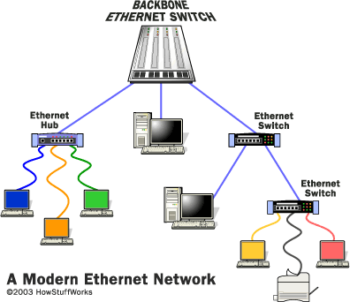
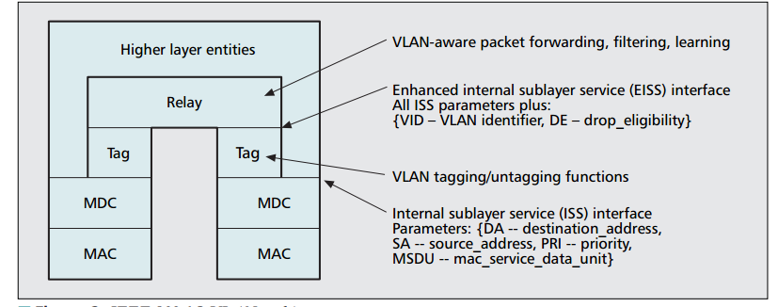
Ethernet bridge
The 802.1D bridge is a transparent, connectionless frame relay.
Packets can sometimes become misrouted or “black-holed” (go around in circles until they are dropped). [Y(J)S]
Notes:
Why do we need source MAC?

Slide 9
MAC Addresses Learning
Frame Arrived
FRWDB limit
achieved?
Drop
Unknown
Unicast?
Drop Frame
Yes
Yes
No
No
Learning=Off?
Go to Forward
Yes
No
MAC SRC
is Unicast?
Process of Aging
removes timed-out
MAC records from
FRWDBs
No
No
Yes
Yes
Yes
Pass MAC Filter?
Learning Limit
achieved?
Drop Unknown
Unicast?
No
No
VID=Y
VID=Z
RX port is
VID member?
MAC
Port to TX
Drop Frame
VID=X
MAC
Port to TX
No
MAC
…
…
Port to TX
Yes
…
…
Process of Learning
Records MAC SRC and RX port
to the FRWDB (of VID)
and starts a timer = Aging interval
…
MAC SRC
RX port(s)>
…
MAC SRC
RX port(s)>
<MAC SRC>
<RX port(s)>

Slide 10
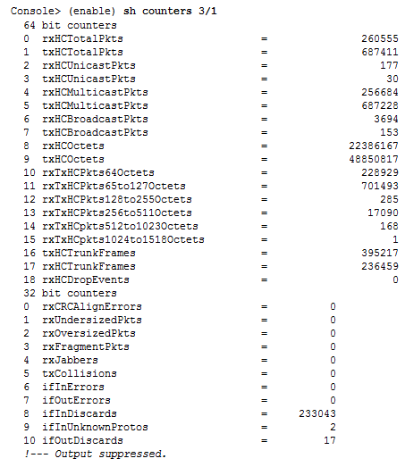
Counters

Slide 11
Ethernet Control Protocols

Slide 12
Ethernet OAM (Operations, Administration and Management)
IEEE 802.3ah OAM or Ethernet in the First Mile OAM provides:
  Link performance monitoring
  Fault detection and fault signaling
  Loopback testing
Can be implemented on any Point-to-Point or emulated Point-to-Point Ethernet link
OAM is a slow protocol with very limited bandwidth requirements
Uses “Slow Protocol” frames called OAMPDUs which are
never forwarded by MAC clients
Aliases: 802.3ah OAM, EFM OAM, Clause 57 OAM

Slide 13
802.3ah OAM Functionality
Discovery: how OAM enabled devices discover each other and notify one another of their capabilities
Link monitoring: attributes and status information for Ethernet links
Remote fault detection: how downed or compromised links are detected and handled
Remote loopback: the testing of segments and links by sending test frames through them
MIB variable retrieval: getting information from a management information base
Organization specific enhancements: the provision for vendor specific enhancements to the protocol

Slide 14
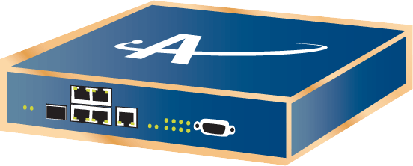

802.3ah OAM: Discovery
Allows for the EFM switch to determine Link OAM capabilities of the attached switch (e.g. CPE)
If both sides support Link OAM, then they exchange state and configuration
  Mode: Active vs. Passive
  OAMPDU size
  Identity
  Capabilities, e.g. Loopback support
OAMPDUs must be sent at least once per second. When there is no other OAMPDU to be sent within a one second window, an Information OAMPDU must be sent.
Similarly, OAMPDUs must be received at least once every 5 seconds . When the timer expires, the local OAM entity assumes that the remote OAM entity is non-operational and resets its state machine.
Active OAM DTE
Passive or Active OAM DTE
Discovery Request
WAN
LAN

Slide 15
802.3ah OAM: Loopback
OAM loopback – loop back all the traffic except for OAM frames
Started and Stopped on request from the remote Active OAM side
Both peer ports must be OAM enabled and Up
Local Eth. counters show Tx/Rx statistics
OAM Loopback
Originator
OAM Loopback
Terminator
Eth. Traffic
Generator
LAN
Count
& Drop

Slide 16
802.3ah OAM: Link Monitoring
Link monitoring uses the Event Notification OAMPDU, and sends events to the remote OAM entity when there are problems detected on the link.
The error events are:
  Errored Symbol Period (errored symbols per second): the number of symbol errors that occurred during a specified period exceeded a threshold. These are coding symbol errors (for example, a violation of 4B/5B coding).
  Errored Frame (errored frames per second): the number of frame errors detected during a specified period exceeded a threshold.
  Errored Frame Period (errored frames per N frames): the number of frame errors within the last N frames has exceeded a threshold.
  Errored Frame Seconds Summary (errored secs per M seconds): the number of errored seconds (one second intervals with at least one frame error) within the last M seconds has exceeded a threshold.
Active OAM DTE
Passive or Active OAM DTE
Link Monitoring OAMPDU
WAN
LAN

Slide 17
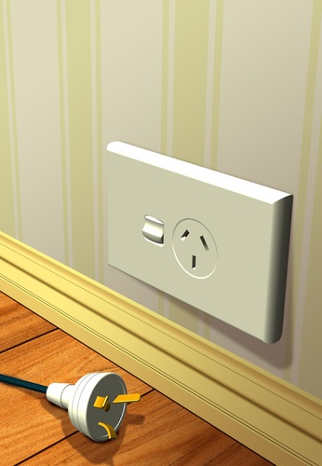

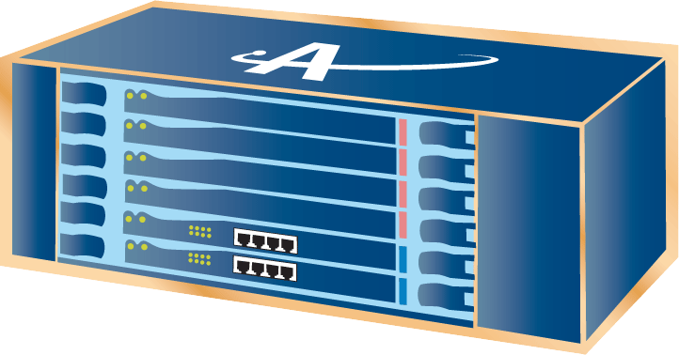
802.3ah OAM: Dying gasp
A flag in the OAMPDU allows an OAM entity to convey failure conditions to its peer. The failure conditions are as follows:
  Link Fault: Loss of signal is detected by the receiver; this is sent once per second in the Information OAMPDU
  Dying Gasp: Unrecoverable condition (e.g., a power failure) has occurred; these may be sent immediately and continuously
  Critical Event: Unspecified critical event has occurred; these may also be sent immediately and continuously
LinkDown
SNMP trap
Dying Gasp
RPWFLT
TL1 alarm
HSL-x

Slide 18
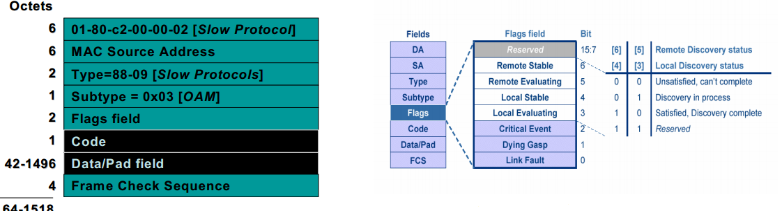
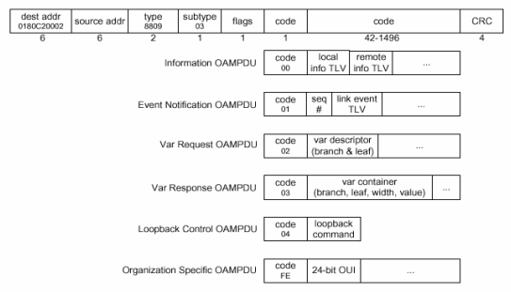
802.3ah OAM: OAMPDU

Slide 19
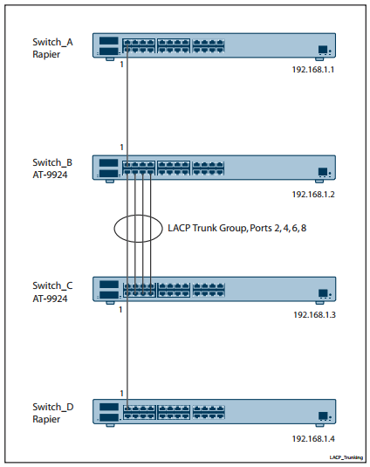
Ethernet Link Aggregation (LAG)
Treat a set of one or more ports as if it were a single port
Binding may be under manual control
Automatic
  Determination
  Configuration
  Monitoring
  may occur through the use of a Link Aggregation Control Protocol (LACP)

Slide 20
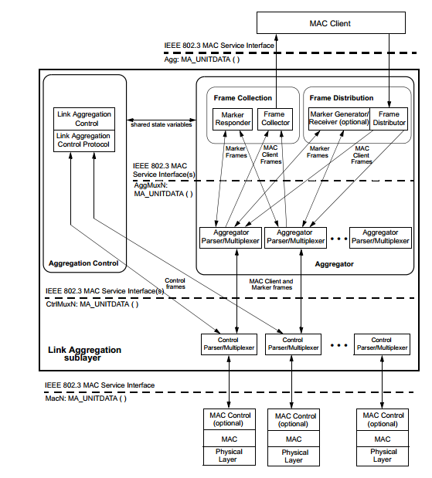
LAG: Frames distribution and collection
Frame Distribution: takes frames from MAC Client and transmits them via the appropriate port, selected by a frame distribution algorithm
Frame Collection: passes frames received from the various ports to the MAC Client

Slide 21
Link Aggregation Control Protocol
Link Aggregation Control Protocol (LACP)
  automatically detects multiple links between two LACP enabled devices
  configures them to use their maximum possible bandwidth by automatically trunking the links together
LACP controlled ports can be in one of two modes, either Active or Passive:
  A port in Active mode will send LACP Data Units (LACPDUs) at regular intervals to seek out partners
  A Passive mode port will only begin sending out LACPDUs in response to a received LACPDU
The protocol depends upon the transmission of information and state, rather than the transmission of commands
LACPDUs sent by the first party (the Actor) convey to the second party (the Actor’s protocol Partner) what the Actor knows, both about its own state and that of the Partner

Slide 22
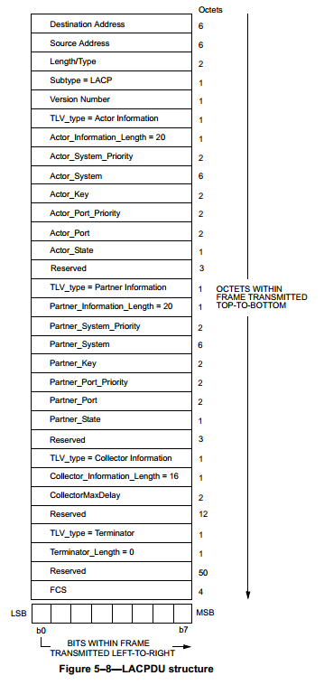
LACPDU
Key elements
Port number The port that the LACPDU was emitted from System ID . Typically, the MAC address is used
Port key
Active/Passive setting
Timeout how long to wait before timing out the partner/actor
Port’s aggregation settings Whether the port is allowed to become part of an aggregation, or must stay individual
Port’s synchronization settings If the LACP parameters on the device have recently been updated, but the new settings have not yet been committed to the hardware controlling this port, then the synchronization status will be ‘out of sync’; otherwise it will be ‘in sync’
Port’s collecting status: frame reception state: enabled or disabled
Port’s distributing status: frame transmission state: enabled or disabled
Destination address: Slow_Protocols_Multicast address 01-80-C2-00-00-02 hex
Type: Slow_Protocols_Type 88-09 hex

Slide 23
LACP Keys
Summarizes the ability of a port to aggregate with other ports – only ports with equal keys can be trunked together
Keys are set by network administrator
Port keys are part of the exchange of LACPDUs between the actor and the partner devices

Slide 24
IEEE 802.1Q Ethernet Bridges

Slide 25
Virtual Lan (Vlan)
VLANs allow different communities to share a physical local area network infrastructure. They provide connectivity within a community but isolation between communities. Each packet carries a VLAN tag that identifies the community to which it belongs.
VLANs enable a LAN to be partitioned based on functional requirements while maintaining connectivity across all devices on the network. VLAN groups network devices and enables them to behave as if they are in one single network.
VLAN types
  Port based VLANs
    When a data frame is received on a port, the VLAN bridge (VBridge) determines the associated VLAN based on the port of reception. Using the forwarding database information, the VBridge forwards the data frame on the appropriate port(s).
  MAC based VLANs
    In MAC-based VBridges, when a data packet is received on a port, the source MAC address determines the associated VLAN. While MAC-based VLANs provide benefits, they are rarely used due to administrative overheads.
Notes:
Broadcast limitation – one of objectives

Slide 26
Optional IEEE 802.1Q tag
  Priority - 802.1p priority levels.
  CFI - Canonical Format Indicator. Zero for Ethernet switches.
  VID- 4096 VLAN Identifiers. (0 and 4095 reserved).
Notes:
Tagged and untagged frames
Priority tagged frames
Q: What VLAN you’ll allocate for in-band control?

Slide 27
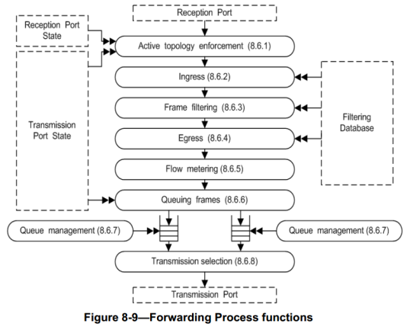
Data processing in VLAN-enabled Bridges
  Ingress rule check
  The filtering rules are based on destination MAC address and the VID in the filtering database.
  The data frame selected for further forwarding after frame filtering process is checked for egress rules, such as whether the forwarding port is a valid member of the VLAN, the data frame needs to be tagged or untagged.
  The egress rules applied when the data frame is queued for further transmission. Data frames are picked up from the queue based on user priority associated with the frames. The required frame format modification and frame check sequence (FCS) calculations are then done before final transmission.
Notes:
MAC Access Lists
The reason VLAN 1 became a special VLAN is that L2 devices needed to have a default VLAN to assign to their
ports, including their management port(s).

Slide 28
VLAN filtering database
  Contains information for determining the forwarding process of a data frame
  The forwarding is done based on the data frame's destination MAC address and associated VID.
  Filtering database contains both management configured static information and dynamically learnt information during the bridge operations.
  Filtering information database (FID) contains information associated with the source MAC addresses learnt by the normal bridge process.
  A FID contains source address (SA) information associated to a single VLAN or with multiple VLANs
  independent VLAN learning (IVL) - a single VID to FID mapping
  shared VLAN learning (SVL) - multiple VIDs mapped to a FID
  A filtering database has:
    Static filtering entries
    Dynamic filtering entries
    Static VLAN registration entries
    Dynamic VLAN registration entries
Notes:
Question: MAC Flooding Attack
This is not properly a network “attack” but more a limitation of the way all switches and bridges work. They possess
a finite hardware learning table to store the source addresses of all received packets: when this table becomes full,
the traffic that is directed to addresses that cannot be learned anymore will be permanently flooded. Packet flooding
however is constrained within the VLAN of origin, therefore no VLAN hopping is permitted (as @ stake’s
report shows)
How to prevent? Limit the number of MACs to be learned by the port.

Slide 29
Tagged membership
From wire
Wire
RX direction
Ingress
Handling
UNTAGGED FRAME
VID=XXX
UNTAGGED FRAME
VID=XXX
UNTAGGED FRAME
Permit VID=XXX
VID=NNN
UNTAGGED FRAME
Switch
To switch
VID=MMM
VID=NNN
UNTAGGED FRAME
From switch
UNTAGGED FRAME
TX direction
Egress Handling
VID=XXX
UNTAGGED FRAME
VID=XXX
UNTAGGED FRAME
Permit VID=XXX
VID=NNN
UNTAGGED FRAME
Wire
VID=MMM
VID=NNN
UNTAGGED FRAME
To wire
ACTELIS CONFIDENTIAL

Slide 30
Untagged Membership
From wire
Wire
VID=XXX
UNTAGGED FRAME
RX direction
PORT
Ingress
Handling
UNTAGGED FRAME
VID=XXX
UNTAGGED FRAME
VID=XXX
UNTAGGED FRAME
Add VID=XXX
VID=NNN
UNTAGGED FRAME
Switch
To switch
VID=MMM
VID=NNN
UNTAGGED FRAME
From switch
TX direction
PORT
Egress
Handling
UNTAGGED FRAME
UNTAGGED FRAME
VID=XXX
UNTAGGED FRAME
UNTAGGED FRAME
VID=XXX
VID=NNN
UNTAGGED FRAME
Strip VID=XXX
VID=NNN
UNTAGGED FRAME
VID=XXX
VID=MMM
VID=NNN
UNTAGGED FRAME
VID=MMM
VID=NNN
UNTAGGED FRAME
VID=NNN
UNTAGGED FRAME
Wire
VID=MMM
VID=NNN
UNTAGGED FRAME
To wire

Slide 31
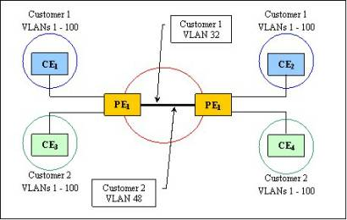
VLAN stacking
As a result, the question arose as to who owned the VLAN ID space, the customer or the provider? It was clear that the market needed separate VLAN tags for the customer and the provider.
IEEE 802.1ad (provider bridges) enables the service provider to use Layer 2 (bridging and VLAN) protocols and solutions in their networks to connect the customer sites.
VLAN stacking is a simple and effective solution to expand LANs, however it has certain drawbacks. Some of these are:
Scaling issues, since there can exist only 4094
Support for tracing the Q-in-Q paths does not exist.
The size of the bridged network diameter is limited to seven due to bridge protocol constraints.

Slide 32
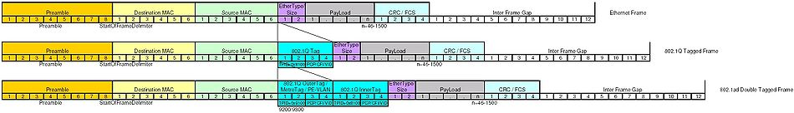
VLAN stacking – frame format

Slide 33
Stacked membership
RX direction
Ingress
Handling
From wire
Wire
VID=XXX
UNTAGGED FRAME
UNTAGGED FRAME
VID=XXX
VID=XXX
UNTAGGED FRAME
VID=XXX
UNTAGGED FRAME
Add VID=XXX
VID=XXX
VID=NNN
UNTAGGED FRAME
VID=NNN
UNTAGGED FRAME
VID=XXX
VID=MMM
VID=NNN
UNTAGGED FRAME
VID=MMM
VID=NNN
UNTAGGED FRAME
Switch
To Switch
From switch
TX direction
Egress
Handling
VID=XXX
UNTAGGED FRAME
UNTAGGED FRAME
VID=XXX
VID=XXX
UNTAGGED FRAME
VID=XXX
UNTAGGED FRAME
VID=XXX
VID=MMM
VID=NNN
UNTAGGED FRAME
Strip VID=XXX
VID=MMM
VID=NNN
UNTAGGED FRAME
Wire
VID=NNN
UNTAGGED FRAME
To wire
VID=MMM
VID=NNN
UNTAGGED FRAME

Slide 34
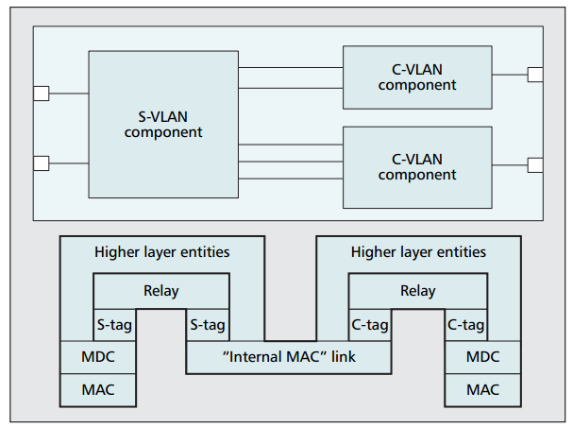
VLAN stacking – Provider Edge Bridge
A bridge component is a full set of bridge functionality
A PEB contains one C-VLAN component per customer with an internal connection per service instance to an S-VLAN component

Slide 35
Resources
Kerim Fouli and Martin Maier, Optical Zeitgeist Laboratory, INRS “The Road to Carrier-Grade Ethernet” http://ieeexplore.ieee.org/xpl/login.jsp?tp=&arnumber=4804387&url=http%3A%2F%2Fieeexplore.ieee.org%2Fxpls%2Fabs_all.jsp%3Farnumber%3D4804387

Slide 36
Questions?

