Slide 1
High Speed Networks Packet Classification
Robert Iakobashvili
Author: Akiva Sadovski from Broadcom
Spring 2022

Slide 2
Simple Network Node

Slide 3
Input and Output Queues in the Ethernet port
HH
MH
L2 Switch
(Bridge)
SP/WFQ
L
LLL
ETH-1
HSL
ETH-2
ETH-3
HH
ETH-4
MH
SP/WFQ
L
ETH-5
LLL
Classification to 4 queues is done on Ingress direction of any port inspecting traffic “Arrival Port”, Frame L2 COS bits or Frame L3 TOS/DSCP bits content (as specified for the port).
TOS/DSCP– to-Queue
Classification table
is per Bridge configured
COS– to - Queue
Classification table
is per Bridge configured

Slide 4
Packet Switching Advantages
Line efficiency
Single node to node link can be shared by many packets over time
Packets queued and transmitted as fast as possible
Data rate conversion
Each station connects to the local node at its own speed
Nodes buffer data if required to equalize rates
Packets are accepted even when network is busy
Delivery may slow down
Priorities can be used

Slide 5
Why packet classification?
Organizations desire Quality of Service (QoS) and security guarantees
Both QoS and security guarantees require a finer discrimination of packets, based on fields other than the destination

Slide 6
Packet Classification
In modern switches/routers, the route and resources allocated to a packet are determined by:
destination address as well as other header fields of the packet:
source address
TCP/UDP port numbers
Fields used in packet classification:
source addresses (to forbid or provide different service to some source networks)
port fields (to discriminate between traffic types, such as Napster and E-mail)
TCP flags (to distinguish between externally and internally initiated connections)

Slide 7
Use of Packet Classification
network address translation (NAT)
metering
traffic shaping
policing
monitoring
firewalls

Slide 8
Packet Classification Rules
In classification, the forwarding database of a router consists of a potentially large number of rules on key header fields
A given packet header can match multiple rules

Slide 9
Rule database
Each rule is given a cost, and the packet is forwarded using the least-cost matching rule
Each rule has associated directive which specifies how to forward the packet matching the rule

Slide 10
Packet Classification requirements and metrics
Wire speed for minimum-size packets; speed is the dominant metric
Dynamic or stateful packet rules – fast update times required
Large rule database – it is useful to reduce amount of memory needed
Notes:
Dynamic or stateful packet rules - this capability is useful, for
example, for handling UDP traffic. Because UDP headers do not contain an ACK bit that can
be used to determine whether a packet is the bellwether packet of a connection, the screening
router cannot tell the difference between the first packet sent from the outside to an internal
server (which it may want to block) and a response sent to a UDP request to an internal client
(which it may want to pass). The solution used in some products is to have the outgoing request
packet dynamically trigger the insertion of a rule (which has addresses and ports that match the
request) that allows the inbound response to be passed.

Slide 11
Queues and network traffic
Queues exist to absorb the burstiness that occurs naturally in statistically multiplexed (packet) networks
These bursts are short-term mismatches in traffic arrival and departure rates

Slide 12
Problem definition from IEEE 802.1D
Frame corruption during physical layer transmission or reception.
Frame discard by a Bridge because
It is unable to transmit the frame within some maximum period of time, and is required to discard the frame to prevent the maximum frame lifetime (6.3.6) from being exceeded.
It is unable to continue to store the frame due to exhaustion of internal buffering capacity as frames continue to arrive at a rate in excess of that at which they can be transmitted.
The size of the service data unit carried by the frame exceeds the maximum supported by the MAC procedures employed on the LAN to which the frame is to be relayed.
Changes in the physical topology of the network necessitate frame discard for a limited period of time to maintain other aspects of QoS (see 17.10).
The device attached to the Port is not authorized for access to the network.
The configuration of Static Filtering Entries in the Filtering Database (7.9.1) disallows the forwarding of frames with particular destination addresses on specific Ports.

Slide 13
Buffer (Queue) Scheduling
Whom to send next?
What happens when buffer is full?
Whom to discard?

Slide 14
Queue Management Algorithms
Metrics:
Packet loss
Queuing delay
Throughput
Fairness

Slide 15
Packet Classification

Slide 16
Packet Classification Problem
The information relevant to a lookup is contained in K distinct header fields in each packet
These header fields are denoted H[1],H[2],...,H[K], where each field is a string of bits
The classifier, or rule database consists of a finite set of rules, R1,R2,...,RN
Each rule is a combination of K values, one for each header field
Each rule R[i] has an associated directive disp[i] which specifies how to forward the packet matching this rule
A packet P is said to match a rule R if each field of P matches the corresponding field of R
A packet may match multiple rules in the database, each rule R in the database is associated with a nonnegative number, cost(R).
Ambiguity is avoided by returning the least cost rule matching the packet’s header

Slide 17
Types of match
exact match
The header field of the packet should exactly match the rule field
prefix match
the rule field should be a prefix of the header field (this could be useful for blocking access from a certain subnetwork)
range match
header values should lie in the range specified by the rule (this can be useful for specifying port number ranges)

Slide 18
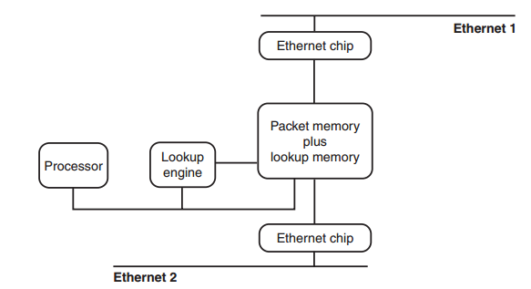
Exact match lookup use
Source: Network Algorithmics by George Varghese

Slide 19
Exact match lookup - challenge
The challenge: scaling lookupBinary search
Suppose:
The forwarding DB size is 64K entries
Single DRAM access takes 100 ns
Then:
Destination and source addresses search will take 3.2 µs.
64 bytes packet will be received in 4.9 µs
Conclusion: two binary search lookups would use almost up all of the packet-processing budget for a single link, leaving no time for other chores, such as inserting and removing from link chip queues
Notes:
64 bytes – minimal Ethernet packet

Slide 20
Exact match lookup enhancements - 1
Hashing, on average, is much faster (constant time) than binary search (logarithmic time)
Hashing is much slower in the worst case
The trick: to use a parameterized hash function:
The hash function can be changed by varying some parameters
Then appropriate values of the parameters can be precomputed to obtain a hash function such that the worst-case number of collisions is small and bounded

Slide 21
Exact match lookup enhancements - 2
Each hash table entry points to the root of a balanced binary tree of height at most 3
Any search is guaranteed to take no more than four memory accesses, one to lookup the hash table and three more to navigate a height-3 binary tree

Slide 22
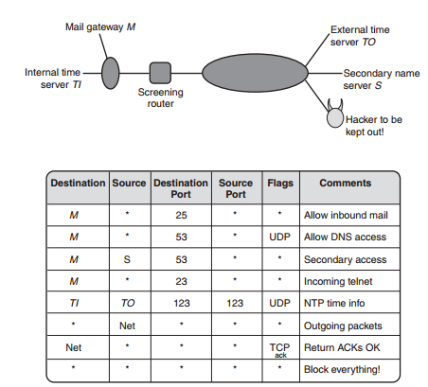
Classifier (rule) data base example
Source: Network Algorithmics by George Varghese

Slide 23
Simple Solutions
Linear Search
Performance degradation
Caching
Low hit rate
Requires Linear Search
Prefix match
allows wildcards to occur only at the end of a rule: (D,S,∗,∗,∗) is allowed, but not (D,∗,Prot,∗,SourcePort)
Passing Labels
MPLS
Notes:
Linear search is reasonable for small rule sizes but is extremely slow
for large rule sets. For example, a core router that does linear search among a rule set of
2000 rules (used at the time of writing by some ISPs) will considerably degrade its forwarding
performance below wire speed.
Some implementations even cache the result of the search keyed against the whole header.

Slide 24
Why variable length prefixes?
A packet arrives on an input link
Each packet carries a 32-bit Internet (IP) address
The processor consults a routing table to determine the output link for the packet
The routing table contains a set of prefixes with their corresponding output links
The packet is matched to the longest prefix that matches the destination address in the packet, and
The packet is forwarded to the corresponding output link

Slide 25
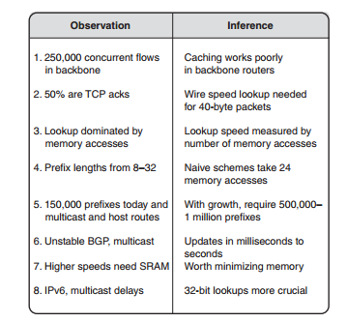
Some observations
Source: Network Algorithmics by George Varghese

Slide 26
Prefix matching: algorithmic techniques
Unibit tries
Multibit and Fixed-Stride tries
Lulea scheme

Slide 27
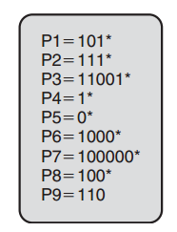
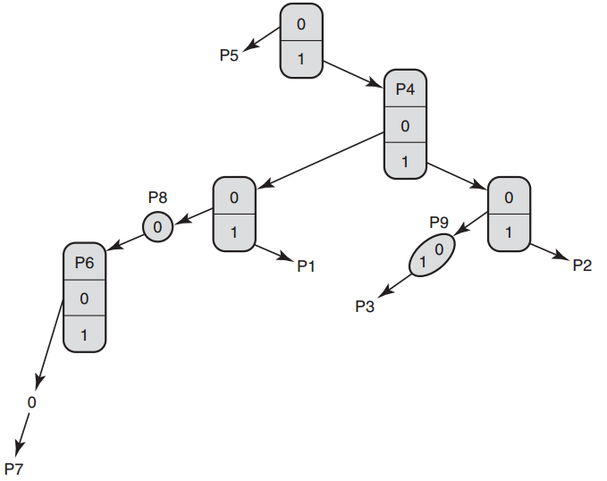
Prefix matching – unibit tries
A unibit trie is a tree in which each node is an array containing a 0-pointer and a 1-pointer.
At the root:
all prefixes that start with 0 are stored in the subtrie pointed to by the 0-pointer
all prefixes that start with a 1 are stored in the subtrie pointed to by the 1-pointer.
Notes:
What do we have in the root? *-prefix – default route
Each subtrie is then constructed recursively in a similar fashion using the remaining bits
of the prefixes allocated to the subtrie.
For example, P1 = 101 is stored in a path traced by following a 1-pointer at the root, a 0-pointer at the right child of the
root, and a 1-pointer at the next node in the path.
There are two other fine points to note.
In some cases, a prefix may be a substring of
another prefix. For example, P4=1* is a substring of P2=111*. In that case, the smaller
string, P4, is stored inside a trie node on the path to the longer string.

Slide 28
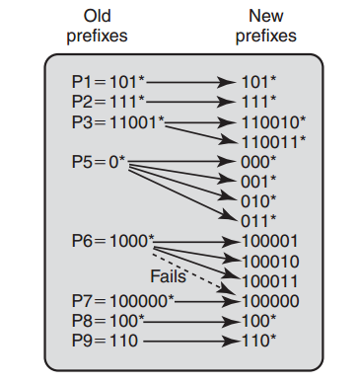
Prefix matching – multibit tries
Controlled prefix expansion transforms an existing prefix database into a new database:
Fewer prefix lengths but with potentially more prefixes.
By eliminating all lengths that are not multiples of the chosen stride length, expansion allows faster multibit trie search
The cost: increased database size
Notes:
However, the expanded prefixes may collide with an existing prefix at the new length. In
that case, the expanded prefix is removed. The existing prefix is given priority because it was
originally of longer length.

Slide 29
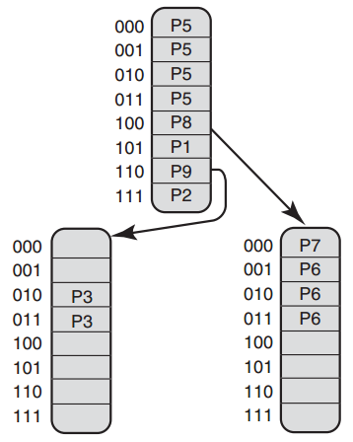
Prefix matching – multibit and fixed-stride tries
Each trie node uses 3 bits
The replicated entries within trie nodes correspond exactly to the expanded prefixes
Notes:
These three expanded prefixes are pointed to by the 100 pointer in the root node
(because all three expanded prefixes start with 100) and are stored in the 001, 010,
and 011 entries of the right child of the root node.
Notice also that the entry 100 in the root node
has a stored prefix P8 (besides the pointer pointing to P6’s expansions), because P8=100* is
itself an expanded prefix.
Question: how to avoid backtracking?

Slide 30
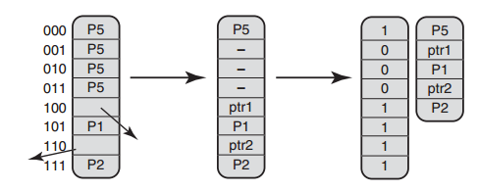
Lulea-Compressed Tries - string compression
String compression:
a string with repetitions (e.g., AAAABBAAACCCCC) can be compressed using a bitmap denoting repetition points (i.e., 10001010010000) together with a compressed sequence (i.e., ABAC).
Similarly, the root node at the figure contains a repeated sequence (P5, P5, P5, P5) caused by expansion.
Notes:
The Lulea scheme avoids this obvious waste by compressing repeated information using a bitmap and a compressed sequence without paying a high penalty in search time.

Slide 31
Lulea-Compressed Tries – leaf pushing
Each entry has exactly one value – next-hop information or a pointer
The leaves do not have a pointer, therefore they keep the next-hop information
Non-leaf nodes have only pointers
Notes:
For example, to avoid the extra stored prefix in the 110 entry of the root node,
the P9 stored prefix is pushed to all the entries in the leftmost trie node, with the exception of
the 010 and 011 entries (both of which continue to contain P3). Similarly, the P8 stored prefix
in the 100 root node entry is pushed down to the 100, 101, 110, and 111 entries of the rightmost
trie node. Once this is done, each node entry contains either a stored prefix or a pointer but
not both.

Slide 32
Lulea-Compressed Tries – an example
A search for an address that starts with 100111
Use the first three bits (100) to index into the root-node bitmap
The algorithm indexes into the second element of the compressed node (the algorithm needs to count the bits set before a given bit)
In the rightmost leaf node, the algorithm uses the next 3 bits (111) of the destination address to index into bit 8
There is no pointer to follow
To retrieve the best matching prefix (if any) at this node, the algorithm must find any prefix stored before this entry
The algorithm counts the number of bits set before position 8 (which happens to be 3) and then indexes into the third element of the compressed sequence

Slide 33
Lulea-Compressed Tries - chunks
The purpose is to speed up the bit counting
The algorithm accompanies each bitmap with a summary array that contains a cumulative count of the number of set bits associated with fixed-size chunks of the bit map
Counting the bits set up to position i now takes two steps:
Access the summary array at position j, where j is the chunk containing bit i
Access chunk j and count the bits in chunk j up to position i
The sum of the two values gives the count.

Slide 34
Lulea-Compressed Tries – pros and cons
Pros
Compact storage: the database of around 40,000 entries with 20-bit pointer per prefix has been compressed to around 160KB, approx. 32 bits per prefix
Cons
counting bits requires at least one extra memory reference per node
leaf pushing makes worst-case insertion times large

Slide 35
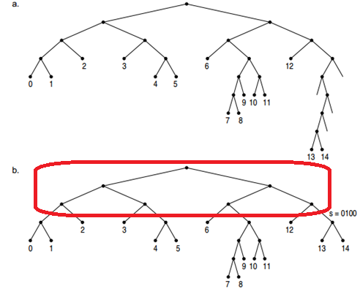
Level-Compressed (LC) Tries
A variable stride trie where every node contains no empty entries
Level compression replaces the i complete levels of a binary trie with a single node of degree 2^{i}
Generally both compression techniques are used – path compression and level compression
Source: Implementing a dynamic compressed trie S Nilsson, M Tikkanen - Algorithm Engineering, 1998

Slide 36
LC-tries implementation
In the final form LC tries are laid out in the breadth-first order
An internal node is represented by two integers:
a reference to a prefix
an array of references to the children of the node
Two additional integers:
“pos” that indicates the position of the first bit used for branching
“bits” that gives the number of bits used for child selection

Slide 37
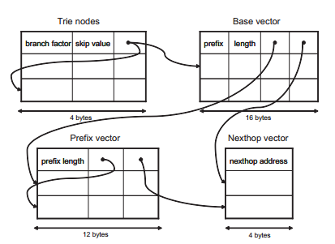
LC-tries fine tuning
Two types of nodes:
Trie nodes (internal and leafs)
Base vectors which contain complete prefixes
Base vector contains two pointers:
To nexthop vector
To prefix vector
Notes:
The prefix pointer is needed, since it might happen that a path in a trie contains more than one prefix.
Optimization:
If there is no default route, add a default drop prefix for packets that should be discarded. A default drop prefix is of zero length and matches all IP-addresses. This makes the prefix set complete since an IP-address will match the drop prefix if no other prefix matches.
Construct a prefix trie according to the routing table.
Perform leaf pushing
Collapse subtries: If all leaf nodes of a subtrie have the same nexthop, the nexthop of the subtrie root node is set to this nexthop.
Outcome:
The prefix vector is removed since there are no proper prefixes of other prefixes.
Second, the base vector is removed since all IP-addresses match exactly one prefix.

Slide 38
Variants of binary tries
Unibit trie
Path-Compressed trie
Multibit trie
Leaf pushing
Bitmap compression

Slide 39
Binary search on ranges
Each prefix is represented as a range, two endponts are generated for each prefix by padding with 0s and 1s.
Range endpoints for N prefixes partition the space of addresses (number line) into 2N+1 disjoint intervals.
The algorithm uses binary search to find the interval in which a destination address lies

Slide 40
Table representation of the ranges
The rightmost entry, called the > entry, is the next hop corresponding to addresses that are strictly greater than the endpoint but strictly less than the next range endpoint in sorted order.
The leftmost entry, called the = entry, corresponds to addresses that are exactly equal to the endpoint.
Rationale behind two separate entries for > and =:
If an address is strictly greater than 101111 but strictly less than the next entry, 111111,then the best match is P1.
If an address is exactly equal to 101111, its best match is P2

Slide 41
Prefix matching: hardware-based schemes
DIR-24-8
Ternary CAM (TCAM)

Slide 42
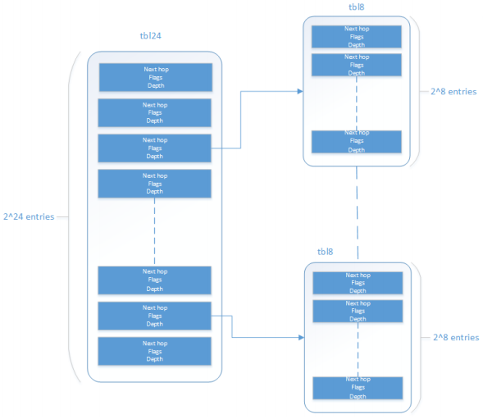
DIR-24-8
The first table stores all possible route prefixes that are up to and including 24 bits
The second table stores all route prefixes that are longer that 24 bits
Drawbacks:
Memory is used inefficiently
Insertion and deletion of the routes require multiple accesses
Source: Intel® Data Plane Development Kit (Intel ® DPDK)
Notes:
When a destination address is presented to the routing lookup mechanism:
The single memory read from the tbl24 table yields 2 bytes
If the 1st bit equals zero the remaining 15 bits describe the next hop information
Otherwise, the remaining 15 bits are multiplied by 256, last 8 bits of the original destination address are added to the product and the relevant tbl8 is read
Bitmap Compression is used for better memory utilization

Slide 43
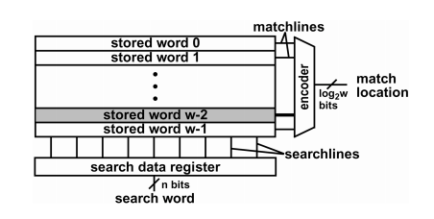
Content Addressable Memory
The first cell that matches a data item will be returned using a parallel lookup in hardware
A ternary CAM (TCAM) allows each bit of data to be either a 0, a 1, or a wildcard
Actually each entry is stored as a (value, mask) pair. For example, a prefix 110* can be stored as (110000,111000)
CAM drawbacks:
smaller density and larger power of CAMs versus SRAMs
Rule multiplication caused by ranges
Source: Content-Addressable Memory(CAM) Circuits and
Architectures: A Tutorial and Survey by Kostas Pagiamtzis and Ali Sheikholeslami, IEEE JOURNAL OF SOLID STATE CIRCUITS,VOL.41,NO.3,MARCH2006

Slide 44
Two-dimensional prefix matching schemes - 1
Build a trie on the destination prefixes in the database and then hang a number of source tries off the leaves
Consider D=00∗
Both rules R₄ and R₅ have this destination prefix
The destination prefix 0∗ in rules R₁,R₂, and R₃ also matches any destination that D matches
The wildcard destination prefix ∗ of R₇ also matches whatever D matches
Rule | Destination | Source
R₁ | 0* | 10*
R₂ | 0* | 01*
R₃ | 0* | 1*
R₄ | 00* | 1*
R₅ | 00* | 11*
R₆ | 10* | 1*
R₇ | * | 00*

Slide 45
Two-dimensional prefix matching schemes - 2
Rule | Dest. (D) | Source (S)
R₁ | 0* | 10*
R₂ | 0* | 01*
R₃ | 0* | 1*
R₄ | 00* | 1*
R₅ | 00* | 11*
R₆ | 10* | 1*
R₇ | * | 00*
Each prefix D in the destination trie prunes the set of rules from the entire set of rules down to the set of rules compatible with D
The same idea can be extended to more than two fields, with each field value in the path pruning the set of rules further

Slide 46
Naïve two-dimensional prefix matching schemes drawbacks
Memory explosion problem – N² in the worst case
O(N^{k}) bound for general set-pruning tries in K dimensions

Slide 47
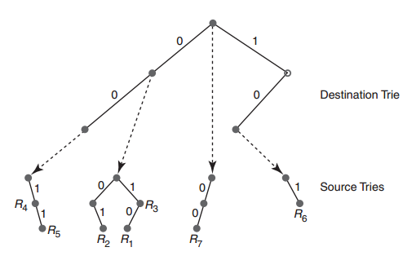
Reducing Memory Using Backtracking
Instead of just searching the source trie for the best-matching destination prefix D, the search algorithm must now search the source tries associated with all ancestors of D
In order to search for the least-cost rule, the algorithm first traverses the destination trie and finds the longest destination prefix D’ matching the header
The search algorithm now works its way back up the destination trie and search the source trie associated with every prefix of D’ that points to a nonempty source trie
The memory requirement for the new structure is O(NW)

Slide 48
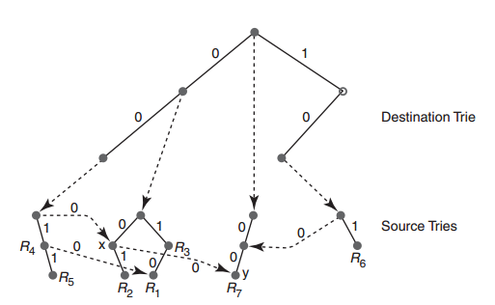
Grid of Tries
Backing up the trie is a waste
For each failure point in a source trie, the trie building algorithm precomputes what we call as a switch pointer
Switch pointers allow search to jump directly to the next possible source trie that can contain a matching rule
A switching pointer labeled with 0/1 is inserted at node y whenever its ancestor contains the pointer to another node x while y does not
Notes:
consider matching the packet with destination address 001 and source address 001

Slide 49
Geometric View of Classification
Multiple-rule matches, such as R₁ and R₂, correspond to overlapping boxes
The first advantage of the geometric view is that it enables the application of algorithms from computational geometry
The second advantage is that the geometric view provides a useful metric, the number of disjoint (i.e., nonintersecting) classification regions
Notes:
In two dimensions, for example, with N rules one can create N²
classification regions by having N/2 rules that correspond geometrically to horizontal strips together with N/2 rules
that correspond geometrically to vertical strips.

Slide 50
Beyond destination and source
Bad News
General multidimensional range searching over N ranges in k dimensions requires Ω((logN)^{K−1}) worst-case time if the memory is limited to about linear size or requires O(N^{K}) size memory
Good News
Prefix containment is rare
Many fields are not general ranges
The number of disjoint classification regions is small
Source–Destination matching
Notes:
1. It is somewhat rare to have prefixes that are prefixes of other
prefixes, as, for example, the prefixes 00* and 0001*
2. port 80 for Web traffic
4. No packet matched more than 20 distinct source–destination pairs

Slide 51
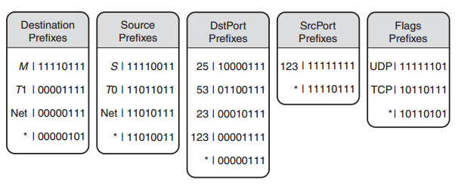
Bit Vector Linear Search
Do a match in one of individual columns, say the destination address
Find a bit string S as the longest match
Eliminate all rules that to not match S
Do the linear search in all remaining rules that match S
Notes:
When a packet header arrives with fields H[1]...H[K], the search algorithm first performs
a longest-matching-prefix lookup in each field i to obtain matches M_{i} and the corresponding
set S(M_{i}) of matching rules. The search algorithm then proceeds to compute the intersection
of all the sets S(M_{i}) and returns the lowest-cost element in the intersection set.
Computing the AND of K bit vectors and searching the intersection
bit vector is still an O(K·N) operation; however, the constants are much lower than doing
naive linear search because we are dealing with bitmaps.

Slide 52
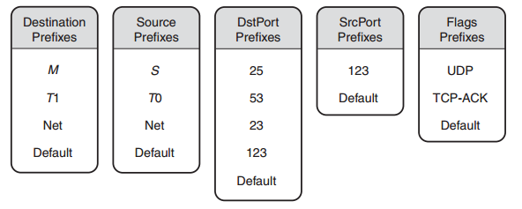
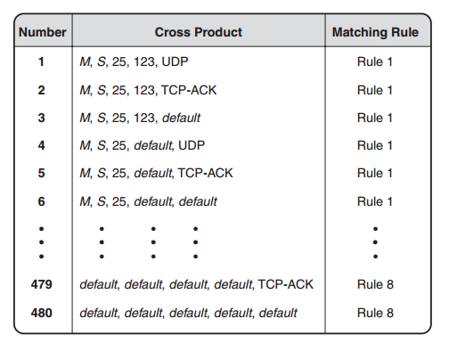
Cross-Producting
Builds a table of all possible cross products and precomputes the least-cost rule matching each cross product
Given a packet header, the search algorithm can determine the least-cost matching rule for the packet by performing K longest-matching-prefix operations, together with a single hash lookup of the cross-product table
Notes:
Look at Slide 22

Slide 53
Decision Tree Approaches
The hierarchical cuttings (HiCuts) scheme described in Gupta and McKeown uses range checks instead of bit tests at each node of the decision tree
A range test (cut) can be viewed geometrically in two dimensions as a line in either dimension that splits the space into half; in general, each range cut is a hyperplane
The algorithm
Pick a field: The HiCuts paper suggests first picking a field to cut on at each stage based on the number of distinct field values in that field;
Pick a cut: For each field, rather than just pick one range check one can pick k ranges or cuts
The process stops when all decision tree leaves have no more than binth (bin threshold) rules
Notes:
HiCut – the rule set is cut in one dimension each time
HyperCut – the rule is cut in multiple dimensions

Slide 54
Resources
Network Algorithmics: An Interdisciplinary Approach to Designing Fast Networked Devices by George Varghese (The Morgan Kaufmann Series in Networking) ISBN-13: 978-0120884773 December 29, 2004
High Performance Switches and Routers by H. Jonathan Chao and Bin Liu ISBN: 978-0-470-05367-6 May 2007, Wiley-IEEE Press

