Slide 1
High Speed Networks Queue Management Packet Scheduling
Robert Iakobashvili
Author: Akiva Sadovski from Broadcom
Spring 2022

Slide 2
Simple Network Node

Slide 3
Input and Output Queues in the Ethernet port
HH
MH
L2 Switch
(Bridge)
SP/WFQ
L
LLL
ETH-1
HSL
ETH-2
ETH-3
HH
ETH-4
MH
SP/WFQ
L
ETH-5
LLL
Classification to 4 queues is done on Ingress direction of any port inspecting traffic “Arrival Port”, Frame L2 COS bits or Frame L3 TOS/DSCP bits content (as specified for the port).
TOS/DSCP– to-Queue
Classification table
is per Bridge configured
COS– to - Queue
Classification table
is per Bridge configured

Slide 4
Queue Management

Slide 5
Queues

Slide 6
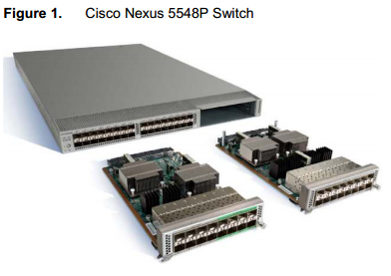
Cisco Nexus 5500
One-rack-unit (1RU)
960 Gbps of throughput
32 fixed 1 and 10 Gigabit Ethernet ports
One expansion module slot can be configured to support:
Up to 16 additional 1 and 10 Gigabit Ethernet ports
Or 8 Fibre Channel ports plus 8 1 and 10 Gigabit Ethernet ports
Source: Cisco Nexus 5548P Switch Architecture © 2010 Cisco

Slide 7
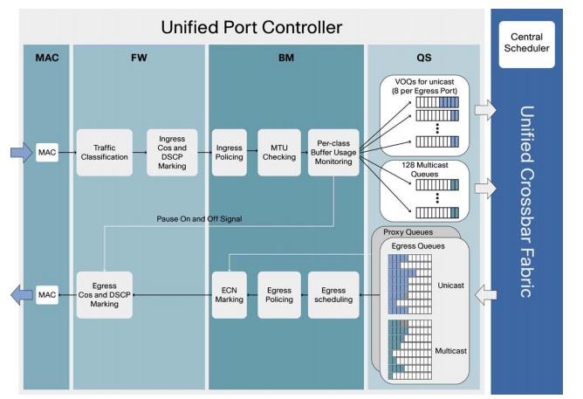
Cisco Nexus 5500 Unified Port Controller
Source: Cisco Nexus 5548P Switch Architecture © 2010 Cisco

Slide 8
Tail Drop
With tail drop, packets are queued until the maximum threshold is exceeded, and then all the packets are dropped.

Slide 9
Tail Drop Limitations
Lock-Out
In some situations tail drop allows a single connection or a few flows to monopolize queue space, preventing other connections from getting room in the queue
Full Queues
The tail drop discipline allows queues to maintain a full (or almost full) status for long periods of time, since tail drop signals congestion (via a packet drop) only when the queue has become full

Slide 10
Other options
We could place packets in multiple queues based on packet headers and schedule these output queues according to some scheduling policy
Even if we had a single queue, we need not always drop from the tail when buffers overflow; we can drop a packet when the packet buffer is not full

Slide 11
Random Early Detection (RED)
Maintains an exponentially-weighted moving average (EWMA) of the queue length which it uses to detect congestion
When the average queue length exceeds a minimum threshold (min_{th}), packets are randomly dropped or marked with an explicit congestion notification (ECN) bit
When the average queue length exceeds a maximum threshold (max_{th}), all packets are dropped or marked.
Notes:
TCP responds to small increases in loss rate with large
decreases in its sending rate.
A TCP connection that uses less than
the fair share will reduce its congestion window on a single packet
loss. In general, TCP connections with fewer buffers are at a
disadvantage competing with other connections.

Slide 12
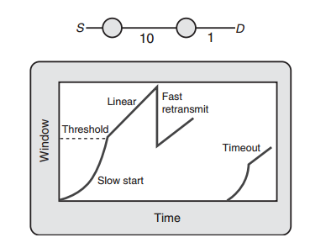
TCP congestion control
Fast retransmit
Timer expiration and window size restart at 1
Source: Network Algorithmics by George Varghese
Notes:
Assuming no dropped packets, the source increases its window size exponentially, doubling
every round-trip delay, until W reaches a threshold. After this, the source increases W linearly. If there is a single dropped packet (this can be inferred from a number of acknowledgments with the same number), the “gap” is repaired by retransmitting only the dropped packet; this is called fast retransmit. In this special case, the source detects some congestion and reduces its window size to half the original size and then starts trying to increase again. If several packets are lost, the only way for the source to recover is by having a slow, 200-msec timer expire. In this case, the source infers more drastic congestion and restarts the window
size at 1

Slide 13
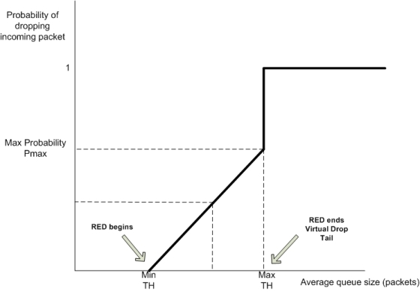
RED – probability of dropping
Notes:
In all simulations, the average queue size varied slightly about the RED
minimum threshold (BS/4)
There is the thorny problem of generating a random number at a router. This can be done by grabbing bits from some seemingly random register on the router;
a possible example is the low-order bits of a clock that runs faster than packet arrivals.

Slide 14
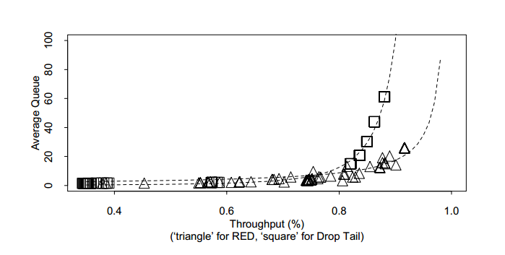
RED performance
RED vs Tail Drop
Source: Random Early Detection Gateways for Congestion Avoidance
by Sally Floyd and Van Jacobson in August 1993 IEEE/ACM Transactions on Networking

Slide 15
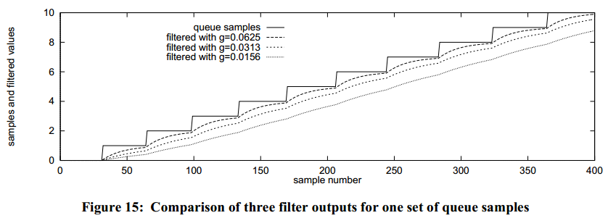
RED – queue length estimations
exponentially-weighted moving average (EWMA) of the queue length
The EWMA equation is: F_{k}=(1-g)F_{k-1}+gQ_{k} (LPF),
g is the gain of the filter
F_{k} is the filtered queue size at sample time k, and
Q_{k} is the sampled queue size at sample time k
Source: RED in a Different Light by V. Jacobson K. Nichols, K. Poduri Cisco Systems
Notes:
The unnecessary generality can be avoided by allowing g to be only a reciprocal of power of 2

Slide 16
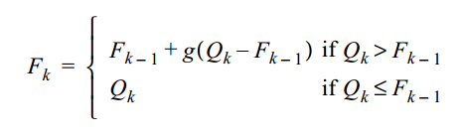
RED – fast reaction to the queue drain
The way to respond more quickly to a draining queue is to set the filtered value to the queue sample when the latter is smaller than the former
Source: RED in a Different Light by V. Jacobson K. Nichols, K. Poduri Cisco Systems

Slide 17
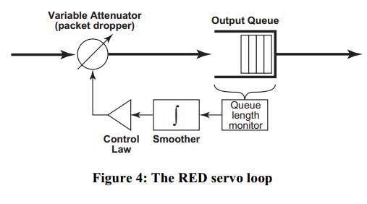
RED drawbacks - 1
RED is unfair
Outer, transport level congestion avoidance servo loop must work in concert with the router’s RED loop
Source: RED in a Different Light by V. Jacobson K. Nichols, K. Poduri Cisco Systems
Notes:
It is well-known that the stability of a control loop worsens as
the lag between the source and the network increases.

Slide 18
RED drawbacks – 2
Traffic categories
Non-adaptive (non-responsive to implicit congestion notifications from the network, such as packet loss)
Robust (can adjust rate in response to implicit congestion notifications)
Fragile (congestion-aware, but sensitive to loss)
RED can pick the same connection arbitrary to drop packets for a short period of time
Accepting the packet from one connection may cause higher drop probability for packets from other connections
Notes:
For example, if two
TCP connections unevenly share one link, dropping one packet
periodically from the low speed flow will almost certainly prevent
it from claiming its fair share, even if the faster flow experiences
more packet drops.
When the window size drops below four packets,
connection falls into a one-second retransmission time-out
(RTO).

Slide 19
RED tuning
As aliasing can result when the sampling intervals are fixed, we recommend that an average sampling interval be picked and a suitable random algorithm be picked
min_{th} is recommended to be set to 0.3*(queue size)
max_{th} : The control range (maximum - threshold) must be large enough that a source gets notified of the drop that occurred when the threshold was crossed and packets started to be dropped

Slide 20
Dark Buffers in the Internet
Bufferbloat: the existence of excessively large and frequently full buffers inside the network
Long delays from bufferbloat are frequently attributed incorrectly to network congestion
April, 2010 – simple bandwidth/latency test clearly demonstrated a problem: poor latency during continuous data transfers: 1-2 seconds latency, with very rapidly varying 1-2 seconds jitter
Source: http://queue.acm.org/detail.cfm?id=2071893 Bufferbloat: Dark Buffers in the Internet by Jim Gettys, Bell Labs, Alcatel-Lucent; and Kathleen Nichols, Pollere Inc

Slide 21
Internet Buffers and Congestion
Paths between communicating endpoints in the Internet are typically made up of many hops with links of different rates or bandwidths
The smallest bandwidth along the path is referred to as the bottleneck bandwidth
Buffers are placed in front of a communications link in case packets arrive while the link is in use, thus requiring storage while the previous arrivals are serviced
The important location for buffers is at the path bottleneck

Slide 22
Bandwidth Delay Product
Buffering is necessary. But how much is “right”?
Have a BDP’s (bandwidth-delay product) worth of buffer, where bandwidth is the bottleneck link and delay is the RTT (round-trip time) between sender and destination
The buffers are now part of the pipe
Filling these buffers would cause delay to increase
Persistently full buffers lack the space to absorb the routine burstiness of a packet network

Slide 23
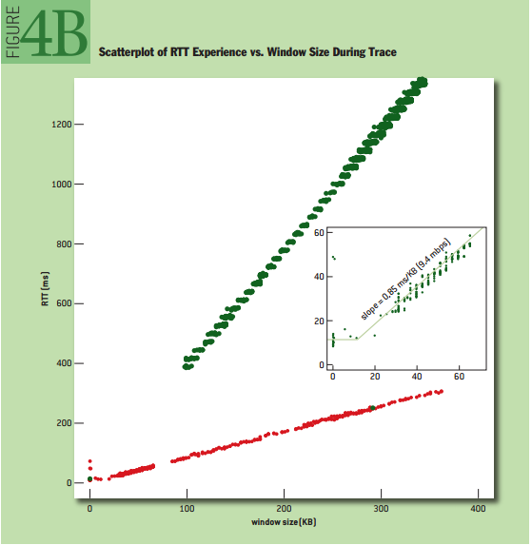
Bloated Buffers and TCP Congestion Avoidance
For TCP congestion avoidance to be useful a TCP connection causing congestion must react quickly to changes in demand at the bottleneck link
TCP’s reaction time is quadratic to the amount of overbuffering
Destination is unaware of the dropped packet until the entire bloated buffer has been transmitted

Slide 24
Where is the bottleneck
The first residential Internet systems connected personal computers through low-bandwidth links into an Internet of relatively high-speed links
Today residential and small business Internet connections increasingly connect customers’ high-bandwidth stub networks through smaller bandwidth links into the core

Slide 25
Why is overbuffering a problem?
Oversized buffers fill and cause delay, destroying many uses of the Internet: • Stock traders and gamers do not want their competition to have even a 1-ms advantage over them. • To play music, jitter (variation in delay) and latency must be controlled and kept below 100 ms. • For something to “feel” attached to your hand (perfect rubber banding), latencies need to be below the 30-ms range; for keyboard echoing to be imperceptible, 50 ms. • Speed-of-light latency dominates VoIP (voice over IP) over long-haul networks, making access latencies critical for keeping end-to-end latency below 150 ms (the longtime telephony metric). • Excessive packet loss induced by bufferbloat may cause DNS (Domain Name System) lookup failure. • Essential network protocols such as ARP, DHCP, RA, and ND all presume timely response and can fail without it. • Web browsing becomes painful as delays go from hundreds of milliseconds to multiple seconds. Many service providers would like to be able to provide low-latency services in their networks

Slide 26
AQM for the Modern World
Main concern: finding an algorithm that could be configured for any link by setting a single-rate parameter
Surprising to most, AQM is essential for broadband service, home routers, and even operating systems: it isn’t just for big Internet routers

Slide 27
Good vs Bad Queues
Buffers and queues is a necessary part of the network
Good queue: – Function as shock absorber, allow and handle burst
Bad queue: – Long standing queue, Only adds delay
CoDel: first AQM to distinguish – between good vs. bad queue

Slide 28
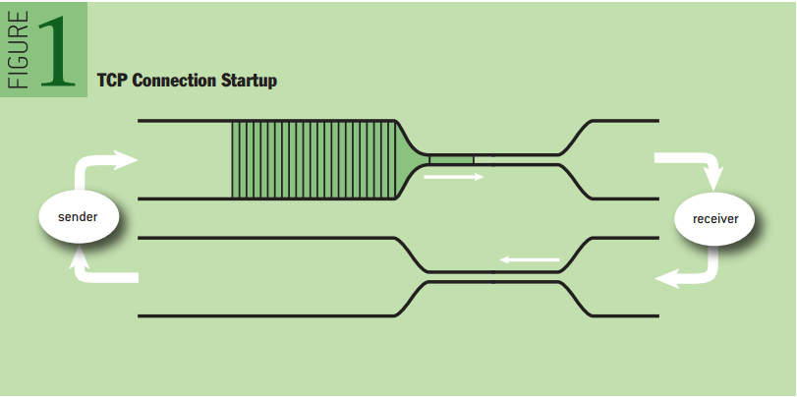
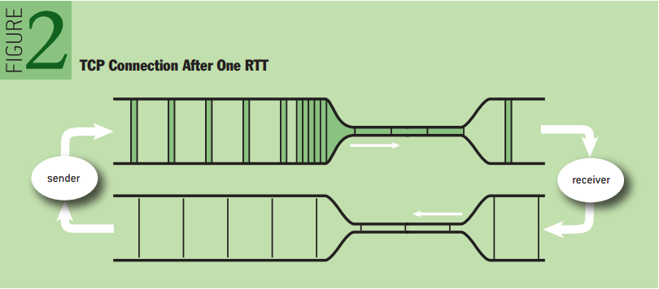
Typical TCP connection startup
Notes:
Figure 2 shows the connection one RTT (round-trip time) later. The bottleneck spaces out the packets, and they retain that spacing after leaving. The receiver just turns a data packet into an ack (acknowledgment packet), so the ack stream retains the spacing on the return path.

Slide 29
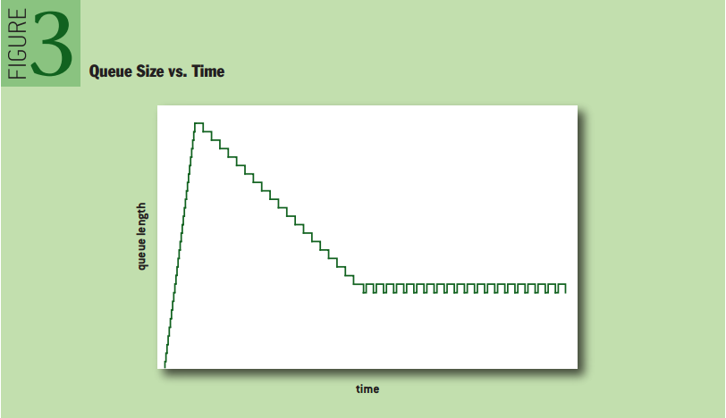
Standing Queues - Bad
This standing queue, resulting from a mismatch between the window and pipe size, is the essence of bufferbloat
It is not a phenomenon treated by queuing or traffic theory (these theories usually assume Poisson arrival processes)
Notes:
Note, however, that the steady-state queue in figure 3 is not zero. Figures 1 and 2 are sized so that the distance in time between the sender and receiver is 10 bottleneck packet times (e.g., 100 ms if the bottleneck packet spacing is 10 ms); thus, it takes 20 packets in flight to “fill the pipe” and use 100 percent of the bottleneck capacity. The window in this example is 25 packets

Slide 30
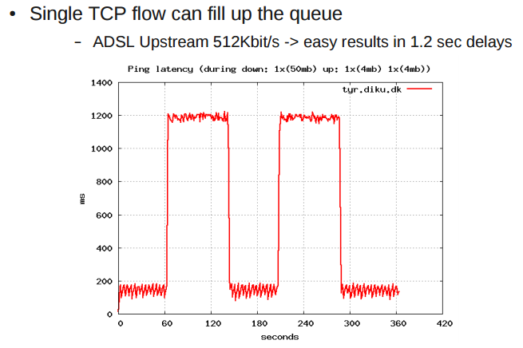
Influence on Latency
Source: http://workshop.netfilter.org/2013/wiki/images/a/a2/Bufferbloat_Solution_JesperBrouer.pdf
Notes:
– Bandwidth is 454 Kbit/s (ADSL overhead)
– Measured delay was 1138 ms
– Buffer size: 454 Kbit/s * 1138 ms = 64581 bytes
– Forgot to look at Latency under load

Slide 31
CoDel (Controlled Delay Management)
It is parameterless—it has no knobs for operators, users, or implementers to adjust
It treats good queue and bad queue differently—that is, it keeps the delays low while permitting bursts of traffic
It controls delay, while insensitive to round-trip delays, link rates, and traffic loads
It adapts to dynamically changing link rates with no negative impact on utilization
It is simple and efficient—it can easily span the spectrum from low-end, Linux-based access points and home routers up to high-end commercial router silicon

Slide 32
CoDel queue management principles
Queuing viewed as a servo loop feedback system – Observe that (TCP) bursts go away in a RTT – Queue that does not go away in a RTT is bad queue – Good queue is min queue size over a sliding window

Slide 33
CoDel: queue size in bytes is wrong
Measure queue size in bytes (is the traditional method) – It is bad because:
we really just care about the delay queue causes
to compute delay, need to know (output) bandwidth
(and bandwidth can change over time)
Instead look at time-in-queue rather than bytes – Easy to directly measure (delay of a single packet) – Termed: Sojourn Time ("a temporary stay")
Notes:
Byte queue does not scale – classical byte counting require locking

Slide 34
CoDel: sojourn time
The beauty of measuring time-in-queue (sojourn time) – No locking required
Simply timestamp SKB/packet on enqueuer
Calc time-in-queue (sojourn time) at dequeue time
Be smart at dequeue time
Basically allow unlimited enqueuer
Not a problem, memory was cheap right
Works for time-varying bandwidth
e.g. wireless and shared links

Slide 35
CoDel: Interval
Interval is a time on the order of a worst-case RTT of connections through the bottleneck
Nominal Interval (RTT target) should be bigger than any real RTT – of connections going through the box

Slide 36
CoDel: simplified algorithm
If sojourn time > 5 ms (setpoint target)
for interval of 100 ms nominal target RTT
Then begin to drop packets
increasing according to a control law
that is TCP friendly
basically: drop more and more packets if the queue stays congested

Slide 37
CoDel: Algorithm - dequeue
typedef struct {
packet_t* p;
flag_t ok_to_drop;
} dodeque_result;
dodeque_result codel_queue_t::dodeque(time_t now)
{
dodeque_result r = { 0, queue::deque() };
if (r.p == NULL) {
first_above_time = 0;
} else {
time_t sojourn_time = now - r.p->tstamp;
if (sojourn_time < target || bytes() < maxpacket) {
// went below so we'll stay below for at least interval
first_above_time = 0;
} else {
if (first_above_time == 0) {
// just went above from below. if we stay above
// for at least interval we'll say it's ok to drop
first_above_time = now + interval;
} else if (now >= first_above_time) {
r.ok_to_drop = 1;
}
}
}
return r;
}
Code from: http://queue.acm.org/appendices/codel.html

Slide 38
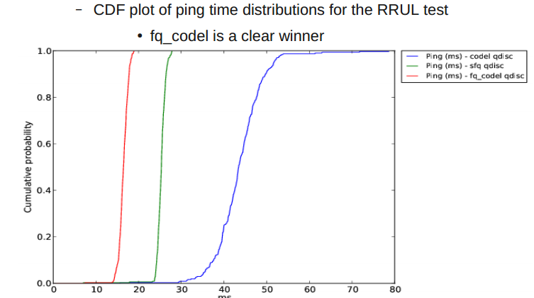
Why to choose CoDel

Slide 39
Try CoDel
#!/bin/bash -xv
#
# Replace root qdisc
#
sudo tc qdisc replace dev eth0.100 root handle 1: htb default 20
#
# Define hierarchical token busket (my uplink is 10Mbps want to share it between TCP and UDP)
#
sudo tc class add dev eth0.100 parent 1: classid 1:10 htb rate 3Mbit
sudo tc qdisc add dev eth0.100 parent 1:10 fq_codel
sudo tc filter add dev eth0.100 protocol ip parent 1: prio 1 u32 match ip protocol 6 0xff flowid 1:10
#
sudo tc class add dev eth0.100 parent 1: classid 1:20 htb rate 1Mbit
sudo tc qdisc add dev eth0.100 parent 1:20 fq_codel
#
# Show everything
#
sudo tc qdisc show dev eth0.100
sudo tc class show dev eth0.100
sudo tc filter show dev eth0.100

Slide 40
QCN – Quantized Congestion Notification
The QCN (Quantized Congestion Notification) algorithm has been developed to provide congestion control at L2 - at the Ethernet layer.
Ethernet has been designed with PAUSE frames as a main congestion prevention mechanism. But:
A consequence of link-level pausing is the phenomenon of “congestion spreading”: the domino effect of buffer congestion propagating upstream causing secondary bottlenecks

Slide 41
Ethernet features affecting the congestion control schemes
No per-packet acks in Ethernet
Packets may not be dropped. As mentioned, Ethernet links may be paused and packets may not be dropped. A significant side-effect of this is that congestion spreading can occur, causing spurious secondary bottlenecks.
No packet sequence numbers.
Sources start at the line rate. Unlike the slow-start mechanism in TCP, L2 sources may start transmission at the full line rate of 10 Gbps.
Very shallow buffers. Ethernet switch buffers are typically 100s of KBytes deep, as opposed to Internet router buffers which are 100s of MBytes deep.
Small number-of-sources regime is typical. In the Internet literature on congestion control, one usually studies the system when the number of sources is large, which is typical in the Internet. However, in Ethernet (especially in Data Centers), it is the small number of sources that is typical.
Multipathing

Slide 42
The QCN Algorithm

Slide 43
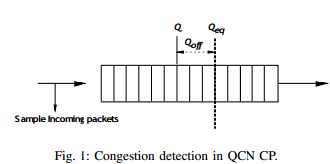
QCN: CP
At Congestion Point:
Q_{eq} – desired operating point of buffer occupancy
Q – instantaneous queue size
Q_{old} – the queue size when the last feedback message F_{b} has been generated
Let Q_{off}=Q-Q_{eq} and Q_{delta}=Q-Q_{old}
Then F_{b}=-(Q_{off}+ wQ_{delta})
The 1st part of the right side equation shows how much smaller the current queue size from Q_{eq}
The 2nd part shows how much the queue length has decreased since last feedback message
Negative value indicates:
That the current queue length is larger than Q_{eq}
And/or the queue size is increasing
In that case F_{b} is sent to RP

Slide 44
QCN: RP
Reaction Point algorithm
Terminology:
Current Rate (CR): The transmission rate at any time.
Target Rate (TR): The sending rate just before the arrival of the last feedback message (which requires rate decrease).
Byte Counter: A counter at the RP for counting the bytes transmitted by the interface.
Timer: A clock at the RP which is also used for timing rate increases.

Slide 45
QCN: Rate adjustments
Rate Decrease: occurs only when the feedback message F_{b} is received, in which case CR and TR are updated as follows:
TR=CR
CR = CR(1-G_{d}|F_{b}|)
G_{d} is a constant satisfying G_{d}F_{b-max}=0.5
Rate Increase: occurs when no feedback is received in two phases
Fast Recovery
Active Increase
Notes:
TR – the rate that was before the rate decrease. It will be stored…

Slide 46
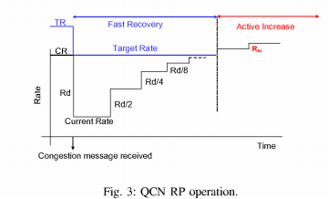
QCN: Recovery
Fast recovery. Consists of 5 cycles, each of 150KBytes of data
CR = 0.5*(CR+TR)
Active Increase.
TR = TR + R_{AI}
CR = 0.5 * (CR + TR)
R_{AI} - is a constant chosen to be 5 Mbps
Source: Data Center Transport Mechanisms: Congestion Control Theory and IEEE Standardization by
Mohammad Alizadeh, Berk Atikoglu, Abdul Kabbani, Ashvin Lakshmikantha, Rong Pan
Balaji Prabhakar, and Mick Seaman

Slide 47
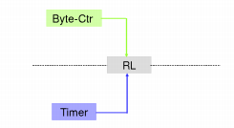
QCN: Timer
The duration of Byte Counter cycles will be unacceptably large when the CR is very small
The Timer is reset when a feedback message arrives, enters FR and counts out 5 cycles of T ms and then enter AI where each cycle is T/2 ms long
T is 10 ms long in the baseline
Source: Data Center Transport Mechanisms: Congestion Control Theory and IEEE Standardization by
Mohammad Alizadeh, Berk Atikoglu, Abdul Kabbani, Ashvin Lakshmikantha, Rong Pan
Balaji Prabhakar, and Mick Seaman

Slide 48
CHOKE
Active queue management algorithm
Differentially penalizes misbehaving flows by dropping more of their packets
CHOKe (CHOose and Keep for responsive flows, CHOose and Kill for unresponsive flows)
Minimize the resource consumption of the maximum flow or seek to achieve minmax fairness

Slide 49
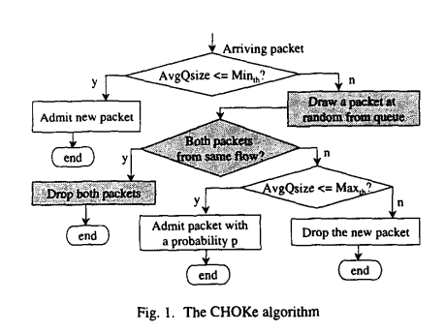
The CHOKE algorithm - 1
CHOKe calculates the average occupancy of the FIFO buffer using an exponential moving average
Marks two thresholds on the buffer, a minimum threshold min_{th} and a maximum threshold max_{th}
Source: CHOKe A stateless active queue management scheme
for approximating fair bandwidth allocation Rong Pan, Balaji Prabhakar”, Konstantinos Psounis

Slide 50
The CHOKE algorithm - 2
If the average queue size is less than min_{th} , every arriving packet is queued into the FIFO buffer
If the average queue size is greater than max_{th}, every arriving packet is dropped
Otherwise:
each arriving packet is compared with a randomly selected from the buffer packet, called drop candidate packet
If they have the same Flow ID – both are dropped
Otherwise, the randomly chosen packet is kept in the buffer (in the same position as before) and the arriving packet is dropped with a probability that depends on the average queue size
Source: CHOKe A stateless active queue management scheme
for approximating fair bandwidth allocation Rong Pan, Balaji Prabhakar”, Konstantinos Psounis
Notes:
Drawbacks:
How to get Flow ID
Random number generation
How to drop the packet from the queue

Slide 51
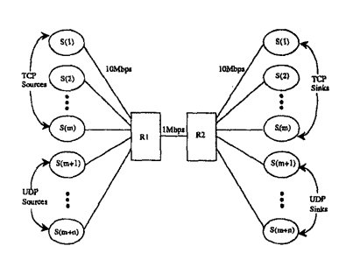
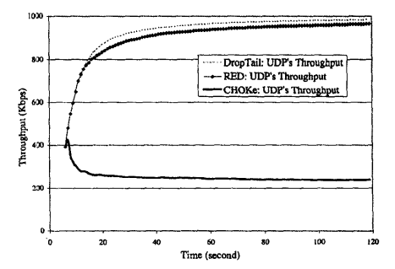
The CHOKE algorithm – simulation results
RED and DropTail gateways do not discriminate against unresponsive flows.
The UDP flow takes away more than 95% of the bottleneck link capacity and the TCP connections can only take the remaining 50 Kbps.
CHOKe, on the other hand, improves the throughput of the TCP flows dramatically by limiting the UDP throughput to 250 Kbps, which is only around 25% of the link capacity
Source: CHOKe A stateless active queue management scheme
for approximating fair bandwidth allocation Rong Pan, Balaji Prabhakar”, Konstantinos Psounis
Notes:
In the above simulation, we find that matches are responsible for 85% of the UDP packet dropping, while 70% of
the TCP packets dropping are caused by random discard.

Slide 52
Summary
Tail Drop – simplest
RED – effective, but might be unfair
Weighted RED
Flow based RED
QCN – developed for Ethernet
CHOKe - stateless flow based RED

Slide 53
Packet Scheduling

Slide 54
Packet scheduling
The scheduler determines the departure sequence of the packets stored in the memory

Slide 55
FCFS / FIFO Queuing
Simplest Algorithm, widely used
Scheduling is done using first-in first-out (FIFO) discipline
All flows are fed into the same queue

Slide 56
FIFO Queuing - 2
First-In First-Out (FIFO) queuing
First Arrival, First Transmission
Completely dependent on arrival time
No notion of priority or allocated buffers
No space in queue → packet discarded
Flows can interfere with each other:
No isolation M
Malicious monopolization
Various hacks for priority, random drops,...

Slide 57
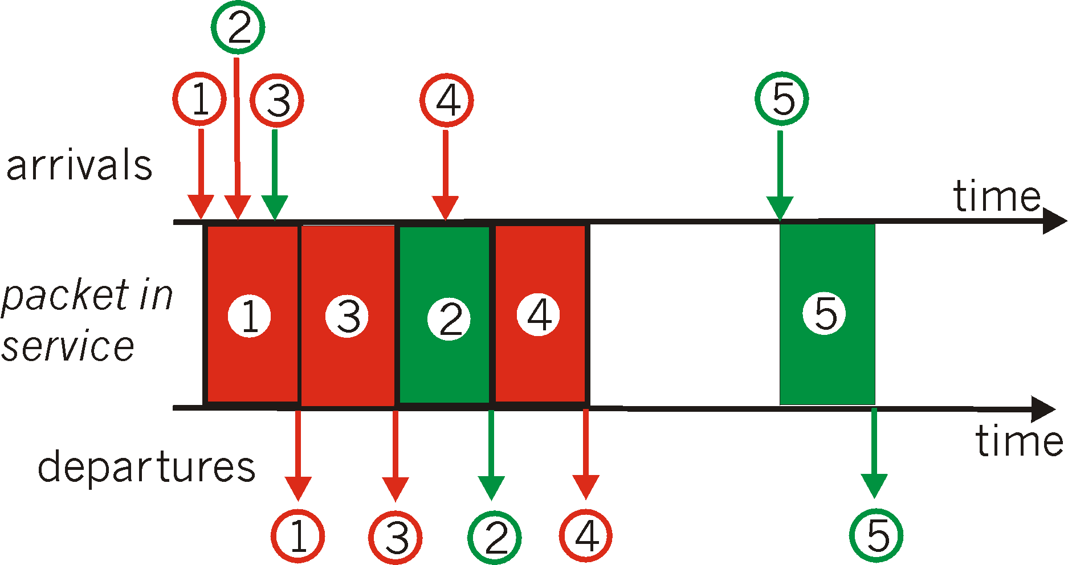
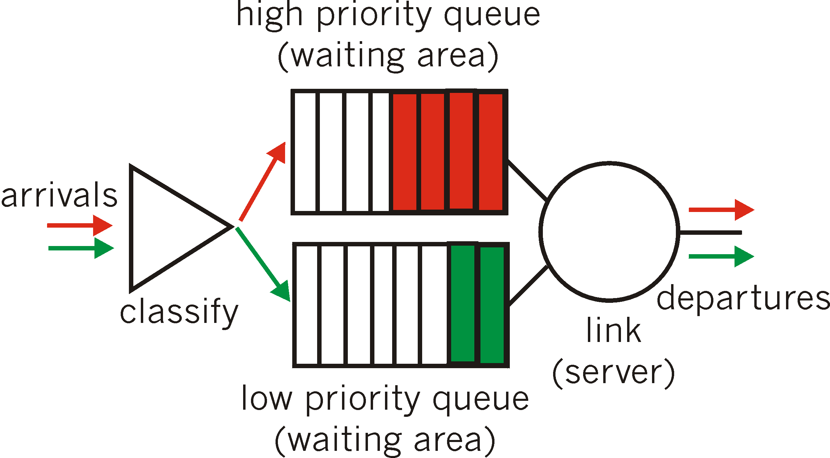
Strict Priority
Packet discard
when full
High-priority
packets
Transmission link
Low-priority
packets
When
high-priority
queue empty
Packet discard
when full

Slide 58
Round Robin: Architecture
Flow 1
Transmission link
Flow 2
Round robin
Flow 3

Slide 59
Round Robin
Characteristics:
Classify incoming traffic into flows (source-destination pairs)
Round-robin among flows
Problems:
Ignores packet length (GPS, Fair queuing)
Inflexible allocation of weights (WRR,WFQ)
Benefits:
protection against heavy users (why?)

Slide 60
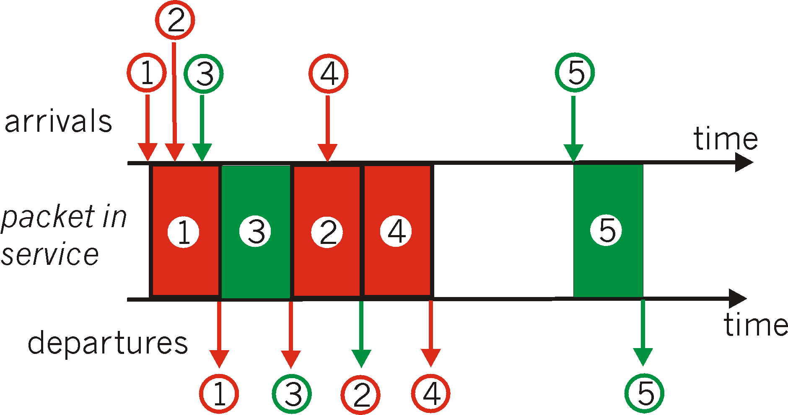
Round Robin Scheduling
Round Robin: scan class queues serving one from each class that has a non-empty queue

Slide 61
Weighted Round-Robin
Weighted round-robin
Different weight w_{i} (per flow)
Flow j can send w_{j} packets in a period
Period of length Σ w_{j}
Disadvantage
Variable packet size
Fair only over time scales longer than a period time
If a connection has a small weight, or the number of connections is large, this may lead to long periods of unfairness

Slide 62
Providing Bandwidth Guarantees: Deficit Round Robin
Each connection periodically gets a credit – a quantum of service assigned to the queue
Serve the queues in the round robin fashion
For each HoL (Head of Line) packet
if its size is ≤ (remainder from prev. quantum + credit) send and save excess
otherwise save entire quantum
If no packet to send, reset counter (to remain fair)
Each connection has a deficit counter (to store credits) with initial value zero
Easier implementation than other fair policies, for example WFQ
Notes:
The only difference from traditional Round Robin is that if a queue was not able to send a packet in the previous round because the packet is too large, the remainder of the quantum is added to the quantum in the next round.
Bit-by-bit round robin is considered as an ideal system

Slide 63
Deficit Round-Robin
DRR can handle variable packet size
Quantum size : 1000 byte
1st Round
A’s count : 1000
B’s count : 200 (served twice)
C’s count : 1000
2nd Round
A’s count : 500 (served)
B’s count : 0
C’s count : 800 (served)
2000
1000
0
1500
A
500
300
B
1200
C
Second
Round
First
Round
Head of
Queue
Notes:
Note that DRR shares bandwidth among flows in proportion to quantum sizes.
For example, suppose there are three flows,F1,F2, andF3, with respective quantum sizes 2, 2,and
3, who have reservations. Then if all three are active,F2 should get a fraction 2/(2+2+3) =2/7
of the output-link bandwidth. If, for example,F3 is idle, then F2 is guaranteed the fraction
2/(2+2) =1/2 of the output-link bandwidth. In all cases, a flow is guaranteed a minimum
bandwidth, measured over the period the flow is active, that is proportional to the ratio of its
quantum size to the sum of the quantum sizes of all other reservations.

Slide 64
DRR: performance
Handles variable length packets fairly
Backlogged sources share bandwidth equally
Preferably, packet size < Quantum
Simple to implement
Similar to round robin

Slide 65
Schedulers that provide delay guarantees
Generalized Processor Sharing (GPS)
Algorithm (Parech, 1993)
Serve queues in round robin fashion
In any finite time interval visit each queue at least once
Imaginary bit-by-bit system: During each round, each queue with data sends a number of bits proportional to the flow’s weight
Advantages
Ideal fairness, complete isolation of flows and delay bounds
Disadvantages
Not implementable

Slide 66
GPS Example
Packets of size 10, 20 & 30 arrive at time 0
30
50
60

Slide 67
Fairness using GPS
Non-backlogged connections receive what they ask for.
Backlogged connections share the remaining bandwidth in proportion to the assigned weights.
Every backlogged connection i receives a service rate of :
Active(t): the set of backlogged flows at time t
No packet discipline can be as fair as GPS
while a packet is being served, we are unfair to others
Notes:
A session is backlogged at time t if a positive amount of that session’s traffic is queued
at time t

Slide 68
GPS approximation
We can’t implement GPS
So, lets see how to emulate it
We want to be as fair as possible
But also have an efficient implementation

Slide 69
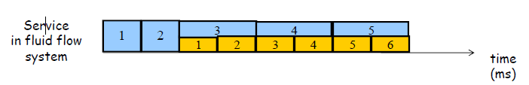

Packet-by-packet system
bit-by-bit round robin is not practical
Idea: Use finishing time of packet in fluid system as priority for choosing the next packet for service
Notes:
Compute when each packet shall depart and use the timestamp as a priority for next packet selection
Worse, when a new queue becomes active, potentially all the timestamps have to change.

Slide 70
Weighted Fair Queue
Finish time of a packet in the WFQ system compared to the GPS system will not be later than at most the transmission time of a maximum sized packet
The number of bits serviced in a session by the WFQ system will not fall behind the GPS system by more than a maximum sized packet
Notes:
Stochastic Fair Queuing: all flows mapped to the same bucket are treated equivalently.

Slide 71
GPS vs WFQ
2
GPS: both packets served
at rate 1/2
Queue 1
@ t=0
Queue 2
@ t=0
1
Packet from queue
2 served at rate 1
t
0
2
3
Packet from
queue 2 waiting
queue 2 served at rate 1
1
Packet from
queue 1 being
served at rate 1
t
0
1
2
3

Slide 72
Weighted Fair Queue algorithm
What is the departure time of a packet p of flow F arriving at a router dedicated to F that always transmits at r bits per second?
p arrives before the previous packet from flow F is transmitted – will have to wait
Otherwise p gets transmitted right away
In an ideal system, packet p will depart by:
Maximum(Arrival Time(p), Departure Time(prev)) +Length(p)/r
Serve packets in order of their finish times - a very famous form of real-time scheduler called earliest deadline first
The corresponding packet scheduler is called virtual clock

Slide 73
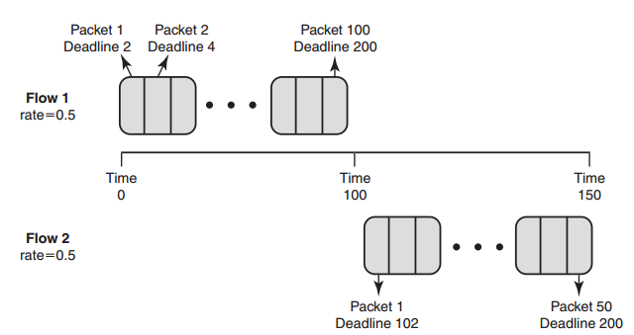
Flow oversubscription
A flow is oversubscribed if the flow sends at the rate higher than its reserved rates during short periods
Deadlines of oversubscribed flows can exceed real time by an unbounded amount
We need to ensure that oversubscribed flow deadlines exceed real time by the time taken to send a maximum-size packet at the smallest rate of any flow
Notes:
Two flows, Flow 1 and Flow 2, are assigned rates of half the link bandwidth each, where the link bandwidth is 1.
from time 0 to time 100, since Flow 1 is the only active queue, virtual clock will send 100 packets of size 1 each from Flow 1.
The first packet of Flow 1 will have ideal deadline 2, the second 4, and the 100th will have deadline 200.
By the time we reach time 100, Flow 1’s 101st packet has ideal deadline 202.
We now bring on 100 packets of Flow 2 at time 100, Flow 2’s packets have deadlines 102, 104, 106,..., and the 50th packet of Flow 2 has deadline 200
during the period from 100 to 150, Flow 2 has taken all the link bandwidth, despite the presence of Flow 1 packets.

Slide 74
WFQ – Virtual Time
Advance the real-time counter to be within δ of the smallest deadline whenever the smallest deadline exceeds the real-time counter by δ.
Now the “real-time” counter no longer represents “real-time,” but is only the reference “clock” used to stamp deadlines for future packets.
The single clock adjustment is more efficient than adjusting multiple deadlines

Slide 75
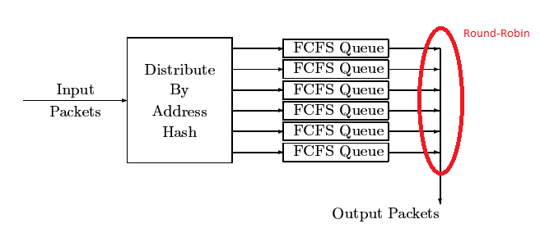
Stochastic Fairness Queuing (SFQ)
Queues are serviced in strict round-robin order and a simple hash function is used to map from source-destination address pair into a fixed set of queues
Several hash functions are used
Hash function switching is done in such a way as to avoid packet reordering

Slide 76
SFQ Advantages and Drawbacks
From net/sched/sch_sfq.c
ADVANTAGE:
- It is very cheap. Both CPU and memory requirements are minimal.
DRAWBACKS:
- "Stochastic" -> It is not 100% fair.
When hash collisions occur, several flows are considered as one.
- "Round-robin" -> It introduces larger delays than virtual clock
based schemes, and should not be used for isolating interactive
traffic from non-interactive. It means, that this scheduler
should be used as leaf of CBQ or P3, which put interactive traffic
to higher priority band.

Slide 77
Summary
FIFO
Round Robin
Bit-by-bit round robin
Deficit Round Robin
Virtual Time (WFQ)

Slide 78
Hierarchical scheduling

Slide 79
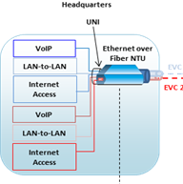
Rationale behind HQoS
Providers are offering sophisticated Service Level Agreements:
Differentiated SLA-based performance commitments for voice, video and data
Customers differentiation
Asymmetric Access systems

Slide 80
HQoS Example 1
Egress
Queues
(to HSL)
Frame Matching
(Assignment to
Service)
B/W
Profiles
Services
SERV-3
Prof-1
HHH
FOR (x from 1 to 32) IF (Frame ~ RULE-x) Frame -> SERV-y
SERV-1
HH
SERV-4
Prof-2
H
SERV-5
MH
8/15
Unlimited
Profile-0
4/15
SP
SERV-6
ML
4/15
WFQ
SERV-7
L
2/15
Classification to 8 queues (via identification RULES of Service) is done on toward HSL direction only inspecting traffic “Arrival Port”, and any fields of L2,L3 or L4 which is required to be found in the frame.
1/15
SERV-8
Prof-2
LL
1/15
SERV-2
Prof-3
LLL
Weight
(1..15)
Shaper
(Y/N)
trTCM
CIR
Frame– to–Queue Classification is done
via Rule –Service configuration
EIR
MEF10 QoS

Slide 81
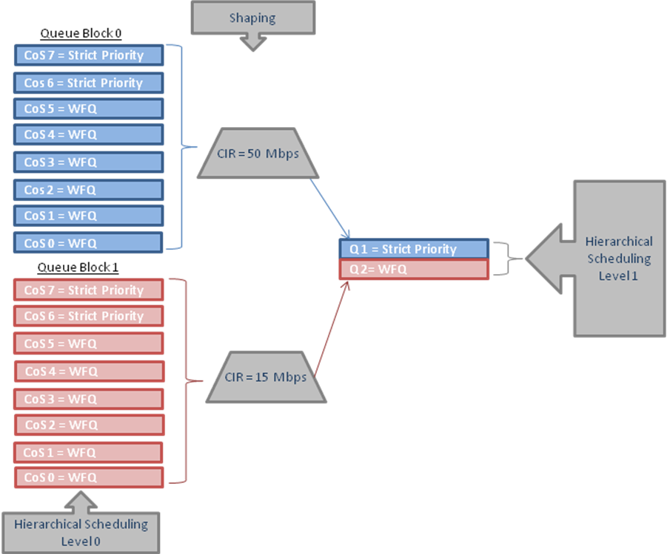
HQoS Example 2

Slide 82
Traffic Classification and Marking

Slide 83
Traffic Classification and Marking
Each incoming packet shall be classified to determine whether it complies with the service agreement
The level of compliance is expressed as one of three colors: Green, Yellow or Red
Marking is used to differentiate the packets further in the path
Marking permits the network to be partitioned into multiple priority levels or classes of service

Slide 84
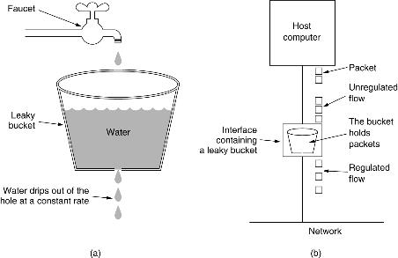
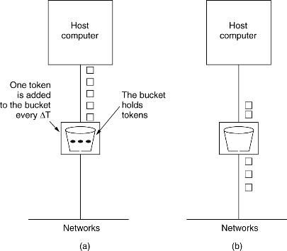
Leaky bucket vs Token bucket
Leaky bucket: no matter at what rate the water enters the bucket, the outflow is at a constant rate, ρ, when there is any water in the bucket or zero if the bucket is dry. Also, when the bucket is full, any additional water entering it spills over the sides and is lost
Token bucket: the leaky bucket holds tokens , generated by a clock at the rate of one token each ϪT seconds. For a packet to be transmitted, it must capture and destroy amount of tokens corresponding to the packet size
leaky bucket provides smooth departures
Token bucket provides bursty departure
Notes:
As can be seen, these two descriptions are essentially mirror images of one another: one adds something to the bucket on a regular basis and takes something away for conforming packets down to a limit of zero; the other takes away regularly and adds for conforming packets up to a limit of the bucket's capacity. So, is an implementation that adds tokens for a conforming packet and removes them at a fixed rate an implementation of the leaky bucket or of the token bucket? Similarly, which algorithm is used in an implementation that removes water for a conforming packet and adds water at a fixed rate? In fact both are effectively the same, i.e. implementations of both the leaky bucket and token bucket, as these are the same basic algorithm described differently. This explains why, given equivalent parameters, the two algorithms will see exactly the same packets as conforming or nonconforming. The differences in the properties and performance of implementations of the leaky and token bucket algorithms thus result entirely from the differences in the implementations, i.e. they do not stem from differences in the underlying algorithms.
On bursty arrivals after long idle:
--leaky bucket provides smooth output (smooth departures);
--token bucket provides bursty output (bursty departures);

Slide 85
Bandwidth profile parameters
Committed Information Rate (CIR) expressed as bits per second CIR MUST be ≥ 0
Committed Burst Size (CBS) expressed as bytes. When CIR > 0, CBS MUST be greater than or equal to the maximum Service Frame
Excess Information Rate (EIR) expressed as bits per second. EIR MUST be ≥ 0
Peak Information Rate (PIR) expressed as bits per second. PIR MUST be ≥ 0
Excess Burst Size (EBS) expressed as bytes. When EIR > 0, EBS MUST be greater than or equal to the maximum Service Frame
Coupling Flag (CF) MUST have only one of two possible values, 0 or 1.
Color Mode (CM) MUST have only one of two possible values, “color-blind” and “color-aware”

Slide 86
Single Rate Three Color Marker (IETF RFC2697)
The srTCM meters a traffic stream and marks its packets according to three traffic parameters:
Committed Information Rate (CIR),
Committed Burst Size (CBS),
and Excess Burst Size (EBS), to be green, yellow, or red.
A packet is marked:
green if it doesn’t exceed the CBS,
yellow if it does exceed the CBS, but not the EBS,
and red otherwise.

Slide 87
Single Rate Three Color Marker algorithm
The token buckets C and E are initially (at time 0) full, i.e., the
token count Tc(0) = CBS and the token count Te(0) = EBS. Thereafter,
the token counts Tc and Te are updated CIR times per second as
follows:
o If Tc is less than CBS, Tc is incremented by one, else
o if Te is less then EBS, Te is incremented by one, else
o neither Tc nor Te is incremented.
When a packet of size B bytes arrives at time t, the following
happens if the srTCM is configured to operate in the Color-Aware
mode:
o If the packet has been precolored as green and Tc(t)-B >= 0, the
packet is green and Tc is decremented by B down to the minimum
value of 0, else
o If the packet has been precolored as green or yellow and if
Te(t)-B >= 0, the packets is yellow and Te is decremented by B
down to the minimum value of 0, else
o the packet is red and neither Tc nor Te is decremented.

Slide 88
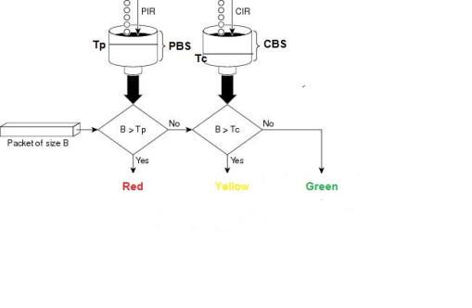
Two Rate Three Color Marker (RFC 2698)
A packet is marked red if it exceeds the Peak Information Rate (PIR). Otherwise it is marked either yellow or green depending on whether it exceeds or doesn't exceed the Committed Information Rate (CIR).

Slide 89
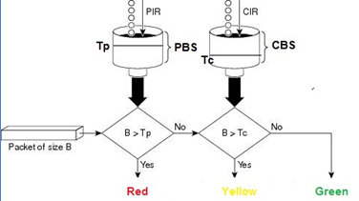
Two Rate Three Color Marker algorithm
The token buckets P and C are initially (at time 0) full, i.e., the
token count Tp(0) = PBS and the token count Tc(0) = CBS. Thereafter,
the token count Tp is incremented by one PIR times per second up to
PBS and the token count Tc is incremented by one CIR times per second
up to CBS.
When a packet of size B bytes arrives at time t, the following
happens if the trTCM is configured to operate in the Color-Aware
mode:
o If the packet has been precolored as red or if Tp(t)-B < 0, the
packet is red, else
o if the packet has been precolored as yellow or if Tc(t)-B < 0,
the packet is yellow and Tp is decremented by B, else
o the packet is green and both Tp and Tc are decremented by B.

Slide 90
A Differentiated Service Two-Rate, Three-Color Marker (IETF RFC4115)
In the color-aware operation, it is assumed that the algorithm can
recognize the color of the incoming packet (green, yellow, or red).
The color-aware operation of the metering is described below.
When a green packet of size B arrives at time t, then
o if Tc(t)- B > 0, the packet is green, and Tc(t) is decremented
by B; else
o if Te(t)- B > 0, the packet is yellow, and Te(t) is decremented
by B; else
o the packet is red.
When a yellow packet of size B arrives at time t, then
o if Te(t)- B > 0, the packet is yellow, and Te(t) is decremented
by B; else
o the packet is red.
Incoming red packets are not tested against any of the two token
buckets and remain red.
In the color-blind operation, the meter assumes that all incoming
packets are green. The operation of the meter is similar to that in
the color-aware operation for green packets.

Slide 91
Summary
Packet Classification
Queue Management
Tail Drop
RED
WRED
FRED
QCN
CHOKe
Buffer scheduling
FIFO
Bit-by-bit round robin
Round Robin
DRR, WRR and FRR
GPS
WFQ
Hierarchical Scheduling
Marking
Single Rate, Three Color
Two Rate, Three Color
DS Two Rate, Three Color

Slide 92
Resources
Network Algorithmics: An Interdisciplinary Approach to Designing Fast Networked Devices by George Varghese (The Morgan Kaufmann Series in Networking) ISBN-13: 978-0120884773 December 29, 2004
High Performance Switches and Routers by H. Jonathan Chao and Bin Liu ISBN: 978-0-470-05367-6 May 2007, Wiley-IEEE Press
RED in a Different Light V. J a c o b s o n K. Nichols K. Poduri Cisco Systems https://www.cnaf.infn.it/~ferrari/papers/ispn/red_light_9_30.pdf
Efficient fair queueing using deficit round robin, by Shreedhar, M. ; Dept. of Comput. Sci., Washington Univ., St. Louis, MO, USA ; Varghese, G. http://users.ece.gatech.edu/~siva/ECE4607/presentations/DRR.pdf
“CHOKe A stateless active queue management scheme for approximating fair bandwidth allocation” by Rong Pan, Balaji Prabhakar, Konstantinos Psounis Department of Electrical Engineering Stanford University Stanford, CA 94305 http://www-bcf.usc.edu/~kpsounis/Papers/choke_infocom.pdf
“Data Center Transport Mechanisms: Congestion Control Theory and IEEE Standardization” by Mohammad Alizadeh, Berk Atikoglu, Abdul Kabbani, Ashvin Lakshmikantha, Rong Pan Balaji Prabhakar, and Mick Seaman http://www.stanford.edu/~balaji/datacenters.html

Slide 93
Questions?

