Slide 1
High Speed Networks Linux Networking
Robert Iakobashvili,
Author: Akiva Sadovski from Broadcom
Spring 2022

Slide 2
Linux distributions
A Linux distribution (often called a distro for short) is an operating system made as a software collection based on the Linux kernel and, often, on a package management system. Linux users usually obtain their operating system by downloading one of the Linux distributions, which are available for a wide variety of systems ranging from embedded devices (for example, OpenWrt) and personal computers to powerful supercomputers (for example, Rocks Cluster Distribution).
Source: https://en.wikipedia.org/wiki/Linux_distribution
https://www.linux.com/news/software/applications/810295-the-top-11-best-linux-distros-for-2015

Slide 3
Linux Kernel
Application 1
Application 2
Application 3
User space
C Library – printf()
System Call Interface – write()
Kernel Space
Kernel Subsystems
Device Drivers
Hardware
Hardware
Hardware
Hardware

Slide 4
Monolithic vs Microkernel
Monolithic kernels are implemented as single process running in a single address space
Mikrokernel: the functionality is broken down into separate processes, usually called servers. Only a servers absolutely requiring such capabilities are running in the privileged mode
App 1
App 2
App 1
App 2
Monolithic
same mem space
server 3
server 4
server 1
server 2

Slide 5
Linux Kernel
https://www.kernel.org/
GIT from Kernel org
GPLv2
Patches

Slide 6
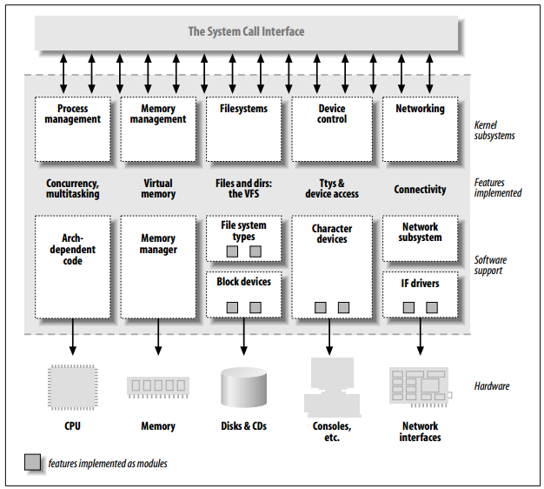
Linux Kernel – Split View
From: Linux Device Drivers, 3rd edition by Jonathan Corbet (Author), Alessandro Rubini (Author), Greg Kroah-Hartman (Author)

Slide 7
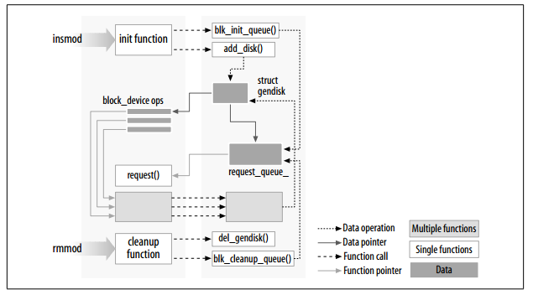
Building and Running Linux Kernel Modules
Kernel module makefile
Loading and unloading modules: insmod, lsmod and rmmod utilities
Module initialization and cleanup functions
From: Linux Device Drivers, 3rd edition by Jonathan Corbet (Author), Alessandro Rubini (Author), Greg Kroah-Hartman (Author)

Slide 8
Building Linux Kernel – How?
Download sources/patches from GIT, build and maintain in local directory
Don’t overwrite /usr/src/linux
Based on Makefiles (make tutorials at http://www.gnu.org/software/make/manual/make.html#toc-Overview-of-make)
Each architecture requires it’s own toolchain (compiler, linker, libraries, etc.), GNU-based (kernel code is GNU C)
Configuration based on .config file
CONFIG_FEATURE format
make menuconfig to select features and modules
boolean and tristate selections
make defconfig to create default configuration for your architecture
make oldconfig
Validates the content of .config
Allow to update .config manually
Must run if you upgrade/patch the kernel

Slide 9
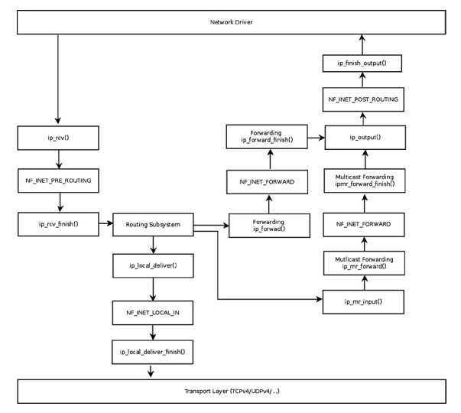
The Linux Networking Stack
Passing incoming packets:
from L2 (the network device drivers)
to L3 (the network layer, usually IPv4 or IPv6)
Local delivery: to L4 (to TCP or UDP listening sockets which implements the L4)
Forwarding: back to L2 for transmission
Outgoing packets are passed:
From L4 to L3 and then to L2 for actual transmission by the network device driver
From: Linux Kernel Networking: Implementation and Theory 1st Edition by Rami Rosen (Author)

Slide 10
Linux Network Device
Each interface is described by a struct net_device item
Contains:
The IRQ number of the device
The MTU of the device
The MAC address of the device
The name of the device (like eth0 or eth1)
The flags of the device (for example, whether it is up or down)
A list of multicast addresses associated with the device
The features that the device supports (like GSO or GRO offloading)
An object of network device callbacks (net_device_ops object item), which consists of function pointers, such as for opening and stopping a device, starting to transmit, changing the MTU of the network device, and more.
An object of ethtool callbacks, which supports getting information about the device by
running the command-line ethtool utility
The number of Tx and Rx queues if the device supports multiqueues
The timestamp of the last transmit of a packet on this device
The timestamp of the last reception of a packet on this device
Etc

Slide 11
The Socket Buffer (sk_buff)
Packets in Linux kernel are represented as struct sk_buff items
SKB API
Once a packet is received on the wire, an SKB is allocated by the network device driver
The SKB includes the packet headers (L2, L3, and L4 headers) and the packet payload
In the packet traversal in the network stack, a header can be added or removed
Each SKB has a dev member, which is an instance of the net_device structure. For incoming packets, it is the incoming network device, and for outgoing packets it is the outgoing network device
Each received packet should be handled by a matching network layer protocol handler. For example, an IPv4 packet should be handled by the ip_rcv()method
Notes:
include/linux/skbuff.h

Slide 12
List of sk_buff elements

Slide 13
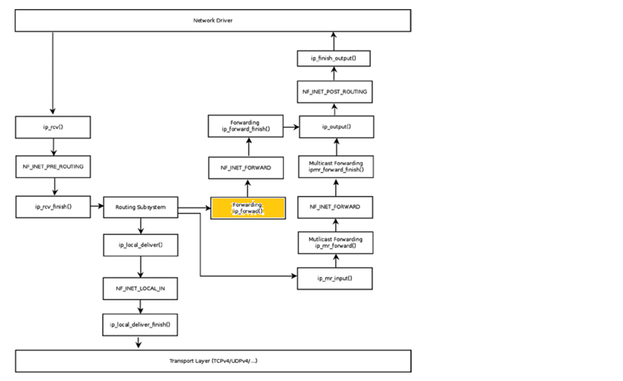
Linux Forwarding Information Base (FIB)

Slide 14
Forwarding in Linux
Routing subsystem in Linux is responsible for forwarding packets and maintaining the forwarding database
A lookup in the routing subsystem is done for each packet, both in the Rx path and in the Tx path
Notes:
Ipv4/fib_trie.c

Slide 15
Routing Lookup in Linux
Routing cache - exact match in a simple hash table
Table for local addresses - separate hash-based routing table where the kernel stores only local addresses
Table for remote addresses – data structure where lookups are based on a Longest Prefix Match (LPM) algorithm
Notes:
Here switch to David Miller’s presentation

Slide 16
Linux 3.6
A long effort to remove the IPv4 routing cache from the networking subsystem has come to its conclusion. David Miller wrote:
The ipv4 routing cache is non-deterministic, performance wise, and is subject to reasonably easy to launch denial of service attacks.
The routing cache works great for well behaved traffic, and the world was a much friendlier place when the tradeoffs that led to the routing cache's design were considered.
What it boils down to is that the performance of the routing cache is a product of the traffic patterns seen by a system rather than being a product of the contents of the routing tables.
The replacement code simplifies the networking subsystem and, hopefully, gives better performance on high-volume systems.

Slide 17
Lookup in the Routing Subsystem

Slide 18
Lookup data structures
fib_nh represents the next hop (several next hops can be defined)
fib_alias (represents route itself):
ip route add 192.168.1.10 via 192.168.2.1 tos 0x2
ip route add 192.168.1.10 via 192.168.2.1 tos 0x4
ip route add 192.168.1.10 via 192.168.2.1 tos 0x6
Trie node struct tnode

Slide 19
Linux FIB: prefix analysis
bits – node degree (number of descendants of the node)
pos – how many bits we have to analyze yet
If pos + bits <= 32 and bits > 0, then the node is a tnode
If pos == 0 and bits ==0, then the node is a leaf
If pos == 32 and bits == 0, then the node is a root node

Slide 20
Linux FIB: lookup
fib_table_lookup() in net/ipv4/fib_trie.c
Terse highly optimized code
get_index(key, trie)
Computes a difference between the destination address and the prefix stored in tnode
Step 1 – go down until the leaf node is found
Step 2 – find the element corresponding to longest sub-prefix in the tnode
Suppose that currently analyzed ‘bits’ field in the DA contains 1101. Then, we need to test children: 1100, 1000
Backtrace if no leaf at given level is found
Step 3 – find matching element in the alias list and determine the next hop
Notes:
Code:
if (index & (~0ul << n->bits)) -- in compressed trie some bits might be skipped; mismatch in skipped bits detected
If (IS_LEAF(n)) is defined as (!(n)->bits)
prefix_mismatch(key, prefix) is defined as ((key ^ prefix) & (prefix | -prefix)) // (prefix | -prefix) produce a mask

Slide 21
Linux FIB: route insertion/deletion
fib_table_insert() in net/ipv4/fib_trie.c
Leaf found and prefix match – insert fib_info element
Leaf or tnode found, key doesn’t match – allocate leaf/tnode, insert
Resize:
Double if above higher threshold
Halve if empty children above threshold

Slide 22
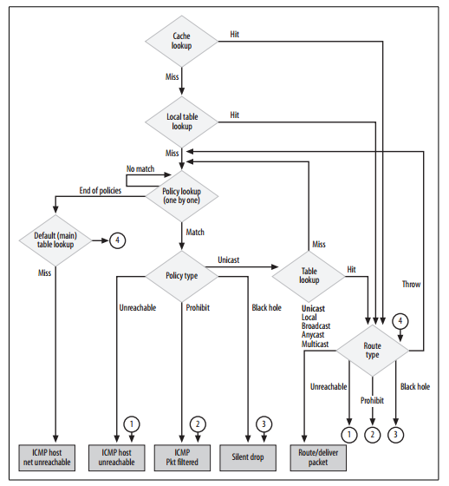
Policy Routing
Allows the user to configure the routing on more parameters than just the destination IP address
Purpose: streams separation
Examples:
Route traffic based on the originating customer
Route traffic according to QoS requirements
From: Understanding Linux Network Internals by Christian Benvenuti

Slide 23
Policy Routing – non-routing actions
unicast — Standard route lookup within the table referenced by the rule. This is the default action when a table is specified.
blackhole — Rule action drops the packet without any messages.
unreachable — Rule action generates a “Network is unreachable” error. An ICMP Type 3 Code 0 packet is returned to the sender.
prohibit — Rule action generates a “Communication is administratively prohibited” error. ICMP Type 3 Code 13 returned to sender.

Slide 24
Policy Routing – Routing Table Selection
Policies can be based on:
Source and/or destination IP address
Ingress device
TOS [byte]
Fwmark – Firewall classification mark inserted into packet buffer

Slide 25
Policy Routing – user interface
Implemented by IPROUTE2 package, administrator can configure up to 255 different routing tables:
ip rule add tos 0x04 table 252
ip route add default via 192.168.2.10 table 252
ip rule list

Slide 26
Multipath Routing
The ability to add more than one next hop to a route
ip route add 192.168.1.10 nexthop via 192.168.2.1 weight 3 nexthop via 192.168.2.10 weight 5
The kernel needs a mechanism to select the next hop to use each time the route matches a route lookup
Flexibility – admin can assign a weight to next hop
Notes:
If all thenext hops are assigned the same weight, the algorithm falls back to the so-called equal cost multipath algorithm.

Slide 27
Multipath Routing – Next Hop selection
Originally the granularity used to distribute traffic among the next hops was not per packet but per routing cache entry – roughly corresponds to flow
Kernel allows the admin to choose the algorithm for next hop selection:
Random
Weighted Random
Round Robin
Device Round Robin - instead of distributing traffic based on the routes, traffic is distributed in round robin fashion on the interfaces

Slide 28
Multicast routing
Multicast routing table contains a multicast cache – an array of mfc_cache objects
Index is the hash value computed from the multicast group address and the source IP address
Notes:
Actual lookup is done by ipmr_cache_find() in net/ipv4/ipmr.c

Slide 29
Netfilter Framework
Packet selection (iptables)
Packet filtering
Network Address Translation (NAT)
Modifying the contents of packet headers before or after routing (Packet mangling)
Connection tracking
Gathering network statistics

Slide 30
Netfilter Hooks

Slide 31
Hook parameters
pf: Protocol family. NFPROTO_IPV4 for IPv4 and NFPROTO_IPV6 for IPv6
hook: One of the five netfilter hooks mentioned earlier (for example, NF_INET_PRE_ROUTING or NF_INET_LOCAL_OUT)
skb: The SKB object represents the packet that is being processed
in: The input network device (net_device object)
out: The output network device (net_device object). There are cases when the output device is NULL, as it is yet unknown
okfn: A pointer to a continuation function which will be called when the hook will terminate. It gets one argument, the SKB.
Notes:
out=NULL for example, in the ip_rcv() method, net/ipv4/ip_input.c which is called before a routing lookup is performed, and you don’t know yet which is the output device; the NF_HOOK() macro is invoked in this method with a NULL output device.

Slide 32
Netfilter verdicts
NF_DROP (0): Discard the packet silently
NF_ACCEPT (1): The packet continues its traversal in the kernel network stack as usual
NF_STOLEN (2): Do not continue traversal. The packet is processed by the hook method
NF_QUEUE (3): Queue the packet for user space
NF_REPEAT (4): The hook function should be called again

Slide 33
Connection Tracking
Connection Tracking (conntrack) allows the kernel to keep track of sessions
FTP session
the client first creates a TCP control connection on TCP port 21 (default FTP port)
Commands sent from the FTP client (such as listing the contents of a directory) to the server are sent on this control port
FTP server opens a data socket on port 20
destination port on the client side is dynamically allocated
Notes:
Kernel shall be built with connection tracking support (CONFIG_NF_CONNTRACK is set)

Slide 34
Contrack hooks
Netfilter hook | Conntrack callback
NF_INET_PRE_ROUTING | ipv4_conntrack_in()
NF_INET_LOCAL_OUT | ipv4_conntrack_local()
F_INET_POST_ROUTING | ipv4_helper() ipv4_confirm()
NF_INET_LOCAL_IN | ipv4_helper() ipv4_confirm()
Both ipv4_conntrack_in() and ipv4_conntrack_local() invoke nf_conntrack_in()

Slide 35
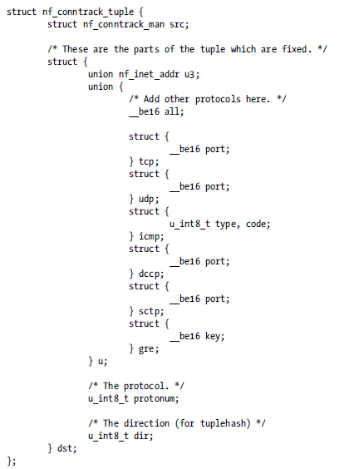
Connection representation
include/net/netfilter/nf_conntrack_tuple.h
Notes:
For bidirectional entity look at: include/net/netfilter/nf_conntrack.h

Slide 36
Connection states
IP_CT_ESTABLISHED The packet is part of an established connection, in the original direction.
IP_CT_RELATED The packet is related to the connection, and is passing in the original direction.
IP_CT_NEW The packet is trying to create a new connection (obviously, it is in the original direction).
IP_CT_ESTABLISHED + IP_CT_IS_REPLY The packet is part of an established connection, in the reply direction.
IP_CT_RELATED + IP_CT_IS_REPLY The packet is related to the connection, and is passing in the reply direction.

Slide 37
Connection Tracking Extensions
Extend connection tracking tuple with more information
Connection Tracking Extension module:
Defines nf_ct_ext_type object
Performs registration by the nf_ct_extend_register() method
Defines a method to attach its Connection Tracking Extension to a connection (nf_conn) object
Notes:
The Connection Tracking Extensions infrastructure is implemented in net/netfilter/nf_conntrack_extend.c

Slide 38
IPTABLES
Table-based firewalling
User space iptables utility
x_tables refers to the kernel module that provides the generic protocol-independent table-based firewalling in Linux
Default table, the filter table registers at 3 netfilter hooks:
NF_INET_LOCAL_IN
NF_INET_FORWARD
NF_INET_LOCAL_OUT
iptables -A INPUT -p udp --dport=5001 -j LOG --log-level 1

Slide 39
Network Address Translation (NAT)
Enables a group of hosts with a private IP address on a Local Area Network to access the Internet via some residential gateway
Notes:
NAT and conntrack:
before Conntrack after that NAT (The reason behind this is that NAT performs a lookup in the
Connection Tracking layer, and if it does not find an entry, NAT does not perform any address translation action)

Slide 40
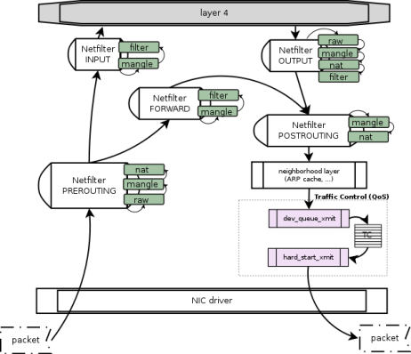
Queues in Linux kernel - 1
Traffic Control (TC) is composed of:
queuing disciplines, or qdisc, that represent the scheduling policies applied to a queue
filter that is a rule that identify packets and direct them to a class
Source: http://wiki.linuxwall.info/doku.php/en:ressources:dossiers:networking:traffic_control

Slide 41
Queues in Linux kernel - 2
dev_queue_xmit main tasks:
Selecting which frame to transmit (the one pointed to by the input sk_buff may not be the one to transmit because there is a queue to honor)
Checking whether the frame is composed of fragments and whether the device can handle them through scatter/gather DMA; combining the fragments otherwise
Calculating L4 checksums
After that, if the netdev have a valid qdisc (skb→dev→qdisc):
qdisc_run function is called to select a packet to transmit
The input frame is queued with the enqueue virtual function, and one frame is then dequeued and transmitted
Source: http://wiki.linuxwall.info/doku.php/en:ressources:dossiers:networking:traffic_control
Notes:
Code: net/core/dev.c
sch_direct_xmit() OR q->enqueue() are called from
__dev_xmit_skb() called from
__dev_queue_xmit

Slide 42
Qdisc callbacks (methods)
dequeue - usually returns a skb to send (allowed to return NULL)
enqueue – insert skb to the queue. May return:
NET_XMIT_DROP - this packet dropped
NET_XMIT_CN - probably this packet enqueued, but another one dropped
peek - like dequeue but without removing a packet from the queue
requeue - puts back on the queue an element that was previously extracted (e.g., because of a transmission failure)
reset
init
destroy
change - changes qdisc parameters
Notes:
include/net/sch_generic.h
struct Qdisc_ops
Transmission Failure:
NETDEV_TX_BUSY - The driver has discovered that the NIC lacks sufficient room in its transmit buffer pool. When this condition is detected, the driver often calls netif_stop_ queue too (see the section “Enabling and Disabling Transmissions”). NETDEV_TX_LOCKED - The driver is locked. This return value is used only by drivers that support NETIF_F_LLTX.

Slide 43
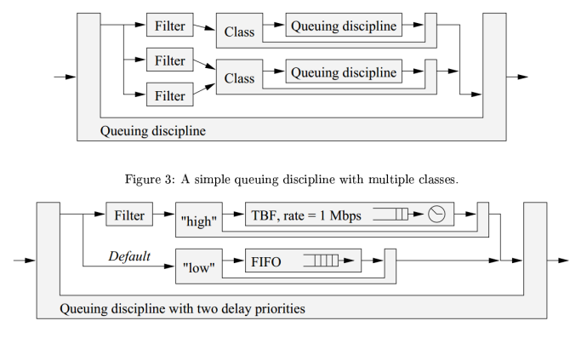
Qdiscs, classes and filters
Elaborate queuing disciplines may use filters to distinguish among different classes of packets and process each class in a specific way

Slide 44
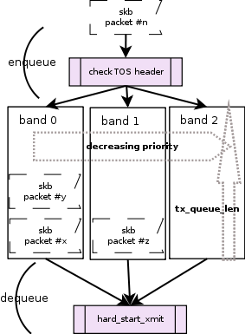
Qdisc example: pfifo_fast
default scheduling algorithm
basic FIFO queue subdivided into 3 bands
once the length of the band is passed, TC will start dropping packets
Source: http://wiki.linuxwall.info/doku.php/en:ressources:dossiers:networking:traffic_control
Notes:
net/sched/sch_generic.c
pfifo_fast_enqueuer():
Map priority to band
__qdisc_enqueuer_tail()
pfifo_fast_dequeuer():
Dequeue from active band with highest priority

Slide 45
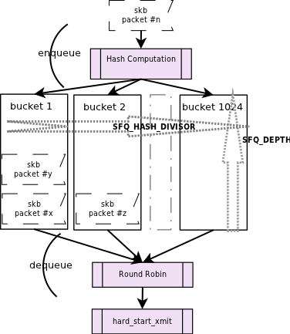
Qdisc example: SFQ
hash of the packet based on its header, is used to send the packet to one of the 1024 buckets available
For de-queueing buckets are selected in a round-robin fashion
Source: http://wiki.linuxwall.info/doku.php/en:ressources:dossiers:networking:traffic_control
Notes:
sfq_enqueue() :
sfq_classify() is called from sfq_enqueue()
sfq_classify() can consider the priority from skb as a queue identifier
sfq_dequeuer():
Rather simple…
sfq_perturbation() is activated by the timer calls sfq_rehash():
1) Packets from all buckets are thrown to the list
2) Packets are inserted into hash table according to new hashing rules

Slide 46
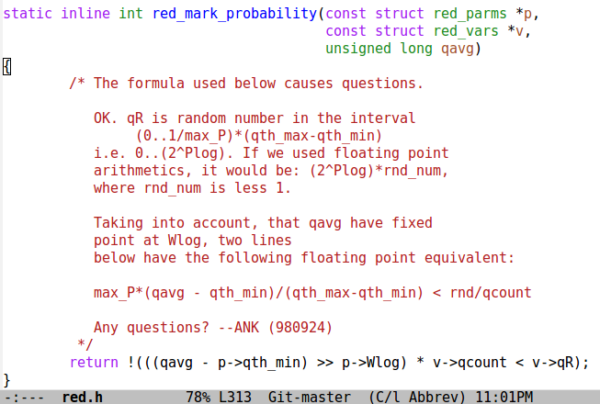
Qdisc example: RED
Notes:
include/net/red.h

Slide 47
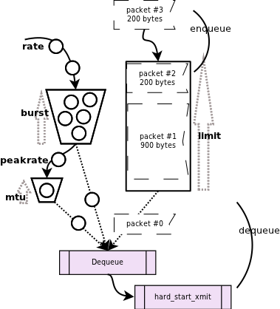
TBF – Token Bucket Filter
A sequence of packets with the sizes s[i],s[i+1]…s[k] obeys Token Bucket if s[i]+s[i+1]+…+s[k] ≤ Burst + Rate*(t[k] – t[i])
Algorithm:
Let N(t[i]) be Burst/Rate initially
N(t) grow continuously with time as: N(t+delta) = min{B/R, N(t) + delta} [ “grows continuously” means that N is increased once processing of new packet is started by delta = T_{prev.packet} – T_{curr.packet}
If the first packet in queue has length S, it may be transmitted only at the time t[i] when S/R <= N(t[i]),
N(t) is updated: N(t) = N(t) - S/R.
Source: http://wiki.linuxwall.info/doku.php/en:ressources:dossiers:networking:traffic_control
Notes:
Implemented in net/sched/sch_tbf.c
Work is done in tbf_dequeue() function

Slide 48
Resources
Linux Kernel Networking: Implementation and Theory (Expert's Voice in Open Source) 1st Edition by Rami Rosen http://www.amazon.com/Linux-Kernel-Networking-Implementation-Experts/dp/143026196X
“Writing Netfilter modules” by Jan Engelhardt and Nicolas Bouliane http://inai.de/documents/Netfilter_Modules.pdf

Slide 49
Questions?

