Slide 1
High Speed Networks QoS
Robert Iakobashvili,
Author: Akiva Sadovski from Broadcom
Spring 2022

Slide 2
QoS Promise
By QoS we mean meeting defined levels of a set of measureable network parameters, such as availability, delay, delay variability, and information loss
The objective of various Internet QoS efforts is to augment a best-effort service with a number of selectable service responses
Two basic actions of an active network router:
Queuing
Discarding
Altering the queuing and discard behaviors selectively, service outcomes that differ from the best-effort service may be generated
The service outcome is claimed to be no worse than best-effort at any time (and superior to best-effort under conditions of congestion load)
Notes:
Mechanisms we have for QoS implementation:
Ingress and Egress Queues
Tail Drop, RED, WRED, CHOKE etc for Discarding
WFQ and SP Queues

Slide 3
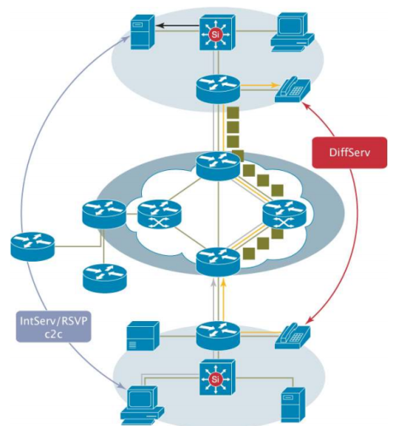
QoS models
Internet Engineering Task Force (IETF) has defined two models:
Integrated Services (IntServ) which follows the signaled-QoS model, where the end-hosts signal their QoS needs to the network
Differentiated Services (DiffServ) which works on the provisioned-QoS model, where network elements are set up to service multiple classes of traffic with varying QoS requirements
Notes:
QoS is disabled by default on the Catalyst 3750 Switches. While QoS is disabled, all frames/packets are passed-through the switch unaltered.

Slide 4
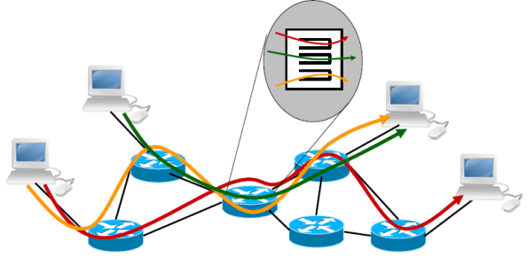
Integrated Services - 1
The application is the trigger to QoS
It signals its service requirements to the network in the form of a reservation request, and the network responds to this request
The reservation remains in force until:
the application explicitly requests termination of the reservation, or
the network signals to the application that it is unable to continue the reservation

Slide 5
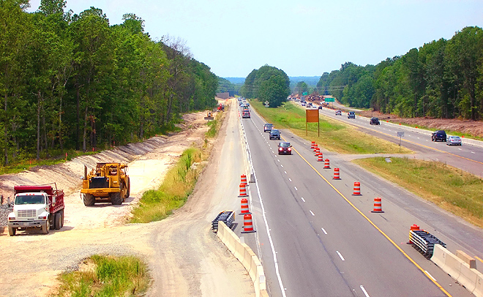
Integrated Services - 2
Taking the cars and roads analogy, Intserv is a bit like trying to construct a new lane in the road system every time a premium service passenger wants to take a journey.
It's an expensive undertaking that simply cannot scale!

Slide 6
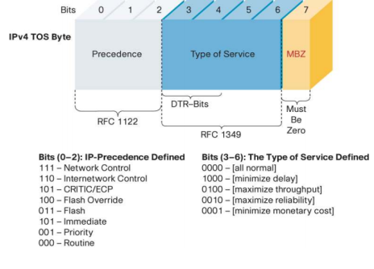
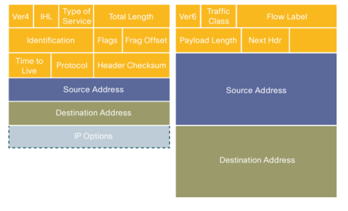
Intserv traffic classes
Packets are first divided into classes by marking the Type of Service (ToS) byte in the IP header

Slide 7
Intserv classes of service
The Intserv architecture defines two major classes of service:
Guaranteed service
Controlled-load service
Guaranteed Service provides an assured level of bandwidth , a firm end-to-end delay bound, and no queuing loss for conforming packets of a data flow.
Controlled-load Service simply prioritizes the packets in the flow, ensuring that they do not wait too long in router queues as they cross the network

Slide 8
RSVP – ReSerVation Protocol
Resource ReSerVation Protocol.
Allows applications running in hosts to reserve resources in the Internet for their data flows.
RSVP software must be present in the receivers, sender, and routers.
Two principle characteristics of RSVP
It provides reservations for bandwidth in multicast trees(unicast is handled as a special case).
It is receiver-oriented.
RSVP is not a routing protocol and sometimes referred to as a signaling protocol
RSVP is an extendable protocol. The message is built from the header and series of objects (TLVs).
Message exchange is reliable.

Slide 9
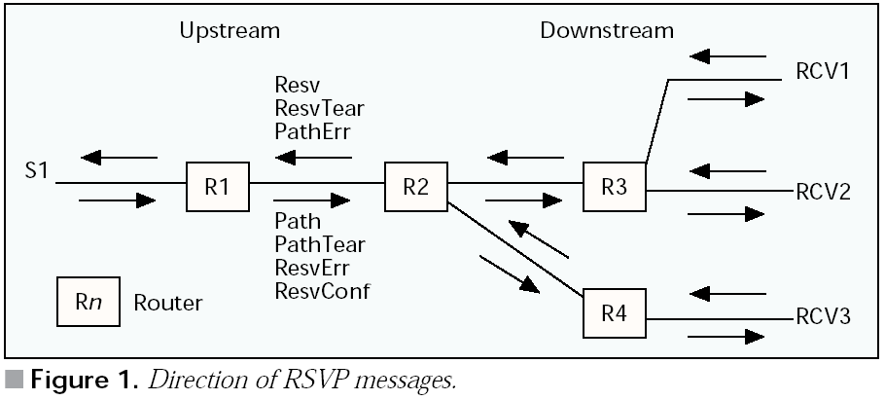
RSVP
RSVP depends on an underlying routing protocol(unicast or multicast) to determine the routes for the flows
Requires admission control
Operation:
Source: RSVP and Integrated Services in the Internet: A Tutorial by Paul P. White, University College London

Slide 10
RSVP state refresh
The Path messages should be periodically retransmitted (refreshed)
Once the routing changes, the Path messages will adopt to these changes
Unattended reservations will be aged

Slide 11
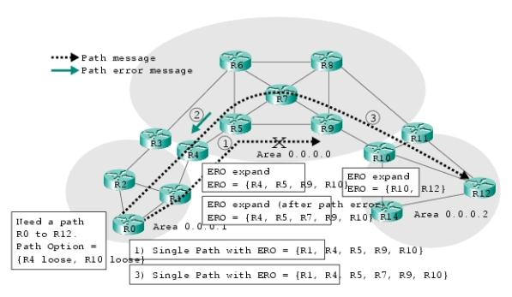
RSVP error messages
The downstream error message is used during path establishment if a router cannot satisfy the reservation request carried in the Resv message. This message goes downstream.
The upstream error message is used if a request (Path) message cannot be satisfied. For example, it may be impossible to route the path according to the explicit route supplied. The upstream error message is also used to report the errors and problems at already established paths.
Notes:
An LSP downstream error messages does not remove the LSP
LSP Notify message

Slide 12
RSVP Controlled load service
The router makes a commitment to offer the flow a service equivalent to that seen by a best-effort flow on a lightly loaded network
The controlled-load flow does not noticeably deteriorate as the network load increases
The controlled-load service targets the applications requiring reliable and enhanced best effort service.

Slide 13
RSVP Guaranteed Service
Guaranteed Service provides:
an assured level of bandwidth
a firm end-to-end delay bound
no queuing loss for conforming packets of a data flow

Slide 14
RSVP – the protocol itself
The session is identified by combination of the IP destination address, IP protocol type and L4 destination port.
The primary messages used by RSVP are the Path message, which originates from the traffic sender, and the Resv message, which originates from the traffic receivers.
RSVP messages can be transported “raw” within IP datagrams using protocol number 46, although hosts without this raw input/output (I/O) capability may first encapsulate the RSVP messages within a UDP header.

Slide 15
RSVP Path message
Phop, the address of the last RSVP-capable node which forwarded this Path message. This address is updated at every RSVP-capable router along the path.
The Sender Template, a filter specification identifying the sender. It contains the IP address of the sender and optionally the sender port (in the case of IPv6 a flow label may be used in place of the sender port).
The Sender Tspec defining the sender traffic characteristics.
An optional Adspec containing One Pass With Advertising (OPWA) information which is updated at every RSVP-capable router along the path to attain end-to-end significance before being presented to receivers to enable them to calculate the level of resources that must be reserved to obtain a given end-to-end QoS.
Notes:
Add examples sender template adspec

Slide 16
RSVP Path message Tspec
Tspec parameters:
p= peak rate of flow (bytes/s)
b= bucket depth (bytes)
r= token bucket rate (bytes/s)
m= minimum policed unit (bytes)
M= maximum datagram size (bytes)

Slide 17
Tspec example
Comment: RSVP Sender information
*Mar 1 05:28:57.302: SENDER_TSPEC type 2 length 36:
*Mar 1 05:28:57.302: version=0, length in words=7
*Mar 1 05:28:57.302: Token bucket fragment (service_id=1, length=6 words
*Mar 1 05:28:57.302: parameter id=127, flags=0, parameter length=5
*Mar 1 05:28:57.302: average rate=3000 bytes/sec, burst depth=120 bytes
*Mar 1 05:28:57.302: peak rate =3000 bytes/sec
*Mar 1 05:28:57.306: min unit=60 bytes, max pkt size=60 bytes
Sample debug ip rsvp detail output

Slide 18
RSVP Path message Adspec
Comment: Reservation parameters contained in TSPEC
*Mar 1 05:28:57.306: ADSPEC type 2 length 48:
*Mar 1 05:28:57.306: version=0 length in words=10
*Mar 1 05:28:57.306: General Parameters break bit=0 service length=8
*Mar 1 05:28:57.306: IS Hops:1
*Mar 1 05:28:57.306: Minimum Path Bandwidth (bytes/sec):193000
*Mar 1 05:28:57.306: Path Latency (microseconds):0
*Mar 1 05:28:57.306: Path MTU:1500
*Mar 1 05:28:57.306: Controlled Load Service break bit=0 service length=0
Sample debug ip rsvp detail output

Slide 19
RSVP Path Message Processing
Update the path state entry for the sender identified by the Sender Template. If no path state exists, create it
Set cleanup timer equal to cleanup timeout interval and restart timer
The router is responsible to send the Path message whenever RSVP detects any changes to the path state; otherwise the Path message is generated every refresh period

Slide 20
RSVP Path message’s Adspec
Contains:
Default General Parameters
Minimum path latency (summation of individual link latencies)
Path bandwidth (minimum of individual link bandwidths along the path)
Global break bit – router not supporting RSVP encountered
Integrated services(IS) hop count
Path MTU – minimum of MTUs of individual links along the path
Guaranteed Service fragments
End to end delay estimations
Service break bit
Controlled-Load Service fragments
Service break bit
Notes:
Controlled-Load Service Break Bit — This bit is cleared when the Adspec is created by the sender. Encountering
any routers that support RSVP/IS but do not support controlled-load service will result in this bit being set to
one in order to inform the receiver that the Adspec may be invalid and the service cannot be guaranteed

Slide 21
RSVP – making a reservation
Upon receiving Path messages the receiver extracts the Sender Tspec and the Adspec
Estimates total end-to-end delay and required bandwidth
Creates a reservation specification, Rspec, comprising first the calculated value R of bandwidth to be reserved in each router
Resv message contains:
Rspec
Reservation style FF/WF/SE
A filter specification, Filterspec which describes the packets to which the reservation applies
A flow specification, Flowspec which describes the flow parameters – rate, end-to-end delay etc.
The Resv message is sent to the previous hop upstream as obtained from the stored path state. Upon reaching the next upstream router, the Resv message can be merged with other Resv messages.

Slide 22
RSVP Re-shaping
at branch points in the distribution tree where the reserved Tspecs of the outgoing branches are not the same, the reserved Tspec of the incoming branch is given by the “maximum” of the reserved Tspecs on each of the outgoing branches
some of the outgoing branches will have a reserved Tspec which is less than the reserved Tspec of the incoming branch – reshaping required
at merge points in the distribution tree for sources sharing the same reservation, the sum of the Tspecs relating to the incoming branches will be greater than the Tspec reserved on the outgoing branch

Slide 23
RSVP Reservation Styles
Fixed Filter (FF) (Distinct Reservation and Explicit Sender Selection)
The Filterspec of each FF reservation installed at an interface consists of a single sender only
The effective Flowspec of the reservation installed is the maximum of all FF reservation requests received on that interface for that particular sender
Wildcard Filter (WF) (Shared Reservation and Wildcard Sender Selection)
The Filterspec of each WF reservation installed at an interface is wildcard and matches on any sender from upstream
The effective Flowspec installed is the maximum from all WF reservation requests received on that particular interface
Shared Explicit (SE) (Shared Reservation and Explicit Sender Selection)
The Filterspec of each SE reservation installed at an interface contains a specific set of senders from upstream and is obtained by taking the union of the individual Filterspecs from each SE reservation request received on that interface
The effective Flowspec installed is the maximum from all SE reservation requests received on that particular interface

Slide 24
Intserv drawbacks
Every device along the path of a packet, including the end systems such as servers and PCs, need to be fully aware of RSVP and capable of signaling the required QoS
Maintaining soft-states in each router, combined with admission control at each hop and increased memory requirements to support a large number of reservations, adds to the complexity of each network node along the path
Scalability
Bottom line: Per-flow QoS is difficult to achieve in an end-to-end network without adding significant complexity, cost, and introducing scalability issues

Slide 25
DiffServ
Bandwidth reservations is carried out on a per-class basis
Traffic-generating applications will be assigned to different classes of service and the traffic will be marked appropriately
In order to deliver end-to-end QoS, this architecture (RFC-2475) has two major components:
Packet classification functions
Per hop behaviors (PHBs)
DiffServ is essentially a relative-priority scheme
Notes:
DiffServ working group objectives:
“A small bit-pattern in each packet”;
“A common understanding about the use and interpretation of this bit-pattern is required for inter-domain use, multi-vendor interoperability”

Slide 26
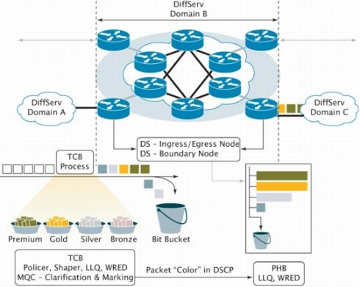
DiffServ domain
DiffServ domain is a contiguous set of nodes which operate with a common set of:
service provisioning policies
per-hop-behavior (PHB) definitions

Slide 27
DiffServ architecture
Dropping the concept of a per-application path state across the network
The amount of state information is proportional to the number of classes rather than to number of flows
On entry to the network each packet is classified into a particular aggregated service profile
Numerous unresolved issues relating to the quality signaling between individual applications and the network
No uniform definition of the aggregated services

Slide 28
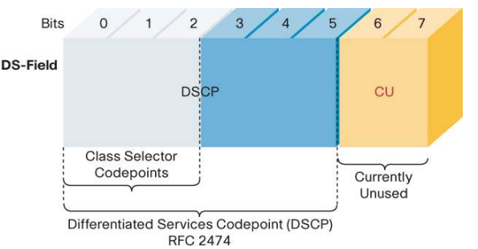
DiffServ – packet marking
Up to 64 different aggregates/classes can be supported
8 classes coincide with Intserv priority classes

Slide 29
Diffserv – Per Hop Behavior (PHB)
PHB is an externally observable forwarding behavior applied at a DS-compliant node to a DS BA
In other words, PHB is a base set of packet forwarding treatments:
Packet scheduling
Queuing
Policing
Shaping

Slide 30
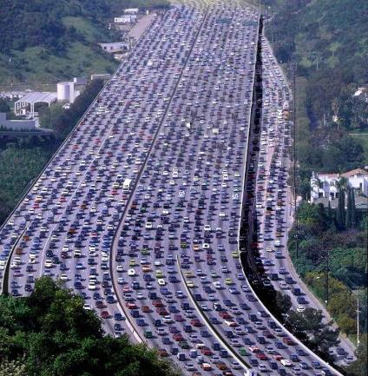
Diffserv - Default PHB (RFC2474)
DSCP codepoint ‘000000’.
Traditional best effort service
if a packet arrives at a DS-compliant node and its DSCP value is not mapped to any of the other PHBs, it will get mapped to the default PHB

Slide 31

Diffserv - Expedited Forwarding PHB (RFC-2598)
Proves a low-loss, low-latency, low-jitter, and assured bandwidth service
Used for VoIP
EF can be implemented using priority queuing, along with rate limiting on the class (formally, a BA)

Slide 32
Diffserv - Assured Forwarding PHB (RFC-2597)
Designed for applications requiring better reliability than Best Effort
Defines a per-hop-behavior group
Four independently forwarded Assured Forwarding (AF) classes
Within each AF class, an IP packet can be assigned one of three different levels of drop precedence
The AFxy PHB defines four AFx classes: AF1, AF2, AF3, and AF4. Each class is assigned a certain amount of
buffer space
interface bandwidth
The subscript “y” in AFxy denotes the drop precedence within an AFx class: dP(AFx1) <= dP(AFx2) <= dp(AFx3)
Notes:
A DS node does not reorder IP packets of the same microflow if they belong to the same AF class
Technically in the Network Element can allocate 4 queues – a queue per AF class, 3 WRED profiles at each queue – a profile for each drop precedence.
defines a method by which BAs can be given different forwarding assurances. For example: gold, silver and bronze classes of traffic
gold being allocated 50 percent of the available link bandwidth,
silver 30 percent,
and bronze 20 percent.

Slide 33
DiffServ AF PHB details - 1
the level of forwarding assurance of an IP packet depends on:
how much forwarding resources has been allocated to the AF class that the packet belongs to
what is the current load of the AF class
what is the drop precedence of the packet (in the event of congestion)
A node must allocate a configurable, minimum amount of resources to each AF class
Each class should be serviced in a manner to achieve the configured rate
A congested DS node tries to protect packets with a lower drop precedence value from being lost by preferably discarding packets with a higher drop precedence value

Slide 34
DiffServ AF PHB details - 2
Within an AF class, the IP packets with lower drop precedence have higher probability to be forwarded
A node must not reorder AF packets of the same microflow when they belong to the same AF class regardless of their drop precedence
A DS domain MAY at the edge of a domain control the amount of AF traffic that enters or exits the domain at various levels of drop precedence. The means of control:
Traffic shaping
Discarding of packets
Increasing or decreasing the drop precedence
Reassigning of packets to other AF classes

Slide 35
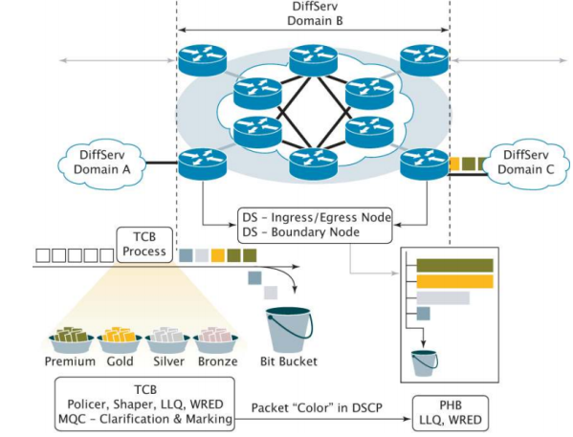
DiffServ – bringing it all together
An example service policy:
Premium gets 10 percent, gold 40 percent, silver 30 percent, bronze 10 percent, and best effort traffic (default class/PHB) the remaining 10 percent of the bandwidth
Gold, silver, and bronze could be mapped to AF classes AF1,AF2, and AF3. Premium traffic is mapped to EF
This can be enforced in any part of the cloud, including end-to-end

Slide 36
Default public Internet service
Quality of Service was in fact more myth than reality for the public Internet
The default service offering associated with the Internet is a best-effort service:
When the load level on the data path is low, the network delivers a high quality service;
As the instantaneous load levels increase beyond the carriage capacity of the network, the network congestion levels increase, and service-quality levels decline

Slide 37
QoS in public Internet
Motivation: provide a network client with a range of service-quality levels at a range of prices.
The objective of various Internet QoS efforts is to augment a best-effort service with a number of selectable service responses.
Some service responses may have lower average end-to-end delay, lower jitter, or greater bandwidth.
Alternatively, QoS service responses may provide a consistent, and therefore predictable, service response that is unaffected by network congestion level

Slide 38
QoS approaches comparison
Neither approach alone is adequate to meet the QoS requirements
The Integrated Services approach imposes an excessive load in the core of large networks through the imposition of a per-application path state.
The Differentiated Services approach provides superior scaling properties through the use of aggregated service elements, but:
The existing tools are insufficient to support widespread use of QoS-based services on the multi-provider public Internet.

Slide 39
QoS from the engineering perspective
The service-quality mechanism chosen must be deployed across all networks along the end-to-end paths of the quality-service traffic
The potential scenario is deployment of isolated islands of QoS services
Strict requirement for the “bridges” across the non-QoS-aware parts of the network
In effect, this scenario requires a QoS response from a non-QoS system

Slide 40
QoS from the economic perspective
No Internet retail tariff structure includes a concept of end-to-end tariffed transactions. All tariffs are access based, because application transactions are not readily visible to the Internet network
The initiator of the end-to-end QoS transaction generates an end-to-end service profile that pre-empts network resources that would otherwise be distributed to other users of the network
The entire scenario is highly improbable:
The arbitrary nature of the Internet transits
The dynamic nature of inter-domain routing
The lack of transaction setups in any scalable form to support QoS mechanisms

Slide 41
Factors working against QoS deployment in public Internet
QoS has major barriers in the world of the public Internet, including:
no convergence on a single QoS technology
no understanding of network-to-network signaling technologies
no clear concept of feedback control
no clear concept of application signaling
high degree of complexity and operational cost
the continuing existence of cheaper alternatives (more bandwidth)

Slide 42
QoS and sustained delivery of increasing network capacity
The problem that QoS is attempting to address is one of allocation of network capacity at those points in time when the network is under sustained load
The alternative approach is to incur additional cost by augmenting the capacity of the network - bigger has continued to be cheaper, as larger networks drive the transmission network's unit cost base down

Slide 43
Quality of Experience (QoE)
QoE is defined as the acceptability of a service, as perceived subjectively by the end-user
The first QoE parameter to be directly measured was voice quality
This QoE was quantified using the Mean Opinion Score (MOS), defined in ITU-T Recommendation P.800
MOS is measured by having a number of listeners subjectively scoring the speech quality on a scale from 1 (bad) to 5 (excellent), and averaging over these scores (finding the mean)

Slide 44

Carrier Ethernet 3.0
Businesses Today are served by two types of modern data networks:
Private and Virtual Private Networks based on CE 2.0, using transport technologies such as Ethernet, MPLS and OTN, delivering services with assured performance and security, but taking days if not months to initiate across network operator domains.
The Internet, delivering on-demand, ubiquitous services but leaving users to deal with security and performance issues.
Source: Metro Ethernet Forum

Slide 45
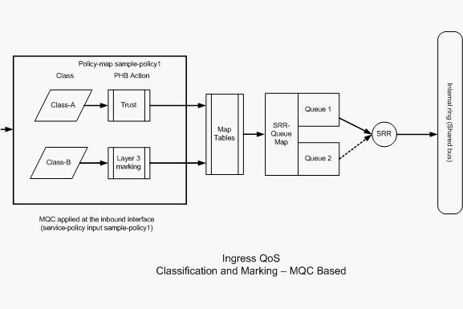
Cisco QoS configuration
Distribution1(config)#class-map Class-A
Distribution1(config-cmap)#match access-group name voice-traffic
Distribution1(config-cmap)#exit
Distribution1(config)#class-map Class-B
Distribution1(config-cmap)#match access-group name
database-application
Distribution1(config-cmap)#exit
!--- Section B
Distribution1(config)#policy-map sample-policy1
Distribution1(config-pmap)#class Class-A
Distribution1(config-pmap-c)#trust cos
Distribution1(config-pmap-c)#exit
Distribution1(config-pmap)#class Class-B
Distribution1(config-pmap-c)#set dscp af21
Distribution1(config-pmap-c)#exit
Distribution1(config-pmap)#exit
!--- Section C
Distribution1(config)#interface gigabitEthernet 1/0/13
Distribution1(config-if)#switchport access vlan 10
Distribution1(config-if)#switchport mode access
Distribution1(config-if)#switchport voice vlan 100
Distribution1(config-if)#spanning-tree portfast
Distribution1(config-if)#service-policy input sample-policy1
Distribution1(config-if)#exit

Slide 46
We learned about
QoS
Upstream and Downstream
TLV – {Type, Length, Value} tuple
Signaling protocol

Slide 47
Summary
Integrated Services are dead
But RSVP is widely used…
Differentiated Services got substantial deployment
Simple DS codepoints translation mechanisms at the DS domains boundaries

Slide 48
Resources
RFC2475 An Architecture for Differentiated Services http://www.ietf.org/rfc/rfc2475.txt
RFC2474 Definition of the Differentiated Services Field http://www.ietf.org/rfc/rfc2474.txt
Quality of Service-Fact or Fiction? by Geoff Huston, Telstra http://www.internetsociety.org/publications/isp-column-june-2012-qos-emperors-wardrobe-1
Quality of Experience (QoE) by Yaakov (J) Stein http://raddata.blogspot.co.il/2012/08/quality-of-experience-qoe.html

Slide 49
Questions?

