Slide 1
High Speed Networks VPNs,PseudoWires and Over-MPLS Services
Robert Iakobashvili,
Author: Akiva Sadovski from Broadcom
Spring 2022

Slide 2
What is Pseudowire?
Pseudowire (PW) is a mechanism to tunnel native service traffic through a PSN
PWs are usually bidirectional (unlike MPLS LSPs)
Service provided by PS: Virtual Pseudo Wire Service (VPWS)

Slide 3
Network Element roles
Notes:
Provider network is any Packet Switching Network
Original intention was to support IP tunnels: IP-in-IP, L2TP, Ipsec etc)

Slide 4
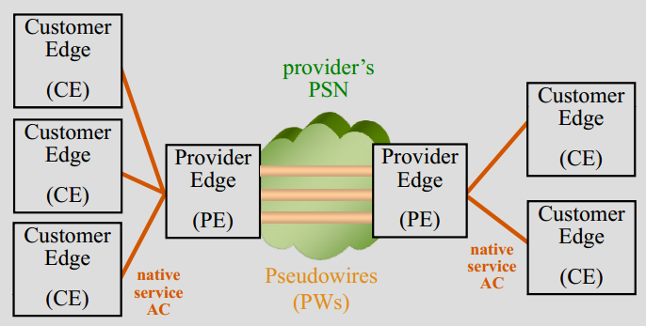
Motivation for Pseudowire
Similar to existing circuit switched environment
Leverage the existing installed gear
Provide circuit-based services in addition to packet/IP-based services
Trunking Layer 2 over an MPLS network:
Ethernet
Frame Relay
ATM—AAL5, cell mode
PPP
Cisco HDLC
SONET
Notes:
Note that most are legacy services
but the most interesting service today is Ethernet

Slide 5
Pseudowire: what else?
All pseudowires, by definition, constitute a form of layer inversion
PWs emulate the native service
But may not completely reproduce it (applicability statement)

Slide 6
Simplistic approach to MPLS pseudowires
each customer network mapped to pair of (unidirectional) LSPs
scaling problem

Slide 7
Martini Pseudowires
transport MPLS tunnel is set up between PEs
multiple PWs may be set up inside tunnels
P-routers are unaware of individual customer networks

Slide 8
Pseudowire encapsulation for MPLS

Slide 9
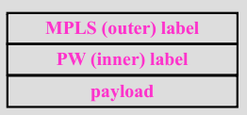
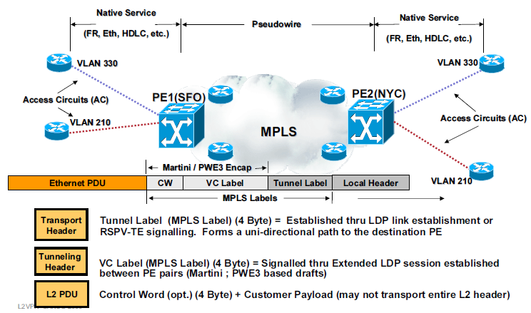
Pseudowire encapsulation for MPLS

Slide 10
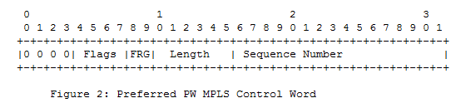
Pseudowire Control Word (RFC4385)
0 0 0 0
identifies packet as PW (not IP – which has 0100 or 0110)
gives clue to ECMP mechanisms
0001 for PWE associated channel (ACh) used for OAM
Flags (4 b)
Not all encapsulation define
used to transport native service fault indications
FRG
may be used to indicate payload fragmentation
00 = unfragmented
01 = fragment
10 = last fragment 11 = intermediate fragment
Length (6 b)
– used when packet may be padded by L2
Sequence Number (16 b)
used to detect packet loss / misordering
processing slightly different in TDM PWs

Slide 11
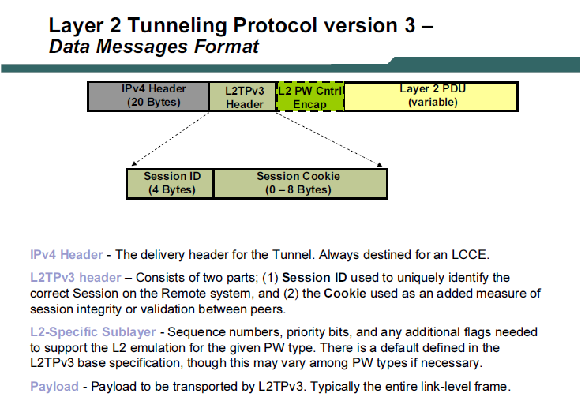
Layer 2 Tunneling Protocol version 3 – The Native IP Service Provider’s answer to MPLS

Slide 12
Traditional WAN architecture
the Ethernet layer is terminated at WAN ingress
the traffic is no longer Ethernet at all

Slide 13
Ethernet Pseudowire or Ethernet-over-MPLS
Can transport tagged or untagged Ethernet frames
If tagged encapsulation can be:
“raw mode”
“tagged mode”
Tagged mode processes (swaps) SP tags
Control word is optional
Even if control word is used, sequence number if optional
Standard mode – FCS is stripped and regenerated
FCS retention mode (RFC 4720) allows retaining FCS

Slide 14
EoMPLS encapsulation details
Ethernet Frame usually has FCS stripped, but may retain it
SP tags may be modified
Generation and processing of sequence number is optional

Slide 15
Pseudowire associated channel
PW associated channel fate-shares with user data
Inside the channel we can run different OAM mechanisms
The use of the ACh was extended to MPLS-TP as the GACh

Slide 16
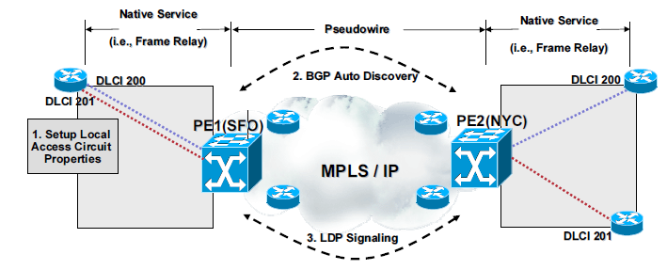
Control plane for Pseudowire
Discovers other PE members of the given VPN
Requires Signalling and Interwork with native services

Slide 17
Pseudowire Provisioning
Control protocol based on LDP is used
Targeted LDP is used to communicate with the remote endpoint
2 new FECs for PWs
New TLVs added for PW-specific functionality
Associates two labels with PW

Slide 18
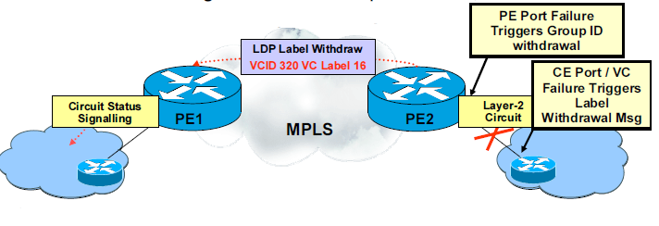
Pseudowire – label withdrawal
If a PE router detects a condition that affects normal service it must withdraw the corresponding VC label
A PE router must provide circuit status signaling

Slide 19
Why Virtual Private Network (VPN)?
It is a network because it provides connectivity between separate sites
it is private because the customer requires it to have the same properties and guarantees as a private network, both in terms of network operations (addressing space, routing) and in terms of traffic forwarding
it is virtual because the provider may use the same resources and facilities to provide the service to more than one customer

Slide 20
L2 Virtual Private Networks
Alternative to dedicated point-to-point connections
Service provider establishes virtual connections between the customers devices
When customers are connected with virtual circuits through a shared service provider infrastructure, it is called an overlay

Slide 21
L2 VPN
SP devices forward customer frames based on L2 information (eg. DLCI, VLAN ID)
No SP involvement in customer IP routing enterprise stands in control of L3 policies
Simultaneous multiprotocol support:
Ethernet
Frame Relay
ATM
Notes:
Tunneling (encapsulation of protocol units at a certain layer of OSI model into protocol units at the same or higher layer of OSI model).

Slide 22
VPWS
Virtual Private Wire Service is a L2 point-to-point service
It emulates a wire supporting the Ethernet physical layer
Set up MPLS tunnel between PEs
Set up Ethernet PW inside tunnel
CEs appear to be connected by a single L2 circuit

Slide 23
VPN Topologies: Full mesh
every site in the network is directly connected to every other site in the network

Slide 24
VPN Topologies: Partial-Mesh Topology
each site is directly connected to one or two other sites in the network

Slide 25
VPN Topologies : Hub-and-Spoke Topology
The spoke sites communicate with the central site, a hub
Represents centralized resources made accessible to the branch offices

Slide 26
VPN Topologies : Hub-and-Spoke Topology with redundancy
multiple hubs and multiple connections between the hubs and the spokes

Slide 27
VPLS
VPLS emulates a LAN over an MPLS network
Set up MPLS tunnel between every pair of PEs (full mesh)
Set up Ethernet PW inside tunnels, for each VPN instance
CEs appear to be connected by a single LAN
PE must know where to send Ethernet frames …
but this is what an Ethernet bridge does

Slide 28
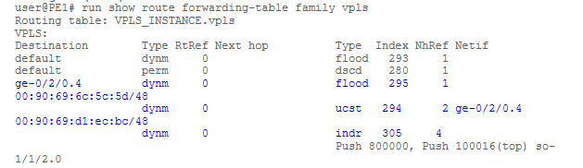
VPLS Bridge – 1
a VPLS-enabled PE has, in addition to its MPLS functions:
VPLS code module (IETF drafts)
Bridging module(standard IEEE802.1D learning bridge)
SP network(inside rectangle) looks like a single Ethernet bridge!

Slide 29
VPLS Bridge - 2
PE maintains a separate bridging module for each VPN
VPLS bridging module must perform:
MAC learning
MAC aging
flooding of unknown MAC frames
replication (for unknown/multicast/broadcast frames)
unlike true bridge, Spanning Tree Protocol is not used:
limited traffic engineering capabilities
scalability limitations
slow convergence
forwarding loops are avoided by split horizon
PE never forwards packet from MPLS network to another PE
Not a limitation since there is a full mesh of PWs so always send directly to the right PE

Slide 30
VPLS Bridge – split horizon
packet from a CE:
may be sent back to a CE
may be sent to a PE via a PW
a packet from a PE:
is only sent to a CE (split horizon)

Slide 31
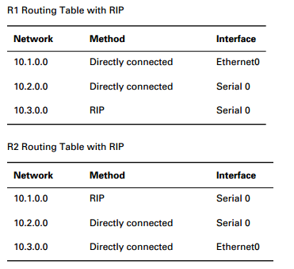
VPN Routing

Slide 32
Virtual Private LAN Service
VPN membership auto discovery
Reduces VPN configuration and errors related to the configuration
Signaling of connection between edge devices associated with a VPN

Slide 33
MPLS L3 VPN
A VPN is a collection of sites sharing common routing information

Slide 34
VPN models
Overlay Virtual Private Networks where the Service Provider provides virtual point-to-point links between customer sites
Peer-to-Peer Virtual Private Networks where the Service Provider participates in the customer routing

Slide 35
Peer-to-peer VPN benefits and drawbacks
Pros:
A single infrastructure is used to serve all VPN customers
Guarantees optimum routing between customer sites
Easier to provision an additional VPN
Only the sites are provisioned, not the links between them, therefore there is no need to know the exact traffic matrix between customers sites
Simple routing from the CE point of view
Cons:
Service Provider participates in customer routing
SP becomes responsible for customer convergence
PE routers carry all routes from all customers
SP needs detailed IP routing knowledge

Slide 36

Provider Edge Router Architecture
At PE router each customer is assigned a Virtual Router
Routing across the provider backbone is performed by another routing process that uses global IP routing table

Slide 37
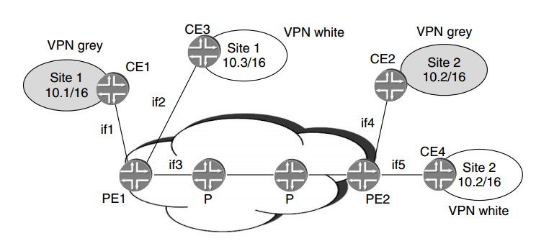
MPLS L3 VPN: Virtual Routing and Forwarding (VRF) Tables - 1
Isolation of traffic between the different VPNs: a customer in one VPN should not be able to send traffic to another VPN

Slide 38
MPLS L3 VPN: Virtual Routing and Forwarding (VRF) Tables - 2
Per-VPN routing and forwarding tables (VRFs) maintain separate information for each VPN
These tables are in addition to the global routing forwarding table used for non-VPN (Internet) traffic
VRFs contain routes for the customer’s destinations both at the local site and at remote sites
A customer interface is associated with particular VRF by configuration
The use of multiple forwarding tables is a necessary condition for allowing support of overlapping address spaces

Slide 39
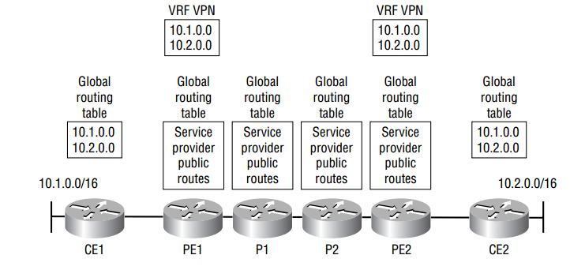
VRF example
Router CE1 has a global routing table which contains only routes for the VPN
On PE1, there are two separate routing tables. One of the routing tables is used for the VPN; the global routing table contains routes for the service provider network
Routers P1 and P2 have no knowledge of the customer routes coming from CE1 and CE2.
Router PE2 has both a global routing table and a separate routing table just for the customer’s VPN

Slide 40
Constrained route distribution
1st approach: to run separate copies of the routing protocol per VPN
2nd approach: to carry all VPN routes in a single protocol
Notes:
2nd approach is employed in the BGP/MPLS VPNs, where BGP is the protocol carrying routes

Slide 41
BGP advantages
Has support for route filtering using the community attribute; thus it can do constrained route distribution. Can attach arbitrary attributes to routes, so the community paradigm can be easily extended.
Has support for a rich set of attributes, allowing control of the preferred routing exit point.
Can carry a very large number of routes; thus it can support a large number of customer routes.
Can exchange information between routers that are not directly connected; thus the routing exchanges can be kept between the PE routers only.
Can carry label information associated with routes.
Has support for multiple address families. (not only IPv4)
Can operate across provider boundaries.

Slide 42
Route Distinguisher
BGP is used in MPLS VPN architecture to transport customer routes directly between PE-routers;
A 64-bit prefix, called route distinguisher (RD), is used in MPLS VPN to convert non-unique 32-bit customer addresses into 96-bit unique addresses that can be transported between PE-routers.
The enhanced version of BGP is called Multi-Protocol Border Gateway Protocol (MP-BGP). The 96-bit routes are treated by MP-BGP as addresses of a new address family, the VPN-IPv4 address family.
Notes:
1) VPN-IP addresses only need
to be known by routers in the provider’s network, and only by
those routers actually involved in exchanging routing information
for VPN destinations

Slide 43
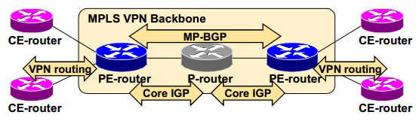
Routing protocols
PE-routers:
Exchange VPN routes with CE-routers via per VPN routing protocols
Exchange core routes with P-routers and PE-routers via core IGP
Exchange VPNv4 routes with other PE-routers via multiprotocol iBGP sessions

Slide 44
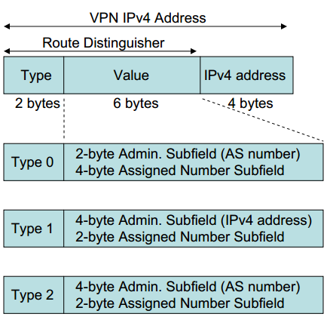
MPLS L3 VPN - Route Distinguisher
A VPN-IPv4 address consists of an 8-byte Route Distinguisher (RD) and a 4-byte IPv4 address
Makes a route unique so customers don’t see each other’s routes
Ex: differentiate 10.0.0.0/8 in VPN-A from 10.0.0.0/8 in VPN-B
Unique route is now RD:IPaddr (96 bits) plus a mask
Configured as ASN:YY
ASN - Autonomous System Number
Each VRF is associated with one RD
Notes:
The VPN-IPv4 addresses are only exchanged between PE-routers; they are never
used between CE-routers and CE-routers or P-routers. PE routers support exchange of VPNv4 prefixes

Slide 45
Route Distinguisher usage in MPLS VPNs
RD has no special meaning—it is only used to make potentially overlapping IPv4 addresses globally unique
Simple VPN topologies require one RD per customer
RD could serve as VPN identifier for simple VPN topologies, but this design could not support all topologies required by the customers
Implementation of more complex VPN topologies, like when a customer site belongs to multiple VPNs cannot be based solely on RD

Slide 46
Route Target (RT)
Actually the requirement is broader than simply separating the routing information per VPN, for two reasons:
Customers may require arbitrary and complex connectivity models between their sites
Support for overlapping VPNs means that the same route must be present in several VPN routing tables
Route Targets are additional attributes attached to VPN IPv4 BGP routes to indicate VPN membership
Any number of route targets can be attached to a single route
Notes:
Route Targets are coded as Extended BGP communities.
Extended BGP communities are 64-bit values.
The semantics of the extended BGP community is encoded in the high-order 16 bits of the value, making them
useful for a number of different applications.
For example, the value of high-order 16 bits of extended BGP community is two (2) for MPLS VPN Route Targets.

Slide 47
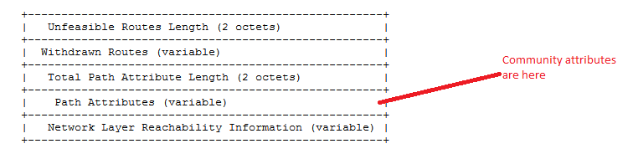
BGP Community Attributes
Used for route filtering
The attribute is a 32-bit string, where the first 16 bits represent the AS number allocated to the provider and the last 16 bits represent a locally assigned number
Extended communities are just like communities, except that they use 32 bits for the locally assigned portion
Route Targets are coded as Extended BGP communities
Source: RFC1771 A Border Gateway Protocol 4 (BGP-4)

Slide 48
RT Properties
One or more RTs can be attached to the same route
Attaching an RT to a route can be done with arbitrary granularity:
the same RT can be attached to all the routes in a particular site
different RTs may be attached to each route

Slide 49
MPLS L3 VPN – How RT work?
Export route targets identifying VPN membership are appended to customer route when it is converted into VPNv4 route;
Each virtual routing table has a set of associated import route targets that select routes to be inserted into the virtual routing table;
Route targets usually identify VPN membership
Notes:
Two VPNs in the organization,
One identified by RT=100.1, another identified by RT=100.2
Both VPNs need an access to the central site

Slide 50
MPLS L3 VPN: Relationship between RDs and RTs
RDs convert IPv4 addresses to unique VPN-IPv4 addresses that can be carried in BGP
RTs are attributes of VPN IPv4 routes that control which sites can access these routes
In BGP, each route can have multiple attributes, therefore the fact that a route is a member of multiple VPNs can be conveyed in one UPDATE message
An alternative design could have used RDs to determine VPN membership
When a site is in multiple VPNs, its routes would be advertised multiple times, each with a different RD
This would not be a scalable solution

Slide 51
MP-BGP Update
MP-BGP update contains:
VPN-IPv4 address
BGP Next-Hop
Extended communities (route targets, optionally site-of-origin)
Label used for VPN packet forwarding
Any other BGP attribute (AS-Path, Local Preference, MED, standard community …)
Notes:
The VPN label will be used in combination with the next-hop label to form a label
stack. The next-hop label will be the top-most label which directs packets across
the MPLS/VPN backbone to the remote PE. The VPN label is assigned by the
remote PE and will be used by it to forward the packets to the correct site.

Slide 52
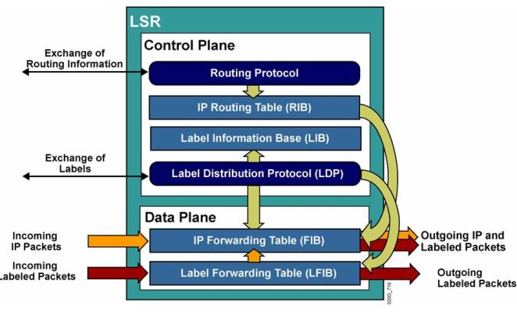
MPLS recap
Control Plane—responsible for maintaining correct label tables among Label Switching Routers
Forwarding (aka Data) Plane—uses label carried by packet and label table maintained by LSR to forward the packet

Slide 53
VPN Packet Forwarding Across MPLS VPN Backbone
P-routers perform label switching, packet reaches egress PE-router.
Egress PE-router has two options:
An MPLS lookup on the VPN label to determine the appropriate VRF, followed by an IP lookup in that VRF
An MPLS lookup based on the VPN label, in which case the label provides an outgoing interface
Notes:
1) The second label in the stack could point directly toward an
outgoing interface, in which case the egress PE-router only performs label lookup
on the VPN packet.
2) The second label could also point to a VRF, in which case the
egress PE-router performs a label lookup first to find the target VRF and then
performs an IP lookup within the VRF.

Slide 54
MPLS L3 VPN: Route Distribution Among PEs by BGP
PEs can distribute VPN IPv4 routes using full-mesh I-BGP connections between them or via an I-BGP connection to a route reflector
PEs may distribute the exact set of routes that appears in the VRF or perform aggregation PEs distribute routes with their address as the BGP next hop
PEs assign and distribute MPLS labels with the routes
A single label may be used for the entire VRF
A single label may be used for each attachment circuit
Different labels may be used for each route

Slide 55
Resources
RFC4448 Encapsulation Methods for Transport of Ethernet over MPLS Networks http://tools.ietf.org/pdf/rfc4448.pdf
RFC3985 Pseudo Wire Emulation Edge-to-Edge (PWE3) Architecture http://tools.ietf.org/html/rfc3985

