Slide 1
Luci Lexer
Dani Strausburger & Isabel Mattivi

Slide 2

01
Token Types
02
03
Data
Includes Identifier tokens
Operation
Includes arithmetic, comparison, logic, & assignment
Keywords
Conditionals, loops, and more

Slide 3
Comparison
Arithmetic
ADD (+)
Assignment & Miscellaneous
ASSIGN <-
EOF
GREATER >
LESS <
GREQUAL >=
LEQUAL <=
ISNOT ~=
EQUALS =?
NOT ~
AND &
OR |
SUB (-)
MULT (*)
DIV (/)
L_PAREN (
R_PAREN )

Slide 4
Keywords
IF
SCENE
Also Known As
IF
ELSE
Literals
NUMBER
CHARCHAR
ELIF
EL
FROM
DEAL
EX
ACTION
CUT
ELIF / ELSE IF
FOR
SWITCH
CASE
{
WHILE
}
Represents a numeric literal
Integers & floating-point numbers
Represents characters, identifiers
TO

Slide 5
Lexer Generator
Lex.py tokenizes input text based on defined regular expression rules, breaking it into distinct tokens.
Tokens
Regular expression rules
Additional Rules and defining actions
Converting strings to integers or floats
Handling new line characters
Error handling
Build the lexer

Slide 6
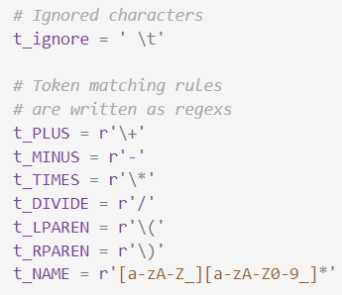
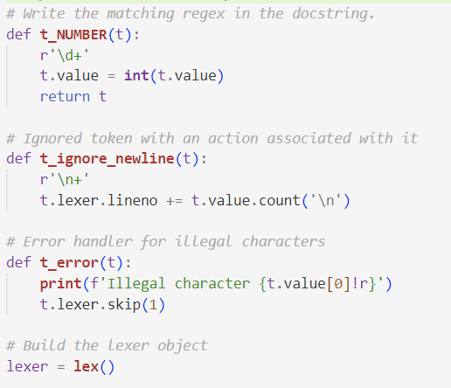
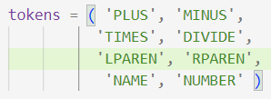
An Example
01
02
03
Tokens
Rules
Actions & Building

Slide 7
The Output
LexToken(NUMBER,3,2,1) LexToken(PLUS,'+',2,3) LexToken(NUMBER,4,2,5) LexToken(TIMES,'*',2,7) LexToken(NUMBER,10,2,10) LexToken(PLUS,'+',3,14) LexToken(MINUS,'-',3,16) LexToken(NUMBER,20,3,18) LexToken(TIMES,'*',3,20) LexToken(NUMBER,2,3,21)
Given Input
Data = ‘’’
3 + 4 * 10
+ -20 * 2
‘’’
Printing It
lexer.input(data)
for token in lexer:
print(token)

Slide 8
Thank you!
Does anyone have any questions?

