Slide 1
Luci Parser
Dani Strausburger & Isabel Mattivi

Slide 2

Luci Conditional Syntax
If – Elif – El
Syntax:
if (expression) action statement cut elif (expression) action statement cut el action statement cut
Example:
If (x < 5) action x <- 5 cut elif (x < 7) action x <- 7 cut el action x <- 0 cut
Deal - Ex
Syntax:
Deal (expression) action ex expression action statement cut cut
Example:
Scene (x) action ex x < 5 action x <- 1 cut cut

Slide 3
Luci Loop Syntax
Scene
Syntax:
Scene (expression) action statement cut
Example:
Scene (x < 5) action x <- x++ cut
From - To
Syntax:
From (expression) to (expression) action statement cut
Example:
From x to 5 action x <- x++ cut

Slide 4
Parser Generator
We used the PLY parser generator, yacc.py. It uses our lexer by parsing the stream of tokens produced by it. It analyzes the syntax, defined by the grammar rules we provide.
Grammar Rules
AST Construction
- No special functions to construct an AST
Build the Parser
- Produces a Parser.out file
- Produces errors/warnings
Notes:
Mention output of parser_tab.py file (holds grammar info)

Slide 5
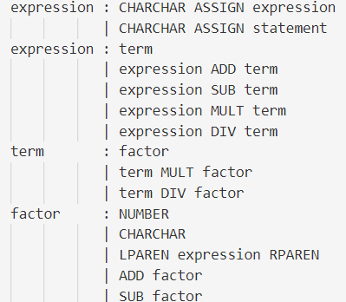
Grammar Rules
The parser generator uses a technique called LR-parsing . It works from the 'bottom up' meaning it takes pieces of the grammar first and then builds the appropriate syntax.
Whenever a valid rule from the right-hand side is found in the input, the corresponding left-hand side is used to replace it.
The parser.out file contains the grammar info and stages.

Slide 6
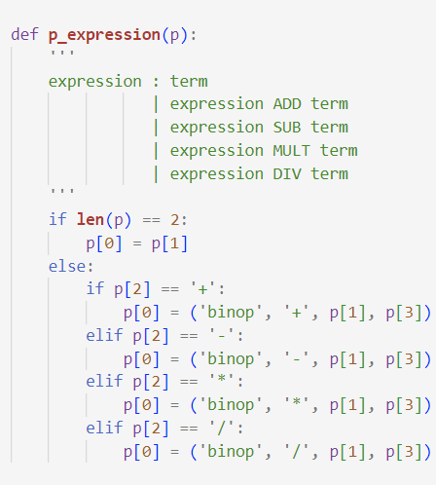
AST Construction
This is the formatting of our AST.
Generally: (Type, Operator, Value(s))

Slide 7
An Example
Given Input
Data = ‘’’
(9 + 4) * x
‘’’
Printing It
# Build the parser
parser = yacc()
ast = parser.parse(data)
Print(ast)
Output
('binop', '*', ['grouped', ('binop', '+', ('number', 9.0), ('number', 4.0))], ('CHARCHAR', 'x'))

Slide 8
Questions?

