Slide 1

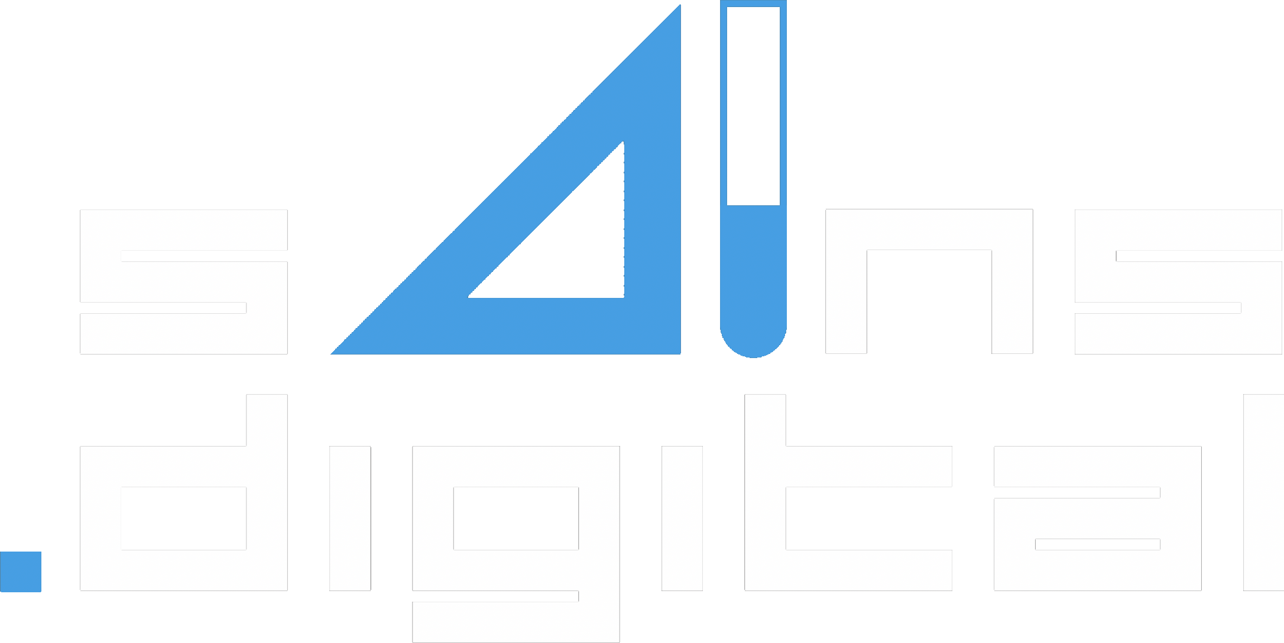
sAIns.digital Digitalizing the Laboratory, Bridging the Gap with IoT Integration
( Theme: Building Intelligent Products and Platforms )
Danny Ismarianto Ruhiyat ( info@danito.net )

Slide 2
Problem Statement
Laboratories play a vital role in research, but many are still reliant on manual data entry and outdated processes, hindering efficiency and collaboration
Conventional laboratory instruments often lack connectivity, making data collection and analysis cumbersome and time-consuming
CYIENT - CYIENTIFIQ INNOVATION LEAGUE GLOBAL HACKATHON
sAIns.digital - Digitalizing the Laboratory, Bridging the Gap with IoT Integration ( Danny Ismarianto Ruhiyat / info@danito.net )
01

Slide 3
Solution Overview
sAIns.digital is a breakthrough solution that enables any laboratory instrument, even conventional ones, to seamlessly transmit data via IoT. There will be at least one sAIns.digital controller with several sensor modules.
CYIENT - CYIENTIFIQ INNOVATION LEAGUE GLOBAL HACKATHON
sAIns.digital - Digitalizing the Laboratory, Bridging the Gap with IoT Integration ( Danny Ismarianto Ruhiyat / info@danito.net )
02

Slide 4
Value Proposition
sAIns.digital will revolutionizes laboratory operations, improving data accuracy, and streamlining research processes
Benefits:
More than 50% reduction in data entry errors
Accelerated research with real-time data access
Enhanced collaboration through shared data repositories
CYIENT - CYIENTIFIQ INNOVATION LEAGUE GLOBAL HACKATHON
sAIns.digital - Digitalizing the Laboratory, Bridging the Gap with IoT Integration ( Danny Ismarianto Ruhiyat / info@danito.net )
03

Slide 5
Feasibility & Uniqueness
Implementation:
The sAIns.digital's plug-and-play IoT modules easily attach to lab instruments
Seamless integration with cloud platforms for data storage and analysis
Differentiator:
sAIns.digital is the first universal IoT solution for laboratories, bridging the gap between conventional and modern instrumentation
Cost-effective and user-friendly, sAIns.digital sets a new industry standard
Unique Aspects:
Universal compatibility with existing lab equipment
Real-time data transfer to cloud-based platforms
Integration with data analytics tools for instant insights
CYIENT - CYIENTIFIQ INNOVATION LEAGUE GLOBAL HACKATHON
sAIns.digital - Digitalizing the Laboratory, Bridging the Gap with IoT Integration ( Danny Ismarianto Ruhiyat / info@danito.net )
04

Slide 6
Impact & Sustainability
Impact:
Significant reduction in paper usage and waste
Accelerated research leads to faster discoveries
Enhanced data-driven decision-making in laboratory operations
Sustainability:
Reduced environmental impact through paperless data collection
Ongoing data analysis leads to resource-efficient processes
CYIENT - CYIENTIFIQ INNOVATION LEAGUE GLOBAL HACKATHON
sAIns.digital - Digitalizing the Laboratory, Bridging the Gap with IoT Integration ( Danny Ismarianto Ruhiyat / info@danito.net )
05

Slide 7

Meet sAIns.digital team ...
The word science in Bahasa Indonesia is "sains". Yes, there is AI in sAIns; because sAIns.digital provide Artificial Intelligence based solutions, mostly using "Computer Vision" to replace the eye's function in seeing the instrument output.
sAIns.digital can modernize laboratories by providing a feasible and unique solution that enhances efficiency, collaboration, and sustainability.
Meet Danny Ismarianto Ruhiyat a.k.a danito the solo fighter in sAIns.digital team.
CYIENT - CYIENTIFIQ INNOVATION LEAGUE GLOBAL HACKATHON
Danny Ismarianto Ruhiyat
AIoT Engineer
sAIns.digital - Digitalizing the Laboratory, Bridging the Gap with IoT Integration ( Danny Ismarianto Ruhiyat / info@danito.net )
06

