Slide 1
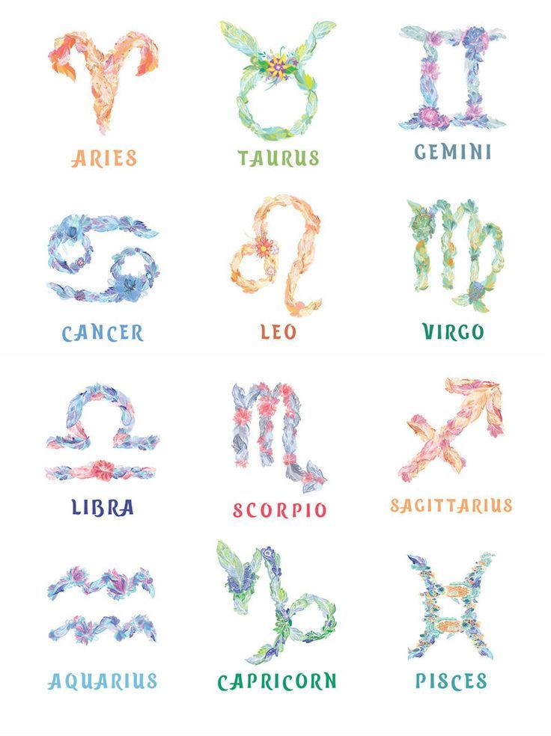
Zodiac Personality Test
Presented by:
*Noor Tahir
*Daniya Imran
*Fatima Iqbal

Slide 2
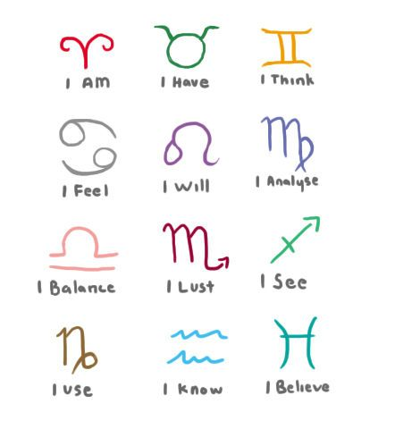
Introduction
Our code Describes The basic Personality Traits of All the Horoscopic signs
The main purpose is to evaluate the user’s characteristic qualities in an entertaining and fun manner.
This lies in the domain of pseudoscience.
User enters data and the following quiz evaluates one’s horoscopic percentage
The code is merely meant for entertainment and regalement purposes.
The questions in this quiz are non-factual and does not define a person’s abilities
The use of programming associated with pseudoscience is something new and not researched on much.

Slide 3


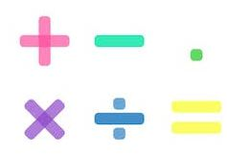

Implementation Details
IF-ELSE
Use of IF-ElSE for condition assignment. In order to choose between different options. And decision making between different answers of the quiz questions
Loops
Use of loops for repeating the function over and again. Instead of writing it all for effective coding technique
Compound Assignment
Use of compound assignment is another technique in which we used mathematical operations- another feature of C language
Compound Assignment
Loops

Slide 4



C language is a case-sensitive language. However, our program is on the contrarily. You can user both upper case and lower case letters and it will work anyway!
We display the input on a colourful console screen. To attract the audience. And for better visual display.
Use of strings. Enable a user to get input in a form of long sentences and displays them as such. Our code enables us to do so. And takes user’s in following manner.
Our program is built in a way that it not case- sensitive unlike C language ! and uses techniques of strings to input user’s name and displays them in orderly manner!
Our visual display is all colorful to attract the audience and make it interesting!

Slide 5
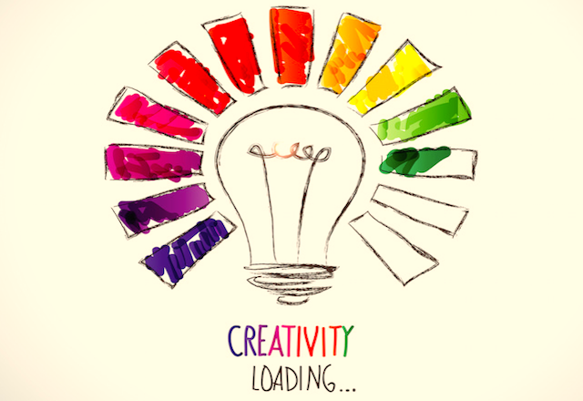
Creativity and Novelty

Slide 6
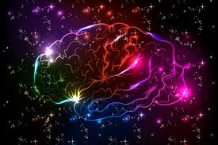

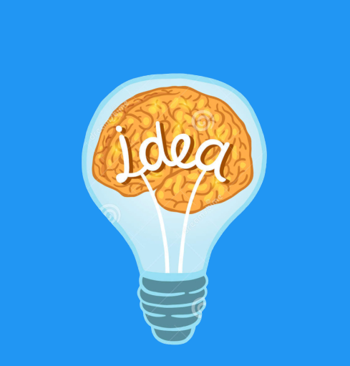
The code is specifically built to increase the entertainment purpose. It is creative in a way that pseudoscience has never been related with astrology or C language before
The creativity of our code is also increased multiple times as we are using a colorful console screen and also by adding humor to it mainly for the entertainment purpose
Innovation of our idea.
It is pretty new in a manner that C language has never been used before to make an astrology quiz. It’s novelty lies in the fact that it is simple yet efficient.
Do you know?
Our quiz can also tell your age is days?
Ever saw that happen before?
That’s where its novelty lies.

Slide 7


Things that make it creative:
Change of input colors
Change of console screen.
To amalgamate pseudoscience with C language and horoscope
To make the users imagine themselves in different scenarios hence, improving their imaginative powers and make them understand their personality in a better manner.
To thing behind the box and implement C language for some recreational activity.

Slide 8
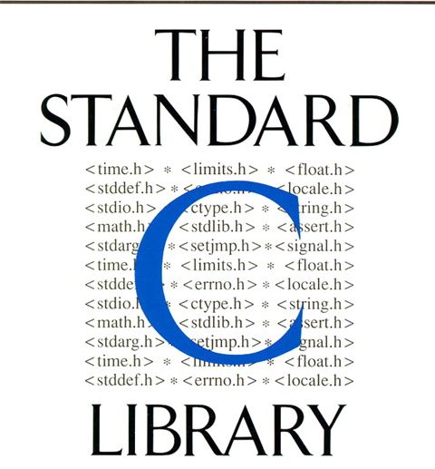
Libraries Included

Slide 9
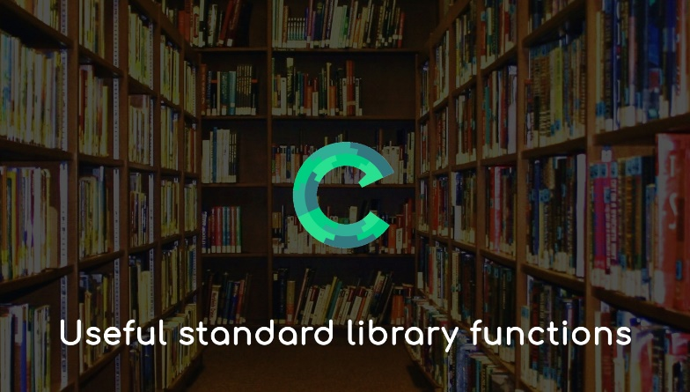


Stdlib.h: It stands for standard library and has various features like allocating memory, and process controls and conversions.
Windows.h: It is the basic Window’s library for win32 programming. Which increases the functionality of the program.
Cosio.h: The following library is associated with including different colors to the console screen and for attracting the audience!
A lot of functions are built together in C language and they make up a library!
Maths.h and windows.h are some of the libraries that have cool functions!

Slide 10

Problems faced during our work

Slide 11

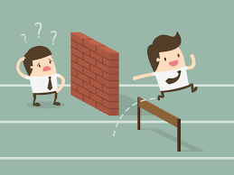
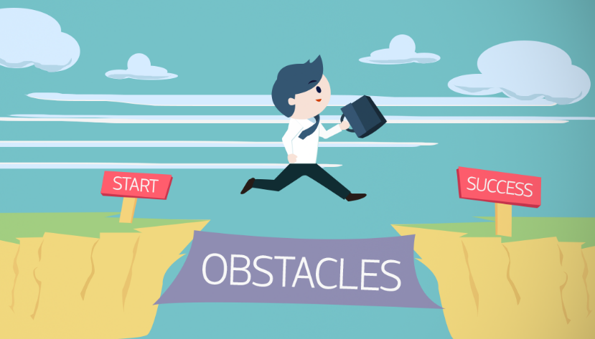
We had a hard time adjusting colors and figuring out the various libraries that work for them and learning new functions for that was also tiresome but was fruitful in the end.
The missing brackets was one tough job! And to find matching if to the else. The accurate percentage display was also a little hard job.

Slide 12

How did we resolve those problems?

Slide 13
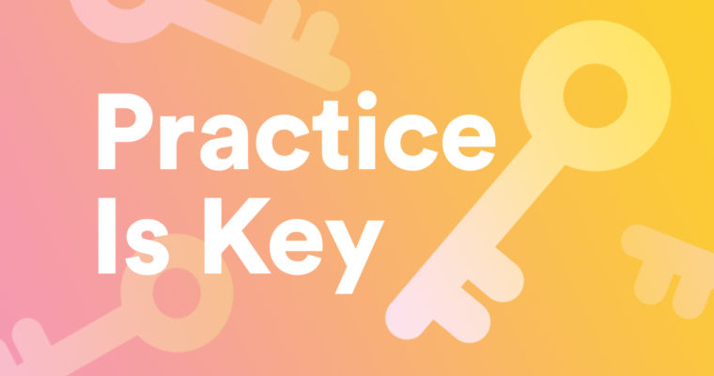



After multiple attempts and revising the syntax manifold we were able to resolve the issue. Careful administration of different functions is the key in finding those errors.
Use of different educational websites like github, quora and online youtube tutorials for implementation o colors was the ultimate solution. Various test codes were ran to get the correct combinations.
Consulting various seniors and asking about there guidelines for effective coding experience and to know about there dilemmas so we can avoid them.

Slide 14

Goal of our project:
To regale the user and make him/her have some recreation.
To help the user comprehend his/her astrological abilities in a more effective manner.
To deny the notion that astrology has the ability to define a human’s capabilities, potential and skill set.
To increase the captivity of positivity.
To widen the vision of the audience regarding the stars and horoscopy and also making them comprehend the interrelation of science and astrology.
To make the users imagine themselves in different scenarios hence, improving their imaginative powers and make them understand their personality in a better manner.

Slide 15

Individual work assignment

Slide 16
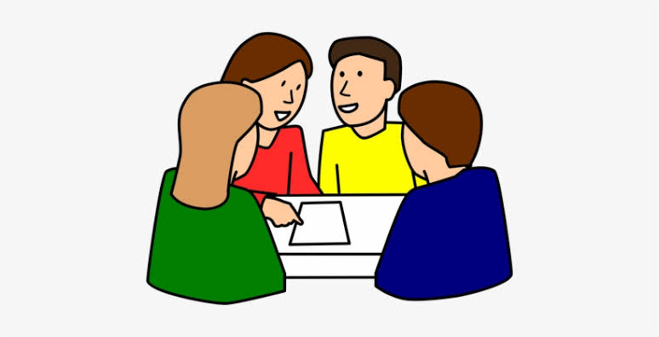

We sat together as a group and performed all the activities from mutual consultation and suggestions. All the work was shared equally among all the three individuals and we did productive work and also enjoyed doing it this way.
Sitting together enabled us to know and understand each other’s opinion better and also working with joint collaboration made us realize about different logical things we can work on together as a team.
Group work yields productivity and also increases the thinking capabilities and horizons

Slide 17

Conclusion

Slide 18



The whole project enabled us to improve and hone our capabilities at a massive rate.
Use of new coding techniques increased our self-learning attitude and research behavior
Group work enabled us to understand each other’s opinions and respect them
The research on pseudoscience increased our knowledge in not only programming but also horoscopy and other art related context
Strong practice of if-else statement used for practical exhibition was a productive thing of this following project.

Slide 19

Thanks a lot to you all

