Slide 1
Mini Shopping Cart in C
Applied Programming Project — Beginner-Friendly Walkthrough
Notes:
Welcome! We’ll walk through our C project that simulates a mini shopping cart in the console. Structure: Intro to problem, features, how code flows, functions, demo, tests, and improvements. Target duration: ~20 minutes.

Slide 2
Team Introduction
Team Members: 3
Alishba Habib CT-153
Daniya Ali CT-159
Amber Tariq CT-163
Roles:
• Alishba Habib — Requirements & Flowchart
• Daniya Ali — Coding & Debugging
• Amber Tariq — Testing, Documentation & Slides
Notes:
Briefly introduce each member and their contribution. Keep this under one minute.

Slide 3
Project Overview
Goal: Build a console-based shopping cart in C
User chooses a category → selects items → enters quantity
Program accumulates totals and applies a discount
Final bill shows total, discounted total, and savings
Notes:
Explain the real-world analogy: mini supermarket interface through terminal input.

Slide 4
C Concepts Used (Beginner)
Standard I/O: printf, scanf
Variables & data types: int, float, char
Control flow: switch, if-else, do-while loops
Functions: modular code for categories, discount, and bill
Notes:
Reassure the audience: only core C features are used. No advanced pointers except in scanf format handling.

Slide 5
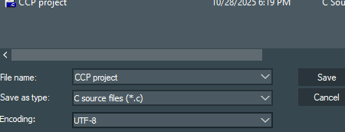
How to Compile & Run
File: CCP project.c
Compile: gcc "CCP project.c" -o cart
Run: ./cart (Linux/Mac) or cart.exe (Windows)
Notes:
Show a brief terminal demo during recording if possible.

Slide 6
Program Flow (High Level)
Show main menu of categories
Inside category: pick an item, enter quantity
Subtotal updates after each selection
Option to continue in same category or switch category
At the end: discount → final bill
Notes:
This primes the audience before diving into specific code blocks.

Slide 7


Key Variables
int category, item, quantity
float price, itemTotal, total, discountedTotal
char choice, sameCategoryChoice
Notes:
Explain how each variable supports user input and running totals.

Slide 8
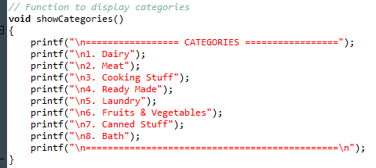
Function: showCategories()
Displays numbered list of 8 categories
Keeps UI consistent and readable
Notes:
Modularity: keeping category display separate from main logic is clean and reusable.

Slide 9
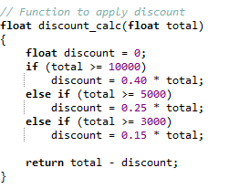
Function: discount_calc(total)
If total ≥ 10000 → 40% off
Else if total ≥ 5000 → 25% off
Else if total ≥ 3000 → 15% off
Returns total - discount
Notes:
Straightforward tiered-discount logic. Mention how we could externalize to a lookup table later.

Slide 10
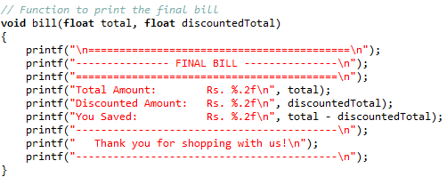
Function: bill(total, discountedTotal)
Prints a formatted final receipt
Shows Total, Discounted Amount, and Savings
Notes:
User-friendly output closes the purchase flow.

Slide 11
Control Flow: Outer do-while
Asks user to pick a category
Switch-case to handle each category
At end: ask to go to another category (y/n)
Loop continues until user exits
Notes:
Introduce the pattern: do { … } while(choice == 'y' || choice == 'Y')

Slide 12
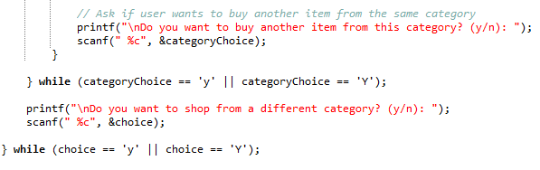
Control Flow: Inside a Category
Inner do-while loop for repeated purchases in the same category
Item menu → pick item → set price
Enter quantity → subtotal updates
Prompt: buy more from same category?
Notes:
Same y/n pattern keeps UI intuitive.

Slide 13
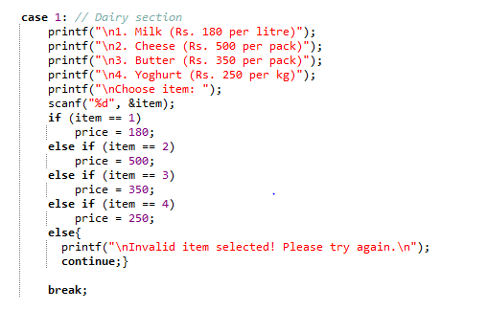
Example Category: Dairy
Items: Milk (180), Cheese (500), Butter (350), Yoghurt (250)
If item valid → input quantity → itemTotal = price × quantity
total += itemTotal; print subtotal
Notes:
Point out the same pattern repeats with different prices across categories.

Slide 14
All Categories
1: Dairy
2: Meat
3: Cooking Stuff
4: Ready Made
5: Laundry
6: Fruits & Vegetables
7: Canned Stuff
8: Bath
Notes:
Explain that each category follows the same template, simplifying maintenance.

Slide 15
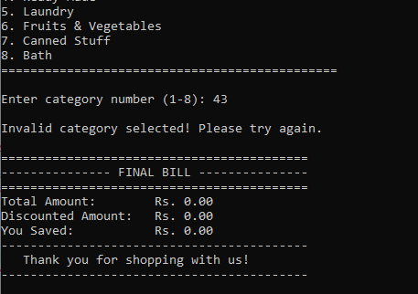
Input Validation (Basic)
If invalid item → show error message
If valid item → ask quantity and compute subtotal
Improvement idea: check for negative quantities and non-numeric inputs
Notes:
Acknowledge current scope vs. future work for robustness.

Slide 16
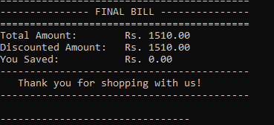
Sample Interaction (Scripted)
User picks Category 1 (Dairy)
Chooses Milk, qty 2 → subtotal updates
Buys again from Dairy: Cheese, qty 1 → subtotal updates
Switches to Meat → Chicken, qty 1
Ends shopping → discount & final bill
Notes:
Use this as a live narration in the video; type the inputs to replicate.

Slide 17
User Interface & Experience (UI/UX)
Focused on simplicity and clarity in a text-based interface
Used numbered menus and consistent prompts for easy navigation
Clear spacing and formatting make outputs easy to read
Friendly messages like “Invalid choice, please try again” guide the user Interactive flow feels like a basic online shopping system
Prioritized readability and ease of use for beginners
Notes:
Good for beginners; later refactor to arrays/structs for DRY code.

Slide 18
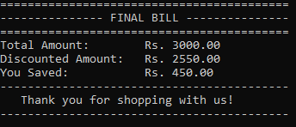
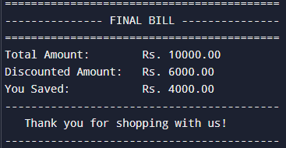
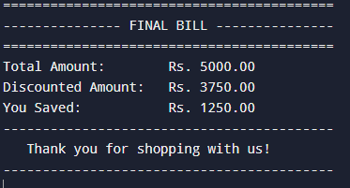
Testing Strategy
Happy path: multiple categories, valid items, typical quantities
Boundary totals: 2999, 3000, 4999, 5000, 9999, 10000
Invalid selections: item out of range
Usability check: prompts, clarity, formatting
Notes:
Show screenshots or console recording if possible.

Slide 19
Future Improvements
Replace repeated menus with arrays/structs
Persist cart to file, load previous session
Add remove/edit cart items
Stronger validation and error handling
Notes:
Mention how this becomes a stepping stone to larger projects.

Slide 20
Conclusion & Takeaways
We implemented a beginner-friendly shopping cart in C
Practiced variables, loops, switch, and functions
Clear output and discounts make it engaging
Ready for next step: data structures & files

