Slide 1
NESSUS PROJECT
DANIYAL ALI
SAP: 27670
NETWORK SECURITY

Slide 2
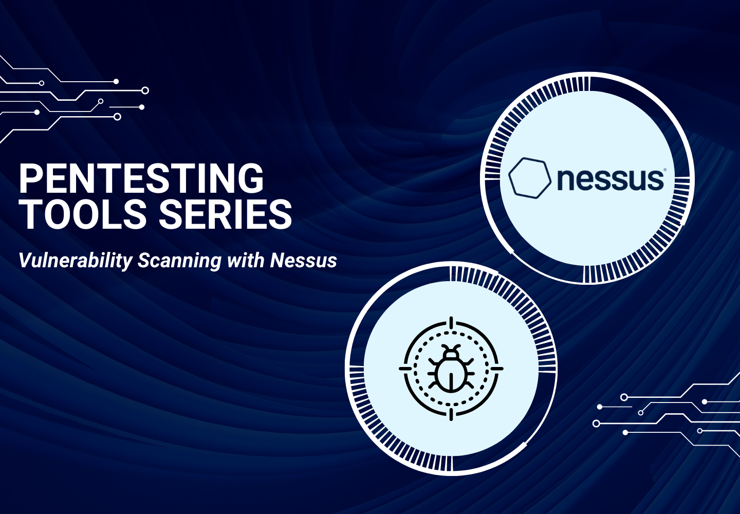

Slide 3
OBJECTIVE $ TOOLS
Goal: Secure host 192.168.1.4 from cyber attacks
looked for security problems
Tool Used: Nessus Vulnerability Scanner

Slide 4
PROJECT STATS
Total Issues: 121
Critical: 9
High: 5
Medium: 15
Low: 10
Informational: 82

Slide 5
METHODOLOGY

Slide 6
Scan Type: Uncredentialed (no login needed)
Safe Scan: No service was interrupted
Target: Only 192.168.1.4

Slide 7
HOST OVERVIEW
OS: Ubuntu Linux
Services: Apache Tomcat, Samba (SMB), VNC
Issues: Outdated software, weak settings, poor security

Slide 8
CRITICAL VULNERABILITY: GHOSTCAT
Problem: Apache AJP is exposed
Risk: Hackers can run code remotely
Fix: Secure server.xml and restrict access

Slide 9
CRITICAL: OPENSSL & UNREALIRCD
OpenSSL: Weak keys, can be broken → Fix: Upgrade OpenSSL
UnrealIRCd: Hacked version installed → Fix: Remove & reinstall clean version

Slide 10
HIGH VULNERABILITIES
BIND DNS: Weak to downgrade attack → Fix: Update BIND
Samba: Writable shares allow code run → Fix: Patch and restrict shares

Slide 11
MEDIUM VULNERABILITIES
Weak SSL Ciphers: Risk of hijack → Fix: Use AES encryption
SMB Signing Off: Data can be changed → Fix: Turn on signing

Slide 12
LOW VULNERABILITIES
Logjam Attack: Weak key exchange → Fix: Use 2048-bit keys
Weak SSH MACs: Easier to hack → Fix: Use strong MACs

Slide 13
INFORMATIONAL FINDINGS

Slide 14
Apache Version Exposed
Tomcat Default Page Visible Fix: Hide version banners & remove default pages

Slide 15
12. RISK HEATMAP 🟥 Critical 🟧 High 🟨 Medium 🟩 Low

Slide 16
. SCREENSHOTS & EVIDENCE

Slide 17
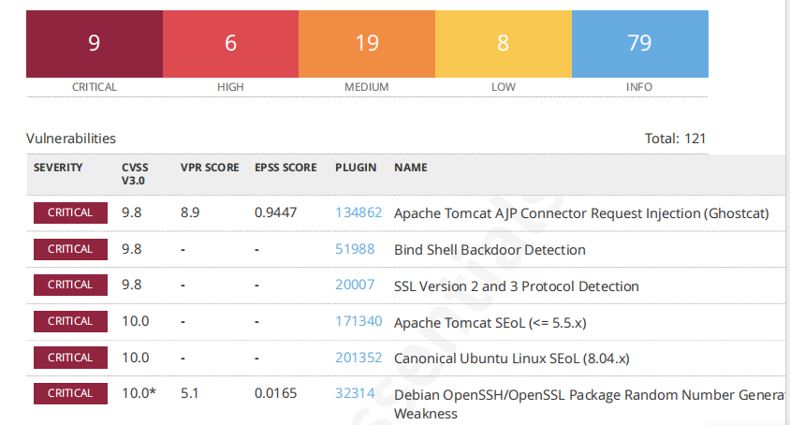

Slide 18
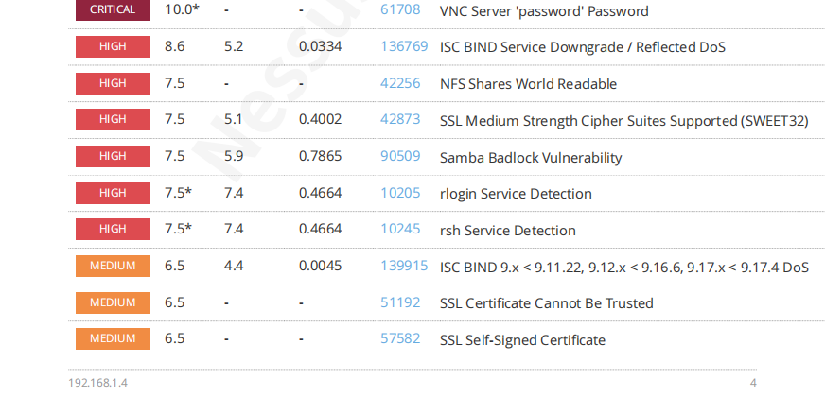

Slide 19
BEST SECURITY PRACTICES
Keep systems updated
Use strong passwords
Enable firewalls
Regularly scan for threats

Slide 20
Nmap scanning

Slide 21
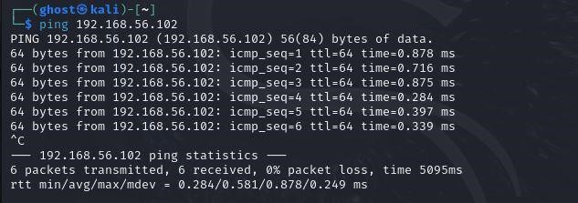
Step 1: Connectivity Test
Ping 192.168.56.102

Slide 22
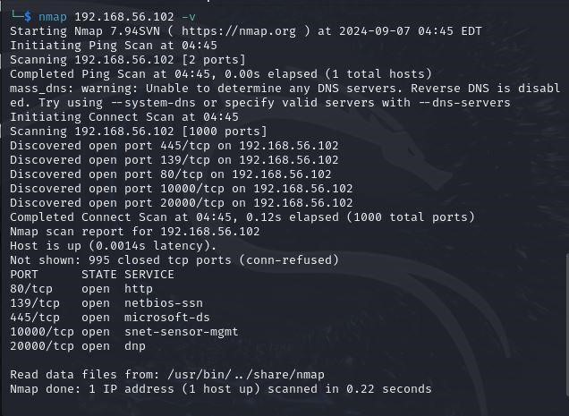
Step 2: Nmap Light Scan
Simple Nmap scan, for example, it can be run with the following command:
Basic nmap scan and open ports

Slide 23
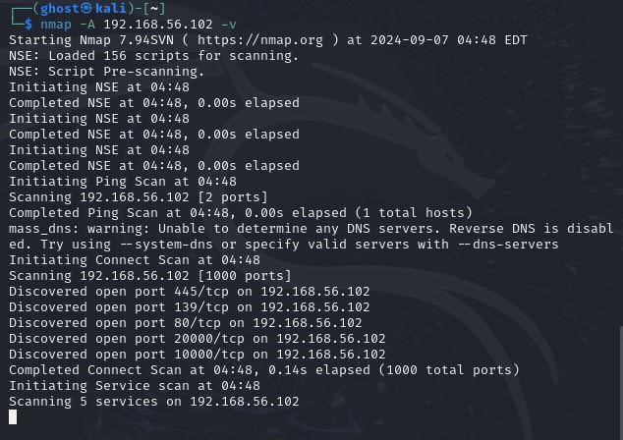
Step 3: Nmap Aggressive Scan
I then did a deep scan with
nmap -A 192.168.56.102 -v

Slide 24

Step 5: Vulnerability Scanning
Nmap vulnerability scanning script, vulscan, and checked it against known vulnerabilities based on the determined service versions.
nmap -sV --script vulscan/ 192.168.56.102

Slide 25
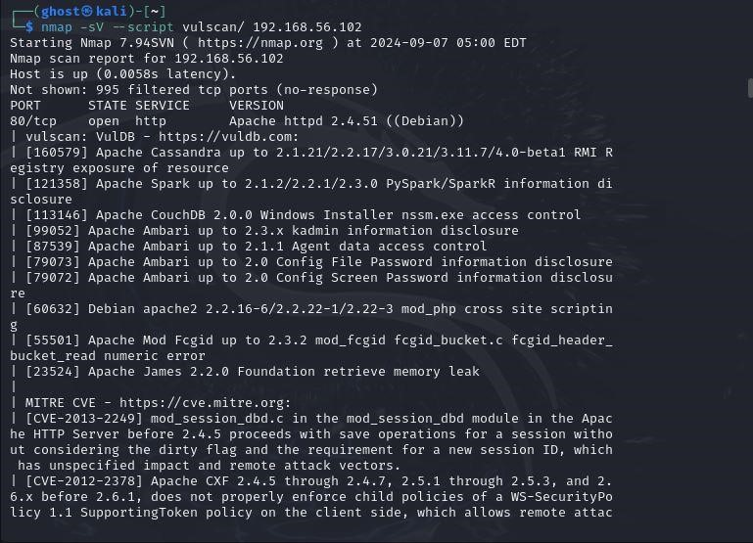
Figure
7
:
Vul
ner
abilites found during scan

Slide 26
Conclusion
In this project, I used Nessus to check one computer for security problems. I found many issues like outdated software and weak settings. I explained each problem, its risk, and how to fix it. By fixing critical and high-risk issues, I made the system much safer. This project shows how important it is to keep systems updated and secure.

