Slide 1

Seasonal Agriculture Performance Analysis
Md Daniyal Islam St. Xavier’s College of Management and Technology
AICTE STU ID: STU6a2677514dd0c1780905809

Slide 2

PROBLEM STATEMENT
Agricultural activities are influenced by seasonal variations in environmental conditions, farming practices, resource availability and market conditions. As a result, agricultural performance may differ from one season to another. However, raw agricultural data does not clearly explain how agricultural performance changes across seasons or what patterns can be observed in different seasonal conditions. The problem is to analyze the given agricultural dataset and investigate seasonal differences in agricultural performance by identifying meaningful patterns, trends, relationships and variations within the available data

Slide 3
Project Description This project analyzes seasonal agriculture performance using data from different farms, crops and regions. The dataset includes information about seasons, rainfall, temperature, soil conditions, irrigation methods, crop yield, production, cost, revenue, profit, water usage and disease or pest risk. The main purpose of this project is to compare agricultural performance across the Kharif, Rabi and Zaid seasons. The analysis studies differences in yield, profit, rainfall, water usage, crop performance, irrigation methods and disease risk. Python, Pandas, Matplotlib and Seaborn are used to load, clean and analyze the dataset. Different tables and charts are created to understand seasonal patterns and relationships between agricultural factors. The project also includes missing-value checking, duplicate checking, descriptive analysis, outlier investigation, univariate analysis, bivariate analysis, multivariate analysis, correlation analysis and comparisons between crops, states, seasons and irrigation methods. The final results provide useful observations and recommendations for better seasonal crop planning, irrigation decisions and agricultural resource management.

Slide 4

WHO ARE THE END USERS?
• Farmers planning crops for different seasons
• Agricultural officers
• People studying farm performance
• Irrigation and resource planners
• Students learning data analysis

Slide 5

Technology Used
Python
Jupyter Notebook
Pandas
Matplotlib
Seaborn
CSV dataset

Slide 6
RESULTS - DATA CHECKING
Dataset loaded successfully
Rows: 4,000
Columns: 28
Top 5 rows were viewed using data.head().
Missing values found:
• Rainfall: 48
• Soil moisture: 40
• Yield: 32
Duplicate rows: 0
For the main analysis, rows missing the main values were removed. Final analysis rows: 3,968

Slide 7
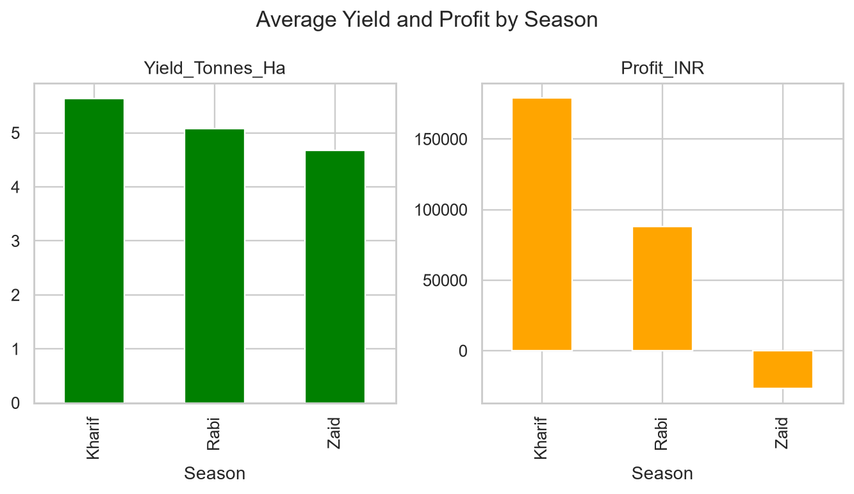
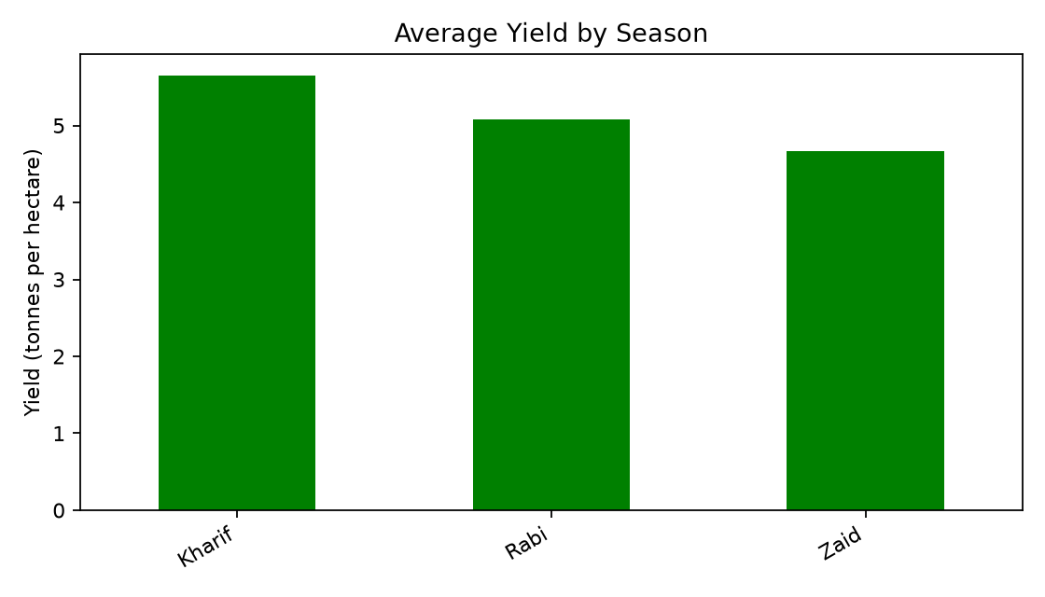
RESULTS - SEASONAL COMPARISON
I grouped the data by Season and calculated averages.
Kharif:
• Highest average yield
• Highest average profit
Rabi:
• Middle result for most measures
Zaid:
• Lowest average yield and profit
• Lowest disease/pest risk
This is a descriptive comparison of the given data.

Slide 8
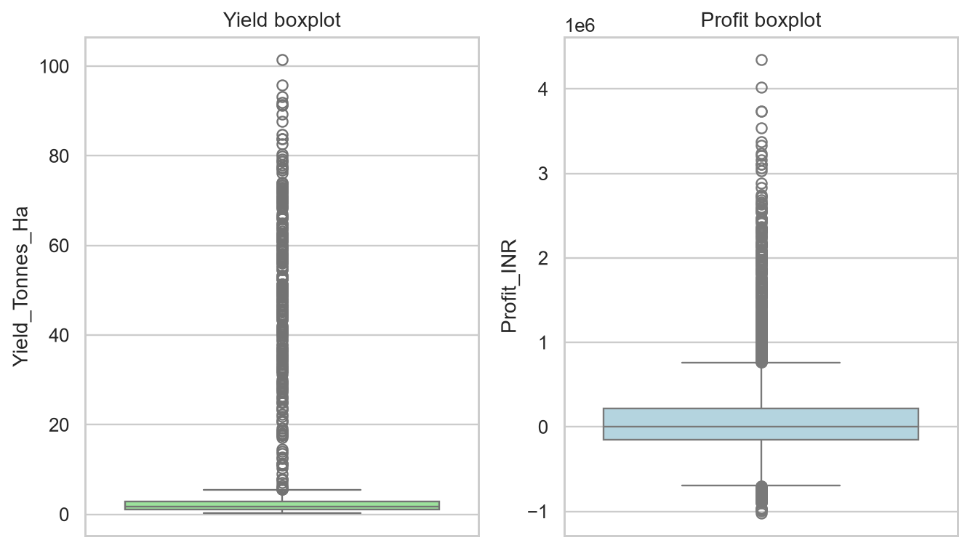
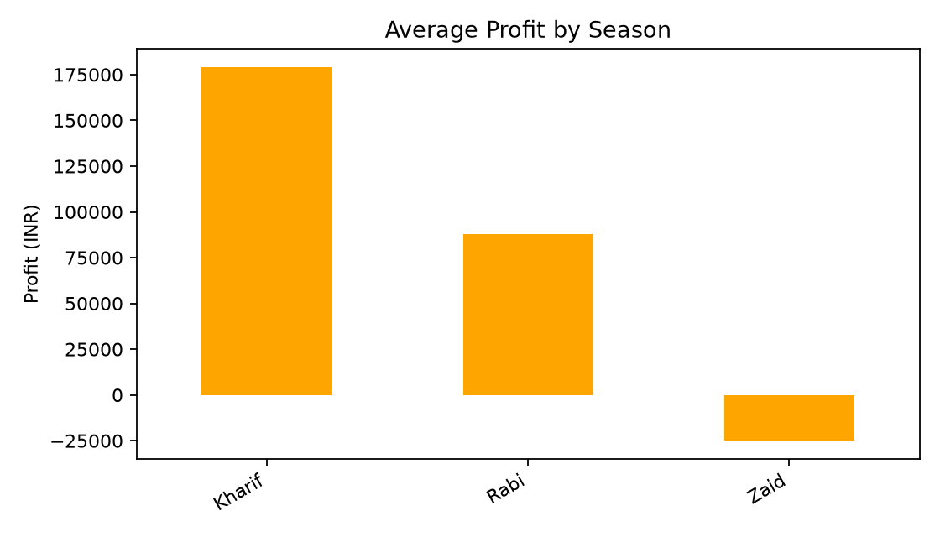
RESULTS - OUTLIERS AND BASIC ANALYSIS
The boxplots help investigate unusual values in yield and profit.
I also used:
• Histogram for one-variable analysis
• Scatter plot for rainfall and yield
• Bar charts for crop counts and seasonal profit
Some values are far from the middle, especially profit. They were investigated but not changed because they may be real farm results.

Slide 9
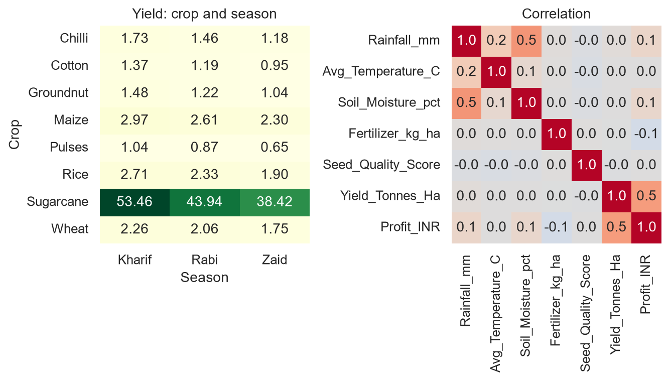
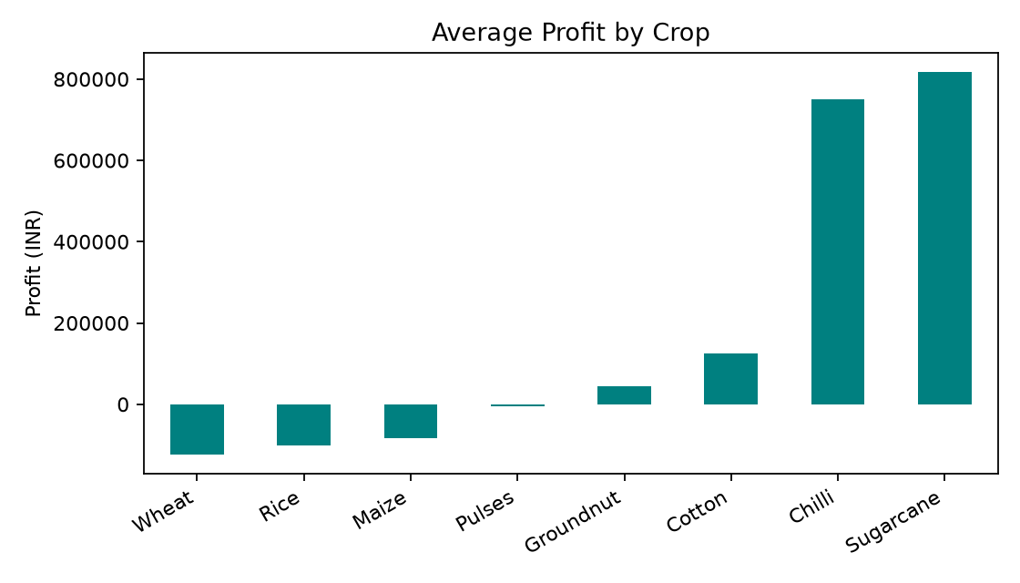
RESULTS - MULTIVARIATE AND CORRELATION
The left chart compares crop and season together.
The right chart shows correlations between rainfall, temperature, soil moisture, fertilizer, seed quality, yield and profit.
This helps compare more than two variables. Correlation shows a relationship, but it does not prove cause and effect.

Slide 10
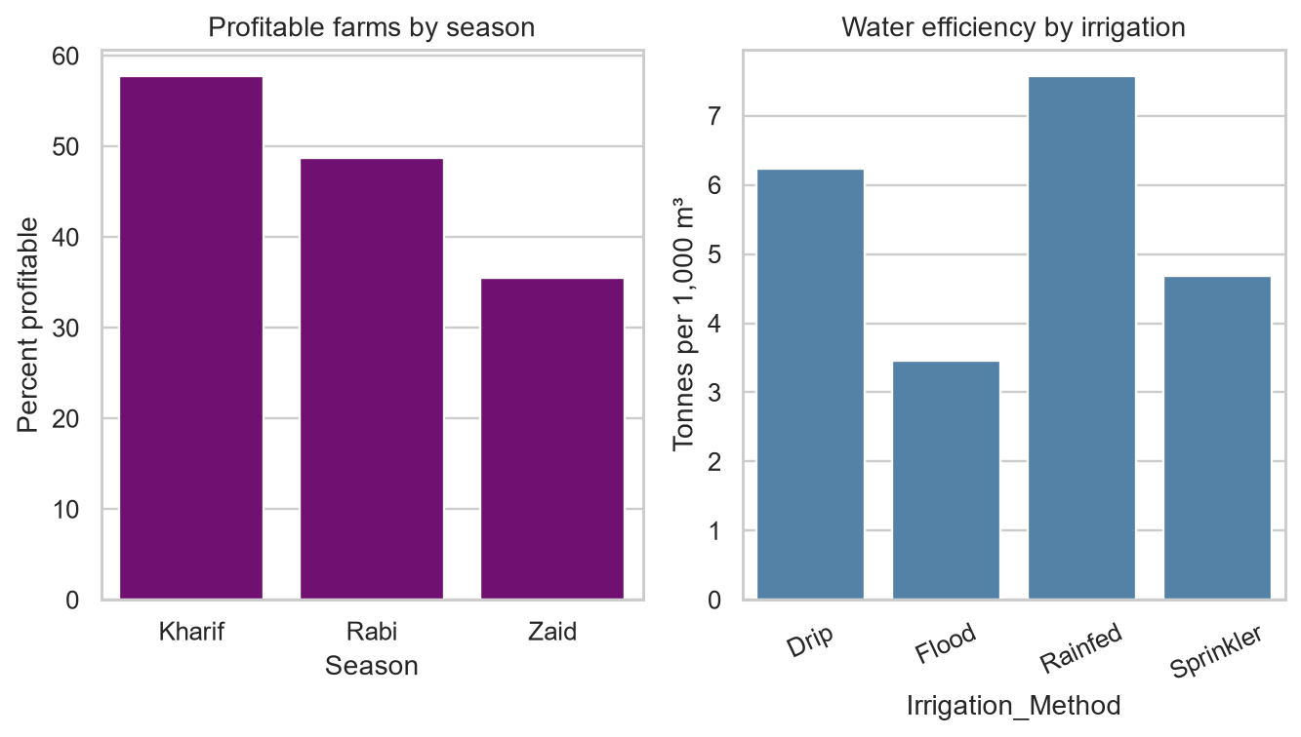
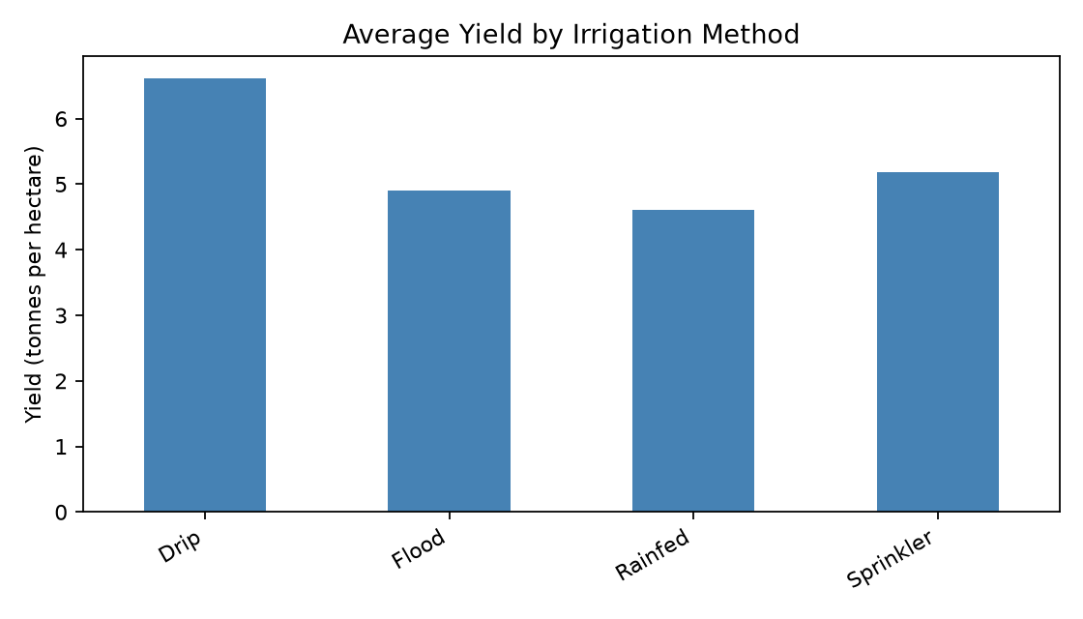
RESULTS - STUDENT ANALYSES
Student analysis 1: percentage of profitable farms by season.
Student analysis 2: average yield and profit for crop-season combinations.
Student analysis 3: irrigation method, water use and water efficiency.
Main observation:
• Kharif has the highest profitable-farm percentage.
• Rainfed has the highest average water efficiency in this dataset.
• Crop and season combinations give different results.

Slide 11
Future scope
• Add data from more years
• Compare more districts
• Study weather changes in more detail
• Use live market prices
• Build a simple dashboard in the future

Slide 12
GitHub Link
[Paste your GitHub repository link here]

Slide 13
VOIS Course completion certificate - Course name: Data Visualization
[Insert your certificate screenshot here]

Slide 14
Thank you
Questions?

