Slide 1

DEVELOPMENT OF AN ANOMALY DETECTION SYSTEM FOR NUCLEAR POWER PLANTS USING TRANSFORMER MODELS
By:
Muhammad Daniyal Nazeer
BS Physics 21-25
Supervisor: Dr. Asifullah Khan, DCIS
Co-Supervisor: Dr. Awais Zahur, DNE

Slide 2
PRESENTATION LAYOUT
INTRODUCTION
Nuclear Power Plants and their safety ensurance.
OBJECTIVES
Need for an Anomaly Detection System.
LITERATURE REVIEW
Pressurized Water Reactor & It’s related accidents.
Deep learning architectures study.
Papers review.
METHODOLOGY
Data Extraction.
Preprocessing.
Model Implementations.
RESULTS

Slide 3
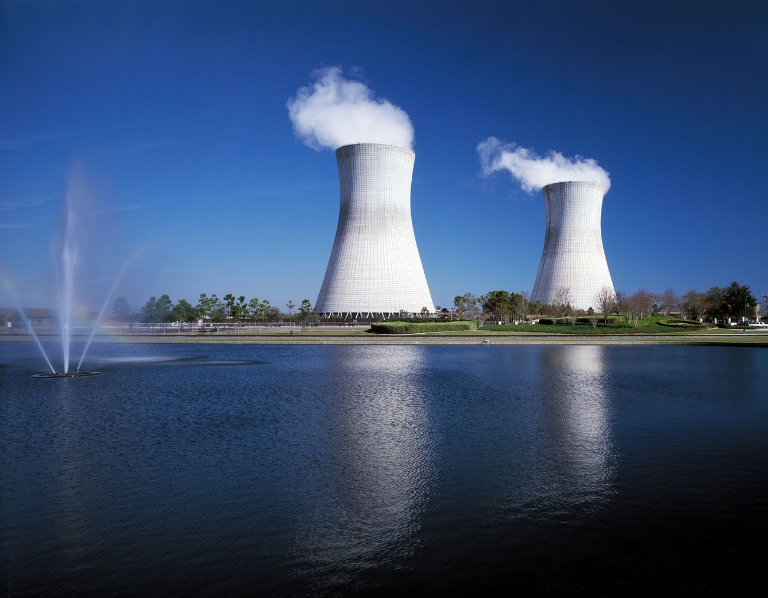
INTRODUCTION
Significance of Nuclear Power Plants (NPPs).
Challenges with NPPs.
Need for safety systems.
Source: rawpixel.com

Slide 4
OBJECTIVES
Main to-find agenda points of this research (project) are:
Develop an anomaly detection system for NPPs.
After classification success we went for sequential forecasting.
From simulated readings to real time reading monitoring (Try).
Ensure safety and efficient operation of NPPs.

Slide 5

LITERATURE REVIEW
Why Pressurized Water Reactors?
What potential AI methods are suitable?
MLPs ⁴
CNNs ¹
RNNs (LSTM & GRU) ²
Transformer ³
Source: networkworld.com
https://arxiv.org/abs/1511.08458 4. https://arxiv.org/abs/1404.7828
https://arxiv.org/abs/1912.05911
https://arxiv.org/abs/1706.03762
Notes:
https://arxiv.org/abs/1511.08458
https://arxiv.org/abs/1912.05911
https://arxiv.org/abs/1706.03762

Slide 6
PRESSURIZED WATER REACTORS
A type of nuclear reactor where water is used as both a coolant and a moderator, operating at high pressure to prevent boiling, ensuring efficient heat transfer to generate electricity. ⁴
Major Components:
Pressurizer
Pressure Vessel
Recirculation Pumps
Steam Generators
Containment Building
4. https://en.wikipedia.org/wiki/Pressurized_water_reactor
Notes:
4. https://en.wikipedia.org/wiki/Pressurized_water_reactor

Slide 7
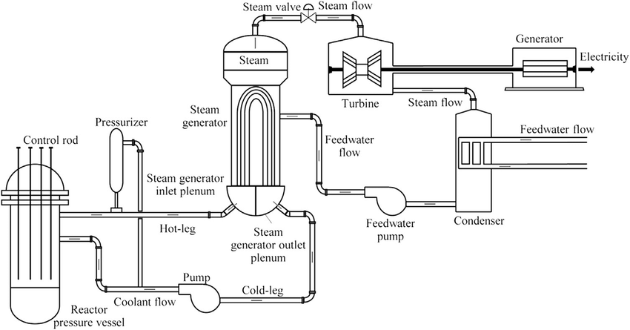
CONT’d
Pressurized Water Reactor Structure
Source: ResearchGate.com

Slide 8
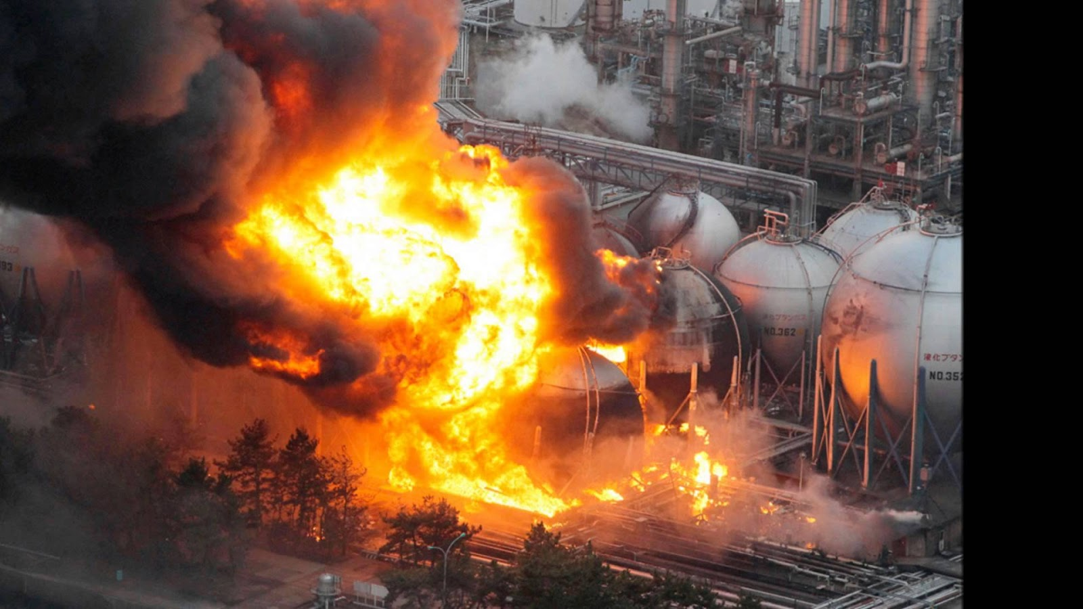
ACCIDENTS
17 types of accidents in a Pressurized Water Reactor (PWR) :
LOCA ( Loss-of-Coolant Accident )
LOCAC ( Loss of Coolant Accident – Cold Leg )
SLBIC ( Steam Line Break Inside Containment )
SLBOC ( Steam Line Break Outside Containment )
SGATR ( Steam Generator A Tube Rupture )
SGBTR ( Steam Generator B Tube Rupture )
RW ( Rod Withdrawal )
TT ( Turbine Trip)
RI ( Rod Insertion )
FLB ( Feed Water Line Break )
MD ( Moderator Dilution )
LR ( Load Rejection )
LLB ( Letdown Line Break Auxiliary )
SP ( Spark Presence for Hydrogen Burn )
LCAP ( Loss of AC Power )
LOF ( Loss of Flow )
ATWS ( Anticipated Transient Without Scram )
Source: understandingsociety.blog
7

Slide 9
PAPERS REVIEW
Mainly the following research papers and articles were reviewed to support and inform the development of this project.
Qi, B., Wang, Y., Xiao, X., & Liang, J. (2024, August). Underlying Deep Learning Networks Diagnosis Evaluation and Generative Adversarial Network Data Augmentation Based on a Benchmark Accident Dataset. In International Conference on Nuclear Engineering (Vol. 88254, p. V005T05A019). American Society of Mechanical Engineers.
Yi, S., Zheng, S., Yang, S., Zhou, G., & He, J. (2024). Robust transformer-based anomaly detection for nuclear power data using maximum correntropy criterion. Nuclear Engineering and Technology, 56(4), 1284-1295.
Hou, J., Ni, K., & Hawari, A. (2019). An artificial neural network based anomaly detection algorithm for nuclear power plants. Transactions, 120(1), 219-222.
Qi, B., Xiao, X., Liang, J., Po, L. C. C., Zhang, L., & Tong, J. (2022). An open time-series simulated dataset covering various accidents for nuclear power plants. Scientific data, 9(1), 766.
8

Slide 10
DEEP LEARNING ARCHITECTURES
MODEL | STRENGTHS | USE CASE FOR DATASET
MLPs | Easy to use, fast to train, handles general data well. | Used as a staring point to see how basic models perform.
CNNs | Good at feature extraction and have Hierarchical learning. | Helps detect sudden changes or patterns in sensor readings. (But had to add a extra channel)
LSTM/GRU | Good at remembering past information over time. | Helps track how an accident develops step by step over time.
Transformer | Very Strong at understanding long sequences and overall patterns across all time steps. | Best for both identifying the accident type and predicting future data.
9

Slide 11
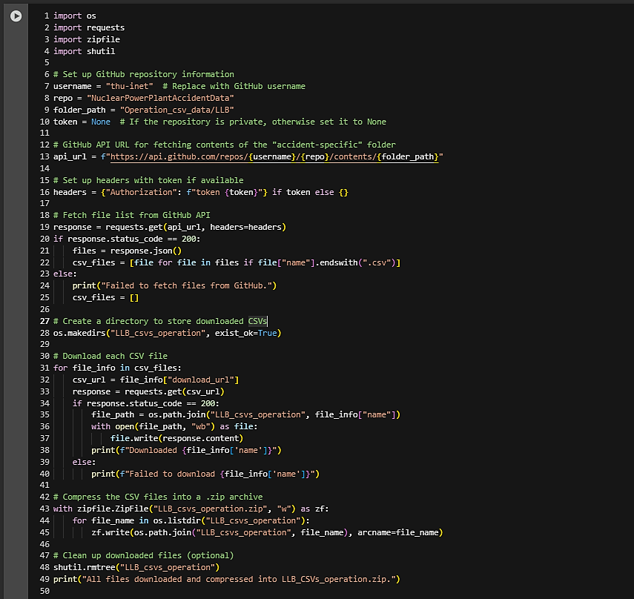
Following Python script was coded for extracting the data from repository.
10

Slide 12
METHODOLOGY
NPPAD Dataset Overview (Nuclear Power Plant Accident Dataset) ⁶
A open source simulated dataset using PCTRAN (Simulation Software) ⁷
Data Arrangement:
Root_directory / sub_directories (NORM, LOCA, LOCAC, SLBIC, SLBOC, SGATR, SGBTR, RW, RI, FLB, MD, LR, LLB, SP, LACP, LOF & ATWS)
Inside each of these sub_directories we have 100’s of csv files
Sub_directories / 1.csv, 2.csv.3.csv …. K.csv
Each CSV file has around shape of (~ 400, ~ 95)
6. https://www.nature.com/articles/s41597-022-01879-1
7. https://github.com/thu-inet/NuclearPowerPlantAccidentData/tree/main
Notes:
6. https://www.nature.com/articles/s41597-022-01879-1
7. https://github.com/thu-inet/NuclearPowerPlantAccidentData/tree/main

Slide 13
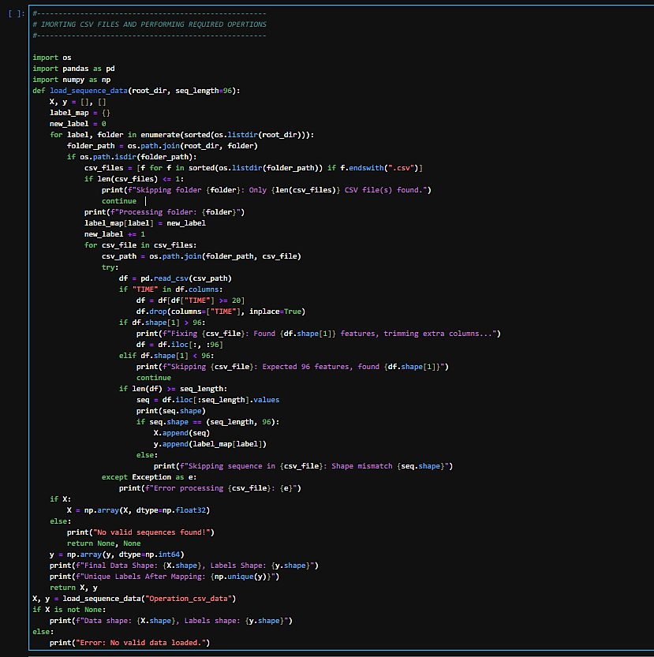
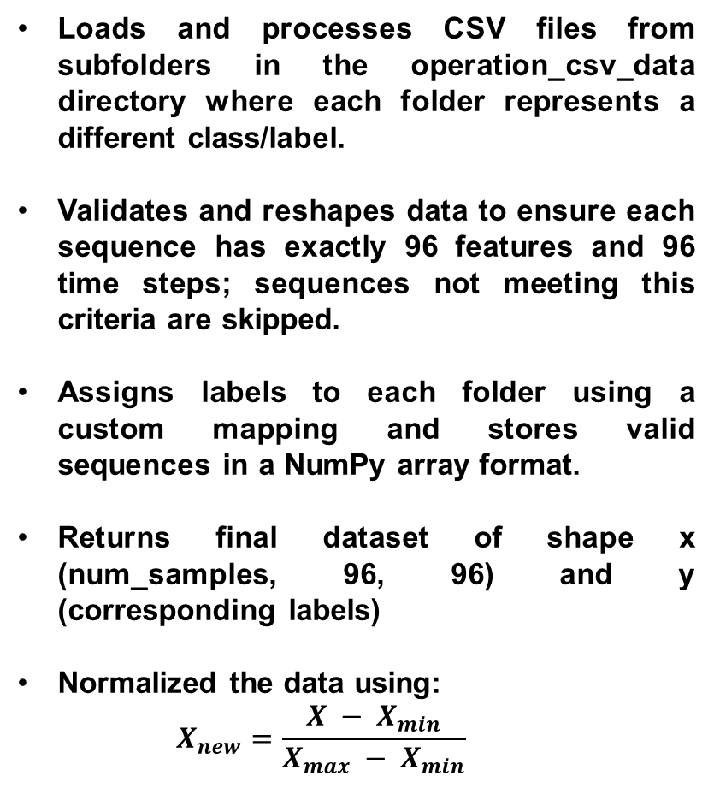
Loads and processes CSV files from subfolders in the operation_csv_data directory where each folder represents a different class/label.
Validates and reshapes data to ensure each sequence has exactly 96 features and 96 time steps; sequences not meeting this criteria are skipped.
Assigns labels to each folder using a custom mapping and stores valid sequences in a NumPy array format.
Returns final dataset of shape x (num_samples, 96, 96) and y (corresponding labels)
Normalized the data using:
$$X_{new}=\frac{X − X_{min}}{X_{max} − X_{min}}$$
12

Slide 14
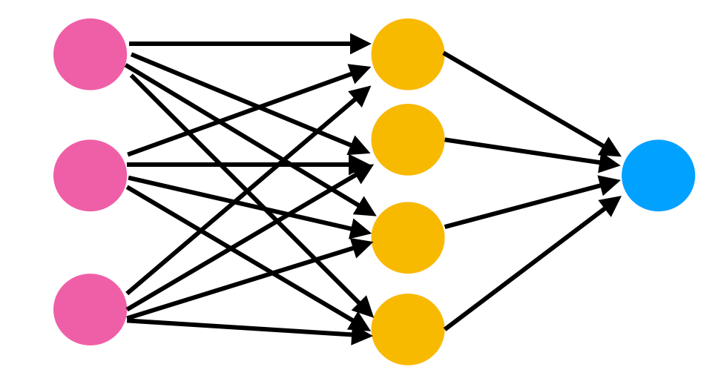
RESULTS (CLASSIFICATION PART)
Multi-Layer Perceptrons (MLPs)
Model - 1: Single Layer MLP
Test Accuracy 92.50%
Model - 2: Two Layer MLP
Test Accuracy 89.17%
Model - 03: Four Layer MLP
Test Accuracy: 89.15%
Model - 4: Four Layer MLP with Batch Normalization (BN)
Test Accuracy: 87.50%
Source: becominghuman.ai
13

Slide 15
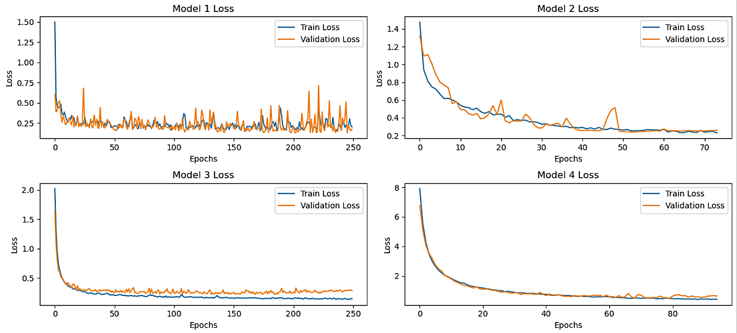
LOSS CURVES CONVERGENCES, CONT’d (MLPs)
14

Slide 16
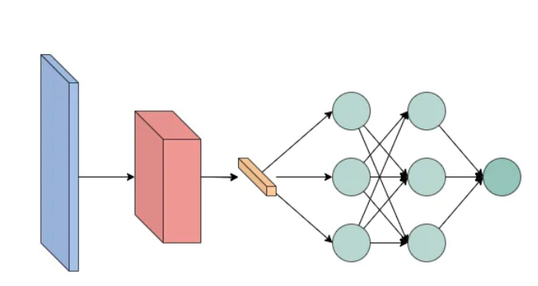
CONT’d
Convolutional Neural Networks (CNNs)
First reshaped the input data to add one more dimension (gray-channel). For DenseNet, accuracy plateaus because noticeable flu cations in validation accuracy curves.
Model - 1: 05 Layer CNN
Test Accuracy: 75.83%
Model - 2: 04 Block DenseNet
Test Accuracy: 54%-56%
Source: towardsdev.com
15

Slide 17
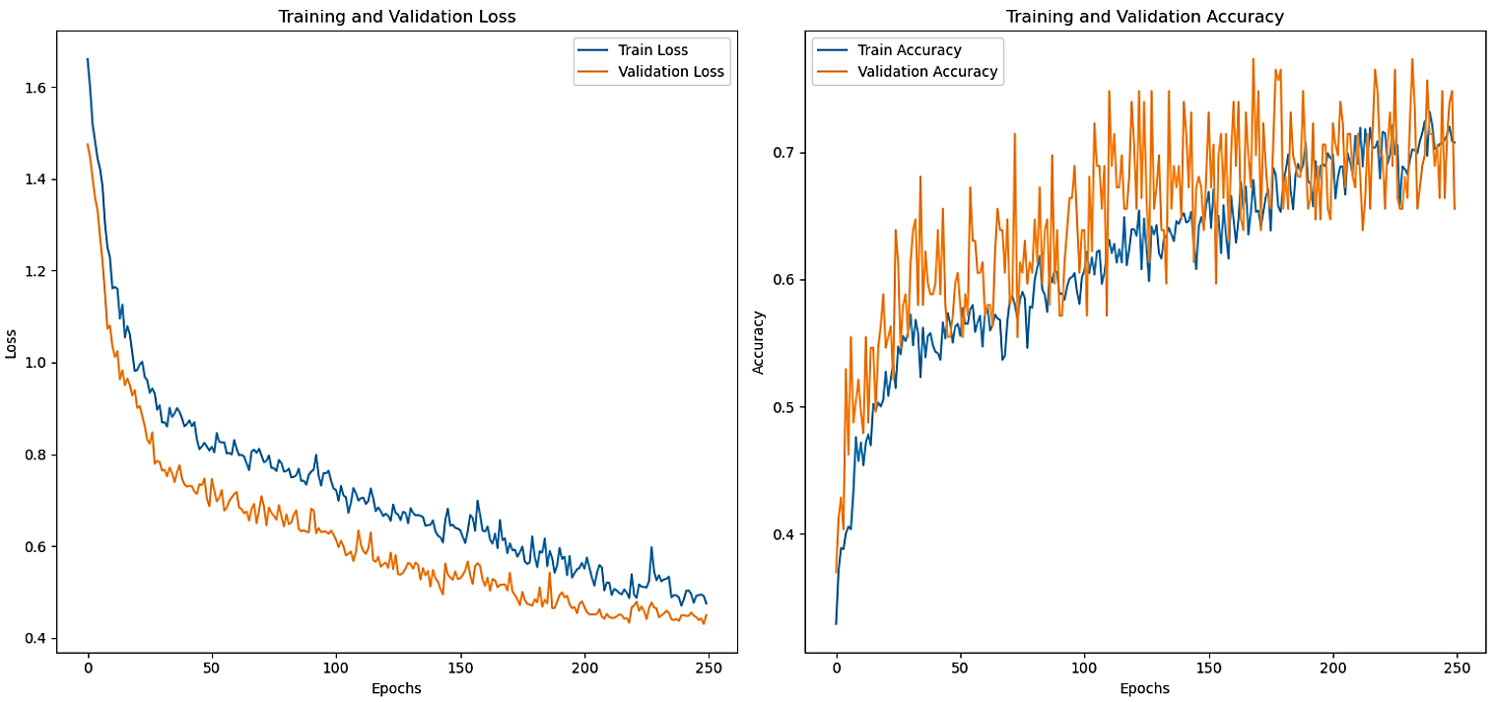
LOSS AND ACCURACY CURVES FOR CNN
16

Slide 18
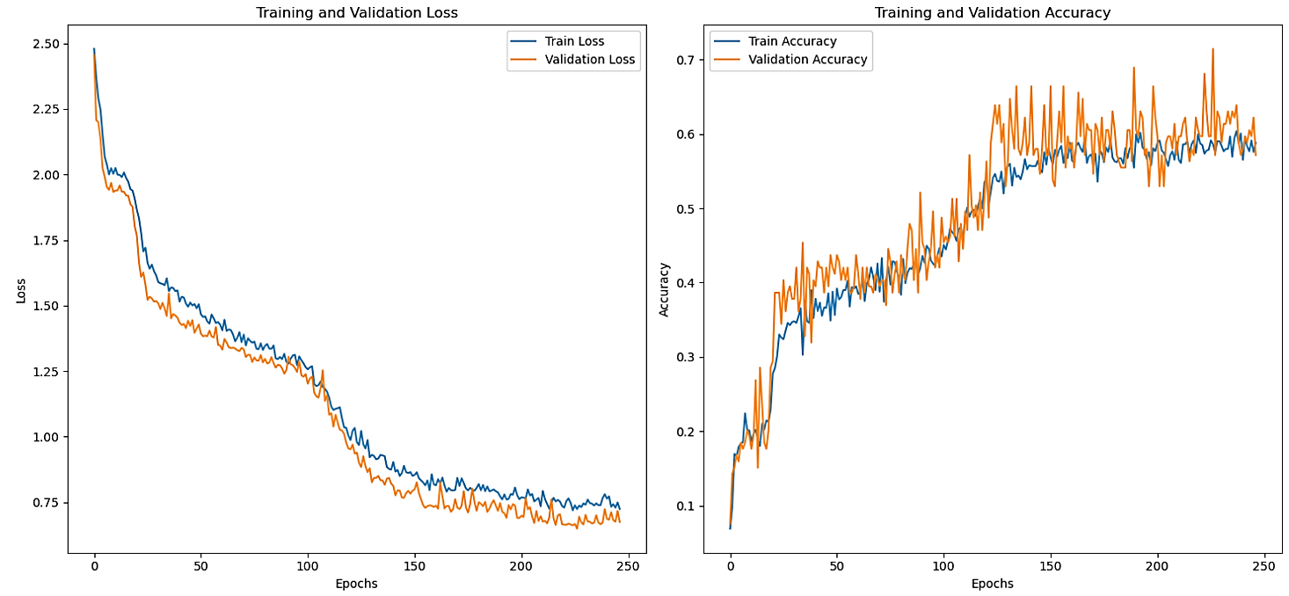
LOSS AND ACCURACY CURVES FOR DenseNet
17

Slide 19
LIMITED ACCURACY REASONS (CNNs)
Data Complexity: Some features might still be irrelevant, noisy, or redundant, affecting learning quality.
Models might be too strong (Overfitting) the given data shape.
CNNs aren’t great at capturing time-based patterns.
Batch size / learning rate / Regularization experimentation
18

Slide 20
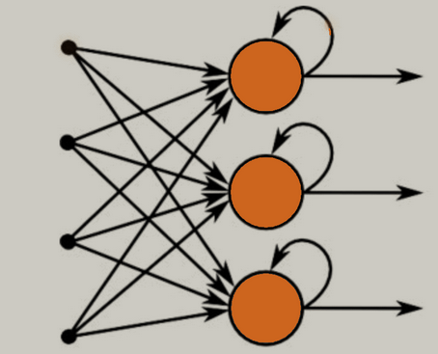
CONT’d
Recurrent Neural Networks (RNNs)
Long-Short Term Memory Models
With GRU (Gated Recurrent Unit) Cells
Model – 1: GRU-Based Model with Two GRU Cells
Test Accuracy: 40%
Model – 2: GRU Stack with Batch Normalization
Test Accuracy: 50.83%
Model – 3: Two-Layer LSTM with Dropout
Test Accuracy: 60.83%
Model – 4: LSTM with BN and Learning Rate Decay
Test Accuracy: 66.67%
Source: k21academy.com
19

Slide 21
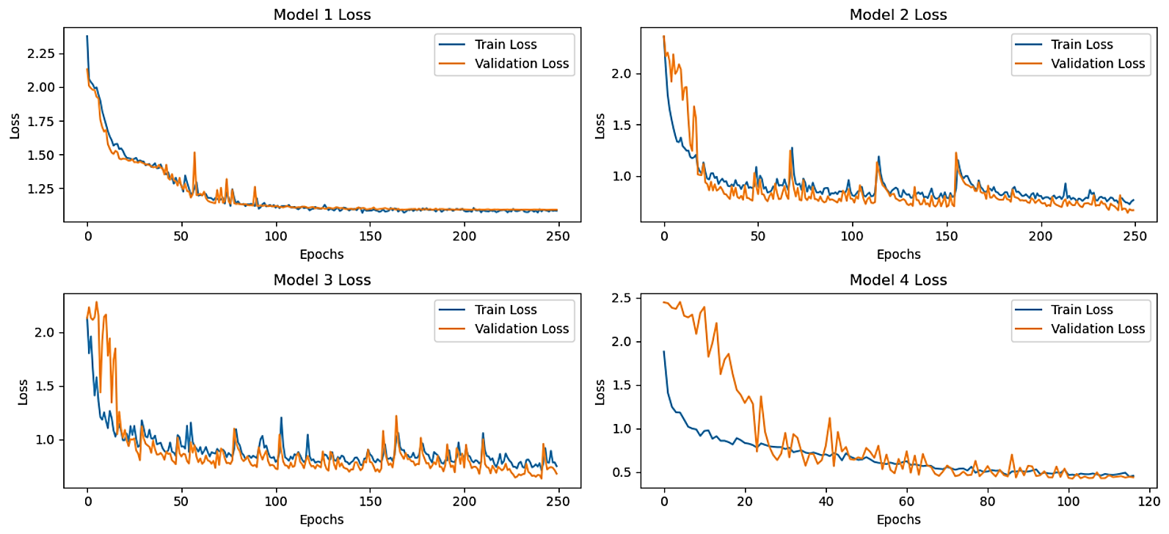
LOSS CURVES CONVERGENCES, CONT’d (LSTM & GRU Cells)
20

Slide 22
EVALUATION (RNNs)
Accuracy improved as models became more advanced and better regularized.
Batch Normalization, Dropout, Dense bottleneck layers and learning rate scheduling helped.
All these kind of enhanced stabilized training, reduced overfitting and tried to reasonably extract patterns.
However, accuracy stayed within 60%-70%, possibly due to limitations also seen in DenseNet but with I think more lack of sufficient temporal dependencies captures.
21

Slide 23
RESULTS (SEQUENCE BASED CLASSIFICATION)
For Transformer feeding, all the data kept as it was. Like there is no trimming of columns or rows.
There is no skipping of CSV files.
All the accidents are taken into account including NORM as well.
A python is coded to do above all mentioned and got the result as
It’s a sequence classification problem over time
Total sequences: (9386, 50, 96)
Label map: {0: 'SLBIC', 1: 'FLB', 2: 'SP', 3: 'SGBTR', 4: 'LLB', 5: 'TT', 6: 'RI', 7: 'SGATR', 8: 'LACP', 9: 'LOCAC', 10: 'RW', 11: 'MD', 12: 'ATWS', 13: 'LOCA', 14: 'SLBOC', 15: 'LR', 16: 'Normal', 17: 'LOF'}
22

Slide 24
DEFINING TRANSFORMER ARCHITECTURE
A custom Transformer built using PyTorch for sequence classification.
Input Parameters
input_size = 96 (Each time step has 96 features)
num_classes = 18 (Predicts on of 18 possible classes)
num_heads = 4 (Multi-head attention with 4 heads)
num_layers = 3 (Stack 3 transformer encoder layers)
hidden_dim = 64 (Each encoder layer has a feedforward network of size 64)
dropout = 0.1 (Dropout applied for regularization
nn.TransformerEncoderLayer: Handles self-attention and feedforward processing.
nn.TransformerEncoder: Stacks multiple encoder layers to learn deep temporal patterns
nn.linear: Final fully connected layer to classify the sequence.
23

Slide 25
TRANSFORMER TRAINING PIPELINE
Data Split: The dataset is split into 80% training and 20% testing with stratified labels for balanced class distribution.
Data Conversion: All data is converted to PyTorch tensors and wrapped in DataLoaders for efficient batch processing.
CrossEntropyLoss with Adam Optimizer is used.
The model is trained for just 20 epochs with back propagation.
Model is then saved as transformer.pth and StandardScaler used during preprocessing too as scaler.pth
24

Slide 26
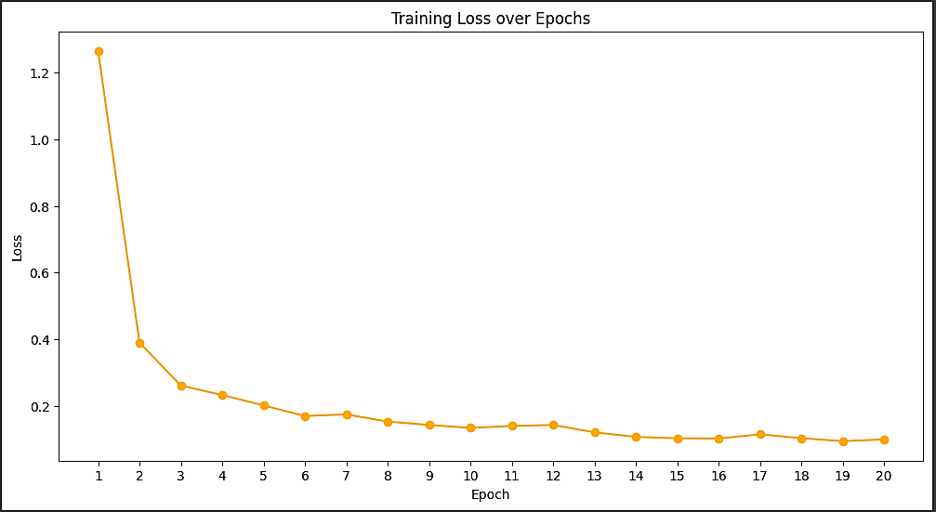
LOSS CONVERGENCE
Model reached a test accuracy of 94.25%
25

Slide 27
SCOPE OF THE PROJECT
As we have achieved the accuracy, but it’s still AI and we cannot hand over the whole nuclear operations to it alone.
Human check will always be there.
This project is kind of an effort toward incorporation of AI into NPPs operations, safety and handling.
This system is designed to assist operators, not replace them — serving as an early warning tool to detect anomalies before they escalate.
AI into nuclear plant operations represents a step toward smart, data-driven decision-making, enhancing both safety and efficiency under human supervision.
26

Slide 28
STILL, FOR CONTINUOUS MONITORING
A new python script is coded to monitor a folder in real time, looking for new .csv files containing sensor readings and then detect if any abnormal event is happening on those readings using this pre-trained Transformer model. Now what the script does is:
Loads the saved model i.e., trained transformer, from a .pth file.
It also uses a saved (trained on dataset) StandardScaler to normalize the input data, ensuing values are within a consistent range as it was during the training.
It keeps watching a specified folder (we can also change the path) /live_data for new .csv files.
Every few seconds (default is set 5), it checks if new files have arrived and do the required CSV file processing.
Now for each sequence, the model predicts a class label (e.g., “LCOA”, “NORMAL”, “RW”, etc.).
If the label is anything other than “NORMAL”, it prints an alert with the predicted anomaly name.
If it’s “NORMAL”, it simply logs that as information.
27

Slide 29
CONCLUSION
Model performances varied widely, showing how architectures and training strategies directly affect accuracy and stability.
Single-layer MLP (Model – 1) achieved highest classification accuracy (92.50%), likely due to stable and extended training.
Deeper MLPs and DenseNet struggled with instability, with DenseNet plateauing around 54-56%, suggesting it may be over-parameterized for this dataset.
LSTM-based models outperformed GRUs when enhanced with Batch Normalization and learning rate scheduling.
Transformer with 03 Encoder blocks achieved the best overall performance (94.25%), proving highly effective for sequential data due to multi-head attention and paves way for incoming readings classification. (We can adjust the timestamps and detection time)
28

Slide 30
Links to Code-Notebooks
Python script for extracting CSV files form repository:
https://colab.research.google.com/drive/1ZwPpMr06Ad2Uepk_dzVjvoTaDGWenNmI?usp=sharing
Transformer Model scripts.
https://colab.research.google.com/drive/1oFhA62HBbNCYcPaVACnpXf3kewtud_g4?usp=sharing
Scripts for data preprocessing, normalization, model training (MLPs, CNNs and RNNs), and saving/loading models.
https://drive.google.com/drive/folders/1KkLwm1YEdo8zUuavMGWhISLVXSSmiUvz?usp=drive_link
29

Slide 31
THANK YOU FOR YOUR TIME AND ATTENTION

