Slide 1
Optimizing Marketing ROI Using Calibrated Probabilistic Classifiers Under Class Imbalance
Presenter: Daniyal Shahzad

Slide 2
The Problem
Imagine, we are to spend $100,000 on making new ads, these ads will be targeted towards our existing customer base, to persuade them to buy a vehicle insurance.
Can we do better?
What if every dollar spent is targeted towards the segment of the customers are more likely to buy a vehicle insurance?

Slide 3
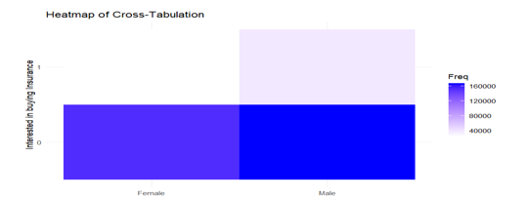
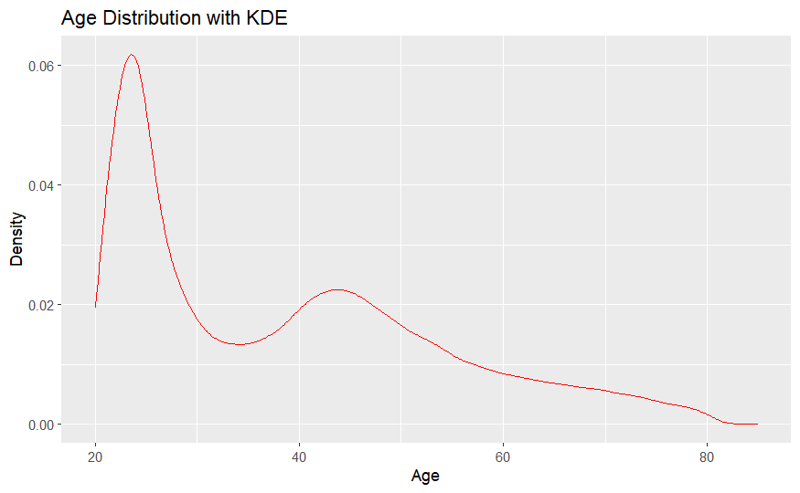
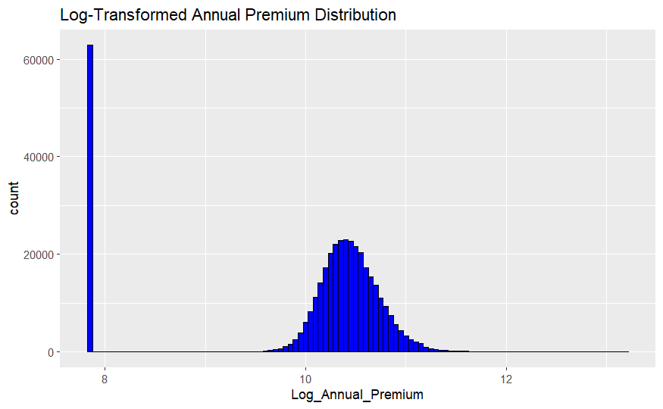
Dataset and Challenges!
The dataset consists of current customers who had purchased life insurance and their response to past marketing strategies to persuade them to buy a vehicle insurance
Challenges:
It consists of 10 features, with 2 of them having 53 and 156 levels!
It shows spurious relations between features! Implying the existence of confounding variables!
Existence of Outliers! (Or maybe rare but important information)

Slide 4
Methodology
1) Data Preprocessing
2) A Logisitic Regression with L1 (LASSO) Regularization was fit to the data
Justification:
Very high number of levels present in some categorical features (Feature Selection)
A logisitic regression probabilities that are better calibrated than other models
Computationally efficient and Interpretable
3) Predictions were done on unseen data to assess the performance
Metrics used:
Brier Score
Calibration Curves
Bootstrapping is utilized to get prediction intervals

Slide 5
Findings and Results
People who were more likely to buy insurance:
Possess a new vehicle
Haven't been insured previously
Belonging to specific regions (a proxy for income)
Specific sales channels are preferred
Note: As assumed, Sex feature was dropped as assumed.
These characteristic are inline with the business context and hence act in favor of the validity of modelling technique

Slide 6
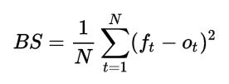
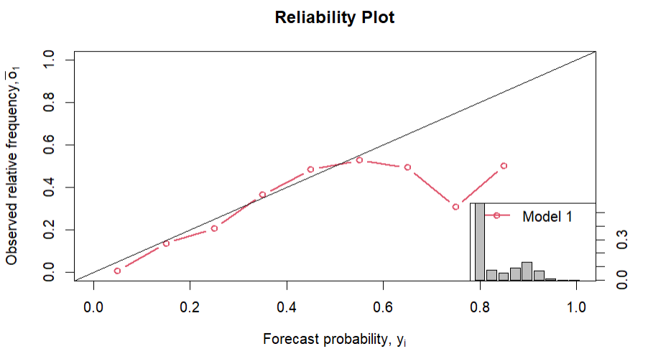

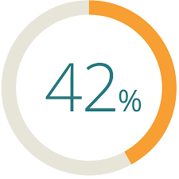
Findings and Results

Slide 7
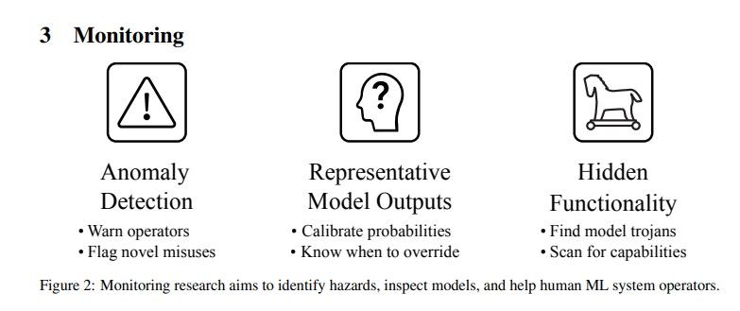
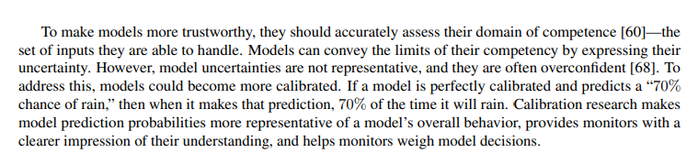
Thank you!

