Slide 1
Evaluation of LLMs on Bloom’s Taxonomy Classification
A Comparative Study on Open-Source LLMs using Monash CLO Dataset
Muhammad Daniyal
April 2026

Slide 2
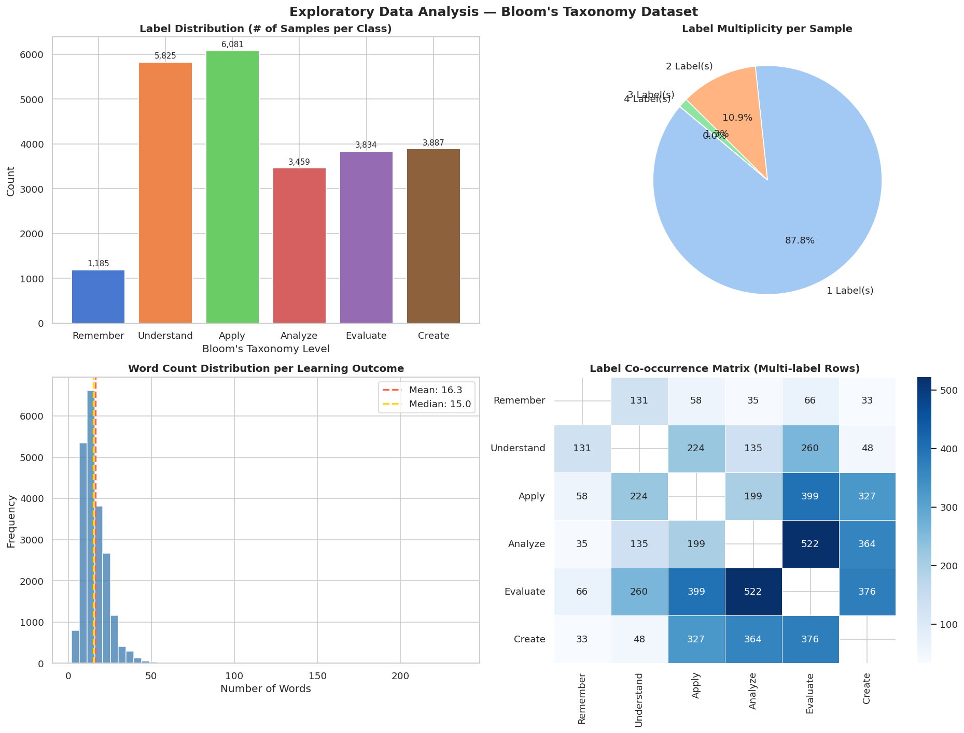
EDA – The CLO Dataset (EDM2022)

Slide 3
EDA – The CLO Dataset (EDM2022)

Slide 4
EDA – The CLO Dataset (EDM2022)

Slide 5
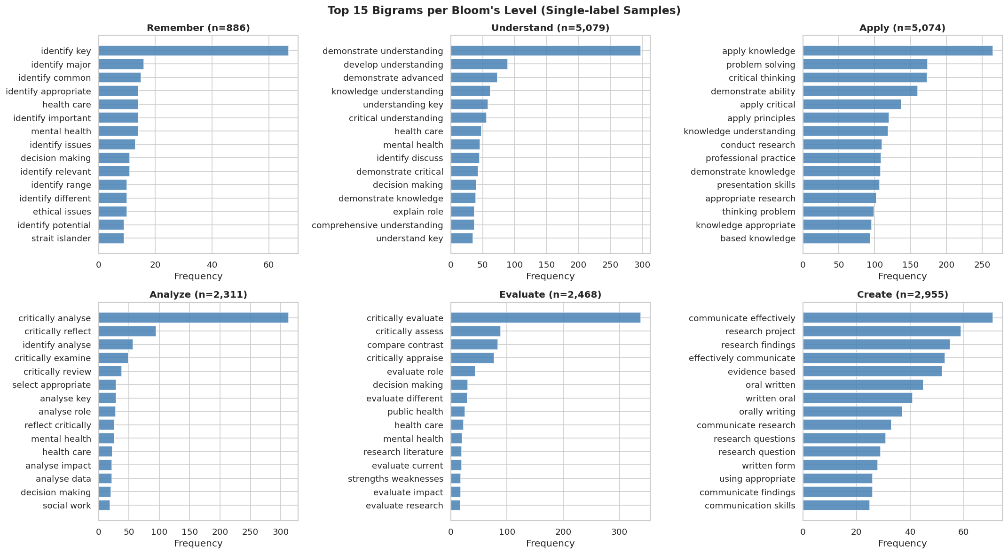
Top 15 Bigrams per level (single label)

Slide 6
Top 15 Bigrams per level (single label)

Slide 7
Top 15 Bigrams per level (single label)

Slide 8
Top 15 Bigrams per level (single label)

Slide 9
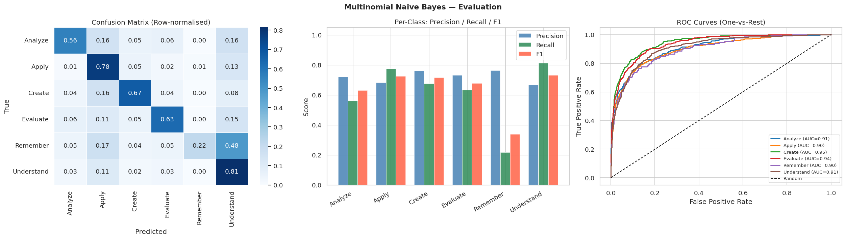
Multinomial Naïve Bayes Evaluation

Slide 10
Multinomial Naïve Bayes Evaluation

Slide 11
Multinomial Naïve Bayes Evaluation

Slide 12
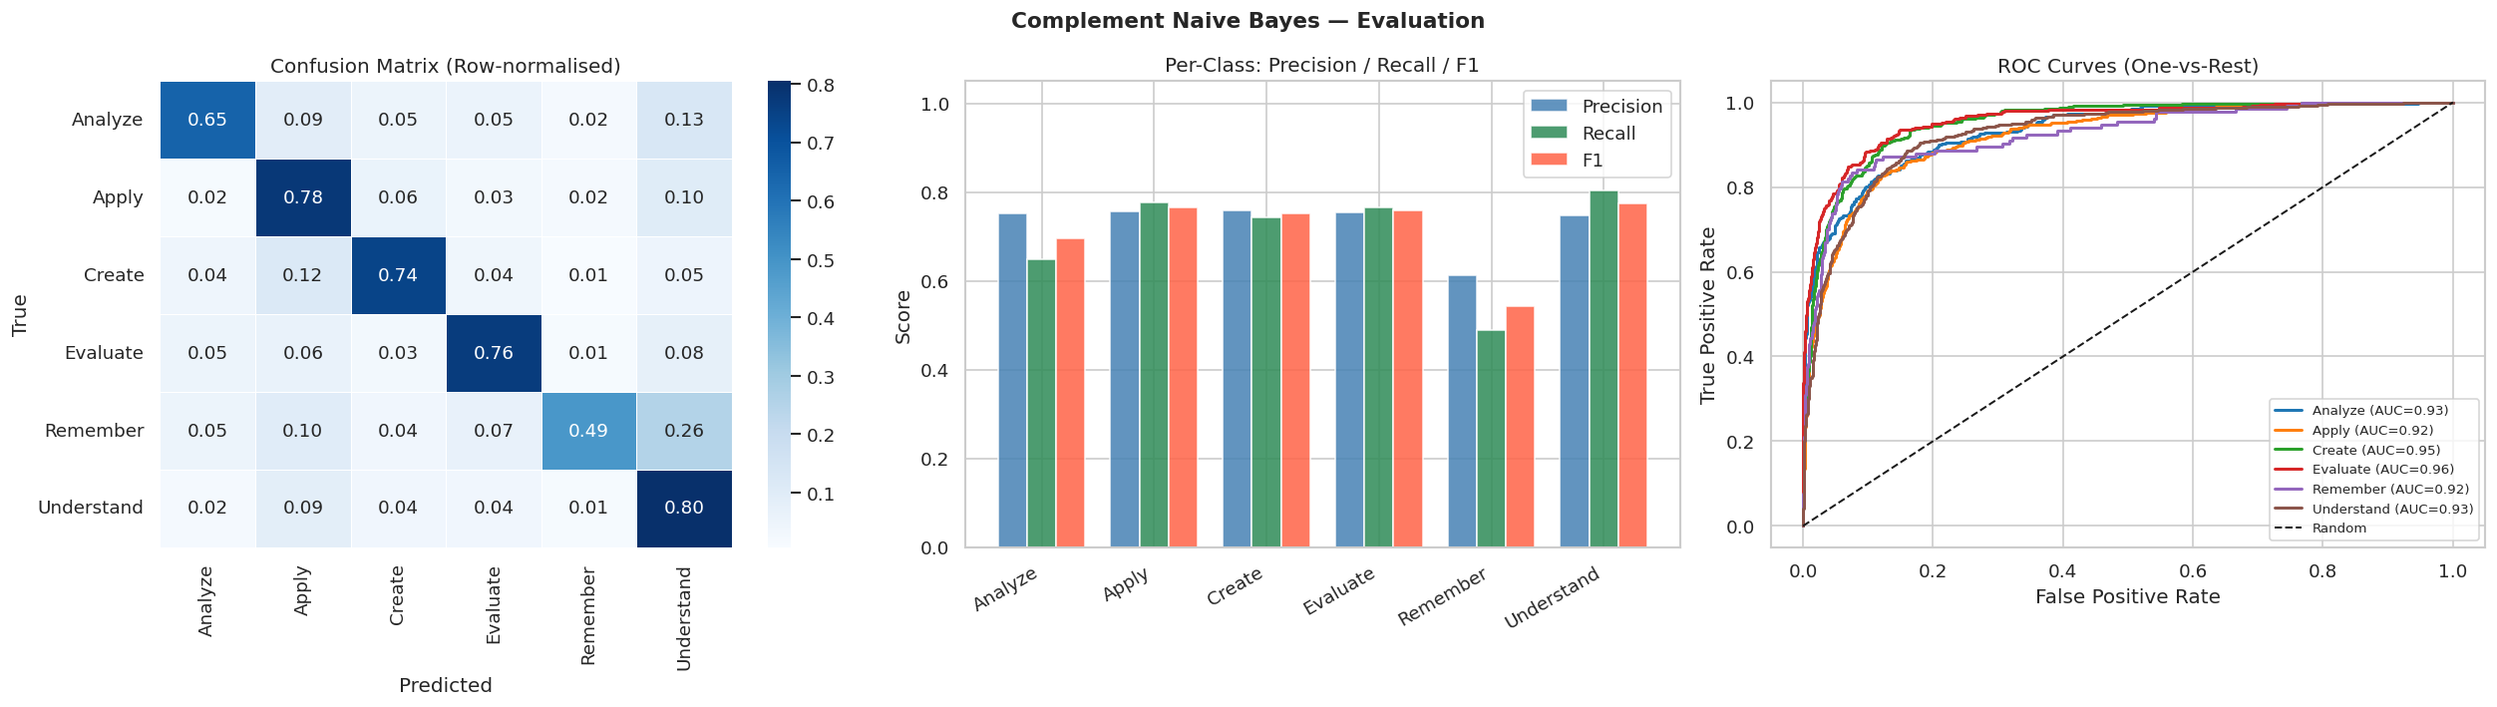
Complement Naïve Bayes Evaluation

Slide 13
Complement Naïve Bayes Evaluation

Slide 14
Complement Naïve Bayes Evaluation

Slide 15
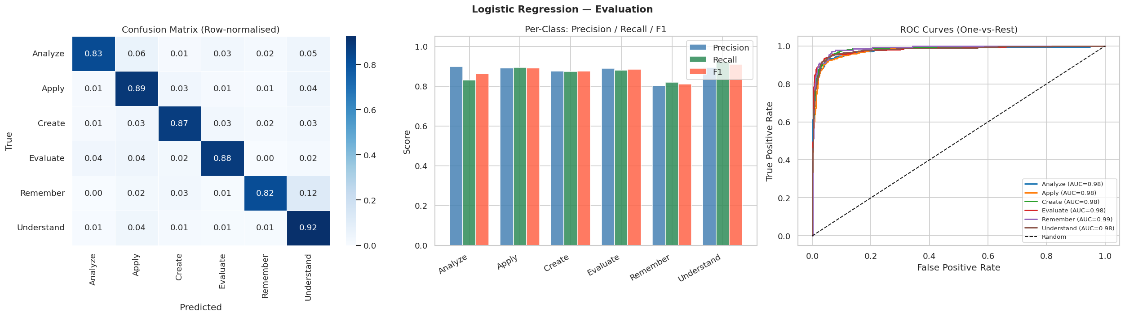
Logistic Regression - Evaluation

Slide 16
Logistic Regression - Evaluation

Slide 17
Logistic Regression - Evaluation

Slide 18
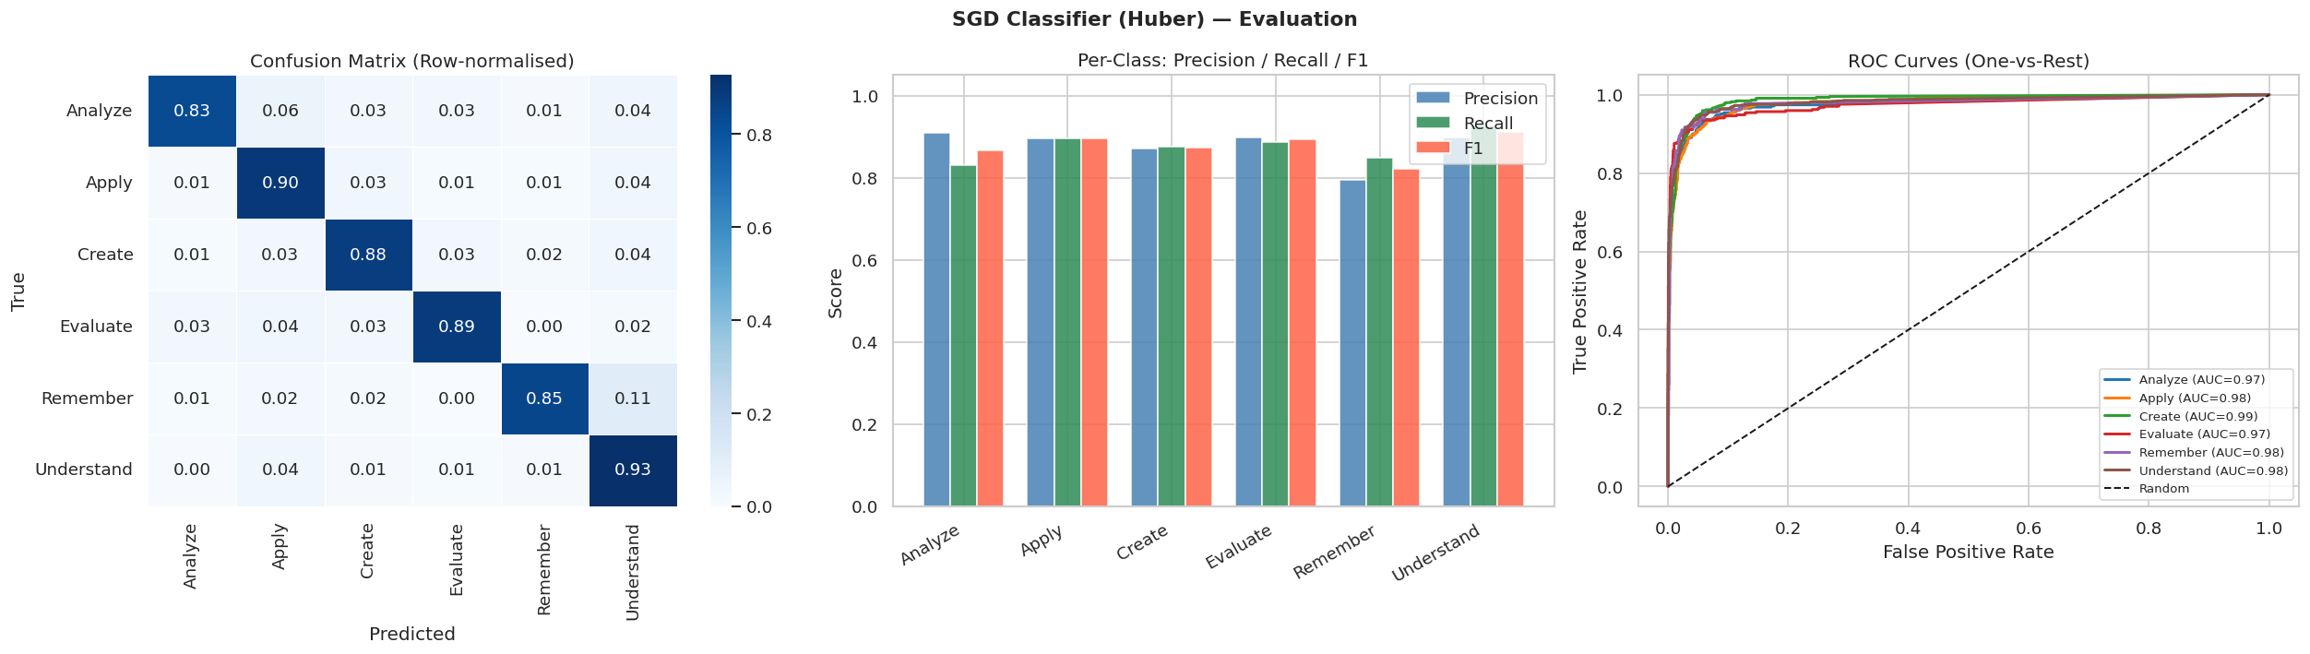

Slide 19


Slide 20
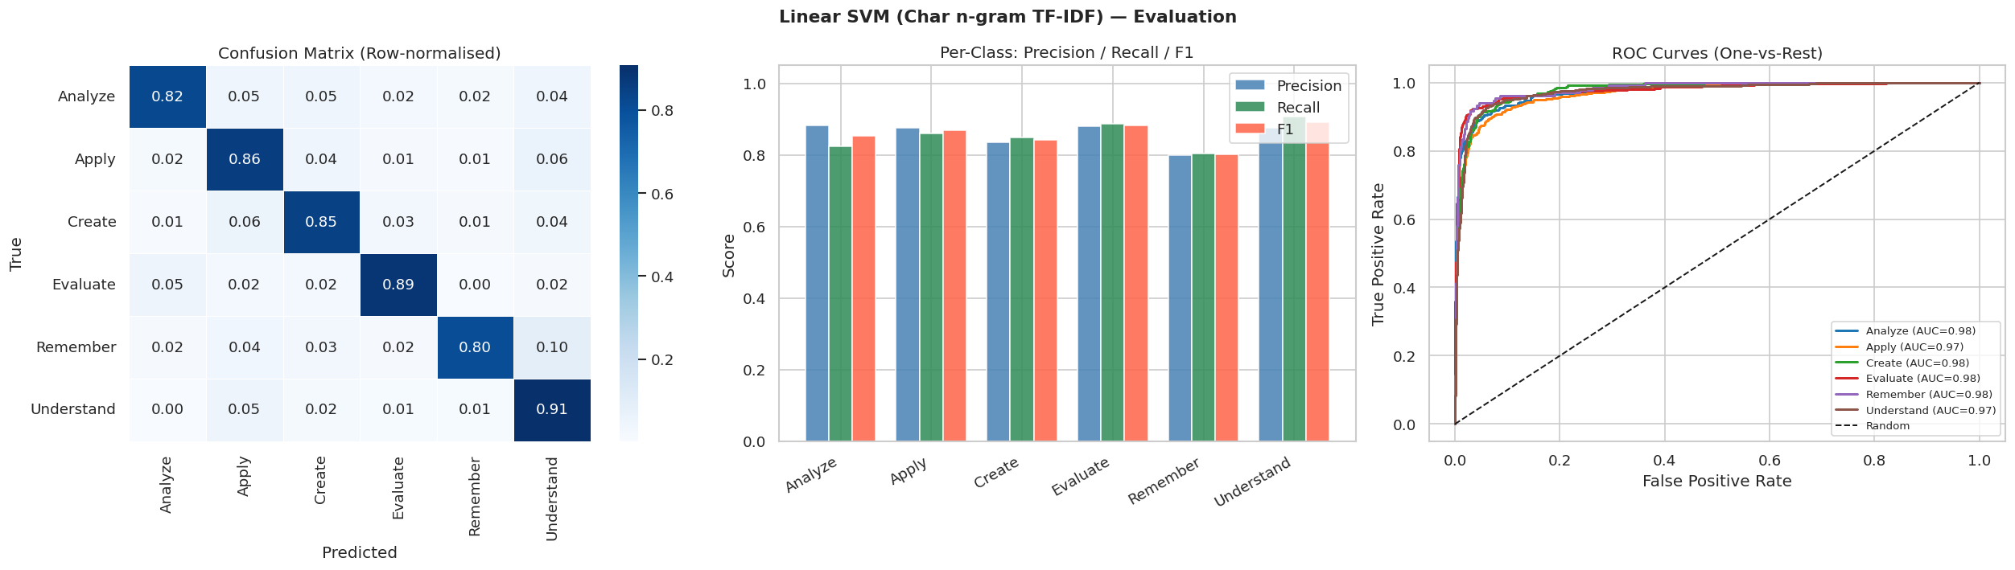

Slide 21
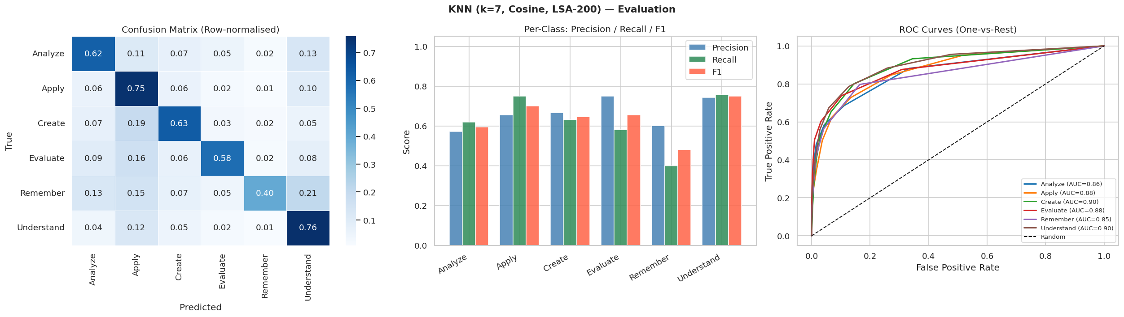

Slide 22
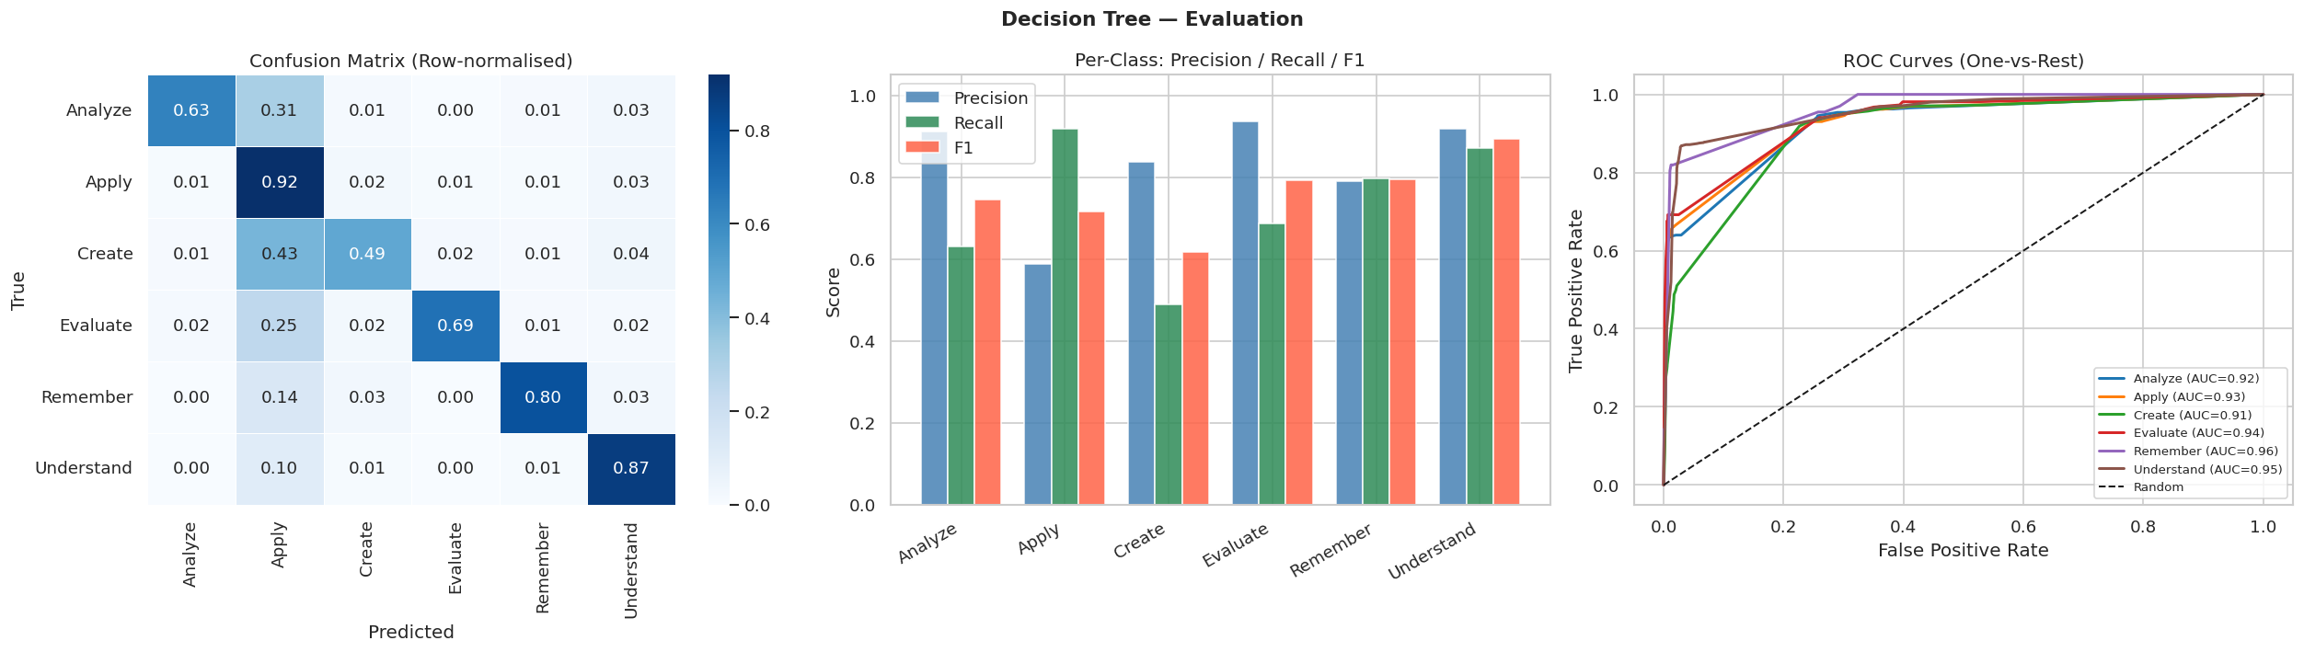

Slide 23
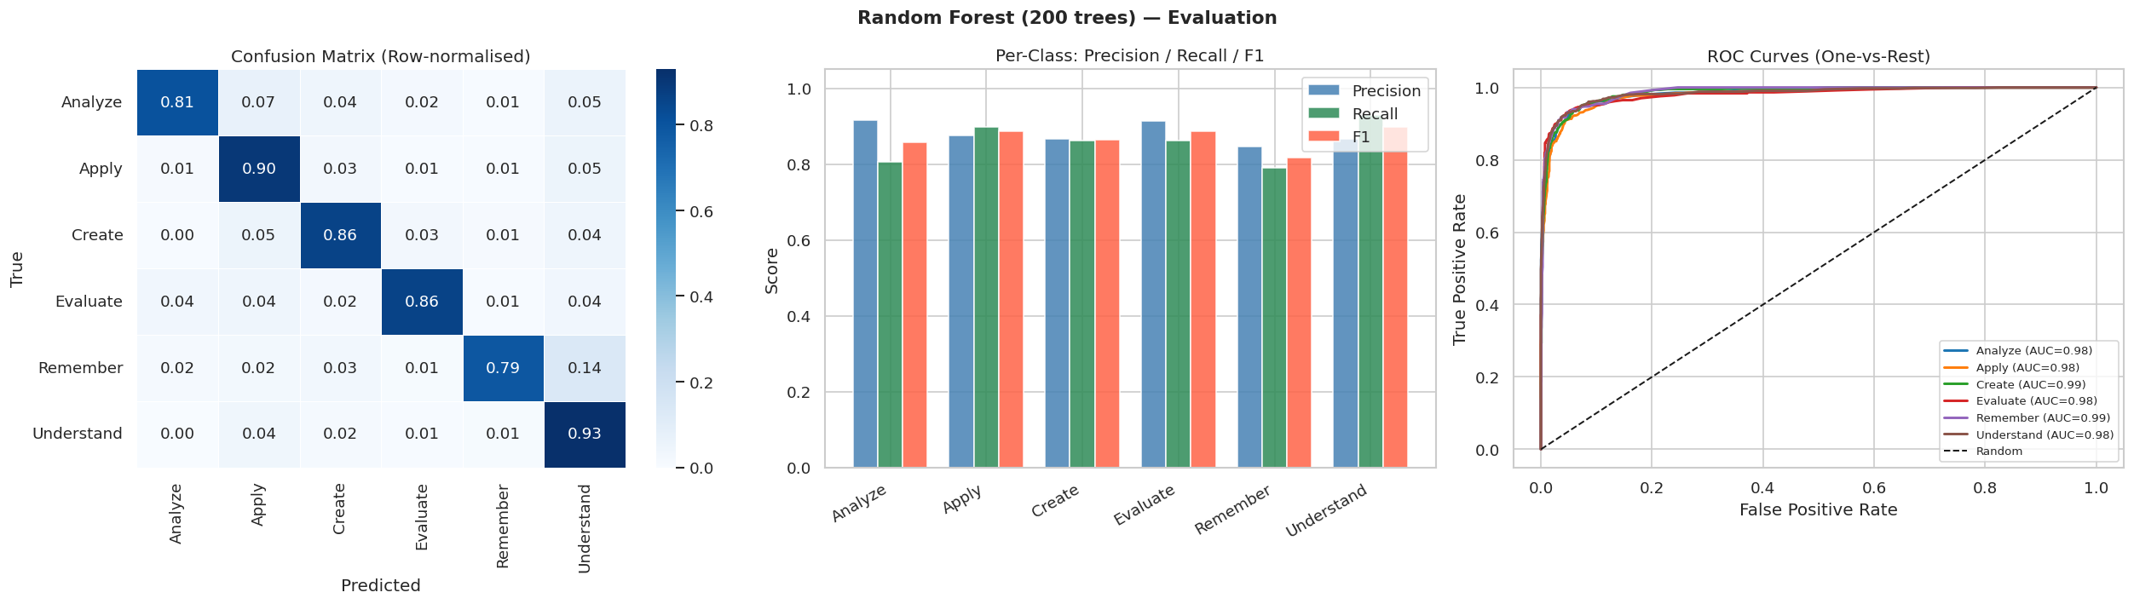

Slide 24
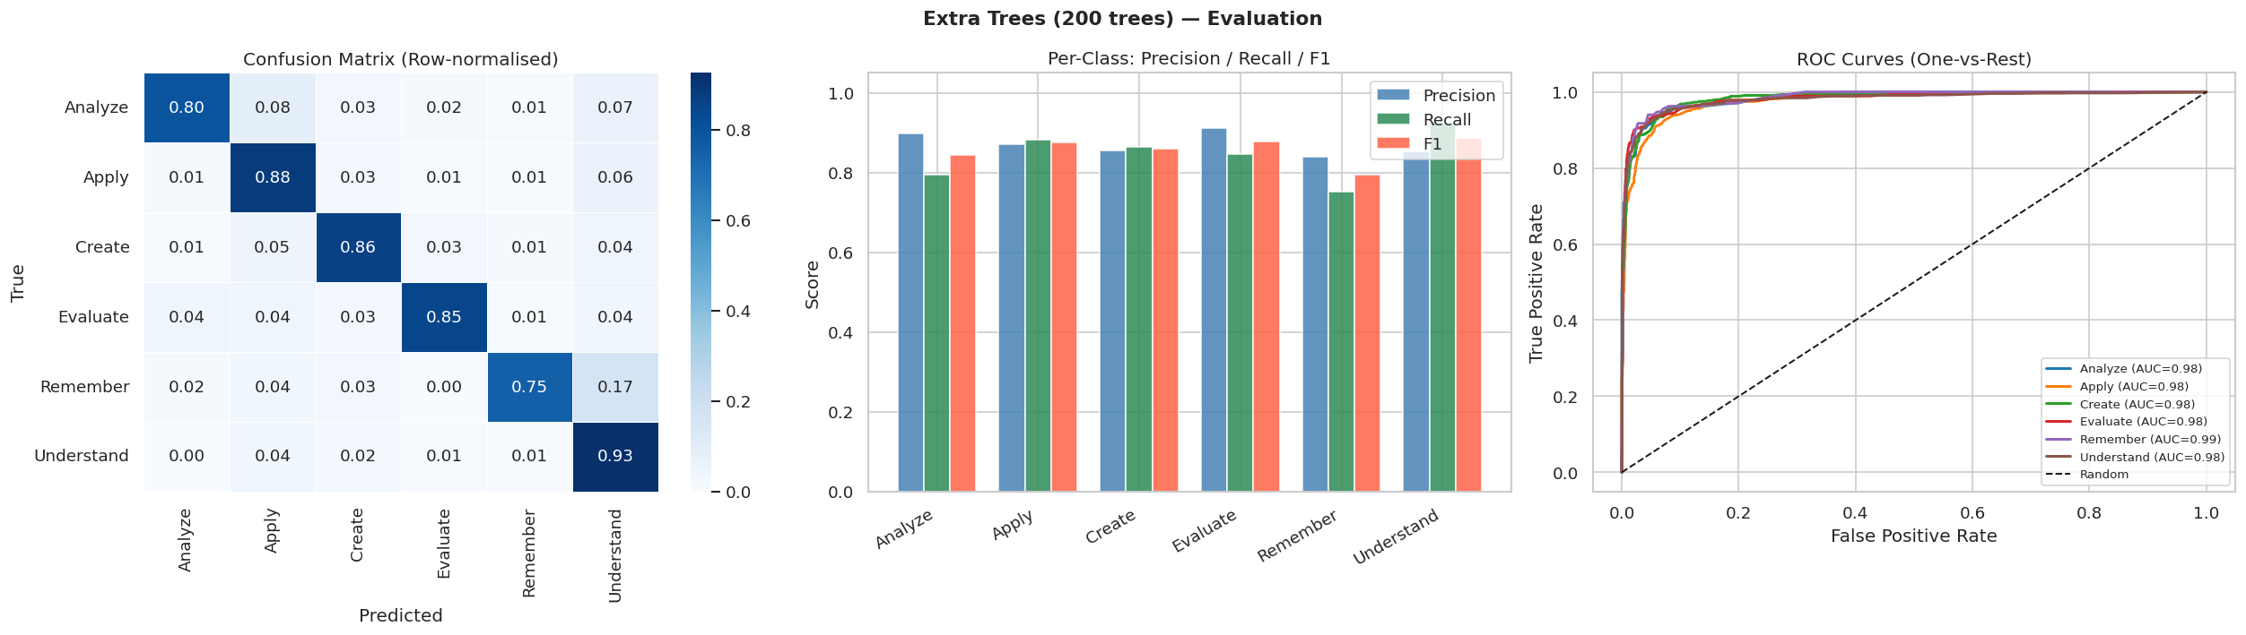

Slide 25
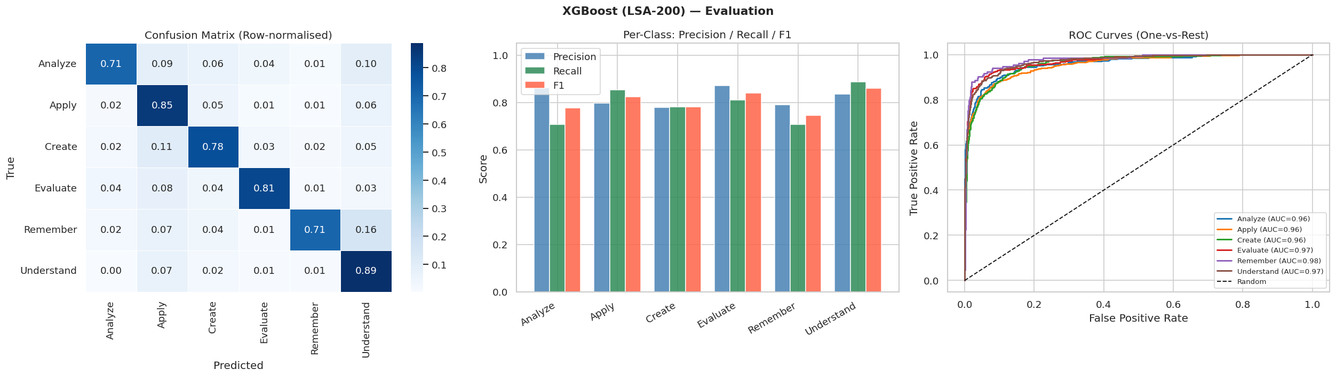

Slide 26


Slide 27
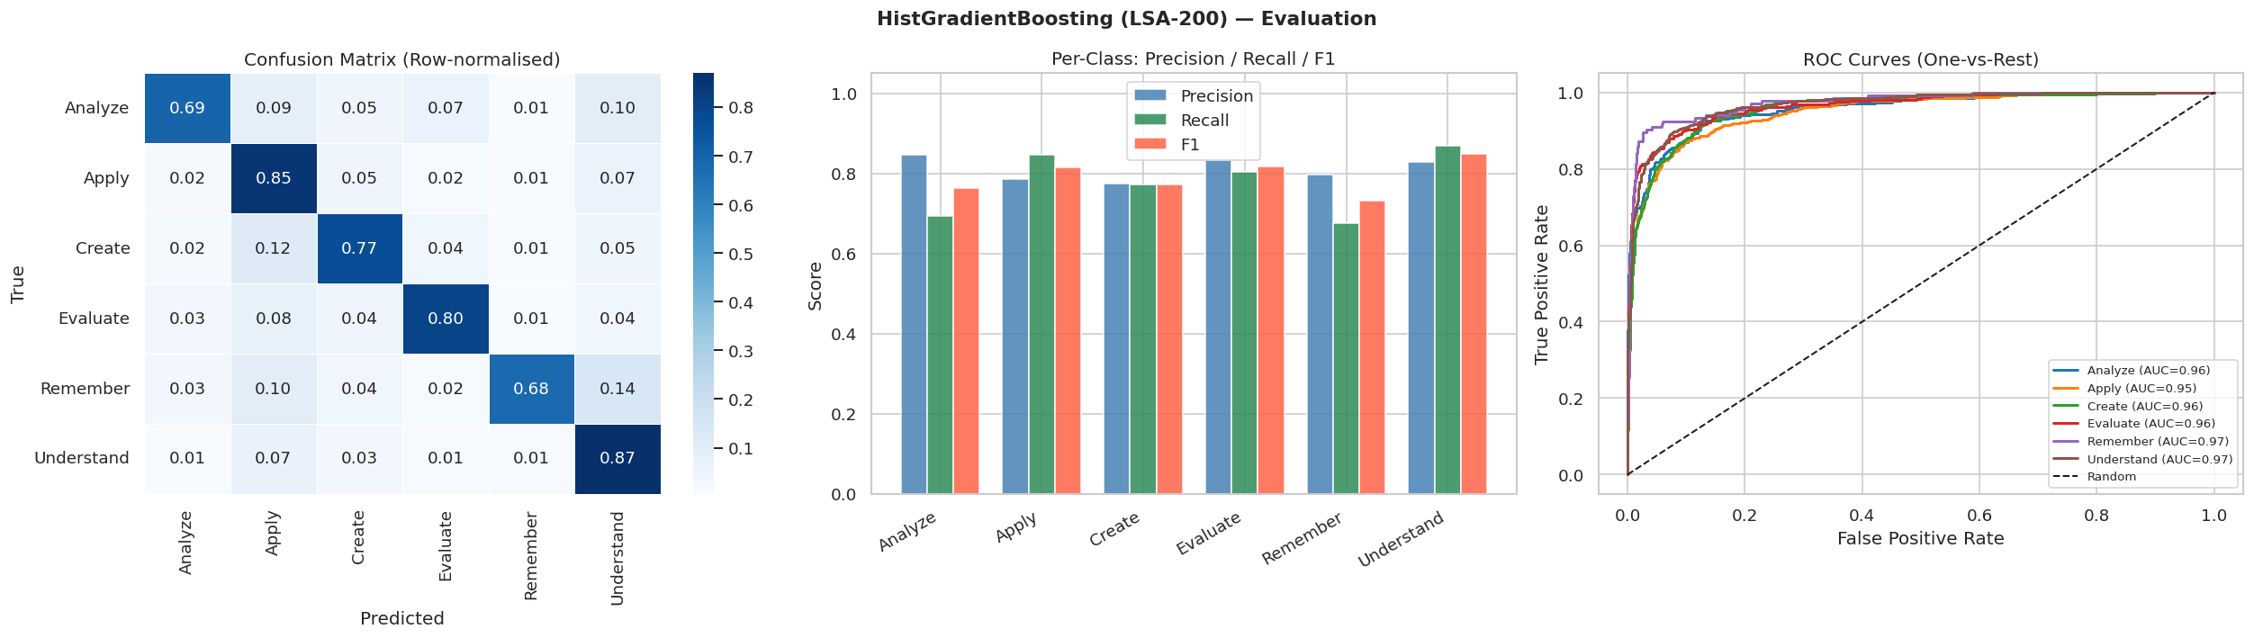

Slide 28
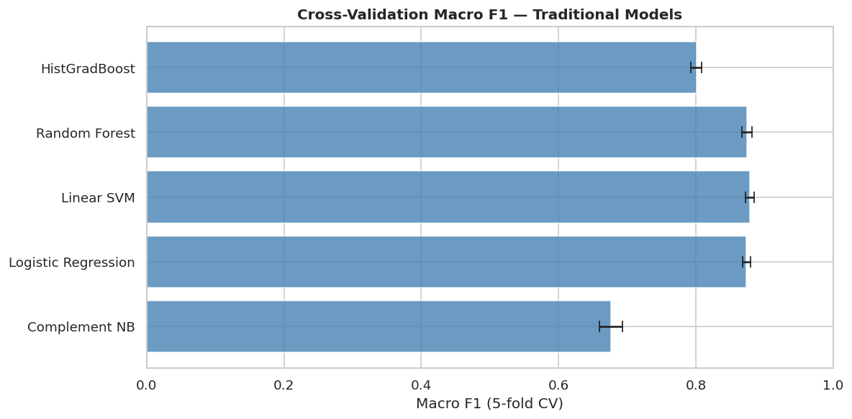

Slide 29
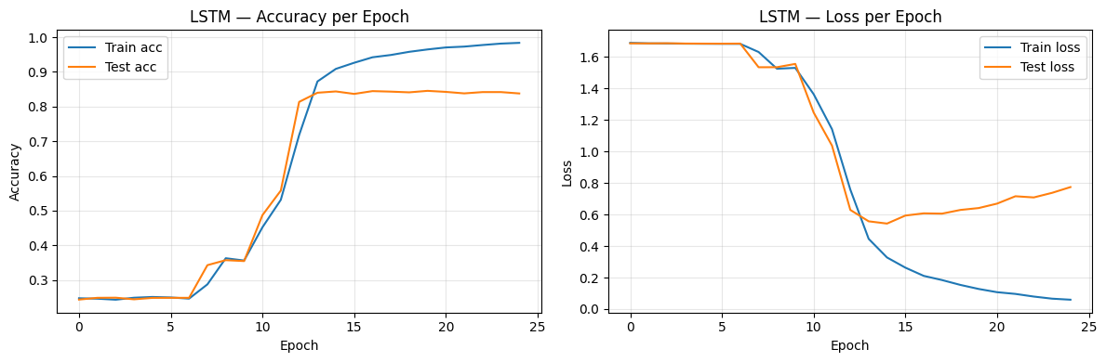
LSTM

Slide 30
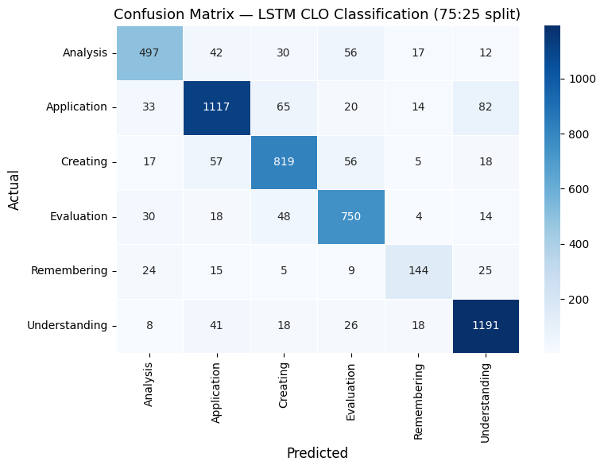
LSTM

Slide 31
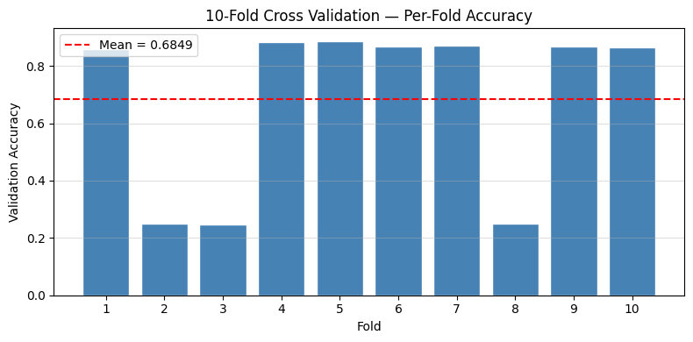
LSTM

Slide 32
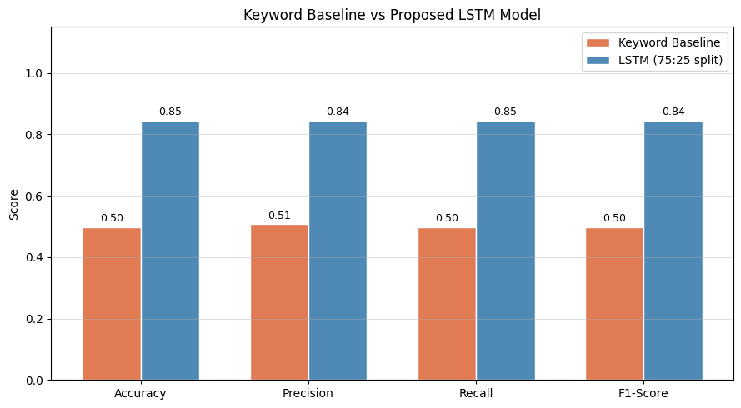
LSTM

Slide 33
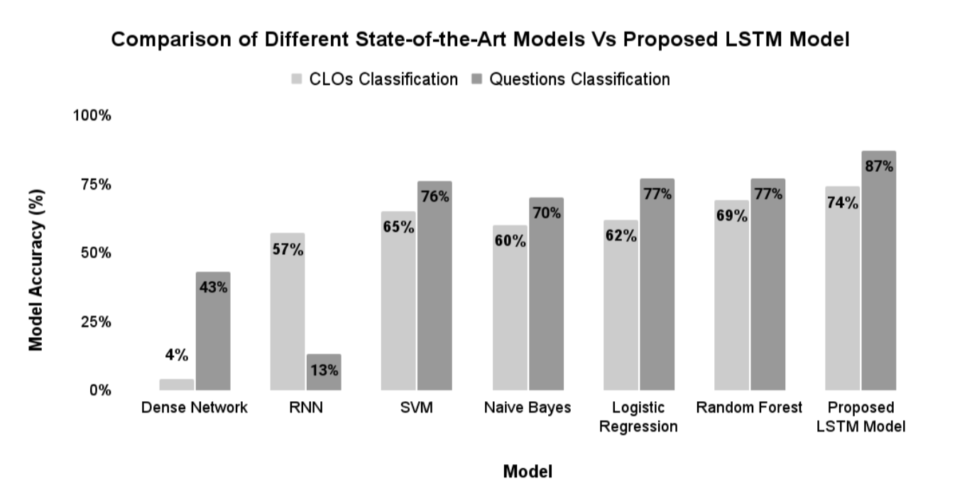
LSTM (Shaikh et al. 2021)

Slide 34
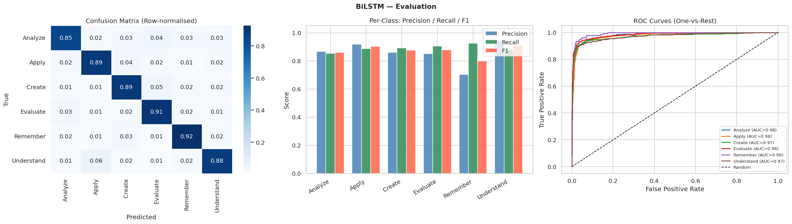
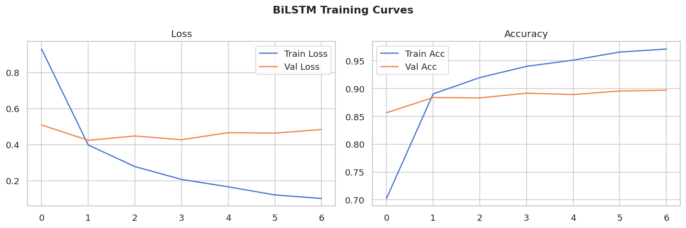

Slide 35
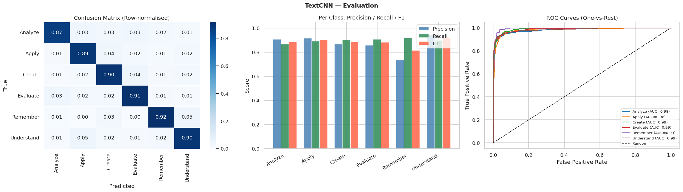
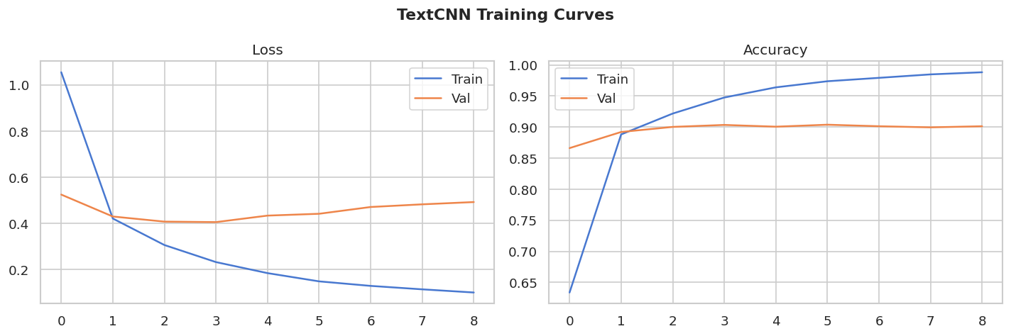

Slide 36

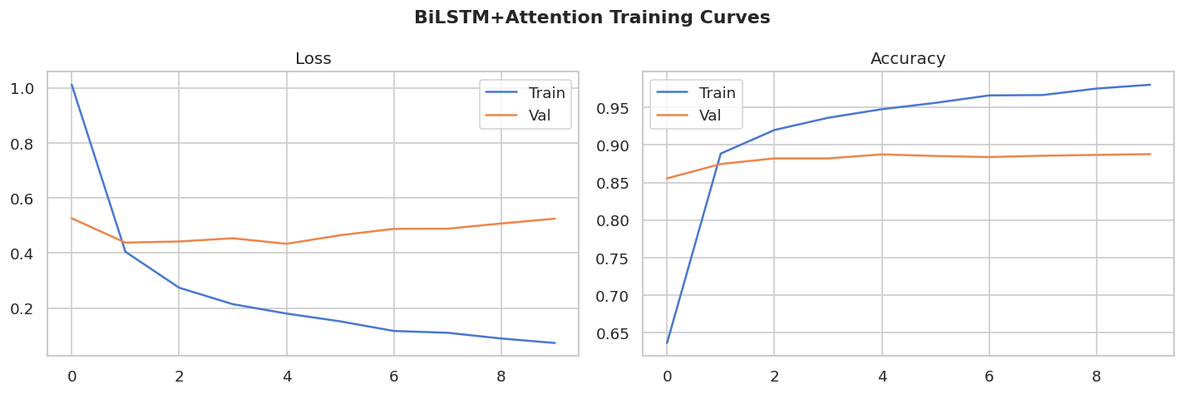

Slide 37
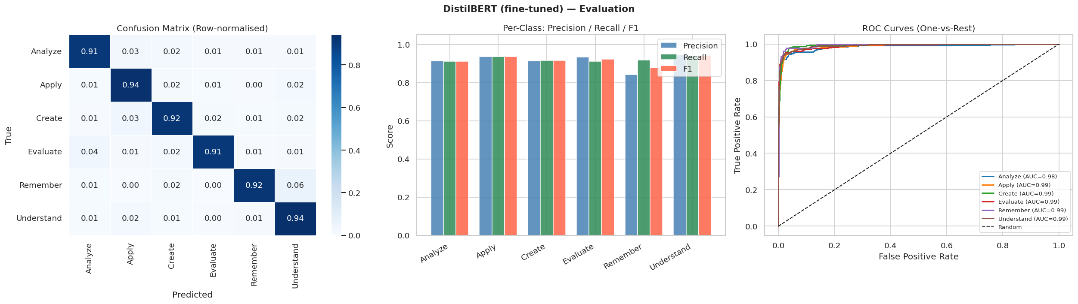

Slide 38


Slide 39


Slide 40
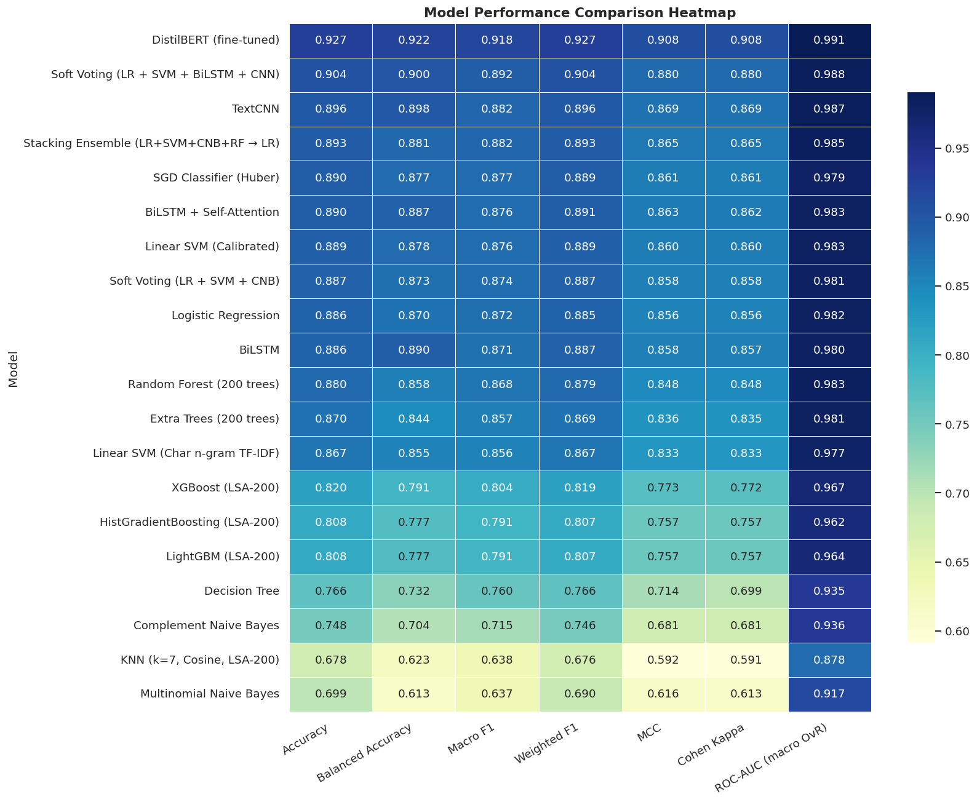

Slide 41
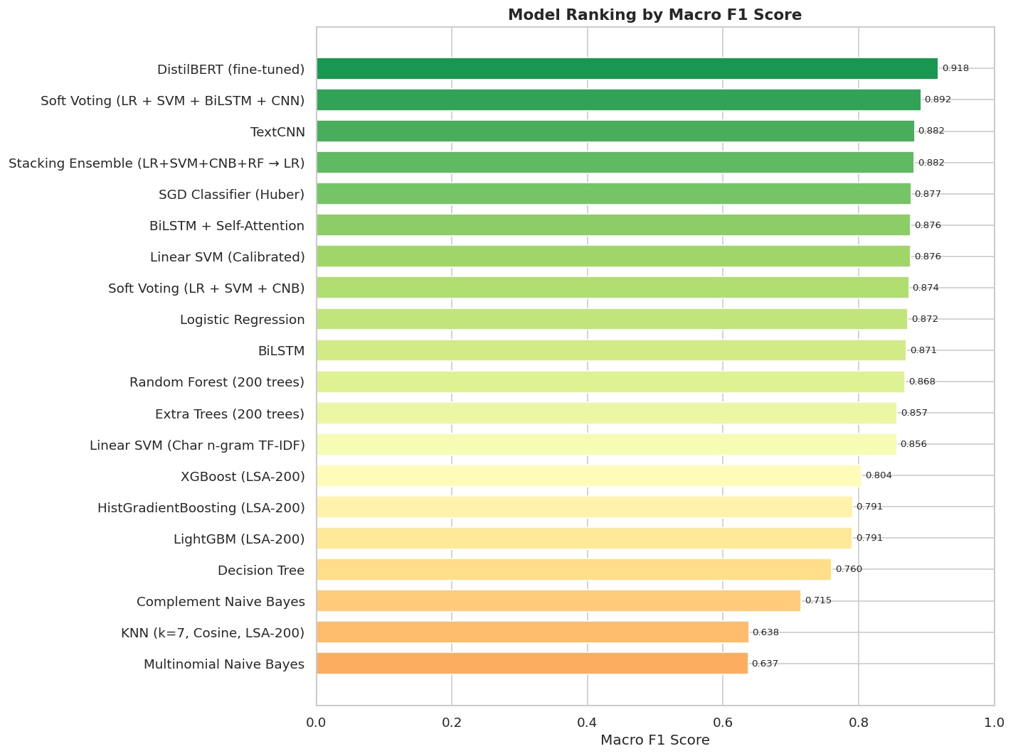

Slide 42
13 Open Source LLMs
mistral_7b_instruct_v02
llama3_8b_instruct
phi35_mini_4k_instruct
qwen2_7b_instruct
llama31_8b_instruct
qwen25_7b_instruct
qwen25_3b_instruct
qwen25_1_5b_instruct
smollm2_1_7b_instruct
gemma2_2b_instruct
gemma2_9b_instruct
phi35_mini_Instruct
mistral_nemo_instruct

Slide 43
Metrics for Evaluation
ACCURACY: Did the model guess right overall?
MICRO F1: How good is the model when treating all predictions as one big group?
MACRO F1: How good is the model on average for each category separately?
WEIGHTED F1: How good is the model for each category, adjusted by how many items are in each?
MACRO PRECISION: On average, when the model says "yes," is it actually correct for each category?
MACRO RECALL: On average, does the model catch all the correct items for each category?
BALANCED ACCURACY: Does the model do equally well at recognizing each category?
MCC: How strongly does the model's prediction match reality (from perfect to completely wrong)?
COHEN'S KAPPA: Does the model agree with the real answer more than just lucky guessing?

Slide 44
Metrics for Evaluation
ACCURACY: The fraction of all predictions that were correct.
MICRO F1: Overall F1 score treating every prediction equally across all classes.
MACRO F1: Average of each class’s F1 score (treats all classes equally).
WEIGHTED F1: Average of class F1 scores weighted by each class’s support (frequency).
MACRO PRECISION: Average of each class’s precision (how correct positive predictions are), averaged across classes.
MACRO RECALL: Average of each class’s recall (how many true items are found), averaged across classes.
BALANCED ACCURACY: Average of per-class recall (equal weight per class), i.e., mean recall across classes.
MCC (Matthews Correlation Coefficient): Single-number correlation between predictions and true labels, ranging from -1 (worst) to +1 (best), 0 = random.
COHEN'S KAPPA: Agreement between predictions and truth adjusted for chance agreement (1 = perfect, 0 = chance).

Slide 45
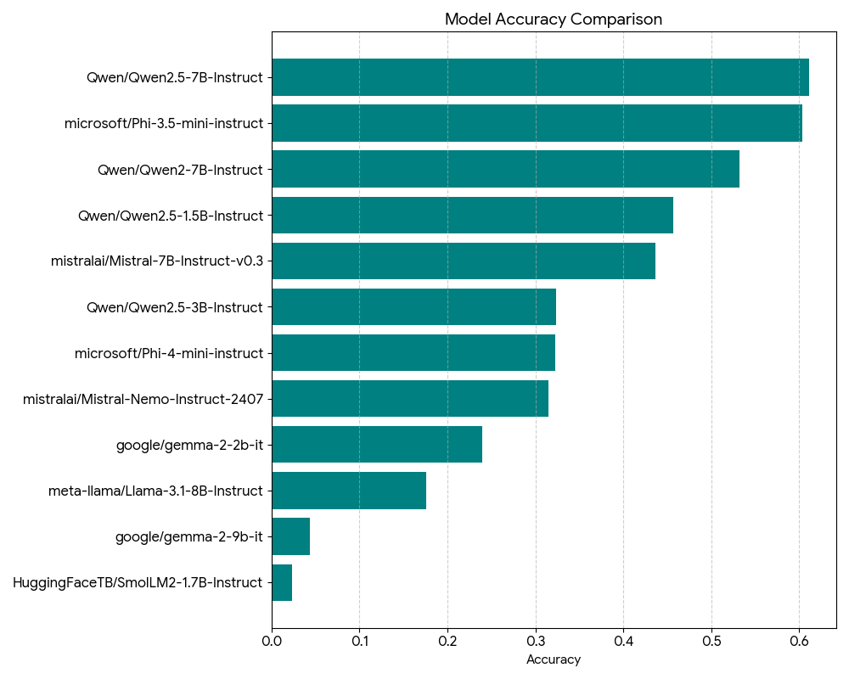
Zero-shot comparison via Accuracy

Slide 46
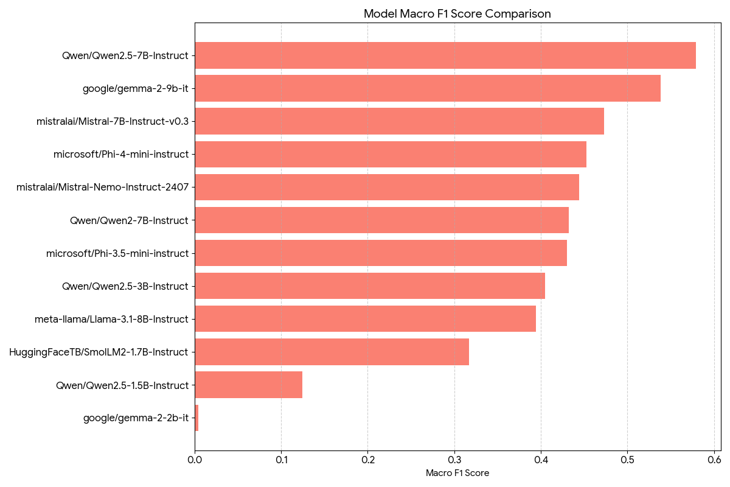
Zero-shot comparison via Macro F1

Slide 47
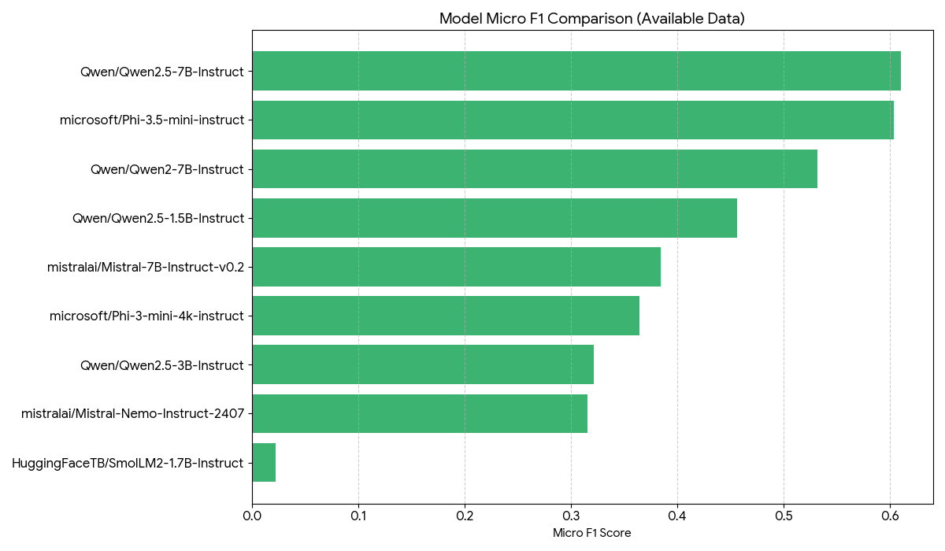
Zero Shot Comparison with Micro F1

Slide 48
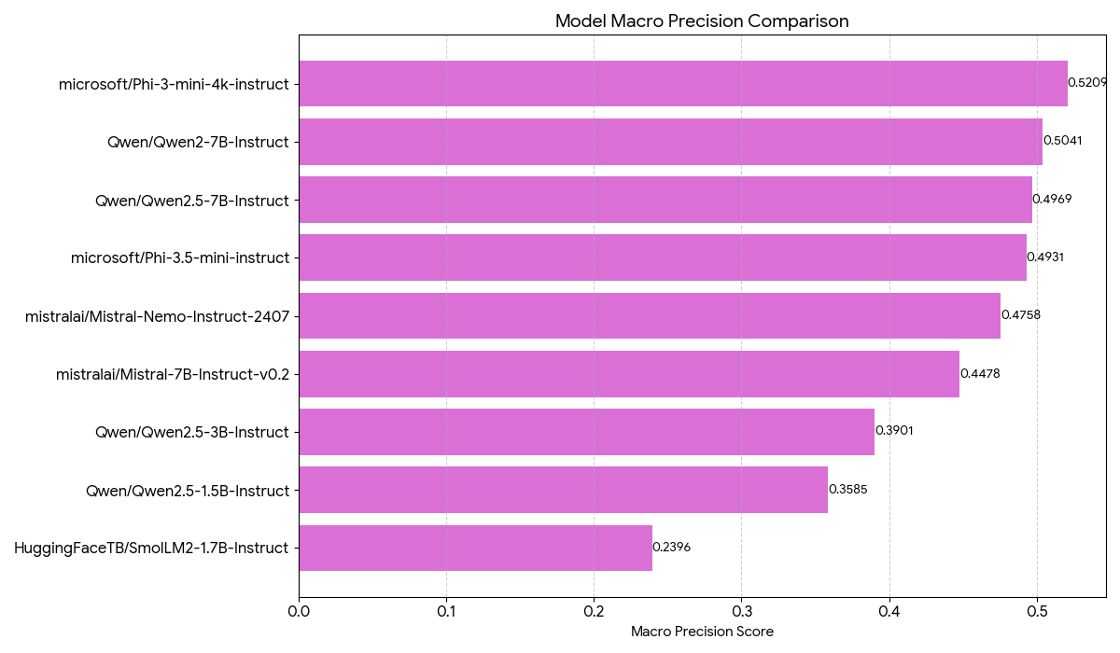
Zero Shot Comparison with Macro Precision

Slide 49
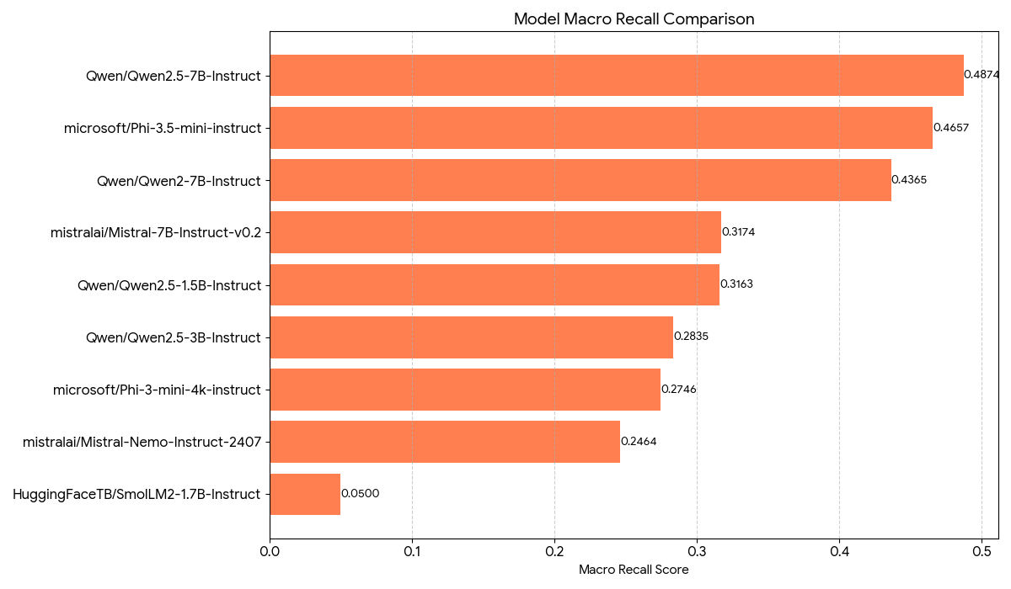
Zero Shot Comparison with Macro Recall

Slide 50

Zero Shot Comparison with Balanced Accuracy

Slide 51
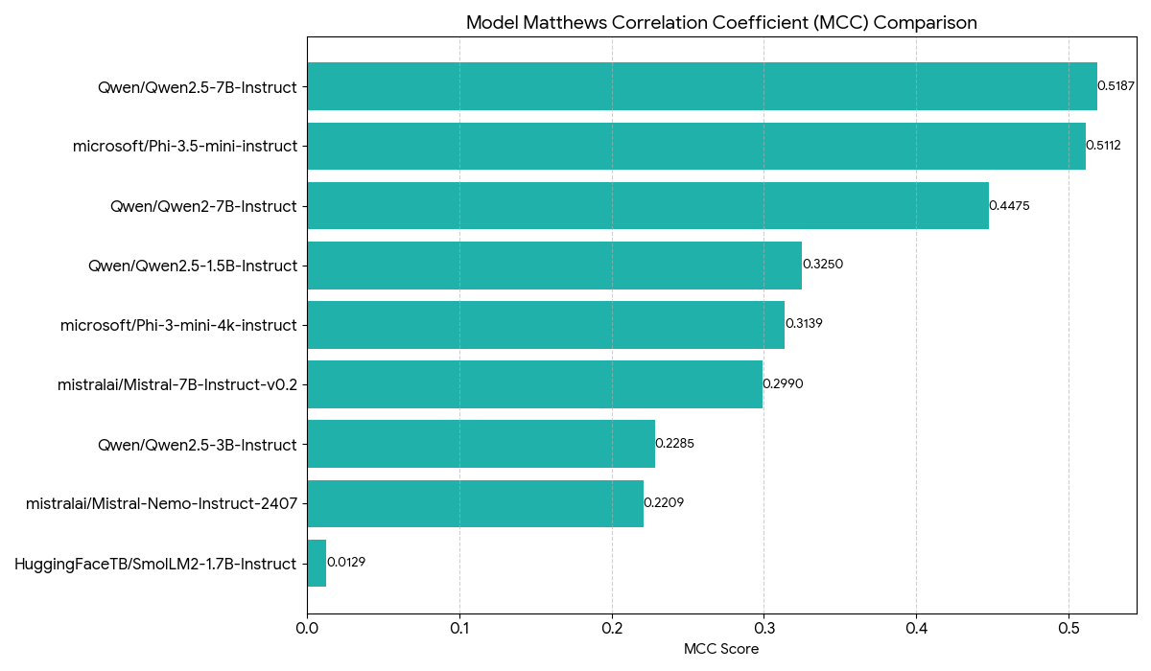
Zero Shot comparison via MCC

Slide 52
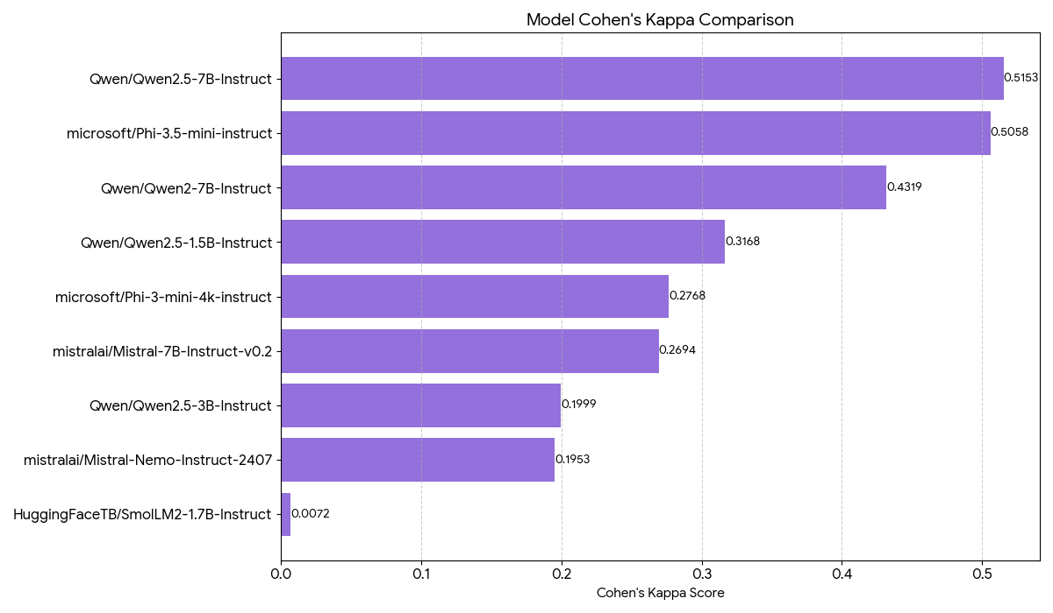
Zero Shot, Cohen’s Kappa

Slide 53
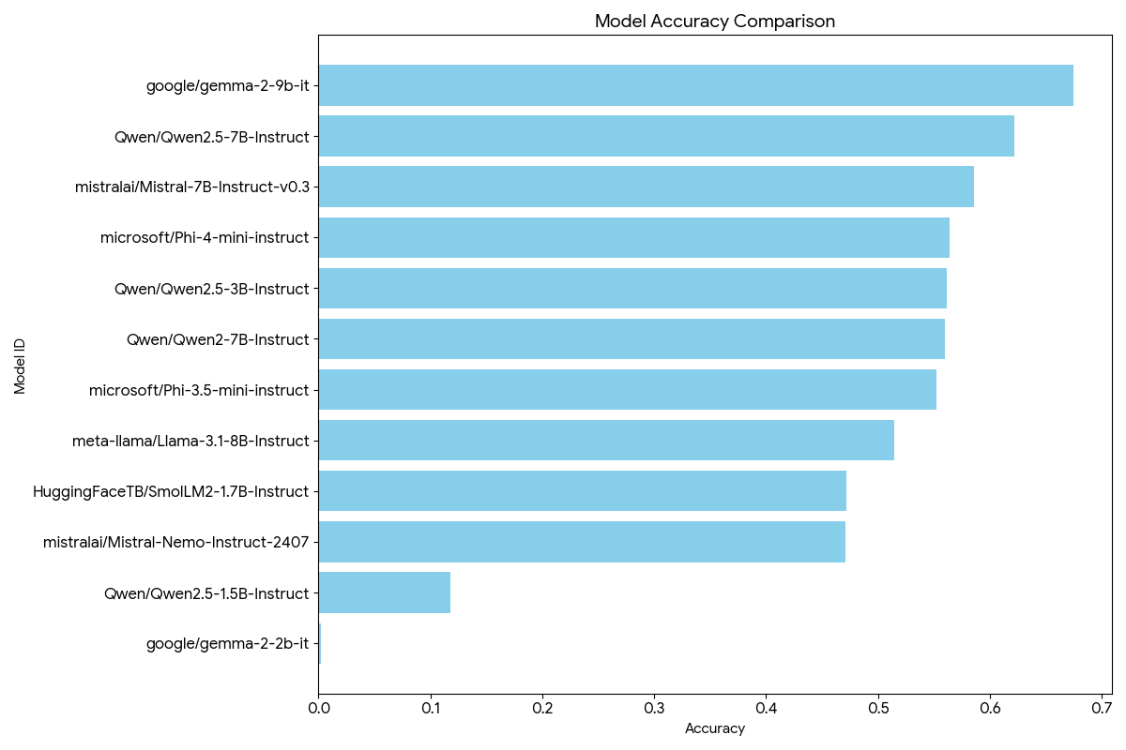
Few shot comparison via Accuracy

Slide 54
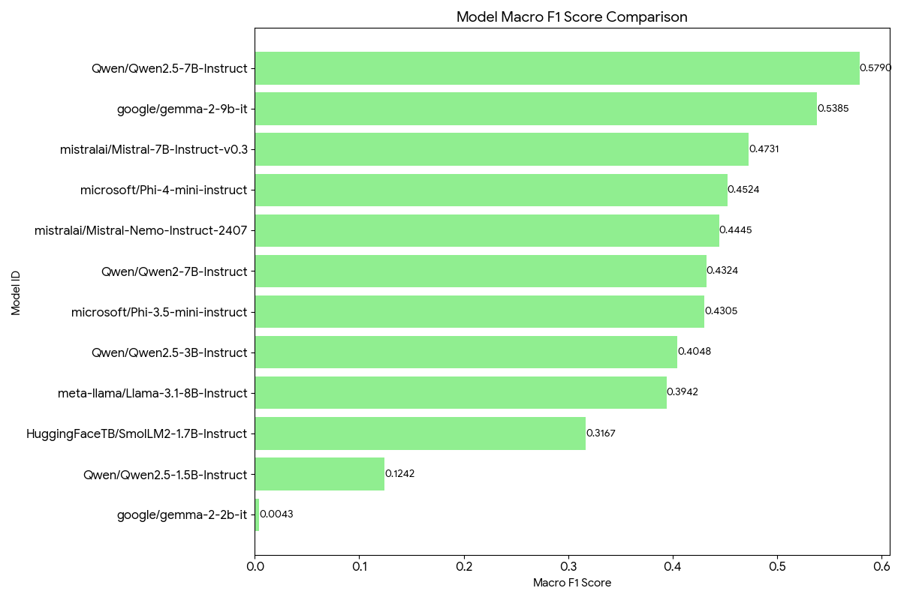
Few Shot Comparison via Macro F1

Slide 55
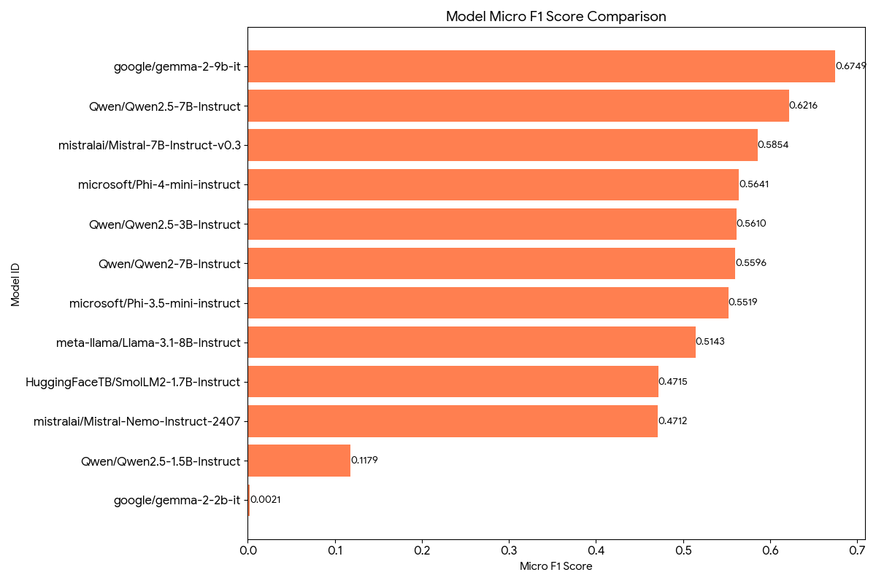
Few Shot Comparison via Micro F1

Slide 56
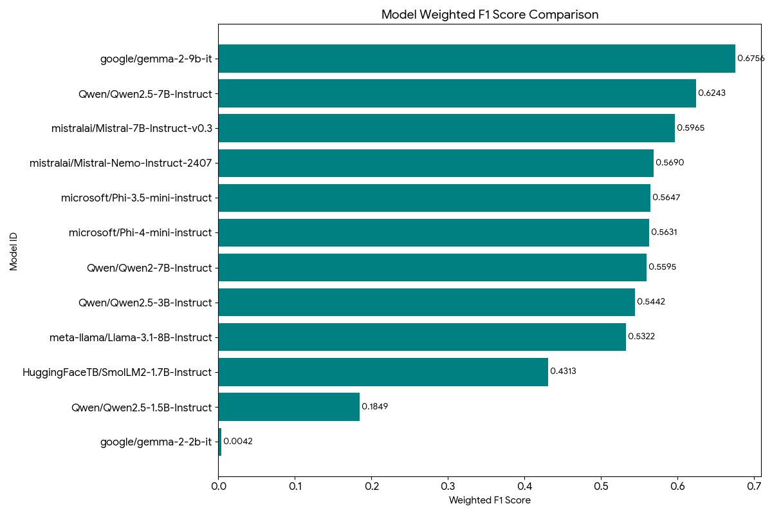
Few Shot Comparison via F1 Score

Slide 57
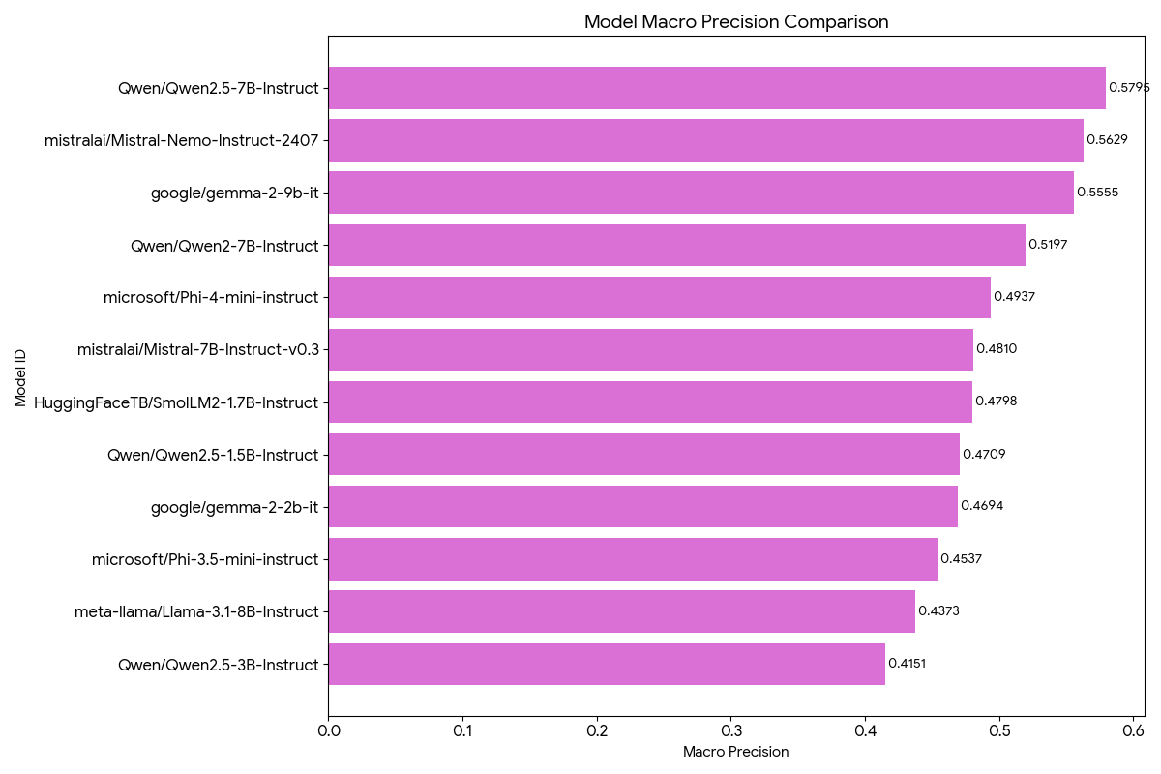
Few Shot Comparison via Macro Precision

Slide 58
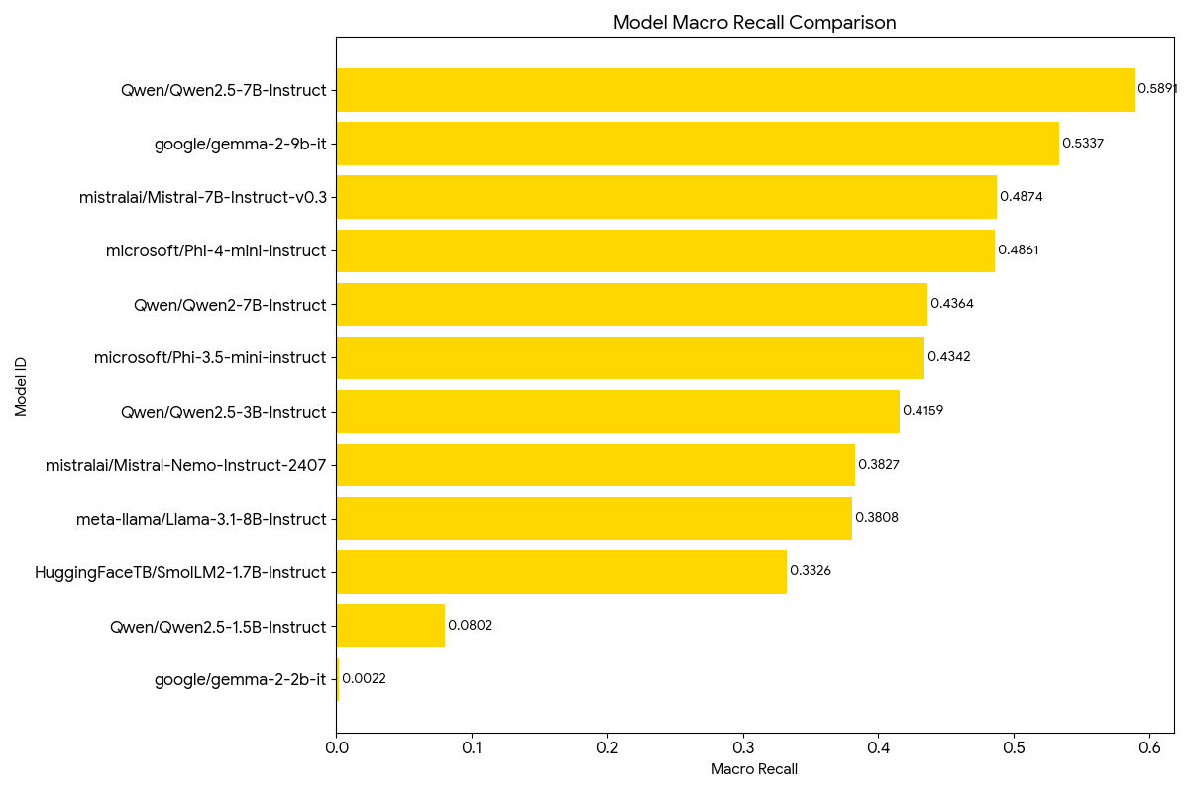
Few Shot Comparison via Macro Recall

Slide 59
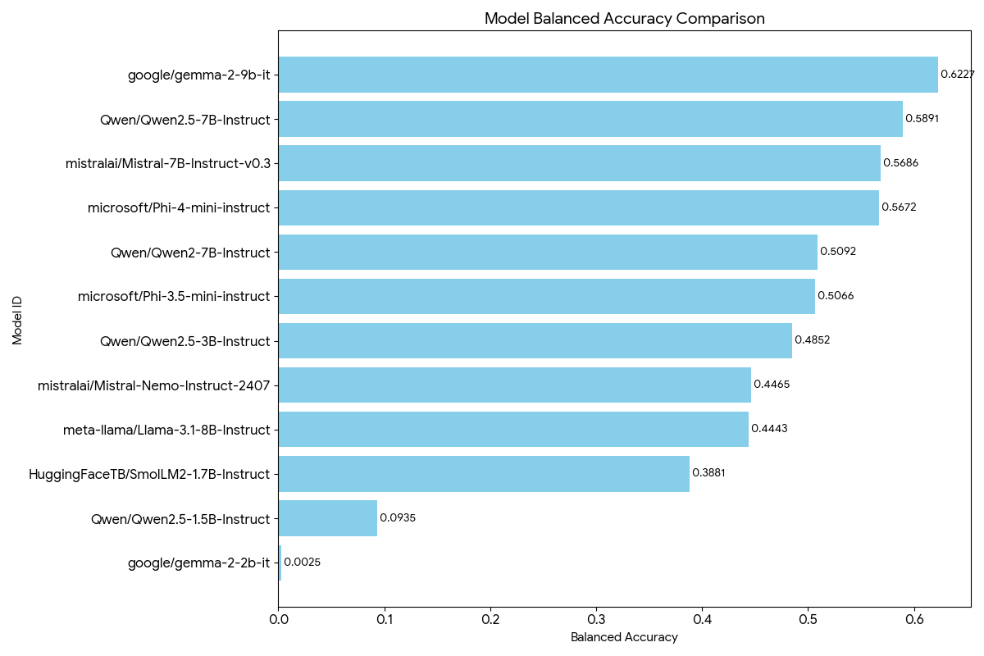
Few Shot Comparison via Balanced Accuracy

Slide 60
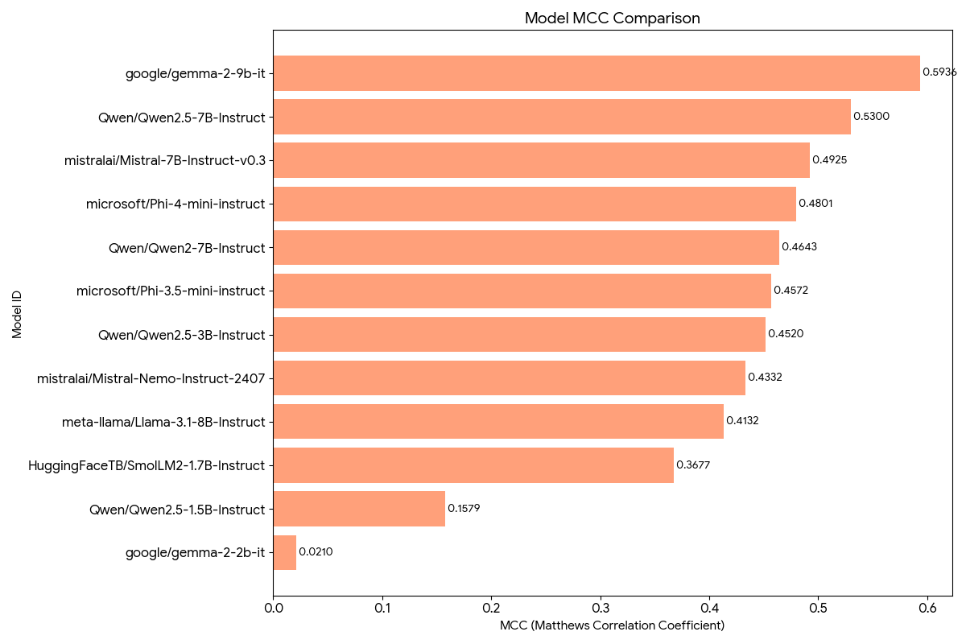
Few shot comparison via MCC

Slide 61
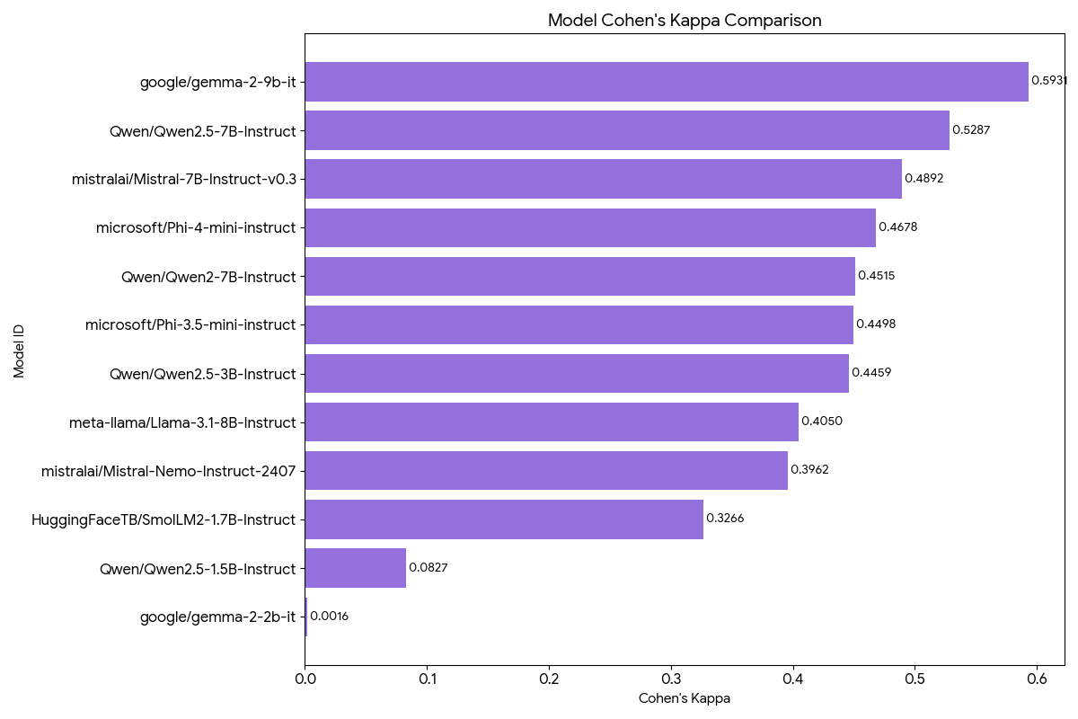
Few Shot Comparison via Cohen’s Kappa

Slide 62
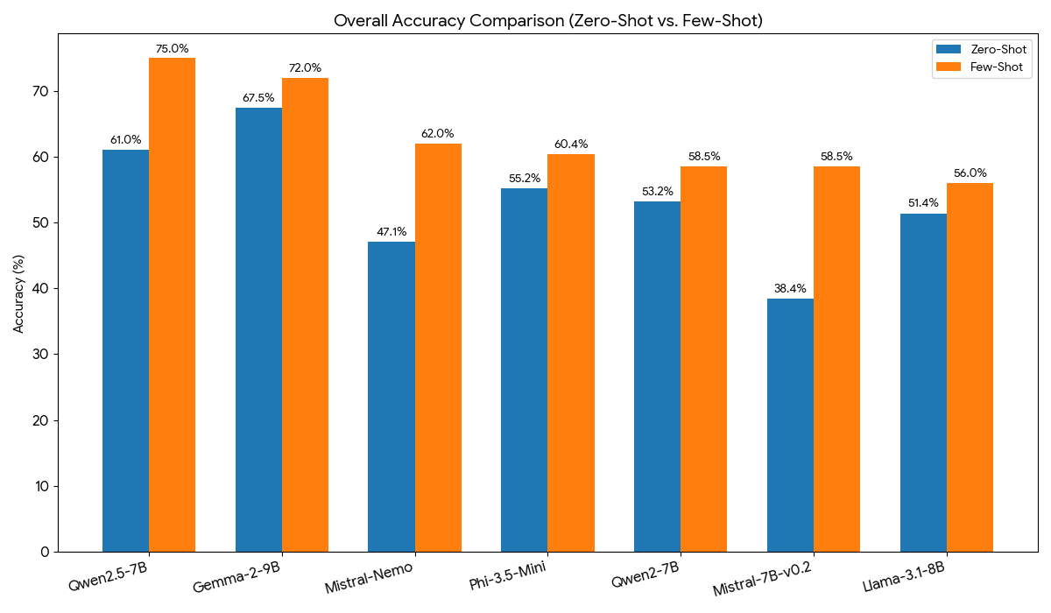
Zero vs Few Comparison (Accuracy)

Slide 63
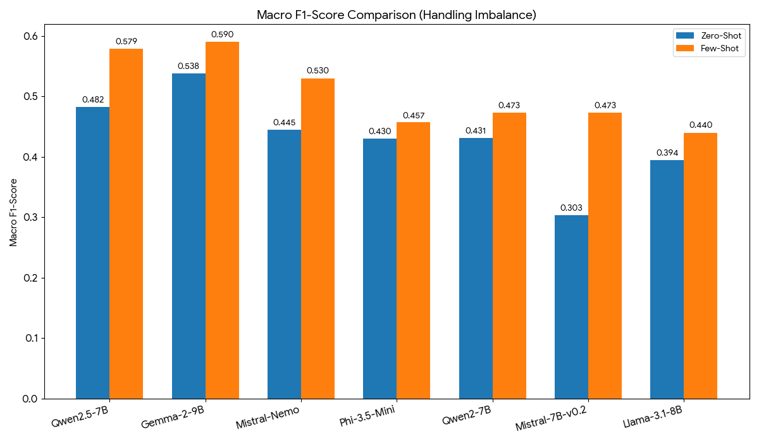
Zero vs Few Comparison (Macro F1 Score)

Slide 64
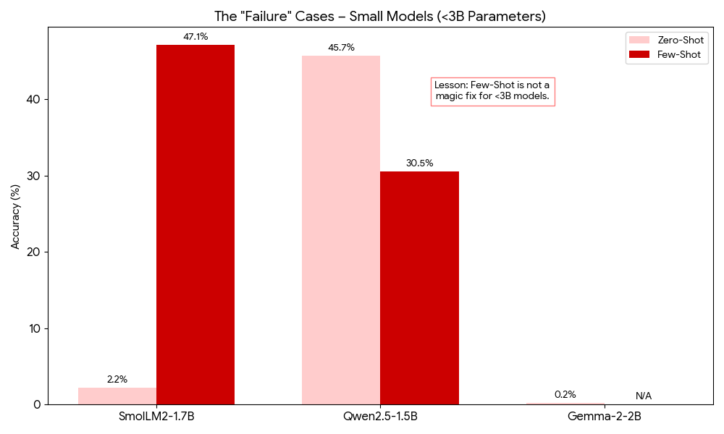
The “Failure” Cases

Slide 65
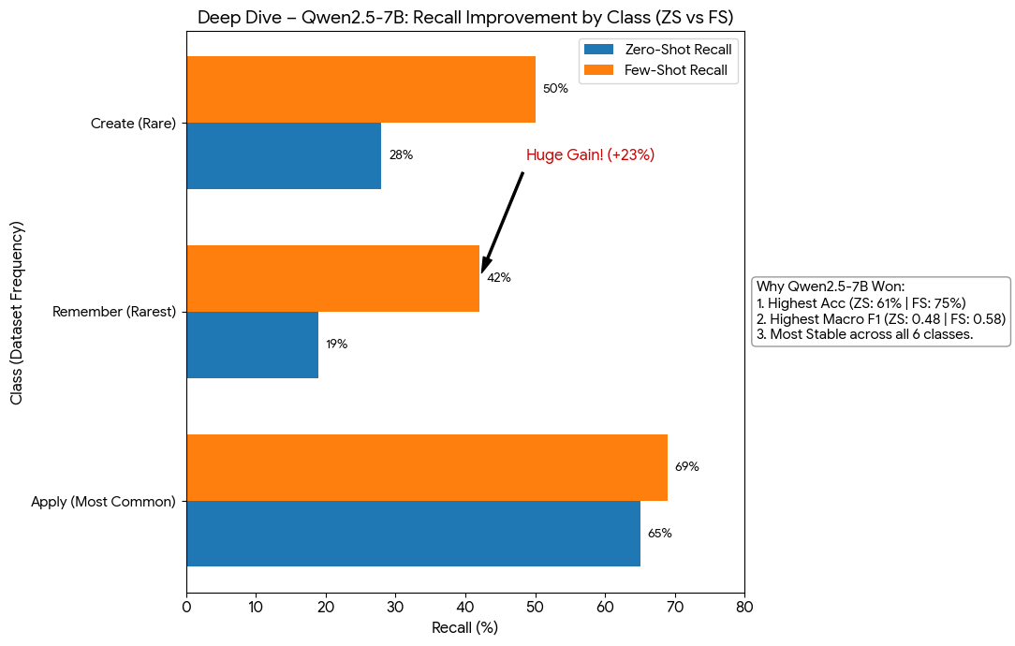
The Best Model Qwen2.5-7B
Why Qwen2.5-7B Won:
Highest Accuracy in both ZS (61%) and FS (75%).
Highest Macro F1 in both ZS (0.48) and FS (0.58).
Most stable performance across all 6 classes.
Class-Level Improvement (Few-Shot vs Zero-Shot):
"Apply" (Most Common): ZS Recall ~65% → FS Recall ~69%.
"Remember" (Rarest): ZS Recall ~19% → FS Recall ~42%. (Huge Gain!)
"Create": ZS Recall ~28% → FS Recall ~50%.
Takeaway: Few-Shot prompting specifically helped the model find the rare classes it was ignoring in Zero-Shot.

Slide 66
ML RESEARCH • FINE-TUNING PIPELINE
Bloom's Taxonomy
LLM Fine-Tuning Pipeline
Teaching three 7–9B parameter models to classify academic learning outcomes into six cognitive levels using QLoRA.
3
21,379
18.77K
93.2%
Models
Training samples
Clean rows
Best accuracy
NVIDIA RTX A6000 • 48GB VRAM • QLoRA 4-bit NF4

Slide 67
Based on Shot-experiment results, Three of the open-source models proved to be promising than the others, hence fine tuned
Qwen 2.5 7B
Gemma 2 9B
Mistral 7B

Slide 68
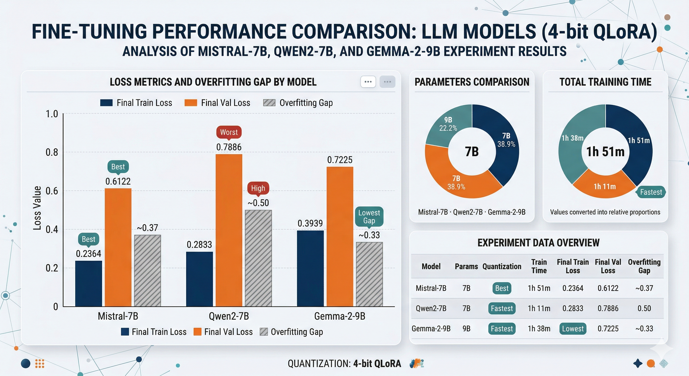
Fine Tuning Comparison

Slide 69
THE TASK
Classifying what students actually learn
Higher-order thinking ↑
Every academic course lists dozens of learning outcomes —
Create
design, compose, construct
“Define, explain, calculate, analyze, design…”
Evaluate
critique, judge, defend
Each verb signals a different level of cognitive demand. Benjamin Bloom's taxonomy (1956, revised 2001) organizes these into six progressive tiers — a backbone of curriculum design.
Analyze
compare, contrast, examine
Apply
calculate, solve, demonstrate
THE QUESTION
Can a 7-billion parameter open model, fine-tuned on ~16K examples, reliably sort learning outcomes into Bloom's six levels?
Understand
explain, summarize, classify
Remember
define, list, identify
Spoiler: two can. One spectacularly can't.
Lower-order recall ↓
Bloom's Taxonomy LLM Fine-Tuning
2 / 12

Slide 70
THE CONTENDERS
Three instruction-tuned open models
All fine-tuned identically: same data, same QLoRA config, same 3 epochs. Only the base weights differ.
01
Mistral-7B-Instruct
02
Qwen2-7B-Instruct
03
Gemma-2-9B-IT
Mistral AI
Alibaba Cloud
Google DeepMind
7B
parameters
7B
parameters
9B
parameters
Trainable
41.9M (0.57%)
Trainable
40.4M (0.53%)
Trainable
54.0M (0.58%)
Vocabulary
32,768
Vocabulary
151,643
Vocabulary
256,000
Runtime
1h 51m
Runtime
1h 38m
Runtime
1h 11m
Method
QLoRA 4-bit NF4
Method
QLoRA 4-bit NF4
Method
QLoRA 4-bit NF4
Bloom's Taxonomy LLM Fine-Tuning
3 / 12

Slide 71
THE DATASET
18,773 labelled learning outcomes
Streamed from sample_full.csv in 2,000-row chunks — a memory-safe pipeline that drops multi-labelled and stub rows.
PIPELINE FUNNEL
LABEL DISTRIBUTION
Raw rows
21,379
After chunked parse
18,773
Training split (85%)
15,957
Test split (15%)
2,816
2,607 rows dropped
(multi-label / unlabelled)
Class imbalance: Remember is ~5.7× rarer than Understand. Handled via stratified 85/15 split.
Bloom's Taxonomy LLM Fine-Tuning
4 / 12

Slide 72
THE RECIPE
QLoRA: memory-efficient fine-tuning
4-bit NF4 quantised weights + low-rank adapters. Fits 9B models into 48 GB with room to train.
EPOCHS
BATCH SIZE
PROMPT TEMPLATE
3
4 × 4
Instruction-style supervised fine-tuning
Full passes over 15,957 rows
Effective batch = 16 (grad accum)
### System:
You are an expert educator. Classify the
following academic learning outcome into
exactly one of Bloom's Taxonomy cognitive
levels: Remember, Understand, Apply, Analyze,
Evaluate, or Create.
### Learning Outcome:
Analyze the health economic implications
of efficient perioperative practice.
### Bloom's Level:
Analyze
LEARNING RATE
MAX SEQ. LEN
2e-4
256
Cosine schedule, 5% warmup
Prompts fit comfortably
LORA RANK
PRECISION
r = 16
bf16
α = 32, dropout 0.05
NF4 double-quant, bf16 compute
Bloom's Taxonomy LLM Fine-Tuning
5 / 12

Slide 73
TRAINING DYNAMICS
How each model learned over time
Training and validation loss at each epoch. Lower train loss + higher val loss = classic overfitting signal.
Bloom's Taxonomy LLM Fine-Tuning
6 / 12

Slide 74
HEADLINE RESULT
The Leaderboard
Evaluated on 2,816 held-out test samples. Weighted F1 is the primary metric.
1st
BEST
2nd
STRONG
3rd
FAILED
Mistral-7B-Instruct
Qwen2-7B-Instruct
Gemma-2-9B-IT
93.22%
92.47%
20.24%
Accuracy
Accuracy
Accuracy
Weighted F1
Macro F1
Weighted F1
Macro F1
Weighted F1
Macro F1
0.9324
0.9206
0.9250
0.9149
0.3097
0.3050
Bloom's Taxonomy LLM Fine-Tuning
7 / 12

Slide 75
PER-CLASS F1
How each model handles each Bloom level
Gemma's collapse is uniform across higher-order levels — precision is strong, but recall falls off a cliff.
WINNER
Mistral dominates across the board
Best F1 on 4 of 6 classes. Most balanced recall-precision profile.
CLOSE
Qwen2 matches on Evaluate & Create
Essentially tied with Mistral on the hardest creative levels.
BROKEN
Gemma collapses above Remember
F1 drops from 0.83 → 0.12 on Analyze & Evaluate. See next slide.
Bloom's Taxonomy LLM Fine-Tuning
8 / 12

Slide 76
CASE STUDY
The Gemma paradox — precise yet wrong
Its training loss dropped to 0.28 (lowest of the three). Yet accuracy stalled at 20%. What happened?
1
Precision → ~1.0
When Gemma *does* predict a class, it's almost always right. It isn't confused about meaning — it's silent on most inputs.
2
Recall → ~0.06
Only ~6% of Analyze/Evaluate outcomes get labelled at all. The model abstains or produces tokens that don't match any Bloom label.
3
Likely cause
Gemma-2's safety/instruction format differs from Mistral & Qwen. Without a chat template, outputs drift and the parser captures 'Unknown'.
4
The fix
Apply Gemma's official chat template, or retrain with `attn_implementation="eager"` AND a matching prompt structure.
Bloom's Taxonomy LLM Fine-Tuning
9 / 12

Slide 77
WINNER SPOTLIGHT
Mistral-7B — full per-class breakdown
Class
Precision
Recall
F1
Support
Remember
0.85
0.88
0.86
133
Understand
0.96
0.94
0.95
762
Apply
0.94
0.93
0.94
761
Analyze
0.92
0.92
0.92
347
Evaluate
0.95
0.91
0.93
370
Create
0.88
0.95
0.92
443
Macro F1
Weighted F1
Accuracy
0.9206
0.9324
93.22%
Bloom's Taxonomy LLM Fine-Tuning
10 / 12

Slide 78
IN THE WILD
Live predictions from the best model
Six unseen learning outcomes. Mistral classifies each in under 100 ms on an A6000.
INPUT
→
INPUT
→
“Define the key terms used in thermodynamics.”
Understand
“Explain the principles of natural selection.”
Understand
INPUT
→
INPUT
→
“Calculate the acceleration of a falling object using Newton's 2nd law.”
Apply
“Compare and contrast supervised and unsupervised ML.”
Evaluate
INPUT
→
INPUT
→
“Critique a peer's experimental design for potential confounds.”
Evaluate
“Design an algorithm to solve the travelling salesman problem.”
Create
$ classify_learning_outcome("Design a curriculum unit on climate change.") → Create
Bloom's Taxonomy LLM Fine-Tuning
11 / 12

Slide 79
TAKEAWAYS
What this experiment proved
01
02
QLoRA works — at scale.
Bigger ≠ better.
Fine-tuning <1% of parameters lifted instruction-tuned models to 93% accuracy on a 6-way classification task.
The 9B Gemma failed while both 7B models excelled. Architecture, chat templates, and tokenizer alignment matter more than raw parameter count.
03
04
Class imbalance was survivable.
Always inspect recall, not just loss.
Remember class had only 886 rows (<5% of data) yet still achieved F1 ≥ 0.86 in both winning models. Stratified splitting + QLoRA handled it.
Gemma's training loss was the lowest of the three. A loss curve alone would have declared it the winner. Class-level recall told the real story.
Mistral-7B-Instruct-v0.3 • 93.22% accuracy • 0.9324 weighted F1 • ~1h 51m training on a single A6000

