Slide 1
Measuring Media Campaign Effectiveness Using Machine Learning
A Comprehensive Approach for CPG Companies
Your Name
Date

Slide 2
Introduction

Slide 3
Overview of the Need
In the competitive CPG industry, it's crucial to measure the effectiveness of media campaigns to maximize ROI.
Understanding the impact of different media channels helps allocate budgets more efficiently.

Slide 4
Data Visualization

Slide 5
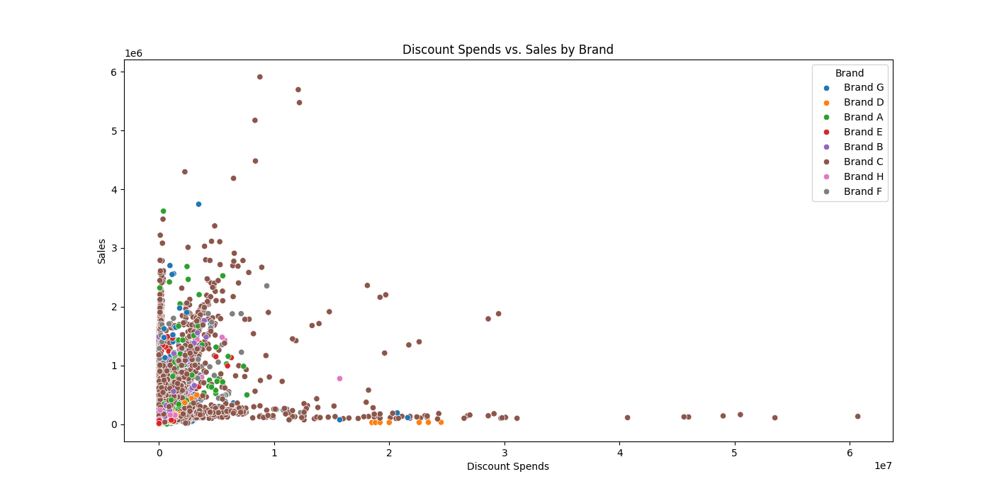
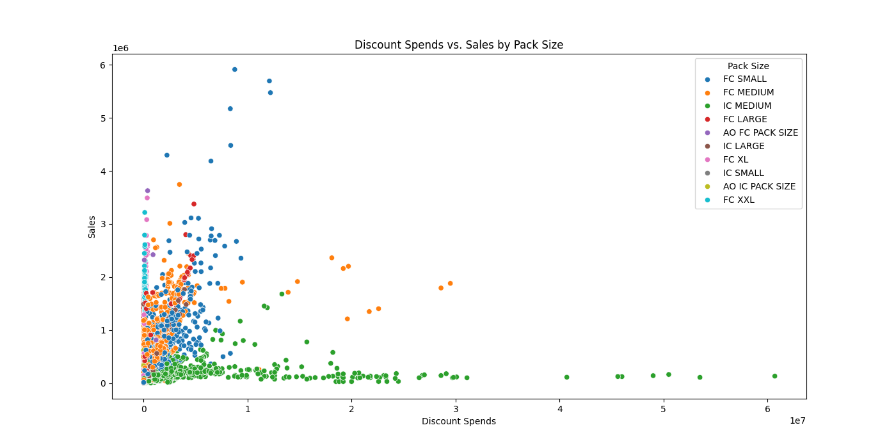
Scatter Plot
Discount Spends vs. Sales by Brand
Discount Spends vs. Sales by Pack Size
Discounts had the most effect on Brand C and least on Brand D.
Discounts had the most effect on FC Small and least on IC Medium.

Slide 6
Overall Cost Analysis
Brand C seems to be the notable benefiter from different sources of marketing.
Relatively more brands benefitted from other media sources.
Coupons/Offers showed less notable results on most brands.

Slide 7
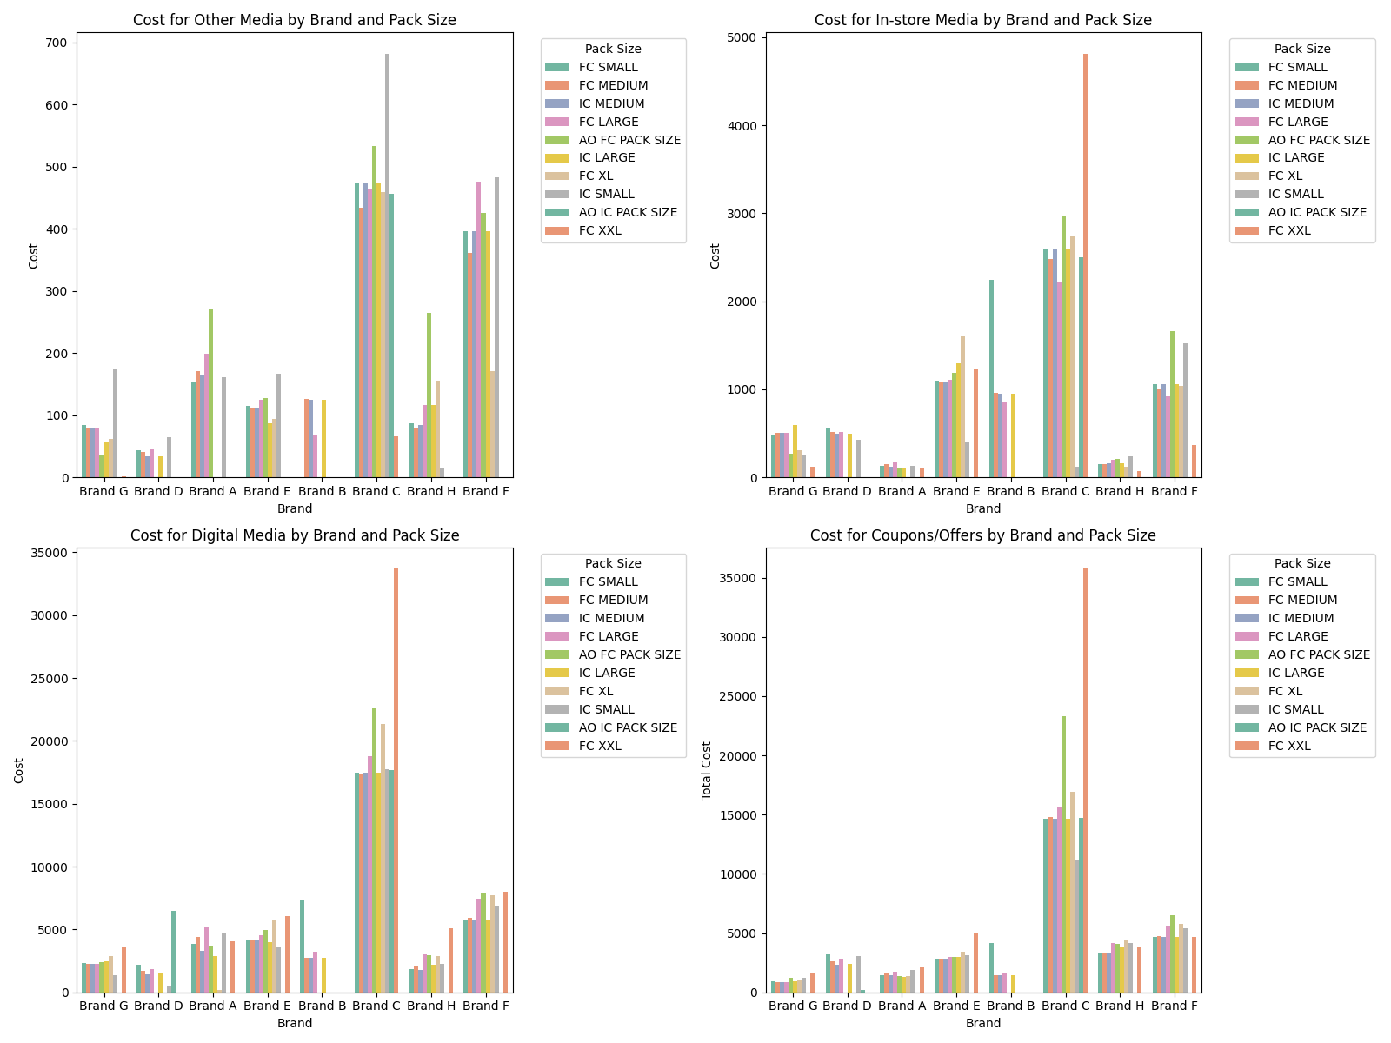

Slide 8
Model Training and Results

Slide 9
Model Training
Data preparation steps.
Overview of machine learning models used: Linear Regression, Lasso Regression, Random Forest Regressor, Logistic Regression, SVM, Naive Bayes.
Training and evaluation process for each model.
Summary and comparison of model performances.

Slide 10
Model Efficiencies
Regression:
Random Forest Regressor showed notable results with an accuracy of almost 97% on the testing dataset.
Classification:
Random Forest Classifier obtained the highest results, with an accuracy of 97% too.

Slide 11
Results and Insights
Optimize Media Spend: Use model insights to allocate media budgets more effectively.
Focus on High Impact Channels: Identify and invest in media channels with the highest sales impact (e.g., digital, in-store).
Regular Monitoring: Continuously update the model with new data to maintain accuracy and relevance.

Slide 12
Q&A
Any Questions?

Slide 13
Appendix

Slide 14
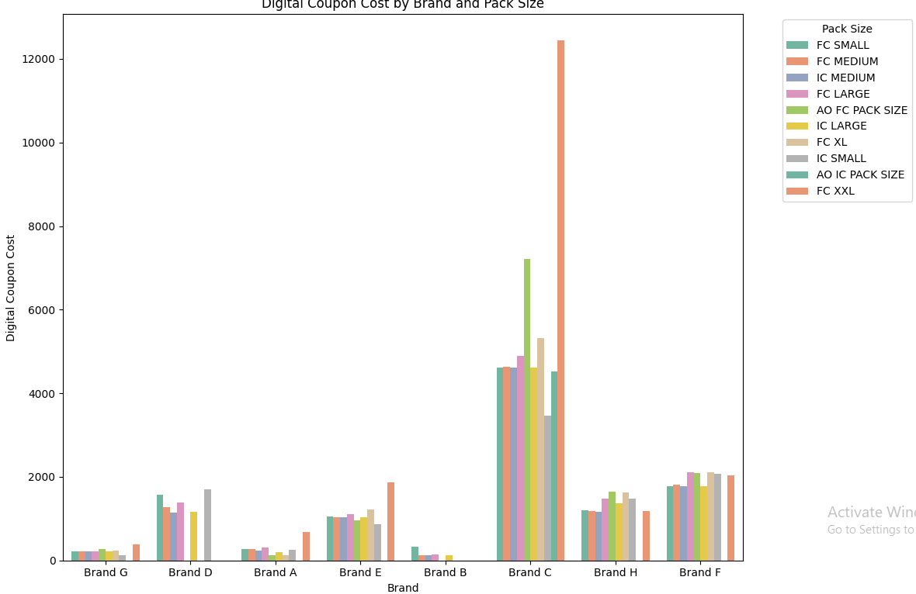
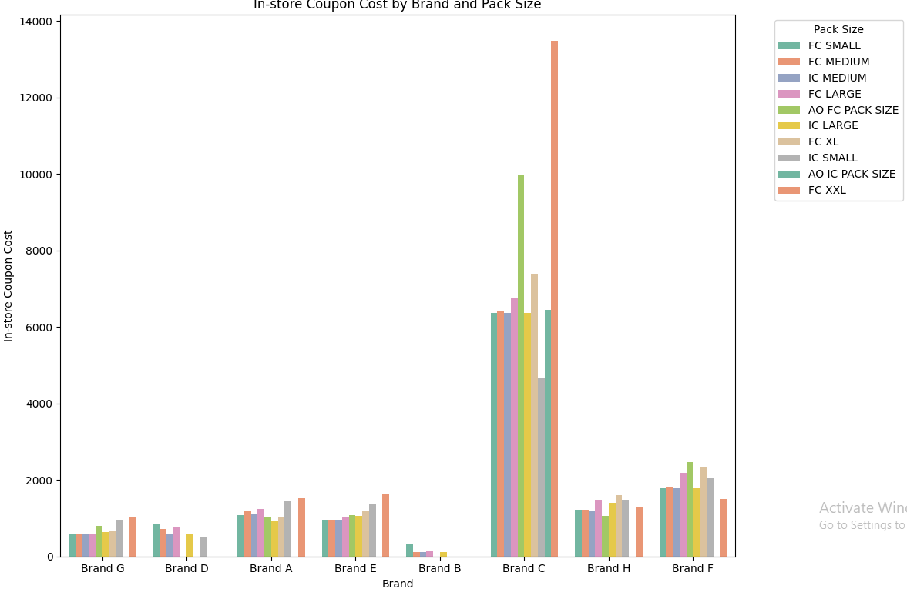
Digital and In store coupon cost
Both the digital and in store coupons proved to have notable benefits on Brand C.
Brands B and G had the least effects.

Slide 15
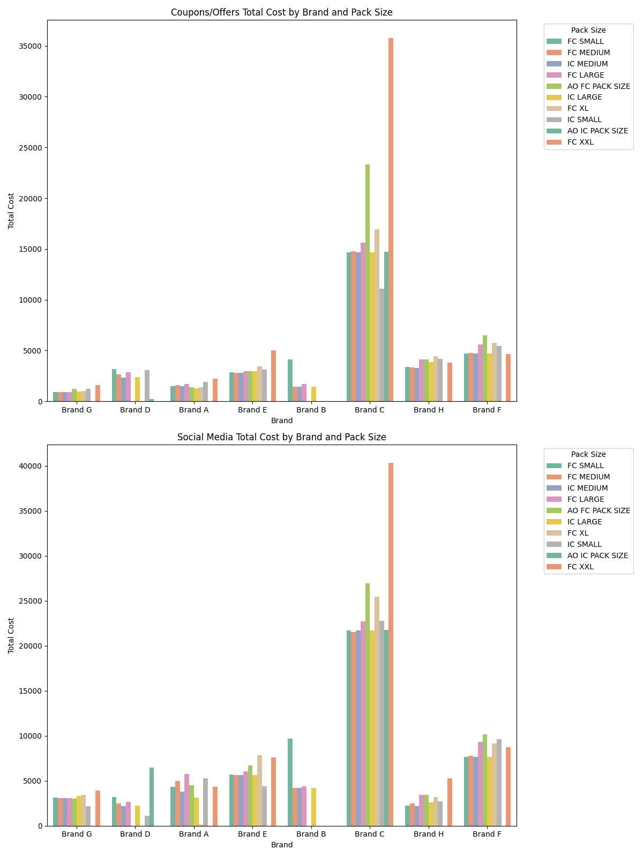
Distribution Plot
Both the coupons and social media improved the notable results for only Brand C.

Slide 16
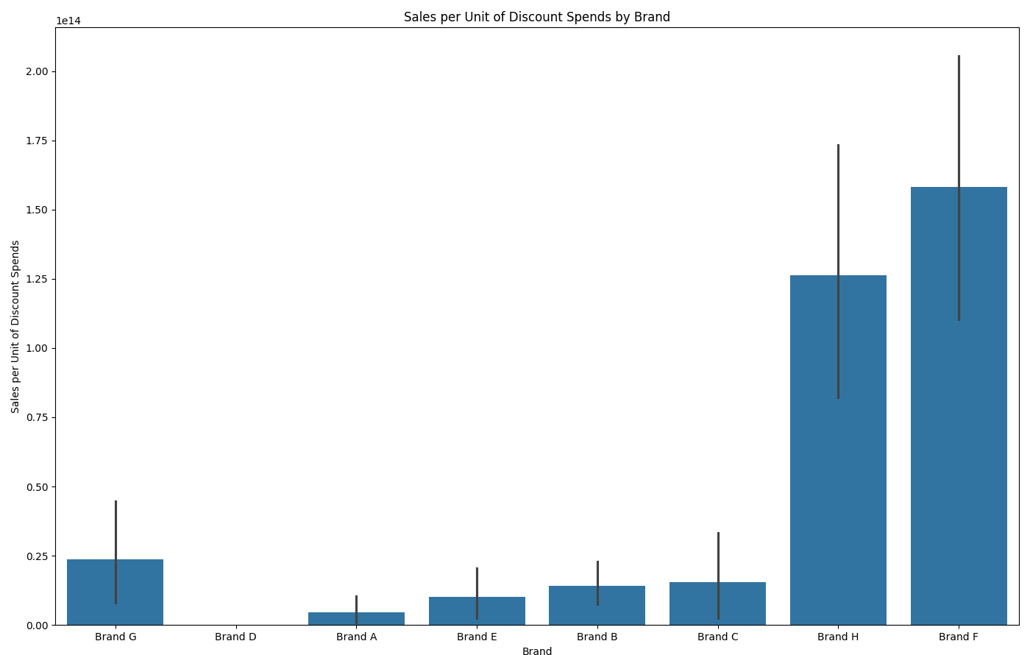
Bar Plot
Sales per discount spend obtained by dividing sum of sales with sum of discount spends.
Proved to be most effective on Brands H and F and least on D.

Slide 17
Feature Engineering
Creation of lag features for time series analysis.
Aggregation of data at a monthly level.
One-hot encoding for categorical variables.

Slide 18
Key Insights
Significant Features: Key predictors of sales include total media spend, CP_TOTAL_COST, sum_Disc_Spends, sum_Units, and sum_EQ_Lbs.
High Predictive Power: A high R² value indicates these features effectively predict sales.
Impact of Media Spend: Positive correlation between media spend and sales shown by scatter plot and model performance.

