Slide 1
Evening 4
al-Buṭāḥ and al-Yamāma
10–12 AH

Slide 2
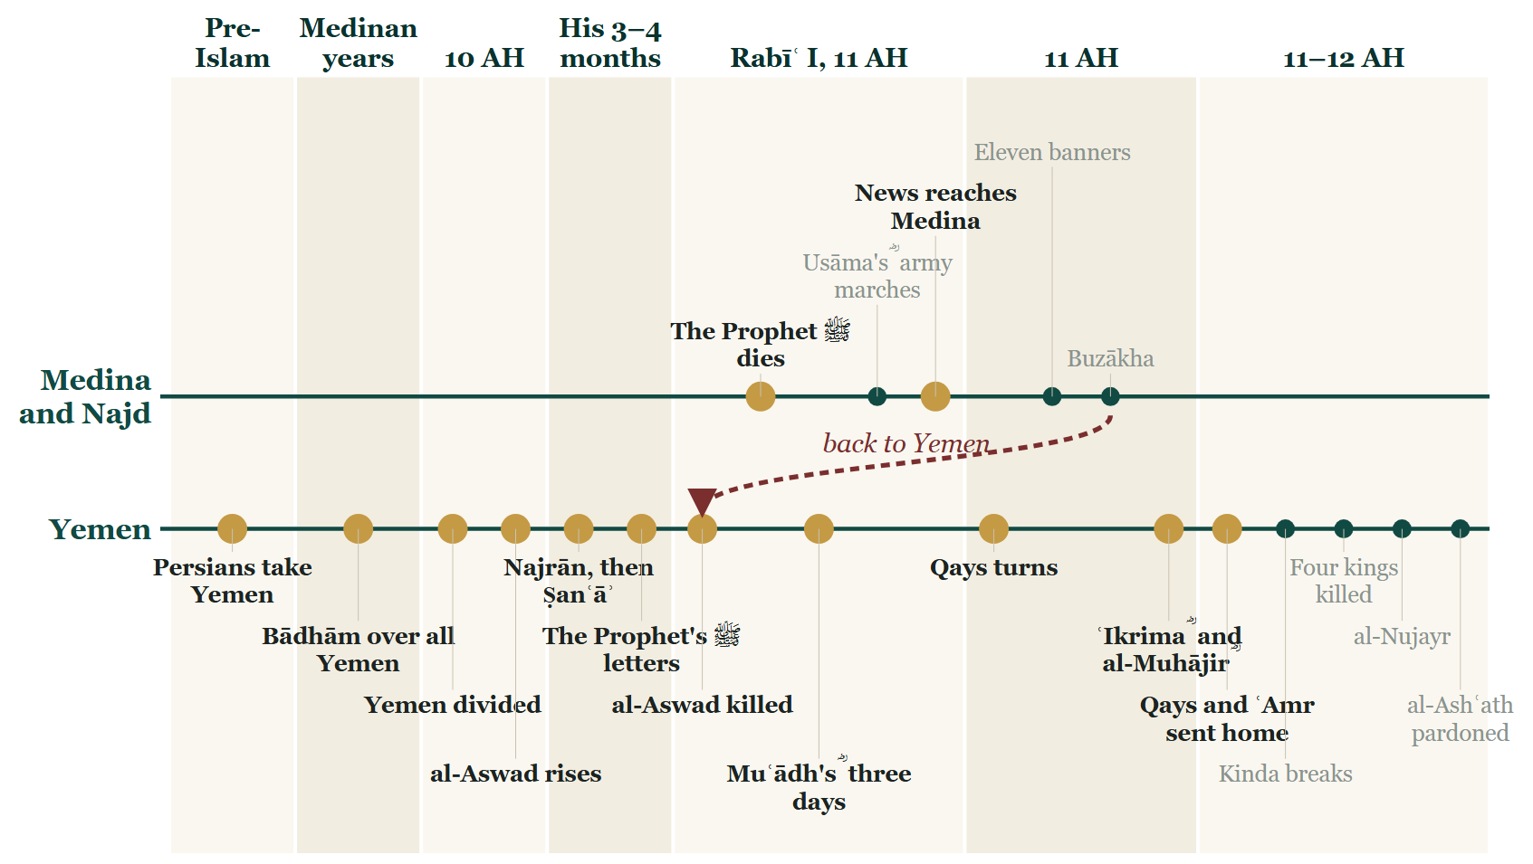
Where we stopped
Notes:
BOOKEND IN — evening 3's STOP B Line: the same image its closing slide showed (DECISIONS.md #23).
Say: while all of that was happening in the south, the northern war had never stopped. Tonight we go back to Khālid ؓ, who we last saw at Buzākha. The one province still grey on your map, Ḥaḍramawt, stays grey tonight — we come back to it when the northern war has caught up.
The map does a loop tonight, and that loop is the truth of the campaign: eleven armies were moving at once, not one after another.

Slide 3
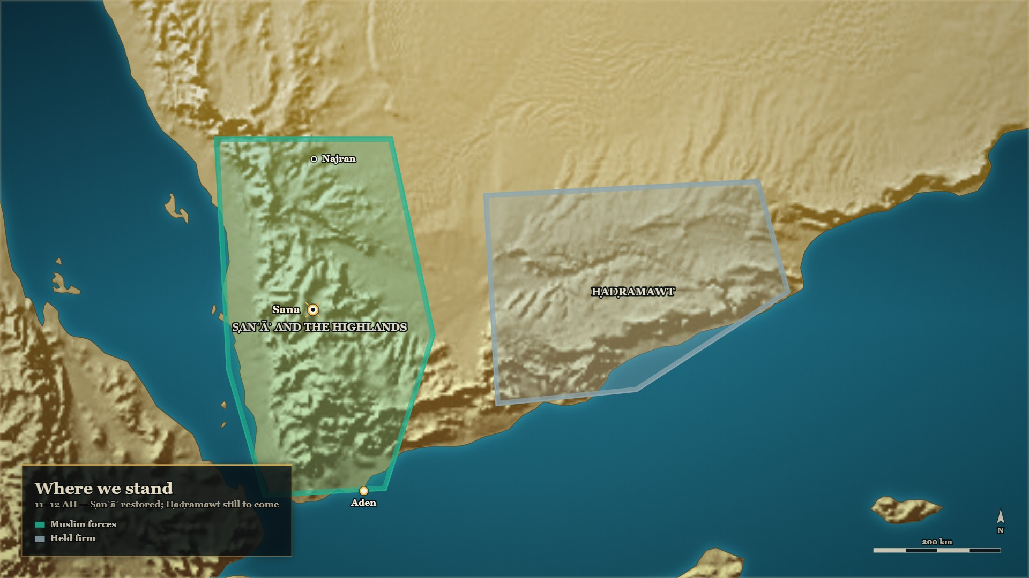
From last week
Where we stand
Ṣanʿāʾ
restored
Ḥaḍramawt
still to come
Notes:
MAP: tools/mapstudio/scenes/s03-close-stop-b.json at step 1, rendered by make_maps.py. The earlier steps are beside it in visuals/maps/ if you want the build-up across slides. Sites are approximate; tribal names are loose labels.

Slide 4
Part I
The two claimants still standing (10–12 AH)

Slide 5
Where the story stands
Tonight: back to the north
Evening 2
Evening 3
Tonight
Khālid ؓ at Buzākha, in Najd: Ṭulayḥa walked off the field
The south: al-Aswad killed in Ṣanʿāʾ, the Yemen restored; Ḥaḍramawt still to come
Two claimants still standing in the north: Musaylima at al-Yamāma, and Sajāḥ
Notes:
BRIDGE — say:
While the south was being settled, the war in the north had never stopped. Two claimants were still standing: Musaylima of Banū Ḥanīfa at al-Yamāma, and Sajāḥ, coming down from al-Jazīra. We meet them first, before the armies reach them.

Slide 6
End of 10 AH
Musaylima's letter, and the reply
فإنَّ الأرضَ لله يُورِثُها منْ يَشاءُ من عباده والعاقبة للمتقين
…the earth belongs to Allah; He gives it in inheritance to whomever He wills of His servants; and the outcome is for those who fear Him.
al-Bidaya wa'l-Nihaya, vol. 5, p. 24
Notes:
RUNSHEET: The note's own judgement: the best pair in the strand. [HANDS] 1: "A man writes to the Prophet ﷺ proposing terms. What do you think he asks for?" — ask at beat 1
SAY —
1. A letter comes from al-Yamāma — He writes as if to an equal: from Musaylima, 'messenger of Allah', to Muḥammad ﷺ.
2. What it actually proposes — Not a revelation: a partition. Half the matter ours, half Quraysh's.
3. "But Quraysh are a people who transgress" — The complaint is about a tribe, not about a religion.
^ read the Arabic on the face here
4. The reply refuses the premise — Not the arithmetic: the earth belongs to Allah.
5. "He gives it in inheritance to whom He wills" — And the outcome is for those who fear Him.
6. The date — The book puts the exchange at the end of the year 10.
QUOTE — من مُسَيْلَمة رسولِ اللهِ إلى محمدٍ رسولِ الله، سلامٌ عَلَيْكَ، أما بعدُ، فإني قد أُشْرِكْتُ في الأمْرِ معكَ، فإنّ لنا نِصْفَ الأمْرِ، ولقُرَيشٍ نصف الأمْرِ، ولكن قُريشًا قومٌ يَعْتدون.
"From Musaylima the Messenger of Allah, to Muḥammad the Messenger of Allah. Peace be upon you. To proceed: I have been given a share in the matter with you. Half the matter is ours and half the matter is Quraysh's — but Quraysh are a people who transgress."
— البدایہ والنہایہ ج۵ ص۲۴
عبرت — One document divides the country between two tribes, and the other answers that the country belongs to neither of them.
HANDS UP — Before telling it: *"A man writes to the Prophet ﷺ proposing terms. What do you think he asks for?"*
MAP — One line from **اليمامة** to **المدینہ** and one back. Two documents side by side on the screen, nothing else.
⚠ The editor footnotes a **variant wording** of the letter — «نصف **الأرض** ولقريش نصف **الأرض**»
(مجموعة الوثائق السياسية ٢٠٥). **Note both; never merge them into one.**
BACKGROUND (read at home, not aloud) —
Musaylima wrote to the Prophet ﷺ. The letter does not argue about revelation at all. It proposes a partition: I have been given a share in the matter with you, half the matter is ours and half is Quraysh's — but Quraysh are a people who transgress. The reply is on the same page, and it refuses the premise rather than the arithmetic. The earth belongs to Allah; He gives it in inheritance to whom He wills of His servants; and the outcome is for those who fear Him. The book dates the exchange to the end of the year 10.
WHEN, as the card gives it: آخر سنة عشر

Slide 7
in the Prophet's ﷺ lifetime
Musaylima at Medina
لو سألتني هذه القطعة ما أعطيتكها
If you asked me for this piece, I would not give it to you…
al-Bidaya wa'l-Nihaya, vol. 5, p. 21 — Sahih al-Bukhari 4373
Notes:
RUNSHEET: ⁨صحيح البخاري 4373⁩. Thābit b. Qays ؓ is standing beside the Prophet ﷺ here — name him, and say nothing more. He comes back at #26
SAY —
1. He came to Medina himself — While the Prophet ﷺ was alive, with a large number of his own people.
2. What he kept saying — Make the succession mine, and I will follow you.
3. The Prophet ﷺ came out to him — With Thābit b. Qays b. Shammās ؓ beside him.
4. There was a piece of palm-branch in his hand — And what he said to him was about that piece.
5. "If you asked me for this, I would not give it to you" — The claim was refused while it was still a request.
^ read the Arabic on the face here
6. Remember the man standing beside him — Thābit b. Qays ؓ. The room will meet him again.
QUOTE — لو سألتني هذه القطعة ما أعطيتكها، ولن تعدوَ أمرَ اللهِ فيك، ولئن أدبرتَ ليعقرنَّك اللهُ
"If you asked me for this piece, I would not give it to you. You will not pass beyond Allah's decree concerning you. And if you turn away, Allah will surely destroy you."
— البدایہ والنہایہ ج۵ ص۲۱ — **صحيح البخاري ٤٣٧٣**, via ابن عباس ؓ
عبرت — The claim was refused while it was still only a request, years before it had to be fought.
BACKGROUND (read at home, not aloud) —
Musaylima came to Medina while the Prophet ﷺ was alive, with a large number of his own people, and kept saying that if Muḥammad ﷺ would make the succession his, he would follow him. The Prophet ﷺ came out to him with Thābit b. Qays b. Shammās ؓ, and there was a piece of a palm-branch in his hand. And what he said to him was about that piece.
**Cross-reference:** the Companion standing beside the Prophet ﷺ in this scene, **ثابت بن قيس بن
شماس ؓ**, is the man killed carrying the banner of the Anṣār at اليمامة against this same claimant
(ج۷ ص۳۳–۳۴) — carded in `ridda-campaign-the-conduct-of-the-wars.md`. If both cards are used, put
this one first and let the room make the connection.
WHEN, as the card gives it: in the Prophet's ﷺ lifetime — صحيح البخاري 4373

Slide 8
11–12 AH, al-Yamāma
"A liar of Rabīʿa"
فقال أشهد أنَّك كذّابٌ وأن محمدًا صادقٌ، ولكن كذّابَ رَبيعة أحبُّ إلينا من صادقِ مُضَر
He said: I bear witness that you are a liar and that Muḥammad ﷺ is truthful — but a liar of Rabīʿa is dearer to us than a truthful man of Muḍar.
al-Bidaya wa'l-Nihaya, vol. 7, p. 37
Notes:
RUNSHEET: Rabīʿa and Muḍar. The most efficient sentence in the strand
SAY —
1. A bedouin speaks to Musaylima's face — And tells him what he actually thinks of the claim.
2. "I bear witness that you are a liar" — And that Muḥammad ﷺ is truthful.
3. And then the rest of it — But a liar of Rabīʿa is dearer to us than a truthful man of Muḍar.
^ read the Arabic on the face here
4. Both trunks are northern Arabs — Banū Ḥanīfa of Rabīʿa, Quraysh of Muḍar, and both of ʿAdnān.
5. He followed him anyway — Knowing, by his own words, that he was following a liar.
QUOTE — فقال أشهد أنَّك كذّابٌ وأن محمدًا صادقٌ، ولكن كذّابَ رَبيعة أحبُّ إلينا من صادقِ مُضَر
"He said: I bear witness that you are a liar and that Muḥammad is truthful — but a liar of Rabīʿa is dearer to us than a truthful man of Muḍar."
— البدایہ والنہایہ ج۷ ص۳۷
عبرت — A man can know which of two claims is true and still act on which of two families is his.
MAP — not a map — two trunk names on the screen, **رَبيعة** and **مُضَر**, with the fork shown one level below **عدنان**, so the room can see that both sides of this sentence are northern Arabs.
BACKGROUND (read at home, not aloud) —
A bedouin said to Musaylima's face that he bore witness Musaylima was a liar and that Muḥammad ﷺ was truthful. And then he said the rest of it. But a liar of Rabīʿa, he said, is dearer to us than a truthful man of Muḍar. He followed him, and he was killed with him at ʿAqrabāʾ. Banū Ḥanīfa are of Rabīʿa and Quraysh are of Muḍar, and both trunks are ʿAdnānī. So the fault line is not only north against south. It forks again, one level down.
**Note:** the clause that follows on the page carries Ibn Kathīr's own imprecation against the man;
the quotation stands complete without it. This is the most efficient sentence in the whole strand —
the tribal principle stated by a man who admits the religious claim is false.
WHEN, as the card gives it: 11 AH–12 AH, اليمامة

Slide 9
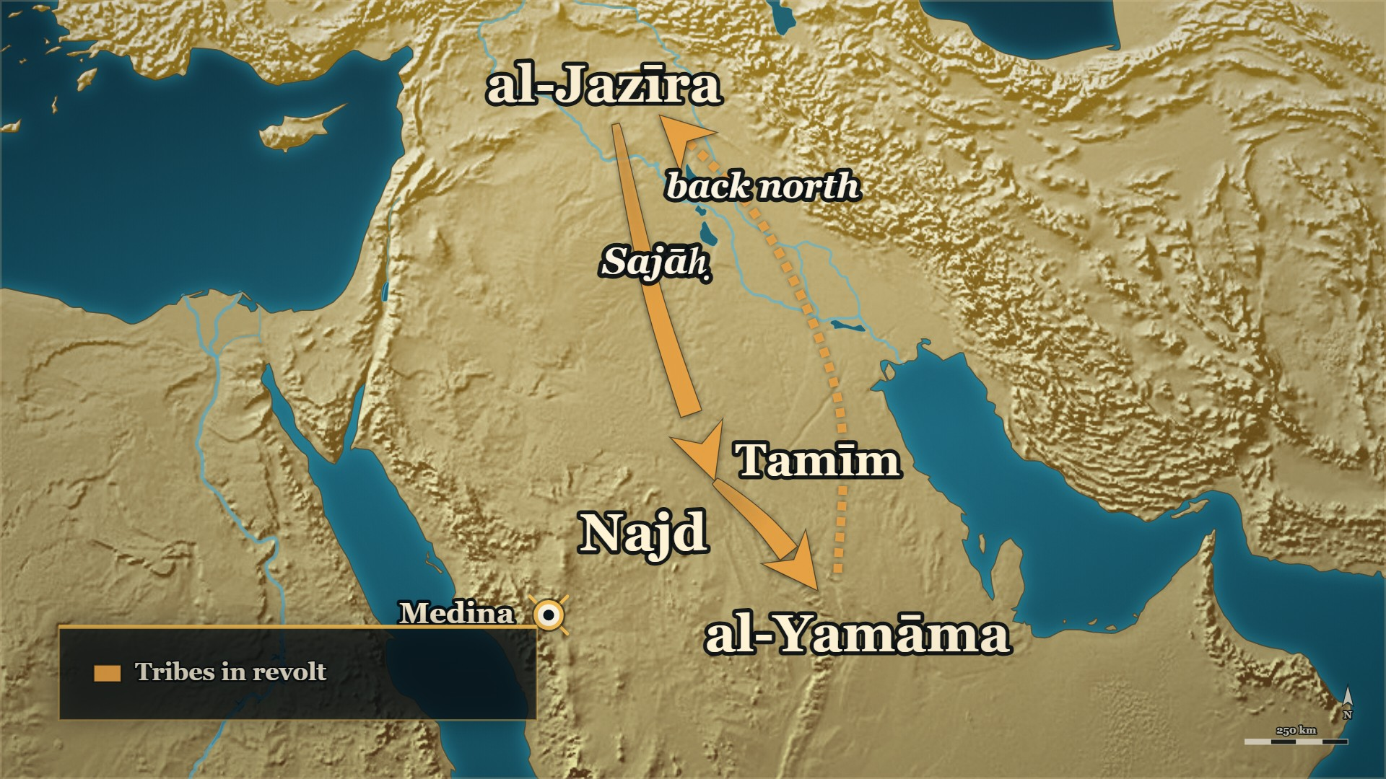
Sajāḥ comes down from the north
al-Jazīra
where she came from
al-Yamāma
where she turned back
Notes:
MAP: tools/mapstudio/scenes/s04-01-sajah.json at step 3, rendered by make_maps.py. The earlier steps are beside it in visuals/maps/ if you want the build-up across slides. Sites are approximate; tribal names are loose labels.

Slide 10
11 AH
Sajāḥ — who she actually was
إذ أقبلت سجاح … التغلبية من الجزيرة، وهي من نصارى العرب، وقد ادَّعتِ النبوَّة
…Sajāḥ … al-Taghlibiyya came forward from al-Jazīra — and she was of the Christians of the Arabs — having claimed prophethood.
al-Bidaya wa'l-Nihaya, vol. 7, p. 28
Notes:
RUNSHEET: ⚠ she is Taghlibī, not Tamīmī. She deals with Mālik b. Nuwayra ؓ here — that is what #8 picks up
SAY —
1. She comes down from al-Jazīra — With troops of her own people and whoever had joined them.
2. She had claimed prophethood — And, the book says, they had resolved on making war on Abū Bakr ؓ.
3. Who she actually was — Of Taghlib, and of the Christians of the Arabs.
^ read the Arabic on the face here
4. Not of Tamīm — Tamīm is only the tribe she gathered on the way.
5. Most of Tamīm answered her — Including Mālik b. Nuwayra ؓ, ʿUṭārid b. Ḥājib and a number of chiefs.
6. Others held back — The tribe split, as tribes did all through this war.
QUOTE — إذ أقبلت سجاح بنتُ الحارث بن سويد بن عقفان التغلبية من الجزيرة، وهي من نصارى العرب، وقد ادَّعتِ النبوَّة
"…when Sajāḥ bint al-Ḥārith b. Suwayd b. ʿAqfān al-Taghlibiyya came forward from al-Jazīra — and she was of the Christians of the Arabs — having claimed prophethood."
— البدایہ والنہایہ ج۷ ص۲۸
عبرت — The tribe that supplied her following was not the tribe she came from, and the book is careful to say so.
MAP — An arrow from **الجزيرة** in the far north, down into نجد, on to **اليمامة**, and then back north again. **It never reaches Medina.**
**Also on the page** — a verse said about it by ʿUṭārid b. Ḥājib, one of the men who had answered
her: «**أمستْ نَبيَّتُنا أُنثَى نُطيفُ بها … وأصبحَتْ أنبياءُ النَّاس ذُكرانا**» — *"our prophetess has
become a woman we circle around, while the prophets of other people are men."*
⚠ **Correction recorded, because two existing artifacts have it wrong:** she is **Taghlibī**, not
Tamīmī. It is **مالك بن نويرة ؓ** who is التميمي اليربوعي (§6.2 item 3).
⚠ **مالك بن نويرة ؓ is named here only as one of the men who answered her call, which is what the
page says.** What happened to him afterwards at **البُطاح** is مشاجرات-adjacent, is carded separately
in `ridda-campaign-the-conduct-of-the-wars.md` under **⚠ SPEAKER'S DISCRETION**, and must not be
opened from this card.
BACKGROUND (read at home, not aloud) —
Sajāḥ bint al-Ḥārith came down from al-Jazīra with troops of her own people and whoever had joined them, having claimed prophethood — and, the book says, they had resolved on making war on Abū Bakr ؓ. She was of Taghlib, and she was of the Christians of the Arabs. She was not of Tamīm, which is only the tribe she gathered on the way. When she passed through the country of Banū Tamīm she called them to her cause and most of them answered — Mālik b. Nuwayra ؓ among them, and ʿUṭārid b. Ḥājib, and a number of the chiefs of Tamīm. Others of them held back.
WHEN, as the card gives it: 11 AH

Slide 11
11 AH, and afterwards
What her claim was worth
فكرَّتْ راجعةً إلى الجزيرة بعدما قبضَتْ من مسيلمة نصفَ خراجِ أرضِهِ
…she went back to al-Jazīra after she had taken from Musaylima half the kharāj of his land…
al-Bidaya wa'l-Nihaya, vol. 7, p. 30
Notes:
RUNSHEET: ⚠ the narrative at ⁨ج7 ص29⁩–30 is obscene and must not be read, paraphrased or alluded to. Say "the price he paid", not "dowry". End on her Islam in ʿUmar's ؓ days. Prepared answer: QABANK.md §6.10
SAY —
1. The two claimants meet at al-Yamāma — The northern claim and the Yamāma claim, in one place.
2. He bought her off — She took half the kharāj of his land.
^ read the Arabic on the face here
3. The price he paid — The remission of two of the five prayers: the dawn and the night prayer.
4. What that tells you — That is what one claim to prophethood was worth to the other.
5. She went home — Back north to al-Jazīra, and stayed among Banū Taghlib for many years.
6. And afterwards — She became Muslim in ʿUmar's ؓ days, and her Islam was good. End the card here.
QUOTE — ثم انثنت سَجَاح راجعةً إلى بلادها … فكرَّتْ راجعةً إلى الجزيرة بعدما قبضَتْ من مسيلمة نصفَ خراجِ أرضِهِ، فأقامت في قومها بني تَغْلِب، إلى زمان معاوية
"Then Sajāḥ turned back to her own country … she went back to al-Jazīra after she had taken from Musaylima half the kharāj of his land, and she stayed among her people, Banū Taghlib, until the time of Muʿāwiya."
— البدایہ والنہایہ ج۷ ص۳۰
عبرت — A claim that could be settled for half a land-tax was priced by the man who bought it.
MAP — her arrow reaches **اليمامة**, turns, and goes back north to **الجزيرة**.
**And afterwards — البدایہ ج۵ ص۲۴** (https://shamela.ws/book/30097/2208), Ibn Kathīr quoting
السهيلي: «**وقد أسْلَمَتْ هي أيضًا أيام عُمَرَ بن الخطاب، فحسن إسلامُها**» — *"and she too became
Muslim in the days of ʿUmar b. al-Khaṭṭāb, and her Islam was good."* **End the card here**, not on
the withdrawal — the note flags this as the resolution the room should be given.
⚠ **The narrative of that meeting at ج۷ ص۲۹–۳۰ contains explicitly obscene material. It must not be
read, paraphrased, or alluded to in the hall.** The usable fact is exactly the one clean sentence
above: he bought her off, and the dowry he paid was two of the five prayers.
BACKGROUND (read at home, not aloud) —
The two claimants met at al-Yamāma, and he bought her off. She took half the kharāj of his land and turned back to her own country, and she stayed among her people, Banū Taghlib, until the time of Muʿāwiya ؓ. The dowry he paid her was the remission of two of the five prayers — the dawn prayer and the night prayer. That is what one claim to prophethood was worth to the other. And al-Suhaylī, whom Ibn Kathīr quotes, records that she became Muslim in the days of ʿUmar b. al-Khaṭṭāb ؓ, and that her Islam was good.
WHEN, as the card gives it: 11 AH, at اليمامة, and afterwards

Slide 12
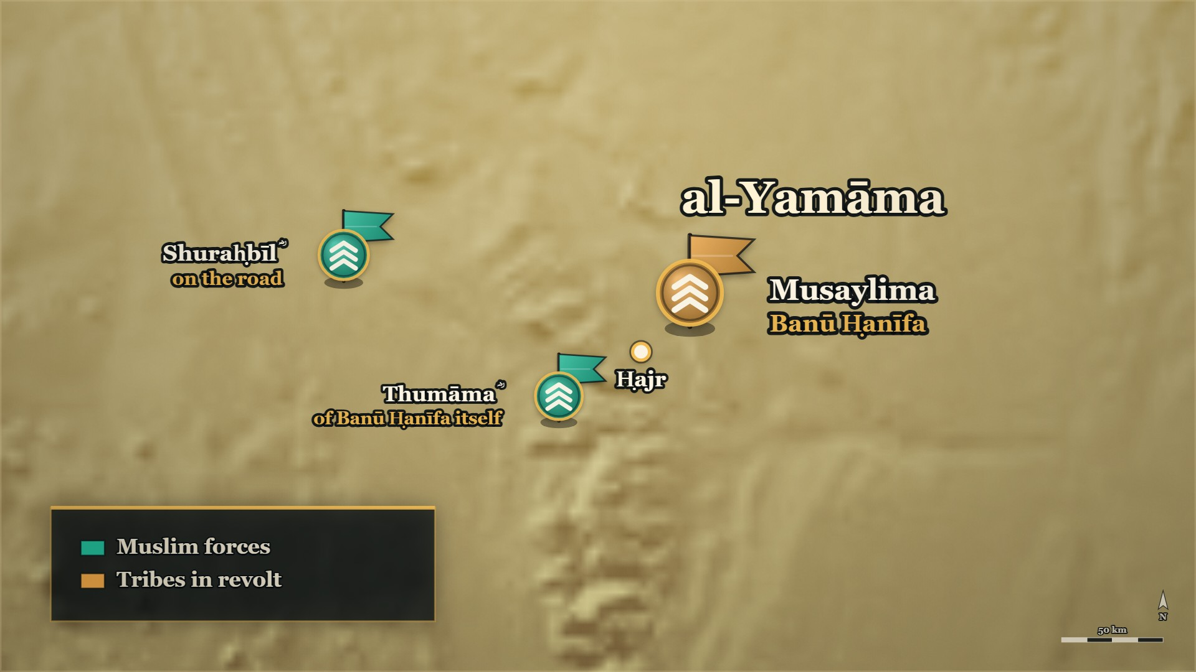
al-Yamāma before the army came
Ḥajr
the town
Thumāma ؓ
of Banū Ḥanīfa itself
Notes:
HANDS UP FIRST — ask it before you click to this map, because the map shows the answer:
Before beat 1: *"Forty thousand men followed him. Do you think anybody in that country refused?"*
MAP: tools/mapstudio/scenes/s04-02-al-yamama-before.json at step 2, rendered by make_maps.py. The earlier steps are beside it in visuals/maps/ if you want the build-up across slides. Sites are approximate; tribal names are loose labels.

Slide 13
11 AH, before Khālid ؓ arrived
There were Muslims inside already
فَخَافَ إِنْ هُوَ شُغِلَ بِهَا أَنْ يَغْلِبَ ثُمَامَةُ وَشُرَحْبِيلُ بْنُ حَسَنَةَ وَالْقَبَائِلُ التى حَوْلَهُمْ عَلَى حَجْرٍ، وَهِيَ الْيَمَامَةُ
"He feared that if he were occupied with her, Thumāma and Shuraḥbīl b. Ḥasana and the tribes around them would overcome Ḥajr — which is al-Yamāma."
al-Kamil, vol. 2, p. 210
Notes:
RUNSHEET: Thumāma ؓ, of Banū Ḥanīfa itself. Answers the question the room is about to ask · [HANDS] spare
SAY —
1. Musaylima was not facing one army — He had a war inside his own country before Khālid ؓ set out.
2. Thumāma b. Uthāl ؓ — Of Banū Ḥanīfa itself, Musaylima's own tribe, and fighting him.
3. Reinforcements from Tamīm — They reached Thumāma ؓ until ʿIkrima ؓ came up to him.
4. What Musaylima actually feared from Sajāḥ — Not her army: being tied up while the town was taken.
5. Ḥajr, which is al-Yamāma — Thumāma ؓ, Shuraḥbīl ؓ and the tribes around them could have taken it.
^ read the Arabic on the face here
6. So the answer is on the page — Men of Banū Ḥanīfa were fighting Musaylima before Medina's army arrived.
QUOTE — فَخَافَ إِنْ هُوَ شُغِلَ بِهَا أَنْ يَغْلِبَ ثُمَامَةُ وَشُرَحْبِيلُ بْنُ حَسَنَةَ وَالْقَبَائِلُ التى حَوْلَهُمْ عَلَى حَجْرٍ، وَهِيَ الْيَمَامَةُ
"He feared that if he were occupied with her, Thumāma and Shuraḥbīl b. Ḥasana and the tribes around them would overcome Ḥajr — which is al-Yamāma."
— الکامل فی التاریخ ج۲ ص۲۱۰
عبرت — The men who held out against him were of his own tribe, and they were holding out before any help came.
HANDS UP — Before beat 1: *"Forty thousand men followed him. Do you think anybody in that country refused?"*
MAP — Inside the al-Yamāma country, a **second, small blue marker** beside the large red one — Thumāma ؓ and the men with him, and Shuraḥbīl ؓ on the road outside.
BACKGROUND (read at home, not aloud) —
Musaylima was not facing one army. Thumāma b. Uthāl al-Ḥanafī ؓ — of Banū Ḥanīfa itself, Musaylima's own tribe — had been fighting him, with reinforcements reaching him from Tamīm, until ʿIkrima b. Abī Jahl ؓ came up to him. And when Sajāḥ turned toward al-Yamāma, what Musaylima feared was not her: it was that if she tied him up, Thumāma ؓ and Shuraḥbīl b. Ḥasana ؓ and the tribes around them would take Ḥajr — which is the town of al-Yamāma — out from under him. So the question a listener is about to ask is already answered: there were Muslims of Banū Ḥanīfa fighting Musaylima before any army arrived from Medina.
**Also on the page:**
> وَكَانَ ثُمَامَةُ بْنُ أُثَالٍ الْحَنَفِيُّ تَأْتِيهِ أَمْدَادُ تَمِيمٍ … وَكَانَ مُقَاتِلًا لِمُسَيْلِمَةَ الْكَذَّابِ، حَتَّى قَدِمَ عَلَيْهِ عِكْرِمَةُ بْنُ أَبِي جَهْلٍ
> — الکامل فی التاریخ ج۲ ص۲۱۰ · https://shamela.ws/book/21712/901
> *English:* "Thumāma b. Uthāl al-Ḥanafī used to receive reinforcements from Tamīm … and he was
> fighting Musaylima the liar, until ʿIkrima b. Abī Jahl came up to him."
**The same page** also carries Sajāḥ's dealing with Mālik b. Nuwayra ؓ — she sent to him asking for a
truce, he answered her and turned her away from marching on Abū Bakr ؓ. That is the page-cited basis
for what `E-RC45` says about him. **ثمامة ؓ's own story** — the captive tied to the pillar of the
mosque, and the grain of al-Yamāma — is `RCT/E-RC28`, held for a later evening. One sentence at most
here.
WHEN, as the card gives it: 11 AH, before Khālid ؓ arrived

Slide 14
Part II
al-Buṭāḥ, and the reckoning at Medina (11 AH)

Slide 15
11 AH
After Buzākha
The orders
Buzākha
al-Buṭāḥ
Tied at Dhū al-Qaṣṣa: Ṭulayḥa first; when done, Mālik b. Nuwayra ؓ at al-Buṭāḥ
Done: Ṭulayḥa walked off the field, and the tribes around him came back
Next in the orders: the Tamīm country, and Mālik b. Nuwayra ؓ
Notes:
BRIDGE — say:
We left Khālid ؓ at Buzākha. His orders, tied at Dhū al-Qaṣṣa, were Ṭulayḥa first — and when he had finished, Mālik b. Nuwayra ؓ at al-Buṭāḥ, if he held out against him. Buzākha was done. So the army turns towards al-Buṭāḥ.
The orders, al-Bidāya vol. 7 p. 22: «عقدَ لخالد بن الوليد وأمره بطُلَيْحة بن خُوَيْلد، فإذا فرغَ سار إلى مالك بن نُوَيْرَةَ بالبطاح إن أقام له» (https://shamela.ws/book/30097/3168).

Slide 16
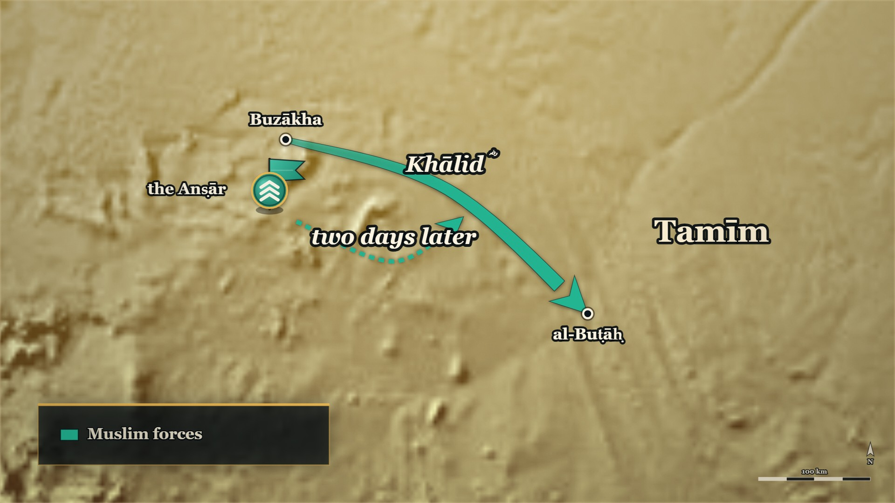
From Buzākha to al-Buṭāḥ
Buzākha
where evening 2 stopped
al-Buṭāḥ
the third stop in the orders
Notes:
MAP: tools/mapstudio/scenes/s04-03-buzakha-to-al-butah.json at step 2, rendered by make_maps.py. The earlier steps are beside it in visuals/maps/ if you want the build-up across slides. Sites are approximate; tribal names are loose labels.

Slide 17
11 AH
The Anṣār who would not march
قَدْ عَهِدَ إِلَيَّ أَنْ أَمْضِيَ، وَأَنَا الْأَمِيرُ … فَأَنَا قَاصِدٌ إِلَى مَالِكٍ وَمَنْ مَعِي، وَلَسْتُ أُكْرِهُهُمْ.
"He instructed me to go on, and I am the commander … So I am making for Mālik, with whoever is with me — and I do not compel them."
al-Kamil, vol. 2, p. 212
Notes:
RUNSHEET: Opens the part. Khālid ؓ comes here straight from Buzākha, where evening 2 stopped
SAY —
1. The orders named a third stop — al-Buṭāḥ, in the Tamīm country, was written into Khālid's ؓ instructions.
2. The Anṣār refuse to march — They said they had done what they were ordered to do, and their part was finished.
3. "I am the commander" — No letter had come; the reports came to him; the decision was his to take.
4. And he would not compel them — He told them plainly he would not force any man onto the road.
^ read the Arabic on the face here
5. He marched without them — Two days later their messenger caught him and asked him to wait.
QUOTE — قَدْ عَهِدَ إِلَيَّ أَنْ أَمْضِيَ، وَأَنَا الْأَمِيرُ … فَأَنَا قَاصِدٌ إِلَى مَالِكٍ وَمَنْ مَعِي، وَلَسْتُ أُكْرِهُهُمْ.
"He instructed me to go on, and I am the commander … So I am making for Mālik, with whoever is with me — and I do not compel them."
— الکامل فی التاریخ ج۲ ص۲۱۲
عبرت — A commander who could not be argued out of a decision also would not force a single man to share it.
MAP — Khālid's ؓ arrow continues from بُزاخة south-east to **البُطاح**, in the Tamīm country. Draw the Anṣār contingent detached from it for two days, then rejoining.
BACKGROUND (read at home, not aloud) —
Khālid's ؓ written orders had named al-Buṭāḥ as his third stop. The Anṣār with him refused to march: they said they had already done what the Ṣiddīq ؓ ordered them to do, and their part was finished. Khālid ؓ did not argue it as a point of obedience. He said this was a thing that had to be done and an opening that had to be taken; that no letter had come to him about it; that he was the commander and the reports came to him; that he would not force any man onto the road — and that he was going to al-Buṭāḥ. He marched. Two days out, their messenger caught him and asked him to wait, and they rejoined him.
**Also on the page:**
> فقال لهم خالد: إن هذا أمرٌ لا بدَّ من فعله، وفرصةٌ لابدَّ من انتهازها، وإنه لم يأتني فيها كتابٌ، وأنا الأمير وإليّ تردُ الأخبارُ، ولست بالذي أجبركم على المسير، وأنا قاصدٌ البطاحَ
> — البدایہ والنہایہ ج۷ ص۳۰ · https://shamela.ws/book/30097/3176
> *English:* "Khālid said to them: This is a thing that must be done and an opening that must be
> taken, and no letter has come to me about it. I am the commander and the reports come to me. I am
> not the man to force you onto the road — and I am making for al-Buṭāḥ."
> فسارَ يومين ثم لحقَهُ رسول الأنصار يطلبون منه الانتظار، فلحقوا به
> — البدایہ والنہایہ ج۷ ص۳۰ · https://shamela.ws/book/30097/3176
> *English:* "He marched two days, and then the messenger of the Anṣār caught him asking him to wait;
> and they rejoined him."
WHEN, as the card gives it: 11 AH

Slide 18
11 AH
Mālik b. Nuwayra ؓ stands apart
إلَّا ما كانَ من مالك بن نويرة فإنّه متحيرٌ في أمره، مُتَنحٍّ عن الناس
"— except for what was from Mālik b. Nuwayra, for he was perplexed about his own affair, keeping apart from the people."
al-Bidaya wa'l-Nihaya, vol. 7, p. 30
Notes:
RUNSHEET: The ⁨تراجم⁩ notice in one breath (#28). Honorific ؓ throughout. Sajāḥ is already known from #4
SAY —
1. Who he was — A chief of Banū Yarbūʿ of Tamīm, at a place called al-Buṭāḥ.
2. He had made terms with Sajāḥ — When she came into the Tamīm country, he had dealt with her.
3. And then regretted it — When she attached herself to Musaylima and went back north, he regretted it.
4. The patrols go out — Khālid ؓ spread his patrols through al-Buṭāḥ, calling people in.
5. The chiefs of Tamīm come in and pay — Every one of them, with hearing and obedience.
6. Except one — Mālik ؓ stayed where he was, perplexed, keeping apart from people.
^ read the Arabic on the face here
QUOTE — إلَّا ما كانَ من مالك بن نويرة فإنّه متحيرٌ في أمره، مُتَنحٍّ عن الناس
"— except for what was from Mālik b. Nuwayra, for he was perplexed about his own affair, keeping apart from the people."
— البدایہ والنہایہ ج۷ ص۳۰
عبرت — The men who came in and paid are a line in a book; the one who could not decide is the whole chapter.
MAP — Hold still on البُطاح. One dot for the camp of Banū Yarbūʿ, and the Tamīm chiefs' arrows coming in to Khālid ؓ from every side except that one.
BACKGROUND (read at home, not aloud) —
Mālik b. Nuwayra ؓ of Banū Yarbūʿ of Tamīm had made terms with Sajāḥ when she came into the Tamīm country. When she attached herself to Musaylima and then went back north, he regretted what he had done and could not settle on what to do next. He was camped at a place called al-Buṭāḥ. Khālid ؓ spread his patrols through al-Buṭāḥ calling people in, and the chiefs of Banū Tamīm came to him with hearing and obedience and paid their zakāt — every one of them except Mālik ؓ, who stayed where he was, perplexed about his own affair and keeping away from people.
**Also on the page:** الکامل ج۲ ص۲۱۲ says the same of him in three words — «قَدْ تَرَدَّدَ عَلَيْهِ
أَمْرُهُ», his affair had gone back and forth on him.
WHEN, as the card gives it: 11 AH

Slide 19
11 AH
"Disperse, and enter into this matter"
إِنَّا دُعِينَا إِلَى هَذَا الْأَمْرِ فَأَبْطَأْنَا عَنْهُ فَلَمْ نُفْلِحْ … فَتَفَرَّقُوا وَادْخُلُوا فِي هَذَا الْأَمْرِ
…we were called to this matter and we were slow to it and did not prosper … Disperse, and enter into this matter.
al-Kamil, vol. 2, pp. 212–213
Notes:
RUNSHEET: His own last recorded counsel. State it; build nothing on it
SAY —
1. He gathers Banū Yarbūʿ — Before the patrols came, he told his own tribe what he had concluded.
2. "We were slow, and we did not prosper" — They had been called to this matter and had hung back.
3. What he had looked into — He could see the affair coming to Medina's people without contrivance.
4. His counsel — Do not oppose a people for whom things are being made.
5. "Disperse, and enter into this matter" — His last recorded word to his tribe was: submit.
^ read the Arabic on the face here
6. And then he was killed — Say it plainly, and build nothing on it.
QUOTE — يَا بَنِي يَرْبُوعٍ، إِنَّا دُعِينَا إِلَى هَذَا الْأَمْرِ فَأَبْطَأْنَا عَنْهُ فَلَمْ نُفْلِحْ، وَقَدْ نَظَرْتُ فِيهِ فَرَأَيْتُ الْأَمْرَ يَتَأَتَّى لَهُمْ بِغَيْرِ سِيَاسَةٍ … فَإِيَّاكُمْ وَمُنَاوَأَةَ قَوْمٍ صُنِعَ لَهُمْ، فَتَفَرَّقُوا وَادْخُلُوا فِي هَذَا الْأَمْرِ.
"Banū Yarbūʿ — we were called to this matter and we were slow to it and did not prosper. I have looked into it and I see the affair coming to them without contrivance … so beware of opposing a people for whom things are being made. Disperse, and enter into this matter."
— الکامل فی التاریخ ج۲ ص۲۱۲–۲۱۳
عبرت — The last thing he is recorded saying to his own tribe was: submit.
MAP — No movement. Hold on البُطاح.
BACKGROUND (read at home, not aloud) —
Before any of it, Mālik ؓ had gathered Banū Yarbūʿ and told them what he had concluded. They had been called to this matter, he said, and they had been slow to it, and they had not prospered. He had looked into it, and he could see the affair coming to the people of Medina without contrivance. So: do not set yourselves against a people for whom things are being made. Disperse, and enter into this matter. **He told his own tribe to submit — and then he was killed.** That is on the page in al-Kāmil, and it is the single fact that makes the matter painful. State it, and build nothing on it.
WHEN, as the card gives it: 11 AH

Slide 20
11 AH
The patrol could not agree
فشهد أبو قتادة - الحارث بن ربعي الأنصاري - أنهم أقاموا الصلاةَ، وقال آخرون: إنهم لم يُؤَذّنوا ولا صَلّوا
…Abū Qatāda al-Anṣārī — al-Ḥārith b. Ribʿī — testified that they had established the prayer, and others said they had neither given the adhān nor prayed.
al-Bidaya wa'l-Nihaya, vol. 7, p. 30
Notes:
RUNSHEET: Give Abū Qatāda's ؓ notice in one breath before the testimony — ⁨فارس رسول الله ﷺ⁩. [HANDS] 2 — ask it before you click to this slide: its face shows both testimonies
SAY —
1. The patrols take him — Mālik ؓ was taken prisoner, and his companions with him.
2. And then the patrol fell out — Over what it had just seen with its own eyes.
3. Who Abū Qatāda ؓ was — al-Ḥārith b. Ribʿī of the Anṣār, at Uḥud and al-Ḥudaybiya; the books title him the Prophet's ﷺ horseman.
4. He testified — That the men had established the prayer.
5. Others in the same patrol denied it — They said they neither gave the adhān nor prayed.
^ read the Arabic on the face here
6. Where the disagreement sits — Not between later historians, but between the men who were there.
QUOTE — واختلفت السريةُ فيهم، فشهد أبو قتادة - الحارث بن ربعي الأنصاري - أنهم أقاموا الصلاةَ، وقال آخرون: إنهم لم يُؤَذّنوا ولا صَلّوا
"The patrol disagreed about them: Abū Qatāda al-Anṣārī — al-Ḥārith b. Ribʿī — testified that they had established the prayer, and others said they had neither given the adhān nor prayed."
— البدایہ والنہایہ ج۷ ص۳۰
عبرت — Two men can stand in the same place at the same hour and carry away two different nights.
HANDS UP — Before the answer: *"Two men from the same patrol. Do you think they told the same story?"*
MAP — No movement. One arrow in, and the prisoners brought back to Khālid's ؓ camp.
BACKGROUND (read at home, not aloud) —
The patrols came on Mālik ؓ and took him prisoner, and his companions with him. Then the patrol itself fell out over what it had seen. Abū Qatāda al-Anṣārī ؓ — al-Ḥārith b. Ribʿī, whom al-Dhahabī's notice titles the Prophet's ﷺ horseman, and who was at Uḥud and al-Ḥudaybiya — testified that the men had established the prayer. Others in the same patrol said they had neither given the adhān nor prayed. The disagreement is not between later historians. It is between the men who were standing there.
**His تراجم notice, for the one breath:**
> ٨٧ - أَبُو قَتَادَةَ الأَنْصَارِيُّ السُّلَمِيُّ الحَارِثُ بنُ رِبْعِيٍّ … فَارِسُ رَسُوْلِ اللهِ -صَلَّى اللَّهُ عَلَيْهِ وَسَلَّمَ- شَهِدَ أُحُداً وَالحُدَيْبِيَةَ، وَلَهُ عِدَّةُ أَحَادِيْثَ.
> — سیر أعلام النبلاء ج۲ ص۴۴۹ · https://shamela.ws/book/10906/2429
> *English:* "Abū Qatāda al-Anṣārī al-Sulamī, al-Ḥārith b. Ribʿī … the Prophet's ﷺ horseman. He
> witnessed Uḥud and al-Ḥudaybiya, and a number of ḥadīth are from him."
**Why it matters:** the man the rest of the patrol contradicted is not an unknown in the ranks. Give
the notice in one breath before the testimony and the weight of the disagreement lands.
WHEN, as the card gives it: 11 AH

Slide 21
11 AH — the books disagree
One night, four accounts
The cold night
Summoned
al-Bidāya: the crier's "warm your prisoners" taken as an order to kill. al-Kāmil: only warmth was meant
al-Bidāya, "it is said": reproached over Sajāḥ and the zakāt, then an order to strike
Heard, then ordered
Quarter given?
Siyar: Abū Qatāda ؓ spoke for him; Khālid ؓ disliked what was said, and ordered the blow
Siyar, from al-Zuhrī: arms laid down; Abū Qatāda ؓ said quarter was given, the rest said not
Four accounts in the books. We record them, and we do not choose.
Notes:
RUNSHEET: The centre of the part. Lay the accounts side by side and stop. Do not use the cooking-pot detail
SAY —
1. Here the books stop agreeing — What happened that night is told four different ways.
2. The cold night, and the crier — Two words called through the camp which, on their face, mean warm your prisoners.
3. Taken for an order to kill — The men killed them, Mālik ؓ among them.
4. Ibn al-Athīr's explanation — In the dialect of Kināna that phrase means killing; only warmth was meant.
5. The second version — Khālid ؓ summoned him, reproached him over Sajāḥ and the zakāt, and it ended in an order to strike.
6. The Siyar's two — Including al-Zuhrī's: the men had laid down their arms, and the patrol split over whether quarter had been given.
7. What we say — The books do not agree, and where they do not agree we record and we stop.
QUOTE — وَهِيَ فِي لُغَةِ كِنَانَةَ الْقَتْلُ، فَظَنَّ الْقَوْمُ أَنَّهُ أَرَادَ الْقَتْلَ، وَلَمْ يُرِدْ إِلَّا الدِّفْءَ
"— and in the dialect of Kināna that word means killing. So the people supposed he meant killing, and he had meant nothing but warmth."
— الکامل فی التاریخ ج۲ ص۲۱۳
عبرت — Where four books tell one night four ways, the honest thing is to say so and stop.
⚠ and take no questions on it from the floor.
MAP — No movement. Hold on البُطاح and let the screen stay still while this is told.
> ⚠ **HOW TO DELIVER.** Show the disagreement, not a verdict. What is **not** in dispute, in all four
> books: the Anṣār refused and then followed; Mālik ؓ was undecided; the patrol was divided; Abū Qatāda ؓ
> testified they had prayed; they were killed; Ḍirār killed Mālik ؓ; Khālid ؓ married the widow; ʿUmar ؓ
> demanded his removal; Abū Bakr ؓ paid the blood-money and kept him in command. **Disputed: how they
> died.** Say: *"The books do not agree, and where they do not agree we record and we stop."*
> **Do not use the cooking-pot detail** (البدایہ ج۷ ص۳۱) — it is graphic, it adds nothing the room
> needs, and it is exactly the kind of detail that turns an evening. **Do not adjudicate.** Defer
> everything else to the session that handles the مشاجرات with اصول.
BACKGROUND (read at home, not aloud) —
What happened that night is the part the books do not agree on, and the honest thing is to lay the accounts side by side and stop there. Ibn Kathīr's first version: the prisoners were held through a bitterly cold night, and Khālid's ؓ crier called out two words which, on their face, mean warm your prisoners. The men took it for an order to kill, and killed them; Ḍirār b. al-Azwar killed Mālik ؓ. Khālid ؓ came out when he heard the noise, and it was already done. Ibn al-Athīr gives the same words with an explanation attached: in the dialect of Kināna that phrase means killing, so the men understood killing, and nothing but warmth had been meant. Ibn Kathīr then gives a second version — «ويقال» — in which Khālid ؓ summoned him and reproached him over Sajāḥ and over the zakāt, and the exchange ended in an order to strike. The Siyar carries two more, one of them al-Zuhrī's, in which the men had already laid down their arms and Abū Qatāda ؓ told Khālid ؓ they had been given quarter, and the rest of the patrol told him they had not. Four accounts, and we do not choose between them.
**Also on the page:**
> فيقال: إن الأسارى باتوا في كبولهم في ليلة شديدةِ البردِ، فنادى منادي خالدٍ: أن أدفئوا أسراكم، فظنَّ القوم أنّه أراد القتلَ، فقتلوهم، وقتل ضرارُ بن الأزور مالكَ بن نُوَيْرة
> — البدایہ والنہایہ ج۷ ص۳۰ · https://shamela.ws/book/30097/3176
> *English:* "It is said that the prisoners passed the night in their irons on a bitterly cold night,
> and Khālid's crier called out: warm your prisoners! And the people supposed he meant killing, and
> killed them; and Ḍirār b. al-Azwar killed Mālik b. Nuwayra."
> ويقال: بل استدعى خالدٌ مالكَ بن نويرة، فأنّبه على ما صدر منه من متابعة سَجَاح، وعلى منعِه الزكاة وقال: ألم تعلمْ أنها قرينةُ الصلاة؟ فقال مالكٌ: إن صاحبَكم كان يزعمُ ذلك
> — البدایہ والنہایہ ج۷ ص۳۰ · https://shamela.ws/book/30097/3176
> *English:* "And it is said: rather Khālid summoned Mālik b. Nuwayra and reproached him for what he
> had done in following Sajāḥ and for withholding the zakāt, and said: did you not know that it is the
> companion of the prayer? Mālik said: your companion used to claim that."
The reply, and the order to strike, are overleaf at البدایہ ج۷ ص۳۱ — *"Is he our companion and not
yours?"* Both halves of the exchange must be cited to their own page; it straddles the break.
WHEN, as the card gives it: 11 AH

Slide 22
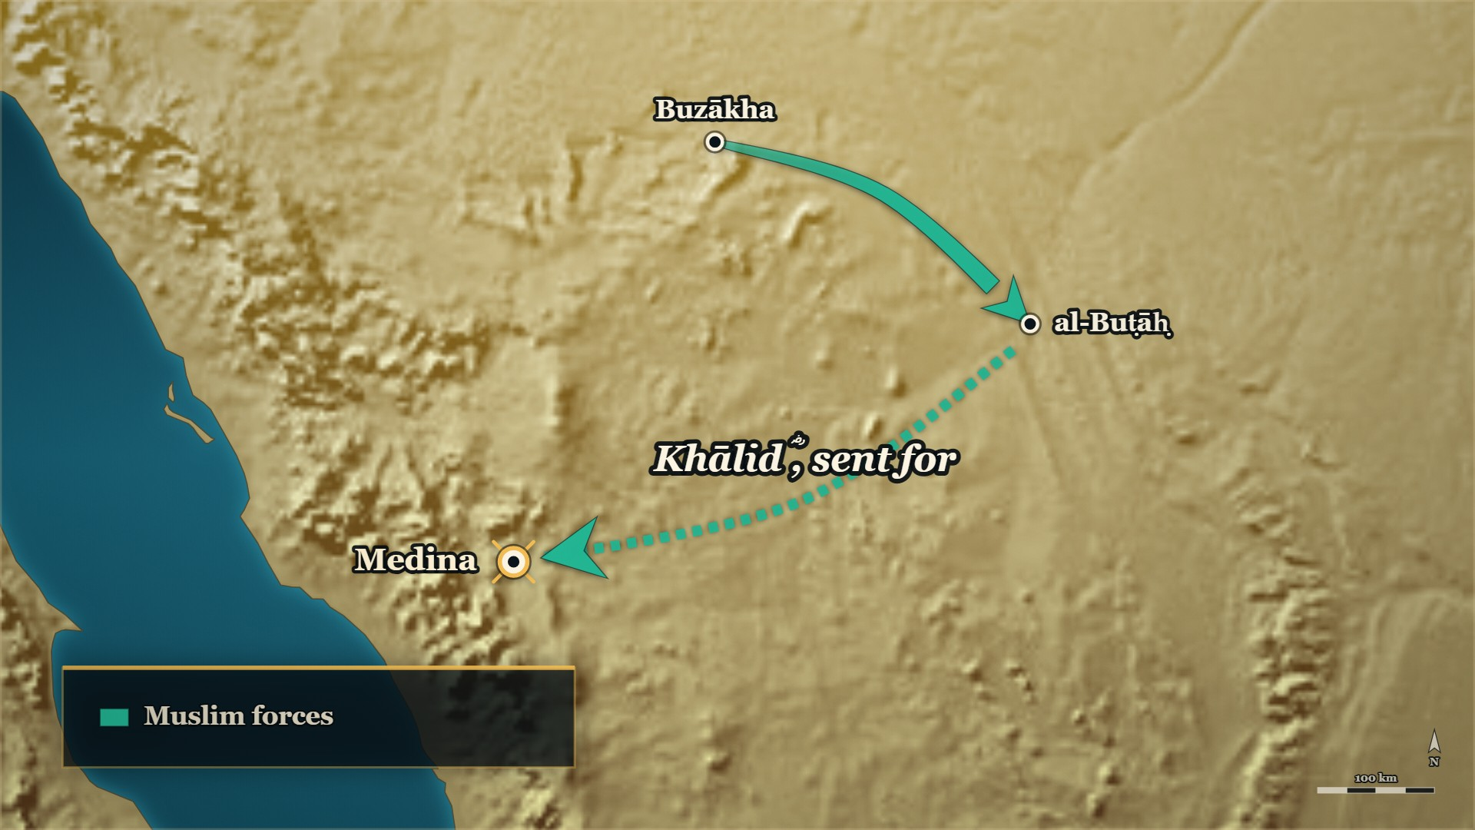
Back to Medina
To Medina
Khālid ؓ is sent for
Notes:
MAP: tools/mapstudio/scenes/s04-04-back-to-medina.json at step 1, rendered by make_maps.py. The earlier steps are beside it in visuals/maps/ if you want the build-up across slides. Sites are approximate; tribal names are loose labels.

Slide 23
11 AH, Medina
ʿUmar ؓ in the mosque
أرياءً قتلتَ امرأً مسلمًا ثم نزوتَ على امرأته، والله لأرجمنَّك بالجنادلِ
"Was it for show? You killed a Muslim man, then you leapt upon his wife. By Allah, I will stone you with stones!"
al-Bidaya wa'l-Nihaya, vol. 7, p. 31
Notes:
RUNSHEET: The map runs backwards to Medina for the first time in the campaign
SAY —
1. ʿUmar ؓ keeps pressing — Remove him: there is recklessness in that sword.
2. Khālid ؓ is sent for — And came to Medina in rusted mail, arrows stuck in his turban.
3. In the mosque — ʿUmar ؓ stood, pulled the arrows out of his turban and broke them.
4. And said it to his face — You killed a Muslim man, and then you took his wife.
^ read the Arabic on the face here
5. Khālid ؓ says nothing — He assumed the caliph's view was ʿUmar's ؓ view.
QUOTE — أرياءً قتلتَ امرأً مسلمًا ثم نزوتَ على امرأته، والله لأرجمنَّك بالجنادلِ
"Was it for show? You killed a Muslim man, then you leapt upon his wife. By Allah, I will stone you with stones!"
— البدایہ والنہایہ ج۷ ص۳۱
عبرت — The objection was not whispered. It was made in the mosque, to the man's face, by the man who would be caliph next.
MAP — The arrow returns to **المدينة**. This is the first time in the campaign the map runs backwards.
BACKGROUND (read at home, not aloud) —
ʿUmar ؓ kept pressing the Ṣiddīq ؓ to remove Khālid ؓ from command — there was recklessness in that sword, he said — until Abū Bakr ؓ sent for him and he came to Medina. He came in his iron mail, rusted with blood, with arrows stuck into his turban. When he walked into the mosque, ʿUmar ؓ stood up, pulled the arrows out of his turban and broke them, and said it to his face. Khālid ؓ did not answer him a word, because he assumed the Ṣiddīq's ؓ view was ʿUmar's ؓ view.
**Also on the page:** الکامل ج۲ ص۲۱۳ has ʿUmar's ؓ words as «قَتَلْتَ امْرَأً مُسْلِمًا، ثُمَّ نَزَوْتَ عَلَى
امْرَأَتِهِ، وَاللَّهِ لَأَرْجُمَنَّكَ بِأَحْجَارِكَ» — *"I will stone you with your own stones"*
(https://shamela.ws/book/21712/904).
WHEN, as the card gives it: 11 AH

Slide 24
11 AH, Medina
"He interpreted, and he was mistaken"
هِيهِ يَا عُمَرُ! تَأَوَّلَ فَأَخْطَأَ، فَارْفَعْ لِسَانَكَ عَنْ خَالِدٍ، فَإِنِّي لَا أَشِيمُ سَيْفًا سَلَّهُ اللَّهُ عَلَى الْكَافِرِينَ.
"Enough, ʿUmar! He interpreted and was mistaken. Lift your tongue off Khālid — for I do not sheathe a sword Allah has drawn against the disbelievers."
al-Kamil, vol. 2, p. 213
Notes:
RUNSHEET: No hands-up here (review, 2026-09-22): the card's spare one asks the room to choose between ʿUmar's ؓ position and Abū Bakr's ؓ, in the part that is never a verdict. build.py drops it (NOHANDS)
SAY —
1. The demand is refused — Abū Bakr ؓ would not remove him.
2. "He interpreted and was mistaken" — Not: he was right. The caliph says plainly that he erred.
3. "Lift your tongue off Khālid" — And: I do not sheathe a sword Allah has drawn against the disbelievers.
^ read the Arabic on the face here
4. The blood-money is paid — For Mālik b. Nuwayra ؓ, from the caliph's own side.
5. And he stays in command — The error is named, the price is paid, the commander is kept.
QUOTE — هِيهِ يَا عُمَرُ! تَأَوَّلَ فَأَخْطَأَ، فَارْفَعْ لِسَانَكَ عَنْ خَالِدٍ، فَإِنِّي لَا أَشِيمُ سَيْفًا سَلَّهُ اللَّهُ عَلَى الْكَافِرِينَ.
"Enough, ʿUmar! He interpreted and was mistaken. Lift your tongue off Khālid — for I do not sheathe a sword Allah has drawn against the disbelievers."
— الکامل فی التاریخ ج۲ ص۲۱۳
عبرت — The caliph said out loud that his commander had got it wrong, paid for it, and kept him. Those three are one decision, not three.
MAP — Hold on **المدينة**.
BACKGROUND (read at home, not aloud) —
Abū Bakr ؓ did not accept the demand and did not dismiss him. He said Khālid ؓ had made an interpretation and had got it wrong; that ʿUmar ؓ was to lift his tongue off him; and that he would not sheathe a sword Allah had drawn against the disbelievers. Then he did the three things that are in all four books: he accepted Khālid's ؓ excuse and passed over what had been done, he paid the blood-money for Mālik b. Nuwayra ؓ out of his own side, and he left him in command.
**Also on the page:**
> اعزلْهُ فإنَّ في سيفه رَهَقًا، فقال أبو بكر: لا أشيم سيفًا سلّه اللهُ على الكفار
> — البدایہ والنہایہ ج۷ ص۳۱ · https://shamela.ws/book/30097/3177
> *English:* "Dismiss him, for there is recklessness in his sword. Abū Bakr said: I do not sheathe a
> sword Allah has drawn against the disbelievers."
> ليس على خالد ما تقول، هبه تأول فأخطأ
> — سیر أعلام النبلاء (سير الخلفاء الراشدين) ص۴۶ · https://shamela.ws/book/10906/1194
> *English:* "Khālid does not bear what you say. Grant that he interpreted and was mistaken."
The blood-money is at البدایہ ج۷ ص۳۲ — «وودى مالك بن نويرة» (https://shamela.ws/book/30097/3178).
WHEN, as the card gives it: 11 AH

Slide 25
the historian's own comment
The historian's own verdict
واستمرَّ أبو بكر بخالدٍ على الإمرة، وإن كان قد اجتهد في قتلِ مالك بن نويرة وأخطأَ في قتله
"Abū Bakr continued with Khālid in command, even though he had exercised his judgement in the killing of Mālik b. Nuwayra and was mistaken in killing him."
al-Bidaya wa'l-Nihaya, vol. 7, p. 32
Notes:
RUNSHEET: The safest sentence available on the whole matter. Banū Jadhīma, in the Prophet's ﷺ own hand
SAY —
1. The historian writes his own verdict — And it is the safest sentence available on the whole matter.
2. "He exercised judgement, and he was mistaken" — Ibn Kathīr says the error plainly, and keeps the man in command.
^ read the Arabic on the face here
3. He sets a precedent beside it — Banū Jadhīma, in the Prophet's ﷺ own lifetime.
4. The prisoners who said the wrong word — They said ṣabaʾnā, not knowing how to say we have accepted Islam.
5. What the Prophet ﷺ did — Paid the blood-money down to the dog's bowl, and dissociated himself from the act.
6. And what he did not do — He did not remove him from command.
QUOTE — واستمرَّ أبو بكر بخالدٍ على الإمرة، وإن كان قد اجتهد في قتلِ مالك بن نويرة وأخطأَ في قتله
"Abū Bakr continued with Khālid in command, even though he had exercised his judgement in the killing of Mālik b. Nuwayra and was mistaken in killing him."
— البدایہ والنہایہ ج۷ ص۳۲
عبرت — A mistake can be named as a mistake, paid for, and still not end a man — and the precedent for that is from the Prophet's ﷺ own hand.
MAP — No map. This is the evening's one large-statement slide.
BACKGROUND (read at home, not aloud) —
Ibn Kathīr writes his own sentence over the whole matter, and it is the safest sentence available on it: Abū Bakr ؓ continued with Khālid ؓ in command, **even though he had exercised his judgement in the killing of Mālik b. Nuwayra and was mistaken in killing him.** And then he puts a precedent beside it, from the Prophet's ﷺ own lifetime: when Khālid ؓ was sent to Banū Jadhīma and killed prisoners who had said *ṣabaʾnā, ṣabaʾnā* because they did not know how to say *we have accepted Islam*, the Prophet ﷺ paid their blood-money down to the dog's bowl, raised his hands and said *"O Allah, I dissociate myself from what Khālid has done"* — **and, with that, did not remove him from command either.**
**Also on the page:**
> فوداهم رسول الله ﷺ حتى ردَّ إليهم ميلغة الكلب، ورفع يديه وقال: اللهم إني أبرأ إليك مما صنع خالد، ومع هذا لم يعزل خالدًا عن الإمرة
> — البدایہ والنہایہ ج۷ ص۳۲ · https://shamela.ws/book/30097/3178
> *English:* "So the Messenger of Allah ﷺ paid their blood-money, until he returned to them even the
> dog's bowl, and raised his hands and said: O Allah, I dissociate myself from what Khālid has done —
> and with all that, he did not remove Khālid from command."
WHEN, as the card gives it: the historian's own comment

Slide 26
ʿUmar's ؓ caliphate
ʿUmar ؓ and Mutammim
فَقَالَ مُتَمِّمٌ: … لَوْ كَانَ أَخِي صُرِعَ مَصْرَعَ أَخِيكَ لَمَا بَكَيْتُهُ. فَقَالَ عُمَرُ: مَا عَزَّانِي أَحَدٌ بِأَحْسَنَ
Mutammim said: … had my brother fallen where your brother fell, I would not have wept for him. ʿUmar said: No one has ever consoled me better…
al-Kamil, vol. 2, p. 214
Notes:
RUNSHEET: Closes on consolation, not blame. ⚠ do not say where Zayd ؓ fell — that is #28's to tell, later tonight
SAY —
1. Mutammim comes to Medina — Complaining of Khālid ؓ, with ʿUmar ؓ helping him.
2. The elegies are recited to the caliph — And Abū Bakr ؓ paid him the blood-money from his own side.
3. Years later, ʿUmar ؓ is caliph — And the two men sit together: each had lost a brother in this war.
4. "I would have elegised my brother Zayd ؓ" — If I were a man who made verse. **Do not say yet where Zayd ؓ fell.**
5. Mutammim's answer — Had my brother fallen where yours fell, I would not have wept for him.
^ read the Arabic on the face here
6. "No one has ever consoled me better" — And that is where this block ends.
QUOTE — فَقَالَ عُمَرُ: لَوْ كُنْتُ أَقُولُ الشِّعْرَ لَرَثَيْتُ أَخِي زَيْدًا. فَقَالَ مُتَمِّمٌ: وَلَا سَوَاءَ يَا أَمِيرَ الْمُؤْمِنِينَ، لَوْ كَانَ أَخِي صُرِعَ مَصْرَعَ أَخِيكَ لَمَا بَكَيْتُهُ. فَقَالَ عُمَرُ: مَا عَزَّانِي أَحَدٌ بِأَحْسَنَ مِمَّا عَزَّيْتَنِي بِهِ.
"ʿUmar said: Were I a man who made verse, I would have elegised my brother Zayd. Mutammim said: They are not alike, Commander of the Believers — had my brother fallen where your brother fell, I would not have wept for him. ʿUmar said: No one has ever consoled me better than you have consoled me."
— الکامل فی التاریخ ج۲ ص۲۱۴
عبرت — The quarrel is not closed by a verdict. It is closed by two bereaved men consoling each other.
MAP — No map. Close the block on two men sitting down.
⚠ **Do not name al-Yamāma as the place Zayd ؓ fell, unless that evening has already been given.** On a
chronological running order this card comes before al-Yamāma, and naming it here spends the death of
ʿUmar's ؓ brother — one of the most affecting moments of the war — a week early. Say "each of them had
lost a brother in this war". The room closes the loop itself when `RCT/E-RC60` is told.
**Also on the page:**
⚠ الکامل ج۲ ص۲۱۴ also records that two of Khālid's ؓ own nephews were killed «في هذه الوقعة». The
antecedent is not unambiguous on the page. **Do not use.**
BACKGROUND (read at home, not aloud) —
Mutammim b. Nuwayra came to Medina complaining of Khālid ؓ to the Ṣiddīq ؓ, with ʿUmar ؓ helping him and reciting to the caliph the elegies he had made for his brother; and Abū Bakr ؓ paid him the blood-money from his own side. Years later, with ʿUmar ؓ himself caliph, the two men sat together — each of them had lost a brother in this war, in two different places. ʿUmar ؓ said that if he were a man who made verse he would have elegised his brother Zayd ؓ. Mutammim said: they are not alike, Commander of the Believers — had my brother fallen where your brother fell, I would not have wept for him. And ʿUmar ؓ said: no one has ever consoled me better than you have consoled me.
> وجاء مُتمّم بن نُوَيْرة فجعل يشكو إلى الصديق خالدًا، وعمرُ يساعده وينشد الصديقَ ما قال في أخيه من المراثي، فوداه الصديق من عنده
> — البدایہ والنہایہ ج۷ ص۳۱ · https://shamela.ws/book/30097/3177
> *English:* "Mutammim b. Nuwayra came and began to complain of Khālid to the Ṣiddīq, with ʿUmar
> helping him and reciting to the Ṣiddīq the elegies he had made for his brother; and the Ṣiddīq paid
> him the blood-money from his own side."
WHEN, as the card gives it: 13 AH onwards, in ʿUmar's ؓ caliphate

Slide 27
Part III
The road to al-Yamāma (11–12 AH)

Slide 28
11 AH, Medina
Back to the mosque, 11 AH
al-Buṭāḥ
Medina
Next
Mālik b. Nuwayra ؓ killed: a night the books tell four ways
ʿUmar ؓ objects in the mosque; Abū Bakr ؓ: he interpreted, and was mistaken
One claimant still standing: Musaylima, at al-Yamāma
Notes:
BRIDGE — say:
That consolation came years later, in ʿUmar's ؓ own caliphate. Now back to 11 AH, and to the mosque at Medina where we left Khālid ؓ being answered for — and then sent straight out again.

Slide 29
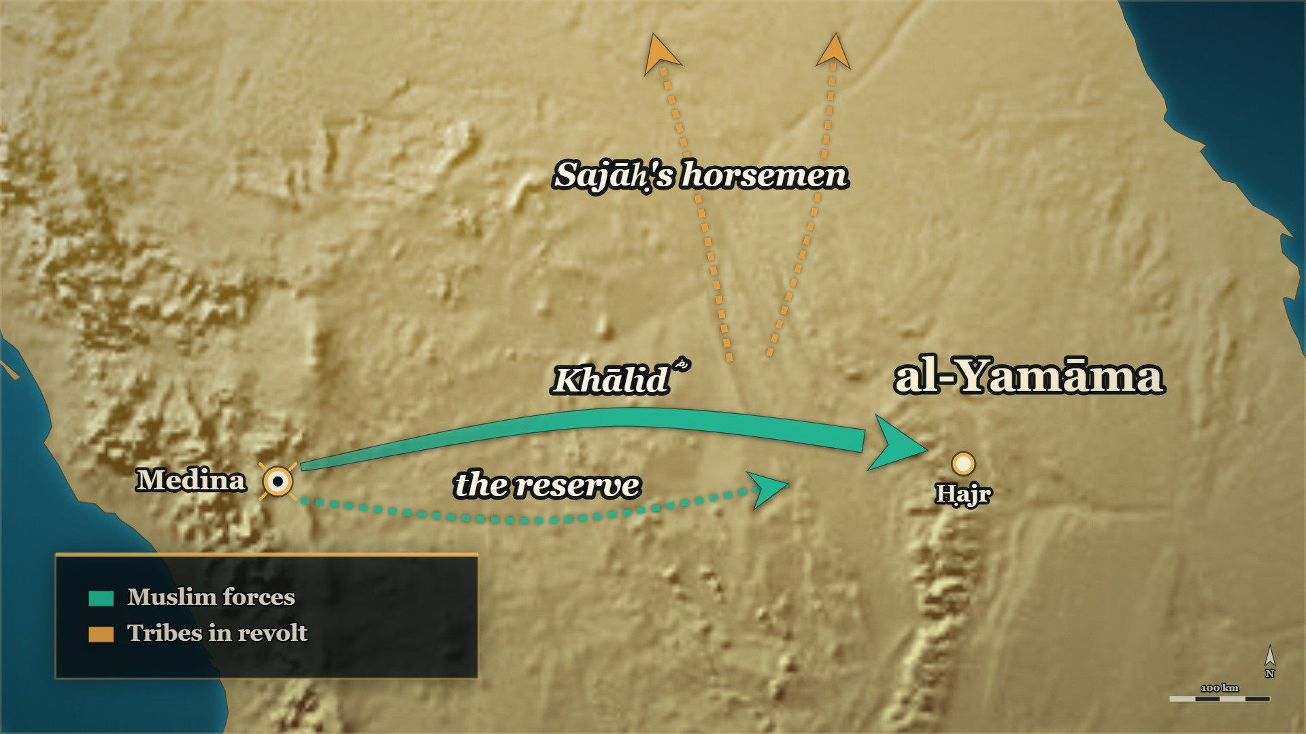
Out again, to al-Yamāma
To al-Yamāma
the army, and the reserve behind it
Notes:
MAP: tools/mapstudio/scenes/s04-05-medina-to-al-yamama.json at step 2, rendered by make_maps.py. The earlier steps are beside it in visuals/maps/ if you want the build-up across slides. Sites are approximate; tribal names are loose labels.

Slide 30
11 AH, Medina
Excused, and sent to al-Yamāma
لما رضيَ الصدِّيقُ عن خالد بن الوليد وعذَرَهُ بما اعتذرَ به، بعثَه إلى قتالِ بني حنيفة باليمامة
When the Ṣiddīq was satisfied with Khālid b. al-Walīd and accepted the excuse he made, he sent him to fight Banū Ḥanīfa at al-Yamāma.
al-Bidaya wa'l-Nihaya, vol. 7, p. 32
Notes:
RUNSHEET: The hinge. Without it the room is left standing in the mosque and the next card opens on an army
SAY —
1. Excused, and immediately employed — The same audience that cleared him ended with new orders.
2. To fight Banū Ḥanīfa at al-Yamāma — The last claimant still standing, and the largest force in Arabia.
^ read the Arabic on the face here
3. The Muslims turned out in force — Thābit b. Qays b. Shammās ؓ over the Anṣār.
4. A reserve sent out behind him — Abū Bakr ؓ put a second detachment at his back.
5. He cleared the road as he went — He passed no group that had broken away without dealing with it.
6. Sajāḥ's horsemen scattered — And ordered out of the Arabian peninsula altogether.
QUOTE — لما رضيَ الصدِّيقُ عن خالد بن الوليد وعذَرَهُ بما اعتذرَ به، بعثَه إلى قتالِ بني حنيفة باليمامة، وأوعب معه المسلمون، وعلى الأنصار ثابتُ بن قيس بن شمّاس
"When the Ṣiddīq was satisfied with Khālid b. al-Walīd and accepted the excuse he made, he sent him to fight Banū Ḥanīfa at al-Yamāma. The Muslims turned out with him in force, and Thābit b. Qays b. Shammās was over the Anṣār."
— البدایہ والنہایہ ج۷ ص۳۲
عبرت — The reckoning ended and the orders began in the same room, on the same day.
MAP — The arrow leaves **المدينة** again and runs east to **اليمامة**. A second, thinner arrow follows behind it — the reserve detachment. On the way, Sajāḥ's horsemen scatter off the map to the north.
BACKGROUND (read at home, not aloud) —
The moment the Ṣiddīq ؓ was satisfied with him and had accepted his excuse, he sent him out again — to fight Banū Ḥanīfa at al-Yamāma. The Muslims turned out with him in force. Thābit b. Qays b. Shammās ؓ was put over the Anṣār. Abū Bakr ؓ sent a detachment out behind him to be a reserve at his back. And Khālid ؓ marched: he did not pass a single one of those who had broken away without dealing with them, and when he came across horsemen belonging to Sajāḥ's following he scattered them and ordered them put out of the Arabian peninsula altogether.
**Also on the page:**
> وأردفَ الصديق خالدًا بسريةٍ لتكونَ رِدْءًا له من ورائهِ
> — البدایہ والنہایہ ج۷ ص۳۲ · https://shamela.ws/book/30097/3178
> *English:* "And the Ṣiddīq sent a detachment after Khālid, to be a reserve for him at his back."
> فسار لا يمرّ بأحدٍ من المُرْتدّين إلَّا نكَّلَ بهم، وقد اجتازَ بخيولٍ لأصحاب سَجَاح فشرَّدَهُمْ وأمرَ بإخراجهم من جزيرة العرب
> — البدایہ والنہایہ ج۷ ص۳۲ · https://shamela.ws/book/30097/3178
> *English:* "He marched, passing no one of those who had broken away without dealing with them; and
> he came upon horsemen belonging to Sajāḥ's following, and scattered them, and ordered them put out
> of the Arabian peninsula."
**This card is the hinge between al-Buṭāḥ and al-Yamāma.** Without it the room is left standing in the
mosque at Medina and the next card opens on an army outside al-Yamāma.
WHEN, as the card gives it: 11 AH

Slide 31
11 AH, before Khālid ؓ arrived
Meanwhile, at al-Yamāma
One banner
Behind him
First there
Of the eleven banners, ʿIkrima ؓ had the one sent against Musaylima
Shuraḥbīl b. Ḥasana ؓ, sent to follow him
Both reached al-Yamāma before Khālid ؓ and the main army
Notes:
BRIDGE — say:
Khālid ؓ was not the first to be sent against Musaylima. Back at Dhū al-Qaṣṣa one of the eleven banners had gone to ʿIkrima ؓ, with Shuraḥbīl ؓ sent after him — and both reached al-Yamāma before Khālid ؓ did. Here is what happened to them.

Slide 32
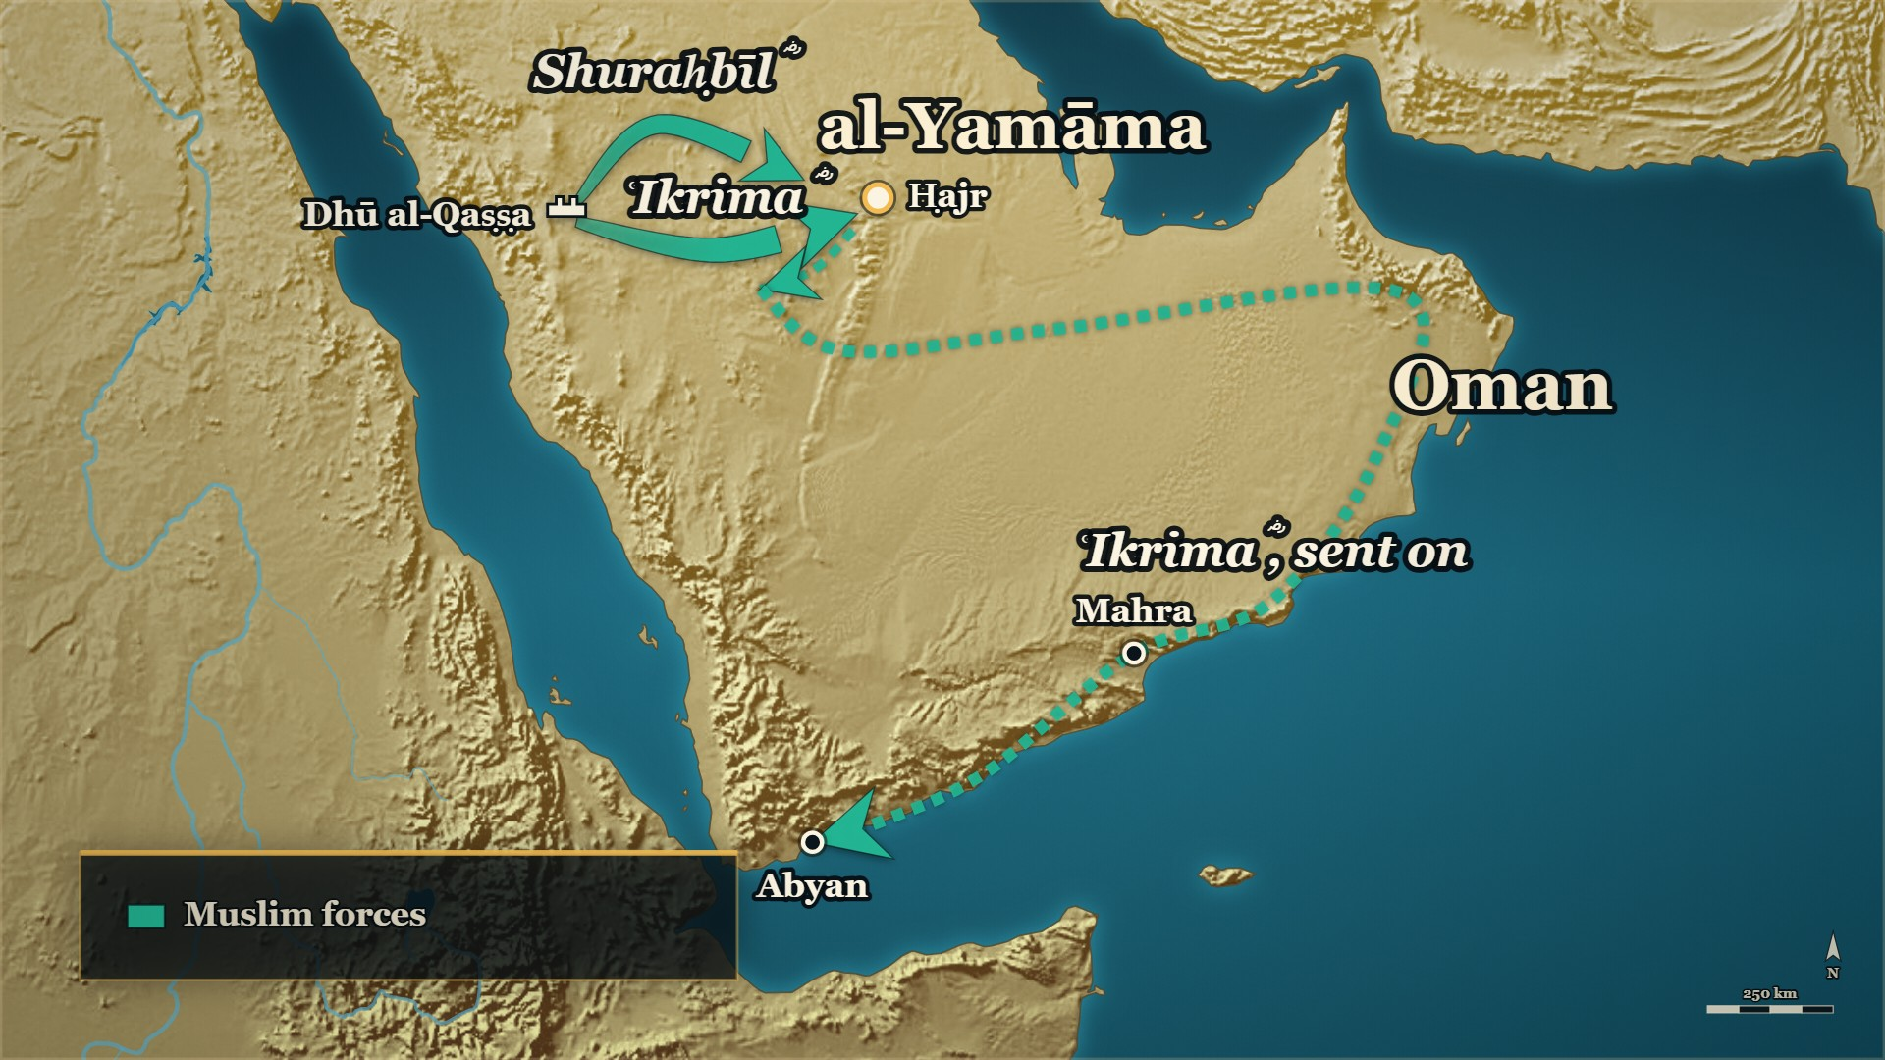
Two commanders sent ahead
ʿIkrima ؓ
beaten, then sent on to Oman
Shuraḥbīl ؓ
halted on the road
Notes:
HANDS UP FIRST — ask it before you click to this map, because the map shows the answer:
Before telling it: *"A commander loses a battle by moving too soon. What should the letter from the capital say?"*
MAP: tools/mapstudio/scenes/s04-06-two-commanders.json at step 3, rendered by make_maps.py. The earlier steps are beside it in visuals/maps/ if you want the build-up across slides. Sites are approximate; tribal names are loose labels.

Slide 33
11 AH, al-Yamāma
ʿIkrima ؓ goes too early
لَا أَرَيَنَّكَ وَلَا تَرَانِي، لَا تَرْجِعَنَّ فَتُوهِنَ النَّاسَ … فَقَاتِلْ أَهْلَ عُمَانَ وَمَهْرَةَ
Let me not see you and do not you see me. Do not come back and weaken the people … fight the people of ʿUmān and Mahra…
al-Kamil, vol. 2, pp. 214–215
Notes:
RUNSHEET: Callback: the room already met him at the far end of this road, arriving in Yemen on evening 3. Beats 1–2 are the one-breath notices for ʿIkrima ؓ and Shuraḥbīl ؓ (added 2026-09-22, #43). Ask the card's hands-up before you click to the map, which shows the answer
SAY —
1. Who ʿIkrima ؓ was — ʿIkrima b. Abī Jahl ؓ of Banū Makhzūm, "the noble, the chief, the martyr": he led his clan after his father fell at Badr, then accepted Islam; he died a martyr in Syria, 13 or 15 AH (634 or 636 CE).
2. And Shuraḥbīl b. Ḥasana ؓ — Ḥasana was his mother, and the name stuck; an early Muslim who emigrated to Abyssinia, later a commander in Syria, dead in the plague of 18 AH (639 CE).
3. Two commanders sent ahead — ʿIkrima ؓ had the banner for Musaylima; Shuraḥbīl ؓ was sent behind him.
4. He attacked before the second came up — To carry off the fame of it alone.
5. And was beaten — The first Muslim force to reach al-Yamāma was thrown back.
6. He reported it and waited for recall — What came back was not a recall.
7. "Do not come back and weaken the people" — Go on to Oman, then Mahra, then keep marching.
^ read the Arabic on the face here
8. The longest march of the war — One man's line crosses the whole southern edge of the map.
QUOTE — لَا أَرَيَنَّكَ وَلَا تَرَانِي، لَا تَرْجِعَنَّ فَتُوهِنَ النَّاسَ، امْضِ إِلَى حُذَيْفَةَ وَعَرْفَجَةَ فَقَاتِلْ أَهْلَ عُمَانَ وَمَهْرَةَ، ثُمَّ تَسِيرُ أَنْتَ وَجُنْدُكَ تَسْتَبْرُونَ النَّاسَ، حَتَّى تَلْقَى مُهَاجِرَ بْنَ أَبِي أُمَيَّةَ بِالْيَمَنِ وَحَضْرَمَوْتَ.
"Let me not see you and do not you see me. Do not come back and weaken the people. Go on to Ḥudhayfa and ʿArfaja and fight the people of ʿUmān and Mahra; then you and your troops march on, testing the people, until you meet Muhājir b. Abī Umayya in Yemen and Ḥaḍramawt."
— الکامل فی التاریخ ج۲ ص۲۱۴–۲۱۵ · **straddles the page break**
عبرت — He was not dismissed for the defeat; he was given more ground to cross.
HANDS UP — Before telling it: *"A commander loses a battle by moving too soon. What should the letter from the capital say?"*
MAP — ʿIkrima's ؓ arrow reaches **اليمامة** and **recoils**. Shuraḥbīl's ؓ arrow halts short of it on the road. Then a **new, very long line** starts from that point and runs east to عمان, then west along the southern edge — مَهْرة, أبْيَن, حضرموت. **That line is one man, and it ends only in Ḥaḍramawt.**
BACKGROUND (read at home, not aloud) —
ʿIkrima ؓ had the banner for Musaylima, and Shuraḥbīl ؓ was sent behind him. ʿIkrima ؓ attacked before Shuraḥbīl ؓ came up — Ibn al-Athīr says he wanted to carry off the fame of it alone. He was beaten. He wrote to Medina and reported it, and waited for his recall. What came back was not a recall. He was not to come home and demoralise people. He was to keep going: join Ḥudhayfa and ʿArfaja, fight in Oman and Mahra, and keep marching after that until he met al-Muhājir ؓ in Yemen and Ḥaḍramawt.
**The two notices, for the one breath** (`DECISIONS.md` #28, #43 — added 2026-09-22 after the evening-4
review found both men carrying cards with no تراجم notice):
> الشَّرِيْفُ، الرَّئِيْسُ، الشَّهِيْدُ، أَبُو عُثْمَانَ القُرَشِيُّ، المَخْزُوْمِيُّ، المَكِّيُّ. لَمَّا قُتِلَ أَبُوْهُ، تَحَوَّلَتْ رِئَاسَةُ بَنِي مَخْزُوْمٍ إِلَى عِكْرِمَةَ، ثُمَّ إِنَّهُ أَسْلَمَ، وَحَسُنَ إِسْلاَمُهُ بِالمَرَّةِ
> — سیر أعلام النبلاء ج۱ ص۳۲۳ · https://shamela.ws/book/10906/1749
> *English:* "The noble, the chief, the martyr, Abū ʿUthmān al-Qurashī al-Makhzūmī al-Makkī. When his
> father was killed, the leadership of Banū Makhzūm passed to ʿIkrima; then he accepted Islam, and his
> Islam was excellent — completely."
> وحَسَنَةُ أمه، نسب إليها وغلب عليه ذلك. أسلم قديمًا وهاجر إلى الحبشة وجهزه الصّدّيق إلى الشام، فكان أميرًا على ربع الجيش
> — البدایہ والنہایہ ج۷ ص۲۰۸ · https://shamela.ws/book/30097/3354
> *English:* "Ḥasana was his mother; he was named after her, and the name stuck. He accepted Islam early,
> emigrated to Abyssinia, and the Ṣiddīq equipped him for Syria, where he commanded a quarter of the army."
The same page ends his notice: «وطعن هو وأبو عبيدة وأبو مالك الأشعري في يوم واحد سنة ثماني عشرة» — he, Abū
ʿUbayda ؓ and Abū Mālik al-Ashʿarī ؓ were struck by the plague on one day, in 18 AH. ʿIkrima's ؓ death is
13 or 15 AH, the books differing on Ajnādayn or al-Yarmūk (`the-men-who-had-fought-against-it.md` §3.5).
WHEN, as the card gives it: 11 AH, at اليمامة

Slide 34
11 AH, al-Yamāma
And then it happened again
وَعَجَّلَ شُرَحْبِيلُ بْنُ حَسَنَةَ، وَبَادَرَ خَالِدًا بِقِتَالِ مُسَيْلِمَةَ، فَنُكِبَ، فَلَامَهُ خَالِدٌ.
"Shuraḥbīl b. Ḥasana hurried, and got ahead of Khālid in fighting Musaylima, and was struck down; and Khālid reproached him."
al-Kamil, vol. 2, p. 215
Notes:
RUNSHEET: Beaten, reproached — and then given the vanguard
SAY —
1. His orders were to wait — Stay until Khālid ؓ comes up, and afterwards go and help ʿAmr b. al-ʿĀṣ ؓ against Quḍāʿa.
2. He did not wait — He got ahead of Khālid ؓ in engaging Musaylima.
3. Beaten, and reproached — Khālid ؓ blamed him for it, as Medina had blamed ʿIkrima ؓ.
^ read the Arabic on the face here
4. Both advance forces beaten separately — That is why the day ahead would be so hard.
5. And then he was given the vanguard — At ʿAqrabāʾ, the man who had just failed led the front of the army.
QUOTE — وَعَجَّلَ شُرَحْبِيلُ بْنُ حَسَنَةَ، وَبَادَرَ خَالِدًا بِقِتَالِ مُسَيْلِمَةَ، فَنُكِبَ، فَلَامَهُ خَالِدٌ.
"Shuraḥbīl b. Ḥasana hurried, and got ahead of Khālid in fighting Musaylima, and was struck down; and Khālid reproached him."
— الکامل فی التاریخ ج۲ ص۲۱۵
عبرت — The same mistake twice in one month, and neither man was thrown away for it.
MAP — Shuraḥbīl's ؓ halted arrow starts again, reaches اليمامة and recoils in its turn. Then, when Khālid's ؓ arrow arrives, Shuraḥbīl's ؓ re-forms **in front of it** as the vanguard.
BACKGROUND (read at home, not aloud) —
Shuraḥbīl b. Ḥasana ؓ had been written to with an order to stay where he was until Khālid ؓ came up, and then, once Musaylima was finished with, to go and help ʿAmr b. al-ʿĀṣ ؓ against Quḍāʿa. He did not wait. He got ahead of Khālid ؓ in engaging Musaylima, and he was beaten too, and Khālid ؓ reproached him for it. Both of the advance commanders were beaten in detail before the main army ever arrived — which is the military shape of al-Yamāma and the reason it was the hardest fighting of the war. And then, at ʿAqrabāʾ, the man who had just been beaten and reproached was given the vanguard.
**Also on the page:** البدایہ ج۷ ص۳۳ puts him at the head of the army days later — «وقد جعل على
المقدمة شرحبيل بن حسنة» (https://shamela.ws/book/30097/3179).
WHEN, as the card gives it: 11 AH, at اليمامة

Slide 35
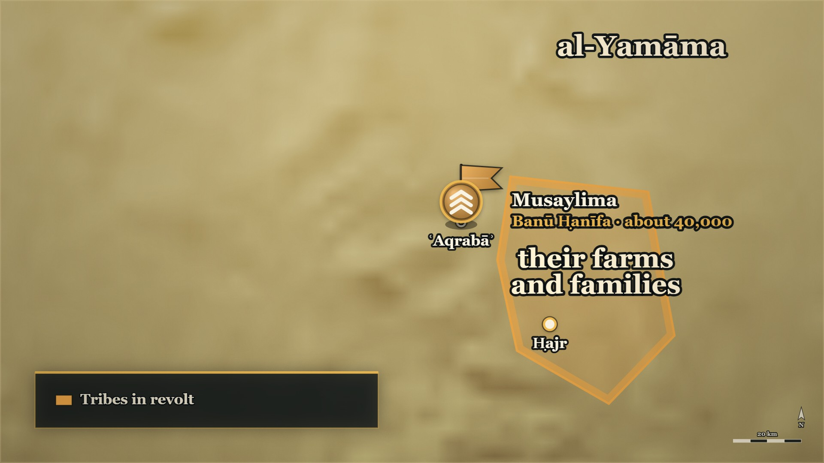
ʿAqrabāʾ, and the ground behind it
ʿAqrabāʾ
the enemy camp
The farmland
behind their own line
Notes:
MAP: tools/mapstudio/scenes/s04-07-aqraba.json at step 2, rendered by make_maps.py. The earlier steps are beside it in visuals/maps/ if you want the build-up across slides. Sites are approximate; tribal names are loose labels.

Slide 36
11–12 AH
Forty thousand, and the ground he chose
فلما سمع مسيلمةُ بقدوم خالدٍ عسكر بمكانٍ يقال له: (عقربا) في طرف اليمامة والريفُ وراءَ ظهورهم
"When Musaylima heard of Khālid's coming, he encamped at a place called ʿAqrabāʾ, at the edge of al-Yamāma, with the cultivated country behind their backs."
al-Bidaya wa'l-Nihaya, vol. 7, p. 32
Notes:
RUNSHEET: [HANDS] 3: "Why would a commander put his own villages behind his army?" — ask at beat 4
SAY —
1. Forty thousand fighting men — Three books, one figure.
2. Musaylima hears Khālid ؓ is coming — And chooses his ground before the army arrives.
3. ʿAqrabāʾ, on the edge of al-Yamāma — The town itself is Ḥajr; put it on the map.
4. The farmland behind his back — The property and the families were left behind his own line.
^ read the Arabic on the face here
5. What that decision means — No man in his line could retreat except through his own household.
6. Why neither line could give ground — Neither army had anywhere to go.
QUOTE — فلما سمع مسيلمةُ بقدوم خالدٍ عسكر بمكانٍ يقال له: (عقربا) في طرف اليمامة والريفُ وراءَ ظهورهم
"When Musaylima heard of Khālid's coming, he encamped at a place called ʿAqrabāʾ, at the edge of al-Yamāma, with the cultivated country behind their backs."
— البدایہ والنہایہ ج۷ ص۳۲
عبرت — He put his own people's homes behind his line so that no one could run. **Held for the end of the battle:** the note's own second sentence — *"It worked, and it cost more lives than any other day of the war"* — gives away a day the room has not yet seen decided. Say it with the dead of al-Yamāma, not here (evening-4 review, 2026-09-22).
HANDS UP — Before beat 5: *"Why would a commander put his own villages behind his army?"*
MAP — The enemy camp at **عَقْرَباء**, on the edge of the cultivated country, with **the farmland and the households behind it**. Draw the red block with **no line of retreat**. Name the town of اليمامة on the map: **حَجْر**.
BACKGROUND (read at home, not aloud) —
Banū Ḥanīfa were about forty thousand fighting men — the figure is the same in three books. When Musaylima heard Khālid ؓ was coming he camped at a place called ʿAqrabāʾ on the edge of al-Yamāma, and he put the cultivated country behind his back: the farms, the property and the families. Ibn al-Athīr says it in one line — he left the property behind him. That is a decision about his own men, not about the enemy. A man in that line could not fall back without running through his own household. It is the reason the battle was fought to the finish.
**Also on the page:** «لأنهم نحو أربعين ألفًا من المقاتلةِ» (البدایہ ج۷ ص۳۲ ·
https://shamela.ws/book/30097/3178); الکامل ج۲ ص۲۱۵ gives the same count, and الکامل ج۲ ص۲۱۶ has
«وَتَرَكَ مُسَيْلِمَةُ الْأَمْوَالَ وَرَاءَ ظَهْرِهِ» (https://shamela.ws/book/21712/907).
WHEN, as the card gives it: 11 AH→12 AH

Slide 37
11–12 AH
The tent and the prisoner
أيها الرجل إن كنتَ تريد بأهل اليمامة غدًا خيرًا أو شرًا فاستبق هذا الرجل
Man — if you intend anything tomorrow for the people of Yamāma, good or ill, keep this man alive…
al-Bidaya wa'l-Nihaya, vol. 7, p. 33
Notes:
RUNSHEET: Say "forty to sixty riders" and do not fix a number. This decision settles evening 5
SAY —
1. The night before the battle — The vanguard picked up a mounted party coming home.
2. Who they were — Between forty and sixty riders under Mujjāʿa b. Murāra, a chief of Banū Ḥanīfa.
3. Their excuses were not believed — Khālid ؓ ordered the whole party executed.
4. One man spoke first — If you mean anything for the people of Yamāma tomorrow, keep this one alive.
^ read the Arabic on the face here
5. Kept in irons, in the commander's own tent — With Khālid's ؓ wife Umm Tamīm, and: treat him well.
6. Remember where he is sitting — That decision settles the end of the battle before it has begun.
QUOTE — أيها الرجل إن كنتَ تريد بأهل اليمامة غدًا خيرًا أو شرًا فاستبق هذا الرجل … فاستبقاه خالد مقيدًا، وجعله في الخيمة مع امرأته، وقال: استوصي به خيرًا.
"Man — if you intend anything tomorrow for the people of Yamāma, good or ill, keep this man alive … So Khālid kept him, in irons, and put him in the tent with his wife, and said: treat him well."
— البدایہ والنہایہ ج۷ ص۳۳
عبرت — He kept one prisoner alive on a stranger's advice, and that decision settled the end of the battle before it started.
MAP — Khālid's ؓ arrow, out of Medina again (the hinge card), runs east to **اليمامة**, and halts on a ridge overlooking it. One marker for Khālid's ؓ own tent, behind the line.
BACKGROUND (read at home, not aloud) —
The night before the battle Khālid's ؓ vanguard picked up a mounted party coming home — the books say between forty and sixty riders — under Mujjāʿa b. Murāra, a chief of Banū Ḥanīfa, who had been away settling a blood feud. They were brought in and made their excuses; he did not believe them, and ordered the whole party executed. One of them spoke up first: if you mean anything at all for the people of Yamāma tomorrow, good or ill, keep this one man alive. So Khālid ؓ kept him, in irons, and put him in his own tent with his wife Umm Tamīm, and told her to treat him well.
**Also on the page:** the numbers differ — البدایہ ج۷ ص۳۳ «نحو من أربعين وقيل ستين فارسًا»; الکامل
ج۲ ص۲۱۶ «مَا بَيْنَ أَرْبَعِينَ إِلَى سِتِّينَ»; سیر (الراشدون) ص۴۳ says twenty-three. **Say "forty to
sixty riders" and do not fix a number.**
WHEN, as the card gives it: 11 AH→12 AH

Slide 38
Part IV
The day begins (11–12 AH)

Slide 39
The night before ʿAqrabāʾ
Where we are
Medina
The road
The tent
Khālid ؓ answered for al-Buṭāḥ, and was kept in command
ʿIkrima ؓ and Shuraḥbīl ؓ beaten ahead of him; forty thousand at ʿAqrabāʾ
A prisoner in irons in Khālid's ؓ own tent: Mujjāʿa of Banū Ḥanīfa
Notes:
BRIDGE — say:
After the worksheet — and for anyone who has just come in. Khālid ؓ was called to Medina over al-Buṭāḥ and kept in command. The two commanders sent ahead of him were both beaten. Forty thousand men of Banū Ḥanīfa wait at ʿAqrabāʾ, with their farms behind them — and there is a prisoner in Khālid's ؓ own tent. Morning comes.

Slide 40
11–12 AH — the books disagree
The order of battle
ورايةُ المهاجرين مع سالم … ورايةُ الأنصار مع ثابت بن قيس … والعرب على راياتها
The Muhājirūn's banner was with Sālim … the Anṣār's banner with Thābit b. Qays … and the Arabs each under their own banners.
al-Bidaya wa'l-Nihaya, vol. 7, p. 33
Notes:
RUNSHEET: Do not print a banner diagram. Three books, three arrangements
SAY —
1. The vanguard — Shuraḥbīl b. Ḥasana ؓ, at the head of the army.
2. The two wings — Zayd b. al-Khaṭṭāb ؓ and Abū Ḥudhayfa ؓ.
3. The two banners — The Muhājirūn's with Sālim ؓ, the Anṣār's with Thābit b. Qays ؓ.
4. The tribes under their own — Each clan behind its own banner.
^ read the Arabic on the face here
5. And the books do not agree — Three books arrange the same three men three ways.
6. So: name the men, not the chart — Remember these four names; they all come back within the hour.
QUOTE — ورايةُ المهاجرين مع سالم مولى أبي حذيفة، ورايةُ الأنصار مع ثابت بن قيس بن شمّاس، والعرب على راياتها
"The Muhājirūn's banner was with Sālim, the freedman of Abū Ḥudhayfa; the Anṣār's banner with Thābit b. Qays b. Shammās; and the Arabs each under their own banners."
— البدایہ والنہایہ ج۷ ص۳۳
عبرت — Where three books arrange the same men three ways, name the men and leave the diagram unbuilt.
MAP — The blue block forms up on the ridge: vanguard forward, two wings, the Muhājirūn's banner and the Anṣār's banner, and the tribes each under their own. **No labelled diagram of who held which banner.**
BACKGROUND (read at home, not aloud) —
Khālid ؓ put Shuraḥbīl b. Ḥasana ؓ at the head of the army and Zayd b. al-Khaṭṭāb ؓ and Abū Ḥudhayfa ؓ on the two wings. The Muhājirūn's banner went to Sālim ؓ, the freedman of Abū Ḥudhayfa ؓ, and the Anṣār's to Thābit b. Qays b. Shammās ؓ, and the tribes were each under their own banners. That is Ibn Kathīr. Ibn al-Athīr has Sālim ؓ carrying it after the man who had it before him was killed, and puts Abū Ḥudhayfa ؓ and Zayd ؓ over the Muhājirūn; al-Dhahabī has Zayd ؓ carrying the Muslims' banner and Sālim ؓ taking it up when Zayd ؓ fell. **Three books, three arrangements of the same three men.** Name the men; do not draw the chart.
**Also on the page:** «وقد جعل على المقدمة شرحبيل بن حسنة، وعلى المَجْنبتين زيدًا وأبا حذيفة»
(البدایہ ج۷ ص۳۳ · https://shamela.ws/book/30097/3179). الکامل ج۲ ص۲۱۵–۲۱۶ and سیر ج۱ ص۲۹۸ give the
two other arrangements — **do not print a banner diagram** (§6.3).
WHEN, as the card gives it: 11 AH→12 AH, at عَقْرَباء

Slide 41
11–12 AH — attribution disputed
"Today is the day of honour"
اليوم يوم الغيرة، اليوم إن هُزمتم تُستنكح النساء سَبيّاتٍ … فقاتلوا عن أحسابكم، وامنعوا نساءكم.
Today is the day of honour. Today, if you are routed, the women will be taken as captives … So fight for your own standing, and protect your women.
al-Bidaya wa'l-Nihaya, vol. 7, p. 33
Notes:
RUNSHEET: Say "one of their leaders" — three books name three men
SAY —
1. The armies come into sight — And a call goes along the enemy line.
2. "Today is the day of honour" — If you are routed, your women are taken.
3. "Fight for your own honour" — And protect your women.
^ read the Arabic on the face here
4. Who said it — Three books name three different men.
5. What we say — One of their leaders. We do not pick between the three.
QUOTE — اليوم يوم الغيرة، اليوم إن هُزمتم تُستنكح النساء سَبيّاتٍ، ويُنكحن غيرَ حظيّاتٍ، فقاتلوا عن أحسابكم، وامنعوا نساءكم.
"Today is the day of honour. Today, if you are routed, the women will be taken as captives and married without being cherished. So fight for your own standing, and protect your women."
— البدایہ والنہایہ ج۷ ص۳۳
عبرت — Both sides that day were fighting with their families behind them. That is the whole reason the ground did not give.
MAP — The two blocks face each other. Nothing moves yet.
BACKGROUND (read at home, not aloud) —
As the two armies came into each other's sight, a call went along the enemy line: today is the day of honour; if you are routed, your women will be taken as captives and married without being asked for; so fight for your own honour, and protect your women. Ibn Kathīr puts those words in Musaylima's own mouth. Ibn al-Athīr gives them to Shuraḥbīl b. Musaylima, and al-Dhahabī to Shuraḥbīl b. Salama. **On the slide, say "one of their leaders".**
**Also on the page:** الکامل ج۲ ص۲۱۶ attributes the same words to شرحبيل بن مسيلمة
(https://shamela.ws/book/21712/907); سیر (الراشدون) ص۴۷ to شرحبيل بن سلمة
(https://shamela.ws/book/10906/1195).
WHEN, as the card gives it: 11 AH→12 AH, at عَقْرَباء

Slide 42
11–12 AH, ʿAqrabāʾ
The line breaks, and the two protections
فكانت جولة … حتى دخلت بنو حنيفة خيمةَ خالد بن الوليد وهمّوا بقتل أم تميم، حتى أجارها مجاعة
There was a rout … Banū Ḥanīfa entered Khālid b. al-Walīd's own tent and were minded to kill Umm Tamīm — until Mujjāʿa gave her his protection…
al-Bidaya wa'l-Nihaya, vol. 7, p. 33
Notes:
RUNSHEET: Neither book softens the rout. Tell both halves of the protection
SAY —
1. The armies collide — And the Muslim line gives way.
2. The bedouin contingents break — The rout is in the books plainly; neither book softens it.
3. Into the commander's own tent — Banū Ḥanīfa came through, and were minded to kill Umm Tamīm ؓ.
4. The prisoner stands up — Mujjāʿa, still in irons, gave her his protection: this is a fine free woman.
^ read the Arabic on the face here
5. Later the same day, the mirror — Muslims entered the same tent to kill him, and she gave him hers.
6. Both halves are in the books — On the worst day of the war, each saved the other.
QUOTE — فكانت جولة وانهزمتِ الأعرابُ حتى دخلت بنو حنيفة خيمةَ خالد بن الوليد وهمّوا بقتل أم تميم، حتى أجارها مجاعة وقال: نعمتِ الحُرَّةُ هذه.
"There was a rout: the bedouin broke, until Banū Ḥanīfa entered Khālid b. al-Walīd's own tent and were minded to kill Umm Tamīm — until Mujjāʿa gave her his protection and said: This is a fine free woman."
— البدایہ والنہایہ ج۷ ص۳۳
عبرت — Each of them saved the other's life on the same day, and the book keeps both halves.
MAP — The blue block at عَقْرَباء is pushed **backwards**. A red spike reaches the marker for Khālid's ؓ own tent, behind the line.
BACKGROUND (read at home, not aloud) —
The two armies collided, and the Muslim line broke. The bedouin contingents ran, and Banū Ḥanīfa came through them and into Khālid's ؓ own tent, and were going to kill his wife. The prisoner in irons in that tent stood up and gave her his protection: *this is a fine free woman*. Later in the same day, Muslims came into the same tent meaning to kill him, and Umm Tamīm ؓ said: by Allah, he will not be killed — and gave him hers. Each of them saved the other's life on the same day, and the books keep both halves.
**The mirror, from سیر:** «فَقَالَتْ أُمُّ تَمِيمٍ: وَاللَّهِ لَا يُقْتَلُ، وَأَجَارَتْهُ» — سیر أعلام النبلاء
(سير الخلفاء الراشدين) ص۴۷ · https://shamela.ws/book/10906/1195.
WHEN, as the card gives it: 11 AH→12 AH, at عَقْرَباء

Slide 43
11–12 AH, ʿAqrabāʾ
The man who made the lie believable
فَكَانَ أَعْظَمَ فِتْنَةً عَلَى بَنِي حَنِيفَةَ مِنْ مُسَيْلِمَةَ … فَصَدَّقُوهُ وَاسْتَجَابُوا لَهُ
He was a greater fitna upon Banū Ḥanīfa than Musaylima … and they believed him and answered him.
al-Kamil, vol. 2, p. 215
Notes:
RUNSHEET: ⚠ do not use the ḥadīth attached to him — the editor marks it «⁨ضعيف جدًّا⁩»
SAY —
1. Killed in the rout — Zayd b. al-Khaṭṭāb ؓ killed a man named al-Rajjāl b. ʿUnfuwa.
2. Who he was — He had come to the Prophet ﷺ and had recited the Qurʾān.
3. What he was sent to do — Abū Bakr ؓ sent him to al-Yamāma to hold the people to Islam.
4. What he did instead — He testified that the Prophet ﷺ had made Musaylima a partner in the matter.
5. And they believed him — Because of who was saying it, not because of what was said.
^ read the Arabic on the face here
6. The historians' verdict — He was a greater fitna upon Banū Ḥanīfa than Musaylima himself.
QUOTE — فَكَانَ أَعْظَمَ فِتْنَةً عَلَى بَنِي حَنِيفَةَ مِنْ مُسَيْلِمَةَ، شَهِدَ أَنَّ مُحَمَّدًا - صَلَّى اللَّهُ عَلَيْهِ وَسَلَّمَ - يَقُولُ: إِنَّ مُسَيْلِمَةَ قَدْ أُشْرِكَ مَعَهُ، فَصَدَّقُوهُ وَاسْتَجَابُوا لَهُ
"He was a greater fitna upon Banū Ḥanīfa than Musaylima. He testified that Muḥammad ﷺ said that Musaylima had been made a partner with him — and they believed him and answered him."
— الکامل فی التاریخ ج۲ ص۲۱۵
عبرت — The false prophet needed someone with the Qurʾān to vouch for him, and that man did more damage than he did.
HANDS UP — Before beat 5: *"Why would a whole tribe believe it from him?"*
MAP — No movement. Hold on the broken line.
**Also on the page:** «وقد قُتل الرَّجَّالُ بن عنفوة … في هذه الجولة، قتله زيدُ بن الخطاب» and
«فكانت فتنةُ الرجَّال أَعظمَ من فتنة مسيلمة» — البدایہ ج۷ ص۳۳ · https://shamela.ws/book/30097/3179.
⚠ **البدایہ ج۷ ص۳۲–۳۳ attaches a ḥadīth to him which the editor there marks «وإسناده ضعيف جدًّا».
Do not use the ḥadīth.** The bare fact is in both books and is enough.
BACKGROUND (read at home, not aloud) —
In that same rout, Zayd b. al-Khaṭṭāb ؓ killed a man named al-Rajjāl b. ʿUnfuwa. He was not a man of Banū Ḥanīfa's making. He had come to the Prophet ﷺ, he had recited the Qurʾān, and Abū Bakr ؓ had sent him to al-Yamāma precisely to hold the people to Islam. Instead he testified that the Prophet ﷺ had said Musaylima was made a partner with him in the matter — and because it was he who said it, they believed him. Ibn al-Athīr's verdict: he was a greater fitna upon Banū Ḥanīfa than Musaylima was. Ibn Kathīr says the same in his own words.
WHEN, as the card gives it: 11 AH→12 AH, at عَقْرَباء

Slide 44
11–12 AH, ʿAqrabāʾ
"People of Sūrat al-Baqara"
وجعلت الصحابة يتواصَون بينهم ويقولون: يا أصحاب سورةِ البقرةِ، بَطلَ السِّحْرُ اليوم
"And the Companions began enjoining one another, saying: People of Sūrat al-Baqara — today the sorcery is undone."
al-Bidaya wa'l-Nihaya, vol. 7, p. 33
Notes:
RUNSHEET: What re-formed the line was what the men had memorised
SAY —
1. The line has broken — And the Companions begin calling to one another across the field.
2. "Set us clear, Khālid!" — The call goes up from every side.
3. A company cuts its way through — Muhājirūn and Anṣār, forcing a way clear.
4. And they call each other by a sūra — People of Sūrat al-Baqara: today the sorcery is undone.
^ read the Arabic on the face here
5. What re-formed the army — Not an order. Men naming each other by what they had memorised.
QUOTE — وجعلت الصحابة يتواصَون بينهم ويقولون: يا أصحاب سورةِ البقرةِ، بَطلَ السِّحْرُ اليوم
"And the Companions began enjoining one another, saying: People of Sūrat al-Baqara — today the sorcery is undone."
— البدایہ والنہایہ ج۷ ص۳۳
عبرت — When the line broke, what re-formed it was what the men had memorised.
MAP — The blue block stops going backwards and begins to re-form.
BACKGROUND (read at home, not aloud) —
With the line broken, the Companions began calling to each other across the field. From every side they called to Khālid ؓ to clear them a way through. And they began enjoining one another by the thing they had in common that the bedouin contingents did not: *People of Sūrat al-Baqara — today the sorcery is undone.* The army was re-formed by men calling each other by what they had memorised.
**Also on the page:** «ونادَوْا من كل جانب: أخلصنا يا خالد» — *"and they called from every side: set us
clear, Khālid!"* (البدایہ ج۷ ص۳۳ · https://shamela.ws/book/30097/3179).
WHEN, as the card gives it: 11 AH→12 AH, at عَقْرَباء

Slide 45
11–12 AH, ʿAqrabāʾ
Thābit b. Qays ؓ puts on his shroud
هَكَذَا عَنْ وُجُوْهِنَا نُقَارِعُ القَوْمَ … مَا هَكَذَا كُنَّا نُقَاتِلُ مَعَ رَسُوْلِ اللهِ ﷺ.
Get out of our faces so we can strike the enemy … This is not how we used to fight alongside the Messenger of Allah ﷺ.
Siyar A'lam al-Nubala, vol. 1, p. 311 — Sahih al-Bukhari 2845
Notes:
RUNSHEET: ⁨صحيح البخاري 2845⁩. Give his notice first — ⁨خطيب الأنصار⁩ — and the room closes the loop from #2 itself
SAY —
1. Who he was — Thābit b. Qays ؓ, the orator of the Anṣār, at Uḥud and Bayʿat al-Riḍwān, carrying their banner.
2. Anas ؓ finds him — While the line is going backwards, he is perfuming himself with ḥanūṭ.
3. He is putting on his shroud — The two white garments he was buried in.
4. "In a moment, nephew" — Asked whether he can see what is happening.
5. Then he comes forward — Past the men falling back: get out of our faces so we can strike them.
6. "This is not how we used to fight with the Messenger of Allah ﷺ" — Said to a generation that knew exactly what he meant.
^ read the Arabic on the face here
7. He digs his feet in — Holding the Anṣār's banner, to the middle of his shins, and did not move.
8. And was killed there — He never left the spot.
QUOTE — هَكَذَا عَنْ وُجُوْهِنَا نُقَارِعُ القَوْمَ، بِئْسَ مَا عَوَّدْتُم أَقْرَانَكُم، مَا هَكَذَا كُنَّا نُقَاتِلُ مَعَ رَسُوْلِ اللهِ ﷺ.
"Get out of our faces so we can strike the enemy. Wretched is what you have accustomed your opponents to! This is not how we used to fight alongside the Messenger of Allah ﷺ."
— سیر أعلام النبلاء ج۱ ص۳۱۱ — **صحيح البخاري ٢٨٤٥**
عبرت — He did not tell them what to do; he told them what they had already been.
MAP — No movement. Hold the map still on عَقْرَباء for this card.
BACKGROUND (read at home, not aloud) —
Thābit b. Qays b. Shammās ؓ was the orator of the Anṣār — of the Khazraj, brother by his mother to ʿAbdallāh b. Rawāḥa ؓ; not at Badr, and at Uḥud and at Bayʿat al-Riḍwān. He carried the Anṣār's banner that day. Anas ؓ came to him while the line was going backwards and found him rubbing himself with burial perfume. He had put on two white garments — the ones he was buried in. Anas ؓ said: do you not see what is happening? He said: in a moment, nephew. Then he came forward past the men who were falling back, told them to get out of his way, and said the thing everyone in that generation would have understood: this is not how we used to fight alongside the Messenger of Allah ﷺ. Then he took the Anṣār's banner, dug his feet into the ground to the middle of his shins, and did not move from there until he was killed.
**His تراجم notice, for the one breath:**
> خَطِيْبُ الأَنْصَارِ، كَانَ مِنْ نُجَبَاءِ أَصْحَابِ مُحَمَّدٍ -صَلَّى اللَّهُ عَلَيْهِ وَسَلَّمَ- وَلَمْ يَشْهَدْ بَدْراً، شَهِدَ أُحُداً، وَبَيْعَةَ الرُّضْوَانِ.
> — سیر أعلام النبلاء ج۱ ص۳۰۹ · https://shamela.ws/book/10906/1735
> *English:* "The orator of the Anṣār. He was among the noblest of Muḥammad's ﷺ Companions. He was
> not at Badr; he was at Uḥud and at Bayʿat al-Riḍwān."
His mother's other sons were عبد الله بن رواحة ؓ and عمرة بنت رواحة (same page). **He is also the
Companion standing beside the Prophet ﷺ in `ATA/E-TB16`** — tell that card first and let the room make
the connection itself.
**Also on the page:** الکامل ج۲ ص۲۱۷ has him adding that he dissociated himself before Allah from what
**both** armies were doing that day. And البدایہ ج۷ ص۳۳–۳۴ has him holding the position: «وحفر ثابتُ
بن قيس لقدميه في الأرض إلى أنصافِ ساقَيْه، وهو حاملُ لواءِ الأنصارِ بعدما تحنَّطَ وَتكفَّنَ»
(https://shamela.ws/book/30097/3179).
WHEN, as the card gives it: 11 AH→12 AH, at عَقْرَباء

Slide 46
Sālim ؓ with the Muhājirūn's banner
"A wretched bearer of the Qurʾān"
أتخشى أن نؤتى من قبلك؟ فقال: بئس حامل القرآن أنا إذًا.
…Do you fear we shall be broken from your side? He said: A wretched bearer of the Qurʾān I should be, then.
al-Bidaya wa'l-Nihaya, vol. 7, p. 34
Notes:
RUNSHEET: One sentence of the ⁨سیر⁩ notice, not the whole of it
SAY —
1. The question put to him — Do you fear we shall be broken from your side?
2. His answer — A wretched bearer of the Qurʾān I should be, then.
^ read the Arabic on the face here
3. Who he was — The freedman of Abū Ḥudhayfa ؓ, and the best reciter among the Muhājirūn.
4. He led them in prayer at Qubāʾ — Before the Prophet ﷺ arrived, because he carried the most Qurʾān.
5. The Prophet ﷺ went out at night to listen to him — One line, and the room knows what was lost.
6. He was killed there — Holding the banner he had been asked about.
QUOTE — وقال المهاجرون لسالم مولى أبي حذيفة: أتخشى أن نؤتى من قبلك؟ فقال: بئس حامل القرآن أنا إذًا.
"The Muhājirūn said to Sālim, the freedman of Abū Ḥudhayfa: Do you fear we shall be broken from your side? He said: A wretched bearer of the Qurʾān I should be, then."
— البدایہ والنہایہ ج۷ ص۳۴
عبرت — He answered a question about the battle line with a statement about the Qurʾān, and the two were the same answer.
MAP — No movement. The Muhājirūn's banner, held.
BACKGROUND (read at home, not aloud) —
The Muhājirūn asked the man holding their banner whether he was afraid the line would be broken from his side. Sālim ؓ, the freedman of Abū Ḥudhayfa ؓ, answered in six words: a wretched bearer of the Qurʾān I should be, then. This is the man the Prophet ﷺ went out at night to listen to, and the man who had led the Muhājirūn in prayer at Qubāʾ before the Prophet ﷺ arrived, because he carried more of the Qurʾān than any of them. He was killed on that field.
**Also in the books:** سیر ج۱ ص۱۶۸ — the Prophet ﷺ went out at night to the voice and found it was
Sālim ؓ, and said «الحَمْدُ لِلِّهِ الَّذِي جَعَلَ فِي أُمَّتِي مِثْلَكَ»; al-Dhahabī grades the chain «إسناده جيد».
Use one sentence of this, not the whole notice.
WHEN, as the card gives it: 11 AH→12 AH, at عَقْرَباء

Slide 47
11–12 AH, ʿAqrabāʾ
Zayd b. al-Khaṭṭāb ؓ — "I will not speak"
والله لا أتكلَّمُ حتى يهزمهم اللهُ أو ألقىَ اللهَ فأكلِّمه بحجَّتي
…By Allah, I will not speak until Allah routs them, or I meet Allah and speak to Him with my case.
al-Bidaya wa'l-Nihaya, vol. 7, p. 34
Notes:
RUNSHEET: ʿUmar's ؓ elder brother. This is where #15's loop closes. ʿUmar's ؓ grief for him is told on evening 5, with the dead of al-Yamāma
SAY —
1. Who he was — ʿUmar's ؓ elder brother, Muslim before ʿUmar ؓ was, holding one wing.
2. "Bite down on your back teeth" — Strike into your enemy, and go forward.
3. And then the vow — I will not speak until Allah routs them.
4. "Or I meet Allah and speak to Him with my case" — He said nothing more that day.
^ read the Arabic on the face here
5. He was killed there — A martyr, on that wing.
QUOTE — أيها الناس عَضُّوا على أضراسكم، واضربوا في عدوِّكم وامضوا قدمًا … والله لا أتكلَّمُ حتى يهزمهم اللهُ أو ألقىَ اللهَ فأكلِّمه بحجَّتي
"People — bite down on your back teeth, strike into your enemy and go forward … By Allah, I will not speak until Allah routs them, or I meet Allah and speak to Him with my case."
— البدایہ والنہایہ ج۷ ص۳۴
عبرت — He put his own silence on the outcome, and did not live to break it.
MAP — No movement. One wing of the blue block.
BACKGROUND (read at home, not aloud) —
ʿUmar's ؓ elder brother — Muslim before ʿUmar ؓ was — held one of the wings. He called out to the men to bite down on their back teeth, strike into the enemy and go forward. Then he said that he would not speak another word until Allah routed them, or until he met Allah and put his case to Him. And he was killed there.
**Also on the page:** الکامل ج۲ ص۲۱۷ adds «لَا نَحُورُ بَعْدَ الرِّجَالِ» and «غُضُّوا أَبْصَارَكُمْ»
(https://shamela.ws/book/21712/908). ʿUmar's ؓ grief for him is carried by the people strand
(`zayd-ibn-al-khattab-and-the-dead-of-yamama.md`), and by `RCT/E-RC23`.
WHEN, as the card gives it: 11 AH→12 AH, at عَقْرَباء

Slide 48
The other wing: Abū Ḥudhayfa ؓ
"Adorn the Qurʾān with deeds"
يا أهلَ القرآنِ زيِّنوا القرآنَ بالفِعال
"People of the Qurʾān — adorn the Qurʾān with deeds."
al-Bidaya wa'l-Nihaya, vol. 7, p. 34
Notes:
RUNSHEET: Three men, three answers, all three about the Qurʾān
SAY —
1. The other wing — Abū Ḥudhayfa ؓ, whose own father fell at Badr on the other side.
2. One line to the men around him — People of the Qurʾān: adorn the Qurʾān with deeds.
^ read the Arabic on the face here
3. Then he charged — Until he had driven them back.
4. And was killed — On the same field, on the same day as Sālim ؓ.
5. Master and freedman — The two of them are buried out of the same battle.
QUOTE — يا أهلَ القرآنِ زيِّنوا القرآنَ بالفِعال
"People of the Qurʾān — adorn the Qurʾān with deeds."
— البدایہ والنہایہ ج۷ ص۳۴
عبرت — Three men that morning answered the same question three ways, and all three answers were about the Qurʾān.
MAP — No movement. The other wing.
BACKGROUND (read at home, not aloud) —
On the other wing, Abū Ḥudhayfa ؓ — whose own father had been killed at Badr fighting against the Muslims — called out one line to the men around him: people of the Qurʾān, adorn the Qurʾān with deeds. Then he charged into them until he had driven them back, and he was killed. He and Sālim ؓ, his freedman, died on the same field on the same day.
WHEN, as the card gives it: 11 AH→12 AH, at عَقْرَباء

Slide 49
11–12 AH, ʿAqrabāʾ
Khālid ؓ between the lines
أنا ابن الوليد العَوْد، أنا ابن عامر وزيد … وجعل لا يبرز لهم أحدٌ إلا قتله
I am the son of al-Walīd the seasoned; I am the son of ʿĀmir and Zayd … and no one came out against him but he killed him.
al-Bidaya wa'l-Nihaya, vol. 7, p. 34
Notes:
RUNSHEET: ⚠ The watchword «⁨يا محمداه⁩» is off the face and off the cue (review, 2026-09-22): in this country it is a proof-text in a live dispute. It stays in the notes; say it only as the army's battle-cry, recorded as history, or not at all. Prepared answer: QABANK.md §6.11
SAY —
1. He rides the length of the line — Past them, opposite Musaylima, watching for a chance at him.
2. Then he stands in the gap — Between the two armies, and calls for single combat.
3. He names himself — I am the son of al-Walīd the seasoned; I am the son of ʿĀmir and Zayd.
4. And calls the watchword — Their watchword that day was: Yā Muḥammadāh.
^ read the Arabic on the face here
5. No one came out to him and lived — The books say it plainly.
6. And he had offered terms first — He came near Musaylima and offered him a return to the truth. Refused.
QUOTE — أنا ابن الوليد العَوْد، أنا ابن عامر وزيد، ثم نادى بشعار المسلمين - وكان شعارهم يومئذ: يا محمداه - وجعل لا يبرز لهم أحدٌ إلا قتله
"I am the son of al-Walīd the seasoned; I am the son of ʿĀmir and Zayd — then he called out the Muslims' watchword, and their watchword that day was: Yā Muḥammadāh! — and no one came out against him but he killed him."
— البدایہ والنہایہ ج۷ ص۳۴
عبرت — He offered terms in the middle of the worst day of the war, and it is recorded that they were refused.
MAP — A single marker in the gap between the two blocks.
BACKGROUND (read at home, not aloud) —
Khālid ؓ charged through until he was past them, rode along opposite Musaylima watching for a chance to reach him, then came back and stood in the gap between the two lines and called for single combat, naming his own father and his own people. Then he called out the Muslims' watchword for that day — *Yā Muḥammadāh* — and no one came out to him whom he did not kill. And before the fighting closed, he came near Musaylima and offered him terms and a return to the truth. It was refused.
**Also on the page:** «ثم اقترب من مسيلمة، فعرض عليه النَّصَفَ والرجوع إلى الحق» — *"then he drew near
Musaylima and offered him fair terms and a return to the truth"* (البدایہ ج۷ ص۳۴ ·
https://shamela.ws/book/30097/3180).
WHEN, as the card gives it: 11 AH→12 AH, at عَقْرَباء

Slide 50
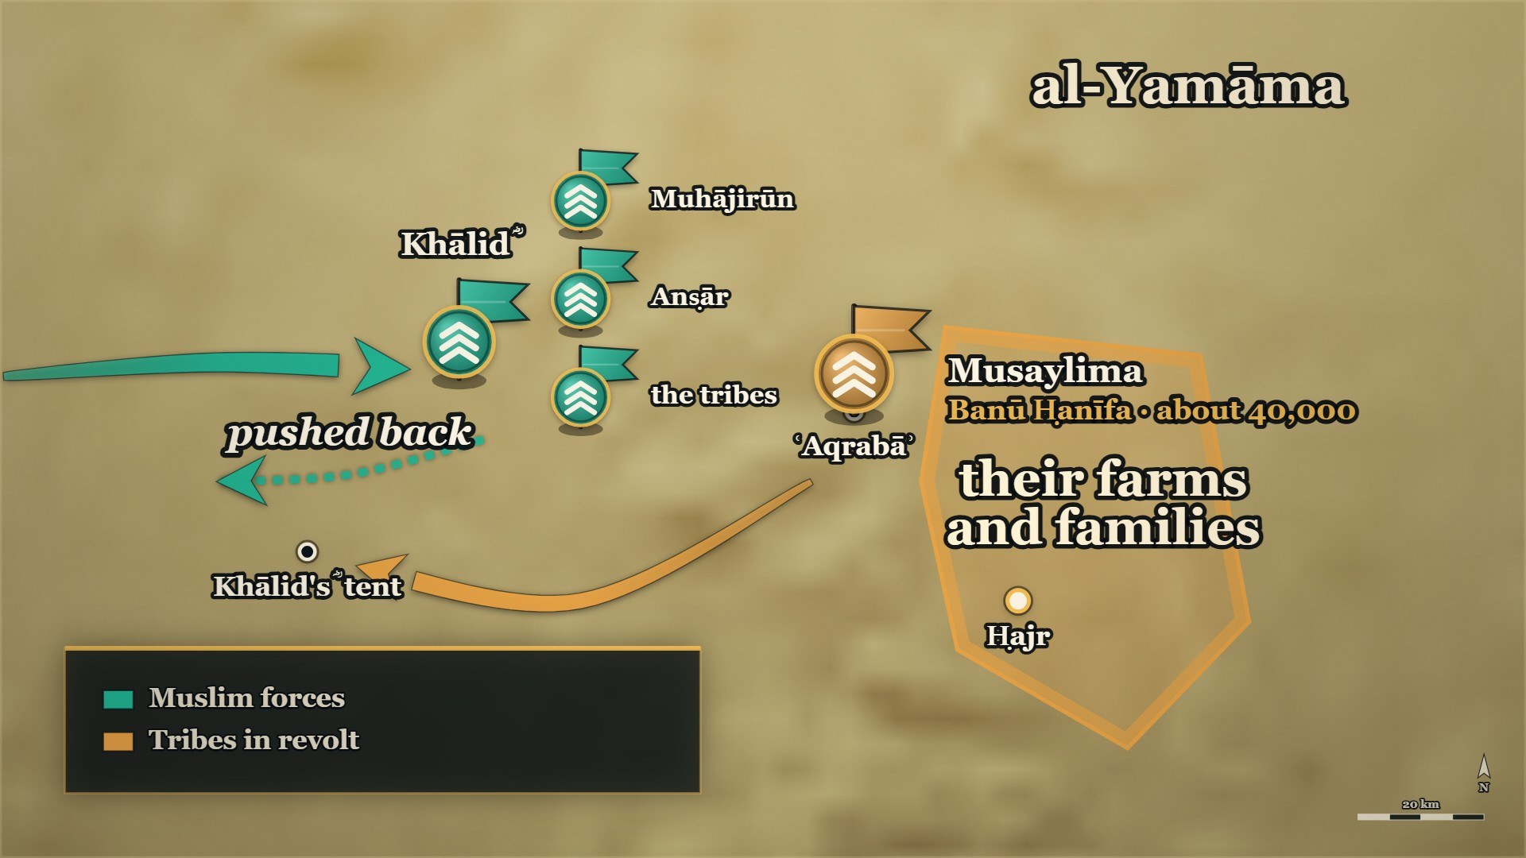
The line re-formed
Clan by clan
Muhājirūn, Anṣār, the tribes
Notes:
HANDS UP FIRST — ask it before you click to this map, because the map shows the answer:
Before telling it: *"The line is breaking and you do not know where. What do you change?"*
MAP: tools/mapstudio/scenes/s04-07-aqraba.json at step 5, rendered by make_maps.py. The earlier steps are beside it in visuals/maps/ if you want the build-up across slides. Sites are approximate; tribal names are loose labels.

Slide 51
11–12 AH, ʿAqrabāʾ
Every clan under its own banner
امْتَازُوا أَيُّهَا النَّاسُ لِنَعْلَمَ بَلَاءَ كُلِّ حَيٍّ … قَالَ بَعْضُهُمْ لِبَعْضٍ: الْيَوْمَ يُسْتَحَى مِنَ الْفِرَارِ.
Separate out, people, so we may know what each clan is worth … they said to one another: Today, running is shameful.
al-Kamil, vol. 2, p. 217
Notes:
RUNSHEET: Spare [HANDS]: "The line is breaking and you do not know where. What do you change?" — ask it before you click to the map, which shows the answer. The face title is Every clan under its own banner: the day is not yet decided at STOP C
SAY —
1. He looks at the state of his men — And gives an order that has nothing to do with weapons.
2. "Separate out" — Every clan under its own banner, fighting under it.
3. Why — So we may know what each clan is worth, and where we are being broken.
4. They separated — Muhājirūn, Anṣār, and every tribe under its own.
5. And then they said it to each other — Today, running is shameful.
^ read the Arabic on the face here
6. The honest coda — The books do not settle which clan fought hardest.
QUOTE — امْتَازُوا أَيُّهَا النَّاسُ لِنَعْلَمَ بَلَاءَ كُلِّ حَيٍّ، وَلِنَعْلَمَ مِنْ أَيْنَ نُؤْتَى … فَلَمَّا امْتَازُوا قَالَ بَعْضُهُمْ لِبَعْضٍ: الْيَوْمَ يُسْتَحَى مِنَ الْفِرَارِ.
"Separate out, people, so we may know what each clan is worth, and know from where we are being broken … and when they had separated, they said to one another: Today, running is shameful."
— الکامل فی التاریخ ج۲ ص۲۱۷
عبرت — He did not make them braver; he made it impossible for anyone's failure to be anonymous.
HANDS UP — Before telling it: *"The line is breaking and you do not know where. What do you change?"*
MAP — The blue block at عَقْرَباء splits into separate labelled sections — Muhājirūn, Anṣār, and the tribes each under their own banner.
**Also on the page:** ⚠ Ibn al-Athīr adds, on the same page, that it did not settle who fought hardest
— only that the dead were more numerous among the Muhājirūn, the Anṣār and the townsmen than among
the bedouin: «وَلَمْ يُدْرَ أَيُّ الْفَرِيقَيْنِ كَانَ أَعْظَمَ نِكَايَةً». And البدایہ ج۷ ص۳۴ gives the same order
in narrative — «وقد ميز خالد المهاجرين من الأنصار من الأعراب، وكل بني أبٍ على رايتهم، يقاتلون تحتها،
حتى يعرفَ الناسُ من أين يُؤْتون» (https://shamela.ws/book/30097/3180).
BACKGROUND (read at home, not aloud) —
Khālid ؓ looked at what was happening to his men and gave an order that had nothing to do with weapons. Separate out. Every clan under its own banner, fighting under it. He wanted two things: to know what each group was actually worth, and to know exactly where the line was being broken. They separated. And once they had, they started saying to one another that today, running would be shameful.
WHEN, as the card gives it: 11 AH→12 AH, at عَقْرَباء

Slide 52
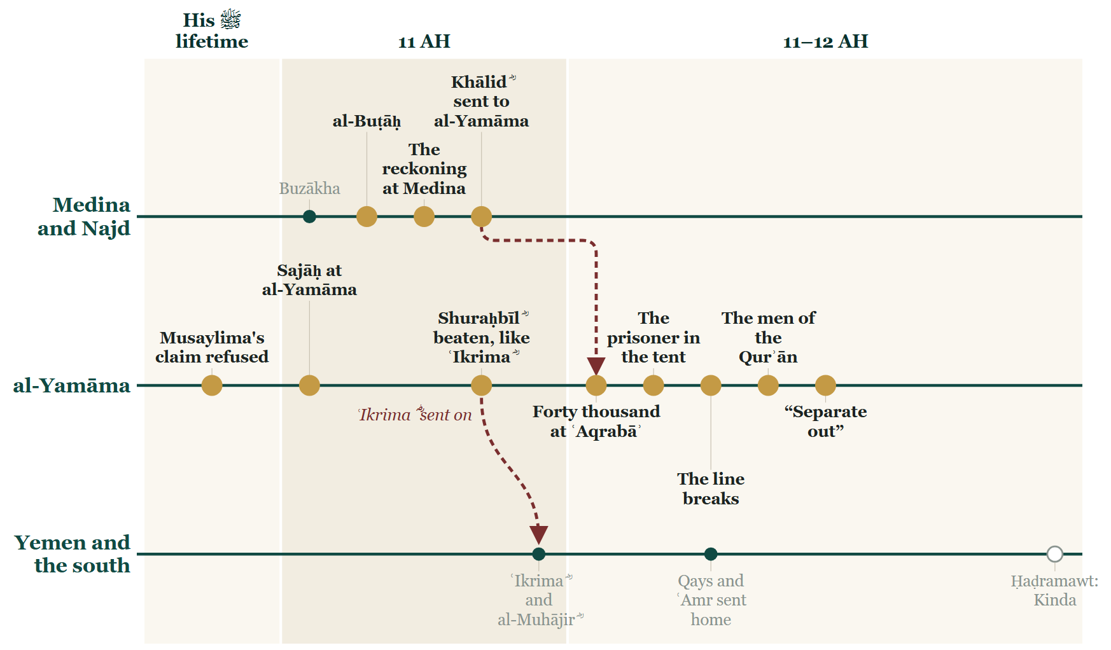
Tonight on the Line
Notes:
BOOKEND OUT STOP C — the Line. Re-used verbatim as next evening's opening slide (DECISIONS.md #23).

Slide 53
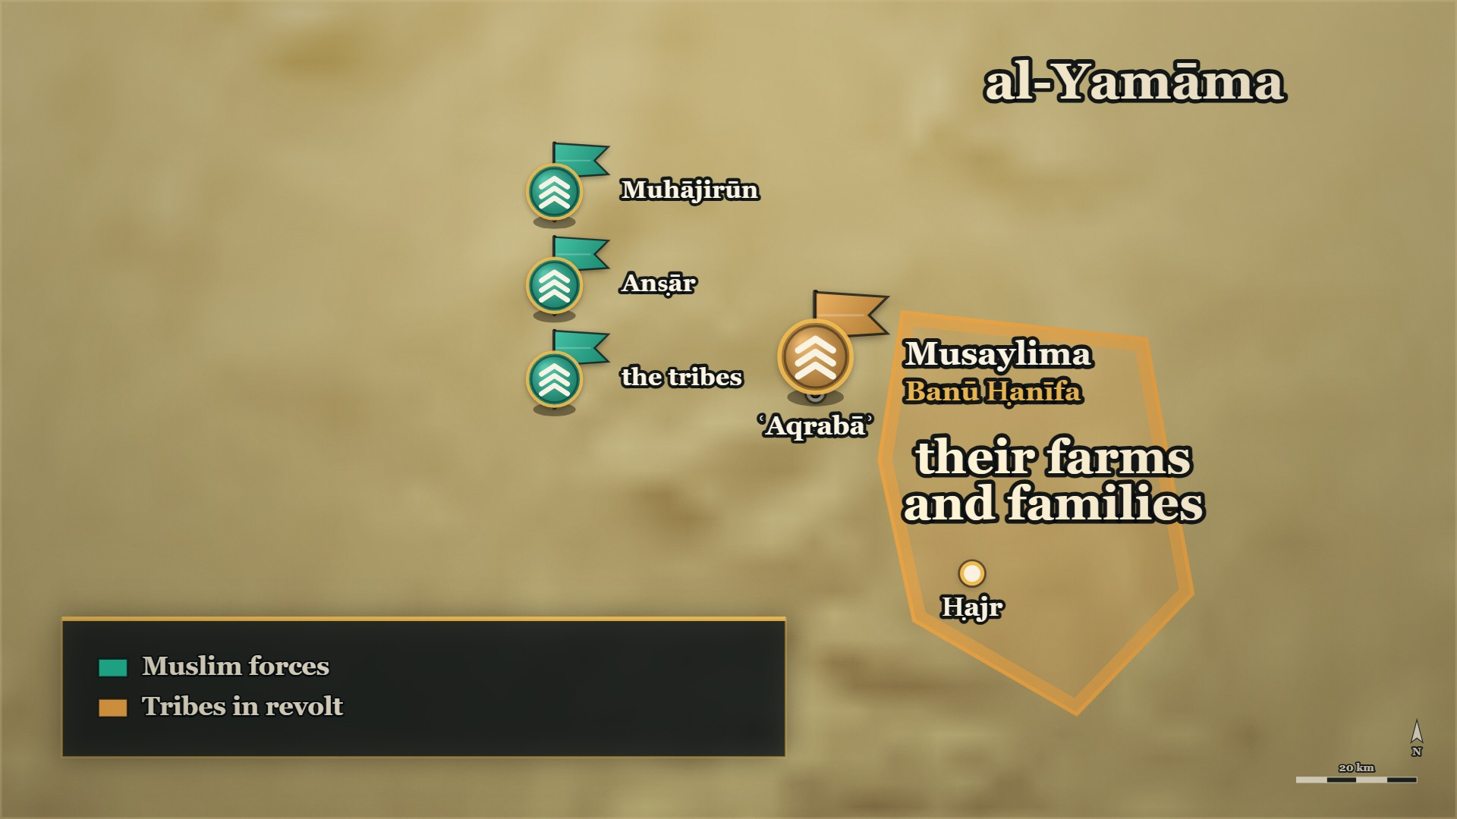
Where we stand
ʿAqrabāʾ
the line re-formed
Ḥajr
the town behind them
Notes:
MAP: tools/mapstudio/scenes/s04-close-stop-c.json at step 1, rendered by make_maps.py. The earlier steps are beside it in visuals/maps/ if you want the build-up across slides. Sites are approximate; tribal names are loose labels.

Slide 54
Tonight
One document divides the country between two tribes, and the other answers that the country belongs to neither of them.
The caliph said out loud that his commander had got it wrong, paid for it, and kept him. Those three are one decision, not three.
When the line broke, what re-formed it was what the men had memorised.
He did not make them braver; he made it impossible for anyone's failure to be anonymous.
Notes:
TONIGHT'S عبرت — say each one, then move on:
1. One document divides the country between two tribes, and the other answers that the country belongs to neither of them.
2. The caliph said out loud that his commander had got it wrong, paid for it, and kept him. Those three are one decision, not three.
3. When the line broke, what re-formed it was what the men had memorised.
4. He did not make them braver; he made it impossible for anyone's failure to be anonymous.

Slide 55
Next week
The line has been re-formed and the day is not yet decided. Where does an army go when it cannot retreat?
Notes:
Ask it, and pause. Then the salām, loudly — and the dua. The room must know it has ended.

Slide 56
Part V
The day decided

Slide 57
11–12 AH, ʿAqrabāʾ
Past the close: the day is decided
Where we stopped
What happens next
What this last part is
The line re-formed, every clan under its own banner, and the day undecided
Banū Ḥanīfa give way — and fall back into a walled garden
The garden, the end of Musaylima, the terms at the forts, and one order at Medina
Notes:
BRIDGE — say:
We have just closed, and we are going on. Where we left it: the line had re-formed, every clan under its own banner, and the day was not decided. Now it is decided — and what comes out of it is the reason you can hold a muṣḥaf tonight.

Slide 58
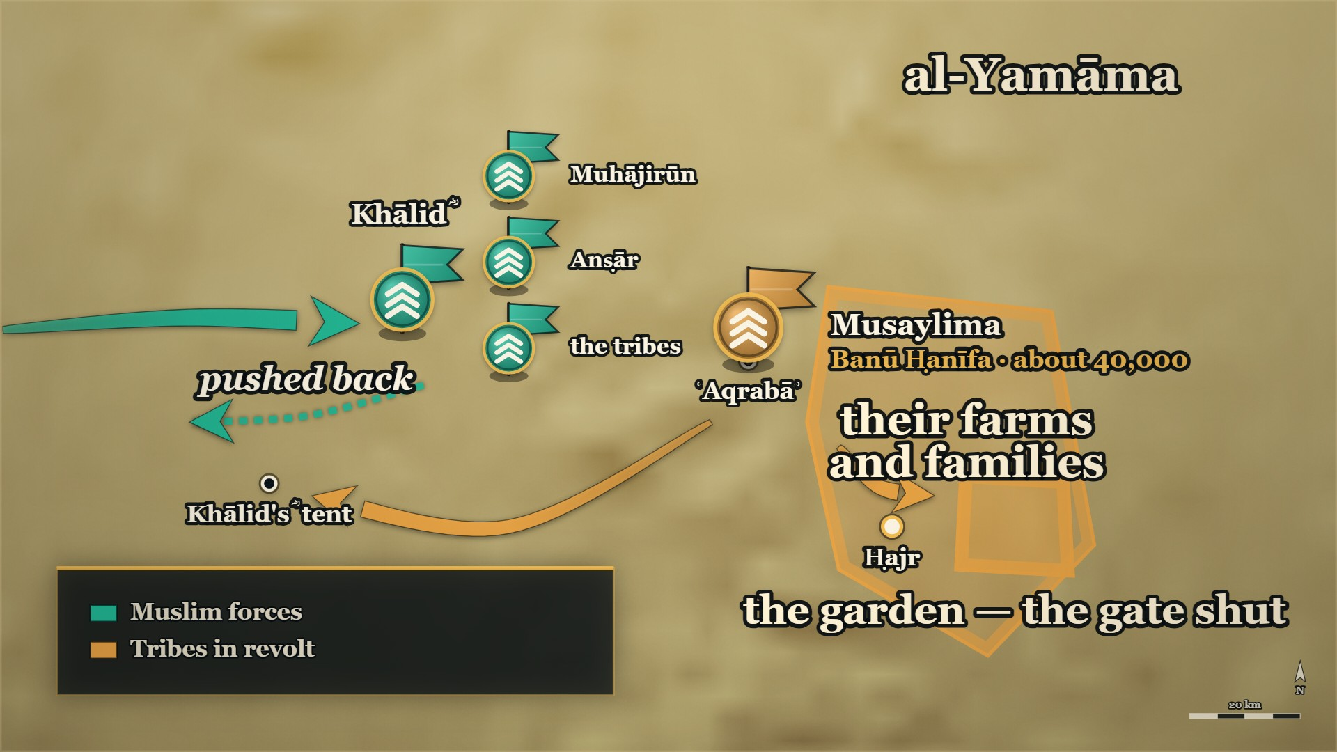
Into the garden
The garden
the gate shut behind them
Notes:
HANDS UP FIRST — ask it before you click to this map, because the map shows the answer:
Before telling it: *"The gate is shut, the wall is solid, and there are thousands inside. What do you do?"*
MAP: tools/mapstudio/scenes/s04-07-aqraba.json at step 6, rendered by make_maps.py. The earlier steps are beside it in visuals/maps/ if you want the build-up across slides. Sites are approximate; tribal names are loose labels.

Slide 59
11–12 AH, ʿAqrabāʾ
Ḥadīqat al-Mawt — over the wall
يَا مَعْشَرَ الْمُسْلِمِينَ، أَلْقُونِي عَلَيْهِمْ فِي الْحَدِيقَةِ. فَقَالُوا: لَا نَفْعَلُ، فَقَالَ: وَاللَّهِ لَتَطْرَحُنَّنِي عَلَيْهِمْ بِهَا! … وَقَاتَلَ عَلَى الْبَابِ وَفَتَحَهُ لِلْمُسْلِمِينَ.
"Company of Muslims — throw me over onto them into the garden. They said: we will not…"
al-Kamil, vol. 2, p. 218
Notes:
RUNSHEET: The climax. [HANDS] 4: "The gate is shut, the wall is solid, and there are thousands inside. What do you do?" — ask it before the map slide, which shows the answer. Beat 3 is al-Barāʾ's ؓ notice, in one breath. Gloss the name once — the books call it «⁨حديقة الموت⁩», the Garden of Death (⁨البدایہ ج7 ص34⁩). ⚠ He lived — ⁨سیر⁩ says eighty-odd wounds and a month under Khālid's ؓ care; do not say he died there
SAY —
1. The line breaks the other way — Banū Ḥanīfa fall back, and one of their commanders calls them into a walled garden.
2. The gate is shut behind them — Thousands inside, the wall solid; the books call it the Garden of Death.
3. Who al-Barāʾ ؓ was — al-Barāʾ b. Mālik ؓ, the brother of Anas ؓ, the Prophet's ﷺ servant.
4. "Throw me over onto them" — The men refuse. He swears by Allah that they will do it.
^ read the Arabic on the face here
5. Over the wall on a shield — Lifted on spear-shafts until he topped it, and he went down among them alone.
6. He opens the gate from the inside — He fought his way to it, and the army came in behind him.
7. What it cost him — Some eighty-odd wounds, and Khālid ؓ stayed a month treating them. He lived.
QUOTE — يَا مَعْشَرَ الْمُسْلِمِينَ، أَلْقُونِي عَلَيْهِمْ فِي الْحَدِيقَةِ. فَقَالُوا: لَا نَفْعَلُ، فَقَالَ: وَاللَّهِ لَتَطْرَحُنَّنِي عَلَيْهِمْ بِهَا! … وَقَاتَلَ عَلَى الْبَابِ وَفَتَحَهُ لِلْمُسْلِمِينَ.
"Company of Muslims — throw me over onto them into the garden. They said: we will not. He said: By Allah, you will throw me onto them in it! … And he fought at the gate and opened it for the Muslims."
— الکامل فی التاریخ ج۲ ص۲۱۸
عبرت — One man asked to be thrown where nobody could follow him, and the whole army came in behind him through the gate he opened.
HANDS UP — Before telling it: *"The gate is shut, the wall is solid, and there are thousands inside. What do you do?"*
MAP — The red block collapses back from عَقْرَباء into a small walled enclosure. The gate is drawn shut. Then it opens **from the inside**.
**What it cost him — سیر ج۱ ص۱۹۶:** «فَجُرِحَ يَوْمَئِذٍ **بِضْعَةً وَثَمَانِيْنَ جُرْحاً**، وَلِذَلِكَ أَقَامَ
خَالِدُ بنُ الوَلِيْدِ عَلَيْهِ شَهْراً يُدَاوِي جِرَاحَهُ» — *some eighty-odd wounds, and Khālid ؓ stayed a
month over him treating them.* **He survived.** ⚠ Ibn Khaldūn appears to list him among the killed;
سیر contradicts it. **Do not say he died there.**
BACKGROUND (read at home, not aloud) —
When Banū Ḥanīfa broke, one of their commanders called them into a walled garden and shut the gate behind them. There were thousands of them inside and the wall was solid. Al-Barāʾ b. Mālik ؓ — the brother of Anas ؓ, the Prophet's ﷺ servant — told the Muslims to throw him over it. They refused. He made them do it. They lifted him on a shield raised on spear-shafts until he topped the wall, and he went down among them alone, and fought his way to the gate, and opened it.
WHEN, as the card gives it: 11 AH→12 AH

Slide 60
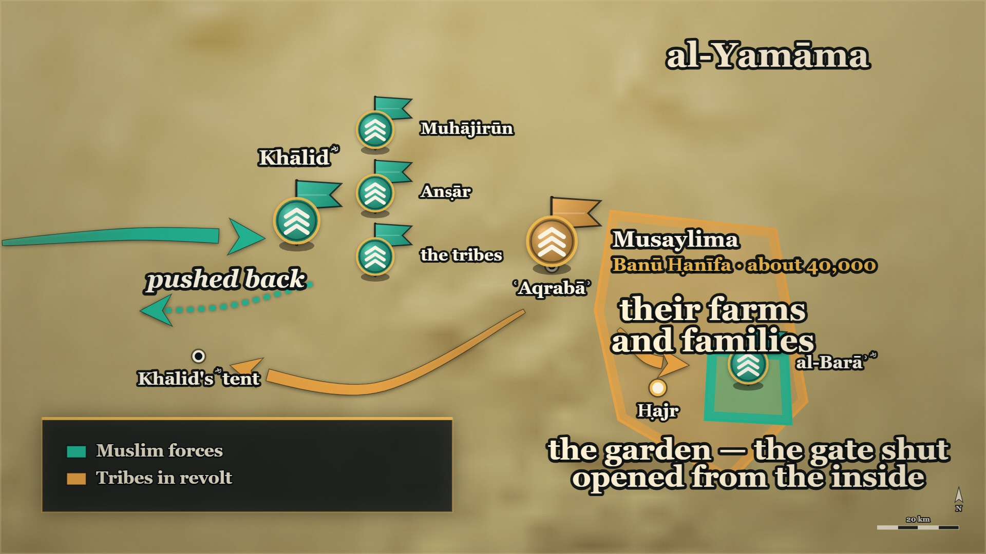
The gate opens
al-Barāʾ ؓ
over the wall, and the gate
al-Yamāma
taken
Notes:
MAP: tools/mapstudio/scenes/s04-07-aqraba.json at step 7, rendered by make_maps.py. The earlier steps are beside it in visuals/maps/ if you want the build-up across slides. Sites are approximate; tribal names are loose labels.

Slide 61
11–12 AH, ʿAqrabāʾ
The death of Musaylima
وَعَنْ وَحْشِيٍّ، قَالَ: لَمْ أَرَ قَطُّ أَصْبَرَ عَلَى الْمَوْتِ مِنْ أَصْحَابِ مُسَيْلِمَةَ، ثُمَّ ذَكَرَ أَنَّهُ شَارَكَ فِي قَتْلِ مُسَيْلِمَةَ.
"From Waḥshī: I never saw men more steadfast in the face of death than Musaylima's companions — then he mentioned that he had a share in killing Musaylima."
Siyar A'lam al-Nubala, p. 48
Notes:
RUNSHEET: ⚠ "a second man came up" — the books name different men. ⚠ Do not use the ⁨سیر⁩ line about "the best of the people of the earth and the worst": it is a ranking claim the room will argue with
SAY —
1. They reach him in a gap in the wall — The fighting comes to where Musaylima stood.
2. Waḥshī b. Ḥarb ؓ — The man who had killed Ḥamza ؓ at Uḥud, before he was a Muslim.
3. The javelin, and a second man — It went through him and out the other side; a second man came up and struck, and he fell.
4. A woman cried out from the fort above — At the moment he went down.
5. Khālid ؓ is shown a body — Is this him? "No, by Allah — this one is better than him."
6. What Waḥshī ؓ said afterwards — Not about himself: he never saw men more steadfast in death than Musaylima's companions.
^ read the Arabic on the face here
QUOTE — وَعَنْ وَحْشِيٍّ، قَالَ: لَمْ أَرَ قَطُّ أَصْبَرَ عَلَى الْمَوْتِ مِنْ أَصْحَابِ مُسَيْلِمَةَ، ثُمَّ ذَكَرَ أَنَّهُ شَارَكَ فِي قَتْلِ مُسَيْلِمَةَ.
"From Waḥshī: I never saw men more steadfast in the face of death than Musaylima's companions — then he mentioned that he had a share in killing Musaylima."
— سیر أعلام النبلاء (سير الخلفاء الراشدين) ص۴۸
عبرت — The man who killed their leader is the one the book quotes praising their courage.
MAP — The enclosure fills blue. اليمامة turns from red to blue.
⚠ **Sources differ on the second man**: البدایہ ج۷ ص۳۴ names Abū Dujāna ؓ; الکامل ج۲ ص۲۱۸ says only
"a man of the Anṣār". **Say "a second man came up".** ⚠ **Do not use the anonymous saying on the same
سیر page about "the best of the people of the earth and the worst" — it makes a ranking claim the room
will want to argue with.** Use البدایہ's plain apposition instead: *Waḥshī b. Ḥarb ؓ, who had killed
Ḥamza ؓ.*
**And Khālid ؓ walking the dead with the prisoner** — البدایہ ج۷ ص۳۵: he was shown a body and asked, is
this him? «**لا، والله هذا خيرٌ منه**». Then they came to a small sallow man, and Khālid ؓ said: «**قبَّحكم
الله على اتّباعكم هذا**» — *"May Allah disfigure you for following this."*
BACKGROUND (read at home, not aloud) —
They got through to him standing in a gap in the wall. Waḥshī b. Ḥarb ؓ — the man who had killed Ḥamza ؓ at Uḥud, before he was a Muslim — threw his javelin, and it went through him and out the other side; a second man struck him with a sword and he fell. A woman cried out from the fort above. And afterwards, when Waḥshī ؓ was asked about the battle, what he said was not about himself.
WHEN, as the card gives it: 11 AH→12 AH

Slide 62
12 AH, the forts of al-Yamāma
The treaty he was tricked into, and kept
وَوَصَلَ كِتَابُ أَبِي بَكْرٍ إِلَى خَالِدٍ أَنْ يَقْتُلَ كُلَّ مُحْتَلِمٍ … فَوَفَى لَهُمْ وَلَمْ يَغْدِرْ.
And Abū Bakr's letter reached Khālid, ordering him to kill every man who had reached puberty … so he kept faith with them and did not betray them.
al-Kamil, vol. 2, p. 219
Notes:
RUNSHEET: Mujjāʿa's third appearance, and the end of his arc. Say it beside evening 2's reprisals (): the same commander, one campaign, both pages
SAY —
1. The forts are still holding — The fighting is over, the forts are not, and the army is exhausted.
2. The prisoner is now the negotiator — Mujjāʿa goes in to consult his own people.
3. What he actually did — He put the women and the old men up on the walls in armour.
4. Khālid ؓ looks at the battlements — He sees them full of heads, and settles on terms.
5. The forts open — Inside there are women, children and old men, and nobody else.
6. "You tricked me" — "They are my people, and I could not do other than I did."
7. Then the caliph's letter arrives — Kill every grown man among them. The terms had already been given.
^ read the Arabic on the face here
8. He kept faith and did not betray them — The agreement had been made, so it stood.
QUOTE — وَوَصَلَ كِتَابُ أَبِي بَكْرٍ إِلَى خَالِدٍ أَنْ يَقْتُلَ كُلَّ مُحْتَلِمٍ، وَكَانَ قَدْ صَالَحَهُمْ، فَوَفَى لَهُمْ وَلَمْ يَغْدِرْ.
"And Abū Bakr's letter reached Khālid, ordering him to kill every man who had reached puberty — but he had already made terms with them, so he kept faith with them and did not betray them."
— الکامل فی التاریخ ج۲ ص۲۱۹
عبرت — He had been deceived into the agreement and he kept it anyway, because the agreement had already been made.
HANDS UP — Before telling it: *"You have signed terms. Then you find out you were tricked into them. Are you still bound?"*
MAP — The forts of اليمامة, ringed and then unringed.
BACKGROUND (read at home, not aloud) —
The forts were still holding, and the Muslims were exhausted. The prisoner — Mujjāʿa, now the negotiator — went in to consult his people and came back saying they refused the terms. What he had actually done was dress the women and the old men in armour and put them up on the walls. Khālid ؓ looked at the battlements, saw them full of heads, and settled. Then the forts were opened and there was nobody inside but women, children and old men. And then a letter arrived from Medina ordering him to kill every grown man among them.
**The exchange:** «**وَيْحَكَ! خَدَعْتَنِي!**» — «**هُمْ قَوْمِي، وَلَمْ أَسْتَطِعْ إِلَّا مَا صَنَعْتُ**»
(الکامل ج۲ ص۲۱۹). ابن خلدون ج۲ ص۵۰۳ confirms the kept treaty independently.
**Pair this card directly with E-RC11.** The same commander, in one campaign: reprisals by fire on
one page, and a treaty honoured against a caliph's written order on another. Say both.
WHEN, as the card gives it: 12 AH

Slide 63
12 AH, Rabīʿ I
Zayd b. al-Khaṭṭāb ؓ and his brother
وَكَانَ يَقُوْلُ: أَسْلَمَ قَبْلِي، وَاسْتُشْهِدَ قَبْلِي … وَكَانَ يَقُوْلُ: مَا هَبَّتِ الصَّبَا إِلاَّ وَأَنَا أَجِدُ رِيْحَ زَيْدٍ.
"He used to say: He became Muslim before me and was martyred before me … And he used to say: The east wind never blows but I find in it the scent of Zayd."
Siyar A'lam al-Nubala, vol. 1, p. 298
Notes:
RUNSHEET: This is where #28's silence is answered. ʿUmar's ؓ grief, and his son's reply
SAY —
1. The elder brother — Older than ʿUmar ؓ, and a Muslim before him.
2. At Badr, the mail coat — ʿUmar ؓ offered him his own; he refused it, wanting from martyrdom what his brother wanted.
3. At al-Yamāma — He carried a banner, would not speak until it was over, and was killed.
4. The army comes home — ʿUmar ؓ turns on his own son ʿAbdullāh ؓ for coming back alive.
5. The son's answer — He asked Allah for martyrdom and was given it; I strove for it and was not.
6. "He became Muslim before me, and was martyred before me" — And: the east wind never blows but I find in it the scent of Zayd.
^ read the Arabic on the face here
QUOTE — وَكَانَ يَقُوْلُ: أَسْلَمَ قَبْلِي، وَاسْتُشْهِدَ قَبْلِي … وَكَانَ يَقُوْلُ: مَا هَبَّتِ الصَّبَا إِلاَّ وَأَنَا أَجِدُ رِيْحَ زَيْدٍ.
"He used to say: He became Muslim before me and was martyred before me … And he used to say: The east wind never blows but I find in it the scent of Zayd."
— سیر أعلام النبلاء ج۱ ص۲۹۸
عبرت — The Companions' grief is recorded as carefully as their victories, and by the same men.
MAP — No movement.
BACKGROUND (read at home, not aloud) —
He was older than ʿUmar ؓ and he had become a Muslim before him. At Badr, ʿUmar ؓ offered him his own mail coat and he refused it — he said he wanted from martyrdom what his brother wanted. At al-Yamāma he carried a banner and would not speak until it was over, and he was killed. When the army came home, ʿUmar ؓ turned on his own son ʿAbdullāh ؓ for coming back alive.
**The son's answer, on the page** — الکامل ج۲ ص۲۱۹: «**سَأَلَ اللَّهَ الشَّهَادَةَ فَأُعْطِيَهَا، وَجَهَدْتُ
أَنْ تُسَاقَ إِلَيَّ فَلَمْ أُعْطَهَا**» — *"He asked Allah for martyrdom and was given it; I strove for it
to be driven to me and I was not given it."*
WHEN, as the card gives it: 12 AH, ربيع الأول

Slide 64
12 AH, Medina
The Qurʾān was collected because of this
أمرَ الصديق زيدَ بن ثابتٍ أن يجمعَ القرآن … وذلك بعد ما استَحَرّ القتلُ في القُرّاء يوم اليمامة
…al-Ṣiddīq ordered Zayd b. Thābit to gather the Qurʾān … and that was after killing had grown severe among the reciters on the day of al-Yamāma.
al-Bidaya wa'l-Nihaya, vol. 7, p. 79 — Sahih al-Bukhari 4986
Notes:
RUNSHEET: The true ending. End here and go straight to the closing bookend — say nothing after it
SAY —
1. Count this day's dead differently — So many of the reciters were killed at al-Yamāma.
2. Abū Bakr ؓ gives an order — Zayd b. Thābit ؓ is to gather the Qurʾān.
3. Out of what it was gathered — The flat stones, the palm-stalks, and the memories of men.
4. Why then — So that it would not go with the men who carried it.
^ read the Arabic on the face here
5. Both books say it in the same place — al-Bidāya and al-Kāmil, and both point at al-Bukhārī.
6. The muṣḥaf in this room — It was gathered because of the men who were killed in that garden.
QUOTE — فيها أمرَ الصديق زيدَ بن ثابتٍ أن يجمعَ القرآن من اللِّخاف والعُسُب وصدور الرجال، وذلك بعد ما استَحَرّ القتلُ في القُرّاء يوم اليمامة كما ثبت به الحديث في صحيح البخاري.
"In it, al-Ṣiddīq ordered Zayd b. Thābit to gather the Qurʾān from the flat stones and the palm-stalks and the breasts of men — and that was after killing had grown severe among the reciters on the day of al-Yamāma, as the ḥadīth in Ṣaḥīḥ al-Bukhārī establishes."
— البدایہ والنہایہ ج۷ ص۷۹ — **صحيح البخاري ٤٩٨٦**
عبرت — The mushaf the room reads from was gathered because of the men who were killed in the garden.
⚠ end here and go straight to the closing bookend.
MAP — The Line, not the map. Put a single mark on ۱۲ھ.
BACKGROUND (read at home, not aloud) —
So many of the reciters were killed at al-Yamāma that Abū Bakr ؓ ordered the Qurʾān gathered — from the flat stones and the palm-stalks and the memories of men — so that it would not go with them. Two of the four books say it in the same place, and both of them point at al-Bukhārī for it.
**الکامل ج۲ ص۲۱۹, in the same place:** «أَمَرَ أَبُو بَكْرٍ بِجَمْعِ الْقُرْآنِ لِمَا رَأَى مِنْ كَثْرَةِ مَنْ
قُتِلَ مِنَ الصَّحَابَةِ؛ **لِئَلَّا يَذْهَبَ الْقُرْآنُ**».
WHEN, as the card gives it: 12 AH

Slide 65
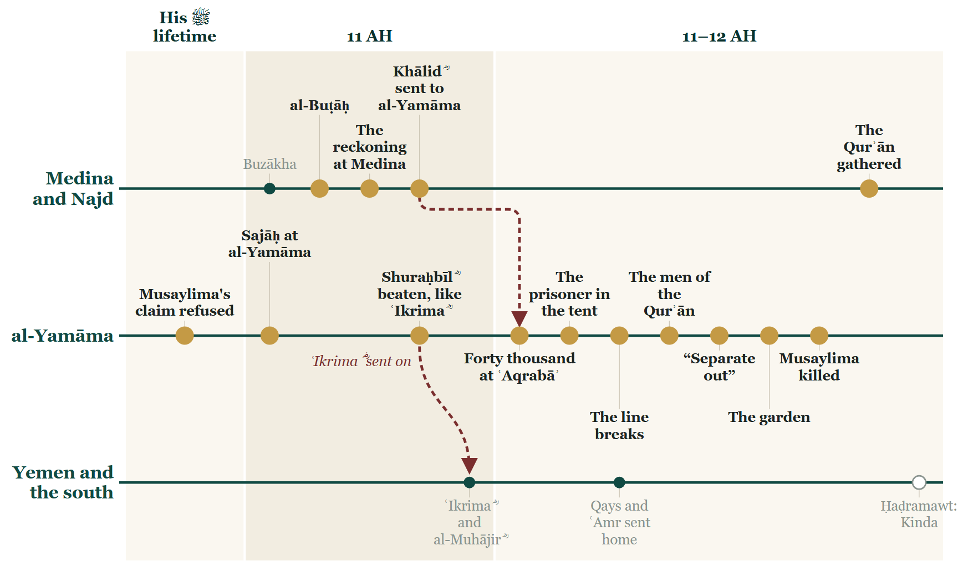
Tonight on the Line
Notes:
BOOKEND OUT STOP D — the Line. Re-used verbatim as next evening's opening slide (DECISIONS.md #23).

Slide 66
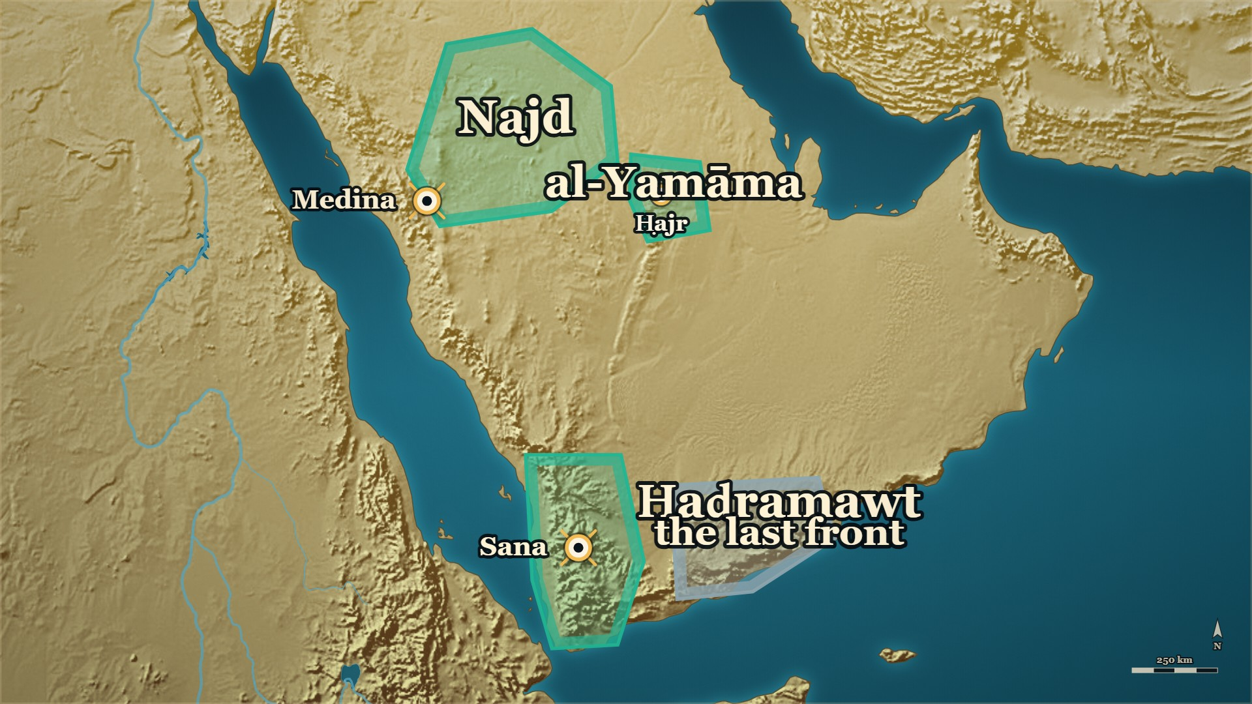
Where we stand
al-Yamāma
taken at last
Ḥaḍramawt
the last front
Notes:
MAP: tools/mapstudio/scenes/s04-close-stop-d.json at step 1, rendered by make_maps.py. The earlier steps are beside it in visuals/maps/ if you want the build-up across slides. Sites are approximate; tribal names are loose labels.

Slide 67
Tonight
The caliph said out loud that his commander had got it wrong, paid for it, and kept him. Those three are one decision, not three.
When the line broke, what re-formed it was what the men had memorised.
One man asked to be thrown where nobody could follow him, and the whole army came in behind him through the gate he opened.
The mushaf the room reads from was gathered because of the men who were killed in the garden.
Notes:
TONIGHT'S عبرت — say each one, then move on:
1. The caliph said out loud that his commander had got it wrong, paid for it, and kept him. Those three are one decision, not three.
2. When the line broke, what re-formed it was what the men had memorised.
3. One man asked to be thrown where nobody could follow him, and the whole army came in behind him through the gate he opened.
4. The mushaf the room reads from was gathered because of the men who were killed in the garden.

Slide 68
Next week
One province on your map is still grey. The last front of the war is Ḥaḍramawt — and it begins with a quarrel over one she-camel.
Notes:
Ask it, and pause. Then the salām, loudly — and the dua. The room must know it has ended.

Slide 69
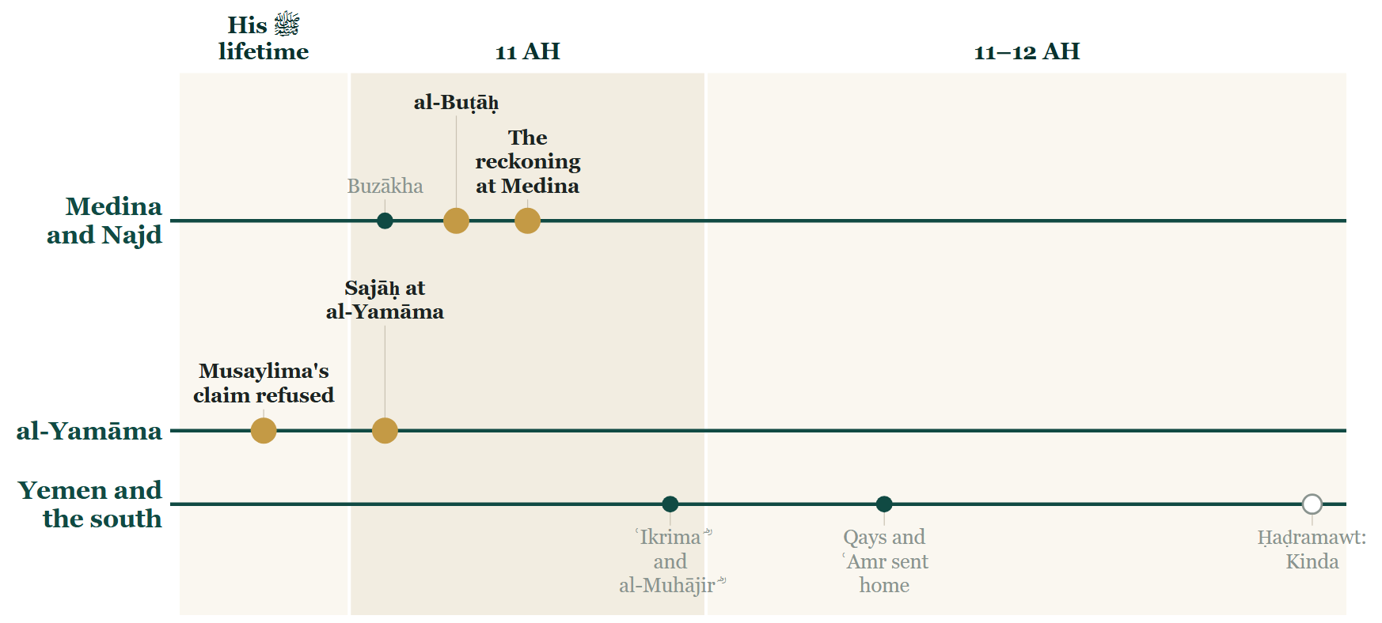
Tonight on the Line
Notes:
BOOKEND OUT STOP A — the Line. Re-used verbatim as next evening's opening slide (DECISIONS.md #23).

Slide 70
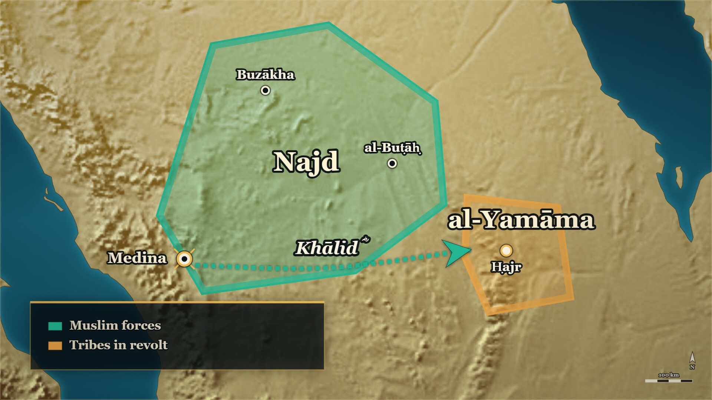
Where we stand
Najd
Buzākha and al-Buṭāḥ behind him
al-Yamāma
still in revolt
Notes:
MAP: tools/mapstudio/scenes/s04-close-stop-a.json at step 1, rendered by make_maps.py. The earlier steps are beside it in visuals/maps/ if you want the build-up across slides. Sites are approximate; tribal names are loose labels.

Slide 71
Tonight
One document divides the country between two tribes, and the other answers that the country belongs to neither of them.
Two men can stand in the same place at the same hour and carry away two different nights.
The caliph said out loud that his commander had got it wrong, paid for it, and kept him. Those three are one decision, not three.
The quarrel is not closed by a verdict. It is closed by two bereaved men consoling each other.
Notes:
TONIGHT'S عبرت — say each one, then move on:
1. One document divides the country between two tribes, and the other answers that the country belongs to neither of them.
2. Two men can stand in the same place at the same hour and carry away two different nights.
3. The caliph said out loud that his commander had got it wrong, paid for it, and kept him. Those three are one decision, not three.
4. The quarrel is not closed by a verdict. It is closed by two bereaved men consoling each other.

Slide 72
Next week
Khālid ؓ keeps his command, and the last claimant is waiting in al-Yamāma with forty thousand men. What happens when the army reaches him?
Notes:
Ask it, and pause. Then the salām, loudly — and the dua. The room must know it has ended.

Slide 73
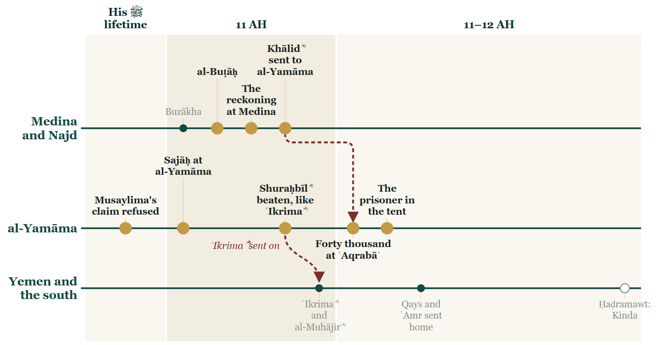
Tonight on the Line
Notes:
BOOKEND OUT STOP B — the Line. Re-used verbatim as next evening's opening slide (DECISIONS.md #23).

Slide 74
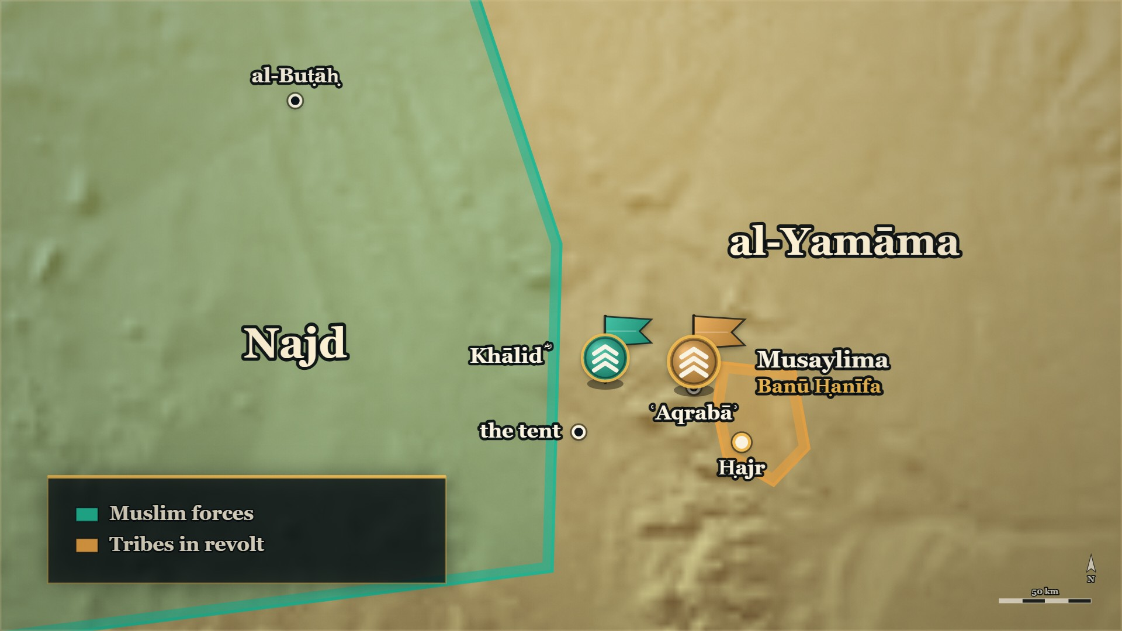
Where we stand
al-Yamāma
the armies in position
Najd
settled behind them
Notes:
MAP: tools/mapstudio/scenes/s04-close-stop-b.json at step 1, rendered by make_maps.py. The earlier steps are beside it in visuals/maps/ if you want the build-up across slides. Sites are approximate; tribal names are loose labels.

Slide 75
Tonight
One document divides the country between two tribes, and the other answers that the country belongs to neither of them.
Two men can stand in the same place at the same hour and carry away two different nights.
The caliph said out loud that his commander had got it wrong, paid for it, and kept him. Those three are one decision, not three.
He was not dismissed for the defeat; he was given more ground to cross.
Notes:
TONIGHT'S عبرت — say each one, then move on:
1. One document divides the country between two tribes, and the other answers that the country belongs to neither of them.
2. Two men can stand in the same place at the same hour and carry away two different nights.
3. The caliph said out loud that his commander had got it wrong, paid for it, and kept him. Those three are one decision, not three.
4. He was not dismissed for the defeat; he was given more ground to cross.

Slide 76
Next week
There is a man in irons in Khālid's ؓ own tent. Next week he saves a life, and then a life is saved for him.
Notes:
Ask it, and pause. Then the salām, loudly — and the dua. The room must know it has ended.

