Slide 1
Evening 6
Bahrayn and Ḥaḍramawt
11–12 AH — the last two fronts
Notes:
SAY
1. السلام علیکم — evening six.
2. Tonight: Bahrayn, and then Ḥaḍramawt — the last two fronts.

Slide 2
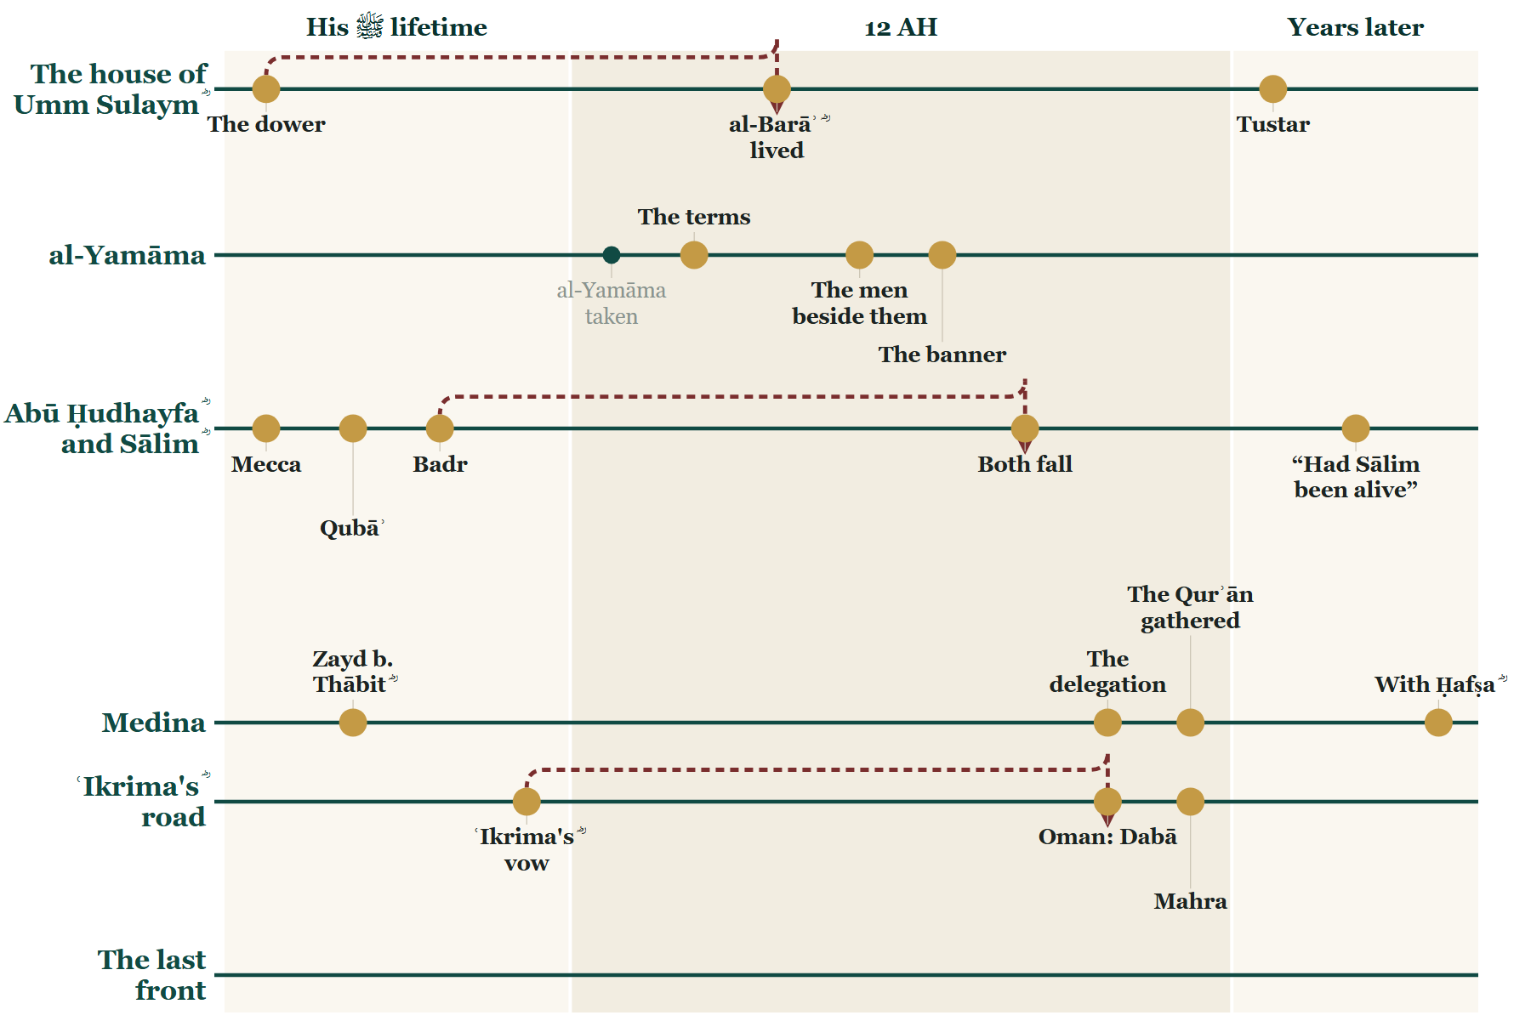
Where we stopped
Notes:
BOOKEND IN — last week's Line, unchanged
SAY
1. Last week ended with Oman and Mahra settled.

Slide 3
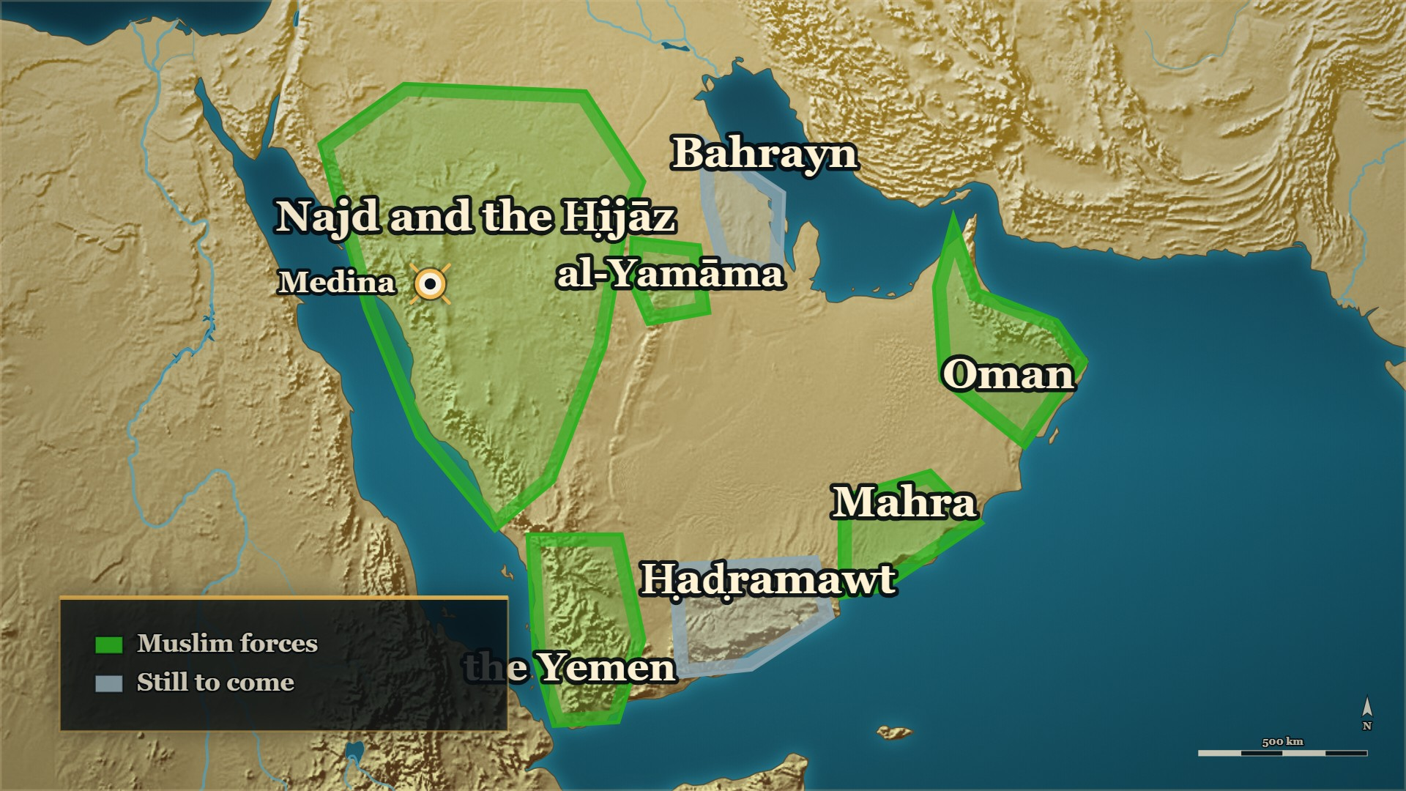
From last week
Where we stand
Oman, Mahra
settled by ʿIkrima ؓ and Ḥudhayfa
Ḥaḍramawt
not yet told
Notes:
BOOKEND IN — last week's map, unchanged
SAY
1. Tonight: Bahrayn — and then Ḥaḍramawt, the last front.

Slide 4
Part I
Arabia, as the year 12 opens
Notes:
SAY
1. Arabia, as the year 12 opens.

Slide 5
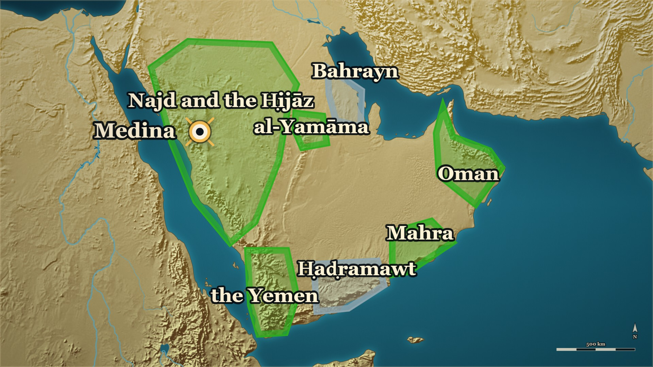


12 AH, Arabia
Arabia, as the year 12 opens
Bahrayn
not yet told
Ḥaḍramawt
not yet told
Notes:
SAY
1. Where we are on the Line
2. Ibn Kathīr does not begin the year with a battle
▶ CLICK 1 — The two fronts we have not told: Bahrayn, and Ḥaḍramawt.
3. Right and left
4. What it was for, in his words
5. And what came of it
6. Which fronts you already have
7. Which two are still grey
8. And one step back before we go there
▶ NEXT SLIDE — the Arabic, and its lesson
ASK — Before the map goes up: hands up if you thought these fronts were fought one after another.
──────── DETAIL — only if you need it ────────
1. Where we are on the Line — the year 12 opens. The map you are looking at is the one you walked out on last week.
2. Ibn Kathīr does not begin the year with a battle — he begins it with a description of where everybody was.
3. Right and left — the two direction words in the sentence you have just read out are the whole point: the armies were out in every direction at once, not taking their turn.
4. What it was for, in his words — to lay down the foundations of Islam, and to fight the tyrants among men.
5. And what came of it — the straying brought back, the truth returned to its place, the peninsula levelled, the furthest-off made as near as the nearest.
6. Which fronts you already have — al-Yamāma, the Yemen, Oman, Mahra. They overlapped. They were not fought one after another and then reported in a queue.
7. Which two are still grey — البحرين on the Gulf, and حضرموت on the south coast. That is tonight.
8. And one step back before we go there — three things that were happening while you were watching al-Yamāma.
استُهلَّت هذه السنة، وجيوشُ الصديق وأُمراؤه الذين بعثهم لقتال أهل الرّدّة جَوّالون في البلاد يمينًا وشمالًا، لتمهيد قواعد الإسلام، وقتال الطُّغاة من الأنام، حتى ردَّ شاردَ الدّين بعد ذهابه، ورجعَ الحقُّ إلى نصابه، وتمهدتْ جزيرةُ العرب، وصار البعيدُ الأقْصى كالقريب الأدْنى
"This year began while al-Ṣiddīq's armies and his commanders, whom he had sent to fight the people of the ridda, were roving the land right and left — to lay down the foundations of Islam and to fight the tyrants among men — until the straying of the religion was brought back after it had gone, and the truth returned to its proper place, and the Arabian peninsula was made level, and the furthest-off became like the nearest at hand."
— Ibn Kathīr, opening his chapter on the year 12 · البدایہ والنہایہ ج۷ ص۶۱
──────── BACKGROUND — for home, not for the lectern ────────
One view, and the page hedges it — on the same page, immediately after the dating of اليمامة: > وقد قيل: إن وقعةَ جُواثا وعُمان ومهرة وما كان من الوقائع التي أشرنا إليها إنما كانت في سنة ثنتي عشرة
> — البدایہ والنہایہ ج7 ص61 · https://shamela.ws/book/30097/3207
> English: "And it has been said that the affair of Juwāthā, and Oman, and Mahra, and what there was
> of the engagements we have referred to, were only in the year 12." ⚠ The sentence opens with the hedge "and it has been said". Report it as one view, never as the
book's own position. It matters for two reasons. It places Juwāthā — which is the البحرين front, tonight's first
front — in the year 12. And it would put Oman and Mahra, which this room was given last week,
a year later than the course placed them. The course follows the narrative sequence; Ibn Kathīr
records this as an alternative and does not choose. If a slip asks why the dates differ, that is
the answer: the book carries both and declines to pick.
Ibn Kathīr's own unhedged body text, on the same page — this one carries no "it is said": > وفيها كان قتلُ الملوك الأربعة: جَمْدٍ ومِخْوسٍ وأبْضَعة ومِشْرَحٍ
> — البدایہ والنہایہ ج7 ص61 · https://shamela.ws/book/30097/3207
> English: "And in it was the killing of the four kings: Jamd, Mikhwas, Abḍaʿa and Mishraḥ." The very next clause of the same sentence adds their sister: > وأسروا أختهم العَمرَّدة
> — البدایہ والنہایہ ج7 ص61 · https://shamela.ws/book/30097/3207
> English: "…and they took their sister al-ʿAmarrada captive." So the four kings of Kinda, whom evening 4 gave the room, are placed by Ibn Kathīr in the year 12,
in his own voice. ⚠ Spell the four names from the pool, not from this page. The pool prints
Mikhwaṣ, Mishraḥ, Jamad, Abḍaʿa, al-ʿAmarrada ; this page's own footnote (6) sets out
how the manuscripts and the printed edition differ over three of the four and calls both readings
corrupt, which is why the transliteration in the blockquote above — which follows this page — is
not quite the pool's. Two artifacts must not disagree on a name: use the pool's forms on the slide.
⚠ The two blockquotes above are one sentence in the book, split here because a footnote marker «(6)»
stands between them in the printed text. Read them as one line.
⚠⚠ The words "and they were killed on the day of al-Nujayr" on ص61 are the EDITOR'S FOOTNOTE, not
Ibn Kathīr's body text. The phrase sits inside footnote (6) of that page, where Tadmurī is quoting
al-Fīrūzābādī's القاموس: > فقتلوا يوم النُّجير
> — البدایہ والنہایہ ج7 ص61 — footnote (6), NOT the body text · https://shamela.ws/book/30097/3207
> English: "…so they were killed on the day of al-Nujayr." Do not cite ص61 for the link between the four kings and al-Nujayr. That link is carried on the
pool's own al-Nujayr pages; cite those.
اليمامة's date, on the same page, and it agrees with what the pool already says: > وفد قال جماعةٌ من علماءَ السِّير والتواريخ: إنّ وقعة اليمامةِ كانت في ربيع الأول من هذه السنة، وقيل إنها كانت في أواخر [السنة] التي قبلها، والجَمْعُ بينَ القولين أنَّ ابتداءها كان في السنة الماضية، وانتهاءَها وقع في هذه السنة الآتية
> — البدایہ والنہایہ ج7 ص61 · https://shamela.ws/book/30097/3207
> English: "And a body of the scholars of sīra and of the histories have said that the affair of
> al-Yamāma was in Rabīʿ al-Awwal of this year; and it is said that it was in the latter part of the
> year before it. And the reconciling of the two views is that its beginning was in the year past and
> its ending fell in this year coming." ⚠ The cache file reads «وفد قال» where the sense plainly requires «وقد قال». Eyeball this one against
the page image before it reaches a slide . Safer still: speak the sense and quote only the
reconciliation clause.
⚠ This is Ibn Kathīr reconciling it in his own voice on ص61, and it matches the pool's existing card
(البدایہ ج7 ص35–36 + سیر الراشدون ص49: begun in 11, finished in 12). Second page, same answer — do not
present it as a new finding.
⚠ "Concurrent" means the FRONTS overlapped — not that every action did. The sentence licenses the
shape of the evening and no more than that. Several individual commanders' own fronts were plainly
sequential, and the books say so in terms: ʿIkrima ؓ went to Oman, then to Mahra, then on to join
al-Muhājir ؓ, and Khālid ؓ went Buzākha, then al-Buṭāḥ, then al-Yamāma. So the honest claim is: the
fronts ran alongside one another; each commander's own road ran in order. If a listener presses, that
distinction is the answer, and it costs nothing to give.
⚠ THE MONTHS INSIDE 11–12ھ ARE NOT FIXED BY THE BOOKS. Two months are dated on pages we hold —
Usāma's ؓ march in ربيع الأول 11ھ, and this page's ربيع الأول for اليمامة, which is itself one view of
two. Everything else is sequence, not calendar. So the order this course tells the fronts in is
the course's order, built from the narrative order and the explicit "when you are done with X, go
to Y" instructions — not a dated timetable in the books. Say that aloud on this slide. It is the
sentence that licenses the whole evening, and it is also what keeps the course honest.
⚠ Cross-reference — the pool's closing card already carries Ibn Kathīr's duration
sentence: > وعامة ما وقع من هذه الحروب كان في أواخر سنة إحدى عشرة وأوائل سنة ثنتي عشرة
> — البدایہ والنہایہ ج7 ص43 · https://shamela.ws/book/30097/3189
> English: "And the general run of these wars was in the last part of the year 11 and the first part
> of the year 12." This card and that one say the same thing from two pages and must not be made to disagree. RC80 is the
opening frame; RC36 is the closing frame. If both are in the deck, RC80 states the shape and RC36
states the duration — do not let RC80 also claim the duration.
⚠ The quotation stops at «كالقريب الأدْنى». The printed text continues with a bracketed «[الأقرب]»,
which footnote (2) marks as an addition from manuscript أ. It is left out deliberately.

Slide 6
12 AH, Arabia
Arabia, as the year 12 opens
استُهلَّت هذه السنة، وجيوشُ الصديق وأُمراؤه الذين بعثهم لقتال أهل الرّدّة
This year began while al-Ṣiddīq's armies and his commanders, whom he had sent to fight the people of the ridda
جَوّالون في البلاد يمينًا وشمالًا
were roving the land right and left
— Ibn Kathīr, opening his chapter on the year 12
al-Bidaya wa'l-Nihaya, vol. 7, p. 61
Notes:
READ the Arabic on the slide — then its English.
WHO IS SPEAKING — Ibn Kathīr, opening his chapter on the year 12
LESSON — The book does not open the year with a battle. It opens it with a map — and on that map the armies are out in every direction at the same time.
──────── DETAIL — only if you need it ────────
استُهلَّت هذه السنة، وجيوشُ الصديق وأُمراؤه الذين بعثهم لقتال أهل الرّدّة جَوّالون في البلاد يمينًا وشمالًا، لتمهيد قواعد الإسلام، وقتال الطُّغاة من الأنام، حتى ردَّ شاردَ الدّين بعد ذهابه، ورجعَ الحقُّ إلى نصابه، وتمهدتْ جزيرةُ العرب، وصار البعيدُ الأقْصى كالقريب الأدْنى
"This year began while al-Ṣiddīq's armies and his commanders, whom he had sent to fight the people of the ridda, were roving the land right and left — to lay down the foundations of Islam and to fight the tyrants among men — until the straying of the religion was brought back after it had gone, and the truth returned to its proper place, and the Arabian peninsula was made level, and the furthest-off became like the nearest at hand."
— البدایہ والنہایہ ج۷ ص۶۱

Slide 7
Part II
Bahrayn: the front that began first (11→12 AH)
Notes:
SAY
1. Bahrayn: the front that began first (11→12 AH).

Slide 8
11 AH, the Gulf coast
From ʿIkrima's ؓ journey, to Bahrayn
Last week
Tonight
Then
ʿIkrima's ؓ journey: Oman, then Mahra
Bahrayn — the front that began before them
Ḥaḍramawt, the last front
Notes:
BRIDGE
SAY
1. Last week: ʿIkrima's ؓ journey east — Oman, then Mahra.
2. Tonight we go back once: to Bahrayn, which began before any of them.
3. Then forward, to Ḥaḍramawt — and we do not go back again.

Slide 9
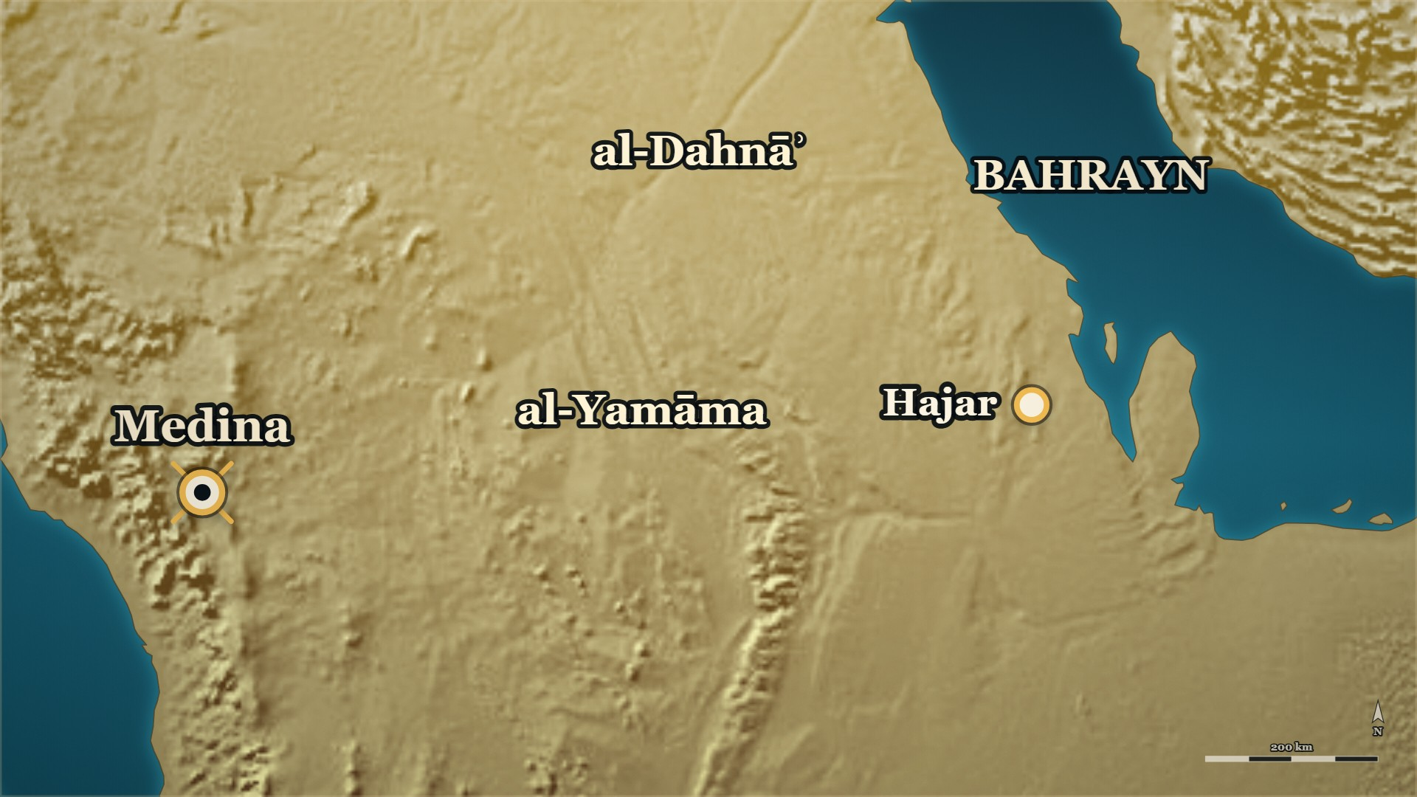





Before the conquest of Mecca
Bahrayn, in the Prophet's ﷺ lifetime
al-Mundhir b. Sāwā ؓ
holds Bahrayn for the Prophet ﷺ
Hajar
its chief town
Notes:
⚠ Ibn al-Athīr: year 6 — “or, it is said, 8”. Say “before the conquest of Mecca”.
SAY
1. Bahrayn is the whole Gulf coast of Arabia — not the island.
▶ CLICK 1 — The Prophet ﷺ sends al-ʿAlāʾ b. al-Ḥaḍramī ؓ to al-Mundhir b. Sāwā.
2. al-Mundhir: of ʿAbd al-Qays, the ruler of Bahrayn.
▶ CLICK 2 — Bahrayn comes under Islam; al-Mundhir ؓ holds it for him.
3. Remember al-ʿAlāʾ ؓ. Abū Bakr ؓ sends him to Bahrayn tonight.

Slide 10





11 AH, Bahrayn
al-Mundhir b. Sāwā ؓ — and Rabīʿa
al-Jārūd ؓ
holds ʿAbd al-Qays to Islam
al-Ḥuṭam
leads Bakr b. Wāʾil out
Notes:
⚠ Name no king — three books give his name three ways.
SAY
1. Bahrayn was already Muslim
▶ CLICK 1 — 11 AH. al-Mundhir ؓ dies, shortly after the Prophet ﷺ.
2. Two deaths, close together
▶ CLICK 2 — Rabīʿa turn — all of Bahrayn but al-Jārūd ؓ and those with him.
3. Rabīʿa turn
4. "We will restore the kingship"
5. Name no king
▶ CLICK 3 — al-Ḥuṭam b. Ḍubayʿa comes out, at the head of Bakr b. Wāʾil.
6. al-Ḥuṭam b. Ḍubayʿa comes out
7. Not all of them had ever been Muslim
▶ NEXT SLIDE — the Arabic, and its lesson
──────── DETAIL — only if you need it ────────
1. Bahrayn was already Muslim — Under al-Mundhir b. Sāwā al-ʿAbdī ؓ, the Prophet's ﷺ own man there.
2. Two deaths, close together — The Prophet ﷺ; and shortly after him, al-Mundhir ؓ.
3. Rabīʿa turn — all but al-Jārūd ؓ — Rabīʿa in Bahrayn agreed on the ridda, except al-Jārūd ؓ and those who followed him.
4. "We will restore the kingship" — In a son of al-Nuʿmān b. al-Mundhir's house: a monarchy brought back, not a false prophet followed.
5. Name no king — Three books give his name three ways; say only "a king of the old royal house".
6. al-Ḥuṭam b. Ḍubayʿa comes out — Of Banū Qays b. Thaʿlaba, at the head of Bakr b. Wāʾil.
7. Not all of them had ever been Muslim — Men who had never been Muslims joined him: on this front the ridda was not all ridda.
وَاجْتَمَعَتْ رَبِيعَةُ بِالْبَحْرَيْنِ عَلَى الرِّدَّةِ إِلَّا الْجَارُودُ وَمَنْ تَبِعَهُ، وَقَالُوا: نَرُدُّ الْمُلْكَ
"And Rabīʿa in Bahrayn agreed together upon the ridda — except al-Jārūd and those who followed him — and they said: we will restore the kingship."
— Ibn al-Athīr, on what Rabīʿa said · الکامل فی التاریخ ج۲ ص۲۲۲
──────── BACKGROUND — for home, not for the lectern ────────
The administration that was already there (البدایہ ج7 ص37):
> كان من خبرهم أنَّ رسولَ الله ﷺ كان قد بعثَ العلاءَ بن الحَضْرميّ إلى مَلِكِها، المُنْذر بن ساوى العَبْدي، وأسلم على يديه وأقام فيهم الإسلامَ والعدلَ، فلما توفي رسولُ الله ﷺ توفي المنذر بعدَه بقليل
> — البدایہ والنہایہ ج7 ص37 · https://shamela.ws/book/30097/3183
> English: "The account of them is that the Messenger of Allah ﷺ had sent al-ʿAlāʾ b. al-Ḥaḍramī to
> its king, al-Mundhir b. Sāwā al-ʿAbdī, and he accepted Islam at his hands and established Islam and
> justice among them. And when the Messenger of Allah ﷺ died, al-Mundhir died shortly after him." He was already ill when the news came (الکامل ج2 ص221):
> فَلَمَّا مَاتَ النَّبِيُّ - صَلَّى اللَّهُ عَلَيْهِ وَسَلَّمَ - كَانَ الْمُنْذِرُ بْنُ سَاوَى الْعَبْدِيُّ مَرِيضًا
> — الکامل فی التاریخ ج2 ص221 · https://shamela.ws/book/21712/912
> English: "And when the Prophet ﷺ died, al-Mundhir b. Sāwā al-ʿAbdī was ill." What became of the governor — and it is on the page (البدایہ ج7 ص37–38). ʿAmr b. al-ʿĀṣ ؓ was
present with him in that final illness. Al-Mundhir asked him whether the Messenger of Allah ﷺ used to
allow a sick man to assign anything out of his wealth; ʿAmr ؓ said yes, a third. He asked what to do
with it, and ʿAmr ؓ offered him three ways — to give it to his relatives, or to the needy, or to make
it a ṣadaqa after him, tied up and inalienable. He refused the third — he said he disliked making it
like the
dedicated animals of the Jāhiliyya: > أن أجعله كالبَحيرةِ والسّائبة والوَصِيلةِ والحام
> — البدایہ والنہایہ ج7 ص38 · https://shamela.ws/book/30097/3184
> English: "...that I should make it like the baḥīra and the sāʾiba and the waṣīla and the ḥām." He gave it away outright instead, and died; and ʿAmr ؓ used to marvel at him. ⚠ This is a story about one man's scruple, not a ruling on waqf. Narrate it and move on; do not
invite the room to draw a fiqh conclusion from it,
and if a slip comes in asking, it goes to the later session. It is optional colour — the card works
without it. ⚠⚠ NAME NO KING — and this is the reason, so that no rebuild can undo it. Our pages carry three
different forms of this man's name, and one of our authorities argues with himself about whether the
word is a name at all:
- «الغرور», and the full form المنذر بن النعمان بن المنذر — البدایہ ج7 ص38 and الکامل ج2 ص222 (the two safe-list books agree on the patronymic; it is the لقب that moves);
- «المعرور بن النعمان بن المنذر» — البدایہ ج7 ص19, inside محمد بن إسحاق's roster of the risings;
- «المغرور بن سويد» — ابن خلدون ج2 ص504، ص505, where the same two pages also carry the other form and the remark that المغرور may be a name rather than a لقب. On stage: "they brought out a man of the old royal house and made him king." No name, no dynasty
label. The word Lakhmid is modern scholarship and is on no page we hold [CONVENTIONAL-ESTIMATE];
الحيرة reaches us here only through ابن خلدون, who is framing-only — so neither
word goes on the slide face. Not for the slide face — the naming, for the speaker only. Daniyal should see exactly what he is
withholding, and that it is not a disagreement about who the man was but about what he was called:
> نَرُدُّ الْمُلْكَ فِي الْمُنْذِرِ بْنِ النُّعْمَانِ بْنِ الْمُنْذِرِ، وَكَانَ يُسَمَّى الْغَرُورُ
> — الکامل فی التاریخ ج2 ص222 · https://shamela.ws/book/21712/913
> English: "We will restore the kingship in al-Mundhir b. al-Nuʿmān b. al-Mundhir — and he used to
> be called al-Gharūr." > فلما مات المنذرُ ارتدَّ أهلُ البحرين وملَّكوا عليهم الغرور، وهو المنذر بن النعمان بن المنذر. وقال قائلهم: لو كان محمد نبيًا ما مات
> — البدایہ والنہایہ ج7 ص38 · https://shamela.ws/book/30097/3184
> English: "When al-Mundhir died, the people of Bahrayn apostatised and made al-Gharūr king over
> them — and he is al-Mundhir b. al-Nuʿmān b. al-Mundhir. And one of them said: if Muḥammad had been
> a prophet, he would not have died." ⚠ The slogan in that second quotation belongs to , where it is answered — do not spend
it here. If it is spoken on this card it must not be spoken again later in the evening; pick one. > وارتدَّتْ ربيعةُ مع المعرور بن النعمان بن المنذر
> — البدایہ والنہایہ ج7 ص19 · https://shamela.ws/book/30097/3165 (inside محمد بن إسحاق's roster)
> English: "And Rabīʿa apostatised with al-Maʿrūr b. al-Nuʿmān b. al-Mundhir." ابن خلدون, named as his reading only — never as what happened. He reads the
programme as the restoration of a client throne, and his own pages carry both name-forms:
> ونصبوا المنذر بن النعمان بن المنذر وكان يسمّى المغرور، فأقاموه ملكا كما كان قومه بالحيرة
> — تاریخ ابن خلدون ج2 ص504 · https://shamela.ws/book/12320/1301
> English: "And they set up al-Mundhir b. al-Nuʿmān b. al-Mundhir, who used to be called
> al-Maghrūr, and established him as a king, as his people had been at al-Ḥīra." > وأرسل إلى المغرور بن سويد أخي النعمان بن المنذر
> — تاریخ ابن خلدون ج2 ص504 · https://shamela.ws/book/12320/1301
> English: "And he sent to al-Maghrūr b. Suwayd, brother of al-Nuʿmān b. al-Mundhir." > ويقال إن المغرور اسمه وليس هو بلقب
> — تاریخ ابن خلدون ج2 ص505 · https://shamela.ws/book/12320/1302
> English: "And it is said that al-Maghrūr is his name, and not a nickname." ⚠ No ؓ for al-Mundhir b. Sāwā on any artifact until a page is held. He accepted Islam in the
Prophet's ﷺ lifetime and held his appointment, and he is conventionally counted a Companion — but
no page in sources/ states his Companionship, and al-ʿAlāʾ ؓ was sent to him, so our pages do
not even place him in the Prophet's ﷺ presence. [STANDARD] (to verify). Nothing printed may carry
the honorific; whether Daniyal says it aloud from his own knowledge is his own call. A ترجمة page
(سیر, or الإصابة, which is outside the safe list) would settle it in one fetch. ⚠ The pun at the end of this front is not this card's. The captured king's own later line — "I am
the deceived one, not the deceiver" (الکامل ج2 ص222) — belongs to the night of the trenches, where he is taken in the pursuit and becomes
a Muslim — before the flight to Dārīn, not at it; ; البدایہ ج7 ص40, الکامل ج2 ص224). And
note the tension before anyone speaks it: it is a pun on the very name this card refuses to say. It
is Daniyal's decision whether to speak it at all; if he does, it is spoken as the man's own words
about himself, after his Islam, and never as our label for him. ⚠ It is not on as
that card currently stands — if it is wanted, it has to be put there. ⚠ Dating. The rising itself is 11ھ: it begins at the Prophet's ﷺ death and the governor's death
shortly after. But Ibn Kathīr records a dissent about the fighting that followed — > وقد قيل: إن وقعةَ جُواثا وعُمان ومهرة وما كان من الوقائع التي أشرنا إليها إنما كانت في سنة ثنتي عشرة
> — البدایہ والنہایہ ج7 ص61 · https://shamela.ws/book/30097/3207
> English: "And it has been said that the affair of Juwāthā and Oman and Mahra, and the events we
> have pointed to, were only in the year twelve." Do not let the Line put a hard 11ھ on the battles of this front.

Slide 11
11 AH, Bahrayn
al-Mundhir b. Sāwā ؓ — and Rabīʿa
وَاجْتَمَعَتْ رَبِيعَةُ بِالْبَحْرَيْنِ عَلَى الرِّدَّةِ
And Rabīʿa in Bahrayn agreed together upon the ridda
إِلَّا الْجَارُودُ وَمَنْ تَبِعَهُ
except al-Jārūd and those who followed him
وَقَالُوا: نَرُدُّ الْمُلْكَ
and they said: we will restore the kingship.
— Ibn al-Athīr, on what Rabīʿa said
al-Kamil, vol. 2, p. 222
Notes:
READ the Arabic on the slide — then its English.
WHO IS SPEAKING — Ibn al-Athīr, on what Rabīʿa said
LESSON — The thing they wanted back on this front was not a religion. It was a throne.
──────── DETAIL — only if you need it ────────
وَاجْتَمَعَتْ رَبِيعَةُ بِالْبَحْرَيْنِ عَلَى الرِّدَّةِ إِلَّا الْجَارُودُ وَمَنْ تَبِعَهُ، وَقَالُوا: نَرُدُّ الْمُلْكَ
"And Rabīʿa in Bahrayn agreed together upon the ridda — except al-Jārūd and those who followed him — and they said: we will restore the kingship."
— الکامل فی التاریخ ج۲ ص۲۲۲

Slide 12
11 AH, Bahrayn
al-Jārūd b. al-Muʿallā ؓ
ʿAbd al-Qays were saying: had he been a prophet, he would not have died.
فإنَّ محمدًا ﷺ ماتَ كما ماتوا
Muḥammad ﷺ has died just as they died
وإني أشهدُ أن لا إله إلا الله وأن محمدًا رسول الله
and I bear witness that there is no god but Allah and that Muḥammad is the Messenger of Allah.
— al-Jārūd b. al-Muʿallā ؓ, to his people
al-Bidaya wa'l-Nihaya, vol. 7, p. 38
Notes:
SAY
1. What ʿAbd al-Qays were saying
2. al-Jārūd b. al-Muʿallā ؓ
3. He gathers them, and sets a condition
4. Were there prophets before him?
5. Do you know it, or only suppose it?
6. And what became of them?
7. "Then Muḥammad ﷺ died as they died"
↑ read the Arabic on the slide
8. They said it back to him
9. He argued with nobody
LESSON — Both sides in that region were arguing from the same fact, and the difference was one man who asked his questions in the right order.
ASK — Before telling it: "Their slogan was: if he had been a prophet, he would not have died. How would you answer it?"
──────── DETAIL — only if you need it ────────
1. What ʿAbd al-Qays were saying — "If Muḥammad had been a prophet, he would not have died."
2. al-Jārūd b. al-Muʿallā ؓ — Of ʿAbd al-Qays; he had come to the Prophet ﷺ and learned the dīn with him.
3. He gathers them, and sets a condition — "Answer me if you know it, and do not answer me if you do not."
4. Were there prophets before him? — They said: yes.
5. Do you know it, or only suppose it? — They said: we know it.
6. And what became of them? — They said: they died.
7. "Then Muḥammad ﷺ died as they died" — And he bears witness aloud: no god but Allah, and Muḥammad is His servant and messenger.
8. They said it back to him — And added: you are the best of us, and our chief. They held firm on their Islam.
9. He argued with nobody — He asked them what they already knew, in order, and let them reach it themselves.
فإنَّ محمدًا ﷺ ماتَ كما ماتوا، وإني أشهدُ أن لا إله إلا الله وأن محمدًا رسول الله
"Muḥammad ﷺ has died just as they died — and I bear witness that there is no god but Allah and that Muḥammad is the Messenger of Allah."
— al-Jārūd b. al-Muʿallā ؓ, to his people · البدایہ والنہایہ ج۷ ص۳۸
──────── BACKGROUND — for home, not for the lectern ────────
The slogan itself, on the same page: «وقال قائلهم: لو كان محمد نبيًا ما مات».
And on the same page, the besieged at جُواثى put their message out in four lines of verse:
«ألا أبلغْ أبا بَكْرٍ رَسولًا … وَفتيانَ المَدينةِ أجْمَعينا / فهَلْ لكُمُ إلى قومٍ كرامٍ … قُعود في جُواثا
مُحصرينا». ⚠ The last word of the verse differs between البدایہ and الکامل; read it off a page
image before printing it (logged in the campaign note). What became of him is on a page — in ʿUmar's ؓ time, on the sea expedition al-ʿAlāʾ ؓ sent out against Persia, where he commanded one of the corps:
> بِمَكَانٍ يُدْعَى طَاوُسَ فَقُتِلَ سَوَّارٌ وَالْجَارُودُ
> — الکامل فی التاریخ ج2 ص362 · https://shamela.ws/book/21712/1053
> English: “… at a place called Ṭāwūs; and Sawwār and al-Jārūd were killed.”
Still no dates on any page we hold. Ibn Hishām's note, as Ibn Kathīr carries it, is that he had been a Christian before his Islam .

Slide 13
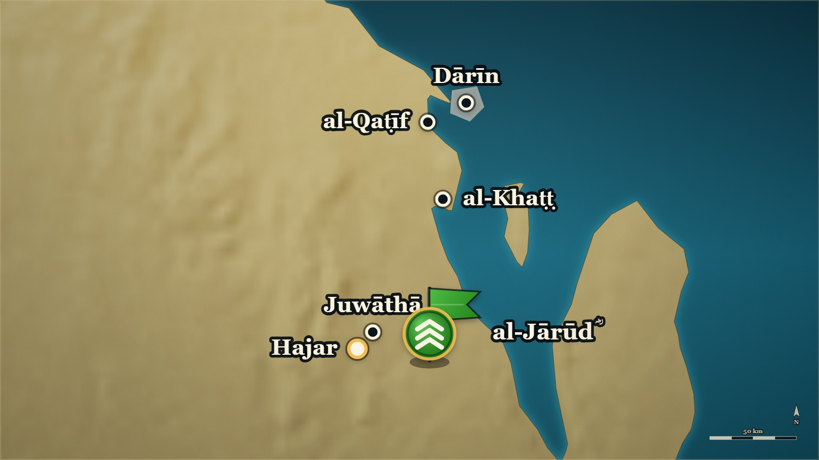












11 AH, the coast of Bahrayn
al-Ḥuṭam b. Ḍubayʿa
al-Ḥuṭam
comes down at al-Qaṭīf and Hajar
Juwāthā
besieged by al-Ḥuṭam's men
Notes:
⚠ “Came down at” — the page does not say he took them.
⚠ The page does not say where al-Khaṭṭ is. The marker is approximate.
SAY
1. al-Ḥuṭam, with Bakr b. Wāʾil
▶ CLICK 1 — al-Ḥuṭam comes down at al-Qaṭīf and at Hajar.
2. He comes down at al-Qaṭīf and Hajar
▶ CLICK 2 — al-Khaṭṭ is won over, with the Zuṭṭ and the Sabābija who live in it.
3. al-Khaṭṭ is won over
▶ CLICK 3 — He sends a force across the water, to Dārīn.
4. He sends a force to Dārīn
▶ CLICK 4 — And he sends to Juwāthā, and besieges the Muslims in it.
5. And he besieges Juwāthā
▶ NEXT SLIDE — the Arabic, and its lesson
──────── DETAIL — only if you need it ────────
1. al-Ḥuṭam, with Bakr b. Wāʾil — He is the man who does the fighting on this front.
2. He comes down at al-Qaṭīf and Hajar — "Came down at" is the page's verb. It does not say he took them.
3. al-Khaṭṭ is won over — A place the page names with the two peoples living in it, the Zuṭṭ and the Sabābija: drawn in, not marched on.
4. He sends a force to Dārīn — Across the water. Remember that island: this front ends there.
5. And he besieges Juwāthā — He sent to Juwāthā and shut the Muslims inside it.
وَخَرَجَ الْحُطَمُ بْنُ ضُبَيْعَةَ أَخُو بَنِي قَيْسِ بْنِ ثَعْلَبَةَ فِي بَكْرِ بْنِ وَائِلٍ، فَاجْتَمَعَ إِلَيْهِ مِنْ غَيْرِ الْمُرْتَدِّينَ مِمَّنْ لَمْ يَزَلْ مُشْرِكًا
"And al-Ḥuṭam b. Ḍubayʿa, of Banū Qays b. Thaʿlaba, went out at the head of Bakr b. Wāʾil; and there gathered to him, besides the apostates, men who had never ceased to be idolaters."
— Ibn al-Athīr, on al-Ḥuṭam · الکامل فی التاریخ ج۲ ص۲۲۲
──────── BACKGROUND — for home, not for the lectern ────────
The ground, verbatim (الکامل ج2 ص222):
> حَتَّى نَزَلَ الْقَطِيفَ وَهَجَرَ، وَاسْتَغَوَوُا الْخَطَّ وَمَنْ بِهَا مِنَ الزُّطِّ وَالسَّبَابِجَةِ، وَبَعَثَ بَعْثًا إِلَى دَارِينَ، وَبَعَثَ إِلَى جُوَاثَا فَحَصَرَ الْمُسْلِمِينَ
> — الکامل فی التاریخ ج2 ص222 · https://shamela.ws/book/21712/913
> English: "...until he came down upon al-Qaṭīf and Hajar, and they drew in al-Khaṭṭ and those of
> the Zuṭṭ and the Sabābija who were there; and he sent a force to Dārīn, and he sent to Juwāthā and
> besieged the Muslims." الزُّطّ and السَّبابجة — exactly what we may say, and no more. الکامل ج2 ص222 gives two things only:
they were at الخَطّ, and they were drawn in with the place. They are listed apart from the Arab
tribes, which is why they are named at all. No page in sources/shamela/ glosses either name — the
only other cached occurrence is ابن خلدون ج2 ص610 («الزطّ والسابحة», forty men on guard), a different
event thirty years later, which identifies nothing. So: say they were two communities already settled
on that coast who were brought in with it, and say that who they were is not in the books we read.
⚠ Any identification beyond that needs معجم البلدان or a ترجمة fetched first. Do not supply one from
general knowledge. ⚠ Two sieges, or one told twice? Record it; do not resolve it. The same page carries both:
> وَحَصَرَهُمْ أَصْحَابُ الْمُنْذِرِ بَعْدَهُ حَتَّى اسْتَنْقَذَهُمُ الْعَلَاءُ بْنُ الْحَضْرَمِيِّ
> — الکامل فی التاریخ ج2 ص222 · https://shamela.ws/book/21712/913
> English: "And al-Mundhir's own men besieged them after him, until al-ʿAlāʾ b. al-Ḥaḍramī
> delivered them." That sentence besieges عبد القيس and attributes it to the dead governor's own men; the sentence in
this card's second quotation besieges جُواثى and attributes it to al-Ḥuṭam. جُواثى was a stronghold
of عبد القيس (البدایہ ج7 ص38, ed. fn. quoting معجم البلدان), so these are plausibly one siege reported
twice — but no page says so, and we do not say it either. On stage, tell one siege: the one at
جُواثى. ⚠ — this card is the only place al-Ḥuṭam is introduced, and it must never be cut. His death is
told on (the stirrup-leather, the severed foot, Qays b. ʿĀṣim's regret) and his
embroidered cloak carries — and in the delivered series his name reaches a slide face for
the first time on the last card of the block, after he is already dead. If this card is cut, a man
the room has never met dies in front of it. ⚠ Dating: as — the rising is 11ھ; Ibn Kathīr records that some put the fighting of
this front, جُواثى included, in 12ھ (البدایہ ج7 ص61).

Slide 14
11 AH, the coast of Bahrayn
al-Ḥuṭam b. Ḍubayʿa
وَخَرَجَ الْحُطَمُ بْنُ ضُبَيْعَةَ أَخُو بَنِي قَيْسِ بْنِ ثَعْلَبَةَ فِي بَكْرِ بْنِ وَائِلٍ
And al-Ḥuṭam b. Ḍubayʿa, of Banū Qays b. Thaʿlaba, went out at the head of Bakr b. Wāʾil
فَاجْتَمَعَ إِلَيْهِ مِنْ غَيْرِ الْمُرْتَدِّينَ مِمَّنْ لَمْ يَزَلْ مُشْرِكًا
and there gathered to him, besides the apostates, men who had never ceased to be idolaters.
— Ibn al-Athīr, on al-Ḥuṭam
al-Kamil, vol. 2, p. 222
Notes:
READ the Arabic on the slide — then its English.
WHO IS SPEAKING — Ibn al-Athīr, on al-Ḥuṭam
LESSON — The word «ridda» names this whole front, and on this front it does not fit everyone inside it. Some of those men had never been Muslims to leave.
──────── DETAIL — only if you need it ────────
وَخَرَجَ الْحُطَمُ بْنُ ضُبَيْعَةَ أَخُو بَنِي قَيْسِ بْنِ ثَعْلَبَةَ فِي بَكْرِ بْنِ وَائِلٍ، فَاجْتَمَعَ إِلَيْهِ مِنْ غَيْرِ الْمُرْتَدِّينَ مِمَّنْ لَمْ يَزَلْ مُشْرِكًا
"And al-Ḥuṭam b. Ḍubayʿa, of Banū Qays b. Thaʿlaba, went out at the head of Bakr b. Wāʾil; and there gathered to him, besides the apostates, men who had never ceased to be idolaters."
— الکامل فی التاریخ ج۲ ص۲۲۲

Slide 15
11 AH, Juwāthā
Juwāthā
Inside Juwāthā — besieged, and starving.
أَلَا أَبْلِغْ أَبَا بَكْرٍ رَسُولًا … وَفِتْيَانَ الْمَدِينَةِ أَجْمَعِينَا
Take a message to Abū Bakr, and to all the young men of Medina:
فَهَلْ لَكُمُ إِلَى قَوْمٍ كِرَامٍ … قُعُودٍ فِي جُوَاثَا مُحْصَرِينَا
have you any thought for a noble people, sitting besieged in Juwāthā?
— ʿAbd Allāh b. Ḥadhf, besieged in Juwāthā
al-Kamil, vol. 2, p. 222
Notes:
⚠ Do not speak the fourth line of the verse — the two books differ.
SAY
1. One village did not break
2. Shut in, and starving
3. A man inside sends four lines
4. Read the first two lines
↑ read the Arabic on the slide
5. Do not speak the fourth line
6. "Until Allah relieved them"
LESSON — The place that held out longest was one village, and its message out was four lines of verse.
──────── DETAIL — only if you need it ────────
1. One village did not break — Juwāthā: Ibn Kathīr says no other town in Bahrayn held.
2. Shut in, and starving — off from food until the hunger became severe.
3. A man inside sends four lines — ʿAbd Allāh b. Ḥadhf, one of the besieged.
4. Read the first two lines — A message to Abū Bakr ؓ and all the young men of Medina.
5. Do not speak the fourth line — The two books print a different word in it.
6. "Until Allah relieved them" — Ibn Kathīr's own words for how the siege ended; he gives no terms.
أَلَا أَبْلِغْ أَبَا بَكْرٍ رَسُولًا … وَفِتْيَانَ الْمَدِينَةِ أَجْمَعِينَا فَهَلْ لَكُمُ إِلَى قَوْمٍ كِرَامٍ … قُعُودٍ فِي جُوَاثَا مُحْصَرِينَا
"Take a message to Abū Bakr, and to all the young men of Medina: have you any thought for a noble people, sitting besieged in Juwāthā?"
— ʿAbd Allāh b. Ḥadhf, besieged in Juwāthā · الکامل ج۲ ص۲۲۲ (also البدایہ ج۷ ص۳۸)
──────── BACKGROUND — for home, not for the lectern ────────
⚠ The rising there was not all apostasy: الکامل ج2 ص222 notes that men who had never been Muslims
joined al-Ḥuṭam — «مِمَّنْ لَمْ يَزَلْ مُشْرِكًا». And nearby, ʿAbd al-Qays held firm behind al-Jārūd ؓ.
No honest map shades Bahrayn one colour. ⚠ The last hemistich of the verse differs between the two
books (الصبر / النصر): read it off a page image before it reaches a slide.

Slide 16
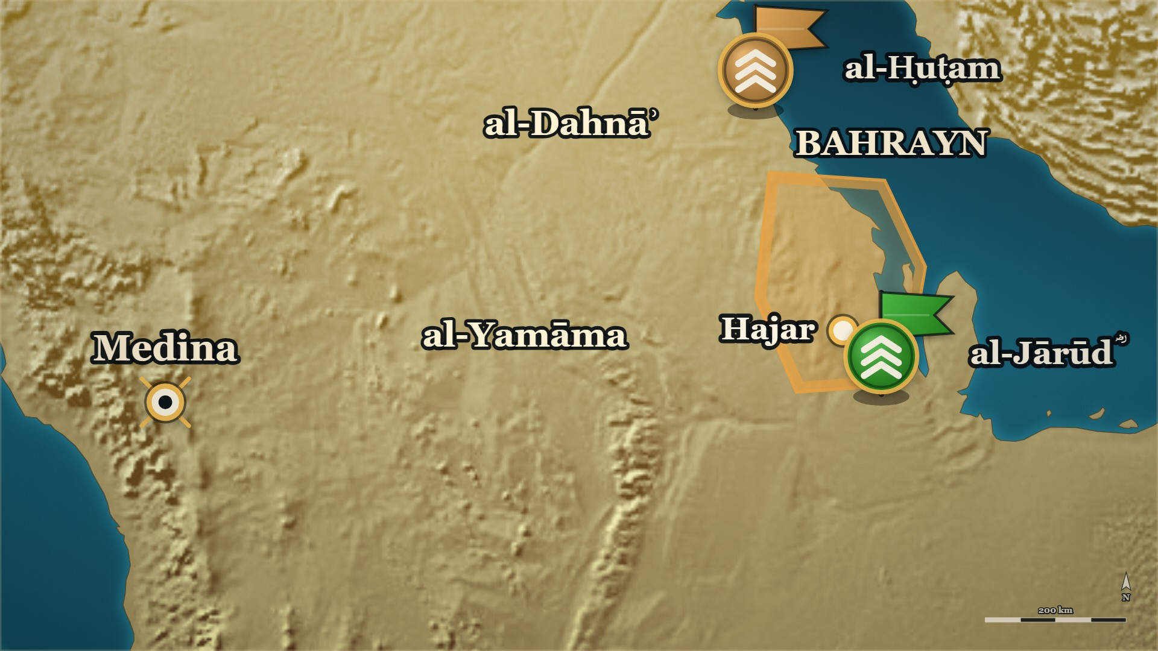







11 AH, Medina to al-Dahnāʾ
al-ʿAlāʾ b. al-Ḥaḍramī ؓ — the sixteen
al-ʿAlāʾ ؓ
sixteen riders, then an army
al-Dahnāʾ
he camps in the middle of it
Notes:
⚠ The page names who joined him, not his road. The road is drawn through their lands.
SAY
1. al-ʿAlāʾ b. al-Ḥaḍramī ؓ
▶ CLICK 1 — al-ʿAlāʾ ؓ leaves Medina.
2. Sixteen riders, and a letter
▶ CLICK 2 — Thumāma ؓ joins, with Banū Ḥanīfa.
3. Thumāma b. Uthāl ؓ joins
▶ CLICK 3 — Qays b. ʿĀṣim joins, and other clans of Tamīm.
4. Qays b. ʿĀṣim joins, and more
▶ CLICK 4 — Into al-Dahnāʾ.
5. Into al-Dahnāʾ
6. Abū Hurayra ؓ was on this march
▶ NEXT SLIDE — the Arabic, and its lesson
ASK — line. notesfor reads everything after that line into
──────── DETAIL — only if you need it ────────
1. al-ʿAlāʾ b. al-Ḥaḍramī ؓ — The man the Prophet ﷺ had sent to Bahrayn; Abū Bakr ؓ sends him now.
2. Sixteen riders, and a letter — Every Muslim he passes is to march out with him.
3. Thumāma b. Uthāl ؓ joins — With the Muslims of Banū Ḥanīfa.
4. Qays b. ʿĀṣim joins, and more — He had divided the ṣadaqa out among his own clans, and repented; now he brings ṣadaqa out to meet him. Then other clans of Tamīm — a force the size of his own.
5. Into al-Dahnāʾ — He takes them into the sands, and camps in the middle of it.
6. Abū Hurayra ؓ was on this march — He went back afterwards with a guide, to look at the place.
فَخَرَجَ مِنَ المَدِيْنَةِ فِي سِتَّةَ عَشَرَ رَاكِباً، وَكَتَبَ لَهُ كِتَاباً: أَنْ يَنْفِرَ مَعَهُ كُلُّ مَنْ مَرَّ بِهِ مِنَ المُسْلِمِيْنَ إِلَى عَدُوِّهِم.
"He left Medina with sixteen riders, and he wrote him a letter: that every Muslim he passed should march out with him against their enemy."
— al-Dhahabī, from Ibn Saʿd · سیر أعلام النبلاء ج۱ ص۲۶۴
──────── BACKGROUND — for home, not for the lectern ────────
BACKGROUND, which is where the lifted Arabic belongs: the beats are what he
says aloud, this is what he reads at home. markdown
Who he was, in one breath — and all three lines are on a page we hold: > وَلاَّهُ رَسُوْلُ اللهِ -صَلَّى اللَّهُ عَلَيْهِ وَسَلَّمَ- البَحْرَيْنِ، ثُمَّ وَلِيَهَا لأَبِي بَكْرٍ، وَعُمَرَ.
> — سیر أعلام النبلاء ج1 ص263 · https://shamela.ws/book/10906/1689
> English: "The Messenger of Allah صلى الله عليه وسلم appointed him over Bahrayn; then he held it for Abū Bakr, and for ʿUmar."
> تُوُفِّيَ سَنَةَ: إِحْدَى وَعِشْرِيْنَ.
> — سیر أعلام النبلاء ج1 ص264 · https://shamela.ws/book/10906/1690
> English: "He died in the year twenty-one."
> وقد كان العلاء من ساداتِ الصحابةِ العلماءِ العُبَّادِ مجابي الدعوة
> — البدایہ والنہایہ ج7 ص39 · https://shamela.ws/book/30097/3185
> English: "al-ʿAlāʾ was among the chiefs of the Companions, the learned, the much-worshipping, whose supplication was answered."
The three questions, the فجر, and the water — البدایہ's telling, which is fuller than the one the
card carries: > أيها الناسُ ألستم المسلمين؟ ألستُم في سبيل الله؟ ألستُم أنصارَ الله؟ قالوا: بلى، قال: فأبشروا فواللهِ لا يخذل اللهُ منْ كانَ في مثل حالكم
> — البدایہ والنہایہ ج7 ص39 · https://shamela.ws/book/30097/3185
> English: "O people — are you not the Muslims? Are you not in the path of Allāh? Are you not the helpers of Allāh? They said: yes. He said: then rejoice, for by Allāh, Allāh does not abandon men who are in a state like yours."
> ونُودي بصلاةِ الصبحِ، حين طلعَ الفجرُ فصلَّى بالناس، فلما قضى الصلاةَ جثا على رُكبتيه وجثا الناسُ، ونصبَ في الدعاء ورفع يديه وفعلَ الناسُ مثله حتى طلعتِ الشمسُ
> — البدایہ والنہایہ ج7 ص39 · https://shamela.ws/book/30097/3185
> English: "The call was given for the dawn prayer as the fajr broke, and he prayed with the people; and when he had finished the prayer he went down on his knees, and the people went down on theirs, and he set himself to supplicate and raised his hands, and the people did as he did, until the sun rose."
> فلما بلغَ الثالثةَ إذا قد خلق الله إلى جانبهم غديرًا عظيمًا من الماءَ القَراح
> — البدایہ والنہایہ ج7 ص39 · https://shamela.ws/book/30097/3185
> English: "And when he reached the third time — there, Allāh had created beside them a great pool of sweet, clear water."
> فما تعالى النهارُ حتى أقبلتِ الإبل من كلّ فجٍّ بما عليها، لم يفقدِ الناسُ من أمتعتهم سِلْكًا
> — البدایہ والنہایہ ج7 ص39 · https://shamela.ws/book/30097/3185
> English: "And the day had not grown high before the camels came in from every pass with their loads upon them; the people had not lost a thread of their baggage."
And أبو هريرة ؓ was standing in it — the detail that puts a Companion the whole room knows inside
the scene, and it is الکامل's, not البدایہ's: > وَكَانَ أَبُو هُرَيْرَةَ فِيهِمْ، فَلَمَّا سَارُوا عَنْ ذَلِكَ الْمَكَانِ قَالَ لِمِنْجَابِ بْنِ رَاشِدٍ: كَيْفَ عِلْمُكَ بِمَوْضِعِ الْمَاءِ؟ قَالَ: عَارِفٌ بِهِ. فَقَالَ لَهُ: كُنْ مَعِي حَتَّى تُقِيمَنِي عَلَيْهِ
> — الکامل فی التاریخ ج2 ص223 · https://shamela.ws/book/21712/914
> English: "And Abū Hurayra was among them. When they had moved on from that place he said to Minjāb b. Rāshid: how well do you know where the water is? He said: I know it. He said to him: come with me until you set me over it."
> وَمَلَأْتُ إِدَاوَتِي ثُمَّ وَضَعْتُهَا عَلَى شَفِيرِ الْغَدِيرِ وَقُلْتُ: إِنْ كَانَ مَنَّا مِنَ الْمَنِّ عَرَفْتُهُ، وَإِنْ كَانَ عَيْنًا عَرَفْتُهُ، فَإِذَا مَنٌّ مِنَ الْمَنِّ. فَحَمِدَ اللَّهَ
> — الکامل فی التاریخ ج2 ص223 · https://shamela.ws/book/21712/914
> English: "… and I filled my water-skin, then set it on the lip of the pool and said: if it is a gift of the kind that is given, I shall know it; and if it is a spring, I shall know it — and it was a gift of the kind that is given. And he praised Allāh."
⚠ This is a كرامہ narrative, and in البدایہ it comes through سيف بن عمر. The card's own standing
instruction, kept: narrate it as what the book narrates; build no doctrinal point on it. Beat 9
carries that to the lectern, which is the only place it was missing. ⚠ «Abū Hurayra ؓ was his muezzin» — on the page, but the page marks the chain very weak.
سیر ج1 ص264 carries «بَعَثَنِي رَسُوْلُ اللهِ ﷺ مَعَ العَلاَءِ بنِ الحَضْرَمِيِّ، وَوَصَّاهُ بِي، فَكُنْتُ أُؤَذِّنُ لَهُ» — "The
Messenger of Allah ﷺ sent me with al-ʿAlāʾ b. al-Ḥaḍramī and charged him concerning me, and I used to
give the adhān for him" — and that same page's editorial note says of its isnād: > وإسناده ضعيف جدا لان الواقدي
> — سیر أعلام النبلاء ج1 ص264 · https://shamela.ws/book/10906/1690
> English: "… and its isnād is very weak, because al-Wāqidī is discarded."
Do not say it flatly. What is solid is الکامل's «وَكَانَ أَبُو هُرَيْرَةَ فِيهِمْ» — he was among them on
that march — and that is what beat 8 says. ⚠ The books give no total for the force that reached Bahrayn. الکامل ج2 ص222 says only that the
Rabāb came in «فِي مِثْلِ عُدَّتِهِ», in the like of his own number. There is no figure anywhere we hold.
If a slip asks how many, say the books do not give one. ⚠ سیر compresses this campaign into two lines and its order is not the order we tell. Where
الکامل and البدایہ have هَجَر, the pincer and a month of trenches, سیر ج1 ص264 has only: > فَسَارَ العَلاَءُ فِيْمَنْ تَبِعَهُ، حَتَّى لَحِقَ بِحِصْنِ جُوَاثَى (3) ، فَقَاتَلَهُم، فَلَمْ يُفْلِتْ مِنْهُم أَحَدٌ. ثُمَّ أَتَى القَطِيْفَ وَبِهَا جَمْعٌ، فَقَاتَلَهُم، فَانْهَزَمُوا
> — سیر أعلام النبلاء ج1 ص264 · https://shamela.ws/book/10906/1690
> English: "So al-ʿAlāʾ marched with those who followed him, until he reached the fort of Juwāthā, and fought them, and not one of them escaped. Then he came to al-Qaṭīf, where there was a gathering, and fought them, and they were routed."
Tell الکامل's and البدایہ's sequence — the march, هَجَر, the trench month, the night attack,
دارين. سیر is a biographical summary, not a second battle, and its wording at جُواثى does not make
clear whom he fought there. That ambiguity is not to be resolved from the platform. عبرت: The state had almost no soldiers to send; what it sent instead was a commander and a piece
of writing.
Hands-up? Before telling it: "You have sixteen men and a province in revolt. What do you send?"
On the road: in the middle of the Dahnāʾ the camels bolted at night with the water, the food and
the tents, and the men were left in open sand. He told them — «لَنْ تُرَاعُوا، أَنْتُمُ الْمُسْلِمُونَ،
وَفِي سَبِيلِ اللَّهِ، وَأَنْصَارُ اللَّهِ، فَأَبْشِرُوا، فَوَاللَّهِ لَنْ تُخْذَلُوا» (الکامل ج2 ص223), and prayed
with them until sunrise, and البدایہ ج7 ص39 says water appeared beside them and the camels came back
with nothing missing. Narrate it as what the book narrates; do not build a doctrinal point on it.

Slide 17
11 AH, Medina to al-Dahnāʾ
al-ʿAlāʾ b. al-Ḥaḍramī ؓ — the sixteen
فَخَرَجَ مِنَ المَدِيْنَةِ فِي سِتَّةَ عَشَرَ رَاكِباً
He left Medina with sixteen riders
وَكَتَبَ لَهُ كِتَاباً:
and he wrote him a letter:
أَنْ يَنْفِرَ مَعَهُ كُلُّ مَنْ مَرَّ بِهِ مِنَ المُسْلِمِيْنَ إِلَى عَدُوِّهِم.
that every Muslim he passed should march out with him against their enemy.
— al-Dhahabī, from Ibn Saʿd
Siyar A'lam al-Nubala, vol. 1, p. 264
Notes:
READ the Arabic on the slide — then its English.
WHO IS SPEAKING — al-Dhahabī, from Ibn Saʿd
LESSON — The state had almost no soldiers to send; what it sent instead was a commander and a piece of writing.
──────── DETAIL — only if you need it ────────
فَخَرَجَ مِنَ المَدِيْنَةِ فِي سِتَّةَ عَشَرَ رَاكِباً، وَكَتَبَ لَهُ كِتَاباً: أَنْ يَنْفِرَ مَعَهُ كُلُّ مَنْ مَرَّ بِهِ مِنَ المُسْلِمِيْنَ إِلَى عَدُوِّهِم.
"He left Medina with sixteen riders, and he wrote him a letter: that every Muslim he passed should march out with him against their enemy."
— سیر أعلام النبلاء ج۱ ص۲۶۴

Slide 18
11 AH, al-Dahnāʾ — night
al-ʿAlāʾ ؓ at al-Dahnāʾ — three questions
Night, in the sands. The camels have bolted with all they had.
أيها الناسُ ألستم المسلمين؟
O people — are you not the Muslims?
ألستُم في سبيل الله؟
Are you not in the path of Allah?
— al-ʿAlāʾ b. al-Ḥaḍramī ؓ, to the army
al-Bidaya wa'l-Nihaya, vol. 7, p. 39
Notes:
⚠ Tell it as the book tells it — it comes through Sayf b. ʿUmar.
SAY
1. Night, in the middle of the sands
2. Nothing left but their clothes
3. He calls them together
4. Three questions
↑ read the Arabic on the slide
5. They said: yes
6. "Then rejoice"
LESSON — He did not promise them water. He reminded them who they were.
▶ NEXT SLIDE — the same words go on (3 slides in all)
──────── DETAIL — only if you need it ────────
1. Night, in the middle of the sands — The camels bolt with the food, the tents and the water; not one is caught.
2. Nothing left but their clothes — The men begin making their bequests to one another.
3. He calls them together — al-ʿAlāʾ ؓ has his caller summon the whole column.
4. Three questions — Are you not the Muslims? Are you not in the path of Allah? Are you not the helpers of Allah?
5. They said: yes — All of them.
6. "Then rejoice" — "By Allah, Allah does not abandon those who are in a state like yours."
أيها الناسُ ألستم المسلمين؟ ألستُم في سبيل الله؟ ألستُم أنصارَ الله؟ قالوا: بلى، قال: فأبشروا فواللهِ لا يخذل اللهُ منْ كانَ في مثل حالكم
"O people — are you not the Muslims? Are you not in the path of Allah? Are you not the helpers of Allah?" They said: "Yes." He said: "Then rejoice — for by Allah, Allah does not abandon those who are in a state like yours."
— al-ʿAlāʾ b. al-Ḥaḍramī ؓ, to the army · البدایہ والنہایہ ج۷ ص۳۹
──────── BACKGROUND — for home, not for the lectern ────────
⚠ Narrate it as the book narrates it. In ⁨البدایہ⁩ this account comes through Sayf b. ʿUmar; it is told,
and no ruling or creed is built on it.
──────── IMAGE BRIEF — paste into the image generator ────────
Night in a sand desert. A scatter of pack-saddles, water-skins and folded tents left on the sand, and the tracks of many camels running off into the dark; a few camels far away, small, moving away from the viewer. A sky full of stars. Empty and still. Restrained editorial illustration, muted ochre, deep teal and bone. Flat pure-white background (#FFFFFF) with no border, so it sits on a white slide with no seam. No text, no lettering, no map. No people and no faces — landscape, animals and objects only. 16:9.

Slide 19
11 AH, al-Dahnāʾ — night
al-ʿAlāʾ ؓ at al-Dahnāʾ — three questions
ألستُم أنصارَ الله؟
Are you not the helpers of Allah?
قالوا: بلى
They said: "Yes."
— al-ʿAlāʾ b. al-Ḥaḍramī ؓ, to the army
al-Bidaya wa'l-Nihaya, vol. 7, p. 39
Notes:
READ the Arabic — the same words, continued (slide 2 of 3).
Each part: the Arabic, then its meaning.
──────── DETAIL — only if you need it ────────
ألستُم أنصارَ الله؟
Are you not the helpers of Allah?
قالوا: بلى
They said: "Yes."

Slide 20
11 AH, al-Dahnāʾ — night
al-ʿAlāʾ ؓ at al-Dahnāʾ — three questions
قال: فأبشروا فواللهِ لا يخذل اللهُ منْ كانَ في مثل حالكم
He said: Then rejoice — for by Allah, Allah does not abandon those who are in a state like yours.
— al-ʿAlāʾ b. al-Ḥaḍramī ؓ, to the army
al-Bidaya wa'l-Nihaya, vol. 7, p. 39
Notes:
READ the Arabic — the same words, continued (slide 3 of 3).
Each part: the Arabic, then its meaning.
──────── DETAIL — only if you need it ────────
قال: فأبشروا فواللهِ لا يخذل اللهُ منْ كانَ في مثل حالكم
He said: Then rejoice — for by Allah, Allah does not abandon those who are in a state like yours.

Slide 21
11 AH, al-Dahnāʾ — dawn
al-ʿAlāʾ ؓ at al-Dahnāʾ — the prayer
Dawn. An army with nothing left but its clothes.
فلما قضى الصلاةَ جثا على رُكبتيه وجثا الناسُ
When he had finished the prayer he went down on his knees, and the people went down on theirs
ونصبَ في الدعاء ورفع يديه وفعلَ الناسُ مثله حتى طلعتِ الشمس
he set himself to supplication and raised his hands, and the people did as he did, until the sun rose.
— Ibn Kathīr, on what al-ʿAlāʾ ؓ did at dawn
al-Bidaya wa'l-Nihaya, vol. 7, p. 39
Notes:
⚠ Tell it as the book tells it — build no ruling on it.
SAY
1. Fajr is called
2. He kneels, and they kneel
↑ read the Arabic on the slide
3. The shimmer, again and again
4. At the third time: water
5. And the camels come back
6. "Among the signs of Allah"
7. Told as the book tells it
LESSON — The first thing he did with an army that had lost everything was pray.
──────── DETAIL — only if you need it ────────
1. Fajr is called — At dawn he leads them in the prayer.
2. He kneels, and they kneel — He raises his hands in duʿāʾ and the men do the same — until the sun is up.
3. The shimmer, again and again — They watch the mirage on the sand while he keeps on in his duʿāʾ.
4. At the third time: water — A great pool of pure water beside them; they walk to it, drink, and wash.
5. And the camels come back — From every pass, with everything on them; not a thread was lost.
6. "Among the signs of Allah" — Ibn Kathīr's own closing words for what the men saw on that expedition.
7. Told as the book tells it — It comes through Sayf b. ʿUmar; narrate it, and build nothing on it.
فلما قضى الصلاةَ جثا على رُكبتيه وجثا الناسُ، ونصبَ في الدعاء ورفع يديه وفعلَ الناسُ مثله حتى طلعتِ الشمس
"When he had finished the prayer he went down on his knees, and the people went down on theirs; he set himself to supplication and raised his hands, and the people did as he did, until the sun rose."
— Ibn Kathīr, on what al-ʿAlāʾ ؓ did at dawn · البدایہ والنہایہ ج۷ ص۳۹
──────── BACKGROUND — for home, not for the lectern ────────
What the book then narrates:
> فلما بلغَ الثالثةَ إذا قد خلق الله إلى جانبهم غديرًا عظيمًا من الماءَ القَراح، فمشى ومشى الناسُ إليه فشربوا واغتسلوا، فما تعالى النهارُ حتى أقبلتِ الإبل من كلّ فجٍّ بما عليها، لم يفقدِ الناسُ من أمتعتهم سِلْكًا
> — البدایہ والنہایہ ج7 ص39 · https://shamela.ws/book/30097/3185
> English: "When he reached the third time, Allah had created beside them a great pool of pure water.
> He walked to it, and the people walked to it, and they drank and washed; and the day was not high before
> the camels came from every pass with what was on them — the people did not lose a thread of their baggage." And Ibn Kathīr's closing line:
> فكان هذا مما عاينَ الناس من آيات الله بهذه السرية
> — البدایہ والنہایہ ج7 ص39 · https://shamela.ws/book/30097/3185
> English: "This was among the signs of Allah that the people saw with their own eyes on that expedition."
──────── IMAGE BRIEF — paste into the image generator ────────
First light over a sand desert. In the foreground a wide, still pool of clear water lying in a hollow between dunes, catching the dawn; in the distance a line of loaded camels walking back toward it from several directions. Restrained editorial illustration, muted ochre, deep teal and bone. Flat pure-white background (#FFFFFF) with no border, so it sits on a white slide with no seam. No text, no lettering, no map. No people and no faces — landscape, animals and objects only. 16:9.

Slide 22
11 AH, al-Dahnāʾ
al-ʿAlāʾ ؓ at al-Dahnāʾ — the duʿāʾ
يا عليمُ، يا حليمُ، ويا عليُّ، يا عظيمُ
O All-Knowing, O Forbearing, O Most High, O Tremendous
إنا عبيدُك وفي سبيلك نقاتلُ عدوَّك
we are Your servants, and in Your path we fight Your enemy
— al-ʿAlāʾ b. al-Ḥaḍramī ؓ — in another telling, that of Sahm b. Minjāb
al-Bidaya wa'l-Nihaya, vol. 6, p. 231
Notes:
⚠ Another telling, on another page. Do not join it to the dawn prayer.
SAY
1. In another telling
2. Read the duʿāʾ
↑ read the Arabic on the slide
3. "We are Your servants, and in Your path"
4. And at the sea
5. Two tellings, not one
LESSON — He said whose servants they were before he asked for anything.
▶ NEXT SLIDE — the same words go on (2 slides in all)
──────── DETAIL — only if you need it ────────
1. In another telling — Sahm b. Minjāb tells this march in the first person; Ibn Kathīr carries it among the signs.
2. Read the duʿāʾ — Slowly. Four names of Allah; then whose they are; then what they ask.
3. "We are Your servants, and in Your path" — He says whose they are before he asks for anything.
4. And at the sea — The same telling has one line for the crossing: "Make for us a way to Your enemy."
5. Two tellings, not one — There: the dawn prayer, on their knees, a pool. Here: two rakʿas, and rain. Do not join them.
وقال في الدعاء: يا عليمُ، يا حليمُ، ويا عليُّ، يا عظيمُ، إنا عبيدُك وفي سبيلك نقاتلُ عدوَّك، اسقنا غَيثًا نشربُ منه ونتوضَّأ، فإذا تركناه فلا تجعل لأحدٍ فيه نصيبًا غيرَنا. وقال في البحر: اجعل لنا سبيلًا إلى عدوِّك
"And he said in the supplication: O All-Knowing, O Forbearing, O Most High, O Tremendous — we are Your servants, and in Your path we fight Your enemy; give us rain from which we may drink and make wuḍūʾ, and when we leave it, give no one a share in it but us. And he said at the sea: Make for us a way to Your enemy."
— al-ʿAlāʾ b. al-Ḥaḍramī ؓ — in another telling, that of Sahm b. Minjāb · البدایہ والنہایہ ج۶ ص۲۳۱
──────── BACKGROUND — for home, not for the lectern ────────
⚠ Not the dawn telling. These words are on a different page, through a different chain (Sahm b. Minjāb, by
way of Ibn Abī al-Dunyā and al-Bayhaqī). The page that describes the kneeling gives no words
. ⚠ Eyeball the duʿāʾ against the page image before it is projected
(CLAUDE.md ). ⚠ No honorific for Sahm b. Minjāb: no page we hold states his Companionship. ## Yemen I: al-Aswad al-ʿAnsī, from the Abnāʾ to the dawn adhān Source note: [) — read it for the pages behind these cards.

Slide 23
11 AH, al-Dahnāʾ
al-ʿAlāʾ ؓ at al-Dahnāʾ — the duʿāʾ
اسقنا غَيثًا نشربُ منه ونتوضَّأ
give us rain from which we may drink and make wuḍūʾ
فإذا تركناه فلا تجعل لأحدٍ فيه نصيبًا غيرَنا
and when we leave it, give no one a share in it but us
— al-ʿAlāʾ b. al-Ḥaḍramī ؓ — in another telling, that of Sahm b. Minjāb
al-Bidaya wa'l-Nihaya, vol. 6, p. 231
Notes:
READ the Arabic — the same words, continued (slide 2 of 2).
Each part: the Arabic, then its meaning.
──────── DETAIL — only if you need it ────────
اسقنا غَيثًا نشربُ منه ونتوضَّأ
give us rain from which we may drink and make wuḍūʾ
فإذا تركناه فلا تجعل لأحدٍ فيه نصيبًا غيرَنا
and when we leave it, give no one a share in it but us

Slide 24
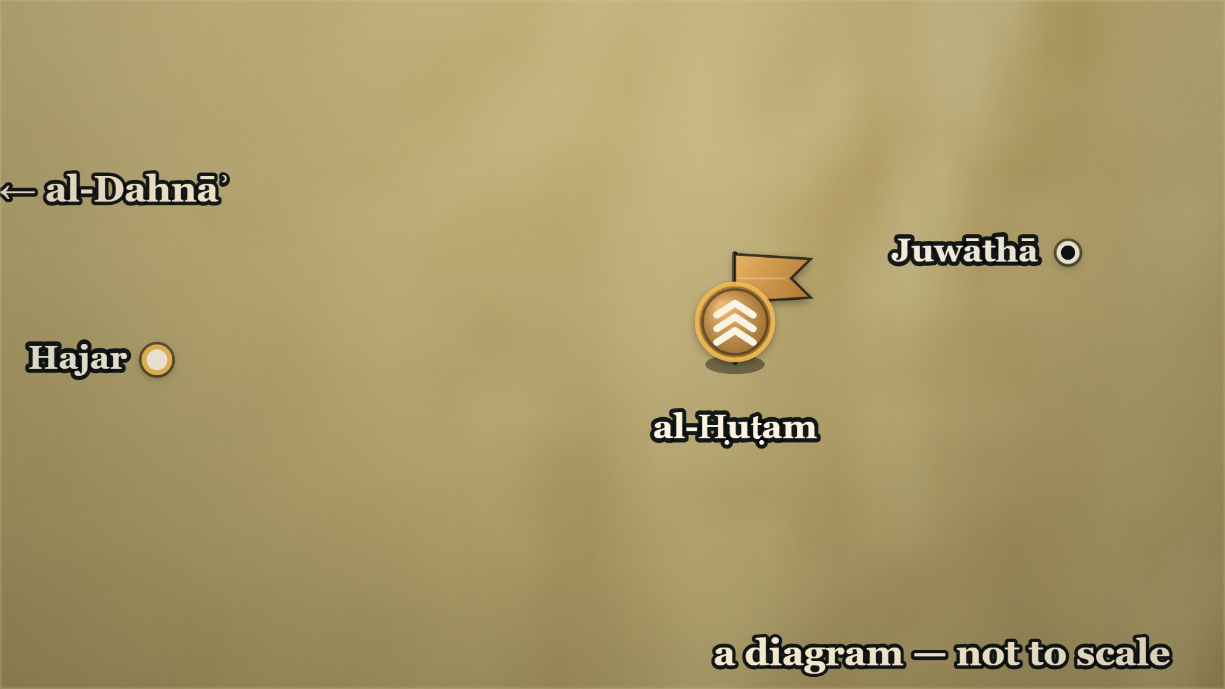


















11 AH, Hajar
Hajar — the trench month
al-ʿAlāʾ ؓ
camps at Hajar; comes down from that side
al-Jārūd ؓ
brings ʿAbd al-Qays down from theirs
Notes:
⚠ A diagram: the page gives sides, no distances. Say “not to scale”.
SAY
▶ CLICK 1 — al-ʿAlāʾ ؓ comes out of al-Dahnāʾ and camps at Hajar.
1. al-ʿAlāʾ ؓ camps at Hajar
▶ CLICK 2 — He sends to al-Jārūd ؓ — and ʿAbd al-Qays come down on al-Ḥuṭam from their side.
2. He sends for al-Jārūd ؓ
▶ CLICK 3 — He comes down on him from the Hajar side. Every one gathers.
3. And comes down on him himself
4. Everyone gathers
▶ CLICK 4 — Both sides dig trenches.
5. Both sides dig trenches
▶ CLICK 5 — A month. They fight by turns, and go back to their trenches.
6. A month
▶ NEXT SLIDE — the Arabic, and its lesson
ASK — line.
──────── DETAIL — only if you need it ────────
1. al-ʿAlāʾ ؓ camps at Hajar — Out of al-Dahnāʾ, the army comes down at Hajar itself.
2. He sends for al-Jārūd ؓ — To bring ʿAbd al-Qays down on al-Ḥuṭam from their own side.
3. And comes down on him himself — From the side next to Hajar.
4. Everyone gathers — All of them to al-Ḥuṭam, except the men of Dārīn; all the Muslims to al-ʿAlāʾ ؓ.
5. Both sides dig trenches — The Muslims round themselves, and the enemy round theirs.
6. A month — They fight by turns and go back to their trenches; a month of it.
وَخَنْدَقَ الْمُسْلِمُونَ عَلَى أَنْفُسِهِمْ وَالْمُشْرِكُونَ، وَكَانُوا يَتَرَاوَحُونَ الْقِتَالَ وَيَرْجِعُونَ إِلَى خَنْدَقِهِمْ، فَكَانُوا كَذَلِكَ شَهْرًا
"The Muslims dug a trench round themselves, and so did the mushrikūn; they would fight by turns and go back to their trench, and they went on like that for a month."
— Ibn al-Athīr, on the trench month · الکامل فی التاریخ ج۲ ص۲۲۳
──────── BACKGROUND — for home, not for the lectern ────────
⚠ AND DELETE its existing sub-note The chief's death, and the regret — البدایہ ج7 ص39: …. now carries that whole scene, with الکامل's name for the man who cut the leg and the
sequence settled. Two artifacts must not tell it twice (CLAUDE.md ). markdown
The dispositions — this is the beat that was on no card, and it is what makes pay off
militarily: > ثُمَّ سَارُوا فَنَزَلُوا بِهَجَرَ، وَأَرْسَلَ الْعَلَاءُ إِلَى الْجَارُودِ يَأْمُرُهُ أَنْ يَنْزِلَ بِعَبْدِ الْقَيْسِ عَلَى الْحُطَمِ مِمَّا يَلِيهِ، وَسَارَ هُوَ فِيمَنْ مَعَهُ حَتَّى نَزَلَ عَلَيْهِ مِمَّا يَلِي هَجَرَ
> — الکامل فی التاریخ ج2 ص223 · https://shamela.ws/book/21712/914
> English: "Then they marched on and camped at Hajar. And al-ʿAlāʾ sent to al-Jārūd, ordering him to come down with ʿAbd al-Qays upon al-Ḥuṭam from his own side, while he himself marched with those who were with him until he camped against him on the Hajar side."
⚠ Beat 2 only works if the room has met al-Jārūd ؓ. He is — Al-Jārūd ؓ asks his
tribe five questions — and that card is CORE. If is cut from the running order, beat
2 must carry his notice in one breath : al-Jārūd b. al-Muʿallā ؓ of ʿAbd al-Qays, the man who
held his own tribe to Islam when the rest of Bahrayn went. Why دارين still needs an operation after this battle is won: > فَاجْتَمَعَ الْمُشْرِكُونَ كُلُّهُمْ إِلَى الْحُطَمِ إِلَّا أَهْلَ دَارِينَ
> — الکامل فی التاریخ ج2 ص223 · https://shamela.ws/book/21712/914
> English: "And all the mushrikūn gathered to al-Ḥuṭam — except the people of Dārīn."
The month, in الکامل's own words: > وَخَنْدَقَ الْمُسْلِمُونَ عَلَى أَنْفُسِهِمْ وَالْمُشْرِكُونَ، وَكَانُوا يَتَرَاوَحُونَ الْقِتَالَ وَيَرْجِعُونَ إِلَى خَنْدَقِهِمْ، فَكَانُوا كَذَلِكَ شَهْرًا
> — الکامل فی التاریخ ج2 ص223 · https://shamela.ws/book/21712/914
> English: "The Muslims dug a trench about themselves, and so did the mushrikūn; and they would take turns at the fighting and go back to their trench — and they were like that for a month."
And why a volunteer was asked for at all — the sentence that explains the whole scene, and it was
on no card: > سَمِعَ الْمُسْلِمُونَ ضَوْضَاءَ هَزِيمَةٍ أَوْ قِتَالٍ، فَقَالَ الْعَلَاءُ: مَنْ يَأْتِينَا بِخَبَرِ الْقَوْمِ؟
> — الکامل فی التاریخ ج2 ص223 · https://shamela.ws/book/21712/914
> English: "The Muslims heard a commotion — of a rout, or of a battle. So al-ʿAlāʾ said: who will bring us news of these people?"
⚠⚠ WHY THE ENEMY CAMP WAS DRUNK: NO PAGE WE HOLD SAYS. Neither book gives an occasion — no feast,
no festival, no reason at all. البدایہ ج7 ص39 carries only: > فوجدهم سُكارى لا يعقلون من الشراب، فرجعَ إليه فأخبره
> — البدایہ والنہایہ ج7 ص39 · https://shamela.ws/book/30097/3185
> English: "… and he found them drunk, past understanding from the drink; and he went back to him and told him."
What the pages do supply is the setting, not the cause — a month of trench stalemate, quoted
above. Give the setting and supply no reason the books withhold. Beat 7 puts that at the lectern
in the words he needs, because he will say it aloud. What the night took — both books, and they agree: > وَاسْتَوْلَى الْمُسْلِمُونَ عَلَى الْعَسْكَرِ، وَلَمْ يُفْلِتْ رَجُلٌ إِلَّا بِمَا عَلَيْهِ
> — الکامل فی التاریخ ج2 ص224 · https://shamela.ws/book/21712/915
> English: "And the Muslims took possession of the camp, and not a man got away with anything but what was on him."
> واستولى على جميعِ أموالهم وحواصلهم وأثقالهم، فكانت غنيمةً عظيمةً جسيمةً
> — البدایہ والنہایہ ج7 ص39 · https://shamela.ws/book/30097/3185
> English: "And he took possession of all their wealth, their stores and their baggage — and it was an immense, massive spoil." عبرت: A month of trenches was decided by one night on which one side could not think.
Hands-up? no
The chief's death, and the regret — البدایہ ج7 ص39: al-Ḥuṭam woke in confusion, his stirrup-leather
parted, a man offered to fix it and cut his foot off; he lay asking every passer-by to finish him, and
when Qays b. ʿĀṣim finally did and then saw the leg, he said: «واسوأتاه، لو أعلمُ ما به لم
أحرِّكْهُ» — "What a shameful thing; had I known his state I would not have touched him."

Slide 25
11 AH, Hajar
Hajar — the trench month
وَخَنْدَقَ الْمُسْلِمُونَ عَلَى أَنْفُسِهِمْ وَالْمُشْرِكُونَ
The Muslims dug a trench round themselves, and so did the mushrikūn
وَكَانُوا يَتَرَاوَحُونَ الْقِتَالَ وَيَرْجِعُونَ إِلَى خَنْدَقِهِمْ
they would fight by turns and go back to their trench
فَكَانُوا كَذَلِكَ شَهْرًا
and they went on like that for a month.
— Ibn al-Athīr, on the trench month
al-Kamil, vol. 2, p. 223
Notes:
READ the Arabic on the slide — then its English.
WHO IS SPEAKING — Ibn al-Athīr, on the trench month
LESSON — A month of trenches was decided by one night on which one side could not think.
──────── DETAIL — only if you need it ────────
وَخَنْدَقَ الْمُسْلِمُونَ عَلَى أَنْفُسِهِمْ وَالْمُشْرِكُونَ، وَكَانُوا يَتَرَاوَحُونَ الْقِتَالَ وَيَرْجِعُونَ إِلَى خَنْدَقِهِمْ، فَكَانُوا كَذَلِكَ شَهْرًا
"The Muslims dug a trench round themselves, and so did the mushrikūn; they would fight by turns and go back to their trench, and they went on like that for a month."
— الکامل فی التاریخ ج۲ ص۲۲۳

Slide 26
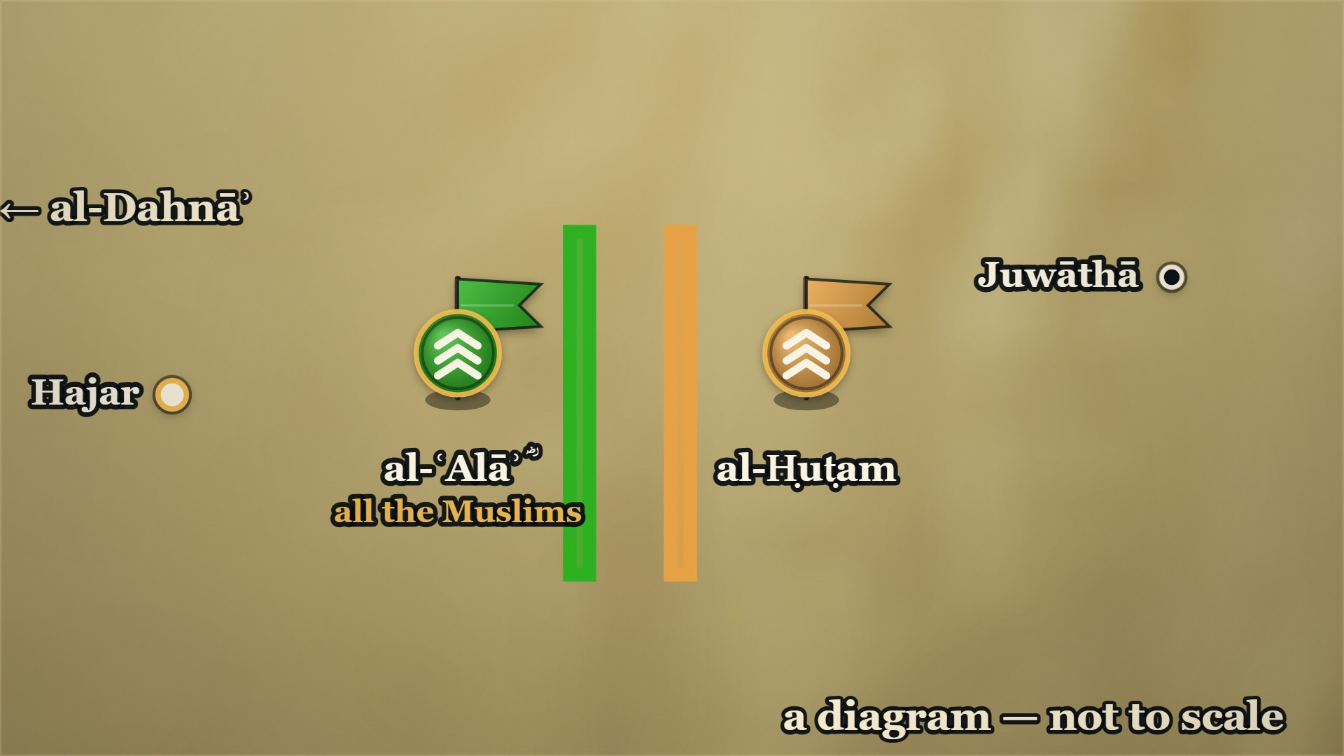
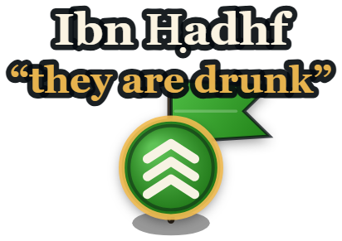




11 AH, Hajar — one night
ʿAbd Allāh b. Ḥadhf, and his uncle
Ibn Ḥadhf
seized by al-Ḥuṭam's men; freed by his uncle
al-Ḥuṭam
his camp is drunk
Notes:
⚠ Do not say why they were drinking. No page does.
SAY
1. A noise in the night
▶ CLICK 1 — A noise in the night. ʿAbd Allāh b. Ḥadhf goes to find out.
2. ʿAbd Allāh b. Ḥadhf goes
▶ CLICK 2 — They seize him at their trench — and he calls for his uncle.
3. He calls for his uncle
4. "A poor sort of sister's son"
5. "Feed me
6. Said to a man overcome by drink
▶ CLICK 3 — Fed, mounted, and let through. He tells al-ʿAlāʾ ؓ: they are drunk.
7. He comes back: they are drunk
8. Why they were drinking: no page says
9. One man or two?
▶ NEXT SLIDE — the Arabic, and its lesson
──────── DETAIL — only if you need it ────────
1. A noise in the night — Like a rout, or like a battle; al-ʿAlāʾ ؓ asks who will find out.
2. ʿAbd Allāh b. Ḥadhf goes — He comes near their trench, and they take him.
3. He calls for his uncle — His mother was of ʿIjl: "Yā Abjarāh!" — and Abjar b. Bujayr comes, and knows him.
4. "A poor sort of sister's son" — "…coming to your uncles tonight."
5. "Feed me — I am dying of hunger" — He is fed; he asks for a mount, and is given one.
6. Said to a man overcome by drink — The book's own explanation of why he was let go.
7. He comes back: they are drunk — He enters the Muslims' camp and tells them.
8. Why they were drinking: no page says — Give the month of stalemate as the setting; supply no reason.
9. One man or two? — The books name an ʿAbd Allāh b. Ḥadhf inside Juwāthā and here, and do not say if he is the same.
وَاللَّهِ إِنِّي لَأَظُنُّكَ بِئْسَ ابْنُ أُخْتٍ أَتَيْتَ اللَّيْلَةَ أَخْوَالَكَ
"By Allāh, I think you a poor sort of sister's-son, coming to your uncles tonight."
— Abjar b. Bujayr, to his sister's son · الکامل فی التاریخ ج۲ ص۲۲۳
──────── BACKGROUND — for home, not for the lectern ────────
The shout, and the uncle who answered it: > فَجَعَلَ يُنَادِي: يَا أَبْجَرَاهُ! فَجَاءَ أَبْجَرُ بْنُ بُجَيْرٍ فَعَرَفَهُ
> — الکامل فی التاریخ ج2 ص223 · https://shamela.ws/book/21712/914
> English: "So he began to call out: O Abjar! And Abjar b. Bujayr came, and recognised him."
> وَكَانَتْ أُمُّهُ عِجْلِيَّةً
> — الکامل فی التاریخ ج2 ص223 · https://shamela.ws/book/21712/914
> English: "And his mother was a woman of ʿIjl."
What he answered when he was asked his business: > عَلَامَ أُقْبِلُ وَحَوْلِي عَسَاكِرُ مِنْ عِجْلٍ وَتَيْمِ اللَّاتِ وَغَيْرِهِمَا؟
> — الکامل فی التاریخ ج2 ص223 · https://shamela.ws/book/21712/914
> English: "What am I to come to, with armies of ʿIjl and Taym al-Lāt and others round about me?"
Food before freedom: > دَعْنِي مِنْ هَذَا وَأَطْعِمْنِي؛ فَقَدْ مُتُّ جُوعًا
> — الکامل فی التاریخ ج2 ص223 · https://shamela.ws/book/21712/914
> English: "Let me alone about that, and feed me — I am dying of hunger."
And الکامل's one clause, which explains the whole scene: > يَقُولُ هَذَا لِرَجُلٍ قَدْ غَلَبَ عَلَيْهِ السُّكْرُ، فَحَمَلَهُ عَلَى بَعِيرٍ وَزَوَّدَهُ وَجَوَّزَهُ
> — الکامل فی التاریخ ج2 ص223 · https://shamela.ws/book/21712/914
> English: "He was saying this to a man whom drink had got the better of — so he mounted him on a camel, provisioned him, and let him through."
And the uncle got away: > فَأَمَّا أَبْجَرُ فَأَفْلَتَ
> — الکامل فی التاریخ ج2 ص224 · https://shamela.ws/book/21712/915
> English: "As for Abjar, he escaped."
⚠⚠ ʿAbdullāh b. Ḥadhf — one man or two? The books do not say. Raised by Daniyal, 2026-09-06, and
it is a real ambiguity rather than a slip in one book. The same name stands in two places. Inside
جُواثى, among the besieged, as the man who put out the four lines of verse: > وقد قال رجل منهم يقال له عبد الله بن حذف، أحد بني بكر بن كلاب، وقد اشتد عليه الجوع
> — البدایہ والنہایہ ج7 ص38 · https://shamela.ws/book/30097/3184
> English: "And a man of theirs called ʿAbdullāh b. Ḥadhf, one of Banū Bakr b. Kilāb, upon whom the hunger had grown severe, said …"
And in al-ʿAlāʾ's ؓ camp at هَجَر, as the volunteer scout — البدایہ ج7 ص39 and الکامل ج2 ص223, the
latter adding the عِجْلي mother. If it is one man the sequence is coherent, and hunger appears in both
scenes. But no page joins them, and البدایہ gives a كلابي paternal line where الکامل gives an
عِجْلي maternal one — which is not a contradiction, and is not a confirmation either. Do not assert
from the platform that they are the same man. ⚠ This whole card is الکامل's. البدایہ ج7 ص39 has the night in one sentence: he went in among
them, found them drunk, came back and told him. The uncle, the mother, the words, the food and the
camel are in الکامل ج2 ص223 and nowhere else we hold. Attribute it that way if asked. ⚠ The second quotation rests on a doubtful word. al-Ṭabarī (corroboration only; vol. 3 p. 308, as read in ) reads the verb as uqtalu — "why am I to be killed, with the troops of ʿIjl all round me?" — which is what the scene needs. Read it off a page image before it is spoken. ⚠ No honorific for either man. No page we hold states the Companionship of ʿAbdullāh b. Ḥadhf or
of Abjar b. Bujayr. Say both names plain.

Slide 27
11 AH, Hajar — one night
ʿAbd Allāh b. Ḥadhf, and his uncle
وَاللَّهِ إِنِّي لَأَظُنُّكَ بِئْسَ ابْنُ أُخْتٍ أَتَيْتَ اللَّيْلَةَ أَخْوَالَكَ
"By Allāh, I think you a poor sort of sister's-son, coming to your uncles tonight."
— Abjar b. Bujayr, to his sister's son
al-Kamil, vol. 2, p. 223
Notes:
READ the Arabic on the slide — then its English.
WHO IS SPEAKING — Abjar b. Bujayr, to his sister's son
LESSON — This war ran straight through families. The man who let him go knew exactly who he was, said so out loud, and let him go because he was his sister's son.
──────── DETAIL — only if you need it ────────
وَاللَّهِ إِنِّي لَأَظُنُّكَ بِئْسَ ابْنُ أُخْتٍ أَتَيْتَ اللَّيْلَةَ أَخْوَالَكَ
"By Allāh, I think you a poor sort of sister's-son, coming to your uncles tonight."
— الکامل فی التاریخ ج۲ ص۲۲۳

Slide 28
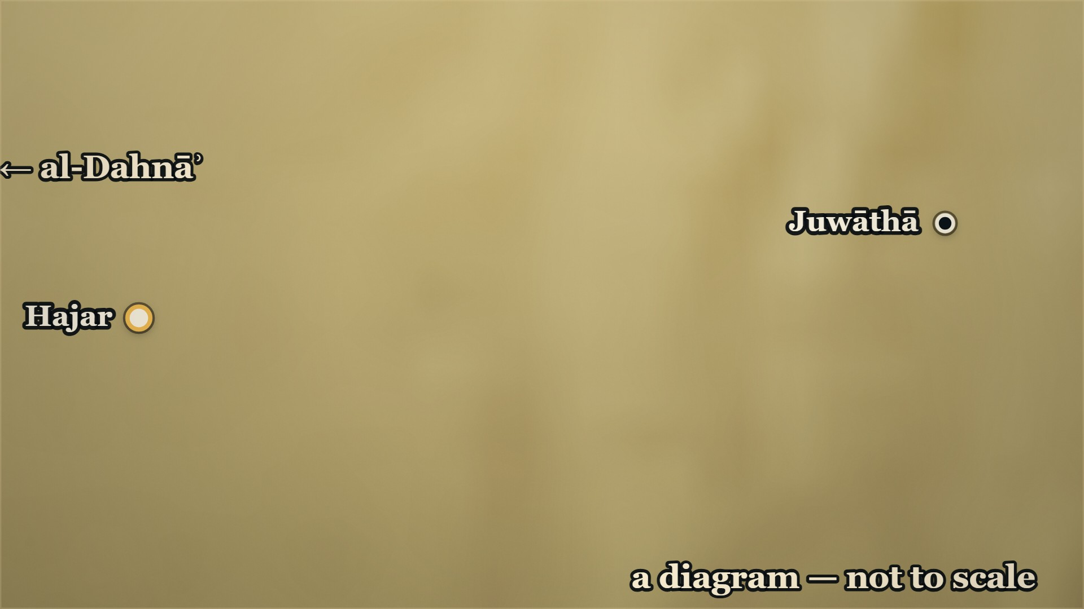





11 AH, Hajar — that night
Qays b. ʿĀṣim, and al-Ḥuṭam
al-ʿAlāʾ ؓ
goes out at them, over the trench
al-Ḥuṭam
killed by Qays b. ʿĀṣim
Notes:
⚠ Do not use Ibn Khaldūn on who killed him.
SAY
▶ CLICK 1 — The Muslims go out at them, over the trench.
1. The Muslims go in
2. al-Ḥuṭam wakes in confusion
3. A man in the dark
4. "Finish me"
▶ CLICK 2 — al-Ḥuṭam is killed. The camp is taken.
5. Qays b. ʿĀṣim does
6. "What a shameful thing"
7. The man they had made king
8. Do not use Ibn Khaldūn here
▶ NEXT SLIDE — the Arabic, and its lesson
──────── DETAIL — only if you need it ────────
1. The Muslims go in — al-ʿAlāʾ ؓ mounts at once, and they fall on the camp.
2. al-Ḥuṭam wakes in confusion — He mounts; his stirrup-leather parts; he calls out for someone to set his foot.
3. A man in the dark — "I will; lift your foot" — and strikes it off. Ibn al-Athīr names him: ʿAfīf b. al-Mundhir.
4. "Finish me" — He asks every man who passes; each one refuses.
5. Qays b. ʿĀṣim does — The same Qays who joined the column on the road.
6. "What a shameful thing" — Then he sees the leg: "had I known his condition, I would not have touched him."
7. The man they had made king — ʿAfīf b. al-Mundhir takes him in the pursuit, that same night, and he accepts Islam. Ibn al-Athīr tells it here — before Dārīn.
8. Do not use Ibn Khaldūn here — He gives three different killers on his own pages.
واسوأتاه، لو أعلمُ ما به لم أحرِّكْهُ
"What a shameful thing — had I known his condition, I would not have touched him."
— Qays b. ʿĀṣim, standing over al-Ḥuṭam · البدایہ والنہایہ ج۷ ص۳۹
──────── BACKGROUND — for home, not for the lectern ────────
The stirrup, the foot, and the long wait — البدایہ ج7 ص39, whole: > فركبَ جوادَهُ فانقطع ركابُه فجعلَ يقولُ: منْ يُصْلح لي ركابي؟ فجاءَ رجلٌ من المسلمين في الليل فقال: أنا أصلحُها لك، ارفع رجلك، فلما رفعها ضربه بالسيف فقطعها مع قدمه
> — البدایہ والنہایہ ج7 ص39 · https://shamela.ws/book/30097/3185
> English: "So he mounted his horse, and his stirrup-leather parted, and he began saying: who will set my stirrup right for me? A man of the Muslims came in the night and said: I will set it right for you — lift your foot. And when he lifted it he struck it with the sword and cut it off, with his foot."
> فوقعَ صريعًا كلما مرَّ به أحدٌ يسأله أن يقتلَه فيأبى، حتى مرَّ به قيسُ بن عاصم فقال له: أنا الحطم فاقتلني فقتله
> — البدایہ والنہایہ ج7 ص39 · https://shamela.ws/book/30097/3185
> English: "So he fell stricken; and every time anyone passed him he would ask him to kill him, and the man would refuse — until Qays b. ʿĀṣim passed him, and he said to him: I am al-Ḥuṭam, kill me. So he killed him."
الکامل names the man who cut the leg, and settles the sequence — the cut first, then the killing: > فَأَمَّا أَبْجَرُ فَأَفْلَتَ، وَأَمَّا الْحُطَمُ فَقُتِلَ، قَتَلَهُ قَيْسُ بْنُ عَاصِمٍ بَعْدَ أَنْ قَطَعَ عَفِيفُ بْنُ الْمُنْذِرِ التَّيْمِيُّ رِجْلَهُ
> — الکامل فی التاریخ ج2 ص224 · https://shamela.ws/book/21712/915
> English: "As for Abjar, he escaped; and as for al-Ḥuṭam, he was killed — Qays b. ʿĀṣim killed him, after ʿAfīf b. al-Mundhir al-Taymī had cut off his leg."
Who Qays b. ʿĀṣim is, in one line from the page — he is already named in , and this is
the line to use for him, because it is the one thing the books say he did: > وَلَحِقَ بِهِ أَيْضًا قَيْسُ بْنُ عَاصِمٍ الْمِنْقَرِيُّ، وَأَعْطَاهُ بَدَلَ مَا كَانَ قُسِمَ مِنَ الصَّدَقَةِ بَعْدَ مَوْتِ النَّبِيِّ - صَلَّى اللَّهُ عَلَيْهِ وَسَلَّمَ -
> — الکامل فی التاریخ ج2 ص222 · https://shamela.ws/book/21712/913
> English: "And Qays b. ʿĀṣim al-Minqarī also caught up with him, and gave him the replacement for what had been divided of the ṣadaqa after the death of the Prophet صلى الله عليه وسلم."
⚠ No honorific for Qays b. ʿĀṣim, and none for ʿAfīf b. al-Mundhir. No page we hold states the
Companionship of either man, and 's rule is the rule. This is a gap worth closing — Qays b.
ʿĀṣim al-Minqarī may well be a Companion in the biographical literature; until a page we hold says so
he is named plain. To verify. ⚠⚠ DO NOT USE ابن خلدون FOR THIS DEATH. It is the clearest worked example in the whole pool of why
; and Jābir b. Buḥayr caught him and struck him and cut his tendon, and he died."
and one page later, inside al-ʿAlāʾ's ؓ own despatch to Abū Bakr ؓ, on ج2 ص506: > وكتب العلاء إلى أبي بكر بهزيمة أهل الخندق وقتل الخطم قتله زيد وسميفع
> — تاریخ ابن خلدون ج2 ص506 · https://shamela.ws/book/12320/1303
> English: "And al-ʿAlāʾ wrote to Abū Bakr with the rout of the people of the trench and the killing of al-Khuṭam — Zayd and Sumayfaʿ killed him."
— and the editor's footnote to that very line records yet another copy reading «مسمع». Three
readings, two pages, one book. He also mis-names the father, and then the man: ج2 ص504 has
«الحطم بن ربيعة» where الکامل ج2 ص222 and البدایہ ج7 ص39 have الحُطَم بن ضُبَيعة, and ج2 ص506 spells
the name «الخطم» against «الحطم» on his own previous page. > ⚠ CORRECTION, and it changes a page citation. ), not ص504, and
> «قتله زيد وسميفع» is on ج2 ص506 (index 1303). ص504 (index 1301) carries only the rising and the
> father's name «بن ربيعة». The pages cited on this card are the checked ones. ⚠ البدایہ does not name the man who cut the foot — only «رجلٌ من المسلمين», a man of the Muslims.
The name عفيف بن المنذر التيمي is الکامل's alone. Say it as الکامل's if asked. ⚠ Where this death sits in the running order. It ends the هَجَر fighting, so it is told before
دارين and never after it: in the survivors take ship, and the man they had been following
is already dead. The خميصة that was his belongs to the Thumāma ؓ card, which is later still — do not
reach forward to it here.

Slide 29
11 AH, Hajar — that night
Qays b. ʿĀṣim, and al-Ḥuṭam
al-Ḥuṭam mounts in the dark; his stirrup-leather parts.
ʿAfīf b. al-Mundhir offers to set it right.
واسوأتاه، لو أعلمُ ما به لم أحرِّكْهُ
"What a shameful thing — had I known his condition, I would not have touched him."
— Qays b. ʿĀṣim, standing over al-Ḥuṭam
al-Bidaya wa'l-Nihaya, vol. 7, p. 39
Notes:
READ the Arabic on the slide — then its English.
WHO IS SPEAKING — Qays b. ʿĀṣim, standing over al-Ḥuṭam
LESSON — He asked every man who passed to kill him and they refused; the one who finally did it was sorry the moment he saw the state he was already in. The book kept the regret, not the kill.
──────── DETAIL — only if you need it ────────
واسوأتاه، لو أعلمُ ما به لم أحرِّكْهُ
"What a shameful thing — had I known his condition, I would not have touched him."
— البدایہ والنہایہ ج۷ ص۳۹
──────── IMAGE BRIEF — paste into the image generator ────────
OPTIONAL — a background image, if you want one:
A saddled Arabian horse standing alone at night in a camp, head turned, with one stirrup-leather broken and hanging loose from the saddle. A low tent edge and a dying fire behind it. Restrained editorial illustration, muted ochre, deep teal and bone. Flat pure-white background (#FFFFFF) with no border, so it sits on a white slide with no seam. No text, no lettering, no map. No people and no faces — landscape, animals and objects only. 16:9.

Slide 30
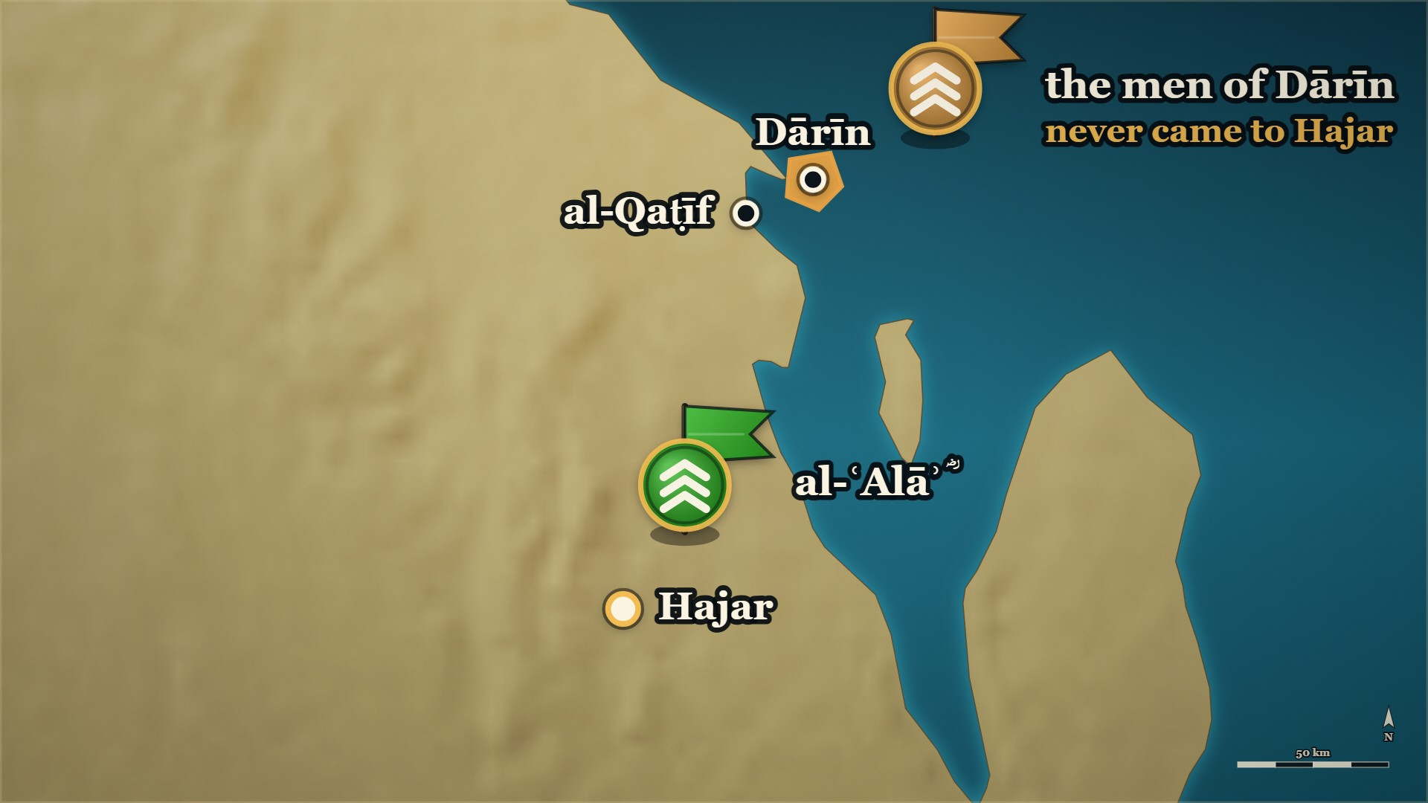







11–12 AH, the coast of Bahrayn
ʿUtayba and al-Muthannā — the roads
the beaten
take ship for Dārīn; the rest go home
ʿUtayba b. al-Nahhās
and al-Muthannā b. Ḥāritha shut the roads
Notes:
⚠ The page says “on every road” — name no place for either man.
SAY
1. Dārīn had never come to Hajar
▶ CLICK 1 — The bulk of the beaten take ship for Dārīn. The rest go home.
2. The beaten take ship
▶ CLICK 2 — al-ʿAlāʾ ؓ writes to the Muslims of Bakr b. Wāʾil: sit in wait on every road.
3. He closes the land first
4. ʿUtayba b. al-Nahhās, al-Muthannā b. Ḥāritha
5. They did it, and sent word
▶ NEXT SLIDE — the Arabic, and its lesson
──────── DETAIL — only if you need it ────────
1. Dārīn had never come to Hajar — Every one of them gathered to al-Ḥuṭam except the people of Dārīn.
2. The beaten take ship — Most of the routed go by sea to Dārīn; the rest go home to their own country.
3. He closes the land first — al-ʿAlāʾ ؓ writes to the Muslims of Bakr b. Wāʾil: sit in wait on every road.
4. ʿUtayba b. al-Nahhās, al-Muthannā b. Ḥāritha — The two he names. al-Muthannā is a name the Iraq evenings will need.
5. They did it, and sent word — Only then does he turn to the sea.
فَكَتَبَ الْعَلَاءُ إِلَى مَنْ ثَبَتَ عَلَى إِسْلَامِهِ مِنْ بَكْرِ بْنِ وَائِلٍ، مِنْهُمْ عُتَيْبَةُ بْنُ النَّهَّاسِ وَالْمُثَنَّى بْنُ حَارِثَةَ وَغَيْرُهُمَا، يَأْمُرُهُمْ بِالْقُعُودِ لِلْمُنْهَزِمِينَ وَالْمُرْتَدِّينَ بِكُلِّ طَرِيق
"So al-ʿAlāʾ wrote to those of Bakr b. Wāʾil who had held firm on their Islam — among them ʿUtayba b. al-Nahhās and al-Muthannā b. Ḥāritha and others — ordering them to sit in wait for the routed and the apostates on every road."
— Ibn al-Athīr, on the letter al-ʿAlāʾ ؓ wrote · الکامل فی التاریخ ج۲ ص۲۲۴
──────── BACKGROUND — for home, not for the lectern ────────
⚠ No page says where each of them sat. The map places them on the roads inland; say "on every road", as
the page does, and name no place for either man. ⚠ No honorific for either on the pages we hold.

Slide 31
11–12 AH, the coast of Bahrayn
ʿUtayba and al-Muthannā — the roads
فَكَتَبَ الْعَلَاءُ إِلَى مَنْ ثَبَتَ عَلَى إِسْلَامِهِ مِنْ بَكْرِ بْنِ وَائِلٍ
So al-ʿAlāʾ wrote to those of Bakr b. Wāʾil who had held firm on their Islam
مِنْهُمْ عُتَيْبَةُ بْنُ النَّهَّاسِ وَالْمُثَنَّى بْنُ حَارِثَةَ وَغَيْرُهُمَا
among them ʿUtayba b. al-Nahhās and al-Muthannā b. Ḥāritha and others
— Ibn al-Athīr, on the letter al-ʿAlāʾ ؓ wrote
al-Kamil, vol. 2, p. 224
Notes:
READ the Arabic on the slide — then its English.
WHO IS SPEAKING — Ibn al-Athīr, on the letter al-ʿAlāʾ ؓ wrote
LESSON — He closed the roads behind the enemy before he opened one in front of himself.
▶ NEXT SLIDE — the same words go on (2 slides in all)
──────── DETAIL — only if you need it ────────
فَكَتَبَ الْعَلَاءُ إِلَى مَنْ ثَبَتَ عَلَى إِسْلَامِهِ مِنْ بَكْرِ بْنِ وَائِلٍ، مِنْهُمْ عُتَيْبَةُ بْنُ النَّهَّاسِ وَالْمُثَنَّى بْنُ حَارِثَةَ وَغَيْرُهُمَا، يَأْمُرُهُمْ بِالْقُعُودِ لِلْمُنْهَزِمِينَ وَالْمُرْتَدِّينَ بِكُلِّ طَرِيق
"So al-ʿAlāʾ wrote to those of Bakr b. Wāʾil who had held firm on their Islam — among them ʿUtayba b. al-Nahhās and al-Muthannā b. Ḥāritha and others — ordering them to sit in wait for the routed and the apostates on every road."
— الکامل فی التاریخ ج۲ ص۲۲۴

Slide 32
11–12 AH, the coast of Bahrayn
ʿUtayba and al-Muthannā — the roads
يَأْمُرُهُمْ بِالْقُعُودِ لِلْمُنْهَزِمِينَ وَالْمُرْتَدِّينَ بِكُلِّ طَرِيق
ordering them to sit in wait for the routed and the apostates on every road.
— Ibn al-Athīr, on the letter al-ʿAlāʾ ؓ wrote
al-Kamil, vol. 2, p. 224
Notes:
READ the Arabic — the same words, continued (slide 2 of 2).
Each part: the Arabic, then its meaning.
──────── DETAIL — only if you need it ────────
يَأْمُرُهُمْ بِالْقُعُودِ لِلْمُنْهَزِمِينَ وَالْمُرْتَدِّينَ بِكُلِّ طَرِيق
ordering them to sit in wait for the routed and the apostates on every road.

Slide 33
11–12 AH, the shore
al-ʿAlāʾ ؓ at the shore
The shore opposite Dārīn. The same men who were at al-Dahnāʾ.
قَدْ أَرَاكُمُ اللَّهُ مِنْ آيَاتِهِ فِي الْبَرِّ
Allah has shown you His signs on land
لِتَعْتَبِرُوا بِهَا فِي الْبَحْرِ
so that you may take heed by them at sea.
— al-ʿAlāʾ b. al-Ḥaḍramī ؓ, to the army at the shore
al-Kamil, vol. 2, p. 224
Notes:
SAY
1. The same men who were at al-Dahnāʾ
2. "His signs on land"
↑ read the Arabic on the slide
3. "Rise against your enemy"
LESSON — What they had seen in the desert was the reason he gave them for the sea.
▶ NEXT SLIDE — the same words go on (2 slides in all)
──────── DETAIL — only if you need it ────────
1. The same men who were at al-Dahnāʾ — He is speaking to the army that lost its camels and found the water.
2. "His signs on land" — "Allah has shown you His signs on land, so that you may take heed by them at sea."
3. "Rise against your enemy" — "…and take the sea in your stride."
قَدْ أَرَاكُمُ اللَّهُ مِنْ آيَاتِهِ فِي الْبَرِّ لِتَعْتَبِرُوا بِهَا فِي الْبَحْرِ، فَانْهَضُوا إِلَى عَدُوِّكُمْ وَاسْتَعْرِضُوا الْبَحْر
"Allah has shown you His signs on land so that you may take heed by them at sea. So rise against your enemy, and take the sea in your stride."
— al-ʿAlāʾ b. al-Ḥaḍramī ؓ, to the army at the shore · الکامل فی التاریخ ج۲ ص۲۲۴

Slide 34
11–12 AH, the shore
al-ʿAlāʾ ؓ at the shore
فَانْهَضُوا إِلَى عَدُوِّكُمْ وَاسْتَعْرِضُوا الْبَحْر
So rise against your enemy, and take the sea in your stride.
— al-ʿAlāʾ b. al-Ḥaḍramī ؓ, to the army at the shore
al-Kamil, vol. 2, p. 224
Notes:
READ the Arabic — the same words, continued (slide 2 of 2).
Each part: the Arabic, then its meaning.
──────── DETAIL — only if you need it ────────
فَانْهَضُوا إِلَى عَدُوِّكُمْ وَاسْتَعْرِضُوا الْبَحْر
So rise against your enemy, and take the sea in your stride.

Slide 35
11–12 AH, the shore
al-ʿAlāʾ ؓ — the duʿāʾ
By ship, a day and a night. He rides his horse into the sea.
يا أرحمَ الراحمين، يا حكيمُ يا كريمُ
O Most Merciful of the merciful; O Wise, O Generous
يا أحدُ يا صمدُ، يا حيُّ يا مُحيي
O One, O Eternal; O Living, O Giver of life
— al-ʿAlāʾ b. al-Ḥaḍramī ؓ, riding into the sea
al-Bidaya wa'l-Nihaya, vol. 7, p. 40
Notes:
⚠ Read the duʿāʾ slowly. It is the whole slide.
SAY
1. The shore, and no time for ships
2. He rides in first
3. Read the duʿāʾ
↑ read the Arabic on the slide
4. He orders the army to say it
LESSON — He asked first, and he went in first.
▶ NEXT SLIDE — the same words go on (2 slides in all)
──────── DETAIL — only if you need it ────────
1. The shore, and no time for ships — By ship the crossing is a day and a night; the enemy would be gone.
2. He rides in first — On his horse, saying the duʿāʾ aloud.
3. Read the duʿāʾ — Slowly; it is the whole of the slide.
4. He orders the army to say it — And to ride in after him; and they did.
يا أرحمَ الراحمين، يا حكيمُ يا كريمُ، يا أحدُ يا صمدُ، يا حيُّ يا مُحيي، يا قيّومُ، يا ذا الجلال والإكرام، لا إله إلا أنت يا ربَّنا
"O Most Merciful of the merciful; O Wise, O Generous; O One, O Eternal; O Living, O Giver of life; O Sustainer; O Lord of majesty and honour — there is no god but You, our Lord."
— al-ʿAlāʾ b. al-Ḥaḍramī ؓ, riding into the sea · البدایہ والنہایہ ج۷ ص۴۰
──────── BACKGROUND — for home, not for the lectern ────────
What they walked on, as the book describes it:
> يمشون على مثل رملةٍ دمثةٍ فوقها ماء لا يغمر أخفاف الإبل، ولا يصلُ إلى ركبِ الخيل
> — البدایہ والنہایہ ج7 ص40 · https://shamela.ws/book/30097/3186
> English: "…walking on something like soft sand with water over it — not covering the camels' pads, nor
> reaching the horses' knees." ⚠ Eyeball the duʿāʾ against the page image before it is projected (CLAUDE.md ). ⚠ Narrated as the
book narrates it; no ruling is built on it.
──────── IMAGE BRIEF — paste into the image generator ────────
A shallow, calm sea at dawn seen from a low sandy shore; the water is glassy and only ankle-deep far out, with a flat low island on the horizon. Hoof-prints lead from the sand into the water. Restrained editorial illustration, muted ochre, deep teal and bone. Flat pure-white background (#FFFFFF) with no border, so it sits on a white slide with no seam. No text, no lettering, no map. No people and no faces — landscape, animals and objects only. 16:9.

Slide 36
11–12 AH, the shore
al-ʿAlāʾ ؓ — the duʿāʾ
يا قيّومُ، يا ذا الجلال والإكرام
O Sustainer; O Lord of majesty and honour
لا إله إلا أنت يا ربَّنا
there is no god but You, our Lord.
— al-ʿAlāʾ b. al-Ḥaḍramī ؓ, riding into the sea
al-Bidaya wa'l-Nihaya, vol. 7, p. 40
Notes:
READ the Arabic — the same words, continued (slide 2 of 2).
Each part: the Arabic, then its meaning.
──────── DETAIL — only if you need it ────────
يا قيّومُ، يا ذا الجلال والإكرام
O Sustainer; O Lord of majesty and honour
لا إله إلا أنت يا ربَّنا
there is no god but You, our Lord.

Slide 37
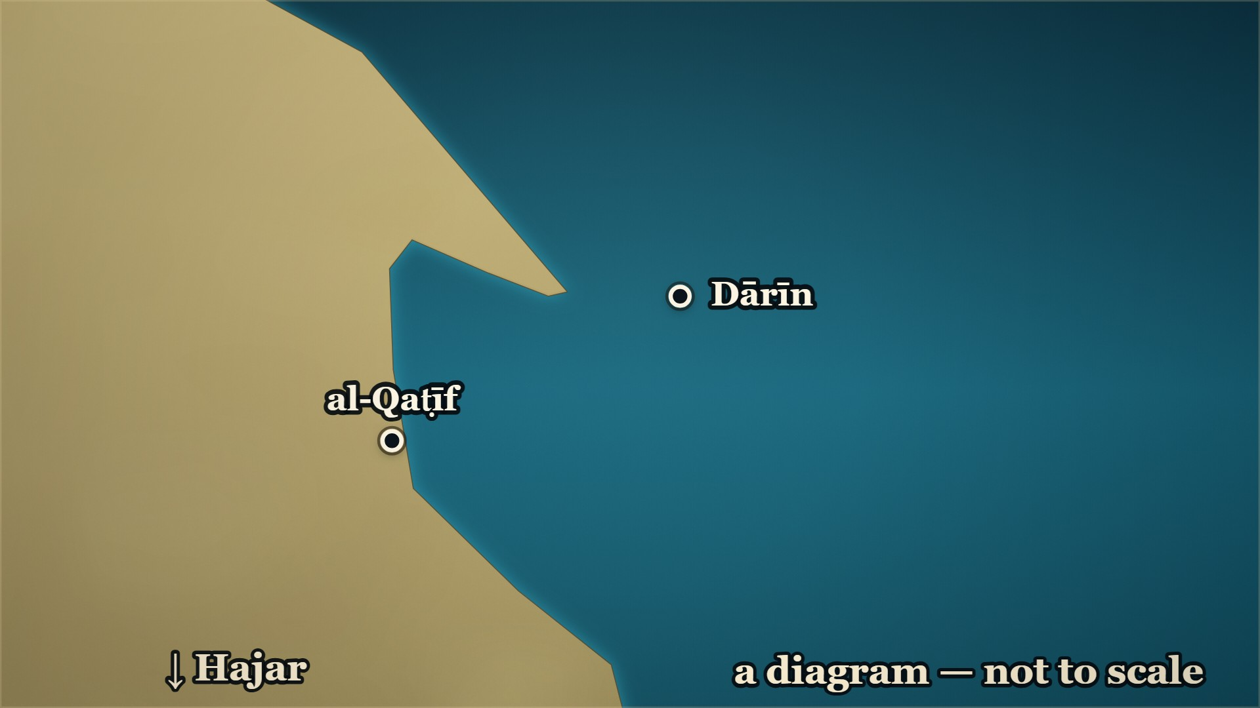









11–12 AH, Dārīn
Dārīn
al-ʿAlāʾ ؓ
fords the strait, on horseback
Dārīn
taken by al-ʿAlāʾ ؓ, the same day
Notes:
⚠ A strait, forded — not a sea that parted. Say what the page says.
⚠ The island is drawn large, and off the shore. A diagram.
SAY
▶ CLICK 1 — al-ʿAlāʾ ؓ comes down to the shore.
1. al-ʿAlāʾ ؓ comes down to the shore
▶ CLICK 2 — Into the water, on horseback — he fords the strait.
2. Into the water, on horseback
3. "Like soft sand with water over it"
▶ CLICK 3 — Dārīn falls. He is back the same day.
4. Dārīn falls
5. Nothing lost in the sea
6. "Islam settled there"
▶ NEXT SLIDE — the Arabic, and its lesson
──────── DETAIL — only if you need it ────────
1. al-ʿAlāʾ ؓ comes down to the shore — With the whole army.
2. Into the water, on horseback — He fords the strait, by Allah's leave.
3. "Like soft sand with water over it" — Ibn Kathīr: not covering the camels' pads, nor reaching the horses' knees. Ibn al-Athīr: covering the pads. Give no depth. By ship: a day and a night.
4. Dārīn falls — He fights them and overcomes them, and is back the same day.
5. Nothing lost in the sea — But one man's nosebag — and al-ʿAlāʾ ؓ went back and brought it.
6. "Islam settled there" — The sentence the chapter closes on.
وَضَرَبَ الْإِسْلَامُ فِيهَا بِجِرَانِهِ.
"And Islam settled its neck to the ground there."
— Ibn al-Athīr, closing the chapter · الکامل فی التاریخ ج۲ ص۲۲۴
──────── BACKGROUND — for home, not for the lectern ────────
The two books do not give the water the same depth (⁨الکامل⁩ has it covering the camels' pads; ) — ⁨البدایہ⁩'s words: «يمشون على مثل رملةٍ دمثةٍ فوقها ماء لا يغمر أخفاف
الإبل» (البدایہ ج7 ص40), out and back in a single day, with nothing lost in the water except one
man's horse-fodder, which al-ʿAlāʾ ؓ went back and brought him. البدایہ ج7 ص40 prints the duʿāʾ they
said going in. And afterwards: «وَضَرَبَ الْإِسْلَامُ فِيهَا بِجِرَانِهِ» (الکامل ج2 ص224).

Slide 38
11–12 AH, Dārīn
Dārīn
وَضَرَبَ الْإِسْلَامُ فِيهَا بِجِرَانِهِ.
"And Islam settled its neck to the ground there."
— Ibn al-Athīr, closing the chapter
al-Kamil, vol. 2, p. 224
Notes:
READ the Arabic on the slide — then its English.
WHO IS SPEAKING — Ibn al-Athīr, closing the chapter
LESSON — He closed the roads behind the enemy before he opened one in front of himself.
──────── DETAIL — only if you need it ────────
وَضَرَبَ الْإِسْلَامُ فِيهَا بِجِرَانِهِ.
"And Islam settled its neck to the ground there."
— الکامل فی التاریخ ج۲ ص۲۲۴

Slide 39
11–12 AH, Hajar
The monk of Hajar
He had been with the army through all of it.
ثَلَاثَةُ أَشْيَاءَ خَشِيتُ أَنْ يَمْسَخَنِي اللَّهُ بَعْدَهَا:
Three things, after which I feared Allah would transform me:
فَيْضٌ فِي الرِّمَالِ، وَتَمْهِيدُ أَثْبَاجِ الْبَحْرِ، وَدُعَاءٌ سَمِعْتُهُ فِي عَسْكَرِهِمْ فِي الْهَوَاءِ سَحَرًا
water welling up in the sands, the levelling of the sea's swells, and a supplication I heard in their camp, in the air, before dawn.
— A monk of Hajar, asked why he became a Muslim
al-Kamil, vol. 2, p. 224
Notes:
SAY
1. A monk of Hajar, with the army
2. He became a Muslim, and was asked why
3. "Three things"
↑ read the Arabic on the slide
4. Water in the sands; the sea laid flat
5. He could repeat the duʿāʾ
6. "Men are not helped like that…"
7. How it reached us
LESSON — The strongest witness for what happened on this front is the one man in it who had no reason to take their side.
ASK — Before beat 3: "Hands up — who has been wondering, while I have been telling all this, how anybody knows that it happened?"
──────── DETAIL — only if you need it ────────
1. A monk of Hajar, with the army — He was with the Muslims through all of it.
2. He became a Muslim, and was asked why — A man explaining himself afterwards.
3. "Three things" — He feared what Allah would do to him had he seen them and not believed.
4. Water in the sands; the sea laid flat — And a duʿāʾ he heard in the camp before dawn.
5. He could repeat the duʿāʾ — The book prints the words he says he heard.
6. "Men are not helped like that…" — "…unless they are on the truth."
7. How it reached us — The Companions used to hear it from him afterwards.
ثَلَاثَةُ أَشْيَاءَ خَشِيتُ أَنْ يَمْسَخَنِي اللَّهُ بَعْدَهَا: فَيْضٌ فِي الرِّمَالِ، وَتَمْهِيدُ أَثْبَاجِ الْبَحْرِ، وَدُعَاءٌ سَمِعْتُهُ فِي عَسْكَرِهِمْ فِي الْهَوَاءِ سَحَرًا
"Three things, after which I feared Allah would transform me: water welling up in the sands, the levelling of the sea's swells, and a supplication I heard in their camp, in the air, before dawn."
— A monk of Hajar, asked why he became a Muslim · الکامل فی التاریخ ج۲ ص۲۲۴
──────── BACKGROUND — for home, not for the lectern ────────
How the question was put to him, in the words that open the report:
> وَكَانَ مَعَ الْمُسْلِمِينَ رَاهِبٌ مِنْ أَهْلِ هَجَرَ، فَأَسْلَمَ، فَقِيلَ لَهُ: مَا حَمَلَكَ عَلَى الْإِسْلَامِ؟
> — الکامل فی التاریخ ج2 ص224 · https://shamela.ws/book/21712/915
> English: "And there was with the Muslims a monk of the people of Hajar, and he became a Muslim. It
> was said to him: what brought you to Islam?" How the account reached us — the line ⁨الکامل⁩ ends the chapter on:
> فَعَلِمْتُ أَنَّ الْقَوْمَ لَمْ يُعَانُوا بِالْمَلَائِكَةِ إِلَّا وَهُمْ عَلَى حَقٍّ، فَكَانَ أَصْحَابُ النَّبِيِّ - صَلَّى اللَّهُ عَلَيْهِ وَسَلَّمَ - يَسْمَعُونَ هَذَا مِنْهُ بَعْدُ.
> — الکامل فی التاریخ ج2 ص225 · https://shamela.ws/book/21712/916
> English: "So I knew that these people would not be helped by the angels unless they were upon the
> truth. And the Companions of the Prophet ﷺ used to hear this from him afterwards." What ⁨البدایہ⁩ has instead, and whose report it is:
> أنه كان مع المسلمين في هذه المواقف والمشاهد التي رَأوْها من أمر العلاءَ، وما أجرى الله على يديه من الكرامات، رجل من أهل هَجَر راهب فأسلم حينئذ
> — البدایہ والنہایہ ج7 ص40 · https://shamela.ws/book/30097/3186
> English: "...that there was with the Muslims, in these scenes and sights which they saw of al-ʿAlāʾ's
> affair and of what Allah brought about by his hands, a man of the people of Hajar, a monk, who became a
> Muslim then and there." Ibn Kathīr gives this on the authority of ⁨سيف بن عمر التميمي⁩, and says so on the page. His version is
also shorter: his man gives one reason — that he feared being transformed, from the signs he had
seen — and then the supplication he heard at ⁨سحر⁩. The three-item list is ⁨الکامل⁩'s form. If the card
says "three", cite ⁨الکامل ج2 ص224⁩ for it, never ⁨البدایہ⁩. What the three refer to — the water in the sands is the night at ⁨الدَّهْناء⁩, where the camels bolted
with everything on them and water was found beside the men by morning (⁨البدایہ ج7 ص39⁩; ⁨الکامل ج2 ص223⁩);
the levelling of the sea is the ⁨دارين⁩ crossing of RC27. ⚠ The page lists the three without naming
either episode. It is ⁨البدایہ ج7 ص40⁩ that places this man at them. Say it the way the pages do — he
had been with them for all of it — and do not assert a one-to-one match the page does not make. ⚠ MONK IS ESTABLISHED. BISHOP IS NOT. Both pages say ⁨راهب⁩, a monk: the ⁨الکامل⁩ report opens with it
(quoted above), and ⁨البدایہ ج7 ص40⁩ has «⁨رجل من أهل هَجَر راهب⁩». So the monk of Hajar is exactly what the
books support, and it is a plain factual descriptor from the source, not a coined title (CLAUDE.md ).
Do not upgrade him to a bishop, do not name him, and do not state what community he came from — no
page we hold gives any of the three. ⚠ NO HONORIFIC. No page we hold states that he ever saw the Prophet ﷺ, so he gets no ؓ. He became a
Muslim in 12ھ, after the Prophet ﷺ had died. If a slip asks whether he was a Companion: the books do not
say, and neither do we. ⚠ THIS IS A ⁨كرامہ⁩-ADJACENT REPORT AND ⁨البدایہ⁩ FRAMES IT AS ONE — «⁨وما أجرى الله على يديه من⁩
⁨الكرامات⁩» (البدایہ ج7 ص40). Narrate it as the book narrates it. Do not build a doctrinal point on it,
do not defend it from the platform, and do not soften it either. If challenged: this is what the book
records, with the name of the man it records it from, and we are reading a book. ⚠ Eyeball every Arabic line on this card against the page image before it reaches a slide
(CLAUDE.md ). ⁨البدایہ⁩'s text here is lightly vocalised and ⁨الکامل⁩'s is fully vocalised, so the two
will not look alike on screen even where they agree. ⚠ ADD TO , ⁨دارين⁩ or ⁨العلاء ؓ⁩ — and this is its best entry in the whole part: an
eyewitness from outside the community, explaining himself, with the chain stated on the page. It is also
the licence for the one source remark this evening is allowed — at the moment a
listener asks "how do we know that?", inside the story. Not a methodology slot, and not a recurring one. ⚠ — the row this card answers. No new proper name walks on stage here: the man is unnamed, and
al-ʿAlāʾ ؓ, ⁨هَجَر⁩, ⁨الدَّهْناء⁩ and ⁨دارين⁩ are all already on earlier cards of the same block. Answer the
runsheet row "the monk of Hajar — no notice needed; the books do not name him".

Slide 40
12 AH, the road from Dārīn
Thumāma b. Uthāl ؓ
On the road home, wearing a cloak from the spoils. It had been al-Ḥuṭam's.
فَقَالُوا لَهُ: أَنْتَ قَتَلْتَ الْحُطَمَ! فَقَالَ: لَمْ أَقْتُلْهُ، وَلَكِنِّي اشْتَرَيْتُهَا مِنَ الْمَغْنَمِ.
They said to him: You killed al-Ḥuṭam! He said: I did not kill him — I bought it from the spoils.
فَوَثَبُوا عَلَيْهِ فَقَتَلُوهُ.
So they fell on him and killed him.
— Banū Qays b. Thaʿlaba, and Thumāma ؓ
al-Kamil, vol. 2, p. 224
Notes:
⚠ Skip this slide if the room is heavy.
SAY
1. Thumāma b. Uthāl ؓ again
2. He had joined al-ʿAlāʾ ؓ on the road
3. A cloak from the spoils
4. al-Ḥuṭam's tribe saw it on him
5. "You killed al-Ḥuṭam"
↑ read the Arabic on the slide
6. Tell it plainly, and move on
LESSON — He survived the war and was killed for a piece of cloth by men who had already surrendered.
──────── DETAIL — only if you need it ────────
1. Thumāma b. Uthāl ؓ again — The room met him on evening 4, of Banū Ḥanīfa itself.
2. He had joined al-ʿAlāʾ ؓ on the road — With the Muslims of Banū Ḥanīfa.
3. A cloak from the spoils — An embroidered one; it had been al-Ḥuṭam's.
4. al-Ḥuṭam's tribe saw it on him — Banū Qays b. Thaʿlaba, on the road home from Dārīn.
5. "You killed al-Ḥuṭam" — "I did not; I came by it out of the spoils." They fell on him and killed him.
6. Tell it plainly, and move on — Two sentences; skip it if the room is heavy.
فَقَالُوا لَهُ: أَنْتَ قَتَلْتَ الْحُطَمَ! فَقَالَ: لَمْ أَقْتُلْهُ، وَلَكِنِّي اشْتَرَيْتُهَا مِنَ الْمَغْنَمِ. فَوَثَبُوا عَلَيْهِ فَقَتَلُوهُ.
"They said to him: You killed al-Ḥuṭam! He said: I did not kill him — I bought it from the spoils. So they fell on him and killed him."
— Banū Qays b. Thaʿlaba, and Thumāma ؓ · الکامل فی التاریخ ج۲ ص۲۲۴
──────── BACKGROUND — for home, not for the lectern ────────
⚠ This is not in البدایہ. Cite الکامل ج2 ص224 (and ابن خلدون ج2 ص506) only.

Slide 41
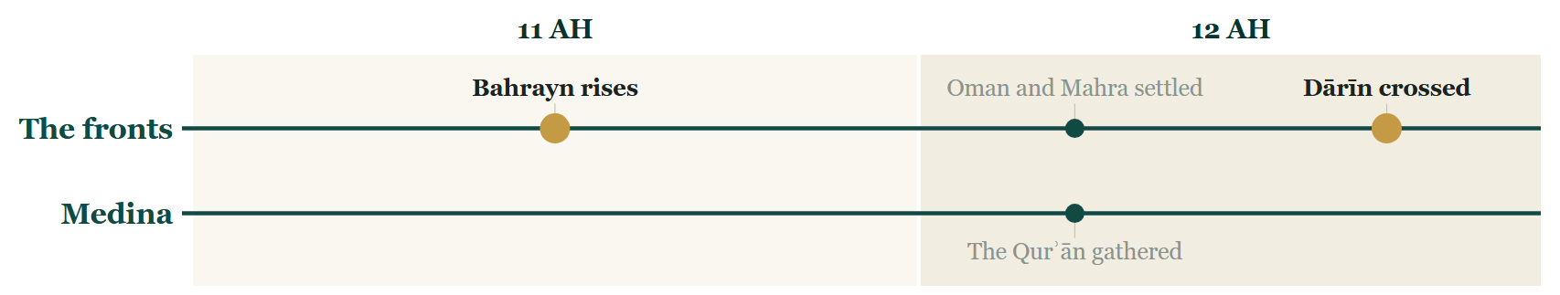
So far tonight
Where we stand
Notes:
CHECKPOINT 1 — the Line
SAY
1. Bahrayn is told: Juwāthā, al-Dahnāʾ, the trench, the sea.
(Next slide: the map. The time check is there.)

Slide 42
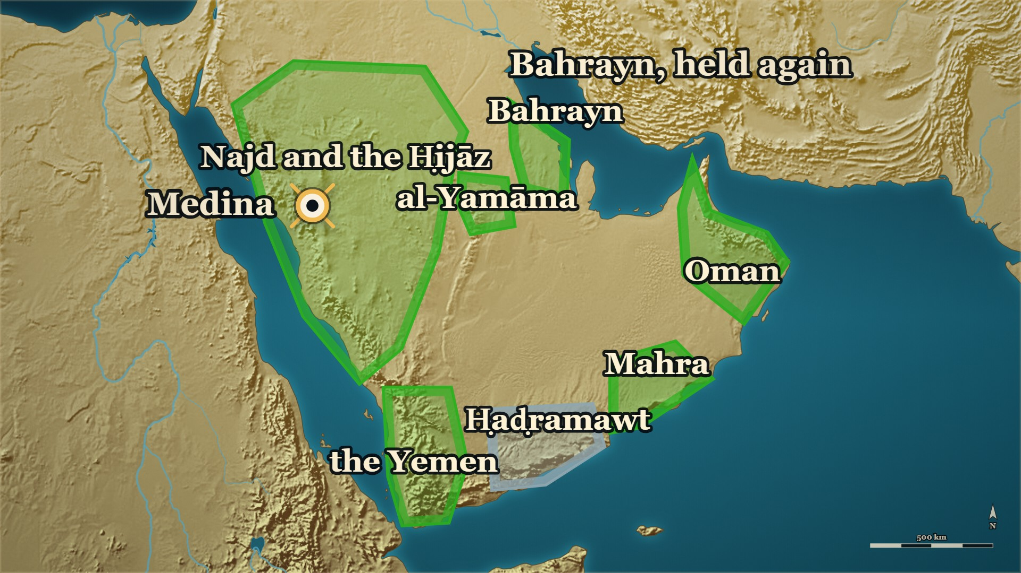
So far tonight
Where we stand
Bahrayn
held again, by al-ʿAlāʾ ؓ
Ḥaḍramawt
not yet told
Notes:
CHECKPOINT 1 — the map
SAY
1. One patch on this map is still grey: Ḥaḍramawt.
⏱ Past 0:36 here — close here.
CARRY ON — “One front is left. It began with a quarrel about camels.”
──────── DETAIL — only if you need it ────────
OUT OF TIME — this is your ending. Stay on this map, and say:
“One front was left, and the books say it began with one she-camel. Next week: how.”
Then a loud السلام علیکم, and the dua. Next week opens on these two slides.

Slide 43
Part III
Kinda, before any of it (10 AH)
Notes:
SAY
1. Kinda, before any of it (10 AH).

Slide 44
10 AH, Medina
Kinda, two years earlier
Two years earlier
At its head
Then
the delegation of Kinda comes to Medina
al-Ashʿath b. Qays
forward again, to Ḥaḍramawt
Notes:
BRIDGE
SAY
1. One step back — and this is the only one tonight.
2. Two years before the Prophet ﷺ died: the delegation of Kinda, at Medina.
3. At its head, al-Ashʿath b. Qays. The last front is his.

Slide 45
kings once — and two branches in 11 AH
Kinda
Banū Muʿāwiya
Ākil al-Murār
kings of the north, before Islam
Banū ʿAmr
Banū al-Ḥārith
the four kings
al-Ashʿath b. Qays
Notes:
TREE — Kinda. Point as you go.
SAY — Who were Kinda?
──────── DETAIL — only if you need it ────────
1. A tribe of the south, of Qaḥṭān, that had once given kings to the northern Arabs: the tribes of Bakr, tired of the strong eating the weak, asked a Tubbaʿ of Yemen for a king, and he gave them a man of Kinda — Ḥujr b. ʿAmr, Ākil al-Murār.
2. Its height: al-Ḥārith b. ʿAmr, given al-Ḥīra by one Persian king and hunted out of it by the next; forty-eight men of the house were put to death. Ibn al-Athīr says openly that some of this looks like Kinda praising itself.
3. In 11 AH, Kinda's Banū Muʿāwiya had two branches: Banū ʿAmr, whose four brothers the books call the four kings — and Banū al-Ḥārith, the branch of al-Ashʿath b. Qays.
4. Side by side, with no line between them: the books show the royal past and the royal title, and do not say that one caused the other. Nor do we.
IF THE ROOM IS WITH YOU: one of al-Ḥārith's sons, another Ḥujr, ruled Banū Asad harshly — and they killed him in his tent.
⚠ No date before Islam is on this slide, and none is to be said: they are estimates.
BACKGROUND (read at home, not aloud) — the house's stories in full:
• A Yemeni house made kings over the northern tribes: Kinda was a southern tribe — Of Qaḥṭān, not of the northern Arabs it came to rule.; The north had a problem — Among Bakr the reckless had overpowered the wise; the strong ate the weak.; They wanted a king from outside — Not one of their own, whom half would obey and half defy.; So they went to a Tubbaʿ of Yemen — And he gave them a man of Kinda: Ḥujr b. ʿAmr, Ākil al-Murār.; What he did with it — He settled at Baṭn ʿĀqil and took back Bakr's lands from al-Ḥīra.; Ibn Khaldūn tells it differently — A Ḥimyarite king set Ḥujr over all of Maʿadd. Say both; resolve neither.
• al-Ḥārith b. ʿAmr — al-Ḥīra given, al-Ḥīra taken back: Ḥujr's grandson al-Ḥārith — A king of great power and far-reaching name, in Ibn al-Athīr's words.; A Persian quarrel reaches the Arabs — Qubādh adopted the teaching of Mazdak; his governor at al-Ḥīra refused.; al-Ḥārith accepted, and was given al-Ḥīra — The high point of the house.; The next Persian king undid it — Anūshirwān killed Mazdak, restored the old governor, and hunted al-Ḥārith.; What it cost the house — Forty-eight men of it were caught and put to death, two of them his sons.; The historian's own caution — Ibn al-Athīr says openly that some of this looks like Kinda praising itself.
• Ḥujr and Banū Asad — "far from us in lineage": The northern chiefs come to him — The killing between us will wipe us out; send your sons to hold us apart.; Four sons set as kings — One over each of the tribes.; Ḥujr goes to Banū Asad — And takes a yearly levy from them.; They throw out his collectors — He came with an army, killed their leading men, drove the rest to Tihāma.; He relented and called them back — And a day's march from him, they turned.; They reached his tent and killed him — The man who struck him was one whose father Ḥujr had killed.
• "The four kings" — side by side, no arrow between: A year or so later, Kinda broke away — The same tribe, the same men, the other side of the line.; "The four kings" — Four brothers of one Kinda clan, with their sister, taking to their strongholds.; al-Ashʿath was not one of them — He was of a different branch of the tribe.; What Ibn al-Athīr says the cause was — An arrangement for carrying zakāt between Kinda and Ḥaḍramawt.; Not the kingship — The books show the royal past, the royal claim and the royal title, and draw no line between them.; And neither do we — The question is left open, because the sources leave it open.

Slide 46
10 AH, Medina
al-Ashʿath b. Qays — at Medina
The delegation of Kinda, in silk. al-Ashʿath claims a shared royal ancestor.
لا، نحن بنو النَّضْر بن كنانة
No. We are the sons of al-Naḍr b. Kināna.
لا نَقْفُو أمَّنا، ولا ننتفي من أبينا
We do not trace ourselves through our mother, and we do not disown our father.
— The Prophet ﷺ, to the delegation of Kinda
al-Bidaya wa'l-Nihaya, vol. 5, p. 56
Notes:
SAY
1. Kinda comes to Medina
2. How they came in
3. "What is this silk on your necks?"
4. Then the claim of kinship
5. The Prophet ﷺ smiled, and refused it
↑ read the Arabic on the slide
6. And al-Ashʿath closed it himself
LESSON — They offered him a royal ancestry as a gift, and he declined it with a smile.
──────── DETAIL — only if you need it ────────
1. Kinda comes to Medina — A large delegation, al-Ashʿath b. Qays at its head.
2. How they came in — Hair combed, kohl on their eyes, Yemeni cloaks edged with silk.
3. "What is this silk on your necks?" — Asked after they had said they had accepted Islam. They tore it off.
4. Then the claim of kinship — We are the sons of Ākil al-Murār, and so are you.
5. The Prophet ﷺ smiled, and refused it — We are the sons of al-Naḍr b. Kināna; we do not trace ourselves through our mother.
6. And al-Ashʿath closed it himself — Any man I hear say it again gets eighty lashes.
لا، نحن بنو النَّضْر بن كنانة، لا نَقْفُو أمَّنا، ولا ننتفي من أبينا
"No. We are the sons of al-Naḍr b. Kināna. We do not trace ourselves through our mother, and we do not disown our father."
— The Prophet ﷺ, to the delegation of Kinda · البدایہ والنہایہ ج۵ ص۵۶

Slide 47
Part IV
Ḥaḍramawt: the last front (11→12 AH)
Notes:
SAY
1. Ḥaḍramawt: the last front (11→12 AH).

Slide 48
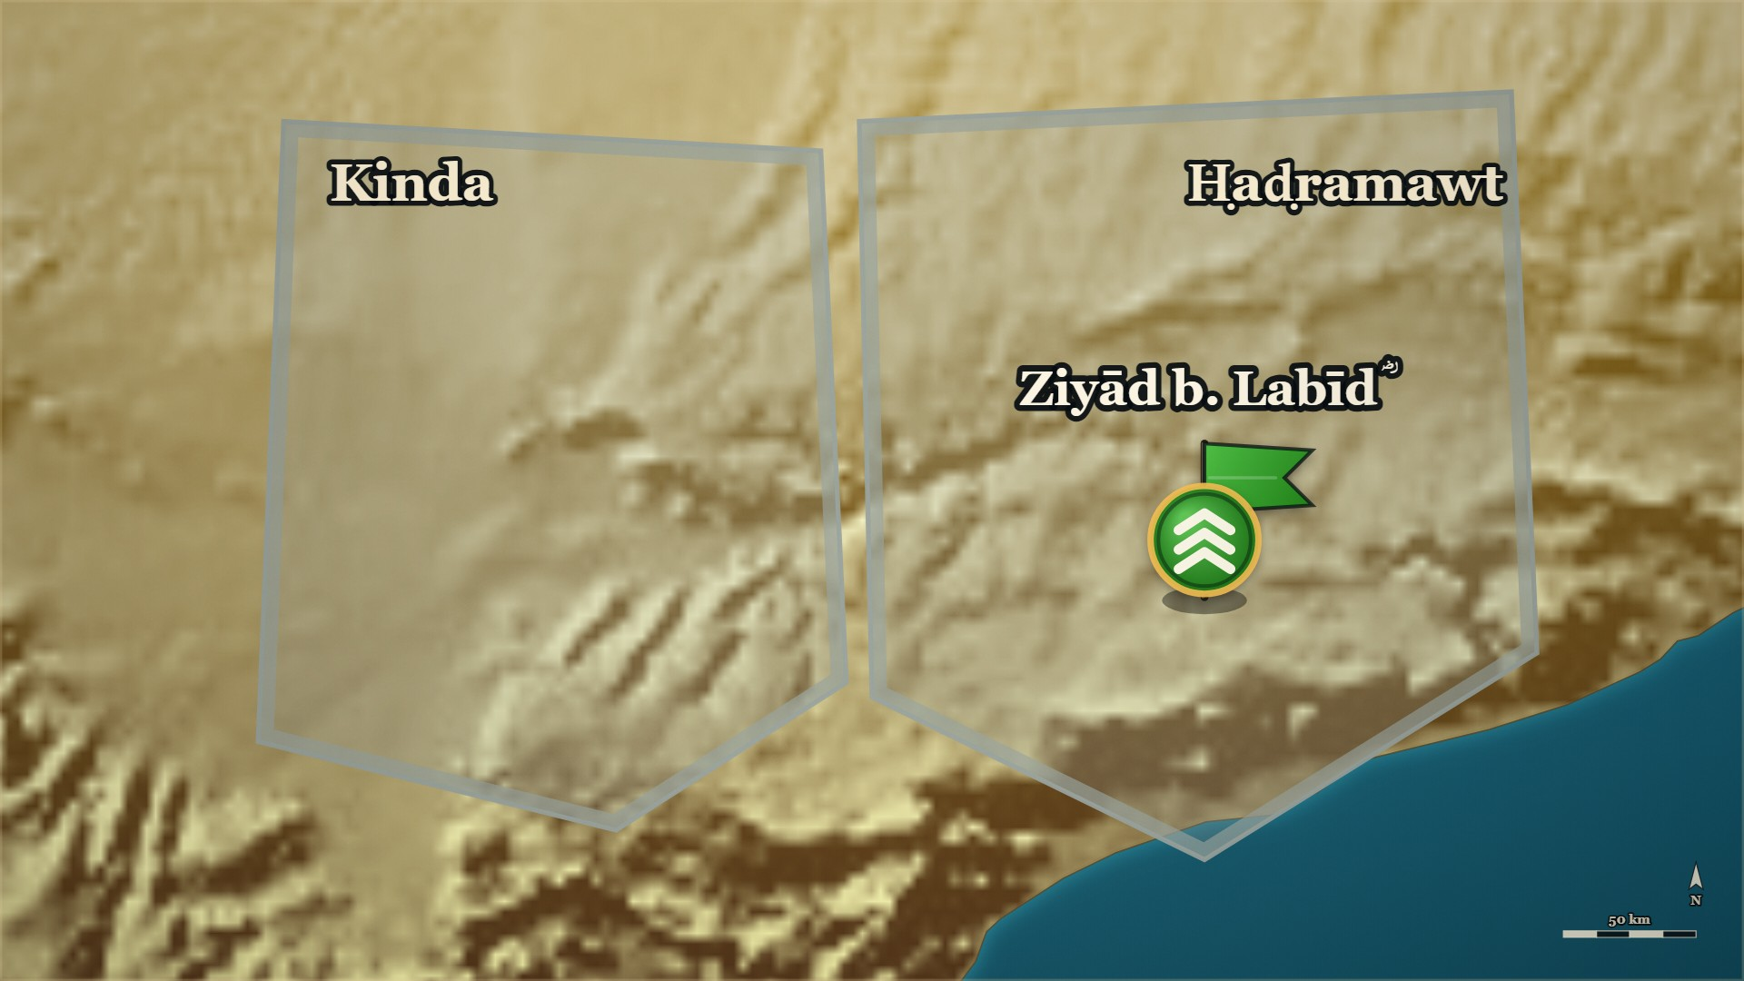




11–12 AH, Ḥaḍramawt
Ziyād b. Labīd ؓ, in Ḥaḍramawt
Ḥaḍramawt
Ziyād b. Labīd ؓ, the Prophet's ﷺ governor
Kinda
its neighbour
Notes:
SAY
1. Who Ziyād b. Labīd ؓ is
▶ CLICK 1 — The arrangement: ṣadaqa carried both ways.
2. An arrangement from the Prophet's ﷺ lifetime
3. Banū Walīʿa have no camels
4. Ḥaḍramawt promises to look into it
5. After the Prophet ﷺ died
▶ CLICK 2 — 'Carry it yourselves' — and it was not carried.
6. Ḥaḍramawt's answer
7. Kinda turns on the governor
8. Home with nothing settled
9. Ziyād ؓ does nothing yet
▶ NEXT SLIDE — the Arabic, and its lesson
──────── DETAIL — only if you need it ────────
1. Who Ziyād b. Labīd ؓ is — Of the Anṣār, of Banū Bayāḍa of the Khazraj; the Prophet's ﷺ own appointee over Ḥaḍramawt, and he held the post through the whole war.
2. An arrangement from the Prophet's ﷺ lifetime — Part of Ḥaḍramawt's ṣadaqa went to Kinda, and part of Kinda's went to Ḥaḍramawt.
3. Banū Walīʿa have no camels — A clan of Kinda told Ḥaḍramawt: we have no camels to carry it; send it to us loaded.
4. Ḥaḍramawt promises to look into it — If you really have no camels, we will send it loaded.
5. After the Prophet ﷺ died — Banū Walīʿa came: deliver it, the way you promised the Messenger of Allah ﷺ.
6. Ḥaḍramawt's answer — You do have camels: carry it yourselves.
7. Kinda turns on the governor — To Ziyād b. Labīd ؓ they said: you are with them against us.
8. Home with nothing settled — Ḥaḍramawt would not carry it; Kinda kept insisting, and went home with the matter undecided.
9. Ziyād ؓ does nothing yet — He was waiting for al-Muhājir ؓ to arrive.
قَالَتْ بَنُو وَلَيْعَةَ: أَبْلِغُونَا كَمَا وَعَدْتُمْ رَسُولَ اللَّهِ - صَلَّى اللَّهُ عَلَيْهِ وَسَلَّمَ -! فَقَالُوا: إِنْ لَكُمْ ظَهْرًا فَاحْتَمِلُوا
"Banū Walīʿa said: Deliver it to us, as you promised the Messenger of Allah ﷺ! They said: You do have mounts — carry it yourselves."
— Banū Walīʿa, to the men of Ḥaḍramawt · الکامل فی التاریخ ج۲ ص۲۳۰
──────── BACKGROUND — for home, not for the lectern ────────
Ziyād b. Labīd ؓ, page-cited, for the one breath: of the Anṣār, of بنو بَيَاضة of the
خزرج (البدایہ ج3 ص466 — see ); the Prophet's ﷺ appointee over حضرموت
(البدایہ ج7 ص41); and he held that post through the whole ردة and ran the campaign there
(الکامل ج2 ص229–232 — where ج2 ص229 spells him زياد بن أبي لبيد الأنصاري and the following pages
زياد بن لبيد). The room last heard his name in one clause of on evening 3.
Also on the page: > فَقَالَ بَعْضُ بَنِي وَلَيْعَةَ: مِنْ كِنْدَةَ لِحَضْرَمَوْتَ لَيْسَ لَنَا ظَهْرٌ، فَإِنْ رَأَيْتُمْ أَنْ تَبْعَثُوا إِلَيْنَا بِذَلِكَ عَلَى ظَهْرٍ. قَالُوا: فَإِنَّا نَنْظُرُ، فَإِنْ لَمْ يَكُنْ لَكُمْ ظَهْرٌ فَعَلْنَا.
> — الکامل فی التاریخ ج2 ص230 · https://shamela.ws/book/21712/921
> English: "Some of Banū Walīʿa of Kinda said to Ḥaḍramawt: We have no mounts — if you see fit, send
> it to us on mounts. They said: We shall look into it; if you have no mounts, we will do it." > فَلَمَّا تُوُفِّيَ رَسُولُ اللَّهِ - صَلَّى اللَّهُ عَلَيْهِ وَسَلَّمَ - قَالَتْ بَنُو وَلَيْعَةَ: أَبْلِغُونَا كَمَا وَعَدْتُمْ رَسُولَ اللَّهِ - صَلَّى اللَّهُ عَلَيْهِ وَسَلَّمَ -! فَقَالُوا: إِنْ لَكُمْ ظَهْرًا فَاحْتَمِلُوا، فَقَالُوا لِزِيَادٍ: أَنْتَ مَعَهُمْ عَلَيْنَا.
> — الکامل فی التاریخ ج2 ص230 · https://shamela.ws/book/21712/921
> English: "When the Messenger of Allah ﷺ died, Banū Walīʿa said: Deliver it to us, as you promised
> the Messenger of Allah ﷺ! They said: You do have mounts — carry it yourselves. And they said to
> Ziyād: You are with them against us." Ziyād's ؓ waiting: «وَأَمْسَكَ عَنْهُمْ زِيَادٌ انْتِظَارًا لِلْمُهَاجِرِ» (ج2 ص230). ⚠ الکامل only — the
Ḥaḍramawt campaign is not in البدایہ. Follow with (the she-camel called Shadhra).

Slide 49
11–12 AH, Ḥaḍramawt
Ziyād b. Labīd ؓ, in Ḥaḍramawt
قَالَتْ بَنُو وَلَيْعَةَ: أَبْلِغُونَا كَمَا وَعَدْتُمْ رَسُولَ اللَّهِ - صَلَّى اللَّهُ عَلَيْهِ وَسَلَّمَ -!
Banū Walīʿa said: Deliver it to us, as you promised the Messenger of Allah ﷺ!
فَقَالُوا: إِنْ لَكُمْ ظَهْرًا فَاحْتَمِلُوا
They said: You do have mounts — carry it yourselves.
— Banū Walīʿa, to the men of Ḥaḍramawt
al-Kamil, vol. 2, p. 230
Notes:
READ the Arabic on the slide — then its English.
WHO IS SPEAKING — Banū Walīʿa, to the men of Ḥaḍramawt
LESSON — A small promise made in the Prophet's ﷺ lifetime was tested the day after he died, and the province went to war over the answer.
──────── DETAIL — only if you need it ────────
قَالَتْ بَنُو وَلَيْعَةَ: أَبْلِغُونَا كَمَا وَعَدْتُمْ رَسُولَ اللَّهِ - صَلَّى اللَّهُ عَلَيْهِ وَسَلَّمَ -! فَقَالُوا: إِنْ لَكُمْ ظَهْرًا فَاحْتَمِلُوا
"Banū Walīʿa said: Deliver it to us, as you promised the Messenger of Allah ﷺ! They said: You do have mounts — carry it yourselves."
— الکامل فی التاریخ ج۲ ص۲۳۰

Slide 50
11–12 AH, Ḥaḍramawt
Ziyād b. Labīd ؓ — and Shadhra
A she-camel, branded for the ṣadaqa by mistake. Ziyād ؓ will not give her back.
فَقَالَ حَارِثَةُ: ذَاكَ إِذَا كُنْتَ يَهُودِيًّا
Ḥāritha said: That would be so if you were a Jew
وَأَطْلَقَ عِقَالَهَا وَبَعَثَهَا وَقَامَ دُونَهَا.
and he untied her hobble and drove her off and stood in front of her.
— Ḥāritha b. Surāqa, to Ziyād b. Labīd ؓ
al-Kamil, vol. 2, p. 230
Notes:
SAY
1. A young she-camel is branded
2. She was not his to give
3. The brothers ask for her back
4. Ziyād ؓ refuses
5. A third man, Ḥāritha, rides up
6. Ḥāritha unties her
↑ read the Arabic on the slide
LESSON — A province went to war over one animal, a naming mistake and a public insult, and every part of that is on one page.
──────── DETAIL — only if you need it ────────
1. A young she-camel is branded — Collecting the zakāt in Kinda, Ziyād b. Labīd ؓ took a young she-camel from a man and branded her.
2. She was not his to give — She belonged to his brother, her name was Shadhra, and he had brought her by mistake.
3. The brothers ask for her back — The brother said so, and the first man agreed and asked for her back.
4. Ziyād ؓ refuses — She had already passed into the right of Allah, he said.
5. A third man, Ḥāritha, rides up — Release her and take another, he said. Ziyād ؓ answered that he had no way to do that.
6. Ḥāritha unties her — He said one sentence, untied her hobble himself, and stood in front of her.
فَقَالَ حَارِثَةُ: ذَاكَ إِذَا كُنْتَ يَهُودِيًّا، وَأَطْلَقَ عِقَالَهَا وَبَعَثَهَا وَقَامَ دُونَهَا.
"Ḥāritha said: That would be so if you were a Jew — and he untied her hobble and drove her off and stood in front of her."
— Ḥāritha b. Surāqa, to Ziyād b. Labīd ؓ · الکامل فی التاریخ ج۲ ص۲۳۰
──────── BACKGROUND — for home, not for the lectern ────────
⚠ البدایہ carries no Ḥaḍramawt campaign at all. Cite الکامل ج2 ص229–232, never البدایہ, for
everything in this card and the next. The underlying grievance was administrative: the Prophet ﷺ
had ordered some of Ḥaḍramawt's zakāt placed in Kinda and some of Kinda's in Ḥaḍramawt, and after his
death nobody would carry it (الکامل ج2 ص230).

Slide 51
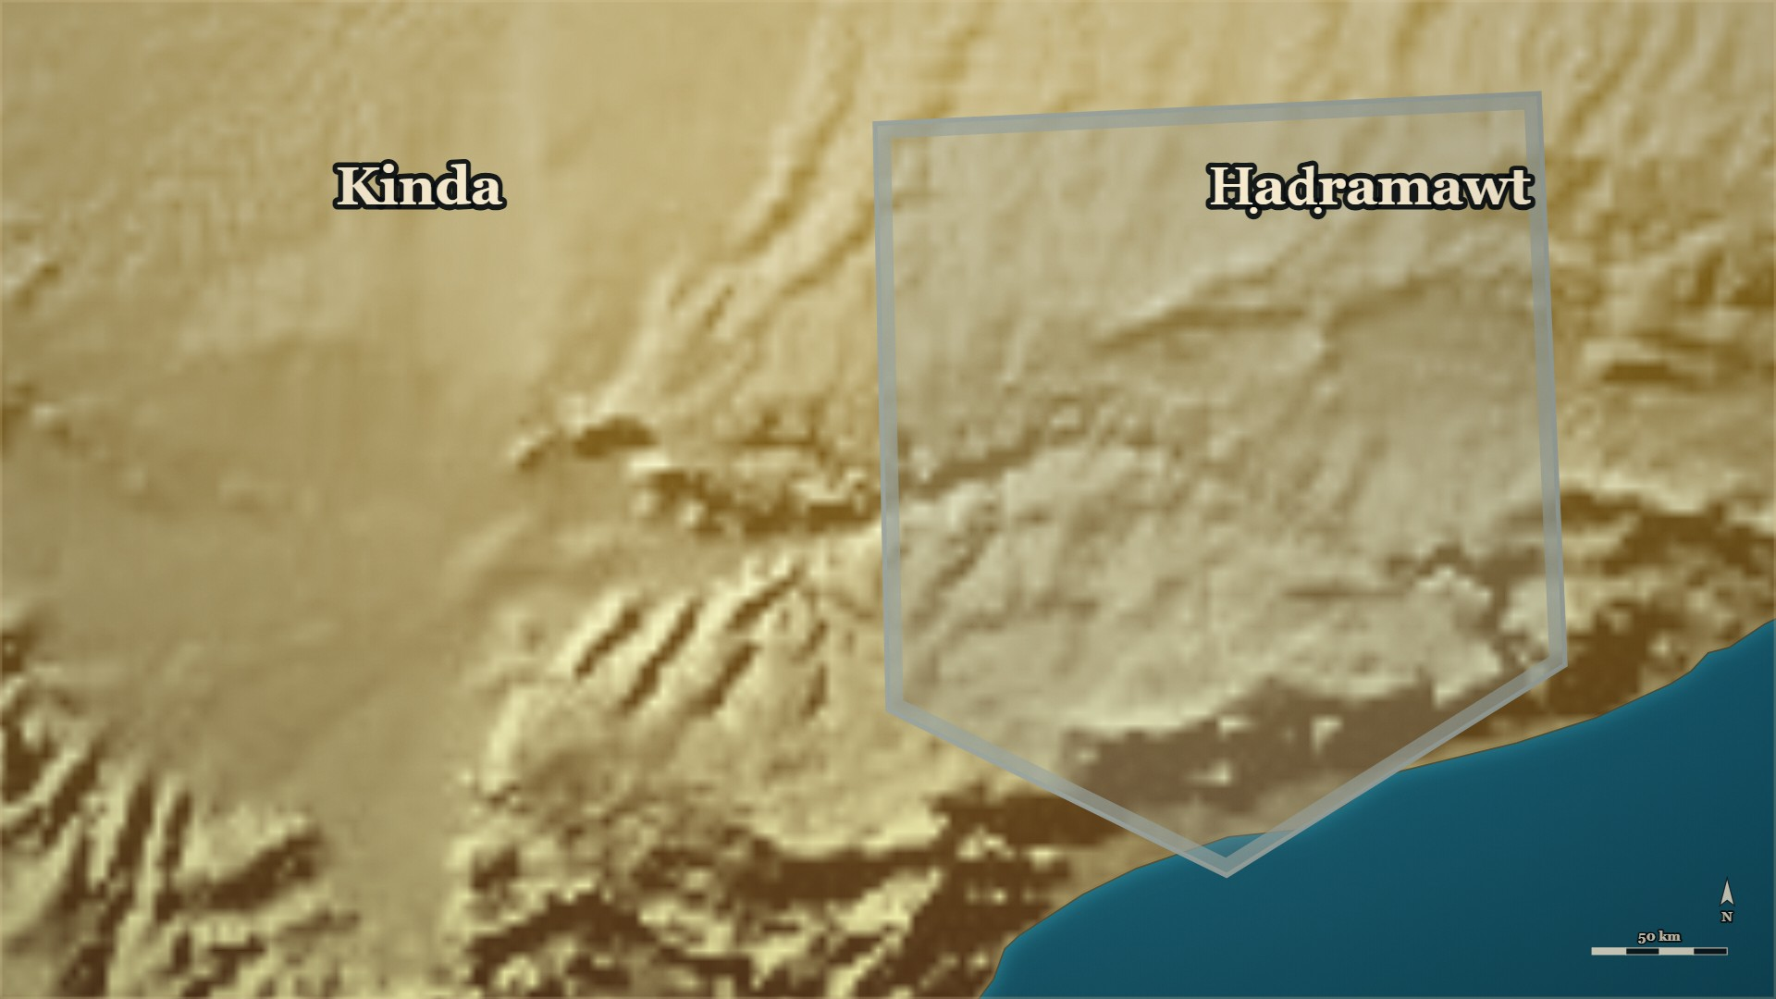









11–12 AH, Ḥaḍramawt
al-ʿAddāʾ, and Ḥāritha b. Surāqa
Ziyād b. Labīd ؓ
with Ḥaḍramawt and al-Sakūn
Banū Muʿāwiya
of Kinda, come out for Ḥāritha
Notes:
⚠ al-Basūs: say only “an old war that had started the same way”.
SAY
1. A warning spoken over the camel
2. Al-ʿAddāʾ calls out to his clan
3. Ḥāritha b. Surāqa unties her
4. Ziyād ؓ takes her back
▶ CLICK 1 — Two great camps face each other.
5. Two great camps face each other
6. Two demands, two refusals
▶ CLICK 2 — A strike by night.
7. A strike by night
▶ CLICK 3 — Kinda roused: no ṣadaqa.
8. The freed men rouse Kinda
9. Al-Ḥuṣayn b. Numayr steps between
▶ NEXT SLIDE — the Arabic, and its lesson
──────── DETAIL — only if you need it ────────
1. A warning spoken over the camel — When Ziyād ؓ refused to give her back: do not let Shadhra be for you what al-Basūs was.
2. Al-ʿAddāʾ calls out to his clan — The camel's owner raised the cry to his own people.
3. Ḥāritha b. Surāqa unties her — He raised the call too, came up to Ziyād ؓ, and untied the camel.
4. Ziyād ؓ takes her back — Young men of Ḥaḍramawt and al-Sakūn tied up Ḥāritha and his companions, and took the camel back.
5. Two great camps face each other — Banū Muʿāwiya for Ḥāritha, Ḥaḍramawt and al-Sakūn for Ziyād ؓ; Kinda held back, their men being prisoners.
6. Two demands, two refusals — Ziyād ؓ told them to put down their weapons; they refused and demanded their men; he refused.
7. A strike by night — Ziyād ؓ hit them in the dark, and they scattered.
8. The freed men rouse Kinda — Ziyād ؓ let Ḥāritha and the others go; they roused their people, and a large force called: no ṣadaqa.
9. Al-Ḥuṣayn b. Numayr steps between — He was sent between the two sides, and for a little while they held off.
فَنَادَى الْعَدَّاءُ: يَا آلَ عَمْرٍو، أُضَامُ وَأُضْطَهَدُ! إِنَّ الذَّلِيلَ مَنْ أُكِلَ فِي دَارِهِ!
"Al-ʿAddāʾ called out: O family of ʿAmr — am I to be wronged and trampled? The humbled man is the one who is devoured in his own home!"
— al-ʿAddāʾ, calling to his clan · الکامل فی التاریخ ج۲ ص۲۳۰
──────── BACKGROUND — for home, not for the lectern ────────
Also on the page: > فَلَجَأَ فِي أَخْذِهَا، فَقَالَ لَهَا: لَا تَكُونَنَّ شَذْرَةً عَلَيْكُمْ كَالْبَسُوسِ. فَنَادَى الْعَدَّاءُ: يَا آلَ عَمْرٍو، أُضَامُ وَأُضْطَهَدُ! إِنَّ الذَّلِيلَ مَنْ أُكِلَ فِي دَارِهِ!
> — الکامل فی التاریخ ج2 ص230 · https://shamela.ws/book/21712/921
> English: "He persisted in taking her, and it was said: Do not let Shadhra be to you what al-Basūs
> was. And al-ʿAddāʾ called out: O family of ʿAmr — am I to be wronged and trampled? The humbled man
> is the one who is devoured in his own home!" > فَأَمَرَ زِيَادٌ شَبَابًا مِنْ حَضْرَمَوْتَ وَالسَّكُونِ فَمَنَعُوهُ وَكَتَّفُوهُ، وَكَتَّفُوا أَصْحَابَهُ وَأَخَذُوا الْبَكْرَةَ، وَتَصَايَحَتْ كِنْدَةُ، وَغَضِبَتْ بَنُو مُعَاوِيَةَ لِحَارِثَةَ وَأَظْهَرُوا أَمْرَهُمْ، وَغَضِبَتْ حَضْرَمَوْتُ وَالسَّكُونُ لِزِيَادٍ، وَتَوَافَى عَسْكَرَانِ عَظِيمَانِ مِنْ هَؤُلَاءِ، وَلَمْ يُحْدِثْ بَنُو مُعَاوِيَةَ شَيْئًا لِمَكَانِ أُسَرَائِهِمْ
> — الکامل فی التاریخ ج2 ص230 · https://shamela.ws/book/21712/921
> English: "Ziyād ordered some young men of Ḥaḍramawt and al-Sakūn, and they stopped him and bound
> him, bound his companions, and took the young camel. Kinda raised a shout; Banū Muʿāwiya were angry
> on Ḥāritha's behalf and came out openly; Ḥaḍramawt and al-Sakūn were angry on Ziyād's behalf; two
> great camps faced each other — and Banū Muʿāwiya did nothing, because their men were prisoners." ⚠ Who spoke the Basūs sentence is unclear in the printed wording («فَقَالَ لَهَا») — say "a warning
was spoken" (§X item 2). Al-Basūs is [STANDARD] (to verify) — the she-camel at the start of the long
pre-Islamic war of Bakr and Taghlib; no page here says so. The release and the call to refuse ṣadaqa:
«وَنَادَوْا بِمَنْعِ الصَّدَقَةِ» (ج2 ص231).

Slide 52
11–12 AH, Ḥaḍramawt
al-ʿAddāʾ, and Ḥāritha b. Surāqa
فَنَادَى الْعَدَّاءُ: يَا آلَ عَمْرٍو، أُضَامُ وَأُضْطَهَدُ!
Al-ʿAddāʾ called out: O family of ʿAmr — am I to be wronged and trampled?
إِنَّ الذَّلِيلَ مَنْ أُكِلَ فِي دَارِهِ!
The humbled man is the one who is devoured in his own home!
— al-ʿAddāʾ, calling to his clan
al-Kamil, vol. 2, p. 230
Notes:
READ the Arabic on the slide — then its English.
WHO IS SPEAKING — al-ʿAddāʾ, calling to his clan
LESSON — Once the quarrel became a matter of honour, being right about the camel no longer decided anything. ⚠ البسوس needs a gloss, and we do not have one on a page we hold. The warning only works if the room
──────── DETAIL — only if you need it ────────
فَنَادَى الْعَدَّاءُ: يَا آلَ عَمْرٍو، أُضَامُ وَأُضْطَهَدُ! إِنَّ الذَّلِيلَ مَنْ أُكِلَ فِي دَارِهِ!
"Al-ʿAddāʾ called out: O family of ʿAmr — am I to be wronged and trampled? The humbled man is the one who is devoured in his own home!"
— الکامل فی التاریخ ج۲ ص۲۳۰

Slide 53
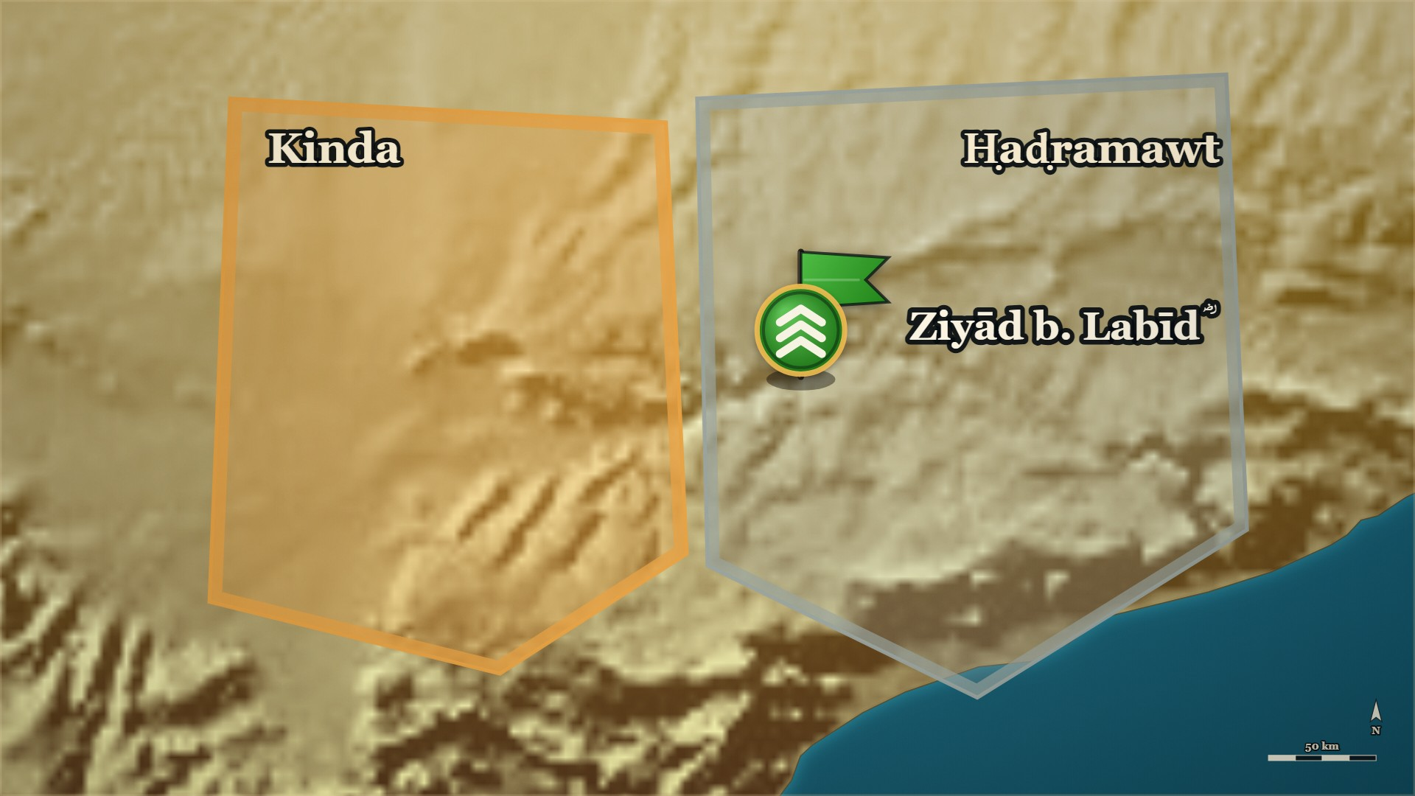







11–12 AH, Ḥaḍramawt
Shuraḥbīl b. al-Simṭ, and his son
Banū Muʿāwiya
each chief holds his own pasture
Shuraḥbīl and his son
go over to Ziyād ؓ
Notes:
SAY
▶ CLICK 1 — Each chief takes his own pasture as a stronghold.
1. Banū Muʿāwiya withhold the ṣadaqa
2. Except one man and his son
3. They tell their clan why
▶ CLICK 2 — One man and his son walk out, to Ziyād's ؓ camp.
4. They move to Ziyād's ؓ camp
5. Their advice: strike tonight
6. The danger in waiting
▶ NEXT SLIDE — the Arabic, and its lesson
──────── DETAIL — only if you need it ────────
1. Banū Muʿāwiya withhold the ṣadaqa — The whole clan agreed, and each chief took up his own reserved pasture as a stronghold.
2. Except one man and his son — Shuraḥbīl b. al-Simṭ and his son would not go with their clan.
3. They tell their clan why — Before leaving, the two men told Banū Muʿāwiya why they would not come.
4. They move to Ziyād's ؓ camp — Father and son moved out, and camped with Ziyād ؓ.
5. Their advice: strike tonight — Before the men drifting toward the rebels from al-Sakāsik, al-Sakūn and Ḥaḍramawt get there.
6. The danger in waiting — If you wait, we are afraid people will drift away from us to them.
إِنَّهُ لَقَبِيحٌ بِالْأَحْرَارِ التَّنَقُّلُ، إِنَّ الْكِرَامَ لَيَلْزَمُونَ الشُّبْهَةَ فَيَتَكَرَّمُونَ أَنْ يَنْتَقِلُوا إِلَى أَوْضَحَ مِنْهَا مَخَافَةَ الْعَارِ، فَكَيْفَ الِانْتِقَالُ مِنَ الْأَمْرِ الْحَسَنِ الْجَمِيلِ وَالْحَقِّ إِلَى الْبَاطِلِ وَالْقَبِيحِ!
"It is an ugly thing in free men to change sides. Men of honour will stay with a doubtful position, and think it beneath them to move even to a clearer one, for fear of the disgrace — so how much worse to move from what is good, fair and true to what is false and ugly!"
— Shuraḥbīl b. al-Simṭ and his son, to their clan · الکامل فی التاریخ ج۲ ص۲۳۱
──────── BACKGROUND — for home, not for the lectern ────────
⚠ Quote only to «وَالْقَبِيحِ!» — the next clause reads against the sense. It was his son, not his
father («وَابْنَهُ») — this corrects the campaign note

Slide 54
11–12 AH, Ḥaḍramawt
Shuraḥbīl b. al-Simṭ, and his son
إِنَّهُ لَقَبِيحٌ بِالْأَحْرَارِ التَّنَقُّلُ
It is an ugly thing in free men to change sides.
إِنَّ الْكِرَامَ لَيَلْزَمُونَ الشُّبْهَةَ
Men of honour will stay with a doubtful position
— Shuraḥbīl b. al-Simṭ and his son, to their clan
al-Kamil, vol. 2, p. 231
Notes:
READ the Arabic on the slide — then its English.
WHO IS SPEAKING — Shuraḥbīl b. al-Simṭ and his son, to their clan
LESSON — He used his tribe's own code of honour — never change sides — as the reason not to follow his tribe.
▶ NEXT SLIDE — the same words go on (2 slides in all)
──────── DETAIL — only if you need it ────────
إِنَّهُ لَقَبِيحٌ بِالْأَحْرَارِ التَّنَقُّلُ، إِنَّ الْكِرَامَ لَيَلْزَمُونَ الشُّبْهَةَ فَيَتَكَرَّمُونَ أَنْ يَنْتَقِلُوا إِلَى أَوْضَحَ مِنْهَا مَخَافَةَ الْعَارِ، فَكَيْفَ الِانْتِقَالُ مِنَ الْأَمْرِ الْحَسَنِ الْجَمِيلِ وَالْحَقِّ إِلَى الْبَاطِلِ وَالْقَبِيحِ!
"It is an ugly thing in free men to change sides. Men of honour will stay with a doubtful position, and think it beneath them to move even to a clearer one, for fear of the disgrace — so how much worse to move from what is good, fair and true to what is false and ugly!"
— الکامل فی التاریخ ج۲ ص۲۳۱

Slide 55
11–12 AH, Ḥaḍramawt
Shuraḥbīl b. al-Simṭ, and his son
فَيَتَكَرَّمُونَ أَنْ يَنْتَقِلُوا إِلَى أَوْضَحَ مِنْهَا مَخَافَةَ الْعَارِ
and think it beneath them to move even to a clearer one, for fear of the disgrace
فَكَيْفَ الِانْتِقَالُ مِنَ الْأَمْرِ الْحَسَنِ الْجَمِيلِ وَالْحَقِّ إِلَى الْبَاطِلِ وَالْقَبِيحِ!
so how much worse to move from what is good, fair and true to what is false and ugly!
— Shuraḥbīl b. al-Simṭ and his son, to their clan
al-Kamil, vol. 2, p. 231
Notes:
READ the Arabic — the same words, continued (slide 2 of 2).
Each part: the Arabic, then its meaning.
──────── DETAIL — only if you need it ────────
فَيَتَكَرَّمُونَ أَنْ يَنْتَقِلُوا إِلَى أَوْضَحَ مِنْهَا مَخَافَةَ الْعَارِ
and think it beneath them to move even to a clearer one, for fear of the disgrace
فَكَيْفَ الِانْتِقَالُ مِنَ الْأَمْرِ الْحَسَنِ الْجَمِيلِ وَالْحَقِّ إِلَى الْبَاطِلِ وَالْقَبِيحِ!
so how much worse to move from what is good, fair and true to what is false and ugly!

Slide 56







11–12 AH, Ḥaḍramawt
The four kings — Mikhwaṣ, Mishraḥ, Jamad, Abḍaʿa
Ziyād b. Labīd ؓ
strikes at night, from five sides
the four kings
killed by Ziyād's ؓ men, at their fires
Notes:
⚠ No source ties the old kingship to the ridda. Imply nothing.
SAY
▶ CLICK 1 — They ring the pastures in the dark — from five sides.
1. Ziyād ؓ agrees to a night attack
2. Round their fires
3. From five directions at once
▶ CLICK 2 — The four kings are killed.
4. The four kings are killed
5. Four, or four and a sister
6. Many killed, the rest run
▶ NEXT SLIDE — the Arabic, and its lesson
──────── DETAIL — only if you need it ────────
1. Ziyād ؓ agrees to a night attack — They gathered in the dark and ringed the pastures.
2. Round their fires — They found the men sitting round their fires.
3. From five directions at once — Banū ʿAmr b. Muʿāwiya, the strongest of Kinda with the numbers, were attacked from five sides.
4. The four kings are killed — Four brothers, the chiefs of Banū ʿAmr: Mikhwaṣ, Mishraḥ, Jamad and Abḍaʿa.
5. Four, or four and a sister — Ibn al-Athīr adds their sister, al-ʿAmarrada; al-Dhahabī, from Ibn Isḥāq, names four kings and no sister.
6. Many killed, the rest run — Many others were killed that night; whoever could run, ran.
فَوَجَدُوهُمْ جُلُوسًا حَوْلَ نِيرَانِهِمْ، فَأَكَبُّوا عَلَى بَنِي عَمْرِو بْنِ مُعَاوِيَةَ، وَفِيهِمُ الْعَدَدُ وَالشَّوْكَةُ - مِنْ خَمْسَةِ أَوْجُهٍ
"They found them sitting round their fires, and fell on Banū ʿAmr b. Muʿāwiya — who had the numbers and the strength — from five directions."
— Ibn al-Athīr, on that night · الکامل فی التاریخ ج۲ ص۲۳۱
──────── BACKGROUND — for home, not for the lectern ────────
Also on the page: > فَأَجَابَهُمْ إِلَى تَبْيِيتِ الْقَوْمِ، فَاجْتَمَعُوا وَطَوَّقُوهُمْ فِي مَحَاجِرِهِمْ، فَوَجَدُوهُمْ جُلُوسًا حَوْلَ نِيرَانِهِمْ، فَأَكَبُّوا عَلَى بَنِي عَمْرِو بْنِ مُعَاوِيَةَ، وَفِيهِمُ الْعَدَدُ وَالشَّوْكَةُ - مِنْ خَمْسَةِ أَوْجُهٍ، فَأَصَابُوا مِشْرَحًا وَمِخْوَصًا وَجَمَدًا وَأَبْضَعَةَ وَأُخْتَهُمُ الْعَمَرَّدَةَ، وَأَدْرَكَتْهُمْ لَعْنَةُ النَّبِيِّ - صَلَّى اللَّهُ عَلَيْهِ وَسَلَّمَ -
> — الکامل فی التاریخ ج2 ص231 · https://shamela.ws/book/21712/922
> English: "He agreed to the night attack. They gathered and ringed them in their pastures, and found
> them sitting round their fires. They fell on Banū ʿAmr b. Muʿāwiya — who had the numbers and the
> strength — from five directions, and struck down Mishraḥ, Mikhwaṣ, Jamad, Abḍaʿa and their sister
> al-ʿAmarrada; and the curse of the Prophet ﷺ overtook them." Al-Dhahabī, from Ibn Isḥāq — four, and no sister: > أن زيادا بيتهم فقتل ملوكا أربعة: جمدا، ومخوصا ومشرحا، وأبضعة.
> — سیر أعلام النبلاء، ج الراشدون ص62 · https://shamela.ws/book/10906/1210
> English: "…that Ziyād fell on them by night and killed four kings: Jamad, Mikhwaṣ, Mishraḥ and
> Abḍaʿa." Record both counts side by side; do not choose. The origin of the Prophet's ﷺ curse is the
Kinda-delegation note; do not explain it from the floor. Ibn Khaldūn adds that the captive women
cried out as they passed (ج2 ص492) — his detail, attributed to him.

Slide 57
11–12 AH, Ḥaḍramawt
The four kings — Mikhwaṣ, Mishraḥ, Jamad, Abḍaʿa
فَوَجَدُوهُمْ جُلُوسًا حَوْلَ نِيرَانِهِمْ
They found them sitting round their fires
فَأَكَبُّوا عَلَى بَنِي عَمْرِو بْنِ مُعَاوِيَةَ، وَفِيهِمُ الْعَدَدُ وَالشَّوْكَةُ - مِنْ خَمْسَةِ أَوْجُهٍ
and fell on Banū ʿAmr b. Muʿāwiya — who had the numbers and the strength — from five directions.
— Ibn al-Athīr, on that night
al-Kamil, vol. 2, p. 231
Notes:
READ the Arabic on the slide — then its English.
WHO IS SPEAKING — Ibn al-Athīr, on that night
LESSON — The night attack ended the four kings and brought the fifth man into the war.
──────── DETAIL — only if you need it ────────
فَوَجَدُوهُمْ جُلُوسًا حَوْلَ نِيرَانِهِمْ، فَأَكَبُّوا عَلَى بَنِي عَمْرِو بْنِ مُعَاوِيَةَ، وَفِيهِمُ الْعَدَدُ وَالشَّوْكَةُ - مِنْ خَمْسَةِ أَوْجُهٍ
"They found them sitting round their fires, and fell on Banū ʿAmr b. Muʿāwiya — who had the numbers and the strength — from five directions."
— الکامل فی التاریخ ج۲ ص۲۳۱

Slide 58





11–12 AH, Ḥaḍramawt
al-Ashʿath b. Qays — the column he stopped
the captives
taken by Ziyād ؓ, on the road home
al-Ashʿath b. Qays
rises, and takes them back
Notes:
SAY
▶ CLICK 1 — The column turns for home.
1. The column turns for home
▶ CLICK 2 — Its road passes one man: al-Ashʿath b. Qays.
2. And its road passes one man
3. Who he is
4. The room has met him before
▶ CLICK 3 — He takes the captives back.
5. He rises with his people
6. And gathers everyone he can
▶ NEXT SLIDE — the Arabic, and its lesson
──────── DETAIL — only if you need it ────────
1. The column turns for home — Ziyād ؓ with the property and the captives of the four kings.
2. And its road passes one man — al-Ashʿath b. Qays, who had not been in the fighting at all.
3. Who he is — Of Kinda, but not of Banū ʿAmr: a different branch from the four brothers just killed.
4. The room has met him before — He led Kinda's delegation into the Prophet's ﷺ mosque, at their head.
5. He rises with his people — And takes the captives back out of the column.
6. And gathers everyone he can — From here, this war is his.
وَعَادَ زِيَادُ بْنُ لَبِيدٍ بِالْأَمْوَالِ وَالسَّبْيِ، وَاجْتَازُوا بِالْأَشْعَثِ، فَثَارَ فِي قَوْمِهِ، فَاسْتَنْقَذَهُمْ وَجَمَعَ الْجُمُوعَ.
"Ziyād b. Labīd returned with the property and the captives, and they passed by al-Ashʿath; so he rose with his people, recovered them, and gathered the gatherings."
— Ibn al-Athīr, on al-Ashʿath · الکامل فی التاریخ ج۲ ص۲۳۱
──────── BACKGROUND — for home, not for the lectern ────────
Who he is, page-cited: he led the Kinda delegation to Medina ; and Ibn al-Athīr's "four kings" are of بنو عمرو بن معاوية, a different branch
of Kinda from his . No source ties the old Kinda kingship to this ردة — say nothing
that implies it .
⚠ This card exists because sits in an optional block. Without it, al-Ashʿath walks
onto the stage as a bare name and then carries seven cards. If the Kinda flashback is cut, this card
is not cut.

Slide 59
11–12 AH, Ḥaḍramawt
al-Ashʿath b. Qays — the column he stopped
وَعَادَ زِيَادُ بْنُ لَبِيدٍ بِالْأَمْوَالِ وَالسَّبْيِ
Ziyād b. Labīd returned with the property and the captives
وَاجْتَازُوا بِالْأَشْعَثِ
and they passed by al-Ashʿath
فَثَارَ فِي قَوْمِهِ، فَاسْتَنْقَذَهُمْ وَجَمَعَ الْجُمُوعَ.
so he rose with his people, recovered them, and gathered the gatherings.
— Ibn al-Athīr, on al-Ashʿath
al-Kamil, vol. 2, p. 231
Notes:
READ the Arabic on the slide — then its English.
WHO IS SPEAKING — Ibn al-Athīr, on al-Ashʿath
LESSON — The man who had brought his tribe to the Prophet ﷺ himself is the man who now raises it against Medina — and that is not a contradiction the books explain.
──────── DETAIL — only if you need it ────────
وَعَادَ زِيَادُ بْنُ لَبِيدٍ بِالْأَمْوَالِ وَالسَّبْيِ، وَاجْتَازُوا بِالْأَشْعَثِ، فَثَارَ فِي قَوْمِهِ، فَاسْتَنْقَذَهُمْ وَجَمَعَ الْجُمُوعَ.
"Ziyād b. Labīd returned with the property and the captives, and they passed by al-Ashʿath; so he rose with his people, recovered them, and gathered the gatherings."
— الکامل فی التاریخ ج۲ ص۲۳۱

Slide 60
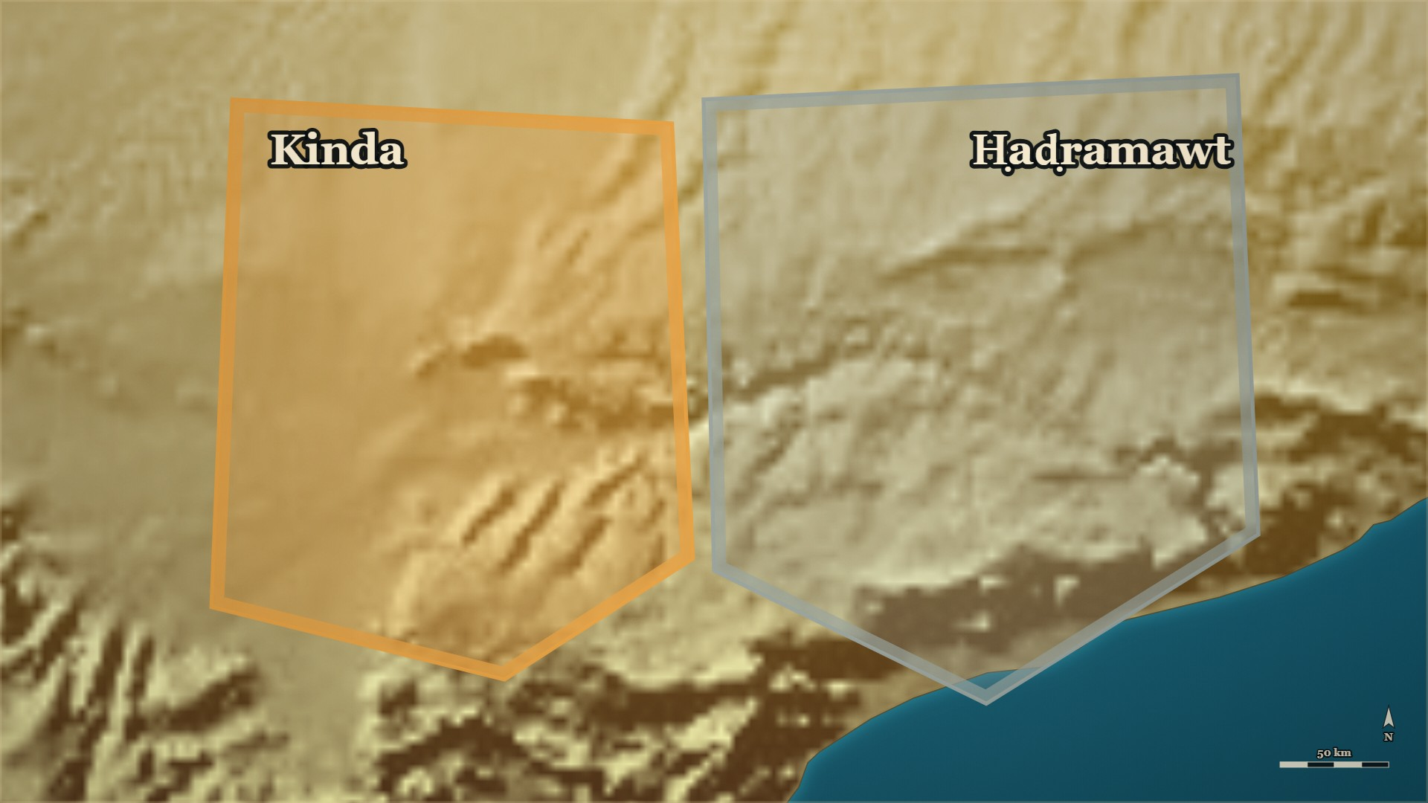




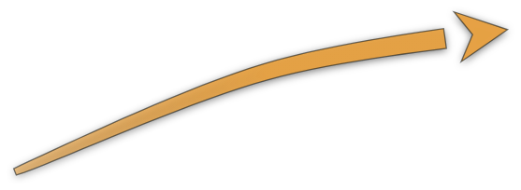


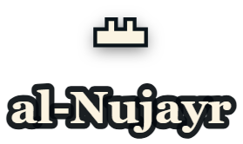







11–12 AH, Ḥaḍramawt
al-Muhājir ؓ and ʿIkrima ؓ — to al-Nujayr
al-Muhājir ؓ
from Ṣanʿāʾ, ahead of his army
ʿIkrima ؓ
with the main body
al-Nujayr
the fort
Notes:
SAY
1. A letter: hurry
▶ CLICK 1 — al-Muhājir ؓ rides ahead with the fastest men.
2. Al-Muhājir ؓ rides ahead
▶ CLICK 2 — Maḥjar al-Zurqān: Kinda breaks, and runs.
3. The battle at Maḥjar al-Zurqān
▶ CLICK 3 — Kinda run for al-Nujayr. ʿIkrima ؓ brings up the main body.
4. A fort already repaired
▶ NEXT SLIDE — the Arabic, and its lesson
──────── DETAIL — only if you need it ────────
1. A letter: hurry — Ziyād ؓ wrote to al-Muhājir ؓ, and the letter met him on the road.
2. Al-Muhājir ؓ rides ahead — He handed the army to ʿIkrima ؓ and hurried on with the fastest men.
3. The battle at Maḥjar al-Zurqān — Al-Muhājir ؓ joined Ziyād ؓ and marched on Kinda; they met, and Kinda broke and ran.
4. A fort already repaired — Kinda took refuge in the fort of al-Nujayr, which they had already repaired and put in order.
فَرَجَعُوا إِلَى حِصْنِهِمْ، وَخَشَعَتْ نُفُوسُهُمْ وَخَافُوا الْقَتْلَ
"They went back into their fort; their spirits sank, and they feared death."
— Ibn al-Athīr, on al-Nujayr · الکامل فی التاریخ ج۲ ص۲۳۱
──────── BACKGROUND — for home, not for the lectern ────────
Also on the page: > وَكَتَبَ زِيَادٌ إِلَى الْمُهَاجِرِ يَسْتَحِثُّهُ، فَلَقِيَهُ الْكِتَابُ بِالطَّرِيقِ فَاسْتَخْلَفَ عَلَى الْجُنْدِ عِكْرِمَةَ بْنَ أَبِي جَهْلٍ، وَتَعَجَّلَ فِي سَرَعَانِ النَّاسِ
> — الکامل فی التاریخ ج2 ص231 · https://shamela.ws/book/21712/922
> English: "Ziyād wrote to al-Muhājir urging him on; the letter met him on the road, and he left
> ʿIkrima b. Abī Jahl in charge of the army and hurried ahead with the quickest of the men." > فَانْهَزَمَتْ كِنْدَةُ وَقُتِلَتْ، وَخَرَجُوا هُرَّابًا فَالْتَجَئُوا إِلَى النُّجَيْرِ، وَقَدْ رَمُّوهُ وَأَصْلَحُوهُ.
> — الکامل فی التاریخ ج2 ص231 · https://shamela.ws/book/21712/922
> English: "Kinda was routed and cut down; they fled and took refuge in al-Nujayr — which they had
> already repaired and put in order." Where the letter met him: الکامل says only «بالطريق»; Ibn Khaldūn says «بالمفازة بين مأرب وحضرموت»
(ج2 ص494) — his detail, not for the map as fact. Pairs with 's map line (ʿIkrima ؓ
closing the last road).

Slide 61
11–12 AH, Ḥaḍramawt
al-Muhājir ؓ and ʿIkrima ؓ — to al-Nujayr
فَرَجَعُوا إِلَى حِصْنِهِمْ، وَخَشَعَتْ نُفُوسُهُمْ وَخَافُوا الْقَتْلَ
"They went back into their fort; their spirits sank, and they feared death."
— Ibn al-Athīr, on al-Nujayr
al-Kamil, vol. 2, p. 231
Notes:
READ the Arabic on the slide — then its English.
WHO IS SPEAKING — Ibn al-Athīr, on al-Nujayr
LESSON — They had prepared the place to retreat to before they fought, and it became the place they could not leave.
──────── DETAIL — only if you need it ────────
فَرَجَعُوا إِلَى حِصْنِهِمْ، وَخَشَعَتْ نُفُوسُهُمْ وَخَافُوا الْقَتْلَ
"They went back into their fort; their spirits sank, and they feared death."
— الکامل فی التاریخ ج۲ ص۲۳۱

Slide 62
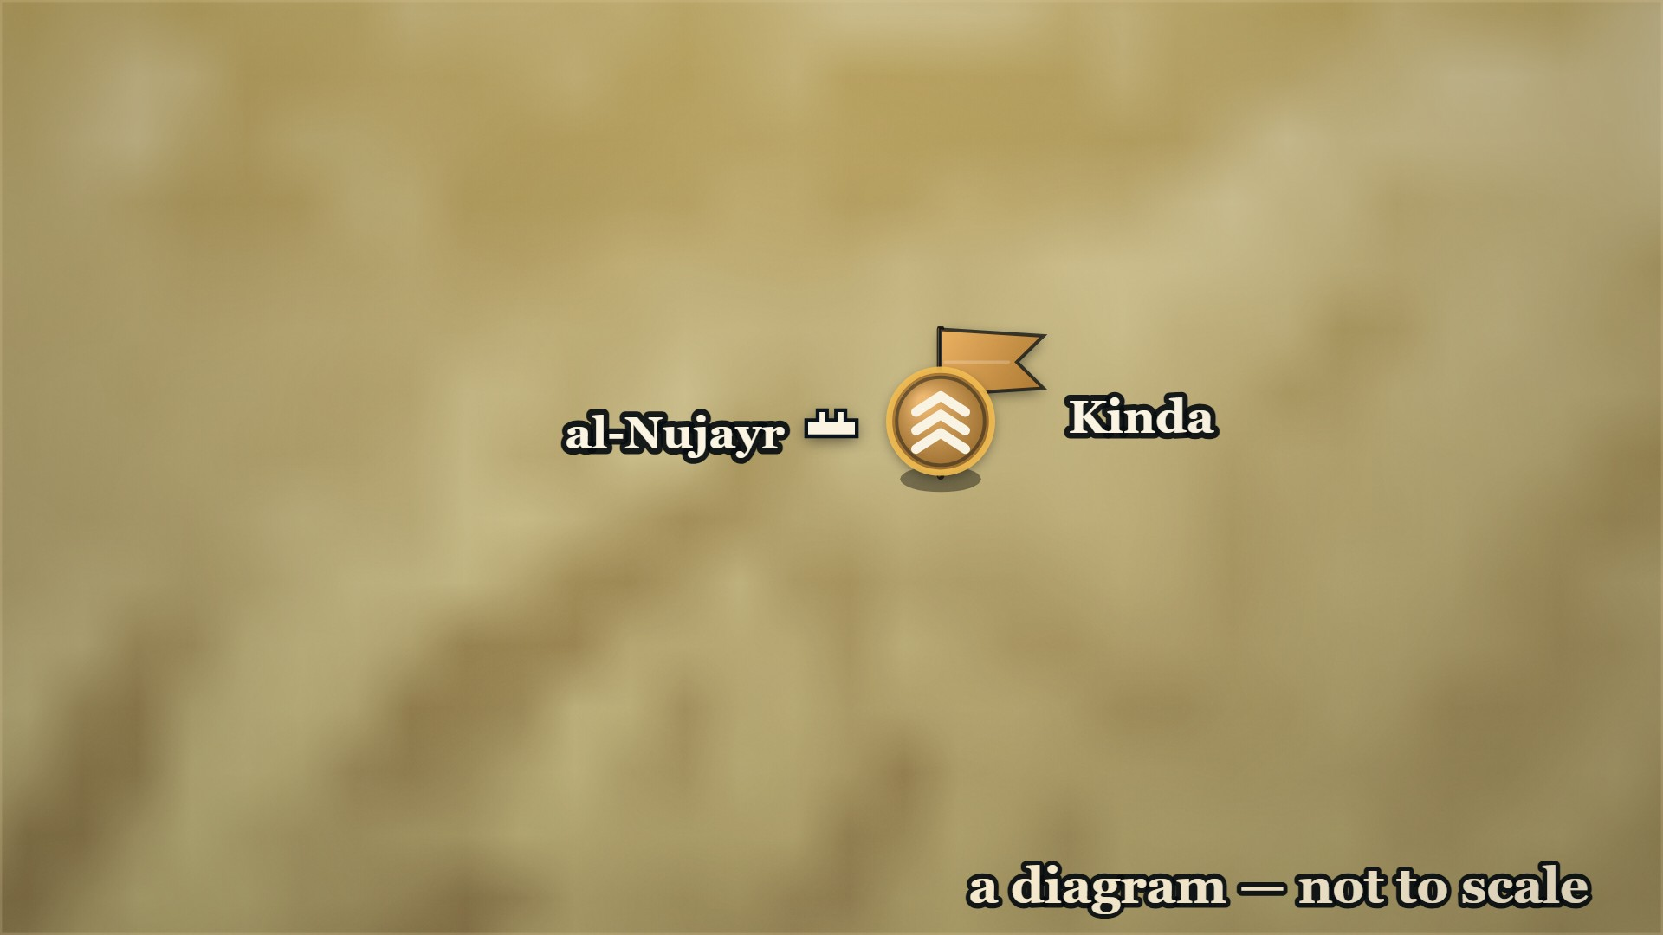













11 or 12 AH, Ḥaḍramawt
al-Nujayr — the siege
al-Muhājir ؓ
with Ziyād ؓ, besieges Kinda in the fort
ʿIkrima ؓ
brings up the main body
Notes:
⚠ A diagram: the page gives no side to any commander. Say “not to scale”.
SAY
1. Kinda are inside al-Nujayr — the fort they had already repaired.
▶ CLICK 1 — al-Muhājir ؓ comes down on them, with Ziyād ؓ. The Muslims besiege the fort.
▶ CLICK 2 — ʿIkrima ؓ arrives with the main body. The siege grows hard.
▶ CLICK 3 — Raiding parties spread out through the country, after the rest.
▶ CLICK 4 — Those inside come out and fight. Many are killed — and they go back in.
2. Their spirits sank, and they feared death. Next: what al-Ashʿath did.

Slide 63
11 or 12 AH, al-Nujayr
al-Ashʿath b. Qays — and Jaḥdam
Inside al-Nujayr. al-Ashʿath writes the names of the men to be spared.
وَنَسِيَ الْأَشْعَثُ أَنْ يَكْتُبَ نَفْسَهُ لِأَنَّ جَحْدَمًا وَثَبَ عَلَيْهِ بِسِكِّينٍ، فَقَالَ: تَكْتُبُنِي أَوْ أَقْتُلُكَ؟
Al-Ashʿath forgot to write himself in, because Jaḥdam leapt at him with a knife and said: Will you write me in, or shall I kill you?
فَكَتَبَهُ وَنَسِيَ نَفْسَهُ
So he wrote him in, and forgot himself.
— Ibn al-Athīr, on the writing
al-Kamil, vol. 2, p. 232
Notes:
⚠ Say “11 or 12 AH” — the books differ.
SAY
1. Al-Ashʿath comes out with nine men
2. A guarantee in return for the gate
3. Write whatever you want
4. Jaḥdam and the knife
5. He forgets himself
↑ read the Arabic on the slide
6. The gate is opened
7. The document comes out
8. Al-Muhājir ؓ has him bound
9. Sent to Abū Bakr ؓ with the captives
LESSON — The decision about al-Ashʿath was not taken in anger at the gate; it was sent to the man whose job it was.
──────── DETAIL — only if you need it ────────
1. Al-Ashʿath comes out with nine men — The leaders inside had begun to fear for their own lives.
2. A guarantee in return for the gate — They asked Ziyād ؓ to guarantee them and their families, in return for opening the gate.
3. Write whatever you want — Ziyād ؓ agreed: write it, and bring it to me to seal.
4. Jaḥdam and the knife — As al-Ashʿath wrote, Jaḥdam leapt at him with a knife: write me in, or I kill you.
5. He forgets himself — Al-Ashʿath wrote Jaḥdam in, and left his own name out.
6. The gate is opened — Every fighting man inside was killed.
7. The document comes out — Everyone named in it was spared, and al-Ashʿath's own name was not there.
8. Al-Muhājir ؓ has him bound — He praised Allah that al-Ashʿath's mouth had erred, and had him bound tight.
9. Sent to Abū Bakr ؓ with the captives — Someone said: send him to Abū Bakr ؓ, who knows best the ruling on him.
وَنَسِيَ الْأَشْعَثُ أَنْ يَكْتُبَ نَفْسَهُ لِأَنَّ جَحْدَمًا وَثَبَ عَلَيْهِ بِسِكِّينٍ، فَقَالَ: تَكْتُبُنِي أَوْ أَقْتُلُكَ؟ فَكَتَبَهُ وَنَسِيَ نَفْسَهُ
"Al-Ashʿath forgot to write himself in, because Jaḥdam leapt at him with a knife and said: Will you write me in, or shall I kill you? So he wrote him in, and forgot himself."
— Ibn al-Athīr, on the writing · الکامل فی التاریخ ج۲ ص۲۳۲
──────── BACKGROUND — for home, not for the lectern ────────
Also on the page: > فَخَرَجَ الْأَشْعَثُ وَمَعَهُ تِسْعَةُ نَفَرٍ، فَطَلَبُوا مِنْ زِيَادٍ أَنْ يُؤَمِّنَهُمْ وَأَهْلِيَهُمْ عَلَى أَنْ يَفْتَحُوا لَهُ الْبَابَ. فَأَجَابَهُمْ إِلَى ذَلِكَ وَقَالَ: اكْتُبُوا مَا شِئْتُمْ ثُمَّ هَلُمُّوا الْكِتَابَ حَتَّى أَخْتِمَهُ. فَفَعَلُوا، وَنَسِيَ الْأَشْعَثُ أَنْ يَكْتُبَ نَفْسَهُ لِأَنَّ جَحْدَمًا وَثَبَ عَلَيْهِ بِسِكِّينٍ، فَقَالَ: تَكْتُبُنِي أَوْ أَقْتُلُكَ؟ فَكَتَبَهُ وَنَسِيَ نَفْسَهُ
> — الکامل فی التاریخ ج2 ص232 · https://shamela.ws/book/21712/923
> English: "Al-Ashʿath came out with nine men, and they asked Ziyād to guarantee them and their
> households on condition that they opened the gate to him. He agreed and said: Write whatever you
> want, then bring me the document so that I can seal it. They did — and al-Ashʿath forgot to write
> himself in, because Jaḥdam leapt at him with a knife and said: Will you write me in, or shall I kill
> you? So he wrote him in, and forgot himself." > فَقَالَ الْمُهَاجِرُ: الْحَمْدُ لِلَّهِ الَّذِي خَطَّأَ فَاكَ يَا أَشْعَثُ يَا عَدُوَّ اللَّهِ! قَدْ كُنْتُ أَشْتَهِي أَنْ يُخْزِيَكَ اللَّهُ! وَشَدَّهُ كِتَافًا، فَقِيلَ لَهُ: أَخِّرْهُ وَسَيِّرْهُ إِلَى أَبِي بَكْرٍ؛ فَهُوَ أَعْلَمُ بِالْحُكْمِ فِيهِ. فَسَيَّرَهُ إِلَى أَبِي بَكْرٍ مَعَ السَّبْيِ.
> — الکامل فی التاریخ ج2 ص232 · https://shamela.ws/book/21712/923
> English: "Al-Muhājir said: Praise be to Allah, who made your mouth err, Ashʿath — you enemy of
> Allah! I had been longing for Allah to disgrace you! And he bound him tight. Someone said to him:
> Hold him back and send him to Abū Bakr — he knows best the ruling on him. So he sent him to Abū Bakr
> with the captives." Pairs with , whose statement opens al-Muhājir's ؓ sentence («الحمد لله الذي خطأ فاك»).
⚠ «يَا عَدُوَّ اللَّهِ» is said to a man who is later a Companion — keep it in the notes, not on a slide.
Jaḥdam is named once, with no lineage (§X item 5). The page also says the fighters were beheaded
after capture — «وَضَرَبُوا أَعْنَاقَهُمْ صَبْرًا». Narrate it plainly if asked; do not enlarge it.

Slide 64
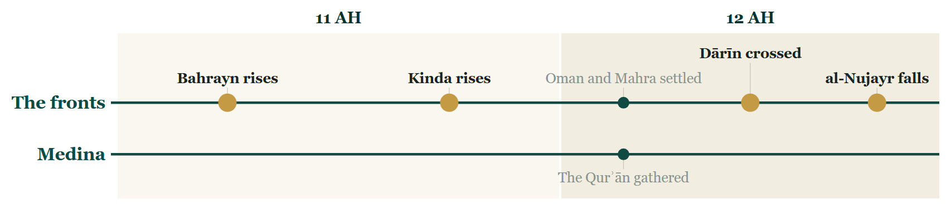
So far tonight
Where we stand
Notes:
CHECKPOINT 2 — the Line
SAY
1. Ḥaḍramawt is told: from a she-camel to a fort.
(Next slide: the map. The time check is there.)

Slide 65
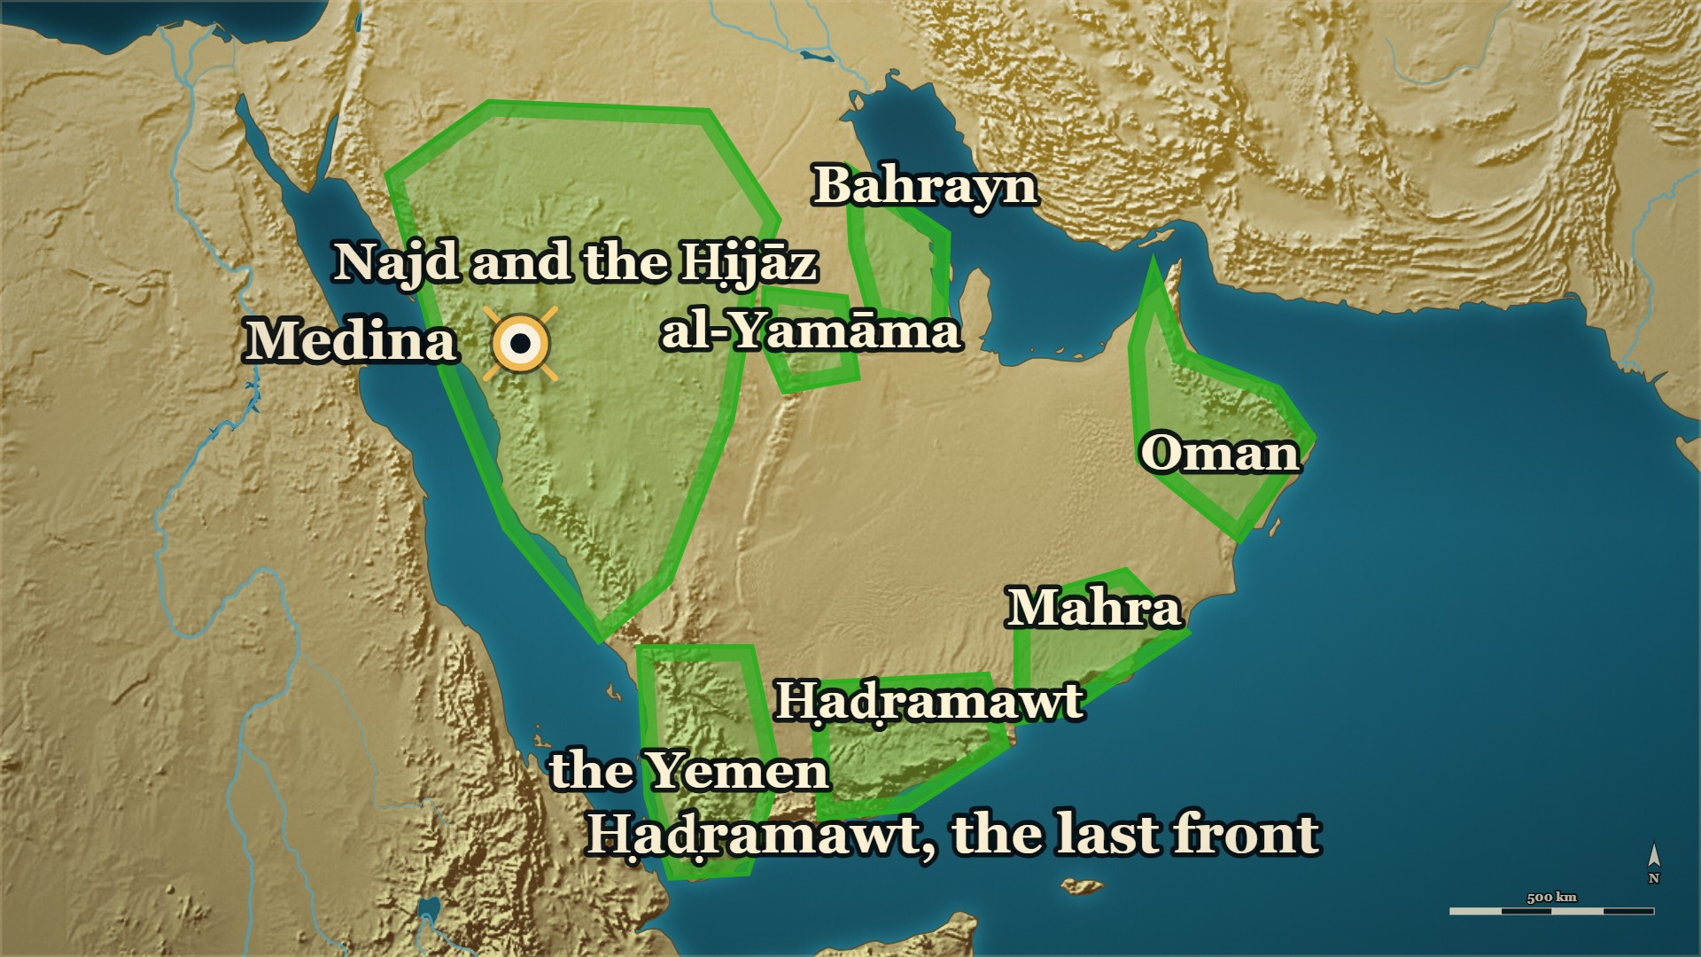
So far tonight
Where we stand
al-Nujayr
opened to Ziyād ؓ and al-Muhājir ؓ
al-Ashʿath
sent to Medina in bonds
Notes:
CHECKPOINT 2 — the map
SAY
1. Every front is settled. al-Ashʿath goes to Medina, in bonds.
⏱ Past 0:40 here — close here.
CARRY ON — “He had left his own name off the paper. Now he stands before Abū Bakr ؓ.”
──────── DETAIL — only if you need it ────────
OUT OF TIME — this is your ending. Stay on this map, and say:
“al-Ashʿath stood in front of Abū Bakr ؓ, in bonds. Next week: what Abū Bakr ؓ did with him.”
Then a loud السلام علیکم, and the dua. Next week opens on these two slides.

Slide 66
Part V
Medina, and after (12 AH → years later)
Notes:
SAY
1. Medina, and after (12 AH → years later).

Slide 67
12 AH, Medina
Abū Bakr ؓ and al-Ashʿath, at Medina
al-Ashʿath, in bonds, argues that the truce covers him.
قَالَ: إِنَّمَا وَجَبَ الصُّلْحُ بَعْدَ خَتْمِ الصَّحِيفَةِ عَلَى مَنْ فِيهَا
He said: The peace became binding, once the document was sealed, only on those named in it
وَإِنَّمَا كُنْتَ قَبْلَ ذَلِكَ مُرَاوِضًا.
before that you were only negotiating.
— Abū Bakr ؓ, to al-Ashʿath
al-Kamil, vol. 2, p. 232
Notes:
SAY
1. Al-Ashʿath before Abū Bakr ؓ
2. Abū Bakr ؓ gives the answer
3. Al-Ashʿath argues the law
4. Abū Bakr ؓ answers on the law
↑ read the Arabic on the slide
5. Fearing death, he stops arguing
6. Give me back my wife
7. The best man in my country
8. Abū Bakr ؓ spares him
9. Al-Dhahabī's shorter version
10. Ten, or seventy
LESSON — He won his life only after he stopped arguing that he was owed it.
──────── DETAIL — only if you need it ────────
1. Al-Ashʿath before Abū Bakr ؓ — Asked what he thought would be done with him, he said he did not know.
2. Abū Bakr ؓ gives the answer — Then I will kill you.
3. Al-Ashʿath argues the law — I negotiated that peace for ten, he said, so my blood is not lawful.
4. Abū Bakr ؓ answers on the law — The answer turned on the document, and on the moment it was sealed.
5. Fearing death, he stops arguing — Look for some good in me. Free me. Forgive my stumble. Treat me as you treated others like me.
6. Give me back my wife — He had asked for Abū Bakr's ؓ sister and delayed the wedding; then the Prophet ﷺ died, and he apostatised.
7. The best man in my country — Do that, he said, and you will find me the best in my country for the religion of Allah.
8. Abū Bakr ؓ spares him — He spared al-Ashʿath's life and gave him back his family.
9. Al-Dhahabī's shorter version — We will kill you. Be gracious to me, and I accept Islam. He did, and married his sister to him.
10. Ten, or seventy — Ibn al-Athīr has the peace negotiated for ten; al-Dhahabī gives seventy. The books differ.
قَالَ: إِنَّمَا وَجَبَ الصُّلْحُ بَعْدَ خَتْمِ الصَّحِيفَةِ عَلَى مَنْ فِيهَا، وَإِنَّمَا كُنْتَ قَبْلَ ذَلِكَ مُرَاوِضًا.
"He said: The peace became binding, once the document was sealed, only on those named in it; before that you were only negotiating."
— Abū Bakr ؓ, to al-Ashʿath · الکامل فی التاریخ ج۲ ص۲۳۲
──────── BACKGROUND — for home, not for the lectern ────────
Also on the page: > فَلَمَّا قَدِمَ الْمَدِينَةَ قَالَ لَهُ أَبُو بَكْرٍ: مَا تَرَانِي أَصْنَعُ بِكَ؟ قَالَ: لَا أَعْلَمُ. قَالَ: فَإِنِّي أَقْتُلُكَ. قَالَ: فَأَنَا الَّذِي رَاوَضْتُ الْقَوْمَ فِي عَشْرَةٍ فَمَا يَحِلُّ دَمِي. قَالَ: إِنَّمَا وَجَبَ الصُّلْحُ بَعْدَ خَتْمِ الصَّحِيفَةِ عَلَى مَنْ فِيهَا، وَإِنَّمَا كُنْتَ قَبْلَ ذَلِكَ مُرَاوِضًا.
> — الکامل فی التاریخ ج2 ص232 · https://shamela.ws/book/21712/923
> English: "When he reached Medina, Abū Bakr said to him: What do you think I will do with you? He
> said: I do not know. He said: Then I will kill you. He said: But I am the one who negotiated with the
> people for ten — so my blood is not lawful. He said: The peace became binding, once the document was
> sealed, only on those named in it; before that you were only negotiating." > فَلَمَّا خَشِيَ الْقَتْلَ قَالَ: أَوَتَحْتَسِبُ فِيَّ خَيْرًا، فَتُطْلِقُ إِسَارِيْ وَتُقِيلُنِي عَثْرَتِي، وَتَفْعَلُ بِي مِثْلَ مَا فَعَلْتَ بِأَمْثَالِي، وَتَرُدُّ عَلَيَّ زَوْجَتِي؟
> — الکامل فی التاریخ ج2 ص232 · https://shamela.ws/book/21712/923
> English: "When he feared he would be killed, he said: Or will you look for some good in me — free
> me from my bonds, forgive my stumble, do with me what you have done with men like me, and give me
> back my wife?" > فَإِنْ فَعَلْتَ ذَلِكَ تَجِدُنِي خَيْرَ أَهْلِ بِلَادِي لِدِينِ اللَّهِ. فَحَقَنَ دَمَهُ وَرَدَّ عَلَيْهِ أَهْلَهُ
> — الکامل فی التاریخ ج2 ص232 · https://shamela.ws/book/21712/923
> English: "If you do that, you will find me the best of the people of my country for the religion
> of Allah. So he spared his blood and gave him back his family." Al-Dhahabī's shorter version (al-Nakhaʿī, via Abū ʿUbayd's al-Amwāl) — a variant, kept beside
the first, not in place of it: > فَأُتِيَ بِهِ الصِّدِّيْقَ، فَقَالَ: إِنَّا قَاتِلُوْكَ، لاَ أَمَانَ لَكَ. فَقَالَ: تَمُنُّ عَلَيَّ وَأُسْلِمُ؟ قَالَ: فَفَعَلَ، وَزَوَّجَهُ أُخْتَهُ.
> — سیر أعلام النبلاء ج2 ص39 · https://shamela.ws/book/10906/2019
> English: "He was brought to al-Ṣiddīq, who said: We are going to kill you; you have no
> safe-conduct. He said: Will you do me a kindness, and I become Muslim? He said: And he did so, and
> married his sister to him." ⚠ Her name differs: Umm Farwa in الکامل, Farwa bint Abī Quḥāfa in سیر ج2 ص39, where he asks for
the marriage after the pardon rather than having it restored. Say "Abū Bakr's ؓ sister". ⚠ The
number differs: ten in الکامل («فِي عَشْرَةٍ»), seventy in سیر — the card's narrative keeps الکامل's ten
because it tells الکامل's exchange; do not reconcile them. Which "men like me" he meant is not on the
page (§X item 12). Follow with (the wedding feast in the camel market), which tells
al-Dhahabī's version in its narrative.

Slide 68
12 AH, Medina
al-Ashʿath ؓ — pardoned, and married
Pardoned, and married to Abū Bakr's ؓ sister.
وَاللهِ مَا كَفَرْتُ؛ وَلَكِنَّ هَذَا الرَّجُلَ زَوَّجَنِي أُخْتَهُ
By God, I have not disbelieved. This man has married his sister to me
وَلَو كُنَّا فِي بِلاَدِنَا لَكَانَتْ لَنَا وَلِيْمَةٌ غَيْرُ هَذِهِ
and had we been in our own country we would have had a wedding feast other than this one.
— al-Ashʿath ؓ, in the market at Medina
Siyar A'lam al-Nubala, vol. 2, p. 39
Notes:
⚠ Do not name Abū Bakr's ؓ sister — the books differ.
SAY
1. Safe conduct, but not for himself
2. Brought captive to Abū Bakr ؓ
3. He asks for favour
4. Released, and married into the family
5. A sword in the camel market
6. Medina thinks he has turned again
7. He throws the sword down
↑ read the Arabic on the slide
LESSON — A man newly forgiven will sometimes announce it in the loudest and least convenient way available to him.
▶ NEXT SLIDE — the same words go on (2 slides in all)
──────── DETAIL — only if you need it ────────
1. Safe conduct, but not for himself — Besieged, he took safe conduct for seventy men, al-Dhahabī says, and not for himself.
2. Brought captive to Abū Bakr ؓ — We are going to kill you, Abū Bakr ؓ told him plainly; you have no safe conduct.
3. He asks for favour — Will you show me favour, he asked, and I become Muslim?
4. Released, and married into the family — Abū Bakr ؓ showed him favour, loosed his bonds, and married his own sister to him.
5. A sword in the camel market — He drew his sword, walked into the camel market of Medina, and began hamstringing every camel and bull he saw.
6. Medina thinks he has turned again — The people shouted that he had apostatised again.
7. He throws the sword down — Then he threw the sword down and explained himself.
وَاللهِ مَا كَفَرْتُ؛ وَلَكِنَّ هَذَا الرَّجُلَ زَوَّجَنِي أُخْتَهُ؛ وَلَو كُنَّا فِي بِلاَدِنَا لَكَانَتْ لَنَا وَلِيْمَةٌ غَيْرُ هَذِهِ، يَا أَهْلَ المَدِيْنَةِ، انْحَرُوا، وَكُلُوا! وَيَا أَهْلَ الإِبِلِ تَعَالَوْا خُذُوا شَرْوَاهَا!
"By God, I have not disbelieved. This man has married his sister to me, and had we been in our own country we would have had a wedding feast other than this one. People of Medina — slaughter and eat! And owners of the camels, come and take the like of them!"
— al-Ashʿath ؓ, in the market at Medina · سیر أعلام النبلاء ج۲ ص۳۹

Slide 69
12 AH, Medina
al-Ashʿath ؓ — pardoned, and married
يَا أَهْلَ المَدِيْنَةِ، انْحَرُوا، وَكُلُوا! وَيَا أَهْلَ الإِبِلِ تَعَالَوْا خُذُوا شَرْوَاهَا!
People of Medina — slaughter and eat! And owners of the camels, come and take the like of them!
— al-Ashʿath ؓ, in the market at Medina
Siyar A'lam al-Nubala, vol. 2, p. 39
Notes:
READ the Arabic — the same words, continued (slide 2 of 2).
Each part: the Arabic, then its meaning.
──────── DETAIL — only if you need it ────────
يَا أَهْلَ المَدِيْنَةِ، انْحَرُوا، وَكُلُوا! وَيَا أَهْلَ الإِبِلِ تَعَالَوْا خُذُوا شَرْوَاهَا!
People of Medina — slaughter and eat! And owners of the camels, come and take the like of them!

Slide 70
Years later: al-Qādisiyya, Nahāwand
Ṭulayḥa ؓ, ʿAmr ؓ and Qays
Years later. Three men who had once turned, now in the army.
ولقد اتهمنا ثلاثةَ نفرٍ
We did suspect three men
فما رأينا كما هجمنا عليهم من أمانتهم وزهدهم:
and when we came upon them we found nothing to match their trustworthiness and their abstinence:
— Jābir b. ʿAbd Allāh ؓ, of the army at al-Qādisiyya
al-Bidaya wa'l-Nihaya, vol. 7, p. 243
Notes:
SAY
1. A look ahead, and say so
2. Three men of this evening go north
3. Sent to call Rustam to Islam
4. Qays commands the left wing
5. An eye each at the Yarmūk
6. Side by side at Nahāwand
7. What Jābir ؓ swore
8. Three men were suspected
9. They looked into the three
↑ read the Arabic on the slide
10. Who the three were
11. Two books on Qays
LESSON — The army kept watching the men who had once turned, and the watching found nothing; both of those facts are in the record.
▶ NEXT SLIDE — the same words go on (2 slides in all)
──────── DETAIL — only if you need it ────────
1. A look ahead, and say so — The next four names are battles this course reaches in later evenings; note only that these men are in them.
2. Three men of this evening go north — Qays, ʿAmr ؓ and al-Ashʿath ؓ are met again at the Yarmūk, al-Qādisiyya and Nahāwand.
3. Sent to call Rustam to Islam — Al-Ashʿath ؓ and ʿAmr b. Maʿdī Karib ؓ were among the men Saʿd ؓ sent before al-Qādisiyya.
4. Qays commands the left wing — He fought at the Yarmūk, came east with reinforcements from Syria, and commanded the left at al-Qādisiyya.
5. An eye each at the Yarmūk — Qays and al-Ashʿath ؓ each lost an eye at the Yarmūk.
6. Side by side at Nahāwand — Ibn Kathīr lists ʿAmr ؓ, Qays and Ṭulayḥa ؓ among the leading men of the army.
7. What Jābir ؓ swore — Ibn Kathīr records that Jābir ؓ swore: we found no one at al-Qādisiyya wanting this world with the next.
8. Three men were suspected — They had suspected three men of wanting this world.
9. They looked into the three — And when they looked, they found nothing to match their honesty and their indifference to this world.
10. Who the three were — Ṭulayḥa ؓ, who had claimed prophethood; ʿAmr ؓ, who had followed al-Aswad; Qays, who had turned on the Abnāʾ.
11. Two books on Qays — Ibn Kathīr says Qays left Islam; al-Dhahabī's notice of him, a commander known for courage, does not mention it.
ولقد اتهمنا ثلاثةَ نفرٍ، فما رأينا كما هجمنا عليهم من أمانتهم وزهدهم: طُلَيْحة بن خوَيْلد الأسدي، وعَمْرو بن معدي كرب، وقيس بن المكشوح.
"We did suspect three men — and when we came upon them we found nothing to match their trustworthiness and their abstinence: Ṭulayḥa b. Khuwaylid al-Asadī, ʿAmr b. Maʿdī Karib, and Qays b. al-Makshūḥ."
— Jābir b. ʿAbd Allāh ؓ, of the army at al-Qādisiyya · البدایہ والنہایہ ج۷ ص۲۴۳
──────── BACKGROUND — for home, not for the lectern ────────
⚠ The saying comes through Sayf b. ʿUmar — say "Ibn Kathīr records that Jābir ؓ said". ⚠ SPEAKER'S
DISCRETION on Qays: no honorific — no page here states his Companionship. Stop at the Yarmūk and
Nahāwand; both al-Ashʿath's and Qays's notices go on to Ṣiffīn, which is not this session. Close
with («إِنَّ هَذَا لَمْ يَرْتَدَّ، وَإِنِّي ارْتَدَدْتُ»). Hand-off: al-Ashʿath's later house
is the third sister note.
Also on the page: > ثم بعث سعدٌ جماعةً من السادات منهم النعمان بن مُقرِّن، وفُرات بن حَيَّان، وحَنْظلة بن الربيع التميمي، وعطارد بن حاجب، والأشعث بن قيس، والمغيرة بن شعبة، وعمرو بن معد يكرب، يدعون رستم إلى الله
> — البدایہ والنہایہ ج7 ص133 · https://shamela.ws/book/30097/3279
> English: "Then Saʿd sent a group of the leading men — among them al-Nuʿmān b. Muqarrin, Furāt b.
> Ḥayyān, Ḥanẓala b. al-Rabīʿ al-Tamīmī, ʿUṭārid b. Ḥājib, al-Ashʿath b. Qays, al-Mughīra b. Shuʿba
> and ʿAmr b. Maʿdī Karib — to call Rustam to Allah." > وعلى الميسرة قيس بن مكشوح، وكان قيس والمغيرة بن شعبة قد قدما على سعد مددًا من عند أبي عبيدة من الشام بعدما شهدا وقعة اليرموك.
> — البدایہ والنہایہ ج7 ص139 · https://shamela.ws/book/30097/3285
> English: "And over the left wing, Qays b. Makshūḥ. Qays and al-Mughīra b. Shuʿba had come to Saʿd as
> reinforcements from Abū ʿUbayda in Syria, after they had fought at the Yarmūk." > ما اطَّلعنا على أحدٍ من أهل القادسية يريد الدنيا مع الآخرة، ولقد اتهمنا ثلاثةَ نفرٍ، فما رأينا كما هجمنا عليهم من أمانتهم وزهدهم: طُلَيْحة بن خوَيْلد الأسدي، وعَمْرو بن معدي كرب، وقيس بن المكشوح.
> — البدایہ والنہایہ ج7 ص243 · https://shamela.ws/book/30097/3389
> English: "[Jābir b. ʿAbd Allāh said, on oath:] We never came upon anyone among the men of
> al-Qādisiyya who wanted this world along with the next. We did suspect three men — and when we came
> upon them we found nothing to match their trustworthiness and their abstinence: Ṭulayḥa b. Khuwaylid
> al-Asadī, ʿAmr b. Maʿdī Karib, and Qays b. al-Makshūḥ." Al-Dhahabī's whole notice on Qays b. Makshūḥ — it does not mention the ridda at all: > الأَمِيْرُ، أَبُو حَسَّانٍ المُرَادِيُّ، مِنْ وُجُوْهِ العَرَبِ المَوْصُوْفِيْنَ بِالشَّجَاعَةِ. وَكَانَ مِمَّنْ أَعَانَ عَلَى قَتْلِ الأَسْوَدِ العَنْسِيِّ، وَقُلِعَتْ عَيْنُهُ يَوْمَ اليَرْمُوْكِ.
> — سیر أعلام النبلاء ج3 ص520 · https://shamela.ws/book/10906/3128
> English: "The commander, Abū Ḥassān al-Murādī, one of the notable Arabs known for courage. He was
> among those who helped kill al-Aswad al-ʿAnsī, and his eye was put out on the day of the Yarmūk." ⚠ The same notice goes on to say Qays was killed at Ṣiffīn among ʿAlī's ؓ commanders — that clause
is not quoted here and does not go into this session. The books differ on Qays: «ارتدّ عن الإسلام»
(البدایہ ج7 ص42) against a notice that is silent on it (سیر ج3 ص520). Record both; decide nothing. ## Kinda: the kingdom before Islam, and the house of al-Ashʿath Source note: [) — read it for the pages behind these cards.

Slide 71
Years later: al-Qādisiyya, Nahāwand
Ṭulayḥa ؓ, ʿAmr ؓ and Qays
طُلَيْحة بن خوَيْلد الأسدي، وعَمْرو بن معدي كرب، وقيس بن المكشوح.
Ṭulayḥa b. Khuwaylid al-Asadī, ʿAmr b. Maʿdī Karib, and Qays b. al-Makshūḥ.
— Jābir b. ʿAbd Allāh ؓ, of the army at al-Qādisiyya
al-Bidaya wa'l-Nihaya, vol. 7, p. 243
Notes:
READ the Arabic — the same words, continued (slide 2 of 2).
Each part: the Arabic, then its meaning.
──────── DETAIL — only if you need it ────────
طُلَيْحة بن خوَيْلد الأسدي، وعَمْرو بن معدي كرب، وقيس بن المكشوح.
Ṭulayḥa b. Khuwaylid al-Asadī, ʿAmr b. Maʿdī Karib, and Qays b. al-Makshūḥ.

Slide 72
Years later
al-Ashʿath ؓ and Jarīr b. ʿAbd Allāh ؓ
A funeral, years later. al-Ashʿath ؓ steps back for Jarīr ؓ.
إِنَّ هَذَا لَمْ يَرْتَدَّ، وَإِنِّي ارْتَدَدْتُ.
"This man did not apostatise. And I did."
— al-Ashʿath ؓ, of Jarīr b. ʿAbd Allāh ؓ
Siyar A'lam al-Nubala, vol. 2, p. 40
Notes:
SAY
1. He steps back at a funeral
2. Somebody asks him why
↑ read the Arabic on the slide
3. Said in public, years afterwards
LESSON — A man who will say the worst thing about himself out loud has taken its power away from everybody else.
──────── DETAIL — only if you need it ────────
1. He steps back at a funeral — At a funeral, al-Ashʿath ؓ stepped back and put Jarīr b. ʿAbd Allāh ؓ forward to lead the prayer.
2. Somebody asks him why — He gave the reason in six words.
3. Said in public, years afterwards — Forgiven, married into al-Ṣiddīq's ؓ family, made a commander, and he still said it of himself.
إِنَّ هَذَا لَمْ يَرْتَدَّ، وَإِنِّي ارْتَدَدْتُ.
"This man did not apostatise. And I did."
— al-Ashʿath ؓ, of Jarīr b. ʿAbd Allāh ؓ · سیر أعلام النبلاء ج۲ ص۴۰

Slide 73
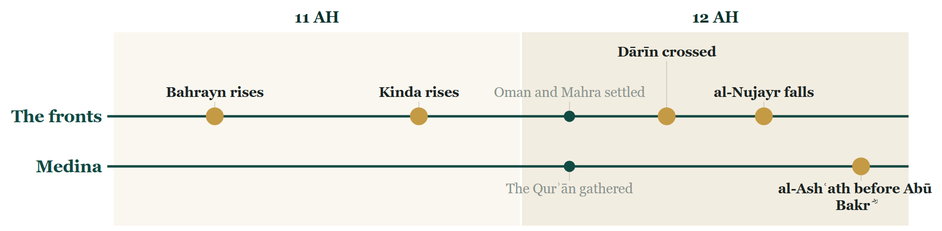
So far tonight
Where we stand
Notes:
CHECKPOINT 3 — the Line
SAY
1. The last two fronts are told — and al-Ashʿath ؓ, who came back.
(Next slide: the map. The time check is there.)

Slide 74
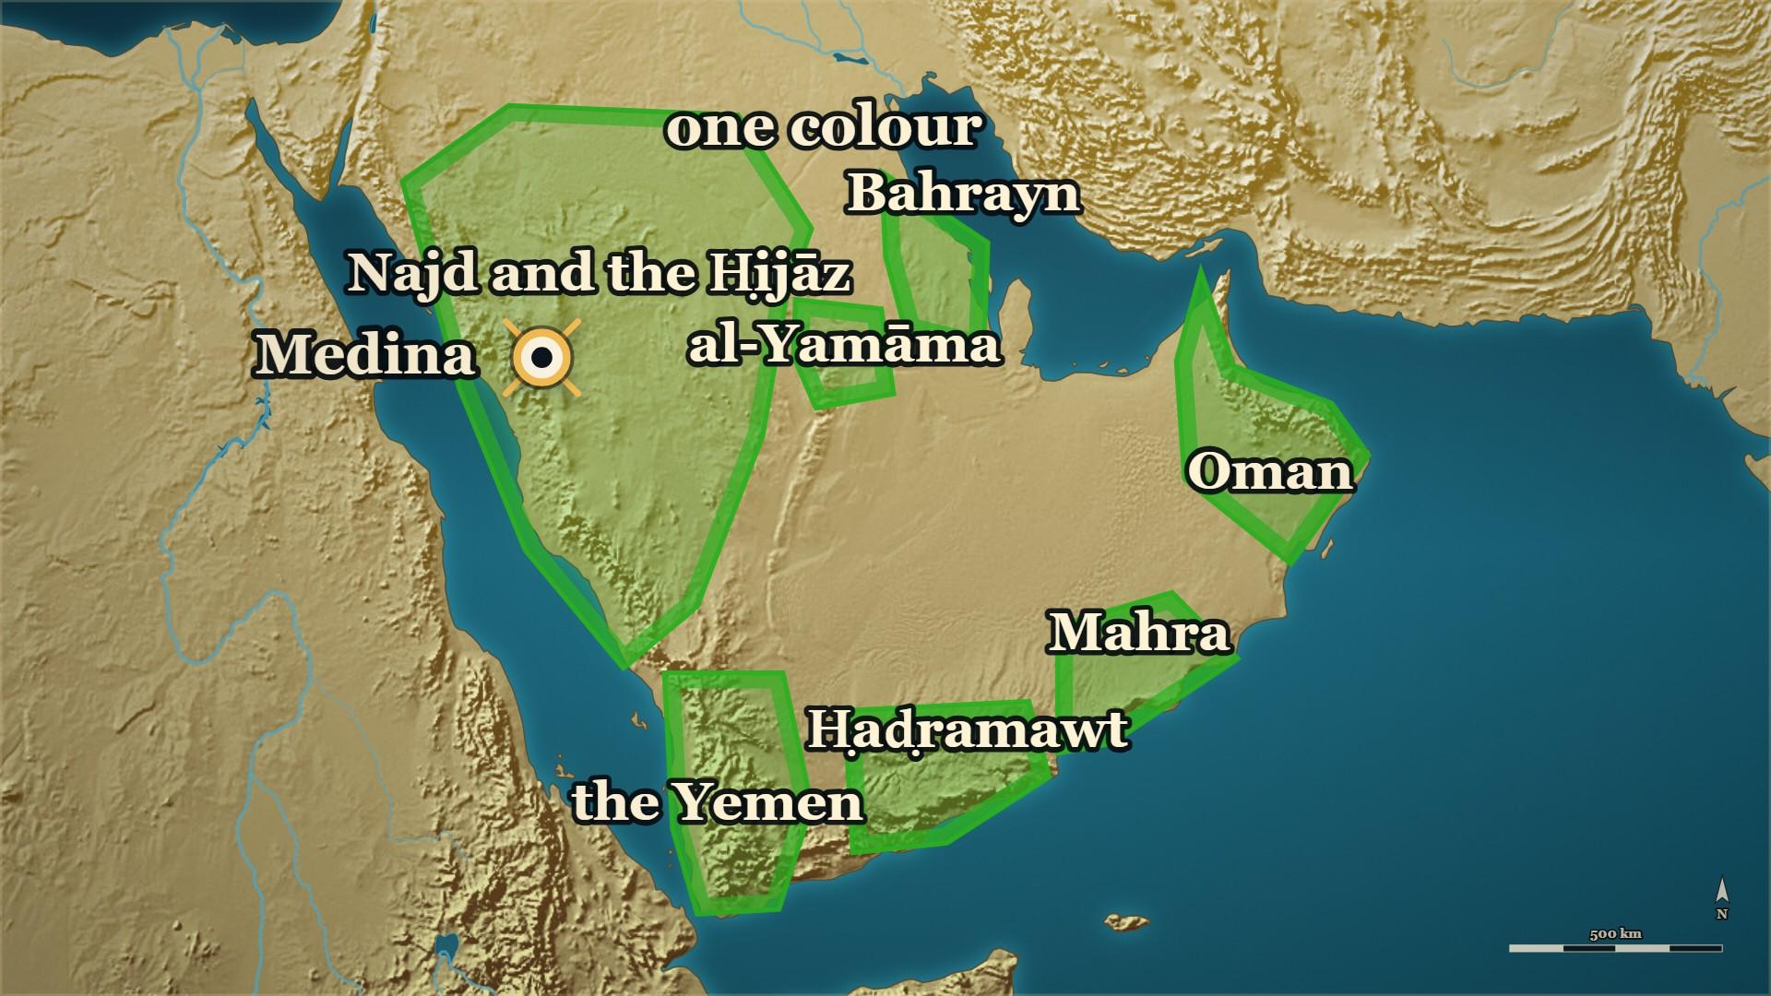
So far tonight
Where we stand
Arabia
one colour, in two years
al-Ashʿath ؓ
pardoned by Abū Bakr ؓ
Notes:
CHECKPOINT 3 — the map
SAY
1. The peninsula is one colour.
⏱ Past 0:40 here — close here. This is the natural end.
CARRY ON — “The fighting is over. Now: what do the books say the whole of it was?”
──────── DETAIL — only if you need it ────────
OUT OF TIME — this is your ending. Stay on this map, and say:
“Two years after the Prophet ﷺ died, all of Arabia was on one side. Next week: what the books say the whole of it was.”
Then a loud السلام علیکم, and the dua. Next week opens on these two slides.

Slide 75
Part VI
Medina, 12 AH: Ibn Kathīr and Ibn Masʿūd ؓ on the whole war
Notes:
SAY
1. Medina, 12 AH: Ibn Kathīr and Ibn Masʿūd ؓ on the whole war.

Slide 76
12 AH, the whole peninsula
Ibn Kathīr, on the whole war
Ibn Kathīr has finished telling the war. He stops, and says what it was.
ما من ناحية من جزيرة العرب إلا وحصلَ في أهلها ردَّةٌ لبعض الناس
There was no region of the Arabian peninsula in which apostasy did not occur among some of its people
فبعثَ الصدِّيقُ إليهم جيوشًا وأمراء يكونون عونًا لمن في تلك الناحية من المؤمنين
so al-Ṣiddīq sent them armies and commanders to be a support to whichever believers were in that region
— Ibn Kathīr, summing up the war
al-Bidaya wa'l-Nihaya, vol. 7, p. 43
Notes:
SAY
1. Ibn Kathīr stops and sums up
2. No region untouched
↑ read the Arabic on the slide
3. Armies sent to support believers
4. The fifth went to Medina
5. Obedience, or covenant
6. The end of 11, the start of 12
LESSON — The armies were sent to hold up people who were already standing, and the whole thing was over in a little more than a year.
──────── DETAIL — only if you need it ────────
1. Ibn Kathīr stops and sums up — At the end of his own account; this comes after Ḥaḍramawt, never before it.
2. No region untouched — There was no part of Arabia in which some people did not turn.
3. Armies sent to support believers — Abū Bakr ؓ sent commanders to help whichever believers were already standing in each region — not to subdue it.
4. The fifth went to Medina — And was spent among the people.
5. Obedience, or covenant — Until nobody was left but people in obedience and people under a covenant, "like the people of Najrān" — who were not Muslim, and who had sent to Medina in those same months to renew theirs.
6. The end of 11, the start of 12 — His own words for how long it took: two years, not a generation.
ما من ناحية من جزيرة العرب إلا وحصلَ في أهلها ردَّةٌ لبعض الناس، فبعثَ الصدِّيقُ إليهم جيوشًا وأمراء يكونون عونًا لمن في تلك الناحية من المؤمنين … ولم يزل الأمر كذلك حتى لم يبق بجزيرة العرب إلَّا أهل طاعة للّه ولرسوله، وأهل ذمة من الصديق، كأهل نجران وما جرى مجراهم ولله الحمد. وعامة ما وقع من هذه الحروب كان في أواخر سنة إحدى عشرة وأوائل سنة ثنتي عشرة.
"There was no region of the Arabian peninsula in which apostasy did not occur among some of its people; so al-Ṣiddīq sent them armies and commanders to be a support to whichever believers were in that region … And matters continued so until there remained in the peninsula none but people obedient to Allah and His Messenger, and people under al-Ṣiddīq's protection, such as the people of Najrān. The general run of these wars was in the last part of the year 11 and the first part of the year 12."
— Ibn Kathīr, summing up the war · البدایہ والنہایہ ج۷ ص۴۳

Slide 77
11 AH, Medina
ʿAbd Allāh b. Masʿūd ؓ
Ibn al-Athīr opens his whole chapter on the war with these words.
لَقَدْ قُمْنَا بَعْدَ رَسُولِ اللَّهِ - صَلَّى اللَّهُ عَلَيْهِ وَسَلَّمَ - مَقَامًا كِدْنَا نَهْلِكُ فِيهِ
We stood, after the Messenger of Allah ﷺ, in a position in which we nearly perished
لَوْلَا أَنَّ اللَّهَ مَنَّ عَلَيْنَا بِأَبِي بَكْرٍ
had Allah not favoured us with Abū Bakr.
— ʿAbd Allāh b. Masʿūd ؓ
al-Kamil, vol. 2, p. 201
Notes:
⚠ No isnād is given. Narrate it as what the book carries.
SAY
1. Ibn al-Athīr opens with a verdict
2. ʿAbd Allāh b. Masʿūd ؓ is speaking
3. "We nearly perished"
↑ read the Arabic on the slide
4. They had agreed not to fight
5. To keep to their towns
6. The consensus went the other way
7. Then Allah resolved Abū Bakr ؓ
8. The two terms of evening 2
LESSON — A Companion, looking back, says plainly that the right answer was not the one they had all agreed on.
ASK — Before beat 4: "He says they had already agreed on something. What do you think they had agreed?"
▶ NEXT SLIDE — the same words go on (3 slides in all)
──────── DETAIL — only if you need it ────────
1. Ibn al-Athīr opens with a verdict — Before any event of the Ridda, he quotes a Companion looking back.
2. ʿAbd Allāh b. Masʿūd ؓ is speaking — The room knows him; no introduction.
3. "We nearly perished" — "We stood, after the Messenger of Allah ﷺ, in a position in which we nearly perished — had Allah not favoured us with Abū Bakr."
4. They had agreed not to fight — All of them, over the zakāt: two young she-camels. A few camels, they had said, are not worth a war.
5. To keep to their towns — To live off the Arab towns, and worship Allah until the certainty came: until death.
6. The consensus went the other way — Say it plainly; a Companion is the one who records it.
7. Then Allah resolved Abū Bakr ؓ — "Then Allah gave Abū Bakr the resolve to fight them."
8. The two terms of evening 2 — He accepted nothing but the humiliating terms or the war that drives out; the loop closes on the words it opened with. The page says what each was: their dead in the Fire and ours in the Garden, blood-money for ours, what they took returned — or out of their lands.
لَقَدْ قُمْنَا بَعْدَ رَسُولِ اللَّهِ - صَلَّى اللَّهُ عَلَيْهِ وَسَلَّمَ - مَقَامًا كِدْنَا نَهْلِكُ فِيهِ، لَوْلَا أَنَّ اللَّهَ مَنَّ عَلَيْنَا بِأَبِي بَكْرٍ، أَجْمَعْنَا عَلَى أَنْ لَا نُقَاتِلَ عَلَى ابْنَةِ مَخَاضٍ وَابْنَةِ لَبُونٍ، وَأَنْ نَأْكُلَ قُرًى عَرَبِيَّةً، وَنَعْبُدَ اللَّهَ حَتَّى يَأْتِيَنَا الْيَقِينُ، فَعَزَمَ اللَّهُ لِأَبِي بَكْرٍ عَلَى قِتَالِهِمْ، فَوَاللَّهِ مَا رَضِيَ مِنْهُمْ إِلَّا بِالْخُطَّةِ الْمُخْزِيَةِ أَوِ الْحَرْبِ الْمُجْلِيَةِ
"We stood, after the Messenger of Allah ﷺ, in a position in which we nearly perished, had Allah not favoured us with Abū Bakr. We had all agreed not to fight over a yearling she-camel or a two-year-old, and to live off the Arab towns, and to worship Allah until the certainty came to us. Then Allah gave Abū Bakr the resolve to fight them; and by Allah, he accepted nothing from them but the humiliating terms, or the war that drives out."
— ʿAbd Allāh b. Masʿūd ؓ · الکامل فی التاریخ ج۲ ص۲۰۱
──────── BACKGROUND — for home, not for the lectern ────────
What each of the two terms was — the page says it, straight after:
> فَأَمَّا الْخُطَّةُ الْمُخْزِيَةُ أَنْ يُقِرُّوا بِأَنَّ مَنْ قُتِلَ مِنْهُمْ فِي النَّارِ، وَمَنْ قُتِلَ مِنَّا فِي الْجَنَّةِ، وَأَنْ يَدُوا قَتْلَانَا وَنَغْنَمَ مَا أَخَذْنَا مِنْهُمْ، وَأَنَّ مَا أَخَذُوا مِنَّا مَرْدُودٌ عَلَيْنَا. وَأَمَّا الْحَرْبُ الْمُجْلِيَةُ فَأَنْ يُخْرَجُوا مِنْ دِيَارِهِمْ
> — الکامل فی التاریخ ج2 ص201 · https://shamela.ws/book/21712/892
> English: "As for the humiliating terms: that they acknowledge that those of them who were killed are in
> the Fire and those of us who were killed are in the Garden; that they pay the blood-money of our dead; that
> what we took from them is ours as spoil, and what they took from us is returned to us. And as for the war
> that drives out: that they be driven from their lands."
The words in it. [STANDARD] (to verify) — the Arabic names two camels: a bint makhāḍ, a she-camel in
her second year, and a bint labūn, one in her third. They are the young animals of the zakāt schedule, so
"not to fight over" them means: not to go to war over the zakāt. "Until the certainty came to us" is the
wording of Sūrat al-Ḥijr, verse 99; the certainty is death. "To live off the Arab towns" is literal, and the
page does not gloss it — its next paragraph says every tribe turned "except Quraysh and Thaqīf", the towns.
⚠ Ibn al-Athīr prints this at the head of the chapter with no isnād. Narrate it as what the book
carries — "Ibn al-Athīr opens his account by quoting Ibn Masʿūd ؓ" — and build no ruling on it.
⚠ This is not a ⁨مشاجرات⁩ card. It is a Companion praising Abū Bakr ؓ for a decision, and nothing in it
judges anyone. Keep it there.

Slide 78
11 AH, Medina
ʿAbd Allāh b. Masʿūd ؓ
أَجْمَعْنَا عَلَى أَنْ لَا نُقَاتِلَ عَلَى ابْنَةِ مَخَاضٍ وَابْنَةِ لَبُونٍ
We had all agreed not to fight over a yearling she-camel or a two-year-old
وَأَنْ نَأْكُلَ قُرًى عَرَبِيَّةً، وَنَعْبُدَ اللَّهَ حَتَّى يَأْتِيَنَا الْيَقِينُ
and to live off the Arab towns, and to worship Allah until the certainty came to us.
— ʿAbd Allāh b. Masʿūd ؓ
al-Kamil, vol. 2, p. 201
Notes:
READ the Arabic — the same words, continued (slide 2 of 3).
Each part: the Arabic, then its meaning.
──────── DETAIL — only if you need it ────────
أَجْمَعْنَا عَلَى أَنْ لَا نُقَاتِلَ عَلَى ابْنَةِ مَخَاضٍ وَابْنَةِ لَبُونٍ
We had all agreed not to fight over a yearling she-camel or a two-year-old
وَأَنْ نَأْكُلَ قُرًى عَرَبِيَّةً، وَنَعْبُدَ اللَّهَ حَتَّى يَأْتِيَنَا الْيَقِينُ
and to live off the Arab towns, and to worship Allah until the certainty came to us.

Slide 79
11 AH, Medina
ʿAbd Allāh b. Masʿūd ؓ
فَعَزَمَ اللَّهُ لِأَبِي بَكْرٍ عَلَى قِتَالِهِمْ
Then Allah gave Abū Bakr the resolve to fight them
فَوَاللَّهِ مَا رَضِيَ مِنْهُمْ إِلَّا بِالْخُطَّةِ الْمُخْزِيَةِ أَوِ الْحَرْبِ الْمُجْلِيَةِ
and by Allah, he accepted nothing from them but the humiliating terms, or the war that drives out.
— ʿAbd Allāh b. Masʿūd ؓ
al-Kamil, vol. 2, p. 201
Notes:
READ the Arabic — the same words, continued (slide 3 of 3).
Each part: the Arabic, then its meaning.
──────── DETAIL — only if you need it ────────
فَعَزَمَ اللَّهُ لِأَبِي بَكْرٍ عَلَى قِتَالِهِمْ
Then Allah gave Abū Bakr the resolve to fight them
فَوَاللَّهِ مَا رَضِيَ مِنْهُمْ إِلَّا بِالْخُطَّةِ الْمُخْزِيَةِ أَوِ الْحَرْبِ الْمُجْلِيَةِ
and by Allah, he accepted nothing from them but the humiliating terms, or the war that drives out.

Slide 80
11 AH, Medina
Abū Bakr ؓ, and the men of Badr
On who was given command — and who was not.
لَا أَسْتَعْمِلُ أَهْلَ بَدْرٍ، أَدَعُهُمْ حَتَّى يَلْقَوُا اللَّهَ بِصَالِحِ أَعْمَالِهِمْ
I do not put the men of Badr into office. I leave them so they may meet Allah with their good deeds
فَإِنَّ اللَّهَ يَدْفَعُ بِهِمْ وَبِالصَّالِحِينَ أَكْثَرَ مِمَّا يَنْتَصِرُ بِهِمْ.
for Allah wards off by them and by the righteous more than He gives victory through them.
— Abū Bakr ؓ — and, beside it, ʿUmar's ؓ view
al-Kamil, vol. 2, p. 215
Notes:
⚠ A difference of judgement, not a dispute. Do not adjudicate.
SAY
1. Whom Abū Bakr ؓ would not appoint
2. Not the men of Badr
3. His reason
↑ read the Arabic on the slide
4. ʿUmar ؓ saw it differently
5. Both views, on one page
6. A difference of judgement, not a dispute
LESSON — Two men who agreed about the war disagreed about who should run it, and the book records both without making a quarrel of it.
▶ NEXT SLIDE — the same words go on (2 slides in all)
──────── DETAIL — only if you need it ────────
1. Whom Abū Bakr ؓ would not appoint — He had a policy about who did not get commands.
2. Not the men of Badr — "I leave them so they may meet Allah with their good deeds."
3. His reason — Allah wards off harm through such men more than He gives victory through them.
4. ʿUmar ؓ saw it differently — The book records, on the same page, that he held they should be employed.
5. Both views, on one page — Two men who agreed about the war disagreed about who should run it.
6. A difference of judgement, not a dispute — Do not dress it as one, and do not adjudicate it.
لَا أَسْتَعْمِلُ أَهْلَ بَدْرٍ، أَدَعُهُمْ حَتَّى يَلْقَوُا اللَّهَ بِصَالِحِ أَعْمَالِهِمْ، فَإِنَّ اللَّهَ يَدْفَعُ بِهِمْ وَبِالصَّالِحِينَ أَكْثَرَ مِمَّا يَنْتَصِرُ بِهِمْ. وَكَانَ عُمَرُ يَرَى اسْتِعْمَالَهُمْ عَلَى الْجُنْدِ وَغَيْرِهِ.
"I do not put the men of Badr into office. I leave them so they may meet Allah with their good deeds — for Allah wards off by them and by the righteous more than He gives victory through them. And ʿUmar held that they should be employed over the troops and otherwise."
— Abū Bakr ؓ — and, beside it, ʿUmar's ؓ view · الکامل فی التاریخ ج۲ ص۲۱۵
──────── BACKGROUND — for home, not for the lectern ────────
This is the safest possible demonstration of how the sources handle disagreement — a real
difference of judgement between the first two caliphs, recorded plainly, with nothing at stake.

Slide 81
11 AH, Medina
Abū Bakr ؓ, and the men of Badr
وَكَانَ عُمَرُ يَرَى اسْتِعْمَالَهُمْ عَلَى الْجُنْدِ وَغَيْرِهِ.
And ʿUmar held that they should be employed over the troops and otherwise.
— Abū Bakr ؓ — and, beside it, ʿUmar's ؓ view
al-Kamil, vol. 2, p. 215
Notes:
READ the Arabic — the same words, continued (slide 2 of 2).
Each part: the Arabic, then its meaning.
──────── DETAIL — only if you need it ────────
وَكَانَ عُمَرُ يَرَى اسْتِعْمَالَهُمْ عَلَى الْجُنْدِ وَغَيْرِهِ.
And ʿUmar held that they should be employed over the troops and otherwise.

Slide 82
11 AH, Dhū al-Qaṣṣa
The eleven banners, from Dhū al-Qaṣṣa
Dhū al-Qaṣṣa
eleven banners, tied by Abū Bakr ؓ
IMAGE GOES HERE
Eleven plain cloth banners on spear-shafts, planted upright in a row on open stony ground at first light, each a different muted colour, stirring slightly in the wind; a low line of dark hills behind. Nothing else on the
Notes:
SAY
1. The eleven banners, read back
2. One sitting at Dhū al-Qaṣṣa
3. Round the map, by name
4. The books differ on the count
5. Khālid b. Saʿīd ؓ: no battle on any page
6. Ordered in one sitting
LESSON — The whole war was ordered in one sitting, by a man who had just been turned back from leading it himself.
ASK — Before the table: "Medina is one town. How many armies would you send out at once?"
──────── DETAIL — only if you need it ────────
1. The eleven banners, read back — A recap: the room saw this on evening 2; tonight every sector is settled.
2. One sitting at Dhū al-Qaṣṣa — A day's ride from Medina: eleven banners tied, each commander given a region.
3. Round the map, by name — Name them now that the room has met almost all of them.
4. The books differ on the count — One of them folds two commands into one; say that and pick no number.
5. Khālid b. Saʿīd ؓ: no battle on any page — He has the Syrian marches on the roster and nothing narrated of him there; say so aloud.
6. Ordered in one sitting — By a man who had just been turned back from leading it himself.
──────── IMAGE BRIEF — paste into the image generator ────────
Eleven plain cloth banners on spear-shafts, planted upright in a row on open stony ground at first light, each a different muted colour, stirring slightly in the wind; a low line of dark hills behind. Nothing else on the ground. Restrained editorial illustration, muted ochre, deep teal and bone. Flat pure-white background (#FFFFFF) with no border, so it sits on a white slide with no seam. No text, no lettering, no map. No people and no faces — landscape, animals and objects only. 16:9.

Slide 83
ʿUmar's ؓ caliphate, Medina
ʿUmar ؓ — the captives bought back
Years later, the captives of these wars are still held.
إِنَّهُ لَقَبِيحٌ بِالْعَرَبِ أَنْ يَمْلِكَ بَعْضُهُمْ بَعْضًا
"It is a shameful thing for the Arabs that some of them should own others."
— ʿUmar ؓ, as caliph
al-Kamil, vol. 2, p. 232
Notes:
SAY
1. Years later: ʿUmar ؓ as caliph
2. "Shameful for Arabs to own Arabs"
↑ read the Arabic on the slide
3. A ransom price
4. Lighter for Ḥanīfa and Kinda
5. The women were found
6. The state bought them back
LESSON — The war's last act was the state buying back the people its own victory had taken.
──────── DETAIL — only if you need it ────────
1. Years later: ʿUmar ؓ as caliph — A look ahead, and say so; the page does not fix the year.
2. "Shameful for Arabs to own Arabs" — He said it was a shameful thing for Arabs to own one another.
3. A ransom price — He consulted, and set it: six or seven camels a head.
4. Lighter for Ḥanīfa and Kinda — Because so many of their men had been killed — the two names of these evenings.
5. The women were found — Sought out wherever they had been taken.
6. The state bought them back — The war's last act was buying back the people its own victory had taken.
إِنَّهُ لَقَبِيحٌ بِالْعَرَبِ أَنْ يَمْلِكَ بَعْضُهُمْ بَعْضًا
"It is a shameful thing for the Arabs that some of them should own others."
— ʿUmar ؓ, as caliph · الکامل فی التاریخ ج۲ ص۲۳۲ (the ransom terms run on to ج۲ ص۲۳۳

Slide 84
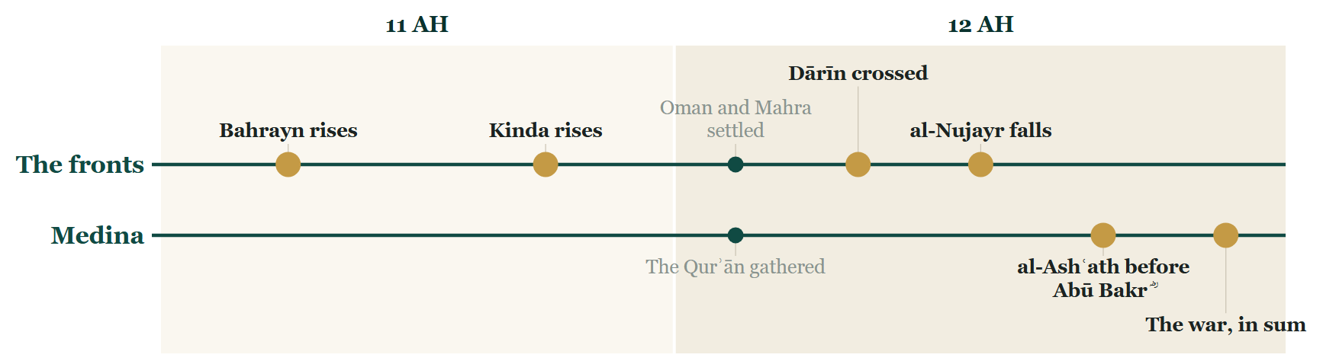
Tonight on the Line
Notes:
THE CLOSE — the Line
SAY
1. Bahrayn: Juwāthā, al-Dahnāʾ, the trench, the sea.
2. Kinda, two years earlier — then Ḥaḍramawt, to al-Nujayr.
3. Medina: al-Ashʿath, in bonds — and pardoned.
4. And the whole war — Ibn Kathīr, and Ibn Masʿūd ؓ.

Slide 85







12 AH, Arabia
Where we stand
Bahrayn
held again, by al-ʿAlāʾ ؓ
Ḥaḍramawt
taken by Ziyād ؓ and al-Muhājir ؓ
Notes:
THE CLOSE — the map
SAY
1. When you came in, two patches here were grey.
▶ CLICK 1 — Bahrayn — held again.
▶ CLICK 2 — Ḥaḍramawt — the last front, taken.
▶ CLICK 3 — The peninsula, in one colour.

Slide 86
Tonight
Bahrayn
al-Dahnāʾ
Ḥaḍramawt
al-Ashʿath ؓ
Ibn Masʿūd ؓ, on the war
Notes:
TONIGHT — say each name, then its line
SAY
1. Bahrayn
2. al-Dahnāʾ
3. Ḥaḍramawt
4. al-Ashʿath ؓ
5. Ibn Masʿūd ؓ, on the war
──────── DETAIL — only if you need it ────────
1. Bahrayn — He closed the roads behind the enemy before he opened one in front of himself.
2. al-Dahnāʾ — He did not promise them water. He reminded them who they were.
3. Ḥaḍramawt — The decision about al-Ashʿath was not taken in anger at the gate; it was sent to the man whose job it was.
4. al-Ashʿath ؓ — A man who will say the worst thing about himself out loud has taken its power away from everybody else.
5. Ibn Masʿūd ؓ, on the war — A Companion, looking back, says plainly that the right answer was not the one they had all agreed on.

Slide 87
Next week
Two years after the Prophet ﷺ died, all of Arabia was on one side. There were two empires on the other side of the desert. Did either of them know?
Notes:
IF YOU STOP HERE — ask it, and pause. Then a loud السلام علیکم — and the dua.
IF YOU CARRY ON — ask it, and go straight on: Part VII is the answer.

Slide 88
Part VII
Persia and Rome: the other side of the desert (12 AH)
Notes:
SAY
1. Persia and Rome: the other side of the desert (12 AH).

Slide 89
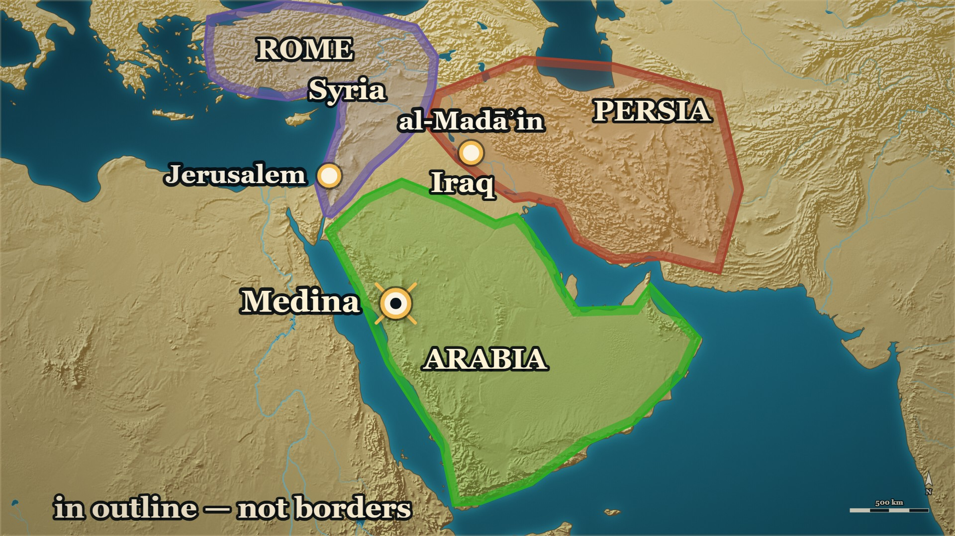


12 AH, the other side of the desert
Persia and Rome — beyond Arabia
PERSIA
al-Madāʾin — the house of Kisrā
ROME
Heraclius — Syria is his
Notes:
⚠ The two zones are outlines. No page we hold gives either empire's borders.
SAY
1. All of Arabia is one colour. Now look past it.
▶ CLICK 1 — Persia. You know how its king died: by his own son.
▶ CLICK 2 — Rome. Its emperor is Heraclius, and Syria is his.
2. What our books say of each, and what each was told.

Slide 90
12–13 AH, al-Madāʾin
The house of Kisrā
Shīrā, Kisrā's son, had killed the males of his own house.
Persia's great men ask its women for one heir.
لَمْ يَبْقَ إِلَّا غُلَامٌ يُدْعَى يَزْدَجِرْدَ مِنْ وَلَدِ شَهْرَيَارَ بْنِ كِسْرَى، وَأُمُّهُ مِنْ أَهْلِ بَادُورَيَا.
“None is left but a boy called Yazdagird, of the line of Shahriyār son of Kisrā; his mother is of the people of Bādūrayā.”
فَأَرْسَلُوا إِلَيْهَا وَطَلَبُوهُ مِنْهَا
So they sent to her and asked her for him.
— Ibn al-Athīr, on how Persia found its last king
al-Kamil, vol. 2, p. 284
Notes:
⚠ Say the names as the page's. Do not reconcile them with other histories.
⚠ Stop before Rustam and al-Qādisiyya — later evenings.
SAY
1. You know how Kisrā died
2. The books name the son
3. What Shīrā did to his own house
4. So Persia had to search for a king
5. One boy had been got away
↑ read the Arabic on the slide
6. That is the house the letter went to
7. Ibn al-Athīr tells the search a year on
LESSON — The throne they were about to face had been emptied by its own family.
▶ NEXT SLIDE — the same words go on (2 slides in all)
──────── DETAIL — only if you need it ────────
1. You know how Kisrā died — Evening 3: “my Lord has killed your lord tonight” — by his own son.
2. The books name the son — Shīrā.
3. What Shīrā did to his own house — He took the throne; and he gathered the women of the house, and killed its males. Ibn al-Athīr says it in passing.
4. So Persia had to search for a king — Its great men sent for the women of Kisrā's house, to find one male of the line.
5. One boy had been got away — Yazdagird: Kisrā's grandson, through another son, Shahriyār. His mother had sent him to her brothers. They made him king, at twenty-one.
6. That is the house the letter went to — Khālid's ؓ letter was sent on “to Shīrā son of Kisrā, and Ardashīr son of Shīrā”.
7. Ibn al-Athīr tells the search a year on — Under year 13. The killing it looks back to is older.
لَمْ يَبْقَ إِلَّا غُلَامٌ يُدْعَى يَزْدَجِرْدَ مِنْ وَلَدِ شَهْرَيَارَ بْنِ كِسْرَى، وَأُمُّهُ مِنْ أَهْلِ بَادُورَيَا. فَأَرْسَلُوا إِلَيْهَا وَطَلَبُوهُ مِنْهَا، وَكَانَتْ قَدْ أَنْزَلَتْهُ أَيَّامَ شِيرَى حِينَ جَمَعَهُنَّ فَقَتَلَ الذُّكُورَ، وَأَرْسَلَتْهُ إِلَى أَخْوَالِهِ، فَلَمَّا سَأَلُوهَا عَنْهُ دَلَّتْهُمْ عَلَيْهِ، فَجَاءُوا بِهِ فَمَلَّكُوهُ وَهُوَ ابْنُ إِحْدَى وَعِشْرِينَ سَنَة
“None is left but a boy called Yazdagird, of the line of Shahriyār son of Kisrā; his mother is of the people of Bādūrayā.” So they sent to her and asked her for him. She had got him away in the days of Shīrā — when he gathered them and killed the males — and had sent him to his mother's brothers. When they asked her about him she led them to him; and they brought him and made him king, at twenty-one.
— Ibn al-Athīr, on how Persia found its last king · الکامل فی التاریخ ج۲ ص۲۸۴
──────── BACKGROUND — for home, not for the lectern ────────
Who is who — only what the pages we hold say. [SOURCED — البدایہ ج7 ص13، ص64; الکامل ج2 ص284]
Kisrā — the king the Prophet ﷺ wrote to; killed by his own sons, the night the Prophet ﷺ said so in Medina
(evening 3). Shīrā — his son, who took the throne after him; the page of evening 3 spells him Shīrawayh.
In his days the women of the house were gathered and its males killed. Shahriyār — another son of Kisrā, so
Shīrā's brother; the page names him only as the boy's father and does not say how he died. Ardashīr —
Shīrā's son. Būrān — Kisrā's daughter; the great men ask her for the list of the women of the house.
Yazdagird — Shahriyār's son, Kisrā's grandson: the one male left, hidden by his mother with her brothers.
Rustam and al-Fayrūzān — the two great men whose quarrel forced the search; later evenings.
⚠ Who killed whom: his sons killed Kisrā, and Shīrā the males of the house. No page we hold says how Shīrā
or Ardashīr ended, and none gives a date for any of them.
Who the letter was sent on to:
> فكتب إليه خالدٌ فبعث هرمزُ بكتابِ خالدٍ إلى شيرَى بن كسرى، وأردشير بن شيرَى
> — البدایہ والنہایہ ج7 ص64 · https://shamela.ws/book/30097/3210
> English: “So Khālid wrote to him; and Hurmuz sent Khālid's letter on to Shīrā son of Kisrā, and Ardashīr son of Shīrā.”
⚠ Say the names as the page's, and do not reconcile them. General histories put Shīrā's death within months of
his father's [CONVENTIONAL-ESTIMATE]; Ibn Kathīr's page, following Sayf, has the letter sent on to him in year 12.
⚠ Narrate and stop. This is Persian court history told by Muslim historians. Rustam, the Bridge and
al-Qādisiyya are later evenings — the page names Rustam and al-Fayrūzān; the slide does not.
⚠ No dates for Shīrā, Ardashīr or Yazdagird are on any page we hold
.

Slide 91
12–13 AH, al-Madāʾin
The house of Kisrā
وَكَانَتْ قَدْ أَنْزَلَتْهُ أَيَّامَ شِيرَى حِينَ جَمَعَهُنَّ فَقَتَلَ الذُّكُورَ، وَأَرْسَلَتْهُ إِلَى أَخْوَالِهِ
She had got him away in the days of Shīrā — when he gathered them and killed the males — and had sent him to his mother's brothers.
فَلَمَّا سَأَلُوهَا عَنْهُ دَلَّتْهُمْ عَلَيْهِ، فَجَاءُوا بِهِ فَمَلَّكُوهُ وَهُوَ ابْنُ إِحْدَى وَعِشْرِينَ سَنَة
When they asked her about him she led them to him; and they brought him and made him king, at twenty-one.
— Ibn al-Athīr, on how Persia found its last king
al-Kamil, vol. 2, p. 284
Notes:
READ the Arabic — the same words, continued (slide 2 of 2).
Each part: the Arabic, then its meaning.
──────── DETAIL — only if you need it ────────
وَكَانَتْ قَدْ أَنْزَلَتْهُ أَيَّامَ شِيرَى حِينَ جَمَعَهُنَّ فَقَتَلَ الذُّكُورَ، وَأَرْسَلَتْهُ إِلَى أَخْوَالِهِ
She had got him away in the days of Shīrā — when he gathered them and killed the males — and had sent him to his mother's brothers.
فَلَمَّا سَأَلُوهَا عَنْهُ دَلَّتْهُمْ عَلَيْهِ، فَجَاءُوا بِهِ فَمَلَّكُوهُ وَهُوَ ابْنُ إِحْدَى وَعِشْرِينَ سَنَة
When they asked her about him she led them to him; and they brought him and made him king, at twenty-one.

Slide 92
Part VIII
Iraq: al-Muthannā, and the order to Khālid ؓ (12 AH)
Notes:
SAY
1. Iraq: al-Muthannā, and the order to Khālid ؓ (12 AH).

Slide 93
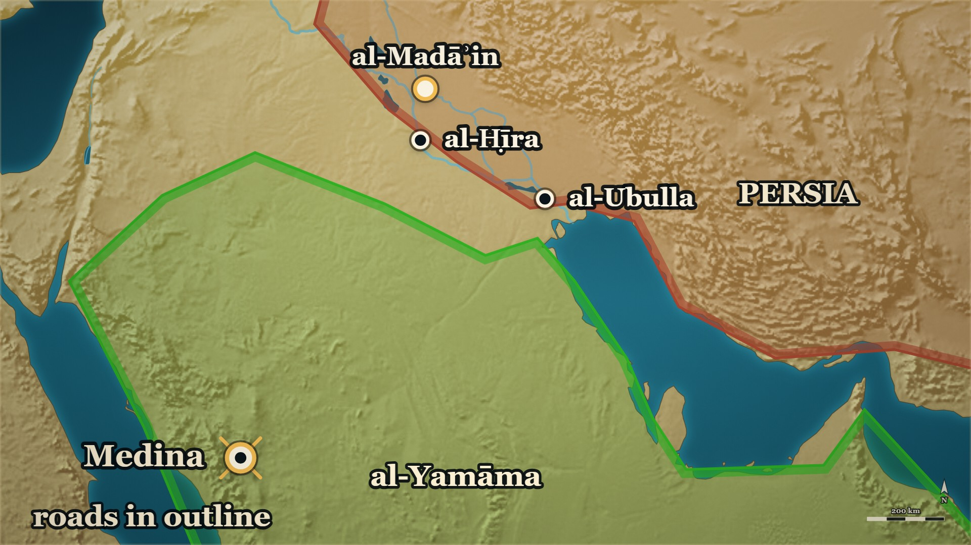


12 AH, the Iraq frontier
al-Muthannā b. Ḥāritha al-Shaybānī
al-Muthannā
raiding in Iraq, with Abū Bakr's ؓ leave
al-Madāʾin
the Persian capital
Notes:
⚠ No honorific is written for al-Muthannā on our pages. Name him plainly.
SAY
1. It does not begin in Medina
▶ CLICK 1 — al-Muthannā b. Ḥāritha is already here — raiding the edge of the Sawād, with Abū Bakr's ؓ leave.
2. You have met him
3. He had asked leave to raid Iraq
4. Eight thousand with him
5. Then the caliph writes to him
▶ NEXT SLIDE — the Arabic, and its lesson
──────── DETAIL — only if you need it ────────
1. It does not begin in Medina — It begins with a man who is already on the Persian frontier.
2. You have met him — al-Muthannā b. Ḥāritha al-Shaybānī: he closed the roads behind the beaten army in Bahrayn.
3. He had asked leave to raid Iraq — And Abū Bakr ؓ gave it. Ibn al-Athīr: he was raiding them before Khālid ؓ came.
4. Eight thousand with him — With al-Muthannā and his companions, when the armies join.
5. Then the caliph writes to him — Join Khālid ؓ at al-Ubulla. The frontier raid becomes a campaign.
وَكَانَ الْمُثَنَّى بْنُ حَارِثَةَ الشَّيْبَانِيُّ قَدِ اسْتَأْذَنَ أَبَا بَكْرٍ أَنْ يَغْزُوَ بِالْعِرَاقِ فَأَذِنَ لَهُ
"Al-Muthannā b. Ḥāritha al-Shaybānī had asked Abū Bakr for leave to raid in Iraq, and he gave it to him."
— Ibn al-Athīr, on al-Muthannā · الکامل فی التاریخ ج۲ ص۲۳۴
──────── BACKGROUND — for home, not for the lectern ────────
⚠ The sentence runs over the page: “…and he was raiding them before Khālid came” is on the next (الکامل ج2 ص235).
⚠ No honorific is written for him here. Whether al-Muthannā met the Prophet ﷺ is on no page we hold; the pool
names him plainly, as does.
⚠ Kūfa is al-Madāʾinī's word for the country (البدایہ ج7 ص62). Say the country of Kūfa, or the edge of
the Sawād; do not point at a town.

Slide 94
12 AH, the Iraq frontier
al-Muthannā b. Ḥāritha al-Shaybānī
وَكَانَ الْمُثَنَّى بْنُ حَارِثَةَ الشَّيْبَانِيُّ قَدِ اسْتَأْذَنَ أَبَا بَكْرٍ أَنْ يَغْزُوَ بِالْعِرَاقِ
Al-Muthannā b. Ḥāritha al-Shaybānī had asked Abū Bakr for leave to raid in Iraq
فَأَذِنَ لَهُ
and he gave it to him.
— Ibn al-Athīr, on al-Muthannā
al-Kamil, vol. 2, p. 234
Notes:
READ the Arabic on the slide — then its English.
WHO IS SPEAKING — Ibn al-Athīr, on al-Muthannā
LESSON — The order from the capital found a man already doing the work.
──────── DETAIL — only if you need it ────────
وَكَانَ الْمُثَنَّى بْنُ حَارِثَةَ الشَّيْبَانِيُّ قَدِ اسْتَأْذَنَ أَبَا بَكْرٍ أَنْ يَغْزُوَ بِالْعِرَاقِ فَأَذِنَ لَهُ
"Al-Muthannā b. Ḥāritha al-Shaybānī had asked Abū Bakr for leave to raid in Iraq, and he gave it to him."
— الکامل فی التاریخ ج۲ ص۲۳۴

Slide 95




Muḥarram 12 AH, al-Yamāma to Iraq
Khālid ؓ — the order to Iraq
Khālid ؓ
ordered to Iraq, from its lower end
al-Ubulla
Abū Bakr ؓ: begin here
Notes:
⚠ Muḥarram 12 is al-Madāʾinī's date — say whose it is.
SAY
▶ CLICK 1 — The order reaches Khālid ؓ at al-Yamāma: to Iraq, from its lower end — beginning with al-Ubulla.
1. Khālid ؓ has just finished al-Yamāma
2. Not “conquer Iraq”
▶ CLICK 2 — And ʿIyāḍ b. Ghanm ؓ is ordered in from the upper end — to meet him.
3. And a second commander, from the other end
4. Call them first
5. Then the jizya; then the sword
6. Compel no one to march
7. And use no man who turned
8. Whose date it is
▶ NEXT SLIDE — the Arabic, and its lesson
──────── DETAIL — only if you need it ────────
1. Khālid ؓ has just finished al-Yamāma — And a letter comes from Abū Bakr ؓ, in Medina.
2. Not “conquer Iraq” — Come at Iraq from its lower end: begin with al-Ubulla, “the frontier of India”.
3. And a second commander, from the other end — ʿIyāḍ b. Ghanm ؓ is to enter Iraq from its upper end, and meet him. Ibn al-Athīr.
4. Call them first — If they answer, they are Muslims: what is yours is theirs.
5. Then the jizya; then the sword — In that order, as the order gives it.
6. Compel no one to march — The first restraint: no man is forced to go.
7. And use no man who turned — The second: nobody who apostatised, even if he has come back.
8. Whose date it is — Muḥarram of year 12 is al-Madāʾinī's, by his chain. Ibn Kathīr reports it.
وأن يَتألَّفَ الناسَ ويدعوهم إلى الله عز وجل، فإن أجابوا وإلا أخذ منهم الجزيةَ فإن امتنعوا عن ذلك قاتلهم، وأمره أن لا يُكْرِه أحدًا على المسير معه، ولا يستعينُ بمنِ ارتدّ عن الإسلام وإن كان [قد] عاد إليه
"…that he should win the people over and call them to God; if they answered, well, and if not, take the jizya from them; and if they refused that, fight them. And he ordered him not to compel anyone to march with him, and not to make use of any man who had apostatised from Islam, even if he had returned to it."
— Ibn Kathīr, on what Abū Bakr ؓ ordered Khālid ؓ · البدایہ والنہایہ ج۷ ص۶۲
──────── BACKGROUND — for home, not for the lectern ────────
The second commander [SOURCED — الکامل ج2 ص234] — Ibn al-Athīr, in the telling that begins “and it is
said”: Abū Bakr ؓ ordered Khālid ؓ to begin with al-Ubulla, and wrote to ʿIyāḍ b. Ghanm ؓ to make for Iraq, enter
it from its upper end, and march until he met Khālid ؓ. Where ʿIyāḍ ؓ set out from is on no page we hold.

Slide 96
Muḥarram 12 AH, al-Yamāma to Iraq
Khālid ؓ — the order to Iraq
وأن يَتألَّفَ الناسَ ويدعوهم إلى الله عز وجل
…that he should win the people over and call them to God
فإن أجابوا وإلا أخذ منهم الجزيةَ فإن امتنعوا عن ذلك قاتلهم
if they answered, well, and if not, take the jizya from them; and if they refused that, fight them.
— Ibn Kathīr, on what Abū Bakr ؓ ordered Khālid ؓ
al-Bidaya wa'l-Nihaya, vol. 7, p. 62
Notes:
READ the Arabic on the slide — then its English.
WHO IS SPEAKING — Ibn Kathīr, on what Abū Bakr ؓ ordered Khālid ؓ
LESSON — A state that has just won a civil war and still refuses to conscript the defeated is telling you what it thinks it is for.
▶ NEXT SLIDE — the same words go on (2 slides in all)
──────── DETAIL — only if you need it ────────
وأن يَتألَّفَ الناسَ ويدعوهم إلى الله عز وجل، فإن أجابوا وإلا أخذ منهم الجزيةَ فإن امتنعوا عن ذلك قاتلهم، وأمره أن لا يُكْرِه أحدًا على المسير معه، ولا يستعينُ بمنِ ارتدّ عن الإسلام وإن كان [قد] عاد إليه
"…that he should win the people over and call them to God; if they answered, well, and if not, take the jizya from them; and if they refused that, fight them. And he ordered him not to compel anyone to march with him, and not to make use of any man who had apostatised from Islam, even if he had returned to it."
— البدایہ والنہایہ ج۷ ص۶۲

Slide 97
Muḥarram 12 AH, al-Yamāma to Iraq
Khālid ؓ — the order to Iraq
وأمره أن لا يُكْرِه أحدًا على المسير معه
And he ordered him not to compel anyone to march with him
ولا يستعينُ بمنِ ارتدّ عن الإسلام وإن كان [قد] عاد إليه
and not to make use of any man who had apostatised from Islam, even if he had returned to it.
— Ibn Kathīr, on what Abū Bakr ؓ ordered Khālid ؓ
al-Bidaya wa'l-Nihaya, vol. 7, p. 62
Notes:
READ the Arabic — the same words, continued (slide 2 of 2).
Each part: the Arabic, then its meaning.
──────── DETAIL — only if you need it ────────
وأمره أن لا يُكْرِه أحدًا على المسير معه
And he ordered him not to compel anyone to march with him
ولا يستعينُ بمنِ ارتدّ عن الإسلام وإن كان [قد] عاد إليه
and not to make use of any man who had apostatised from Islam, even if he had returned to it.

Slide 98
12 AH, Medina
al-Qaʿqāʿ b. ʿAmr — the reinforcement
Khālid ؓ has written to Medina for more men.
فَأَمَدَّ خَالِدًا بِالْقَعْقَاعِ بْنِ عَمْرٍو التَّمِيمِيِّ
So he reinforced Khālid with al-Qaʿqāʿ b. ʿAmr al-Tamīmī.
فَقِيلَ لَهُ: أَتُمِدُّهُ بِرَجُلٍ وَاحِدٍ؟
It was said to him: “Do you reinforce him with one man?”
— Ibn al-Athīr, on what Abū Bakr ؓ answered
al-Kamil, vol. 2, p. 235
Notes:
⚠ Name al-Qaʿqāʿ and al-Muthannā; leave the other three unnamed.
SAY
1. The order had a condition
2. So Khālid ؓ asks for more men
3. Abū Bakr ؓ sends him one
4. “With one man?”
5. “An army with the like of him is not beaten”
↑ read the Arabic on the slide
6. And the frontier is told to join
7. Eighteen thousand
LESSON — He kept the men who had turned out of it, and counted one proven man as a reinforcement.
ASK — Before beat 5: "He asked for reinforcements and was sent one man. What would you say to the caliph?"
▶ NEXT SLIDE — the same words go on (2 slides in all)
──────── DETAIL — only if you need it ────────
1. The order had a condition — Only those who fought the ridda; no man who had himself turned.
2. So Khālid ؓ asks for more men — He writes to Medina.
3. Abū Bakr ؓ sends him one — al-Qaʿqāʿ b. ʿAmr, of Tamīm.
4. “With one man?” — Somebody asks it aloud.
5. “An army with the like of him is not beaten” — Read the line.
6. And the frontier is told to join — al-Muthannā and three others: to Khālid ؓ, at al-Ubulla.
7. Eighteen thousand — Ten thousand with Khālid ؓ; eight thousand with al-Muthannā.
فَأَمَدَّ خَالِدًا بِالْقَعْقَاعِ بْنِ عَمْرٍو التَّمِيمِيِّ، فَقِيلَ لَهُ: أَتُمِدُّهُ بِرَجُلٍ وَاحِدٍ؟ فَقَالَ: لَا يُهْزَمُ جَيْشٌ فِيهِمْ مِثْلُ هَذَا
"So he reinforced Khālid with al-Qaʿqāʿ b. ʿAmr al-Tamīmī. It was said to him: “Do you reinforce him with one man?” He said: “An army with the like of this man in it is not beaten.”"
— Ibn al-Athīr, on what Abū Bakr ؓ answered · الکامل فی التاریخ ج۲ ص۲۳۵
──────── BACKGROUND — for home, not for the lectern ────────
The count:
> فَقَدِمَ خَالِدٌ وَمَعَهُ عَشَرَةُ آلَافِ مُقَاتِلٍ، وَكَانَ مَعَ الْمُثَنَّى وَأَصْحَابِهِ ثَمَانِيَةُ آلَافٍ
> — الکامل فی التاریخ ج2 ص235 · https://shamela.ws/book/21712/926
> English: "Khālid came with ten thousand fighters, and with al-Muthannā and his companions were eight thousand."
⚠ The three with al-Muthannā are named on the page — Ḥarmala, Maʿdhūr and Salmā — and nothing more is said of
them here. Name al-Muthannā; leave the three.
⚠ Eighteen thousand is also Ibn Kathīr's own total (البدایہ ج7 ص65).

Slide 99
12 AH, Medina
al-Qaʿqāʿ b. ʿAmr — the reinforcement
فَقَالَ: لَا يُهْزَمُ جَيْشٌ فِيهِمْ مِثْلُ هَذَا
He said: “An army with the like of this man in it is not beaten.”
— Ibn al-Athīr, on what Abū Bakr ؓ answered
al-Kamil, vol. 2, p. 235
Notes:
READ the Arabic — the same words, continued (slide 2 of 2).
Each part: the Arabic, then its meaning.
──────── DETAIL — only if you need it ────────
فَقَالَ: لَا يُهْزَمُ جَيْشٌ فِيهِمْ مِثْلُ هَذَا
He said: “An army with the like of this man in it is not beaten.”

Slide 100









12 AH, al-Yamāma to al-Ḥafīr
Khālid ؓ — three columns, to al-Ḥafīr
al-Ḥafīr
where the three columns are to meet
Hurmuz
holds Persia's strongest frontier
Notes:
⚠ Stop before the fight. al-Ḥafīr is named, not placed.
SAY
1. Not one body
2. And not one road
▶ CLICK 1 — al-Muthannā first — toward al-Ḥafīr.
3. al-Muthannā first
▶ CLICK 2 — Then ʿAdī b. Ḥātim ؓ, by a road of his own.
4. Then ʿAdī b. Ḥātim ؓ
▶ CLICK 3 — Khālid ؓ last. All three are to meet at al-Ḥafīr.
5. Khālid ؓ last
▶ CLICK 4 — Hurmuz writes to his king, and hurries to meet them.
6. Who was waiting
7. Hurmuz writes to his king
8. We stop here
▶ NEXT SLIDE — the Arabic, and its lesson
──────── DETAIL — only if you need it ────────
1. Not one body — Khālid ؓ divides the army in three.
2. And not one road — Each part by a road of its own.
3. al-Muthannā first — Two days ahead.
4. Then ʿAdī b. Ḥātim ؓ — A day behind; Ibn Kathīr names ʿĀṣim b. ʿAmr beside him.
5. Khālid ؓ last — And one meeting-place for all of them: al-Ḥafīr.
6. Who was waiting — Hurmuz: lord of the strongest of Persia's frontiers. He fought the Arabs by land, and India by sea.
7. Hurmuz writes to his king — And hurries to meet them.
8. We stop here — What happened when they met is another evening.
وَلَمَّا قَدِمَ خَالِدٌ فَرَّقَ جُنْدَهُ ثَلَاثَ فِرَقٍ، وَلَمْ يَحْمِلْهُمْ عَلَى طَرِيقٍ وَاحِدٍ، عَلَى مُقَدِّمَتِهِ الْمُثَنَّى وَبَعْدَهُ عَدِيُّ بْنُ حَاتِمٍ، وَجَاءَ خَالِدٌ بَعْدَهُمَا، وَوَعَدَهُمَا الْحَفِيرَ لِيُصَادِمُوا عَدُوَّهُمْ
"When Khālid came, he divided his army into three divisions and did not send them by one road: al-Muthannā over his vanguard, and after him ʿAdī b. Ḥātim; and Khālid came after the two of them. And he set al-Ḥafīr as their meeting-place, to strike their enemy."
— Ibn al-Athīr, on how Khālid ؓ came to Iraq · الکامل فی التاریخ ج۲ ص۲۳۵
──────── BACKGROUND — for home, not for the lectern ────────
The man on that frontier:
> فَكَانَ صَاحِبَهُ أُسْوَارُ اسْمُهُ هُرْمُزُ، فَكَانَ يُحَارِبُ الْعَرَبَ فِي الْبَرِّ وَالْهِنْدَ فِي الْبَحْرِ
> — الکامل فی التاریخ ج2 ص235 · https://shamela.ws/book/21712/926
> English: "Its lord was a knight called Hurmuz; he fought the Arabs by land, and India by sea."
⚠ al-Ḥafīr is named, not placed. No page we hold says where it lay; the map sets it near the head of the
Gulf [CONVENTIONAL-ESTIMATE]. Do not point at it as a known spot.
⚠ Where al-Muthannā set out from is told two ways. Ibn Kathīr has Khālid ؓ send him ahead, two days before,
on leaving al-Yamāma (البدایہ ج7 ص64); Ibn al-Athīr has him called down from the frontier to join. The map follows
Ibn al-Athīr. Ibn Kathīr's page also names a guide for each column; they are not needed aloud.
⚠ Stop before the fight. Hurmuz, the chains and the duel are the next page — and a later evening. ## القادسية, the embassy to رستم, and المدائن Source note: [) — read it for the pages behind these cards.

Slide 101
12 AH, al-Yamāma to al-Ḥafīr
Khālid ؓ — three columns, to al-Ḥafīr
وَلَمَّا قَدِمَ خَالِدٌ فَرَّقَ جُنْدَهُ ثَلَاثَ فِرَقٍ، وَلَمْ يَحْمِلْهُمْ عَلَى طَرِيقٍ وَاحِدٍ
When Khālid came, he divided his army into three divisions and did not send them by one road:
— Ibn al-Athīr, on how Khālid ؓ came to Iraq
al-Kamil, vol. 2, p. 235
Notes:
READ the Arabic on the slide — then its English.
WHO IS SPEAKING — Ibn al-Athīr, on how Khālid ؓ came to Iraq
LESSON — Three roads and one meeting-place — a year later the caliph will send four.
▶ NEXT SLIDE — the same words go on (2 slides in all)
──────── DETAIL — only if you need it ────────
وَلَمَّا قَدِمَ خَالِدٌ فَرَّقَ جُنْدَهُ ثَلَاثَ فِرَقٍ، وَلَمْ يَحْمِلْهُمْ عَلَى طَرِيقٍ وَاحِدٍ، عَلَى مُقَدِّمَتِهِ الْمُثَنَّى وَبَعْدَهُ عَدِيُّ بْنُ حَاتِمٍ، وَجَاءَ خَالِدٌ بَعْدَهُمَا، وَوَعَدَهُمَا الْحَفِيرَ لِيُصَادِمُوا عَدُوَّهُمْ
"When Khālid came, he divided his army into three divisions and did not send them by one road: al-Muthannā over his vanguard, and after him ʿAdī b. Ḥātim; and Khālid came after the two of them. And he set al-Ḥafīr as their meeting-place, to strike their enemy."
— الکامل فی التاریخ ج۲ ص۲۳۵

Slide 102
12 AH, al-Yamāma to al-Ḥafīr
Khālid ؓ — three columns, to al-Ḥafīr
عَلَى مُقَدِّمَتِهِ الْمُثَنَّى وَبَعْدَهُ عَدِيُّ بْنُ حَاتِمٍ، وَجَاءَ خَالِدٌ بَعْدَهُمَا
al-Muthannā over his vanguard, and after him ʿAdī b. Ḥātim; and Khālid came after the two of them.
وَوَعَدَهُمَا الْحَفِيرَ لِيُصَادِمُوا عَدُوَّهُمْ
And he set al-Ḥafīr as their meeting-place, to strike their enemy.
— Ibn al-Athīr, on how Khālid ؓ came to Iraq
al-Kamil, vol. 2, p. 235
Notes:
READ the Arabic — the same words, continued (slide 2 of 2).
Each part: the Arabic, then its meaning.
──────── DETAIL — only if you need it ────────
عَلَى مُقَدِّمَتِهِ الْمُثَنَّى وَبَعْدَهُ عَدِيُّ بْنُ حَاتِمٍ، وَجَاءَ خَالِدٌ بَعْدَهُمَا
al-Muthannā over his vanguard, and after him ʿAdī b. Ḥātim; and Khālid came after the two of them.
وَوَعَدَهُمَا الْحَفِيرَ لِيُصَادِمُوا عَدُوَّهُمْ
And he set al-Ḥafīr as their meeting-place, to strike their enemy.

Slide 103
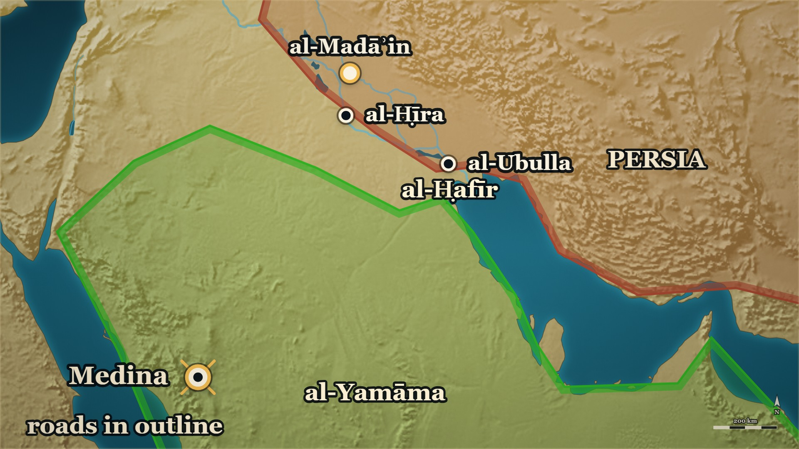



12 AH, al-Ḥīra
Khālid ؓ — the letter to al-Madāʾin
Khālid ؓ
at al-Ḥīra: he writes, and does not march
al-Madāʾin
Kisrā's commanders, governors and ministers
Notes:
⚠ A year's fighting lies before this letter. Say so; do not tell it.
SAY
1. A year's fighting lies between
▶ CLICK 1 — A year on: Khālid ؓ is at al-Ḥīra.
2. al-Ḥīra has chosen the jizya
▶ CLICK 2 — He writes to al-Madāʾin.
3. He does not march on al-Madāʾin
4. How we have the letter
5. Peace
6. What he tells Persia of itself
7. The first way: Islam
8. The second way: a covenant
9. The third is the declaration
10. They were left marvelling
▶ NEXT SLIDE — the Arabic, and its lesson
ASK — Ask the room: how far is Medina from the Persian capital? Then tell them: a letter reached it before any army did.
──────── DETAIL — only if you need it ────────
1. A year's fighting lies between — Lower Iraq, 12 AH: another evening's. Tonight, only what he wrote at the end of it.
2. al-Ḥīra has chosen the jizya — The first taken from Iraq. The country below the capital has made its peace.
3. He does not march on al-Madāʾin — He writes to it: to Kisrā's commanders, his frontier governors — the marzubāns — and his ministers.
4. How we have the letter — al-Shaʿbī: the family of Buqayla, in al-Ḥīra, read it out to him.
5. Peace — on a condition — “Peace be upon whoever follows the guidance.”
6. What he tells Persia of itself — Allah has broken up your company, taken your kingship, weakened your scheming.
7. The first way: Islam — Pray as we pray, face our qibla, eat what we slaughter: what is ours is his.
8. The second way: a covenant — Hostages, and protection.
9. The third is the declaration — “A people who love death as you love life.” Read the line.
10. They were left marvelling — Ibn Kathīr's own last words on it.
من خالد بن الوليد إلى مرازبة أهل فارس: سلامٌ على من اتَّبع الهُدى، أما بعد فالحمد لله الذي فض خدمتكم وسلبَ مُلْككم ووهنَ كيدكَم، وإنَّ منْ صلَّى صلاتنا واستقبل قبلتنا وأكلَ ذبيحتنا فذلك المسلمُ الذي له ما لنا وعليه ما علينا، أما بعد فإذا جاءكم كتابي فابعثوا إليَّ بالرُّهن واعتقدوا مني الذِّمة، و (إلا) فوالذي لا إله غيره لأبعثن إليكم قومًا يحبّون الموتَ كما تحبّون أنتم الحياة
"From Khālid b. al-Walīd to the frontier governors of the people of Persia: peace be upon whoever follows the guidance. To proceed: praise be to Allah, who has broken up your company, taken away your kingship and weakened your scheming. Whoever prays our prayer, faces our qibla and eats what we slaughter — that is the Muslim: what is ours is his, and what is upon us is upon him. To proceed: when my letter reaches you, send me hostages and take a covenant of protection from me. Otherwise — by Him beside whom there is no god — I shall send against you a people who love death as you love life."
— Khālid b. al-Walīd ؓ, to the marzubāns of Persia · البدایہ والنہایہ ج۷ ص۶۴
──────── BACKGROUND — for home, not for the lectern ────────
⚠ The books tell the opening of Iraq two ways. In the short telling — Ibn Isḥāq's, which both books give
first — Khālid ؓ comes, the villages and al-Ḥīra make peace, and he writes this letter. In Sayf's longer telling
there are battles first, beginning with Hurmuz. This card follows the first, and says aloud that the fighting is
another evening's.
⚠ This is not the letter Hurmuz sent on to Shīrā. That was an earlier one, to Hurmuz himself; the page
mentions it and does not quote it (البدایہ ج7 ص64).
⚠ Marzubān is the page's word — a Persian frontier governor. The face says frontier governors.
⚠ It is an ultimatum with three ways out — Islam; a covenant with hostages; or war — in the order Abū Bakr's ؓ
order to Khālid ؓ gives them. Its last line is the declaration; do not tell the whole letter as one.

Slide 104
12 AH, al-Ḥīra
Khālid ؓ — the letter to al-Madāʾin
من خالد بن الوليد إلى مرازبة أهل فارس: سلامٌ على من اتَّبع الهُدى
From Khālid b. al-Walīd to the frontier governors of the people of Persia: peace be upon whoever follows the guidance.
أما بعد فالحمد لله الذي فض خدمتكم وسلبَ مُلْككم ووهنَ كيدكَم
To proceed: praise be to Allah, who has broken up your company, taken away your kingship and weakened your scheming.
— Khālid b. al-Walīd ؓ, to the marzubāns of Persia
al-Bidaya wa'l-Nihaya, vol. 7, p. 64
Notes:
READ the Arabic on the slide — then its English.
WHO IS SPEAKING — Khālid b. al-Walīd ؓ, to the marzubāns of Persia
LESSON — A man who has made peace with his own death is very difficult to bargain with.
▶ NEXT SLIDE — the same words go on (3 slides in all)
──────── DETAIL — only if you need it ────────
من خالد بن الوليد إلى مرازبة أهل فارس: سلامٌ على من اتَّبع الهُدى، أما بعد فالحمد لله الذي فض خدمتكم وسلبَ مُلْككم ووهنَ كيدكَم، وإنَّ منْ صلَّى صلاتنا واستقبل قبلتنا وأكلَ ذبيحتنا فذلك المسلمُ الذي له ما لنا وعليه ما علينا، أما بعد فإذا جاءكم كتابي فابعثوا إليَّ بالرُّهن واعتقدوا مني الذِّمة، و (إلا) فوالذي لا إله غيره لأبعثن إليكم قومًا يحبّون الموتَ كما تحبّون أنتم الحياة
"From Khālid b. al-Walīd to the frontier governors of the people of Persia: peace be upon whoever follows the guidance. To proceed: praise be to Allah, who has broken up your company, taken away your kingship and weakened your scheming. Whoever prays our prayer, faces our qibla and eats what we slaughter — that is the Muslim: what is ours is his, and what is upon us is upon him. To proceed: when my letter reaches you, send me hostages and take a covenant of protection from me. Otherwise — by Him beside whom there is no god — I shall send against you a people who love death as you love life."
— البدایہ والنہایہ ج۷ ص۶۴

Slide 105
12 AH, al-Ḥīra
Khālid ؓ — the letter to al-Madāʾin
وإنَّ منْ صلَّى صلاتنا واستقبل قبلتنا وأكلَ ذبيحتنا فذلك المسلمُ الذي له ما لنا وعليه ما علينا
Whoever prays our prayer, faces our qibla and eats what we slaughter — that is the Muslim: what is ours is his, and what is upon us is upon him.
— Khālid b. al-Walīd ؓ, to the marzubāns of Persia
al-Bidaya wa'l-Nihaya, vol. 7, p. 64
Notes:
READ the Arabic — the same words, continued (slide 2 of 3).
Each part: the Arabic, then its meaning.
──────── DETAIL — only if you need it ────────
وإنَّ منْ صلَّى صلاتنا واستقبل قبلتنا وأكلَ ذبيحتنا فذلك المسلمُ الذي له ما لنا وعليه ما علينا
Whoever prays our prayer, faces our qibla and eats what we slaughter — that is the Muslim: what is ours is his, and what is upon us is upon him.

Slide 106
12 AH, al-Ḥīra
Khālid ؓ — the letter to al-Madāʾin
أما بعد فإذا جاءكم كتابي فابعثوا إليَّ بالرُّهن واعتقدوا مني الذِّمة
To proceed: when my letter reaches you, send me hostages and take a covenant of protection from me.
و (إلا) فوالذي لا إله غيره لأبعثن إليكم قومًا يحبّون الموتَ كما تحبّون أنتم الحياة
Otherwise — by Him beside whom there is no god — I shall send against you a people who love death as you love life.
— Khālid b. al-Walīd ؓ, to the marzubāns of Persia
al-Bidaya wa'l-Nihaya, vol. 7, p. 64
Notes:
READ the Arabic — the same words, continued (slide 3 of 3).
Each part: the Arabic, then its meaning.
──────── DETAIL — only if you need it ────────
أما بعد فإذا جاءكم كتابي فابعثوا إليَّ بالرُّهن واعتقدوا مني الذِّمة
To proceed: when my letter reaches you, send me hostages and take a covenant of protection from me.
و (إلا) فوالذي لا إله غيره لأبعثن إليكم قومًا يحبّون الموتَ كما تحبّون أنتم الحياة
Otherwise — by Him beside whom there is no god — I shall send against you a people who love death as you love life.

Slide 107
Part IX
Syria: the verse, the banners, and four roads (13 AH)
Notes:
SAY
1. Syria: the verse, the banners, and four roads (13 AH).

Slide 108
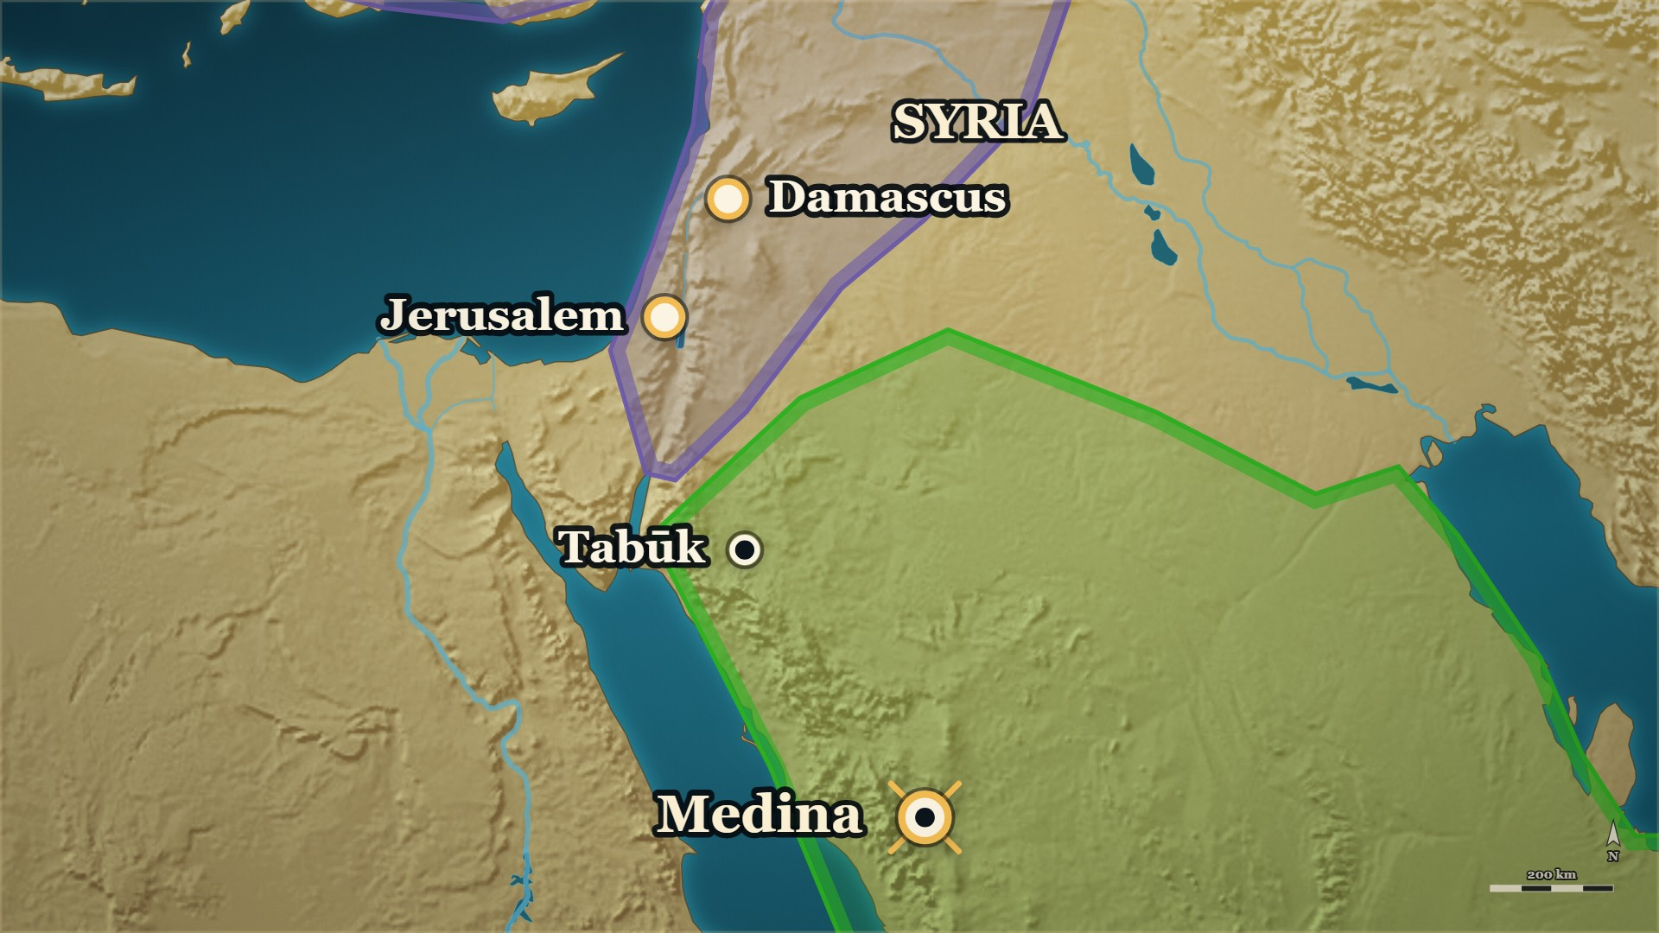


Early 13 AH, Medina
Syria — the Prophet's ﷺ road
Tabūk
the Prophet ﷺ led the Muslims here himself
SYRIA
Usāma's ؓ army: sent toward its borders
Notes:
⚠ These are Ibn Kathīr's grounds. Say “Ibn Kathīr says”.
SAY
1. The year 13 opens
2. Ibn Kathīr says on what grounds
3. “Those who are near you”
▶ CLICK 1 — Tabūk: the Prophet ﷺ led the Muslims this far toward Syria himself, in fierce heat.
4. The Prophet's ﷺ own road
▶ CLICK 2 — And before he died, he sent Usāma b. Zayd ؓ toward these borders.
5. And Usāma's ؓ army
6. First Iraq, then Syria
7. He gathers the commanders
▶ NEXT SLIDE — the Arabic, and its lesson
──────── DETAIL — only if you need it ────────
1. The year 13 opens — Abū Bakr ؓ is back from the ḥajj, and resolved: the armies are to be gathered, and sent to Syria.
2. Ibn Kathīr says on what grounds — A verse, and an example.
3. “Those who are near you” — al-Tawba 123. Read it.
4. The Prophet's ﷺ own road — Tabūk: he led the Muslims toward Syria himself, in fierce heat, and returned.
5. And Usāma's ؓ army — Sent toward the borders of Syria before he died. The room met it on evening 2.
6. First Iraq, then Syria — Arabia finished, he stretched out his right hand to Iraq; then Syria, as he had Iraq.
7. He gathers the commanders — From the scattered places of Arabia where they were posted.
استُهلَّتْ هذه السنة والصدِّيقُ عازم على جمع الجنود ليبعثَهم إلى الشام، وذلك بعد مرجعه من الحج … ﴿يَاأَيُّهَا الَّذِينَ آمَنُوا قَاتِلُوا الَّذِينَ يَلُونَكُمْ مِنَ الْكُفَّارِ …﴾ [التوبة: ١٢٣] … واقتداءً برسول الله ﷺ فإنه جمعَ المسلمين لغزو الشّام - وذلك عام تبوكَ - حتّى وَصلها في حرٍّ شديد وجهد، فرجع عامَهُ ذلك، ثم بعثَ قبل موته أسامةَ بن زيدٍ مولاه ليغزوَ تخوم الشام
"This year opened with al-Ṣiddīq resolved to gather the armies and send them to Syria, after his return from the ḥajj … “O you who believe, fight those of the disbelievers who are near you” … and following the Messenger of Allah ﷺ: for he had gathered the Muslims to march on Syria — that was the year of Tabūk — until he reached it in fierce heat and hardship, and returned that year; then before his death he sent Usāma b. Zayd, his freedman, to raid the borders of Syria."
— Ibn Kathīr, on why Abū Bakr ؓ turned to Syria · البدایہ والنہایہ ج۷ ص۸۲
──────── BACKGROUND — for home, not for the lectern ────────
⚠ These are Ibn Kathīr's grounds, in his words. Say “Ibn Kathīr says”. The second verse he cites is
al-Tawba 29; the face carries the first.
⚠ The long council — the senior Companions each giving his view on Syria — is on no page we hold. It is in
books outside the four this course reads from. Do not tell it.

Slide 109
Early 13 AH, Medina
Syria — the Prophet's ﷺ road
استُهلَّتْ هذه السنة والصدِّيقُ عازم على جمع الجنود ليبعثَهم إلى الشام، وذلك بعد مرجعه من الحج
This year opened with al-Ṣiddīq resolved to gather the armies and send them to Syria, after his return from the ḥajj
… ﴿يَاأَيُّهَا الَّذِينَ آمَنُوا قَاتِلُوا الَّذِينَ يَلُونَكُمْ مِنَ الْكُفَّارِ …﴾ [التوبة: ١٢٣]
… “O you who believe, fight those of the disbelievers who are near you”
— Ibn Kathīr, on why Abū Bakr ؓ turned to Syria
al-Bidaya wa'l-Nihaya, vol. 7, p. 82
Notes:
READ the Arabic on the slide — then its English.
WHO IS SPEAKING — Ibn Kathīr, on why Abū Bakr ؓ turned to Syria
LESSON — He did not open a new road. He took up one the Prophet ﷺ had already set out on.
▶ NEXT SLIDE — the same words go on (2 slides in all)
──────── DETAIL — only if you need it ────────
استُهلَّتْ هذه السنة والصدِّيقُ عازم على جمع الجنود ليبعثَهم إلى الشام، وذلك بعد مرجعه من الحج … ﴿يَاأَيُّهَا الَّذِينَ آمَنُوا قَاتِلُوا الَّذِينَ يَلُونَكُمْ مِنَ الْكُفَّارِ …﴾ [التوبة: ١٢٣] … واقتداءً برسول الله ﷺ فإنه جمعَ المسلمين لغزو الشّام - وذلك عام تبوكَ - حتّى وَصلها في حرٍّ شديد وجهد، فرجع عامَهُ ذلك، ثم بعثَ قبل موته أسامةَ بن زيدٍ مولاه ليغزوَ تخوم الشام
"This year opened with al-Ṣiddīq resolved to gather the armies and send them to Syria, after his return from the ḥajj … “O you who believe, fight those of the disbelievers who are near you” … and following the Messenger of Allah ﷺ: for he had gathered the Muslims to march on Syria — that was the year of Tabūk — until he reached it in fierce heat and hardship, and returned that year; then before his death he sent Usāma b. Zayd, his freedman, to raid the borders of Syria."
— البدایہ والنہایہ ج۷ ص۸۲

Slide 110
Early 13 AH, Medina
Syria — the Prophet's ﷺ road
… واقتداءً برسول الله ﷺ فإنه جمعَ المسلمين لغزو الشّام - وذلك عام تبوكَ - حتّى وَصلها في حرٍّ شديد وجهد، فرجع عامَهُ ذلك، ثم بعثَ قبل موته أسامةَ بن زيدٍ مولاه ليغزوَ تخوم الشام
… and following the Messenger of Allah ﷺ: for he had gathered the Muslims to march on Syria — that was the year of Tabūk — until he reached it in fierce heat and hardship, and returned that year; then before his death he sent Usāma b. Zayd, his freedman, to raid the borders of Syria.
— Ibn Kathīr, on why Abū Bakr ؓ turned to Syria
al-Bidaya wa'l-Nihaya, vol. 7, p. 82
Notes:
READ the Arabic — the same words, continued (slide 2 of 2).
Each part: the Arabic, then its meaning.
──────── DETAIL — only if you need it ────────
… واقتداءً برسول الله ﷺ فإنه جمعَ المسلمين لغزو الشّام - وذلك عام تبوكَ - حتّى وَصلها في حرٍّ شديد وجهد، فرجع عامَهُ ذلك، ثم بعثَ قبل موته أسامةَ بن زيدٍ مولاه ليغزوَ تخوم الشام
… and following the Messenger of Allah ﷺ: for he had gathered the Muslims to march on Syria — that was the year of Tabūk — until he reached it in fierce heat and hardship, and returned that year; then before his death he sent Usāma b. Zayd, his freedman, to raid the borders of Syria.

Slide 111





13 AH, Quḍāʿa to Medina
ʿAmr b. al-ʿĀṣ ؓ — one arrow
ʿAmr ؓ
among Quḍāʿa, collecting the ṣadaqa
Medina
Abū Bakr ؓ writes: Syria, if you will
Notes:
SAY
▶ CLICK 1 — A letter from Medina finds ʿAmr b. al-ʿĀṣ ؓ among Quḍāʿa, collecting the ṣadaqa.
1. The letter finds ʿAmr b. al-ʿĀṣ ؓ at his post
2. Abū Bakr ؓ offers him Syria
3. And leaves him free
4. He answers in one sentence
5. “Shoot the hardest”
▶ CLICK 2 — He names a deputy, and comes to Medina.
6. He names a deputy, and comes to Medina
▶ NEXT SLIDE — the Arabic, and its lesson
──────── DETAIL — only if you need it ────────
1. The letter finds ʿAmr b. al-ʿĀṣ ؓ at his post — Collecting the ṣadaqa of Quḍāʿa: the post the Prophet ﷺ gave him, and promised him again.
2. Abū Bakr ؓ offers him Syria — “I would like to free you for what is better for you, in this world and the next.”
3. And leaves him free — “Unless what you are in is dearer to you.”
4. He answers in one sentence — Read it.
5. “Shoot the hardest” — He asks to be sent where it is hardest.
6. He names a deputy, and comes to Medina — With al-Walīd b. ʿUqba ؓ, who had been written to in the same words.
إِنِّي سَهْمٌ مِنْ سِهَامِ الْإِسْلَامِ، وَأَنْتَ بَعْدَ اللَّهِ الرَّامِي بِهَا وَالْجَامِعُ لَهَا، فَانْظُرْ أَشَدَّهَا وَأَخْشَاهَا وَأَفْضَلَهَا فَارْمِ بِه
"I am one arrow of the arrows of Islam, and you — after God — are the one who shoots them and the one who gathers them. So look for the hardest of them, and the most feared, and the best, and shoot it."
— ʿAmr b. al-ʿĀṣ ؓ, to Abū Bakr ؓ · الکامل فی التاریخ ج۲ ص۲۴۹
──────── BACKGROUND — for home, not for the lectern ────────
Where the letter found him:
> وَكَانَ أَبُو بَكْرٍ قَدْ رَدَّ عَمْرَو بْنَ الْعَاصِ إِلَى عَمَلِهِ الَّذِي كَانَ رَسُولُ اللَّهِ - صَلَّى اللَّهُ عَلَيْهِ وَسَلَّمَ - وَلَّاهُ إِيَّاهُ مِنْ صَدَقَاتِ سَعْدِ هُذَيْمٍ وَعُذْرَةَ وَغَيْرِهِمْ قَبْلَ ذَهَابِهِ إِلَى عُمَانَ
> — الکامل فی التاریخ ج2 ص249 · https://shamela.ws/book/21712/940
> English: "Abū Bakr had returned ʿAmr b. al-ʿĀṣ to the post the Messenger of Allah ﷺ had appointed him to — the
> ṣadaqāt of Saʿd Hudhaym, ʿUdhra and others — before his going to Oman."
What Abū Bakr ؓ wrote to him:
> إِنِّي كُنْتُ قَدْ رَدَدْتُكَ عَلَى الْعَمَلِ الَّذِي وَلَّاكَ رَسُولُ اللَّهِ - صَلَّى اللَّهُ عَلَيْهِ وَسَلَّمَ - مَرَّةً، وَوَعَدَكَ بِهِ أُخْرَى؛ إِنْجَازًا لِمَوَاعِيدِ رَسُولِ اللَّهِ - صَلَّى اللَّهُ عَلَيْهِ وَسَلَّمَ - وَقَدْ وَلَيْتَهُ، وَقَدْ أَحْبَبْتُ أَنْ أُفْرِغَكَ لِمَا هُوَ خَيْرٌ لَكَ فِي الدُّنْيَا وَالْآخِرَةِ، إِلَّا أَنْ يَكُونَ الَّذِي أَنْتَ فِيهِ أَحَبَّ إِلَيْكَ
> — الکامل فی التاریخ ج2 ص249 · https://shamela.ws/book/21712/940
> English: "I had returned you to the post the Messenger of Allah ﷺ appointed you to once, and promised you
> again, to keep the promises of the Messenger of Allah ﷺ; and you have held it. Now I would like to free you
> for what is better for you in this world and the next — unless what you are in is dearer to you."
⚠ The pages name tribes, not a town. Ibn Kathīr says the ṣadaqāt of Quḍāʿa (البدایہ ج7 ص82); Ibn al-Athīr,
Saʿd Hudhaym and ʿUdhra. That their country lies in the north-west, between Medina and Syria, is general
knowledge [STANDARD] (to verify) — the map sets him there in outline.

Slide 112
13 AH, Quḍāʿa to Medina
ʿAmr b. al-ʿĀṣ ؓ — one arrow
إِنِّي سَهْمٌ مِنْ سِهَامِ الْإِسْلَامِ
I am one arrow of the arrows of Islam
وَأَنْتَ بَعْدَ اللَّهِ الرَّامِي بِهَا وَالْجَامِعُ لَهَا
and you — after God — are the one who shoots them and the one who gathers them.
— ʿAmr b. al-ʿĀṣ ؓ, to Abū Bakr ؓ
al-Kamil, vol. 2, p. 249
Notes:
READ the Arabic on the slide — then its English.
WHO IS SPEAKING — ʿAmr b. al-ʿĀṣ ؓ, to Abū Bakr ؓ
LESSON — A man who lets himself be aimed by someone else has settled the question of who he is working for.
▶ NEXT SLIDE — the same words go on (2 slides in all)
──────── DETAIL — only if you need it ────────
إِنِّي سَهْمٌ مِنْ سِهَامِ الْإِسْلَامِ، وَأَنْتَ بَعْدَ اللَّهِ الرَّامِي بِهَا وَالْجَامِعُ لَهَا، فَانْظُرْ أَشَدَّهَا وَأَخْشَاهَا وَأَفْضَلَهَا فَارْمِ بِه
"I am one arrow of the arrows of Islam, and you — after God — are the one who shoots them and the one who gathers them. So look for the hardest of them, and the most feared, and the best, and shoot it."
— الکامل فی التاریخ ج۲ ص۲۴۹

Slide 113
13 AH, Quḍāʿa to Medina
ʿAmr b. al-ʿĀṣ ؓ — one arrow
فَانْظُرْ أَشَدَّهَا وَأَخْشَاهَا وَأَفْضَلَهَا فَارْمِ بِه
So look for the hardest of them, and the most feared, and the best, and shoot it.
— ʿAmr b. al-ʿĀṣ ؓ, to Abū Bakr ؓ
al-Kamil, vol. 2, p. 249
Notes:
READ the Arabic — the same words, continued (slide 2 of 2).
Each part: the Arabic, then its meaning.
──────── DETAIL — only if you need it ────────
فَانْظُرْ أَشَدَّهَا وَأَخْشَاهَا وَأَفْضَلَهَا فَارْمِ بِه
So look for the hardest of them, and the most feared, and the best, and shoot it.

Slide 114
Early 13 AH, Medina
Abū Bakr ؓ — to the armies
The armies have gathered at Medina. Abū Bakr ؓ stands, and speaks.
ومن عملَ للّه كفاهُ اللهُ، عليكم بالجدِّ والقصد فإنَّ القصدَ أبلغُ
Whoever works for Allah, Allah is enough for him. Hold to earnestness and to the middle course, for the middle course carries furthest.
ألا إنه لا دينَ لأحدٍ لا إيمانَ له
There is no religion for one who has no faith
— Abū Bakr ؓ, to the armies gathered at Medina
al-Bidaya wa'l-Nihaya, vol. 7, p. 83
Notes:
SAY
1. The armies have gathered
2. He stands and speaks
3. “Whoever works for Allah”
↑ read the Arabic on the slide
4. Earnestness, and the middle course
5. No deed without intention
6. The reward in the Book
LESSON — Before the armies were told where to go, they were told what to be.
▶ NEXT SLIDE — the same words go on (2 slides in all)
──────── DETAIL — only if you need it ────────
1. The armies have gathered — Around Abū Bakr ؓ, at Medina.
2. He stands and speaks — Praise of Allah first; then he urges them to jihād.
3. “Whoever works for Allah” — “Allah is enough for him.” Read the line.
4. Earnestness, and the middle course — “For the middle course carries furthest.”
5. No deed without intention — “No deed for one who has no intention.”
6. The reward in the Book — One a Muslim should love to be singled out for.
ومن عملَ للّه كفاهُ اللهُ، عليكم بالجدِّ والقصد فإنَّ القصدَ أبلغُ، ألا إنه لا دينَ لأحدٍ لا إيمانَ له … ولا عملَ لمن لا نيَّة له، ألا وإن في كتابِ الله من الثواب على الجهادِ في سبيل الله لما ينبغي للمسلم أن يحبَّ أن يُخصَّ به
"Whoever works for Allah, Allah is enough for him. Hold to earnestness and to the middle course, for the middle course carries furthest. There is no religion for one who has no faith … and no deed for one who has no intention. And in the Book of Allah there is a reward for striving in the way of Allah that a Muslim should love to be singled out for."
— Abū Bakr ؓ, to the armies gathered at Medina · البدایہ والنہایہ ج۷ ص۸۳
──────── BACKGROUND — for home, not for the lectern ────────
⚠ One clause is left out, and marked. Between the two halves the page has a word its editor flags as
doubtful; the face skips it rather than choose a reading.

Slide 115
Early 13 AH, Medina
Abū Bakr ؓ — to the armies
… ولا عملَ لمن لا نيَّة له
… and no deed for one who has no intention.
ألا وإن في كتابِ الله من الثواب على الجهادِ في سبيل الله لما ينبغي للمسلم أن يحبَّ أن يُخصَّ به
And in the Book of Allah there is a reward for striving in the way of Allah that a Muslim should love to be singled out for.
— Abū Bakr ؓ, to the armies gathered at Medina
al-Bidaya wa'l-Nihaya, vol. 7, p. 83
Notes:
READ the Arabic — the same words, continued (slide 2 of 2).
Each part: the Arabic, then its meaning.
──────── DETAIL — only if you need it ────────
… ولا عملَ لمن لا نيَّة له
… and no deed for one who has no intention.
ألا وإن في كتابِ الله من الثواب على الجهادِ في سبيل الله لما ينبغي للمسلم أن يحبَّ أن يُخصَّ به
And in the Book of Allah there is a reward for striving in the way of Allah that a Muslim should love to be singled out for.

Slide 116



13 AH, leaving Medina
Abū Bakr ؓ, to Yazīd b. Abī Sufyān ؓ
Yazīd ؓ
rides out first, by Tabūk
Medina
Abū Bakr ؓ walks beside him, on foot
Notes:
⚠ Abū Sufyān's ؓ son, Muʿāwiya's ؓ brother — say it plainly; nothing of what came later.
SAY
1. Yazīd b. Abī Sufyān ؓ
▶ CLICK 1 — Yazīd b. Abī Sufyān ؓ rides out first, by Tabūk — and Abū Bakr ؓ walks beside him.
2. Abū Bakr ؓ walks him out
3. Not a speech about victory
4. “I have put you in office to test you”
5. “Beware the arrogance of the Jāhiliyya”
6. Ibn al-Athīr's verdict
▶ NEXT SLIDE — the Arabic, and its lesson
──────── DETAIL — only if you need it ────────
1. Yazīd b. Abī Sufyān ؓ — Abū Sufyān's ؓ son and Muʿāwiya's ؓ brother: the house on last evening's family tree. He has the largest column.
2. Abū Bakr ؓ walks him out — On foot, beside his horse.
3. Not a speech about victory — A job description.
4. “I have put you in office to test you” — Do well, and I extend your post; do badly, and I dismiss you.
5. “Beware the arrogance of the Jāhiliyya” — God hates it, and hates those who carry it.
6. Ibn al-Athīr's verdict — One of the best charges ever given to a man in office.
إِنِّي قَدْ وَلَّيْتُكَ لِأَبْلُوَكَ وَأُجَرِّبَكَ وَأُخَرِّجَكَ، فَإِنْ أَحْسَنْتَ رَدَدْتُكَ إِلَى عَمَلِكَ وَزِدْتُكَ، وَإِنْ أَسَأْتَ عَزَلْتُك … فَإِيَّاكَ وَعُبِّيَّةَ الْجَاهِلِيَّةِ، فَإِنَّ اللَّهَ يُبْغِضُهَا وَيُبْغِضُ أَهْلَهَا
"I have put you in office to test you, to try you and to bring you out. If you do well I will return you to your post and add to it; and if you do badly I will dismiss you … And beware the arrogance of the Jāhiliyya — God hates it, and hates those who carry it."
— Abū Bakr ؓ, to Yazīd b. Abī Sufyān ؓ · الکامل فی التاریخ ج۲ ص۲۴۹

Slide 117
13 AH, leaving Medina
Abū Bakr ؓ, to Yazīd b. Abī Sufyān ؓ
إِنِّي قَدْ وَلَّيْتُكَ لِأَبْلُوَكَ وَأُجَرِّبَكَ وَأُخَرِّجَكَ
I have put you in office to test you, to try you and to bring you out.
فَإِنْ أَحْسَنْتَ رَدَدْتُكَ إِلَى عَمَلِكَ وَزِدْتُكَ، وَإِنْ أَسَأْتَ عَزَلْتُك
If you do well I will return you to your post and add to it; and if you do badly I will dismiss you
— Abū Bakr ؓ, to Yazīd b. Abī Sufyān ؓ
al-Kamil, vol. 2, p. 249
Notes:
READ the Arabic on the slide — then its English.
WHO IS SPEAKING — Abū Bakr ؓ, to Yazīd b. Abī Sufyān ؓ
LESSON — An appointment is a trial, not a reward, and saying so at the start is what makes the dismissal fair later.
▶ NEXT SLIDE — the same words go on (2 slides in all)
──────── DETAIL — only if you need it ────────
إِنِّي قَدْ وَلَّيْتُكَ لِأَبْلُوَكَ وَأُجَرِّبَكَ وَأُخَرِّجَكَ، فَإِنْ أَحْسَنْتَ رَدَدْتُكَ إِلَى عَمَلِكَ وَزِدْتُكَ، وَإِنْ أَسَأْتَ عَزَلْتُك … فَإِيَّاكَ وَعُبِّيَّةَ الْجَاهِلِيَّةِ، فَإِنَّ اللَّهَ يُبْغِضُهَا وَيُبْغِضُ أَهْلَهَا
"I have put you in office to test you, to try you and to bring you out. If you do well I will return you to your post and add to it; and if you do badly I will dismiss you … And beware the arrogance of the Jāhiliyya — God hates it, and hates those who carry it."
— الکامل فی التاریخ ج۲ ص۲۴۹

Slide 118
13 AH, leaving Medina
Abū Bakr ؓ, to Yazīd b. Abī Sufyān ؓ
… فَإِيَّاكَ وَعُبِّيَّةَ الْجَاهِلِيَّةِ، فَإِنَّ اللَّهَ يُبْغِضُهَا وَيُبْغِضُ أَهْلَهَا
… And beware the arrogance of the Jāhiliyya — God hates it, and hates those who carry it.
— Abū Bakr ؓ, to Yazīd b. Abī Sufyān ؓ
al-Kamil, vol. 2, p. 249
Notes:
READ the Arabic — the same words, continued (slide 2 of 2).
Each part: the Arabic, then its meaning.
──────── DETAIL — only if you need it ────────
… فَإِيَّاكَ وَعُبِّيَّةَ الْجَاهِلِيَّةِ، فَإِنَّ اللَّهَ يُبْغِضُهَا وَيُبْغِضُ أَهْلَهَا
… And beware the arrogance of the Jāhiliyya — God hates it, and hates those who carry it.

Slide 119
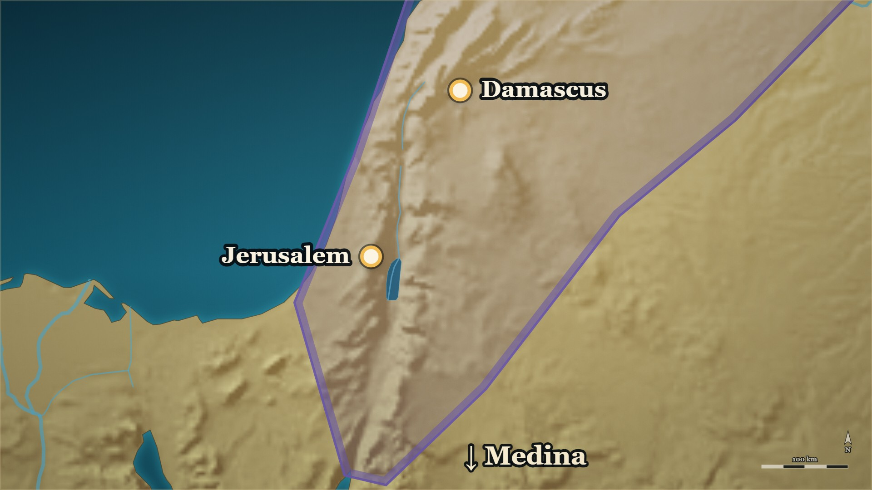








Early 13 AH, Syria
Syria — four commanders, four roads
Yazīd ؓ
al-Balqāʾ
Shuraḥbīl ؓ
Jordan, or Buṣrā
Abū ʿUbayda ؓ
al-Jābiya
ʿAmr ؓ
al-ʿAraba
Notes:
⚠ The provinces are named, not taken. Nothing is taken tonight.
SAY
1. Not one army, and not all at once
▶ CLICK 1 — Yazīd ؓ, first: al-Balqāʾ.
2. Yazīd b. Abī Sufyān ؓ goes first
▶ CLICK 2 — Shuraḥbīl ؓ, after him: Jordan.
3. Shuraḥbīl b. Ḥasana ؓ, after him
▶ CLICK 3 — Abū ʿUbayda ؓ: al-Jābiya.
4. Abū ʿUbayda ؓ
▶ CLICK 4 — ʿAmr ؓ: al-ʿAraba — Palestine.
5. ʿAmr b. al-ʿĀṣ ؓ
6. Each by a road of his own
7. He was following a verse
8. Nothing is taken tonight
▶ NEXT SLIDE — the Arabic, and its lesson
──────── DETAIL — only if you need it ────────
1. Not one army, and not all at once — Early in year 13: al-Madāʾinī's date.
2. Yazīd b. Abī Sufyān ؓ goes first — The largest force: the volunteers, and the men of Mecca. Damascus is named for him. His road is by Tabūk.
3. Shuraḥbīl b. Ḥasana ؓ, after him — He has come from Khālid ؓ in Iraq. Jordan — the post first named for al-Walīd b. ʿUqba ؓ.
4. Abū ʿUbayda ؓ — Ḥimṣ is named for him. He camps at al-Jābiya.
5. ʿAmr b. al-ʿĀṣ ؓ — Palestine.
6. Each by a road of his own — Ordered so: a road that is not the other's.
7. He was following a verse — Ibn Kathīr: Yaʿqūb's words to his sons — do not enter by one gate.
8. Nothing is taken tonight — The provinces are named. Their taking belongs to later evenings.
﴿وَقَالَ يَابَنِيَّ لَا تَدْخُلُوا … مِنْ بَابٍ وَاحِدٍ وَادْخُلُوا مِنْ أَبْوَابٍ مُتَفَرِّقَةٍ …﴾ [يوسف: ٦٧]
"O my sons, do not enter by one gate; enter by separate gates."
— Yaʿqūb, peace be upon him, to his sons — Sūrat Yūsuf 67 · البدایہ والنہایہ ج۷ ص۸۳–۸۴
──────── BACKGROUND — for home, not for the lectern ────────
Each by a road of his own — Ibn Kathīr's words:
> وأمر كلَّ أميرٍ أن يسلكَ طريقًا غير طريق الآخر، لما لحظ في ذلك من المصالح
> — البدایہ والنہایہ ج7 ص83 · https://shamela.ws/book/30097/3229
> English: "And he ordered each commander to take a road other than the other's, for the benefits he saw in that."
Where each of them camped:
> فَلَمَّا وَصَلَ الْأُمَرَاءُ إِلَى الشَّامِ نَزَلَ أَبُو عُبَيْدَةَ الْجَابِيَةَ، وَنَزَلَ يَزِيدُ الْبَلْقَاءَ، وَنَزَلَ شُرَحْبِيلُ الْأُرْدُنَّ، وَقِيلَ: بُصْرَى، وَنَزَلَ عَمْرُو بْنُ الْعَاصِ الْعَرَبَةَ
> — الکامل فی التاریخ ج2 ص251 · https://shamela.ws/book/21712/942
> English: "When the commanders reached Syria, Abū ʿUbayda camped at al-Jābiya, Yazīd at al-Balqāʾ, Shuraḥbīl in
> Jordan — and it is said: at Buṣrā — and ʿAmr b. al-ʿĀṣ at al-ʿAraba."
How Shuraḥbīl ؓ came to Jordan:
> وَكَانَ قَدْ قَدِمَ شُرَحْبِيلُ بْنُ حَسَنَةَ مِنْ عِنْدِ خَالِدِ بْنِ الْوَلِيدِ إِلَى أَبِي بَكْرٍ وَافِدًا، فَأَمَرَهُ أَبُو بَكْرٍ بِالشَّامِ وَنَدَبَ مَعَهُ النَّاسَ، وَاسْتَعْمَلَهُ عَلَى عَمَلِ الْوَلِيدِ بْنِ عُقْبَةَ
> — الکامل فی التاریخ ج2 ص251 · https://shamela.ws/book/21712/942
> English: "Shuraḥbīl b. Ḥasana had come from Khālid b. al-Walīd to Abū Bakr as an envoy. Abū Bakr appointed him
> to Syria, called the people out with him, and put him over the post of al-Walīd b. ʿUqba."
⚠ What this card used to say, and the pages do not: that four provinces were given to four men at one
sitting, and that the caliph walked out beside each of them. The pages name three provinces in the banner
passage; give Jordan to al-Walīd ؓ first; send the commanders one after another; and say he walked beside
Yazīd ؓ (and, in one reading, Abū ʿUbayda ؓ). Corrected 2026-10-08, when Daniyal asked “are you sure?”
⚠ The first banner was a fifth man's — Khālid b. Saʿīd b. al-ʿĀṣ ؓ. That is , and it is held.
⚠ The roads are not named, except Yazīd's ؓ: by Tabūk (البدایہ ج7 ص84). The map draws the others in outline.
⚠ Muʿāwiya ؓ was sent later, behind his brother, with those who gathered afterwards (البدایہ ج7 ص85). Not
tonight's.

Slide 120
Early 13 AH, Syria
Syria — four commanders, four roads
وَقَالَ يَابَنِيَّ لَا تَدْخُلُوا
O my sons, do not enter
مِنْ بَابٍ وَاحِدٍ وَادْخُلُوا مِنْ أَبْوَابٍ مُتَفَرِّقَة
by one gate; enter by separate gates
— Yaʿqūb, peace be upon him, to his sons — Sūrat Yūsuf 67
al-Bidaya wa'l-Nihaya, vol. 7, pp. 83–84
Notes:
READ the Arabic on the slide — then its English.
WHO IS SPEAKING — Yaʿqūb, peace be upon him, to his sons — Sūrat Yūsuf 67
LESSON — A plan is safer when it is not one plan.
──────── DETAIL — only if you need it ────────
﴿وَقَالَ يَابَنِيَّ لَا تَدْخُلُوا … مِنْ بَابٍ وَاحِدٍ وَادْخُلُوا مِنْ أَبْوَابٍ مُتَفَرِّقَةٍ …﴾ [يوسف: ٦٧]
"O my sons, do not enter by one gate; enter by separate gates."
— البدایہ والنہایہ ج۷ ص۸۳–۸۴

Slide 121
13 AH, Syria
Heraclius, to the Romans
The four columns are on the road. The Romans write to their emperor.
ويْحكم إن (هؤلاء) أهلُ دينٍ جديد
Woe to you — these are the people of a new religion
وإنهم لا قبلَ لأحدٍ بهم
and no one has the strength to face them.
— Heraclius, to the Romans — as Ibn Kathīr reports it
al-Bidaya wa'l-Nihaya, vol. 7, p. 86
Notes:
⚠ A Muslim historian's report of a Roman council. Narrate it as the book's.
⚠ Stop at “they refused”. The armies are the next evening.
SAY
1. The four columns are on the road
2. “They feared greatly”
3. Where he was
4. Read what he said
↑ read the Arabic on the slide
5. His advice: make peace
6. “Refuse, and they will take Syria”
7. They refused
8. Stop here
LESSON — He saw it, and said it, and was not listened to.
ASK — Before the name is said: who do you think spoke these words?
▶ NEXT SLIDE — the same words go on (2 slides in all)
──────── DETAIL — only if you need it ────────
1. The four columns are on the road — And the Romans hear of it.
2. “They feared greatly” — And they wrote to Heraclius, the emperor of the Romans.
3. Where he was — At Ḥimṣ, it is said; or on pilgrimage that year at Bayt al-Maqdis. Ibn al-Athīr: in Jerusalem.
4. Read what he said — “The people of a new religion; no one has the strength to face them.”
5. His advice: make peace — Half the revenue of Syria, and the mountains remain yours.
6. “Refuse, and they will take Syria” — And press you hard in your mountains as well.
7. They refused — “They snorted at that”, the page says. He went to Ḥimṣ, and ordered the armies out.
8. Stop here — What the armies did is the next evening.
ويْحكم إن (هؤلاء) أهلُ دينٍ جديد، وإنهم لا قبلَ لأحدٍ بهم، فأطيعوني وصالحوهم بما تصالحونهم على نصفِ خراج الشام ويبقى لكم جبالُ الروم، وإن أنتم أبيتم ذلك أخذوا منكم الشام وضيقوا عليكم جبال الروم
“Woe to you — these are the people of a new religion, and no one has the strength to face them. So obey me, and make peace with them — on half the revenue of Syria, and the mountains of the Romans remain yours. If you refuse that, they will take Syria from you, and press you hard in the mountains of the Romans.”
— Heraclius, to the Romans — as Ibn Kathīr reports it · البدایہ والنہایہ ج۷ ص۸۶
──────── BACKGROUND — for home, not for the lectern ────────
The same, as Ibn al-Athīr has it:
> فَبَلَغَ الرُّومُ ذَلِكَ فَكَتَبُوا إِلَى هِرَقْلَ، وَكَانَ بِالْقُدْسِ، فَقَالَ: أَرَى أَنْ تُصَالِحُوا الْمُسْلِمِينَ، فَوَاللَّهِ لَأَنْ تُصَالِحُوهُمْ عَلَى نِصْفِ مَا يَحْصُلُ مِنَ الشَّامِ وَيَبْقَى لَكُمْ نَصِفُهُ مَعَ بِلَادِ الرُّومِ - أَحَبُّ إِلَيْكُمْ مِنْ أَنْ يَغْلِبُوكُمْ عَلَى الشَّامِ وَنِصْفِ بِلَادِ الرُّومِ. فَتَفَرَّقُوا عَنْهُ وَعَصَوْه
> — الکامل فی التاریخ ج2 ص251 · https://shamela.ws/book/21712/942
> English: “Word of that reached the Romans, and they wrote to Heraclius — he was in Jerusalem. He said: I think you should make peace with the Muslims. By God, to make peace with them for half of what Syria yields, and keep half of it along with the land of the Romans, is dearer to you than that they overcome you for Syria and half the land of the Romans. And they scattered from him, and disobeyed him.” Where he was, and what they did with his advice:
> فيقال: إنه كان يومئذ بحمص، ويقال: [بل] كان حج عامه ذلك إلى بيت المقدس
> — البدایہ والنہایہ ج7 ص86 · https://shamela.ws/book/30097/3232
> English: “It is said that he was at Ḥimṣ that day; and it is said: rather, he had made pilgrimage that year to Bayt al-Maqdis.” > فنخروا من ذلك نخرةَ حُمُرِ الوَحْش
> — البدایہ والنہایہ ج7 ص86 · https://shamela.ws/book/30097/3232
> English: “And they snorted at that, the snort of wild asses.” ⚠ A Muslim historian's report of a Roman council — Ibn Kathīr marks it as Sayf's telling, with others. Narrate
it as what the book carries; build nothing on its wording.
⚠ Stop at “they refused”. The deployments that follow on the same page — ninety thousand against ʿAmr ؓ, and the
rest — are and the next evening.
⚠ Heraclius is new to the room. One breath: the emperor of the Romans. No dates for him are on a page we hold.

Slide 122
13 AH, Syria
Heraclius, to the Romans
فأطيعوني وصالحوهم بما تصالحونهم على نصفِ خراج الشام ويبقى لكم جبالُ الروم
So obey me, and make peace with them — on half the revenue of Syria, and the mountains of the Romans remain yours.
وإن أنتم أبيتم ذلك أخذوا منكم الشام وضيقوا عليكم جبال الروم
If you refuse that, they will take Syria from you, and press you hard in the mountains of the Romans.
— Heraclius, to the Romans — as Ibn Kathīr reports it
al-Bidaya wa'l-Nihaya, vol. 7, p. 86
Notes:
READ the Arabic — the same words, continued (slide 2 of 2).
Each part: the Arabic, then its meaning.
──────── DETAIL — only if you need it ────────
فأطيعوني وصالحوهم بما تصالحونهم على نصفِ خراج الشام ويبقى لكم جبالُ الروم
So obey me, and make peace with them — on half the revenue of Syria, and the mountains of the Romans remain yours.
وإن أنتم أبيتم ذلك أخذوا منكم الشام وضيقوا عليكم جبال الروم
If you refuse that, they will take Syria from you, and press you hard in the mountains of the Romans.

Slide 123
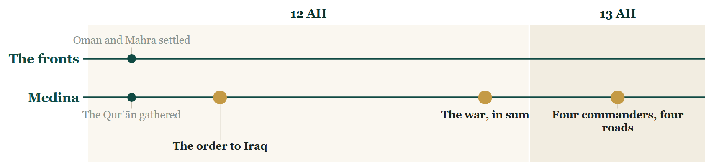
Tonight on the Line
Notes:
THE CLOSE — the Line
SAY
1. The Ridda, whole: every front, one colour.
2. Muḥarram of year 12 — the order to Iraq.
3. Early in year 13 — four commanders, four roads.
4. And nothing taken yet.

Slide 124
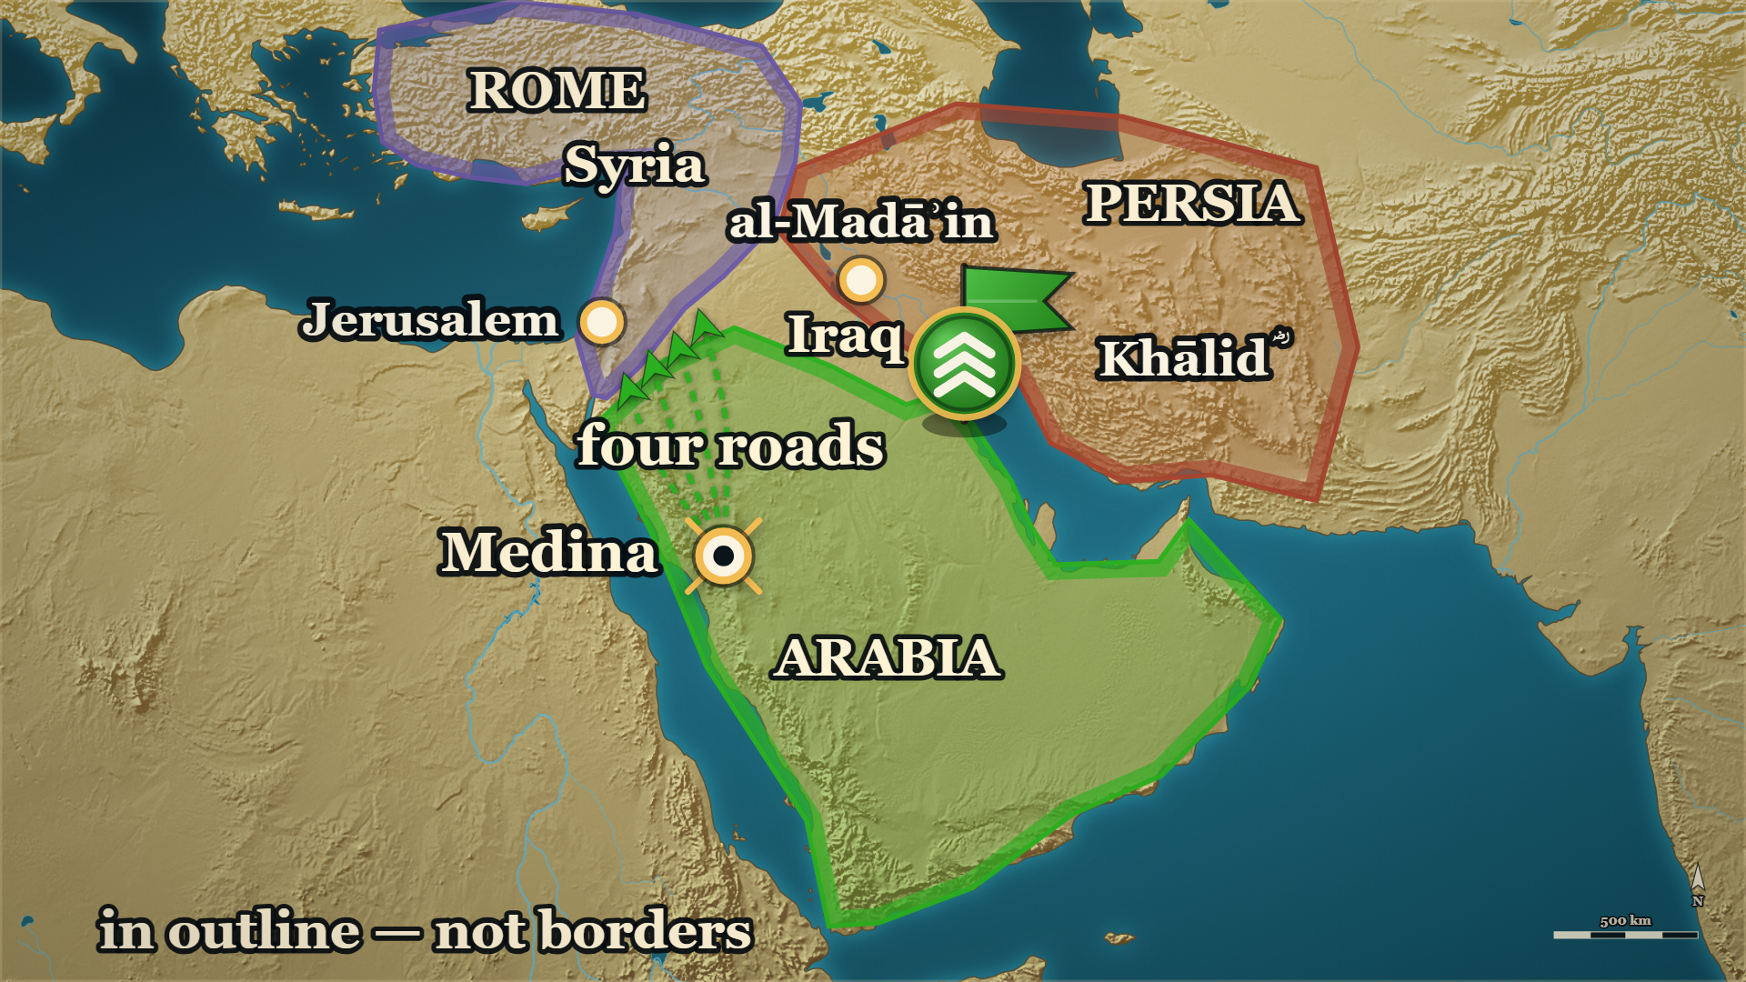
13 AH, beyond Arabia
Where we stand
Iraq
Khālid ؓ at its lower end; a letter
Syria
four commanders, four roads — nothing taken
Notes:
THE CLOSE — the map
SAY
1. When you came in, the map ended at Arabia's edge.
2. East: one commander, and one letter.
3. North: four commanders, on four roads.
4. Not a town has been taken.

Slide 125
Tonight
Persia
al-Muthannā
Khālid's ؓ letter
Syria
Yazīd ؓ
Rome
Notes:
TONIGHT — say each name, then its line
SAY
1. Persia
2. al-Muthannā
3. Khālid's ؓ letter
4. Syria
5. Yazīd ؓ
6. Rome
──────── DETAIL — only if you need it ────────
1. Persia — The throne they were about to face had been emptied by its own family.
2. al-Muthannā — The order from the capital found a man already doing the work.
3. Khālid's ؓ letter — A man who has made peace with his own death is very difficult to bargain with.
4. Syria — He did not open a new road. He took up one the Prophet ﷺ had already set out on.
5. Yazīd ؓ — An appointment is a trial, not a reward, and saying so at the start is what makes the dismissal fair later.
6. Rome — He saw it, and said it, and was not listened to.

Slide 126
Next week
The emperor of the Romans told them: make peace. They refused him. What did it cost them?
Notes:
Ask it, and pause. Then a loud السلام علیکم — and the dua. The room must know it has ended.

