Slide 1
One night, and the whole map
وقت، جگہ، اور ایک رات
Where we are in time · where we are on the map · and one night in Medina
LESSONS FROM HISTORY · SESSION 1 OF 10

Slide 2
THE DESTINATION, NAMED FIRST
Almost none of us could name three men
who were in that courtyard.
On a Monday in 11 AH, in a covered courtyard in Medina, a small number of men decided who would lead the Muslims after the Prophet ﷺ.
Tonight we fix that. But not yet — first, when are we, and where?
Notes:
0:00 (2 min). Say the Q&A policy here: no questions during the 45 minutes, slips into the box at the door, I stay 15 minutes afterwards. Say it once, apply it all ten weeks.

Slide 3
WHAT IS TARIKH?
History is events —
and the order they came in.
Every discipline asks what happened. Tarikh's own question is WHEN, and IN WHAT ORDER.
تاریخ یعنی واقعات، اور ان کی ترتیب
Notes:
0:02 (4 min). Definition from the muqaddima, printed pp.32-33 (al-Sakhawi's wording). Do not turn this into a methodology lecture — see DECISIONS.md #9.

Slide 4
WHY THE ORDER MATTERS
لَمَّا اسْتَعْمَلَ الرُّوَاةُ الْكَذِبَ اسْتَعْمَلْنَاهُمُ التَّارِيخَ
“When the transmitters began to deal in lies,
we dealt with them by means of dates.”
Sufyan al-Thawri · muqaddima, printed p.57 · verified

Slide 5
HOW CHRONOLOGY CATCHES A LIE
A forgery dies on a date.
A document was produced claiming the Prophet ﷺ exempted the people of Khaybar from taxes.
Al-Khatib al-Baghdadi destroyed it without arguing about content at all:
one witness named on it accepted Islam AFTER Khaybar; another had died BEFORE it.
Notes:
0:04. muqaddima printed p.58 - verified. This is why the whole course is built on a timeline. Keep it to 90 seconds.

Slide 6
BEFORE WE GO ANY FURTHER
Three disciplines. One report. Three different jobs.
HADITH
FIQH
TARIKH
A report must be authentic
before it can bind.
It carries the deen.
A report is weighed for
what it obliges.
It carries a ruling.
A report is recorded to fix
what happened, and
in what order.
So a tarikh report is not a ruling, and it is not a creed.
تاریخِ اسلام = تاریخِ مسلمین ۔ یہ مسلمانوں کی تاریخ ہے، دین کا ماخذ نہیں
Notes:
0:05. THE MOST IMPORTANT SLIDE IN THE DECK. Sixty seconds, said calmly, once. Finish with: we narrate what the books narrate, and we do not judge between the Companions. DECISIONS.md #14. Session 3 carries the fuller fiqh of the mushajarat.

Slide 7
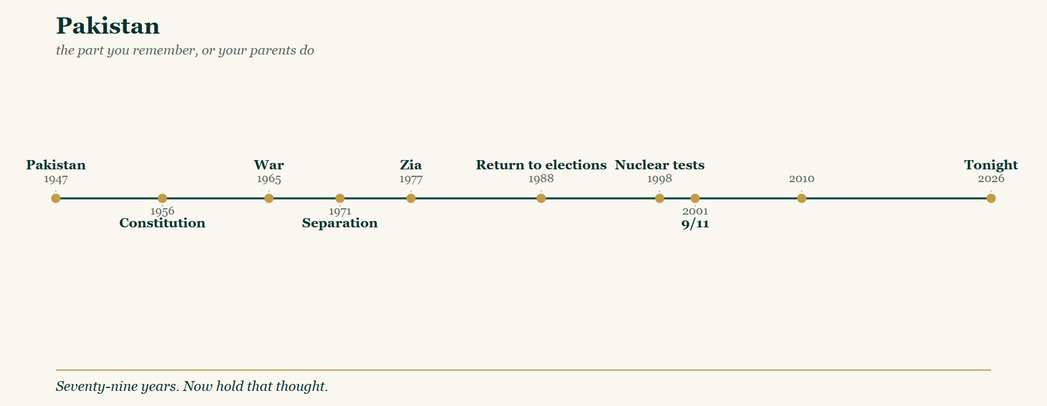
You remember some of this
TIMELINE 1 · 1947 → tonight
Notes:
0:06 (3 min). Name the pegs, do not discuss them. Hand out the worksheet here. If short on time this block goes to 90 seconds.

Slide 8
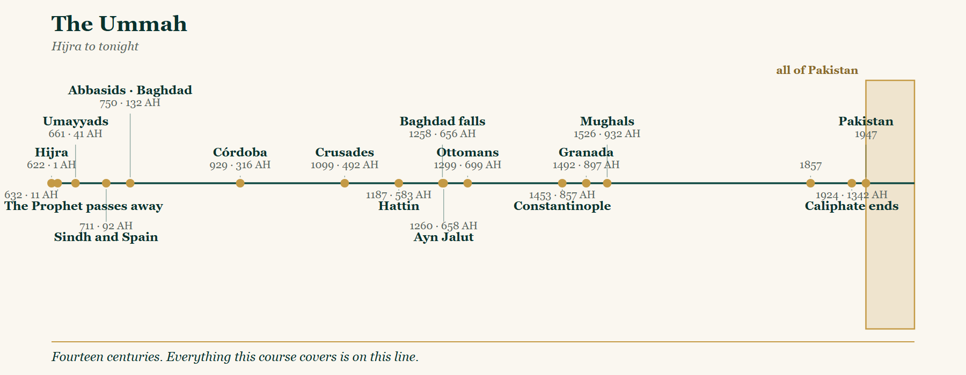
All of that is the last centimetre
TIMELINE 2 · 1 AH → tonight
Notes:
0:09 (5 min). THE WHOLE ARC. This is the only place tonight the room sees all fourteen centuries. Point at each peg and name the session it belongs to. Everything this course covers is on this line.

Slide 9
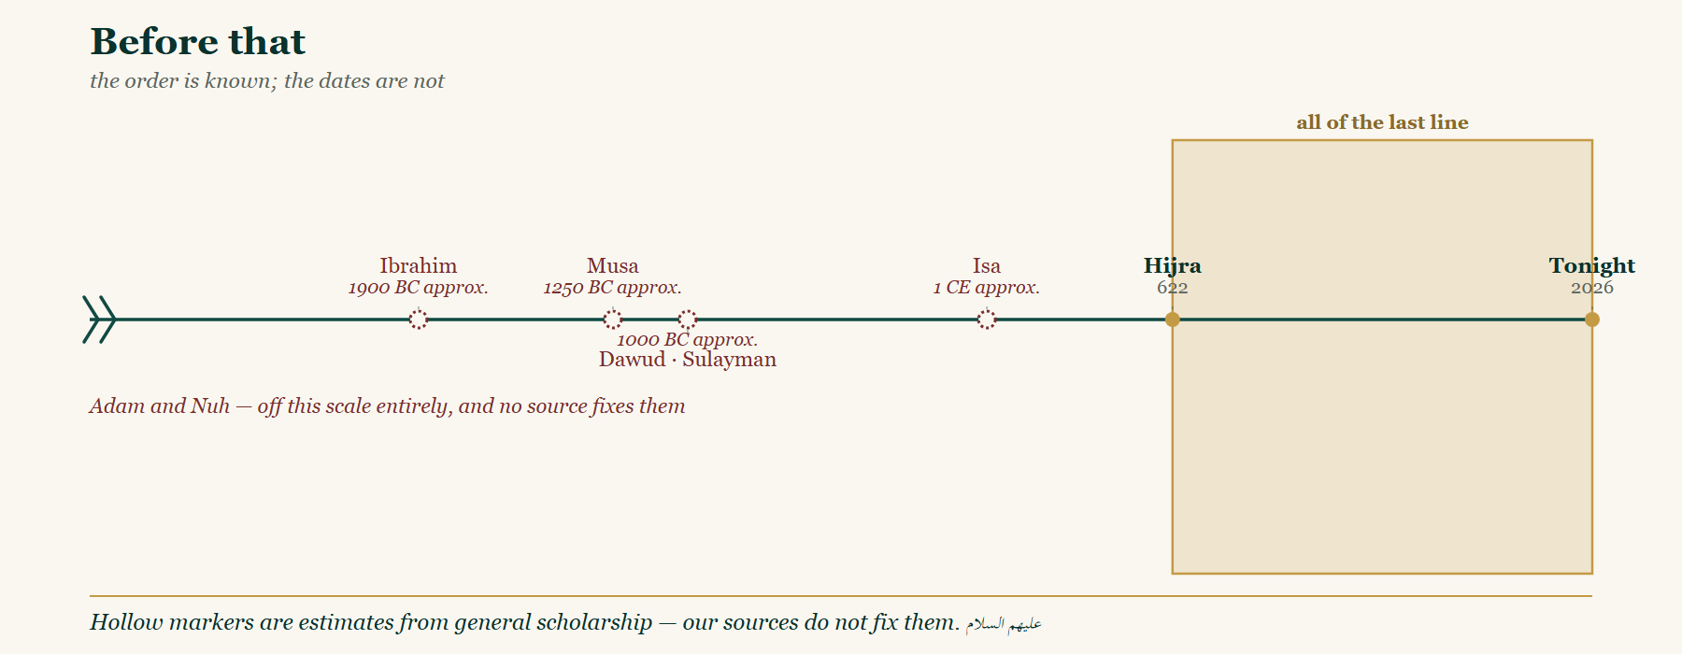
And all of THAT is the last centimetre
TIMELINE 3 · the order is known; the dates are not
Notes:
0:14 (3 min). CAREFUL AND HONEST. The hollow markers are conventional estimates from general scholarship. Our sources do NOT fix dates for Adam, Nuh, Ibrahim, Musa or Dawud. Adam and Nuh are off-scale with no number at all. Say: the order is known from revelation, the dates are not - and what we do not know, we do not claim. DECISIONS.md #16. This is the strongest credibility moment of the evening.

Slide 10
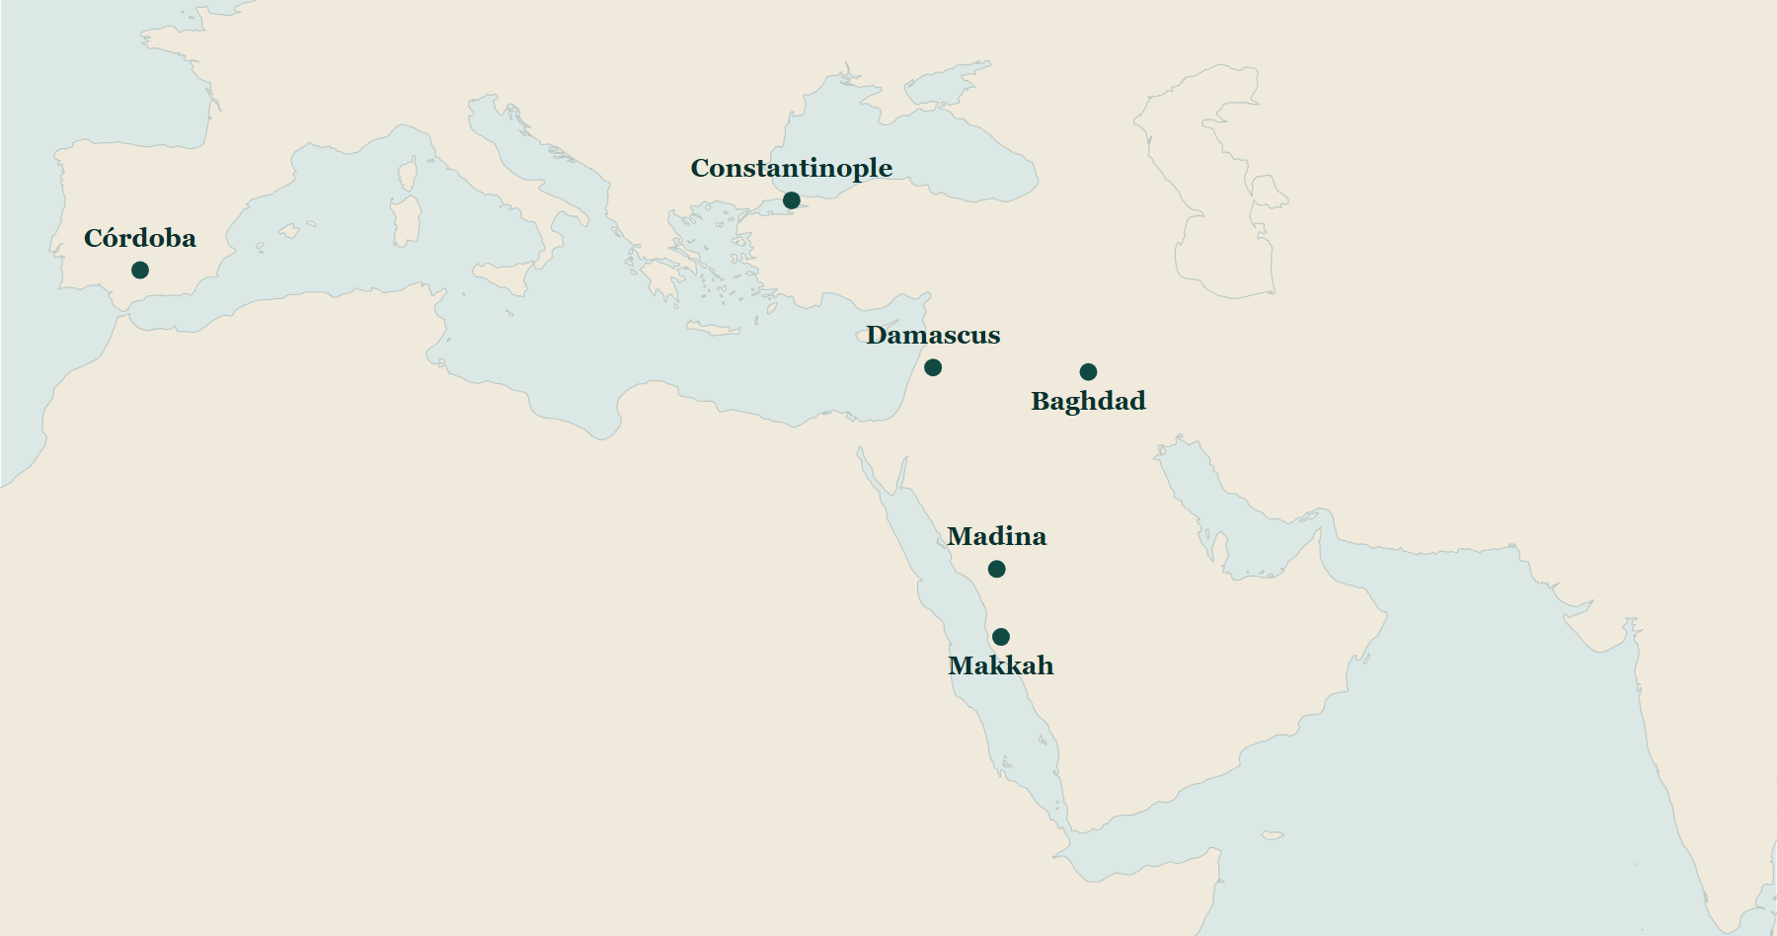
The edge of the world, not its centre
c. 11 AH / 632 CE
Notes:
0:17 (4 min). Rome to the north-west, Persia to the north-east, and Arabia between them. Place the six anchor cities. TO DO: a dedicated empires overlay would be better than the blank base - see MAPS.md / mapstudio.

Slide 11
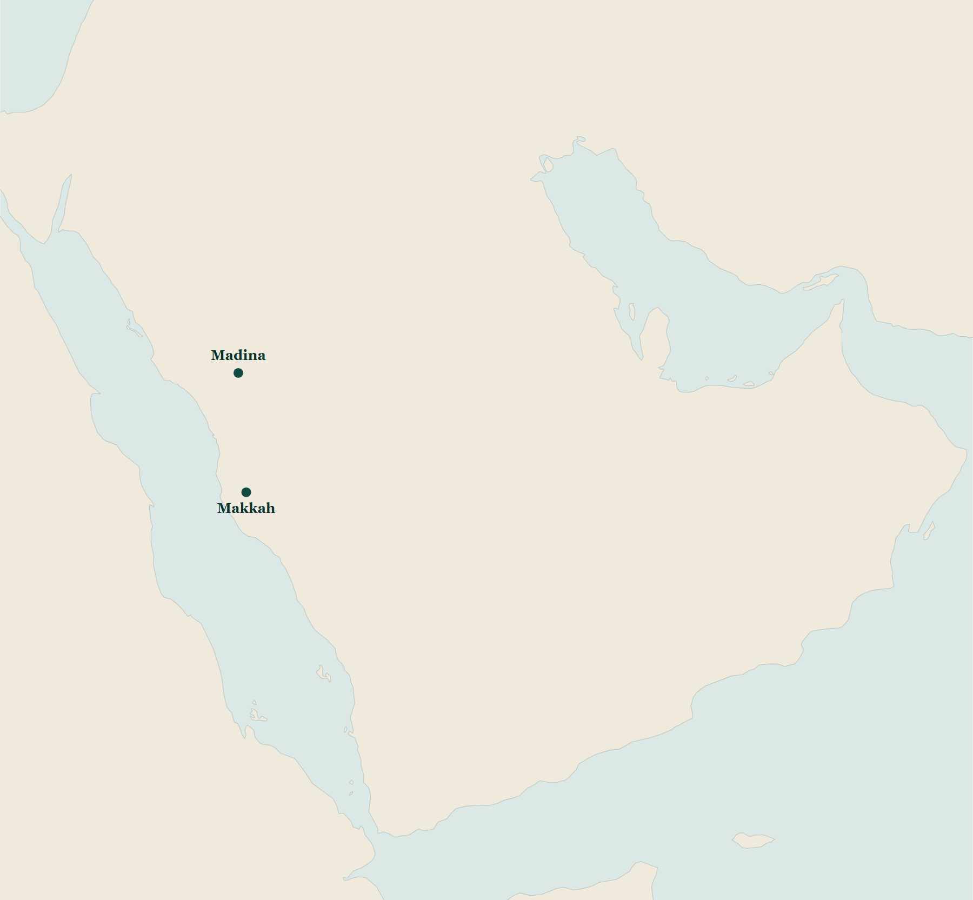
Arabia itself
tribes, and where they sat
Notes:
0:21 (3 min). Makkah, Madina, al-Ta'if, al-Yamama, Najran, San'a, al-Bahrayn, Uman, Hadramawt. Tribal blocs from docs/research/arabian-tribes-and-the-ridda-setup.md.

Slide 12
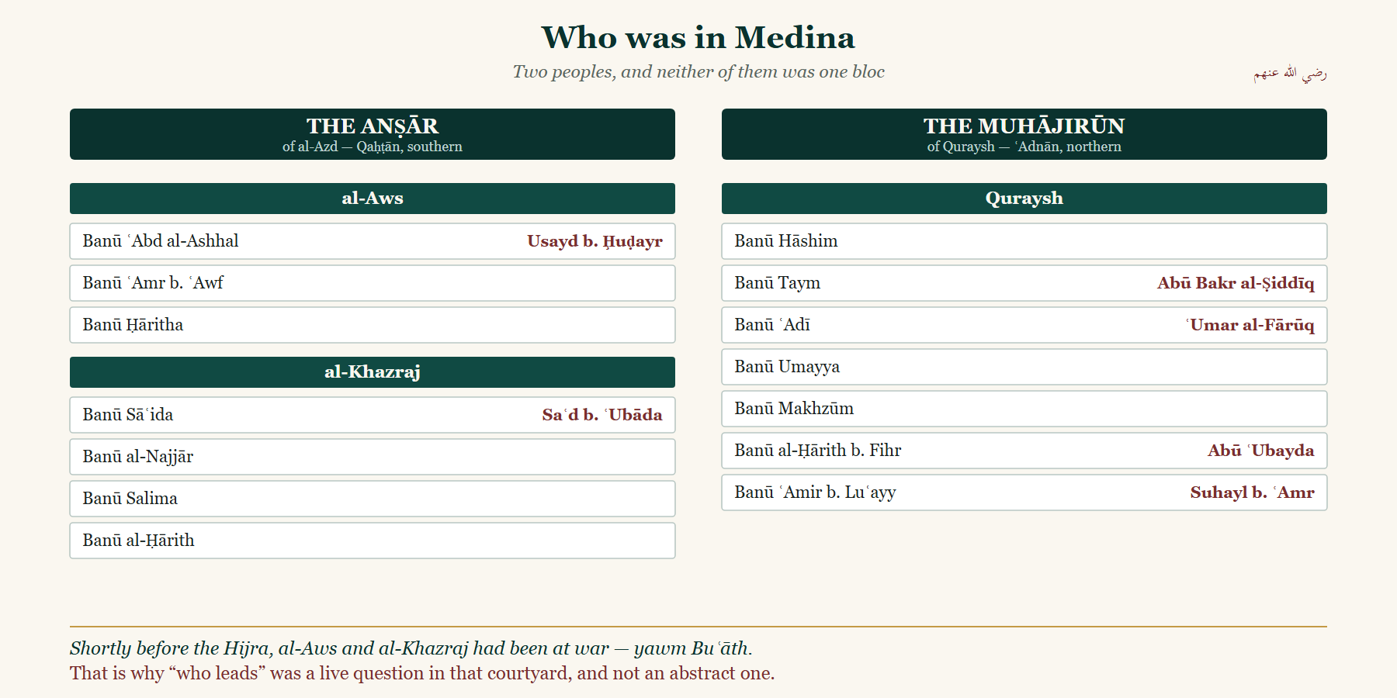
Two peoples — and neither was one bloc
MADINA, 11 AH
Notes:
0:24 (6 min). THE LOAD-BEARING BLOCK. SHOW the chart; do NOT read it aloud - eight sub-clans narrated will lose the room. Name FOUR men out loud, each with his clan. The worksheet version is blank and they write the chiefs in themselves - that is tonight's hand-writing ritual (DECISIONS.md #15). Quraysh tree: al-Bidaya j2 p485, p493.

Slide 13
YAWM BUʿATH
Shortly before the Hijra,
al-Aws and al-Khazraj had been at war.
That is why “who leads” was a live question in that courtyard, and not an abstract one.
The Ansar are of al-Azd — Qahtan, southern. Quraysh are ʿAdnan, northern.
An old fault line, and it was in the room.
Notes:
0:28. Thirty seconds each on Bu'ath and on Adnan/Qahtan. No more.

Slide 14
11 AH
Then, on a Monday, he died.
ربیع الاول، گیارہویں ہجری ۔ مدینہ میں
Notes:
0:30. al-Bidaya j5 p336-342. Umar (ra) stood and said he had not died. Abu Bakr (ra) rode in from al-Sunh, uncovered his blessed face, and then spoke.

Slide 15
ABU BAKR AL-SIDDIQ, THAT MORNING
مَنْ كَانَ يَعْبُدُ مُحَمَّدًا فَإِنَّ مُحَمَّدًا قَدْ مَاتَ، وَمَنْ كَانَ يَعْبُدُ اللَّهَ فَإِنَّ اللَّهَ حَيٌّ لَا يَمُوتُ
“Whoever used to worship Muhammad — Muhammad has died.
Whoever worships Allah — Allah is living and does not die.”
al-Bidaya wa'l-Nihaya · Ibn Kathir · vol. 5, p. 340-341
Notes:
He then recited Al Imran 144. Ibn Abbas (ra): it was as though the people had never known the verse until that day. al-Bidaya j5 p340-342.

Slide 16
SAQIFAT BANI SAʿIDA
Before the burial,
they went to a courtyard.
Same day. Before he ﷺ was buried. Ibn Kathir says so in those words.
Present: Saʿd b. ʿUbada (ra) — ill, wrapped up, of Banu Saʿida · Abu Bakr (ra) · ʿUmar (ra) · Abu ʿUbayda (ra)
and the Ansar of both al-Aws and al-Khazraj.
Notes:
0:31. al-Bidaya j5 p343-345. NOTE: Sa'd b. 'Ubada (ra) gives NO speech in al-Bidaya - the famous speech is Ibn Hisham/Tabari, outside the safe list. Usayd b. Hudayr (ra) and Thabit b. Qays (ra) are NOT mentioned at the Saqifah at all. Do not place them there. See QA_BANK.md 1.9.

Slide 17
THE PROPOSAL THAT WAS REFUSED
أنا جُذَيْلُهَا المُحَكَّك وعُذَيْقُهَا المُرَجَّب، منا أمير، ومنكم أمير، يا معشر قريش
“One commander from us, and one from you — O company of Quraysh.”
al-Hubab b. al-Mundhir (ra), of al-Khazraj · al-Bidaya wa'l-Nihaya · Ibn Kathir · vol. 5, p. 346

Slide 18
WHAT HE ARGUED
فما ذكَرْتُم من خير فأنتم أهله، وما تَعْرف العربُ هذا الأمر إِلَّا لهذا الحيِّ من قُرَيش
“Everything good you have mentioned — you are its people.
But the Arabs will not recognise this authority except in this clan of Quraysh.”
Abu Bakr al-Siddiq (ra) · al-Bidaya wa'l-Nihaya · Ibn Kathir · vol. 5, p. 346
Notes:
And he put forward TWO OTHER MEN, not himself - 'Umar (ra) and Abu 'Ubayda (ra). al-Bidaya j5 p346. Do NOT quote 'al-a'imma min Quraysh' - it is not carried verbatim on these pages. QA_BANK.md 1.10.

Slide 19
THE MOMENT IT TURNED
An Ansari put out his hand first.
Bashir b. Saʿd (ra) — of al-Khazraj, the father of al-Nuʿman b. Bashir (ra) —
reached Abu Bakr's (ra) hand before ʿUmar (ra) could, and the people followed.
al-Bidaya wa'l-Nihaya · Ibn Kathir · vol. 5, p. 347
Notes:
0:35. It was not Quraysh who ended it. It was one of the Ansar. That is the shape of the whole evening - say it plainly and let it sit.

Slide 20
THE WHOLE ACCOUNT IS HIS OWN — TOLD AGAINST HIMSELF
إِنَّ بيعةَ أبي بكر كانَتْ فَلْتَة، ألا وإنها كانَتْ كذلك، ألا إنَّ اللَّه وَقَى شَرَّها
“Abu Bakr's bayʿa was sudden and unarranged — yes, so it was.
And Allah protected us from its danger.”
ʿUmar al-Faruq (ra), later, from the minbar · al-Bidaya wa'l-Nihaya · Ibn Kathir · vol. 5, p. 345
Notes:
CRITICAL: never quote 'falta' without the two clauses after it. In the same breath he legislates against repeating it: whoever pledges to a man without the consultation of the Muslims, there is no bay'a for him (j5 p346). 'Falta' = sudden, unarranged - NOT illegitimate. QA_BANK.md 1.1.

Slide 21
AND FAR AWAY, IN MAKKAH
Seventeen years earlier,
at Badr, a prisoner was brought in.
Suhayl b. ʿAmr, the orator of Quraysh. ʿUmar (ra) asked permission to pull out his two front teeth,
so that he could never stand and speak against the Prophet ﷺ again.
Notes:
0:37. al-Kamil j2 p24-25.

Slide 22
THE ANSWER HE WAS GIVEN
دَعْهُ يَا عُمَرُ؛ فَسَيَقُومُ مَقَامًا تَحْمَدُهُ عَلَيْهِ
“Leave him, ʿUmar. He will yet stand somewhere
and you will be glad of it.”
The Prophet ﷺ, at Badr · al-Kamil fi'l-Tarikh · Ibn al-Athir · vol. 2, p. 25
Notes:
When the news reached Makkah in 11 AH and the city began to waver, the governor took cover - and Suhayl (ra) stood and addressed the people, and Makkah held. al-Bidaya j5 p397-398, al-Kamil j2 p186. HONESTY: this is maghazi reporting, NOT a sahih chain; Ibn Kathir grades his own version mursal, indeed mu'dal. SAY SO. QA_BANK.md 2.3.

Slide 23
This is the state, the night he died
11 AH · the governors, and how far it reached
Notes:
0:38 (3 min). Deliver FLATLY, as a state of affairs. No commentary. Governors from docs/research/governors-at-11h.md. Jaysh Usama (ra) is already outside Madina. TO DO before delivery: build the labelled governors map in tools/mapstudio and save the scene JSON.

Slide 24
TONIGHT'S LESSON
Nearness of blood
was not the currency.
Abu Bakr (ra) and Khalid (ra) meet the Prophet ﷺ at the same ancestor. ʿUmar (ra) is a generation further out.
Abu ʿUbayda (ra) is further out than all of them — and it was Abu ʿUbayda (ra) whom al-Siddiq (ra) was minded to name.
al-Bidaya vol. 2, pp. 485, 493 · al-Siyar vol. 1, pp. 5-6
Notes:
0:41 (2 min). Everyone writes this into the workbook by hand. Wait for them. Final Urdu wording to be set in docs/catalogue/LESSONS.md before delivery.

Slide 25
NEXT WEEK
Within months, most of that map
had broken away.
کیوں؟ اور یہ واپس کیسے آیا؟
Why? And how did it come back?
Notes:
0:43 (2 min). END ON THE QUESTION. Do NOT summarise. Put the map of Arabia back up behind this if you can. Then: slips in the box, I am here for fifteen minutes.

Slide 26
SHOW ONLY IF ASKED
Where tonight came from
al-Bidaya wa'l-Nihaya — Ibn Kathir (the Saqifah, the wafat, the clan lines)
Siyar Aʿlam al-Nubala — al-Dhahabi (the biographical notices)
al-Kamil fi'l-Tarikh — Ibn al-Athir (Suhayl b. ʿAmr)
Tarikh-e-Ummat-e-Muslima — Maulana Muhammad Ismaʿil Rehan (the muqaddima)
البدایہ والنہایہ · سیر أعلام النبلاء · الکامل · تاریخِ امتِ مسلمہ
All four are works this course's own muqaddima names and relies on.
I am reading a book. I am not writing history.
Notes:
Only if asked. Naming the frame openly is the defence - never claim a neutrality the course does not have. QA_BANK.md 2.2 and 2.4.

