Slide 1
The story so far
al-Aswad al-ʿAnsī, and the second ridda of Ṣanʿāʾ
Notes:
RECAP before Part III — paste in at the Part III boundary (slide 238 of the edited S03).

Slide 2
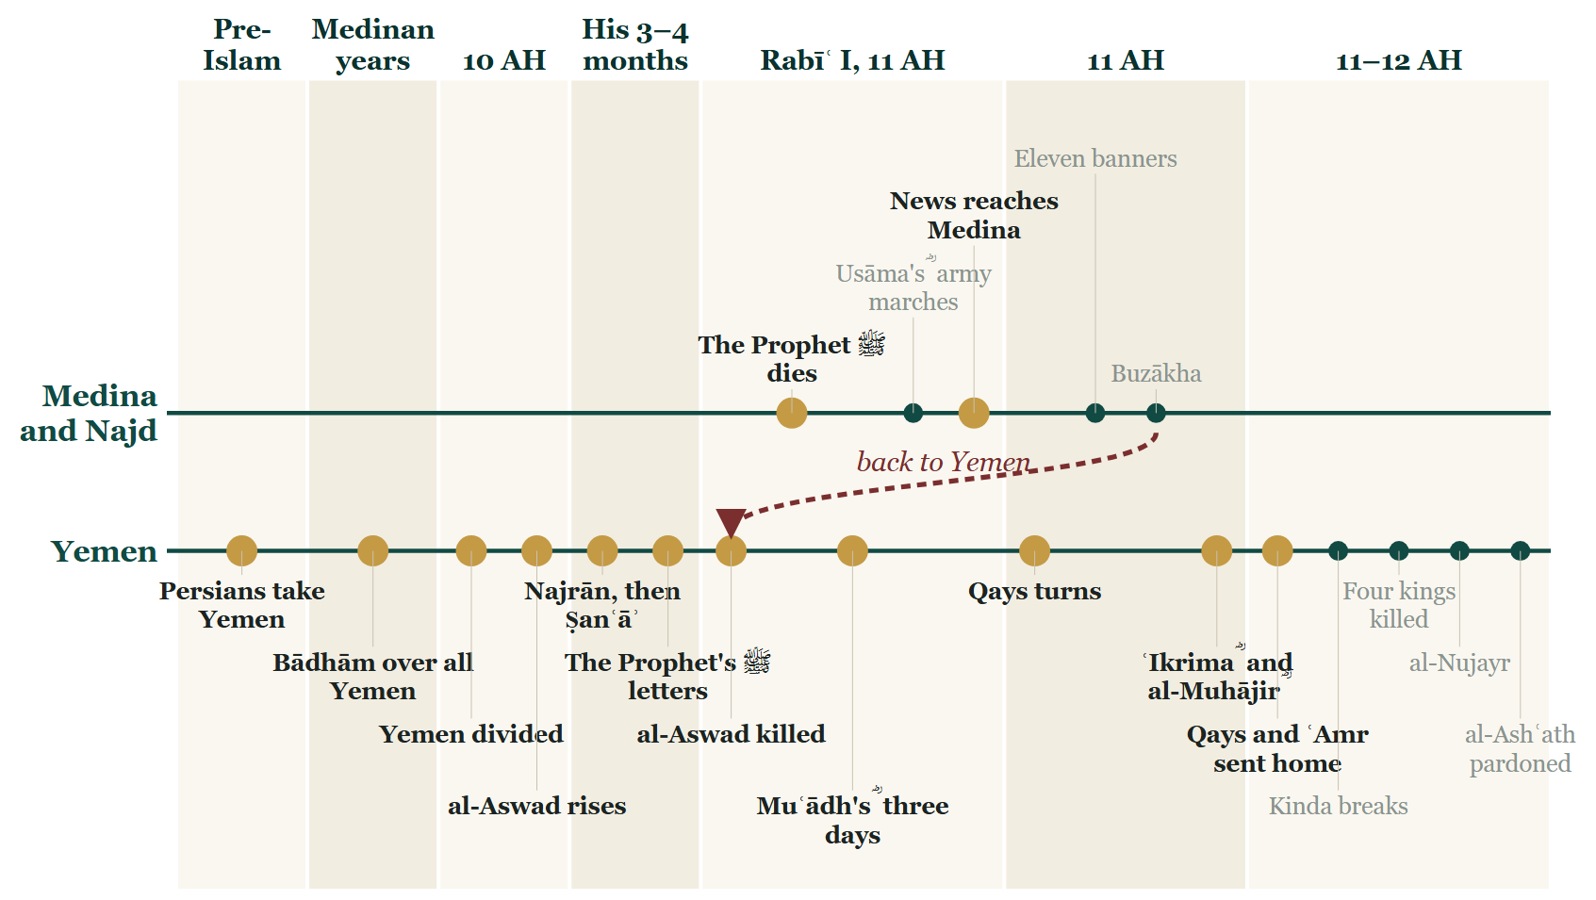
So far tonight
Notes:
The Line as it stands at STOP B: Parts I and II lit. Re-render with S03_yemen/make_timeline.py.

Slide 3
Yemen before al-Aswad
The Abnāʾ
Bādhām
The division
Persians Kisrā sent with Sayf b. Dhī Yazan; they stayed, and their sons held Yemen.
Kisrā's governor accepted Islam; the Prophet ﷺ kept him over all Yemen until he died.
In 10 AH: Shahr over Ṣanʿāʾ, governors over the districts, Muʿādh ؓ teaching among them all.
Notes:
RECAP · summarises AAA/E-AW01 · AAA/E-AW02 · AAA/E-AW19 · AAA/E-AW03
Each card's own slide and speaker notes carry the full telling and the source.

Slide 4
al-Aswad al-ʿAnsī rises
ʿAbhala
Najrān, then Ṣanʿāʾ
Dhū al-Khimār, of ʿAns in Madhḥij; he came out after Ḥajjat al-Wadāʿ, 10 AH, with seven hundred men.
Najrān in ten nights; Shahr killed outside Ṣanʿāʾ; the city his in twenty-five.
Notes:
RECAP · summarises AAA/E-AW04 · AAA/E-AW05
Each card's own slide and speaker notes carry the full telling and the source.

Slide 5
His months in Ṣanʿāʾ
The governors scatter
Three or four months
Muʿādh ؓ and Abū Mūsā ؓ to Ḥaḍramawt; others to Medina and to ʿAkk.
He held Yemen; the Muslims who stayed dealt with him warily.
Notes:
RECAP · summarises AAA/E-AW06 · AAA/E-AW07 · AAA/E-AW15
Each card's own slide and speaker notes carry the full telling and the source.

Slide 6
Ṣanʿāʾ: the plan
The letters
The plan
The Prophet ﷺ wrote to the men of Ṣanʿāʾ: fight him, in the open or by stealth.
Fayrūz, Dādhawayh and Qays; Shahr's widow told them of the one room without a guard.
Notes:
RECAP · summarises AAA/E-AW08 · AAA/E-AW09 · AAA/E-AW10 · AAA/E-AW11 · AAA/E-AW12
Each card's own slide and speaker notes carry the full telling and the source.

Slide 7
Ṣanʿāʾ: the night, Rabīʿ I 11 AH
The night
The dawn
Through the wall, and al-Aswad was killed. The reports differ on the details.
The adhān from the wall, with a new sentence: and that ʿAbhala is a liar.
Notes:
RECAP · summarises AAA/E-AW13 · AAA/E-AW14
Each card's own slide and speaker notes carry the full telling and the source.

Slide 8
How we know, and when
In al-Bukhārī
Nights before
Three days
al-ʿAnsī, whom Fayrūz killed in Yemen.
He was killed before the Prophet ﷺ died; the news reached Medina at the end of Rabīʿ I.
Muʿādh ؓ led them in prayer three days — then came the news of the Prophet's ﷺ death.
Notes:
RECAP · summarises AAA/E-AW20 · ATA/E-TB26 · AAA/E-AW15 · ABU/E-U9 · ATA/E-TB27
Each card's own slide and speaker notes carry the full telling and the source.

Slide 9
Ṣanʿāʾ again, 11 AH
Qays turns
The Abnāʾ driven out
One of the three wanted Yemen for himself; two letters went to the same five chiefs.
Dādhawayh killed at a meal; Fayrūz ؓ escaped to Khawlān; the families were deported.
Notes:
RECAP · summarises AAA/E-AW16 · TSY/E-YK01 · RCT/E-RC31 · TSY/E-YK02 · TSY/E-YK03
Each card's own slide and speaker notes carry the full telling and the source.

Slide 10
The Yemen restored
Fayrūz's ؓ war
Two armies
The families were brought back, and Qays was beaten short of Ṣanʿāʾ.
ʿIkrima ؓ along the coast to Abyan; al-Muhājir ؓ through Najrān to Ṣanʿāʾ.
Notes:
RECAP · summarises TSY/E-YK17 · TSY/E-YK04 · TSY/E-YK05
Each card's own slide and speaker notes carry the full telling and the source.

Slide 11
Judged at Medina
Qays
ʿAmr
Sent home
Charged with killing the servants of Allah; he denied it, and the blood was let go.
b. Maʿdī Karib: every day routed or taken prisoner? He answered: I will turn to it, and not go back.
Abū Bakr ؓ accepted what they showed, left what was inside them to Allah, and released them.
Notes:
RECAP · summarises TSY/E-YK06 · TSY/E-YK18 · RCT/E-RC32
Each card's own slide and speaker notes carry the full telling and the source.

Slide 12
Who we have met
al-Aswad
Fayrūz ؓ
Qays
ʿAbhala of ʿAns, Dhū al-Khimār; rose 10 AH, killed in Ṣanʿāʾ, Rabīʿ I 11 AH.
Of the Abnāʾ; went first through the wall; escaped Qays to Khawlān.
b. Makshūḥ: al-Aswad's commander, one of the three; turned; sent home by Abū Bakr ؓ.
Notes:
RECAP · summarises AAA/E-AW04 · AAA/E-AW13 · TSY/E-YK02 · AAA/E-AW07 · RCT/E-RC32
Each card's own slide and speaker notes carry the full telling and the source.

Slide 13
And two Companions
Muʿādh ؓ
al-Muhājir ؓ
The teacher of Yemen; he led the prayer in Ṣanʿāʾ for three days.
Umm Salama's ؓ brother; the Prophet ﷺ had appointed him over Kinda.
Notes:
RECAP · summarises AAA/E-AW03 · ATA/E-TB27 · TSY/E-YK04
Each card's own slide and speaker notes carry the full telling and the source.

Slide 14
Where we stand
Ṣanʿāʾ
restored
IMAGE GOES HERE
MAP STUDIO, not Gemini: open tools/mapstudio/scenes/s03-close-stop-b.json, export, place here.
Ḥaḍramawt
still to come
Notes:
MAP: tools/mapstudio/scenes/s03-close-stop-b.json — Ṣanʿāʾ blue, Ḥaḍramawt still grey.

Slide 15
The lessons so far
The men came to her with half a plan; she was the one who finished the sentence.
A man who had just put down a rebellion had three quiet days, and then heard the news that undid them.
The man who comes to ask your advice has not always come for your advice.
The state judged what it could see and left what it could not see to the One who sees it.
Notes:
عبرت lines from AAA/E-AW10, ATA/E-TB27, TSY/E-YK01, RCT/E-RC32 — the same four as the STOP B close.

Slide 16
Next: Ḥaḍramawt and Kinda
The Prophet ﷺ had appointed al-Muhājir ؓ over Kinda. From Ṣanʿāʾ, he went on to his post.
Notes:
BRIDGE into Part III (TSY/E-YK04; al-Kāmil vol. 2, p. 229). Then the Ḥaḍramawt map.

