Slide 1
Evening 5
What al-Yamāma cost
12 AH

Slide 2
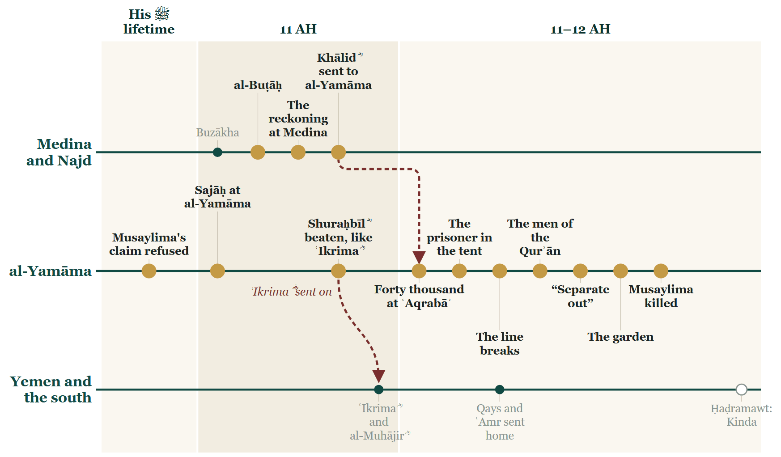
Where we stopped
Notes:
BOOKEND IN — last week's closing Line, unchanged.
SAY — Last week ended with al-Yamāma taken: the garden, the gate, Musaylima dead, and the treaty kept against the caliph's letter.

Slide 3
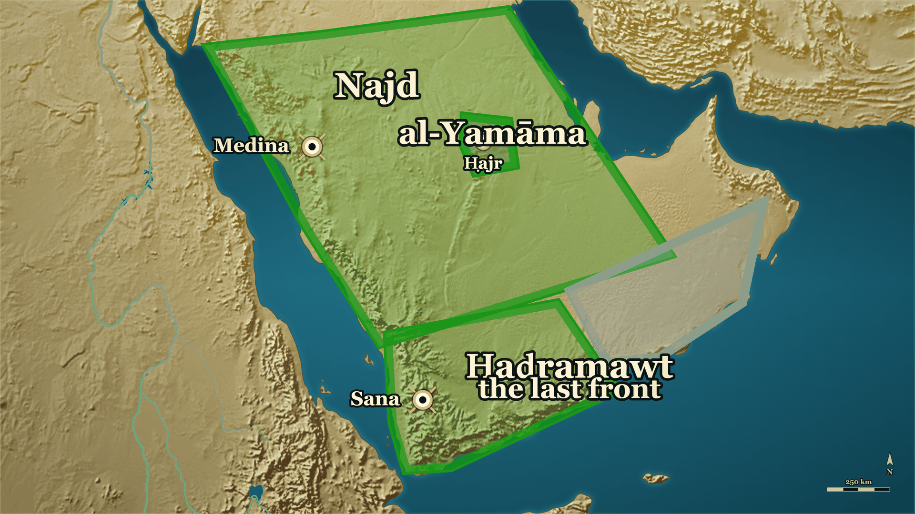
From last week
Where we stand
al-Yamāma
taken
Ḥaḍramawt
the last front
Notes:
BOOKEND IN — last week's closing map, unchanged.
SAY — Tonight: what was signed at the forts, what that day cost — and where the man sent away from al-Yamāma before the battle had gone.

Slide 4
Part I
How the day ended (12 AH)

Slide 5
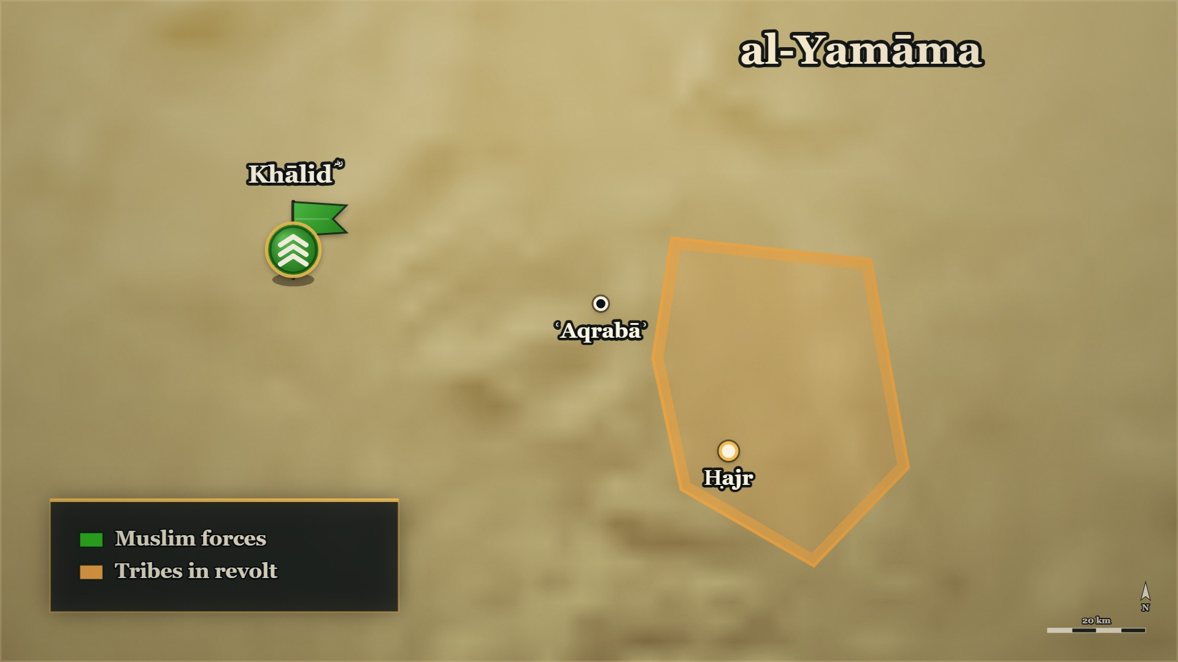






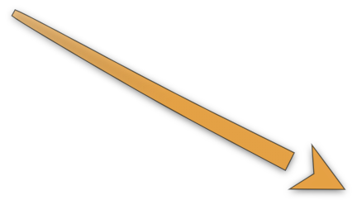










Last week, in one minute
The day at ʿAqrabāʾ
The garden
the gate shut, then opened
Musaylima
falls
The forts
where the terms were made
Notes:
SAY — Last week ended with al-Yamāma taken. Here is the end of that day again, in five moves — and then what was signed.
▶ CLICK 1 — Banū Ḥanīfa break, and fall back into a walled garden. The gate shuts behind them.
▶ CLICK 2 — al-Barāʾ b. Mālik ؓ: throw me over — over the wall, on a shield raised on spears.
▶ CLICK 3 — He fights at the gate and opens it, and the army pours in.
▶ CLICK 4 — In a gap in the wall, Musaylima falls.
▶ CLICK 5 — The survivors reach the forts. And this is where tonight begins: what was signed there.

Slide 6
12 AH, the forts of al-Yamāma
The terms at the forts
… صالحه على الصفراء والبيضاء والحلقة والكراع، وعلى نصف الرقيق، وعلى حائط من كل قرية
…made terms with him on the gold and the silver, the armour and the horses, half of the slaves, and a walled garden from every village
Siyar A'lam al-Nubala (al-Rashidun), p. 48
Notes:
NOTE — Answers the question evening 4 left the speaker without. al-Kamil, vol. 2, p. 218: first "everything except lives", then gold, silver, weapons and half the captives — «وقيل: ربعه». Siyar (al-Rashidun), p. 48 (ʿUrwa): gold and silver, armour and horses, half the slaves, and one walled garden from every village. Salama b. ʿUmayr: fight on — the fort is strong, the food plentiful, winter has come; Mujjāʿa: do not obey him. ⚠ Do not retell the trick — it was told on evening 4
SAY —
1. Where we left them — Banū Ḥanīfa broken, the survivors in their forts, and the army worn out.
2. Mujjāʿa's offer — "Only the first of them came at you; the forts are full. Make terms for what is behind me."
3. The first terms — Everything, except their lives.
4. The refusal you already know — The women on the walls: he came back saying his people would not accept it.
5. What was finally agreed — Gold and silver, armour and horses, half the captives — some say a quarter.
6. And a garden in every village — One walled garden from every village of al-Yamāma.
^ read the Arabic on the face here
7. The man who said no — Salama b. ʿUmayr: fight on; the fort is strong, the food plentiful, winter has come.
8. Mujjāʿa's answer — "Do not obey him — he is ill-omened." They obeyed Mujjāʿa, and the terms were made.
QUOTE — فلم يزل مجاعة حتى صالحه على الصفراء والبيضاء والحلقة والكراع، وعلى نصف الرقيق، وعلى حائط من كل قرية، فتقاضوا على ذلك.
"Mujjāʿa kept at him until he made terms with him on the gold and the silver, the armour and the horses, half of the slaves, and a walled garden from every village — and they settled on that."
— سیر أعلام النبلاء (سير الخلفاء الراشدين) ص۴۸ (from ʿUrwa)
عبرت — The terms took their weapons and their wealth, and left them their lives.
The first offer, and why he settled — الکامل ج۲ ص۲۱۸ (https://shamela.ws/book/21712/909): the first
terms were «فَصَالَحَهُ عَلَى كُلِّ شَيْءٍ دُونَ النُّفُوسِ» — everything except lives. After the refusal,
Khālid ؓ saw the forts full «وَقَدْ نَهَكَتِ الْمُسْلِمِينَ الْحَرْبُ وَطَالَ اللِّقَاءُ، وَأَحَبُّوا أَنْ يَرْجِعُوا عَلَى
الظَّفَرِ» — the war had worn the Muslims down, the fighting had been long, and they wanted to go home with
the victory. The final terms in Ibn al-Athīr's words: «وَصَالَحَهُ خَالِدٌ عَلَى الذَّهَبِ وَالْفِضَّةِ وَالسِّلَاحِ
وَنِصْفِ السَّبْيِ، وَقِيلَ: رُبْعُهُ». البدایہ ج۷ ص۳۵ has Mujjāʿa asking to go to his people «لما رأى بالمسلمين
من الجَهد وقد كَلُّوا من كثرة الحروب والقتال» — because he saw how spent the Muslims were.
Salama's objection, on the same سیر page: «يا بني حنيفة قاتلوا ولا تقاضوا خالدا على شيء، فإن الحصن حصين،
والطعام كثير، وقد حضر الشتاء» — and Mujjāʿa: «لا تطيعوه فإنه مشؤوم» — «فأطاعوا مجاعة، وقاضاهم».
⚠ Do not retell the trick — E-RC22 told the women in armour on the walls on evening 4. This card is
what was signed.
⚠ The books differ on the terms — half the captives or a quarter; al-Kāmil does not list the gardens.
Give ʿUrwa's list as سیر records it, and say *"some say a quarter"*. ابن خلدون ج۲ ص۵۰۳ has half first,
refused, then a quarter — framing only (DECISIONS.md #29), never cited alone.
Why this card exists (#61): evening 4's E-RC22 said *"he settles on terms"* and never said what they were.
BACKGROUND (read at home, not aloud) —
When Banū Ḥanīfa broke, the survivors made for their forts, and Khālid ؓ meant to send the squadrons in after them. Mujjāʿa, still his prisoner, told him that only the first rush of his people had met him and that the forts were full, and offered to make terms for everything behind him. Khālid ؓ agreed first to everything except their lives. Then Mujjāʿa went in to consult them — the trick told on evening 4 — and came back saying they refused. Khālid ؓ looked at forts that seemed full, at an army worn out by a long war, and settled for less: the gold and the silver, the armour and the horses, half of the captives — and some say a quarter — and one walled garden from every village. One man of Banū Ḥanīfa, Salama b. ʿUmayr, told his people to refuse even that: the fort was strong, the food plentiful, and winter had come. Mujjāʿa told them not to listen to him, and they did as Mujjāʿa said.

Slide 7
12 AH, al-Yamāma
To the last man
ودعاهم خالد إلى الإسلام فأسلموا عن آخرهم ورجعوا إلى الحق
And Khālid called them to Islam, and they became Muslims to the last of them and returned to the truth
al-Bidaya wa'l-Nihaya, vol. 7, p. 35
Notes:
NOTE — al-Bidaya, vol. 7, p. 35: called to Islam — «فأسلموا عن آخرهم» — and some captives given back. Siyar (al-Rashidun), p. 48: al-Zuhrī — the men in the fort came down on his judgement and were spared (⚠ say no number: the page misprints the number-word). ⚠ The page goes on to ʿAlī ؓ and the mother of Muḥammad b. al-Ḥanafiyya — not from the platform. Last beat: begun in 11 AH, finished in 12 (Ibn Kathīr, vol. 7, pp. 35–36)
SAY —
1. The terms made — And then a second call: to Islam, and to renounce what they had followed.
2. To the last man — Ibn Kathīr: they became Muslims, every one of them, and came back to the truth.
^ read the Arabic on the face here
3. The captives — Some given back to them; the rest sent on to Abū Bakr ؓ at Medina.
4. The men in the fort — In al-Zuhrī's report they came down on Khālid's ؓ judgement, and he spared them.
5. When it happened — Begun at the end of 11 AH, finished at the start of 12: Ibn Kathīr and al-Dhahabī reconcile it the same way.
QUOTE — ودعاهم خالد إلى الإسلام فأسلموا عن آخرهم ورجعوا إلى الحق. وردّ عليهم خالدٌ بعضَ ما كان أخذ من السبي، وساق الباقين إلى الصدِّيق.
"And Khālid called them to Islam, and they became Muslims to the last of them and returned to the truth. And Khālid gave back to them some of the captives he had taken, and drove the rest on to al-Ṣiddīq."
— البدایہ والنہایہ ج۷ ص۳۵
عبرت — The last thing offered to them was not a sword but a call, and every one of them answered it.
The same, from ʿUrwa — سیر (الراشدون) ص۴۸ (https://shamela.ws/book/10906/1196): «ثم إن خالدا دعاهم إلى
الإسلام والبراءة مما كانوا عليه، فأسلم سائرهم». On the same page, al-Zuhrī: the fighting men of Banū Ḥanīfa
who had shut themselves in their fort «فنزلوا على حكم خالد فاستحياهم». ⚠ The printed page gives their
number with a typographical slip in the number-word, so no figure is spoken from this report.
The date — البدایہ ج۷ ص۳۵–۳۶ (the sentence straddles the page break) and سیر الراشدون ص۴۹ reconcile
the 11/12 AH disagreement the same way: begun in 11, finished in 12. The table is in §6.10 of this note.
⚠ Not for the platform: the same البدایہ page goes on to say that ʿAlī ؓ took a slave-woman from these
captives, the mother of his son Muḥammad, "who is called Muḥammad b. al-Ḥanafiyya". It is a fact of the book
and it opens a figure this course reaches much later. If a slip asks, say that the book records it, and no more.
BACKGROUND (read at home, not aloud) —
Once the terms were made, Khālid ؓ called Banū Ḥanīfa to Islam and to renounce what they had followed, and they became Muslims — to the last man, Ibn Kathīr says — and came back to the truth. He gave back some of the captives he had taken and sent the rest on to Abū Bakr ؓ. In al-Zuhrī's report the fighting men who had fortified themselves came down on Khālid's ؓ judgement, and he spared them. And the books, for once, agree on how to date it: the fighting began at the very end of 11 AH and was finished at the start of 12.

Slide 8
Part II
The man who opened the gate

Slide 9
ʿUmar's ؓ caliphate, 13–23 AH
al-Barāʾ b. Mālik ؓ
لاَ تَسْتَعْمِلُوا البَرَاءَ عَلَى جَيْشٍ، فَإِنَّهُ مَهْلَكَةٌ مِنَ المَهَالِكِ يَقْدَمُ بِهِم.
"Do not put al-Barāʾ in command of an army, for he is a destruction among destructions — he presses forward with them."
Siyar A'lam al-Nubala, vol. 1, p. 196
Notes:
NOTE — Answers evening 4's last question first: he lived. Beat 2 is the way into his brother's house. ⚠ «قيل» — "it is reported that ʿUmar ؓ wrote". The eighty wounds were told on evening 4 — say "you heard he lived" and go on to what was said of him
SAY —
1. The man who went over the wall lived — al-Barāʾ b. Mālik ؓ, and this is what was said of him afterwards.
2. His house — Brother of Anas b. Mālik ؓ, who served the Prophet ﷺ ten years.
3. What is reported of ʿUmar ؓ — That he wrote to his army commanders about him.
4. The instruction — Do not put al-Barāʾ in command of an army.
^ read the Arabic on the face here
5. The reason — Not that he was unreliable: that he presses forward, and takes the men with him.
QUOTE — لاَ تَسْتَعْمِلُوا البَرَاءَ عَلَى جَيْشٍ، فَإِنَّهُ مَهْلَكَةٌ مِنَ المَهَالِكِ يَقْدَمُ بِهِم.
"Do not put al-Barāʾ in command of an army, for he is a destruction among destructions — he presses forward with them."
— سیر أعلام النبلاء ج۱ ص۱۹۶
عبرت — Courage is not the same qualification as command, and a state has to know the difference.
BACKGROUND (read at home, not aloud) —
Anas b. Mālik's elder brother al-Barāʾ was the kind of fighter other men lined up behind. It is reported that ʿUmar wrote to his army commanders about him, and the instruction was not to give him a command. The reason given was not that he was unreliable. It was the opposite.

Slide 10
Banū al-Najjār, of Medina
The house of Umm Sulaym ؓ
al-Naḍr
Milḥān
Anas b. al-Naḍr ؓ
Mālik
Umm Sulaym ؓ
Abū Ṭalḥa ؓ
Umm Ḥarām ؓ
Ḥarām ؓ
al-Barāʾ ؓ
Anas ؓ
a small son
married
Notes:
TREE — the house of Umm Sulaym ؓ. Point as you go. (Every line is glued to its boxes: move a box and its lines follow.)
SAY — Before we go on with him, look at the house he came from: one house of Banū al-Najjār, in Medina.
1. Mālik b. al-Naḍr — the father of al-Barāʾ ؓ and of Anas ؓ. Al-Barāʾ ؓ is the elder.
2. Umm Sulaym ؓ — Anas's ؓ mother, and Mālik's wife. When Mālik died, Abū Ṭalḥa ؓ asked for her hand — the next slide is what she asked of him.
3. Anas ؓ — she brought him to the Prophet ﷺ at ten, dressed in half her own head-covering, to serve him; ten years, and he was never once told off.
4. And their small son — the second slide from here.
IF THE ROOM IS WITH YOU — one line each, pointing:
5. Anas b. al-Naḍr ؓ — their uncle, the man Anas ؓ was named after. At Uḥud he said: I find the scent of Paradise, on this side of the mountain. He was found with more than eighty wounds, and only his sister knew him — by his fingertips. Nine years later his nephew al-Barāʾ ؓ came off the wall at al-Yamāma with eighty-odd wounds, and lived.
6. Ḥarām ؓ — her brother. Sent to Najd to teach, speared from behind under safe-conduct, he said: I have won, by the Lord of the Kaʿba. The Prophet ﷺ went into no house in Medina but hers, because her brother had been killed alongside him.
7. Umm Ḥarām ؓ — her sister, who asked to be among the first of this ummah to ride the sea, and was told she would be; years later, in a caliphate we have not reached, she was.
8. Abū Ṭalḥa ؓ — Bayruḥāʾ, the palm-garden he loved most, he gave away. And at Ḥunayn, when the line was driven back, Umm Sulaym ؓ stood with a dagger: if any of them comes near me, I will use it on him.
⚠ Our pages name Umm Sulaym ؓ as Anas's ؓ mother; none names al-Barāʾ's ؓ mother. Say "Anas's mother" and "his elder brother al-Barāʾ ؓ" — the tree draws only what the pages say.
⚠ Umm Ḥarām ؓ: do not name the fleet's commander. Ḥunayn: stop where the card stops.
BACKGROUND (read at home, not aloud) — the house's stories in full:
• The gift she had left: She brings her son to the Prophet ﷺ — Dressed in half her own head-covering.; What she asked — That he be taken into service, and prayed for.; How old he was — Ten. He stayed ten years.
• Ten years, and not one rebuke: Ten years in that service — Anas ؓ served the Prophet ﷺ from the age of ten.; What he said afterwards, under oath — In ten years he was never once told off.; Not for what he did, and not for what he failed to do — And «uff» was never said to him.
• «I find the scent of Paradise»: He had missed Badr — Anas b. al-Naḍr ؓ, and it weighed on him.; What he said about it — If Allah gives me a battle, He will see what I do.; At Uḥud, when the line broke — He walked forward with his sword and met Saʿd b. Muʿādh ؓ.; What he said to him — I find the scent of Paradise, on this side of the mountain.; Then he went in — He fought until he was killed, and Saʿd ؓ said he could not have done what that man did.
• Known by his fingertips: Afterwards they went out to identify the dead — More than eighty wounds on him: sword, spear and arrow.; His own family could not tell who he was — His sister came.; How she knew him — By his fingertips.; What his nephew said later — The āya of al-Aḥzāb was held to have come down about him and men like him.
• «What will you do with life after him?»: The word goes round the field — That the Prophet ﷺ had been killed.; Men sat down where they were and let their hands fall — Among them ʿUmar ؓ and Ṭalḥa ؓ.; He asks what is keeping them there — And they tell him.; One sentence — And he walks past them into the fighting.
• The water-carriers at Uḥud: He was a boy that day — Anas ؓ remembered two things from Uḥud.; His stepfather in front of the Prophet ﷺ — Breaking bow after bow: my throat before your throat.; Two women running with waterskins — Skirts tucked up, emptying them into the men's mouths, going back to fill them.; Who they were — One was ʿĀʾisha ؓ. The other was his mother.
• «I have won»: A party sent out to Najd to teach — Umm Sulaym's ؓ brother Ḥarām ؓ carries the letter forward.; Safe conduct until the message is delivered — And he begins to speak to them.; What they did while he spoke — Signalled to a man, who came round behind him and ran a spear through him.; What he did with his own blood — Took it in his hand and threw it over his face and head.
• The reason the Prophet ﷺ came to that house: People noticed — He went into no house in Medina except hers.; They asked him why — And the answer was not a compliment to the house.; The reason — Her brother had been killed alongside him.
• Umm Ḥarām and the sea: He rested in her house one afternoon — And woke up laughing.; What he had been shown — People of his umma riding the sea like kings on thrones.; What she asked — That he pray she be one of them; he told her she was among the first.; Years later — A fleet went to Cyprus, and her husband ʿUbāda b. al-Ṣāmit ؓ carried her with it.; Coming ashore on the way back — A mule threw her, and she died there.
• Bayruḥāʾ: More date-palms than any man of the Anṣār — And the one he loved most was Bayruḥāʾ.; He gave it away — And said plainly that he was giving the piece he loved most.; What he asked — That the Prophet ﷺ place it wherever he was shown.; Where it went — Among his own near kin.
• The dagger at Ḥunayn: The Muslims driven back at the start of the day — Abū Ṭalḥa ؓ finds his wife standing with a dagger.; He asks what it is for — If any of them comes near me, I will use it on him.; He turns to the Prophet ﷺ — Have you heard what she is saying?

Slide 11
Before the Hijra, at Medina
Abū Ṭalḥa ؓ and Umm Sulaym ؓ
وَلَكِنَّكَ كَافِرٌ، فَإِنْ تُسْلِمْ فَذَلِكَ مَهْرِي، لاَ أَسْأَلُكَ غَيْرَهُ.
…but you are a disbeliever. If you accept Islam, that is my dower — I ask you for nothing else.
Siyar A'lam al-Nubala, vol. 2, p. 29
Notes:
NOTE — Say it aloud: before the Hijra. Beat 1 is Abū Ṭalḥa's ؓ notice. ⚠ His own name is Zayd b. Sahl — the evening has four Zayds. Always say the full name
⚠ but ثابت's closing line is worth adding aloud: *"We never heard of a nobler dower than Umm Sulaym's dower: Islam."
SAY —
1. Who he is — Abū Ṭalḥa ؓ of the Anṣār; his own name is Zayd b. Sahl. الذہبی: a man of Badr, and one of the twelve naqībs of the night of al-ʿAqaba.
2. He comes to ask for her in marriage — Still a pagan; she had already believed.
3. What she answered — She would not refuse a man like him, but he was a disbeliever.
4. Her price — If he accepted Islam, that would be her dower, and she would ask for nothing else.
^ read the Arabic on the face here
5. What happened — He accepted Islam, and he married her.
QUOTE — أَمَا إِنِّي فِيْكَ لَرَاغِبَةٌ، وَمَا مِثْلُكَ يُرَدُّ، وَلَكِنَّكَ كَافِرٌ، فَإِنْ تُسْلِمْ فَذَلِكَ مَهْرِي، لاَ أَسْأَلُكَ غَيْرَهُ.
"I am indeed willing in your case, and a man like you is not refused; but you are a disbeliever. If you accept Islam, that is my dower — I ask you for nothing else."
— سیر أعلام النبلاء ج۲ ص۲۹
عبرت — She set the terms of her own household before she entered it.
BACKGROUND (read at home, not aloud) —
Abū Ṭalḥa came to ask for Umm Sulaym in marriage. He was still a pagan; she had already believed. She told him she would not refuse a man like him, but that he was a disbeliever. Then she named her price. If he accepted Islam, that would be her dower, and she would ask for nothing else. He accepted Islam, and he married her.

Slide 12
At Medina
Umm Sulaym ؓ
فَإِنَّ ابْنَكَ كَانَ عَارِيَّةً مِنَ اللهِ، فَقَبَضَهُ.
"Your son was a loan from Allah, and He has taken him back."
Siyar A'lam al-Nubala, vol. 2, p. 310
Notes:
NOTE — ⚠ The page does not name the child — do not name him. Tell it slowly; the strongest card in the house
⚠ (Delivery caution: the page does not name the child, and the exchange is at the end of the night, not at the door. Both details are usually got wrong in retelling.)
SAY —
1. Their small son is gravely ill — Abū Ṭalḥa ؓ goes out to the mosque, and the boy dies.
2. She prepares the body herself — And tells the household to say nothing.
3. He comes home — She has his supper ready, and he eats it.
4. At the end of the night, a question — About neighbours who borrowed something and would not give it back.
5. He says they were not fair — And she tells him: your son was a loan, and He has taken him back.
^ read the Arabic on the face here
6. The morning after — He went to the Prophet ﷺ, who prayed for them both.
QUOTE — فَإِنَّ ابْنَكَ كَانَ عَارِيَّةً مِنَ اللهِ، فَقَبَضَهُ.
"Your son was a loan from Allah, and He has taken him back."
— سیر أعلام النبلاء ج۲ ص۳۱۰
عبرت — She made him say the ruling before she told him it was his own case.
BACKGROUND (read at home, not aloud) —
Their small son was gravely ill. Abū Ṭalḥa went out to the mosque, and while he was gone the boy died. Umm Sulaym prepared the body herself and told the household to say nothing. Her husband came home; she had his supper ready, and he ate it. At the end of the night she asked him a question about some neighbours who had borrowed something and then would not give it back. He said they had not been fair. She said: your son was a loan from Allah, and He has taken him back. He said the words of return to Allah, and praised Him. In the morning he went to the Prophet ﷺ, who saw him and prayed for them both.

Slide 13
Undated
al-Barāʾ ؓ and Anas ؓ
أَترَانِي أَمُوْتُ عَلَى فِرَاشِي؟ وَاللهِ لَقَدْ قَتَلْتُ بِضْعاً وَتِسْعِيْنَ.
"Do you see me dying in my bed? By Allah, I have killed ninety-odd."
Siyar A'lam al-Nubala, vol. 1, p. 198
Notes:
NOTE — ↪ Back to al-Barāʾ ؓ — his brother comes in on him. The counts move — "the reports give ninety-odd"
⚠ (Delivery note: the counts move — ninety-nine in one chain, ninety-odd in another, a hundred in a third. Say "the reports give ninety-odd" and move on.)
SAY —
1. His brother comes in on him — Anas ؓ finds him singing over his bow, and asks how long that will go on.
2. The answer is a question — Do you see me dying in my bed?
^ read the Arabic on the face here
3. And then a number — The reports give ninety-odd killed in single combat, besides what he shared in with others.
4. He did not die in his bed — He was killed at Tustar, years later, in the assault he had prayed for.
QUOTE — أَترَانِي أَمُوْتُ عَلَى فِرَاشِي؟ وَاللهِ لَقَدْ قَتَلْتُ بِضْعاً وَتِسْعِيْنَ.
"Do you see me dying in my bed? By Allah, I have killed ninety-odd."
— سیر أعلام النبلاء ج۱ ص۱۹۸
عبرت — Two brothers in one house, and each thought the other needed correcting.
BACKGROUND (read at home, not aloud) —
Anas came in on his brother and found him singing over his bow. He asked him how long that was going to go on. His brother answered with a question of his own, and then with a number: ninety-nine men killed in single combat, not counting what he had shared in with everyone else. In a second telling Anas puts the question the other way and asks him why he sings poetry when Allah has given him the Qurʾān instead.

Slide 14
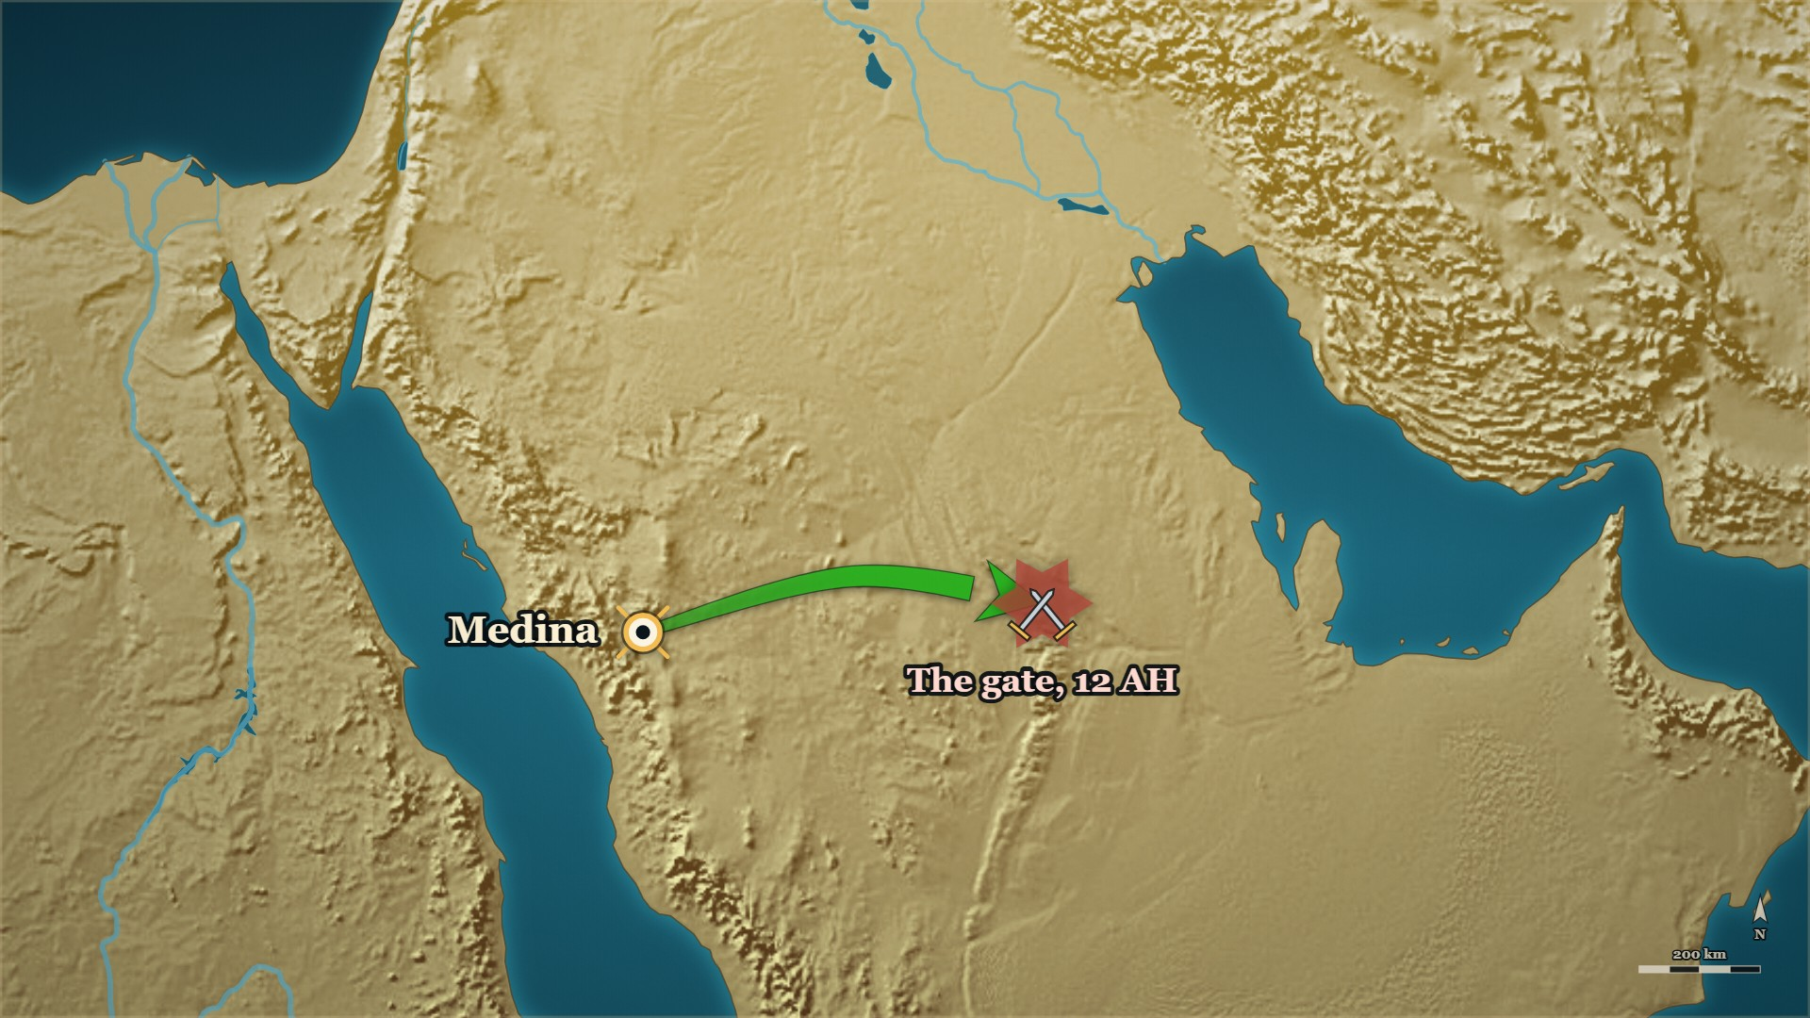



Tustar, 17–20 AH
al-Barāʾ ؓ at Tustar
al-Yamāma
the gate, 12 AH
Tustar
years later — a war not yet reached
Notes:
NOTE — ↪ Forward, framed aloud: years later, in a war we have not reached. «واستشهدني» is where the sources stop — add nothing
⚠ (Delivery note: «واستشهدني» is where the sources stop. Nothing may be added after it.)
SAY —
▶ CLICK 1 — Tustar, years later — in a war we have not reached.
1. Months of siege, and the assaults keep failing — The men know a ḥadīth about al-Barāʾ ؓ.
2. What it says — That if he swore an oath upon Allah, Allah would answer it.
3. What they asked him for — That he swear that oath for them.
4. What he added, unasked — And take me as a martyr.
5. That day — They broke the enemy, and he was killed inside the city.
▶ NEXT SLIDE — the words: read the Arabic, then its English.
BACKGROUND (read at home, not aloud) —
The siege had gone on for months and the assaults kept failing. The men knew there was a ḥadīth about al-Barāʾ — that if he swore an oath upon Allah, Allah would answer it. So in the last assault they asked him to swear that oath for them. He made the prayer they asked for, and then added something to it that they had not asked for. They broke the enemy that day. He was killed inside the city.

Slide 15
Tustar, 17–20 AH
al-Barāʾ ؓ at Tustar
اللَّهُمَّ اهْزِمْهُمْ لَنَا وَاسْتَشْهِدْنِي.
…O Allah, defeat them for us, and take me as a martyr.
al-Kamil, vol. 2, p. 368
Notes:
THE WORDS — the story was told on the map. Read the Arabic, then its English — and the one line.
QUOTE — قَالَ الْمُسْلِمُونَ: يَا بَرَاءُ أَقْسِمْ عَلَى رَبِّكَ لَيَهْزِمَنَّهُمْ لَنَا. قَالَ: اللَّهُمَّ اهْزِمْهُمْ لَنَا وَاسْتَشْهِدْنِي.
"The Muslims said: Barāʾ, swear upon your Lord that He will defeat them for us. He said: O Allah, defeat them for us, and take me as a martyr."
— الکامل فی التاریخ ج۲ ص۳۶۸ (identically at البدایہ ج۷ ص۱۹۷)
عبرت — He was asked to pray for the army; he prayed for the army and put himself in the cost column.

Slide 16
Part III
The men beside them

Slide 17
12 AH, at al-Yamāma
Abū ʿAqīl ؓ
فنزعه، وتحزم وأخذ السيف وقاتل حتى قتل، فوجد به جراحات كثيرة.
…he pulled it out, bound himself up, took his sword and fought until he was killed — and many wounds were found on him.
Siyar A'lam al-Nubala (al-Rashidun), p. 60
Notes:
NOTE — Abū ʿAqīl ؓ, a chief of the Anṣār and a man of Badr. ⚠⚠ The long famous version is in NO approved source — tell only the card's sentence
⚠ البدایہ ج۷ ص۵۷ gives the same sentence. ⚠⚠ The long famous version of this account — the night wound, the dead arm, the severed arm, the fourteen wounds, "who won?" — is NOT in any approved source (§X.2). Tell only what is above.
SAY —
1. Who he was — Abū ʿAqīl ؓ, one of the chiefs of the Anṣār and a man of Badr.
2. The arrow — It struck him at al-Yamāma, and he pulled it out himself.
3. What he did next — Bound himself up, took his sword, and went back into the fighting.
4. Afterwards — He fought until he was killed, and many wounds were found on him.
^ read the Arabic on the face here
QUOTE — أصابه سهم يوم اليمامة فنزعه، وتحزم وأخذ السيف وقاتل حتى قتل، فوجد به جراحات كثيرة.
"An arrow struck him on the day of al-Yamāma and he pulled it out, bound himself up, took his sword and fought until he was killed — and many wounds were found on him."
— سیر أعلام النبلاء (سير الخلفاء الراشدين) ص۶۰
عبرت — Nobody carried him out and nobody was asked to.
BACKGROUND (read at home, not aloud) —
Abū ʿAqīl ؓ was one of the chiefs of the Anṣār and a man of Badr. At al-Yamāma an arrow hit him. He pulled it out himself. Then he bound himself up, took his sword, and went back to fighting. He fought until he was killed. When they came to him afterwards, they found many wounds on him.

Slide 18
11–12 AH
Ḥabīb b. Zayd ؓ, and Umm ʿUmāra ؓ
أتشهدُ أني رسولُ اللَّه؟ فيقول: لا أسمع
Do you testify that I am the Messenger of Allah? And he would say: I do not hear.
al-Bidaya wa'l-Nihaya, vol. 3, p. 428
Notes:
NOTE — ⚠ SPEAKER'S DISCRETION — the most severe card of the evening. What was done to Ḥabīb b. Zayd ؓ, and what his mother did after it. Tell it plainly and without dwelling; skip it if the room is heavy. ⚠ The books differ on her wounds — "covered in wounds"
⚠ The wounds: سیر ج۲ ص۲۸۱ — hand cut off at al-Yamāma and eleven wounds besides. ⚠ البدایہ ج۳ ص۴۲۸ says twelve wounds; give one figure with its caption, or say only "covered in wounds". ⚠ سیر ج۲ ص۲۸۲ names her other son ʿAbd Allāh b. Zayd ؓ as the man who killed Musaylima with his sword —
SAY —
1. A man in Musaylima's hands — Ḥabīb b. Zayd ؓ, asked whether he testified that Muḥammad ﷺ is the Messenger of Allah.
2. He said yes — Then he was asked to testify the same of Musaylima, and said: I do not hear.
3. He was cut apart, limb by limb — And he never gave more than that one answer, until he died.
^ read the Arabic on the face here
4. His mother — Umm ʿUmāra Nusayba bint Kaʿb رضي الله عنها: al-ʿAqaba, Uḥud, al-Ḥudaybiya, Ḥunayn.
5. What al-Dhahabī رحمہ اللہ records of her — She fought, and she did great things; twelve wounds at Uḥud.
6. She went out with the army — Her hand was cut off at al-Yamāma, and she came back covered in wounds.
7. Abū Bakr ؓ, while he was caliph — Was seen coming to her to ask after her.
QUOTE — فيقول: أتشهدُ أني رسولُ اللَّه؟ فيقول: لا أسمع، فجعل يقطِّعُه عضوًا عضوًا حتى مات في يديه، لا يزيدُه على ذلك.
"Then he would say: Do you testify that I am the Messenger of Allah? And he would say: I do not hear. So he began to cut him apart limb by limb until he died in his hands — and he never gave him more than that."
— البدایہ والنہایہ ج۳ ص۴۲۸
عبرت — He was not asked to say anything; he was asked to hear something, and he would not.
BACKGROUND (read at home, not aloud) —
Musaylima had a man named Ḥabīb b. Zayd ؓ in his hands. He asked him whether he testified that Muḥammad ﷺ was the Messenger of Allah, and Ḥabīb ؓ said yes. Then he asked whether he testified that he, Musaylima, was a messenger of Allah — and Ḥabīb ؓ said: I do not hear. So he began to cut him apart, one limb at a time, and Ḥabīb ؓ never gave him more than that answer, until he died in his hands. Ḥabīb's ؓ mother was Umm ʿUmāra Nusayba bint Kaʿb رضي الله عنها, who had been at al-ʿAqaba, at Uḥud, at al-Ḥudaybiya and at Ḥunayn. When the army marched to al-Yamāma, she went with it. Her hand was cut off there. She came back to Medina covered in wounds, and Abū Bakr ؓ, while he was caliph, was seen coming to her to ask after her.
one of four accounts in the safe list; do not settle it (§9.3).

Slide 19
12 AH, at al-Yamāma
ʿAbd Allāh b. Zayd ؓ
وَابْنُهَا الآخَرُ عَبْدُ اللهِ بنُ زَيْدٍ المَازِنِيُّ … وَهُوَ الَّذِي قَتَلَ مُسَيْلِمَةَ الكَذَّابَ بِسَيْفِهِ.
Her other son, ʿAbd Allāh b. Zayd al-Māzinī … and he is the one who killed Musaylima the liar with his sword.
Siyar A'lam al-Nubala, vol. 2, p. 282
Notes:
NOTE — ⚠ One of FOUR names for the man who killed Musaylima — say the other three exist, in the same breath. ⚠ Do not open al-Ḥarra. If the card before is skipped, give Umm ʿUmāra's ؓ notice here
⚠ NEVER state a single killer (QA_BANK.md §5.3). The four: الواقدي names عبد الله بن زيد ؓ ·
ابن کثیر prefers وحشي ؓ striking first and أبو دجانة ؓ finishing · سيف names عدي بن سهل ·
and وحشي ؓ himself: «فَربُّك أعلمُ أيُّنا قَتَله». Say the sentence as الذہبی writes it, and say in
the same breath that three other names are given.
⚠ The same page says he was killed on the day of الحرة. Do not say it and do not open it — it is
63 AH and it is not this course's ground yet.
SAY —
1. She had another son — ʿAbd Allāh b. Zayd ؓ, the brother of Ḥabīb ؓ.
2. What the ummah knows him for — He is the Companion who described the Prophet's ﷺ wuḍūʾ.
3. What al-Dhahabī رحمہ اللہ adds, in her notice — That he is the one who killed Musaylima with his sword.
^ read the Arabic on the face here
4. One of four names — The books give four, and they do not choose between them.
5. And the man best placed to know refused the claim — Your Lord knows better which of us killed him.
QUOTE — وَابْنُهَا الآخَرُ عَبْدُ اللهِ بنُ زَيْدٍ المَازِنِيُّ الَّذِي حَكَى وُضُوْءَ رَسُوْلِ اللهِ -صَلَّى اللَّهُ عَلَيْهِ وَسَلَّمَ- … وَهُوَ الَّذِي قَتَلَ مُسَيْلِمَةَ الكَذَّابَ بِسَيْفِهِ.
"Her other son, ʿAbd Allāh b. Zayd al-Māzinī — the one who described the Messenger of Allah's ﷺ wuḍūʾ — … and he is the one who killed Musaylima the liar with his sword."
— سیر أعلام النبلاء ج۲ ص۲۸۲
عبرت — The same notice records what that house lost and what one account says it did, and the books still decline to say whose hand it was.
BACKGROUND (read at home, not aloud) —
Umm ʿUmāra ؓ had another son besides Ḥabīb ؓ. He is ʿAbd Allāh b. Zayd ؓ, and the ummah knows him for something entirely separate: he is the Companion who described the Prophet's ﷺ wuḍūʾ. In her own notice, al-Dhahabī رحمہ اللہ adds one more sentence about him — that he is the man who killed Musaylima with his sword. That is one of four names the approved books give for Musaylima's killer, and they do not choose between them.
## The people: the men who had fought against it
*Source note: [the-men-who-had-fought-against-it.md](../docs/research/the-men-who-had-fought-against-it.md) — read it for the pages behind these cards.*

Slide 20
Part IV
The banner and the reciters

Slide 21
12 AH, at al-Yamāma
The banner
Last week
Now
And after
Zayd b. al-Khaṭṭāb ؓ at the line, and his vow of silence
what happened to the banner he held
the men who carried the Qurʾān
Notes:
BRIDGE — say:
Last week you saw the banner at the line, and Zayd b. al-Khaṭṭāb ؓ's vow not to speak until it was over. Here is what happened to that banner.

Slide 22
12 AH, at al-Yamāma
Zayd b. al-Khaṭṭāb ؓ — the banner
… ثُمَّ قَاتَلَ حَتَّى قُتِلَ، فَوَقَعَتْ الرَّايَةُ، فَأَخَذَهَا سَالِمٌ مَوْلَى أَبِي حُذَيْفَةَ
…and then fought until he was killed. The banner fell — and Sālim, the freedman of Abū Ḥudhayfa, took it up.
Siyar A'lam al-Nubala, vol. 1, p. 298
Notes:
NOTE — Zayd ؓ falls; Sālim ؓ takes the banner. ⚠ Three books, three arrangements — never a diagram
⚠ Three books give three different banner arrangements at al-Yamāma. Do not draw a diagram —
say only that the banner changed hands because the man holding it was killed.
SAY —
1. Zayd ؓ carries it forward — The Muslims' banner was with him, and he kept pressing forward into the enemy.
2. Until he was killed — He fought on with it until he was killed, and the banner fell.
3. Sālim ؓ takes it up — The freedman of Abū Ḥudhayfa ؓ picks it off the ground.
^ read the Arabic on the face here
4. How we know — al-Dhahabī رحمہ اللہ records it once; Ibn Kathīr رحمہ اللہ twice, on consecutive pages.
QUOTE — وَكَانَتْ رَايَةُ المُسْلِمِيْنَ مَعَهُ يَوْمَ اليَمَامَةِ، فَلَمْ يَزَلْ يَقْدَمُ بِهَا فِي نَحْرِ العَدُوِّ، ثُمَّ قَاتَلَ حَتَّى قُتِلَ، فَوَقَعَتْ الرَّايَةُ، فَأَخَذَهَا سَالِمٌ مَوْلَى أَبِي حُذَيْفَةَ
"The Muslims' banner was with him on the day of al-Yamāma, and he kept pressing forward with it into the enemy's throat, and then fought until he was killed. The banner fell — and Sālim, the freedman of Abū Ḥudhayfa, took it up."
— سیر أعلام النبلاء ج۱ ص۲۹۸
عبرت — Every man who took it knew what had happened to the man before him.
BACKGROUND (read at home, not aloud) —
Zayd b. al-Khaṭṭāb ؓ — the elder brother of ʿUmar ؓ — carried the banner forward into the enemy until he was killed. The banner fell. Sālim ؓ picked it up. Al-Dhahabī رحمہ اللہ records it in one sentence in Zayd's ؓ own notice, and Ibn Kathīr رحمہ اللہ records it twice, in two separate death notices on consecutive pages (ج۷ ص۴۹ and ج۷ ص۵۰).

Slide 23
12 AH, and after it at…
ʿUmar ؓ, and the man who killed Zayd ؓ
وقال لعمر: يا أميرَ المؤمنين إن الله أكرم زيدًا بيدي ولم يُهنِّي على يده.
…said to ʿUmar: Commander of the Faithful — Allah honoured Zayd at my hand, and did not disgrace me at his.
al-Bidaya wa'l-Nihaya, vol. 7, p. 49
Notes:
NOTE — [HANDS] 1: "The man who killed your brother is standing in front of you, and he is now a Muslim. What is there to say?" ⚠ The sources record no answer from ʿUmar ؓ — do not supply one
⚠ The sources record no answer from ʿUmar ؓ. Do not supply one. ⚠ Give Ibn Kathīr's own handling
of the competing report — it is the "how do we know?" beat of this act (§2.7).
SAY —
1. Who killed Zayd ؓ — A man called Abū Maryam al-Ḥanafī, fighting that day on the other side.
2. Afterwards — He became a Muslim.
3. He stands in front of ʿUmar ؓ — The dead man's younger brother, now Commander of the Faithful.
4. What he said — Allah honoured Zayd ؓ at my hand, and did not disgrace me at his.
^ read the Arabic on the face here
5. What the sources do not give — Any answer from ʿUmar ؓ. We do not supply one. He later made him a judge.
6. A competing report, handled on the page — Ibn Kathīr names another killer, says Ibn ʿAbd al-Barr preferred it, then says it does not disprove the first.
QUOTE — ثم قتلَ زيدًا رجل يقال له: أبو مريم الحنفي، وقد أسلم بعد ذلك وقال لعمر: يا أميرَ المؤمنين إن الله أكرم زيدًا بيدي ولم يُهنِّي على يده.
"Then Zayd was killed by a man called Abū Maryam al-Ḥanafī, who afterwards became a Muslim and said to ʿUmar: Commander of the Faithful — Allah honoured Zayd at my hand, and did not disgrace me at his."
— البدایہ والنہایہ ج۷ ص۴۹
عبرت — He did not ask to be forgiven; he told the brother what he thought Allah had done with both of them.
HANDS UP — Before telling it: *"The man who killed your brother is standing in front of you, and he is now a Muslim. What is there to say?"*
BACKGROUND (read at home, not aloud) —
The man who killed Zayd ؓ was called Abū Maryam al-Ḥanafī. He fought that day on the other side. Afterwards he became a Muslim. And at some point after that he stood in front of ʿUmar ؓ — the dead man's younger brother, now the Commander of the Faithful — and said this to him. ʿUmar ؓ later appointed him a judge. Ibn Kathīr records a second report naming a different killer, and records that Ibn ʿAbd al-Barr preferred it, and then says the second report does not disprove the first.

Slide 24
Medina, and 12 AH
Zayd ؓ and Maʿn b. ʿAdī ؓ
وقد آخى رسول الله ﷺ بينه وبين معن بن عديّ الأنصاري وقد قُتلا جميعًا باليمامة.
"The Messenger of Allah ﷺ made him and Maʿn b. ʿAdī al-Anṣārī brothers, and the two of them were killed together at al-Yamāma."
al-Bidaya wa'l-Nihaya, vol. 7, p. 49
Notes:
NOTE — A pair with the next card — both or neither. ⚠ The muʾākhāt's year is an estimate: "when the Muhājirūn arrived"
SAY —
1. The Muhājirūn arrive with nothing — The Prophet ﷺ pairs each of them with a man of the Anṣār, as brothers.
2. Zayd's ؓ brother by appointment — Maʿn b. ʿAdī ؓ, of Banū al-ʿAjlān, an ally of the Anṣār.
3. Years later, one field — Both were at al-Yamāma, and both were killed there.
^ read the Arabic on the face here
4. And not the only such pair — Abū Ḥudhayfa ؓ and ʿAbbād b. Bishr ؓ were paired the same way, and died there too.
QUOTE — وقد آخى رسول الله ﷺ بينه وبين معن بن عديّ الأنصاري وقد قُتلا جميعًا باليمامة.
"The Messenger of Allah ﷺ made him and Maʿn b. ʿAdī al-Anṣārī brothers, and the two of them were killed together at al-Yamāma."
— البدایہ والنہایہ ج۷ ص۴۹
عبرت — The tie was made in a year when they owned nothing, and it was still holding on the day they died.
BACKGROUND (read at home, not aloud) —
When the Muhājirūn arrived in Medina with nothing, the Prophet ﷺ paired each of them with a man of the Anṣār and made the two of them brothers. Zayd b. al-Khaṭṭāb ؓ, of Quraysh, was paired with Maʿn b. ʿAdī ؓ of Banū al-ʿAjlān, an ally of the Anṣār. Years later, both of them were on the field at al-Yamāma. Both of them were killed there, on the same day. And they were not the only such pair: Abū Ḥudhayfa ؓ and ʿAbbād b. Bishr ؓ had been paired the same way, and they died there too.

Slide 25
11 AH Medina → 12 AH…
Maʿn b. ʿAdī ؓ
مَا أُحِبُّ أَنِّي مُتُّ قَبْلَهُ حَتَّى أُصَدِّقَهُ مَيْتاً، كَمَا صَدَّقْتُهُ حَيّاً
…do not wish that I had died before him — so that I may confirm him dead as I confirmed him alive.
Siyar A'lam al-Nubala, vol. 1, p. 321
Notes:
NOTE — Maʿn ؓ — one of the two men on the road to the Saqīfa, evening 1. ⚠ If challenged: مرسل from ʿUrwa
⚠ Chain honesty (§4.2): البدایہ ج۷ ص۵۴ gives it with a connected chain through ابن عمر ؓ; the سیر
editor notes that the preserved form is mursal from عروة. Say so if challenged. This card is the
bookend for E-ZY8 — tell them together or not at all.
SAY —
1. The day the Prophet ﷺ died — Medina wept, and men said they wished they had died before him.
2. One man said the opposite — Maʿn b. ʿAdī ؓ, Zayd's ؓ brother by appointment.
3. What he said — I do not wish I had died first: let me confirm him dead as I confirmed him alive.
^ read the Arabic on the face here
4. Where else he stood — He was one of the two men who met Abū Bakr ؓ and ʿUmar ؓ on the road to the Saqīfa.
5. The year after — He was killed at al-Yamāma, in the war fought to hold what he said he would confirm.
QUOTE — فَقَالَ مَعْنٌ: لَكِنِّي -وَاللهِ- مَا أُحِبُّ أَنِّي مُتُّ قَبْلَهُ حَتَّى أُصَدِّقَهُ مَيْتاً، كَمَا صَدَّقْتُهُ حَيّاً.
"But I, by Allah, do not wish that I had died before him — so that I may confirm him dead as I confirmed him alive."
— سیر أعلام النبلاء ج۱ ص۳۲۱
عبرت — He did not want to be spared what came next; he wanted to be there for it.
BACKGROUND (read at home, not aloud) —
When the Prophet ﷺ died, the people in Medina wept and said they wished they had died before him, because they were afraid of what would happen to them after him. One man said the opposite. He said he did not want to have died first — he wanted to be alive afterwards, so that he could confirm the Prophet ﷺ dead the same way he had confirmed him alive. His name was Maʿn b. ʿAdī ؓ. He was one of the two men who met Abū Bakr ؓ and ʿUmar ؓ on the road to the Saqīfa. And in the following year he was killed at al-Yamāma, in the war fought to hold what he had said he would confirm.

Slide 26
Medina, after al-Ḥujurāt
Thābit b. Qays ؓ
فَقَالَ: (يَا ثَابِتُ! أَمَا تَرْضَى أَنْ تَعِيْشَ حَمِيْداً، وَتُقْتَلَ شَهِيْداً، وَتَدْخُلَ الجَنَّةَ)
"He said: Thābit — are you not content to live praised, to be killed a martyr, and to enter the Garden?"
Siyar A'lam al-Nubala, vol. 1, p. 310
Notes:
NOTE — ↩ Thābit ؓ at Medina, after al-Ḥujurāt. The room saw his shroud on evening 4 — the second of the three things has already happened
⚠ The verse-and-house incident is in صحيح مسلم ١١٩ and صحيح البخاري ٣٦١٣ (سیر ed. fn., ج۱ ص۳۱۰ and ج۱ ص۳۱۱); البدایہ ج۷ ص۴۸ carries both this and the earlier لقمان ۱۸ incident in sequence.
SAY —
1. Who he was — Thābit b. Qays ؓ, the orator of the Anṣār, with a very loud voice.
2. The āya forbidding raised voices above the Prophet's ﷺ — He concluded he was of the people of the Fire.
3. He shut himself in his house — And stopped coming.
4. The Prophet ﷺ noticed he was missing and sent to ask — And said: he is of the people of the Garden.
^ read the Arabic on the face here
5. In another report — He is told he will live praised, be killed a martyr, and enter the Garden.
QUOTE — فَقَالَ: (يَا ثَابِتُ! أَمَا تَرْضَى أَنْ تَعِيْشَ حَمِيْداً، وَتُقْتَلَ شَهِيْداً، وَتَدْخُلَ الجَنَّةَ)
"He said: Thābit — are you not content to live praised, to be killed a martyr, and to enter the Garden?"
— سیر أعلام النبلاء ج۱ ص۳۱۰
عبرت — He was told the end of his own life years before it happened, and then he lived as though he believed it.
BACKGROUND (read at home, not aloud) —
Thābit b. Qays ؓ was the orator of the Anṣār and he had a very loud voice. When the verse came down forbidding the believers to raise their voices above the Prophet's ﷺ, he concluded that he was of the people of the Fire, and he shut himself in his house and stopped coming. The Prophet ﷺ noticed he was missing and sent for the reason. When he heard it, he said Thābit was of the people of the Garden. And in another report he told him what would happen to him: that he would live praised, be killed a martyr, and enter the Garden.
Play this card immediately before RCT/E-RC18 — it is what makes the shroud land.

Slide 27
Quraysh — Badr, 2 AH · al-Yamāma, 12 AH
The house of ʿUtba b. Rabīʿa
Suhayl b. ʿAmr ؓ
Rabīʿa
killed at Badr, 2 AH
killed at al-Yamāma, 12 AH
married
ʿUtba b. Rabīʿa
Shayba
Sahla ؓ
Abū Ḥudhayfa ؓ
al-Walīd
Hind ؓ
Abū Sufyān ؓ
freed slave
Sālim ؓ
Muʿāwiya ؓ
Notes:
TREE — the house of ʿUtba b. Rabīʿa, and who married into it. Point as you go. (Every line is glued to its boxes: move a box and its lines follow.)
SAY — One family, on two battlefields — and some names you know.
1. ʿUtba b. Rabīʿa — al-Dhahabī calls him the elder of the Jāhiliyya — his brother Shayba, and his son al-Walīd: the three who came out for the single combat that opened Badr. All three were killed.
2. Abū Ḥudhayfa ؓ, ʿUtba's son, stood with the Muslims that day: his father and his brother on one side, himself on the other.
3. His sister: Hind bint ʿUtba ؓ — al-Dhahabī names her as Umm Muʿāwiya. Her husband, Abū Sufyān ؓ: the head of Quraysh, their commander at Uḥud and at the Trench — until, in al-Dhahabī's words, Allah rescued him with Islam on the day of the Conquest. Their son, Muʿāwiya ؓ — a name for evenings we have not reached.
4. His wife: Sahla ؓ, the daughter of Suhayl b. ʿAmr ؓ — the orator of Quraysh, the man who held Mecca for Islam when the Prophet ﷺ died. She went with Abū Ḥudhayfa ؓ on the first ship to Abyssinia — hired, it is reported, for half a dīnār.
5. Sālim ؓ — the freed slave the household kept. His origin was Iṣṭakhr, in Persia.
6. Ten years after Badr, Abū Ḥudhayfa ؓ and Sālim ؓ fell at al-Yamāma, side by side.
IF THE ROOM IS WITH YOU — one line each:
7. Abū Ḥudhayfa ؓ married Sālim ؓ to his own brother al-Walīd's daughter — into the family itself. Ibn Kathīr alone carries it.
8. Another brother, Abū Hāshim b. ʿUtba ؓ — a Muslim on the day of the Conquest, "and his Islam was good"; Muʿāwiya ؓ came to his bedside in his last illness.
9. The Prophet ﷺ went out one night with his cloak to listen to Sālim ؓ recite in the mosque; al-Dhahabī marks the chain good.
⚠ Abū Sufyān ؓ and Muʿāwiya ؓ are forward references: say "names for evenings we have not reached", and nothing of what came later.
⚠ The verses Hind is said to have spoken against her brother at Badr are not to be read out.
⚠ Abū Ḥudhayfa's ؓ son Muḥammad, born in Abyssinia, is not on the tree: his later life belongs to the مشاجرات and is not for the platform.
⚠ The tree says "freed slave", not "adopted": the adoption, and what the law did with it, is not for the platform.
BACKGROUND (read at home, not aloud) — the house's stories in full:
• Badr — the father and the brother: Badr opens with single combat — Quraysh call for their equals to come out.; Whom the Prophet ﷺ sent — ʿUbayda b. al-Ḥārith ؓ, Ḥamza ؓ and ʿAlī ؓ.; Who came out against them — ʿUtba b. Rabīʿa, his brother Shayba, and ʿUtba's son al-Walīd.; All three of the Meccans were killed — And Abū Ḥudhayfa ؓ was standing with the Muslims.; What that is — His father and his brother on one side, and himself on the other.
• The ship they hired for half a dinar: The persecution in Mecca got past bearing — A small party left for Abyssinia.; Why there — The Prophet ﷺ had said there was a king there under whom no one was wronged.; Who went — Eleven men and four women, down to the sea.; The ship — Hired for half a dinar.; Who was on it — ʿUthmān ؓ and Ruqayya ؓ; and Abū Ḥudhayfa ؓ with his wife Sahla ؓ.
• The night the Prophet ﷺ took his cloak and went out to listen: ʿĀʾisha ؓ comes in late — The Prophet ﷺ asks what kept her.; What she said — A voice reciting in the mosque, finer than any she had heard.; What he did — He took his cloak and went out to listen.; Who it was — Sālim ؓ, the freedman of Abū Ḥudhayfa ؓ.; The chain — al-Dhahabī رحمہ اللہ records it and marks it good.
• The sentence he was afraid of for ten years — ⚠ SPEAKER'S DISCRETION: Before the fighting at Badr — The Prophet ﷺ names men brought out against their will, not to be killed.; Among them, his own uncle — al-ʿAbbās ؓ.; What Abū Ḥudhayfa ؓ said out loud — Are we to kill our fathers and sons and brothers, and leave al-ʿAbbās?; Word of it reached the Prophet ﷺ — And he never forgave himself for it.; What he said afterwards — He would not stop fearing that word unless martyrdom wiped it away.; Where three books end the sentence — And he was killed a martyr at al-Yamāma.

Slide 28
Mecca, before the house of al-Arqam
Abū Ḥudhayfa b. ʿUtba ؓ
السَّيِّدُ الكَبِيْرُ، الشَّهِيْدُ، أَبُو حُذَيْفَةَ ابْنُ شَيْخِ الجَاهِلِيَّةِ: عُتْبَةَ بنِ رَبِيْعَةَ … البَدْرِيُّ
The great chief, the martyr, Abū Ḥudhayfa — son of the elder of the Jāhiliyya, ʿUtba b. Rabīʿa — … the man of Badr.
Siyar A'lam al-Nubala, vol. 1, p. 164
Notes:
NOTE — ↩ Mecca, before the house of al-Arqam
SAY —
1. Whose son he was — ʿUtba b. Rabīʿa, one of the great men of Quraysh before Islam.
2. How al-Dhahabī رحمہ اللہ opens his notice — He does not soften the position at all.
3. Three things in one sentence — A martyr; the son of the elder of the Jāhiliyya; a man of Badr.
^ read the Arabic on the face here
4. How early he was — A Muslim before the Companions were even meeting in the house of al-Arqam.
QUOTE — السَّيِّدُ الكَبِيْرُ، الشَّهِيْدُ، أَبُو حُذَيْفَةَ ابْنُ شَيْخِ الجَاهِلِيَّةِ: عُتْبَةَ بنِ رَبِيْعَةَ … القُرَشِيُّ، العَبْشَمِيُّ، البَدْرِيُّ
"The great chief, the martyr, Abū Ḥudhayfa — son of the elder of the Jāhiliyya, ʿUtba b. Rabīʿa — al-Qurashī, al-ʿAbshamī, the man of Badr."
— سیر أعلام النبلاء ج۱ ص۱۶۴
عبرت — A man's descent is recorded honestly, and it is not what he is judged by.
BACKGROUND (read at home, not aloud) —
Abū Ḥudhayfa ؓ was the son of ʿUtba b. Rabīʿa — one of the great men of Quraysh before Islam. Al-Dhahabī رحمہ اللہ, opening his notice, does not soften the position at all. In one sentence he calls him a martyr, calls his father the elder of the Jāhiliyya, and calls him a man of Badr. He had accepted Islam before the Companions were even meeting in the house of al-Arqam.

Slide 29
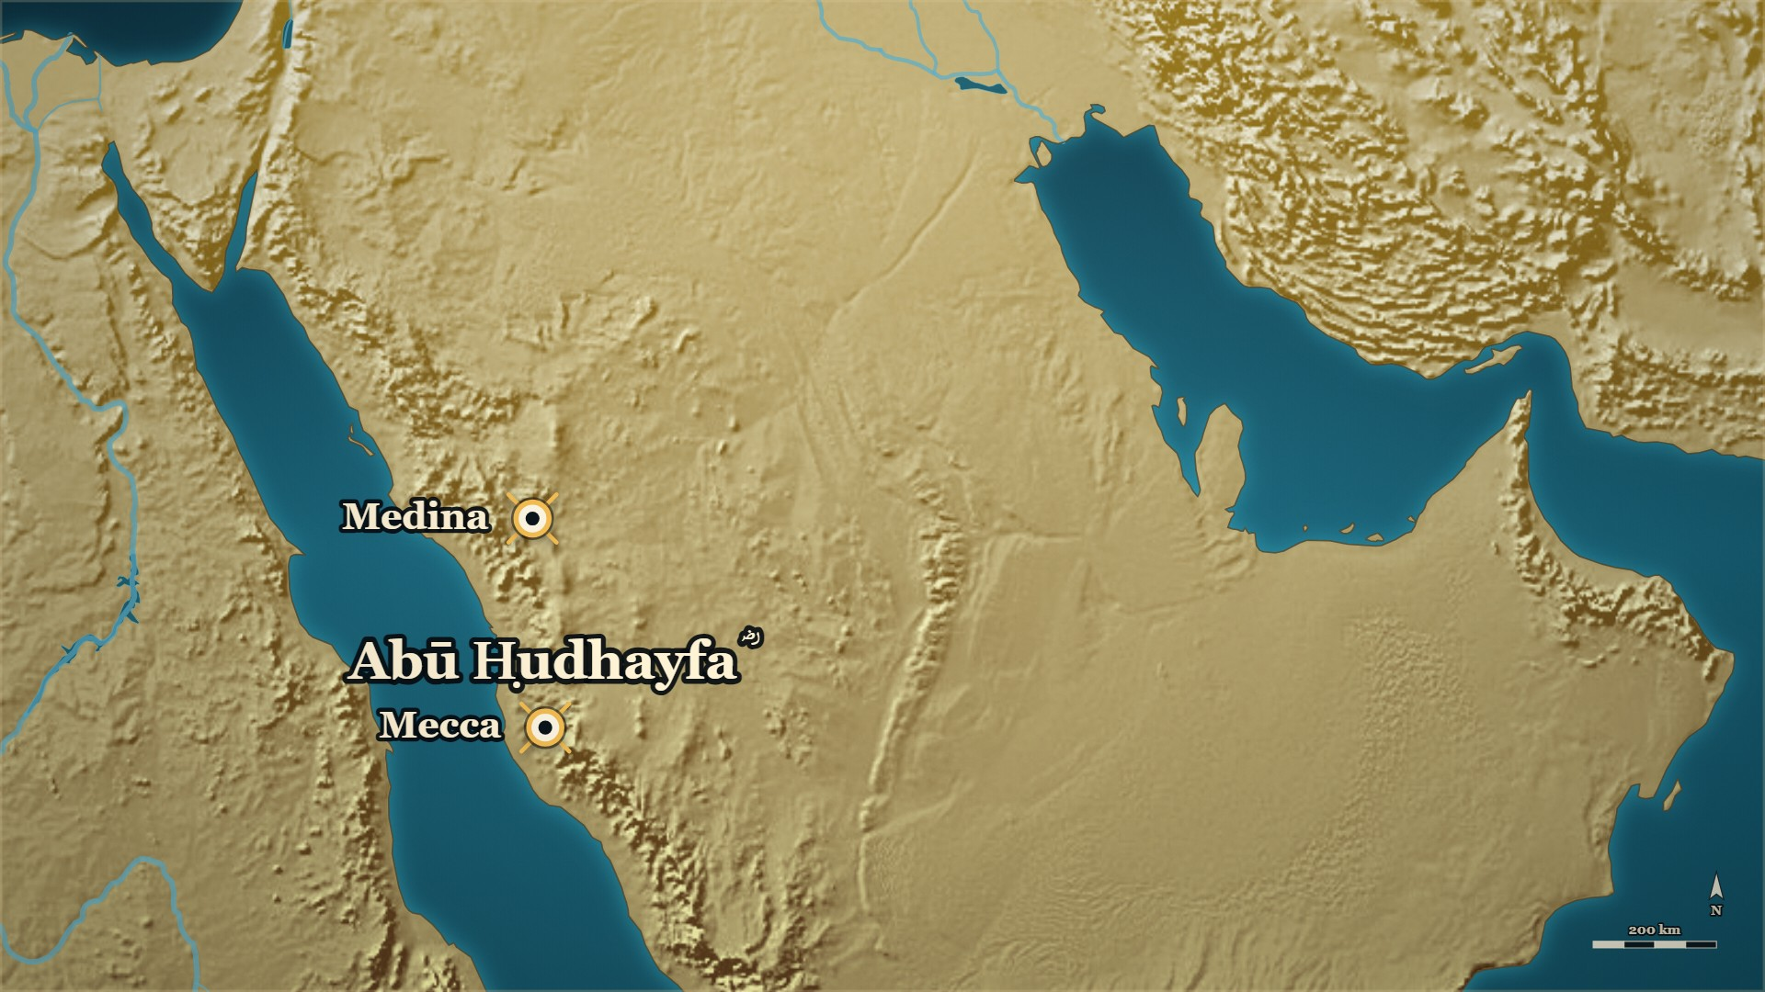


Before the Hijra
Sālim ؓ — from Iṣṭakhr
Mecca
Abū Ḥudhayfa's ؓ house
Iṣṭakhr
in Persia — where Sālim ؓ came from
Notes:
NOTE — [HANDS] spare: "where do you think the man who led the Muhājirūn in prayer came from?" ⚠ The books give his origin, not his road
SAY —
▶ CLICK 1 — Iṣṭakhr, in Persia: where he came from. The books give his origin, not his road.
1. He was a slave — His origin was Iṣṭakhr, in Persia.
2. The household freed him — And Abū Ḥudhayfa ؓ took him as his own.
3. How al-Dhahabī رحمہ اللہ opens his notice — Four descriptions in a row.
▶ NEXT SLIDE — the words: read the Arabic, then its English.
BACKGROUND (read at home, not aloud) —
Sālim ؓ was a slave. His origin was Iṣṭakhr, in Persia. The woman of Abū Ḥudhayfa's ؓ household freed him, and Abū Ḥudhayfa ؓ took him as his own — adopted him outright. Al-Dhahabī رحمہ اللہ opens his notice on him with four descriptions in a row, and not one of them is about where he came from.

Slide 30
Before the Hijra
Sālim ؓ — from Iṣṭakhr
مِنَ السَّابِقِيْنَ الأَوَّلِيْنَ، البَدْرِيِّيْنَ، المُقَرَّبِيْنَ، العَالِمِيْنَ … أَصْلُهُ مِنْ إِصْطَخْرَ
"Of the first forerunners, of the men of Badr, of those brought near, of the learned … his origin is from Iṣṭakhr."
Siyar A'lam al-Nubala, vol. 1, p. 167
Notes:
THE WORDS — the story was told on the map. Read the Arabic, then its English — and the one line.
QUOTE — مِنَ السَّابِقِيْنَ الأَوَّلِيْنَ، البَدْرِيِّيْنَ، المُقَرَّبِيْنَ، العَالِمِيْنَ … أَصْلُهُ مِنْ إِصْطَخْرَ
"Of the first forerunners, of the men of Badr, of those brought near, of the learned … his origin is from Iṣṭakhr."
— سیر أعلام النبلاء ج۱ ص۱۶۷
عبرت — The books record where he came from in four words and what he became in four titles.

Slide 31
Before the Prophet ﷺ reached Medina
Sālim ؓ at Qubāʾ
فَأَمَّهُم سَالِمٌ مَوْلَى أَبِي حُذَيْفَةَ، لأَنَّهُ كَانَ … أَكْثَرَهُم قُرْآناً، فِيْهِم عُمَرُ
Sālim, the freedman of Abū Ḥudhayfa, led them in prayer, because he had the most Qurʾān of them — among them ʿUmar.
Siyar A'lam al-Nubala, vol. 1, pp. 168–169
Notes:
NOTE — Told on evening 4 — a callback only. What is new is why him, and that ʿUmar ؓ was praying behind him
SAY —
1. Why him — Because he carried more of the Qurʾān than any of them.
^ read the Arabic on the face here
2. Who prayed behind him — ʿUmar b. al-Khaṭṭāb ؓ among them.
QUOTE — أَنَّ المُهَاجِرِيْنَ نَزَلُوا بِالعُصْبَةِ إِلَى جَنْبِ قُبَاءَ، فَأَمَّهُم سَالِمٌ مَوْلَى أَبِي حُذَيْفَةَ، لأَنَّهُ كَانَ … أَكْثَرَهُم قُرْآناً، فِيْهِم عُمَرُ، وَأَبُو سَلَمَةَ بنُ عَبْدِ الأَسَدِ
"The Muhājirūn camped at al-ʿUṣba beside Qubāʾ, and Sālim, the freedman of Abū Ḥudhayfa, led them in prayer, because he had the most Qurʾān of them — among them ʿUmar and Abū Salama b. ʿAbd al-Asad."
— سیر أعلام النبلاء ج۱ ص۱۶۸–۱۶۹ و (the ellipsis marks the page turn — nothing is omitted)
عبرت — The first thing the Muhājirūn did on arriving was to put the best reciter in front, whoever he was.
BACKGROUND (read at home, not aloud) —
The Muhājirūn reached Medina before the Prophet ﷺ did. They camped at al-ʿUṣba, beside Qubāʾ, and they had to pray. Someone had to lead. They put forward a freed slave, because he had more of the Qurʾān than any of them. Among the men praying behind him was ʿUmar b. al-Khaṭṭāb ؓ.

Slide 32
Badr, 2 AH
Abū Ḥudhayfa ؓ at Badr
لعلك قد دخلك من شأن أبيك شيء … ما شككت في أبي ولا في مصرعه
Perhaps something has entered you about the matter of your father? … I have not doubted my father nor where he fell.
Siyar A'lam al-Nubala (Siyar ), p. 312
Notes:
NOTE — Not a denial of grief. The single combat that killed his father, uncle and brother was told on the family tree — do not retell it
SAY —
1. After the battle — The dead of Quraysh are put into the well.
2. The Prophet ﷺ looks at the son's face — And sees that it has gone pale.
3. What he asked him — Has something entered you about your father?
4. The answer — I never doubted his fate; I had known a judgement and a forbearance in him, and hoped it would bring him to Islam.
^ read the Arabic on the face here
5. And then — The Prophet ﷺ prayed for him, and spoke kindly to him.
QUOTE — لما سحب عتبة بن ربيعة إلى القليب نظر رسول الله صلى الله عليه وسلم في وجه أبي حذيفة ابنه، فإذا هو كئيب متغير. فقال: "لعلك قد دخلك من شأن أبيك شيء"؟. قال: لا والله ما شككت في أبي ولا في مصرعه، ولكني كنت أعرف منه رأيا وحلما، فكنت أرجو أن يسلم، فلما رأيت ما أصابه وما مات عليه أحزنني ذلك. فدعا له النبي صلى الله عليه وسلم وقال له خيرا
"When ʿUtba b. Rabīʿa was dragged to the well, the Messenger of Allah ﷺ looked into the face of his son Abū Ḥudhayfa, and there he was, downcast and changed. He said: 'Perhaps something has entered you about the matter of your father?' He said: No, by Allah, I have not doubted my father nor where he fell. But I knew in him a judgement and a forbearance, and I used to hope he would accept Islam; and when I saw what befell him and what he died upon, that grieved me. So the Prophet ﷺ prayed for him and spoke kindly to him."
— سیر أعلام النبلاء (السیرة النبویة) ص۳۱۲ (the page spells the honorific out in full, and is quoted as it stands)
عبرت — He was not told that grief was a fault, and he did not pretend he had none.
BACKGROUND (read at home, not aloud) —
After the battle the dead of Quraysh were put into the well. ʿUtba b. Rabīʿa was taken and dragged to it. The Prophet ﷺ looked at the face of his son, and saw it had gone pale. So he asked him whether something had entered him about his father. The answer was not a denial of grief. He said he had never doubted his father's fate, but that he had known a judgement and a forbearance in the man and had hoped it would bring him to Islam — and it had not. The Prophet ﷺ prayed for him, and spoke kindly to him.

Slide 33
12 AH
Back to the field
That was the house
Now
a chief's son of Quraysh, and a freed slave from Persia
the banner, in Sālim's ؓ hands
Notes:
BRIDGE — say:
That was their house. And so, back to the field — where the banner Zayd ؓ dropped is in Sālim's ؓ hands.

Slide 34
In the Prophet's ﷺ lifetime
Sālim ؓ — one of the four
قال فيهم رسول الله ﷺ: "استقرئوا القرآنَ من أربعةٍ" فذكر منهم سالمًا مولى أبي حذيفة
…of whom the Messenger of Allah ﷺ said: 'Take the Qurʾān from four' — and he mentioned Sālim, the freedman of Abū Ḥudhayfa.
al-Bidaya wa'l-Nihaya, vol. 7, p. 50
Notes:
NOTE — ↪ Back on the field. ⚠ The four names do not go on the slide
⚠ Slide rule: Ibn Kathīr's own text quotes only the opening clause. If the four names go on
screen they must be captioned to صحیح مسلم ٢٤٦٤ as given in the editor's note on البدایہ ج۷ ص۵۰ —
never to ابن کثیر. See §5.3.
SAY —
1. Who has just picked up the banner — Sālim ؓ, the freed slave of Abū Ḥudhayfa ؓ, of the household that kept him.
2. Why the ummah remembers Sālim ؓ — The Prophet ﷺ named four men to take the Qurʾān from, and he was one of them.
^ read the Arabic on the face here
3. What that means on this field — The man now holding the banner is one of the four.
QUOTE — وهو أحد الأربعة الذين قال فيهم رسول الله ﷺ: "استقرئوا القرآنَ من أربعةٍ" فذكر منهم سالمًا مولى أبي حذيفة
"And he is one of the four of whom the Messenger of Allah ﷺ said: 'Take the Qurʾān from four' — and he mentioned Sālim, the freedman of Abū Ḥudhayfa, among them."
— البدایہ والنہایہ ج۷ ص۵۰
عبرت — Standing in this matter was decided by what a man carried, and by nothing else about him.
BACKGROUND (read at home, not aloud) —
Ibn Kathīr رحمہ اللہ, writing Sālim's ؓ death notice, gives the reason the ummah remembered him. He was one of four men the Prophet ﷺ named when he told the Companions from whom to take the Qurʾān. One of the four was a freed slave of the house of Abū Ḥudhayfa ؓ.

Slide 35
12 AH, at al-Yamāma
Sālim ؓ — the banner
… فاحتضنها وهو يقول: ﴿وَمَا مُحَمَّدٌ إِلَّا رَسُولٌ قَدْ خَلَتْ مِنْ قَبْلِهِ الرُّسُلُ﴾
…so he clasped it to his chest, saying: ﴾Muḥammad is no more than a Messenger; messengers have passed away before him﴿.
al-Bidaya wa'l-Nihaya, vol. 7, p. 50
Notes:
NOTE — Make the link aloud: the āya Abū Bakr ؓ read the day the Prophet ﷺ died — evening 1
SAY —
1. The right hand — He is holding the banner when his right hand is severed.
2. The left hand — He takes the banner in his left, and that hand is cut too.
3. He holds it with what is left — He clasps the banner to his chest, and he recites.
^ read the Arabic on the face here
4. The āya — The same āya Abū Bakr ؓ read out to Medina the day the Prophet ﷺ died, the year before.
5. And the āya after it — And how many a prophet fought, and with him many devoted men.
QUOTE — انقطعت يدُه اليمنى فأخذها بيساره، فقُطعت فاحتضنها وهو يقول: ﴿وَمَا مُحَمَّدٌ إِلَّا رَسُولٌ قَدْ خَلَتْ مِنْ قَبْلِهِ الرُّسُلُ﴾ [آل عمران: ١٤٤] ﴿وَكَأَيِّنْ مِنْ نَبِيٍّ قَاتَلَ مَعَهُ رِبِّيُّونَ كَثِيرٌ﴾ [آل عمران: ١٤٦]
"His right hand was severed, so he took the banner in his left; that was cut off, so he clasped it to his chest, saying: ﴾Muḥammad is no more than a Messenger; messengers have passed away before him﴿ ﴾And how many a prophet fought, and with him many devoted men﴿."
— البدایہ والنہایہ ج۷ ص۵۰
عبرت — The verse that steadied Medina in the year eleven is the verse a man recited on the ground in the year twelve.
BACKGROUND (read at home, not aloud) —
Sālim ؓ was holding the banner when his right hand was severed. He took the banner in his left. That hand was cut too. So he clasped the banner to his chest, and he recited. The verse he recited was the one Abū Bakr ؓ had recited to the people of Medina the day the Prophet ﷺ died, the year before: *Muḥammad is no more than a Messenger; messengers have passed away before him.* Then he recited the verse that follows it: *and how many a prophet fought, and with him many devoted men.*

Slide 36
12 AH, at al-Yamāma
Sālim ؓ and Abū Ḥudhayfa ؓ
ما فعل أبو حُذَيْفة؟ قالوا: قُتل … قال: فأضجعوني بينهما
What has become of Abū Ḥudhayfa? They said: He has been killed … He said: Then lay me down between the two of them.
al-Bidaya wa'l-Nihaya, vol. 7, p. 50
Notes:
NOTE — ⚠ The second man is «فلان» — do not name him. ⚠ No approved source says they share one grave
⚠ The second man is «فلان» in the source. Do not name him. And no approved source says they
were buried in one grave — see §10.3.
SAY —
1. Struck down — He asks the men near him one question: what has become of Abū Ḥudhayfa ؓ?
2. The answer — He has been killed.
3. He asks about one more man — The source says only "so-and-so", and we do not name him either.
4. The last thing he asked for — Then lay me down between the two of them.
^ read the Arabic on the face here
QUOTE — فلما صرع قال لأصحابه: ما فعل أبو حُذَيْفة؟ قالوا: قُتل، قال: فما فعلَ فلان؟ قالوا: قُتل، قال: فأضجعوني بينهما
"When he was struck down he said to his companions: What has become of Abū Ḥudhayfa? They said: He has been killed. He said: And what has become of so-and-so? They said: He has been killed. He said: Then lay me down between the two of them."
— البدایہ والنہایہ ج۷ ص۵۰
عبرت — The freed slave's last request was to be put back beside the household that had taken him in.
BACKGROUND (read at home, not aloud) —
Struck down, Sālim ؓ asked the men near him a question. What had become of Abū Ḥudhayfa? They told him he had been killed. He asked about one other man. They told him he was dead too. Then he asked them for one thing, and it was the last thing he asked for.

Slide 37
23 AH, Medina
ʿUmar ؓ on Sālim ؓ
قال لما احتُضِر: لو كانَ سالمٌ حيًّا لما جعلتها شُورى
…when death was upon him: Had Sālim been alive I would not have made it a shūrā.
al-Bidaya wa'l-Nihaya, vol. 7, p. 50
Notes:
NOTE — ↪ Forward to 23 AH — ʿUmar ؓ dying, an evening not reached; frame it. "It is related that…" ⚠ Do not merge the Abū ʿUbayda ؓ version
⚠ Say "it is related that…" — Ibn Kathīr's own passive. A second, differently worded report in
سیر ج۱ ص۱۷۰ names both سالم ؓ and أبو عبيدة ؓ, and الذہبی weakens its chain on the page.
Do not merge the two.
SAY —
1. Eleven years later — ʿUmar ؓ is dying of the assassin's wound, and the succession will not wait.
2. What he did — He refused to name one man, and made it a council of six instead.
3. What is related of him — Had Sālim ؓ been alive, I would not have made it a council.
^ read the Arabic on the face here
4. What that means — Ibn ʿAbd al-Barr رحمہ اللہ: he would have gone by Sālim's ؓ judgement on whom to appoint.
5. Say it as Ibn Kathīr رحمہ اللہ writes it — "It is related that…", and nothing stronger.
QUOTE — وروي عن عمر أنه قال لما احتُضِر: لو كانَ سالمٌ حيًّا لما جعلتها شُورى
"And it is related of ʿUmar that he said, when death was upon him: Had Sālim been alive I would not have made it a shūrā."
— البدایہ والنہایہ ج۷ ص۵۰
عبرت — Eleven years later, the man the Commander of the Faithful wished were still in the room was a freed slave who had died holding a banner.
BACKGROUND (read at home, not aloud) —
Eleven years after al-Yamāma, ʿUmar ؓ was dying of the assassin's wound, and the question of who would follow him would not wait. He refused to name one man and set up a council of six instead. And it is related that he said that had Sālim ؓ been alive, he would not have made it a council at all. Ibn ʿAbd al-Barr رحمہ اللہ explains what that means: he would have gone by Sālim's ؓ judgement about whom to appoint.

Slide 38
Part V
Medina: the Qurʾān gathered

Slide 39
12 AH
The news reaches Medina
al-Yamāma
Medina
Then
the field counted, the dead buried
the news arrives — ʿUmar ؓ's own brother among the dead
the order that is why you can hold a muṣḥaf
Notes:
BRIDGE — say:
The field is counted and the dead are buried. Now the news reaches Medina — and ʿUmar ؓ's own brother is among the dead.

Slide 40
12 AH, Medina
Zayd b. al-Khaṭṭāb ؓ and his brother
وَكَانَ يَقُوْلُ: أَسْلَمَ قَبْلِي، وَاسْتُشْهِدَ قَبْلِي … وَكَانَ يَقُوْلُ: مَا هَبَّتِ الصَّبَا إِلاَّ وَأَنَا أَجِدُ رِيْحَ زَيْدٍ.
"He used to say: He became Muslim before me and was martyred before me … And he used to say: The east wind never blows but I find in it the scent of Zayd."
Siyar A'lam al-Nubala, vol. 1, p. 298
Notes:
NOTE — The loop from evening 4's vow of silence closes here — ʿUmar's ؓ grief, and his son's reply
SAY —
1. The elder brother — Older than ʿUmar ؓ, and a Muslim before him.
2. At Badr, the mail coat — ʿUmar ؓ offered him his own; he refused it, wanting from martyrdom what his brother wanted.
3. At al-Yamāma — He carried a banner, would not speak until it was over, and was killed.
4. The army comes home — ʿUmar ؓ turns on his own son ʿAbdullāh ؓ for coming back alive.
5. The son's answer — He asked Allah for martyrdom and was given it; I strove for it and was not.
6. "He became Muslim before me, and was martyred before me" — And: the east wind never blows but I find in it the scent of Zayd.
^ read the Arabic on the face here
QUOTE — وَكَانَ يَقُوْلُ: أَسْلَمَ قَبْلِي، وَاسْتُشْهِدَ قَبْلِي … وَكَانَ يَقُوْلُ: مَا هَبَّتِ الصَّبَا إِلاَّ وَأَنَا أَجِدُ رِيْحَ زَيْدٍ.
"He used to say: He became Muslim before me and was martyred before me … And he used to say: The east wind never blows but I find in it the scent of Zayd."
— سیر أعلام النبلاء ج۱ ص۲۹۸
عبرت — The Companions' grief is recorded as carefully as their victories, and by the same men.
BACKGROUND (read at home, not aloud) —
He was older than ʿUmar ؓ and he had become a Muslim before him. At Badr, ʿUmar ؓ offered him his own mail coat and he refused it — he said he wanted from martyrdom what his brother wanted. At al-Yamāma he carried a banner and would not speak until it was over, and he was killed. When the army came home, ʿUmar ؓ turned on his own son ʿAbdullāh ؓ for coming back alive.
The son's answer, on the page — الکامل ج۲ ص۲۱۹: «سَأَلَ اللَّهَ الشَّهَادَةَ فَأُعْطِيَهَا، وَجَهَدْتُ
أَنْ تُسَاقَ إِلَيَّ فَلَمْ أُعْطَهَا» — *"He asked Allah for martyrdom and was given it; I strove for it
to be driven to me and I was not given it."*

Slide 41
12 AH, Medina
Musaylima's words, at Medina
فيقال: إن الصّدّيق قال لهم: ويحكم، أينَ كانَ يذهبُ بقولكم؟ إن هذا الكلام لم يخرج من إلٍّ
"And it is said that al-Ṣiddīq said to them: Woe to you — where were your minds being taken? This speech never came out of anything divine."
al-Bidaya wa'l-Nihaya, vol. 7, p. 36
Notes:
NOTE — al-Bidaya, vol. 7, p. 36. ⚠ Ibn Kathīr hedges Abū Bakr's ؓ reply — «فيقال»: "it is said that he answered". ⚠ Recite none of the rhymed prose, or one line at most; Ibn Kathīr's own verdict carries it: words children would be ashamed to say at play
⚠ Ibn Kathīr hedges the reply — «فيقال», *it is said* — and the delivery keeps the hedge: *"it is said
that he answered them…"*
⚠ The rhymed prose itself stays off the face and out of the delivery, or one line at most. The page prints
several pieces, and Ibn Kathīr's own verdict is the line to use: «وذكروا أشياءَ من هذه الخرافات التي يأنف من
قولها الصبيان وهم يلعبون». Recited in full, they turn a grave evening comic.
The word إلّ — the editor glosses it from النهاية: divine lordship, or the sound root the Qurʾān came
from (ed. fn., البدایہ ج۷ ص۳۶). ابن خلدون ج۲ ص۵۰۳ has «مَا خَرَجَ مِنْ إِلٍّ وَلَا بِرٍّ» — framing only.
SAY —
1. Banū Ḥanīfa at Medina — Their delegations come to Abū Bakr ؓ, Muslims now.
2. His request — "Let us hear something of Musaylima's 'Qurʾān'."
3. "Excuse us" — They asked to be spared it; he said they must.
4. What they recited — Ibn Kathīr's own word for it: fables that children would be ashamed to say at play.
5. His answer, as it is reported — "Where were your minds being taken? This speech never came out of anything divine."
^ read the Arabic on the face here
QUOTE — فيقال: إن الصّدّيق قال لهم: ويحكم، أينَ كانَ يذهبُ بقولكم؟ إن هذا الكلام لم يخرج من إلٍّ
"And it is said that al-Ṣiddīq said to them: Woe to you — where were your minds being taken? This speech never came out of anything divine."
— البدایہ والنہایہ ج۷ ص۳۶
عبرت — He did not argue with it; he asked for it to be said aloud in front of him, and that was the argument.
BACKGROUND (read at home, not aloud) —
When the delegations of Banū Ḥanīfa came to Abū Bakr ؓ at Medina, he asked them to let him hear something of what Musaylima used to recite as his "Qurʾān". They asked to be excused, and he said they must. So they recited some of it — and Ibn Kathīr, who records it, calls it fables that children would be ashamed to say at play. It is said that Abū Bakr ؓ answered them: woe to you — where were your minds being taken? This speech never came out of anything divine.

Slide 42
12 AH, after the battle
The number nobody can give
وذلك بعد ما استَحَرّ القتلُ في القُرّاء يوم اليمامة كما ثبت به الحديث في صحيح البخاري.
"…and that was after the killing had run hot among the reciters on the day of al-Yamāma, as the ḥadīth in Ṣaḥīḥ al-Bukhārī establishes."
al-Bidaya wa'l-Nihaya, vol. 7, p. 79 — Sahih al-Bukhari 4986
Notes:
NOTE — [HANDS] 2: "How many men who had the whole Qurʾān by heart died that day?" — the honest answer: the books do not give one. Every number with its book
⚠ This is the card that stops a wrong number being said. The figures the safe list does give run
from 58 to more than 1,080 (§Y), and none of them is a count of reciters. ⚠ Anyone who says "450
reciters" has misread البدایہ ج۷ ص۵۵.
Ibn al-Athīr's count, beside Ibn Kathīr's (added 2026-09-27, DECISIONS.md #61 — the room's next question
after the terms is *"and how many of them died?"*) — الکامل ج۲ ص۲۱۸ (https://shamela.ws/book/21712/909):
> وَقَدْ قُتِلَ مِنَ الْمُهَاجِرِينَ وَالْأَنْصَارِ مِنْ أَهْلِ الْمَدِينَةِ ثَلَاثُمِائَةٍ وَسِتُّونَ، وَمِنَ الْمُهَاجِرِينَ مِنْ غَيْرِ الْمَدِينَةِ ثَلَاثُمِائَةِ رَجُلٍ
> — الکامل فی التاریخ ج۲ ص۲۱۸ · https://shamela.ws/book/21712/909
> *English:* "There had been killed, of the Muhājirūn and the Anṣār of the people of Medina, three hundred
> and sixty; and of the Muhājirūn not of Medina, three hundred men."
SAY —
1. The question the room is already asking — How many men who carried the Qurʾān died that day?
2. What the books do say — The killing ran hot among the reciters on the day of al-Yamāma.
^ read the Arabic on the face here
3. What none of them gives — A number for the reciters.
4. Ibn Kathīr's figures are approximate, and he says so — Six hundred Muslim dead, or five hundred: «and Allah knows best».
5. And twenty pages later — Four hundred and fifty, counting reciters, Companions and others together.
6. Ibn al-Athīr counts differently — 360 of the Muhājirūn and Anṣār of Medina, and 300 Muhājirūn from elsewhere.
7. And Banū Ḥanīfa's dead, in his count — Seven thousand at ʿAqrabāʾ, as many in the garden, and about as many in the pursuit.
8. So we say it plainly — We know why the Qurʾān was collected. We do not know how many were lost. Only that it was enough.
QUOTE — وذلك بعد ما استَحَرّ القتلُ في القُرّاء يوم اليمامة كما ثبت به الحديث في صحيح البخاري.
"…and that was after the killing had run hot among the reciters on the day of al-Yamāma, as the ḥadīth in Ṣaḥīḥ al-Bukhārī establishes."
— البدایہ والنہایہ ج۷ ص۷۹ — صحيح البخاري ٤٩٨٦
عبرت — They did not wait to find out how much had been lost before they secured what was left.
HANDS UP — Before telling it: *"How many men who had the whole Qurʾān by heart died that day? What would you guess?"* — then give the honest answer: the books do not say.
BACKGROUND (read at home, not aloud) —
After al-Yamāma, Abū Bakr ؓ ordered the Qurʾān collected, and the reason the books give is that the killing had run hot among the reciters. That is the phrase all three of them use. What none of them gives is a number. Ibn Kathīr's own summary of the Muslim dead is four hundred and fifty — and he says in the same breath that he is counting bearers of the Qurʾān, Companions and others together in that one figure. So we know why the Qurʾān was collected. We do not know how many reciters died. We only know that it was enough.
> وَقُتِلَ مِنْ بَنِي حَنِيفَةَ بِعُقْرَبَاءَ سَبْعَةُ آلَافٍ، وَبِالْحَدِيقَةِ مِثْلُهَا، وَفِي الطَّلَبِ نَحْوٌ مِنْهَا
> — الکامل فی التاریخ ج۲ ص۲۱۸ · https://shamela.ws/book/21712/909
> *English:* "And of Banū Ḥanīfa there were killed at ʿAqrabāʾ seven thousand, in the garden as many,
> and in the pursuit about as many."
Every number is said with its book. None of them is a count of reciters, and the two books' Muslim
totals do not agree — which is the card's point, not a problem for it.

Slide 43
12 AH, and 1 AH
The man he sent for
The dead
The order
Now
the reciters among them — and no number
gather the Qurʾān
the man he sent for, as a boy
Notes:
BRIDGE — say:
Abū Bakr ؓ decided the Qurʾān must be gathered, and he sent for one man. Before we hear what he told him — who was he? Go back with me to the year the Prophet ﷺ came to Medina.

Slide 44
1 AH, Medina
Zayd b. Thābit ؓ, as a boy
يَا زَيْدُ! تَعَلَّمْ لِي كِتَابَ يَهُوْدٍ، فَإِنِّي -وَاللهِ- مَا آمَنُهُمْ عَلَى كِتَابِي
"زيد! Learn for me the writing of the Jews, for by Allah I do not trust them with my correspondence."
Siyar A'lam al-Nubala, vol. 2, pp. 428–429
Notes:
NOTE — ↩ 1 AH — the man Abū Bakr ؓ sent for, as a boy. ⚠ The evening's fourth Zayd — always "Zayd b. Thābit ؓ". ⚠ His age at the collection is on no page — if said: "about twenty-one, by our own arithmetic"
SAY —
1. The man Abū Bakr ؓ sent for — Zayd b. Thābit ؓ, of Banū al-Najjār of the Khazraj; al-Dhahabī calls him the scribe of the revelation.
2. An orphan of Buʿāth — His father was killed before the Hijra, on the day of Buʿāth, and he grew up an orphan.
3. Eleven, and seventeen sūras — When the Prophet ﷺ came to Medina the boy was brought forward: he already knew seventeen sūras.
4. A task on the spot — Zayd, learn for me the writing of the Jews; by Allah, I do not trust them with my letters.
^ read the Arabic on the face here
5. Half a month — He had mastered it inside half a month, and wrote the Prophet's ﷺ letters to them.
6. When revelation came — The Prophet ﷺ would send for him, and he would write it down.
7. What he was remembered for — al-Shaʿbī: Zayd surpassed the people in two things, inheritance-law and the Qurʾān.
QUOTE — يَا زَيْدُ! تَعَلَّمْ لِي كِتَابَ يَهُوْدٍ، فَإِنِّي -وَاللهِ- مَا آمَنُهُمْ عَلَى كِتَابِي
"زيد! Learn for me the writing of the Jews, for by Allah I do not trust them with my correspondence."
— سیر أعلام النبلاء ج۲ ص۴۲۸–۴۲۹ (the last word falls on ص۴۲۹)
عبرت — The people who end up carrying something were given small jobs first, and did them.
The same page as the fortnight (ج۲ ص۴۲۹) records that he learned Syriac too, at the Prophet's ﷺ instruction, in
seventeen days — background, not a beat.
⚠ The evening's fourth Zayd. Say the full name every time: Zayd b. Thābit ؓ.
*(He adds on the next page, سیر ج۲ ص۴۲۹: «فَتَعَلَّمْتُهُ، فَمَا مَضَى لِي نِصْفُ شَهْرٍ حَتَّى
حَذَقْتُهُ» — "I learned it, and half a month had not passed before I had mastered it." His age at
the جمع is not stated in any source we hold; the arithmetic gives about twenty-one, and must be
labelled [CONVENTIONAL-ESTIMATE] if used.)*
BACKGROUND (read at home, not aloud) —
زيد بن ثابت ؓ was eleven when the Prophet ﷺ came to المدینہ. His father had already been killed at بُعاث, so he grew up an orphan. They brought him forward and said: this boy of بنو النجار has already memorised seventeen of the سور that came down to you. He recited, and the Prophet ﷺ was pleased, and gave him a task on the spot.
The notice, line by line (added 2026-09-27 from §5.3 — on no card until now). الذہبی's heading ends:
> الخَزْرَجِيُّ، النَّجَّارِيُّ، الأَنْصَارِيُّ، كَاتِبُ الوَحْيِ
> — سیر أعلام النبلاء ج۲ ص۴۲۷ · https://shamela.ws/book/10906/2407
> *English:* "…the Khazrajī, of Banū al-Najjār, the Anṣārī, the scribe of the revelation."
> وَقَدْ قُتِلَ أَبُوْهُ قَبْلَ الهِجْرَةِ يَوْمَ بُعَاثٍ، فَرُبِّيَ زَيْدٌ يَتِيْماً.
> — سیر أعلام النبلاء ج۲ ص۴۲۷ · https://shamela.ws/book/10906/2407
> *English:* "His father had been killed before the Hijra, on the day of Buʿāth, so Zayd was raised an orphan."
> يَا رَسُوْلَ اللهِ! هَذَا غُلاَمٌ مِنْ بَنِي النَّجَّارِ، وَقَدْ قَرَأَ مِمَّا أُنْزِلَ عَلَيْكَ سَبْعَ عَشْرَةَ سُوْرَةً.
> — سیر أعلام النبلاء ج۲ ص۴۲۸ · https://shamela.ws/book/10906/2408
> *English:* "Messenger of Allah! This is a boy of Banū al-Najjār, and he has already recited seventeen of the
> sūras sent down to you."
> كَانَ رَسُوْلُ اللهِ -صَلَّى اللَّهُ عَلَيْهِ وَسَلَّمَ- إِذَا نَزَلَ عَلَيْهِ الوَحْيُ، بَعَثَ إِلَيَّ، فَكَتَبْتُهُ
> — سیر أعلام النبلاء ج۲ ص۴۲۹ · https://shamela.ws/book/10906/2409
> *English:* "When revelation came down upon the Messenger of Allah ﷺ he would send for me, and I would
> write it."
> غَلَبَ زَيْدٌ النَّاسَ عَلَى اثْنَتَيْنِ: الفَرَائِضِ، وَالقُرْآنِ
> — سیر أعلام النبلاء ج۲ ص۴۳۲ · https://shamela.ws/book/10906/2412 (al-Shaʿbī)
> *English:* "Zayd surpassed the people in two things: the inheritance-law, and the Qurʾān."

Slide 45
12 AH, Medina
«A thing the Prophet ﷺ did not do»
فَتَتَبَّعِ القُرْآنَ، فَاجْمَعْهُ. فَقُلْتُ: كَيْفَ تَفْعَلُوْنَ شَيْئاً لَمْ يَفْعَلْهُ رَسُوْلُ اللهِ … قَالَ: هُوَ -وَاللهِ- خَيْرٌ.
…so follow the Qurʾān up and gather it. I said: How do you do a thing the Messenger of Allah ﷺ did not do? … He said: By Allah, it is good.
Siyar A'lam al-Nubala, vol. 2, p. 431
Notes:
NOTE — ⚠ ʿUmar ؓ is named inside Zayd's ؓ sentence — the page's wording, not a claim about who proposed it — if a slip asks, the report in al-Bukhārī says so; tonight's page is Zayd's ؓ own account
⚠ ʿUmar ؓ is named inside Zayd's ؓ own sentence («شَرَحَ اللهُ صَدْرِي لِلَّذِي شَرَحَ لَهُ صَدْرَ أَبِي
بَكْرٍ وَعُمَرَ»). That is the page's wording, not a claim about who proposed it. Do not build the
"ʿUmar ؓ proposed it" account on this card — it is not on this page.
⚠ This page adds الرقاع and الأكتاف to the materials RCT/E-RC37 lists. Say all four, or say the
two the next card says; do not say "only".
SAY —
1. Why him — A young man, of sound judgement, not suspected; and he had written the revelation for the Prophet ﷺ.
2. The order — Follow the Qurʾān up, and gather it.
3. He did not say yes — How do you do a thing the Messenger of Allah ﷺ did not do?
4. The answer, in three words — By Allah, it is good.
^ read the Arabic on the face here
5. What changed it — Abū Bakr ؓ kept coming back to him, until Allah opened his breast to what He had opened theirs to.
QUOTE — إِنَّكَ رَجُلٌ شَابٌّ عَاقِلٌ لاَ نَتَّهِمُكَ، قَدْ كُنْتَ تَكْتُبَ الوَحْيَ لِرَسُوْلِ اللهِ -صَلَّى اللَّهُ عَلَيْهِ وَسَلَّمَ- فَتَتَبَّعِ القُرْآنَ، فَاجْمَعْهُ. فَقُلْتُ: كَيْفَ تَفْعَلُوْنَ شَيْئاً لَمْ يَفْعَلْهُ رَسُوْلُ اللهِ -صَلَّى اللَّهُ عَلَيْهِ وَسَلَّمَ-. قَالَ: هُوَ -وَاللهِ- خَيْرٌ.
"You are a young man, of sound judgement, and we do not suspect you; you used to write the revelation for the Messenger of Allah ﷺ — so follow the Qurʾān up and gather it. I said: How do you do a thing the Messenger of Allah ﷺ did not do? He said: By Allah, it is good."
— سیر أعلام النبلاء ج۲ ص۴۳۱
عبرت — The man who did it first had to be argued into it, and he is the one who told us so.
BACKGROUND (read at home, not aloud) —
Abū Bakr ؓ sent for Zayd b. Thābit ؓ and told him plainly why it was him: a young man, of sound judgement, not suspected — and he had written the revelation for the Prophet ﷺ. Then he told him to follow the Qurʾān up and gather it. Zayd ؓ did not say yes. He asked how they could do a thing the Messenger of Allah ﷺ had not done. Abū Bakr ؓ answered him in three words: by Allah, it is good. And he kept coming back to him — these are Zayd's ؓ own words — until Allah opened his breast to what He had opened the breast of Abū Bakr ؓ and ʿUmar ؓ to. Then he went and gathered it: from the parchments, the shoulder-blades, the palm-stalks, and the breasts of men.

Slide 46
12 AH, Medina
What it was gathered from
فَكُنْتُ أَتَتَبَّعُ القُرْآنَ، أَجْمَعُهُ مِنَ الرِّقَاعِ، وَالأَكْتَافِ، وَالعُسُبِ، وَصُدُوْرِ الرِّجَالِ.
"So I began to track down the Qur'an, gathering it from the parchments, the shoulder-blades, the palm-stalks, and the breasts of men."
Siyar A'lam al-Nubala, vol. 2, p. 431
Notes:
NOTE — [HANDS] 3: after saying the four once, ask the room to name them. Siyar names parchment where Ibn Kathīr names the thin white stones — the card says both
SAY —
1. Nothing to copy from — There was no single written volume; the Qurʾān had to be tracked down.
2. His own word for it — Tatabbaʿa: to follow a thing up, piece by piece.
3. Parchment and shoulder-blades — Strips of parchment, and the flat shoulder-blades of animals.
4. Palm-stalks and white stones — The bare stalks of palm branches; Ibn Kathīr names thin white stones too.
5. And the breasts of men — The memories of the men who had it by heart.
^ read the Arabic on the face here
6. One set of ṣuḥuf — Until Zayd ؓ had gathered it into ṣuḥuf: in one place, for the first time.
QUOTE — فَكُنْتُ أَتَتَبَّعُ القُرْآنَ، أَجْمَعُهُ مِنَ الرِّقَاعِ، وَالأَكْتَافِ، وَالعُسُبِ، وَصُدُوْرِ الرِّجَالِ.
"So I began to track down the Qur'an, gathering it from the parchments, the shoulder-blades, the palm-stalks, and the breasts of men."
— سیر أعلام النبلاء ج۲ ص۴۳۱
عبرت — Preservation is not one heroic act; it is somebody doing a careful, unglamorous job properly.
HANDS UP — Ask the room to name the four things after you have said them once. It is the one line in the evening everybody will remember.
BACKGROUND (read at home, not aloud) —
There was no volume to copy from. زيد ؓ had to go and track it down — the verb in his own account is تتبَّع, to follow a thing up piece by piece — and gather it off whatever the Companions had written it on: strips of parchment, the flat shoulder-blades of animals, the bare stalks of palm branches, thin white stones — and out of the memories of the men who had it by heart. Then it was one set of صحف, in one place, for the first time.
One set of ṣuḥuf (beat 6) — الذہبی's year-by-year notice:
> حتى جمعه زيد في صحف.
> — سیر أعلام النبلاء، سیر الخلفاء الراشدين ص۶۳ · https://shamela.ws/book/10906/1211
> *English:* "…until Zayd gathered it into ṣuḥuf."
*(Ibn Kathīr's own wording at البدایہ ج۷ ص۷۹ names اللِّخاف — the thin white stones — where الذہبی
names الرقاع. If both are wanted, say so and cite both.)*

Slide 47
ʿAlī ؓ, on the collection
علی ؓ on who deserves the credit
أعظم الناس أجرا في المصاحف أبو بكر، كان أول من جمع القرآن بين اللوحين
"The greatest of men in reward in the matter of the مصاحف is أبو بكر — he was the first to gather the Qur'an between two boards."
Siyar A'lam al-Nubala Siyar, p. 15
Notes:
NOTE — The strongest line in the part for this room: ʿAlī ؓ crediting Abū Bakr ؓ — say al-Dhahabī's grading of the chain. ⚠ Undated: "ʿAlī ؓ said", never "said at the time"
SAY —
1. Whose judgement this is — Not ours, and not a later historian's: ʿAlī b. Abī Ṭālib ؓ.
2. How it is recorded — al-Dhahabī gives its chain, and grades the chain good.
3. What ʿAlī ؓ said — The greatest of men in reward for the maṣāḥif is Abū Bakr ؓ.
4. The reason he gave — He was the first to gather the Qurʾān between two boards.
^ read the Arabic on the face here
QUOTE — أعظم الناس أجرا في المصاحف أبو بكر، كان أول من جمع القرآن بين اللوحين
"The greatest of men in reward in the matter of the مصاحف is أبو بكر — he was the first to gather the Qur'an between two boards."
— سیر أعلام النبلاء، سیر الخلفاء الراشدين ص۱۵
عبرت — When a man's rival in nothing and his equal in much says the thing for you, you do not need to say it yourself.
BACKGROUND (read at home, not aloud) —
The judgement on this decision does not have to come from us, and it does not have to come from a later historian. It comes from علی بن أبی طالب ؓ, and الذہبی records his chain and grades it good.

Slide 48
Years later, Medina
Where the صحف went
فأرسل إلى حفصة أم المؤمنين: أن أرسلي بالصحف التي جمع فيها القرآن، فأرسلت إليه بها … ثم رد عثمان الصحف إلى حفصة
"So he sent to حفصة, mother of the believers: 'Send us the صحف in which the Qur'an was gathered.' And she sent them to him … then عثمان returned the صحف to حفصة."
Siyar A'lam al-Nubala Siyar, p. 157
Notes:
NOTE — ↪ A look ahead, framed by beat 1 — ʿUthmān ؓ is session 3's subject. ⚠ Do not name the Companion who brought the report — the page's Ḥudhayfa; the evening has two already. ⚠ Not "Abū Bakr ؓ → ʿUmar ؓ → Ḥafṣa ؓ" as a chain: what is on the page is with Ḥafṣa ؓ, borrowed, returned
⚠ Corrected 2026-09-27: the prose said *twenty-odd years later*; no page gives an interval, and الکامل files
the copying under the year thirty (RCT/E-RC37). Say *a caliphate and a half later*, or *years later*.
⚠ Do not name the Companion who brought the report on evening 5 — the page names him حذيفة, and the evening
already carries أبو حذيفة ؓ and حذيفة بن محصن. Say *a Companion, back from the front*. The report, on the page:
SAY —
1. A look ahead, and say so — This is in a caliphate the course has not reached; note only where the ṣuḥuf went.
2. Where they stayed — Not in a library or a treasury: in the household.
3. A report from the front — A Companion campaigning toward Armenia heard the men of al-Shām and al-ʿIrāq disputing over the Qurʾān.
4. "Reach this ummah" — Before they differ over the Qurʾān as the Jews and the Christians differed over their books.
5. ʿUthmān ؓ sends to Ḥafṣa ؓ — Mother of the believers: send us the ṣuḥuf in which the Qurʾān was gathered.
6. Copied — Zayd b. Thābit ؓ was one of the four men who copied them into the maṣāḥif.
7. And given back — Then ʿUthmān ؓ returned the ṣuḥuf to Ḥafṣa ؓ.
^ read the Arabic on the face here
QUOTE — فأرسل إلى حفصة أم المؤمنين: أن أرسلي بالصحف التي جمع فيها القرآن، فأرسلت إليه بها … ثم رد عثمان الصحف إلى حفصة
"So he sent to حفصة, mother of the believers: 'Send us the صحف in which the Qur'an was gathered.' And she sent them to him … then عثمان returned the صحف to حفصة."
— سیر أعلام النبلاء، سیر الخلفاء الراشدين ص۱۵۷
عبرت — What is entrusted is returned. The whole transmission of this book is a chain of things handed back intact.
BACKGROUND (read at home, not aloud) —
The صحف زيد ؓ gathered did not go into a library or a treasury. They stayed in the household. A caliphate and a half later, when حذيفة ؓ came back from the Armenian front alarmed at how differently the men of الشام and the men of العراق were reciting, عثمان ؓ sent for them — and he sent to حفصة بنت عمر ؓ, a wife of the Prophet ﷺ and the daughter of the second caliph. She sent them. They were copied. Then he sent them back to her.
> وقال أنس: إن حذيفة قدم على عثمان، وكان يغزو مع أهل العراق قبل أرمينية، فاجتمع في ذلك الغزو أهل الشام وأهل العراق، فتنازعوا في القرآن حتى سمع حذيفة من اختلافهم ما يكره، فركب حتى أتى عثمان فقال: يا أمير المؤمنين أدرك هذه الأمة قبل أن يختلفوا في القرآن اختلاف اليهود والنصارى في الكتب.
> — سیر أعلام النبلاء، سیر الخلفاء الراشدين ص۱۵۷ · https://shamela.ws/book/10906/1299
> *English:* "Anas said: Ḥudhayfa came to ʿUthmān — he had been campaigning with the people of Iraq toward
> Armenia, and the people of al-Shām and of Iraq met in that campaign and disputed over the Qurʾān, until
> Ḥudhayfa heard in their differences what he disliked. He rode to ʿUthmān and said: Commander of the
> Faithful, reach this ummah before they differ over the Qurʾān as the Jews and the Christians differed over
> the books."
*(Do not recite "أبو بكر → عمر → حفصة" as a three-step chain on the slide. The middle step is
البخاري's and is not on any page we hold. What is sourced is: they were with حفصة ؓ, borrowed, and
returned.)*

Slide 49
12 AH, Medina
The Qurʾān was collected because of this
أمرَ الصديق زيدَ بن ثابتٍ أن يجمعَ القرآن من اللِّخاف والعُسُب وصدور الرجال
…al-Ṣiddīq ordered Zayd b. Thābit to gather the Qurʾān from the flat stones and the palm-stalks and the breasts of men.
al-Bidaya wa'l-Nihaya, vol. 7, p. 79 — Sahih al-Bukhari 4986
Notes:
NOTE — The ending of the al-Yamāma story. Say nothing after it but the checkpoint
SAY —
1. Count this day's dead differently — So many of the reciters were killed at al-Yamāma.
^ read the Arabic on the face here
2. Why then — So that it would not go with the men who carried it.
3. Two books, two places — Ibn Kathīr under the year twelve, pointing to al-Bukhārī; Ibn al-Athīr inside the battle: so that the Qurʾān would not be lost.
4. The muṣḥaf in this room — It was gathered because of the men who were killed in that garden.
QUOTE — فيها أمرَ الصديق زيدَ بن ثابتٍ أن يجمعَ القرآن من اللِّخاف والعُسُب وصدور الرجال، وذلك بعد ما استَحَرّ القتلُ في القُرّاء يوم اليمامة كما ثبت به الحديث في صحيح البخاري.
"In it, al-Ṣiddīq ordered Zayd b. Thābit to gather the Qurʾān from the flat stones and the palm-stalks and the breasts of men — and that was after killing had grown severe among the reciters on the day of al-Yamāma, as the ḥadīth in Ṣaḥīḥ al-Bukhārī establishes."
— البدایہ والنہایہ ج۷ ص۷۹ — صحيح البخاري ٤٩٨٦
عبرت — The mushaf the room reads from was gathered because of the men who were killed in the garden.
الکامل ج۲ ص۲۱۹, in the same place: «أَمَرَ أَبُو بَكْرٍ بِجَمْعِ الْقُرْآنِ لِمَا رَأَى مِنْ كَثْرَةِ مَنْ
قُتِلَ مِنَ الصَّحَابَةِ؛ لِئَلَّا يَذْهَبَ الْقُرْآنُ».
⚠ Corrected 2026-09-27. Until today beat 6 and the prose above said that both books point at al-Bukhārī.
الکامل ج۲ ص۲۱۹ does not: it gives the order and its reason, and sends the reader forward —
BACKGROUND (read at home, not aloud) —
So many of the reciters were killed at al-Yamāma that Abū Bakr ؓ ordered the Qurʾān gathered — from the flat stones and the palm-stalks and the memories of men — so that it would not go with them. Two of our books say it: Ibn Kathīr under the year twelve, pointing to al-Bukhārī for it, and Ibn al-Athīr inside his account of the battle itself — so that the Qurʾān would not be lost.
> وَسَيَرِدُ مُبَيَّنًا سَنَةَ ثَلَاثِينَ
> — الکامل فی التاریخ ج۲ ص۲۱۹ · https://shamela.ws/book/21712/910
> *English:* "And it will come, set out in full, under the year thirty."
That is his placement of the later copying, not a date for this order. It also corrects
abu-bakr-usama-and-the-jam-of-the-quran.md §5.1, which says الکامل does not narrate the جمع.

Slide 50
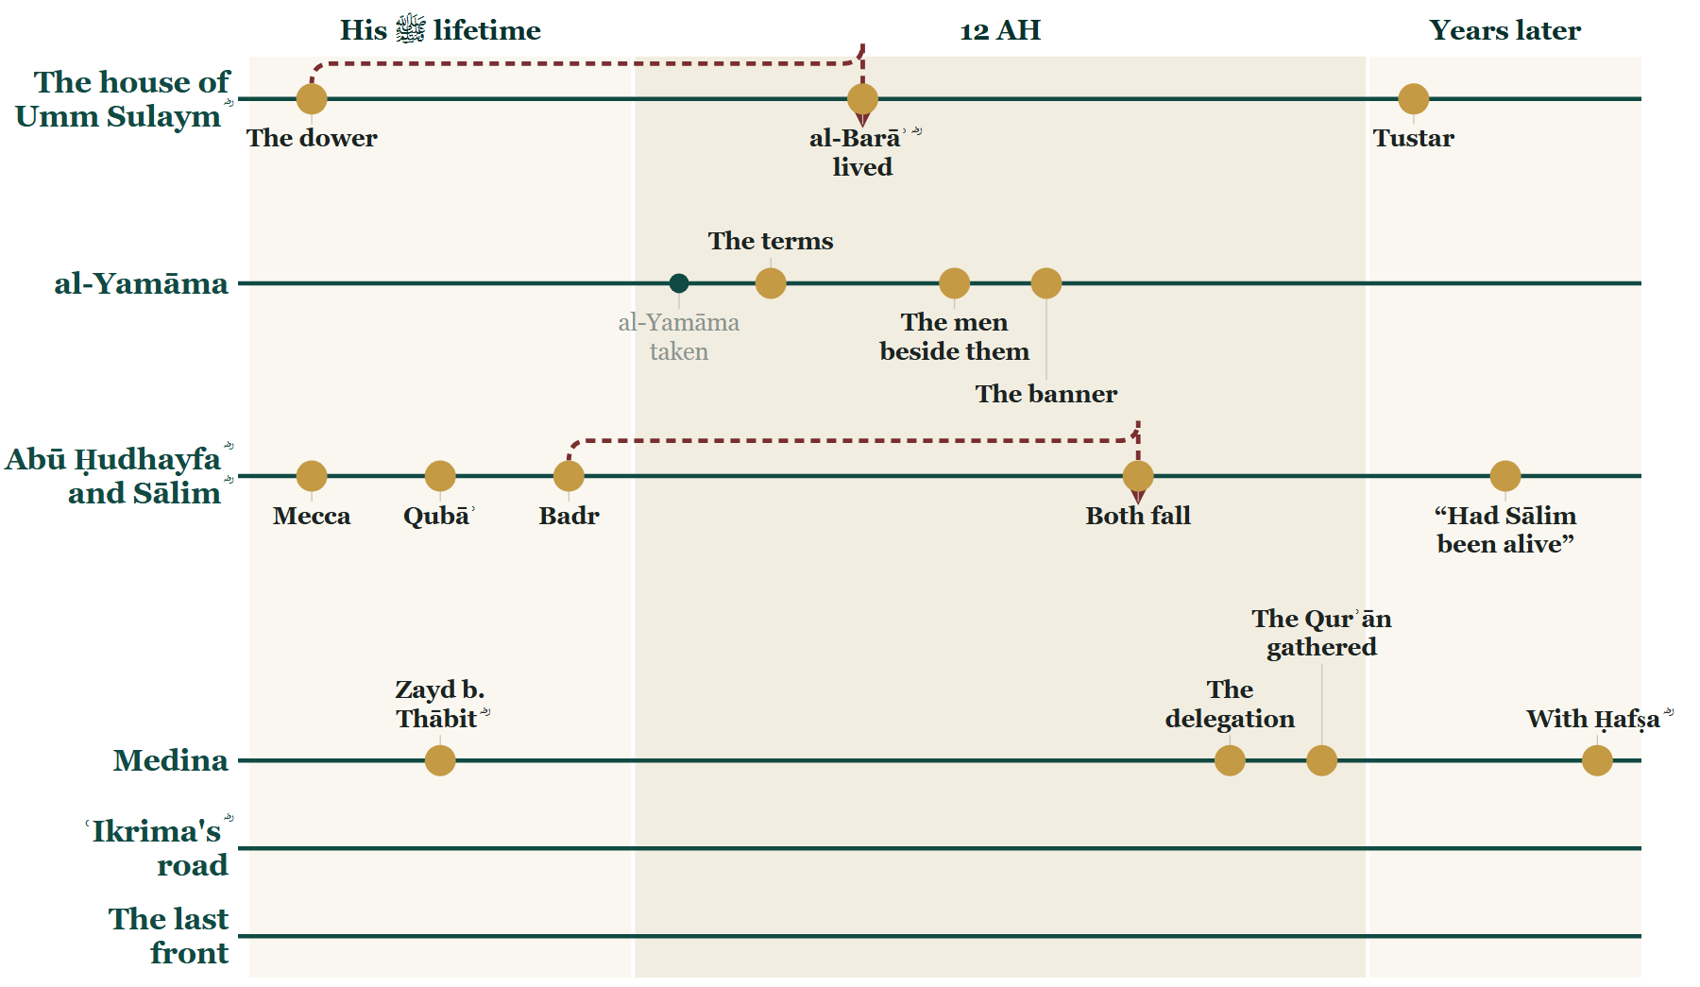
So far tonight
Where we stand
Notes:
CHECKPOINT 1 — the Line.
SAY — Tonight so far: the terms at the forts; the two houses and the men beside them; the reciters — and the order at Medina that they are the reason for.
(Next slide: the map. The time check is there.)

Slide 51
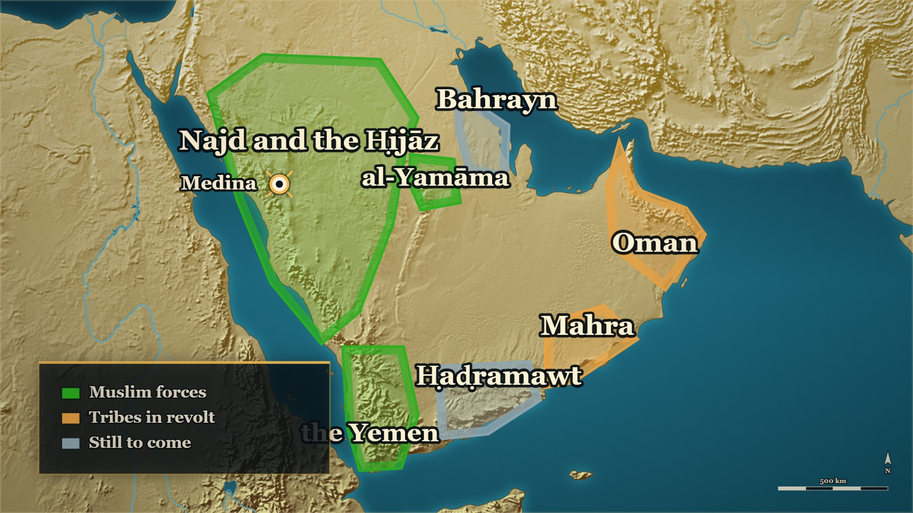
So far tonight
Where we stand
al-Yamāma
taken — and its dead
The east
still fighting
Notes:
CHECKPOINT 1 — the map.
SAY — When you came in, al-Yamāma had just been taken. Now you know what it cost. And look at the east: still fighting.
⏱ Past 0:40 here → close here. ʿIkrima's ؓ road — Oman, Mahra and the last front — opens evening 6, whole.
CARRYING ON → say: "While all of this was happening, one commander had been sent away from al-Yamāma, and told not to come back." — and click on.
OUT OF TIME → this is your ending. Stay on this map and say:
1. The terms took their weapons and their wealth, and left them their lives.
2. She made him say the ruling before she told him it was his own case.
3. The mushaf the room reads from was gathered because of the men who were killed in the garden.
Then next week: "One commander was sent away from al-Yamāma before the battle and told not to come back. Next week: where his road went — all the way to the last front of the war."
Then a loud السلام علیکم, and the dua. Next week opens on these two slides.

Slide 52
Part VI
ʿIkrima's ؓ road: Oman and Mahra (11→12 AH)

Slide 53
11–12 AH
Meanwhile: the man sent away
Evening 3
Last week
Tonight
'ʿIkrima ؓ came into Abyan from Mahra'
sent on from al-Yamāma: 'do not come back'
how he got there — and who he was
Notes:
BRIDGE — say:
On evening 3 you heard one line: ʿIkrima ؓ came into Abyan from Mahra, with a great many men. Last week you heard why he was sent on from al-Yamāma: do not come back — go on to Oman and Mahra. Tonight, how he got to Mahra. But first, who he was.

Slide 54
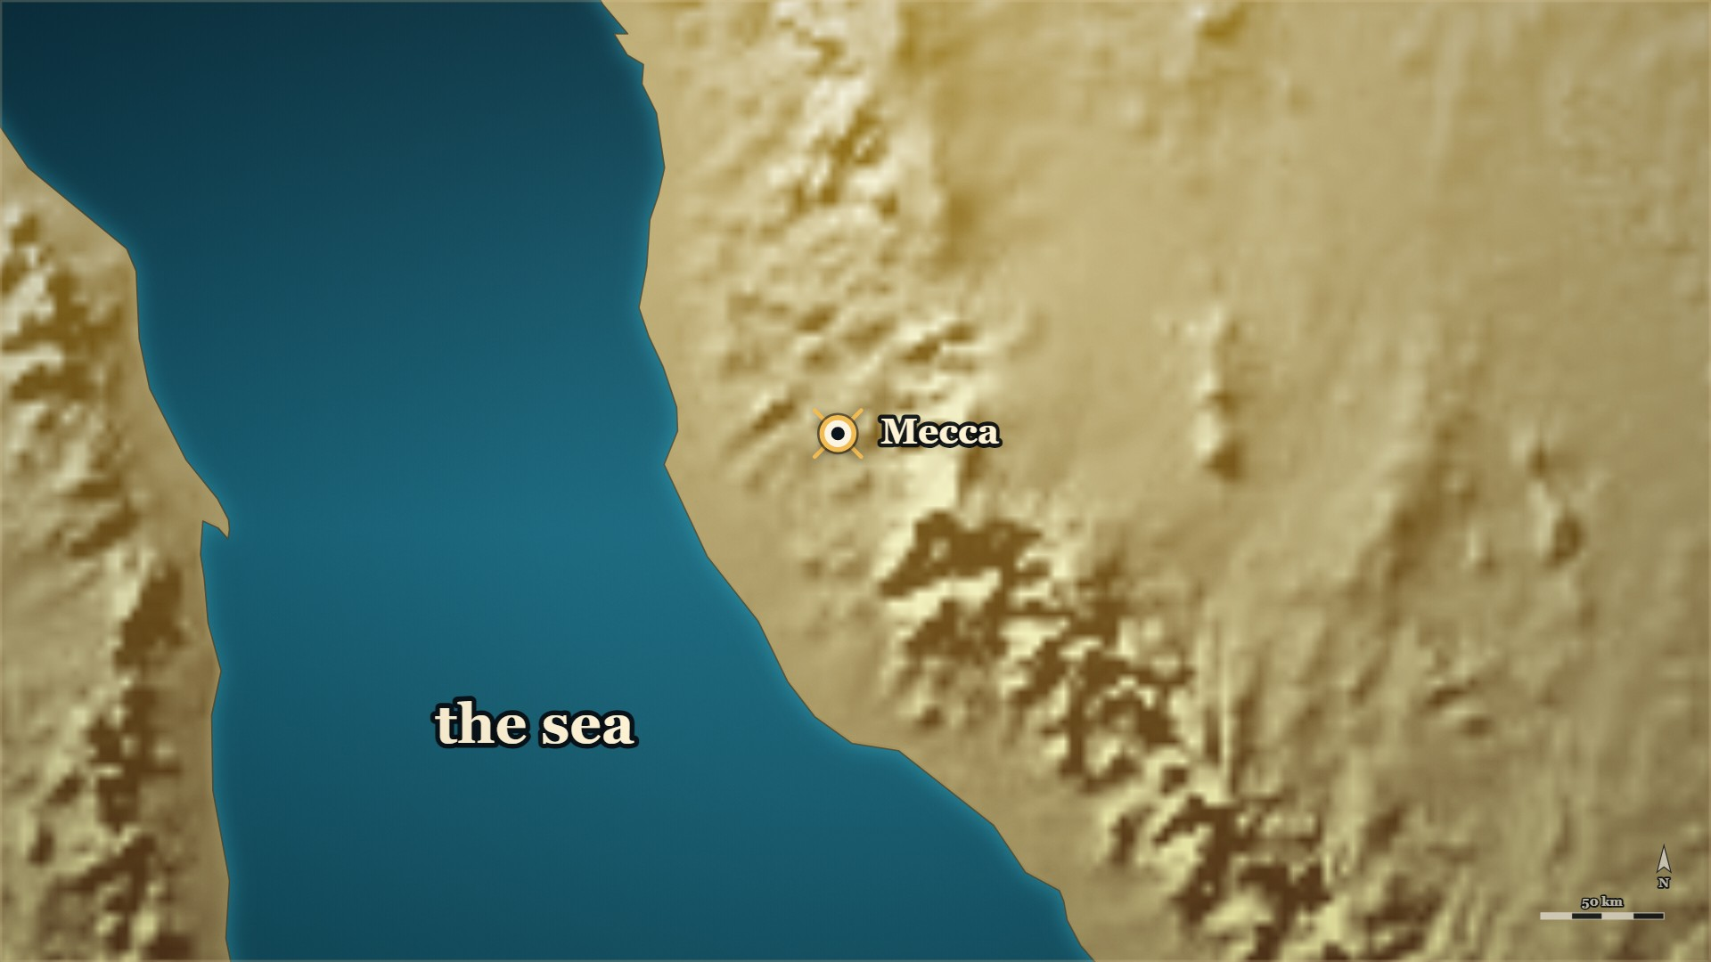


8 AH, the Conquest of Mecca
The ship, and the vow
Mecca
the Conquest, 8 AH
The coast
a ship, and a storm
Notes:
NOTE — ↩ 8 AH, the Conquest. [HANDS] 4 (spare): "Whose son was ʿIkrima?" — the room knows it from evening 4
HANDS UP FIRST — ask it before the first click. "Whose son was ʿIkrima?" Let them say it. Then tell the card.
SAY —
1. Whose son he was — ʿIkrima, son of Abū Jahl: the man who led Quraysh against the Prophet ﷺ at Badr, and was killed there.
2. The Conquest of Mecca, 8 AH — He was one of the few whose blood the amnesty did not cover.
▶ CLICK 1 — He runs for the coast, and takes a ship.
3. He ran for the sea — He rode for the coast and took a ship.
4. The squall — The people on board said: be sincere to God alone; your gods are no use out here.
5. What he said in the storm — If nothing saves at sea but sincerity, then nothing else saves on land either.
6. The vow — If God brings him through, he will go to Muḥammad ﷺ and put his hand in his hand.
▶ NEXT SLIDE — the words: read the Arabic, then its English.
BACKGROUND (read at home, not aloud) —
When Mecca fell, ʿIkrima b. Abī Jahl was one of the few whose blood was not covered by the amnesty. He rode for the coast and took ship. A squall struck. The people on board told one another to be sincere to God alone, because their gods would be no use out there. ʿIkrima heard it. What he said next he said there, in the storm.

Slide 55
8 AH, the Conquest of Mecca
The ship, and the vow
وَاللَّهِ لَئِنْ لَمْ يُنْجِ فِي الْبَحْرِ إِلَّا الْإِخْلَاصُ فَإِنَّهُ لَا يُنْجِي فِي الْبَرِّ غَيْرُهُ … أَنْ آتِيَ مُحَمَّدًا حَتَّى أَضَعَ يَدِي فِي يَدِهِ
By God, if nothing saves at sea but sincerity, then nothing else saves on land either … I will go to Muhammad and put my hand in his hand
al-Bidaya wa'l-Nihaya, vol. 4, p. 550
Notes:
THE WORDS — the story was told on the map. Read the Arabic, then its English — and the one line.
QUOTE — وَاللَّهِ لَئِنْ لَمْ يُنْجِ فِي الْبَحْرِ إِلَّا الْإِخْلَاصُ فَإِنَّهُ لَا يُنْجِي فِي الْبَرِّ غَيْرُهُ، اللَّهُمَّ إِنَّ لَكَ عَلَيَّ عَهْدًا إِنْ أَنْتَ عَافَيْتَنِي مِمَّا أَنَا فِيهِ، أَنْ آتِيَ مُحَمَّدًا حَتَّى أَضَعَ يَدِي فِي يَدِهِ فَلَأَجِدَنَّهُ عَفُوًّا كَرِيمًا
"By God, if nothing saves at sea but sincerity, then nothing else saves on land either. O Allah, I owe You a covenant: if You bring me safe out of what I am in, I will go to Muhammad and put my hand in his hand — and I shall surely find him forgiving and generous."
— البدایہ والنہایہ ج۴ ص۵۵۰
عبرت — He worked out the whole matter from one thing the people on the ship said, and he was right about what he would find.

Slide 56
Banū Makhzūm, of Mecca
ʿIkrima ؓ and Umm Ḥakīm ؓ
Hishām b. al-Mughīra
Abū Jahl
killed at Badr
al-Ḥārith b. Hishām ؓ
ʿIkrima ؓ
Umm Ḥakīm ؓ
married
Notes:
TREE — whose son, and whose daughter. Point as you go. (Every line is glued to its boxes: move a box and its lines follow.)
SAY — Whose son he was, and whose daughter his wife was.
1. Abū Jahl — who led Quraysh against the Prophet ﷺ at Badr, and was killed there.
2. His brother, al-Ḥārith b. Hishām ؓ — in al-Dhahabī's words, one of the noble Companions.
3. So Umm Ḥakīm ؓ — al-Ḥārith's daughter, and ʿIkrima's ؓ wife — was his cousin: his father's brother's daughter. On the day of the Conquest she became a Muslim. He ran.

Slide 57
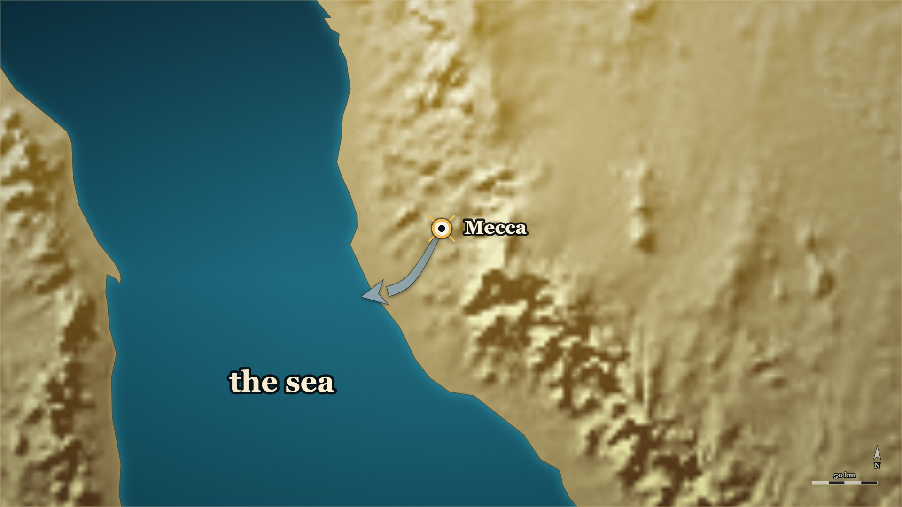




8 AH, the Conquest of Mecca
Umm Ḥakīm ؓ goes after her husband
Umm Ḥakīm ؓ
his wife, with the safe-conduct
Mecca
she brings him back
Notes:
NOTE — A real journey; the map draws it
SAY —
1. His wife — Umm Ḥakīm bint al-Ḥārith b. Hishām ؓ became a Muslim on the day of the Conquest.
2. She went to the Prophet ﷺ herself — And asked leave to go after her husband, and safe-conduct for him. He gave her both.
▶ CLICK 1 — She goes after him, down the coast road.
3. The road — A servant travelling with her turned on her; she held him off until people on the way bound him for her.
▶ CLICK 2 — She reaches him at the shore — and brings him back.
4. At the shore — She reached him in Tihāma, already aboard the ship — and she brought him back.
▶ NEXT SLIDE — the words: read the Arabic, then its English.
BACKGROUND (read at home, not aloud) —
Umm Ḥakīm bint al-Ḥārith b. Hishām accepted Islam on the day of the Conquest. Her husband had fled. She went to the Prophet ﷺ herself and asked leave to go after him, and asked safe-conduct for him. He gave her both. She travelled with a servant who tried to force himself on her; she put him off until she reached some people who bound him for her. She caught her husband somewhere in Tihāma, with him already aboard the ship. She brought him back.
Whose daughter she was (added 2026-09-27 for evening 5's family tree — on §1's household list, on no card until
now). She is «أم حكيم بنت الحارث بن هشام» on the card's own page; and al-Ḥārith b. Hishām ؓ was Abū Jahl's brother,
so she was ʿIkrima's ؓ cousin — his father's brother's daughter:
> وَالحَارِثُ بنُ هِشَامِ بنِ المُغِيْرَةِ المَخْزُوْمِيُّ أَبُو عَبْدِ الرَّحْمَنِ مِنَ الصَّحَابَةِ الأَشْرَافِ، وَهُوَ أَخُو أَبِي جَهْلٍ
> — سیر أعلام النبلاء ج۱ ص۳۳۰ · https://shamela.ws/book/10906/1756
> *English:* "And al-Ḥārith b. Hishām b. al-Mughīra al-Makhzūmī, Abū ʿAbd al-Raḥmān, one of the noble Companions — and he
> is Abū Jahl's brother."

Slide 58
8 AH, the Conquest of Mecca
Umm Ḥakīm ؓ goes after her husband
فاستأذنت رسول الله صلى الله عليه وسلم في طلب زوجها، فأذن لها وآمنه
"She asked the Messenger of Allah ﷺ leave to go after her husband, and he gave her leave and granted him safe-conduct."
Siyar A'lam al-Nubala Siyar 2, p. 164
Notes:
THE WORDS — the story was told on the map. Read the Arabic, then its English — and the one line.
QUOTE — فاستأذنت رسول الله صلى الله عليه وسلم في طلب زوجها، فأذن لها وآمنه
"She asked the Messenger of Allah ﷺ leave to go after her husband, and he gave her leave and granted him safe-conduct."
— سیر أعلام النبلاء، ج السیرۃ ۲ ص۱۶۴
عبرت — The safe-conduct that brought ʿIkrima ؓ back was asked for by his wife, in person.

Slide 59
8 AH
The cloak
فَلَمَّا رَآهُ وَثَبَ فَرَحًا بِهِ، وَرَمَى عَلَيْهِ رِدَاءَهُ حَتَّى بَايَعَهُ
"When he saw him he sprang up in joy at him and threw his cloak over him, until he pledged allegiance to him."
Siyar A'lam al-Nubala Siyar 2, p. 185
Notes:
NOTE — ⚠ Do not say "nothing was said to him about his father" — an argument from silence
⚠ Do not say "nothing was said to him about his father." That is an argument from silence, and it is the door back into the story §X.2 deletes — the page records the welcome, and nothing about what was or was not said.
SAY —
1. The two of them come in — ʿIkrima, with his wife, to the Prophet ﷺ.
2. Whose son this is — The son of the man who led Quraysh against him at Badr, and was killed there.
3. What the Prophet ﷺ did — He did not wait for him to come close: he sprang up in joy and threw his cloak over him.
^ read the Arabic on the face here
4. The pledge — The cloak was over him until he had pledged his allegiance.
QUOTE — فَلَمَّا رَآهُ وَثَبَ فَرَحًا بِهِ، وَرَمَى عَلَيْهِ رِدَاءَهُ حَتَّى بَايَعَهُ
"When he saw him he sprang up in joy at him and threw his cloak over him, until he pledged allegiance to him."
— سیر أعلام النبلاء، ج السیرۃ ۲ ص۱۸۵
عبرت — He was met by the man himself standing up, and the marriage he had come back to was left as it was.
BACKGROUND (read at home, not aloud) —
ʿIkrima came in to the Prophet ﷺ with his wife. This is the son of the man who had led Quraysh against him at Badr, and who had been killed there. The books record what the Prophet ﷺ did when he saw him. He did not wait for him to reach the front. He got up.

Slide 60
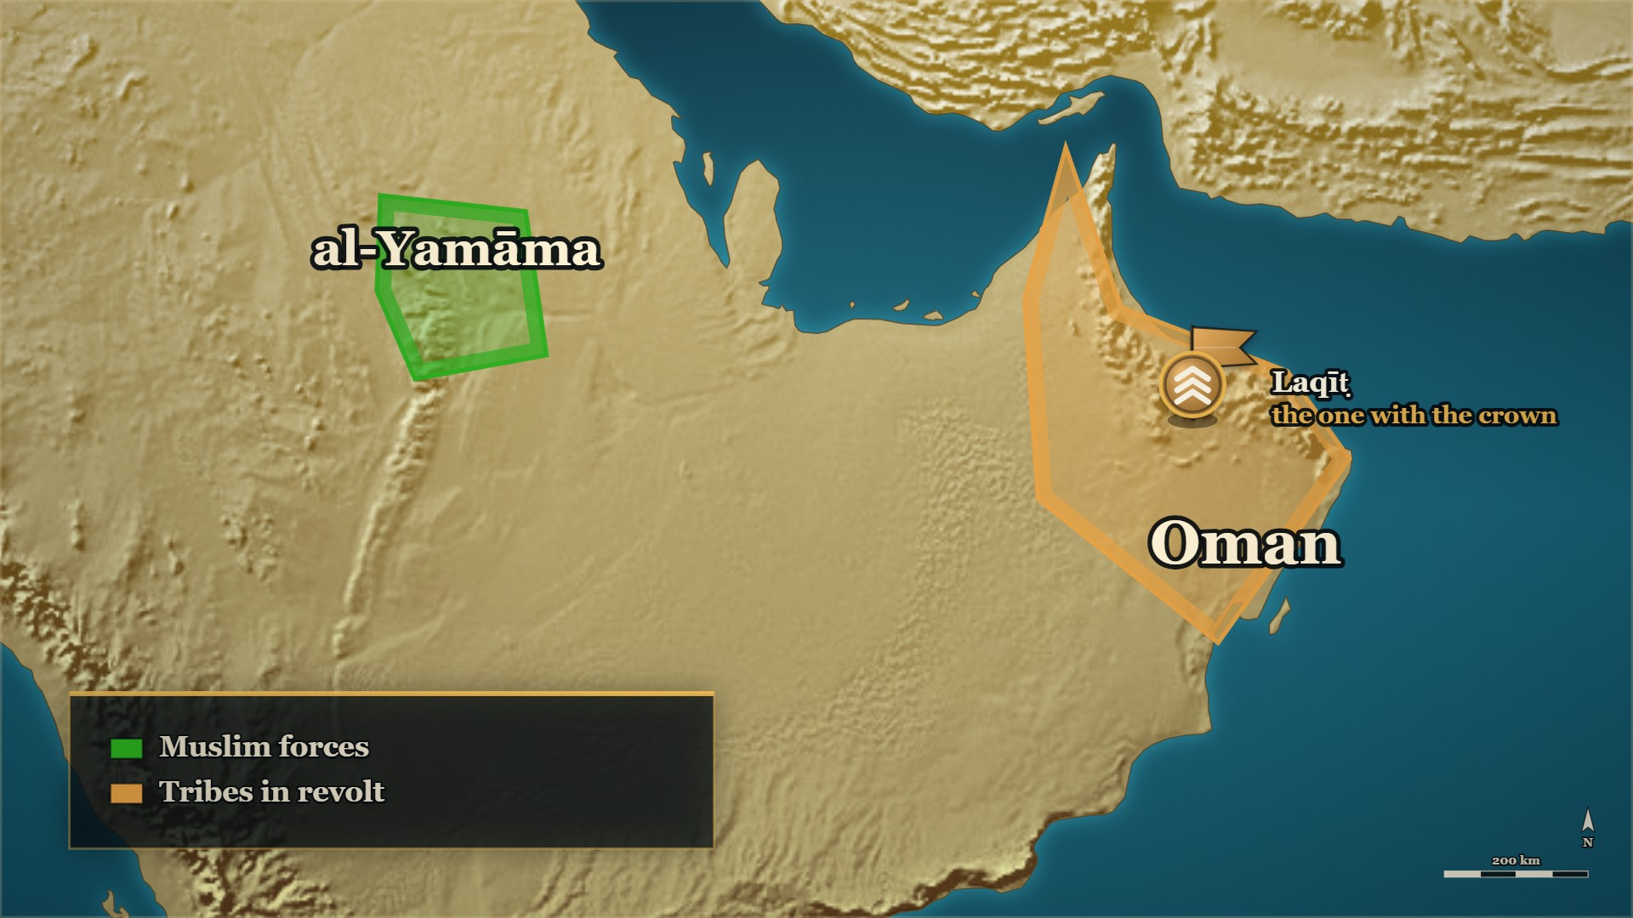











11–12 AH, Oman
Oman asked for help
Oman
Laqīṭ, 'the one with the crown'
Jayfar
asks Medina for help
ʿIkrima ؓ
joins them from al-Yamāma
Notes:
NOTE — The claimant who called himself the one with the crown (⚠ the books differ on how plainly he claimed prophethood), the lawful ruler's letter to Medina, the commanders each in charge in his own theatre, and the letters to the rebel's own chiefs at Rijām
SAY —
1. The claimant with the crown — Laqīṭ b. Mālik al-Azdī, "Dhū al-Tāj", called al-Julandā before Islam: he claimed prophethood too, the ignorant of Oman followed him, and he took the country.
▶ CLICK 1 — The two lawful rulers, driven to the edges of their own country.
2. The lawful rulers — Jayfar and ʿAbbād, driven to the edges of their own country: the mountains and the sea.
▶ CLICK 2 — Jayfar writes to Abū Bakr ؓ, and asks for help.
3. A request, not an invasion — Jayfar wrote to Abū Bakr ؓ and asked for help.
▶ CLICK 3 — Two commanders come from Medina.
4. Two commanders, one arrangement — Ḥudhayfa in command in Oman, ʿArfaja in Mahra; each under the other in the other's country.
▶ CLICK 4 — And ʿIkrima's ؓ line from al-Yamāma — they join at Rijām, near Oman.
5. And the man sent on from al-Yamāma — ʿIkrima ؓ joins them, and Abū Bakr ؓ writes that they are to defer to his judgement.
▶ CLICK 5 — Letters before swords: to the rebel's own chiefs.
6. Letters before swords — Near Oman they wrote to Jayfar — and to the rebel's own chiefs, and some of them left him.
▶ NEXT SLIDE — the words: read the Arabic, then its English.
Who he was, on the same page: «ذو التاج لَقيطُ بن مالك الأَزدي، وكان يُسَمَّى في الجاهلية الجُلَنْدَى، فادّعى
النُّبوَّة أيضًا، وتابعَهُ الجَهَلَةُ من أهل عُمان» (البدایہ ج۷ ص۴۱).
The arrangement — Ibn Kathīr: «وحذيفة هو الأمير فإذا ساروا إلى بلاد مهرة فعرفجة الأمير», and of ʿIkrima ؓ:
«وقد كتب إليهما الصديق إن ينتهيا إلى رأي عكرمة» (البدایہ ج۷ ص۴۱). الکامل ج۲ ص۲۲۵: «وَكُلٌّ مِنْهُمَا أَمِيرٌ
عَلَى صَاحِبِهِ فِي وَجْهِهِ»; the joining at Rijām, «قَرِيبٌ مِنْ عُمَانَ» (ج۲ ص۲۲۵–۲۲۶); and the letters to
Laqīṭ's own chiefs, «وَكَاتَبُوا رُؤَسَاءَ مِنْ لَقِيطٍ وَارْفَضُّوا عَنْهُ» (ج۲ ص۲۲۶).
⚠ Ḥudhayfa b. Miḥṣan is NOT Abū Ḥudhayfa ؓ, whose death the room hears earlier tonight. Say the full name,
or *"the commander in Oman"*. ⚠ No page we hold states the Companionship of Ḥudhayfa b. Miḥṣan or of ʿArfaja
— no honorific.
⚠ How plainly the claimant claimed prophethood differs between the books — Ibn Kathīr says it outright;
الکامل is more guarded (see E-RC29's ⚠). The ruler's name is ʿAbbād in البدایہ, ʿIyādh in الکامل.
BACKGROUND (read at home, not aloud) —
In Oman a man named Laqīṭ b. Mālik al-Azdī — who called himself Dhū al-Tāj, "the one with the crown" — claimed prophethood too, and the ignorant of Oman followed him. He took the country and drove its two rulers, Jayfar and ʿAbbād, to its edges, towards the mountains and the sea. Jayfar wrote to Abū Bakr ؓ, told him what had happened, and asked for troops. Abū Bakr ؓ sent two commanders — Ḥudhayfa b. Miḥṣan to Oman and ʿArfaja to Mahra, each in command in his own theatre — and then ʿIkrima ؓ to join them, with a letter telling the two to defer to his judgement. The columns joined before they reached Oman, and wrote to Jayfar — and to the rebel's own chiefs.

Slide 61
11–12 AH, Oman
Oman asked for help
فتغلَّب عليها وقهر جيفرًا وعبادًا وألجأهما إلى أطرافها، من نواحي الجبال والبحر، فبعثَ جيفر إلى الصديق فأخبره الخبر واستجاشه
"He prevailed over it, overpowered Jayfar and ʿAbbād and drove them to its edges, towards the mountains and the sea…"
al-Bidaya wa'l-Nihaya, vol. 7, p. 41
Notes:
THE WORDS — the story was told on the map. Read the Arabic, then its English — and the one line.
QUOTE — فتغلَّب عليها وقهر جيفرًا وعبادًا وألجأهما إلى أطرافها، من نواحي الجبال والبحر، فبعثَ جيفر إلى الصديق فأخبره الخبر واستجاشه
"He prevailed over it, overpowered Jayfar and ʿAbbād and drove them to its edges, towards the mountains and the sea. So Jayfar sent to al-Ṣiddīq, told him the news, and asked him for an army."
— البدایہ والنہایہ ج۷ ص۴۱
عبرت — This front began with a letter from inside the country asking for help, not with an army from outside it.

Slide 62
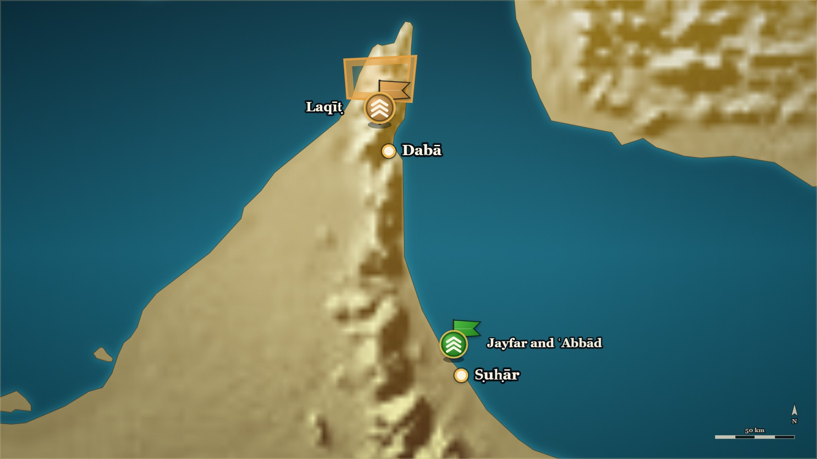










11–12 AH, Oman
Dabā: the relief from inside
Dabā
the great market town
Ṣuḥār
the lawful rulers
The relief
from inside the region
Notes:
NOTE — The Muslims very nearly lost it. Short arrows from inside the region, not one from Medina. [HANDS] spare: "The column from Medina is losing. Who is close enough to help?" ⚠ "ten thousand" — both books give it
⚠ Ibn Kathīr ج۷ ص۴۱ says the Oman claimant claimed prophethood; الکامل is more guarded. Oman is
not a clean case of purely political secession.
Also on the page — البدایہ ج۷ ص۴۱ (https://shamela.ws/book/30097/3187): Laqīṭ at Dabā «وجعل الذراري والأموال
وراءَ ظهورهم ليكونَ أقوى لحربهم» — the same ground Musaylima chose at ʿAqrabāʾ (E-RC54). الکامل ج۲ ص۲۲۶: the
count, «فَقُتِلَ مِنْهُمْ فِي الْمَعْرَكَةِ عَشَرَةُ آلَافٍ» — a figure البدایہ ج۷ ص۴۲ gives too, «عشرة آلاف مقاتل» (corrected
2026-10-01: it is not Ibn al-Athīr's alone) — and afterwards the fifth went to Medina with ʿArfaja while Ḥudhayfa stayed
«يُسَكِّنُ النَّاسَ».
The closing of the front, in both books (added 2026-10-01, DECISIONS.md #69 — beats 7–8, and the closing map before
E-RC30):
⚠ The two books part on ʿArfaja: الکامل has Ḥudhayfa staying, البدایہ has ʿArfaja returning to his companions. Say
both, each as its book's.
Ibn Kathīr's own telling of the crisis (added 2026-09-27 — on §8.1, on no card until now). The fight:
SAY —
1. Where he chose to fight — Laqīṭ camped at Dabā, the country's great market town, with the families and the property behind his lines.
2. The same thing Musaylima did — Put everything you have behind your own army, so that nobody runs.
▶ CLICK 1 — The Muslims advance from Ṣuḥār.
3. The lawful rulers — Jayfar and ʿAbbād camped at Ṣuḥār, and sent to the commanders.
▶ CLICK 2 — Laqīṭ gets the upper hand, and the line gives way. (Spare hands-up before the next click: the column from Medina is losing — who is close enough to help?)
4. The fight — Hard; Laqīṭ got the upper hand, and in Ibn Kathīr's words the Muslims were tried and very nearly turned their backs.
▶ CLICK 3 — The relief: Banū Nājiya and ʿAbd al-Qays — men of that region, not an army from Medina.
5. The relief — Not from Medina: Banū Nājiya and ʿAbd al-Qays, men of that region — Ibn Kathīr: at that very hour.
▶ CLICK 4 — The rebels broken.
6. The end at Dabā — The rebels broke and ran, and the Muslims rode on their backs: ten thousand killed, a figure both books give.
▶ NEXT SLIDE — the words: read the Arabic, then its English.
The relief's two commanders, in الکامل ج۲ ص۲۲۶ (the statement above, in full at §8.1): al-Khirrīt b. Rāshid over
Banū Nājiya, and Sayḥān b. Wuṣḥān over ʿAbd al-Qays. ⚠ Neither has a notice on our pages — name them only if asked.
BACKGROUND (read at home, not aloud) —
Oman had gone to a man who called himself Dhū al-Tāj and claimed prophethood, and he had pushed the two lawful rulers to the edges of the country. One of them wrote to Abū Bakr ؓ and asked for help — so this front began with a request, not an invasion. Three Muslim columns joined before they arrived, wrote to the rulers, and also wrote to the rebel's own chiefs, some of whom left him. Then they fought at Dabā, the country's great market town. And they very nearly lost it.
> فَوَلَّى الْمُشْرِكُونَ الْأَدْبَارَ، فَقُتِلَ مِنْهُمْ فِي الْمَعْرَكَةِ عَشَرَةُ آلَافٍ، وَرَكِبُوهُمْ حَتَّى أَثْخَنُوا فِيهِمْ، وَسَبَوُا الذَّرَارِيَّ وَقَسَّمُوا الْأَمْوَالَ، وَبَعَثُوا بِالْخُمْسِ إِلَى أَبِي بَكْرٍ مَعَ عَرْفَجَةَ، وَأَقَامَ حُذَيْفَةُ بِعُمَانَ يُسَكِّنُ النَّاسَ.
> — الکامل فی التاریخ ج۲ ص۲۲۶ · https://shamela.ws/book/21712/917
> *English:* "The mushrikūn turned their backs; ten thousand of them were killed in the engagement, and the Muslims
> rode them down until they had cut deep into them. They took the families captive and divided the property, sent the
> fifth to Abū Bakr with ʿArfaja, and Ḥudhayfa stayed in Oman, settling the people."
> فولّى المشركون مُدْبرين، وركب المسلمون ظهورهم فقتلوا منهم عشرة آلاف مقاتل، وسَبَوا الذراري، وأخذوا الأموال والسوق بحذافيرها، وبعثوا بالخُمْس إلى الصديق ﵁ مع أحد الأمراء، وهو عرفجة، ثم رجع إلى أصحابه.
> — البدایہ والنہایہ ج۷ ص۴۲ · https://shamela.ws/book/30097/3188
> *English:* "The mushrikūn turned in flight, and the Muslims rode on their backs and killed ten thousand fighters of
> them; they took the families captive, and took the property and the market, all of it; and they sent the fifth to
> al-Ṣiddīq with one of the commanders, ʿArfaja — who then returned to his companions."
> وتقاتلوا قتالًا شديدًا، وابتُلي المسلمون وكادوا أن يُولُّوا
> — البدایہ والنہایہ ج۷ ص۴۱ · https://shamela.ws/book/30097/3187
> *English:* "And they fought hard; the Muslims were tried, and very nearly turned their backs."
And the relief, over the page:
> أن بعثَ إليهم مَددًا، في الساعة الراهنة من بني ناجية وعبد القيس
> — البدایہ والنہایہ ج۷ ص۴۲ · https://shamela.ws/book/30097/3188
> *English:* "…that He sent them reinforcement, at that very hour, from Banū Nājiya and ʿAbd al-Qays."

Slide 63
11–12 AH, Oman
Dabā: the relief from inside
وَاسْتَعْلَى لَقِيطٌ، وَرَأَى الْمُسْلِمُونَ الْخَلَلَ، وَرَأَى الْمُشْرِكُونَ الظَّفَرَ. فَبَيْنَمَا هُمْ كَذَلِكَ جَاءَتِ الْمُسْلِمِينَ مَوَادُّهُمُ الْعُظْمَى مِنْ بَنِي نَاجِيَةَ … وَمِنْ عَبْدِ الْقَيْسِ.
"Laqīṭ got the upper hand; the Muslims saw the breach and the mushrikūn saw victory…"
al-Kamil, vol. 2, p. 226
Notes:
THE WORDS — the story was told on the map. Read the Arabic, then its English — and the one line.
QUOTE — وَاسْتَعْلَى لَقِيطٌ، وَرَأَى الْمُسْلِمُونَ الْخَلَلَ، وَرَأَى الْمُشْرِكُونَ الظَّفَرَ. فَبَيْنَمَا هُمْ كَذَلِكَ جَاءَتِ الْمُسْلِمِينَ مَوَادُّهُمُ الْعُظْمَى مِنْ بَنِي نَاجِيَةَ … وَمِنْ عَبْدِ الْقَيْسِ.
"Laqīṭ got the upper hand; the Muslims saw the breach and the mushrikūn saw victory. And while they were in that state, the Muslims' great relief came in — from Banū Nājiya … and from ʿAbd al-Qays."
— الکامل فی التاریخ ج۲ ص۲۲۶
عبرت — The men who saved that day were from the same country as the men they were fighting.

Slide 64
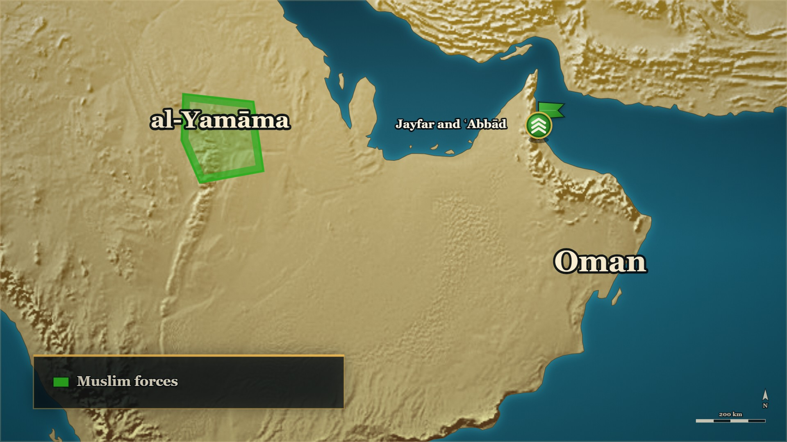









11–12 AH
Oman settled
Ḥudhayfa
stays, settling the people
The fifth
to Medina, with ʿArfaja
ʿIkrima ؓ
on to Mahra, with Nājiya and ʿAbd al-Qays
Notes:
SAY — Dabā is won. Before we leave Oman, the closing of the front — in both books' words.
▶ CLICK 1 — The families they had put behind their lines are taken captive; the property, and the whole market, divided. Ḥudhayfa stays in Oman, settling the people — Oman is settled.
▶ CLICK 2 — The fifth goes to Abū Bakr ؓ at Medina, with ʿArfaja. (Ibn Kathīr has ʿArfaja then returning to his companions; Ibn al-Athīr has Ḥudhayfa staying. Say both, each as its book's.)
▶ CLICK 3 — And ʿIkrima ؓ goes on to Mahra — with the men who came to the rescue at Dabā: Nājiya, ʿAbd al-Qays, and with them Rāsib and Saʿd.
QUOTE — وَسَبَوُا الذَّرَارِيَّ وَقَسَّمُوا الْأَمْوَالَ، وَبَعَثُوا بِالْخُمْسِ إِلَى أَبِي بَكْرٍ مَعَ عَرْفَجَةَ، وَأَقَامَ حُذَيْفَةُ بِعُمَانَ يُسَكِّنُ النَّاسَ
"They took the families captive and divided the property, sent the fifth to Abū Bakr with ʿArfaja, and Ḥudhayfa stayed in Oman, settling the people."
— al-Kamil, vol. 2, p. 226 (al-Bidaya, vol. 7, p. 42 has the same closing, with ʿArfaja then returning to his companions)

Slide 65
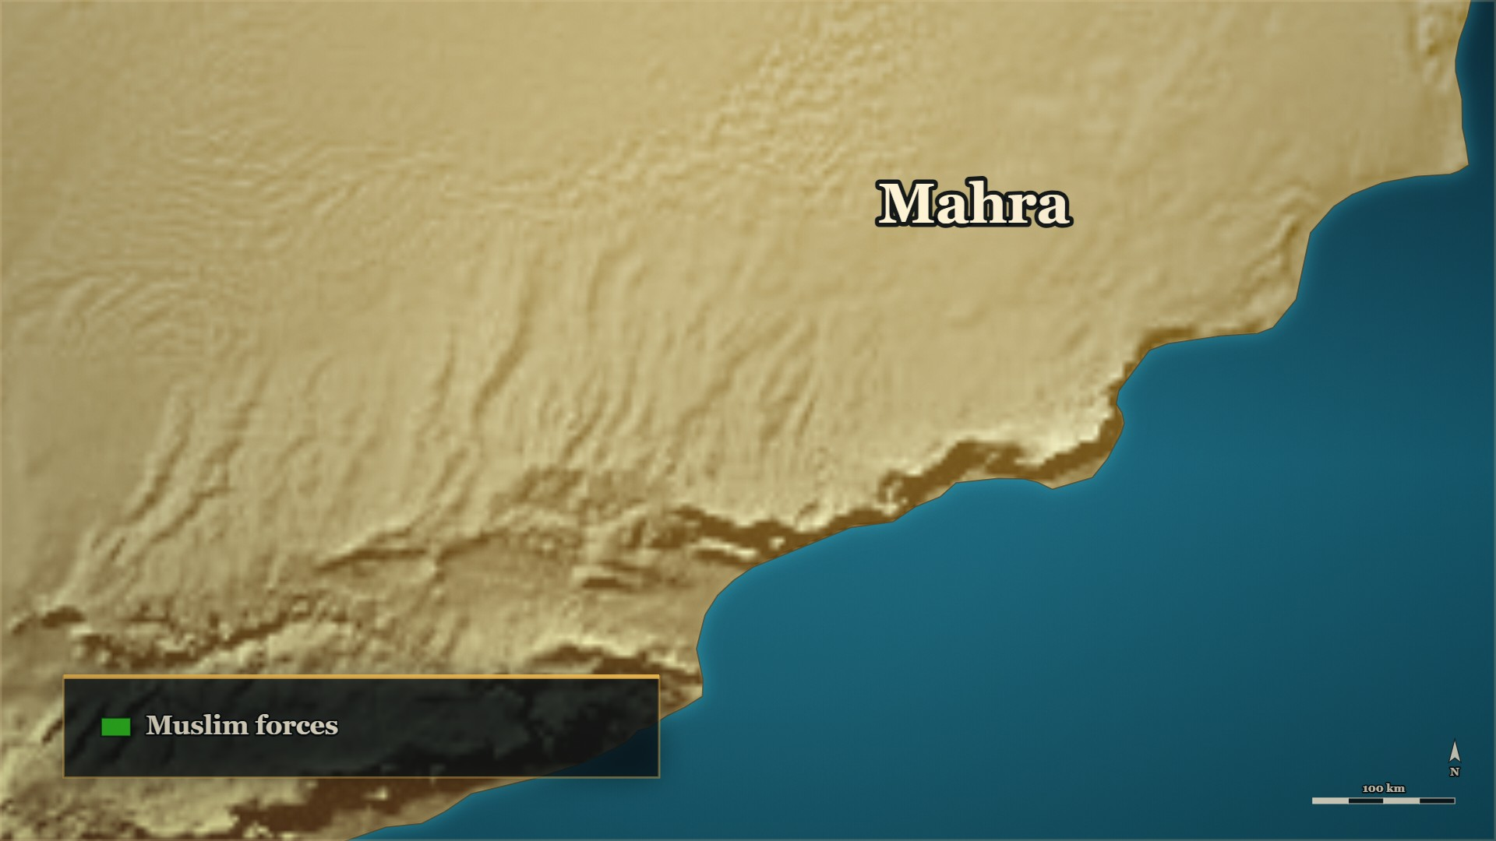


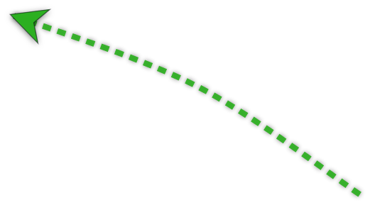







11–12 AH, Mahra
Mahra: won with a letter
Mahra
two chiefs at odds
The letter
half the enemy comes over
The fifth
to Medina
Notes:
NOTE — The fifth went to Medina carried by the man who had led half the rebellion. ⚠ No page gives an interval
SAY —
▶ CLICK 1 — ʿIkrima ؓ comes into Mahra, with the men from Oman.
1. Not one enemy but two — Two forces under two chiefs who would not work together: al-Muṣabbaḥ of Banū Muḥārib, with the greater part, and Shikhrīt.
2. "That discord was a mercy" — Ibn Kathīr's own words for it.
▶ CLICK 2 — The letter — and Shikhrīt comes over.
3. The letter — ʿIkrima ؓ wrote to the smaller chief, Shikhrīt; he answered, came over, and became a Muslim.
▶ CLICK 3 — al-Muṣabbaḥ refuses: the fighting is harder than Dabā.
4. The other one — al-Muṣabbaḥ was called and refused; the fighting was harder than Dabā, and he was killed.
▶ CLICK 4 — And the fifth goes to Medina, carried by Shikhrīt himself.
5. The fifth — Sent to Abū Bakr ؓ, carried by Shikhrīt himself — the man who had led half the rebellion.
▶ NEXT SLIDE — the words: read the Arabic, then its English.
Also on the page — الکامل ج۲ ص۲۲۶ (https://shamela.ws/book/21712/917): Shikhrīt «فَأَجَابَهُ وَأَسْلَمَ». البدایہ ج۷
ص۴۲: «فاقتتلوا مع المصبح أشدَّ من قتال دبا المتقدم», and the fifth sent to Abū Bakr ؓ with Shikhrīt. ⚠ No page
gives an interval between his coming over and the fifth going north — say no span of time.
The two forces, in Ibn Kathīr's words (added 2026-09-27 — on §8.2, on no card until now):
BACKGROUND (read at home, not aloud) —
ʿIkrima ؓ came into Mahra and found not one enemy but two — two forces under two chiefs who would not work together. So he wrote to the smaller one. That man answered, came over, and became a Muslim; and with him the Muslims were strengthened and the other man's nerve failed. Then ʿIkrima ؓ called that one too, and he refused, and the fighting that followed was harder than Dabā had been. Afterwards, the fifth of the spoils was sent to Abū Bakr ؓ — carried to Medina by the man who had been leading half the rebellion.
> فوجدهم جندين؛ على أحدهما - وهم الأكثر - أميرٌ يُقالُ له: المصبح، أحد بني محارب، وعلى الجند الآخر أمير يُقال له: شخريت
> — البدایہ والنہایہ ج۷ ص۴۲ · https://shamela.ws/book/30097/3188
> *English:* "He found them in two forces: over one of them — the greater — a commander called al-Muṣabbaḥ,
> one of Banū Muḥārib; and over the other a commander called Shikhrīt."

Slide 66
11–12 AH, Mahra
Mahra: won with a letter
وهما مختلفان، وكان هذا الاختلاف رحمة على المؤمنين، فراسل عكرمةُ شخريت فأجابه وانضاف إلى عكرمة فقوي بذلك المسلمون، وضعف جأش المصبح.
"The two were at odds, and that discord was a mercy upon the believers…"
al-Bidaya wa'l-Nihaya, vol. 7, p. 42
Notes:
THE WORDS — the story was told on the map. Read the Arabic, then its English — and the one line.
QUOTE — وهما مختلفان، وكان هذا الاختلاف رحمة على المؤمنين، فراسل عكرمةُ شخريت فأجابه وانضاف إلى عكرمة فقوي بذلك المسلمون، وضعف جأش المصبح.
"The two were at odds, and that discord was a mercy upon the believers. ʿIkrima wrote to Shikhrīt, and he answered him and joined ʿIkrima — and by that the Muslims were strengthened, and al-Muṣabbaḥ's nerve weakened."
— البدایہ والنہایہ ج۷ ص۴۲
عبرت — He wrote before he marched, and half the enemy stopped being the enemy.

Slide 67
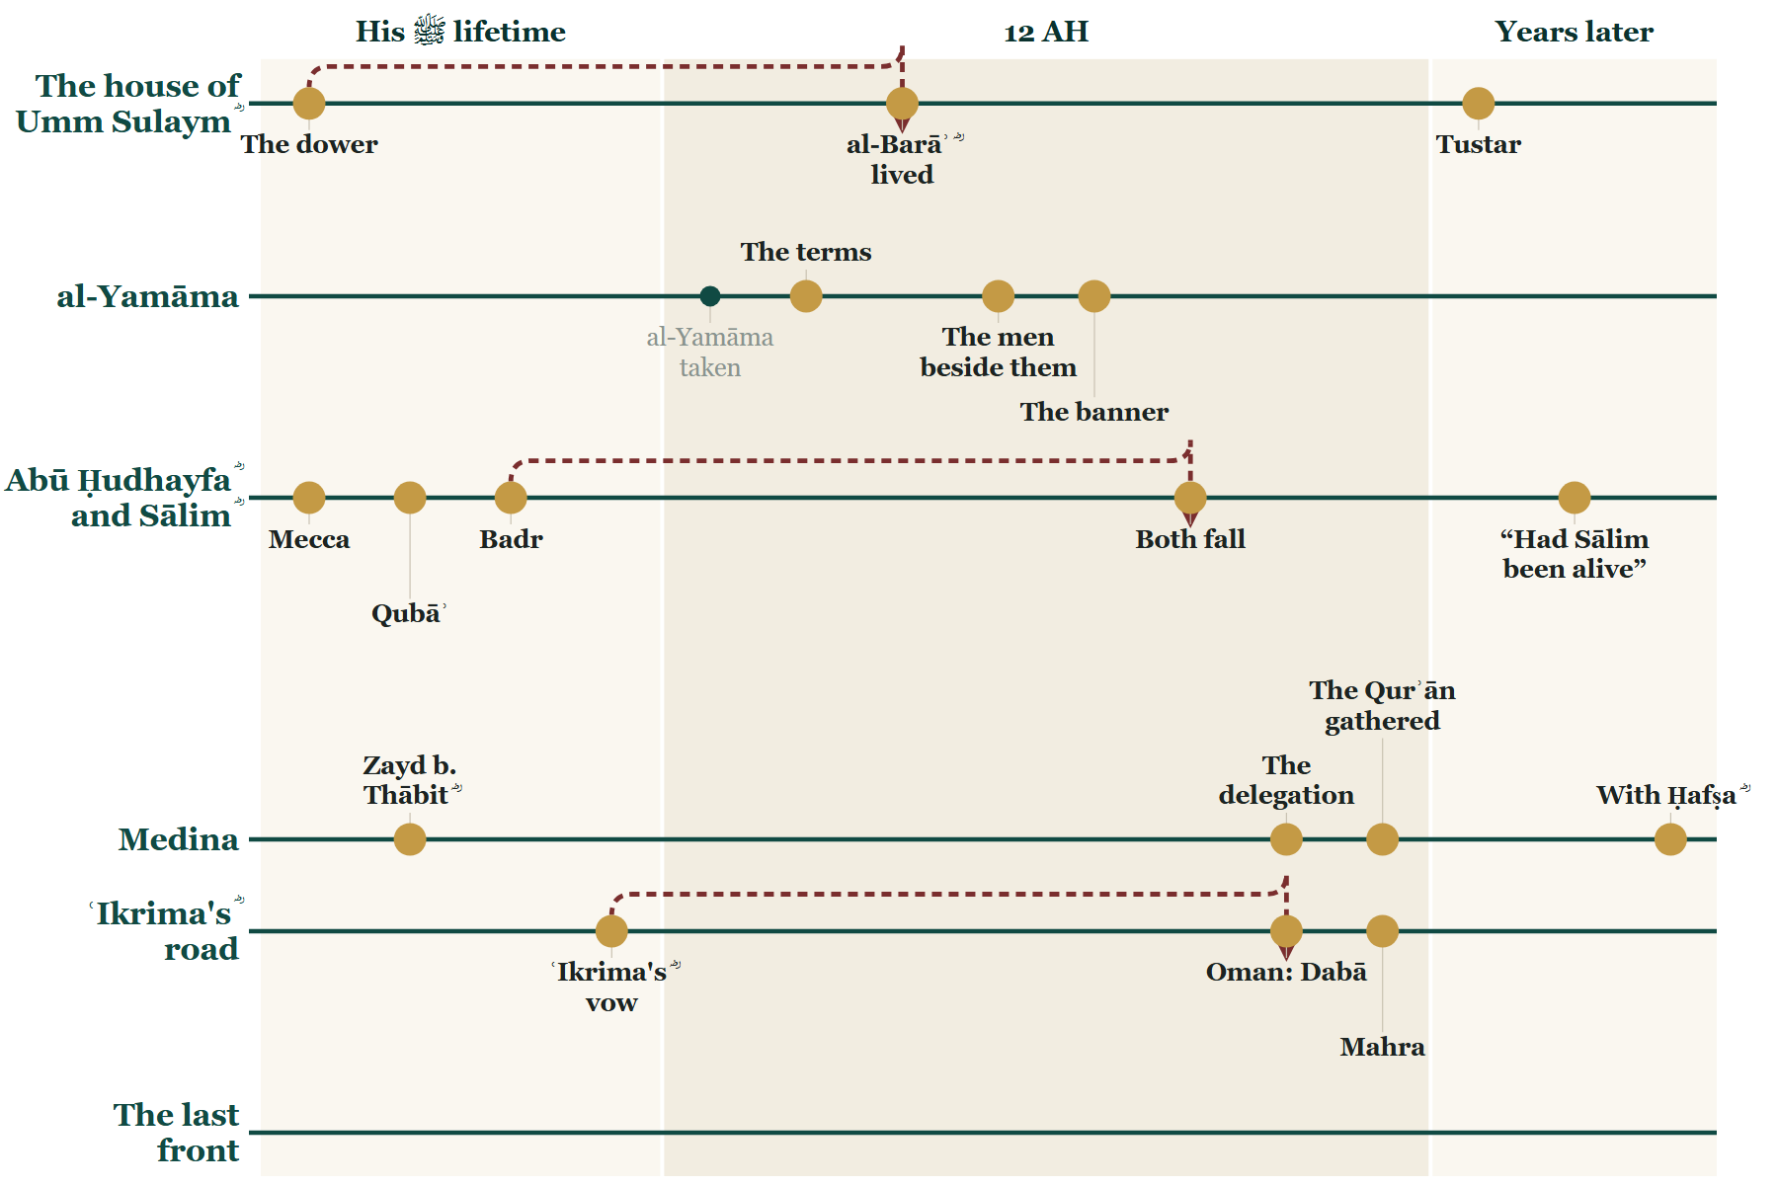
So far tonight
Where we stand
Notes:
CHECKPOINT 2 — the Line.
SAY — Tonight: what al-Yamāma cost, the Qurʾān gathered — and ʿIkrima's ؓ road, through Oman and Mahra.
(Next slide: the map. The time check is there.)

Slide 68
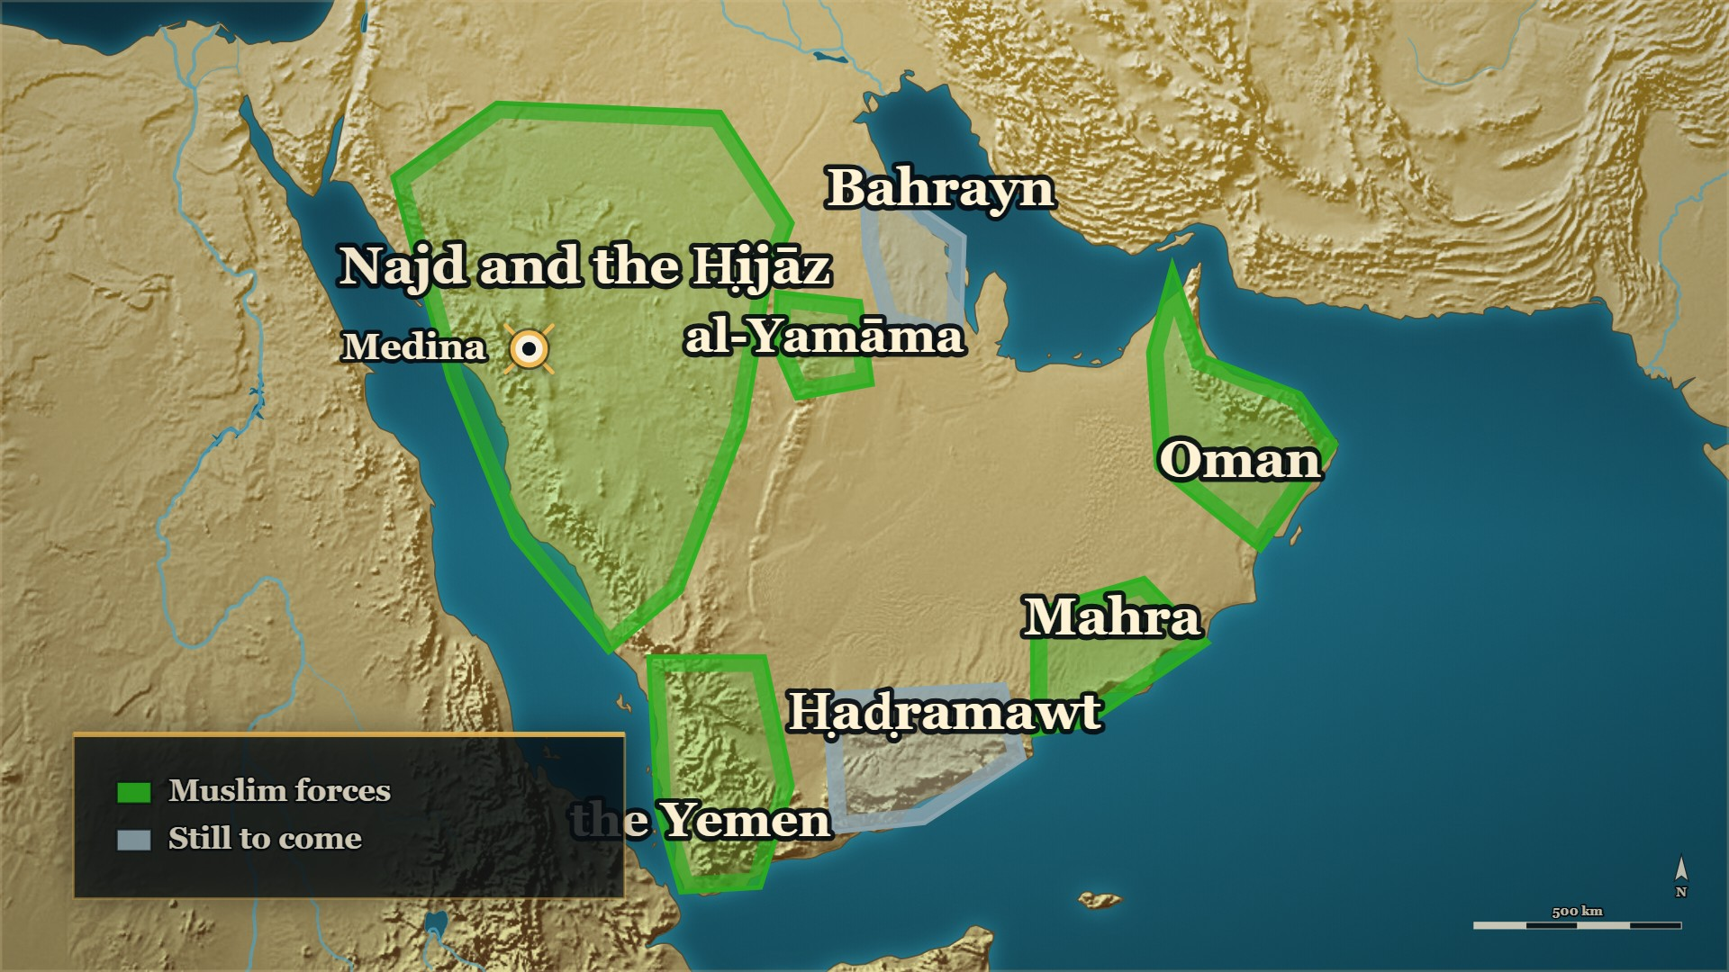
So far tonight
Where we stand
Oman, Mahra
settled
Ḥaḍramawt
still to come
Notes:
CHECKPOINT 2 — the map.
SAY — When you came in, the east was burning. Oman and Mahra are settled. One front is left: Ḥaḍramawt.
⏱ Past 0:40 here → close here. Ḥaḍramawt opens evening 6.
CARRYING ON → say: "One front was left — and it began with a quarrel about camels." — and click on.
OUT OF TIME → this is your ending. Stay on this map and say:
1. The mushaf the room reads from was gathered because of the men who were killed in the garden.
2. The men who saved that day were from the same country as the men they were fighting.
3. He wrote before he marched, and half the enemy stopped being the enemy.
Then next week: "One front was left, and the books say it began with one she-camel. Next week: how."
Then a loud السلام علیکم, and the dua. Next week opens on these two slides.

Slide 69
Part VII
Ḥaḍramawt and Kinda: the last front (11→12 AH)

Slide 70
11→12 AH
From Abyan to the last front
Evening 3
Tonight
Now
al-Muhājir ؓ in Ṣanʿāʾ — then 'your own post'
ʿIkrima ؓ, from Mahra to Abyan
Ḥaḍramawt and Kinda — the last front
Notes:
BRIDGE — say:
On evening 3 you left al-Muhājir ؓ in Ṣanʿāʾ, with Abū Bakr's ؓ double order: first the Yemen, then go on to your own post — Kinda. ʿIkrima ؓ had come into Abyan from Mahra; now you know the road he came by. From here the two of them go east, to the last front of the war. First: who were Kinda?

Slide 71
kings once — and two branches in 11 AH
Kinda
Banū Muʿāwiya
Ākil al-Murār
kings of the north, before Islam
Banū ʿAmr
Banū al-Ḥārith
the four kings
al-Ashʿath b. Qays
Notes:
TREE — Kinda. Point as you go.
SAY — Who were Kinda?
1. A tribe of the south, of Qaḥṭān, that had once given kings to the northern Arabs: the tribes of Bakr, tired of the strong eating the weak, asked a Tubbaʿ of Yemen for a king, and he gave them a man of Kinda — Ḥujr b. ʿAmr, Ākil al-Murār.
2. Its height: al-Ḥārith b. ʿAmr, given al-Ḥīra by one Persian king and hunted out of it by the next; forty-eight men of the house were put to death. Ibn al-Athīr says openly that some of this looks like Kinda praising itself.
3. In 11 AH, Kinda's Banū Muʿāwiya had two branches: Banū ʿAmr, whose four brothers the books call the four kings — and Banū al-Ḥārith, the branch of al-Ashʿath b. Qays.
4. Side by side, with no line between them: the books show the royal past and the royal title, and do not say that one caused the other. Nor do we.
IF THE ROOM IS WITH YOU: one of al-Ḥārith's sons, another Ḥujr, ruled Banū Asad harshly — and they killed him in his tent.
⚠ No date before Islam is on this slide, and none is to be said: they are estimates.
BACKGROUND (read at home, not aloud) — the house's stories in full:
• A Yemeni house made kings over the northern tribes: Kinda was a southern tribe — Of Qaḥṭān, not of the northern Arabs it came to rule.; The north had a problem — Among Bakr the reckless had overpowered the wise; the strong ate the weak.; They wanted a king from outside — Not one of their own, whom half would obey and half defy.; So they went to a Tubbaʿ of Yemen — And he gave them a man of Kinda: Ḥujr b. ʿAmr, Ākil al-Murār.; What he did with it — He settled at Baṭn ʿĀqil and took back Bakr's lands from al-Ḥīra.; Ibn Khaldūn tells it differently — A Ḥimyarite king set Ḥujr over all of Maʿadd. Say both; resolve neither.
• al-Ḥārith b. ʿAmr — al-Ḥīra given, al-Ḥīra taken back: Ḥujr's grandson al-Ḥārith — A king of great power and far-reaching name, in Ibn al-Athīr's words.; A Persian quarrel reaches the Arabs — Qubādh adopted the teaching of Mazdak; his governor at al-Ḥīra refused.; al-Ḥārith accepted, and was given al-Ḥīra — The high point of the house.; The next Persian king undid it — Anūshirwān killed Mazdak, restored the old governor, and hunted al-Ḥārith.; What it cost the house — Forty-eight men of it were caught and put to death, two of them his sons.; The historian's own caution — Ibn al-Athīr says openly that some of this looks like Kinda praising itself.
• Ḥujr and Banū Asad — "far from us in lineage": The northern chiefs come to him — The killing between us will wipe us out; send your sons to hold us apart.; Four sons set as kings — One over each of the tribes.; Ḥujr goes to Banū Asad — And takes a yearly levy from them.; They throw out his collectors — He came with an army, killed their leading men, drove the rest to Tihāma.; He relented and called them back — And a day's march from him, they turned.; They reached his tent and killed him — The man who struck him was one whose father Ḥujr had killed.
• "The four kings" — side by side, no arrow between: A year or so later, Kinda broke away — The same tribe, the same men, the other side of the line.; "The four kings" — Four brothers of one Kinda clan, with their sister, taking to their strongholds.; al-Ashʿath was not one of them — He was of a different branch of the tribe.; What Ibn al-Athīr says the cause was — An arrangement for carrying zakāt between Kinda and Ḥaḍramawt.; Not the kingship — The books show the royal past, the royal claim and the royal title, and draw no line between them.; And neither do we — The question is left open, because the sources leave it open.

Slide 72
10 AH, Medina
"We are the sons of Ākil al-Murār"
لا، نحن بنو النَّضْر بن كنانة، لا نَقْفُو أمَّنا، ولا ننتفي من أبينا
"No. We are the sons of al-Naḍr b. Kināna. We do not trace ourselves through our mother, and we do not disown our father."
al-Bidaya wa'l-Nihaya, vol. 5, p. 56
Notes:
NOTE — ↩ The delegation, 10 AH — a flashback, say so (the date is standard, not page-cited: "in the year of the delegations"). The room meets al-Ashʿath b. Qays here, at the head of his people. Spare [HANDS]: "Someone offers to make you a descendant of kings. What does it cost you to say no?"
SAY —
1. Kinda comes to Medina — A large delegation, al-Ashʿath b. Qays at its head.
2. How they came in — Hair combed, kohl on their eyes, Yemeni cloaks edged with silk.
3. "What is this silk on your necks?" — Asked after they had said they had accepted Islam. They tore it off.
4. Then the claim of kinship — We are the sons of Ākil al-Murār, and so are you.
5. The Prophet ﷺ smiled, and refused it — We are the sons of al-Naḍr b. Kināna; we do not trace ourselves through our mother.
^ read the Arabic on the face here
6. And al-Ashʿath closed it himself — Any man I hear say it again gets eighty lashes.
QUOTE — لا، نحن بنو النَّضْر بن كنانة، لا نَقْفُو أمَّنا، ولا ننتفي من أبينا
"No. We are the sons of al-Naḍr b. Kināna. We do not trace ourselves through our mother, and we do not disown our father."
— البدایہ والنہایہ ج۵ ص۵۶
عبرت — They offered him a royal ancestry as a gift, and he declined it with a smile.
BACKGROUND (read at home, not aloud) —
Kinda came to Medina in a large delegation — eighty riders in one report, seventy in another, ten-odd in a third — with al-Ashʿath b. Qays at their head. They walked into the Prophet's ﷺ mosque with their hair combed and kohl on their eyes, in Yemeni cloaks edged with silk. He asked: have you not accepted Islam? — yes — then what is this silk on your necks? They tore it off. Then al-Ashʿath said: we are the sons of Ākil al-Murār, and so are you. The Prophet ﷺ smiled. Traders of Quraysh used to claim that lineage abroad for the honour of it, the report explains, because Kinda had been kings. He answered: no — we are the sons of al-Naḍr b. Kināna; we do not trace ourselves through our mother, nor disown our father. al-Ashʿath turned to his people: any man I hear say it again gets eighty lashes.

Slide 73
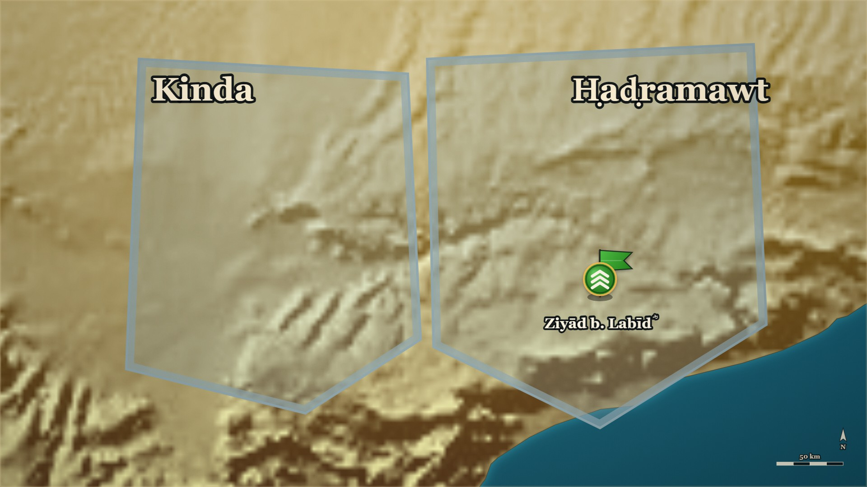




11–12 AH, Ḥaḍramawt
The promise about the camels
Ḥaḍramawt
Ziyād b. Labīd ؓ, the Prophet's ﷺ governor
Kinda
its neighbour
Notes:
NOTE — Give Ziyād b. Labīd's ؓ notice in one breath first — the room heard his name once, in a clause, on evening 3
SAY —
1. Who Ziyād b. Labīd ؓ is — Of the Anṣār, of Banū Bayāḍa of the Khazraj; the Prophet's ﷺ own appointee over Ḥaḍramawt, and he held the post through the whole war.
▶ CLICK 1 — The arrangement: ṣadaqa carried both ways.
2. An arrangement from the Prophet's ﷺ lifetime — Part of Ḥaḍramawt's ṣadaqa went to Kinda, and part of Kinda's went to Ḥaḍramawt.
3. Banū Walīʿa have no camels — A clan of Kinda told Ḥaḍramawt: we have no camels to carry it; send it to us loaded.
4. Ḥaḍramawt promises to look into it — If you really have no camels, we will send it loaded.
5. After the Prophet ﷺ died — Banū Walīʿa came: deliver it, the way you promised the Messenger of Allah ﷺ.
▶ CLICK 2 — 'Carry it yourselves' — and it was not carried.
6. Ḥaḍramawt's answer — You do have camels: carry it yourselves.
7. Kinda turns on the governor — To Ziyād b. Labīd ؓ they said: you are with them against us.
8. Home with nothing settled — Ḥaḍramawt would not carry it; Kinda kept insisting, and went home with the matter undecided.
9. Ziyād ؓ does nothing yet — He was waiting for al-Muhājir ؓ to arrive.
▶ NEXT SLIDE — the words: read the Arabic, then its English.
Ziyād's ؓ waiting: «وَأَمْسَكَ عَنْهُمْ زِيَادٌ انْتِظَارًا لِلْمُهَاجِرِ» (ج۲ ص۲۳۰). ⚠ الکامل only — the
Ḥaḍramawt campaign is not in البدایہ. Follow with RCT/E-RC33 (the she-camel called Shadhra).
BACKGROUND (read at home, not aloud) —
In the Prophet's ﷺ lifetime an arrangement had been made: part of Ḥaḍramawt's ṣadaqa went to Kinda, and part of Kinda's to Ḥaḍramawt. A clan of Kinda, Banū Walīʿa, had said to Ḥaḍramawt: we have no camels to carry it — send it to us loaded. And Ḥaḍramawt had said: we will look into it, and if you really have none, we will. Then the Prophet ﷺ died. Banū Walīʿa came and said: deliver it, the way you promised the Messenger of Allah ﷺ. And Ḥaḍramawt said: you do have camels — carry it yourselves. And Kinda turned to Ziyād b. Labīd ؓ, the governor, and said: you are with them against us. The men of Ḥaḍramawt would not carry it; the men of Kinda kept insisting, and went home with the matter still undecided. Ziyād ؓ did nothing yet. He was waiting for al-Muhājir ؓ.
Ziyād b. Labīd ؓ, page-cited, for the one breath: of the Anṣār, of بنو بَيَاضة of the
خزرج (البدایہ ج۳ ص۴۶۶ — see medina-ansar-structure.md); the Prophet's ﷺ appointee over حضرموت
(البدایہ ج۷ ص۴۱); and he held that post through the whole ردة and ran the campaign there
(الکامل ج۲ ص۲۲۹–۲۳۲ — where ج۲ ص۲۲۹ spells him زياد بن أبي لبيد الأنصاري and the following pages
زياد بن لبيد). The room last heard his name in one clause of TSY/E-YK04 on evening 3.
Also on the page:
> فَقَالَ بَعْضُ بَنِي وَلَيْعَةَ: مِنْ كِنْدَةَ لِحَضْرَمَوْتَ لَيْسَ لَنَا ظَهْرٌ، فَإِنْ رَأَيْتُمْ أَنْ تَبْعَثُوا إِلَيْنَا بِذَلِكَ عَلَى ظَهْرٍ. قَالُوا: فَإِنَّا نَنْظُرُ، فَإِنْ لَمْ يَكُنْ لَكُمْ ظَهْرٌ فَعَلْنَا.
> — الکامل فی التاریخ ج۲ ص۲۳۰ · https://shamela.ws/book/21712/921
> *English:* "Some of Banū Walīʿa of Kinda said to Ḥaḍramawt: We have no mounts — if you see fit, send
> it to us on mounts. They said: We shall look into it; if you have no mounts, we will do it."
> فَلَمَّا تُوُفِّيَ رَسُولُ اللَّهِ - صَلَّى اللَّهُ عَلَيْهِ وَسَلَّمَ - قَالَتْ بَنُو وَلَيْعَةَ: أَبْلِغُونَا كَمَا وَعَدْتُمْ رَسُولَ اللَّهِ - صَلَّى اللَّهُ عَلَيْهِ وَسَلَّمَ -! فَقَالُوا: إِنْ لَكُمْ ظَهْرًا فَاحْتَمِلُوا، فَقَالُوا لِزِيَادٍ: أَنْتَ مَعَهُمْ عَلَيْنَا.
> — الکامل فی التاریخ ج۲ ص۲۳۰ · https://shamela.ws/book/21712/921
> *English:* "When the Messenger of Allah ﷺ died, Banū Walīʿa said: Deliver it to us, as you promised
> the Messenger of Allah ﷺ! They said: You do have mounts — carry it yourselves. And they said to
> Ziyād: You are with them against us."

Slide 74
11–12 AH, Ḥaḍramawt
The promise about the camels
قَالَتْ بَنُو وَلَيْعَةَ: أَبْلِغُونَا كَمَا وَعَدْتُمْ رَسُولَ اللَّهِ - صَلَّى اللَّهُ عَلَيْهِ وَسَلَّمَ -! فَقَالُوا: إِنْ لَكُمْ ظَهْرًا فَاحْتَمِلُوا
"Banū Walīʿa said: Deliver it to us, as you promised the Messenger of Allah ﷺ! They said: You do have mounts — carry it yourselves."
al-Kamil, vol. 2, p. 230
Notes:
THE WORDS — the story was told on the map. Read the Arabic, then its English — and the one line.
QUOTE — قَالَتْ بَنُو وَلَيْعَةَ: أَبْلِغُونَا كَمَا وَعَدْتُمْ رَسُولَ اللَّهِ - صَلَّى اللَّهُ عَلَيْهِ وَسَلَّمَ -! فَقَالُوا: إِنْ لَكُمْ ظَهْرًا فَاحْتَمِلُوا
"Banū Walīʿa said: Deliver it to us, as you promised the Messenger of Allah ﷺ! They said: You do have mounts — carry it yourselves."
— الکامل فی التاریخ ج۲ ص۲۳۰
عبرت — A small promise made in the Prophet's ﷺ lifetime was tested the day after he died, and the province went to war over the answer.

Slide 75
11–12 AH, Ḥaḍramawt
The she-camel called Shadhra
فَقَالَ حَارِثَةُ: ذَاكَ إِذَا كُنْتَ يَهُودِيًّا، وَأَطْلَقَ عِقَالَهَا وَبَعَثَهَا وَقَامَ دُونَهَا.
"Ḥāritha said: That would be so if you were a Jew — and he untied her hobble and drove her off and stood in front of her."
al-Kamil, vol. 2, p. 230
Notes:
NOTE — What set Kinda off, as the books report it
⚠ البدایہ carries no Ḥaḍramawt campaign at all. Cite الکامل ج۲ ص۲۲۹–۲۳۲, never البدایہ, for
everything in this card and the next. The underlying grievance was administrative: the Prophet ﷺ
had ordered some of Ḥaḍramawt's zakāt placed in Kinda and some of Kinda's in Ḥaḍramawt, and after his
death nobody would carry it (الکامل ج۲ ص۲۳۰).
SAY —
1. A young she-camel is branded — Collecting the zakāt in Kinda, Ziyād b. Labīd ؓ took a young she-camel from a man and branded her.
2. She was not his to give — She belonged to his brother, her name was Shadhra, and he had brought her by mistake.
3. The brothers ask for her back — The brother said so, and the first man agreed and asked for her back.
4. Ziyād ؓ refuses — She had already passed into the right of Allah, he said.
5. A third man, Ḥāritha, rides up — Release her and take another, he said. Ziyād ؓ answered that he had no way to do that.
6. Ḥāritha unties her — He said one sentence, untied her hobble himself, and stood in front of her.
^ read the Arabic on the face here
QUOTE — فَقَالَ حَارِثَةُ: ذَاكَ إِذَا كُنْتَ يَهُودِيًّا، وَأَطْلَقَ عِقَالَهَا وَبَعَثَهَا وَقَامَ دُونَهَا.
"Ḥāritha said: That would be so if you were a Jew — and he untied her hobble and drove her off and stood in front of her."
— الکامل فی التاریخ ج۲ ص۲۳۰
عبرت — A province went to war over one animal, a naming mistake and a public insult, and every part of that is on one page.
BACKGROUND (read at home, not aloud) —
Ziyād b. Labīd ؓ was collecting the zakāt in Kinda. A man handed over a young she-camel and Ziyād ؓ branded her. Then it turned out the animal was not his to give — she belonged to his brother, her name was Shadhra, and he had brought her by mistake. The brother said so. The first man agreed and asked for her back. Ziyād ؓ refused: she had already passed into the right of Allah. Then a third man rode up, told him to release her and take another, and when Ziyād ؓ said he had no way to do that, said one sentence — and untied her hobble himself and stood in front of her.

Slide 76






11–12 AH, Ḥaḍramawt
The humbled man
Ziyād's ؓ camp
Ḥaḍramawt and al-Sakūn
Banū Muʿāwiya
of Kinda
Notes:
NOTE — ⚠ البسوس carries the whole warning and we have no page for it — say only "an old war that had started the same way"
⚠ Who spoke the Basūs sentence is unclear in the printed wording («فَقَالَ لَهَا») — say "a warning
was spoken" (§X item 2). Al-Basūs is [STANDARD] (to verify) — the she-camel at the start of the long
pre-Islamic war of Bakr and Taghlib; no page here says so. The release and the call to refuse ṣadaqa:
«وَنَادَوْا بِمَنْعِ الصَّدَقَةِ» (ج۲ ص۲۳۱).
SAY —
1. A warning spoken over the camel — When Ziyād ؓ refused to give her back: do not let Shadhra be for you what al-Basūs was.
2. Al-ʿAddāʾ calls out to his clan — The camel's owner raised the cry to his own people.
3. Ḥāritha b. Surāqa unties her — He raised the call too, came up to Ziyād ؓ, and untied the camel.
4. Ziyād ؓ takes her back — Young men of Ḥaḍramawt and al-Sakūn tied up Ḥāritha and his companions, and took the camel back.
▶ CLICK 1 — Two great camps face each other.
5. Two great camps face each other — Banū Muʿāwiya for Ḥāritha, Ḥaḍramawt and al-Sakūn for Ziyād ؓ; Kinda held back, their men being prisoners.
6. Two demands, two refusals — Ziyād ؓ told them to put down their weapons; they refused and demanded their men; he refused.
▶ CLICK 2 — A strike by night.
7. A strike by night — Ziyād ؓ hit them in the dark, and they scattered.
▶ CLICK 3 — Kinda roused: no ṣadaqa.
8. The freed men rouse Kinda — Ziyād ؓ let Ḥāritha and the others go; they roused their people, and a large force called: no ṣadaqa.
9. Al-Ḥuṣayn b. Numayr steps between — He was sent between the two sides, and for a little while they held off.
▶ NEXT SLIDE — the words: read the Arabic, then its English.
BACKGROUND (read at home, not aloud) —
When Ziyād ؓ refused to give the camel back, a warning was spoken over her: do not let Shadhra be for you what al-Basūs was. And the owner, al-ʿAddāʾ, called out to his clan. Ḥāritha b. Surāqa raised the call too, came up to Ziyād ؓ, and untied her. Ziyād ؓ had young men of Ḥaḍramawt and al-Sakūn tie Ḥāritha up, and his companions, and take the camel back. Kinda shouted. Banū Muʿāwiya came out for Ḥāritha; Ḥaḍramawt and al-Sakūn came out for Ziyād ؓ; two great camps faced each other. Kinda did not attack, because their men were prisoners. Ziyād ؓ told them to put down their weapons; they refused and demanded their men; he refused. He hit them by night, and they scattered. Then he let Ḥāritha and the others go — and the men he let go went straight back and roused their people against him. A large force gathered, and they called out that they would pay no ṣadaqa. Al-Ḥuṣayn b. Numayr was sent between the two sides, and for a little while they held off from each other.
Also on the page:
> فَلَجَأَ فِي أَخْذِهَا، فَقَالَ لَهَا: لَا تَكُونَنَّ شَذْرَةً عَلَيْكُمْ كَالْبَسُوسِ. فَنَادَى الْعَدَّاءُ: يَا آلَ عَمْرٍو، أُضَامُ وَأُضْطَهَدُ! إِنَّ الذَّلِيلَ مَنْ أُكِلَ فِي دَارِهِ!
> — الکامل فی التاریخ ج۲ ص۲۳۰ · https://shamela.ws/book/21712/921
> *English:* "He persisted in taking her, and it was said: Do not let Shadhra be to you what al-Basūs
> was. And al-ʿAddāʾ called out: O family of ʿAmr — am I to be wronged and trampled? The humbled man
> is the one who is devoured in his own home!"
> فَأَمَرَ زِيَادٌ شَبَابًا مِنْ حَضْرَمَوْتَ وَالسَّكُونِ فَمَنَعُوهُ وَكَتَّفُوهُ، وَكَتَّفُوا أَصْحَابَهُ وَأَخَذُوا الْبَكْرَةَ، وَتَصَايَحَتْ كِنْدَةُ، وَغَضِبَتْ بَنُو مُعَاوِيَةَ لِحَارِثَةَ وَأَظْهَرُوا أَمْرَهُمْ، وَغَضِبَتْ حَضْرَمَوْتُ وَالسَّكُونُ لِزِيَادٍ، وَتَوَافَى عَسْكَرَانِ عَظِيمَانِ مِنْ هَؤُلَاءِ، وَلَمْ يُحْدِثْ بَنُو مُعَاوِيَةَ شَيْئًا لِمَكَانِ أُسَرَائِهِمْ
> — الکامل فی التاریخ ج۲ ص۲۳۰ · https://shamela.ws/book/21712/921
> *English:* "Ziyād ordered some young men of Ḥaḍramawt and al-Sakūn, and they stopped him and bound
> him, bound his companions, and took the young camel. Kinda raised a shout; Banū Muʿāwiya were angry
> on Ḥāritha's behalf and came out openly; Ḥaḍramawt and al-Sakūn were angry on Ziyād's behalf; two
> great camps faced each other — and Banū Muʿāwiya did nothing, because their men were prisoners."

Slide 77
11–12 AH, Ḥaḍramawt
The humbled man
فَنَادَى الْعَدَّاءُ: يَا آلَ عَمْرٍو، أُضَامُ وَأُضْطَهَدُ! إِنَّ الذَّلِيلَ مَنْ أُكِلَ فِي دَارِهِ!
"Al-ʿAddāʾ called out: O family of ʿAmr — am I to be wronged and trampled? The humbled man is the one who is devoured in his own home!"
al-Kamil, vol. 2, p. 230
Notes:
THE WORDS — the story was told on the map. Read the Arabic, then its English — and the one line.
QUOTE — فَنَادَى الْعَدَّاءُ: يَا آلَ عَمْرٍو، أُضَامُ وَأُضْطَهَدُ! إِنَّ الذَّلِيلَ مَنْ أُكِلَ فِي دَارِهِ!
"Al-ʿAddāʾ called out: O family of ʿAmr — am I to be wronged and trampled? The humbled man is the one who is devoured in his own home!"
— الکامل فی التاریخ ج۲ ص۲۳۰
عبرت — Once the quarrel became a matter of honour, being right about the camel no longer decided anything. ⚠ البسوس needs a gloss, and we do not have one on a page we hold. The warning only works if the room knows what al-Basūs was — a pre-Islamic war between Bakr and Taghlib said to have started over a she-camel and run for decades. That is [STANDARD] and is NOT page-cited in this repo: it carries (to verify) and must be checked before it is spoken as fact. The safe spoken form, which claims nothing we cannot show, is in the beats: *a warning was spoken over her that named an old war which had started the same way.* If Daniyal wants the story itself, it needs one verification pass first.

Slide 78
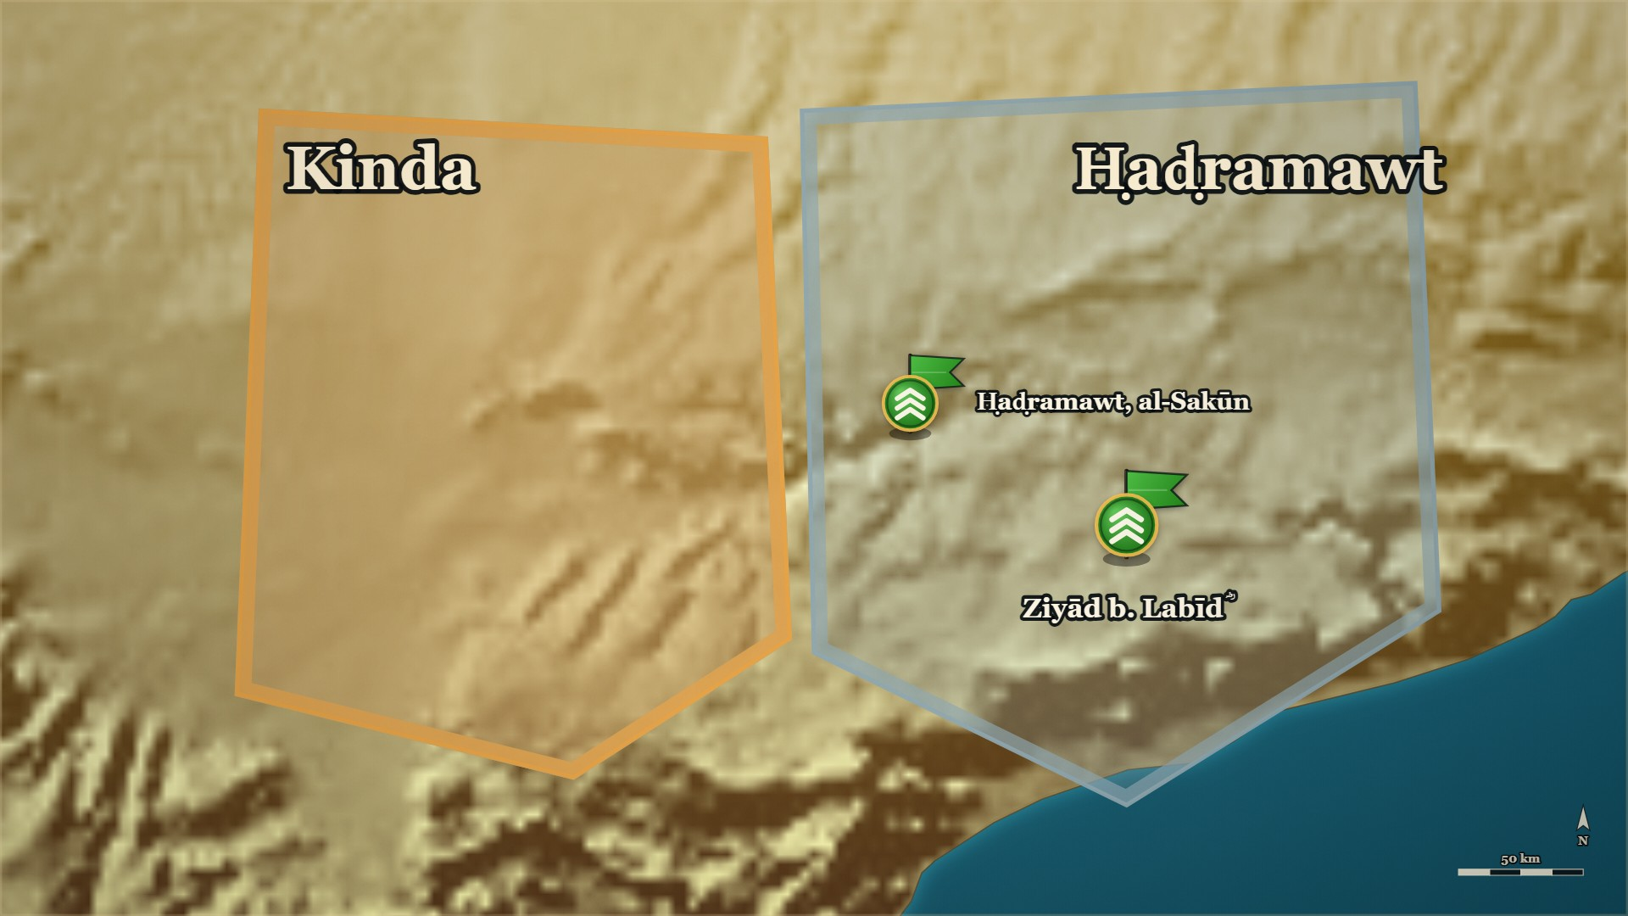







11–12 AH, Ḥaḍramawt
Free men do not change sides
The pastures
each chief's, held as a stronghold
Shuraḥbīl
and his son, to Ziyād ؓ
Notes:
NOTE — Shuraḥbīl b. al-Simṭ and his son
⚠ Quote only to «وَالْقَبِيحِ!» — the next clause reads against the sense. It was his son, not his
father («وَابْنَهُ») — this corrects the campaign note §10.3.
SAY —
▶ CLICK 1 — Each chief takes his own pasture as a stronghold.
1. Banū Muʿāwiya withhold the ṣadaqa — The whole clan agreed, and each chief took up his own reserved pasture as a stronghold.
2. Except one man and his son — Shuraḥbīl b. al-Simṭ and his son would not go with their clan.
3. They tell their clan why — Before leaving, the two men told Banū Muʿāwiya why they would not come.
▶ CLICK 2 — One man and his son walk out, to Ziyād's ؓ camp.
4. They move to Ziyād's ؓ camp — Father and son moved out, and camped with Ziyād ؓ.
5. Their advice: strike tonight — Before the men drifting toward the rebels from al-Sakāsik, al-Sakūn and Ḥaḍramawt get there.
6. The danger in waiting — If you wait, we are afraid people will drift away from us to them.
▶ NEXT SLIDE — the words: read the Arabic, then its English.
BACKGROUND (read at home, not aloud) —
The whole of Banū Muʿāwiya agreed to withhold the ṣadaqa, and each of their chiefs took up his own reserved pasture as a stronghold. All of them — except one man, Shuraḥbīl b. al-Simṭ, and his son. The two of them told their own clan, Banū Muʿāwiya, why they would not come. Then they moved out, and camped with Ziyād ؓ, and they gave him advice: strike tonight, before the men of al-Sakāsik, al-Sakūn and Ḥaḍramawt who are drifting toward the rebels get there — because if you wait, we are afraid people will drift away from us to them.

Slide 79
11–12 AH, Ḥaḍramawt
Free men do not change sides
إِنَّهُ لَقَبِيحٌ بِالْأَحْرَارِ التَّنَقُّلُ، إِنَّ الْكِرَامَ لَيَلْزَمُونَ الشُّبْهَةَ فَيَتَكَرَّمُونَ أَنْ يَنْتَقِلُوا إِلَى أَوْضَحَ مِنْهَا مَخَافَةَ الْعَارِ، فَكَيْفَ الِانْتِقَالُ مِنَ الْأَمْرِ الْحَسَنِ الْجَمِيلِ وَالْحَقِّ إِلَى الْبَاطِلِ وَالْقَبِيحِ!
"It is an ugly thing in free men to change sides. Men of honour will stay with a doubtful position, and…"
al-Kamil, vol. 2, p. 231
Notes:
THE WORDS — the story was told on the map. Read the Arabic, then its English — and the one line.
QUOTE — إِنَّهُ لَقَبِيحٌ بِالْأَحْرَارِ التَّنَقُّلُ، إِنَّ الْكِرَامَ لَيَلْزَمُونَ الشُّبْهَةَ فَيَتَكَرَّمُونَ أَنْ يَنْتَقِلُوا إِلَى أَوْضَحَ مِنْهَا مَخَافَةَ الْعَارِ، فَكَيْفَ الِانْتِقَالُ مِنَ الْأَمْرِ الْحَسَنِ الْجَمِيلِ وَالْحَقِّ إِلَى الْبَاطِلِ وَالْقَبِيحِ!
"It is an ugly thing in free men to change sides. Men of honour will stay with a doubtful position, and think it beneath them to move even to a clearer one, for fear of the disgrace — so how much worse to move from what is good, fair and true to what is false and ugly!"
— الکامل فی التاریخ ج۲ ص۲۳۱
عبرت — He used his tribe's own code of honour — never change sides — as the reason not to follow his tribe.

Slide 80







11–12 AH, Ḥaḍramawt
Round their fires
Banū ʿAmr
the strongest of Kinda
The four kings
killed at their fires
Notes:
NOTE — "The four kings." No source ties the old kingship to the ridda — say nothing that implies it
SAY —
▶ CLICK 1 — They ring the pastures in the dark — from five sides.
1. Ziyād ؓ agrees to a night attack — They gathered in the dark and ringed the pastures.
2. Round their fires — They found the men sitting round their fires.
3. From five directions at once — Banū ʿAmr b. Muʿāwiya, the strongest of Kinda with the numbers, were attacked from five sides.
▶ CLICK 2 — The four kings are killed.
4. The four kings are killed — Four brothers, the chiefs of Banū ʿAmr: Mikhwaṣ, Mishraḥ, Jamad and Abḍaʿa.
5. Four, or four and a sister — Ibn al-Athīr adds their sister, al-ʿAmarrada; al-Dhahabī, from Ibn Isḥāq, names four kings and no sister.
6. Many killed, the rest run — Many others were killed that night; whoever could run, ran.
▶ NEXT SLIDE — the words: read the Arabic, then its English.
BACKGROUND (read at home, not aloud) —
Ziyād ؓ agreed. They gathered in the dark and ringed the pastures, and they found the men sitting round their fires. Banū ʿAmr b. Muʿāwiya were the strongest of Kinda and had the numbers. The Muslims fell on them from five directions at once. Four brothers were killed that night — Mikhwaṣ, Mishraḥ, Jamad and Abḍaʿa — with their sister, al-ʿAmarrada. These were "the four kings", the chiefs of Banū ʿAmr. Many others were killed; whoever could run, ran. Ziyād ؓ turned back with the property and the captives. And his road home passed al-Ashʿath b. Qays. Al-Ashʿath rose with his people, took the captives back, and began to gather every man he could.
Also on the page:
> فَأَجَابَهُمْ إِلَى تَبْيِيتِ الْقَوْمِ، فَاجْتَمَعُوا وَطَوَّقُوهُمْ فِي مَحَاجِرِهِمْ، فَوَجَدُوهُمْ جُلُوسًا حَوْلَ نِيرَانِهِمْ، فَأَكَبُّوا عَلَى بَنِي عَمْرِو بْنِ مُعَاوِيَةَ، وَفِيهِمُ الْعَدَدُ وَالشَّوْكَةُ - مِنْ خَمْسَةِ أَوْجُهٍ، فَأَصَابُوا مِشْرَحًا وَمِخْوَصًا وَجَمَدًا وَأَبْضَعَةَ وَأُخْتَهُمُ الْعَمَرَّدَةَ، وَأَدْرَكَتْهُمْ لَعْنَةُ النَّبِيِّ - صَلَّى اللَّهُ عَلَيْهِ وَسَلَّمَ -
> — الکامل فی التاریخ ج۲ ص۲۳۱ · https://shamela.ws/book/21712/922
> *English:* "He agreed to the night attack. They gathered and ringed them in their pastures, and found
> them sitting round their fires. They fell on Banū ʿAmr b. Muʿāwiya — who had the numbers and the
> strength — from five directions, and struck down Mishraḥ, Mikhwaṣ, Jamad, Abḍaʿa and their sister
> al-ʿAmarrada; and the curse of the Prophet ﷺ overtook them."
Al-Dhahabī, from Ibn Isḥāq — four, and no sister:
> أن زيادا بيتهم فقتل ملوكا أربعة: جمدا، ومخوصا ومشرحا، وأبضعة.
> — سیر أعلام النبلاء، ج الراشدون ص۶۲ · https://shamela.ws/book/10906/1210
> *English:* "…that Ziyād fell on them by night and killed four kings: Jamad, Mikhwaṣ, Mishraḥ and
> Abḍaʿa."
Record both counts side by side; do not choose. The origin of the Prophet's ﷺ curse is the
Kinda-delegation note; do not explain it from the floor. Ibn Khaldūn adds that the captive women
cried out as they passed (ج۲ ص۴۹۲) — his detail, attributed to him.

Slide 81
11–12 AH, Ḥaḍramawt
Round their fires
فَوَجَدُوهُمْ جُلُوسًا حَوْلَ نِيرَانِهِمْ، فَأَكَبُّوا عَلَى بَنِي عَمْرِو بْنِ مُعَاوِيَةَ، وَفِيهِمُ الْعَدَدُ وَالشَّوْكَةُ - مِنْ خَمْسَةِ أَوْجُهٍ
"They found them sitting round their fires, and fell on Banū ʿAmr b. Muʿāwiya — who had the numbers and the strength — from five directions."
al-Kamil, vol. 2, p. 231
Notes:
THE WORDS — the story was told on the map. Read the Arabic, then its English — and the one line.
QUOTE — فَوَجَدُوهُمْ جُلُوسًا حَوْلَ نِيرَانِهِمْ، فَأَكَبُّوا عَلَى بَنِي عَمْرِو بْنِ مُعَاوِيَةَ، وَفِيهِمُ الْعَدَدُ وَالشَّوْكَةُ - مِنْ خَمْسَةِ أَوْجُهٍ
"They found them sitting round their fires, and fell on Banū ʿAmr b. Muʿāwiya — who had the numbers and the strength — from five directions."
— الکامل فی التاریخ ج۲ ص۲۳۱
عبرت — The night attack ended the four kings and brought the fifth man into the war.

Slide 82
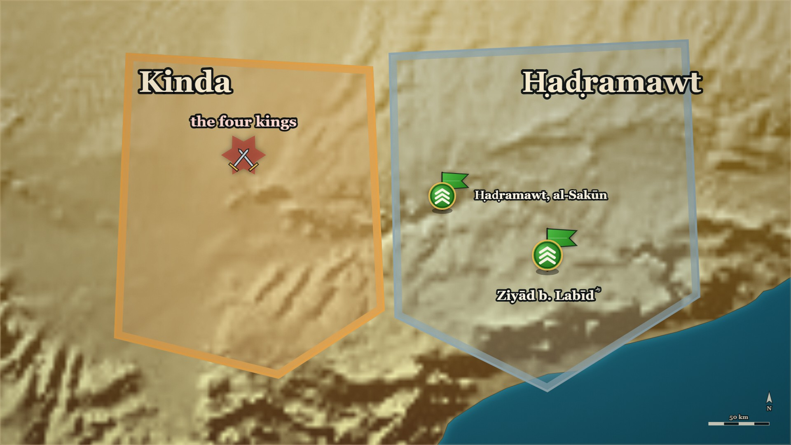



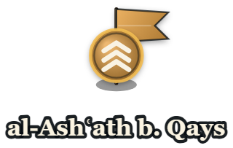

11–12 AH, Ḥaḍramawt
al-Ashʿath b. Qays comes into it
The column
the property and the captives
al-Ashʿath b. Qays
of the other branch
Notes:
NOTE — Never cut, even if the rest of the part is. The room met him with the delegation; this is where the war becomes his
SAY —
▶ CLICK 1 — The column turns for home.
1. The column turns for home — Ziyād ؓ with the property and the captives of the four kings.
▶ CLICK 2 — Its road passes one man: al-Ashʿath b. Qays.
2. And its road passes one man — al-Ashʿath b. Qays, who had not been in the fighting at all.
3. Who he is — Of Kinda, but not of Banū ʿAmr: a different branch from the four brothers just killed.
4. The room has met him before — He led Kinda's delegation into the Prophet's ﷺ mosque, at their head.
▶ CLICK 3 — He takes the captives back.
5. He rises with his people — And takes the captives back out of the column.
6. And gathers everyone he can — From here, this war is his.
▶ NEXT SLIDE — the words: read the Arabic, then its English.
Who he is, page-cited: he led the Kinda delegation to Medina (KTK/E-KD05, and the Kinda note's
pages behind it); and Ibn al-Athīr's "four kings" are of بنو عمرو بن معاوية, a different branch
of Kinda from his (KTK/E-KD06). No source ties the old Kinda kingship to this ردة — say nothing
that implies it (DECISIONS.md, the Kinda note §"the four kings").
⚠ This card exists because KTK/E-KD05 sits in an optional block. Without it, al-Ashʿath walks
onto the stage as a bare name and then carries seven cards. If the Kinda flashback is cut, this card
is not cut.
BACKGROUND (read at home, not aloud) —
Ziyād b. Labīd ؓ turned for home with the property and the captives, and the road passed al-Ashʿath b. Qays. Up to that night he had not been in it. He is of Kinda but not of Banū ʿAmr — a different branch of the tribe from the four brothers just killed — and the room has a reason to know his name already: he is the man who had led Kinda's own delegation into the Prophet's ﷺ mosque, at their head, a year or so before. He rose with his people, took the captives back out of the column, and began gathering every man he could. From here the war in Ḥaḍramawt is his.

Slide 83
11–12 AH, Ḥaḍramawt
al-Ashʿath b. Qays comes into it
وَعَادَ زِيَادُ بْنُ لَبِيدٍ بِالْأَمْوَالِ وَالسَّبْيِ، وَاجْتَازُوا بِالْأَشْعَثِ، فَثَارَ فِي قَوْمِهِ، فَاسْتَنْقَذَهُمْ وَجَمَعَ الْجُمُوعَ.
"Ziyād b. Labīd returned with the property and the captives, and they passed by al-Ashʿath…"
al-Kamil, vol. 2, p. 231
Notes:
THE WORDS — the story was told on the map. Read the Arabic, then its English — and the one line.
QUOTE — وَعَادَ زِيَادُ بْنُ لَبِيدٍ بِالْأَمْوَالِ وَالسَّبْيِ، وَاجْتَازُوا بِالْأَشْعَثِ، فَثَارَ فِي قَوْمِهِ، فَاسْتَنْقَذَهُمْ وَجَمَعَ الْجُمُوعَ.
"Ziyād b. Labīd returned with the property and the captives, and they passed by al-Ashʿath; so he rose with his people, recovered them, and gathered the gatherings."
— الکامل فی التاریخ ج۲ ص۲۳۱
عبرت — The man who had brought his tribe to the Prophet ﷺ himself is the man who now raises it against Medina — and that is not a contradiction the books explain.

Slide 84






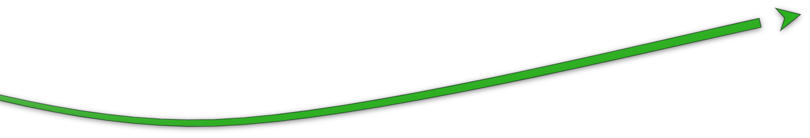



11–12 AH, Ḥaḍramawt
The fort they had already repaired
al-Muhājir ؓ
from Ṣanʿāʾ, ahead of his army
ʿIkrima ؓ
with the main body
al-Nujayr
the fort
Notes:
NOTE — The march from Ṣanʿāʾ — al-Muhājir ؓ ahead, ʿIkrima ؓ with the main body: the road that began at al-Yamāma ends here
SAY —
1. A letter: hurry — Ziyād ؓ wrote to al-Muhājir ؓ, and the letter met him on the road.
▶ CLICK 1 — al-Muhājir ؓ rides ahead with the fastest men.
2. Al-Muhājir ؓ rides ahead — He handed the army to ʿIkrima ؓ and hurried on with the fastest men.
▶ CLICK 2 — Maḥjar al-Zurqān: Kinda breaks, and runs.
3. The battle at Maḥjar al-Zurqān — Al-Muhājir ؓ joined Ziyād ؓ and marched on Kinda; they met, and Kinda broke and ran.
▶ CLICK 3 — Into al-Nujayr — and ʿIkrima ؓ brings up the main body. The ring closes.
4. A fort already repaired — Kinda took refuge in the fort of al-Nujayr, which they had already repaired and put in order.
5. The ring closes — The Muslims camped round it; ʿIkrima ؓ came up with the main body, and the siege tightened.
6. Raids through the country — Raiding parties went out through the country after the rest.
7. The garrison sallies out — They came out to fight, lost many men, and went back in.
▶ NEXT SLIDE — the words: read the Arabic, then its English.
BACKGROUND (read at home, not aloud) —
Ziyād ؓ wrote to al-Muhājir ؓ to hurry. The letter met him on the road. He handed the army to ʿIkrima ؓ and rode ahead with the fastest men, joined Ziyād ؓ, and marched on Kinda. They met at Maḥjar al-Zurqān, and Kinda broke and ran for the fort of al-Nujayr. And the book adds one detail: they had already repaired it and put it in order. The Muslims camped round it. ʿIkrima ؓ came up with the main body, and the siege tightened. Raiding parties went out through the country after the rest. The garrison came out to fight, lost many men, and went back in.
Also on the page:
> وَكَتَبَ زِيَادٌ إِلَى الْمُهَاجِرِ يَسْتَحِثُّهُ، فَلَقِيَهُ الْكِتَابُ بِالطَّرِيقِ فَاسْتَخْلَفَ عَلَى الْجُنْدِ عِكْرِمَةَ بْنَ أَبِي جَهْلٍ، وَتَعَجَّلَ فِي سَرَعَانِ النَّاسِ
> — الکامل فی التاریخ ج۲ ص۲۳۱ · https://shamela.ws/book/21712/922
> *English:* "Ziyād wrote to al-Muhājir urging him on; the letter met him on the road, and he left
> ʿIkrima b. Abī Jahl in charge of the army and hurried ahead with the quickest of the men."
> فَانْهَزَمَتْ كِنْدَةُ وَقُتِلَتْ، وَخَرَجُوا هُرَّابًا فَالْتَجَئُوا إِلَى النُّجَيْرِ، وَقَدْ رَمُّوهُ وَأَصْلَحُوهُ.
> — الکامل فی التاریخ ج۲ ص۲۳۱ · https://shamela.ws/book/21712/922
> *English:* "Kinda was routed and cut down; they fled and took refuge in al-Nujayr — which they had
> already repaired and put in order."
Where the letter met him: الکامل says only «بالطريق»; Ibn Khaldūn says «بالمفازة بين مأرب وحضرموت»
(ج۲ ص۴۹۴) — his detail, not for the map as fact. Pairs with RCT/E-RC34's map line (ʿIkrima ؓ
closing the last road).

Slide 85
11–12 AH, Ḥaḍramawt
The fort they had already repaired
فَرَجَعُوا إِلَى حِصْنِهِمْ، وَخَشَعَتْ نُفُوسُهُمْ وَخَافُوا الْقَتْلَ
"They went back into their fort; their spirits sank, and they feared death."
al-Kamil, vol. 2, p. 231
Notes:
THE WORDS — the story was told on the map. Read the Arabic, then its English — and the one line.
QUOTE — فَرَجَعُوا إِلَى حِصْنِهِمْ، وَخَشَعَتْ نُفُوسُهُمْ وَخَافُوا الْقَتْلَ
"They went back into their fort; their spirits sank, and they feared death."
— الکامل فی التاریخ ج۲ ص۲۳۱
عبرت — They had prepared the place to retreat to before they fought, and it became the place they could not leave.

Slide 86
11 or 12 AH, al-Nujayr
The knife at the writing
وَنَسِيَ الْأَشْعَثُ أَنْ يَكْتُبَ نَفْسَهُ لِأَنَّ جَحْدَمًا وَثَبَ عَلَيْهِ بِسِكِّينٍ، فَقَالَ: تَكْتُبُنِي أَوْ أَقْتُلُكَ؟ فَكَتَبَهُ وَنَسِيَ نَفْسَهُ
"Al-Ashʿath forgot to write himself in, because Jaḥdam leapt at him with a knife and said: Will you write me in, or shall I kill you?…"
al-Kamil, vol. 2, p. 232
Notes:
NOTE — al-Kamil puts al-Nujayr in 11 AH, the Siyar in 12 — say "11 or 12 AH". ⚠ Ibn al-Athīr gives a second telling — no knife; al-Ashʿath came down alone : say that it exists if a slip asks. Checkpoint 3 follows
SAY —
1. Al-Ashʿath comes out with nine men — The leaders inside had begun to fear for their own lives.
2. A guarantee in return for the gate — They asked Ziyād ؓ to guarantee them and their families, in return for opening the gate.
3. Write whatever you want — Ziyād ؓ agreed: write it, and bring it to me to seal.
4. Jaḥdam and the knife — As al-Ashʿath wrote, Jaḥdam leapt at him with a knife: write me in, or I kill you.
5. He forgets himself — Al-Ashʿath wrote Jaḥdam in, and left his own name out.
^ read the Arabic on the face here
6. The gate is opened — Every fighting man inside was killed.
7. The document comes out — Everyone named in it was spared, and al-Ashʿath's own name was not there.
8. Al-Muhājir ؓ has him bound — He praised Allah that al-Ashʿath's mouth had erred, and had him bound tight.
9. Sent to Abū Bakr ؓ with the captives — Someone said: send him to Abū Bakr ؓ, who knows best the ruling on him.
QUOTE — وَنَسِيَ الْأَشْعَثُ أَنْ يَكْتُبَ نَفْسَهُ لِأَنَّ جَحْدَمًا وَثَبَ عَلَيْهِ بِسِكِّينٍ، فَقَالَ: تَكْتُبُنِي أَوْ أَقْتُلُكَ؟ فَكَتَبَهُ وَنَسِيَ نَفْسَهُ
"Al-Ashʿath forgot to write himself in, because Jaḥdam leapt at him with a knife and said: Will you write me in, or shall I kill you? So he wrote him in, and forgot himself."
— الکامل فی التاریخ ج۲ ص۲۳۲
عبرت — The decision about al-Ashʿath was not taken in anger at the gate; it was sent to the man whose job it was.
Pairs with RCT/E-RC34, whose statement opens al-Muhājir's ؓ sentence («الحمد لله الذي خطأ فاك»).
⚠ «يَا عَدُوَّ اللَّهِ» is said to a man who is later a Companion — keep it in the notes, not on a slide.
Jaḥdam is named once, with no lineage (§X item 5). The page also says the fighters were beheaded
after capture — «وَضَرَبُوا أَعْنَاقَهُمْ صَبْرًا». Narrate it plainly if asked; do not enlarge it.
BACKGROUND (read at home, not aloud) —
When the leaders inside began to fear for their own lives, al-Ashʿath came out with nine men. They asked Ziyād ؓ for a guarantee for themselves and their families, in return for opening the gate. Ziyād ؓ said: write whatever you want, and bring it to me to seal. They wrote it. And while al-Ashʿath was writing, a man called Jaḥdam jumped at him with a knife and said: you write me in, or I kill you. Al-Ashʿath wrote him in — and forgot himself. The gate was opened. Every fighting man inside was killed. When it was over, al-Ashʿath called the men and brought out the document, and everyone named in it was spared. Al-Ashʿath's name was not there. Al-Muhājir ؓ had him bound. And someone said: hold him back — send him to Abū Bakr ؓ; he knows best what the ruling on this man is.
Also on the page:
> فَخَرَجَ الْأَشْعَثُ وَمَعَهُ تِسْعَةُ نَفَرٍ، فَطَلَبُوا مِنْ زِيَادٍ أَنْ يُؤَمِّنَهُمْ وَأَهْلِيَهُمْ عَلَى أَنْ يَفْتَحُوا لَهُ الْبَابَ. فَأَجَابَهُمْ إِلَى ذَلِكَ وَقَالَ: اكْتُبُوا مَا شِئْتُمْ ثُمَّ هَلُمُّوا الْكِتَابَ حَتَّى أَخْتِمَهُ. فَفَعَلُوا، وَنَسِيَ الْأَشْعَثُ أَنْ يَكْتُبَ نَفْسَهُ لِأَنَّ جَحْدَمًا وَثَبَ عَلَيْهِ بِسِكِّينٍ، فَقَالَ: تَكْتُبُنِي أَوْ أَقْتُلُكَ؟ فَكَتَبَهُ وَنَسِيَ نَفْسَهُ
> — الکامل فی التاریخ ج۲ ص۲۳۲ · https://shamela.ws/book/21712/923
> *English:* "Al-Ashʿath came out with nine men, and they asked Ziyād to guarantee them and their
> households on condition that they opened the gate to him. He agreed and said: Write whatever you
> want, then bring me the document so that I can seal it. They did — and al-Ashʿath forgot to write
> himself in, because Jaḥdam leapt at him with a knife and said: Will you write me in, or shall I kill
> you? So he wrote him in, and forgot himself."
> فَقَالَ الْمُهَاجِرُ: الْحَمْدُ لِلَّهِ الَّذِي خَطَّأَ فَاكَ يَا أَشْعَثُ يَا عَدُوَّ اللَّهِ! قَدْ كُنْتُ أَشْتَهِي أَنْ يُخْزِيَكَ اللَّهُ! وَشَدَّهُ كِتَافًا، فَقِيلَ لَهُ: أَخِّرْهُ وَسَيِّرْهُ إِلَى أَبِي بَكْرٍ؛ فَهُوَ أَعْلَمُ بِالْحُكْمِ فِيهِ. فَسَيَّرَهُ إِلَى أَبِي بَكْرٍ مَعَ السَّبْيِ.
> — الکامل فی التاریخ ج۲ ص۲۳۲ · https://shamela.ws/book/21712/923
> *English:* "Al-Muhājir said: Praise be to Allah, who made your mouth err, Ashʿath — you enemy of
> Allah! I had been longing for Allah to disgrace you! And he bound him tight. Someone said to him:
> Hold him back and send him to Abū Bakr — he knows best the ruling on him. So he sent him to Abū Bakr
> with the captives."

Slide 87
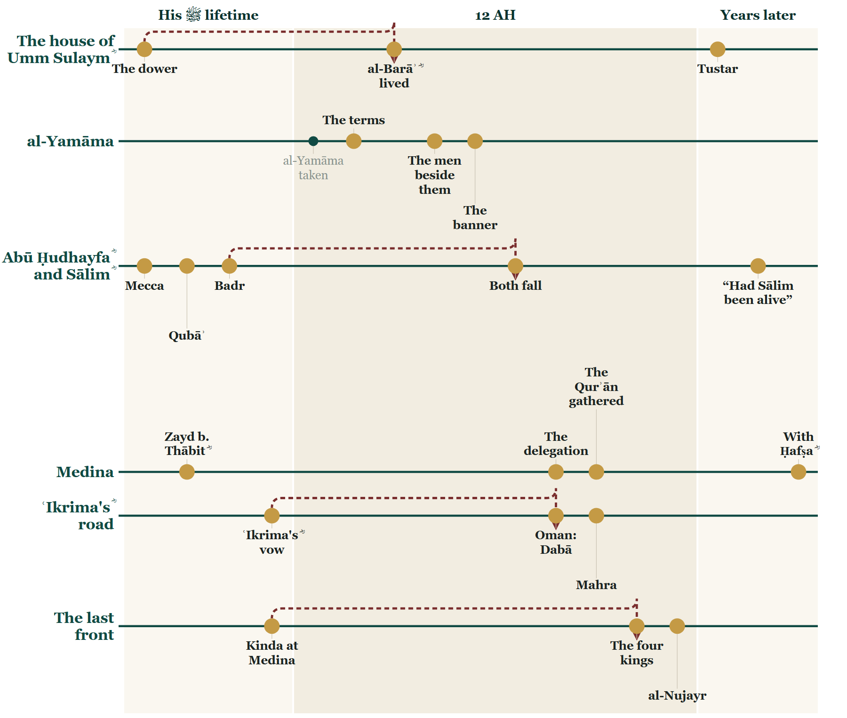
So far tonight
Where we stand
Notes:
CHECKPOINT 3 — the Line.
SAY — Tonight: al-Yamāma's cost, the Qurʾān, Oman and Mahra — and now Kinda, from a camel to a fort.
(Next slide: the map. The time check is there.)

Slide 88
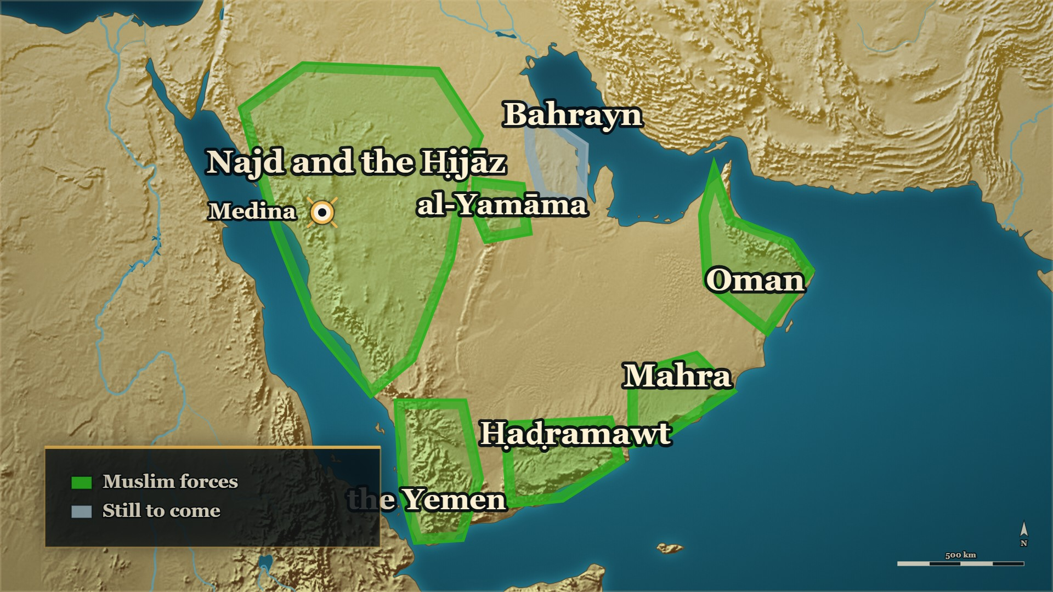
So far tonight
Where we stand
al-Nujayr
opened
al-Ashʿath
in bonds, for Medina
Notes:
CHECKPOINT 3 — the map.
SAY — When you came in, the east was burning. Now every front we have told is settled — and one man is on his way to Medina in bonds.
⏱ Past 0:42 here → close here. The judgement at Medina opens evening 6.
CARRYING ON → say: "He had left his own name off the paper. Now he stood in front of Abū Bakr ؓ." — and click on.
OUT OF TIME → this is your ending. Stay on this map and say:
1. The mushaf the room reads from was gathered because of the men who were killed in the garden.
2. He wrote before he marched, and half the enemy stopped being the enemy.
3. The decision about al-Ashʿath was not taken in anger at the gate; it was sent to the man whose job it was.
Then next week: "A man who had led a whole tribe out of Islam stood in front of Abū Bakr ؓ, in bonds. Next week: what Abū Bakr ؓ did with him."
Then a loud السلام علیکم, and the dua. Next week opens on these two slides.

Slide 89
12 AH, Medina
"What do you think I will do with you?"
قَالَ: إِنَّمَا وَجَبَ الصُّلْحُ بَعْدَ خَتْمِ الصَّحِيفَةِ عَلَى مَنْ فِيهَا، وَإِنَّمَا كُنْتَ قَبْلَ ذَلِكَ مُرَاوِضًا.
"He said: The peace became binding, once the document was sealed, only on those named in it; before that you were only negotiating."
al-Kamil, vol. 2, p. 232
Notes:
NOTE — Spare [HANDS]: ask the room the same question before the answer. ⚠ Ten or seventy — the books differ (beat 10)
⚠ Her name differs: *Umm Farwa* in الکامل, *Farwa bint Abī Quḥāfa* in سیر ج۲ ص۳۹, where he asks for
the marriage after the pardon rather than having it restored. Say "Abū Bakr's ؓ sister". ⚠ The
number differs: ten in الکامل («فِي عَشْرَةٍ»), seventy in سیر — the card's narrative keeps الکامل's ten
because it tells الکامل's exchange; do not reconcile them. Which "men like me" he meant is not on the
page (§X item 12). Follow with POT/E-PG40 (the wedding feast in the camel market), which tells
al-Dhahabī's version in its narrative.
SAY —
1. Al-Ashʿath before Abū Bakr ؓ — Asked what he thought would be done with him, he said he did not know.
2. Abū Bakr ؓ gives the answer — Then I will kill you.
3. Al-Ashʿath argues the law — I negotiated that peace for ten, he said, so my blood is not lawful.
4. Abū Bakr ؓ answers on the law — The answer turned on the document, and on the moment it was sealed.
^ read the Arabic on the face here
5. Fearing death, he stops arguing — Look for some good in me. Free me. Forgive my stumble. Treat me as you treated others like me.
6. Give me back my wife — He had asked for Abū Bakr's ؓ sister and delayed the wedding; then the Prophet ﷺ died, and he apostatised.
7. The best man in my country — Do that, he said, and you will find me the best in my country for the religion of Allah.
8. Abū Bakr ؓ spares him — He spared al-Ashʿath's life and gave him back his family.
9. Al-Dhahabī's shorter version — We will kill you. Be gracious to me, and I accept Islam. He did, and married his sister to him.
10. Ten, or seventy — Ibn al-Athīr has the peace negotiated for ten; al-Dhahabī gives seventy. The books differ.
QUOTE — قَالَ: إِنَّمَا وَجَبَ الصُّلْحُ بَعْدَ خَتْمِ الصَّحِيفَةِ عَلَى مَنْ فِيهَا، وَإِنَّمَا كُنْتَ قَبْلَ ذَلِكَ مُرَاوِضًا.
"He said: The peace became binding, once the document was sealed, only on those named in it; before that you were only negotiating."
— الکامل فی التاریخ ج۲ ص۲۳۲
عبرت — He won his life only after he stopped arguing that he was owed it.
BACKGROUND (read at home, not aloud) —
Al-Ashʿath was brought before Abū Bakr ؓ. Abū Bakr ؓ asked him what he thought would be done with him. He said he did not know. Abū Bakr ؓ said: then I will kill you. And al-Ashʿath argued the law. I am the man who negotiated that peace for ten, he said — my blood is not lawful. And Abū Bakr ؓ answered him on the law: the peace bound only the names in the document, once it was sealed; before the seal you were a negotiator, nothing more. And when he feared he would be killed, he stopped arguing and asked. Look for some good in me. Free me. Forgive my stumble. Treat me as you have treated others like me. And give me back my wife — when he had come to the Prophet ﷺ he had asked for Abū Bakr's ؓ own sister, and put the wedding off until his next visit; then the Prophet ﷺ died, and he apostatised. Do that, he said, and you will find me the best man in my country for the religion of Allah. Abū Bakr ؓ spared his life and gave him back his family.
Also on the page:
> فَلَمَّا قَدِمَ الْمَدِينَةَ قَالَ لَهُ أَبُو بَكْرٍ: مَا تَرَانِي أَصْنَعُ بِكَ؟ قَالَ: لَا أَعْلَمُ. قَالَ: فَإِنِّي أَقْتُلُكَ. قَالَ: فَأَنَا الَّذِي رَاوَضْتُ الْقَوْمَ فِي عَشْرَةٍ فَمَا يَحِلُّ دَمِي. قَالَ: إِنَّمَا وَجَبَ الصُّلْحُ بَعْدَ خَتْمِ الصَّحِيفَةِ عَلَى مَنْ فِيهَا، وَإِنَّمَا كُنْتَ قَبْلَ ذَلِكَ مُرَاوِضًا.
> — الکامل فی التاریخ ج۲ ص۲۳۲ · https://shamela.ws/book/21712/923
> *English:* "When he reached Medina, Abū Bakr said to him: What do you think I will do with you? He
> said: I do not know. He said: Then I will kill you. He said: But I am the one who negotiated with the
> people for ten — so my blood is not lawful. He said: The peace became binding, once the document was
> sealed, only on those named in it; before that you were only negotiating."
> فَلَمَّا خَشِيَ الْقَتْلَ قَالَ: أَوَتَحْتَسِبُ فِيَّ خَيْرًا، فَتُطْلِقُ إِسَارِيْ وَتُقِيلُنِي عَثْرَتِي، وَتَفْعَلُ بِي مِثْلَ مَا فَعَلْتَ بِأَمْثَالِي، وَتَرُدُّ عَلَيَّ زَوْجَتِي؟
> — الکامل فی التاریخ ج۲ ص۲۳۲ · https://shamela.ws/book/21712/923
> *English:* "When he feared he would be killed, he said: Or will you look for some good in me — free
> me from my bonds, forgive my stumble, do with me what you have done with men like me, and give me
> back my wife?"
> فَإِنْ فَعَلْتَ ذَلِكَ تَجِدُنِي خَيْرَ أَهْلِ بِلَادِي لِدِينِ اللَّهِ. فَحَقَنَ دَمَهُ وَرَدَّ عَلَيْهِ أَهْلَهُ
> — الکامل فی التاریخ ج۲ ص۲۳۲ · https://shamela.ws/book/21712/923
> *English:* "If you do that, you will find me the best of the people of my country for the religion
> of Allah. So he spared his blood and gave him back his family."
Al-Dhahabī's shorter version (al-Nakhaʿī, via Abū ʿUbayd's *al-Amwāl*) — a variant, kept beside
the first, not in place of it:
> فَأُتِيَ بِهِ الصِّدِّيْقَ، فَقَالَ: إِنَّا قَاتِلُوْكَ، لاَ أَمَانَ لَكَ. فَقَالَ: تَمُنُّ عَلَيَّ وَأُسْلِمُ؟ قَالَ: فَفَعَلَ، وَزَوَّجَهُ أُخْتَهُ.
> — سیر أعلام النبلاء ج۲ ص۳۹ · https://shamela.ws/book/10906/2019
> *English:* "He was brought to al-Ṣiddīq, who said: We are going to kill you; you have no
> safe-conduct. He said: Will you do me a kindness, and I become Muslim? He said: And he did so, and
> married his sister to him."

Slide 90
12 AH, Medina
The wedding feast in the camel market
وَاللهِ مَا كَفَرْتُ؛ وَلَكِنَّ هَذَا الرَّجُلَ زَوَّجَنِي أُخْتَهُ؛ وَلَو كُنَّا فِي بِلاَدِنَا لَكَانَتْ لَنَا وَلِيْمَةٌ غَيْرُ هَذِهِ، يَا أَهْلَ المَدِيْنَةِ، انْحَرُوا، وَكُلُوا! وَيَا أَهْلَ الإِبِلِ تَعَالَوْا خُذُوا شَرْوَاهَا!
"By God, I have not disbelieved. This man has married his sister to me, and had we been in our own…"
Siyar A'lam al-Nubala, vol. 2, p. 39
Notes:
NOTE — Pardoned, and married to Abū Bakr's ؓ sister (the books differ on her name)
SAY —
1. Released, and married into the family — Abū Bakr ؓ showed him favour, loosed his bonds, and married his own sister to him.
2. A sword in the camel market — He drew his sword, walked into the camel market of Medina, and began hamstringing every camel and bull he saw.
3. Medina thinks he has turned again — The people shouted that he had apostatised again.
4. He throws the sword down — Then he threw the sword down and explained himself.
^ read the Arabic on the face here
QUOTE — وَاللهِ مَا كَفَرْتُ؛ وَلَكِنَّ هَذَا الرَّجُلَ زَوَّجَنِي أُخْتَهُ؛ وَلَو كُنَّا فِي بِلاَدِنَا لَكَانَتْ لَنَا وَلِيْمَةٌ غَيْرُ هَذِهِ، يَا أَهْلَ المَدِيْنَةِ، انْحَرُوا، وَكُلُوا! وَيَا أَهْلَ الإِبِلِ تَعَالَوْا خُذُوا شَرْوَاهَا!
"By God, I have not disbelieved. This man has married his sister to me, and had we been in our own country we would have had a wedding feast other than this one. People of Medina — slaughter and eat! And owners of the camels, come and take the like of them!"
— سیر أعلام النبلاء ج۲ ص۳۹
عبرت — A man newly forgiven will sometimes announce it in the loudest and least convenient way available to him.
BACKGROUND (read at home, not aloud) —
al-Ashʿath ؓ had apostatised in the ridda with a number of Kinda. He was besieged, and he took safe conduct — for seventy men, and not for himself. He was brought captive to Abū Bakr ؓ, who told him plainly: we are going to kill you, you have no safe conduct. And he said: will you show me favour, and I become Muslim? Abū Bakr ؓ did, and loosed his bonds, and married his own sister to him. So al-Ashʿath ؓ drew his sword, walked into the camel market of Medina, and began hamstringing every camel and every bull he saw, while the people shouted that he had apostatised again. Then he threw the sword down and explained himself.

Slide 91
Years later: al-Qādisiyya, Nahāwand
"We suspected three men"
ولقد اتهمنا ثلاثةَ نفرٍ، فما رأينا كما هجمنا عليهم من أمانتهم وزهدهم: طُلَيْحة بن خوَيْلد الأسدي، وعَمْرو بن معدي كرب، وقيس بن المكشوح.
"We did suspect three men — and when we came upon them we found nothing to match their trustworthiness…"
al-Bidaya wa'l-Nihaya, vol. 7, p. 243
Notes:
NOTE — Beat 1 frames the forward reference — al-Qādisiyya and Nahāwand are evenings still ahead
⚠ The saying comes through Sayf b. ʿUmar — say "Ibn Kathīr records that Jābir ؓ said". ⚠ SPEAKER'S
DISCRETION on Qays: no honorific — no page here states his Companionship. Stop at the Yarmūk and
Nahāwand; both al-Ashʿath's and Qays's notices go on to Ṣiffīn, which is not this session. Close
with POT/E-PG41 («إِنَّ هَذَا لَمْ يَرْتَدَّ، وَإِنِّي ارْتَدَدْتُ»). Hand-off: al-Ashʿath's later house
is the third sister note.
Also on the page:
⚠ The same notice goes on to say Qays was killed at Ṣiffīn among ʿAlī's ؓ commanders — that clause
is not quoted here and does not go into this session. The books differ on Qays: «ارتدّ عن الإسلام»
(البدایہ ج۷ ص۴۲) against a notice that is silent on it (سیر ج۳ ص۵۲۰). Record both; decide nothing.
SAY —
1. A look ahead, and say so — The next four names are battles this course reaches in later evenings; note only that these men are in them.
2. Three men of this evening go north — Qays, ʿAmr ؓ and al-Ashʿath ؓ are met again at the Yarmūk, al-Qādisiyya and Nahāwand.
3. Sent to call Rustam to Islam — Al-Ashʿath ؓ and ʿAmr b. Maʿdī Karib ؓ were among the men Saʿd ؓ sent before al-Qādisiyya.
4. Qays commands the left wing — He fought at the Yarmūk, came east with reinforcements from Syria, and commanded the left at al-Qādisiyya.
5. An eye each at the Yarmūk — Qays and al-Ashʿath ؓ each lost an eye at the Yarmūk.
6. Side by side at Nahāwand — Ibn Kathīr lists ʿAmr ؓ, Qays and Ṭulayḥa ؓ among the leading men of the army.
7. What Jābir ؓ swore — Ibn Kathīr records that Jābir ؓ swore: we found no one at al-Qādisiyya wanting this world with the next.
8. Three men were suspected — They had suspected three men of wanting this world.
9. They looked into the three — And when they looked, they found nothing to match their honesty and their indifference to this world.
^ read the Arabic on the face here
10. Who the three were — Ṭulayḥa ؓ, who had claimed prophethood; ʿAmr ؓ, who had followed al-Aswad; Qays, who had turned on the Abnāʾ.
11. Two books on Qays — Ibn Kathīr says Qays left Islam; al-Dhahabī's notice of him, a commander known for courage, does not mention it.
QUOTE — ولقد اتهمنا ثلاثةَ نفرٍ، فما رأينا كما هجمنا عليهم من أمانتهم وزهدهم: طُلَيْحة بن خوَيْلد الأسدي، وعَمْرو بن معدي كرب، وقيس بن المكشوح.
"We did suspect three men — and when we came upon them we found nothing to match their trustworthiness and their abstinence: Ṭulayḥa b. Khuwaylid al-Asadī, ʿAmr b. Maʿdī Karib, and Qays b. al-Makshūḥ."
— البدایہ والنہایہ ج۷ ص۲۴۳
عبرت — The army kept watching the men who had once turned, and the watching found nothing; both of those facts are in the record.
BACKGROUND (read at home, not aloud) —
Three of the men of this evening went north. Al-Ashʿath ؓ and ʿAmr b. Maʿdī Karib ؓ were in the delegation Saʿd ؓ sent to call Rustam to Islam before al-Qādisiyya. Qays b. Makshūḥ fought at the Yarmūk, came east with the reinforcements from Syria, and commanded the left wing at al-Qādisiyya. Qays and al-Ashʿath ؓ each lost an eye at the Yarmūk. At Nahāwand, Ibn Kathīr lists ʿAmr ؓ, Qays and Ṭulayḥa ؓ side by side among the leading men of the army. And he records what Jābir b. ʿAbd Allāh ؓ swore about the army at al-Qādisiyya. He said they had suspected three men of wanting this world — and when they looked into those three, they found nothing to match their honesty and their indifference to it. The three names are Ṭulayḥa, who had claimed prophethood; ʿAmr ؓ, who had followed al-Aswad; and Qays, who had turned on the Abnāʾ.
> ثم بعث سعدٌ جماعةً من السادات منهم النعمان بن مُقرِّن، وفُرات بن حَيَّان، وحَنْظلة بن الربيع التميمي، وعطارد بن حاجب، والأشعث بن قيس، والمغيرة بن شعبة، وعمرو بن معد يكرب، يدعون رستم إلى الله
> — البدایہ والنہایہ ج۷ ص۱۳۳ · https://shamela.ws/book/30097/3279
> *English:* "Then Saʿd sent a group of the leading men — among them al-Nuʿmān b. Muqarrin, Furāt b.
> Ḥayyān, Ḥanẓala b. al-Rabīʿ al-Tamīmī, ʿUṭārid b. Ḥājib, al-Ashʿath b. Qays, al-Mughīra b. Shuʿba
> and ʿAmr b. Maʿdī Karib — to call Rustam to Allah."
> وعلى الميسرة قيس بن مكشوح، وكان قيس والمغيرة بن شعبة قد قدما على سعد مددًا من عند أبي عبيدة من الشام بعدما شهدا وقعة اليرموك.
> — البدایہ والنہایہ ج۷ ص۱۳۹ · https://shamela.ws/book/30097/3285
> *English:* "And over the left wing, Qays b. Makshūḥ. Qays and al-Mughīra b. Shuʿba had come to Saʿd as
> reinforcements from Abū ʿUbayda in Syria, after they had fought at the Yarmūk."
> ما اطَّلعنا على أحدٍ من أهل القادسية يريد الدنيا مع الآخرة، ولقد اتهمنا ثلاثةَ نفرٍ، فما رأينا كما هجمنا عليهم من أمانتهم وزهدهم: طُلَيْحة بن خوَيْلد الأسدي، وعَمْرو بن معدي كرب، وقيس بن المكشوح.
> — البدایہ والنہایہ ج۷ ص۲۴۳ · https://shamela.ws/book/30097/3389
> *English:* "[Jābir b. ʿAbd Allāh said, on oath:] We never came upon anyone among the men of
> al-Qādisiyya who wanted this world along with the next. We did suspect three men — and when we came
> upon them we found nothing to match their trustworthiness and their abstinence: Ṭulayḥa b. Khuwaylid
> al-Asadī, ʿAmr b. Maʿdī Karib, and Qays b. al-Makshūḥ."
Al-Dhahabī's whole notice on Qays b. Makshūḥ — it does not mention the ridda at all:
> الأَمِيْرُ، أَبُو حَسَّانٍ المُرَادِيُّ، مِنْ وُجُوْهِ العَرَبِ المَوْصُوْفِيْنَ بِالشَّجَاعَةِ. وَكَانَ مِمَّنْ أَعَانَ عَلَى قَتْلِ الأَسْوَدِ العَنْسِيِّ، وَقُلِعَتْ عَيْنُهُ يَوْمَ اليَرْمُوْكِ.
> — سیر أعلام النبلاء ج۳ ص۵۲۰ · https://shamela.ws/book/10906/3128
> *English:* "The commander, Abū Ḥassān al-Murādī, one of the notable Arabs known for courage. He was
> among those who helped kill al-Aswad al-ʿAnsī, and his eye was put out on the day of the Yarmūk."
## Kinda: the kingdom before Islam, and the house of al-Ashʿath
*Source note: [kinda-the-kingdom-before-islam-and-the-house-of-al-ashath.md](../docs/research/kinda-the-kingdom-before-islam-and-the-house-of-al-ashath.md) — read it for the pages behind these cards.*

Slide 92
Years later
This man did not apostatise, and I did
إِنَّ هَذَا لَمْ يَرْتَدَّ، وَإِنِّي ارْتَدَدْتُ.
"This man did not apostatise. And I did."
Siyar A'lam al-Nubala, vol. 2, p. 40
Notes:
NOTE — Closes on a man who came back. The close follows
SAY —
1. He steps back at a funeral — At a funeral, al-Ashʿath ؓ stepped back and put Jarīr b. ʿAbd Allāh ؓ forward to lead the prayer.
2. Somebody asks him why — He gave the reason in six words.
^ read the Arabic on the face here
3. Said in public, years afterwards — Forgiven, married into al-Ṣiddīq's ؓ family, made a commander, and he still said it of himself.
QUOTE — إِنَّ هَذَا لَمْ يَرْتَدَّ، وَإِنِّي ارْتَدَدْتُ.
"This man did not apostatise. And I did."
— سیر أعلام النبلاء ج۲ ص۴۰
عبرت — A man who will say the worst thing about himself out loud has taken its power away from everybody else.
BACKGROUND (read at home, not aloud) —
At a funeral where both men were standing, al-Ashʿath b. Qays ؓ stepped back and put Jarīr b. ʿAbd Allāh ؓ forward to lead the prayer. Somebody asked him why, and he gave the reason in six words. He had been forgiven, married into the Ṣiddīq ؓ's own family, and made a commander; and he still said this about himself in public, years afterwards.

Slide 93
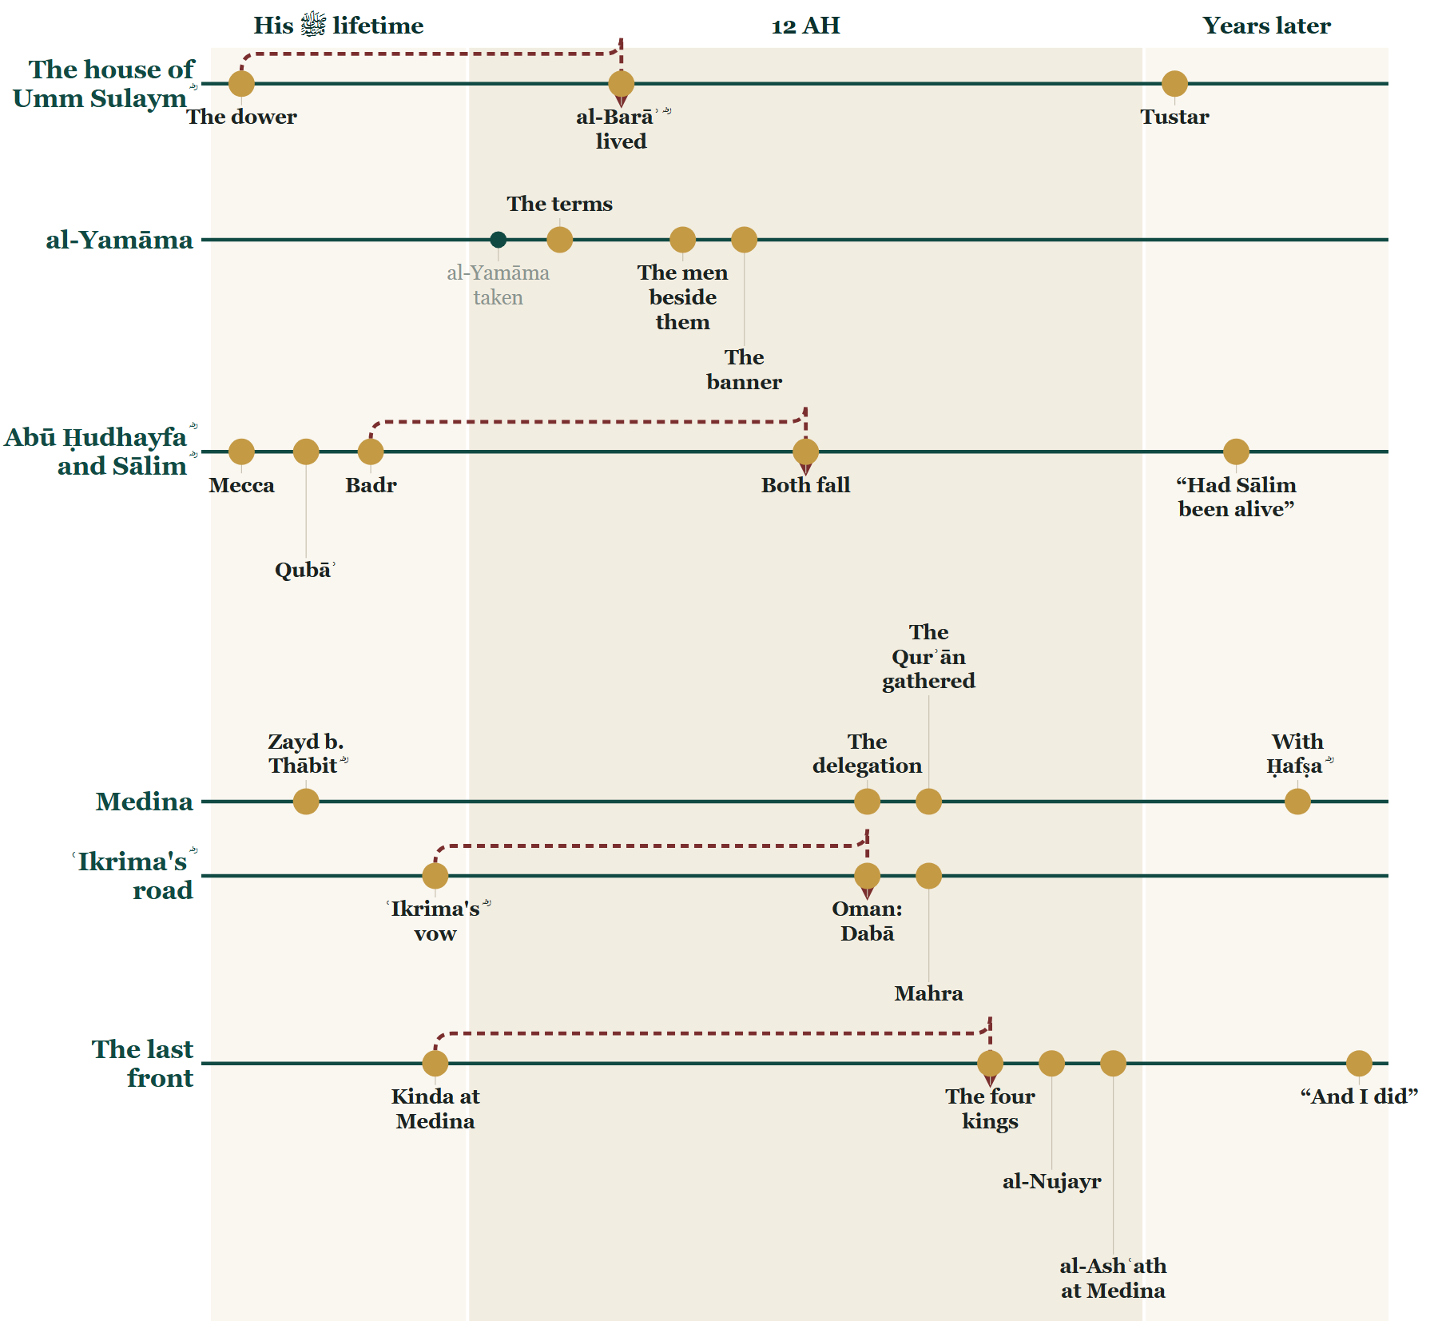
Tonight on the Line
Notes:
THE CLOSE — the Line.
SAY — Tonight began at the forts of al-Yamāma, with what was signed. We went into two houses — Umm Sulaym's ؓ, and Abū Ḥudhayfa's ؓ and Sālim's ؓ — and came out on the field where their men fell, and at Medina, where their deaths became the reason the Qurʾān was gathered. And then one man's road: ʿIkrima ؓ, through Oman and Mahra to the last front.

Slide 94
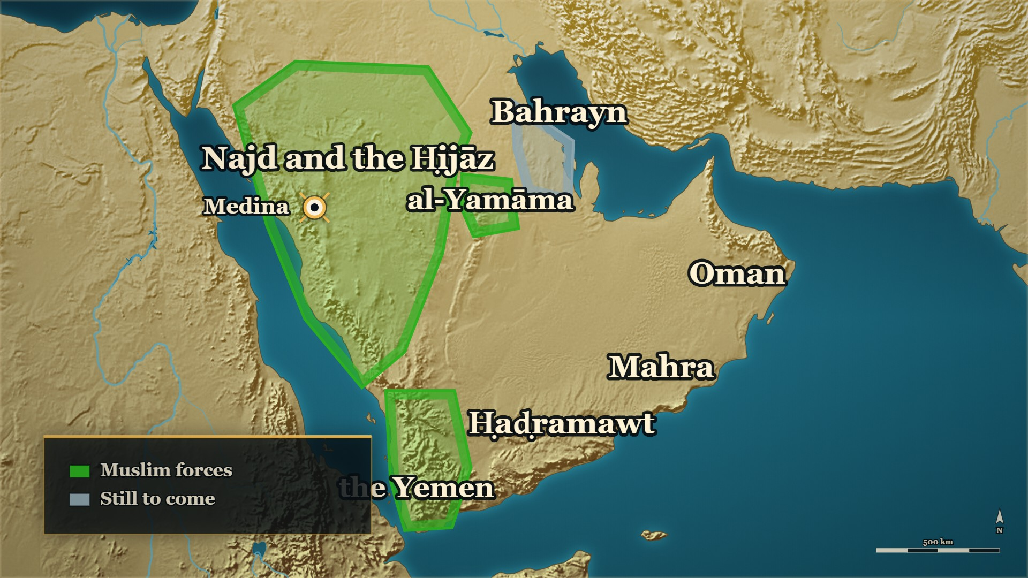


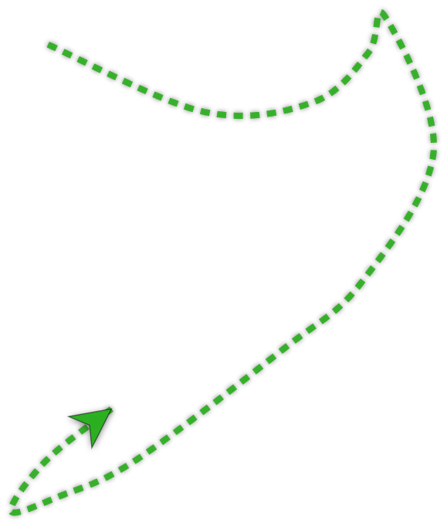





12 AH
Where we stand
Tonight
Oman, Mahra, and the last front
Next week
Bahrayn, told as 'meanwhile'
Notes:
SAY — When you came in, al-Yamāma had just been taken, and the east was burning.
▶ CLICK 1 — Oman and Mahra, settled.
▶ CLICK 2 — Ḥaḍramawt — the last front — settled.
▶ CLICK 3 — And the road one man rode through all of it: ʿIkrima ؓ, from al-Yamāma to al-Nujayr.

Slide 95
Tonight
How the day ended
The house of Umm Sulaym ؓ
The Qurʾān gathered
ʿIkrima's ؓ road
The last front
Notes:
TONIGHT — say each heading, then its line:
1. How the day ended — The terms took their weapons and their wealth, and left them their lives.
2. The house of Umm Sulaym ؓ — She made him say the ruling before she told him it was his own case.
3. The Qurʾān gathered — The mushaf the room reads from was gathered because of the men who were killed in the garden.
4. ʿIkrima's ؓ road — He wrote before he marched, and half the enemy stopped being the enemy.
5. The last front — A man who will say the worst thing about himself out loud has taken its power away from everybody else.

Slide 96
Next week
Sixteen riders left Medina for Bahrayn. By the time they reached it they were an army. How?
Notes:
Ask it, and pause. Then a loud السلام علیکم — and the dua. The room must know it has ended.

