Slide 1
Evening 4
al-Buṭāḥ and al-Yamāma
10–12 AH

Slide 2
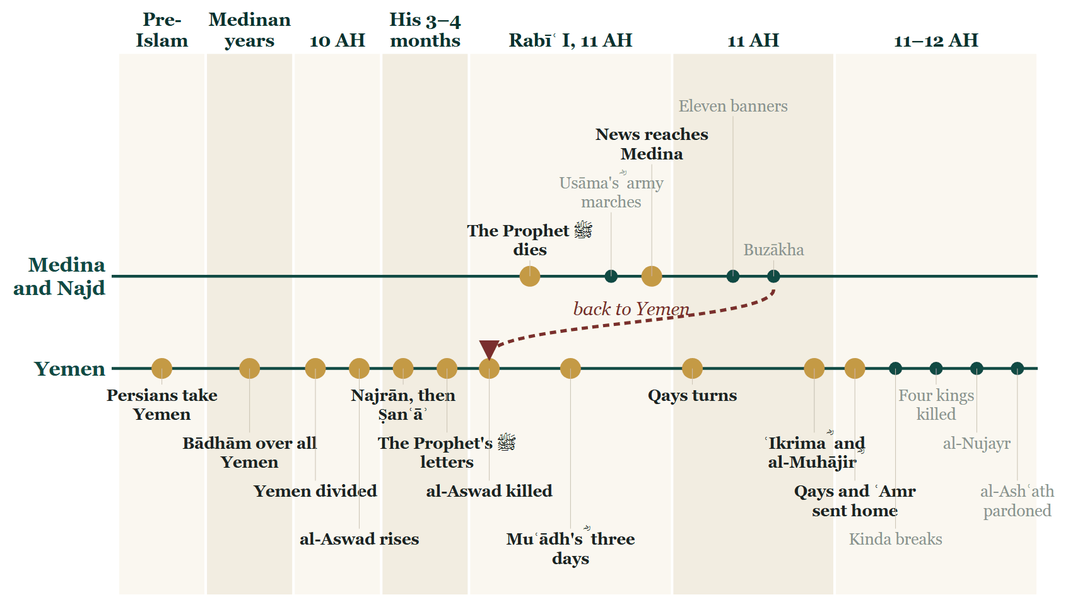
Where we stopped

Slide 3
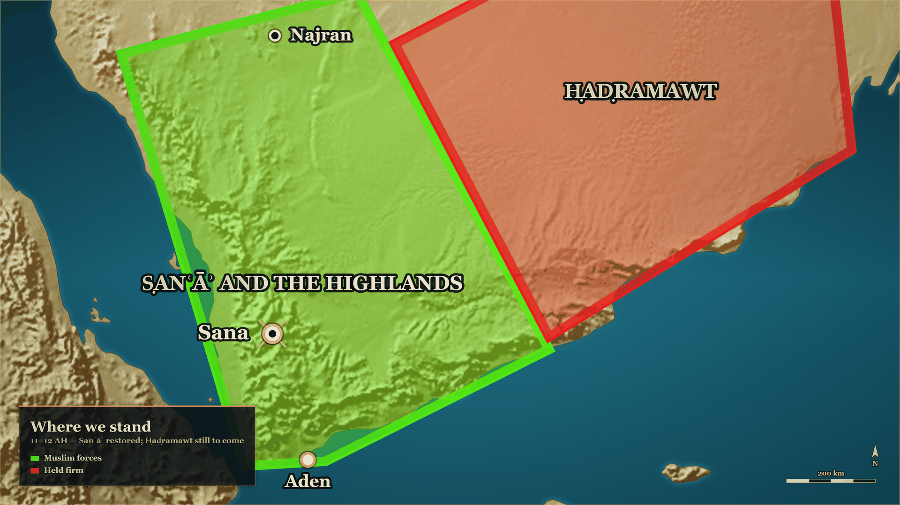
From last week
Where we stand
Ṣanʿāʾ
restored
Ḥaḍramawt
still to come

Slide 4
Part I
The two claimants still standing (10–12 AH)

Slide 5
Where the story stands
Tonight: back to the north
Session 2
Session 3
Tonight
Khālid ؓ at Buzākha, in Najd: Ṭulayḥa al Asadi defeated and flees
The south: al-Aswad killed in Ṣanʿāʾ, the Yemen restored; Ḥaḍramawt still to come
Two claimants still standing in the north: Musaylima at al-Yamāma, and Sajāḥ

Slide 6
End of 10 AH
Musaylima's letter, and the reply
فإنَّ الأرضَ لله يُورِثُها منْ يَشاءُ من عباده والعاقبة للمتقين
…the earth belongs to Allah; He gives it in inheritance to whomever He wills of His servants; and the outcome is for those who fear Him.
al-Bidaya wa'l-Nihaya, vol. 5, p. 24

Slide 7
in the Prophet's ﷺ lifetime
Earlier: Musaylima at Medina
لو سألتني هذه القطعة ما أعطيتكها
If you asked me for this piece, I would not give it to you…
al-Bidaya wa'l-Nihaya, vol. 5, p. 21 — Sahih al-Bukhari 4373

Slide 8
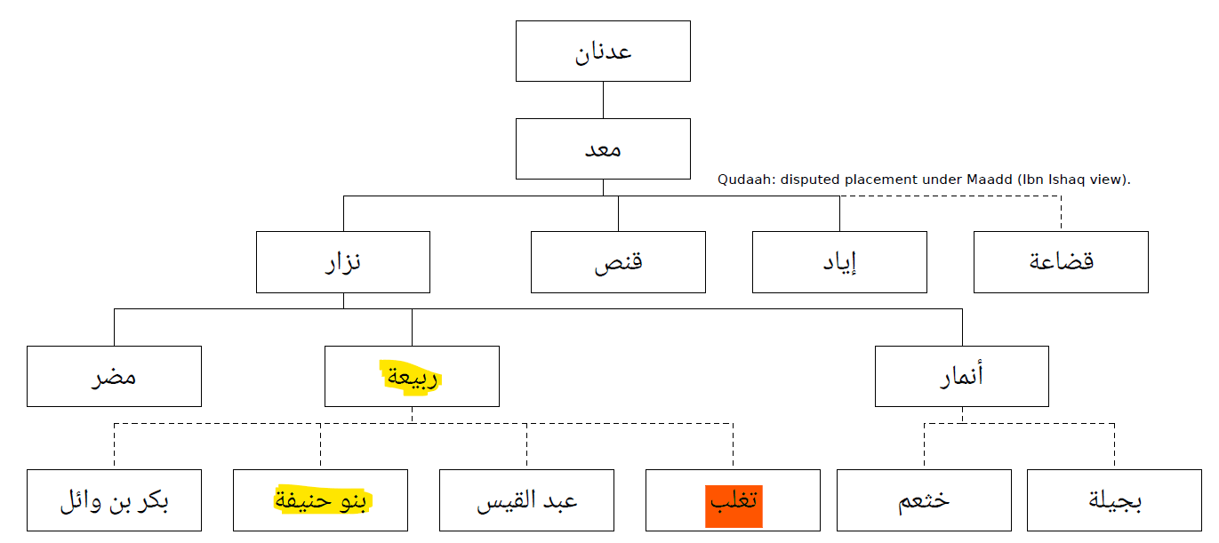

Slide 9
11–12 AH, al-Yamāma
"A liar of Rabīʿa"
فقال أشهد أنَّك كذّابٌ وأن محمدًا صادقٌ، ولكن كذّابَ رَبيعة أحبُّ إلينا من صادقِ مُضَر
He said: I bear witness that you are a liar and that Muḥammad ﷺ is truthful — but a liar of Rabīʿa is dearer to us than a truthful man of Muḍar.
al-Bidaya wa'l-Nihaya, vol. 7, p. 37

Slide 10
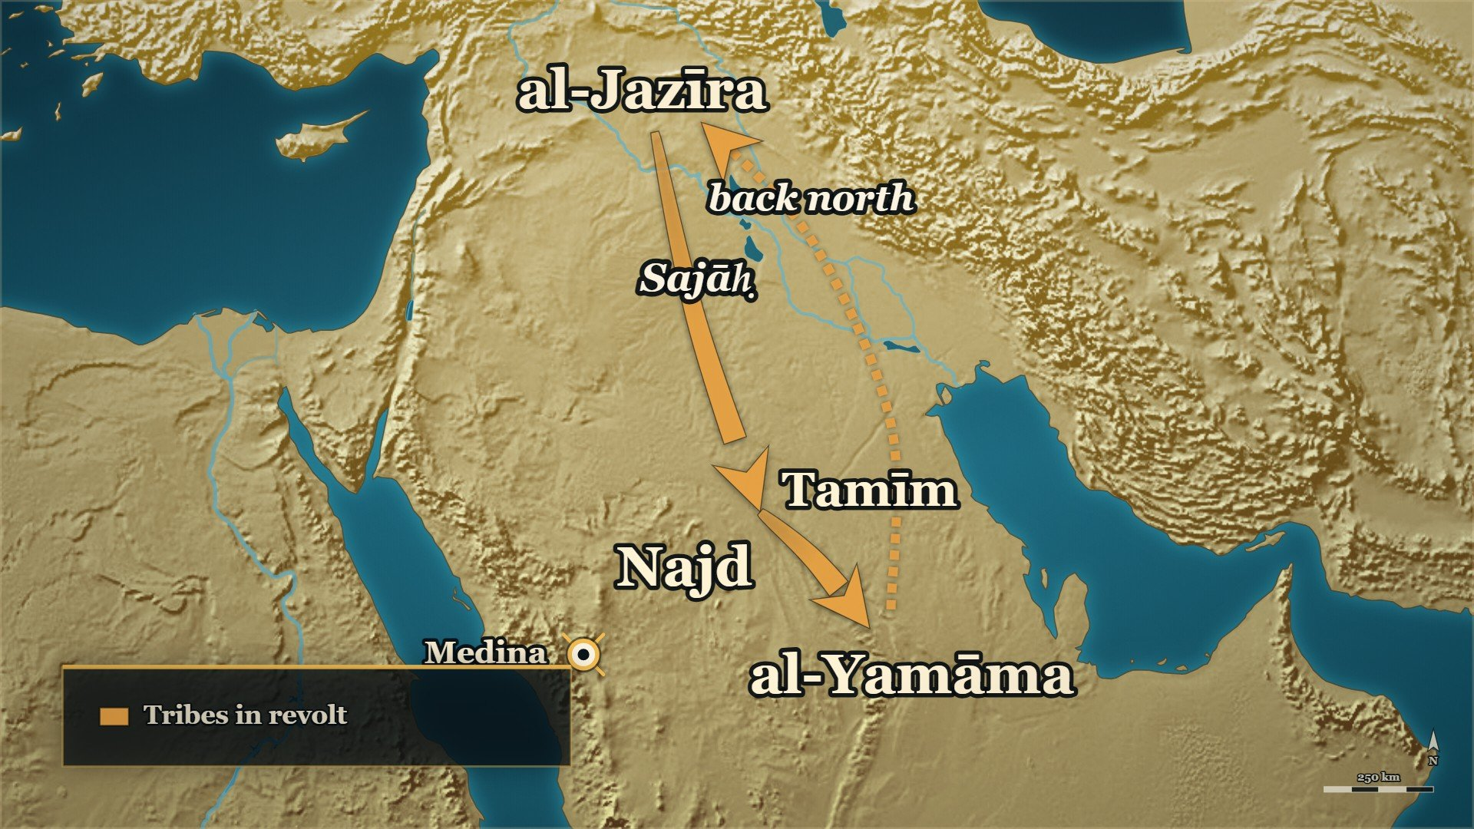
Sajāḥ comes down from the north
al-Jazīra
where she came from
al-Yamāma
where she turned back

Slide 11
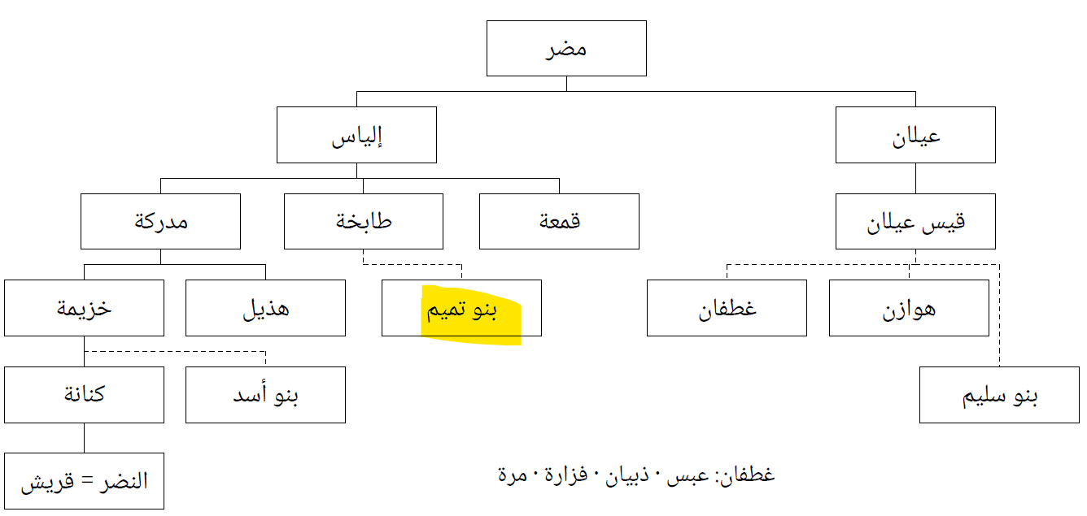

Slide 12
11 AH
Sajāḥ — who she actually was
إذ أقبلت سجاح … التغلبية من الجزيرة، وهي من نصارى العرب، وقد ادَّعتِ النبوَّة
…Sajāḥ … al-Taghlibiyya came forward from al-Jazīra — and she was of the Christians of the Arabs — having claimed prophethood.
al-Bidaya wa'l-Nihaya, vol. 7, p. 28

Slide 13
11 AH, and afterwards
What her claim was worth
فكرَّتْ راجعةً إلى الجزيرة بعدما قبضَتْ من مسيلمة نصفَ خراجِ أرضِهِ
…she went back to al-Jazīra after she had taken from Musaylima half the kharāj of his land…
al-Bidaya wa'l-Nihaya, vol. 7, p. 30

Slide 14
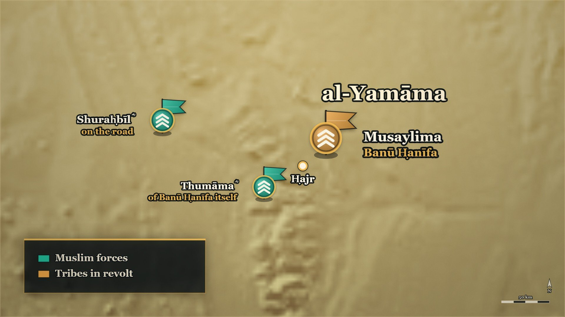
al-Yamāma before the army came
Ḥajr
the town
Thumāma ؓ
of Banū Ḥanīfa itself

Slide 15
11 AH, before Khālid ؓ arrived
There were Muslims inside already
فَخَافَ إِنْ هُوَ شُغِلَ بِهَا أَنْ يَغْلِبَ ثُمَامَةُ وَشُرَحْبِيلُ بْنُ حَسَنَةَ وَالْقَبَائِلُ التى حَوْلَهُمْ عَلَى حَجْرٍ، وَهِيَ الْيَمَامَةُ
"He feared that if he were occupied with her, Thumāma and Shuraḥbīl b. Ḥasana and the tribes around them would overcome Ḥajr — which is al-Yamāma."
al-Kamil, vol. 2, p. 210

Slide 16
Part II
al-Buṭāḥ, and the reckoning at Medina (11 AH)

Slide 17
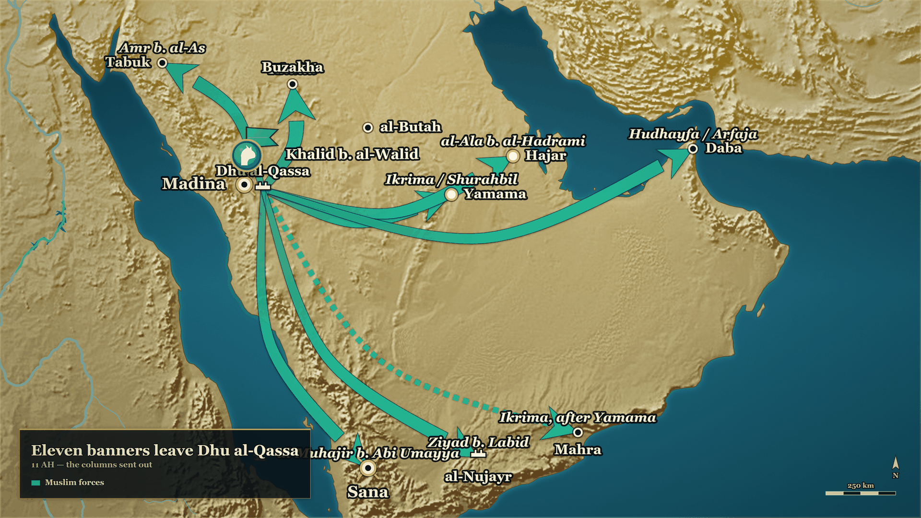

Slide 18
11 AH
After Buzākha
The orders
Buzākha
al-Buṭāḥ
Tied at Dhū al-Qaṣṣa: Ṭulayḥa first; when done, Mālik b. Nuwayra at al-Buṭāḥ
Done: Ṭulayḥa al Asadi flees, and the tribes around him came back
Next in the orders: the Banu Tamīm, and Mālik b. Nuwayra

Slide 19
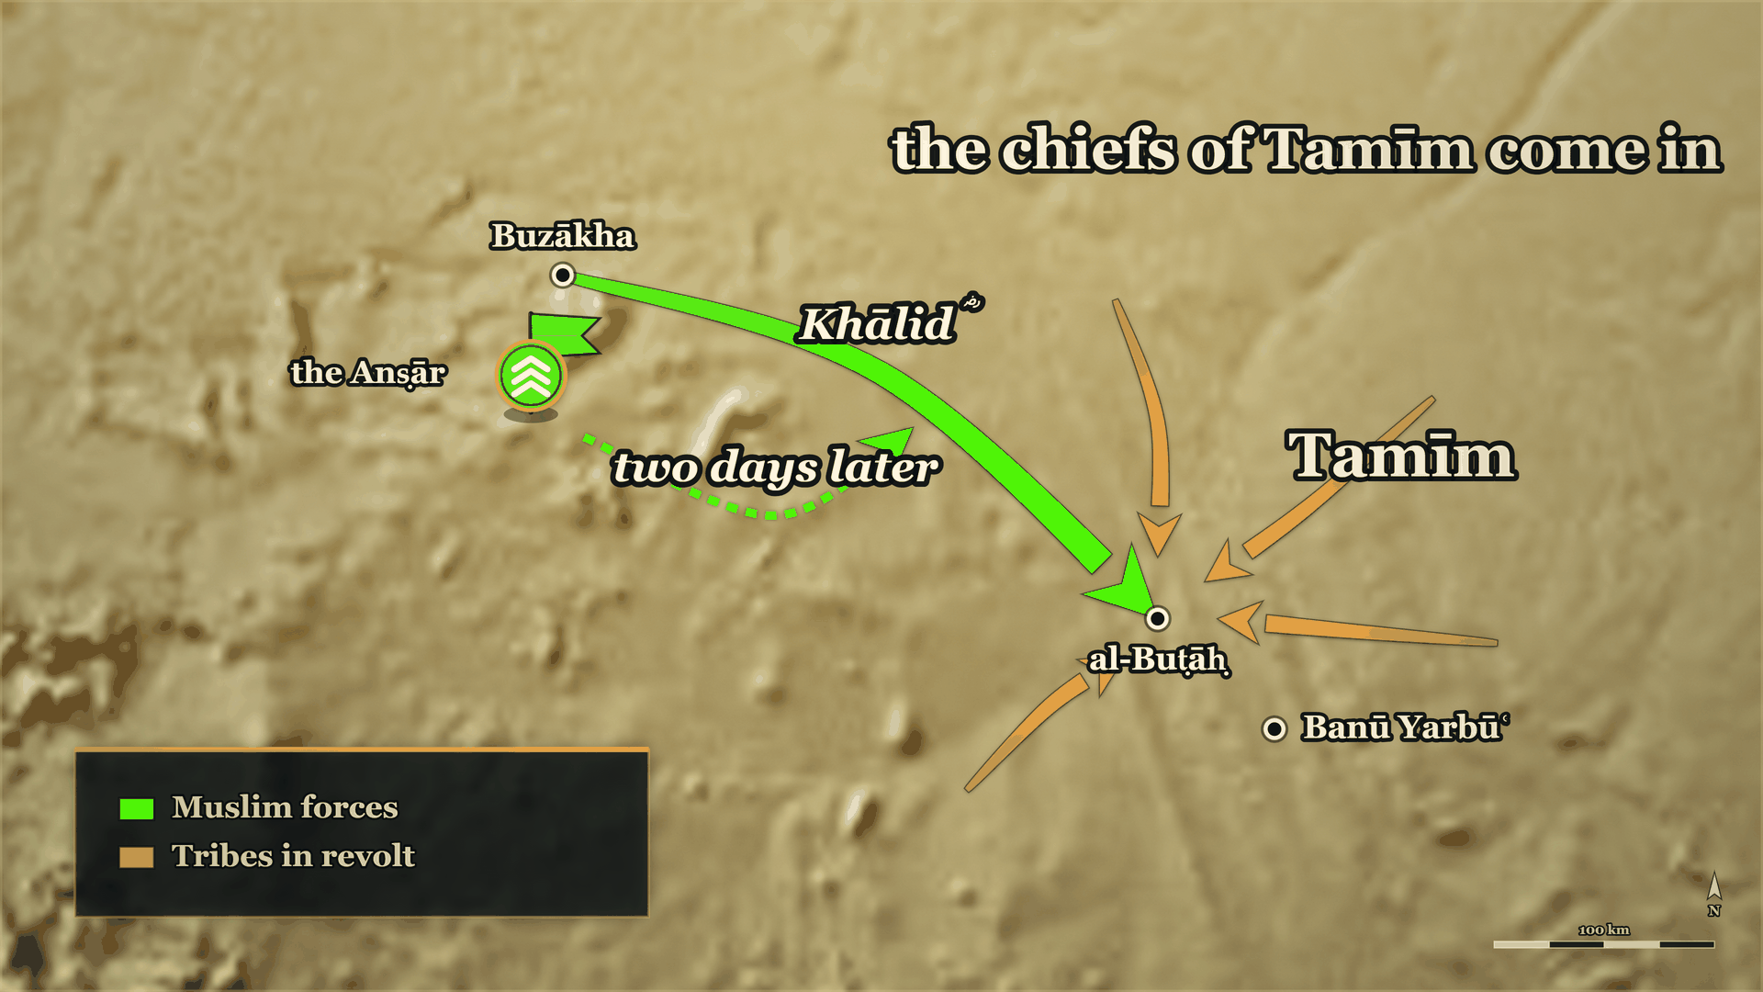
From Buzākha to al-Buṭāḥ
Buzākha
where evening 2 stopped
al-Buṭāḥ
the third stop in the orders

Slide 20
11 AH
The Anṣār who would not march
قَدْ عَهِدَ إِلَيَّ أَنْ أَمْضِيَ، وَأَنَا الْأَمِيرُ … فَأَنَا قَاصِدٌ إِلَى مَالِكٍ وَمَنْ مَعِي، وَلَسْتُ أُكْرِهُهُمْ.
"He instructed me to go on, and I am the commander … So I am making for Mālik, with whoever is with me — and I do not compel them."
al-Kamil, vol. 2, p. 212

Slide 21
11 AH
Mālik b. Nuwayra ؓ stands apart
إلَّا ما كانَ من مالك بن نويرة فإنّه متحيرٌ في أمره، مُتَنحٍّ عن الناس
"— except for what was from Mālik b. Nuwayra, for he was perplexed about his own affair, keeping apart from the people."
al-Bidaya wa'l-Nihaya, vol. 7, p. 30

Slide 22
11 AH
"Disperse, and enter into this matter"
إِنَّا دُعِينَا إِلَى هَذَا الْأَمْرِ فَأَبْطَأْنَا عَنْهُ فَلَمْ نُفْلِحْ … فَتَفَرَّقُوا وَادْخُلُوا فِي هَذَا الْأَمْرِ
…we were called to this matter and we were slow to it and did not prosper … Disperse, and enter into this matter.
al-Kamil, vol. 2, pp. 212–213

Slide 23
11 AH
The patrol could not agree
فشهد أبو قتادة - الحارث بن ربعي الأنصاري - أنهم أقاموا الصلاةَ، وقال آخرون: إنهم لم يُؤَذّنوا ولا صَلّوا
…Abū Qatāda al-Anṣārī — al-Ḥārith b. Ribʿī — testified that they had established the prayer, and others said they had neither given the adhān nor prayed.
al-Bidaya wa'l-Nihaya, vol. 7, p. 30

Slide 24
11 AH — the books disagree
One night, four accounts
1. The cold night
2. Summoned
"warm your prisoners" taken as an order to kill. In banu kinana’s language it meant to kill.
reproached over Sajāḥ and the zakāt, and the muslims of Rabah. then an order to strike

Slide 25
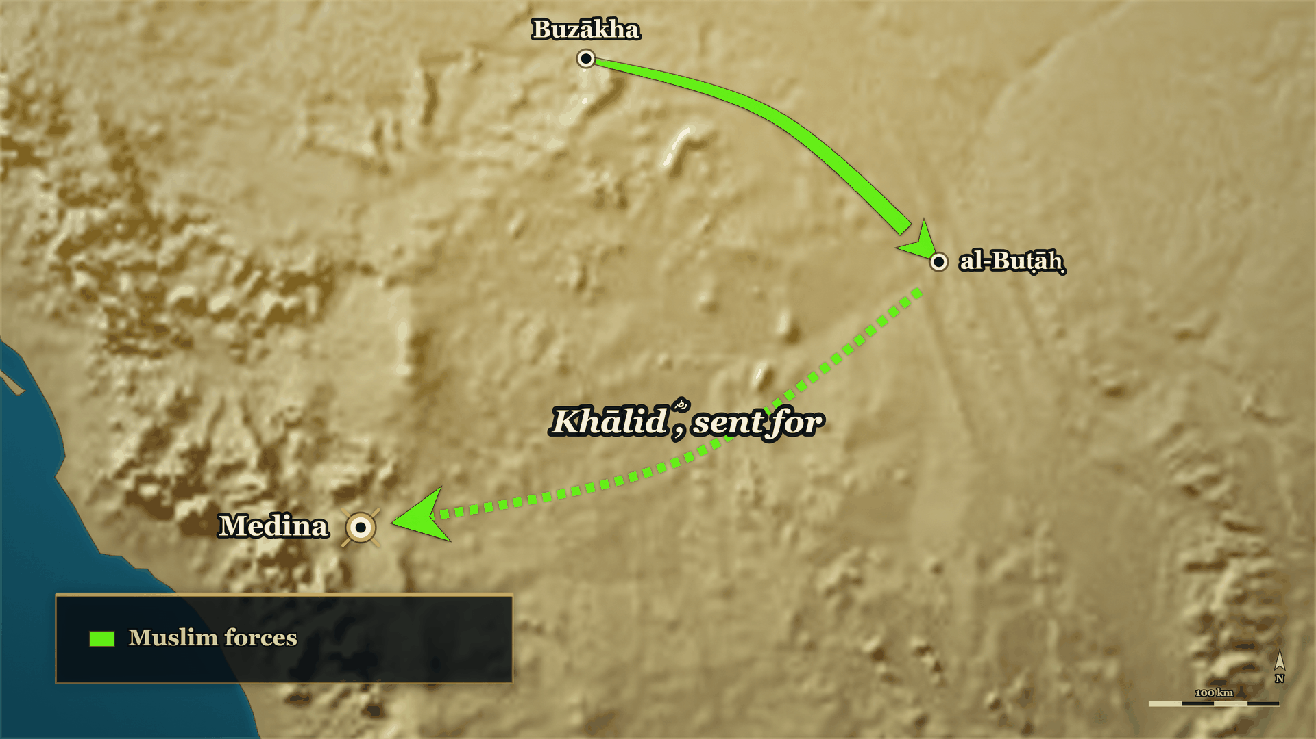
Back to Medina
To Medina
Khālid ؓ is sent for

Slide 26
11 AH, Medina
"He interpreted, and he was mistaken"
هِيهِ يَا عُمَرُ! تَأَوَّلَ فَأَخْطَأَ، فَارْفَعْ لِسَانَكَ عَنْ خَالِدٍ، فَإِنِّي لَا أَشِيمُ سَيْفًا سَلَّهُ اللَّهُ عَلَى الْكَافِرِينَ.
"Enough, ʿUmar! He interpreted and was mistaken. Lift your tongue off Khālid — for I do not sheathe a sword Allah has drawn against the disbelievers."
al-Kamil, vol. 2, p. 213

Slide 27
the historian's own comment
Ibn Kathir's verdict
واستمرَّ أبو بكر بخالدٍ على الإمرة، وإن كان قد اجتهد في قتلِ مالك بن نويرة وأخطأَ في قتله
"Abū Bakr continued with Khālid in command, even though he had exercised his judgement in the killing of Mālik b. Nuwayra and was mistaken in killing him."
al-Bidaya wa'l-Nihaya, vol. 7, p. 32

Slide 28
ʿUmar's ؓ caliphate
ʿUmar ؓ and Mutammim
فَقَالَ مُتَمِّمٌ: … لَوْ كَانَ أَخِي صُرِعَ مَصْرَعَ أَخِيكَ لَمَا بَكَيْتُهُ. فَقَالَ عُمَرُ: مَا عَزَّانِي أَحَدٌ بِأَحْسَنَ
Mutammim said: … had my brother fallen where your brother fell, I would not have wept for him. ʿUmar said: No one has ever consoled me better…
al-Kamil, vol. 2, p. 214

Slide 29
Part III
The road to al-Yamāma (11–12 AH)

Slide 30
11 AH, Medina
Back to the mosque, 11 AH
al-Buṭāḥ
Medina
Next
Mālik b. Nuwayra ؓ killed
ʿUmar ؓ objects in the mosque; Abū Bakr ؓ: he interpreted, and was mistaken
One claimant still standing: Musaylima, at al-Yamāma

Slide 31
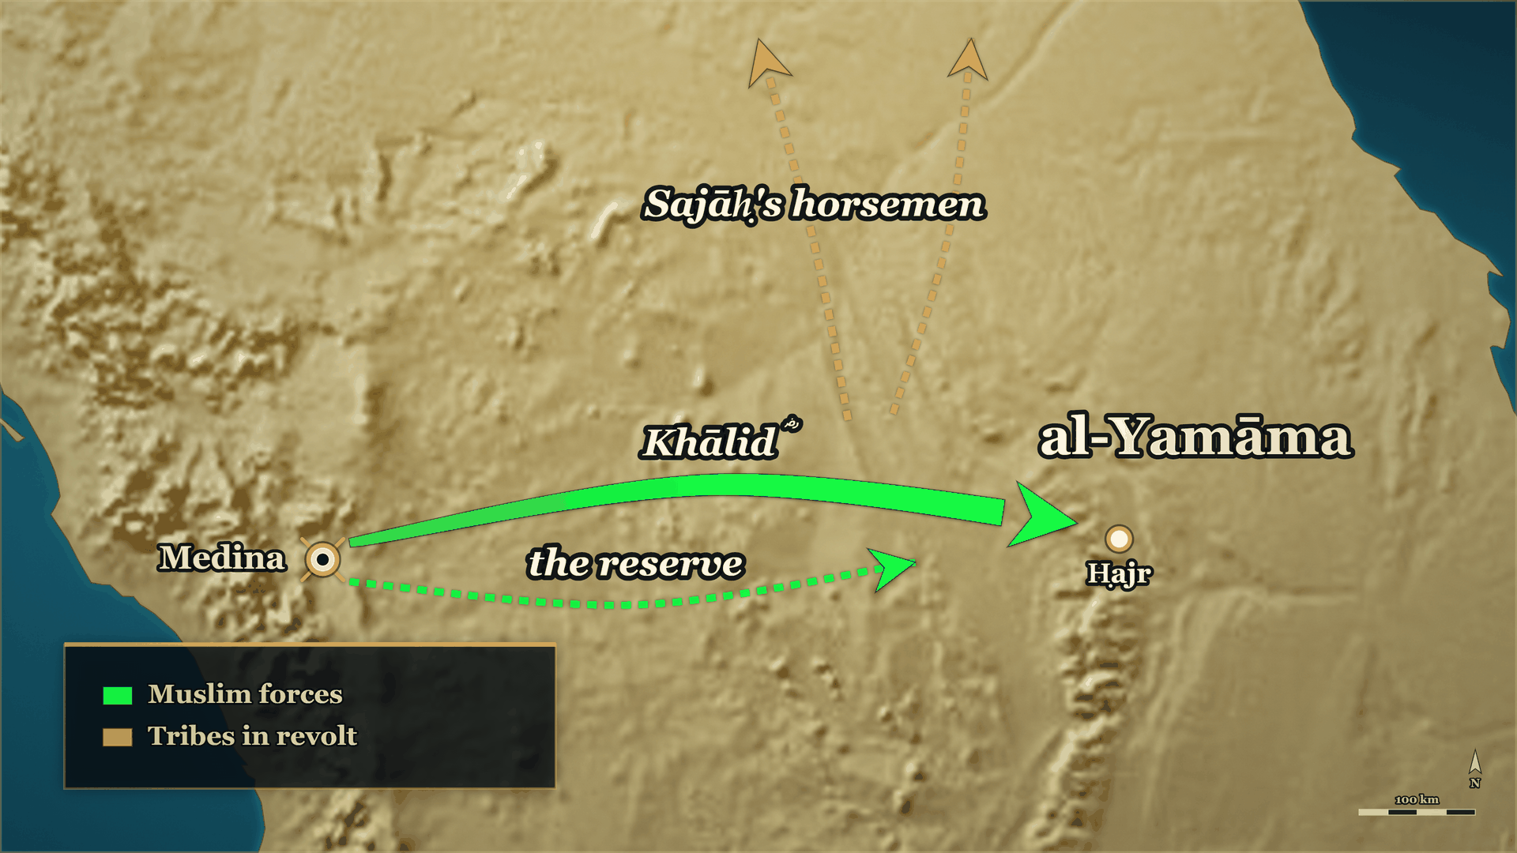
Out again, to al-Yamāma
To al-Yamāma
the army, and the reserve behind it

Slide 32
11 AH, Medina
Excused, and sent to al-Yamāma
لما رضيَ الصدِّيقُ عن خالد بن الوليد وعذَرَهُ بما اعتذرَ به، بعثَه إلى قتالِ بني حنيفة باليمامة
When the Ṣiddīq was satisfied with Khālid b. al-Walīd and accepted the excuse he made, he sent him to fight Banū Ḥanīfa at al-Yamāma.
al-Bidaya wa'l-Nihaya, vol. 7, p. 32

Slide 33
11 AH, before Khālid ؓ arrived
Meanwhile, at al-Yamāma
One banner
Behind him
First there
Of the eleven banners, ʿIkrima ؓ had the one sent against Musaylima
Shuraḥbīl b. Ḥasana ؓ, sent to follow him
Both reached al-Yamāma before Khālid ؓ and the main army

Slide 34
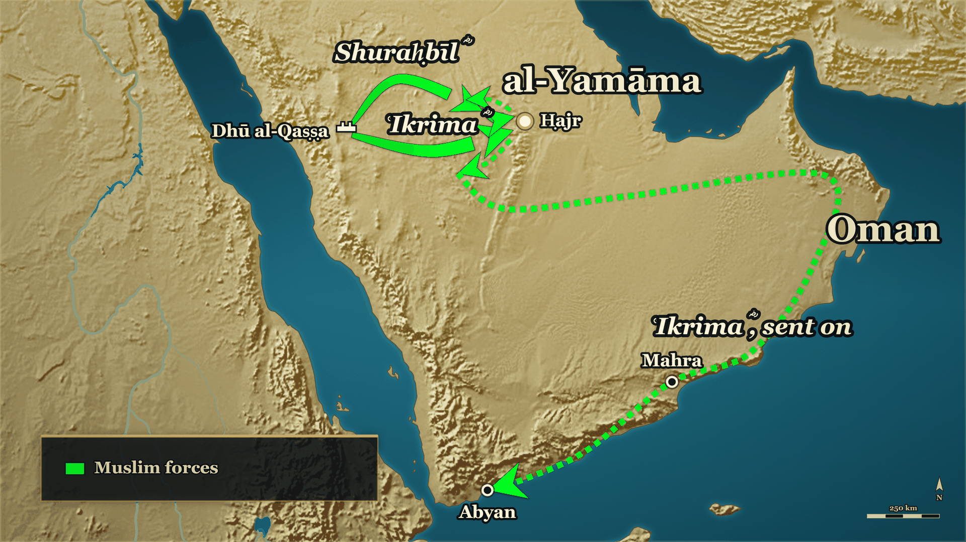
Two commanders sent ahead
ʿIkrima ؓ
Set back, then sent on to Oman
Shuraḥbīl ؓ
halted on the road

Slide 35
11 AH, al-Yamāma
ʿIkrima ؓ goes too early
لَا أَرَيَنَّكَ وَلَا تَرَانِي، لَا تَرْجِعَنَّ فَتُوهِنَ النَّاسَ … فَقَاتِلْ أَهْلَ عُمَانَ وَمَهْرَةَ
Let me not see you and do not you see me. Do not come back and weaken the people … fight the people of ʿUmān and Mahra…
al-Kamil, vol. 2, pp. 214–215

Slide 36
11 AH, al-Yamāma
Another premature attack
وَعَجَّلَ شُرَحْبِيلُ بْنُ حَسَنَةَ، وَبَادَرَ خَالِدًا بِقِتَالِ مُسَيْلِمَةَ، فَنُكِبَ، فَلَامَهُ خَالِدٌ.
"Shuraḥbīl b. Ḥasana hurried, and got ahead of Khālid in fighting Musaylima, and was struck down; and Khālid reproached him."
al-Kamil, vol. 2, p. 215

Slide 37
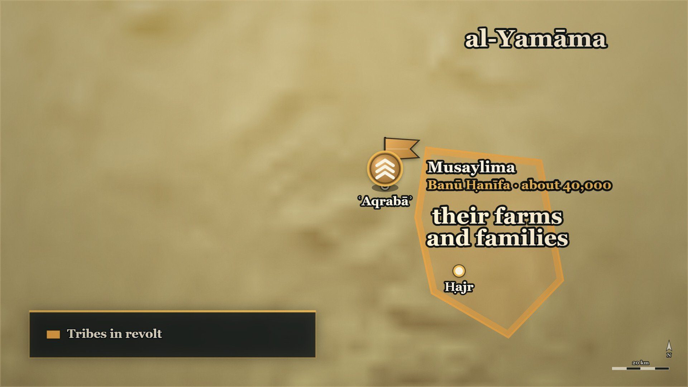
ʿAqrabāʾ, and the ground behind it
ʿAqrabāʾ
the enemy camp
The farmland
behind their own line

Slide 38
11–12 AH
Banu Hanifa
فلما سمع مسيلمةُ بقدوم خالدٍ عسكر بمكانٍ يقال له: (عقربا) في طرف اليمامة والريفُ وراءَ ظهورهم
"When Musaylima heard of Khālid's coming, he encamped at a place called ʿAqrabāʾ, at the edge of al-Yamāma, with the cultivated country behind their backs."
al-Bidaya wa'l-Nihaya, vol. 7, p. 32

Slide 39
11–12 AH
The tent and the prisoner
أيها الرجل إن كنتَ تريد بأهل اليمامة غدًا خيرًا أو شرًا فاستبق هذا الرجل
Man — if you intend anything tomorrow for the people of Yamāma, good or ill, keep this man alive…
al-Bidaya wa'l-Nihaya, vol. 7, p. 33

Slide 40
Part IV
The day begins (11–12 AH)

Slide 41
The night before ʿAqrabāʾ
Where we are
Medina
The road
The tent
Khālid ؓ answered for al-Buṭāḥ, and was kept in command
ʿIkrima ؓ and Shuraḥbīl ؓ face set back ahead of him; forty thousand at ʿAqrabāʾ
A prisoner in irons in Khālid's ؓ own tent: Mujjāʿa of Banū Ḥanīfa

Slide 42
11–12 AH — the books disagree
The order of battle
ورايةُ المهاجرين مع سالم … ورايةُ الأنصار مع ثابت بن قيس … والعرب على راياتها
The Muhājirūn's banner was with Sālim … the Anṣār's banner with Thābit b. Qays … and the Arabs each under their own banners.
al-Bidaya wa'l-Nihaya, vol. 7, p. 33

Slide 43
11–12 AH — attribution disputed
"Today is the day of honour"
اليوم يوم الغيرة، اليوم إن هُزمتم تُستنكح النساء سَبيّاتٍ … فقاتلوا عن أحسابكم، وامنعوا نساءكم.
Today is the day of honour. Today, if you are routed, the women will be taken as captives … So fight for your own standing, and protect your women.
al-Bidaya wa'l-Nihaya, vol. 7, p. 33

Slide 44
11–12 AH, ʿAqrabāʾ
The line breaks
فكانت جولة … حتى دخلت بنو حنيفة خيمةَ خالد بن الوليد وهمّوا بقتل أم تميم، حتى أجارها مجاعة
There was a rout … Banū Ḥanīfa entered Khālid b. al-Walīd's own tent and were minded to kill Umm Tamīm — until Mujjāʿa gave her his protection…
al-Bidaya wa'l-Nihaya, vol. 7, p. 33

Slide 45
11–12 AH, ʿAqrabāʾ
al-Rajjāl b. ʿUnfuwa
فَكَانَ أَعْظَمَ فِتْنَةً عَلَى بَنِي حَنِيفَةَ مِنْ مُسَيْلِمَةَ … فَصَدَّقُوهُ وَاسْتَجَابُوا لَهُ
He was a greater fitna upon Banū Ḥanīfa than Musaylima … and they believed him and answered him.
al-Kamil, vol. 2, p. 215

Slide 46
11–12 AH, ʿAqrabāʾ
"People of Sūrat al-Baqara"
وجعلت الصحابة يتواصَون بينهم ويقولون: يا أصحاب سورةِ البقرةِ، بَطلَ السِّحْرُ اليوم
"And the Companions began enjoining one another, saying: People of Sūrat al-Baqara — today the sorcery is undone."
al-Bidaya wa'l-Nihaya, vol. 7, p. 33

Slide 47
11–12 AH, ʿAqrabāʾ
Thābit b. Qays ؓ puts on his shroud
هَكَذَا عَنْ وُجُوْهِنَا نُقَارِعُ القَوْمَ … مَا هَكَذَا كُنَّا نُقَاتِلُ مَعَ رَسُوْلِ اللهِ ﷺ.
Get out of our faces so we can strike the enemy … This is not how we used to fight alongside the Messenger of Allah ﷺ.
Siyar A'lam al-Nubala, vol. 1, p. 311 — Sahih al-Bukhari 2845

Slide 48
Sālim ؓ with the Muhājirūn's banner
"Salim mawla Abi Hudaifa R.A"
أتخشى أن نؤتى من قبلك؟ فقال: بئس حامل القرآن أنا إذًا.
…Do you fear we shall be broken from your side? He said: A wretched bearer of the Qurʾān I should be, then.
al-Bidaya wa'l-Nihaya, vol. 7, p. 34

Slide 49
11–12 AH, ʿAqrabāʾ
Zayd b. al-Khaṭṭāb ؓ — "I will not speak"
والله لا أتكلَّمُ حتى يهزمهم اللهُ أو ألقىَ اللهَ فأكلِّمه بحجَّتي
…By Allah, I will not speak until Allah routs them, or I meet Allah and speak to Him with my case.
al-Bidaya wa'l-Nihaya, vol. 7, p. 34

Slide 50
The other wing: Abū Ḥudhayfa ؓ
"Adorn the Qurʾān with deeds"
يا أهلَ القرآنِ زيِّنوا القرآنَ بالفِعال
"People of the Qurʾān — adorn the Qurʾān with deeds."
al-Bidaya wa'l-Nihaya, vol. 7, p. 34

Slide 51
11–12 AH, ʿAqrabāʾ
Khālid ؓ between the lines
أنا ابن الوليد العَوْد، أنا ابن عامر وزيد … وجعل لا يبرز لهم أحدٌ إلا قتله
I am the son of al-Walīd the seasoned; I am the son of ʿĀmir and Zayd … and no one came out against him but he killed him.
al-Bidaya wa'l-Nihaya, vol. 7, p. 34

Slide 52
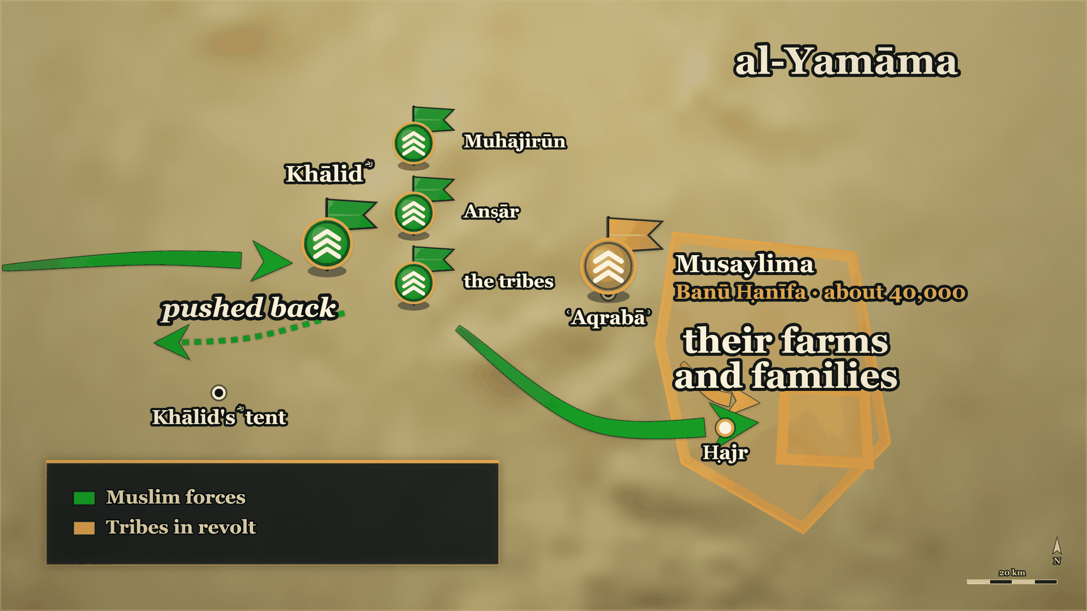
The line re-formed
Clan by clan
Muhājirūn, Anṣār, the tribes

Slide 53
11–12 AH, ʿAqrabāʾ
Every clan under its own banner
امْتَازُوا أَيُّهَا النَّاسُ لِنَعْلَمَ بَلَاءَ كُلِّ حَيٍّ … قَالَ بَعْضُهُمْ لِبَعْضٍ: الْيَوْمَ يُسْتَحَى مِنَ الْفِرَارِ.
Separate out, people, so we may know what each clan is worth … they said to one another: Today, running is shameful.
al-Kamil, vol. 2, p. 217

Slide 54
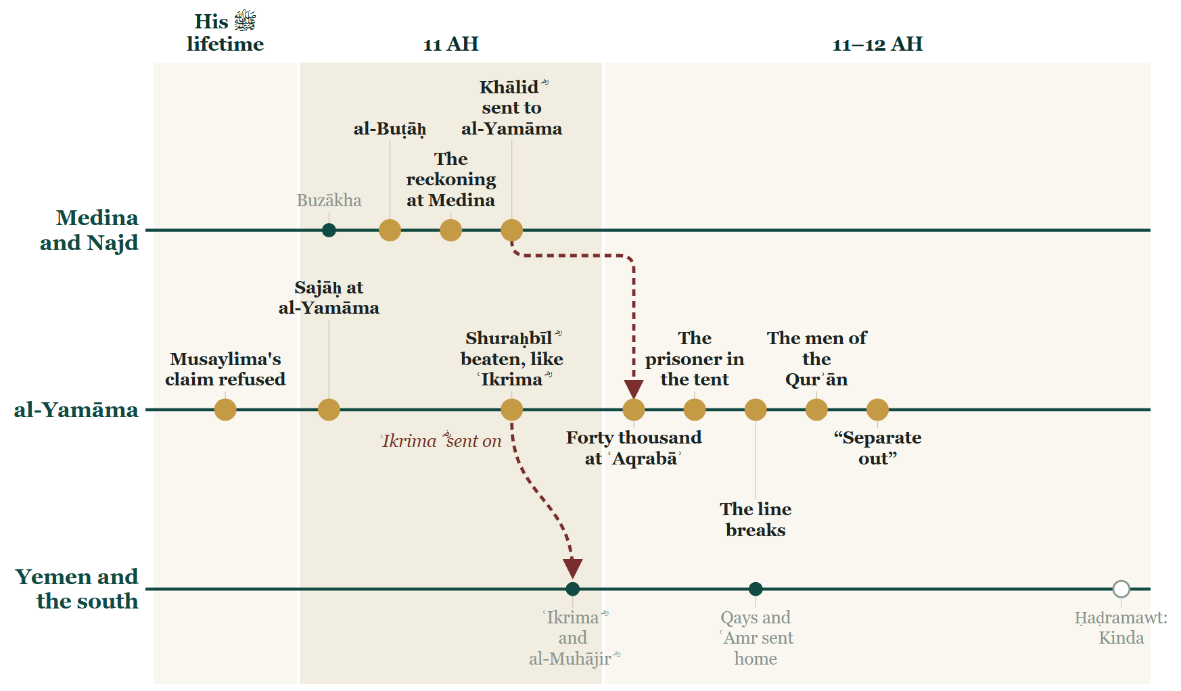
Tonight on the Line

Slide 55
Where we stand
ʿAqrabāʾ
the line re-formed
Ḥajr
the town behind them

Slide 56
Tonight
Musalyma asks for half of Arabia
Abu Bakr R.A accepted that Khalid R.A had erred, paid blood money, but didn’t remove him
When the line broke, what re-formed it was what the men had memorised.
Banu Hanifa go to the garden of death

Slide 57
Part V
The day decided

Slide 58
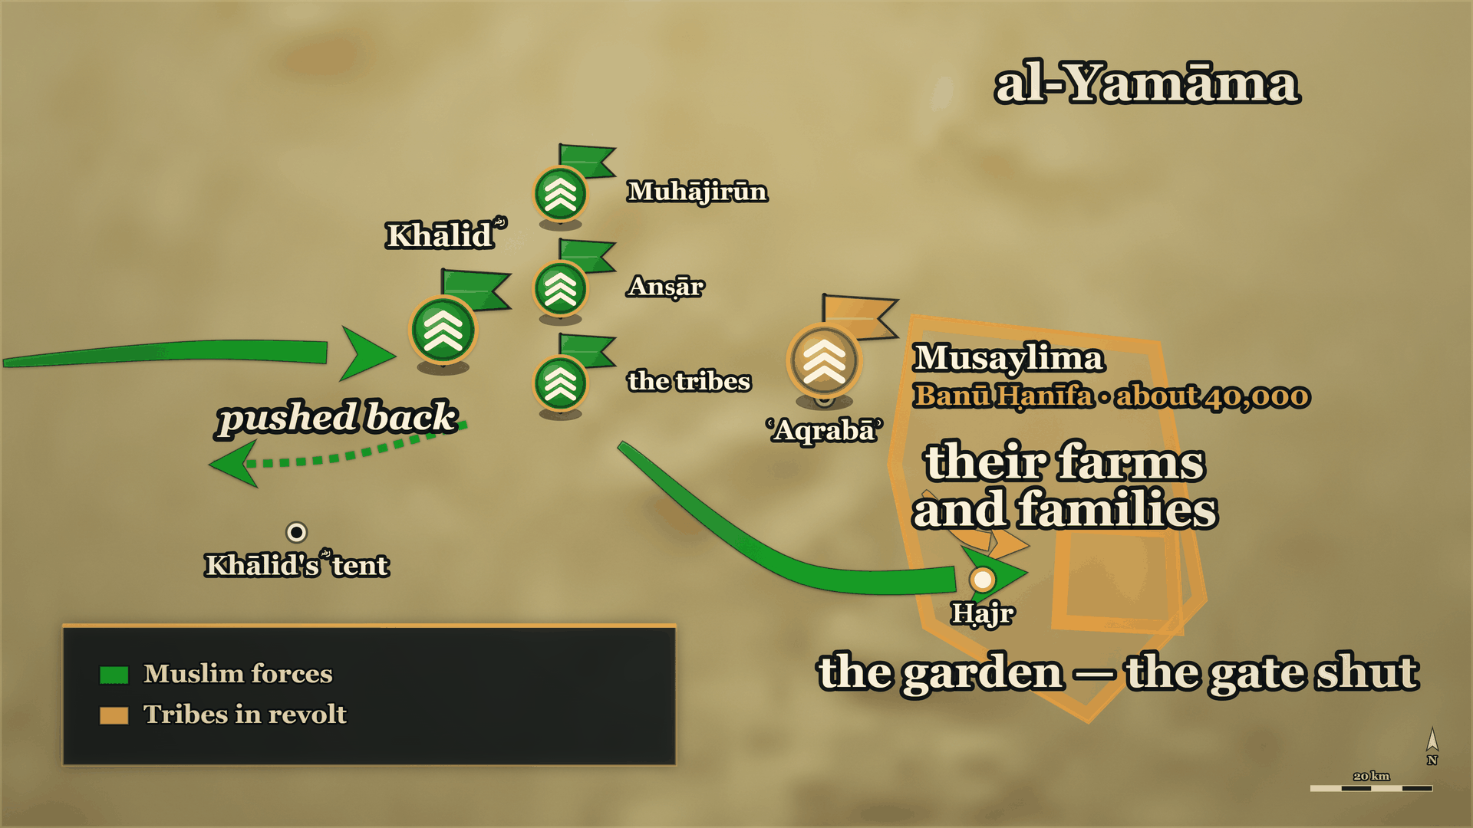
Into the garden
The garden
the gate shut behind them

Slide 59
11–12 AH, ʿAqrabāʾ
«The garden, the garden!»
وَنَادَى الْمُحَكَّمُ: يَا بَنِي حَنِيفَةَ، الْحَدِيقَةَ الْحَدِيقَةَ! فَدَخَلُوهَا وَأَغْلَقُوا عَلَيْهِمْ بَابَهَا.
"And al-Muḥakkam called out: Banū Ḥanīfa — the garden, the garden! So they went into it and barred its gate behind them."
al-Kamil, vol. 2, p. 217

Slide 60
11–12 AH, ʿAqrabāʾ
Ḥadīqat al-Mawt — over the wall
يَا مَعْشَرَ الْمُسْلِمِينَ، أَلْقُونِي عَلَيْهِمْ فِي الْحَدِيقَةِ. فَقَالُوا: لَا نَفْعَلُ، فَقَالَ: وَاللَّهِ لَتَطْرَحُنَّنِي عَلَيْهِمْ بِهَا! … وَقَاتَلَ عَلَى الْبَابِ وَفَتَحَهُ لِلْمُسْلِمِينَ.
"Company of Muslims — throw me over onto them into the garden. They said: we will not…"
al-Kamil, vol. 2, p. 218

Slide 61
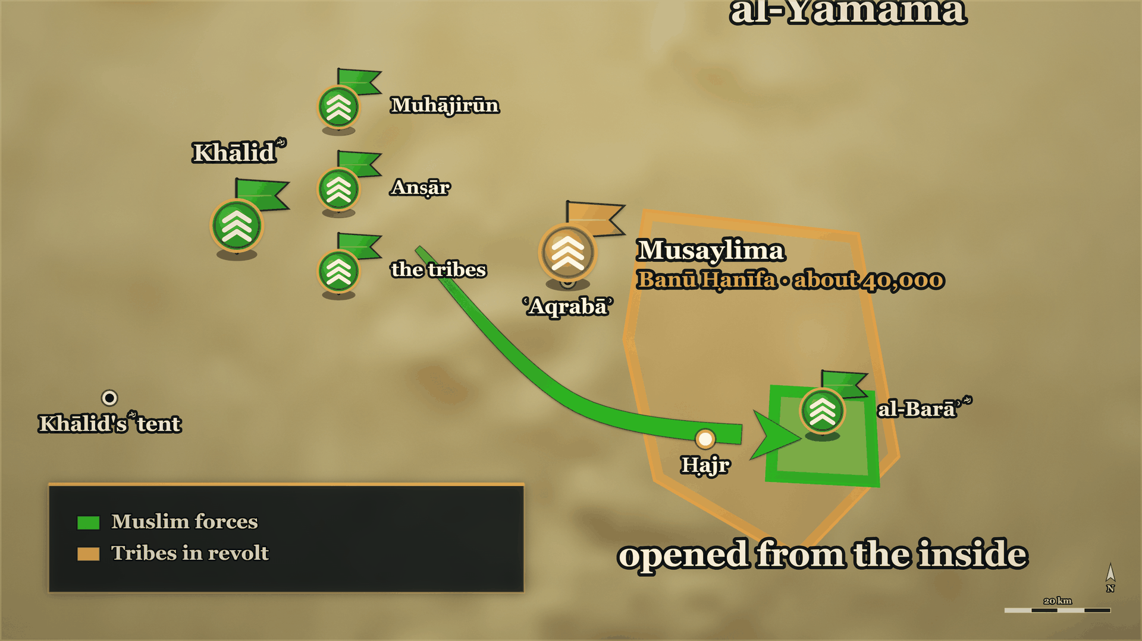
The gate opens
al-Barāʾ ؓ
over the wall, and the gate
al-Yamāma
taken

Slide 62
11–12 AH, ʿAqrabāʾ
The death of Musaylima
وَعَنْ وَحْشِيٍّ، قَالَ: لَمْ أَرَ قَطُّ أَصْبَرَ عَلَى الْمَوْتِ مِنْ أَصْحَابِ مُسَيْلِمَةَ، ثُمَّ ذَكَرَ أَنَّهُ شَارَكَ فِي قَتْلِ مُسَيْلِمَةَ.
"From Waḥshī: I never saw men more steadfast in the face of death than Musaylima's companions — then he mentioned that he had a share in killing Musaylima."
Siyar A'lam al-Nubala, p. 48

Slide 63
12 AH, the forts of al-Yamāma
Mujja’a and the treaty
وَوَصَلَ كِتَابُ أَبِي بَكْرٍ إِلَى خَالِدٍ أَنْ يَقْتُلَ كُلَّ مُحْتَلِمٍ … فَوَفَى لَهُمْ وَلَمْ يَغْدِرْ.
And Abū Bakr's letter reached Khālid, ordering him to kill every man who had reached puberty … so he kept faith with them and did not betray them.
al-Kamil, vol. 2, p. 219

Slide 64
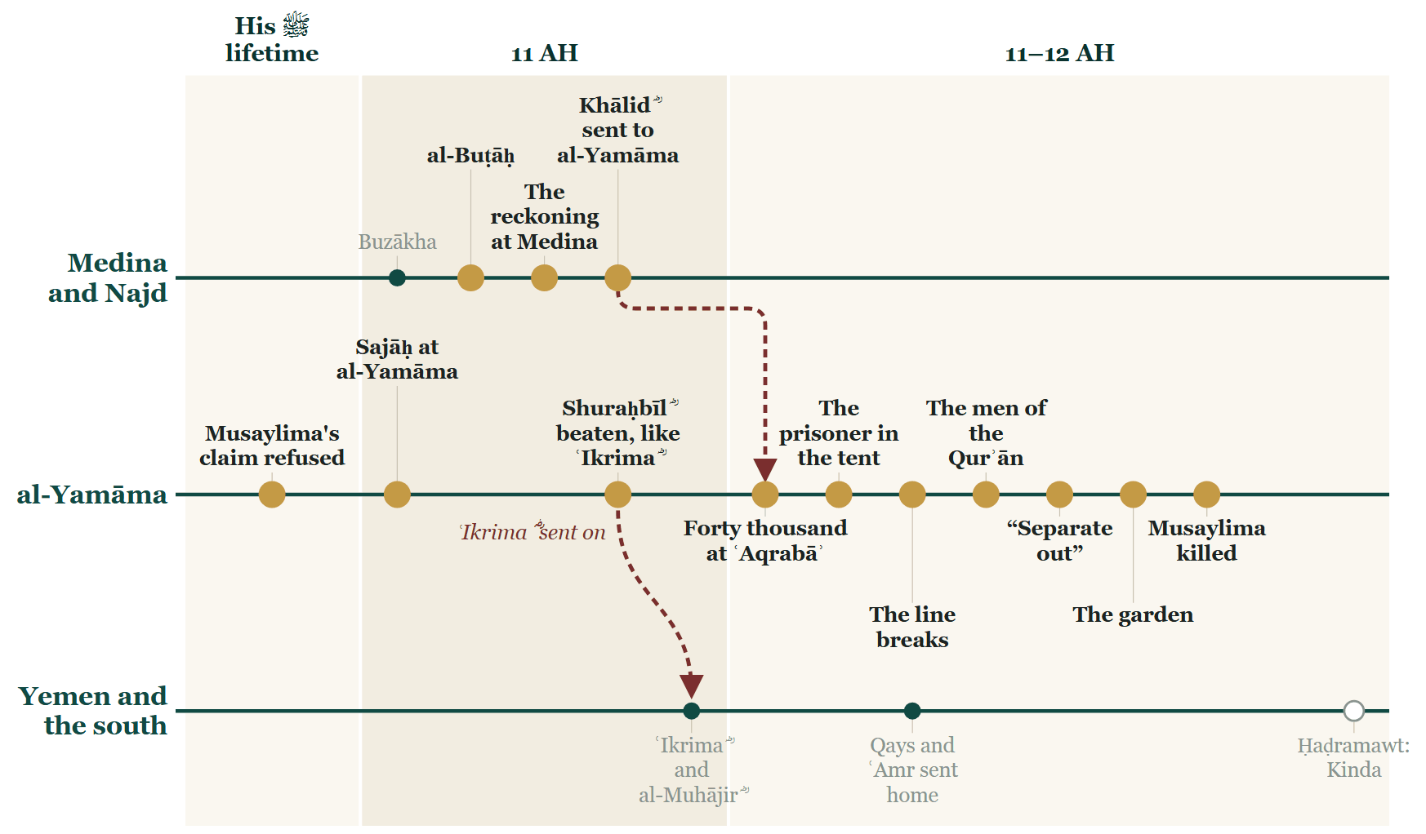
Tonight on the Line

Slide 65
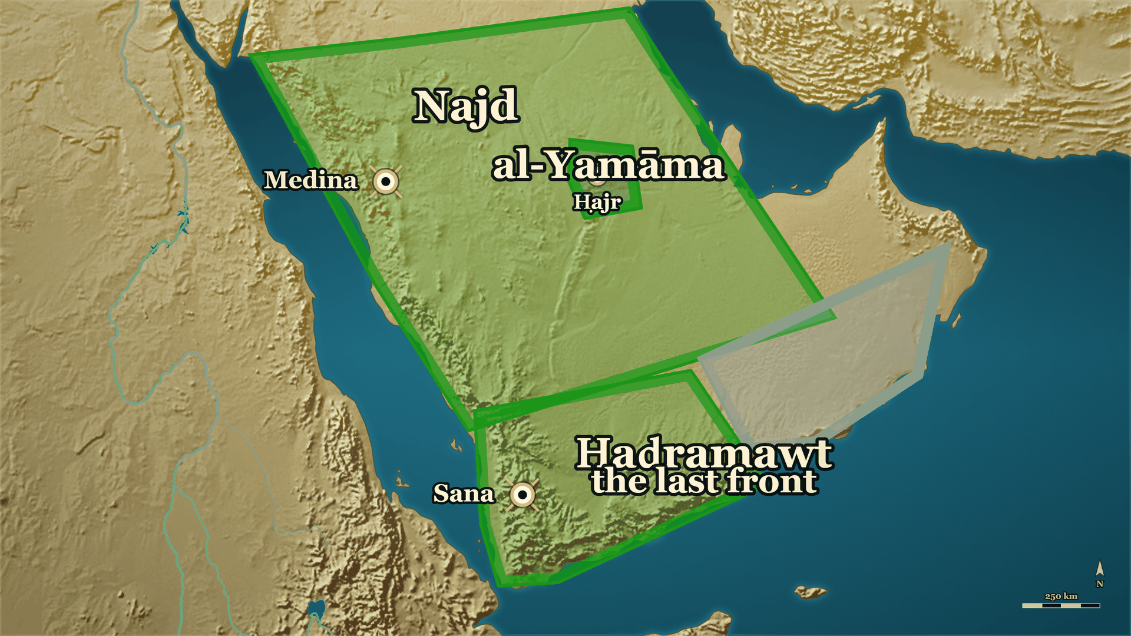
Where we stand
al-Yamāma
taken
Ḥaḍramawt
the last front

Slide 66
Tonight
Al Butah and Khalid R.A
Sajah and Banu Tamim
Musaylima Kazzab and Yamama
The agreement with mujja’a

Slide 67
12 AH, Rabīʿ I
Zayd b. al-Khaṭṭāb ؓ and his brother
وَكَانَ يَقُوْلُ: أَسْلَمَ قَبْلِي، وَاسْتُشْهِدَ قَبْلِي … وَكَانَ يَقُوْلُ: مَا هَبَّتِ الصَّبَا إِلاَّ وَأَنَا أَجِدُ رِيْحَ زَيْدٍ.
"He used to say: He became Muslim before me and was martyred before me … And he used to say: The east wind never blows but I find in it the scent of Zayd."
Siyar A'lam al-Nubala, vol. 1, p. 298

Slide 68
Part VI
The dead of al-Yamāma

Slide 69
12 AH, at al-Yamāma
The banner changed hands
… ثُمَّ قَاتَلَ حَتَّى قُتِلَ، فَوَقَعَتْ الرَّايَةُ، فَأَخَذَهَا سَالِمٌ مَوْلَى أَبِي حُذَيْفَةَ
…and then fought until he was killed. The banner fell — and Sālim, the freedman of Abū Ḥudhayfa, took it up.
Siyar A'lam al-Nubala, vol. 1, p. 298

Slide 70
11–12 AH, ʿAqrabāʾ
The men who did not come back
At the line
All three
Still to tell
Sālim ؓ carried the Muhājirūn's banner; Zayd ؓ and Abū Ḥudhayfa ؓ held the wings
Killed on that field, on the same day
What happened at that banner, and the order it led to at Medina

Slide 71
In the Prophet's ﷺ lifetime
Take the Qurʾān from four
قال فيهم رسول الله ﷺ: "استقرئوا القرآنَ من أربعةٍ" فذكر منهم سالمًا مولى أبي حذيفة
…of whom the Messenger of Allah ﷺ said: 'Take the Qurʾān from four' — and he mentioned Sālim, the freedman of Abū Ḥudhayfa.
al-Bidaya wa'l-Nihaya, vol. 7, p. 50

Slide 72
12 AH, at al-Yamāma
Two men who dug a pit
ما هكذا كنَّا نقاتلُ مع رسول الله ﷺ … فقاتلا حتى قُتلا
This is not how we used to fight alongside the Messenger of Allah ﷺ … and fought until they were killed.
al-Bidaya wa'l-Nihaya, vol. 7, p. 48

Slide 73
12 AH, at al-Yamāma
The hand, and the verse
… فاحتضنها وهو يقول: ﴿وَمَا مُحَمَّدٌ إِلَّا رَسُولٌ قَدْ خَلَتْ مِنْ قَبْلِهِ الرُّسُلُ﴾
…so he clasped it to his chest, saying: ﴾Muḥammad is no more than a Messenger; messengers have passed away before him﴿.
al-Bidaya wa'l-Nihaya, vol. 7, p. 50

Slide 74
12 AH, at al-Yamāma
"Lay me down between them"
ما فعل أبو حُذَيْفة؟ قالوا: قُتل … قال: فأضجعوني بينهما
What has become of Abū Ḥudhayfa? They said: He has been killed … He said: Then lay me down between the two of them.
al-Bidaya wa'l-Nihaya, vol. 7, p. 50

Slide 75
12 AH, after al-Yamāma
It is said they were found together
وَقِيْلَ: إِنَّ سَالِماً وُجِدَ هُوَ وَمَوْلاَهُ أَبُو حُذَيْفَةَ، رَأْسُ أَحَدِهِمَا عِنْدَ رِجْلَي الآخَرِ صَرِيْعَيْنِ
And it is said: Sālim was found, he and his patron Abū Ḥudhayfa, the head of one of them at the feet of the other.
Siyar A'lam al-Nubala, vol. 1, p. 169

Slide 76
23 AH, Medina
"Had Sālim been alive"
قال لما احتُضِر: لو كانَ سالمٌ حيًّا لما جعلتها شُورى
…when death was upon him: Had Sālim been alive I would not have made it a shūrā.
al-Bidaya wa'l-Nihaya, vol. 7, p. 50

Slide 77
After 12 AH
The inheritance that was sent back
وقد بعثَ عمرُ بميراثه إلى مولاته التي أعْتَقَتْه … فردَّتْه وقالتْ: إنّما أعْتَقَتْهُ سائبةٌ
ʿUmar sent his inheritance to the woman who had freed him … and she sent it back and said: I freed him only as sāʾiba.
al-Bidaya wa'l-Nihaya, vol. 7, p. 50

Slide 78
Part VII
Who else was on that field

Slide 79
12 AH, ʿAqrabāʾ
The same field, the men beside them
So far
Now
Why it is told
The banner: Zayd ؓ, then Sālim ؓ, then the pit, then the two found together
The rest of that line — the pairs, the chiefs, the households
The books name them one by one, and so do we

Slide 80
Medina, and 12 AH
Two brothers by appointment
وقد آخى رسول الله ﷺ بينه وبين معن بن عديّ الأنصاري وقد قُتلا جميعًا باليمامة.
"The Messenger of Allah ﷺ made him and Maʿn b. ʿAdī al-Anṣārī brothers, and the two of them were killed together at al-Yamāma."
al-Bidaya wa'l-Nihaya, vol. 7, p. 49

Slide 81
11 AH Medina → 12 AH…
«So that I may confirm him dead»
مَا أُحِبُّ أَنِّي مُتُّ قَبْلَهُ حَتَّى أُصَدِّقَهُ مَيْتاً، كَمَا صَدَّقْتُهُ حَيّاً
…do not wish that I had died before him — so that I may confirm him dead as I confirmed him alive.
Siyar A'lam al-Nubala, vol. 1, p. 321

Slide 82
12 AH, and after it at…
The man who killed Zayd ؓ
وقال لعمر: يا أميرَ المؤمنين إن الله أكرم زيدًا بيدي ولم يُهنِّي على يده.
…said to ʿUmar: Commander of the Faithful — Allah honoured Zayd at my hand, and did not disgrace me at his.
al-Bidaya wa'l-Nihaya, vol. 7, p. 49

Slide 83
12 AH, at al-Yamāma
The arrow he pulled out
فنزعه، وتحزم وأخذ السيف وقاتل حتى قتل، فوجد به جراحات كثيرة.
…he pulled it out, bound himself up, took his sword and fought until he was killed — and many wounds were found on him.
Siyar A'lam al-Nubala, p. 60

Slide 84
12 AH, at al-Yamāma
The son of the head of the hypocrites
وكان أبوه رأسَ المنافقين، وكان أشدَّ الناس على أبيه
His father was the head of the hypocrites, and he was the hardest of all people on his father.
al-Bidaya wa'l-Nihaya, vol. 7, p. 53

Slide 85
12 AH, at al-Yamāma
Three generations, one morning
لا أغيّرُ اسمًا سمانيه أبواي، فلم تزل الحزونة فينا … استُشهد يومَ اليمامة
I will not change a name my parents gave me. So the roughness never left us … He was martyred on the day of al-Yamāma.
al-Bidaya wa'l-Nihaya, vol. 7, p. 49 — the naming report: Sahih al-Bukhari 6190

Slide 86
11–12 AH
The mother at al-Yamāma
أتشهدُ أني رسولُ اللَّه؟ فيقول: لا أسمع
Do you testify that I am the Messenger of Allah? And he would say: I do not hear.
al-Bidaya wa'l-Nihaya, vol. 3, p. 428

Slide 87
12 AH, at al-Yamāma
Her other son, and one of the four names
وَابْنُهَا الآخَرُ عَبْدُ اللهِ بنُ زَيْدٍ المَازِنِيُّ … وَهُوَ الَّذِي قَتَلَ مُسَيْلِمَةَ الكَذَّابَ بِسَيْفِهِ.
Her other son, ʿAbd Allāh b. Zayd al-Māzinī … and he is the one who killed Musaylima the liar with his sword.
Siyar A'lam al-Nubala, vol. 2, p. 282

Slide 88
12 AH, and al-Yarmūk after it
The father at al-Yamāma, the son at al-Yarmūk
بأنه سيقتل ويدفن، وأن ابنه يحرص على الشهادةِ فلا ينالُها عامَه ذلك
…that he would be killed and buried, and that his son would press for martyrdom and not attain it that year.
al-Bidaya wa'l-Nihaya, vol. 7, p. 52

Slide 89
Part VIII
What was left

Slide 90
After the battle
And one man who lived
The garden
He lived
What is left
The man who asked to be thrown over the wall was al-Barāʾ b. Mālik ؓ
Eighty-odd wounds, and Khālid ؓ stayed a month treating them
What was said about him afterwards — and then the count

Slide 91
ʿUmar's ؓ caliphate, 13–23 AH
«Do not put al-Barāʾ over an army»
لاَ تَسْتَعْمِلُوا البَرَاءَ عَلَى جَيْشٍ، فَإِنَّهُ مَهْلَكَةٌ مِنَ المَهَالِكِ يَقْدَمُ بِهِم.
"Do not put al-Barāʾ in command of an army, for he is a destruction among destructions — he presses forward with them."
Siyar A'lam al-Nubala, vol. 1, p. 196

Slide 92
Undated
«Do you see me dying in my bed?»
أَترَانِي أَمُوْتُ عَلَى فِرَاشِي؟ وَاللهِ لَقَدْ قَتَلْتُ بِضْعاً وَتِسْعِيْنَ.
"Do you see me dying in my bed? By Allah, I have killed ninety-odd."
Siyar A'lam al-Nubala, vol. 1, p. 198

Slide 93
12 AH, after the battle
The number nobody can give
وذلك بعد ما استَحَرّ القتلُ في القُرّاء يوم اليمامة كما ثبت به الحديث في صحيح البخاري.
"…and that was after the killing had run hot among the reciters on the day of al-Yamāma, as the ḥadīth in Ṣaḥīḥ al-Bukhārī establishes."
al-Bidaya wa'l-Nihaya, vol. 7, p. 79 — Sahih al-Bukhari 4986

Slide 94
12 AH, Medina
«A thing the Prophet ﷺ did not do»
فَتَتَبَّعِ القُرْآنَ، فَاجْمَعْهُ. فَقُلْتُ: كَيْفَ تَفْعَلُوْنَ شَيْئاً لَمْ يَفْعَلْهُ رَسُوْلُ اللهِ … قَالَ: هُوَ -وَاللهِ- خَيْرٌ.
…so follow the Qurʾān up and gather it. I said: How do you do a thing the Messenger of Allah ﷺ did not do? … He said: By Allah, it is good.
Siyar A'lam al-Nubala, vol. 2, p. 431

Slide 95
12 AH, Medina
The Qurʾān was collected because of this
أمرَ الصديق زيدَ بن ثابتٍ أن يجمعَ القرآن من اللِّخاف والعُسُب وصدور الرجال
…al-Ṣiddīq ordered Zayd b. Thābit to gather the Qurʾān from the flat stones and the palm-stalks and the breasts of men.
al-Bidaya wa'l-Nihaya, vol. 7, p. 79 — Sahih al-Bukhari 4986

Slide 96

Tonight on the Line

Slide 97
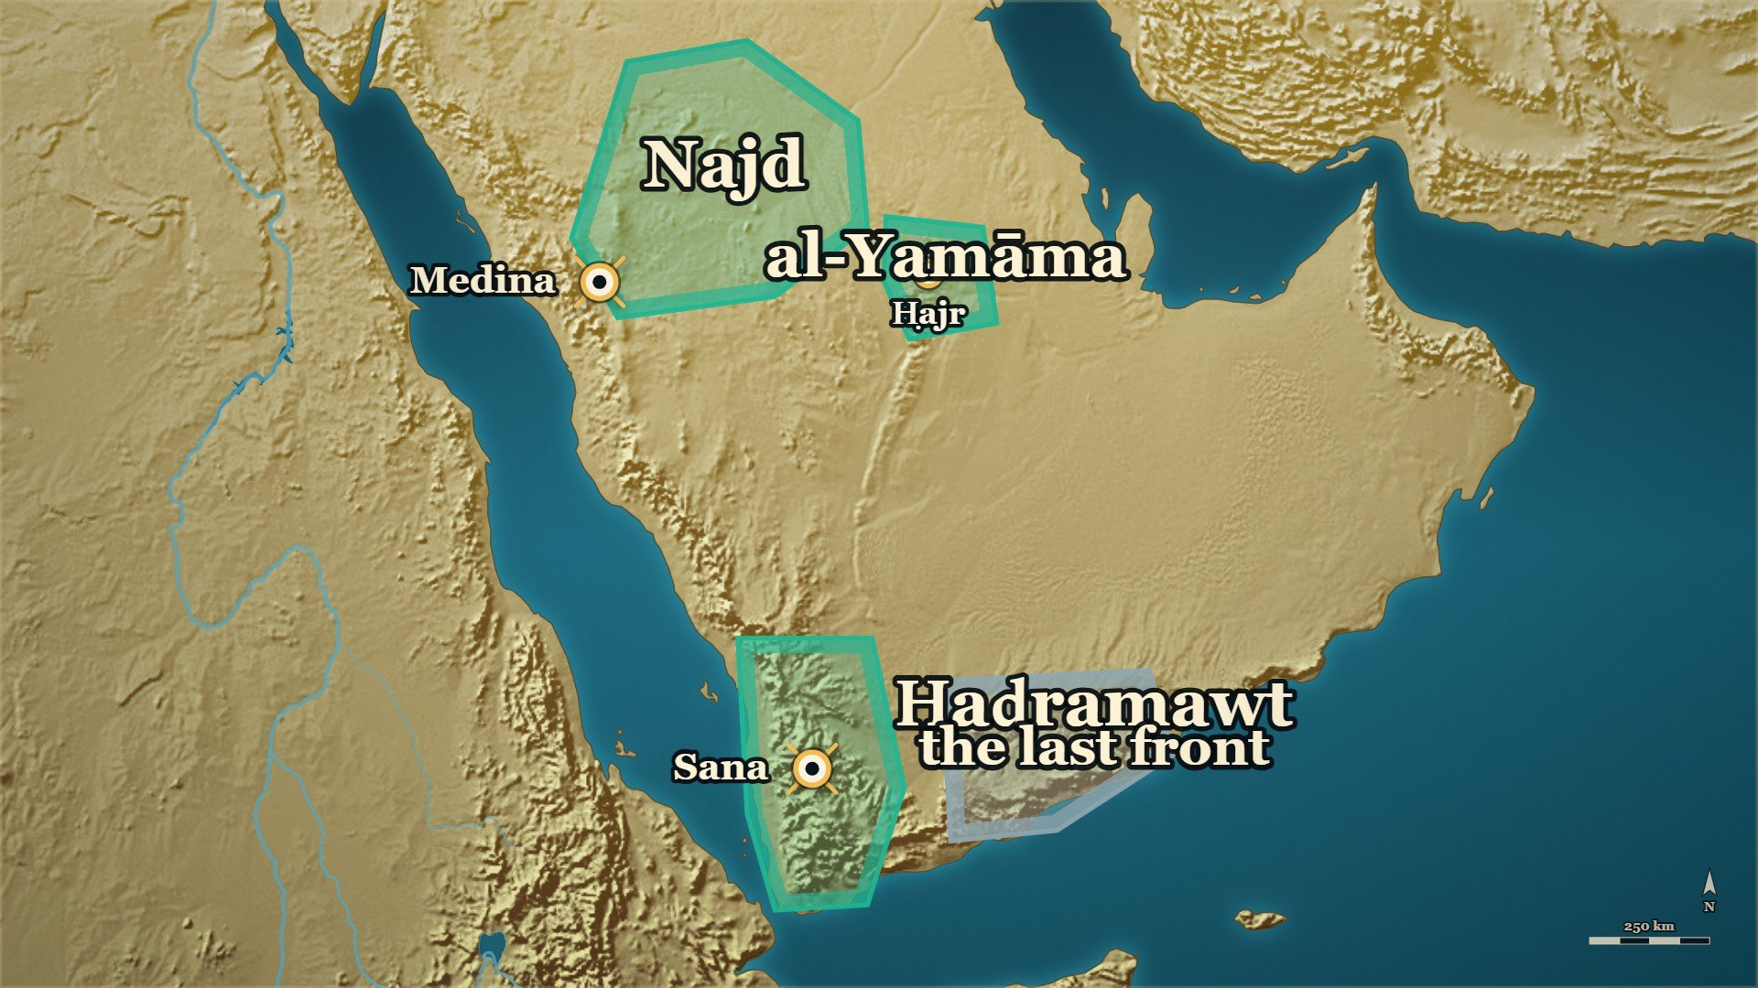
Where we stand
al-Yamāma
taken at last
Ḥaḍramawt
the last front

Slide 98
Tonight
When the line broke, what re-formed it was what the men had memorised.
One man asked to be thrown where nobody could follow him, and the whole army came in behind him through the gate he opened.
The verse that steadied Medina in the year eleven is the verse a man recited on the ground in the year twelve.
The mushaf the room reads from was gathered because of the men who were killed in the garden.

Slide 99
Next week
One province on your map is still grey. The last front of the war is Ḥaḍramawt — and it begins with a quarrel over one she-camel.

Slide 100
Part IX
The house of Umm Sulaym ؓ

Slide 101
Before the Hijra, at Medina
Where these men came from
We have closed
What follows is older
Why
The evening's story ended at Medina, with the order to gather the Qurʾān
Mecca, Uḥud, Biʾr Maʿūna, Ḥunayn — years before tonight
The men who held the line at ʿAqrabāʾ came out of these houses

Slide 102
Before the Hijra, at Medina
The dower that was Islam
وَلَكِنَّكَ كَافِرٌ، فَإِنْ تُسْلِمْ فَذَلِكَ مَهْرِي، لاَ أَسْأَلُكَ غَيْرَهُ.
…but you are a disbeliever. If you accept Islam, that is my dower — I ask you for nothing else.
Siyar A'lam al-Nubala, vol. 2, p. 29

Slide 103
1 AH, soon after the Hijra
The gift she had left
يَا رَسُوْلَ اللهِ! هَذَا أُنَيْسٌ ابْنِي، أَتَيْتُكَ بِهِ يَخْدُمُكَ، فَادْعُ اللهَ لَهُ.
"Messenger of Allah, this is Unays, my son. I have brought him to you to serve you — so pray to Allah for him."
Siyar A'lam al-Nubala, vol. 3, p. 398

Slide 104
1–11 AH
Ten years, and not one rebuke
خدمته صلى الله عليه وسلم عشر سنين، فوالله ما قال لي: أف قط
I served him ﷺ ten years, and by Allah he never said 'uff' to me once.
Siyar A'lam al-Nubala 2, p. 386

Slide 105
Uḥud, 3 AH
«I find the scent of Paradise»
يا أبا عمرو أين؟ واهًا لريح الجنة، أجده دون أحدٍ.
"Abū ʿAmr, where to? Ah, the scent of Paradise — I find it this side of Uḥud."
al-Bidaya wa'l-Nihaya, vol. 4, p. 203

Slide 106
Uḥud, 3 AH
Known by his fingertips
﴿مِنَ الْمُؤْمِنِينَ رِجَالٌ صَدَقُوا مَا عَاهَدُوا اللَّهَ عَلَيْهِ﴾
Among the believers are men true to what they pledged to Allah.
verse as quoted at al-Bidaya wa'l-Nihaya the reference, vol. 4, p. 203

Slide 107
Uḥud, 3 AH
«What will you do with life after him?»
فما تصنعون بالحياة بعده؟! قوموا فموتوا على ما مات عليه رسول اللَّه ﷺ.
"And what will you do with life after him? Rise, and die upon what the Messenger of Allah ﷺ died upon."
al-Bidaya wa'l-Nihaya, vol. 4, p. 207

Slide 108
Uḥud, 3 AH
The water-carriers at Uḥud
لاَ تُشْرِفْ، لاَ يُصِيْبُكَ سَهْمٌ، نَحْرِي دُوْنَ نَحْرِكَ.
…do not look out, lest an arrow strike you. My throat before your throat.
Siyar A'lam al-Nubala, vol. 2, p. 31

Slide 109
Biʾr Maʿūna, 4 AH
«I have won»
اللَّهُ أَكْبَرُ، فُزْتُ وَرَبِّ الكَعْبَةِ.
"Allāhu akbar — I have won, by the Lord of the Kaʿba."
al-Bidaya wa'l-Nihaya, vol. 4, p. 255

Slide 110
After Biʾr Maʿūna, 4 AH
Why he came to that house
إِنِّي أَرْحَمُهَا، قُتِلَ … أَخُوْهَا مَعِي
I have compassion for her — her brother was killed with me.
Siyar A'lam al-Nubala, vol. 2, pp. 306–307

Slide 111
At Medina
«It was a loan»
فَإِنَّ ابْنَكَ كَانَ عَارِيَّةً مِنَ اللهِ، فَقَبَضَهُ.
"Your son was a loan from Allah, and He has taken him back."
Siyar A'lam al-Nubala, vol. 2, p. 310

Slide 112
At Medina
Bayruḥāʾ
إِنَّ أَحَبَّ أَمْوَالِي إِلَيَّ بَيْرُحَاءُ، وَإِنَّهَا صَدَقَةٌ للهِ … فَقَالَ: (بَخٍ! ذَلِكَ مَالٌ رَابِحٌ
The dearest of my property to me is Bayruḥāʾ, and it is a ṣadaqa for Allah … He said: 'Bakhkh! That is profitable property.
Siyar A'lam al-Nubala, vol. 2, p. 33

Slide 113
Ḥunayn, 8 AH
The dagger at Ḥunayn
يَا رَسُوْلَ اللهِ! إِنْ دَنَا مِنِّي مُشْرِكٌ بَقَرْتُ بِهِ بَطْنَهُ.
"Messenger of Allah, if a mushrik comes near me I will open his belly with it."
Siyar A'lam al-Nubala, vol. 2, p. 304

Slide 114
In the Prophet's ﷺ lifetime
Umm Ḥarām and the sea
عُرِضَ عَلَيَّ نَاسٌ مِنْ أُمَّتِي يَرْكَبُوْنَ ظَهْرَ هَذَا البَحْرِ كَالمُلُوْكِ … عَلَى الأَسِرَّةِ
People of my umma were shown to me riding the back of this sea like kings … upon thrones.
Siyar A'lam al-Nubala, vol. 2, pp. 316–317

Slide 115
Tustar, 17–20 AH
The oath at Tustar
اللَّهُمَّ اهْزِمْهُمْ لَنَا وَاسْتَشْهِدْنِي.
…O Allah, defeat them for us, and take me as a martyr.
al-Kamil, vol. 2, p. 368

Slide 116
Tustar, the same morning
The dawn prayer at Tustar
فما صلوا الصبح إلا بعد طلوع الشمس فما أحب أن لي بتلك الصلاة حمرَ النعم.
did not pray Ṣubḥ until after sunrise — and I would not wish red camels in exchange for that prayer.
al-Bidaya wa'l-Nihaya, vol. 7, p. 198

Slide 117
The caliphate of ʿUthmān ؓ
«Equip me»
اسْتَنْفَرَنَا اللهُ وَأَمَرَنَا، شُيُوْخَنَا وَشَبَابَنَا، جَهِّزُوْنِي.
"Allah has called us out and commanded us — our old and our young. Equip me."
Siyar A'lam al-Nubala, vol. 2, p. 34

Slide 118
Part X
Abū Ḥudhayfa ؓ and Sālim ؓ, before the field

Slide 119
Mecca, before the house of al-Arqam
The second house
That was one house
This is another
Where they end
Umm Sulaym's ؓ — Anas ؓ, al-Barāʾ ؓ, and Abū Ṭalḥa ؓ
A chief's son of Quraysh, and a freed slave of Persia
Both of them on the field you have already seen

Slide 120
Mecca, before the house of al-Arqam
The son of the elder of the Jāhiliyya
السَّيِّدُ الكَبِيْرُ، الشَّهِيْدُ، أَبُو حُذَيْفَةَ ابْنُ شَيْخِ الجَاهِلِيَّةِ: عُتْبَةَ بنِ رَبِيْعَةَ … البَدْرِيُّ
The great chief, the martyr, Abū Ḥudhayfa — son of the elder of the Jāhiliyya, ʿUtba b. Rabīʿa — … the man of Badr.
Siyar A'lam al-Nubala, vol. 1, p. 164

Slide 121
Mecca, before the Hijra
The ship they hired for half a dinar
فاستأجروا سفينةً بنصف دينار إلى الحبشة … وأبو حُذيفة بن عتبة، وامرأته سهلة بنت سُهيل
So they hired a ship for half a dinar to Abyssinia … and Abū Ḥudhayfa b. ʿUtba and his wife Sahla bt. Suhayl
al-Bidaya wa'l-Nihaya, vol. 3, p. 281

Slide 122
Before the Hijra
From Iṣṭakhr to the banner of the Muhājirūn
مِنَ السَّابِقِيْنَ الأَوَّلِيْنَ، البَدْرِيِّيْنَ، المُقَرَّبِيْنَ، العَالِمِيْنَ … أَصْلُهُ مِنْ إِصْطَخْرَ
"Of the first forerunners, of the men of Badr, of those brought near, of the learned … his origin is from Iṣṭakhr."
Siyar A'lam al-Nubala, vol. 1, p. 167

Slide 123
Before the Prophet ﷺ reached Medina
The imām at Qubāʾ
فَأَمَّهُم سَالِمٌ مَوْلَى أَبِي حُذَيْفَةَ، لأَنَّهُ كَانَ … أَكْثَرَهُم قُرْآناً، فِيْهِم عُمَرُ
Sālim, the freedman of Abū Ḥudhayfa, led them in prayer, because he had the most Qurʾān of them — among them ʿUmar.
Siyar A'lam al-Nubala, vol. 1, pp. 168–169

Slide 124
Badr, 2 AH
Badr — the father and the brother
فبارز عبيدة، وكان أسنّ القوم، عتبة، وبارز حمزة شيبة، وبارز عليٌّ الوليد بن عتبة
"ʿUbayda — and he was the oldest of them — faced ʿUtba; Ḥamza faced Shayba; and ʿAlī faced al-Walīd b. ʿUtba."
al-Bidaya wa'l-Nihaya, vol. 4, p. 60

Slide 125
Badr, 2 AH
The face the Prophet ﷺ noticed at the well
لعلك قد دخلك من شأن أبيك شيء … ما شككت في أبي ولا في مصرعه
Perhaps something has entered you about the matter of your father? … I have not doubted my father nor where he fell.
Siyar A'lam al-Nubala, p. 312

Slide 126
Badr, 2 AH
The sentence he feared for ten years
ولا أزالُ منها خائفًا إلّا أن تُكفّرها عنّي الشهادةُ، فقُتل يوم اليمامة شهيدًا
…I shall not stop fearing it unless martyrdom wipes it away from me. And he was killed a martyr on the day of al-Yamāma.
al-Bidaya wa'l-Nihaya, vol. 4, p. 77

Slide 127
At Medina
The adoption undone
وقد تَبنّاهُ أبو حُذَيْفة وزوَّجَهُ بابنةِ أخيه … فلما أنزل الله ﴿ادْعُوهُمْ لِآبَائِهِمْ﴾
Abū Ḥudhayfa had adopted him and married him to his brother's daughter … Then Allah sent down: ﴾Call them by their fathers﴿.
al-Bidaya wa'l-Nihaya, vol. 7, p. 50

Slide 128
At Medina
He took his cloak and went out to listen
فَإِذَا هُوَ سَالِمٌ مَوْلَى أَبِي حُذَيْفَةَ … (الحَمْدُ لِلِّهِ الَّذِي جَعَلَ فِي أُمَّتِي مِثْلَكَ)
…and it was Sālim, the freedman of Abū Ḥudhayfa … 'Praise be to Allah, who has put the like of you in my ummah.'
Siyar A'lam al-Nubala, vol. 1, p. 168

Slide 129
Part XI
Thābit b. Qays ؓ, before al-Yamāma

Slide 130
Medina, after al-Ḥujurāt
«Are you not content to live praised?»
فَقَالَ: (يَا ثَابِتُ! أَمَا تَرْضَى أَنْ تَعِيْشَ حَمِيْداً، وَتُقْتَلَ شَهِيْداً، وَتَدْخُلَ الجَنَّةَ)
"He said: Thābit — are you not content to live praised, to be killed a martyr, and to enter the Garden?"
Siyar A'lam al-Nubala, vol. 1, p. 310

