Slide 1
Armeta AI
Serikov Daniyar

Slide 2
Methodology
📄 PDF Upload
↓
🖥️ Streamlit (app.py)
↓
🔧 detectors.py
• Convert PDF → images
• YOLO detects qr/seal/sign
• Draw colored boxes
↓
🖼️ Annotated pages + detection data
↓
📑 app.py creates annotated PDF
↓
⬇️ User downloads:
- 🟩 <file>_annotated.pdf
- 🟦 <file>_detections.json

Slide 3
Methodology
📥 Collect datasets (Roboflow)
↓
🖊️ Annotate / augment datasets
↓
🤖 Train YOLOv8s on multiple dataset variants
↓
💾 Save weights for each model
↓
🔎 Run inference tests on real document samples
↓
🏆 Select the model that detects ALL:
- QR codes
- Seals
- Signatures
↓
🔧 Integrate final model into Streamlit application

Slide 4
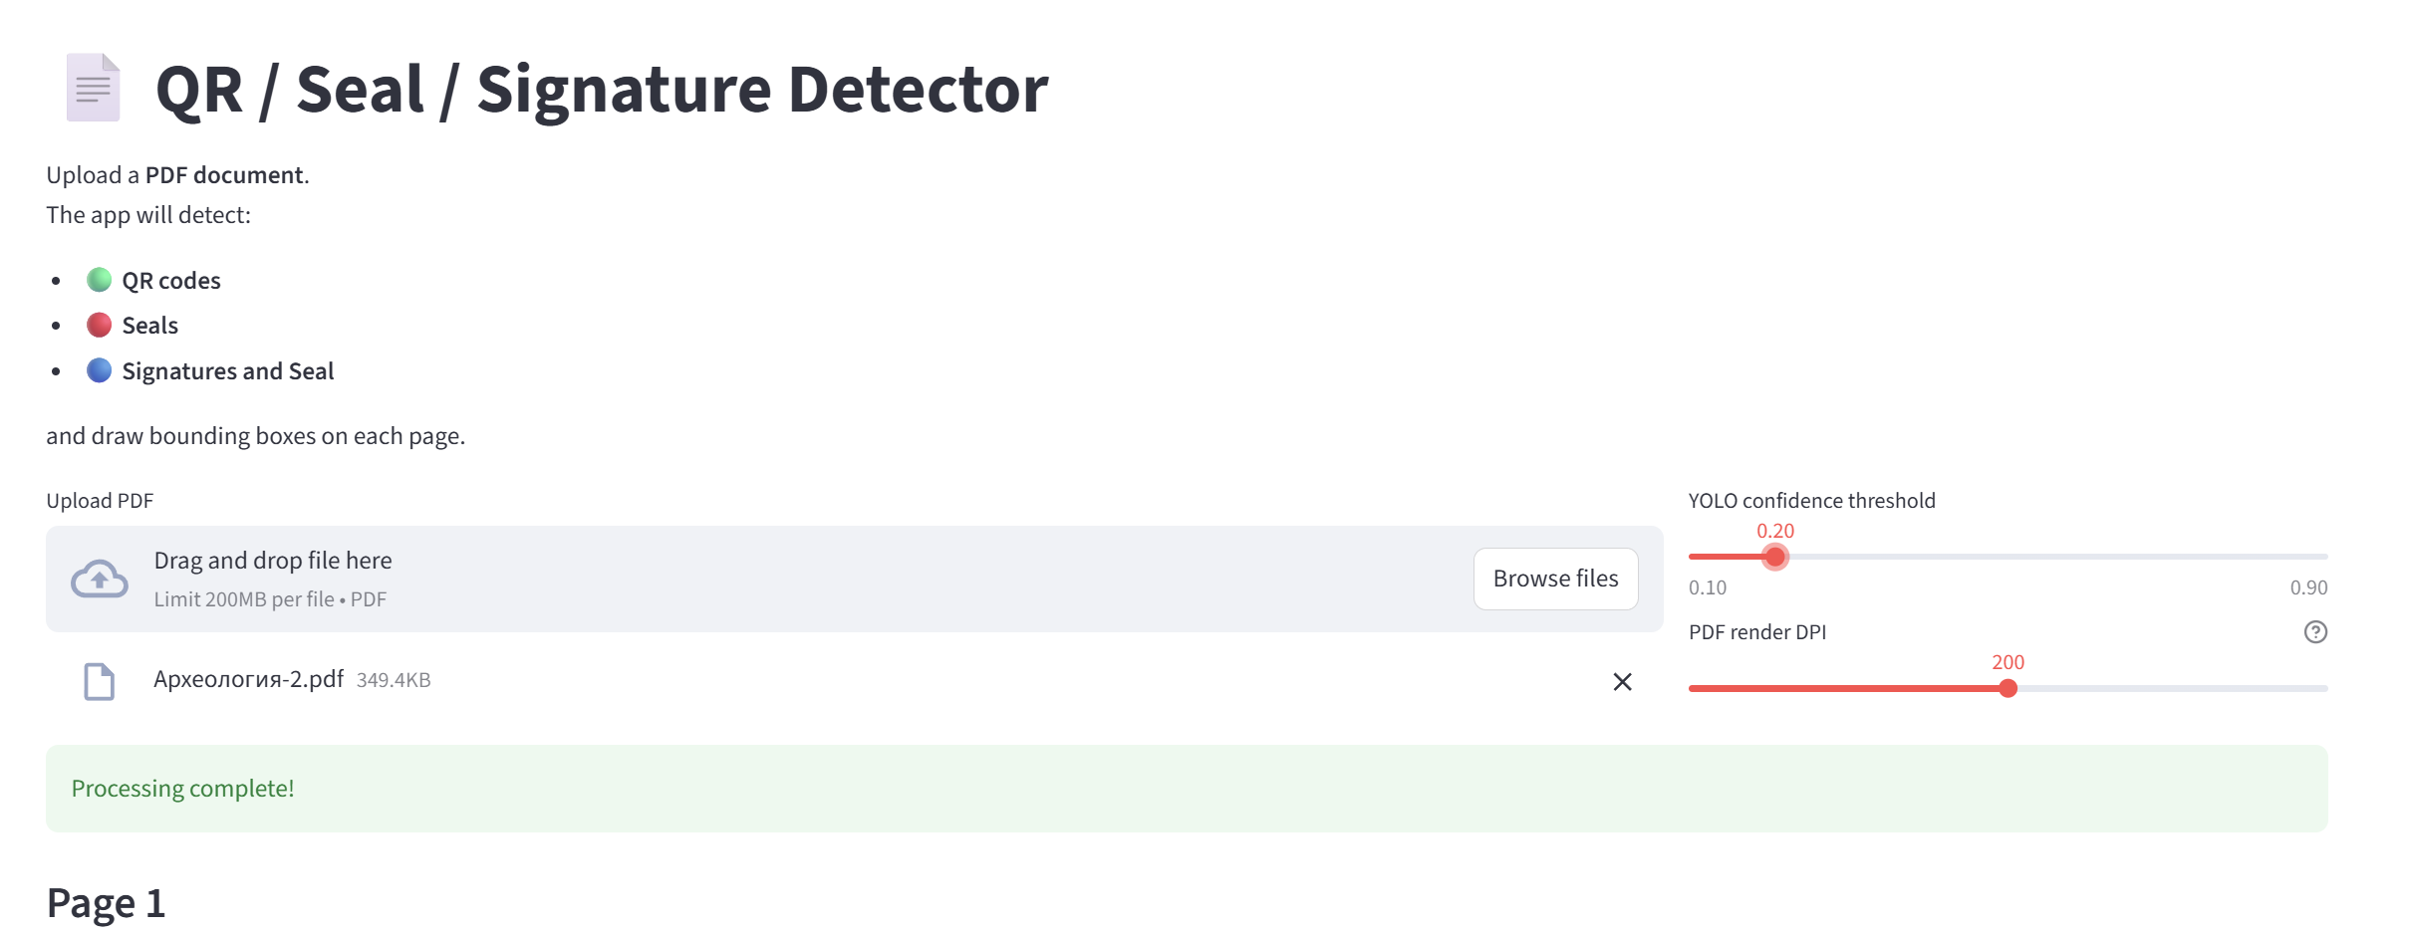
Results

Slide 5
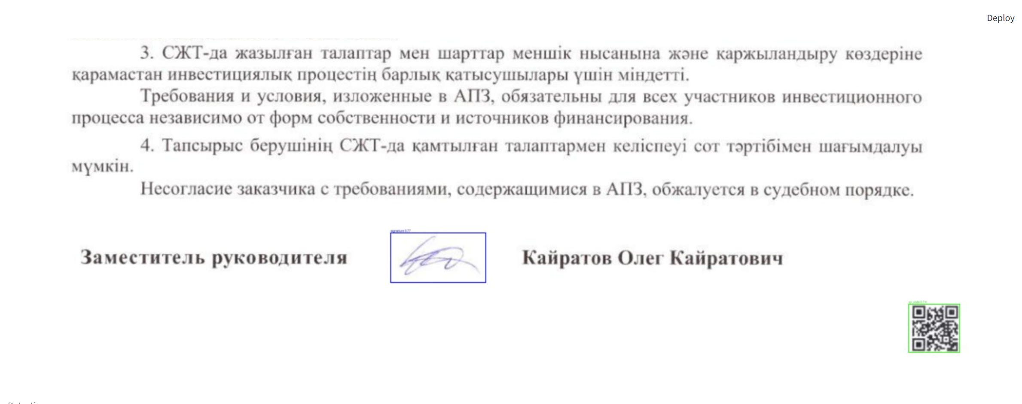
Results

Slide 6
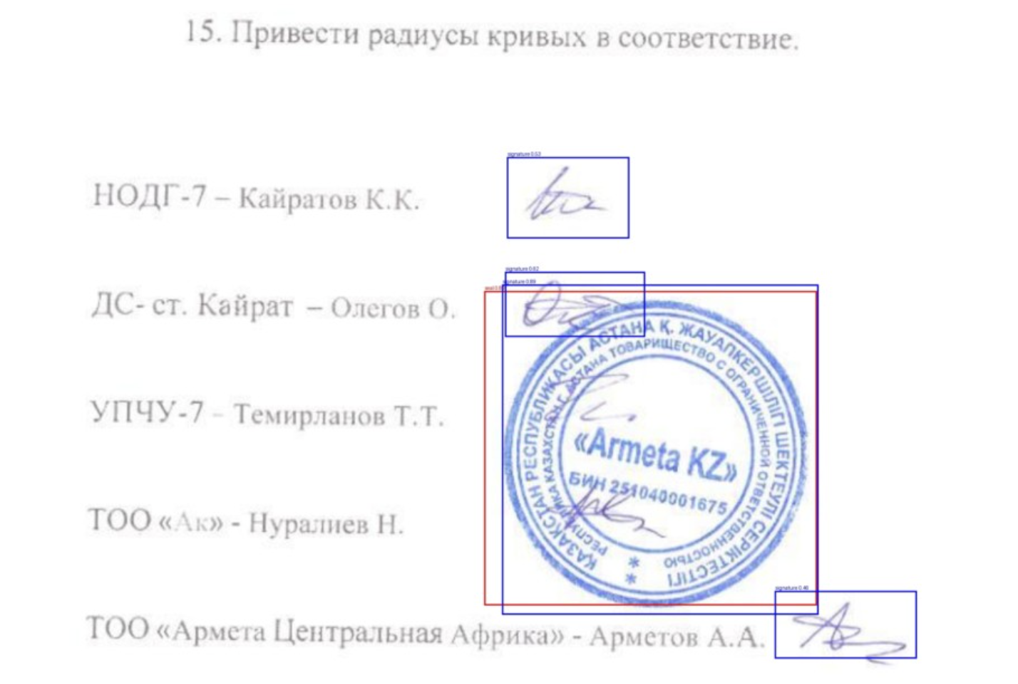
Results

Slide 7
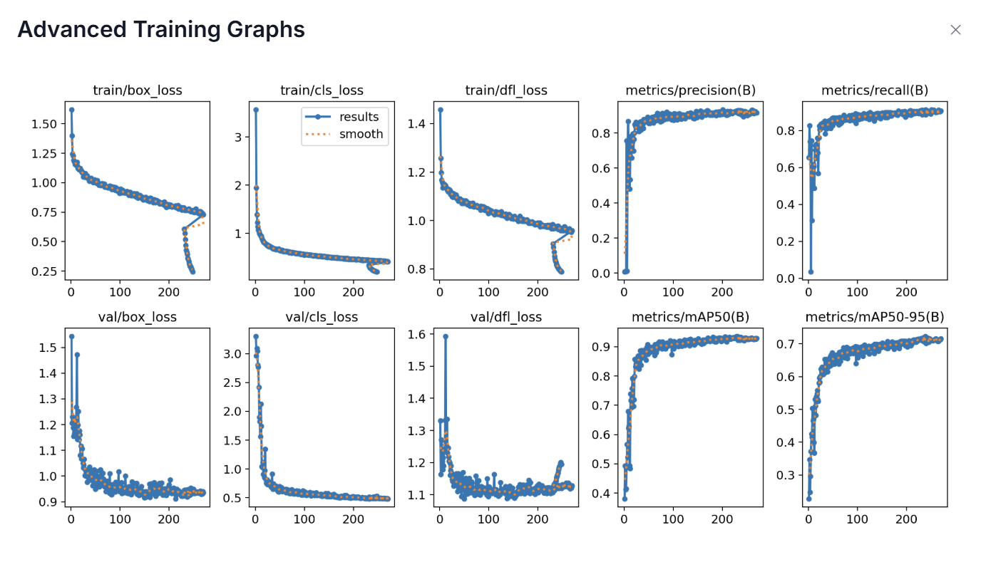
Seals and Stamps training results

Slide 8
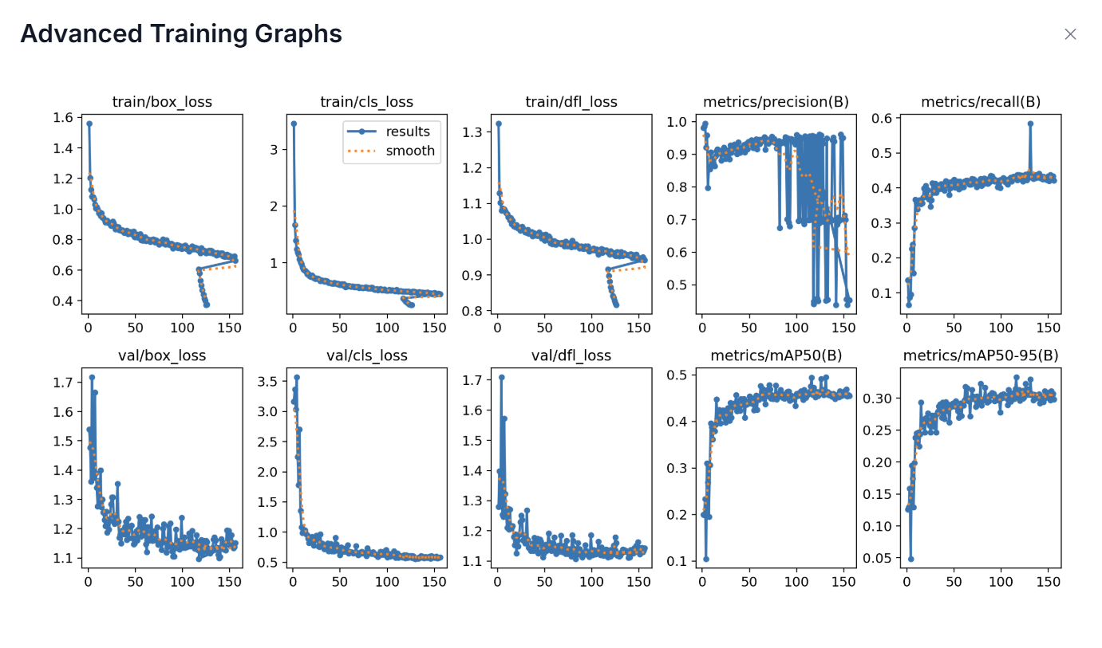
Signatures Training Results

