Slide 1
Centralized news and article reader of KazNet
for android with universal parsing algorithm
AQPARAT
Daniyar Mukhanov 4EN A-04
Faculty of Engineering and Natural Sciences, SDU
Year 2015

Slide 2

General Information about diploma thesis: Application that allows people to read all popular news sites in one place.
Aim: To create convenient product that can be used by people who are interested in Kazakhstan’s mass media
-pure articles
-no comments
-no ads
-no distractive elements of site

Slide 3
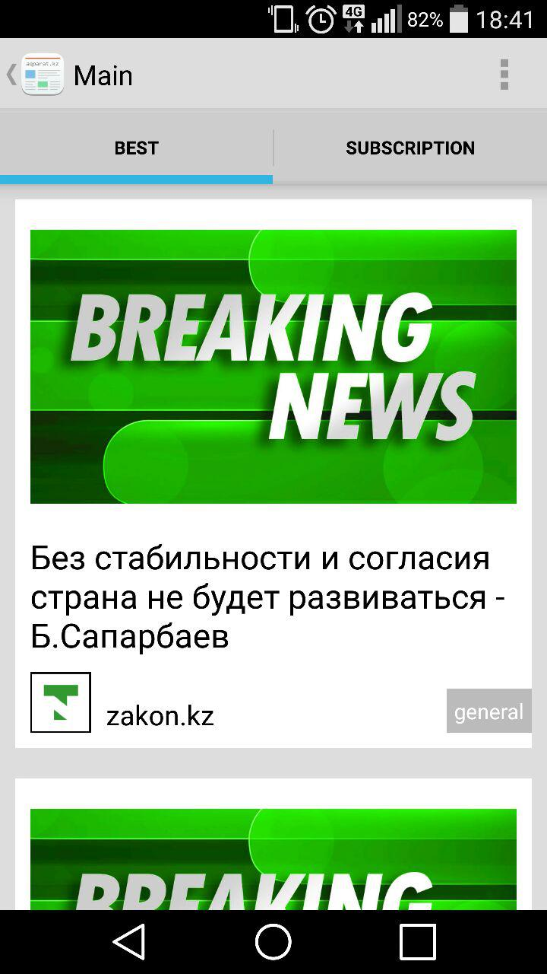
General architecture
Web sites
RSS
REST
HTTP request
Mobile app
virtual server (Ubuntu 14.04)
Apache server
Java application
MySQL Database

Slide 4
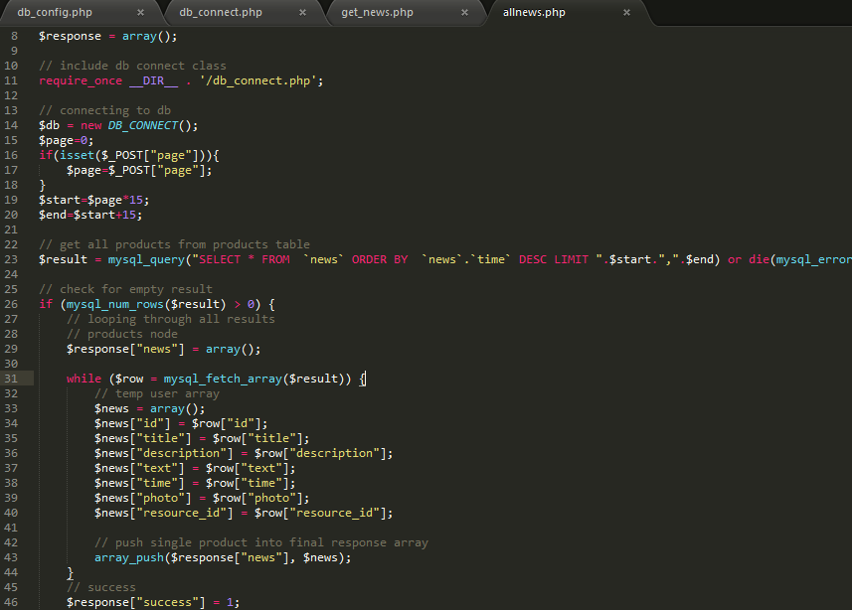
Apache server
- code implemented in PHP language
- used as API
- returns data in JSON format

Slide 5
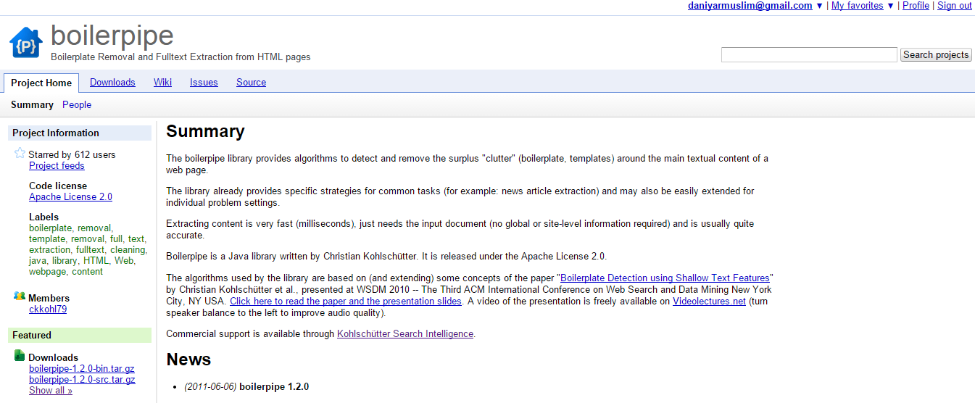
Java application
Parses RSS feeds
Inserts respective data properly to database
Extracts clean text from url using “Boilerpipe” algorithm
https://code.google.com/p/boilerpipe/wiki/QuickStart

Slide 6
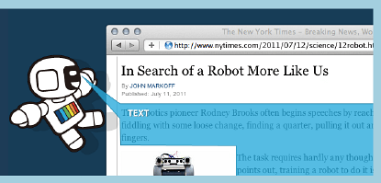
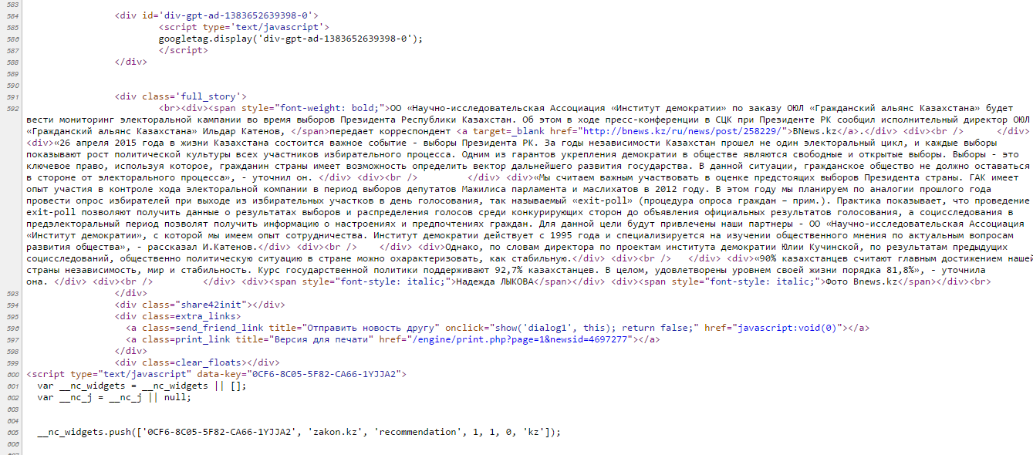
Function of “Boilerpipe” algorithm

Slide 7
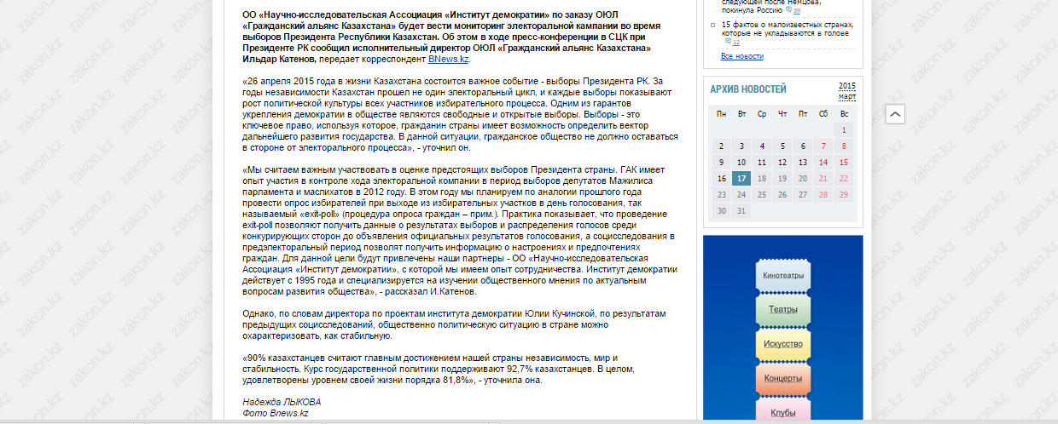
Function of “Boilerpipe” algorithm
URL url = new URL("http://www.zakon.kz/4697277-kazakhstanskijj-institut-demokratii.html");
String text = ArticleExtractor.INSTANCE.getText(url);
String text=

Slide 8
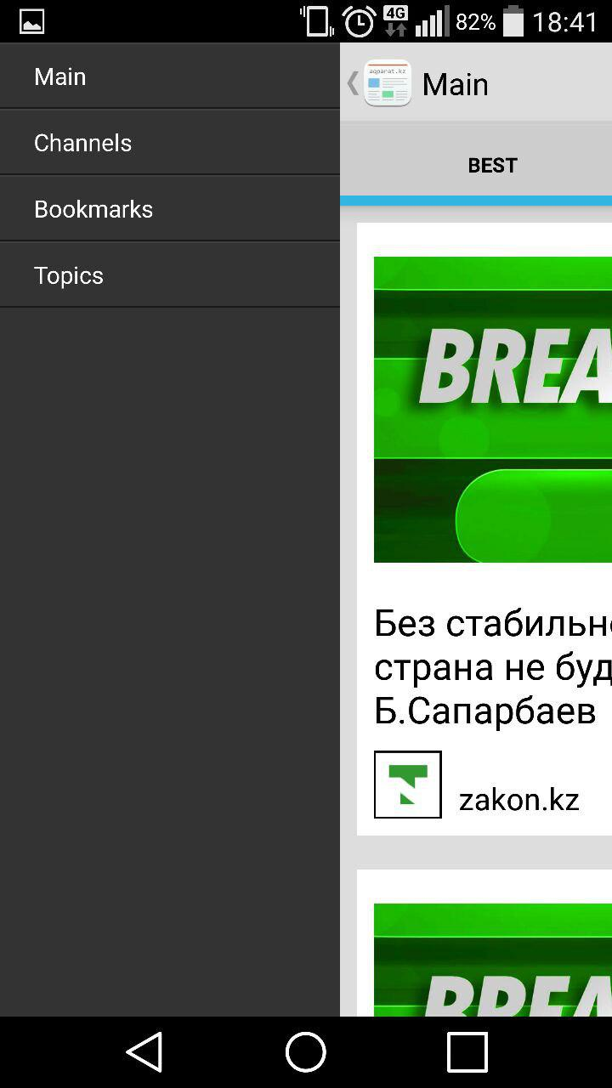
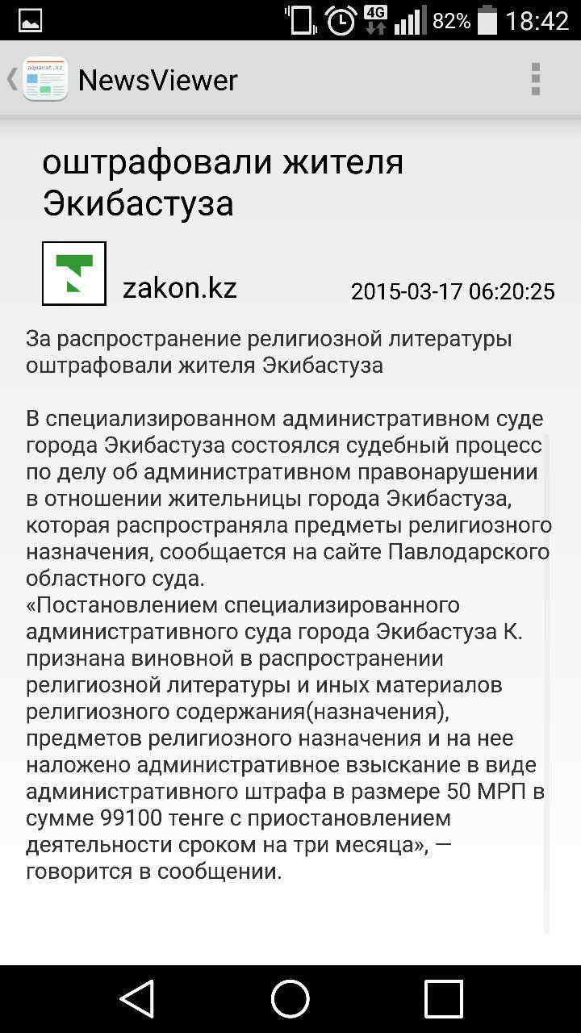
Mobile app

Slide 9
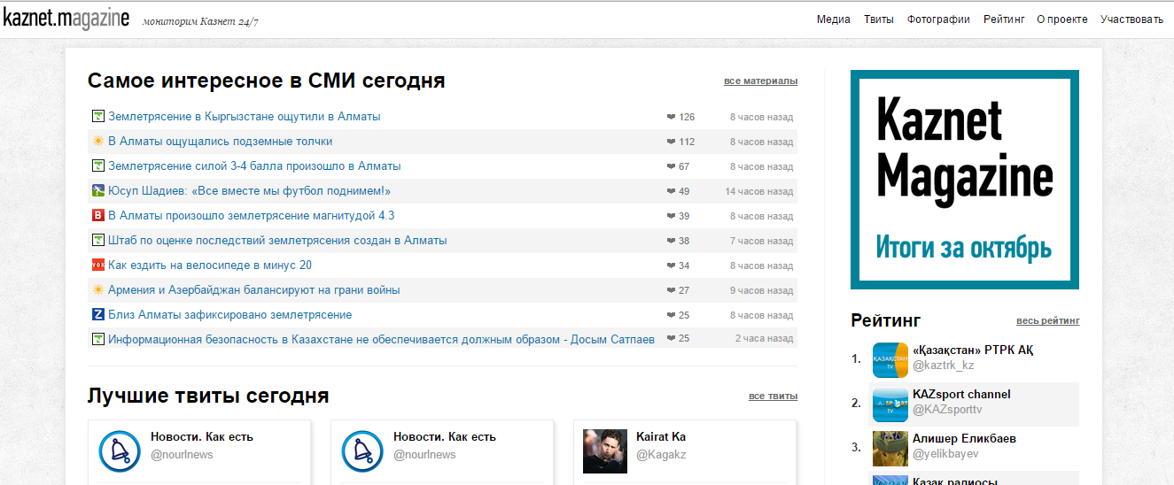
Mobile app
Source for “best news for today” tab
http://kaznet.me/

Slide 10
Use cases
Choose channels to subscribe
user
Choose topics to subscribe
Bookmark to offline reading
View main news feed

Slide 11
Screen flow of Mobile app
sidebar
Main
Channels
Review
Options
News viewer
List of news from channel
List of bookmarked news
News viewer
News viewer
List of news by interest
News viewer
Terms and conditions
Mini view

Slide 12

Joint research
Surfing KazNet
Asking permissions from news sites
Categorizing sites by topics
Identifying popular resources
Research on how actual is mobile media

