Slide 1

Final Project “Software Requirements Specification Development” for discipline “Fundamentals of Information Systems” “Personal Task Management Software”
International Information Technology University JSC
Faculty of Information Technology
Department of Information Systems
Authors: Daniyaruly Danial,
Zhumagulov Temirlan
Group: IT1-2017
Head: Tyan Alexandra Vladimirovna
Almaty, 2022

Slide 2


Relevance of the chosen theme
We are seeing an increasing percentage of people starting to feel overworked.
The traditional method of using a notepad with a pen is beginning to lose its former effectiveness.
The development of PTMS will help with the automation of many processes, while gamification of the system will increase the involvement, motivation and efficiency of the user.

Slide 3
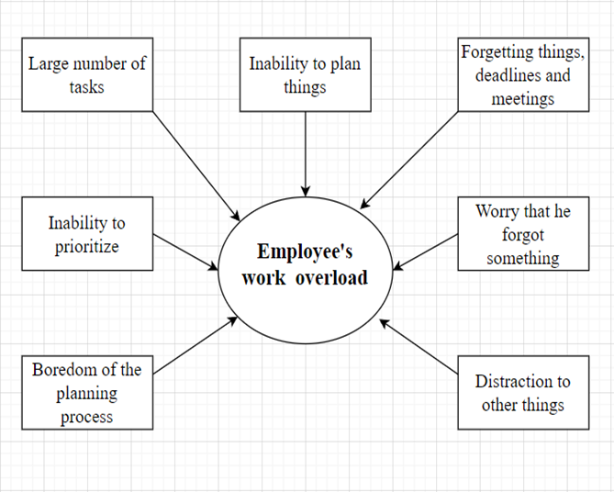
Problem and the idea of work
IDEA:
Automation of the planning process to simplify it and increase user interest through gamification.

Slide 4
Purpose of the work
Development of PTMS in order to solve the problem of overload from work through simplifying the processes of planning and gamification of the system.
A distinctive feature of the software application is an increase in engagement, motivation, and, as a result, productivity with the help of gamification elements.

Slide 5
Objectives and development
Analysis
Design
Development
Testing & Debugging
Deployment
Maintenance & Promotion

Slide 6
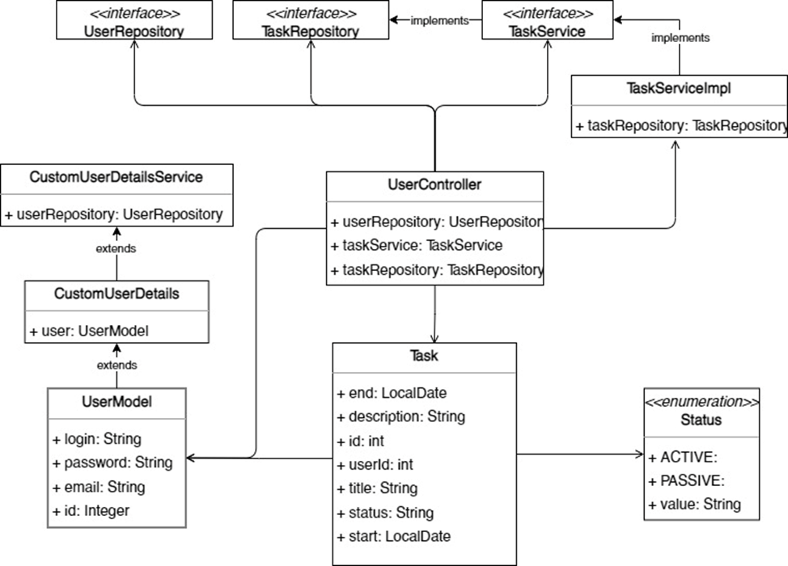
Model Information System
Unified Modeling Language

Slide 7
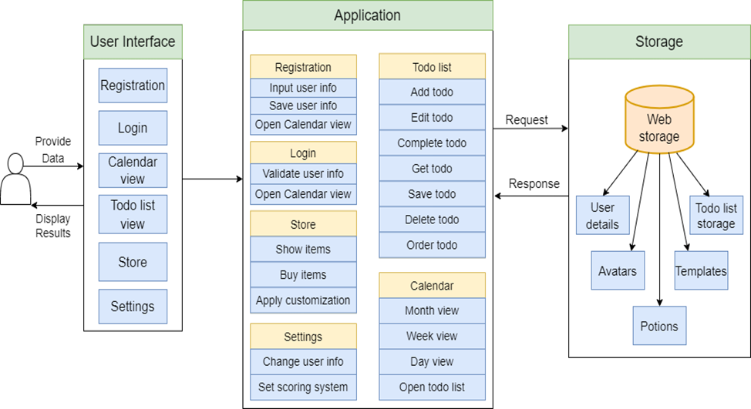
Characteristics and capabilities of IS

Slide 8
Main procedures, functions or subroutines
Show user details (username, email, password).
Show user progress (points, completed tasks, uncompleted tasks).
Change user details (username, email, password).
Change requirements for tasks and points.
Show to-dos (name, description, date, priority).
Create and Save to-do.
Delete to-do.
Edit to-do.
Make to-do completed or uncompleted.
Order to-dos by priority or date.
Show to-dos on calendar.

Slide 9
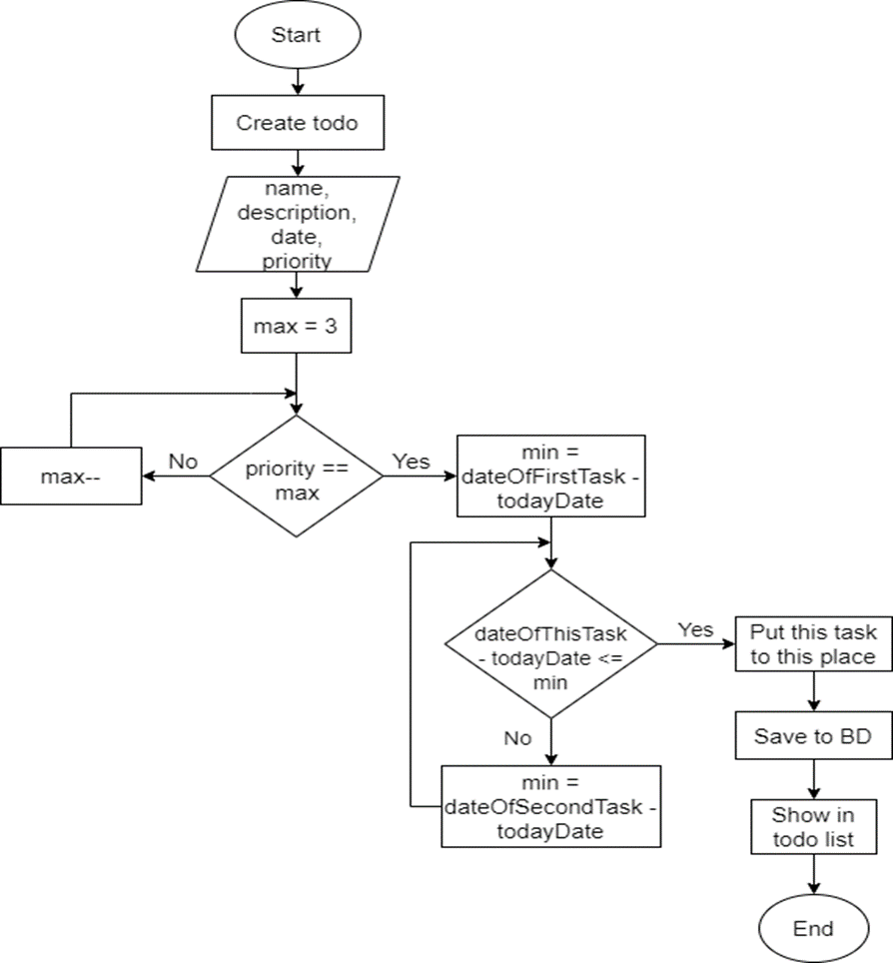
The algorithm of the main unit

Slide 10
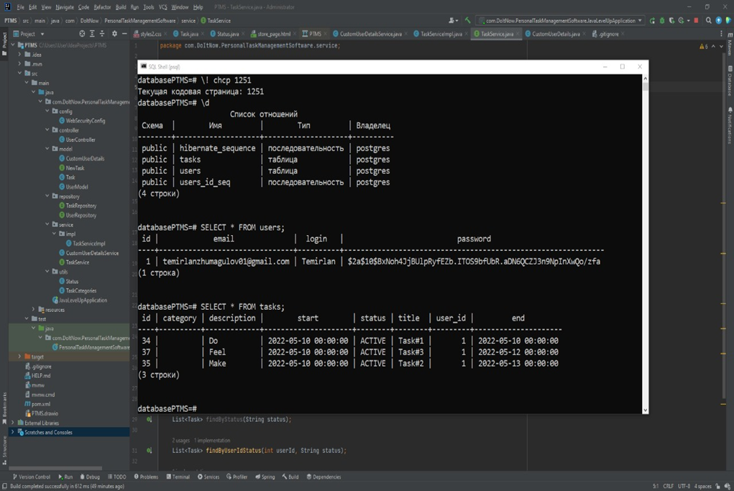
Screenshots

Slide 11
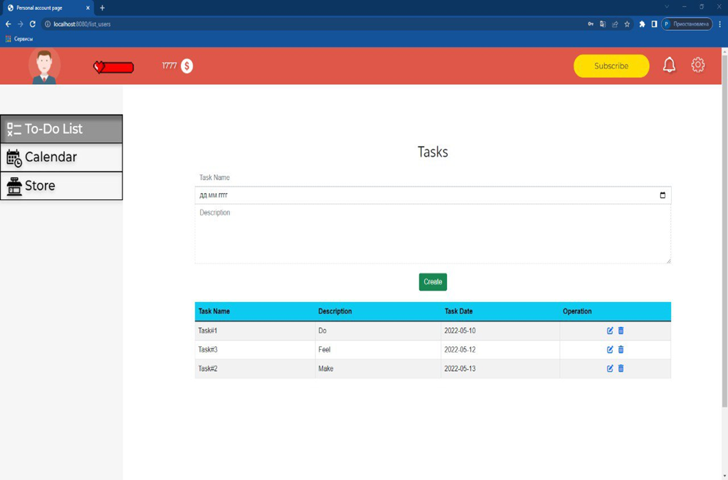
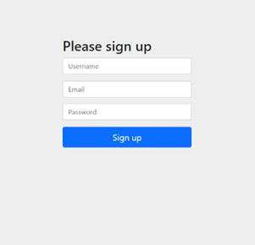
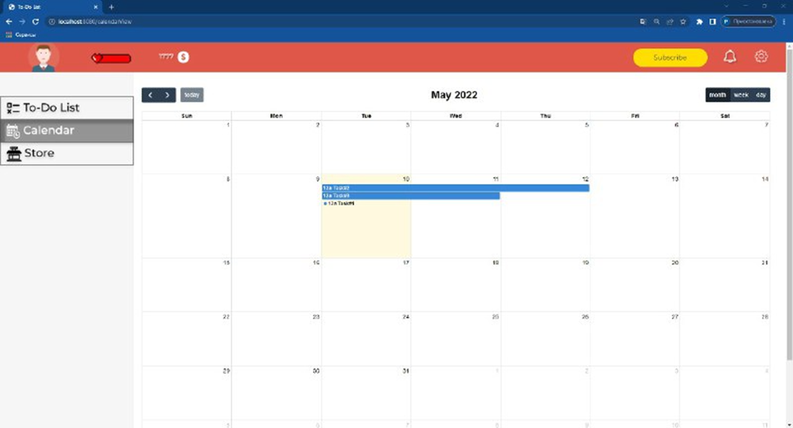
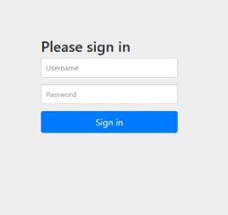

Slide 12
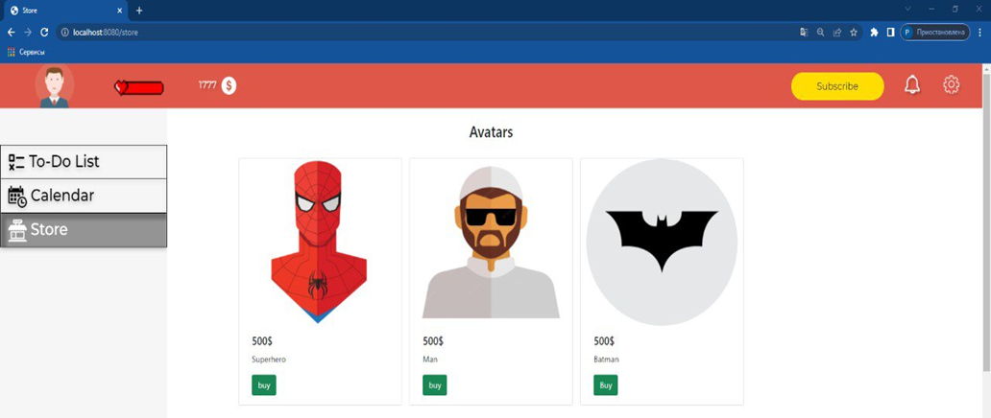
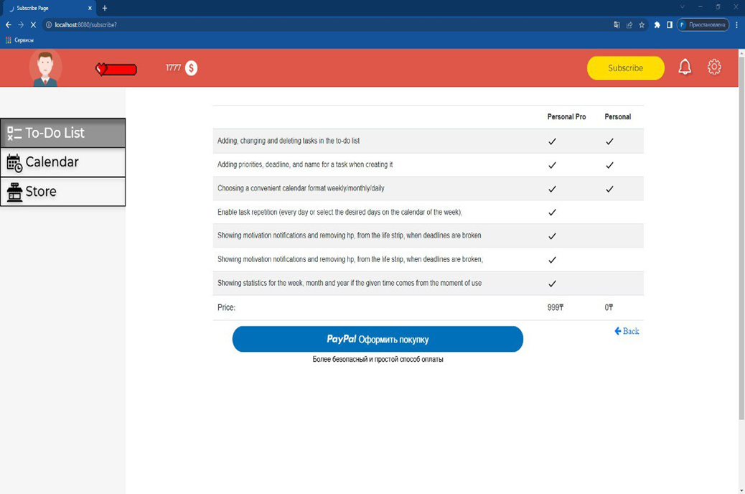
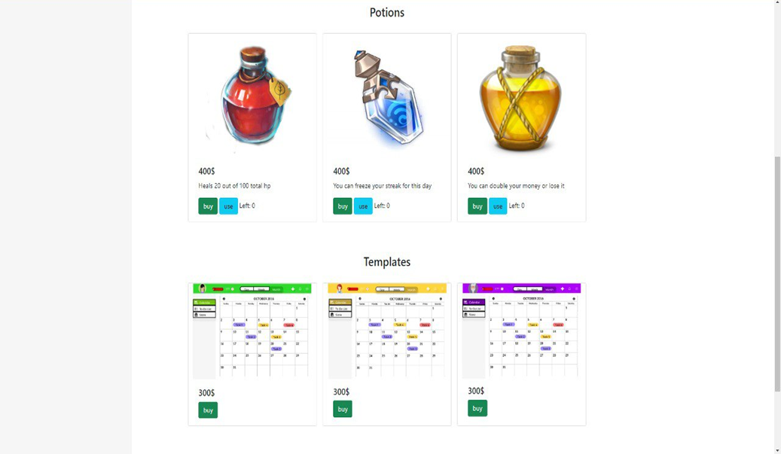
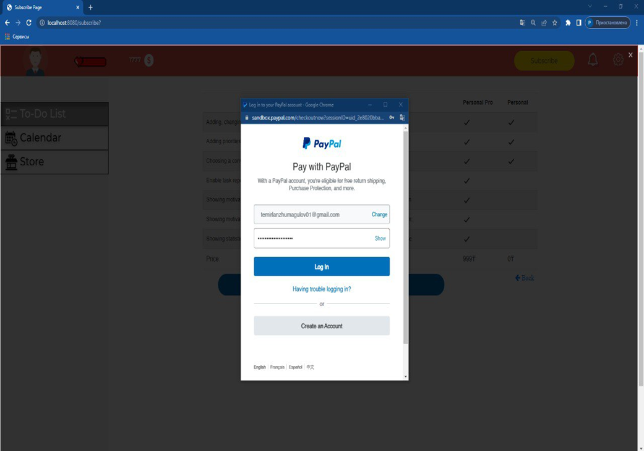

Slide 13
Description of special features of IS
Simplicity: Most similar applications are a bit difficult to use due to the large number of functions and details, which is why we decided to make the program minimalistic on the contrary.
Gamification: The planning process itself is boring for many people and after several times using the application they become too lazy to use the application. Therefore, adding elements of the game will increase interest.

Slide 14
Advantages and disadvantages
Advantages:
Simplicity
Gamification
Easy to use
Faster than using notepad with pan
Realistic system of rewards and penalties
Customization
Disadvantages:
Slow operation of the site at a large number of requests
Possible glitches when synchronizing the calendar with created tasks
Perhaps the database will weigh a lot due to the constantly increasing data
The risk of data leak

Slide 15
Practical value/Scope
As a product: in personal life.
As a system: in work, in education system.
Wherever there is a need for planning.
It should be remembered that this system is for individual use and there is no functionality for collaboration.

Slide 16
THANK YOU FOR YOUR ATTENTION!

