Slide 1
COG-BCI dataset
ERP analysis on the two-back test from 3 subjects
Portable, multimodal cognitive dataset recorded during a visual TWOBACK task.
Current processed EEG subset: 3 participants (files: sub-01_ses-01, sub-03_ses-01, sub-04_ses-01) plus a created grand_avg_all for QA. Subject 2 had a lot of noisy data.
Pipeline exported ERPs for 10 bins (task events); primary stimulus bins used here are B5 (6221) - Normal Trial Onset, B6 (6222) - Hit Trial Onset.
EEG montage: 62 channels (variable across recordings; channels aligned where possible for grand-average).
Trial counts:
A strict rule was applied: MIN_TRIALS ≥ 30 per condition.
After filtering, only Hit and Normal had ≥ 3 subjects with sufficient trials at Pz.
Other bins (CorrectResp, ConflictErr) had too few usable trials.
The Preprocessing and Visualization were done on EEGLAB and ERPLAB. Tests and Statistics were done on Python.
KBTU Student: Daniyaruly Danial

Slide 2
Preprocessing steps
Downsample to 250 Hz
1 Hz high-pass filter (removes slow drift)
CleanLine 50 Hz (line noise removal)
Automatic bad-channel detection (2-SD threshold) + interpolation
ICA decomposition (runica extended)
ICLabel auto-removal of artifacts
  Remove Eye / Muscle / Heart components with prob ≥ 0.90
Epoching: −200 to 800 ms around stimulus
Baseline correction: −200 to 0 ms
Artifact rejection:
  ±100 µV peak amplitude cutoff
  Moving-window (200 ms width, 50 ms step)
MIN_TRIALS ≥ 30 for condition inclusion
Output: subject ERPs, grand averages, peak tables, and plots
P300 window: 250-500 ms

Slide 3
BIN description
bin 1 - TWOBACK_Start_End - .{620}
bin 2 - TWOBACK_End - .{621}
bin 3 - TWOBACK_Block_Start - .{6211}
bin 4 - TWOBACK_Block_End - .{6212}
bin 5 - TWOBACK_Normal_Trial_Onset - .{6221}
bin 6 - TWOBACK_Hit_Trial_Onset - .{6222}
bin 7 - TWOBACK_Conflict_Trial_Onset - .{6223}
bin 8 - TWOBACK_Error_Response - .{6231}
bin 9 - TWOBACK_Correct_Response - .{6232}
bin 10 - TWOBACK_Conflict_Error - .{6233}

Slide 4
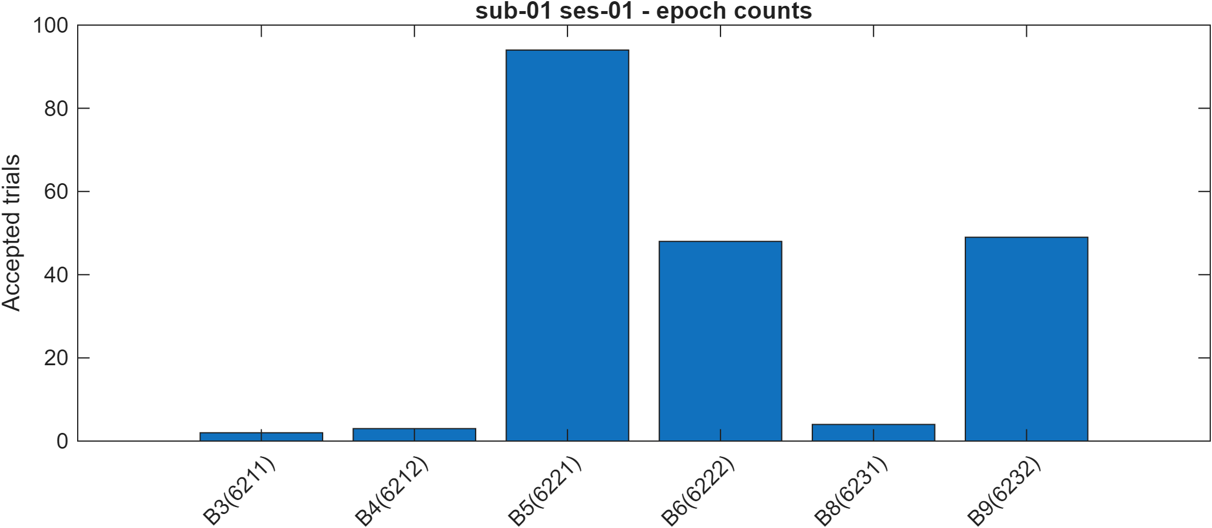
Subject 1
Excluded non-EEG channels for ICA/bad-channel detection: ECG1
Auto-detected 2 bad channels by 2-SD rule: P8, TP8
Interpolated 2 channels and restored to scalp montage
ICA finished: 59 components
Removed 8 ICs: [1 3 4 5 8 29 31 54]
Saved per-bin trial counts CSV (10 bins).
Counts: [0 0 2 3 94 48 0 3 49 13]
Bins passing threshold: [5 6 9]

Slide 5
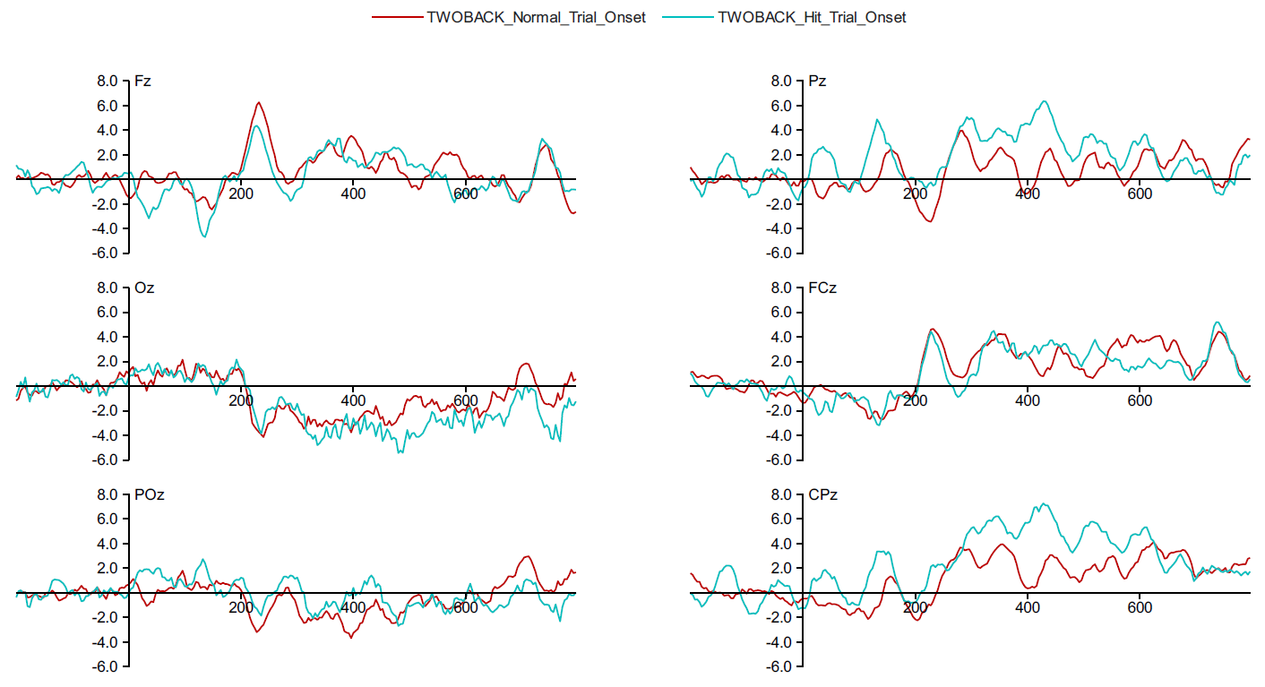
Subject 1

Slide 6
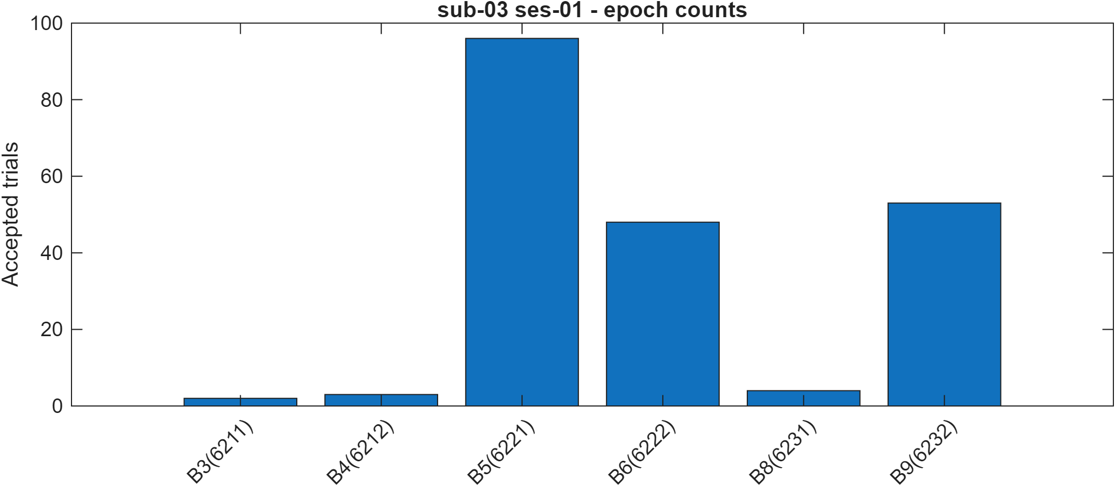
Subject 3
Excluded non-EEG channels for ICA/bad-channel detection: ECG1
Auto-detected 3 bad channels by 2-SD rule: Fp1, T7, AF8
Interpolated 3 channels and restored to scalp montage
ICA finished: 58 components
Removed 9 ICs: [2 5 8 12 16 17 18 23 29]
Saved per-bin trial counts CSV (10 bins).
Counts: [0 0 2 3 96 48 0 3 51 13]
Bins passing threshold: [5 6 9]

Slide 7
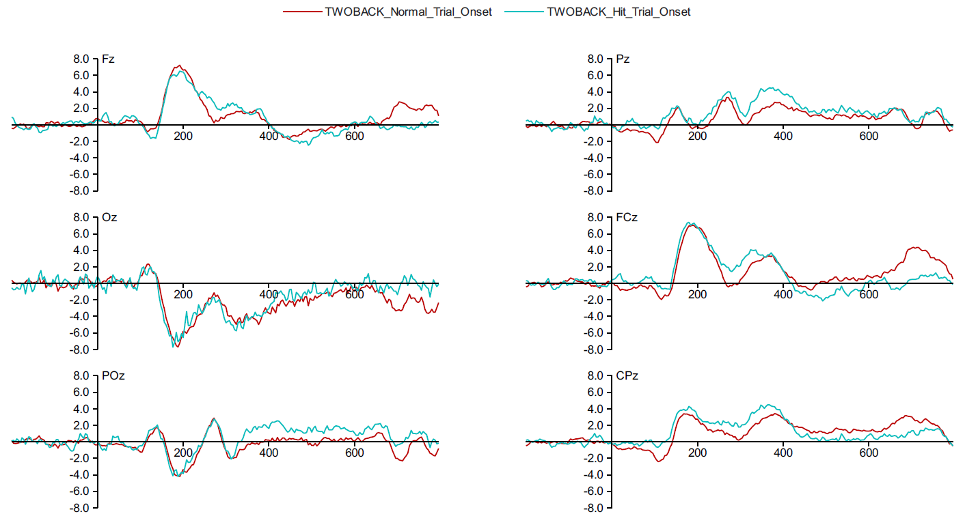
Subject 3

Slide 8
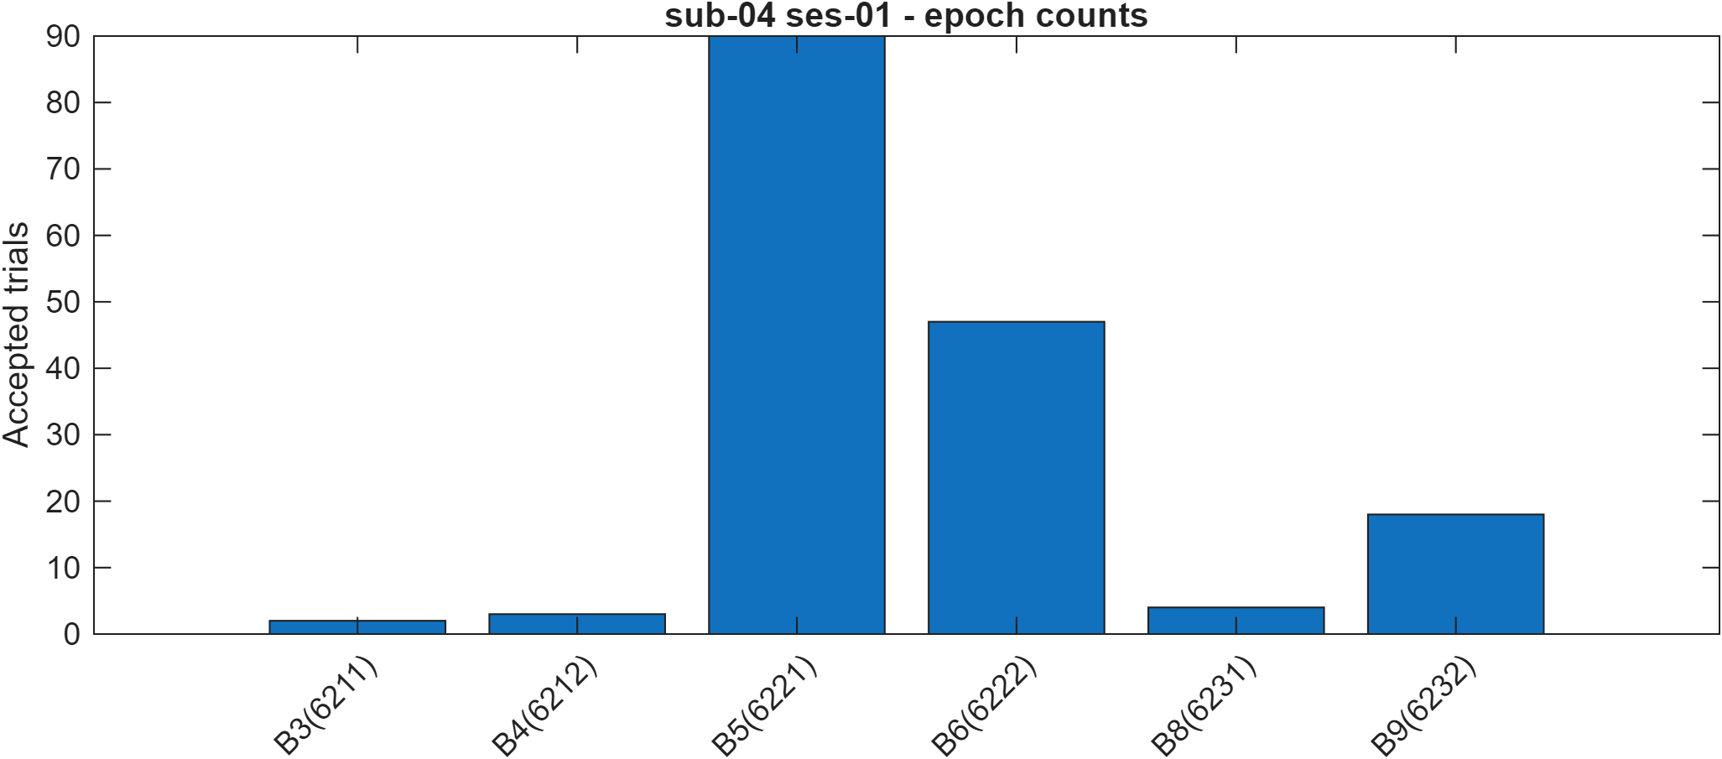
Subject 4
Excluded non-EEG channels for ICA/bad-channel detection: ECG1
Auto-detected 3 bad channels by 2-SD rule: Fp1, Fp2, AF8
Interpolated 3 channels and restored to scalp montage
ICA finished: 58 components
Removed 5 ICs: [8 12 13 18 27]
Saved per-bin trial counts CSV (10 bins).
Counts: [0 0 2 3 90 47 0 4 18 6]
Bins passing threshold: [5 6]

Slide 9
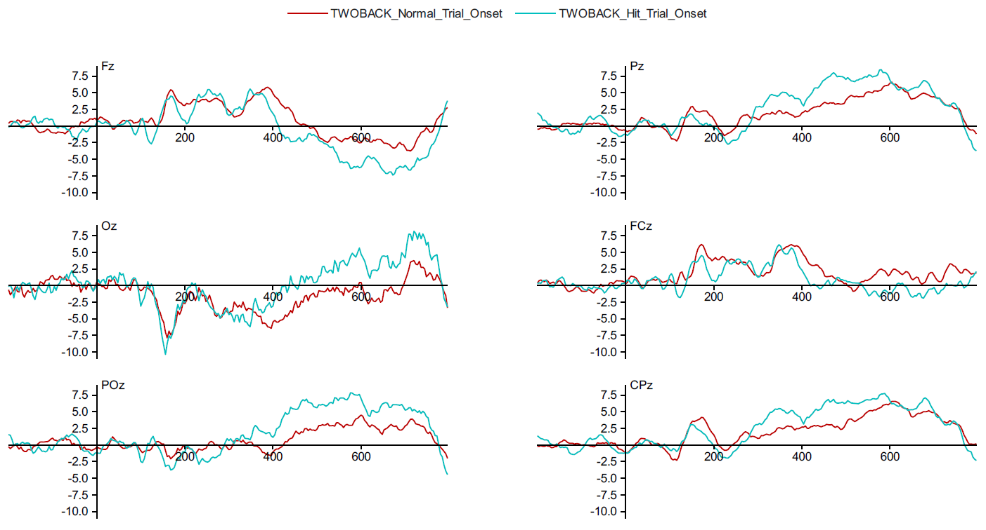
Subject 4

Slide 10
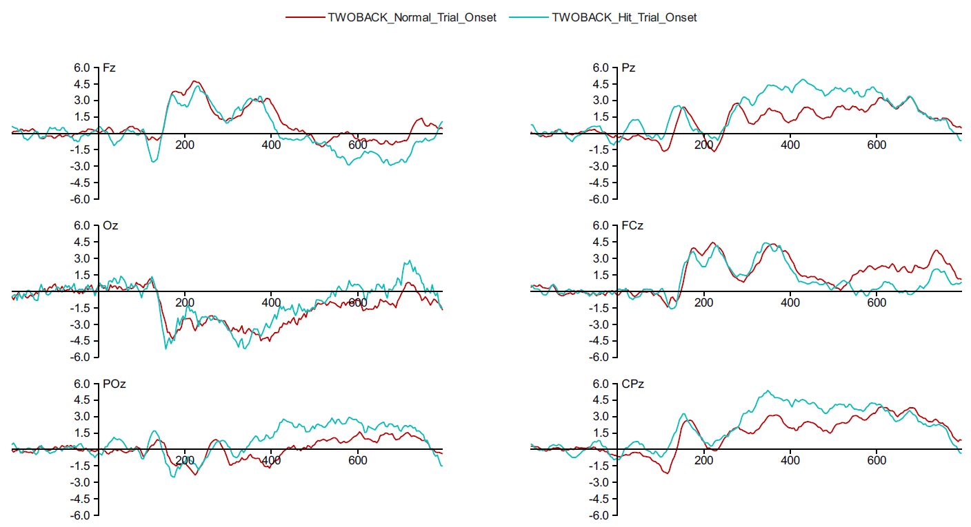
Grand average

Slide 11
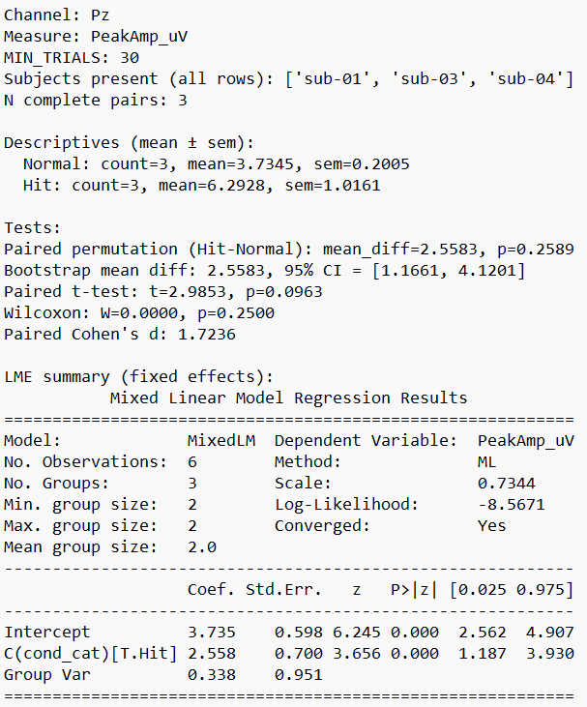
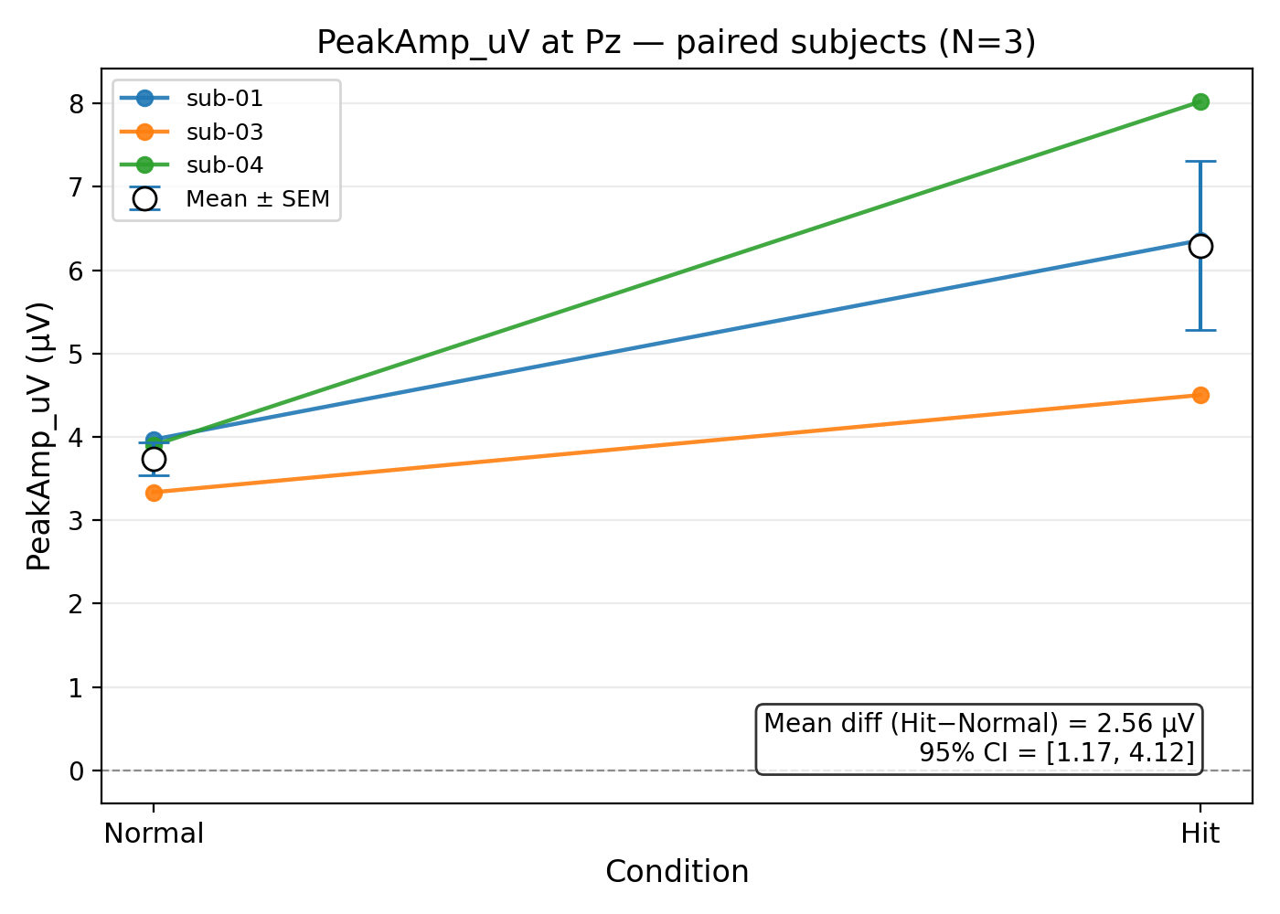
Peak amplitude statistics

Slide 12
Peak amplitude Results
Mean Pz amplitude for Hit = 6.29 µV, Normal = 3.73 µV → mean difference = +2.56 µV.
  Targets produced larger P300s than non-targets.
The bootstrap 95% confidence interval for the paired mean difference is [1.17, 4.12] µV, and paired Cohen’s d ≈ 1.72.
  That means the effect is reasonably large and the bootstrap suggests the difference is plausibly positive, not just noise.
The linear mixed model (LME) reports the Hit effect as highly significant (β = 2.56 µV, p < 0.001), while the paired permutation test (on only the 3 complete pairs) returned p = 0.259.
  This happens because LME uses all available rows and assumes a parametric model.
  The permutation test is nonparametric and uses only the paired subjects (very low power at N=3).
  The takeaway: amplitude consistently points to Hit > Normal, but small N makes some tests inconclusive.
Larger P300 amplitude for Hits is consistent with greater allocation of attention/working-memory updating for target stimuli.
  Targets elicited stronger neural responses in the expected parietal location.

Slide 13
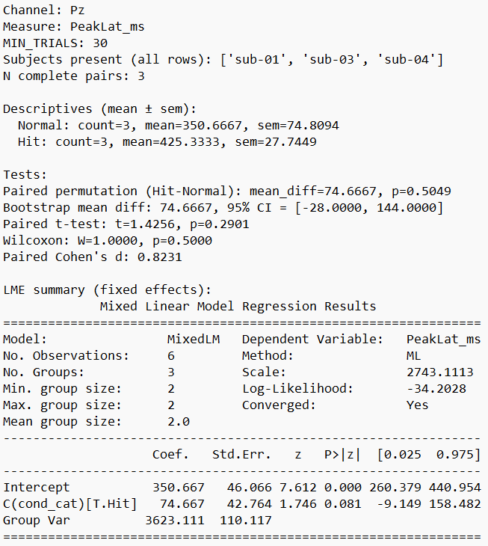
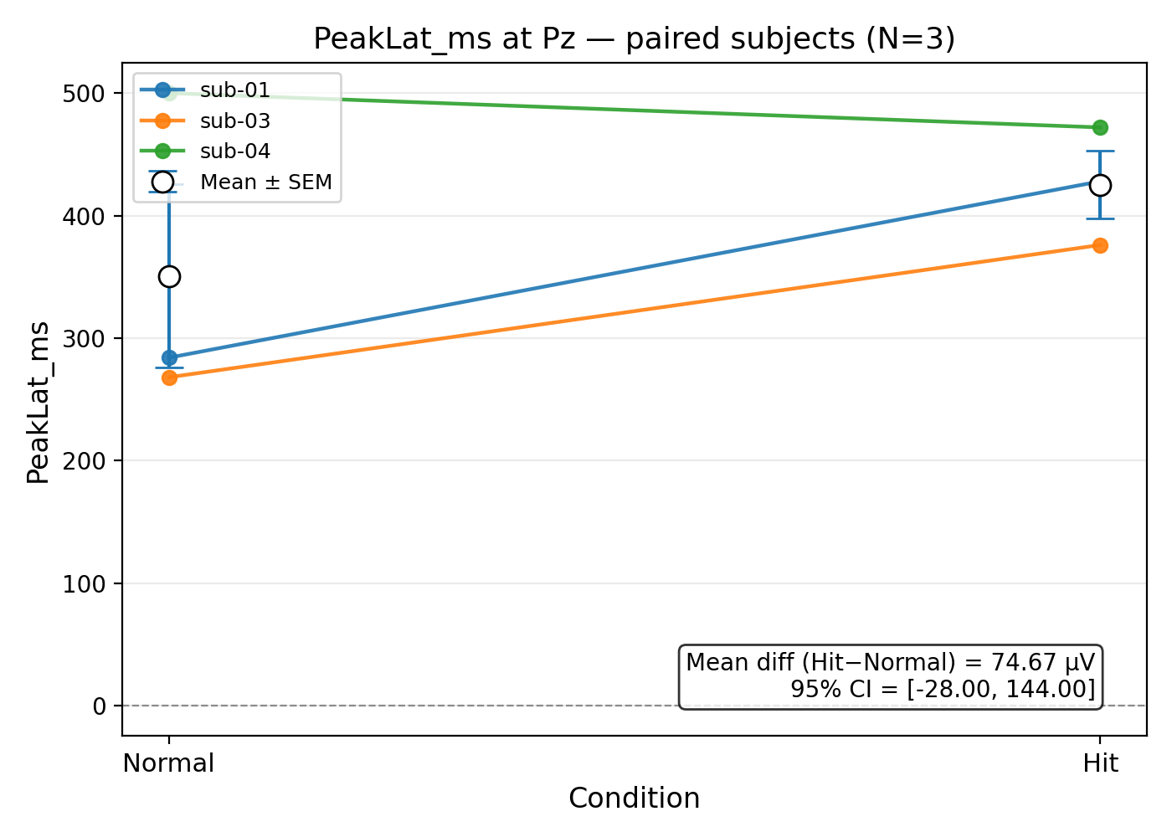
Peak latency statistics

Slide 14
Peak latency Results
Mean Pz latency for Hit = 425 ms, Normal = 351 ms → mean difference ≈ +74.7 ms (Hit later).
  Hits peaked later than Normals.
The LME shows a trend (β ≈ +74.7 ms, p = 0.081) but the paired permutation test gave p = 0.505, and the bootstrap 95% CI is [−28, 144] ms (includes zero).
  Although latencies shift in the expected direction, the evidence is weak and not reliable with this sample size.
Latency estimates are more sensitive to noise and peak shape than amplitudes, especially with few trials/subjects.
  A single noisy peak can swing the latency a lot.
  Amplitude (mean/peak size) tends to be more robust in small datasets.

