Slide 1
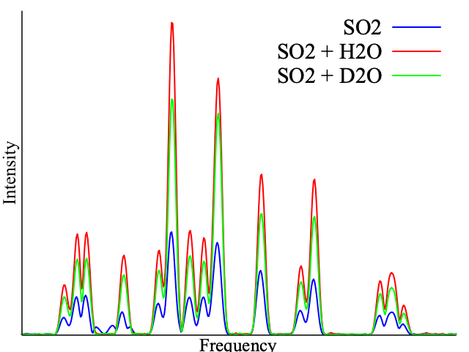
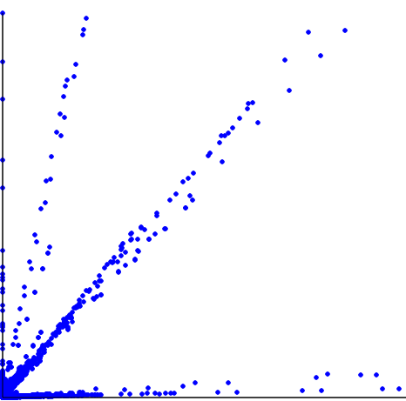
SO₂
[SO₂]_{m}[D₂O]_{n}
SO₂ + H₂O
SO₂ + D₂O
[SO₂]_{m}
Intensity (+D₂O)
Intensity
ML
[SO₂]_{m}[H₂O]_{n}
Frequency
Intensity (+H₂O)
Intensity (+H₂O)

