Slide 1

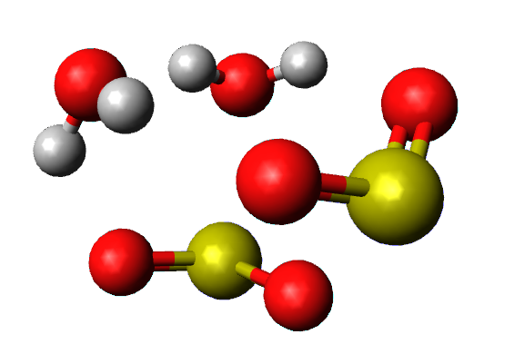
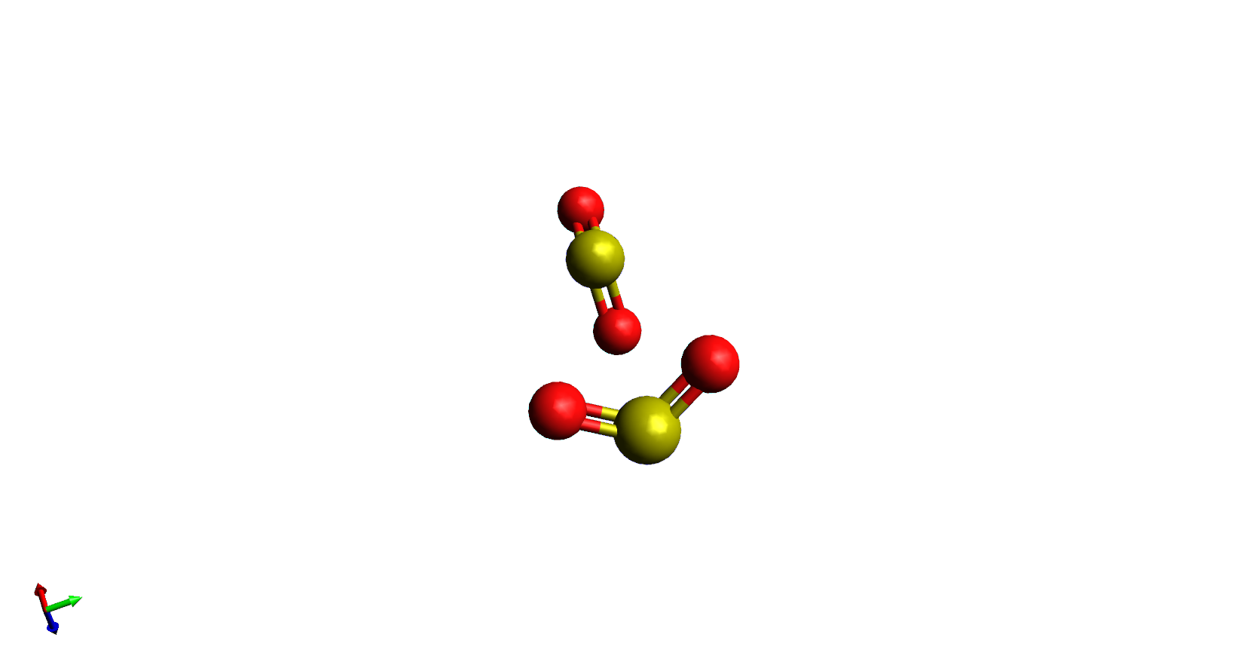
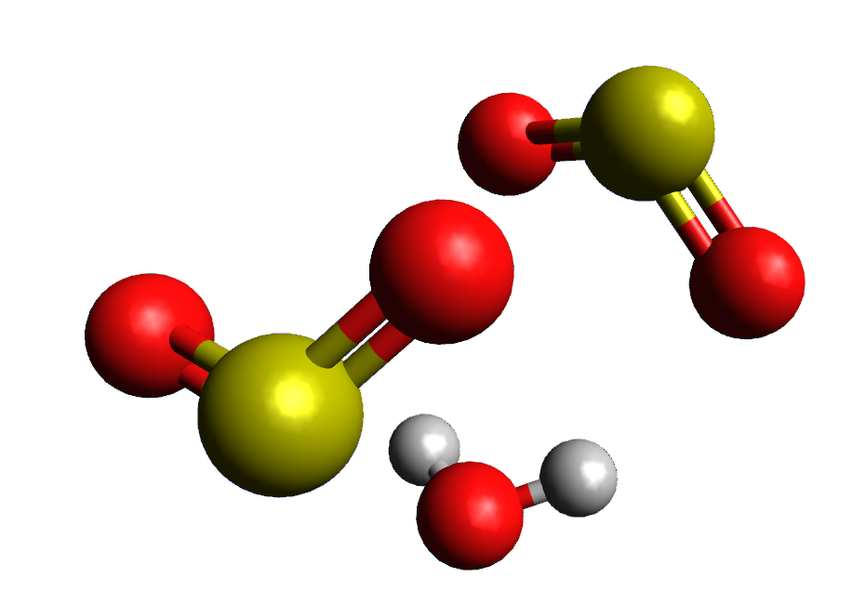

Machine Learning tools to assist the analysis of complex rotational spectra of chemical mixtures
D. Yélamos, Z. Wang, C. Calabrese, A. Lesarri, C. Bermúdez
Universidad de
Valladolid
Departamento de Química Física y Química Inorgánica, Facultad de Ciencias
I.U. CINQUIMA. Paseo de Belén 7, 47011 Valladolid, Spain
Introduction
The possibility of averaging millions of spectra thanks to Broadband chirped pulse Fourier Transform microwave spectroscopy, makes rotational analysis challenging involving thousands of transitions lines. New methods have arised to facilitate the analysis of the molecular spectra, such as frequency-based methods [1]. Within this study we focus on intensity-based methods for chemical mixtures (SO₂/H₂O/D₂O), where we use the unique response of each chemical species to change in composition. We explore new approaches using Machine Learning tools to disentangle rotational spectra.
Experimental
SO₂ pure
+H₂O
+D₂O
We measured rotational spectra of three different mixtures of gases using Broadband CP-FTMW spectrometer placed in Universidad de Valladolid.
Methods
Modified RANSAC Algorithm
1. Iterates over all possible linear regressions forcing the intercept to origin.
2. Scores regressions according to the number of inliers within an angular threshold.
3. Clusters all inliers within the best regression.
4. Removes this cluster and repeats the process.
Hyperparameters
Minimum datapoints used per regression = 2
Maximum number of clusters = 20
Maximum iterations = 10 000
Angular threshold = 0.02 rads
By facing intensities of the spectra of two mixtures with different composition [2], we detect linear patterns called “rays”. Each ray corresponds to a unique response to changes in composition and therefore to a specific chemical specie. We developed different unsupervised clustering Machine Learning algorithms to isolate each ray and assign each cluster to a chemical species of SO₂ / H₂O. We focus on the best perfomance achieved by RANSAC (Random sample consensus) algorithm.
Signal datapoint
Signal Maximum
Discussion
After trying other model’s algorithm like DBSCAN, FLEMIX and GMM we consider RANSAC algorithm to be best suited due to its hyperparameter flexibility. RANSAC shows great results. However it is sensitive to high densities of data and distance threshold. Hyperparameters adjustment is always requiered for specific problems.
How to deal with these drawbacks:
Work only with maximums as data to avoid high densities overfitting.
Analyze distributions of each datapoint distance to each ray slope.
Results of RANSAC model
Signal datapoint
Signal Maximum
References
[1] N. A. Seifert et al., Mol. Spectrosc. 321, 13-21 (2015).
[2] K. C. Gilbert et al., J. Phys. Chem. A. 129 (45), 10393-10403 (2025).
Ackowledgments
This work was funded by
MICIU (Project PID2022-136525NA-I00)
(rads)

Slide 2
Machine Learning tools to assist the analysis of complex rotational spectra of chemical mixtures
D. Yélamos, Z. Wang, C. Calabrese, A. Lesarri, C. Bermúdez
Universidad de
Valladolid
Departamento de Química Física y Química Inorgánica, Facultad de Ciencias
I.U. CINQUIMA. Paseo de Belén 7, 47011 Valladolid, Spain
Introduction
The possibility of averaging millions of spectra thanks to Broadband chirped pulse Fourier Transform microwave spectroscopy, makes rotational analysis challenging involving thousands of transitions lines. New methods have arised to facilitate the analysis of the molecular spectra, such as frequency-based methods [N. A. Seifert et al., J. Mol. Spectrosc. 321, 13-21 (2015)]. Within this study we focus on intensity-based methods for chemical mixtures (SO₂/H₂O/D₂O), where we use the unique response of each chemical species to change in composition. We explore new approaches using Machine Learning tools to disentangle rotational spectra.
Experimental
SO₂ pure
+H₂O
+D₂O
We measured rotational spectra of three different mixtures of gases using Broadband CP-FTMW spectrometer placed in Universidad de Valladolid: pure SO₂, mixture with H₂O and D₂O.
[SO₂]₂[H2O]₂
[SO₂]₂[H2O]
[SO₂]₂
Methods
By facing intensities of the spectra of two mixtures with different composition [K. C. Gilbert et al., J. Phys. Chem. A. 129 (45), 10393-10403 (2025)], we detect linear patterns called “rays”. Each ray corresponds to a unique response to changes in composition and therefore to a specific chemical specie. We developed different unsupervised clustering Machine Learning algorithms to isolate each ray and assign each cluster to a chemical species of SO₂ / H₂O. We focus on the best perfomance achieved by RANSAC (RANdom Sample Consensus) algorithm.
Intensity Correlation plot
Zoomed-in view
Modified RANSAC Algorithm
1. Iterates over all possible linear regressions forcing the intercept to origin.
2. Scores regressions according to the number of inliers within an angular threshold.
3. Clusters all inliers within the best regression.
4. Removes this cluster and repeats the process.
Hyperparameters
Minimum datapoints used per regression = 2
Maximum number of clusters = 20
Maximum iterations = 10 000
Angular threshold = 0.02 rads
Signal datapoint
Signal Maximum
Results - Models
Discussion
RANSAC Model
Zoomed-in view of RANSAC Model
The nature of the RANSAC model makes it very sensible to high densities provoking a bias towards intense signals. It does not look for a comulous of signals with the same slope, it tries to cluster as much points as posible, ignoring low intensity signals.
An overfitted RANSAC clustering and a posterior clustering by slope proximity could be interesting.
Working only with signals maximums removes high densities from intense signals.
Signal datapoint
Signal Maximum
Future prospects
GMM Model
Between all four models tested we present the two of our interest
DBSCAN (Density-Based Spatial Clustering of Applications with Noise).
FlexMix (Flexible Mixture Modeling).
GMM (Gaussian Mixture Models).
RANSAC
While RANSAC offers the highest flexibility in terms of hyperaparameters and returns visible, a priori, good results based on ratios tendency. GMM model fails complety since it clusters based on intensity values and not slopes.
Distance distribution to rays could give hints of good clustering
By converting data into ratio or angular space, GMM model would not deal with absolute magnitudes
2. Increasing dimensionality of the problem:
Different mixture compositions.
Temporal evolution of each signal.
Gaussian centers
Ackowledgments
This work was funded by MICIU (Project PID2022-136525NA-I00)

Slide 3







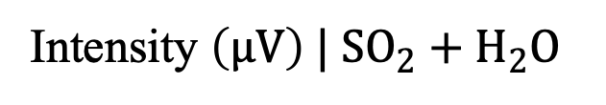

Machine Learning tools to assist the analysis of complex rotational spectra of chemical mixtures
D. Yélamos, Z. Wang, C. Calabrese, A. Lesarri, C. Bermúdez
Departamento de Química Física y Química Inorgánica, Facultad de Ciencias
I.U. CINQUIMA. Paseo de Belén 7, 47011 Valladolid, Spain
Introduction
The possibility of averaging millions of spectra thanks to broadband chirped pulse Fourier Transform microwave spectroscopy, makes rotational analysis challenging involving thousands of transition lines. New methods have arised to facilitate the analysis of the molecular spectra, such as frequency-based methods [N. A. Seifert et al., J. Mol. Spectrosc. 321, 13-21 (2015)]. Within this study we focus on intensity-based methods for chemical mixtures (SO₂/H₂O/D₂O), where we use the unique response of each chemical species to changes in composition. We explore new approaches using Machine Learning tools to disentangle rotational spectra.
z
Experimental
We measured rotational spectra of three different mixtures of gases using broadband CP-FTMW spectrometer placed at Universidad de Valladolid: pure SO₂, and its mixture with H₂O and D₂O.
[SO₂]₂[H₂O]₂
SO₂ pure
+H₂O
+D₂O
[SO₂]₂[H₂O]
[SO₂]₂
Methods
By facing intensities of the spectra of two mixtures with different composition [K. C. Gilbert et al., J. Phys. Chem. A. 129 (45), 10393-10403 (2025)], we detect linear patterns called “rays”. Each ray corresponds to a unique response to changes in composition and therefore to a specific chemical species. We developed different unsupervised clustering Machine Learning algorithms to isolate each ray and assign each cluster to a chemical species of SO₂/H₂O. We focus on the best perfomance achieved by RANSAC (RANdom Sample Consensus) algorithm.
Intensity Correlation plot
Zoomed-in view
Modified RANSAC Algorithm
1. Iterates over all possible linear regressions forcing the intercept to origin.
2. Scores regressions according to the number of inliers within an angular threshold.
3. Clusters all inliers within the best regression.
4. Removes this cluster and repeats the process.
Hyperparameters
Minimum datapoints used per regression = 2
Maximum number of clusters = 20
Maximum iterations = 10 000
Angular threshold = 0.02 rads
Signal datapoint
Intensity $\left(μV\right) | SO_{2}+D_{2}O$
Signal Maxima
Intensity $\left(μV\right) | SO_{2}+H_{2}O$
Intensity $\left(μV\right) | SO_{2}+H_{2}O$
Results - Models
Intensity $\left(μV\right) | SO_{2}+H_{2}O$
Discussion
RANSAC Model
Zoomed-in view of RANSAC Model
[SO₂]_{n}
The nature of the RANSAC model makes it very sensible to high densities leading to a bias towards intense signals. It does not look for a cumulus of signals with the same slope, it tries to cluster as much points as possible, ignoring low intensity signals.
An overfitted RANSAC clustering and a posterior clustering by slope proximity could be interesting.
Working only with signals maxima removes high densities coming from intense signals.
Intensity $\left(μV\right) | SO_{2}+D_{2}O$
Signal datapoint
Signal Maxima
[SO₂]_{n}[H₂O]_{n}
Future prospects
GMM Model
Between the models tested we present the two of our interest:
DBSCAN (Density-Based Spatial Clustering of Applications with Noise).
FlexMix (Flexible Mixture Modeling).
GMM (Gaussian Mixture Models).
RANSAC.
While RANSAC offers the highest flexibility in terms of hyperparameters and returns visible, a priori, good results based on tendency ratios. GMM model fails complety since it clusters based on intensity values and not slopes.
Further assignation of rays to actual chemical species.
By converting data into ratio or angular space, GMM model would not deal with absolute magnitudes.
Increase dimensionality of the problem:
Different mixture compositions.
Temporal evolution of each signal.
Intensity $\left(μV\right) | SO_{2}+D_{2}O$
Gaussian centers
Intensity $\left(μV\right) | SO_{2}+H_{2}O$
Acknowledgements
This work was funded by MICIU (Project PID2022-136525NA-I00) and performed at Universidad de Valladolid.

