Slide 1
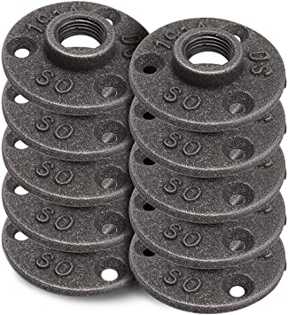
TITLE: Brooklyn Pipe 10 Pack 3/4" Floor Flange Iron Pipe Floor Threaded Pipe Fitting | Industrial Dark Gray Steampunk Vintage Retro Decor Furniture DIY
PRICE: $15.99
STARS: 4.7 out of 5 stars
STYLE: ¾ Inch Flange, 10 Pack
URL: https://amazon.com/dp/B07B9XKP9L
FEATURES: Make sure this fits by entering your model number. ,3/4 INCH PIPE FLANGE - Our Brooklyn Pipe floor flange is a great choice for all your DIY needs. This decorative plumbing flange is the perfect pipe fitting to take your project to the next level. These fittings are for DIY projects only, they are not rated to carry gas nor water.,SUPPORT AMERICAN BUSINESS - We live and sell in America, please help support our USA small business. We always go the extra mile for our awesome customers.,INDUSTRIAL DECOR- Our 3 hole flange is 2.75 inches in diameter and provides a unique look for all projects. Whether you're looking for an industrial, steampunk, vintage, retro, factory look, our flange will fit perfectly into your project. Most other flanges have 4 holes, our design sets us apart while providing a strong triangular mounting configuration which spreads out the payload evenly,NO CHINA STAMP - Our forged malleable iron flange doesn't have the word "CHINA" stamped into the flange which is another reason why Brooklyn Pipe stands out in the pipe fitting products that are on the market. Our 3 hole flange is just as strong as the competition but simply looks better!,QUALITY CONTROL - We work directly with steel factories and hire licensed inspectors to review our Brooklyn Pipe products prior to being packaged. Rest assured you are getting top quality products every time you open our packaging. If there are any issues we stand by our products 100%, just e-mail or call us and we'll make it right.

Slide 2
TITLE: Brooklyn Pipe 10 Pack 1/2 Inch Floor Flange Cast Iron Pipe Floor Threaded Pipe Fitting Industrial Steampunk Vintage Retro Decor Furniture DIY Wall Industrial
PRICE: $15.99
STARS: 4.7 out of 5 stars
STYLE: 1/2" Inch Flange, 10 Pack
URL: https://amazon.com/dp/B07BNB95G6
FEATURES: Make sure this fits by entering your model number. ,1/2 INCH PIPE FLANGE - Our Brooklyn Pipe floor flange is a great choice for all your DIY needs. This decorative flange is the perfect pipe fitting to take your project to the next level. These fittings are for decor and DIY projects only, they are not rated to carry gas or water.,SUPPORT AMERICAN BUSINESS - We live and sell in America, please help support our USA small business. We always go the extra mile for our awesome customers.,INDUSTRIAL DECOR- Our 3 hole flange is 2.5 inches in diameter and provides a unique look for all projects. Whether you're looking for an industrial, steampunk, vintage, retro, factory look, our flange will fit perfectly into your project. Most other flanges have 4 holes, our design sets us apart while providing a strong triangular mounting configuration which spreads out the payload evenly,NO CHINA STAMP - Our forged malleable iron flange doesn't have the word "CHINA" stamped into the flange which is another reason why Brooklyn Pipe stands out in the pipe fitting products that are on the market. Our 3 hole flange is just as strong as the competition but simply looks better!,QUALITY CONTROL - We work directly with steel factories and hire licensed inspectors to review our Brooklyn Pipe products prior to being packaged. Rest assured you are getting top quality products every time you open our packaging. If there are any issues we stand by our products 100%, just e-mail or call us and we'll make it right.

Slide 3
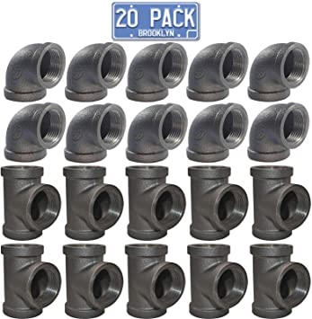
TITLE: Brooklyn Pipe 1/2" Inch Elbow Tee Combo Pack (10 Elbows, 10 Tees) Threaded Pipe, 90 Degree Pipe Elbow Tee | Decorative Iron Piping, Metal Cast Pipe Fittings for DIY Furniture Projects Grey
PRICE: $19.99
STARS: 4.6 out of 5 stars
STYLE: no style provided
URL: https://amazon.com/dp/B07F36449W
FEATURES: Make sure this fits by entering your model number. ,1/2" INCH ELBOW TEE COMBO PACK - Our Brooklyn Pipe malleable iron threaded elbow / tee combo pack provides you with great pipe fittings at a very affordable price,PERFECT FOR DIY - Whether you're looking to build a pipe shelf, pipe towel rack, pipe lamp, our 1/2 value pack of tees and elbows is up to the task. These fittings are for decor and DIY projects only, they are not rated to carry gas or water.,RAW IRON - Malleable iron is raw, unfinished iron. This means that you will need to seal or paint the flanges for your project. When handling raw iron it's normal for your hands to get dirty. You've probably seen iron workers in movies, they don't come home clean!,QUALITY CONTROL - We inspect and pack each pipe fitting we sell. If it doesn't look right, feel right or if there are any issues, we return them to our supplier. We offer a LIFETIME warranty on our products, just give us a call or send an e-mail.,SUPPORT USA BUSINESSES - Brooklyn Pipe is a family owned business in the USA. We are available via e-mail or our cell phone to help answer any questions you have. Please help support small American businesses!

Slide 4
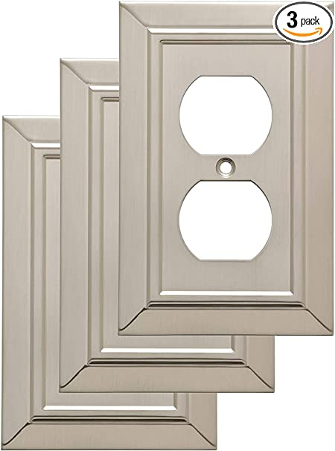
TITLE: Franklin Brass W35218V-SN-C Classic Architecture Single Duplex Wall Plate/Switch Plate/Cover (3 Pack), Satin Nickel
PRICE: $9.37
STARS: 4.7 out of 5 stars
STYLE: no style provided
URL: https://amazon.com/dp/B01HGNPIV4
FEATURES: Make sure this fits by entering your model number. ,Inspired by the classic lines of traditional American design, the Classic Architecture collection adds a statement of subtle elegance to your home’s décor,The satin nickel finish coordinates with the most popular finishes in homes today,Machine screws in a matching finish are included for easy installation,WARNING: Risk of electric shock. Turn off power at fuse box or circuit breaker before installation,CAUTION: Wall plate edges may be sharp. Handle with care

Slide 5
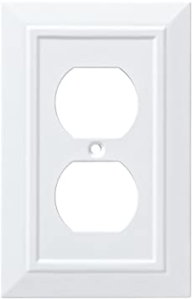
TITLE: Franklin Brass W35242-PW-C Classic Architecture Single Duplex Wall Plate/Switch Plate/Cover, White
PRICE: $6.00
STARS: 4.7 out of 5 stars
STYLE: no style provided
URL: https://amazon.com/dp/B01HMCXLZE
FEATURES: Make sure this fits by entering your model number. ,Inspired by the classic lines of traditional American design, the Classic Architecture collection in natural fiber adds a statement of subtle elegance to your home's décor,The white finish coordinates with white outlets, switches, and trim for a bright, clean look. Also looks great with neutral color walls and woodwork,Machine screws in a matching finish are included for easy installation,WARNING: Risk of electric shock. Turn off power at fuse box or circuit breaker before installation,CAUTION: Wall plate edges may be sharp. Handle with care

Slide 6
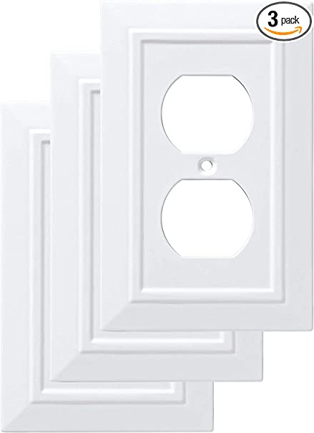
TITLE: Franklin Brass W35242V-PW-C Classic Architecture Single Duplex Wall Plate/Switch Plate/Cover (3 Pack), White
PRICE: $19.99
STARS: 4.7 out of 5 stars
STYLE: no style provided
URL: https://amazon.com/dp/B01HMCXYZ6
FEATURES: Make sure this fits by entering your model number. ,Inspired by the classic lines of traditional American design, the Classic Architecture collection adds a statement of subtle elegance to your home’s décor,The white finish coordinates with white outlets, switches, and trim for a bright, clean look. Also, looks great with neutral color walls and woodwork,Machine screws in a matching finish are included for easy installation,WARNING: Risk of electric shock. Turn off power at fuse box or circuit breaker before installation,CAUTION: Wall plate edges may be sharp. Handle with care,Made of natural fiber material

