Slide 1
Seismic Signals and Sensors

Slide 2
Contents
Introduction
Waves
Wavelength and Period
Seismic Signals
Seismic Scales
Application Frequency Ranges
Seismometers
Accelerometers
GeoSIG Sensor Matrix
GeoSIG Sensor Measuring Ranges
References
Closing

Slide 3
Introduction
The fundamental observations used in seismology (the study of earthquakes) are seismograms which are a record of the ground motion at a specific location.
Seismograms come in many forms,
- "smoked" paper,
- photographic paper,
- common ink recordings on standard paper,
- digital format (on computers, tapes, CD ROMs).
Careful observation of ground vibrations during the last 80 years or so have lead to our understanding these vibrations, which are caused by seismic waves.

Slide 4
Waves
A wave is a disturbance that transfers energy through a medium.
The "disturbance" can be:
an alternating electromagnetic field strength (light),
a variation in water height (ocean waves),
a variation in material density (sound waves),
or a distortion of the shape of the ground (seismic waves).
Seismic waves travel outward in all directions from their source. Waves generated by large earthquakes can be detected throughout the world and are routinely recorded and analyzed by seismologists.
Seismic waves are generated by many different processes:
- Earthquakes
- Volcanoes
- Explosions (especially nuclear bombs)
- Wind
- Vehicles
- People
The range of ground motion amplitudes that are of interest in earthquake studies is very large and seismometers we use are very sensitive.
They can detect motions that are much smaller than the thickness of a sheet of paper or as tall as a room.

Slide 5
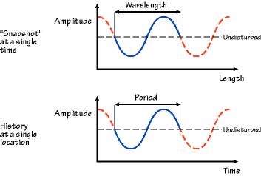
Wavelength and Period
wavelength = period x speed km = s x km/s
frequency = 1 / period Hz = 1 / s
Wavelength:
peak-to-peak distance on a wave measured at a single time
Period:
time between peaks in the motion

Slide 6
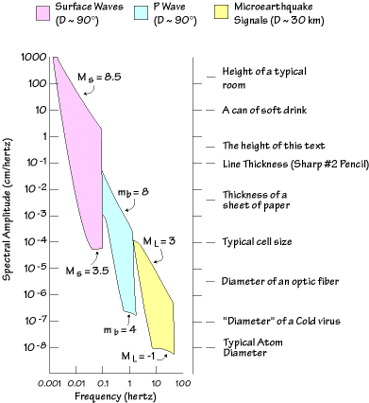
Seismic Signals
Seismic waves contain many different "frequencies" that we can record with specially "tuned" sensors. The idea is completely analogous with light and sound:
Seismic Light Sound
Short-period Blue Treble
Long-period Red Bass
The range of ground motions or any other vibration that are interesting is very large because the process of earth deformation and or other sources of vibrations occur at many different rates and scales.
"D" represents the distance from the earthquake.
1 ° ~ 111.19 km

Slide 7
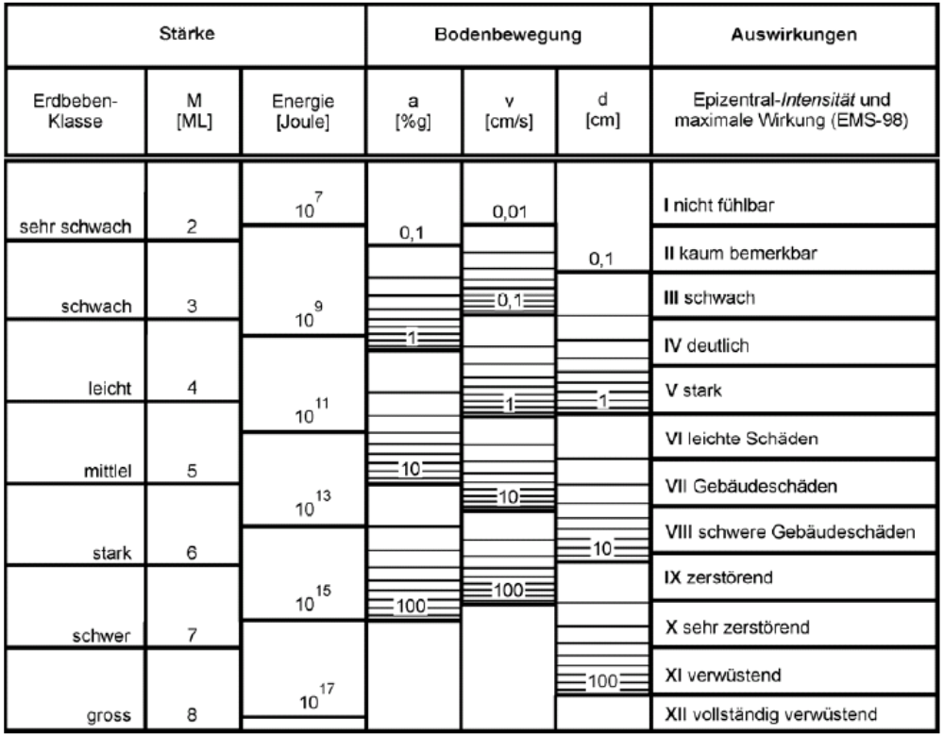
Seismic Scales
An approximation for the empirical link between the Magnitude and other physical quantities.
It is based on worldwide observed and averaged data.
The parameters of the ground movement are the maximum values.
The table only approximately reflects the real relations.
The relationship between magnitude and the other quantities is estimated using a depth of 10-15 km.
Abbreviations:
M_{L}: Magnitude (Richter),
a: acceleration,
v: velocity,
d: displacement,
g: gravitational acceleration
Strength
Ground Movement
Impact
Earthquake Classification
M
[M_{L}]
Energy
[Joule]
a
[%g]
v
[cm/s]
d
[cm]
Epicentral – Intensity and
maximum effect (EMS-98)
very minor
I not felt
II scarcely felt
minor
III weak
IV largely observed
light
V strong
VI slightly damaging
moderate
VII damaging
strong
VIII heavily damaging
IX destructive
major
X very destructive
XI devastating
great
XII completely devastating

Slide 8
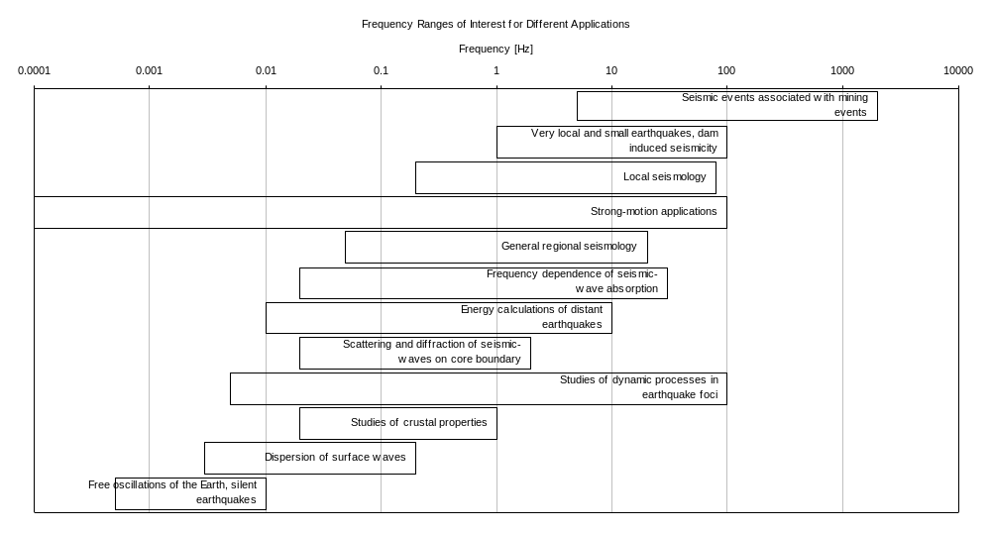
Application Frequency Ranges

Slide 9
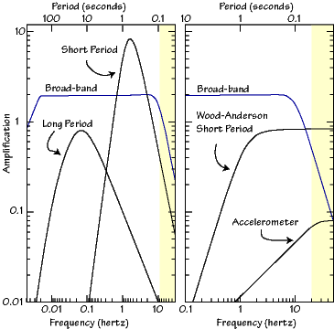
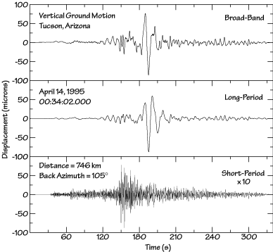
Seismometers
Seismometers are usually designed to record signals over a specified range of frequencies so it is convenient to discuss instruments based on the range of vibration frequencies that they can detect.
Thus one way to characterize seismometers is to describe the range of vibration frequencies that they can detect. A plot of the amplification as a versus frequency is called an instrument response. An instrument is sensitive to vibrations at frequencies for which the "response" curve is relatively large.
To characterize an instrument, what's really important is the range of amplitudes, not the specific amplification, which is usually adjusted depending on the location of the seismometer.

Slide 10
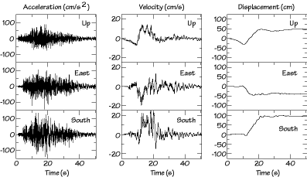
Accelerometers
Accelerometers are developed for recording large amplitude vibrations that are common within a few tens of kilometers of large earthquakes - these are called strong-motion seismometers. Strong-motion instruments were designed to record the high accelerations that are particularly important for designing buildings and other structures.
1985 Mw = 8.1, Michaocan,
Mexico earthquake
The peak acceleration was about 150 cm/s^2 or about 0.15 g.
The acceleration in an elevator is about 2 m/s^2 or about 0.2 g. But smooth and comfortable.
During the earthquake the ground accelerations vary between -0.1g to +0.1g several times each second, for at least 10-15 seconds. That is not very gentle shaking.
The peak velocity for this site during that earthquake was about 20-25 cm/s
The permanent offsets (displacements) near the seismometer were up, west, and south, for a total distance of about 125 cm (vector sum)

Slide 11
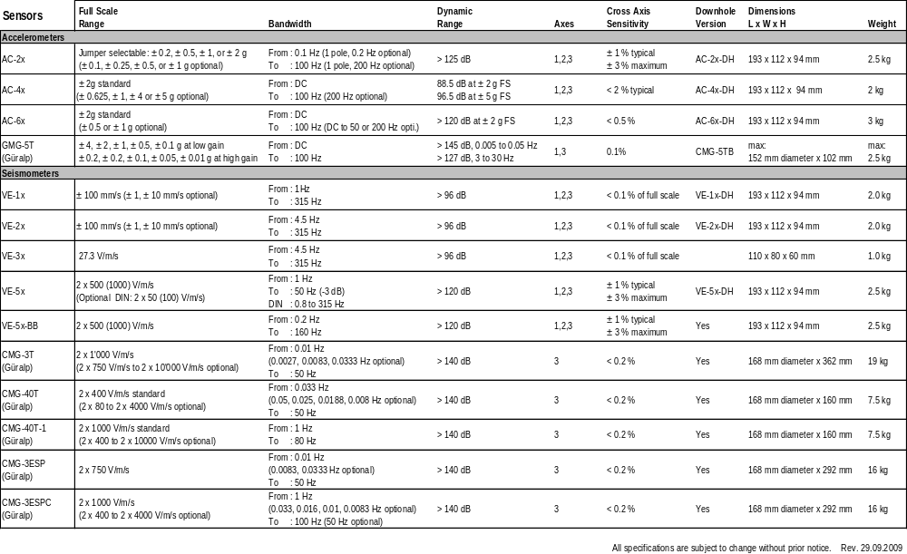
GeoSIG Sensor Matrix

Slide 12
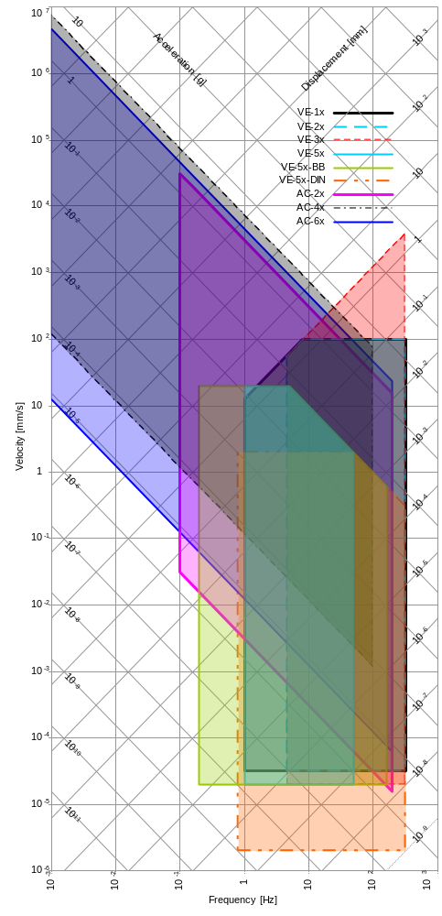
GeoSIG Sensor Measuring Ranges

Slide 13
References
"Waves, Seismograms, and Seismometers"
Ammon, C., Pennstate University, Department of Geosciences, USA, 2001
"New Manual of Seismological Observatory Practice (NMSOP) "
Bormann P., GeoForschungsZentrum, Potsdam, Germany, 2002
"Einsatzkonzept für den Fall eines Erdbebens in der Schweiz"
Nationale Alarmzentrale im Bundesamt für Bevölkerungsschutz, Switzerland, 2005

Slide 14
Thank you
Thank you…

