Slide 1
#iks
Emergent Solutions
Danny Ayers
@danja

Slide 2
Semantic Web
Interest Group
#swig
irc.freenode.net

Slide 3
Changing Reality

Slide 4
“emergence is the way complex systems and patterns arise out of a multiplicity of relatively simple interactions”

Slide 5
Contents
A Little History
Core Semantic Web notions
Emerging Systems
(Interesting Initiatives)

Slide 6
AI Prehistory
Neats vs. Scruffies

Slide 7
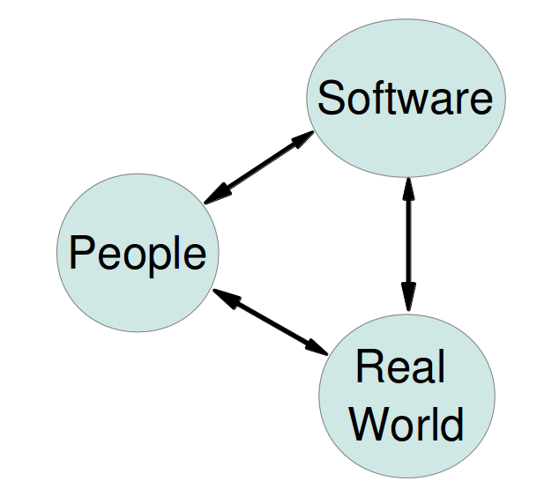

Slide 8
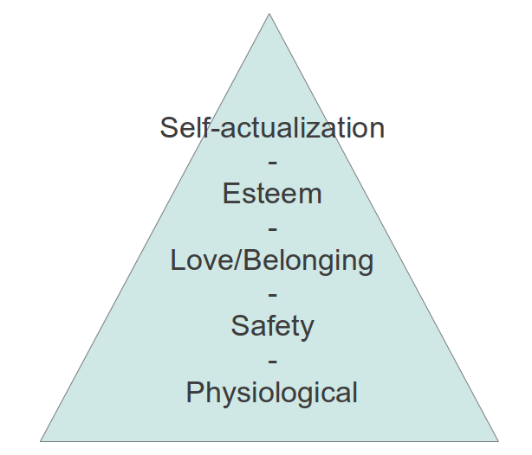
People
Hierarchy of Needs
Abraham Maslow 1943

Slide 9
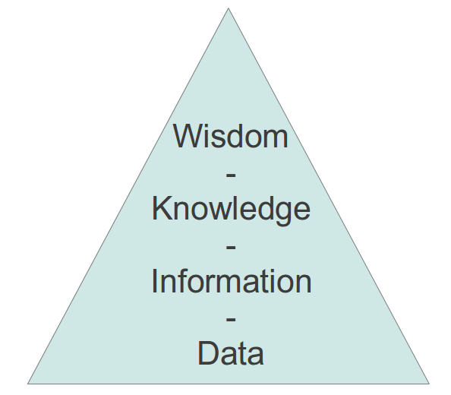
Software
Knowledge Hierarchy
David Skyrme 1999

Slide 10

Real World
Hierarchy of Stuff
Danny Ayers 2012

Slide 11
Knowledge Representation

Slide 12
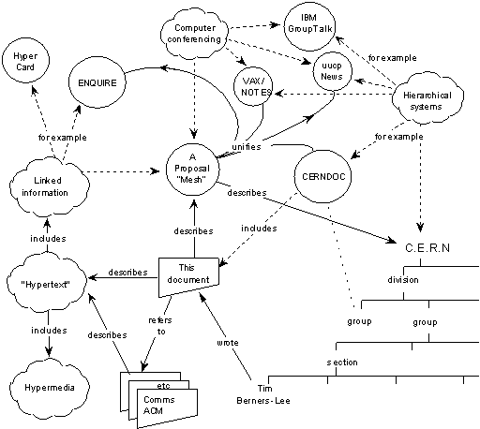
CERN Proposal
Tim Berners-Lee 1989

Slide 13
Library of Babel
- Borges

Slide 14
The Documents

Slide 15
Search

Slide 16

Document Metadata
early example :
Platform for Internet
Content Selection

Slide 17
Semantic Web Technologies
RDF as data language/model
RDF/OWL etc.
SPARQL
Linked Data
Doc metadata NG

Slide 18
"It's all about the docs"

Slide 19
"No, it's all about the things"

Slide 20
FOAF
“machine-readable homepage”

Slide 21
"Look, putting angle brackets around things is not a technology, by itself. I'd rather make progress by having computers understand what humans write, than by forcing humans to write in ways computers can understand."
- Sergey Brin (Google)

Slide 22
"Ok, maybe the docs are important after all"

Slide 23
Time for Synthesis

Slide 24
Semantic Web
Core Concepts

Slide 25
All models are wrong, but some are useful.
- E.P Box

Slide 26
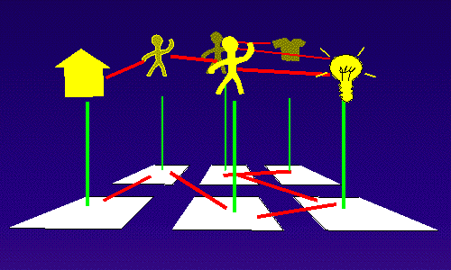

Slide 27
Resource Description Framework
(RDF)

Slide 28
Language :
Vocabulary, Grammar and Syntax

Slide 29
Grammar
~
Data Model

Slide 30
Triples
subject property object

Slide 31
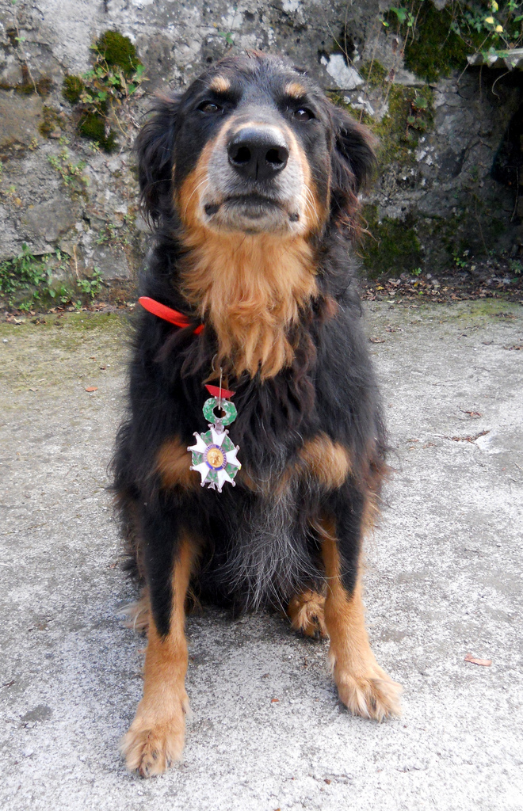

Slide 32
"my dog's name is Basil, he is a Hovawart"

Slide 33
(Basil) name “Basil”
(Basil) type Hovawart

Slide 34
Open World Assumption
true/unknown

Slide 35
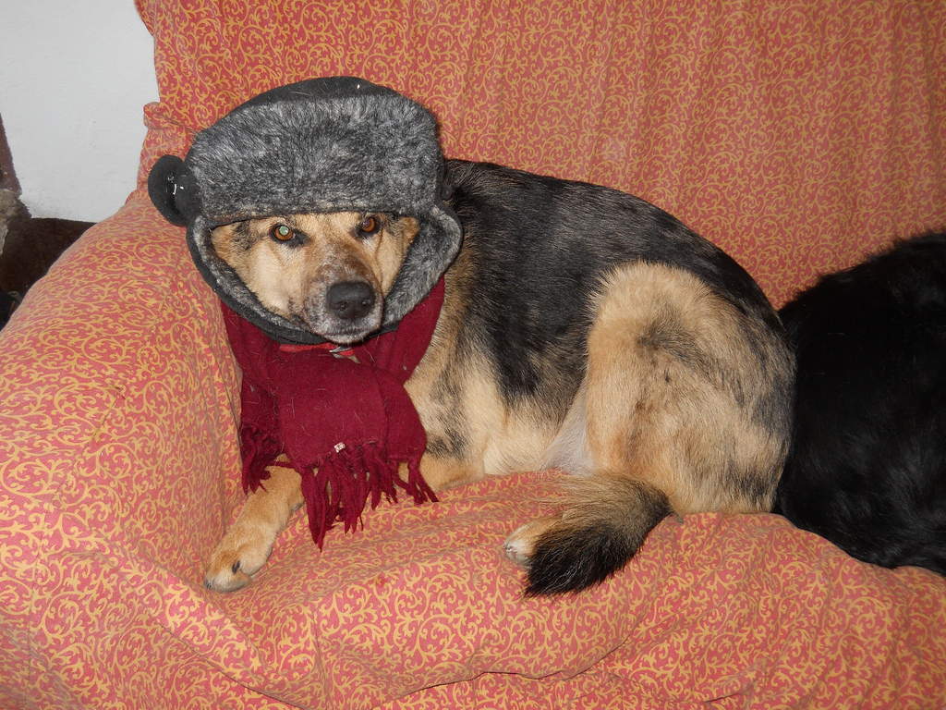

Slide 36
Vocabularies/Ontologies

Slide 37
Hovawart
subClassOf
Dog

Slide 38
Vocab Specification
language spec, e.g. HTML, Atom
registries, e.g. IANA
distributed - Web based

Slide 39
Relaxation of constraints

Slide 40
schema.org
quasi-centralized

Slide 41
Syntaxes
NTriples (raw)
Turtle (human-friendly)
RDF/XML (RDF/XML)
GRDDL (any XML and ...)
RDFa (HTML)
JSON-LD (JSON)
Microformats (HTML)
Microdata (HTML5)

Slide 42
The Web

Slide 43
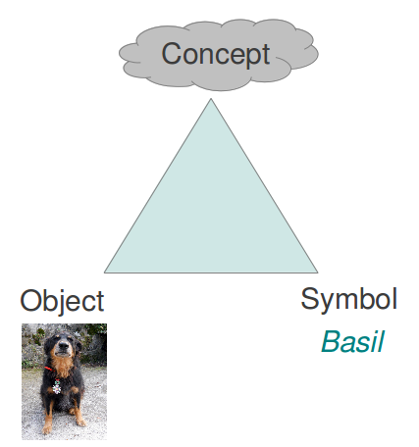
Meaning Triangle

Slide 44
Anything can be identified with a URI

Slide 45
Everything important should be identified with a URI

Slide 46
Ideally a
http: URI
which supports
interactions

Slide 47
http://dannyayers.com/pets/Basil

Slide 48
(Basil) name “Basil”
(Basil) type Hovawart

Slide 49
<http://dannyayers.com/pets/Basil> <http://xmlns.com/foaf/0.1/name> “Basil” .
<http://dannyayers.com/pets/Basil> <http://www.w3.org/1999/02/22-rdf-syntax-ns#type> <http://dbpedia.org/resource/Hovawart> .

Slide 50
@prefix rdf: <http://www.w3.org/1999/02/22-rdf-syntax-ns#type> .
@prefix rdfs: <http://www.w3.org/2000/01/rdf-schema#> .
@prefix foaf: <http://xmlns.com/foaf/0.1/> .
@prefix db: <http://dbpedia.org/resource/> .
@prefix da: <http://dannyayers.com/pets/> .
da:Basil foaf:name “Basil” ;
a db:Hovawart .
db:Hovawart rdfs:subClassOf db:Dog .

Slide 51
Follow your nose

Slide 52


Slide 53
Named Graphs

Slide 54
http://dannyayers.com/pets/Basil
...
da:Basil foaf:name “Basil” ;
a db:Hovawart .
db:Hovawart rdfs:subClassOf db:Dog .

Slide 55
Links are Data

Slide 56
rdf:type
da:Basil
db:Hovawart
da:Sasha
db:Mixed_breed

Slide 57
SPARQL

Slide 58
prefix rdf: <http://www.w3.org/1999/02/22-rdf-syntax-ns#type>
prefix rdfs: <http://www.w3.org/2000/01/rdf-schema#>
prefix foaf: <http://xmlns.com/foaf/0.1/>
prefix db: <http://dbpedia.org/resource/>
prefix da: <http://dannyayers.com/pets/>
SELECT ?x ?name WHERE {
?x foaf:name ?name ;
a db:Hovawart .
}

Slide 59
Linked Data

Slide 60
Linked Open Data 5 Stars
★ make your stuff available
★★ as structured data
★★★ use non-proprietary formats
★★★★ use URIs to identify things
★★★★★ link your data to other data

Slide 61
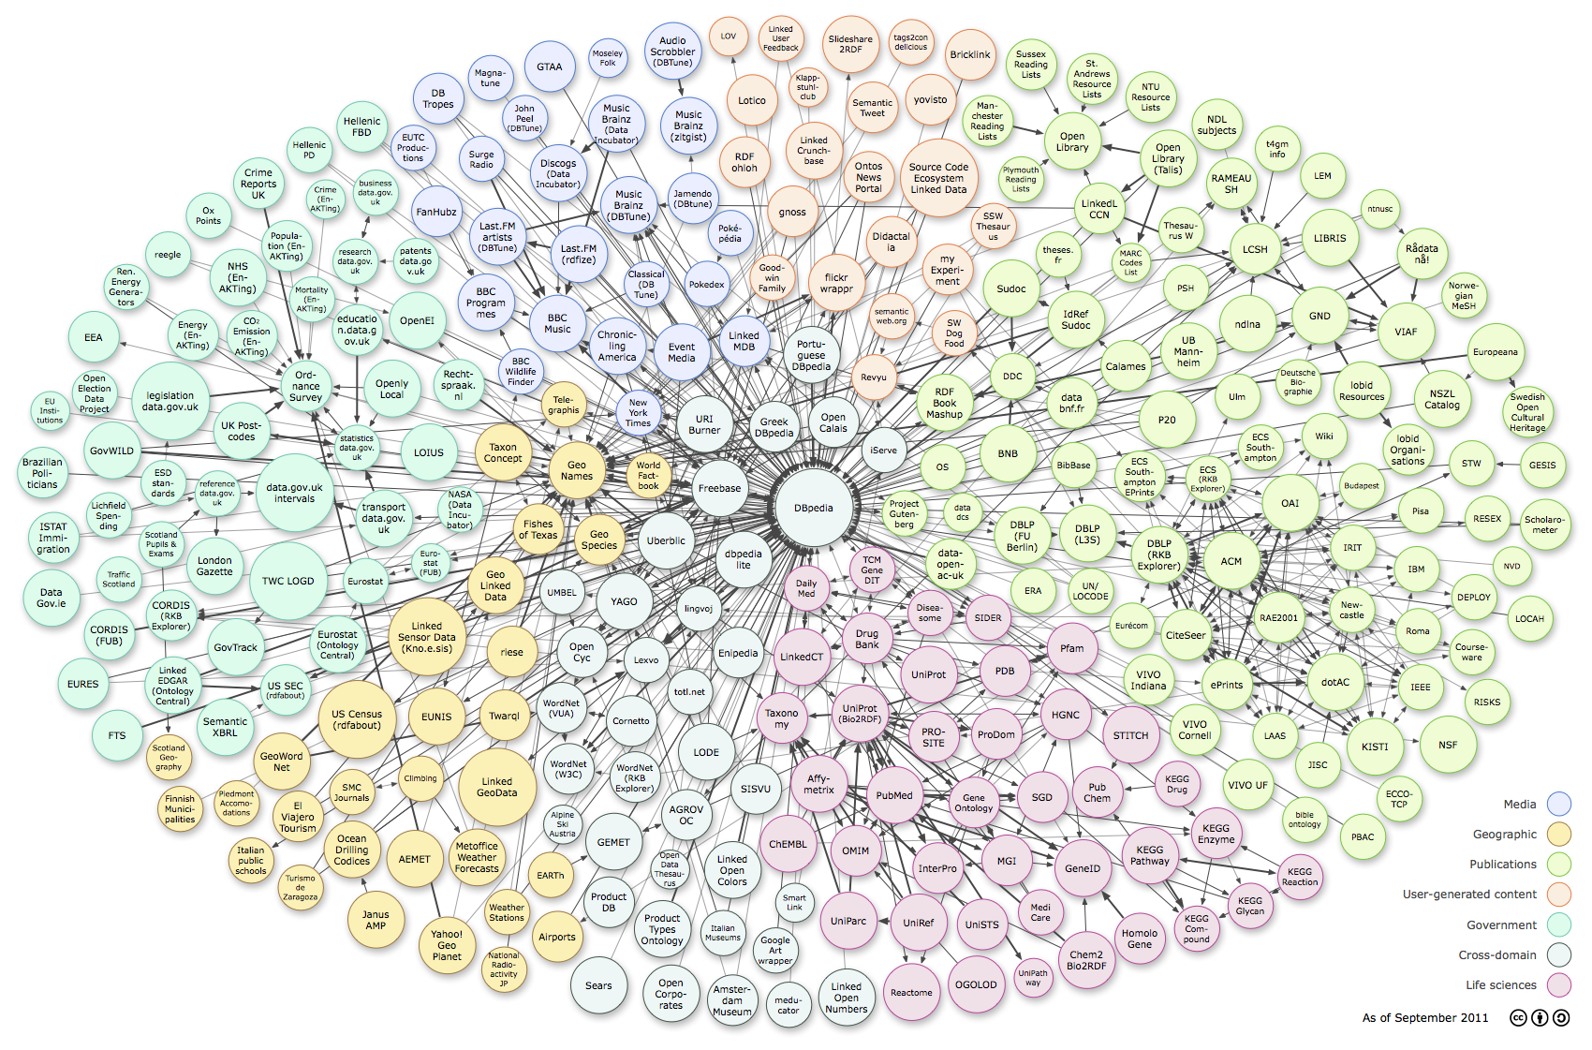
Linked Open Data Cloud

Slide 62
Other semantics

Slide 63
Serendipity

Slide 64
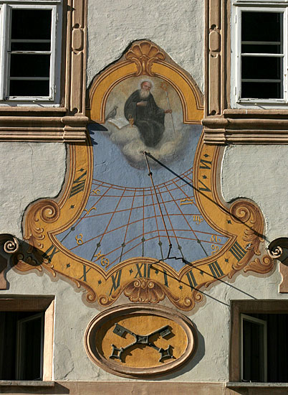

Slide 65
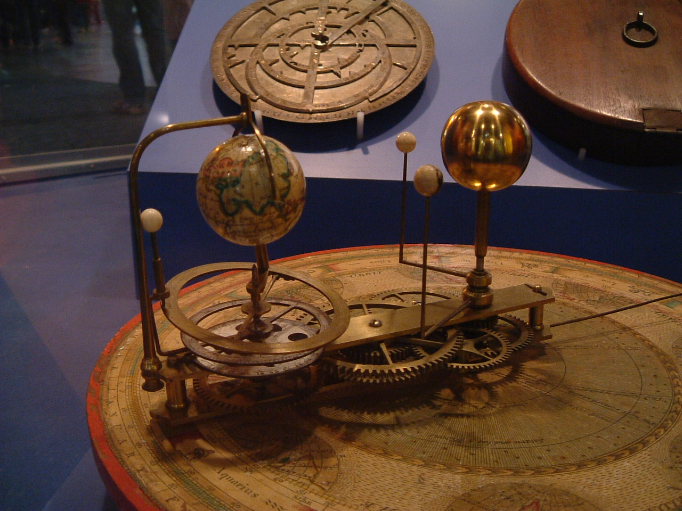

Slide 66
a language needs agents

Slide 67
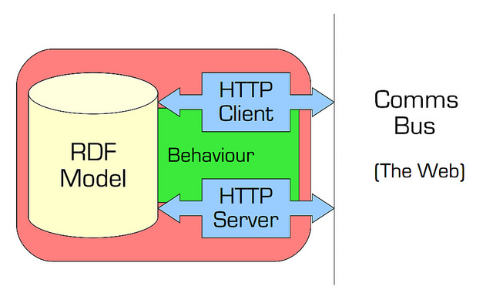

Slide 68
Representational
State Transfer
(REST)

Slide 69
REST Contraints:
Manipulation of resources through representations

Slide 70
REST Contraints:
Uniform Interface

Slide 71
REST Contraints:
Self-descriptive messages

Slide 72
REST Contraints:
Identification of resources

Slide 73
REST Contraints:
Hypermedia as the engine of application state

Slide 74
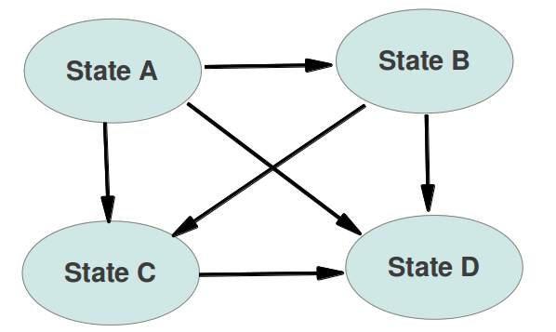
State Machine

Slide 75
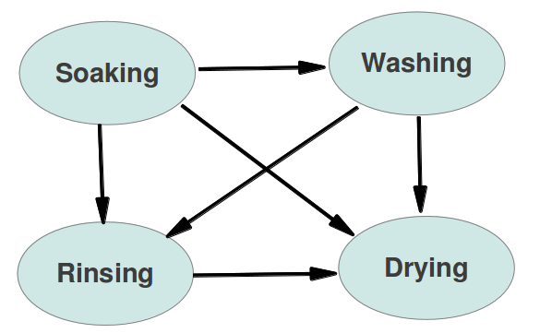
Washing Machine

Slide 76
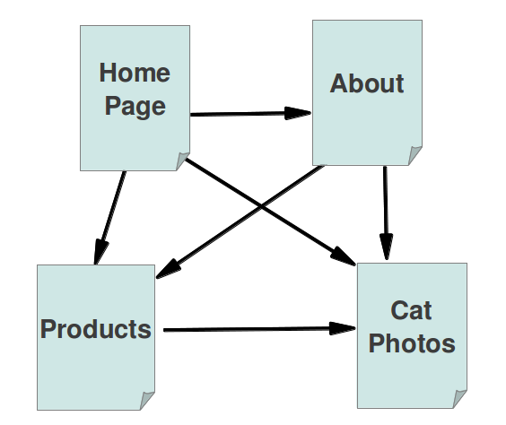
Web Machine

Slide 77
Hypermedia needs links

Slide 78
Tyranny of the Browser

Slide 79
Relaxation of constraints #2
Rich Internet Applications
"Apps" vs. hypermedia

Slide 80
Read/Write Web

Slide 81
Writing
form-encoded
WebDAV
Ajax/JSON
Atom Publishing Protocol
SPARQL 1.1 Update

Slide 82
Affordances
interaction model
follow your nose

Slide 83
Separation of Concerns
data model
interaction model

Slide 84
Reducing friction

Slide 85
Open Source

Slide 86
The Big Intuition
A Semantic Web-friendly site or application costs no more to develop than a
traditional site.

Slide 87
Value Add to Existing
Short term : good for SEO
Longer term : flexible, easy reuse

Slide 88
Blue Ocean Strategies

Slide 89
no two companies offering the same product or service
capturing new demand rather than competing for existing market-share

Slide 90
Innovation!

Slide 91
Interesting Initiatives
see:
http://hyperdata.org/docs/salzburg/

Slide 92
Apache Clerezza

Slide 93
W3C Community & Business Groups
Read/Write Web

Slide 94
W3C Community & Business Groups
Federated Social Web

Slide 95
Linked Data Platform WG

Slide 96
Web Intents

Slide 97
Unhosted

Slide 98
Mozart

