Slide 1
Can I Hack It?
a little celebration of
Open Source

Slide 2
Can I Hack It?
a little celebration of
Open Source

Slide 3
Can I Hack It?
a little celebration of
Open Source

Slide 4
Can I Hack It?
a little celebration of
Open Source

Slide 5
Can I Hack It?
a little celebration of
Open Source

Slide 6
Can I Hack It?
a little celebration of
Open Source

Slide 7
Can I Hack It?
a little celebration of
Open Source

Slide 8
Can I Hack It?
a little celebration of
Open Source

Slide 9
Can I Hack It?
a little celebration of
Open Source

Slide 10
Can I Hack It?
a little celebration of
Open Source

Slide 11
Can I Hack It?
a little celebration of
Open Source

Slide 12
Can I Hack It?
a little celebration of
Open Source

Slide 13
Can I Hack It?
a little celebration of
Open Source

Slide 14
Can I Hack It?
a little celebration of
Open Source

Slide 15
Can I Hack It?
a little celebration of
Open Source

Slide 16
Can I Hack It?
a little celebration of
Open Source

Slide 17
What is
“Open Source”?

Slide 18
What is
“Open Source”?

Slide 19
What is
“Open Source”?

Slide 20
What is
“Open Source”?

Slide 21
What is
“Open Source”?

Slide 22
What is
“Open Source”?

Slide 23
What is
“Open Source”?

Slide 24
What is
“Open Source”?

Slide 25
There are lots of definitions. A practical one could be that -
Open Source is...

Slide 26
There are lots of definitions. A practical one could be that -
Open Source is...

Slide 27
There are lots of definitions. A practical one could be that -
Open Source is...

Slide 28
There are lots of definitions. A practical one could be that -
Open Source is...

Slide 29
There are lots of definitions. A practical one could be that -
Open Source is...

Slide 30
There are lots of definitions. A practical one could be that -
Open Source is...

Slide 31
There are lots of definitions. A practical one could be that -
Open Source is...

Slide 32
There are lots of definitions. A practical one could be that -
Open Source is...

Slide 33
1. Freely Available
- you can legally obtain the raw materials at no cost

Slide 34
1. Freely Available
- you can legally obtain the raw materials at no cost

Slide 35
1. Freely Available
- you can legally obtain the raw materials at no cost

Slide 36
1. Freely Available
- you can legally obtain the raw materials at no cost

Slide 37
1. Freely Available
- you can legally obtain the raw materials at no cost

Slide 38
1. Freely Available
- you can legally obtain the raw materials at no cost

Slide 39
1. Freely Available
- you can legally obtain the raw materials at no cost

Slide 40
1. Freely Available
- you can legally obtain the raw materials at no cost

Slide 41
2. Free to Copy
- you can legally make your own version of the product

Slide 42
2. Free to Copy
- you can legally make your own version of the product

Slide 43
2. Free to Copy
- you can legally make your own version of the product

Slide 44
2. Free to Copy
- you can legally make your own version of the product

Slide 45
2. Free to Copy
- you can legally make your own version of the product

Slide 46
2. Free to Copy
- you can legally make your own version of the product

Slide 47
2. Free to Copy
- you can legally make your own version of the product

Slide 48
2. Free to Copy
- you can legally make your own version of the product

Slide 49
3. Free to Change
- you can legally modify the product

Slide 50
3. Free to Change
- you can legally modify the product

Slide 51
3. Free to Change
- you can legally modify the product

Slide 52
3. Free to Change
- you can legally modify the product

Slide 53
3. Free to Change
- you can legally modify the product

Slide 54
3. Free to Change
- you can legally modify the product

Slide 55
3. Free to Change
- you can legally modify the product

Slide 56
3. Free to Change
- you can legally modify the product

Slide 57
4. Free to Share
- you can legally give your version to other people

Slide 58
4. Free to Share
- you can legally give your version to other people

Slide 59
4. Free to Share
- you can legally give your version to other people

Slide 60
4. Free to Share
- you can legally give your version to other people

Slide 61
4. Free to Share
- you can legally give your version to other people

Slide 62
4. Free to Share
- you can legally give your version to other people

Slide 63
4. Free to Share
- you can legally give your version to other people

Slide 64
4. Free to Share
- you can legally give your version to other people

Slide 65
These 4 points can be checked :

Slide 66
These 4 points can be checked :

Slide 67
These 4 points can be checked :

Slide 68
These 4 points can be checked :

Slide 69
These 4 points can be checked :

Slide 70
These 4 points can be checked :

Slide 71
These 4 points can be checked :

Slide 72
These 4 points can be checked :

Slide 73
Can I get it?

Slide 74
Can I get it?

Slide 75
Can I get it?

Slide 76
Can I get it?

Slide 77
Yes you can!

Slide 78
Yes you can!

Slide 79
Yes you can!

Slide 80
Yes you can!

Slide 81
Can I fork it?

Slide 82
Can I fork it?

Slide 83
Can I fork it?

Slide 84
Can I fork it?

Slide 85
Yes you can!

Slide 86
Yes you can!

Slide 87
Yes you can!

Slide 88
Yes you can!

Slide 89
Can I hack it?

Slide 90
Can I hack it?

Slide 91
Can I hack it?

Slide 92
Can I hack it?

Slide 93
Yes you can!

Slide 94
Yes you can!

Slide 95
Yes you can!

Slide 96
Yes you can!

Slide 97
Can I share it?

Slide 98
Can I share it?

Slide 99
Can I share it?

Slide 100
Can I share it?

Slide 101
Yes you can!

Slide 102
Yes you can!

Slide 103
Yes you can!

Slide 104
Yes you can!

Slide 105
Who uses
Open Source?

Slide 106
Who uses
Open Source?

Slide 107
Who uses
Open Source?

Slide 108
Who uses
Open Source?

Slide 109
Who uses
Open Source?

Slide 110
Who uses
Open Source?

Slide 111
Who uses
Open Source?

Slide 112
Who uses
Open Source?

Slide 113
You do.

Slide 114
You do.

Slide 115
You do.

Slide 116
You do.

Slide 117
You do.
Around 3/4 of the world's Web sites run on an Open Source Web Server
source: netcraft.com 2012

Slide 118
You do.
Around 3/4 of the world's Web sites run on an Open Source Web Server
source: netcraft.com 2012

Slide 119
You do.
Around 3/4 of the world's Web sites run on an Open Source Web Server
source: netcraft.com 2012

Slide 120
You do.
Around 3/4 of the world's Web sites run on an Open Source Web Server
source: netcraft.com 2012

Slide 121
You do.
Around 3/4 of the world's Web sites run on an Open Source Web Server
source: netcraft.com 2012

Slide 122
You do.
Around 3/4 of the world's Web sites run on an Open Source Web Server
source: netcraft.com 2012

Slide 123
You do.
Around 3/4 of the world's Web sites run on an Open Source Web Server
source: netcraft.com 2012

Slide 124
You do.
Around 3/4 of the world's Web sites run on an Open Source Web Server
source: netcraft.com 2012

Slide 125
You do.
More than 52% of Smartphones run
on an Open Source Operating System
source: Gartner 2011

Slide 126
You do.
More than 52% of Smartphones run
on an Open Source Operating System
source: Gartner 2011

Slide 127
You do.
More than 52% of Smartphones run
on an Open Source Operating System
source: Gartner 2011

Slide 128
You do.
More than 52% of Smartphones run
on an Open Source Operating System
source: Gartner 2011

Slide 129
You do.
More than 52% of Smartphones run
on an Open Source Operating System
source: Gartner 2011

Slide 130
You do.
More than 52% of Smartphones run
on an Open Source Operating System
source: Gartner 2011

Slide 131
You do.
More than 52% of Smartphones run
on an Open Source Operating System
source: Gartner 2011

Slide 132
You do.
More than 52% of Smartphones run
on an Open Source Operating System
source: Gartner 2011

Slide 133
There's lots of other
Open Source
for example...

Slide 134
There's lots of other
Open Source
for example...

Slide 135
There's lots of other
Open Source
for example...

Slide 136
There's lots of other
Open Source
for example...

Slide 137
There's lots of other
Open Source
for example...

Slide 138
There's lots of other
Open Source
for example...

Slide 139
There's lots of other
Open Source
for example...

Slide 140
There's lots of other
Open Source
for example...

Slide 141







Word Processors

Slide 142
Word Processors

Slide 143
Word Processors

Slide 144
Word Processors

Slide 145



Spreadsheets

Slide 146
Spreadsheets

Slide 147
Spreadsheets

Slide 148
Spreadsheets

Slide 149



Presentations
also HTML based : Slidy, S5...

Slide 150
Presentations
also HTML based : Slidy, S5...

Slide 151
Presentations
also HTML based : Slidy, S5...

Slide 152
Presentations
also HTML based : Slidy, S5...

Slide 153





Databases

Slide 154
Databases

Slide 155
Databases

Slide 156
Databases

Slide 157




Graphics and
Photo Editing
Gimp

Slide 158
Graphics and
Photo Editing
Gimp

Slide 159
Graphics and
Photo Editing
Gimp

Slide 160
Graphics and
Photo Editing
Gimp

Slide 161


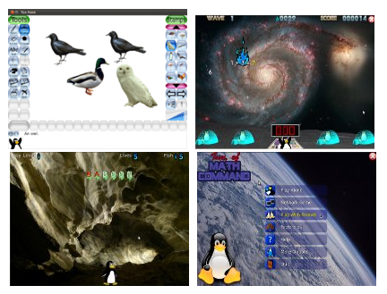

Educational Software
Tux4kids

Slide 162
Educational Software
Tux4kids

Slide 163
Educational Software
Tux4kids

Slide 164
Educational Software
Tux4kids

Slide 165

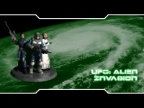
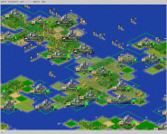

Games
Alien Arena
Freeciv
Freeciv

Slide 166
Games
Alien Arena
Freeciv
Freeciv

Slide 167
Games
Alien Arena
Freeciv
Freeciv

Slide 168
Games
Alien Arena
Freeciv
Freeciv

Slide 169




CAD

Slide 170
CAD

Slide 171
CAD

Slide 172
CAD

Slide 173




Science Tools

Slide 174
Science Tools

Slide 175
Science Tools

Slide 176
Science Tools

Slide 177




Video Editors

Slide 178
Video Editors

Slide 179
Video Editors

Slide 180
Video Editors

Slide 181


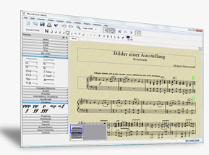

Audio/Music Production
musescore

Slide 182
Audio/Music Production
musescore

Slide 183
Audio/Music Production
musescore

Slide 184
Audio/Music Production
musescore

Slide 185
Can I get it?

Slide 186
Can I get it?

Slide 187
Can I get it?

Slide 188
Can I get it?

Slide 189
Yes you can!

Slide 190
Yes you can!

Slide 191
Yes you can!

Slide 192
Yes you can!

Slide 193
Can I fork it?

Slide 194
Can I fork it?

Slide 195
Can I fork it?

Slide 196
Can I fork it?

Slide 197
Yes you can!

Slide 198
Yes you can!

Slide 199
Yes you can!

Slide 200
Yes you can!

Slide 201
Can I hack it?

Slide 202
Can I hack it?

Slide 203
Can I hack it?

Slide 204
Can I hack it?

Slide 205
Yes you can!

Slide 206
Yes you can!

Slide 207
Yes you can!

Slide 208
Yes you can!

Slide 209
Can I share it?

Slide 210
Can I share it?

Slide 211
Can I share it?

Slide 212
Can I share it?

Slide 213
Yes you can!

Slide 214
Yes you can!

Slide 215
Yes you can!

Slide 216
Yes you can!

Slide 217




Multimedia Players

Slide 218
Multimedia Players

Slide 219
Multimedia Players

Slide 220
Multimedia Players

Slide 221




Email Clients

Slide 222
Email Clients

Slide 223
Email Clients

Slide 224
Email Clients

Slide 225




Web Browsers

Slide 226
Web Browsers

Slide 227
Web Browsers

Slide 228
Web Browsers

Slide 229





Web Authoring and Blogging

Slide 230
Web Authoring and Blogging

Slide 231
Web Authoring and Blogging

Slide 232
Web Authoring and Blogging

Slide 233
There are thousands and thousands
of Open Source-based online tools and systems, not going to attempt to cover those here...

Slide 234
There are thousands and thousands
of Open Source-based online tools and systems, not going to attempt to cover those here...

Slide 235
There are thousands and thousands
of Open Source-based online tools and systems, not going to attempt to cover those here...

Slide 236
There are thousands and thousands
of Open Source-based online tools and systems, not going to attempt to cover those here...

Slide 237
There are thousands and thousands
of Open Source-based online tools and systems, not going to attempt to cover those here...

Slide 238
There are thousands and thousands
of Open Source-based online tools and systems, not going to attempt to cover those here...

Slide 239
There are thousands and thousands
of Open Source-based online tools and systems, not going to attempt to cover those here...

Slide 240
There are thousands and thousands
of Open Source-based online tools and systems, not going to attempt to cover those here...

Slide 241
There are thousands and thousands
of Open Source-based online tools and systems, not going to attempt to cover those here...

Slide 242
There are thousands and thousands
of Open Source-based online tools and systems, not going to attempt to cover those here...

Slide 243
There are thousands and thousands
of Open Source-based online tools and systems, not going to attempt to cover those here...

Slide 244
There are thousands and thousands
of Open Source-based online tools and systems, not going to attempt to cover those here...

Slide 245
There are thousands and thousands
of Open Source-based online tools and systems, not going to attempt to cover those here...

Slide 246
There are thousands and thousands
of Open Source-based online tools and systems, not going to attempt to cover those here...

Slide 247
There are thousands and thousands
of Open Source-based online tools and systems, not going to attempt to cover those here...

Slide 248
There are thousands and thousands
of Open Source-based online tools and systems, not going to attempt to cover those here...

Slide 249
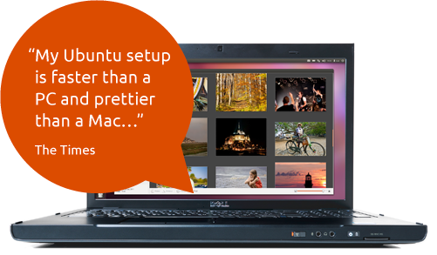
Operating Systems
Again there are lots and lots...
If you've not tried an open source operating system before, Ubuntu is a good place to start

Slide 250
Operating Systems
Again there are lots and lots...
If you've not tried an open source operating system before, Ubuntu is a good place to start

Slide 251
Operating Systems
Again there are lots and lots...
If you've not tried an open source operating system before, Ubuntu is a good place to start

Slide 252
Operating Systems
Again there are lots and lots...
If you've not tried an open source operating system before, Ubuntu is a good place to start

Slide 253
Operating Systems
Again there are lots and lots...
If you've not tried an open source operating system before, Ubuntu is a good place to start

Slide 254
Operating Systems
Again there are lots and lots...
If you've not tried an open source operating system before, Ubuntu is a good place to start

Slide 255
Operating Systems
Again there are lots and lots...
If you've not tried an open source operating system before, Ubuntu is a good place to start

Slide 256
Operating Systems
Again there are lots and lots...
If you've not tried an open source operating system before, Ubuntu is a good place to start

Slide 257
Operating Systems
Again there are lots and lots...
If you've not tried an open source operating system before, Ubuntu is a good place to start

Slide 258
Operating Systems
Again there are lots and lots...
If you've not tried an open source operating system before, Ubuntu is a good place to start

Slide 259
Operating Systems
Again there are lots and lots...
If you've not tried an open source operating system before, Ubuntu is a good place to start

Slide 260
Operating Systems
Again there are lots and lots...
If you've not tried an open source operating system before, Ubuntu is a good place to start

Slide 261
Operating Systems
Again there are lots and lots...
If you've not tried an open source operating system before, Ubuntu is a good place to start

Slide 262
Operating Systems
Again there are lots and lots...
If you've not tried an open source operating system before, Ubuntu is a good place to start

Slide 263
Operating Systems
Again there are lots and lots...
If you've not tried an open source operating system before, Ubuntu is a good place to start

Slide 264
Operating Systems
Again there are lots and lots...
If you've not tried an open source operating system before, Ubuntu is a good place to start

Slide 265
Software Development Tools
no way I'm going to start listing these...

Slide 266
Software Development Tools
no way I'm going to start listing these...

Slide 267
Software Development Tools
no way I'm going to start listing these...

Slide 268
Software Development Tools
no way I'm going to start listing these...

Slide 269
Software Development Tools
no way I'm going to start listing these...

Slide 270
Software Development Tools
no way I'm going to start listing these...

Slide 271
Software Development Tools
no way I'm going to start listing these...

Slide 272
Software Development Tools
no way I'm going to start listing these...

Slide 273
Open Source
=
access to a product's source materials

Slide 274
Open Source
=
access to a product's source materials

Slide 275
Open Source
=
access to a product's source materials

Slide 276
Open Source
=
access to a product's source materials

Slide 277
Open Source
=
access to a product's source materials

Slide 278
Open Source
=
access to a product's source materials

Slide 279
Open Source
=
access to a product's source materials

Slide 280
Open Source
=
access to a product's source materials

Slide 281
software's source material is
“source code”

Slide 282
software's source material is
“source code”

Slide 283
software's source material is
“source code”

Slide 284
software's source material is
“source code”

Slide 285
software's source material is
“source code”

Slide 286
software's source material is
“source code”

Slide 287
software's source material is
“source code”

Slide 288
software's source material is
“source code”

Slide 289
source code is compiled into the software

Slide 290
source code is compiled into the software

Slide 291
source code is compiled into the software

Slide 292
source code is compiled into the software

Slide 293
source code is compiled into the software

Slide 294
source code is compiled into the software

Slide 295
source code is compiled into the software

Slide 296
source code is compiled into the software

Slide 297
anyone who has the
source code to a software application can build their own version

Slide 298
anyone who has the
source code to a software application can build their own version

Slide 299
anyone who has the
source code to a software application can build their own version

Slide 300
anyone who has the
source code to a software application can build their own version

Slide 301
anyone who has the
source code to a software application can build their own version

Slide 302
anyone who has the
source code to a software application can build their own version

Slide 303
anyone who has the
source code to a software application can build their own version

Slide 304
anyone who has the
source code to a software application can build their own version

Slide 305
Free sharing of technological information existed long before computers...

Slide 306
Free sharing of technological information existed long before computers...

Slide 307
Free sharing of technological information existed long before computers...

Slide 308
Free sharing of technological information existed long before computers...

Slide 309
Free sharing of technological information existed long before computers...

Slide 310
Free sharing of technological information existed long before computers...

Slide 311
Free sharing of technological information existed long before computers...

Slide 312
Free sharing of technological information existed long before computers...

Slide 313
... cooking recipes have been shared since the beginning of human culture.

Slide 314
... cooking recipes have been shared since the beginning of human culture.

Slide 315
... cooking recipes have been shared since the beginning of human culture.

Slide 316
... cooking recipes have been shared since the beginning of human culture.

Slide 317
... cooking recipes have been shared since the beginning of human culture.

Slide 318
... cooking recipes have been shared since the beginning of human culture.

Slide 319
... cooking recipes have been shared since the beginning of human culture.

Slide 320
... cooking recipes have been shared since the beginning of human culture.

Slide 321
Can I get it?

Slide 322
Can I get it?

Slide 323
Can I get it?

Slide 324
Can I get it?

Slide 325
Yes you can!

Slide 326
Yes you can!

Slide 327
Yes you can!

Slide 328
Yes you can!

Slide 329
Can I fork it?

Slide 330
Can I fork it?

Slide 331
Can I fork it?

Slide 332
Can I fork it?

Slide 333
Yes you can!

Slide 334
Yes you can!

Slide 335
Yes you can!

Slide 336
Yes you can!

Slide 337
Can I hack it?

Slide 338
Can I hack it?

Slide 339
Can I hack it?

Slide 340
Can I hack it?

Slide 341
Yes you can!

Slide 342
Yes you can!

Slide 343
Yes you can!

Slide 344
Yes you can!

Slide 345
Can I share it?

Slide 346
Can I share it?

Slide 347
Can I share it?

Slide 348
Can I share it?

Slide 349
Yes you can!

Slide 350
Yes you can!

Slide 351
Yes you can!

Slide 352
Yes you can!

Slide 353
get
HTTP/1.1 Method Definitions
The GET method means retrieve whatever information (in the form of an entity) is identified by the Request-URI.
- http://www.w3.org/Protocols/rfc2616/rfc2616-sec9.html

Slide 354
get
HTTP/1.1 Method Definitions
The GET method means retrieve whatever information (in the form of an entity) is identified by the Request-URI.
- http://www.w3.org/Protocols/rfc2616/rfc2616-sec9.html

Slide 355
get
HTTP/1.1 Method Definitions
The GET method means retrieve whatever information (in the form of an entity) is identified by the Request-URI.
- http://www.w3.org/Protocols/rfc2616/rfc2616-sec9.html

Slide 356
get
HTTP/1.1 Method Definitions
The GET method means retrieve whatever information (in the form of an entity) is identified by the Request-URI.
- http://www.w3.org/Protocols/rfc2616/rfc2616-sec9.html

Slide 357
get
HTTP/1.1 Method Definitions
The GET method means retrieve whatever information (in the form of an entity) is identified by the Request-URI.
- http://www.w3.org/Protocols/rfc2616/rfc2616-sec9.html

Slide 358
get
HTTP/1.1 Method Definitions
The GET method means retrieve whatever information (in the form of an entity) is identified by the Request-URI.
- http://www.w3.org/Protocols/rfc2616/rfc2616-sec9.html

Slide 359
get
HTTP/1.1 Method Definitions
The GET method means retrieve whatever information (in the form of an entity) is identified by the Request-URI.
- http://www.w3.org/Protocols/rfc2616/rfc2616-sec9.html

Slide 360
get
HTTP/1.1 Method Definitions
The GET method means retrieve whatever information (in the form of an entity) is identified by the Request-URI.
- http://www.w3.org/Protocols/rfc2616/rfc2616-sec9.html

Slide 361
fork
In software engineering, a project fork happens when developers take a legal copy of source code from one software package and start independent development on it, creating a distinct piece of software.
- http://en.wikipedia.org/wiki/Fork_(software_development)

Slide 362
fork
In software engineering, a project fork happens when developers take a legal copy of source code from one software package and start independent development on it, creating a distinct piece of software.
- http://en.wikipedia.org/wiki/Fork_(software_development)

Slide 363
fork
In software engineering, a project fork happens when developers take a legal copy of source code from one software package and start independent development on it, creating a distinct piece of software.
- http://en.wikipedia.org/wiki/Fork_(software_development)

Slide 364
fork
In software engineering, a project fork happens when developers take a legal copy of source code from one software package and start independent development on it, creating a distinct piece of software.
- http://en.wikipedia.org/wiki/Fork_(software_development)

Slide 365
fork
In software engineering, a project fork happens when developers take a legal copy of source code from one software package and start independent development on it, creating a distinct piece of software.
- http://en.wikipedia.org/wiki/Fork_(software_development)

Slide 366
fork
In software engineering, a project fork happens when developers take a legal copy of source code from one software package and start independent development on it, creating a distinct piece of software.
- http://en.wikipedia.org/wiki/Fork_(software_development)

Slide 367
fork
In software engineering, a project fork happens when developers take a legal copy of source code from one software package and start independent development on it, creating a distinct piece of software.
- http://en.wikipedia.org/wiki/Fork_(software_development)

Slide 368
fork
In software engineering, a project fork happens when developers take a legal copy of source code from one software package and start independent development on it, creating a distinct piece of software.
- http://en.wikipedia.org/wiki/Fork_(software_development)

Slide 369
hack
intransitive verb
4a:
to write computer programs for enjoyment
- http://www.merriam-webster.com/dictionary/hack

Slide 370
hack
intransitive verb
4a:
to write computer programs for enjoyment
- http://www.merriam-webster.com/dictionary/hack

Slide 371
hack
intransitive verb
4a:
to write computer programs for enjoyment
- http://www.merriam-webster.com/dictionary/hack

Slide 372
hack
intransitive verb
4a:
to write computer programs for enjoyment
- http://www.merriam-webster.com/dictionary/hack

Slide 373
hack
intransitive verb
4a:
to write computer programs for enjoyment
- http://www.merriam-webster.com/dictionary/hack

Slide 374
hack
intransitive verb
4a:
to write computer programs for enjoyment
- http://www.merriam-webster.com/dictionary/hack

Slide 375
hack
intransitive verb
4a:
to write computer programs for enjoyment
- http://www.merriam-webster.com/dictionary/hack

Slide 376
hack
intransitive verb
4a:
to write computer programs for enjoyment
- http://www.merriam-webster.com/dictionary/hack

Slide 377
share
verb (used with object)
4.
to use, participate in,enjoy, receive,etc.,jointly: The two chemists shared the Nobel prize.
- http://dictionary.reference.com/browse/share

Slide 378
share
verb (used with object)
4.
to use, participate in,enjoy, receive,etc.,jointly: The two chemists shared the Nobel prize.
- http://dictionary.reference.com/browse/share

Slide 379
share
verb (used with object)
4.
to use, participate in,enjoy, receive,etc.,jointly: The two chemists shared the Nobel prize.
- http://dictionary.reference.com/browse/share

Slide 380
share
verb (used with object)
4.
to use, participate in,enjoy, receive,etc.,jointly: The two chemists shared the Nobel prize.
- http://dictionary.reference.com/browse/share

Slide 381
share
verb (used with object)
4.
to use, participate in,enjoy, receive,etc.,jointly: The two chemists shared the Nobel prize.
- http://dictionary.reference.com/browse/share

Slide 382
share
verb (used with object)
4.
to use, participate in,enjoy, receive,etc.,jointly: The two chemists shared the Nobel prize.
- http://dictionary.reference.com/browse/share

Slide 383
share
verb (used with object)
4.
to use, participate in,enjoy, receive,etc.,jointly: The two chemists shared the Nobel prize.
- http://dictionary.reference.com/browse/share

Slide 384
share
verb (used with object)
4.
to use, participate in,enjoy, receive,etc.,jointly: The two chemists shared the Nobel prize.
- http://dictionary.reference.com/browse/share

Slide 385
Open Source Software is free*

Slide 386
Open Source Software is free*

Slide 387
Open Source Software is free*

Slide 388
Open Source Software is free*

Slide 389
Open Source Software is free*

Slide 390
Open Source Software is free*

Slide 391
Open Source Software is free*

Slide 392
Open Source Software is free*

Slide 393
*
'Free software' is a matter of liberty, not price...

Slide 394
*
'Free software' is a matter of liberty, not price...

Slide 395
*
'Free software' is a matter of liberty, not price...

Slide 396
*
'Free software' is a matter of liberty, not price...

Slide 397
*
'Free software' is a matter of liberty, not price...

Slide 398
*
'Free software' is a matter of liberty, not price...

Slide 399
*
'Free software' is a matter of liberty, not price...

Slide 400
*
'Free software' is a matter of liberty, not price...

Slide 401
...you should think of 'free' as in 'free speech,' not as in 'free beer'.
- Richard Stallman

Slide 402
...you should think of 'free' as in 'free speech,' not as in 'free beer'.
- Richard Stallman

Slide 403
...you should think of 'free' as in 'free speech,' not as in 'free beer'.
- Richard Stallman

Slide 404
...you should think of 'free' as in 'free speech,' not as in 'free beer'.
- Richard Stallman

Slide 405
...you should think of 'free' as in 'free speech,' not as in 'free beer'.
- Richard Stallman

Slide 406
...you should think of 'free' as in 'free speech,' not as in 'free beer'.
- Richard Stallman

Slide 407
...you should think of 'free' as in 'free speech,' not as in 'free beer'.
- Richard Stallman

Slide 408
...you should think of 'free' as in 'free speech,' not as in 'free beer'.
- Richard Stallman

Slide 409
...however Open Source Software is usually free as in
'free beer' as well

Slide 410
...however Open Source Software is usually free as in
'free beer' as well

Slide 411
...however Open Source Software is usually free as in
'free beer' as well

Slide 412
...however Open Source Software is usually free as in
'free beer' as well

Slide 413
...however Open Source Software is usually free as in
'free beer' as well

Slide 414
...however Open Source Software is usually free as in
'free beer' as well

Slide 415
...however Open Source Software is usually free as in
'free beer' as well

Slide 416
...however Open Source Software is usually free as in
'free beer' as well

Slide 417
many other things can be
“Open”

Slide 418
many other things can be
“Open”

Slide 419
many other things can be
“Open”

Slide 420
many other things can be
“Open”

Slide 421
Open Documents,
Open Media
check out :
Creative Commons

Slide 422
Open Documents,
Open Media
check out :
Creative Commons

Slide 423
Open Documents,
Open Media
check out :
Creative Commons

Slide 424
Open Documents,
Open Media
check out :
Creative Commons

Slide 425

http://search.creativecommons.org

Slide 426
http://search.creativecommons.org

Slide 427
http://search.creativecommons.org

Slide 428
http://search.creativecommons.org

Slide 429
Open Data
check out :
Linked Open Data

Slide 430
Open Data
check out :
Linked Open Data

Slide 431
Open Data
check out :
Linked Open Data

Slide 432
Open Data
check out :
Linked Open Data

Slide 433
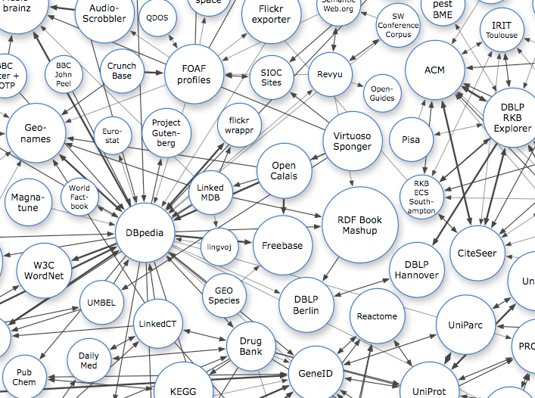
http://linkeddata.org

Slide 434
http://linkeddata.org

Slide 435
http://linkeddata.org

Slide 436
http://linkeddata.org

Slide 437

Open Hardware
check out :
http://www.ohwr.org

Slide 438
Open Hardware
check out :
http://www.ohwr.org

Slide 439
Open Hardware
check out :
http://www.ohwr.org

Slide 440
Open Hardware
check out :
http://www.ohwr.org

Slide 441
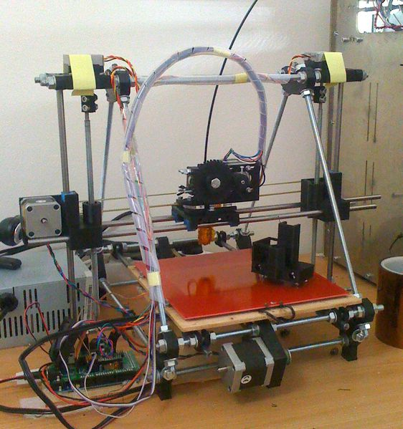
Open Source 3D Printer
http://reprap.org

Slide 442
Open Source 3D Printer
http://reprap.org

Slide 443
Open Source 3D Printer
http://reprap.org

Slide 444
Open Source 3D Printer
http://reprap.org

Slide 445
If you can't take it apart
you don't own it.

Slide 446
If you can't take it apart
you don't own it.

Slide 447
If you can't take it apart
you don't own it.

Slide 448
If you can't take it apart
you don't own it.

Slide 449

Open Ecology
check out :

Slide 450
Open Ecology
check out :

Slide 451
Open Ecology
check out :

Slide 452
Open Ecology
check out :

Slide 453
The Global Village Construction Set is a platform that allows for the easy fabrication of the 50 different Industrial Machines that it takes to build a small, sustainable civilization with modern comforts.

Slide 454
The Global Village Construction Set is a platform that allows for the easy fabrication of the 50 different Industrial Machines that it takes to build a small, sustainable civilization with modern comforts.

Slide 455
The Global Village Construction Set is a platform that allows for the easy fabrication of the 50 different Industrial Machines that it takes to build a small, sustainable civilization with modern comforts.

Slide 456
The Global Village Construction Set is a platform that allows for the easy fabrication of the 50 different Industrial Machines that it takes to build a small, sustainable civilization with modern comforts.

Slide 457
The Global Village Construction Set is a platform that allows for the easy fabrication of the 50 different Industrial Machines that it takes to build a small, sustainable civilization with modern comforts.

Slide 458
The Global Village Construction Set is a platform that allows for the easy fabrication of the 50 different Industrial Machines that it takes to build a small, sustainable civilization with modern comforts.

Slide 459
The Global Village Construction Set is a platform that allows for the easy fabrication of the 50 different Industrial Machines that it takes to build a small, sustainable civilization with modern comforts.

Slide 460
The Global Village Construction Set is a platform that allows for the easy fabrication of the 50 different Industrial Machines that it takes to build a small, sustainable civilization with modern comforts.

Slide 461
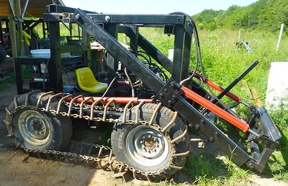
Open Source Tractor
http://opensourceecology.org

Slide 462
Open Source Tractor
http://opensourceecology.org

Slide 463
Open Source Tractor
http://opensourceecology.org

Slide 464
Open Source Tractor
http://opensourceecology.org

Slide 465

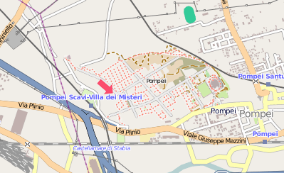
http://www.openstreetmap.org

Slide 466
http://www.openstreetmap.org

Slide 467
http://www.openstreetmap.org

Slide 468
http://www.openstreetmap.org

Slide 469
Open Science,
Open Typography,
Open Journalism
...

Slide 470
Open Science,
Open Typography,
Open Journalism
...

Slide 471
Open Science,
Open Typography,
Open Journalism
...

Slide 472
Open Science,
Open Typography,
Open Journalism
...

Slide 473
Open Science,
Open Typography,
Open Journalism
...

Slide 474
Open Science,
Open Typography,
Open Journalism
...

Slide 475
Open Science,
Open Typography,
Open Journalism
...

Slide 476
Open Science,
Open Typography,
Open Journalism
...

Slide 477

get it!

Slide 478
fork it!

Slide 479
hack it!

Slide 480
share it!

Slide 481
get it!

Slide 482
fork it!

Slide 483
hack it!

Slide 484
share it!

Slide 485
get it!

Slide 486
fork it!

Slide 487
hack it!

Slide 488
share it!

Slide 489
get it!

Slide 490
fork it!

Slide 491
hack it!

Slide 492
share it!

Slide 493
get it!

Slide 494
fork it!

Slide 495
hack it!

Slide 496
share it!

Slide 497
get it!

Slide 498
fork it!

Slide 499
hack it!

Slide 500
share it!

Slide 501
get it!

Slide 502
fork it!

Slide 503
hack it!

Slide 504
share it!

Slide 505
get it!

Slide 506
fork it!

Slide 507
hack it!

Slide 508
share it!

Slide 509
get it!

Slide 510
fork it!

Slide 511
hack it!

Slide 512
share it!

Slide 513
About this soundtrack
Inspiration came from lots of places, the few samples used are here for educational purposes...
Berlin Bouncer photo by Bergi
Everything else (c) Danny Ayers 2011
(CC!!!!!, attribution appreciated)

Slide 514
About this soundtrack
Inspiration came from lots of places, the few samples used are here for educational purposes...
Berlin Bouncer photo by Bergi
Everything else (c) Danny Ayers 2011
(CC!!!!!, attribution appreciated)

Slide 515
About this soundtrack
Inspiration came from lots of places, the few samples used are here for educational purposes...
Berlin Bouncer photo by Bergi
Everything else (c) Danny Ayers 2011
(CC!!!!!, attribution appreciated)

Slide 516
About this soundtrack
Inspiration came from lots of places, the few samples used are here for educational purposes...
Berlin Bouncer photo by Bergi
Everything else (c) Danny Ayers 2011
(CC!!!!!, attribution appreciated)

Slide 517
About this soundtrack
Inspiration came from lots of places, the few samples used are here for educational purposes...
Berlin Bouncer photo by Bergi
Everything else (c) Danny Ayers 2011
(CC!!!!!, attribution appreciated)

Slide 518
About this soundtrack
Inspiration came from lots of places, the few samples used are here for educational purposes...
Berlin Bouncer photo by Bergi
Everything else (c) Danny Ayers 2011
(CC!!!!!, attribution appreciated)

Slide 519
About this soundtrack
Inspiration came from lots of places, the few samples used are here for educational purposes...
Berlin Bouncer photo by Bergi
Everything else (c) Danny Ayers 2011
(CC!!!!!, attribution appreciated)

Slide 520
About this soundtrack
Inspiration came from lots of places, the few samples used are here for educational purposes...
Berlin Bouncer photo by Bergi
Everything else (c) Danny Ayers 2011
(CC!!!!!, attribution appreciated)

Slide 521
About this soundtrack
Inspiration came from lots of places, the few samples used are here for educational purposes...
Berlin Bouncer photo by Bergi
Everything else (c) Danny Ayers 2011
(CC!!!!!, attribution appreciated)

Slide 522
About this soundtrack
Inspiration came from lots of places, the few samples used are here for educational purposes...
Berlin Bouncer photo by Bergi
Everything else (c) Danny Ayers 2011
(CC!!!!!, attribution appreciated)

Slide 523
About this soundtrack
Inspiration came from lots of places, the few samples used are here for educational purposes...
Berlin Bouncer photo by Bergi
Everything else (c) Danny Ayers 2011
(CC!!!!!, attribution appreciated)

Slide 524
About this soundtrack
Inspiration came from lots of places, the few samples used are here for educational purposes...
Berlin Bouncer photo by Bergi
Everything else (c) Danny Ayers 2011
(CC!!!!!, attribution appreciated)

Slide 525
About this soundtrack
Inspiration came from lots of places, the few samples used are here for educational purposes...
Berlin Bouncer photo by Bergi
Everything else (c) Danny Ayers 2011
(CC!!!!!, attribution appreciated)

Slide 526
About this soundtrack
Inspiration came from lots of places, the few samples used are here for educational purposes...
Berlin Bouncer photo by Bergi
Everything else (c) Danny Ayers 2011
(CC!!!!!, attribution appreciated)

Slide 527
About this soundtrack
Inspiration came from lots of places, the few samples used are here for educational purposes...
Berlin Bouncer photo by Bergi
Everything else (c) Danny Ayers 2011
(CC!!!!!, attribution appreciated)

Slide 528
About this soundtrack
Inspiration came from lots of places, the few samples used are here for educational purposes...
Berlin Bouncer photo by Bergi
Everything else (c) Danny Ayers 2011
(CC!!!!!, attribution appreciated)

Slide 529
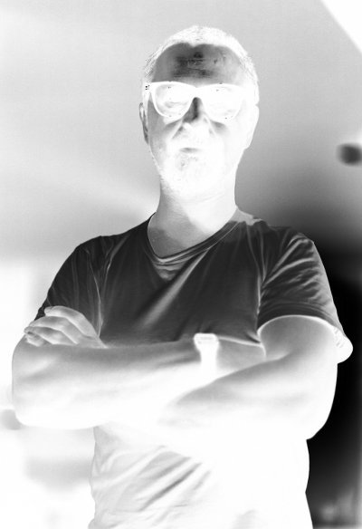
Source available from
http://hyperdata.org/hackit

Slide 530
Source available from
http://hyperdata.org/hackit

Slide 531
Source available from
http://hyperdata.org/hackit

Slide 532
Source available from
http://hyperdata.org/hackit

Slide 533
Source available from
http://hyperdata.org/hackit

Slide 534
Source available from
http://hyperdata.org/hackit

Slide 535
Source available from
http://hyperdata.org/hackit

Slide 536
Source available from
http://hyperdata.org/hackit

Slide 537
Source available from
http://hyperdata.org/hackit

Slide 538
Source available from
http://hyperdata.org/hackit

Slide 539
Source available from
http://hyperdata.org/hackit

Slide 540
Source available from
http://hyperdata.org/hackit

Slide 541
Source available from
http://hyperdata.org/hackit

Slide 542
Source available from
http://hyperdata.org/hackit

Slide 543
Source available from
http://hyperdata.org/hackit

Slide 544
Source available from
http://hyperdata.org/hackit

