Slide 1
UCD BootCamp
California Suicide Trends
Mariko Falke, Daniel Ardoin, John Kozitza

Slide 2
Project Focus
Identify teen suicide trends in California.

Slide 3
Questions
Do economic conditions affect suicide;
Does the geographical location affect suicide rates;

Slide 4
Questions
Are there social conditions that affect suicide rates;

Slide 5
Data Sources
Conducted internet search for data specific to “teens”, “suicide” and “California”
(e.g. Data.gov);

Slide 6
Data Review
The team reviewed the various data sources for matching criteria:
Age: Teenager
Subject: Suicide
Geography: California

Slide 7
Data Review
Most of the data reviewed was:
Too general (e.g. time; national; male/female;…etc.)
Too specific (e.g. race; gender; geographical area)
Insufficient data fields to support proper trend analysis;

Slide 8
Data Review
Most of the data reviewed was: (continued)
Data fields would be difficult to filter for trend analysis;
Data was difficult to find specifically for teens.

Slide 9
Data Review
Project Focus:
Identify suicide trends in California
Specific demographics at risk
Regional hotspots

Slide 10
Data Cleanup
Reviewed the data in Excel:
Sorting data using pivot tables and filters
Determined data required separating into two (2) major categories:
California: Male/Female; Race/Ethnicity
County: Suicide rate by county
Import data into Jupyter Notebook to process and chart.

Slide 11
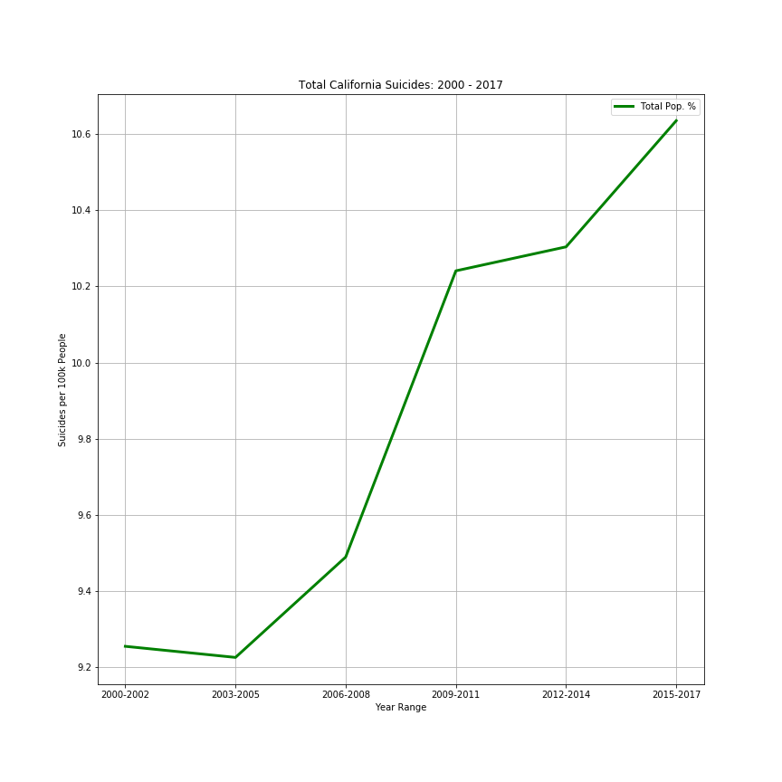
General Trend for Suicides in California

Slide 12
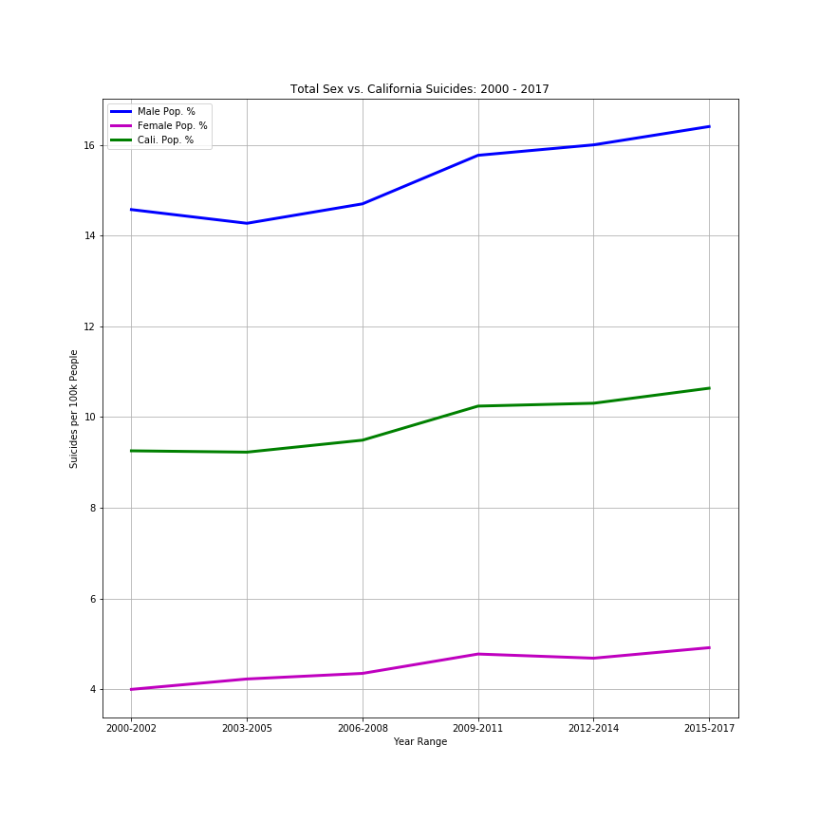
Male/Female Suicide for California

Slide 13
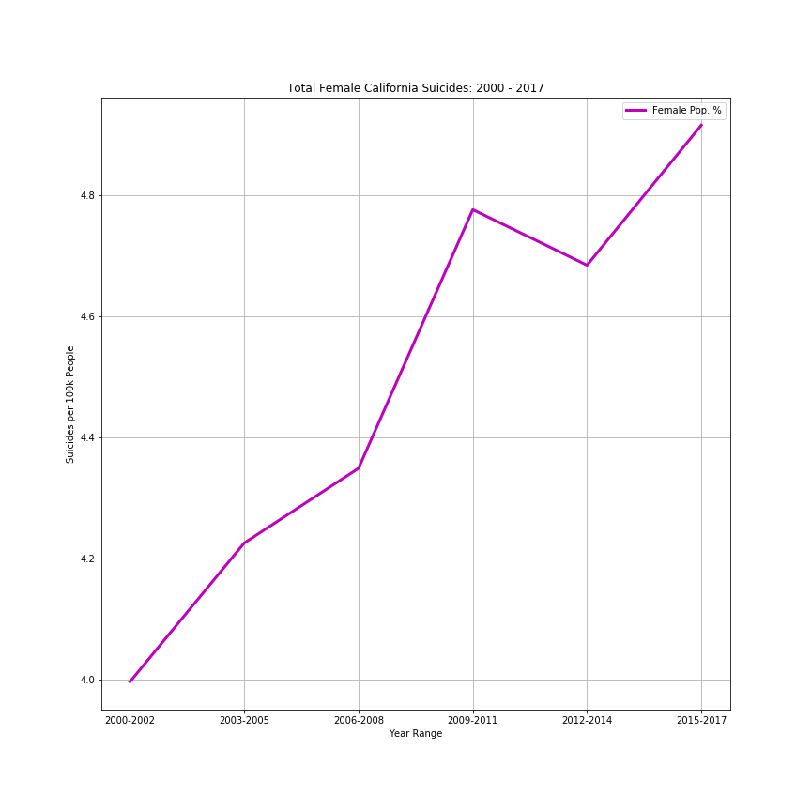
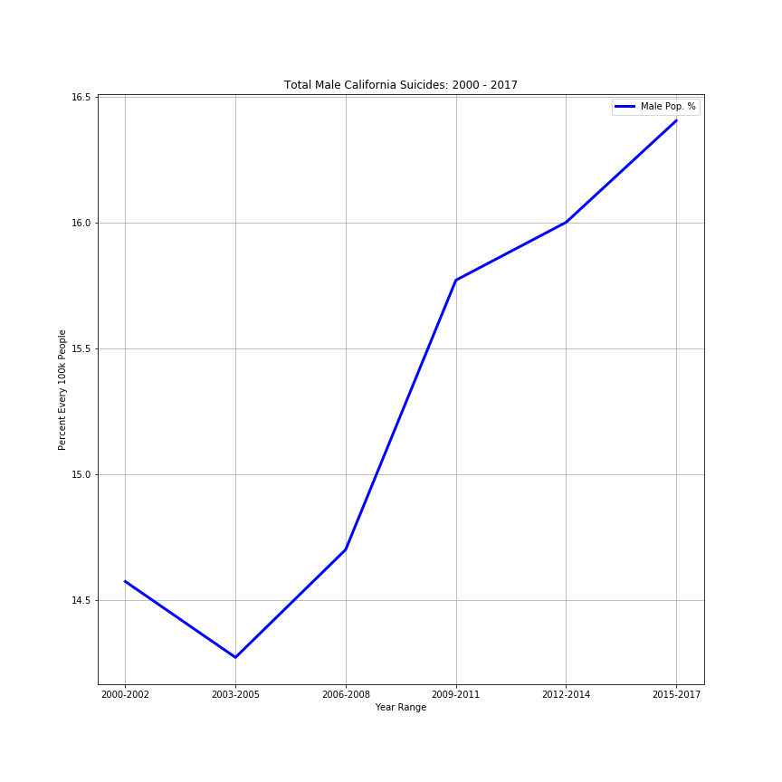
Suicide Trends by Sex in California
Females California Males

Slide 14
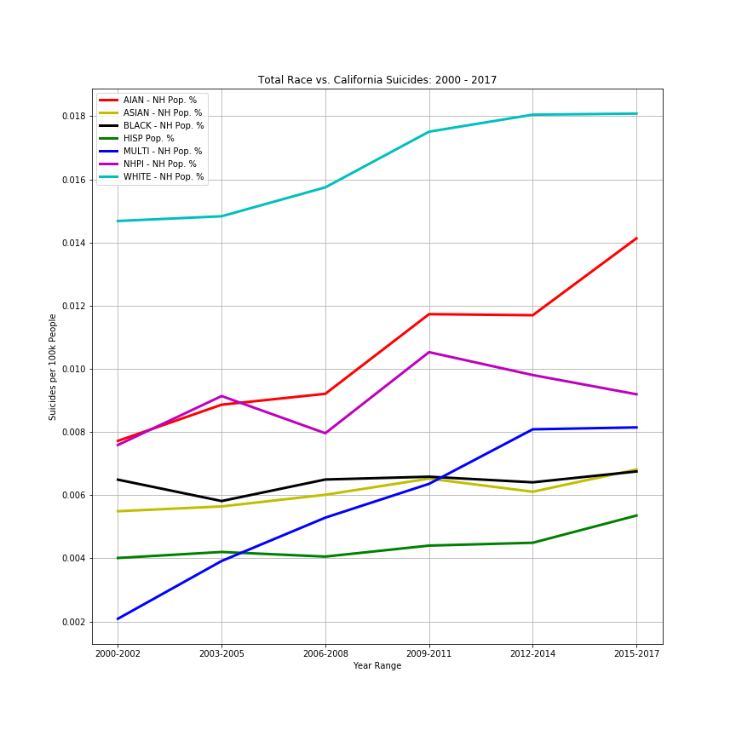
Suicide Grouped by Ethnicity

Slide 15
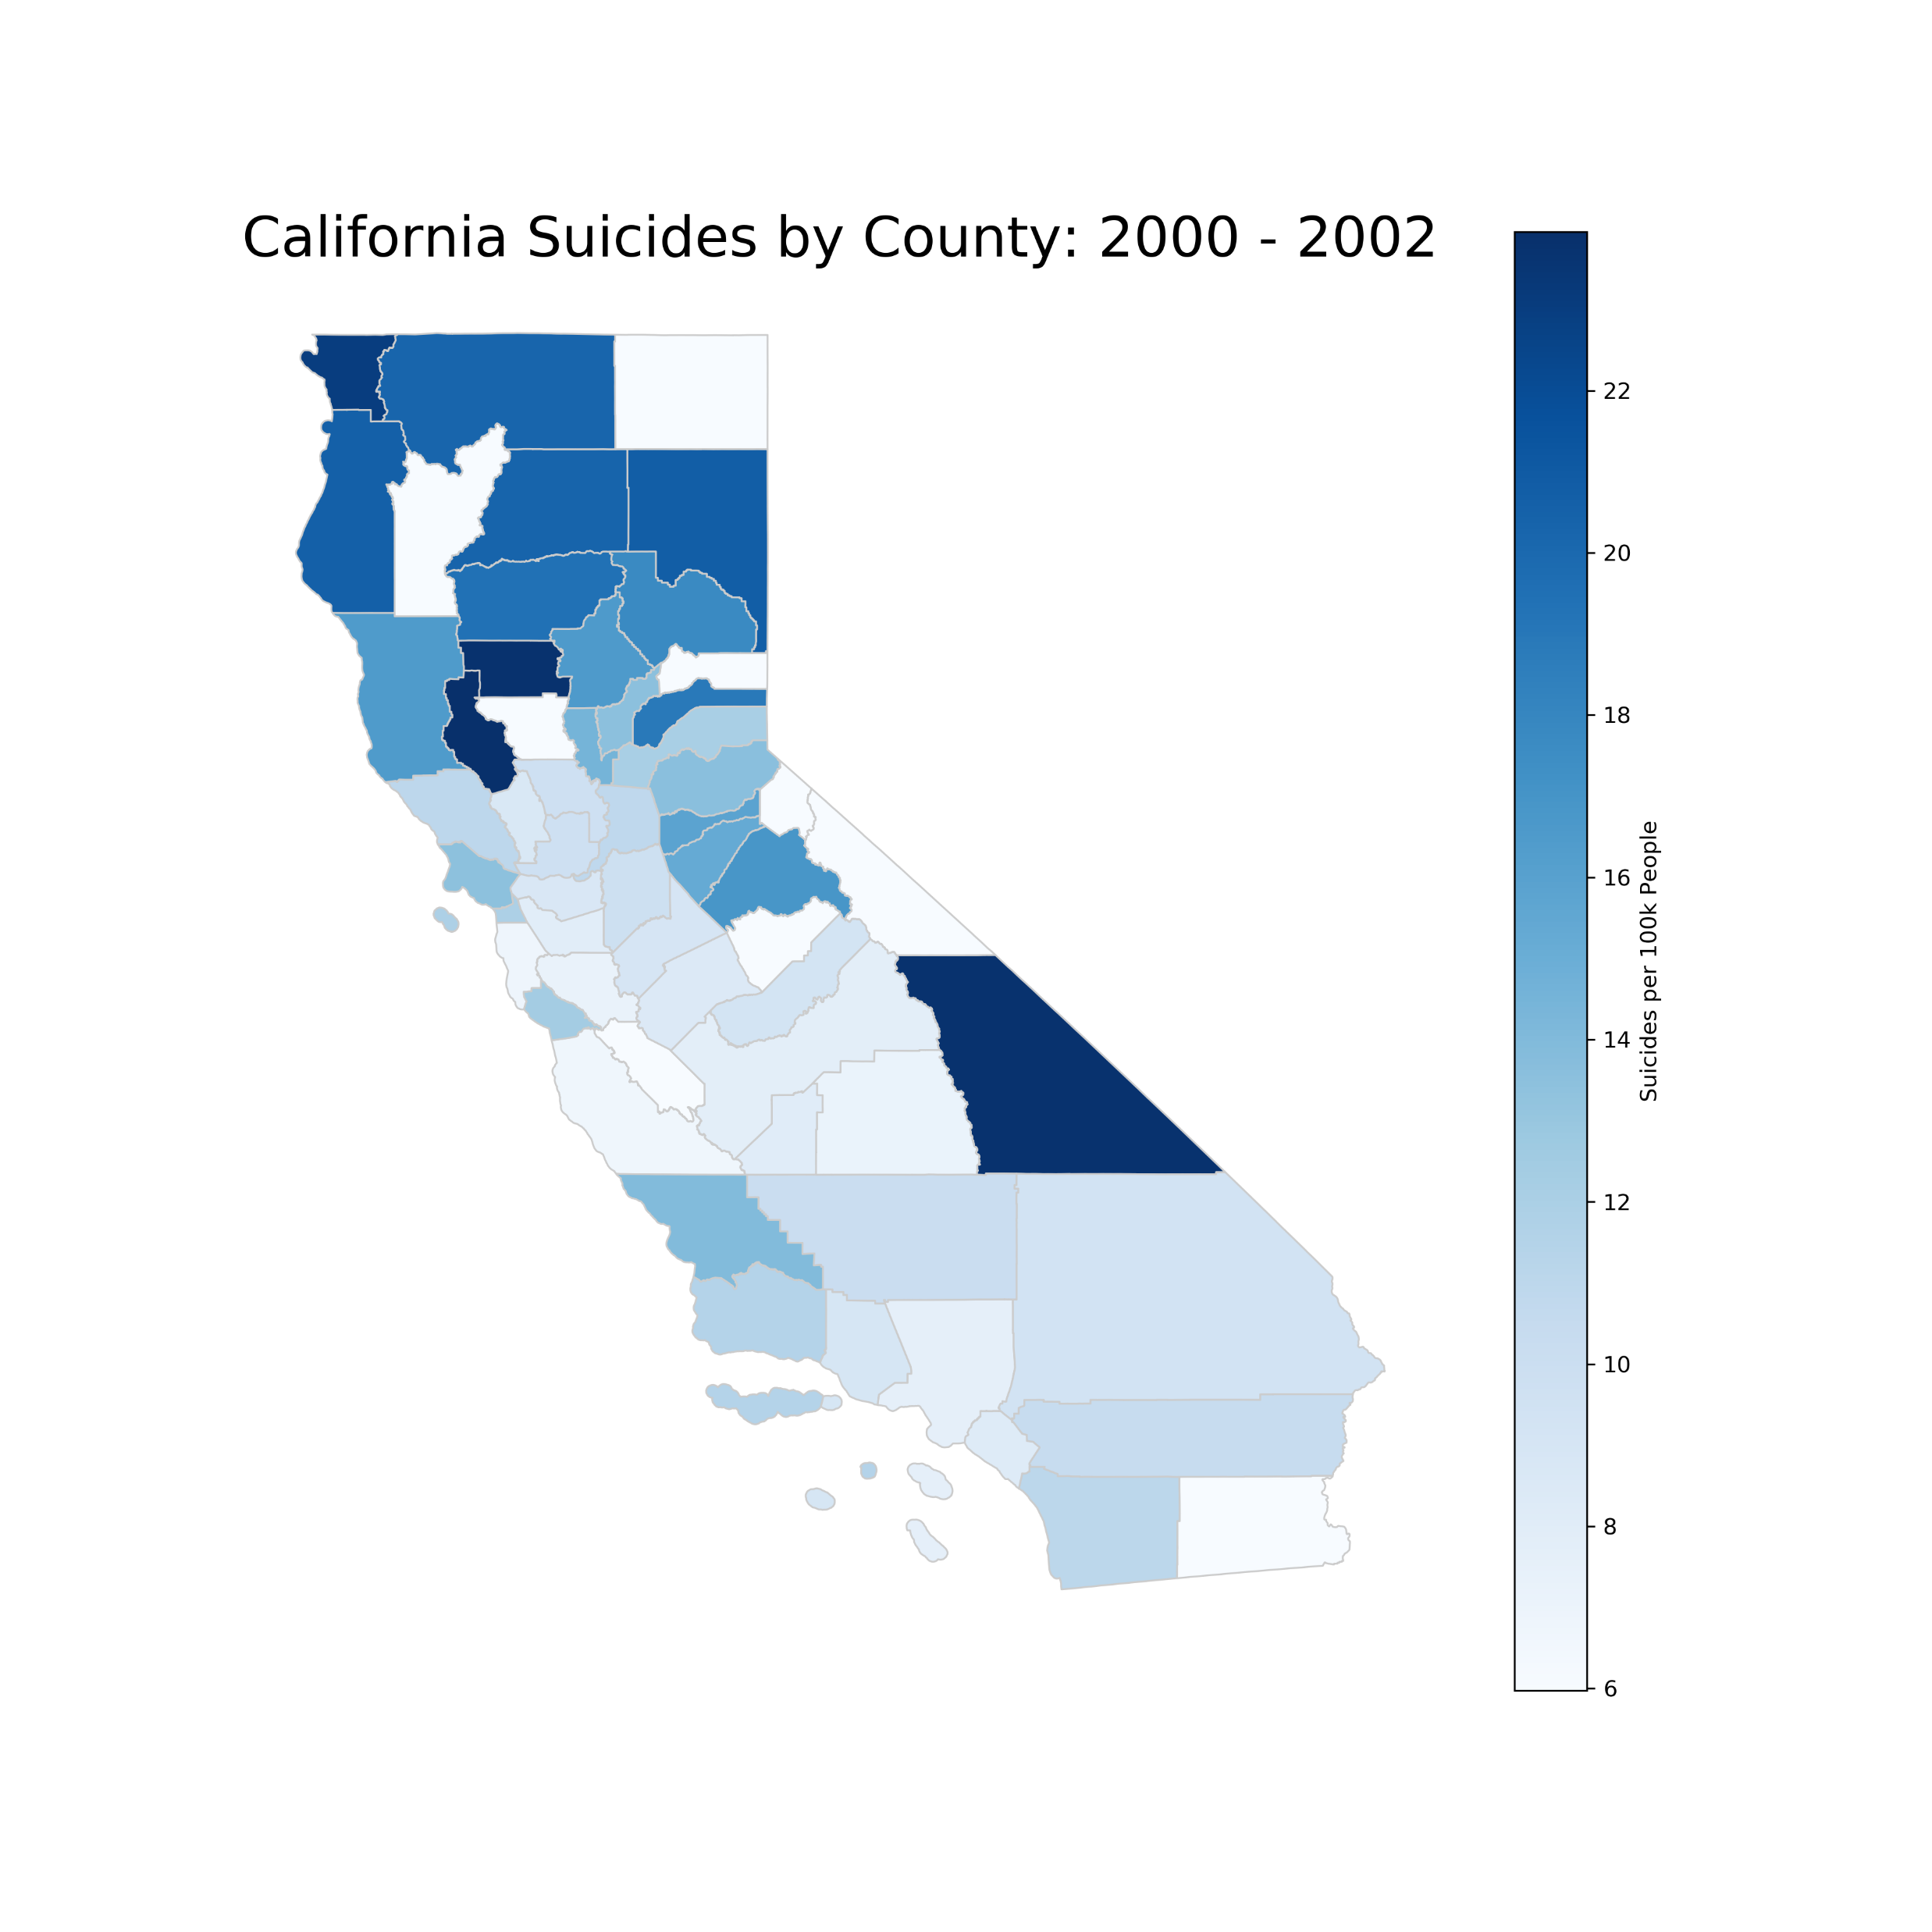
Suicide by Counties
2000-2002

Slide 16
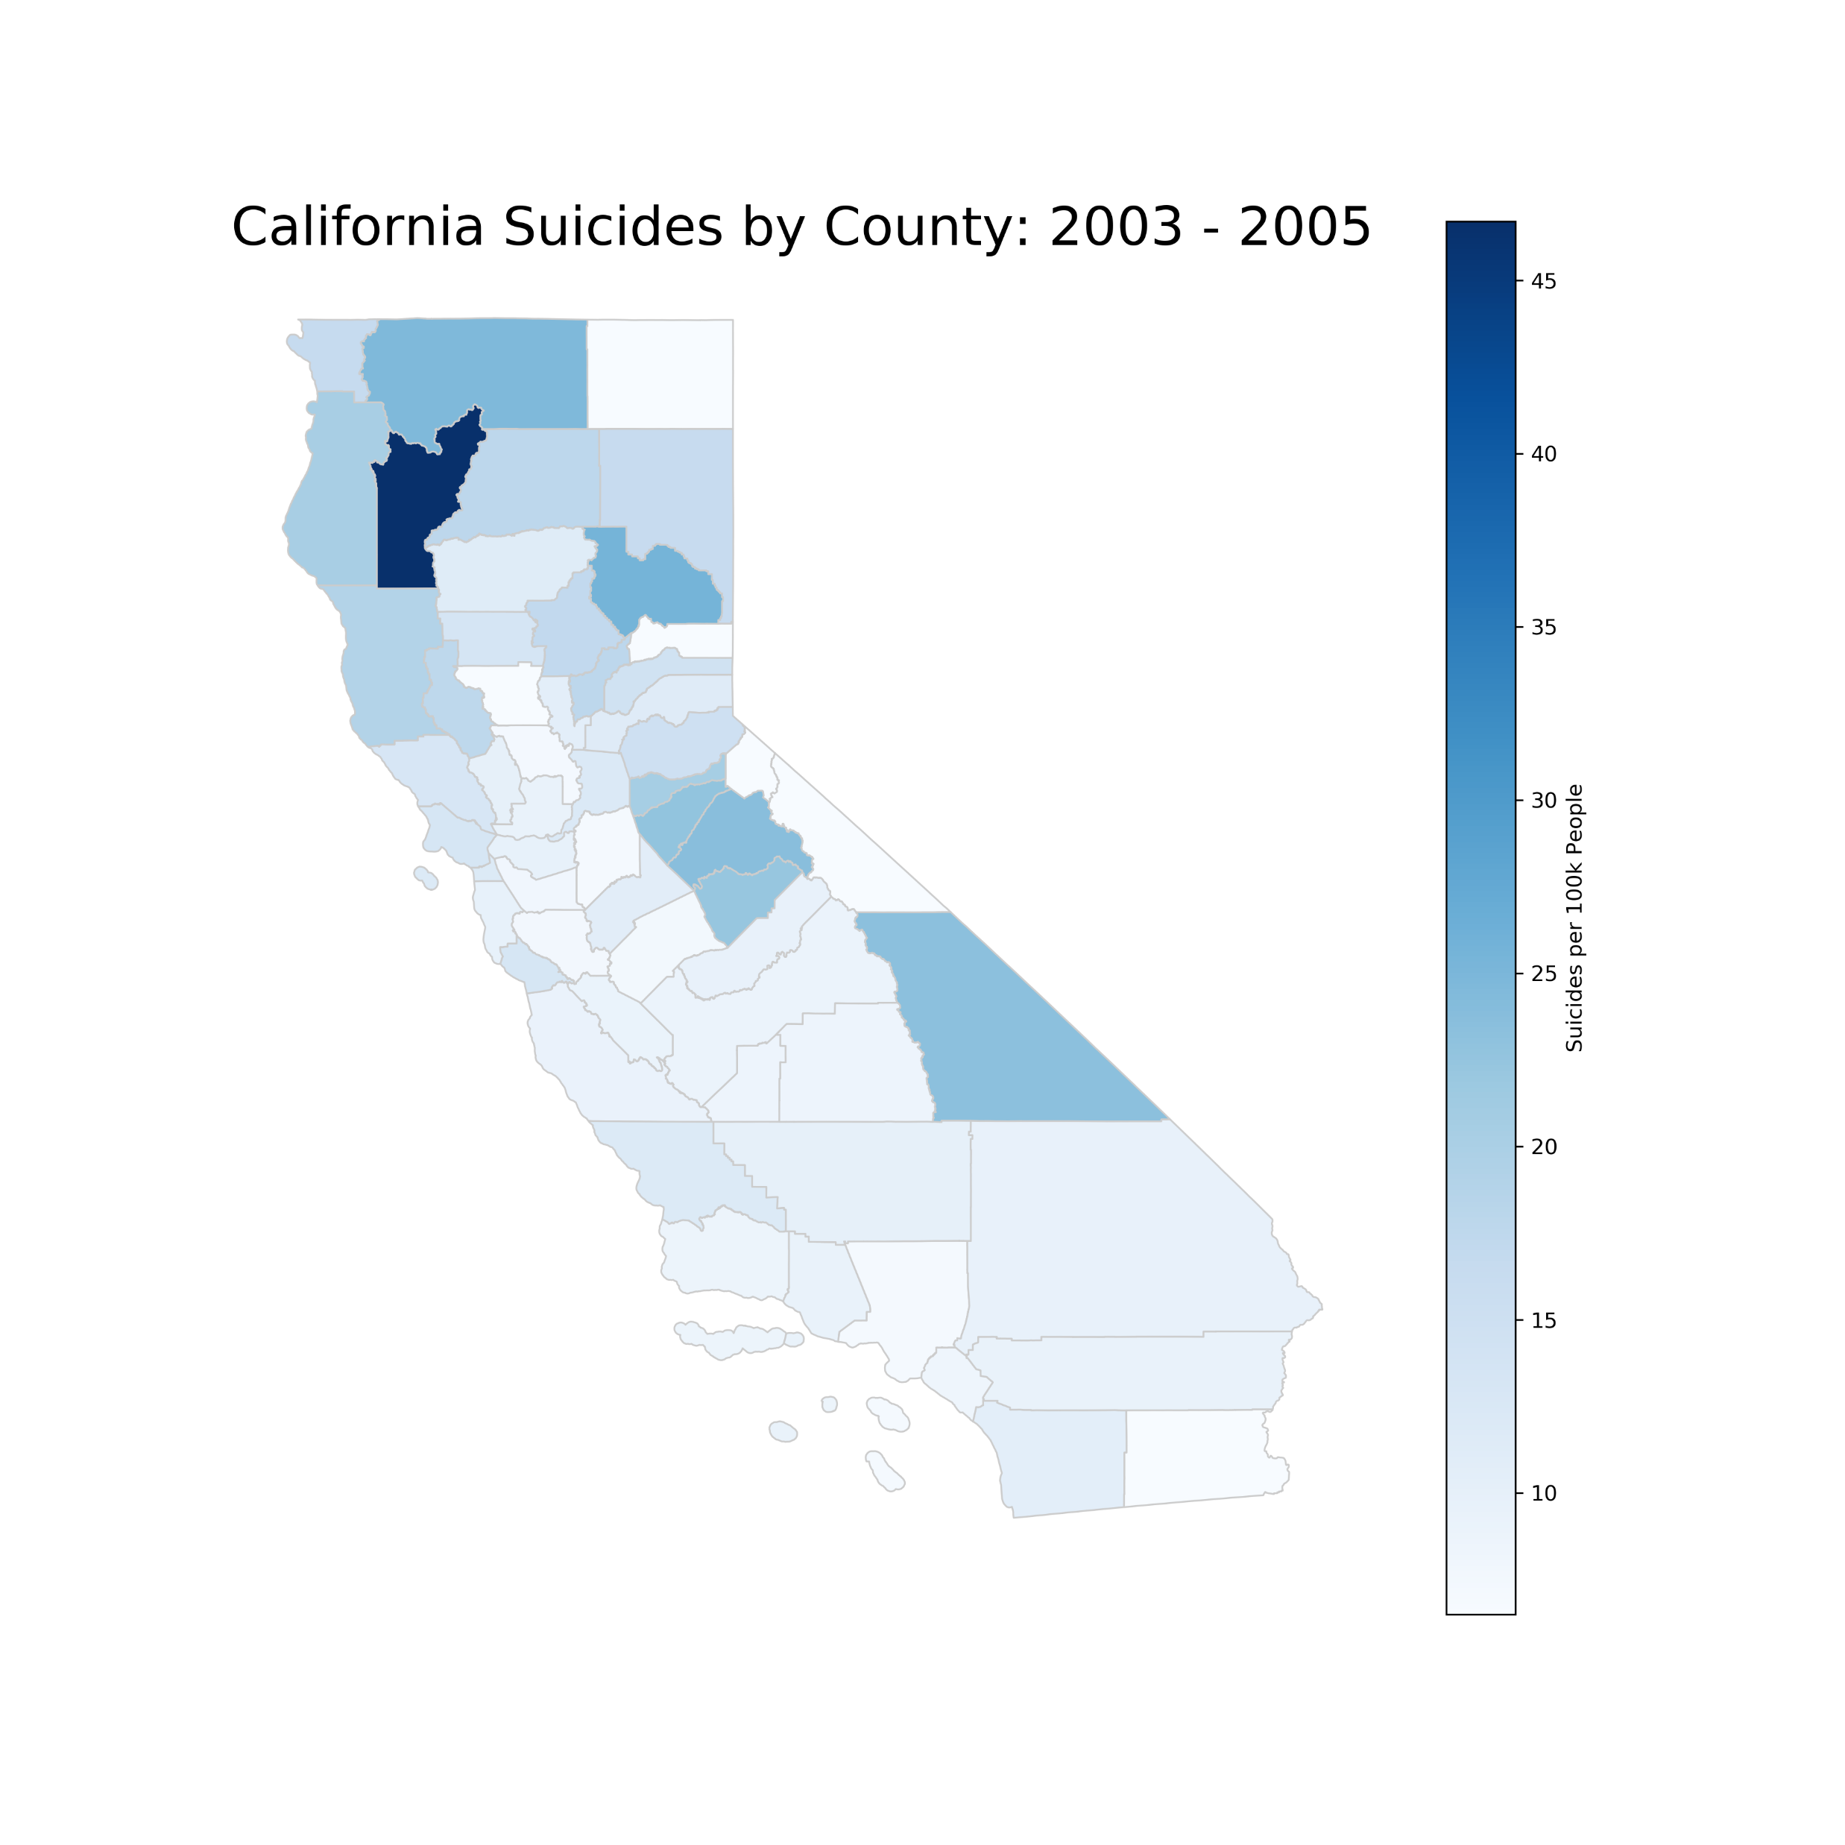
Suicide by Counties
2003-2005

Slide 17
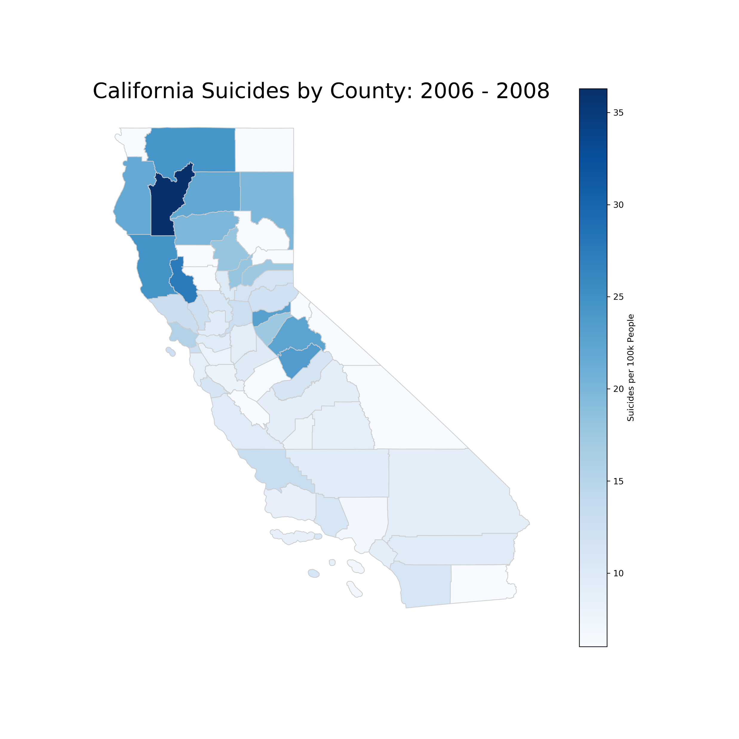
Suicide by Counties
2006-2008

Slide 18
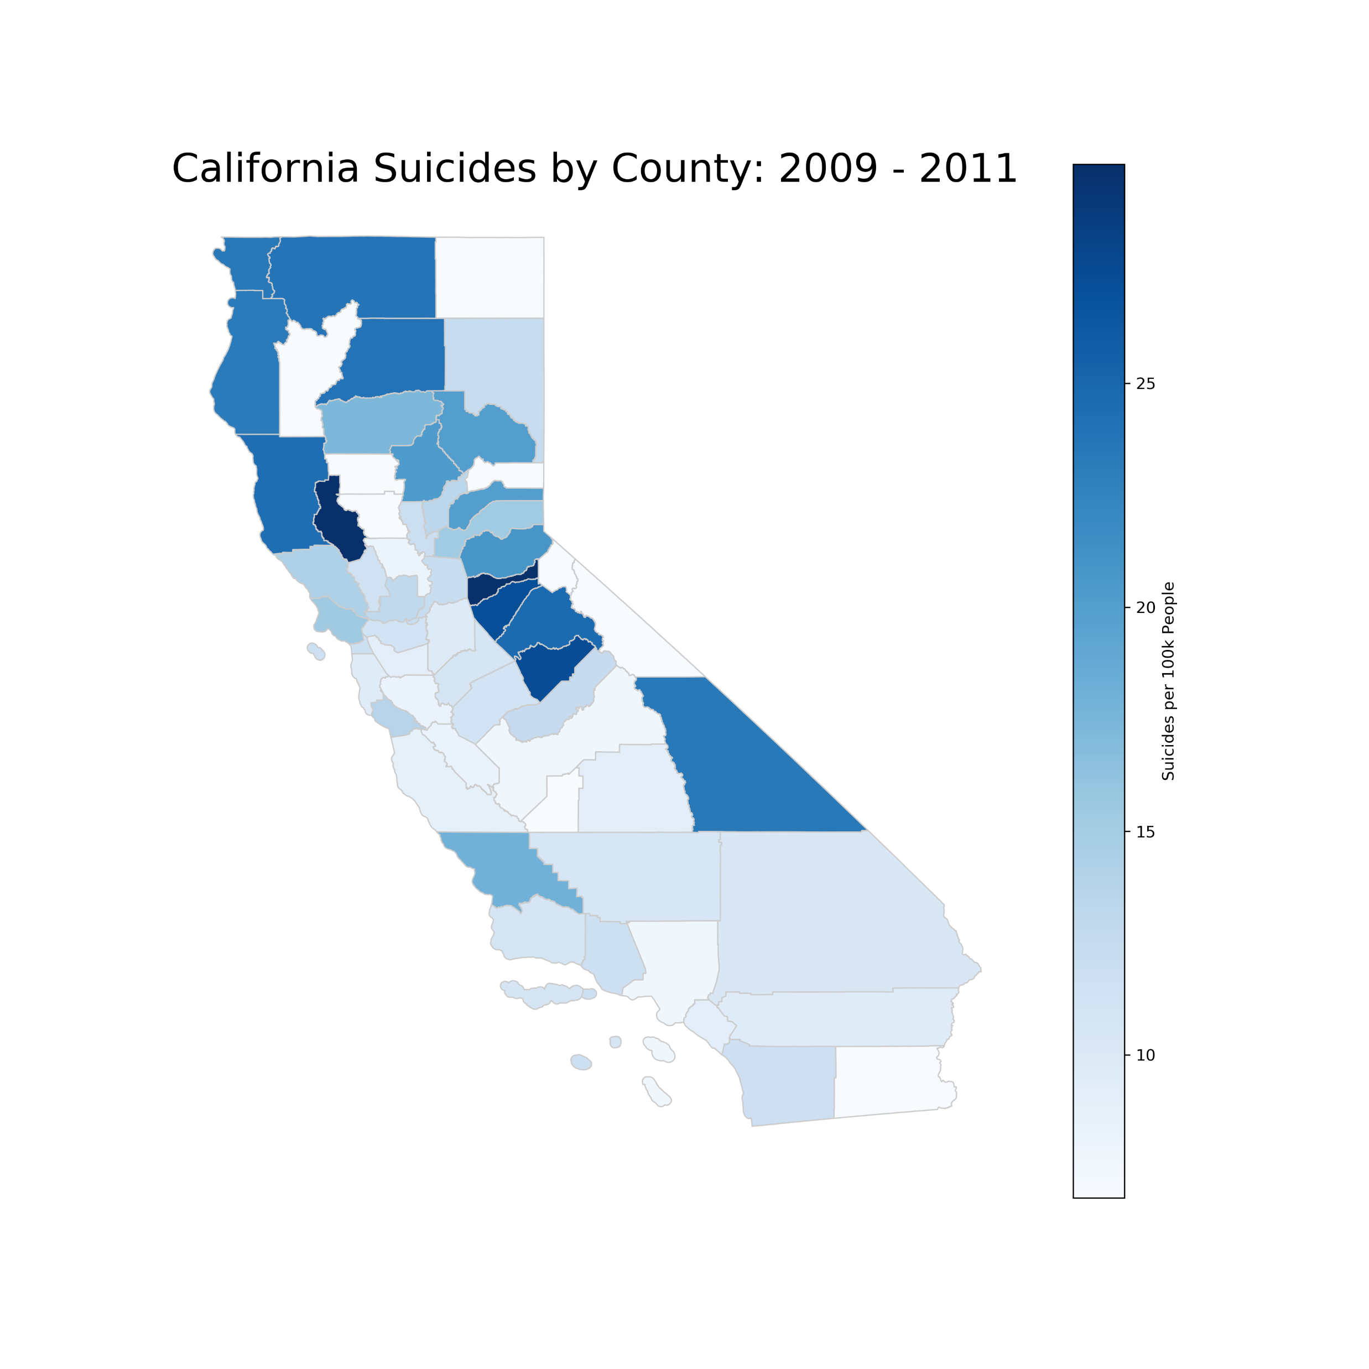
Suicide by Counties
2009-2011

Slide 19
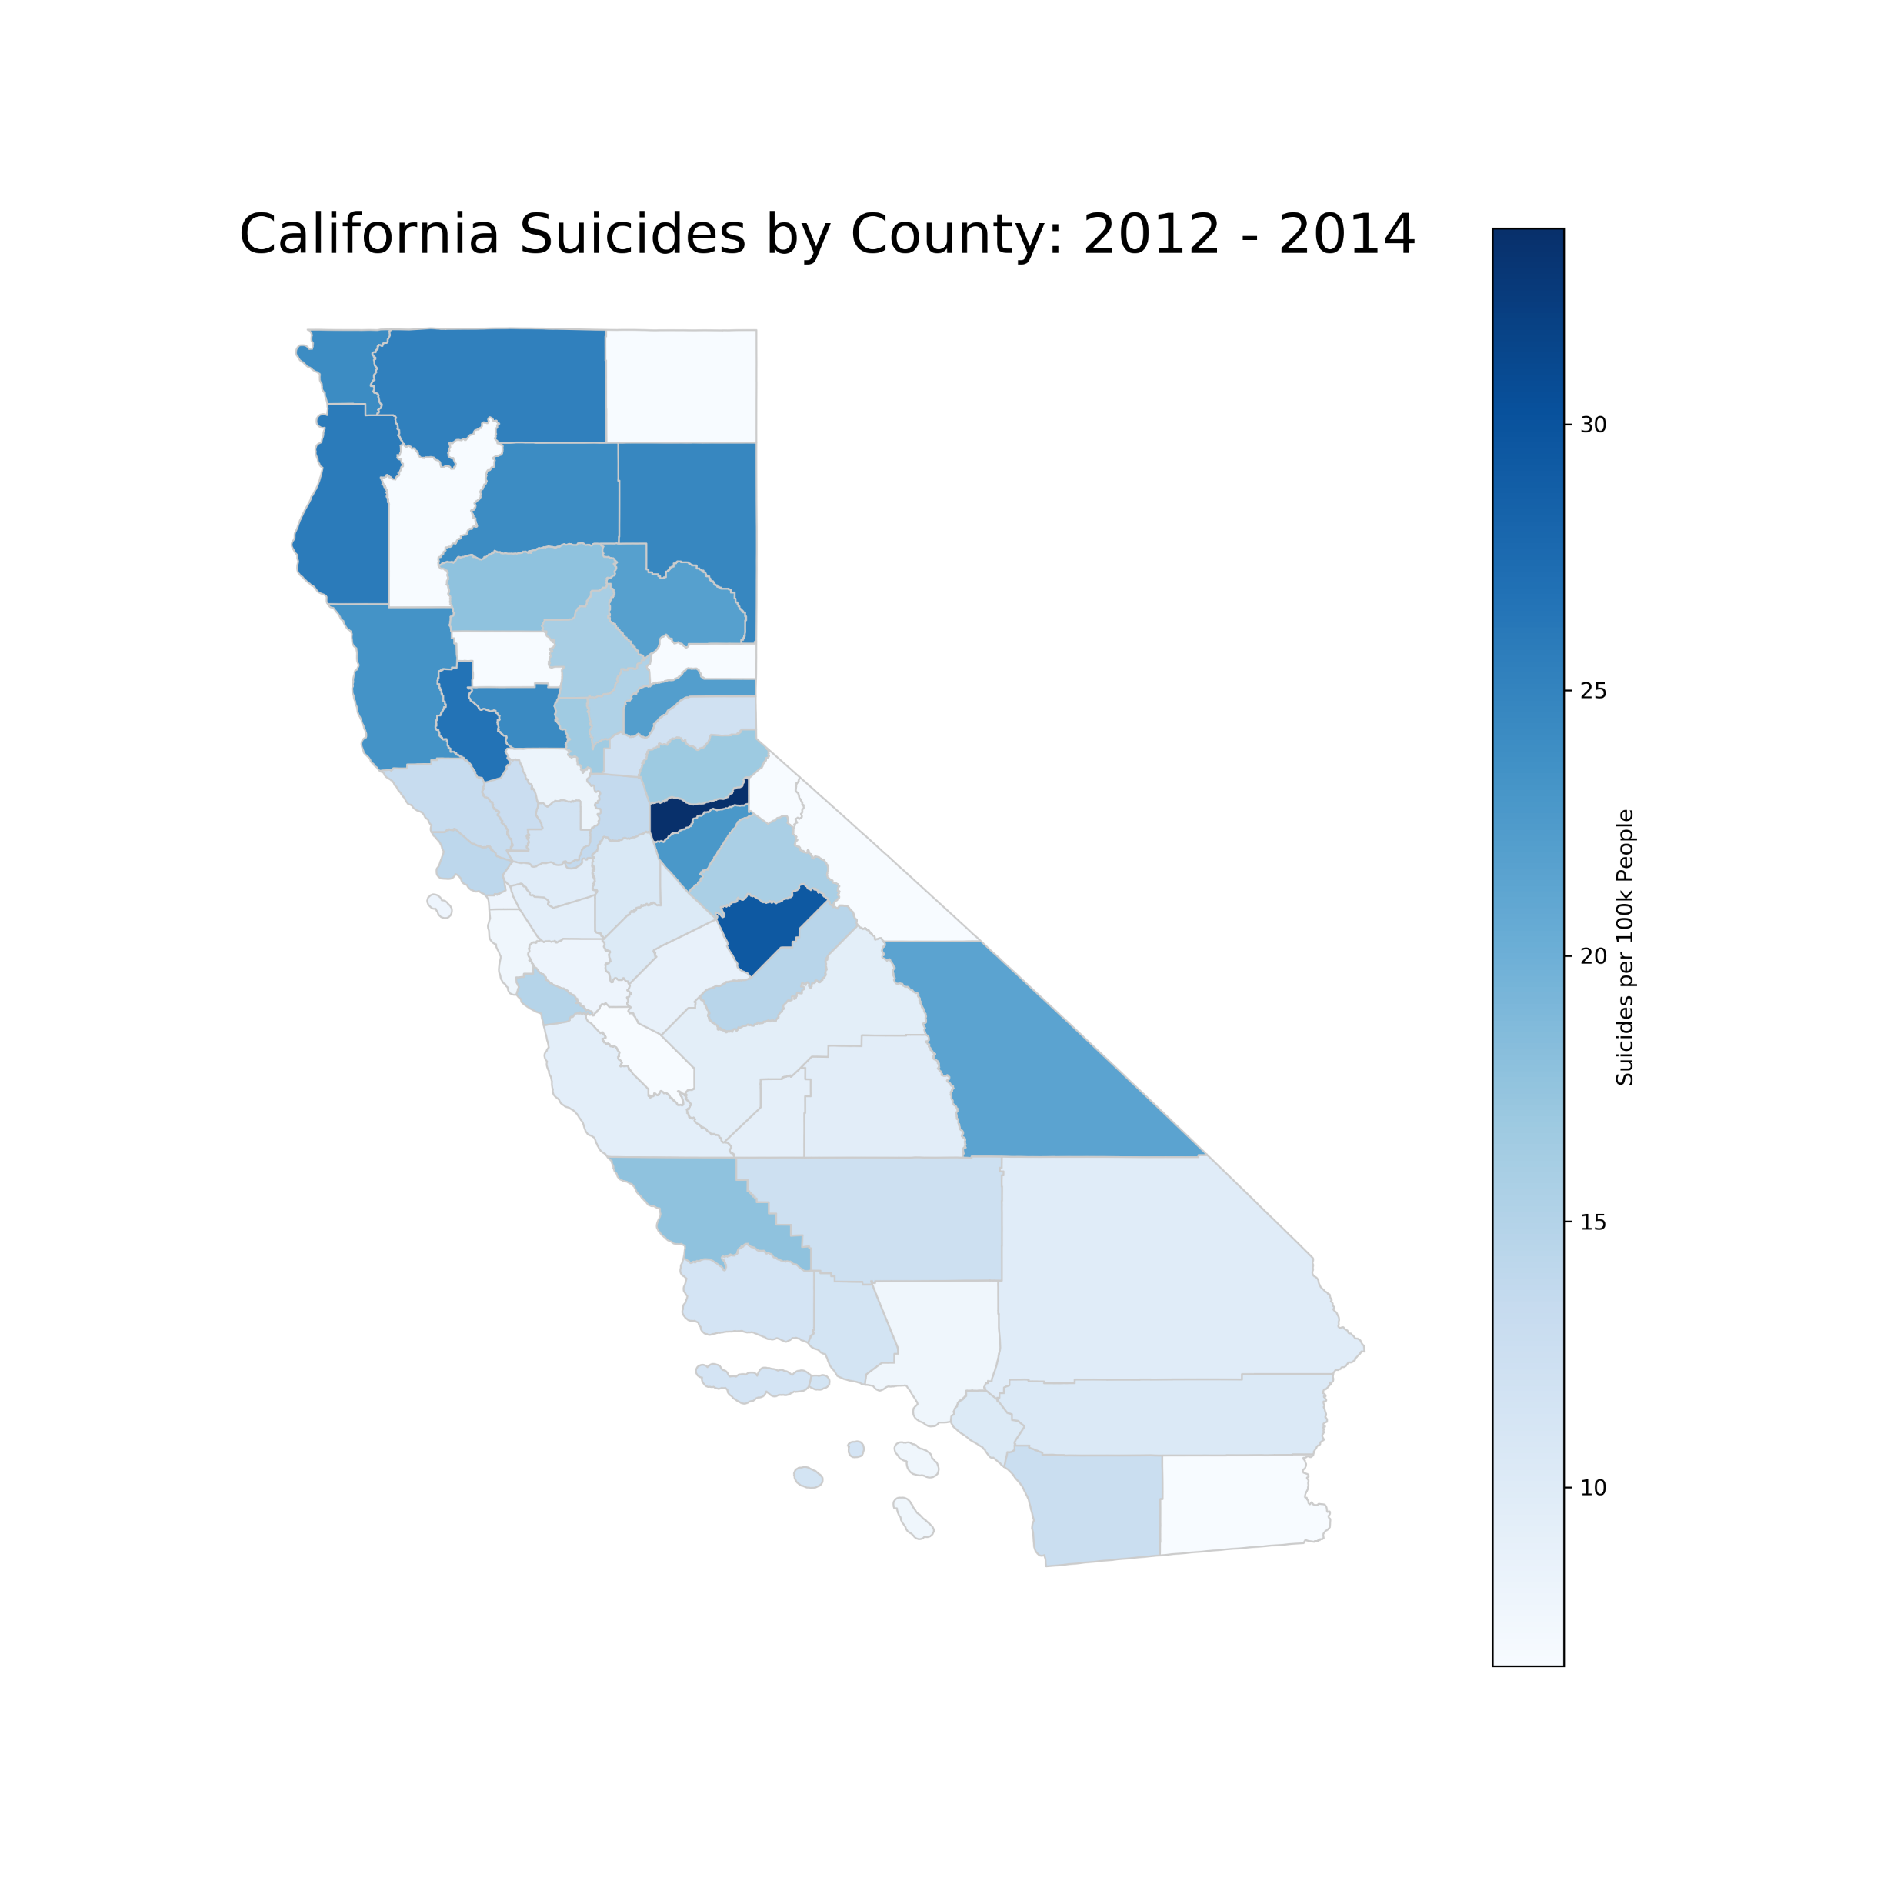
Suicide by Counties
2012-2014

Slide 20
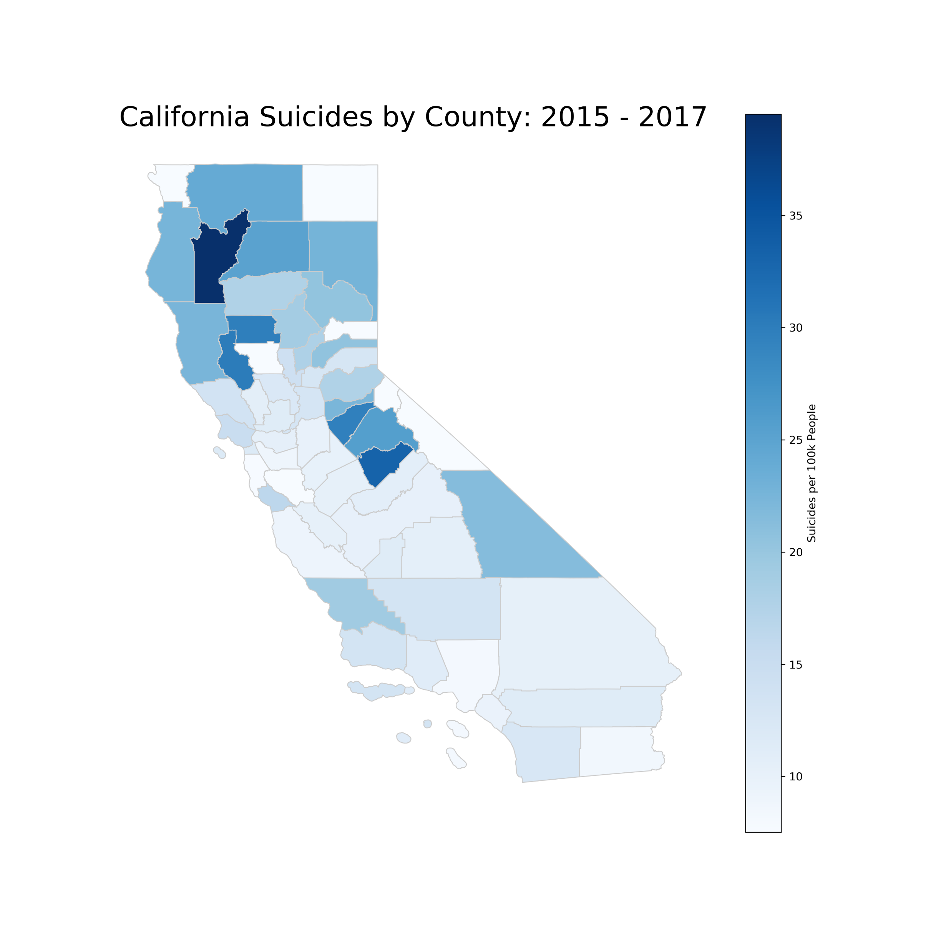
Suicide by Counties
2015-2017

Slide 21
Analysis Process
Time: 2000 – 2017
Geography:
California;
County.
Identify challenges with the data:
Not all counties had reported data for any given time period;
Since “rate” was based on suicides relative to population, lack of reported data for any county affected the “rate” for any given time frame.

Slide 22
Analysis Process
Used Data Frames to sort and filter data:
Process data to plot;
Generate line charts;
Generate choropleth maps

Slide 23
Conclusions
Data Shows:
California suicide rate increase over time.
Suicides per 100,000 population indicates rural areas are affected the most;
Northern California seems to have the most suicides per 100,000 population over time;
As a demographic, white males have a significantly higher rate of suicide compared to others.
Data Challenges:
Data requires averaging of surrounding counties to “plug” a non-reporting county so the charts are minimally affected while maintaining integrity of the data and accuracy of the “story” it tells.

