Slide 3
Project Focus
Identify suicide trends for:
Teenagers in California.

Slide 4
Questions
Do economic conditions affect the suicide;
Does the geographical location afftect suicide rates;

Slide 5
Questions
Does suicide occur with certain age ranges;
Are there social conditions that affect suicide rates;

Slide 6
Data Sources
Conducted internet search for data specific to “teens”, “suicide” and “California”
(e.g. Data.gov);

Slide 7
Data Review
The team reviewed the various data sources for matching criteria:
Age: Teenage
Subject: Suicide
Geography: California

Slide 8
Data Review
Most of the data reviewed was:
Too general (e.g. time; national; male/female;…etc.)
Too specific (e.g. race; gender; geographical area)
Insufficient data fields to support proper trend analysis;
Data fields would be difficult to filter for trend analysis.

Slide 9
Data Cleanup
Reviewed the data in Excel:
Sorting data using pivot tables and filters
Determined data required separating into two (2) major categories (e.g. csv files):
California: Male/Female
County: Race/Ethinicity
Import data into Jupyter Notebook to process and chart.

Slide 10
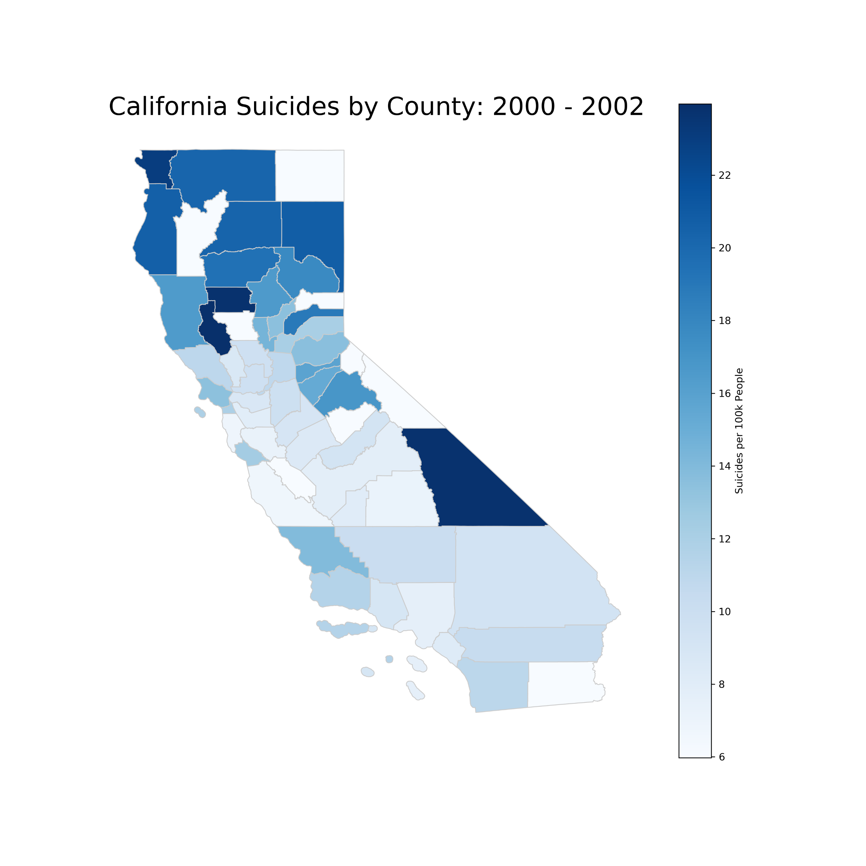
Suicide by Counties
2000-2002

Slide 11
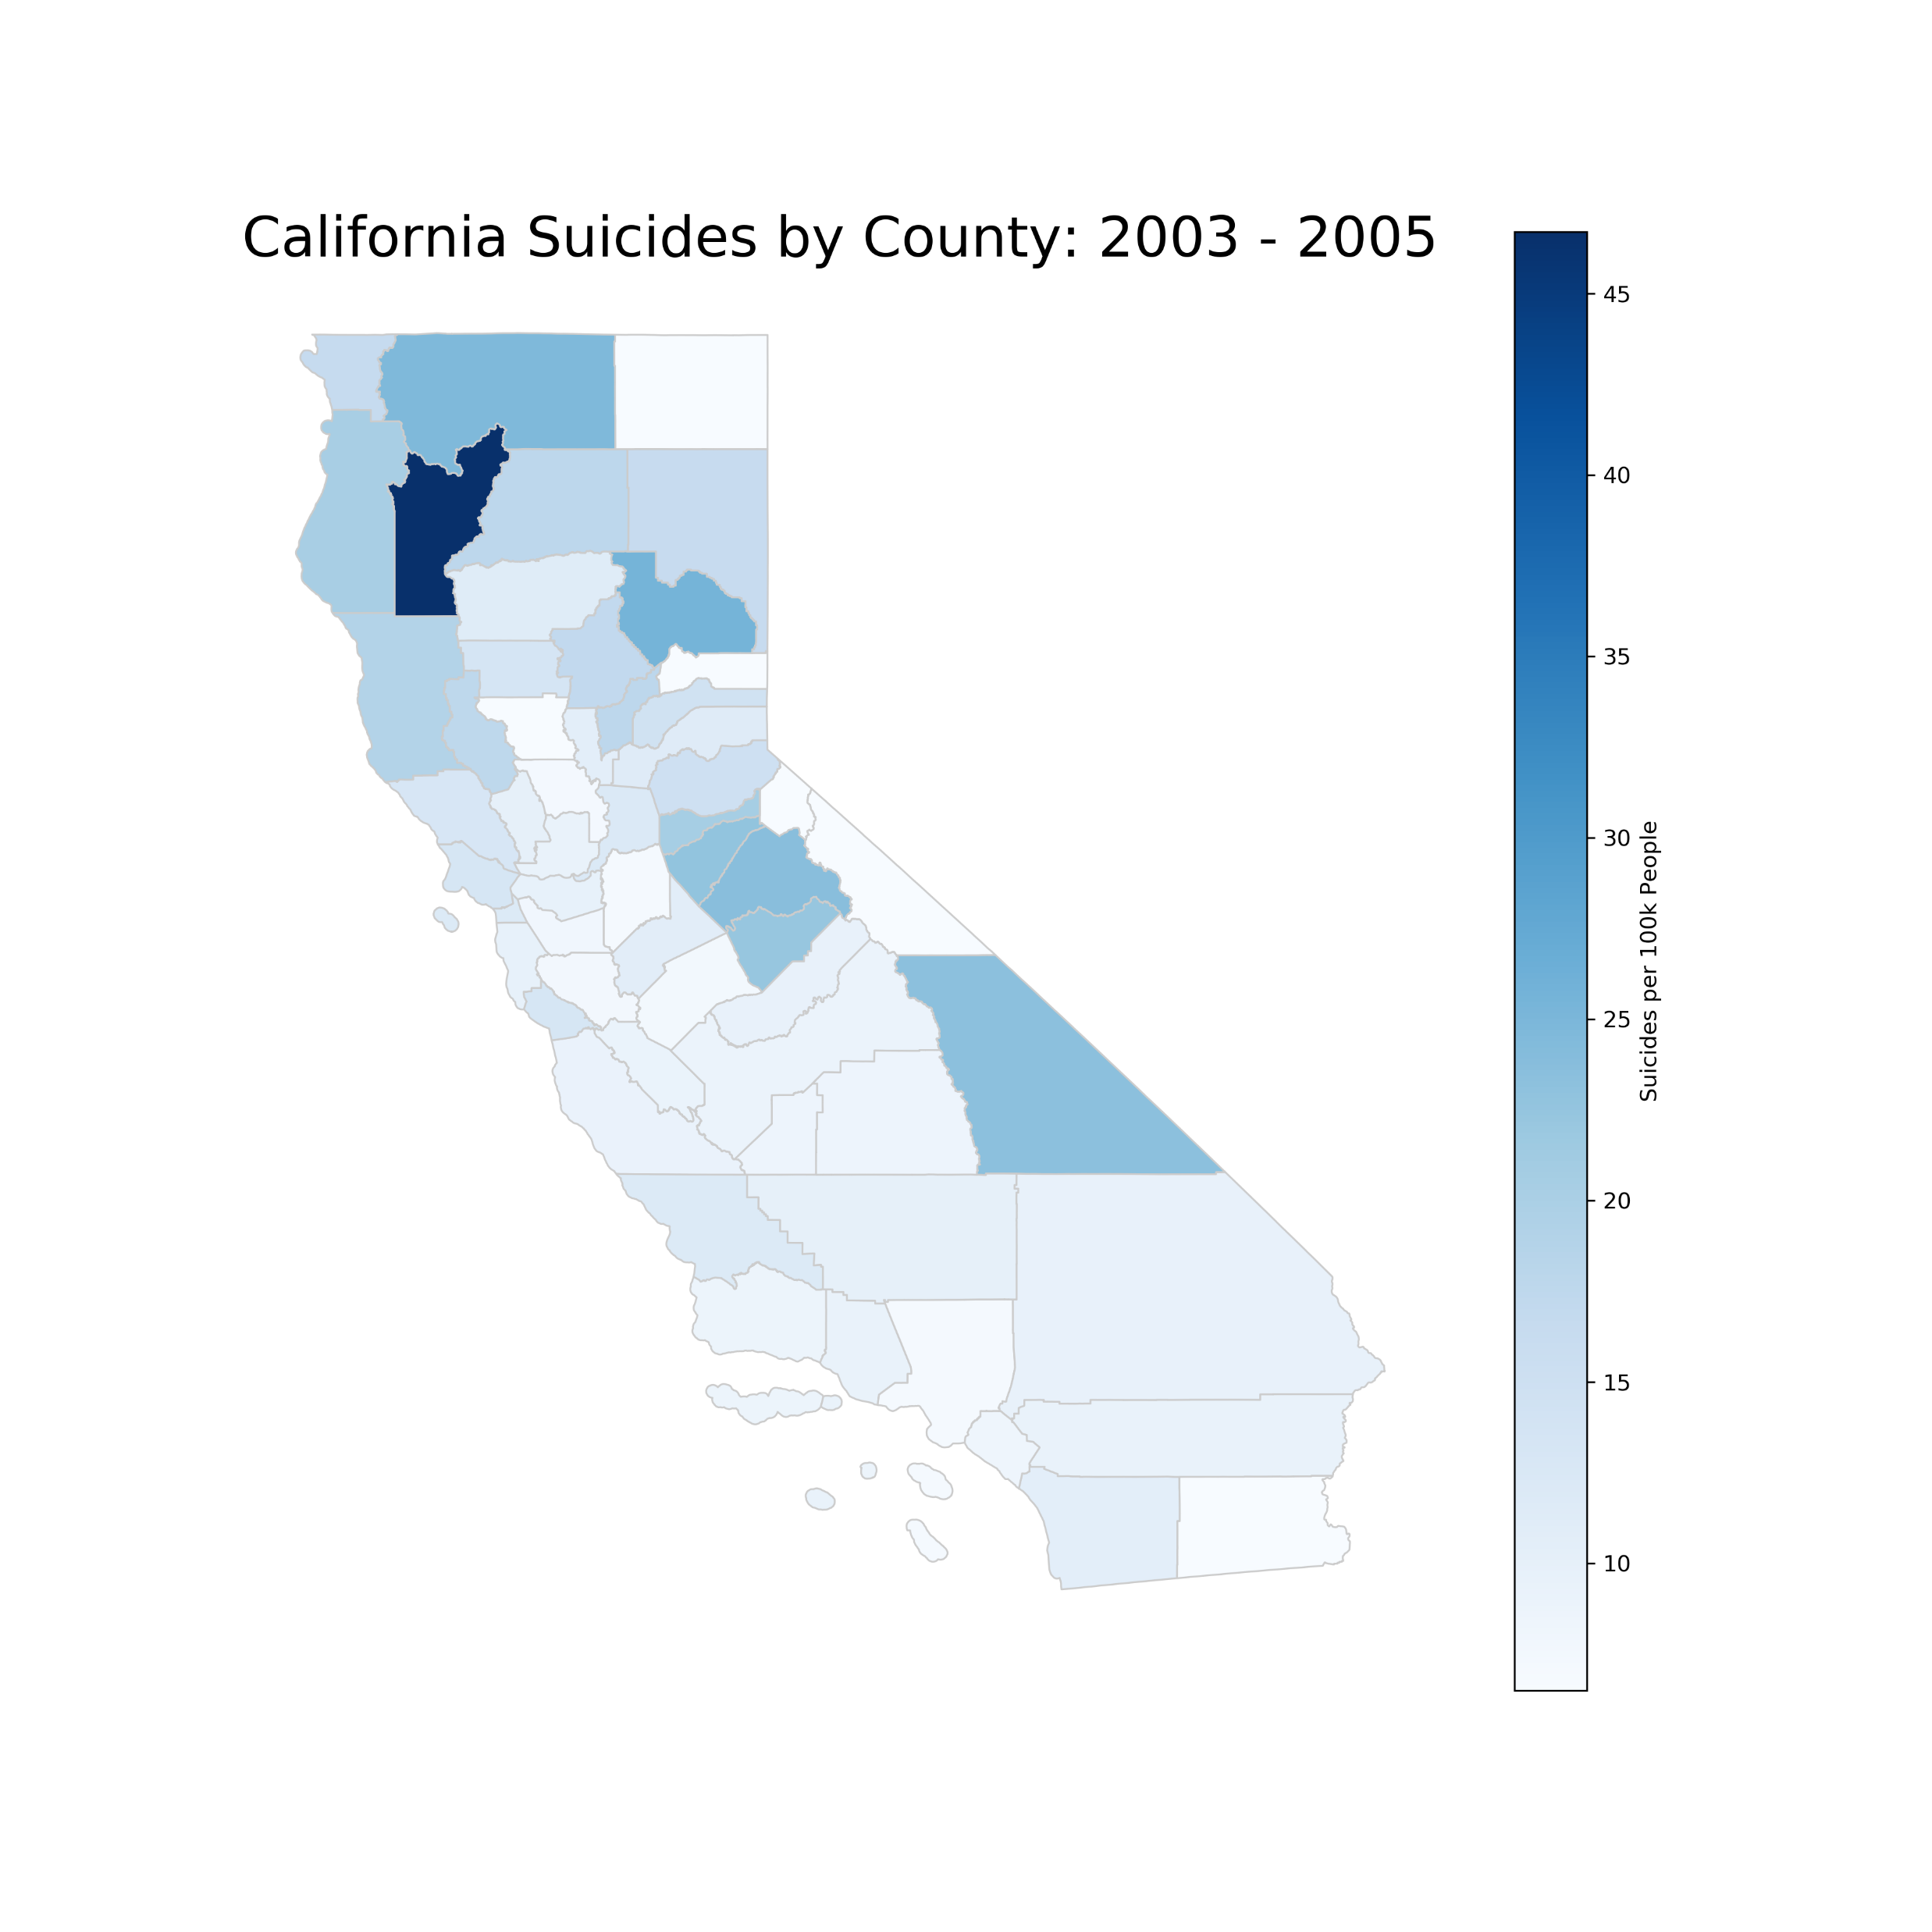
Suicide by Counties
2003-2005

Slide 12
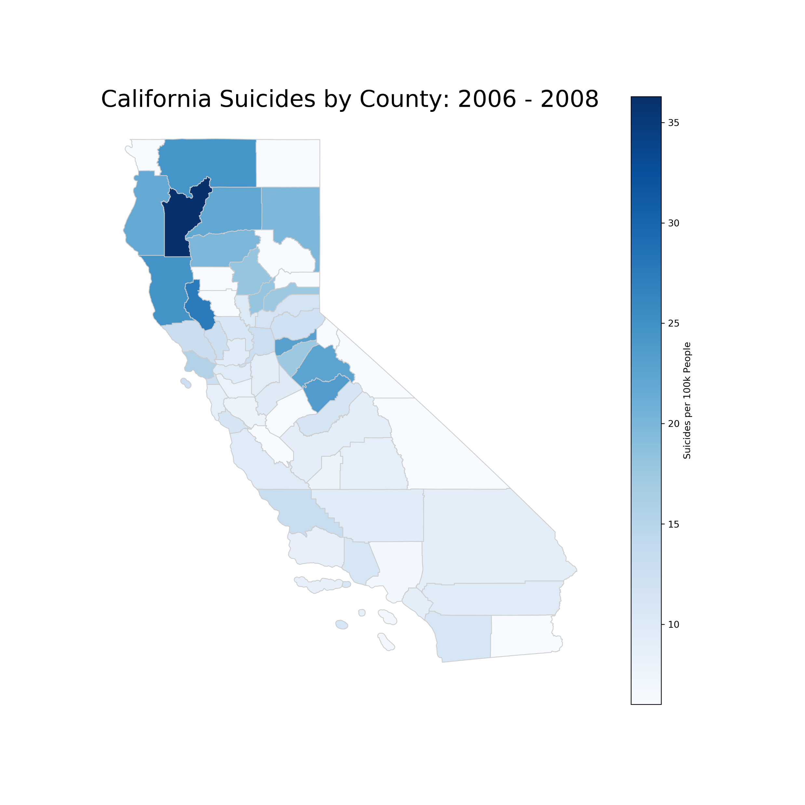
Suicide by Counties
2006-2008

Slide 13
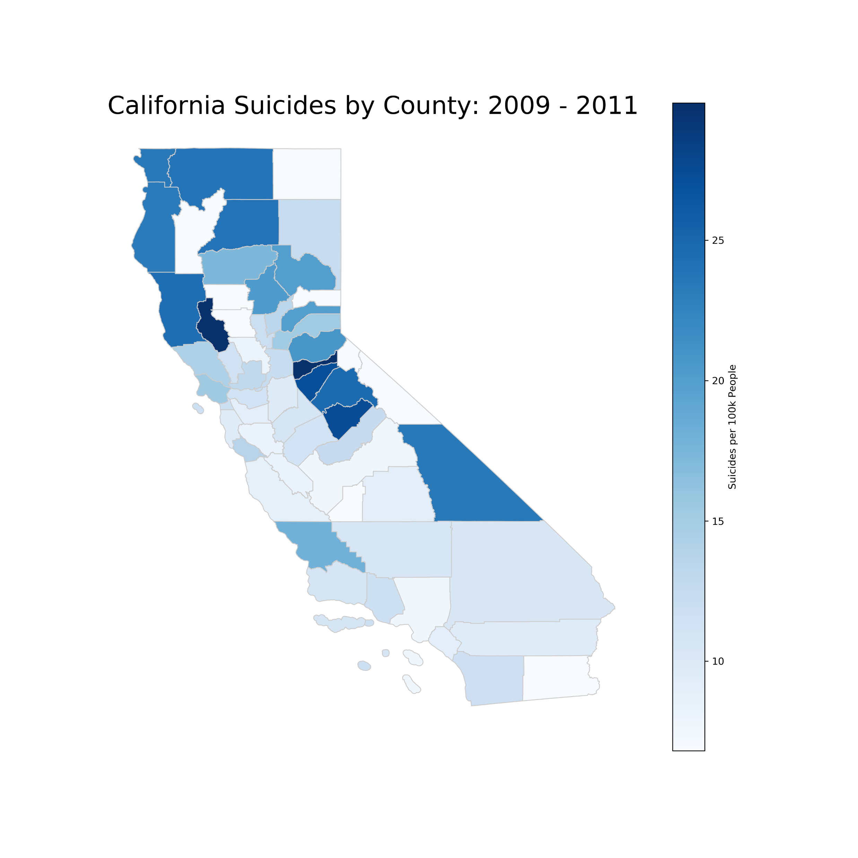
Suicide by Counties
2009-2011

Slide 14
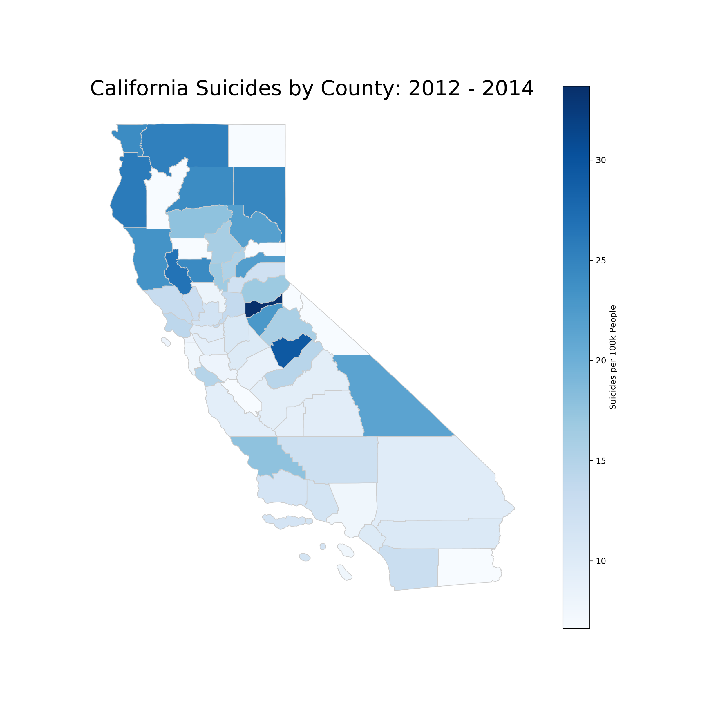
Suicide by Counties
2012-2014

Slide 15
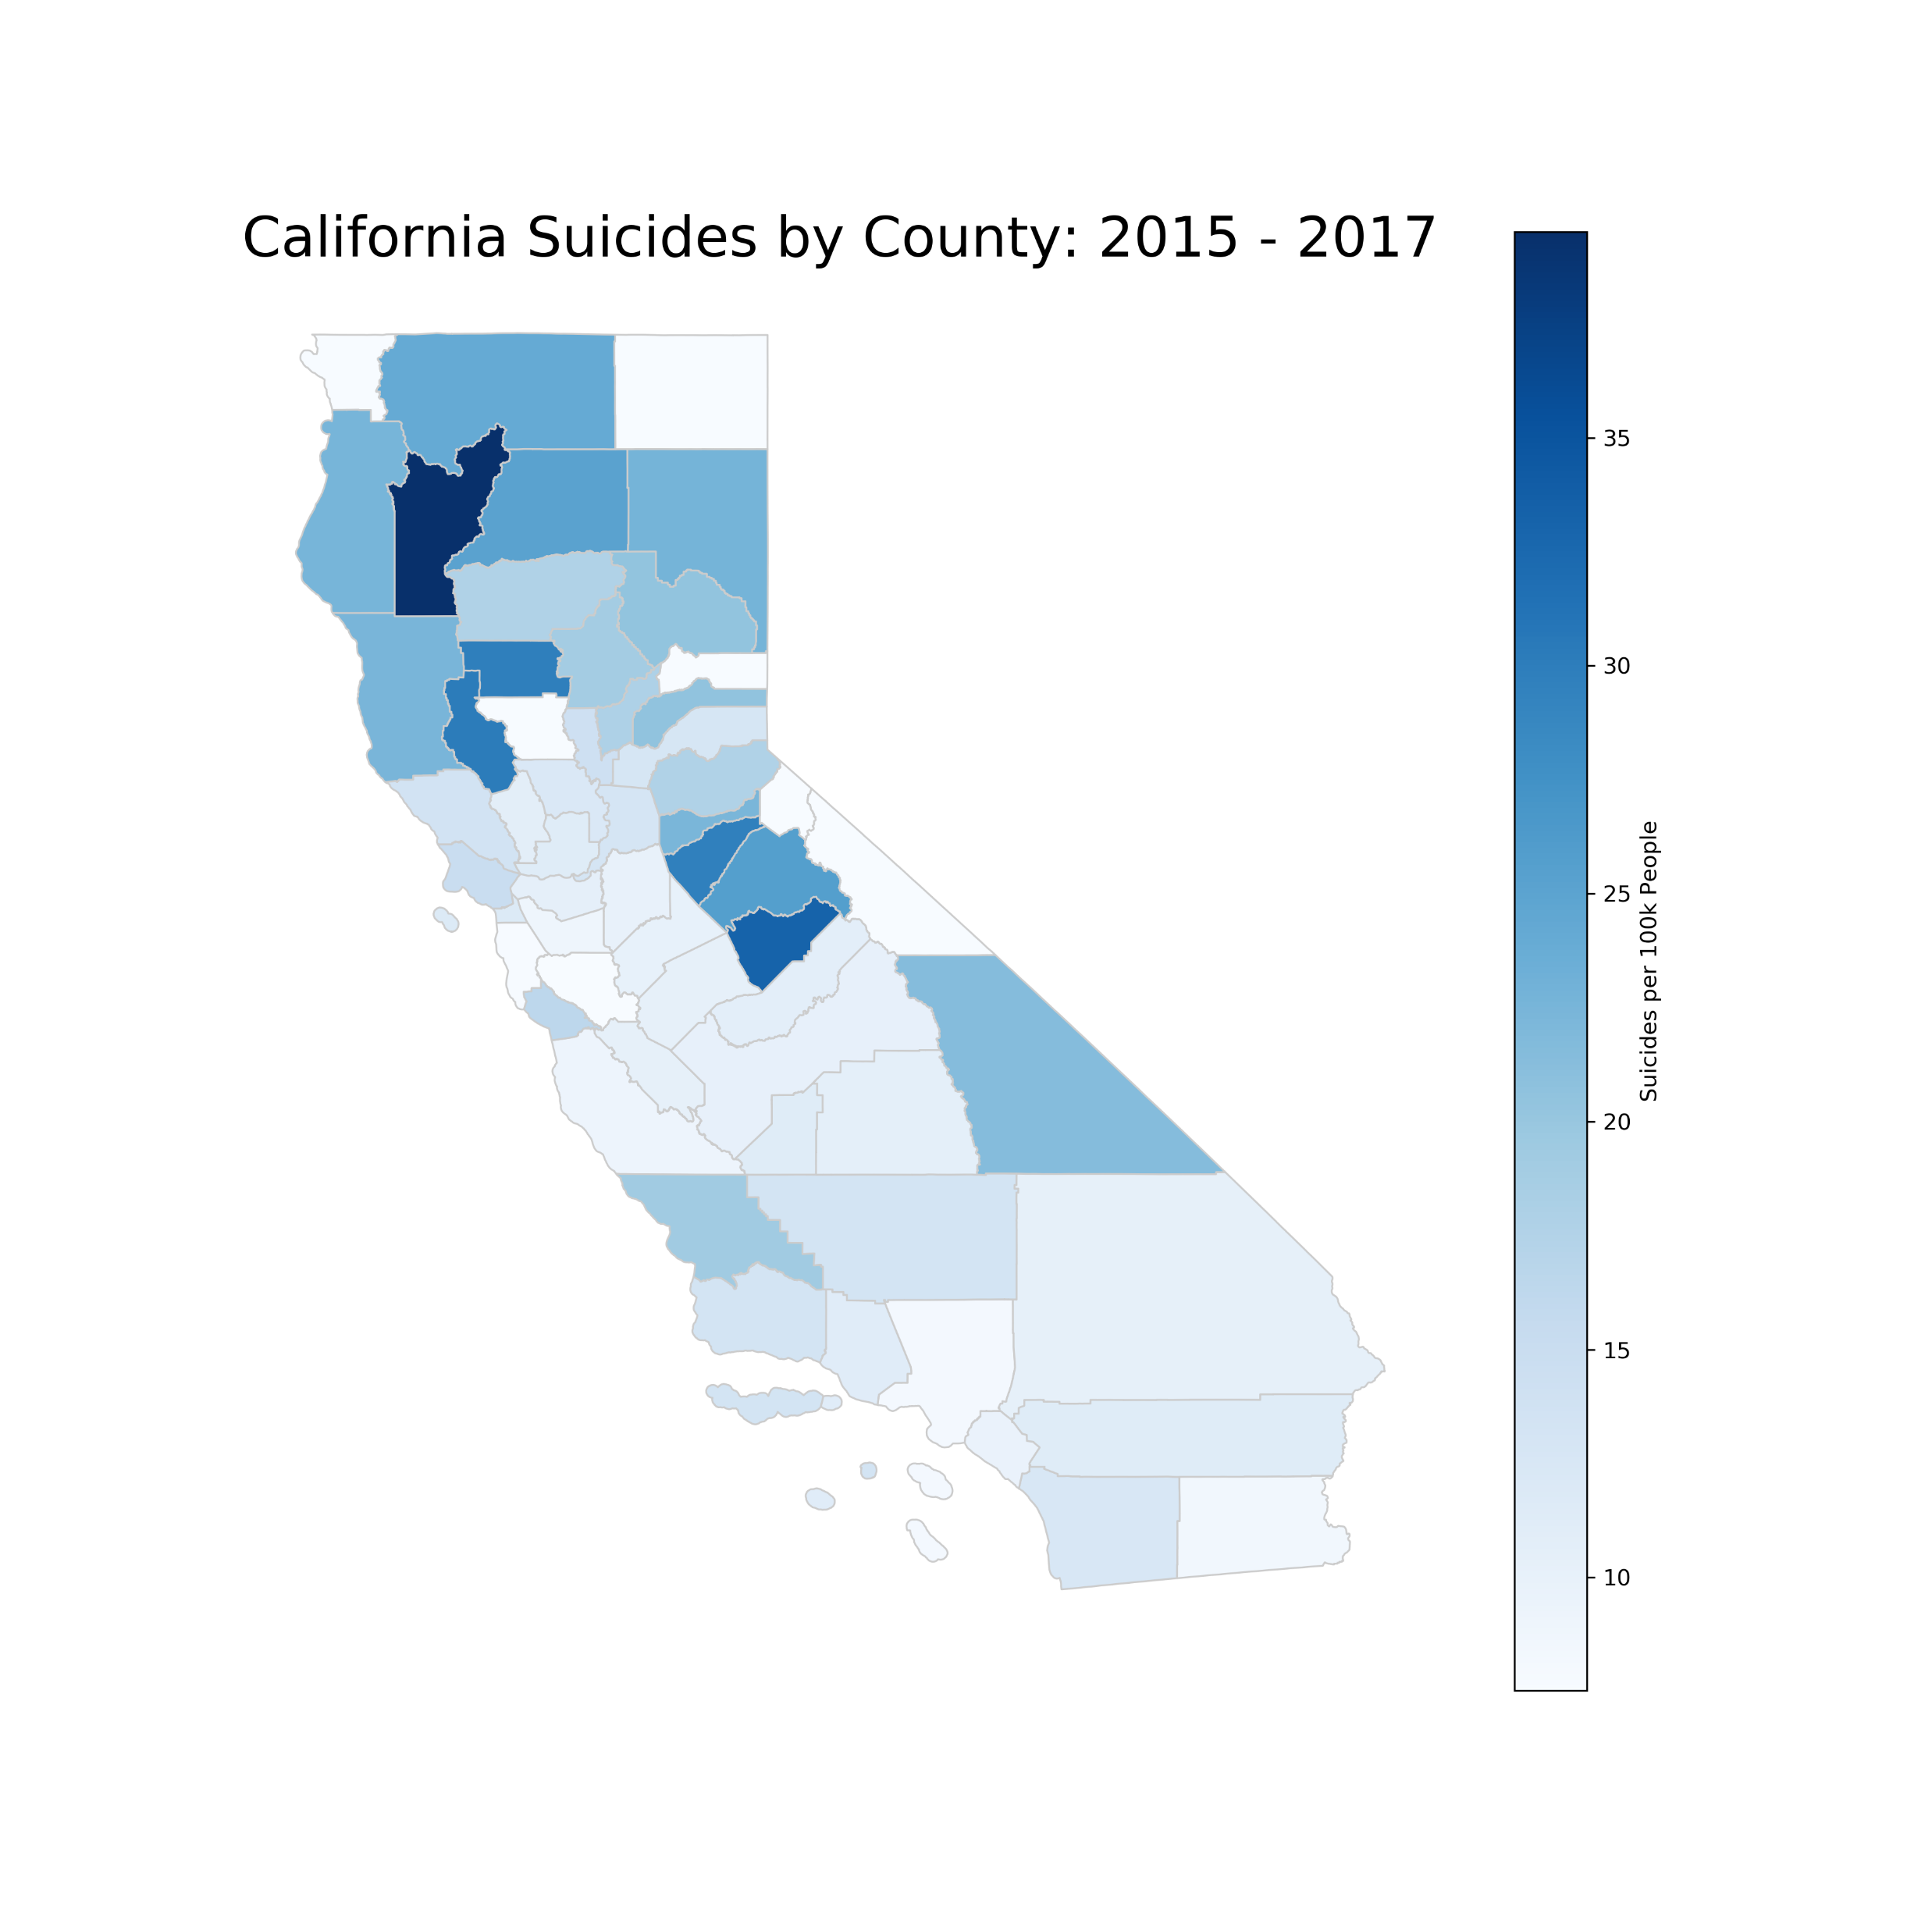
Suicide by Counties
2015-2017

Slide 16
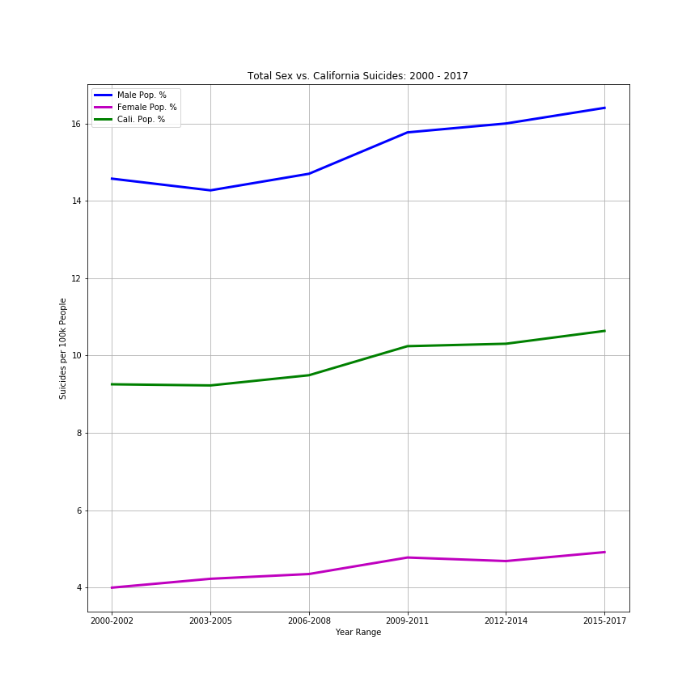
Male/Female Suicide for California

Slide 17
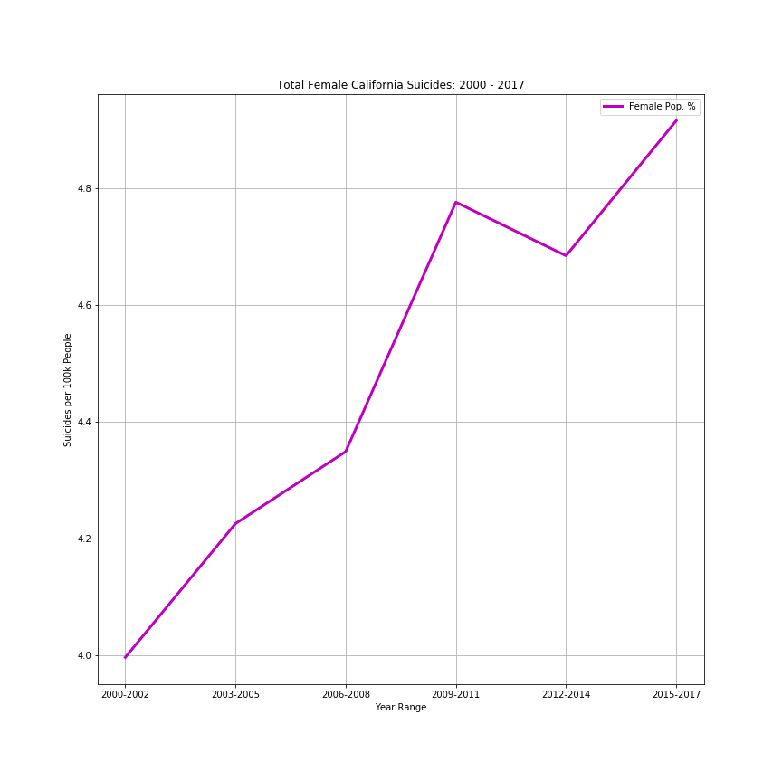
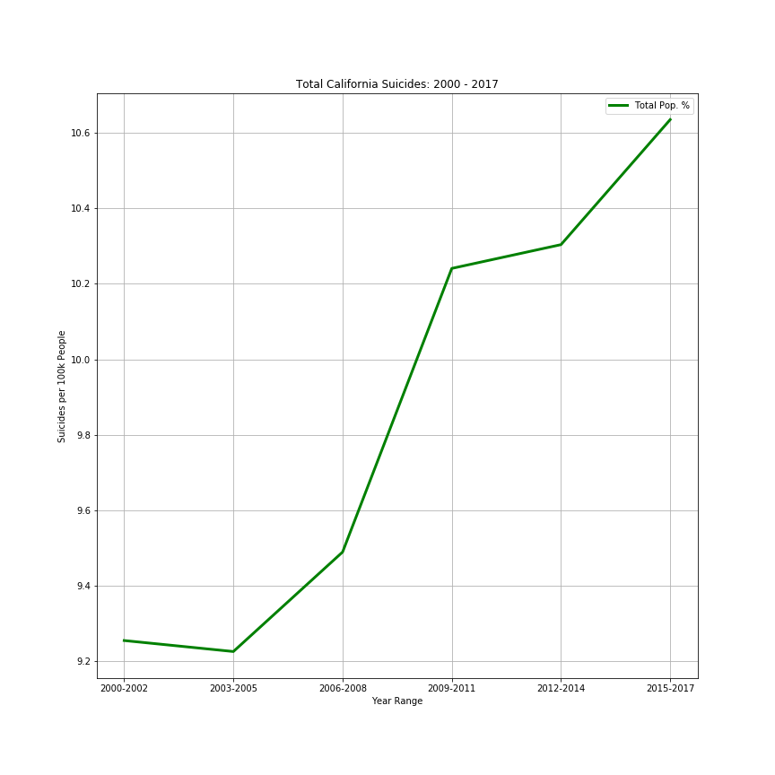
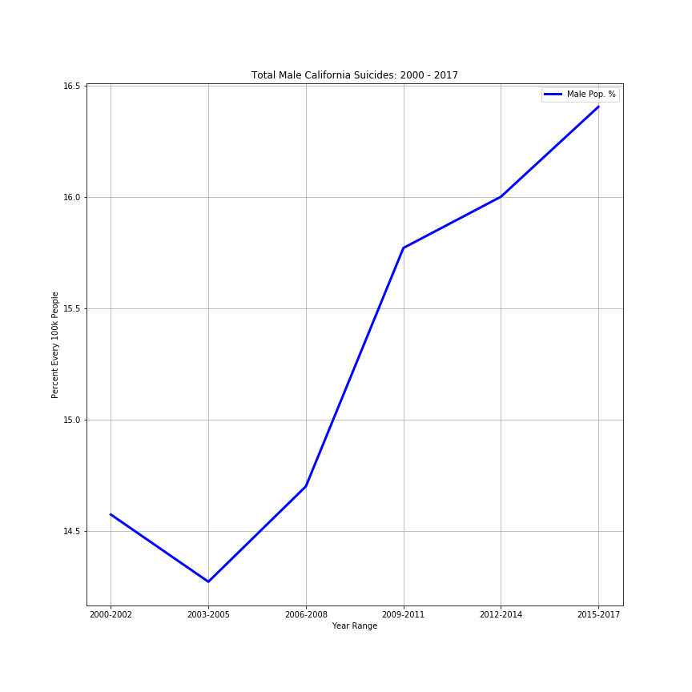
Suicide for California
Females California Males

Slide 18
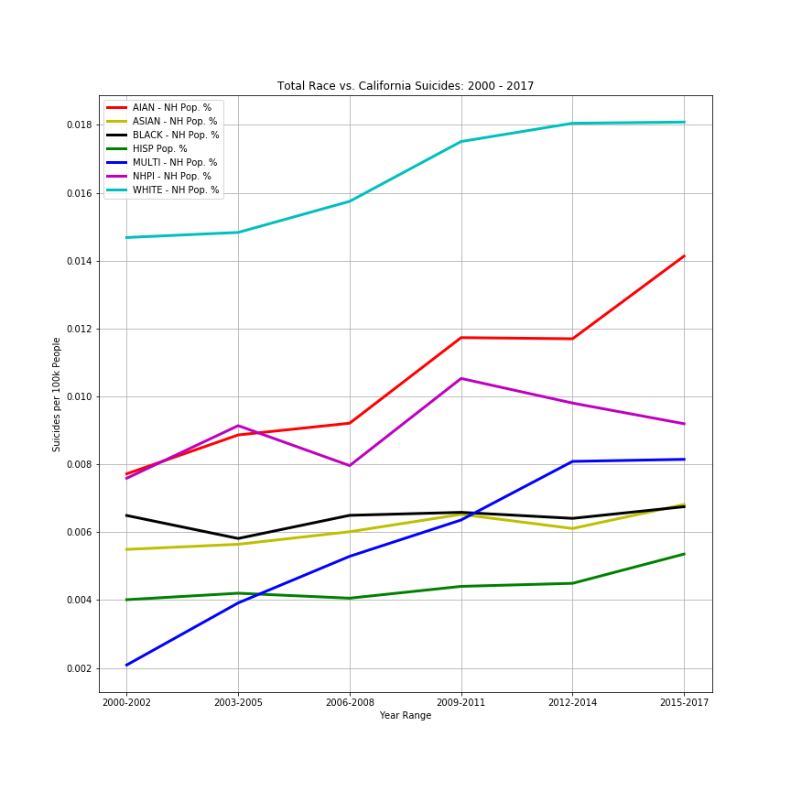
Suicide Grouped by Raced

Slide 19
Analysis Process
Time: 2000 – 2017
Geography:
California;
County.
Identify challenges with the data:
Not all counties had reported data for any given time period;
Since “rate” was based on suicides relative to population, lack of reported data for any county affected the “rate” for any given time frame.

Slide 20
Analysis Process
Used Data Frames to sort and filter data:
Process data so to plot;
Generate line charts;
Generate heatmaps

Slide 21
Conclusions
Data Shows:
Suicides per 100,000 population indicates rural areas are affected the most;
Northern California seems to have the most suicides over time;
Data Challenges:
Data requires averaging of surrounding counties to “plug” a non-reporting county so the charts are minimally affected while maintaining integrity of the the data and accuracy of the “story” it tells.

