Slide 3
UCD BootCamp
Project 1

Slide 4
Project Focus
Identify suicide trends for:
Teenagers in California.

Slide 5
Questions
Do economic conditions affect the suicide;
Does the geographical location afftect suicide rates;

Slide 6
Questions
Does suicide occur with certain age ranges;
Are there social conditions that affect suicide rates;

Slide 7
Data Sources
Conducted internet search for data specific to “teens”, “suicide” and “California”
(e.g. Data.gov);

Slide 8
Data Review
The team reviewed the various data sources for matching criteria:
Age: Teenage
Subject: Suicide
Geography: California

Slide 9
Data Review
Most of the data reviewed was:
Too general (e.g. time; national; male/female;…etc.)
Too specific (e.g. race; gender; geographical area)
Insufficient data fields to support proper trend analysis;

Slide 10
Data Review
Most of the data reviewed was: (continued)
Data fields would be difficult to filter for trend analysis;
Data was difficult to find specifically for teens.

Slide 11
Data Review
Project Focus:
Identify suicide trends for California

Slide 12
Data Cleanup
Reviewed the data in Excel:
Sorting data using pivot tables and filters
Determined data required separating into two (2) major categories (e.g. csv files):
California: Male/Female
County: Race/Ethinicity
Import data into Jupyter Notebook to process and chart.

Slide 13
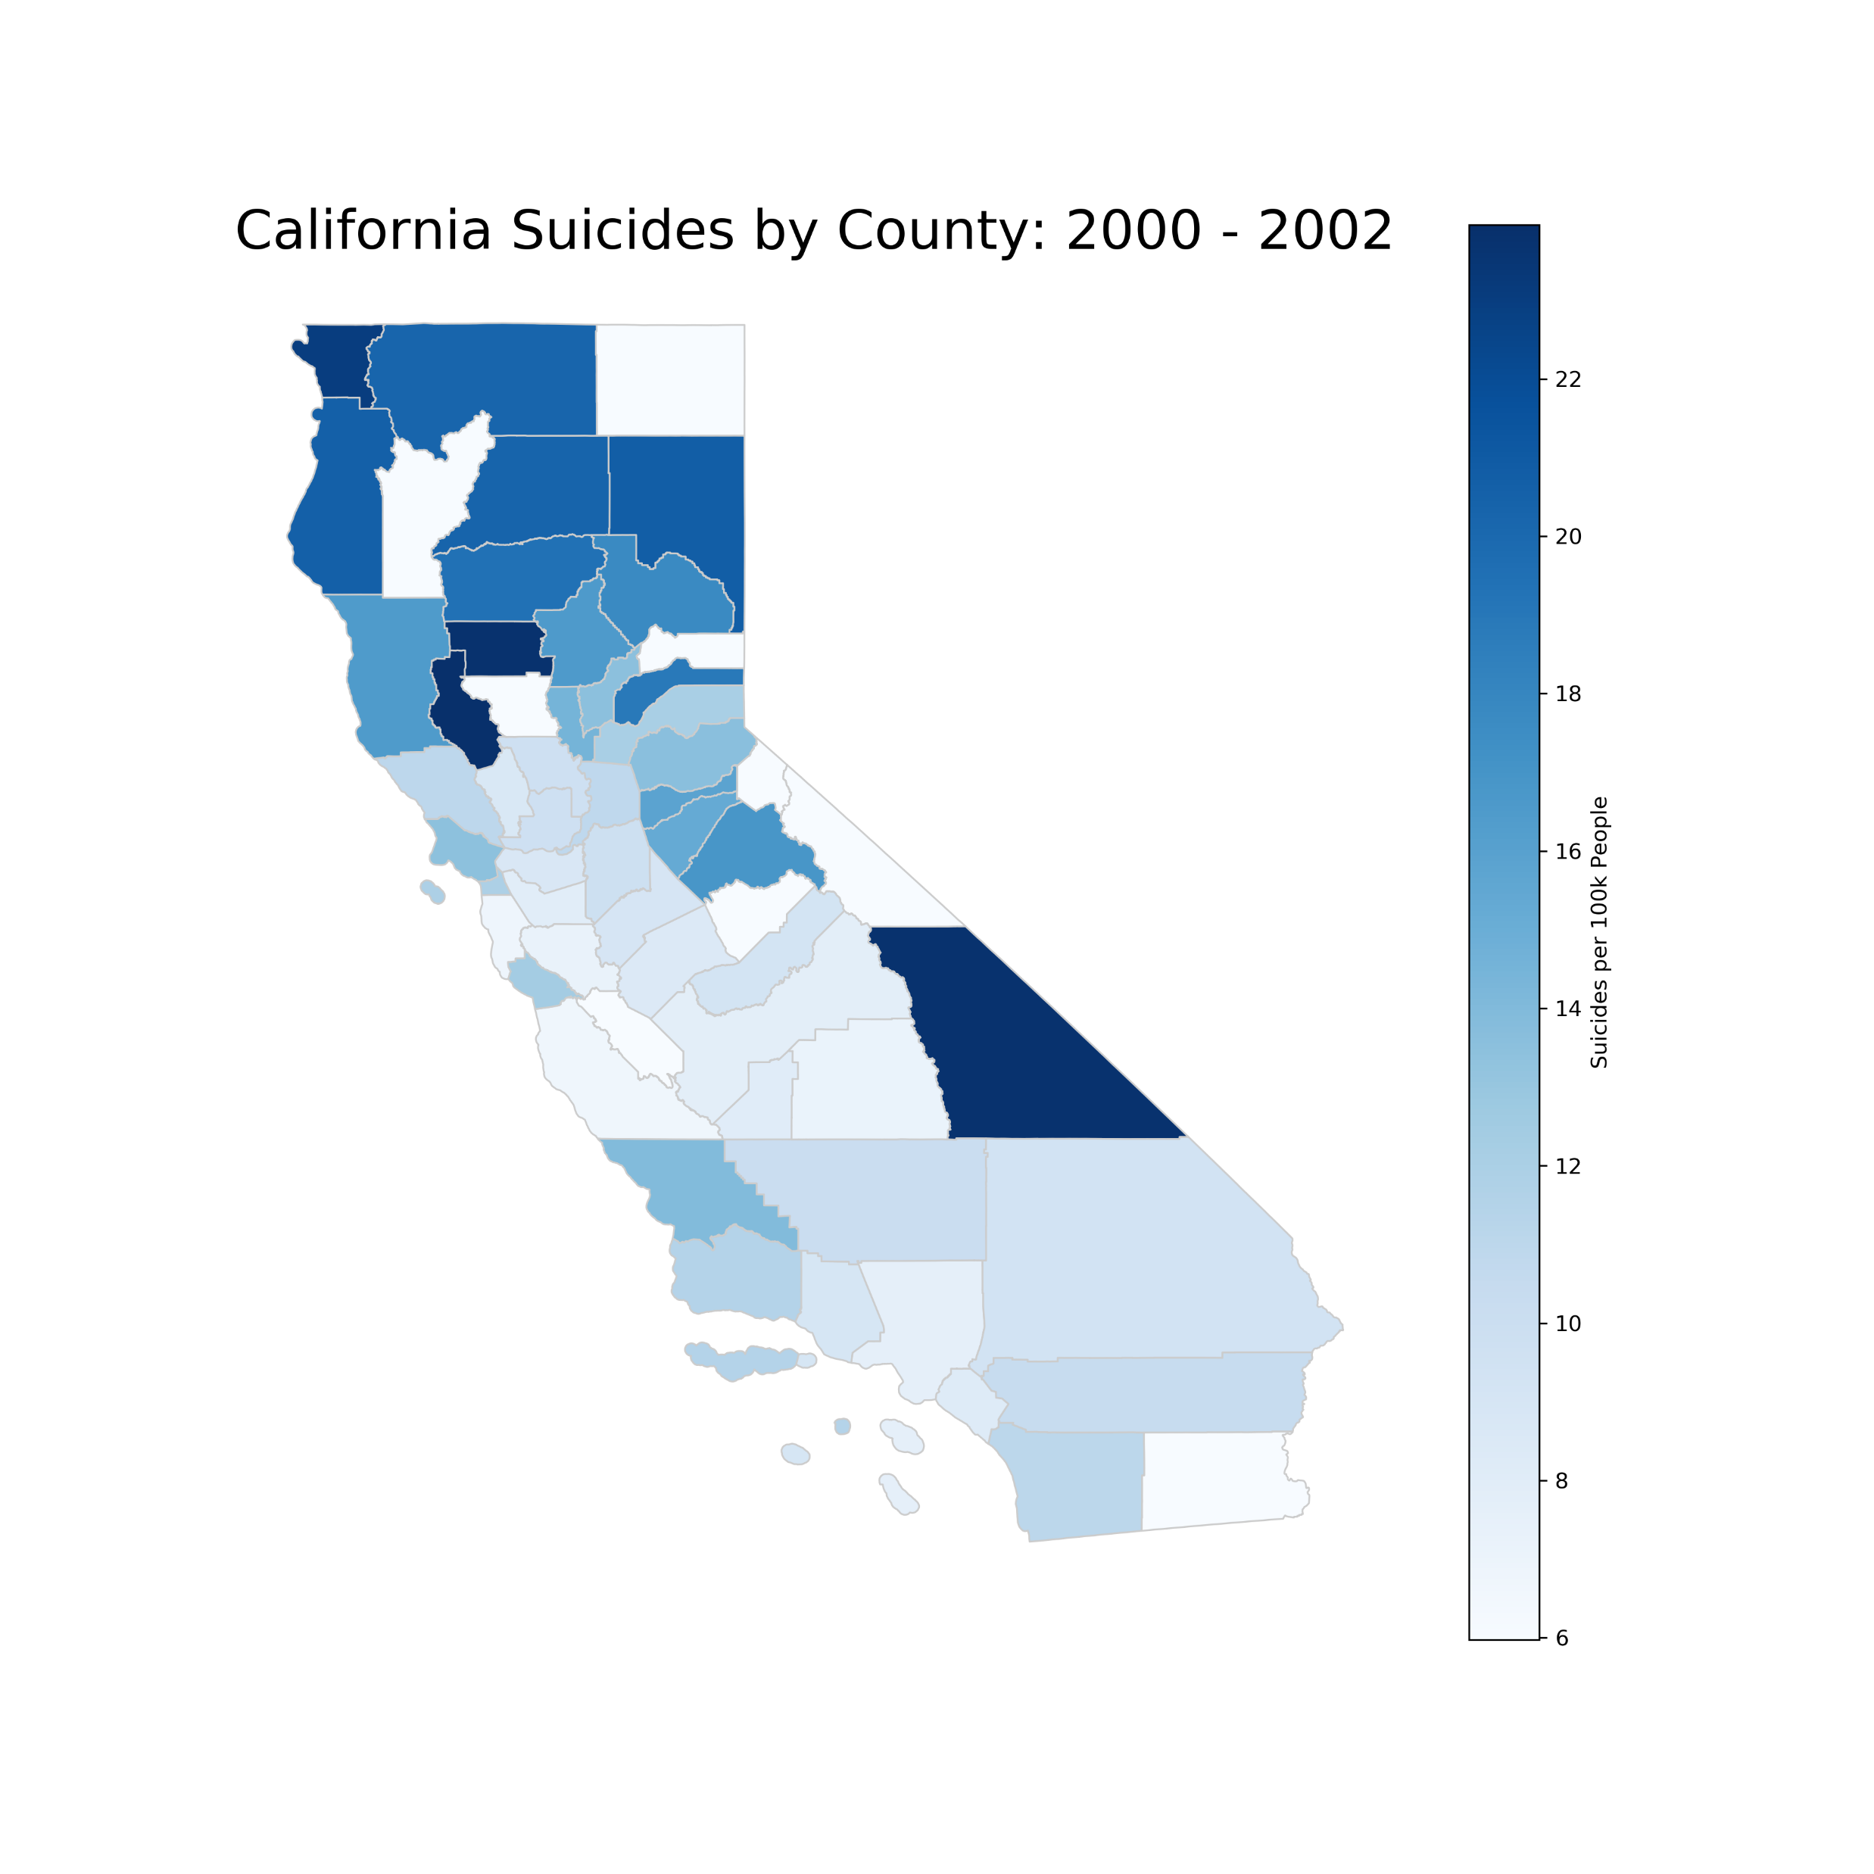
Suicide by Counties
2000-2002

Slide 14
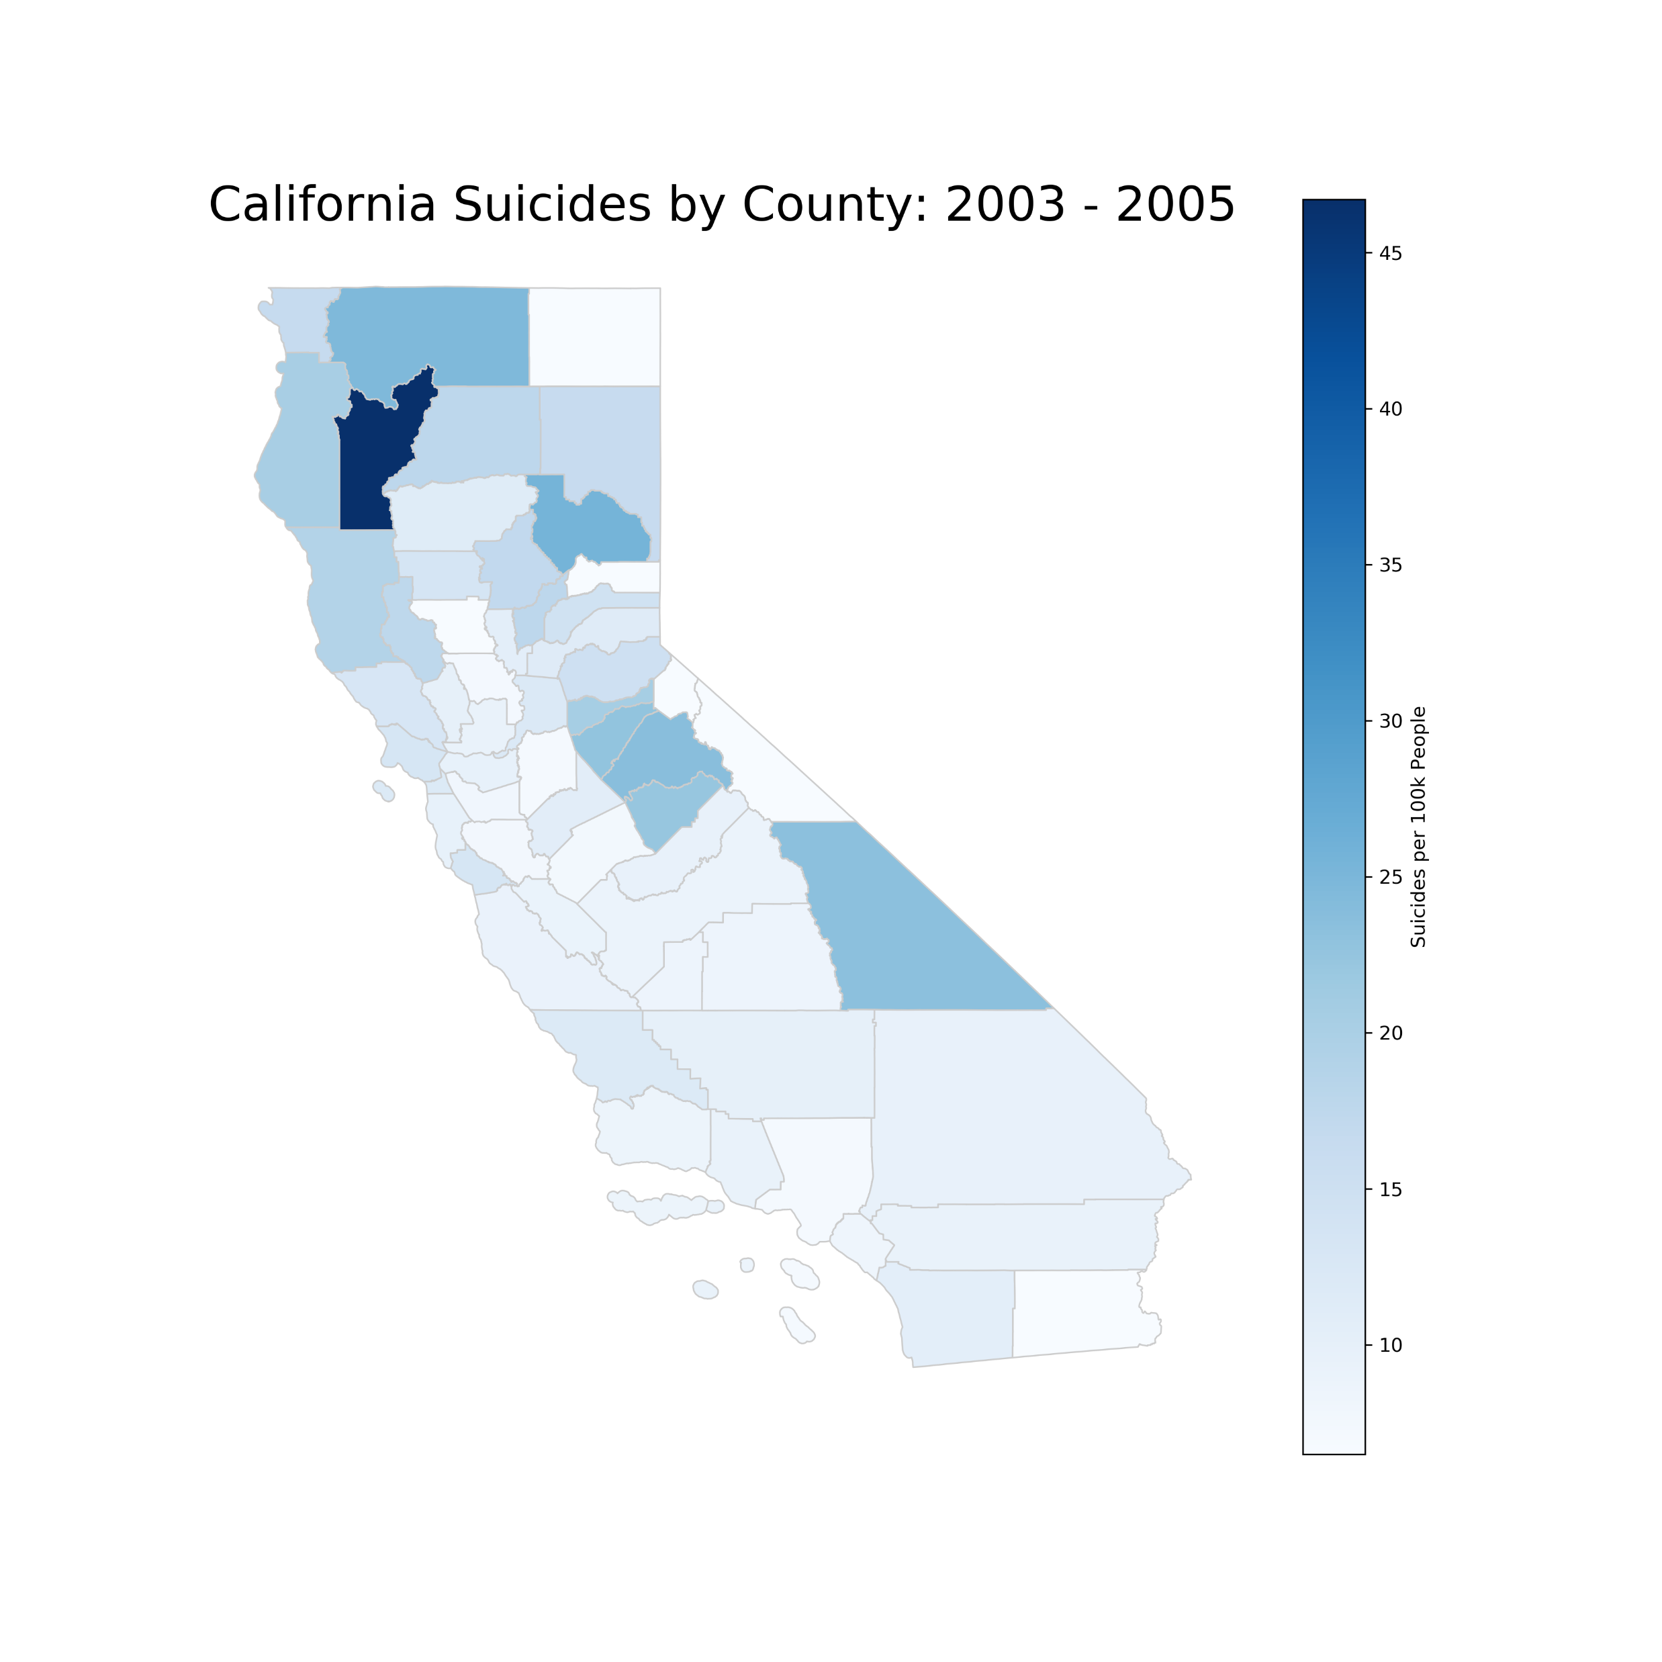
Suicide by Counties
2003-2005

Slide 15
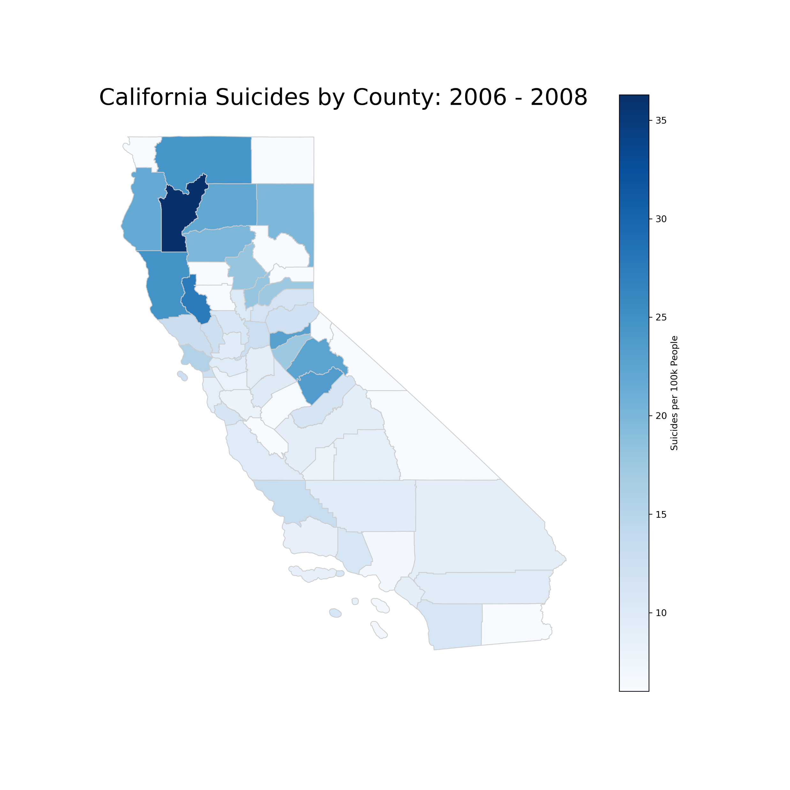
Suicide by Counties
2006-2008

Slide 16
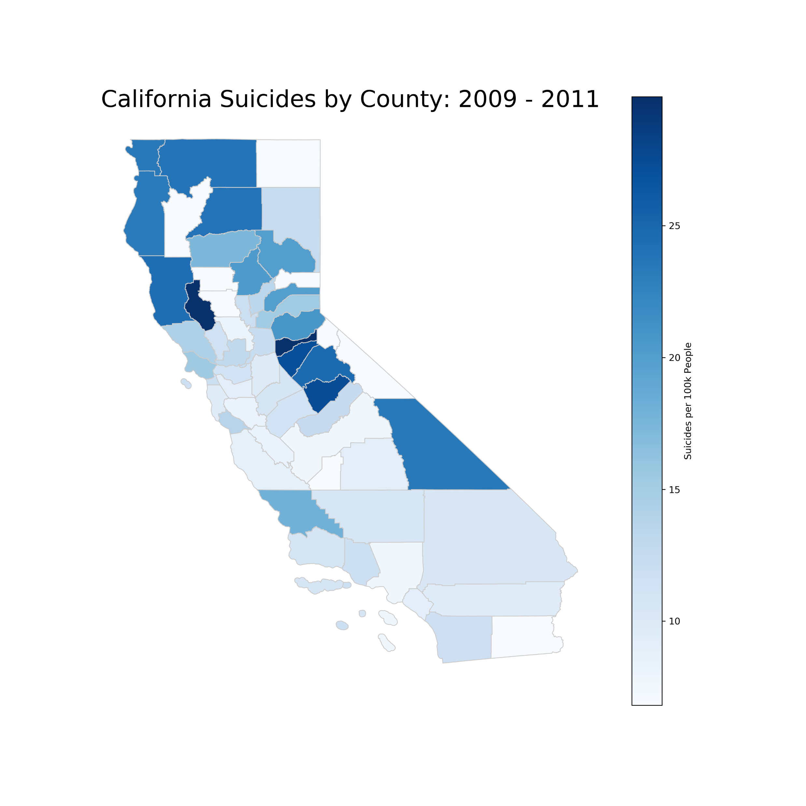
Suicide by Counties
2009-2011

Slide 17
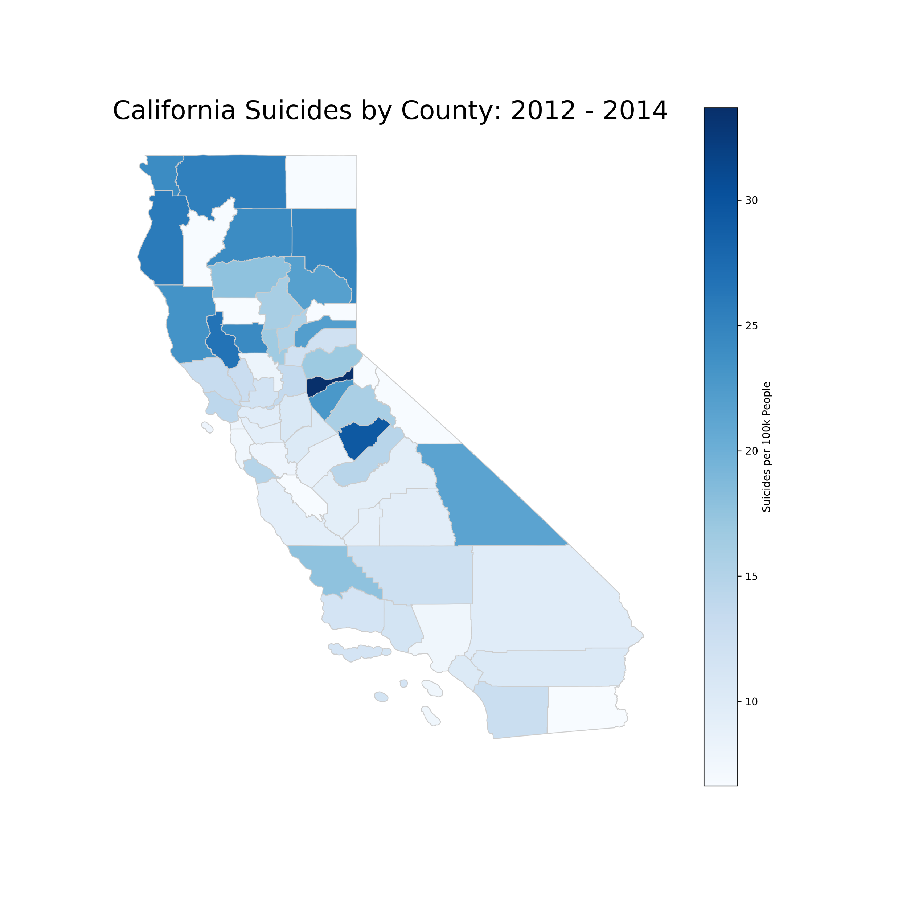
Suicide by Counties
2012-2014

Slide 18
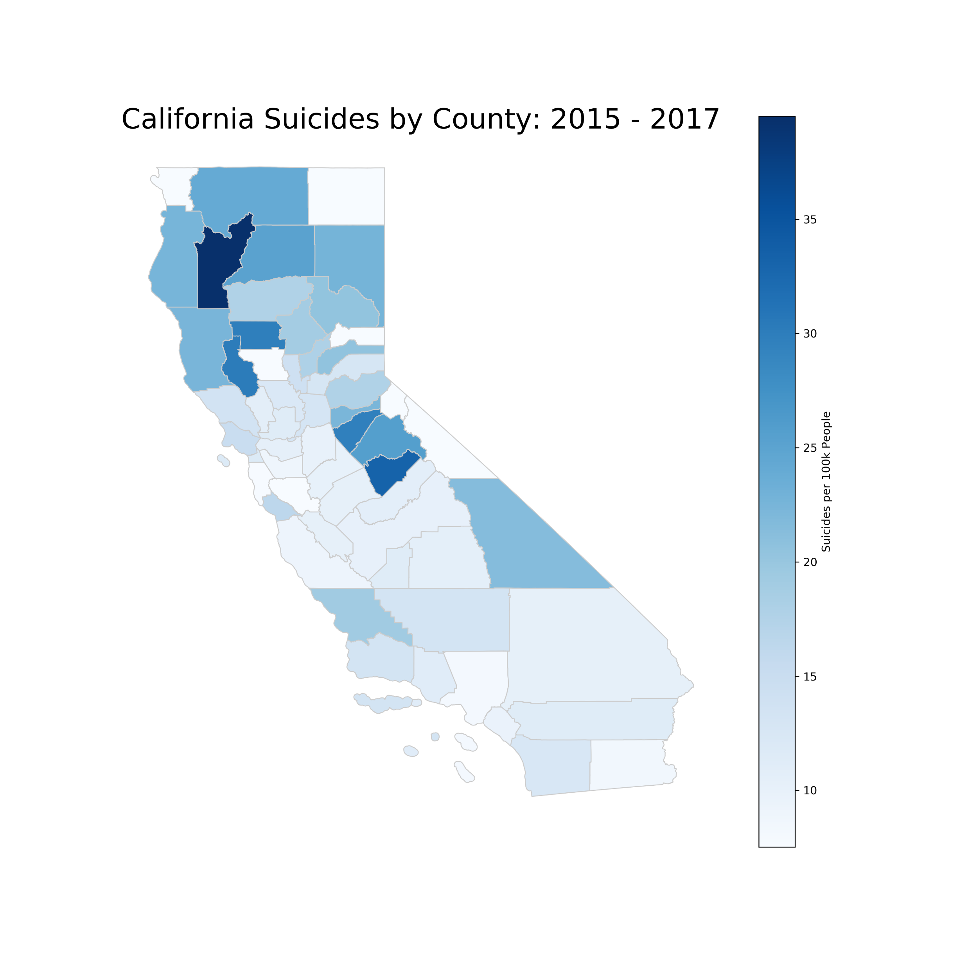
Suicide by Counties
2015-2017

Slide 19
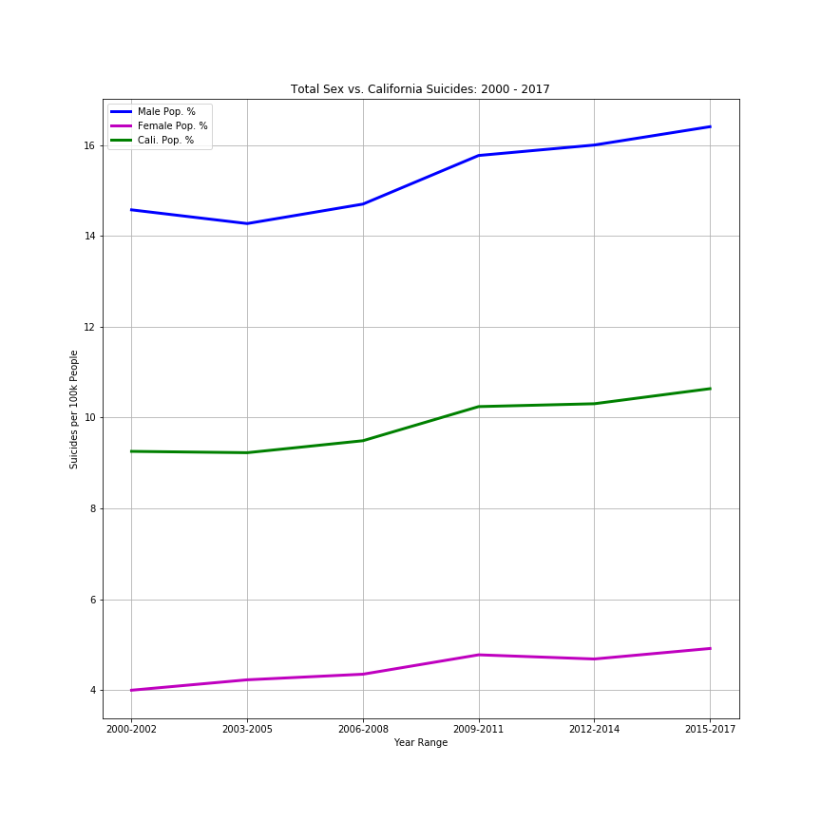
Male/Female Suicide for California

Slide 20
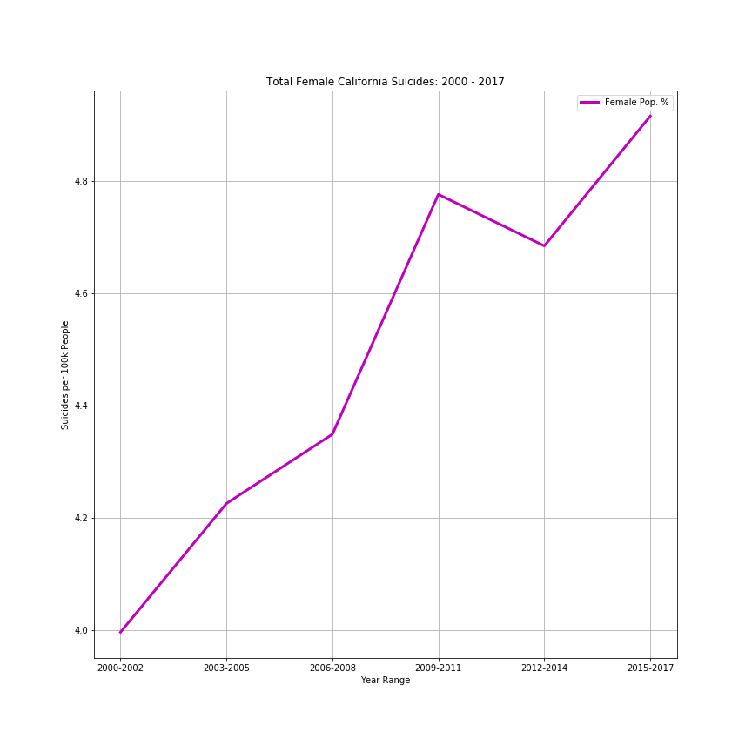
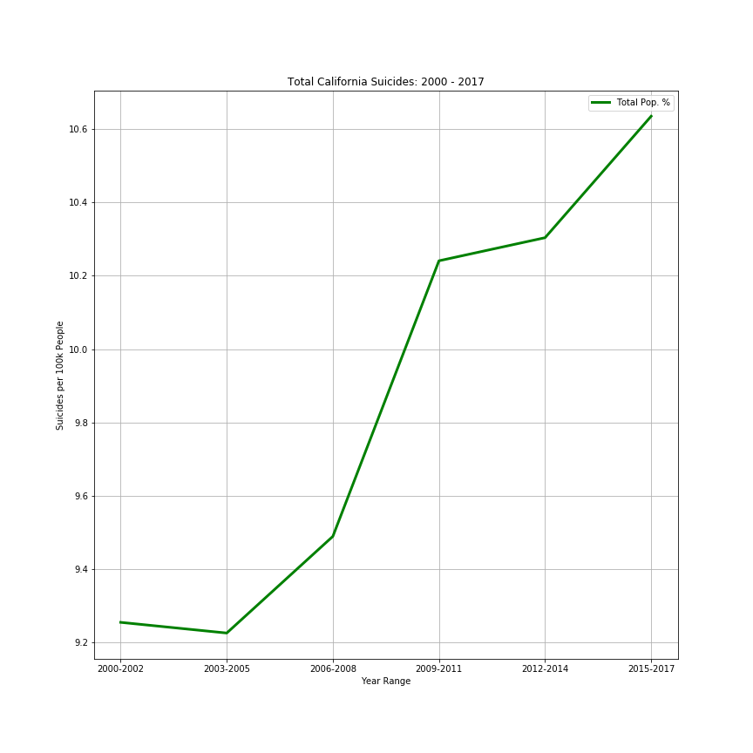
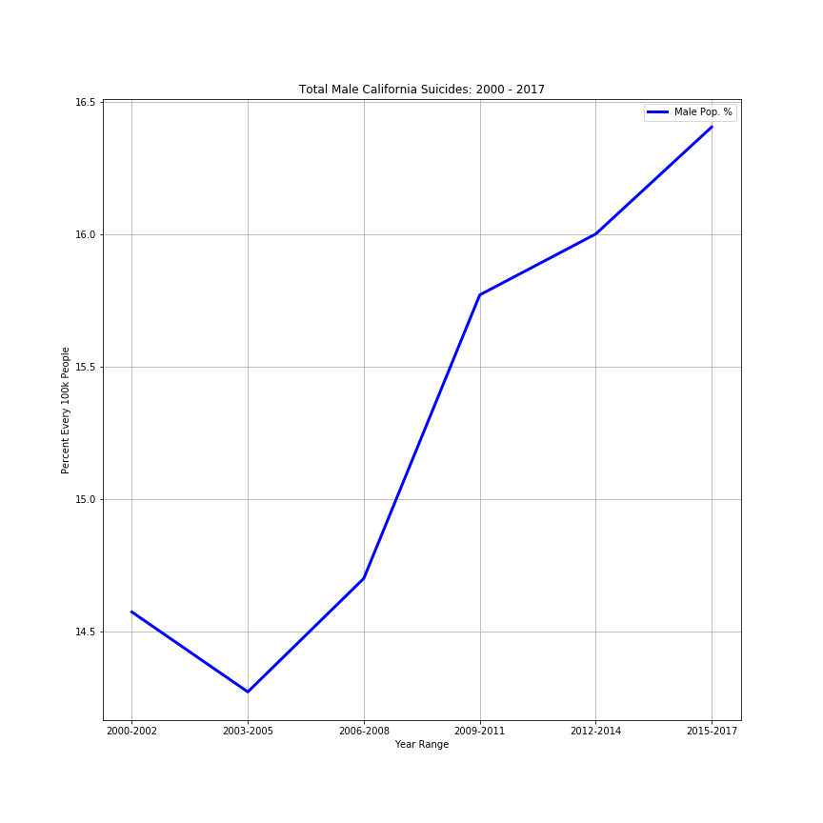
Suicide for California
Females California Males

Slide 21
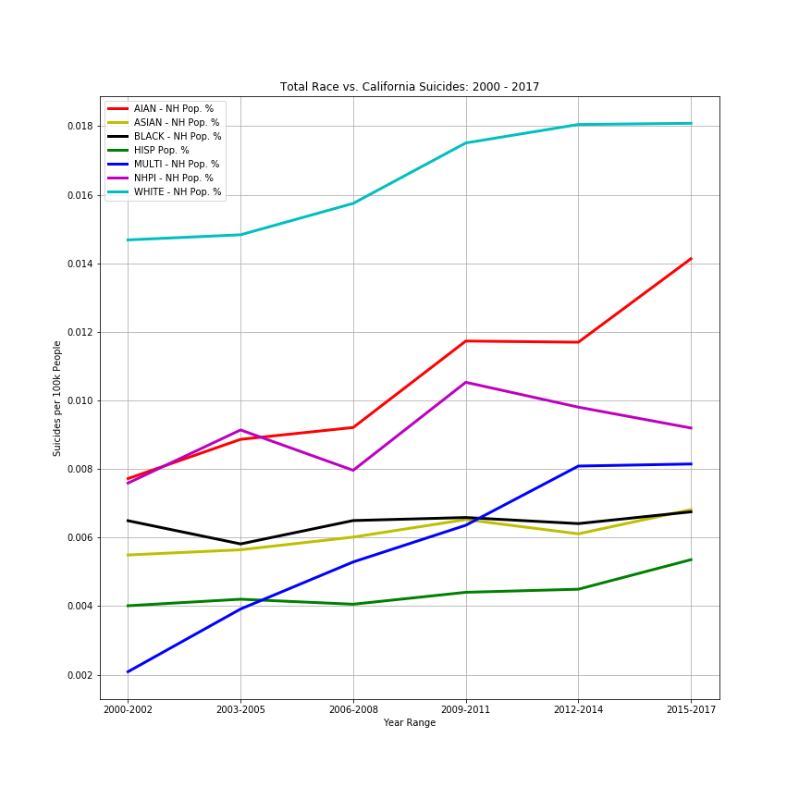
Suicide Grouped by Raced

Slide 22
Analysis Process
Time: 2000 – 2017
Geography:
California;
County.
Identify challenges with the data:
Not all counties had reported data for any given time period;
Since “rate” was based on suicides relative to population, lack of reported data for any county affected the “rate” for any given time frame.

Slide 23
Analysis Process
Used Data Frames to sort and filter data:
Process data to plot;
Generate line charts;
Generate heatmaps

Slide 24
Conclusions
Data Shows:
Suicides per 100,000 population indicates rural areas are affected the most;
Northern California seems to have the most suicides per 100,000 population over time;
Data Challenges:
Data requires averaging of surrounding counties to “plug” a non-reporting county so the charts are minimally affected while maintaining integrity of the the data and accuracy of the “story” it tells.

