Slide 1
Tests
Executing a program with the intent of finding errors
Dan Jane
Notes:
When I was working as a coder the team would always be happy that the tests “passed”. A failing test was always inherently blamed on the QA team, before we would grudgingly look into the problem.

Slide 2





Imagine if you went to the doctor and...
All tests pass
Success ?!
Failure ?!
A test flags
Notes:
Let’s assume you’ve inherited a code base, and the poor code base is sick. No worries, we book it an appointment with a doctor, who will run some tests...

Slide 3
Psychology of testing software
“Testing is the process of executing a program with the intent of finding errors.”
Glenford J. Myers, The art of software testing (1969).
Humans are fallible ∧ Humans design all software ⇒ All software has bugs.
Notes:
Colossus computer built in Bletchley Park in 1943. This book was written 36 years later, 42 years ago… so testing has been an art for the majority of time we have had computers.
I really don’t mean “your code is sick”. But everyone needs to accept that “code is sick”.

Slide 4
Psychology of testing software
“Testing is the process of executing a program with the intent of finding errors.”
Glenford J. Myers, The art of software testing (1969).
Humans are fallible ∧ Humans design all software ⇒ All software has bugs.
Testing takes ≃50% of cost and time in any software development project.
Estimate is stable over types of projects and styles of development.
Estimate has been stable over time.
Includes identifying bugs, diagnosing the problem, designing a solution, implementation…
… and, of course, testing the new code.
Notes:
"If you thought designing and coding that program was hard, you ain’t seen nothing yet."

Slide 5
Principles of testing software
Plan a testing effort knowing that there are errors.
A programmer should avoid attempting to test her own program.
A necessary part of a test case is a definition of the expected output or action.
Avoid throwaway test cases unless the program is a throwaway program.
“The probability of the existence of more errors in a section of program is proportional to the number of errors already found in that section.”
Notes:
Subset of the testing principles in Myers’ 1969 book.
Psychology of testing: “Testing is the process of executing a program with the intent of finding errors.” If you don’t want to find the errors, you can make damn sure you don’t find them.
Problem for one’s ego, and the fact that a lot of effort has just gone into the coding. Of course, the programmer can (and should) be part of a team doing a code review. Give the code to someone else to actually run it (especially for UI decisions).
Thoroughly testing the output or side-effects of the code is a crucial part of each test case. The input has to be defined as the state and the action at the start of the test.
Testing is a creative, demanding process. A company wouldn’t just throw away the code in which it had invested - indeed, the testing process is as valuable as the code base and should be treated as such.

Slide 6
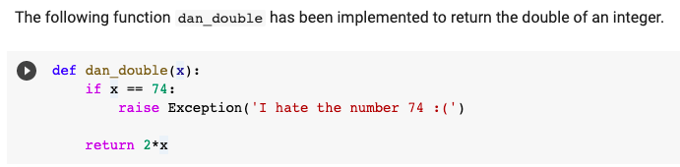
An example
Test the code here, using Google Colaboratory:
https://colab.research.google.com/drive/1OVBXQoZrvTWxRQeqxFdTe3vGBCb5KVZj?usp=sharing
Notes:
Congratulations! You have all just done your first test: a “code inspection”!
A code inspection is an offline test where we read through the code, mentally testing the logic and design choices.
Static code analysis includes code reviews, code walkthroughs, pair programming, linting (including syntax checkers), security audit.
Now we go to the Colab, check everyone can use it, then try out fuzz testing.

Slide 7
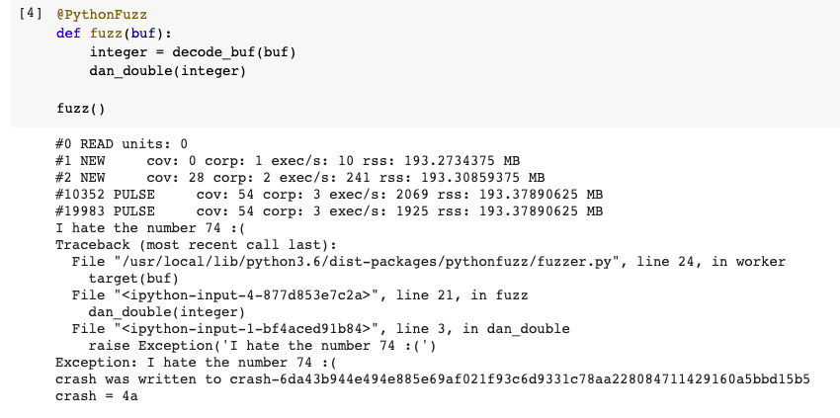
An example
Notes:
Can you guess the decimal representation of hex 4A ?

Slide 8
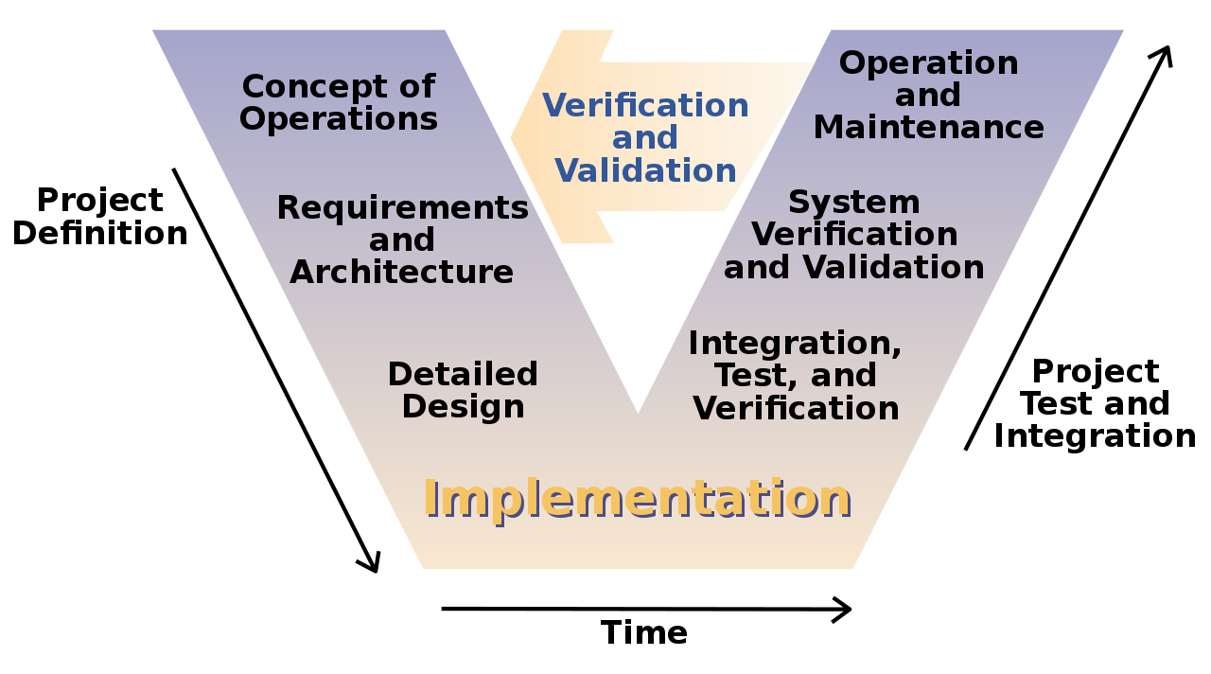
Testing at every step of the development process: V Model
Notes:
MANY tests - WHO is doing the testing, WHAT is being tested, HOW is the testing being done, WHEN in the development process...
TODO: Needs tests on slide
Function level
Static testing: code inspection, code walkthrough, code review, syntax checkers
Dynamic testing: unit testing, fuzz testing
Interface level
Integration tests, regression tests
System level
Smoke testing, Compatibility testing, Load testing, Security testing, Performance testing, Stress testing...
User Acceptance Tests
Is the customer happy?!

Slide 9
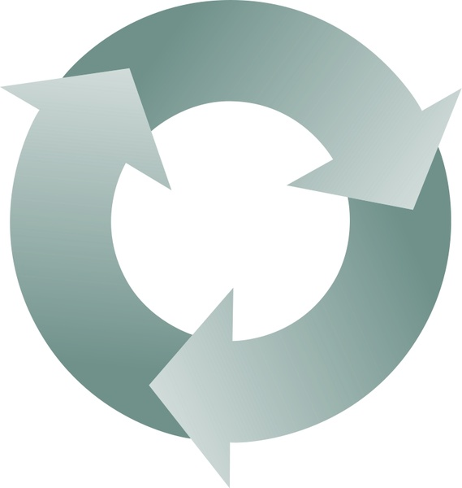
Test driven development
Add a unit test for new functionality
Since writing tests after the code is so tough…
...why not write the tests first?
Refactor code and rerun tests
Write minimal code to pass
Hilarious example:
https://www.youtube.com/watch?v=58jGpV2Cg50&ab_channel=UnityCoin
Notes:
Writing tests is tough - ego, the persistent idea that my code has no bugs and the tests will pass…
Reminder!!! “Testing is the process of executing a program with the intent of finding errors.”
One of the paradigms from the “Extreme Programming” movement of the late nineties: “Follow the wheel”.
Examples of companies who use XP - VW...
Advantages:
Exposes requirement issues early.
Think through one’s requirements or design before writing functional code.
Enables the developer to take a small step during building software.
Values refactoring - easier to keep code alive.

Slide 10
Summary
All software has bugs
Find bugs early
Tests are as valuable as the code
Testing improves the team

