Slide 1
ShareBook
Daniel Brunner, Daniel Huber, Michael Troger

Slide 2

The problem
Old books get dusty
You’ll never read them again
Selling is not worth the effort

Slide 3

The idea
Local book trading app
Offer your books available to trade
Get and send trade offers
Very simple usage
Meet up and trade
Never stop reading!

Slide 4
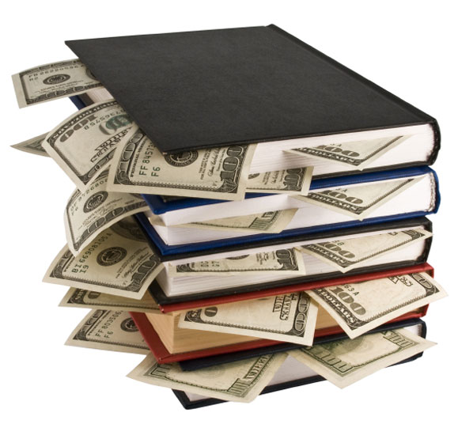
Money, money, money
Strategy
Free to use
Growing the user base
Advertisements
Premium user advantages
Boosting option for faster trades
Unlimited number of trades
Ad-free

Slide 5

Why?
(Nearly) everybody has the problem of unused books at home
Used books are in general not much worth
No competitor specialized in book trading in Austria

