Slide 1

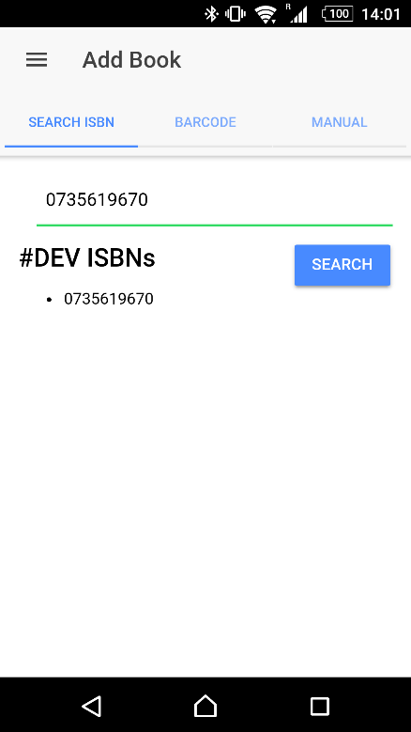
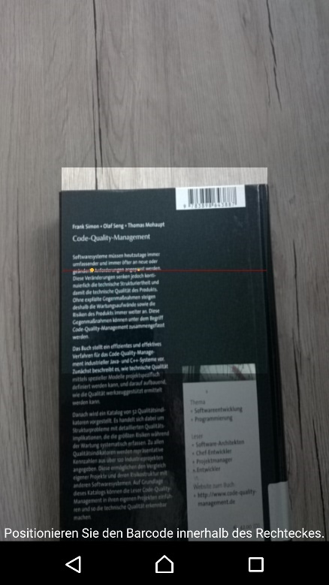
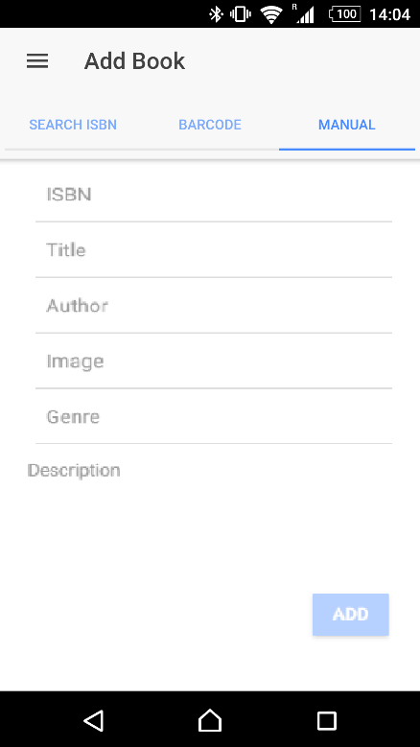
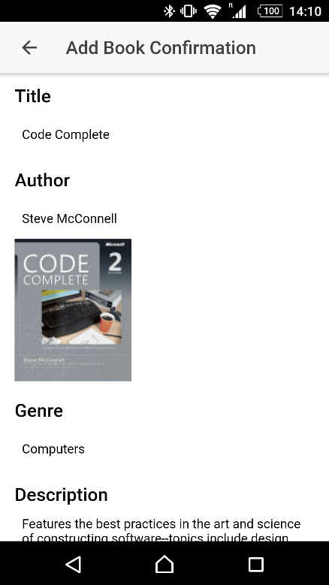

ShareBook
Daniel Brunner, Daniel Huber, Michael Troger
About
Technology Stack
Google Books API
ShareBook is a smartphone app for Android & iOS which enables an easy trading of books.
Have you ever wondered how many books you own and do not need anymore? With ShareBook users are able to easily trade books with other users! Therefore the user simply enters or scans the ISBN of a book and the app takes care of further information like the title, author, abstract, etc. and puts the book on the app’s market.
Users can send trade requests to other users and then meet to finally exchange their books. Books are made to be read - with our app we carry this mentality to our users.
The app is built with the Ionic-Framework, which integrates other popular frameworks like Apache Cordova and Google’s AngularJS 2.
With usage of these established libraries the app can be deployed both on Android and iOS. Furthermore, Ionic serves different predefined designs like Google’s Material Design so users can stick to known user interfaces which are optimized for Usability and User Experience so the user is able interact with the app in an intuitive way (Nielsen und Budiu, 2013).
To retrieve detailed book information (based on the ISBN), ShareBook uses the Google Books API.
The API offers detailed information about a certain book (author, title, image, number of pages, category,..) which can be retrieved via entering/scanning the ISBN.
The Books API can be invoked using REST from JavaScript using the callback query parameter and a callback function. This allows developers to write applications that display Google Books data without writing any server side code.
Motivation
Adding Books
References
The motivation behind this app is to enable an exchange of knowledge, in consequence reduce wastage and to carry our interpreted spirit behind books, which are made to be read, on. In addition, we pursue or idea to enliven bookshelves to be more dynamic instead of serving just as a nice decoration.
Our users are able to give away their old books and get another one in return from another user. As a enormous positive side effect this also tackles the wastage problem, as more and more books are simply thrown away (Morgan, 2009).
Adding books for trading can be done with:
Entering the ISBN of a book
Scanning the barcode of a book
Entering the book details manually
Morgan, S. (2009). Waste, Recycling and Reuse. Evans.
Nielsen, J. & Budiu, R. (2013). Mobile Usability. MITP-Verlags GmbH & Co. KG
(1)
(2)
(3)
(4)
Fig. 1-4: Process for adding books with three different options (1-3) and resulting confirmation page (4)

