Slide 1
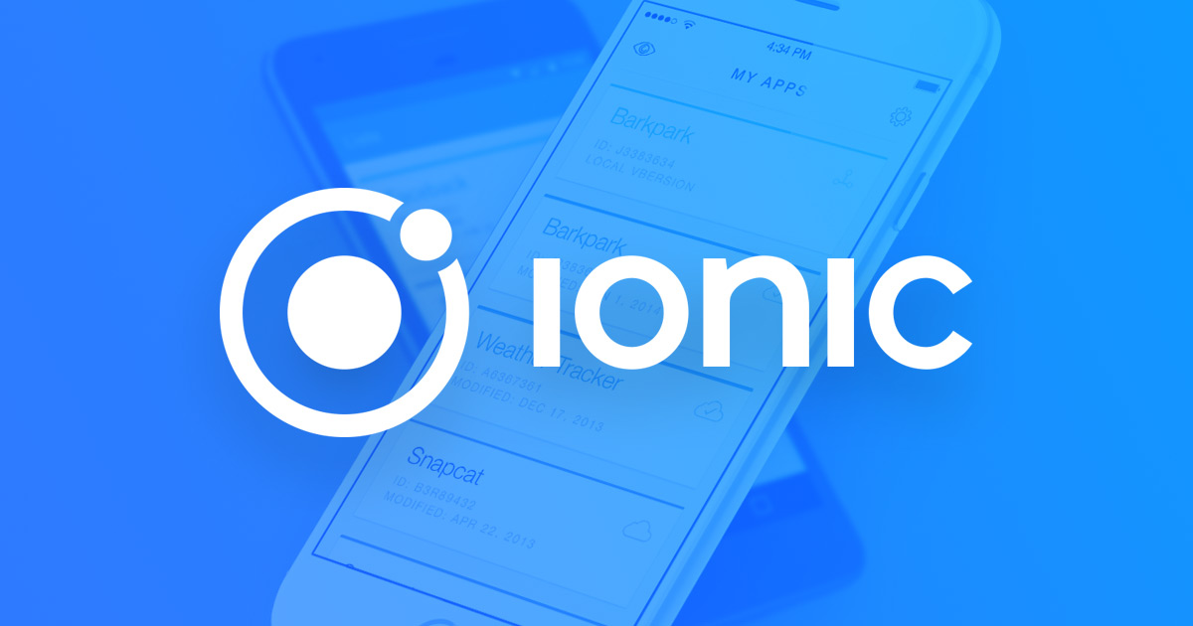

Slide 2
AGENDA
About ShareBook
App Demo
Backend Demo
Swagger
Node
Poster
Conclusio

Slide 3
About ShareBook
App to reuse books
Trade old unused ones, get new books in exchange
Further usage of ‘knowledge’
Trade within your area of living
Motivation to make bookshelfs ‘dynamic’

Slide 4
App Demo
App Demo
Improvements:
Communication with the REST Api
Rewriting views
Frontend routing logic
Error handling

Slide 5
Backend Demo
Backend Demo
RESTful API
in form of a NodeJS Server
generated with Swagger

Slide 6
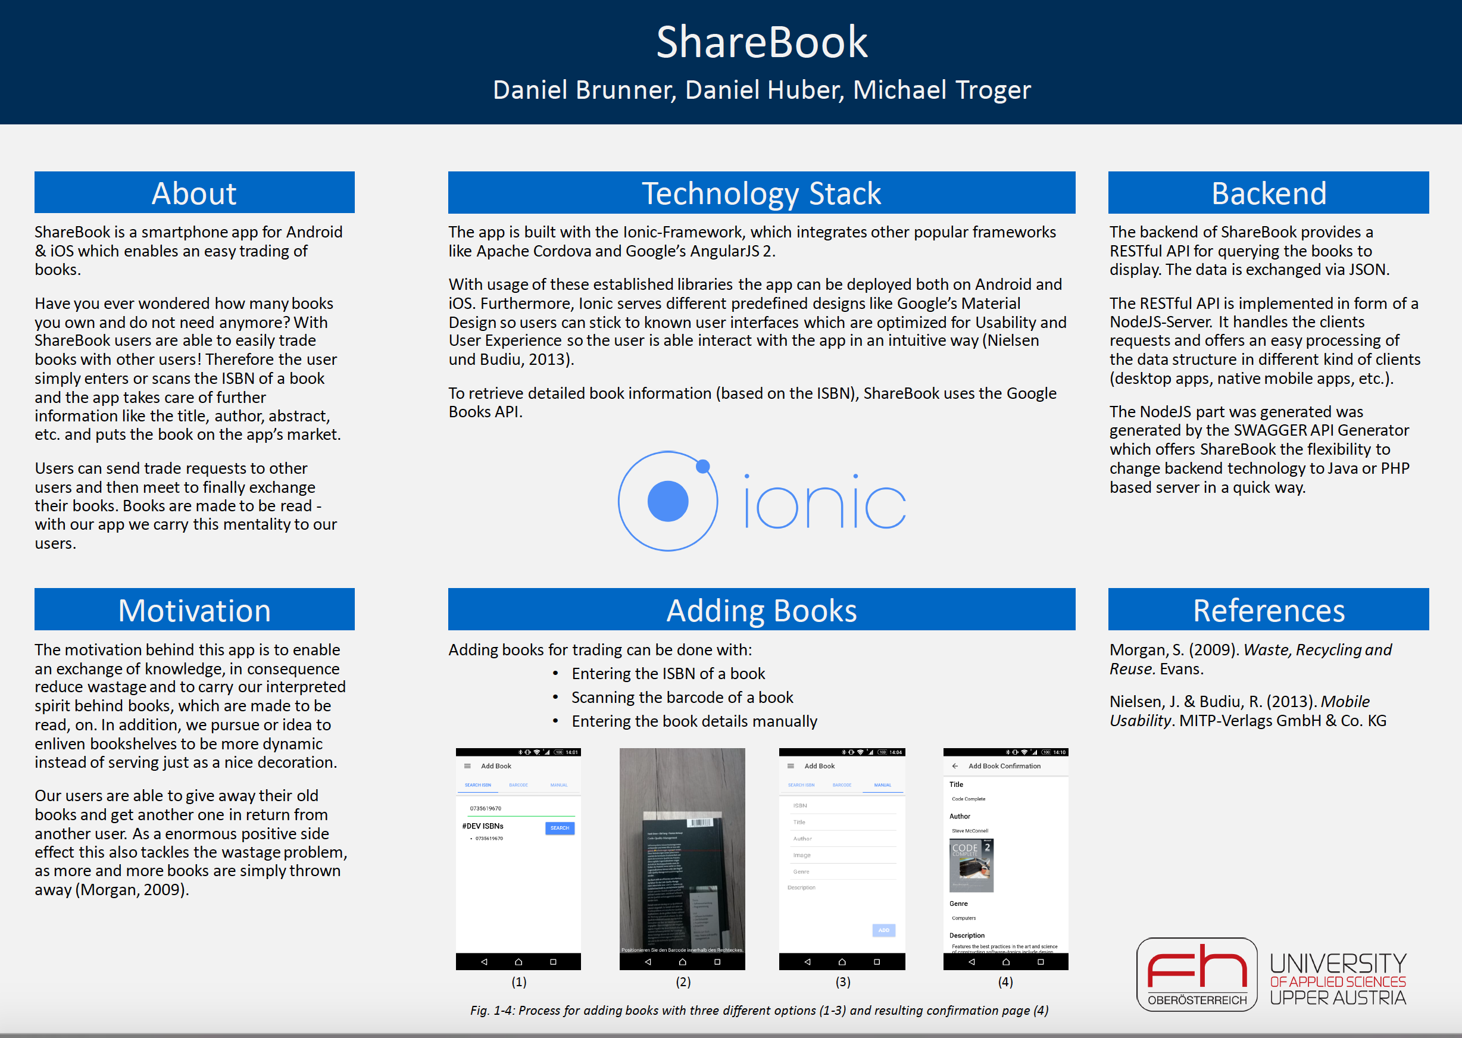
Poster
Poster

Slide 7
Conclusio
Conclusio
Ionic Creator sadly only A1 Output =(
Generall good structure of the project (components, providers, etc → Angular 4)
Native components (Barcode scanner) VERY EASILY accessible: 4 lines of code
Time consuming (new technologies, frontend stuff, divinig into Angular 4)

Slide 8
npm thank-you :)

