Slide 1
AI-Powered SQL to Redshift Converter
Accelerating Data Warehouse Migration with Generative AI
Dan Jin
Redshift CSE/SSA

Slide 2
Migration Challenges
The Problem: Manual SQL Conversion is Painful
Time-Consuming Manual Work
  Average: 2-5 hours per complex stored procedure
  Enterprise migrations: 1,000+ stored procedures
  Months of manual conversion work
High Error Rate
  Syntax differences between databases
  Function mapping errors (NVL vs COALESCE)
  Data type mismatches (VARCHAR2 → VARCHAR)
Knowledge Gap
  Teams need expertise in both source and Redshift
  New Redshift features not utilized
Real Impact:
  Migration projects delayed by 3-6 months
  High consultant costs ($200-300/hour)
  Post-migration bugs and performance issues

Slide 3
AWS SCT Limitations
Need additional resources for setup and configuration
  Need to connect to source and target databases
Rule-Based Approach
  Fixed conversion rules, no context awareness
  Cannot handle complex business logic
Outdated Feature Support
  Doesn't leverage latest Redshift features:
    QUALIFY clause (added 2022)
    MERGE statement (added 2022)
    SUPER data type enhancements
Manual Intervention Required
  30-40% of conversions need manual fixes
  No learning from corrections
  Cannot explain conversion decisions
SCT is a starting point, not a complete solution

Slide 4
GenAI Solution - Our Tool
AI-Powered SQL Converter: The Game Changer
Context-Aware Conversion
  Understands intent, not just syntax
  Handles complex nested queries
  Preserves business logic accurately
Always Up-to-Date
  Uses latest Redshift documentation
  Auto-refreshes feature knowledge from AWS docs
  Leverages newest capabilities (QUALIFY, MERGE, SUPER…)
Multi-Database Support
  Teradata, Oracle, MySQL, Snowflake, BigQuery, Clickhouse
  You can add more
Explainable AI
  Shows what changed and why
  Educational for teams learning Redshift
Integration Capabilities
Natural Language Understanding
  Trained on millions of SQL examples
  Understands semantic meaning, not just syntax
Multi-Modal Learning
  Combines SQL syntax with documentation
  Learns from AWS Redshift docs in real-time
  Adapts to new features without retraining
Contextual Reasoning
  Analyzes entire query structure
  Maintains logical equivalence across conversions
Architecture Benefits:
✅ Serverless - No infrastructure to manage
✅ Scalable - Handles 1 or 10,000 queries
✅ Cost-Effective - ~$0.006 per conversion

Slide 5
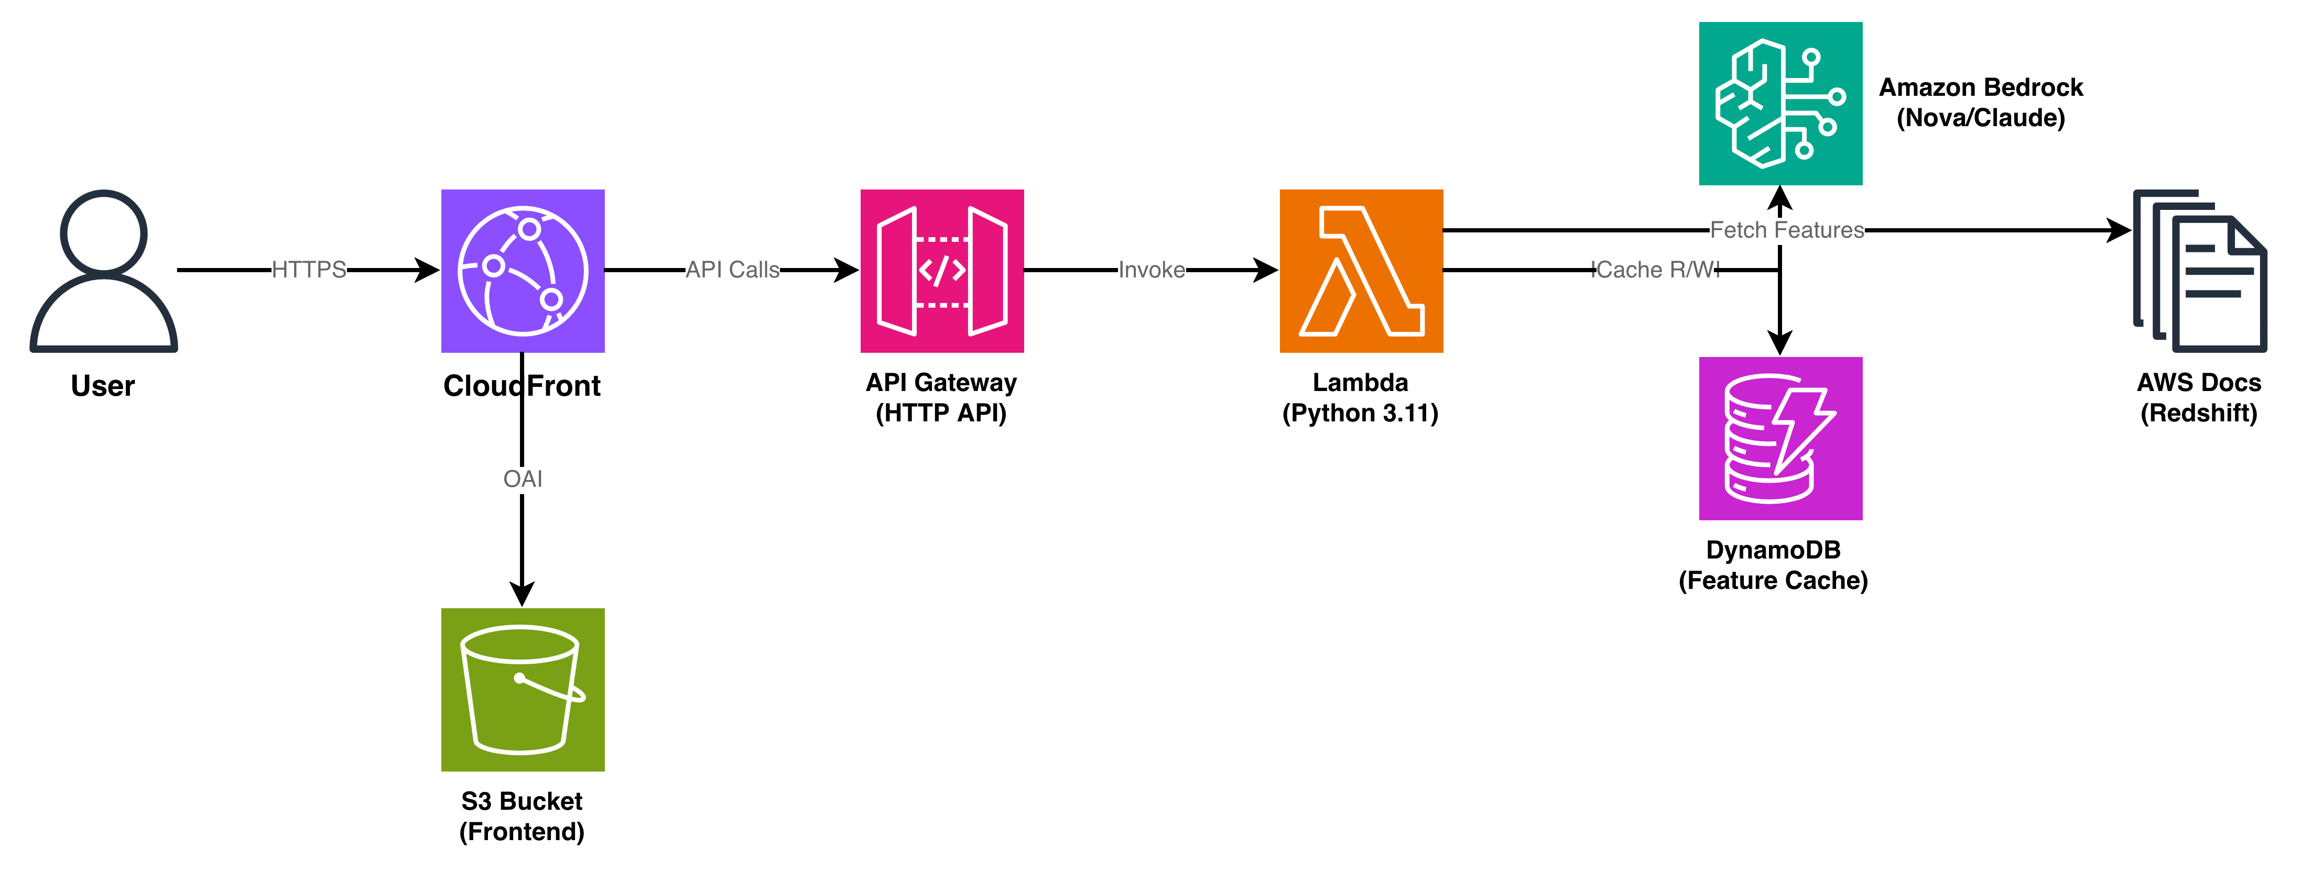
SQL to Redshift Converter - Serverless Architecture
Data Flow:
1. User accesses CloudFront URL
2. CloudFront serves frontend from S3 (OAI secured)
3. Browser calls API Gateway for SQL conversion
4. API Gateway invokes Lambda function
5. Lambda calls Bedrock for AI conversion
6. Lambda caches features in DynamoDB
7. Lambda fetches Redshift docs when refreshing
8. Converted SQL returned to user
URLs:
Frontend: https://d2eg3sx9ta7if9.cloudfront.net
API: https://5eq3avjsm4.execute-api.us-east-1.amazonaws.com

Slide 6
Current Limitations
What the Tool Cannot Do (Yet)
• Validation Against Live Redshift
❌ Doesn't execute SQL to verify correctness
⚠️ Mitigation: Always test on dev Redshift cluster
• Performance Optimization
❌ Doesn't analyze query execution plans
⚠️ Mitigation: Use Redshift Query Advisor post-conversion
• Complex Stored Procedures
⚠️ May struggle with 500+ line procedures
⚠️ Mitigation: Break into smaller functions
• Custom UDFs
❌ Cannot convert proprietary user-defined functions
⚠️ Mitigation: Manual UDF rewrite or Python UDF

Slide 7
Future Roadmap
Making It Even Better
Batch conversion UI (upload .sql files)
Conversion history and favorites
Syntax highlighting in editor
Redshift validation integration
Performance insights and recommendations
Enhanced stored procedure support
Learning from user feedback
Migration project management
Multi-file dependency analysis
Custom model fine-tuning
Full RAG (Bedrock Knowledge Base)
…

Slide 8
Get Started Today
Try It Now
• Web UI:
https://d2eg3sx9ta7if9.cloudfront.net
• Supported Databases:
Teradata, Oracle, MySQL, Snowflake, BigQuery, Clickhouse
• AI Models Available:
  Amazon Nova Pro (Fast, cost-effective)
  Claude Haiku 4.5 (Balanced)
  Claude Opus 4.5 (Highest accuracy)
• Next Steps:
1. Test with your SQL queries
2. Provide feedback for improvements
3. Integrate into your migration workflow
4. Share with your team

