Slide 1
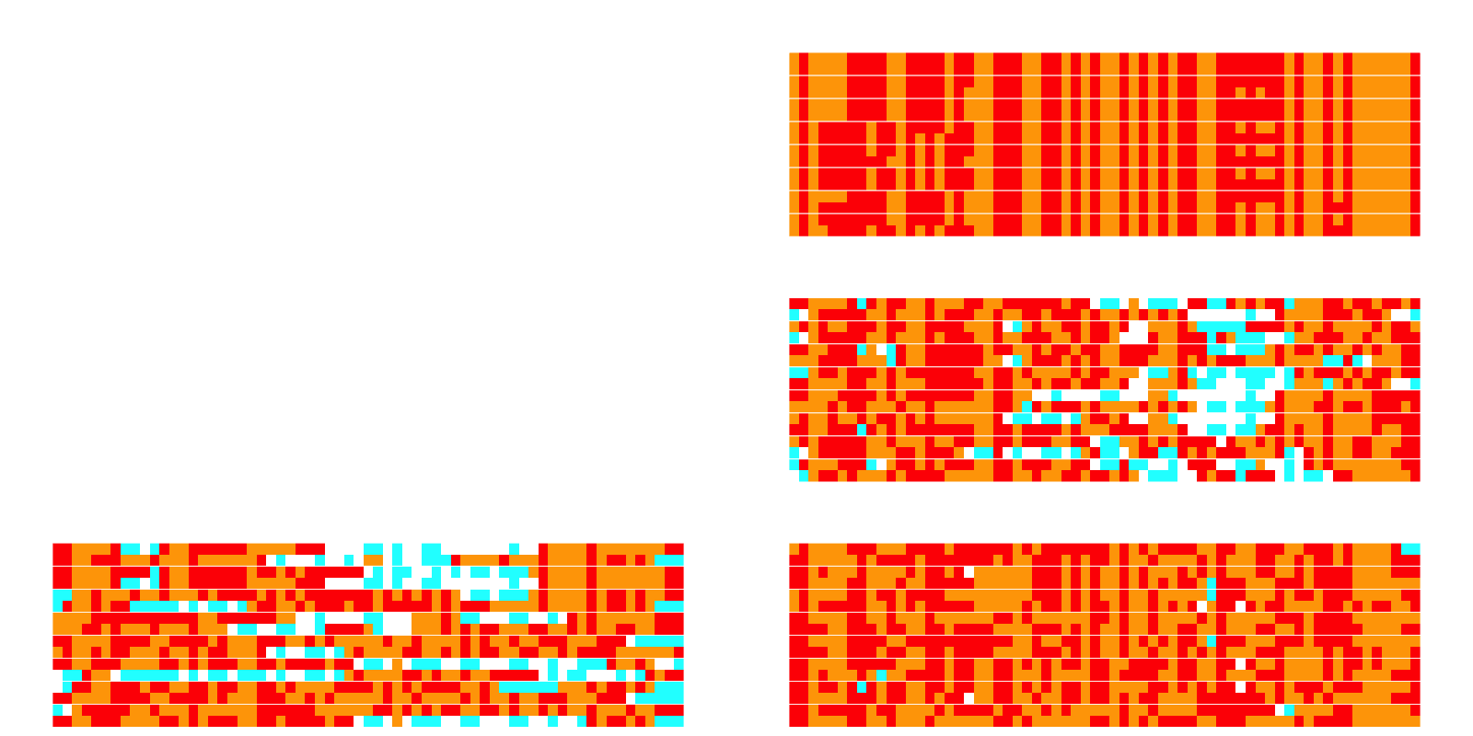
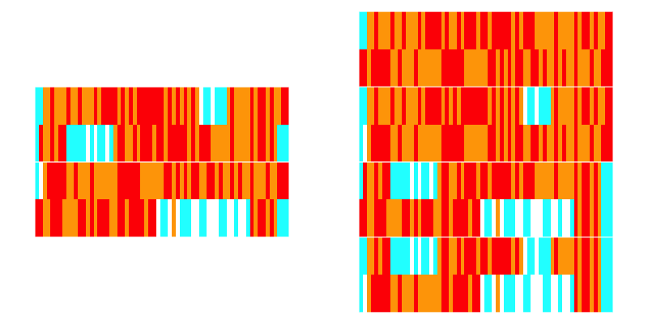
a) Local ancestry selection
c) Selection for Target Ancestry
Offspring
Breeding
Meiosis Pathways
Conservation Target segments
Mother
Father
d) Selection for low Kinship
Introgressed segments
Non-Breeding
b) Founder Panel
e) Selection combining Ancestry & Kinship

