Slide 1
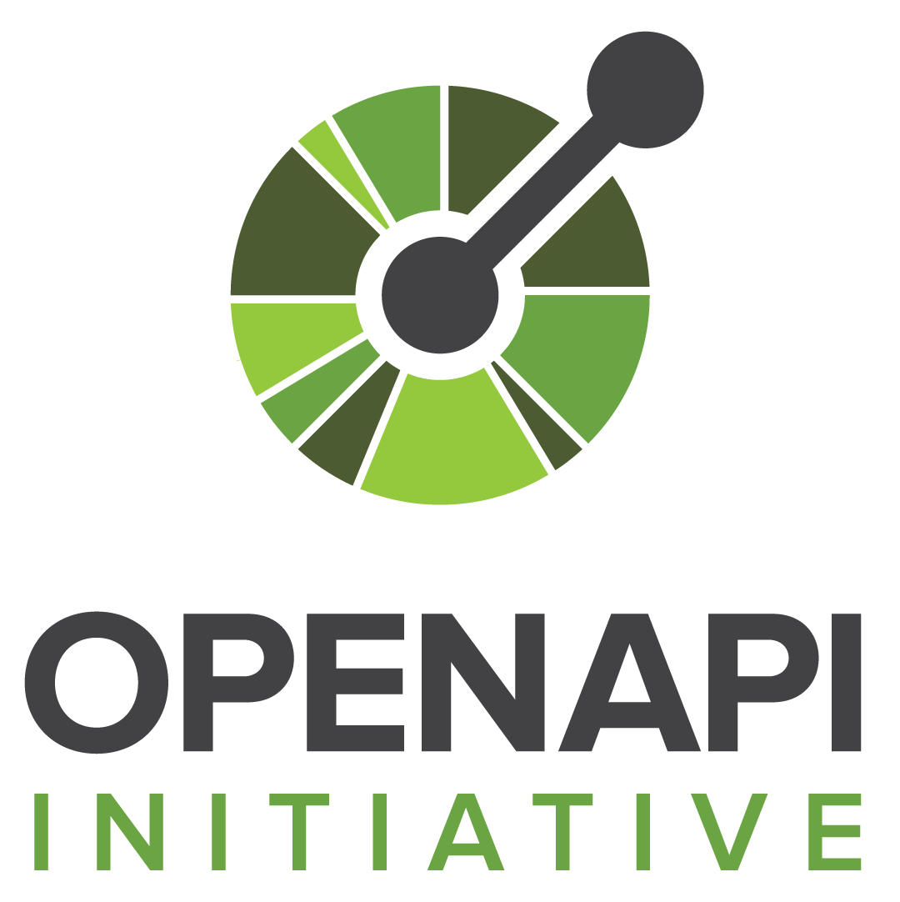
TEACHING DECK
Spec-Driven
API Test
Automation
openapi.yaml
-> generate-tests.ts
-> generate-edge-tests.ts
-> openapi.spec.ts
-> playwright test
Given an OpenAPI spec, generate executable Playwright API tests.
spec in
->
tests out

Slide 2
Why generate tests from OpenAPI?
Because the spec already contains the contract learners need to verify.
01
The contract is already written
`paths`, methods, parameters, responses, and examples describe how the API should behave.
02
Repetition moves into codegen
The generator writes the boring parts: request calls, status checks, content type checks, and expected bodies.
03
One source connects teams
API, docs, and tests can all point back to the same OpenAPI document.
Source anchors: Playwright API request fixture; OpenAPI code generation concepts

Slide 3
Project workflow overview
The repo teaches both a local demo loop and the final provided-spec loop.
Demo path
Real API path
OpenAPI spec
Express API
Playwright
Provided spec
Test file
Target API
->
->
->
->
sample with examples
generated routes
generated tests
file or URL
generated spec
via BASE_URL
npm run generate
npm test
npm run generate:from-spec -- --spec ./openapi.yaml
BASE_URL=https://api.example.com npm run test:generated
Spec-driven API test automation learning project

Slide 4
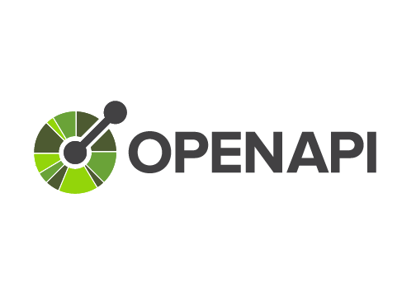
Anatomy of the spec
The generator reads the fields that can become executable behavior.
paths:
/v2:
get:
operationId: getVersionDetailsv2
parameters: [...]
requestBody:
content:
application/json:
example: {...}
responses:
'200':
content:
application/json:
examples:
foo:
value: {...}
A
`paths` + method
Produces a candidate operation.
B
`parameters` + request examples
Builds URL and request body.
C
`responses.2xx.examples`
Builds status, content-type, and body assertions.
Teaching point: examples create stronger generated tests than schema-only responses.

Slide 5
Step 1: Load and validate
`loadSpec()` accepts a local file or URL, parses it, then guards the contract.
file path
HTTP URL
parse
guard
ready
or
->
->
->
./openapi.yaml
https://.../openapi.yaml
YAML or JSON
OpenAPI 3.0.x
non-empty paths
const specInput = values.spec ?? process.env.OPENAPI_SPEC
const spec = await loadSpec(specInput)
if (!document.openapi?.startsWith('3.0.')) throw new Error(...)
if (!document.paths || Object.keys(document.paths).length === 0) throw new Error(...)
Fail early when the source contract cannot produce reliable tests.

Slide 6
Step 2: Discover operations
`listOperations()` walks every path and supported HTTP method.
HTTP_METHODS = [
'get', 'post', 'put',
'patch', 'delete',
'head', 'options'
]
for each path:
for each method:
if operation exists:
add candidate
Candidate test names
GET / listVersionsv2
GET /v2 getVersionDetailsv2
Each operation becomes a candidate. It only emits a test if a 2xx response exists.
Spec-driven API test automation learning project

Slide 7
Step 3: Build the request
OpenAPI examples and defaults become a concrete Playwright request.
1
Path params
const response = await request.get('/v2')
const created = await request.post('/users', {
data: {
name: 'Ada'
}
})
Use parameter examples, schema examples, defaults, or `sample-name`.
2
Query params
Append concrete values through `URLSearchParams`.
->
3
Request body
JSON examples become Playwright `{ data: ... }`.
The generated request uses Playwright Test's built-in `request` fixture, so no browser page is needed.
Playwright API tests can call GET, POST, PUT, PATCH, DELETE, HEAD, and fetch-style requests directly.

Slide 8
Step 4: Build the assertions
The first 2xx response contract decides how rich the generated test can be.
2xx response?
otherwise skip operation
expect(response.status()).toBe(200)
expect(response.headers()['content-type'])
.toContain('application/json')
const body = await response.json()
expect(body).toEqual(expectedExample)
->
JSON content?
assert content-type when present
->
Schema-only responses still produce status checks. Examples unlock full body assertions.
example body?
assert exact JSON body
Implementation anchor: selectSuccessResponseContract() in scripts/lib/openapi.ts

Slide 9
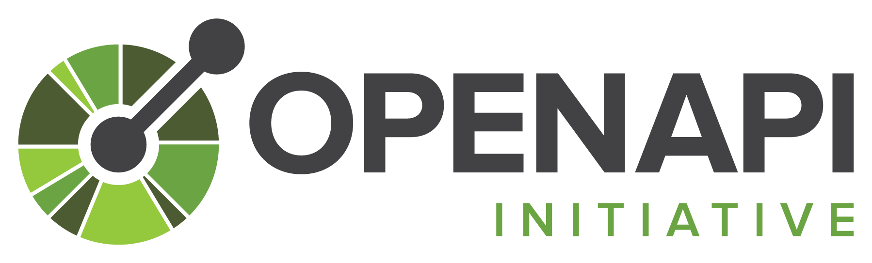
Step 5: Emit the test file
The output is a normal Playwright spec file that can be reviewed, committed, and run.
import { expect, test } from '@playwright/test'
test.describe('OpenAPI generated contract examples', () => {
test('GET /v2 getVersionDetailsv2 returns 200', async ({ request }) => {
const response = await request.get('/v2')
expect(response.status()).toBe(200)
const body = await response.json()
expect(body).toEqual({...})
})
})
operation
test()
->
GET /v2
one generated case
Generated file: `tests/generated/openapi.spec.ts`
Spec-driven API test automation learning project

Slide 10
Edge tests
Step 6: negative tests need invalid requests, not just successful response examples.
Required input?
Omit query, header, or body.
npm run generate:edge-tests
npm run test:edge
test('rejects missing required query parameter', async ({ request }) => {
const response = await request.fetch('/users', {
method: 'GET'
})
expect(response.status()).toBe(400)
})
Schema constraint?
Mutate type, enum, min/max, or format.
Security?
Send request without auth.
The sample spec produces the universal unknown-route edge test. Specs with required params, request bodies, auth, enums, and constraints produce richer negative tests.
No route?
Check undocumented path returns 404.
Implementation anchor: scripts/generate-edge-tests.ts

Slide 11
Run against the demo API
`npm test` proves the whole learning loop end to end.
npm test
generate
webServer
request fixture
assertions pass
->
->
->
->
single command
routes + tests + edge
starts Express
calls the API
contract holds
> npm test
Generated 2 API routes
Generated 2 Playwright API tests
Generated 1 Playwright edge test
API server listening at http://127.0.0.1:3774
3 passed
Playwright webServer handles local startup, so learners do not need a second terminal.

Slide 12
Provided API mode
BASE_URL switches generated tests from demo mode to target-API mode.
1. Generate from any spec
2. Run against the target
npm run generate:from-spec -- \
--spec ./path/to/openapi.yaml \
--output tests/generated/openapi.spec.ts
npm run generate:edge-from-spec -- \
--spec ./path/to/openapi.yaml \
--output tests/generated/openapi.edge.spec.ts
BASE_URL=https://api.example.com \
npm run test:generated
BASE_URL set
Playwright skips local server startup.
The input can be a local YAML/JSON file or an HTTP(S) URL.
Spec-driven API test automation learning project

Slide 13
Limits and next improvements
The current generator is intentionally teachable. The next upgrades are clear.
Current limits
Upgrade path
L1
$ref and composed schemas
Only simple inline cases are handled today.
Edit spec
Generate
Run
->
->
L2
Schema-only responses
examples + schemas
tests refresh
contract checks
Produce status-only happy-path tests.
Next: deeper schema validation, auth profiles, multi-example generation, boundary matrices, and CI.
L3
Validation required
Edge tests pass when the target API enforces the contract.
Close the loop: spec changes should regenerate executable evidence.

Slide 14
Homework
Explore public test APIs: read docs, write Playwright tests, run them.
Read docs
Write tests
Run tests
->
->
understand endpoints
use request fixture
inspect behavior
Swagger Petstore
Restful-Booker
Beeceptor Samples
petstore.swagger.io
restful-booker.herokuapp.com
beeceptor.com/docs/sample-api-for-testing
Best for: OpenAPI basics and tooling compatibility.
Best for: CRUD flows, auth, and bug discovery.
Best for: quick JSON response prototyping.
Authenticate, then create, retrieve, and delete a booking.
Pick one sample API and validate its responses with Playwright.
Cover at least one GET and one POST using the Swagger UI spec.
Homework source: homework.md

