Slide 1
Low Rank Adaptation of Large Language Models (Hu et al. 2021)
Daniel Shaw

Slide 2
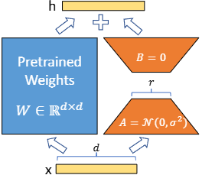
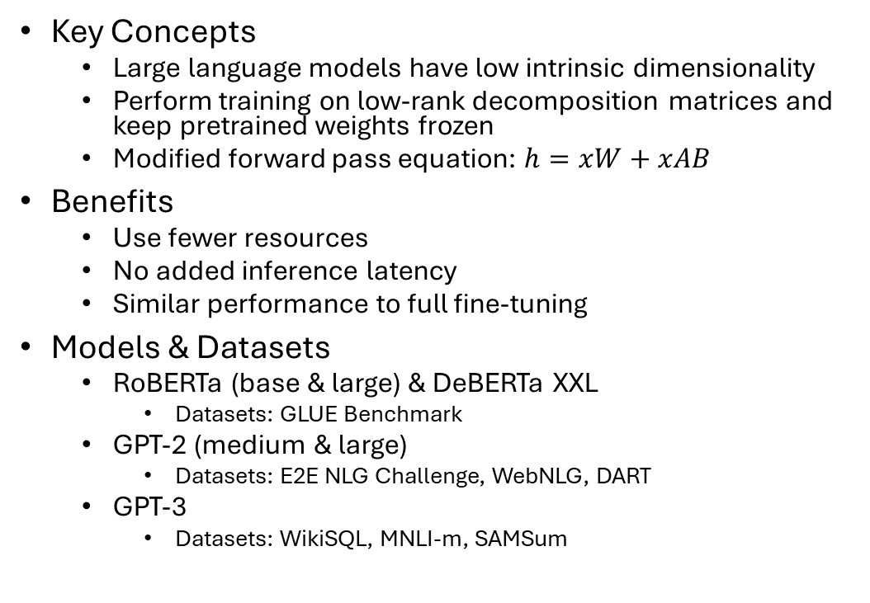
Introduction
Key Concepts
Large language models have low intrinsic dimensionality
Perform training on low-rank decomposition matrices and keep pretrained weights frozen
Modified forward pass equation: $h=xW+xAB$
Benefits
Use fewer resources
No added inference latency
Similar performance to full fine-tuning
Models & Datasets
RoBERTa (base & large) & DeBERTa XXL
Datasets: GLUE Benchmark
GPT-2 (medium & large)
Datasets: E2E NLG Challenge, WebNLG, DART
GPT-3
Datasets: WikiSQL, MNLI-m, SAMSum
Figure 1 from Low-Rank Adaptation of Large Language Models - Reparameterization (Hu et al. 2021)

Slide 3
Project Scope
Re-implement LoRA
Apply it to a model
Evaluate its performance using the General Language Understanding Evaluation (GLUE) benchmark

Slide 4
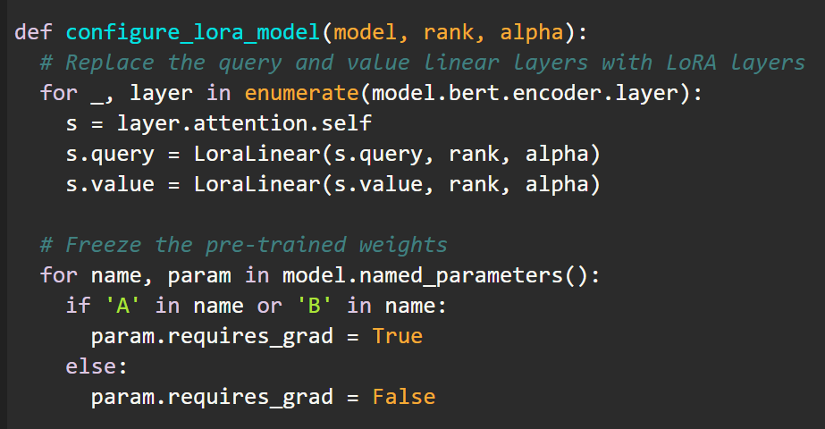
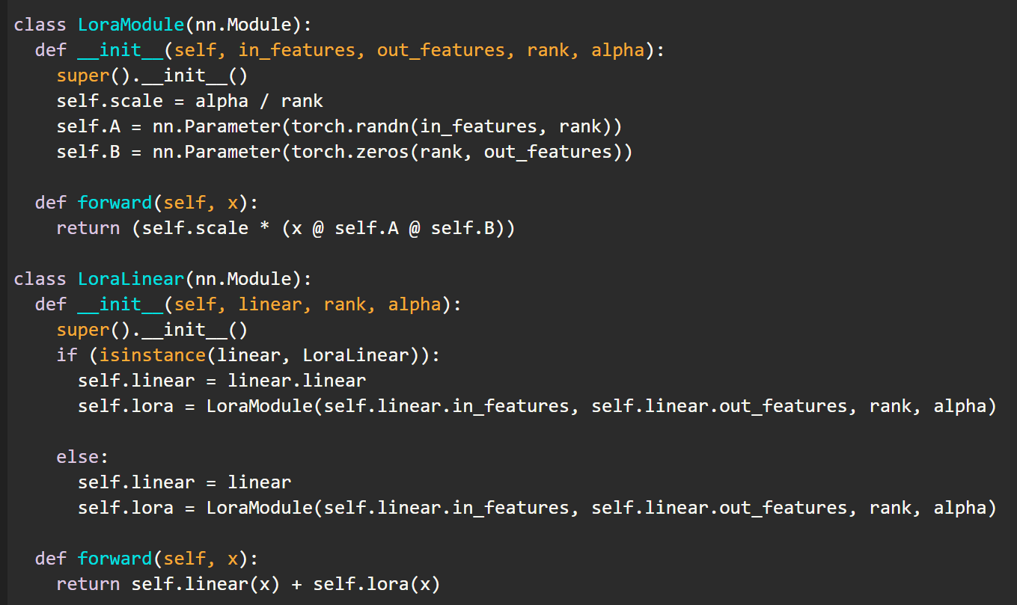
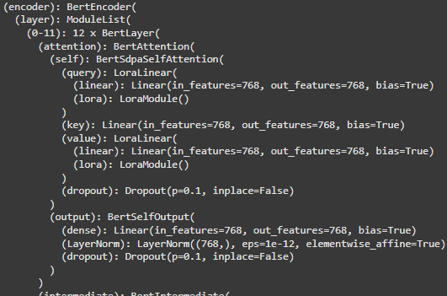
LoRA Implementation
Rank decomposition matrices (A & B) are added to linear query and value matrices
Leave pre-trained parameters intact and frozen

Slide 5
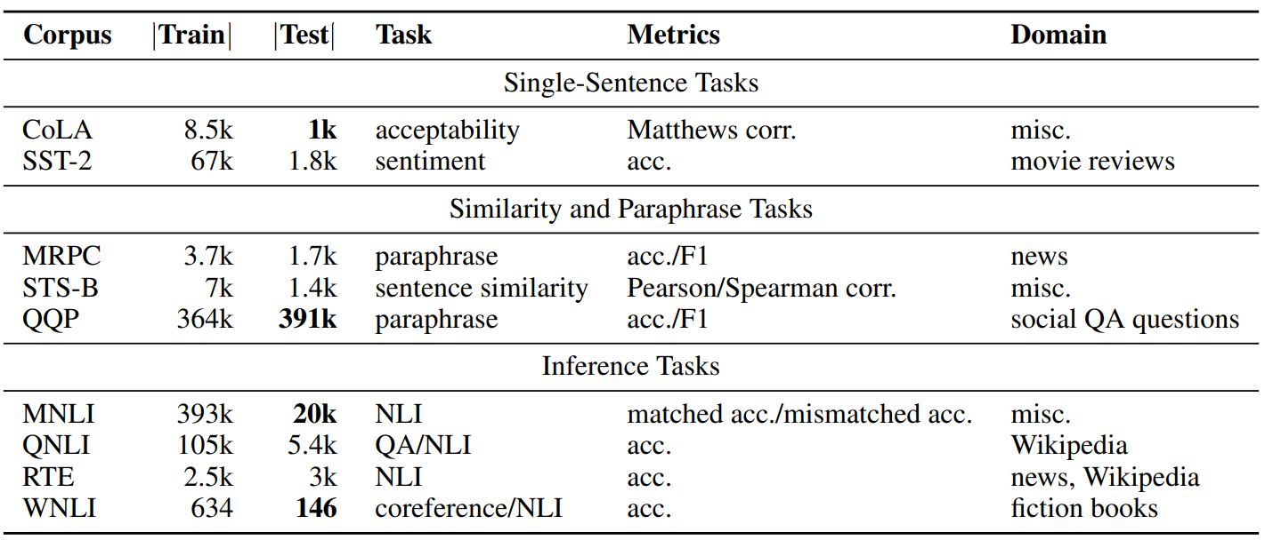
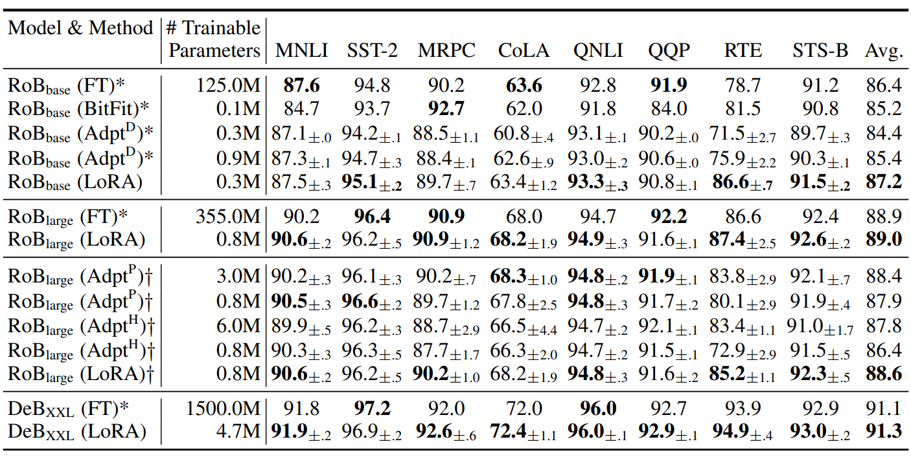
Challenges
Results from training RoBERTa base with MRPC weren’t matching the paper
The MRPC result for RoBERTa base was retrieved from a version fine-tuned on MNLI
MNLI is a very large dataset (approx. 100x the size of the MRPC training dataset) and would be costly to train
Table 1 from Glue: A Multi-task Benchmark and Analysis Platform for Natural Language Understanding (Wang et al. 2019)
Table 2 from Low-Rank Adaptation of Large Language Models (Hu et al. 2021)

Slide 6
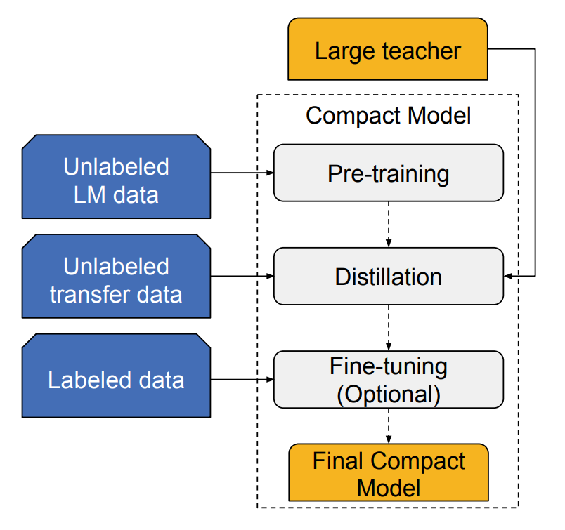
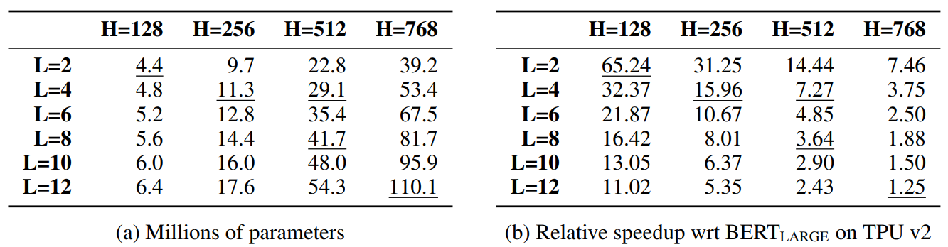
Well-Read Students Learn Better: On the Importance of Pre-training Compact Models (Turc et al. 2019)
Explores pre-training of compact models and distillation
Distillation – transferring knowledge from a larger “teacher” model to a smaller “student” model
Released 24 models to the public ranging from 4.4M parameters to 110.1M parameters
Training on compact models is much more cost effective
Therefore, I decided to use models from this paper instead for the project
BERT Tiny – 4.4M parameters
BERT Mini – 11.3M parameters
BERT Small – 29.1M parameters
L=number of transformer layers, H=hidden embedding sizes
Table 1 from Well-read Students Learn Better: On The Importance Of Pre-training Compact Models (Turc et al. 2019)

Slide 7
Methodology
Grid search hyperparameter tuning
epochs: 4
batch sizes: 8, 16, 32, 64, 128
learning rates: 3e-4, 1e-4, 5e-5, 3e-5
ranks: 1, 2, 4, 8, 16
alphas: 1, 2, 4, 8, 16
Used the Hugging Face Trainer and Transformer API
Google Colab – T4 GPU

Slide 8
Results (Metric: F1/Accuracy)
 | Fine-Tuning Results Reported Results from github.com/google-research/bert | My Fine-Tuning Results | My Fine-Tuning Results with LoRA
BERT Tiny | 81.1/71.1 | 83.9/75 | 82.4/71.3
BERT Mini | 81.1/71.8 | 86.2/80.6 | 86.0/78.9
BERT Small | 83.4/76.2 | 88.5/83.3 | 85.7/78.4

Slide 9
Metrics
 | Rank | Alpha | Batch Size | Learning Rate | Runtime (seconds) | Epochs | Accuracy | F1 | Trainable Parameters
BERT Tiny (Full Fine-Tuning) | - | - | 64 | 0.0003 | 7.3854 | 4 | 75.0% | 83.9% | 4,386,178
BERT Tiny (Fine-Tuning w/ LoRA) | 4 | 8 | 8 | 0.0003 | 20.129 | 4 | 71.3% | 82.4% | 4,096
BERT Mini (Full Fine-Tuning) | - | - | 16 | 0.00005 | 21.2484 | 4 | 80.6% | 86.3% | 11,171,074
BERT Mini (Fine-Tuning w/ LoRA) | 16 | 4 | 8 | 0.0003 | 29.2137 | 4 | 78.9% | 86.0% | 65,536
BERT Small (Full Fine-Tuning) | - | - | 8 | 0.00003 | 58.1944 | 4 | 83.3% | 88.6% | 28,764,674
BERT Small (Fine-Tuning w/ LoRA) | 16 | 16 | 8 | 0.0001 | 33.2218 | 4 | 78.4% | 85.7% | 131,072
 | Runtime (LoRA – Full Fine-Tuning) | Accuracy (LoRA – Full Fine-Tuning) | F1 (LoRA – Full Fine-Tuning) | Trainable Parameters (LoRA / Full Fine-Tuning)
BERT Tiny | 12.7436 | -3.68% | -1.51% | 0.09%
BERT Mini | 7.9653 | -1.72% | -0.22% | 0.59%
BERT Small | -24.9726 | -4.90% | -2.88% | 0.46%

Slide 10
Sources
Hu, Edward J., et al. "Lora: Low-rank adaptation of large language models." arXiv preprint arXiv:2106.09685 (2021).
Aghajanyan, Armen, Luke Zettlemoyer, and Sonal Gupta. "Intrinsic dimensionality explains the effectiveness of language model fine-tuning." arXiv preprint arXiv:2012.13255 (2020).
Turc, Iulia, et al. "Well-read students learn better: On the importance of pre-training compact models." arXiv preprint arXiv:1908.08962 (2019).
“Fine-Tuning a Model with the Trainer Api - Hugging Face NLP Course.” Fine-Tuning a Model with the Trainer API - Hugging Face, huggingface.co/learn/nlp-course/chapter3/3?fw=pt. Accessed 19 Nov. 2024.
Raschka, Sebastian. “Code Lora from Scratch - A Lightning Studio by Sebastian.” Lightning AI, 17 Jan. 2024, lightning.ai/lightning-ai/studios/code-lora-from-scratch.

