Slide 1
( ongoing ) ( fossil ) ( canine ) ( accompanied ) ( breed ) ( domesticated )
The first pterosaur f_____ was described by the Italian naturalist Cosimo Alessandro Collini in 1784.
We fully support the o______ global anti-terrorism efforts.
As a result, his upper right c_____ tooth was broken and he sustained numerous bruises on his body.
Dogs of this weird b____ have super short legs.
D________ dogs a_________ the first humans into the Americas around 15,000 years ago.

Slide 2
An ancient dog fossil helps trace humans’ path into the Americas
Bohdana Yurchenko
TV-01 mp

Slide 3
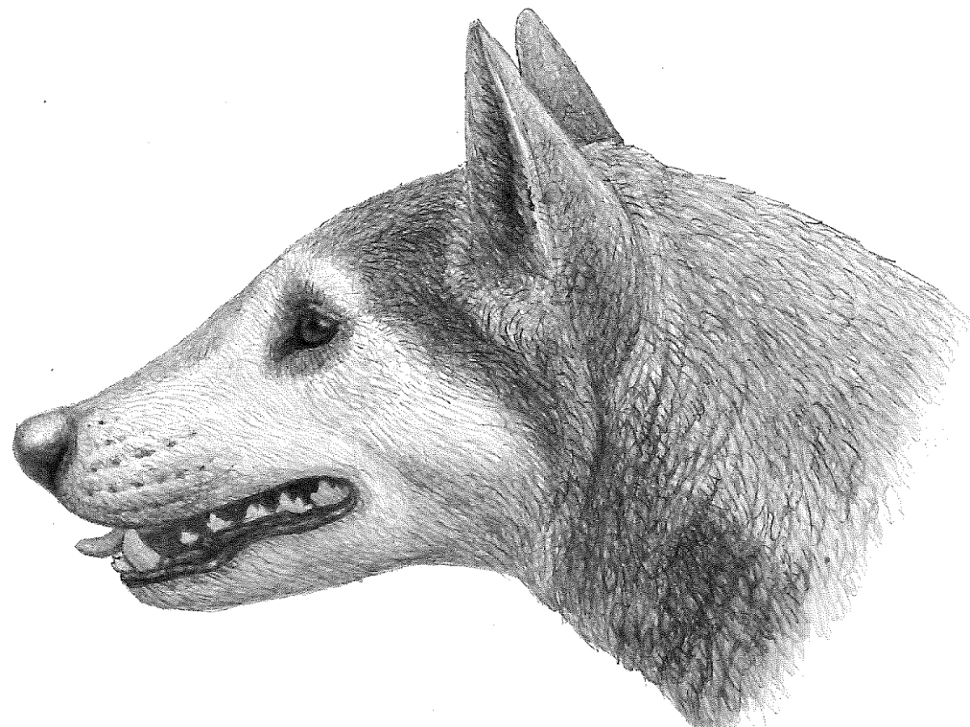
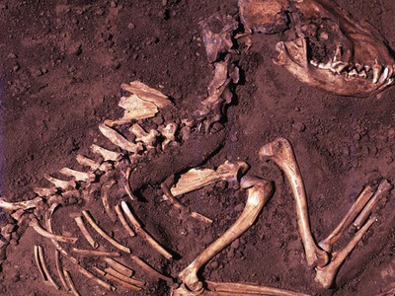
Notes:
An ancient bone from a dog, discovered in a cave in southeast Alaska, hints at when and how humans entered the Americas at the end of the Ice Age.
The bone, just the fragment of a femur, comes from a dog that lived about 10,150 years ago, based on radiocarbon dating. That makes this dog fossil one of the oldest, or possibly the oldest, found in the Americas, researchers report in the Feb. 24 Proceedings of the Royal Society B.
Analysis of DNA from the bone, roughly the same age as three other dogs dating to around the same time period previously found buried in the Midwest (SN: 4/16/18), suggests that the dog belonged to a lineage of dogs that split from Siberian dogs around 16,700 years ago. The timing of that split suggests that the dog’s ancestors, probably following along with humans, had left Asia by around that time.

Slide 4
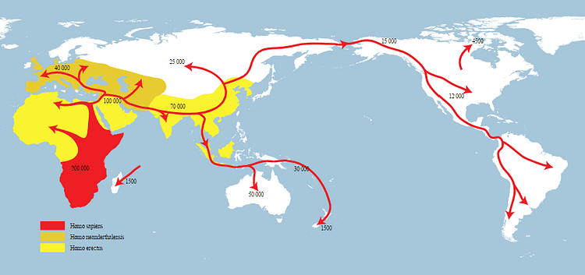

Slide 5
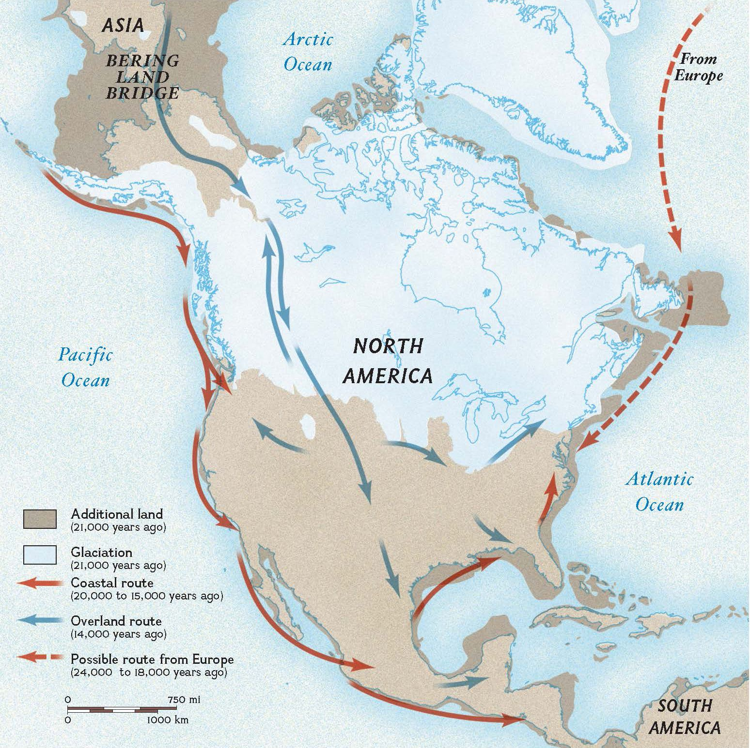
Notes:
Bering Land Bridge
This map shows how a land bridge connected the continents of Asia and North America when the most recent ice age lowered sea levels. Scientists one theorized that the ancestors of today's Native Americans reached North America by walking across this land bridge and made their way southward by following passages in the ice as they searched for food. New evidence shows that some may have arrived by boat, following ancient coastlines.

Slide 6
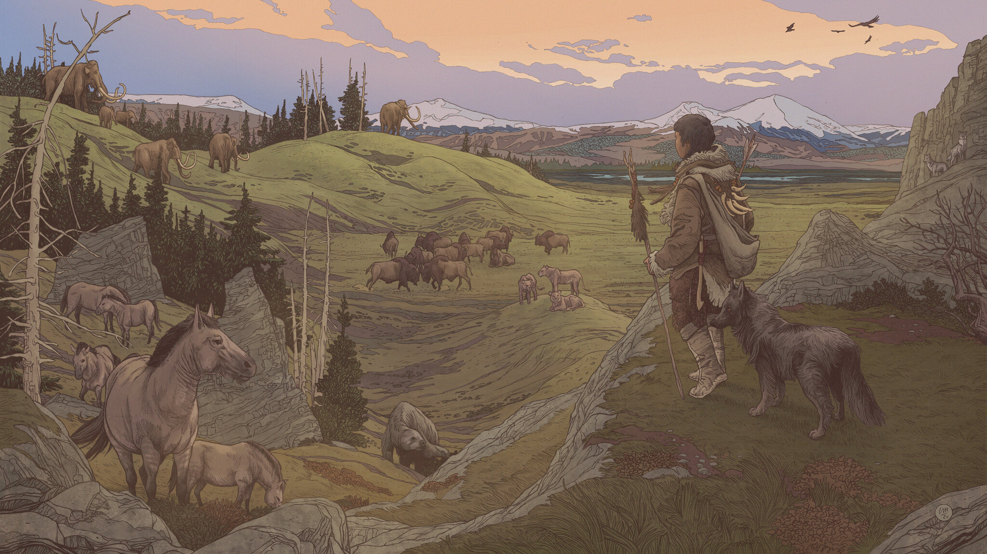
Notes:
“Dogs’ movement and domestication is obviously very, very closely associated with humans. So the interesting thing is, if you’re following dogs’ movement, it can tell you something about humans as well,” says Charlotte Lindqvist, an evolutionary biologist at the University at Buffalo in New York.

Slide 7
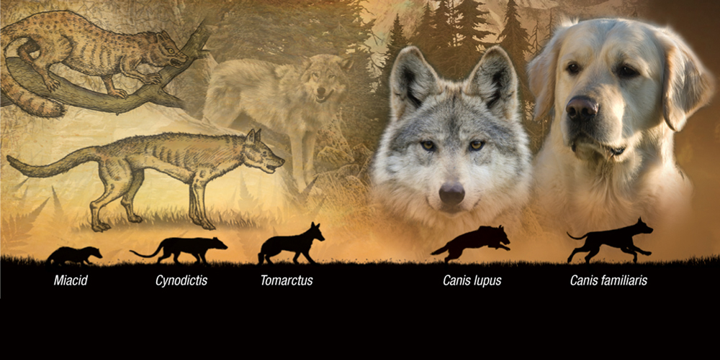
Notes:
The new finding also adds to an ongoing debate about what route humans took after arriving in North America via a land bridge in Alaska. One long-held idea is that these first colonizers traveled inland through an ice-free corridor (SN: 8/8/18). But around 16,700 years ago, that corridor would have been covered in ice. Thus, the existence of this ancient dog supports an alternative idea — that these colonizers hugged the Pacific coast as they moved south, possibly traveling by boat.
The bit of bone, smaller than a dime, was originally thought to be from a bear. But when Lindqvist and colleagues analyzed DNA from the bone, it turned out to be canine. Comparing the DNA with that from wolves, ancient dogs and modern dog breeds allowed the team to estimate when the dog last shared an ancestor with dogs from Siberia.

Slide 8

Notes:
This finding is a big deal, says Angela Perri, an archaeologist at Durham University in England, whose recent genetic research suggests that domesticated dogs accompanied the first humans into the Americas around 15,000 years ago. This new paper suggests that “at least around 16,700 years ago, humans and dogs seemed to be moving into the Americas,” she says. “And that would be almost 2,000 years earlier than we thought.”

Slide 9
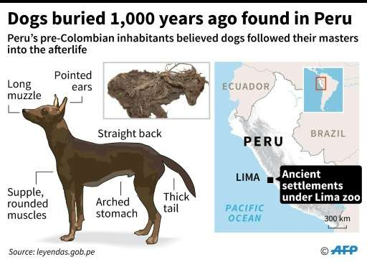

Notes:
Kelsey Witt, a geneticist at Brown University in Providence, R.I., looks forward to additional discoveries of early American dogs. By finding more ancient fossils and studying more DNA, Witt says, “I think we’ll get a better picture of exactly how people migrated and exactly when dogs came through.”

