Slide 1

‘AstrapiMessanger’ Мессенджер для мобільних пристроїв на KaiOS
Юрченко Богдана Олегівна
ТВ-01 мп

Slide 2
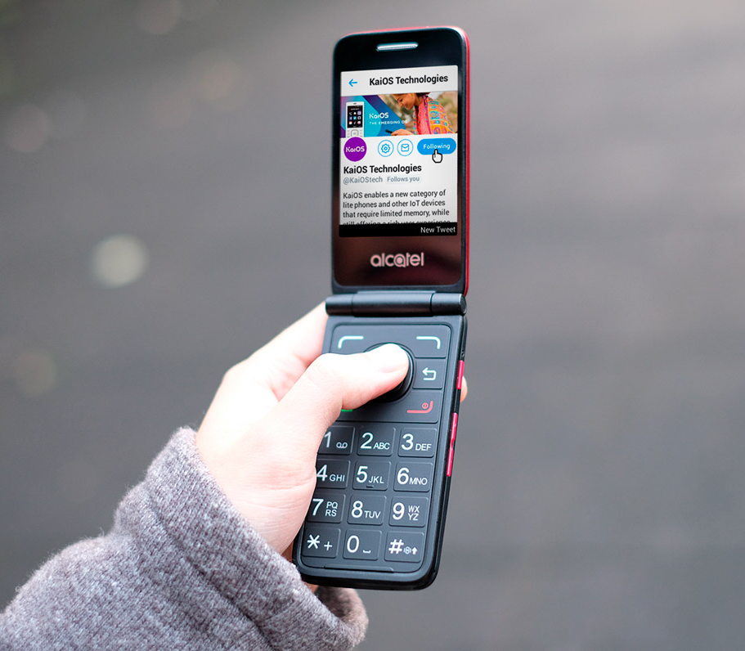
KaiOS - emerging OS
3.6 billion people
In total, 47% of the world’s population (approximately 3.6 billion people) do not use the Internet.
Active users: 150+ million

Slide 3

KaiOS Stakeholders
Largest: TCL Corporation
Google ($50M + invested)
Reliance Jio ($7M+ invested)

Slide 4
KaiOS Market Share
Global market: 0.2%
Indian market: 4.3% share. 2nd place behind Android

Slide 5
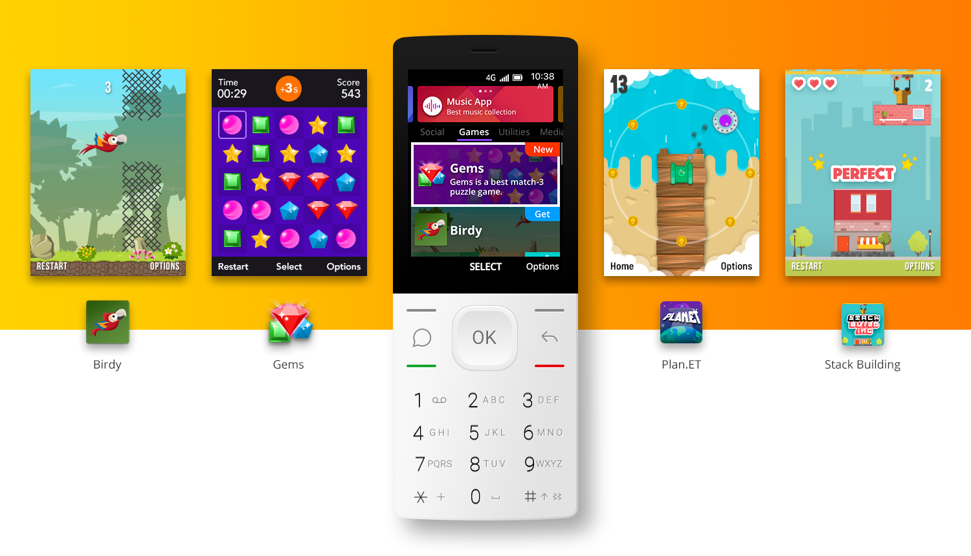
KaiOS Store
500+ apps in Kaistore.

Slide 6
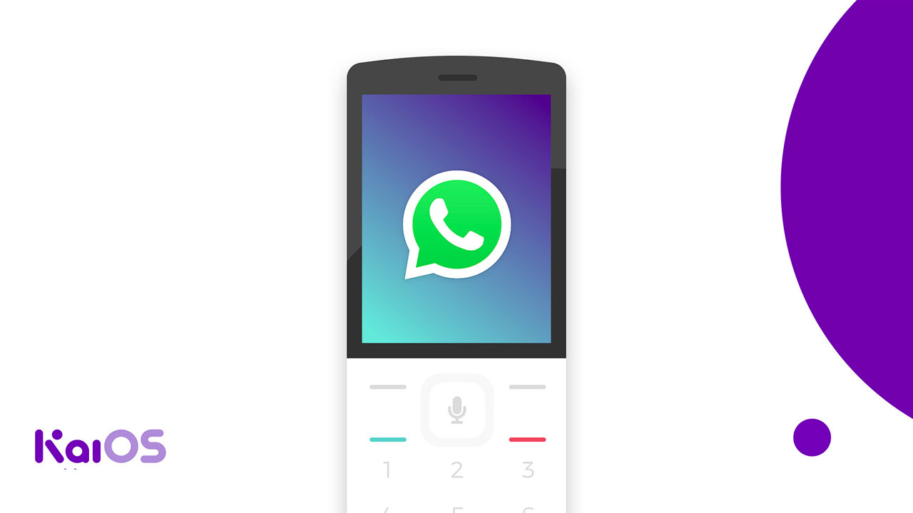

Slide 7
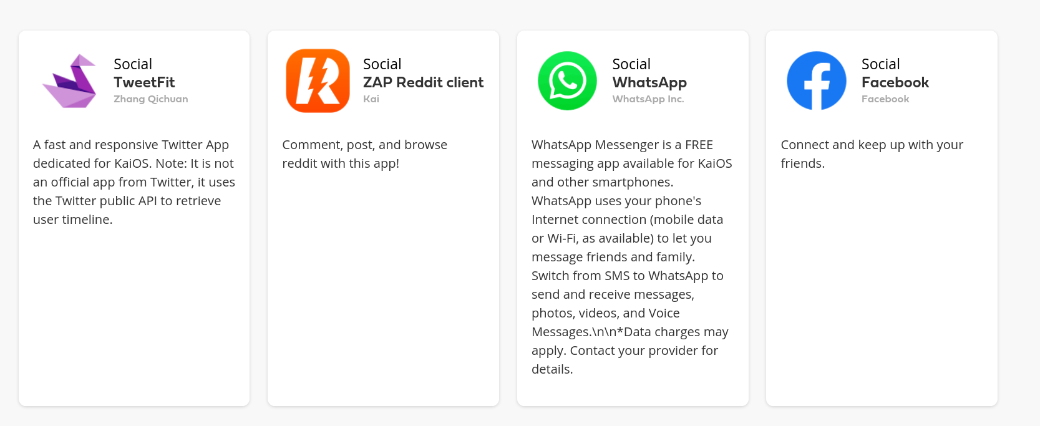
Alternatives (not many)

Slide 8


Slide 9
Features
free text messages
free audio messages
security
privacy
optimisation for cheap devices
desined for feature phones with phisical buttons
alternative to WhatsApp on an emerging market

Slide 11
Income
Free
adds
features for simple users
Pro
subscription
adds free
some pro features
B2B subsription
subsription
adds free
some pro features for small businesses

Slide 12
Risks
Users are too used to WhatsApp
Pro subsription fee is not affordable to the target audience

Slide 13
Future
Clients for other operating systems
Video Calls
Rooms management tools
Chats

Slide 14
Team and Funding
Designer
Front-end developer
Back-end developer
Tester
1 000 000 UAH (1 year of development of the first version)
salaries
office rent
internet

Slide 15
Thanks!

