Slide 1
Master's degree dissertation Topic : "Ontology based models for information search"
Done by: Bohdana Yurchenko
TV-01
Adviser: Коваль О.В.

Slide 2
Actuality. Problem found in the domain
Currently, as mentioned in the previous presentation, there is no software, dedicated to international cooperations reports analysis.
The software to be developed is aimed to simplify and automate gathering of distributed information about international cooperation of different departments of a certain company, institute etc.

Slide 3
Problem to solve
All the information about international cooperations is gathered independently for each department of a university and published in a form of a free text document, that cannot be easily parsed by machine.
So it takes a lot of time and effort for a dedicated person to analyze all reports in order to, let’s say, generate a generalized refort about the whole universtity.
The work is hard, demanding and too costy.

Slide 4
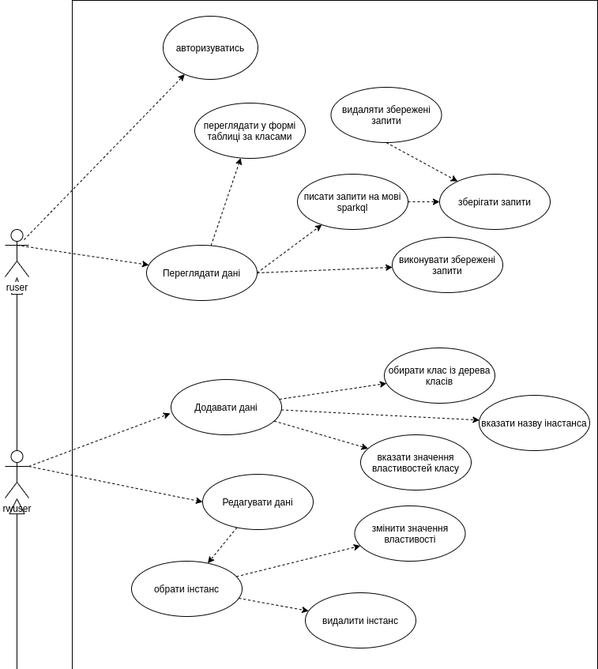
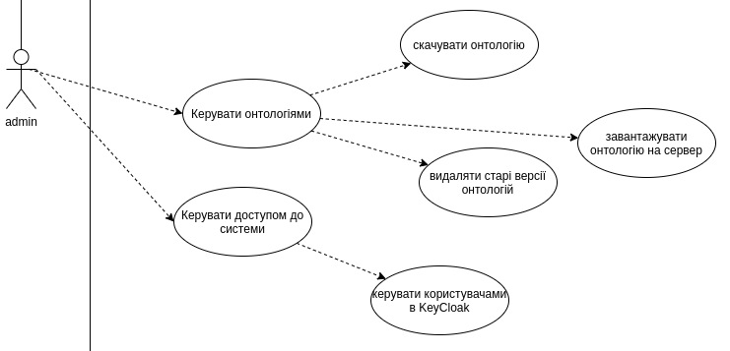
Extended usecases

Slide 5
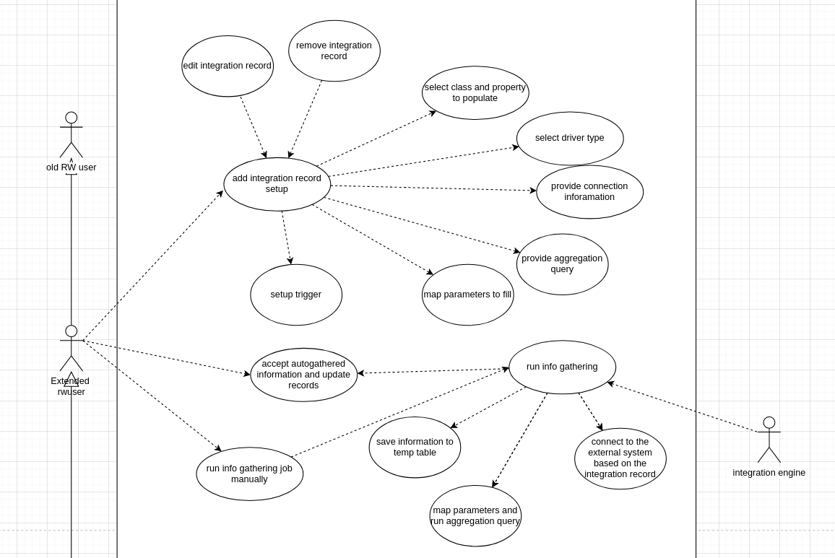
Extended usecases

Slide 6
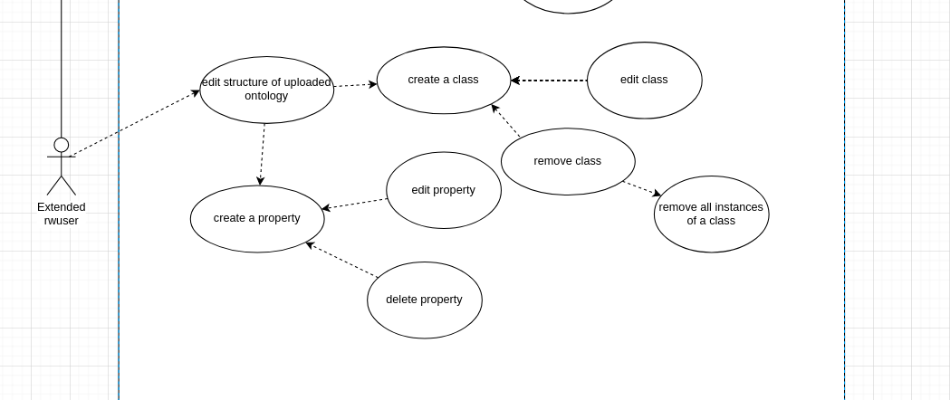
Extended usecases

Slide 7
Plan of work
Analyze published KPI reports about international cooperation
Create an ontology to describe different entities related to internatoinal cooperation
Create an ontology to describe integration information (with realtional databases, NoSQL databases, public OWL files )
Develop a platform for ontology editing and integration

