Slide 1

2019 Car fleet planning

Slide 2
Overview
Purpose of Presentation
2018 Baseline Car Fleet Performance
Proposed Strategies
Conclusion
Next steps
Questions

Slide 3
Purpose of Presentation
How do we make better choices in regards to the
costs & revenue of Lariat’s car fleet?

Slide 4
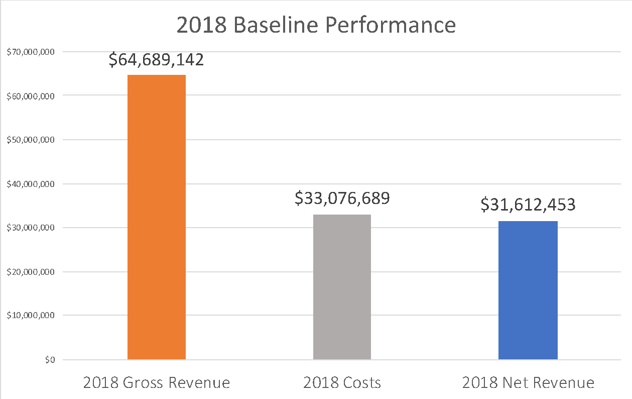
2018 Baseline Car Fleet Performance

Slide 5
Proposed Strategies
Strategy 1: Remove cars hurting net revenue
Strategy 2: Increase rental cost per day of popular cars by 10%
Strategy 3: Add more popular cars to fleet
(popular cars = rented >100 days annually)

Slide 6
Strategy 1: Remove cars hurting net revenue
367 out of 4000 cars made negative net revenue in 2018
$579,552 lost in Net Revenue
Lowers gross revenue and cost, but net revenue increases

Slide 7
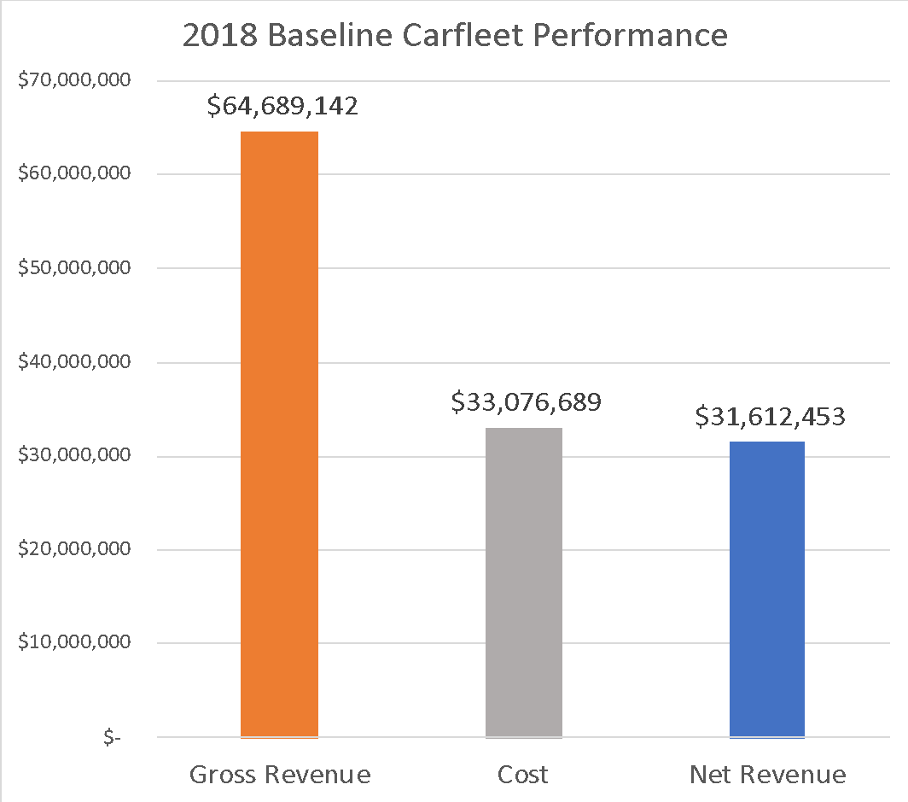
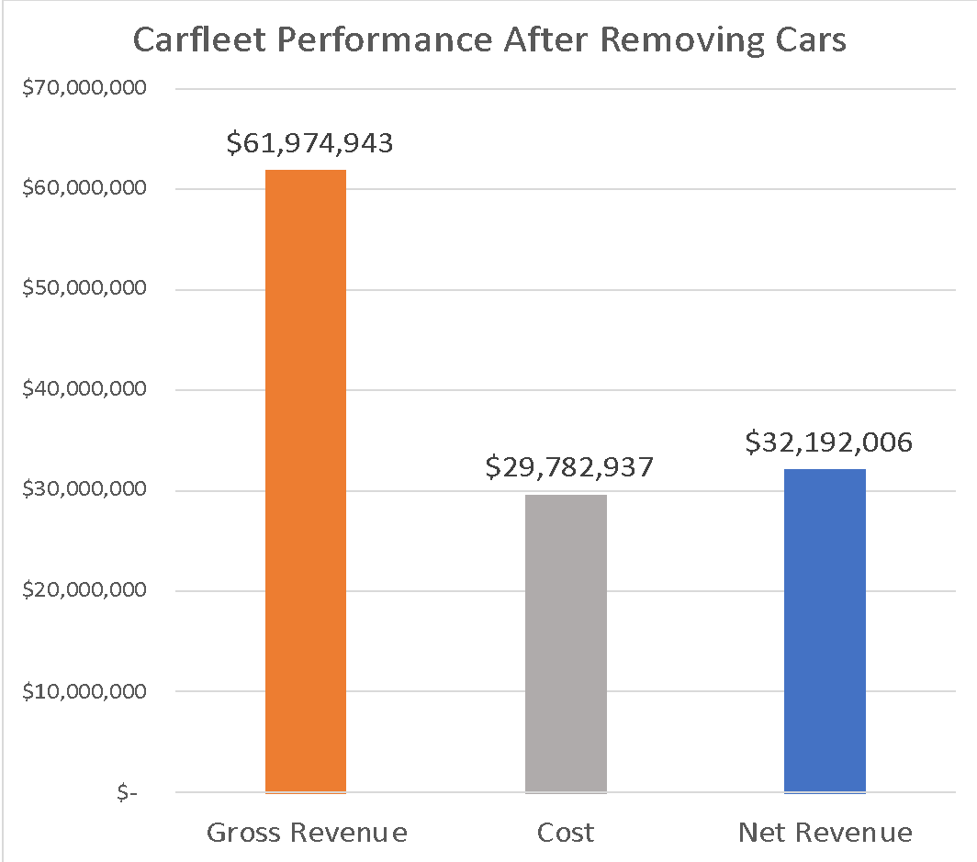
Strategy 1: Remove cars hurting net revenue (cont.)
Difference of $579,552

Slide 8
Strategy 2: Increase rental cost of Popular Cars
Increase daily rental cost by 10%
Popular cars defined as having been rented more than 100 days in a year
Increases gross revenue and net revenue

Slide 9

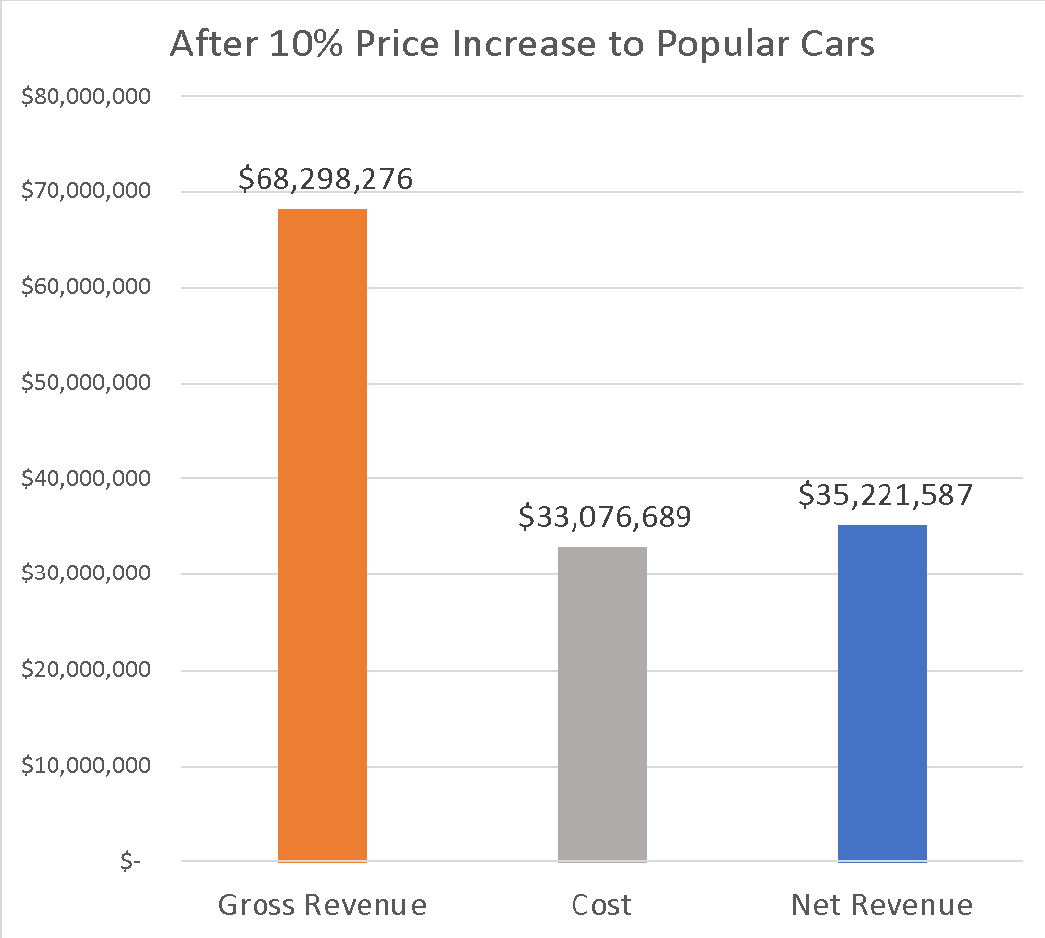
Strategy 2: Increase rental cost of Popular Cars (cont.)
Difference of $3,609,134

Slide 10
Strategy 3: Add more popular cars to fleet
Popular cars are rented more than 100 days in a year
Replace cars that made negative net revenue (367 cars) with popular cars
Increases gross and net revenue

Slide 11

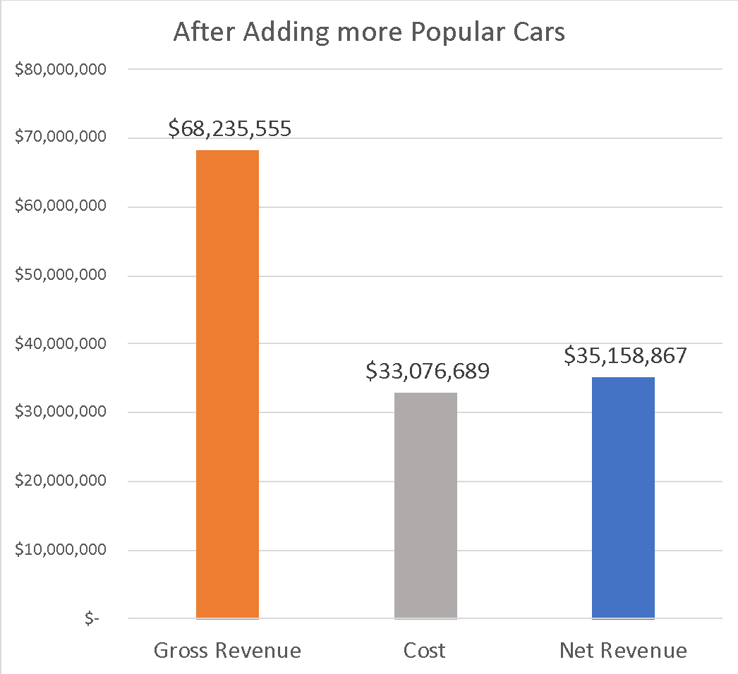
Strategy 3: Add more popular cars to fleet (cont.)
Difference of $3,546,413

Slide 12
Strategy 3: Add more popular cars to fleet (cont.)
Insights
New car models rented more often and make more in net revenue
Cars rented slightly more when branches located in Airports (1:1.03)
Car accidents do not affect profitability

Slide 13
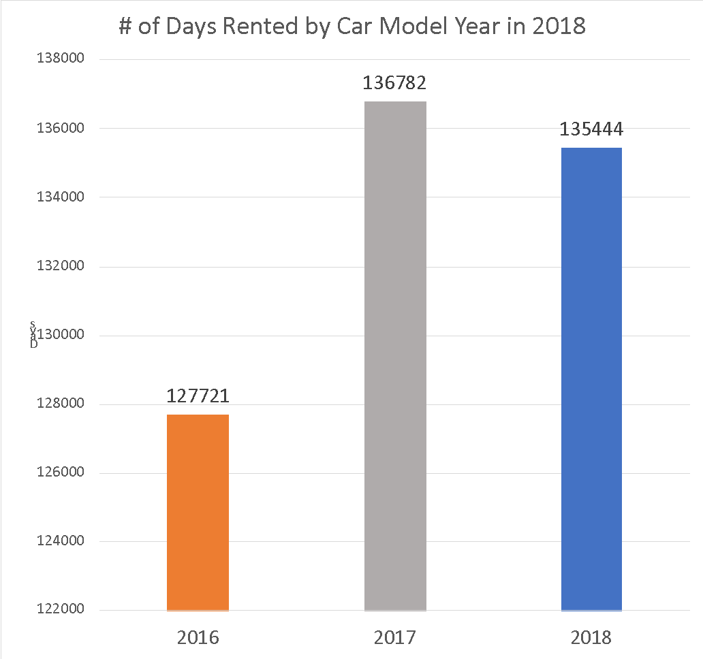
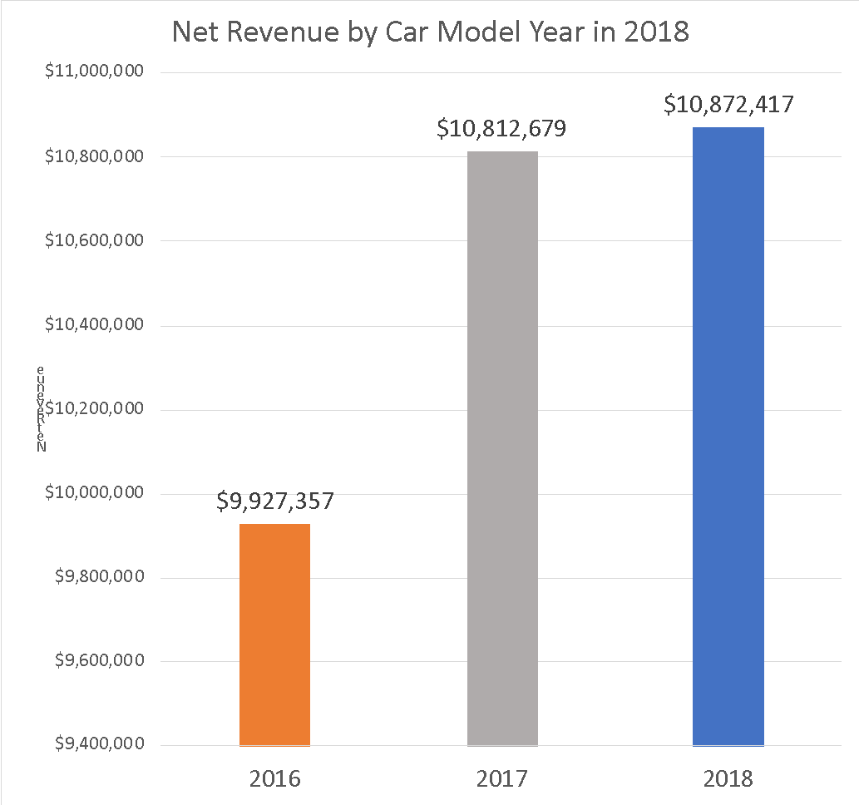
Strategy 3: Add more popular cars to fleet (cont.)
Newer Car models Rented more
Newer cars make more Net Revenue

Slide 14

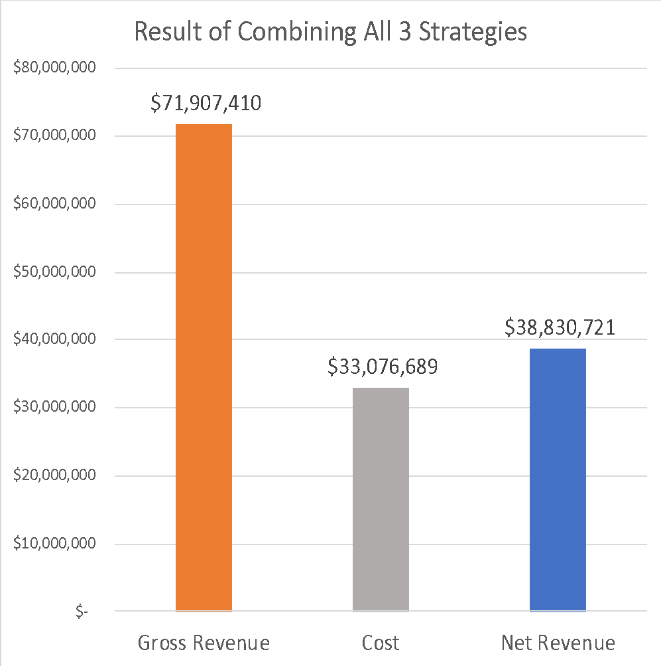
Conclusion
Implement all three strategies to improve Net revenue of Car fleet
Remove cars hurting net revenue
Increase rental costs of popular cars
Add more popular cars
Percentage gain in Net Revenue: 123%
Net Revenue gained: $7,218,268
Difference of $7,218,268

Slide 15
Next Steps
Analyze and compare relationship between daily rental price for each car and days rented for each car
Strategy 2
Analyze car renting pattern by customer gender and age by branch
Strategy 3
Analyze by branch location the distribution of days of the cars rented
Strategy 3

Slide 16

Questions?

