Slide 1
Tracking a Killer
Dan Kolb
Grow and Tell
January, 2018

Slide 2
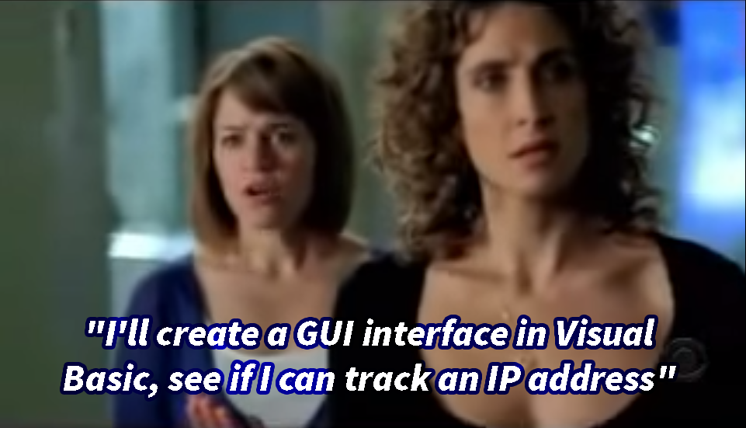
Inspiration
https://www.youtube.com/watch?v=hkDD03yeLnU

Slide 3
Transcript
Mac Taylor: “For weeks I’ve been investigating the cabbie killer murders with a certain morbid fascination”
Stella Bonasera: “This is in real time”
Lindsay Monroe: “I’ll create a GUI Interface using Visual Basic, see if I can track an IP Address”

Slide 4
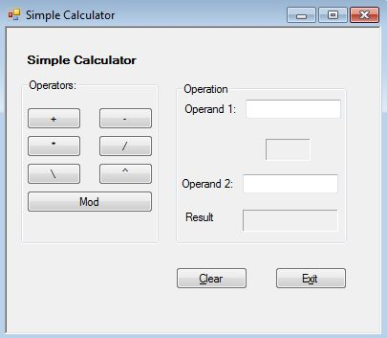
Visual Basic?
Event driven programming language from Microsoft
Incredibly pervasive
Visual Basic for Applications
  macros in Excel/Word

Slide 5
Interface - Electronjs
HTML, CSS, JavaScript
Chromium and Nodejs in single runtime
  Nodejs derived from Chromium’s JavaScript engine
You’re probably using it
  Github Desktop, Atom, Visual Studio Code, Slack...

Slide 6
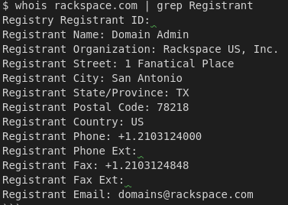
Location Information?
GeoIP
  Open source information (LEGACY from MaxMind)
    https://dev.maxmind.com/geoip/legacy/downloadable/
Whois Information
  ICANN Registry Information

Slide 7
Location Information??
Google
  Collects WAP information with Street View cars
    https://www.theguardian.com/technology/2010/may/15/google-admits-storing-private-data
  Control Access Point Inclusion- determines location from WAPS
    https://support.google.com/maps/answer/1725632?hl=en
  Android – Scanning WAPs REQUIRES ACCESS_*_LOCATION permissions
    https://developer.android.com/reference/android/net/wifi/WifiManager.html#getScanResults()
      Protection level: dangerous
        Dangerous permissions cover areas where the app wants data or resources that involve the user's private information, or could potentially affect the user's stored data or the operation of other apps. For example, the ability to read the user's contacts is a dangerous permission. If an app declares that it needs a dangerous permission, the user has to explicitly grant the permission to the app. Until the user approves the permission, your app cannot provide functionality that depends on that permission.
        https://developer.android.com/guide/topics/permissions/overview#normal-dangerous

Slide 8
Electronjs files
Package.json
  Package information
Index.html
  “front page” of application
Main.js
  Application “Start up”
Render.js
  Nodejs functions
Styles.css
  Cascading StyleSheets information (display)

Slide 9
Demo

Slide 10
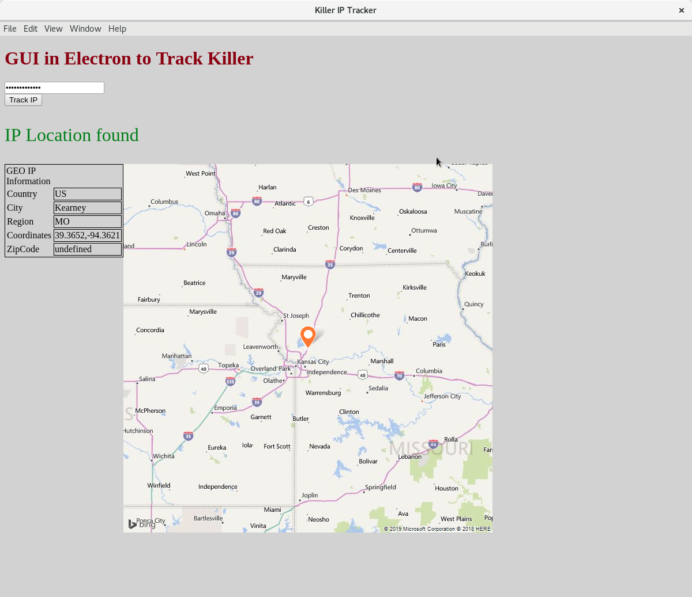
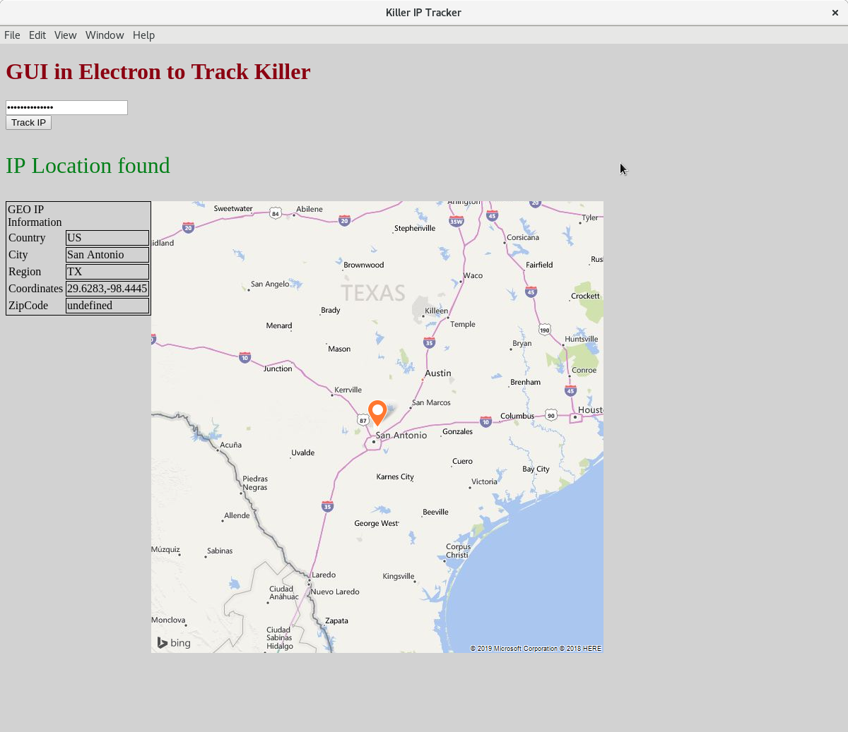
Results

Slide 11
How did TV get it wrong?
Issues with IP address?
  GeoIP not accurate to address
  VPN, TOR, SSH…
  NAT (Network Address Translation)
Get IP address
  Contact IP address owner to track
    Repeat until source found
      (MAC address easily spoofed)
Correlate Cookie/Session/Account information
  Traced phone number registered to account to another user that registered that phone number at that college
  https://www.mcall.com/news/police/mc-nws-lafayette-bomb-threat-bail-hearing-20181218-story.html

Slide 12
What did we learn?
TV is wrong
You don’t want to watch TV shows that involve technology with Dan

