Slide 1
Project: Makerspace
DBM150 - Daniel Koman

Slide 2
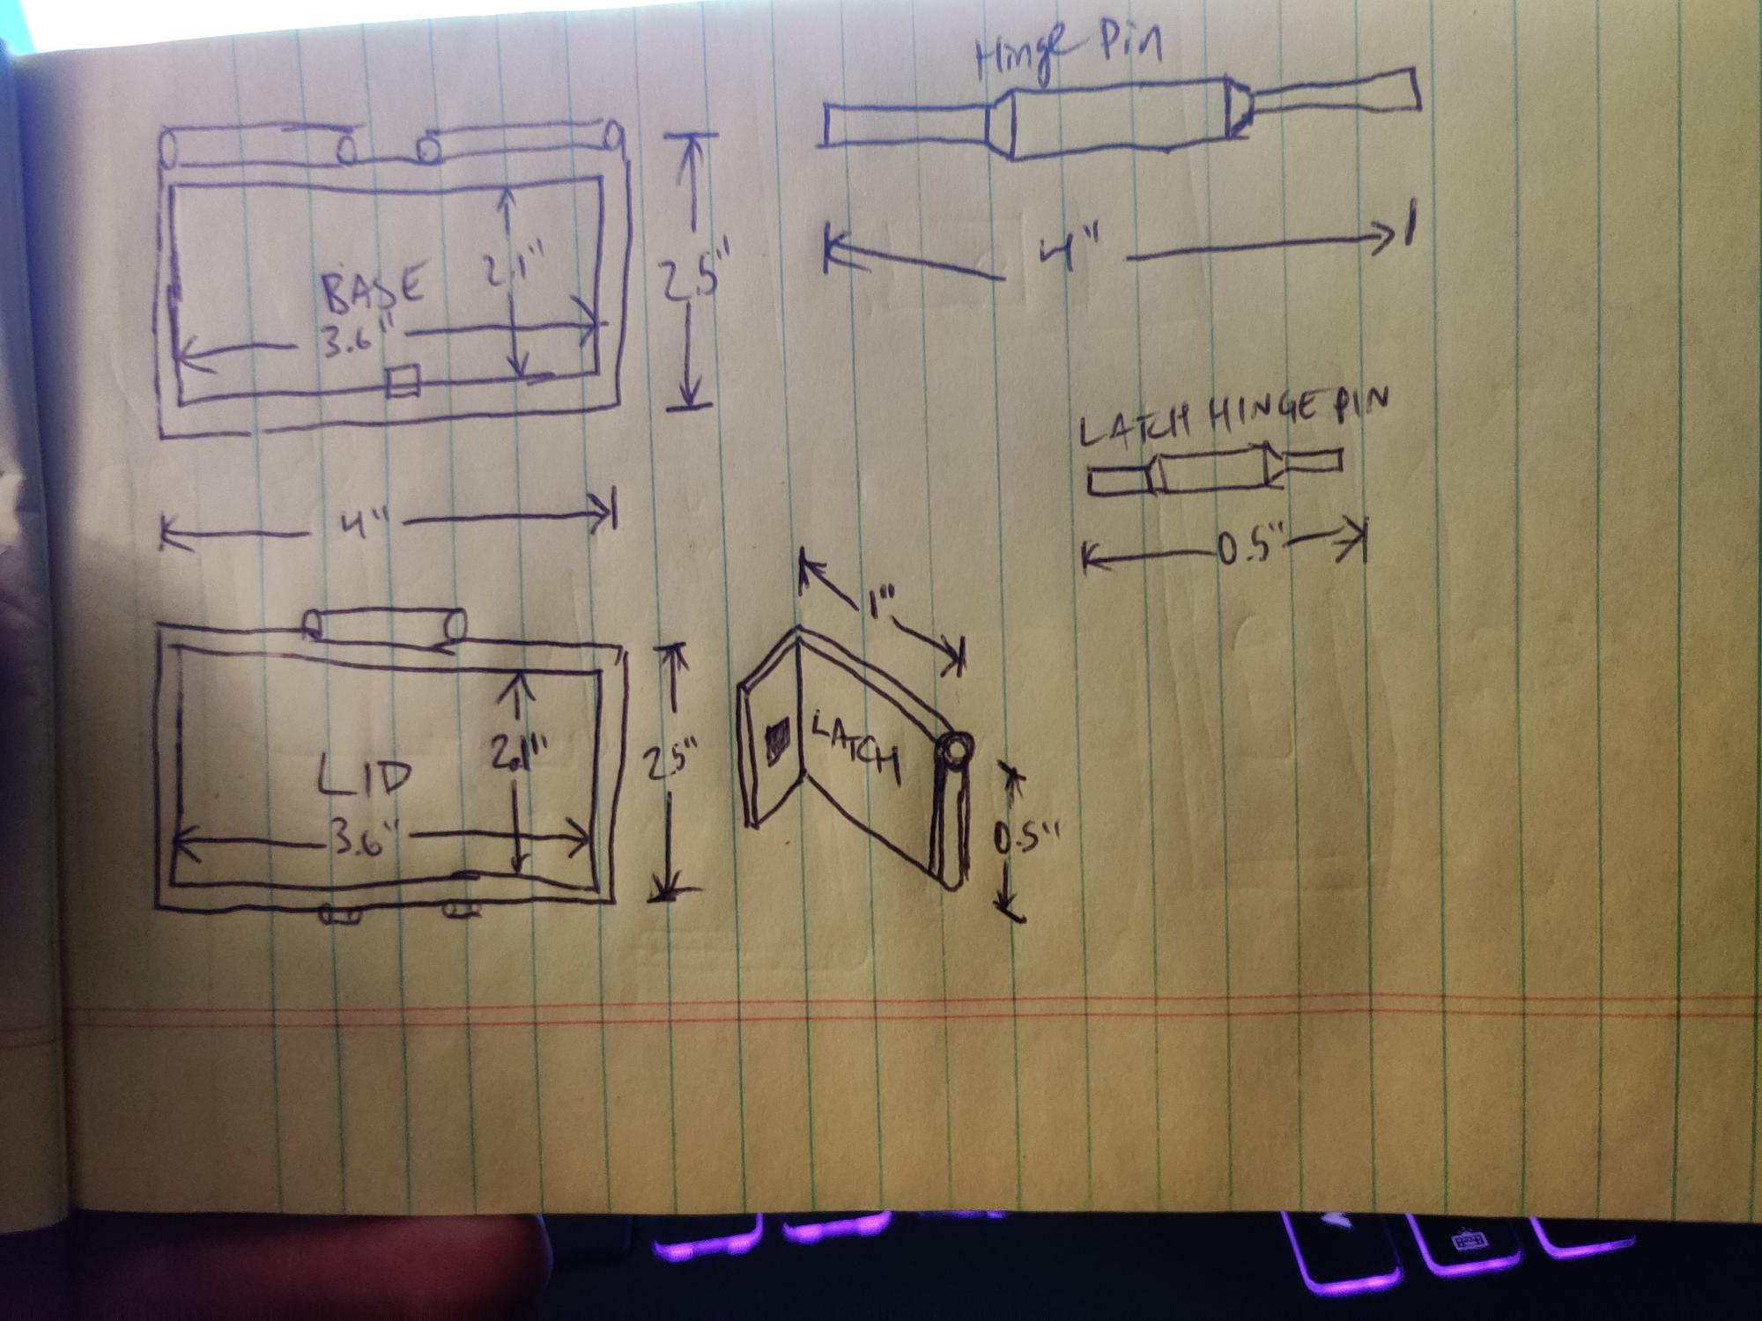
Preliminary Project Sketch
This is my preliminary sketch for my design idea for a business card holder/case.

Slide 3
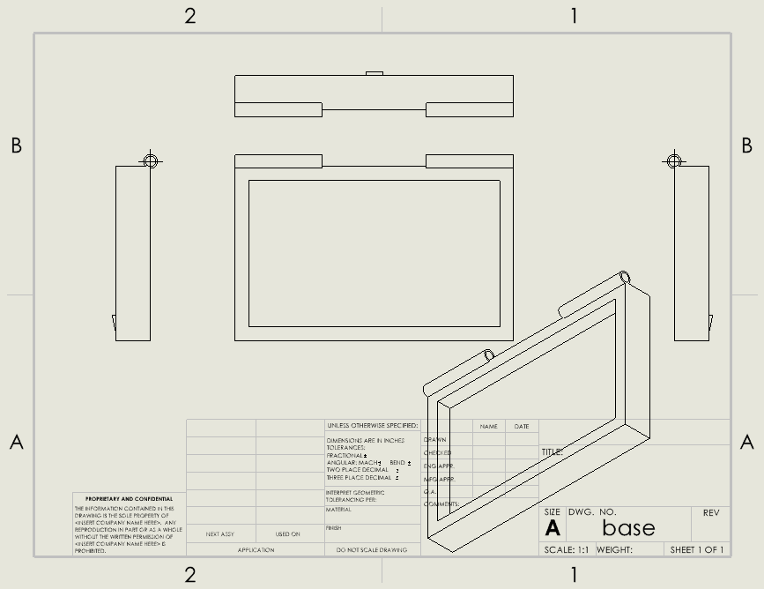
Prototype Drawing 1 - base
This is the base of the card holder case. There are two extruded slots for attachment of the hinge pin at the top edges, as well as an extruded triangular prism at the bottom of the base which will serve as the catch for the latch mechanism.

Slide 4
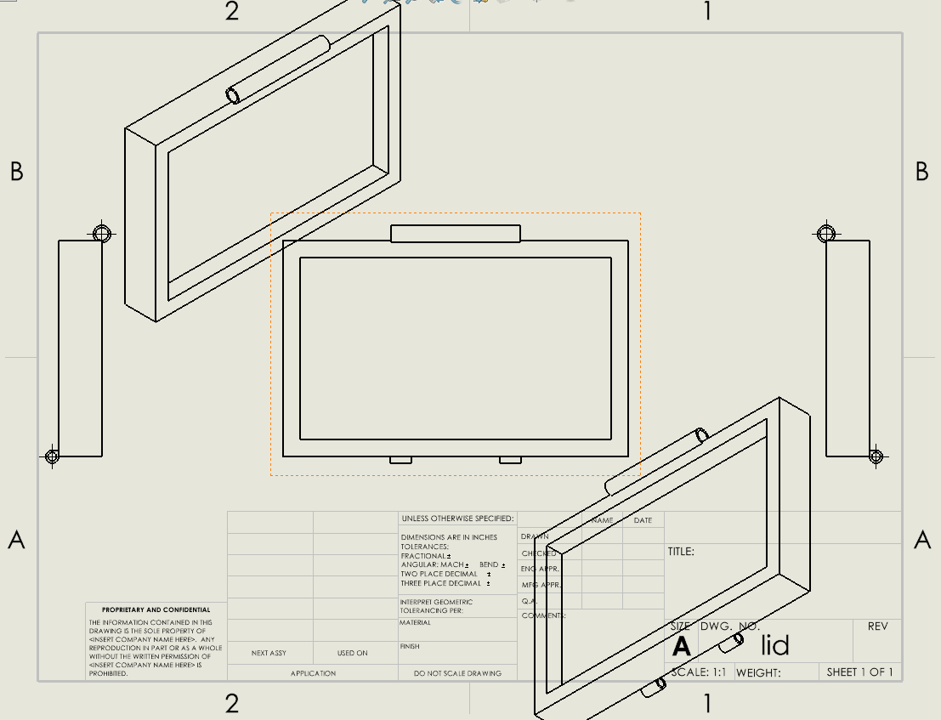
Prototype Drawing 2 - Lid
This is the lid part of the card case. There is a
single extruded hinge pin slot at the top edge, where the hinge pin will attach the lid to the
base. Also, there are two extruded slots at the
alternate diagonal edge for placement of the
latching mechanism. A second, smaller hinge
pin will serve as an attachment for this latch.

Slide 5
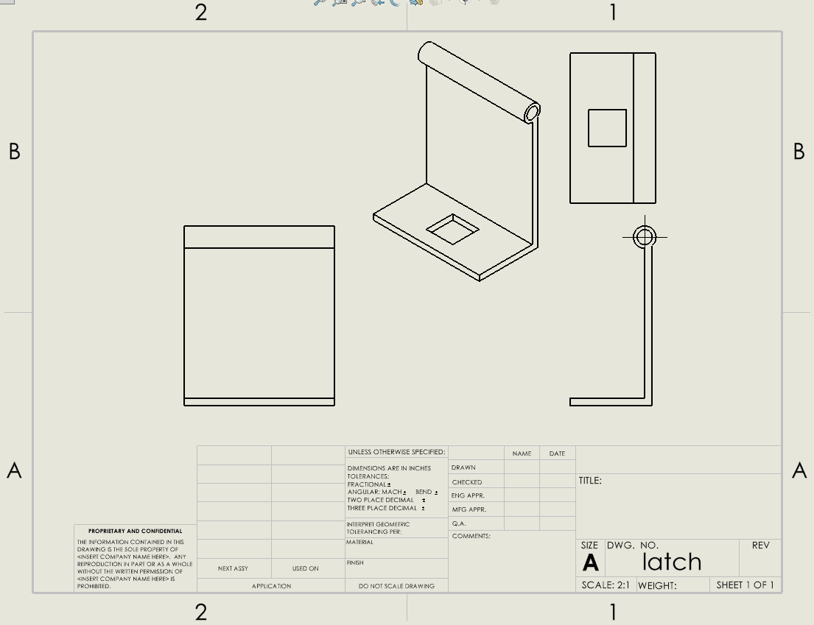
Prototype Drawing 3 - Latch
This is the latch mechanism that will attach to the lid, and hook underneath of the base. A smaller hinge pin will attach the latch to the lid. The square cutout in the latch will snap over the extruded triangular prism underneath the base.

Slide 6
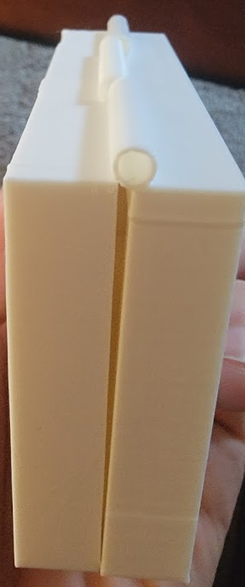
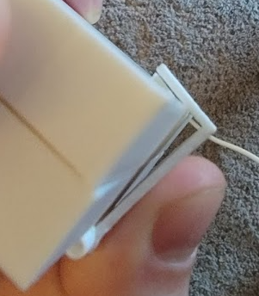
Initial Print
Here’s the initial print, done on a Crealty Ender 3 Pro. Clearly there were some flaws in my original design idea logic - back to the drawing board! The main hinge holes are inset too close to the base and lid body, preventing alignment. In my next design iteration, I will move these hinge slots out a bit from the body.

Slide 7
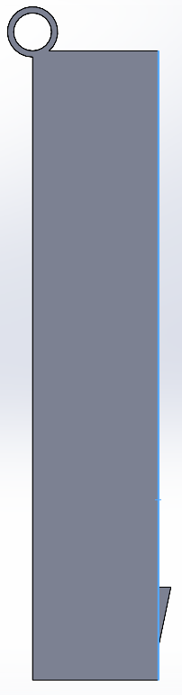
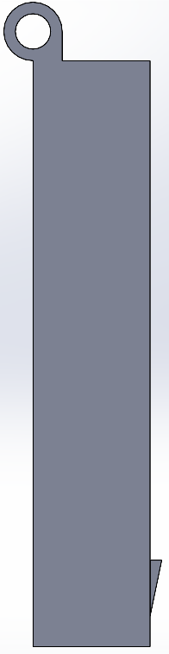
Base v1 versus Base v2
Here is a comparison of the first and second versions of the base part. As you can see, I’ve moved the hinge up a bit to allow for proper alignment. In addition, I’ve thickened the walls of the hinge, as the original design was too thin and brittle, and cracked too easily.

Slide 8
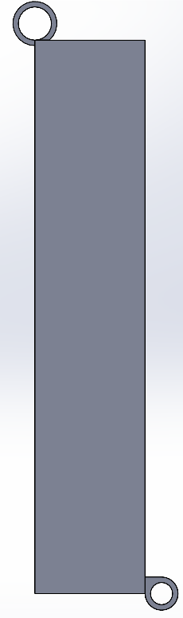
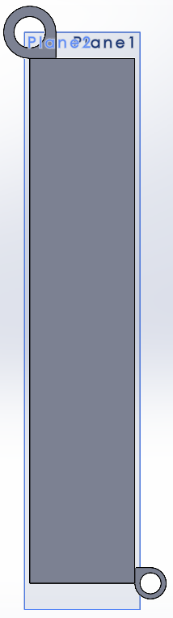
Lid version 1 versus version 2
Similar to the modifications made to the base between design iterations, I’ve modified the hinge design to the lid as well. I’ve moved the hinge up a bit from the body to allow for proper alignment, as well as thickened the hinge body for added support.

Slide 9
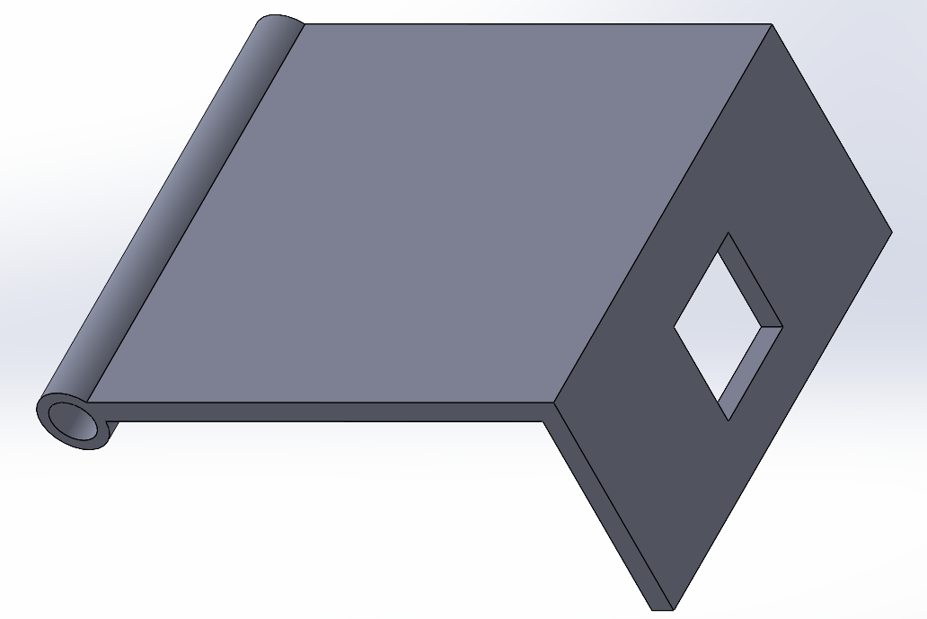
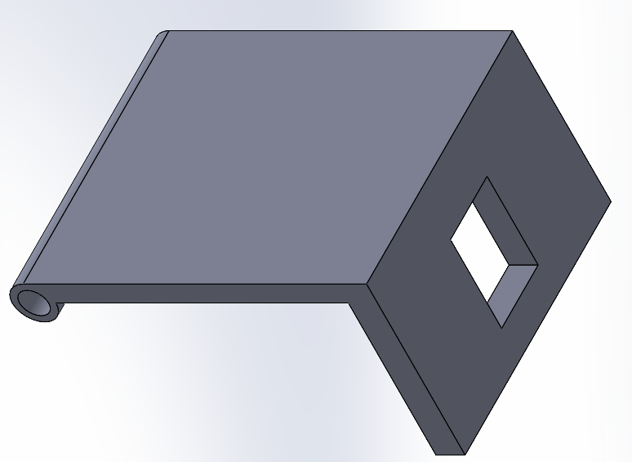
Latch version 1 versus version 2
The final design change I’ve made between versions is to the latching mechanism. I’ve thickened up the latch body for added support. In addition, I’ve lengthened the latch “tongue” to allow for more flexibility in actual usage. The original design assumed perfect fit. In the real world, nothing is perfect and some tolerance is needed. (wow, that’s deep).

Slide 10
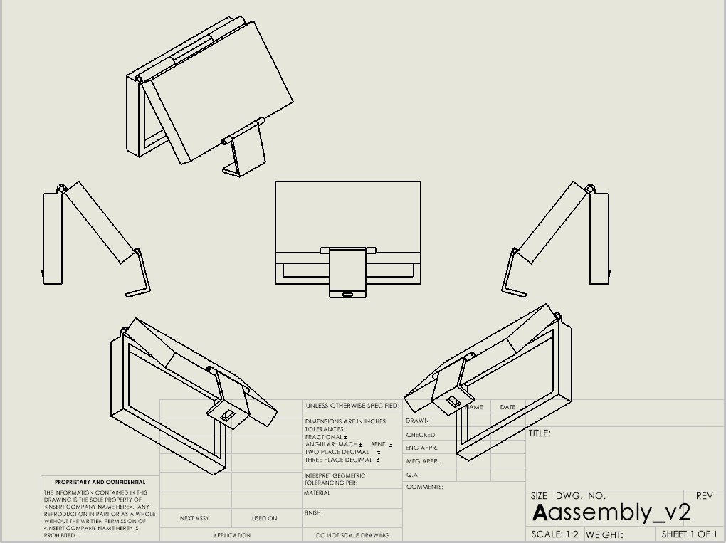
Final design drawing
Here you can see the final drawing of my refined design. I definitely learned much from this project, with the highlight being that often concepts can seem perfect, but when put to play in the real world, design flaws become apparent.

